Slide 1
Relationship Alpha from Reviews: EDA Findings & What Comes Next
Problem: Star ratings could not differentiate advisors, with most receiving similarly high scores This project uses client reviews to uncover meaningful, relationship-driven insights beyond ratings
Goal: Build a review-driven system that surfaces meaningful relationship strengths/gaps
Completed: Reproducible data pipeline + integrity checks + EDA + text cleaning + linguistic scan
Outcome: We now know what signal exists, where noise exists, and what constraints we must handle (sample size + short reviews)
EDA Milestone Report
|
Slide 1

Slide 2
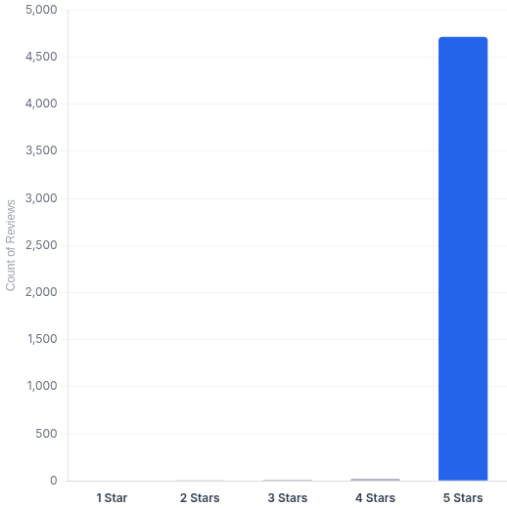

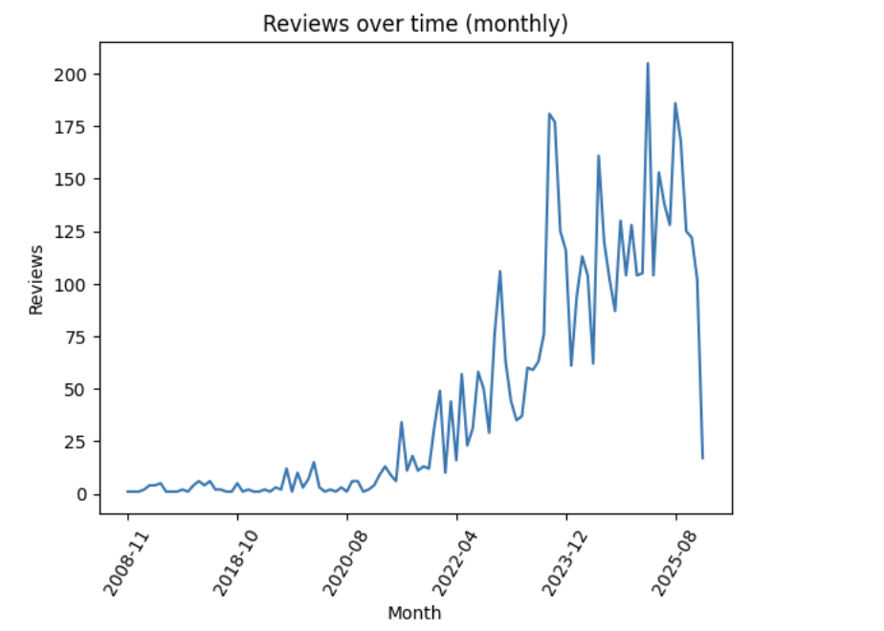
Ratings Saturation: Star Ratings Provide Almost No Differentiation
Rating Distribution (n=4,822)
Dataset Overview: 4,822 reviews across 339 advisors with 20 distinct feature columns. Dates covered 2008–2026, showing major growth in recent years, Ratings missing: ~1.39%, Empty text: ~0.04% (negligible)
Key Insights
4,714 out of 4,822 reviews are 5-star → ~97.8%
Very few reviews are <5 stars (only 41 reviews total are 1–4 stars)
Confirms the business problem: ratings are not a meaningful performance signal
The “real” differentiation must come from review text and relationship themes
Recommendation
De-emphasize star ratings as a primary ranking signal
Use them as a secondary indicator (or quality control), but not the core score
|
EDA Milestone Report
Slide 2

Slide 3

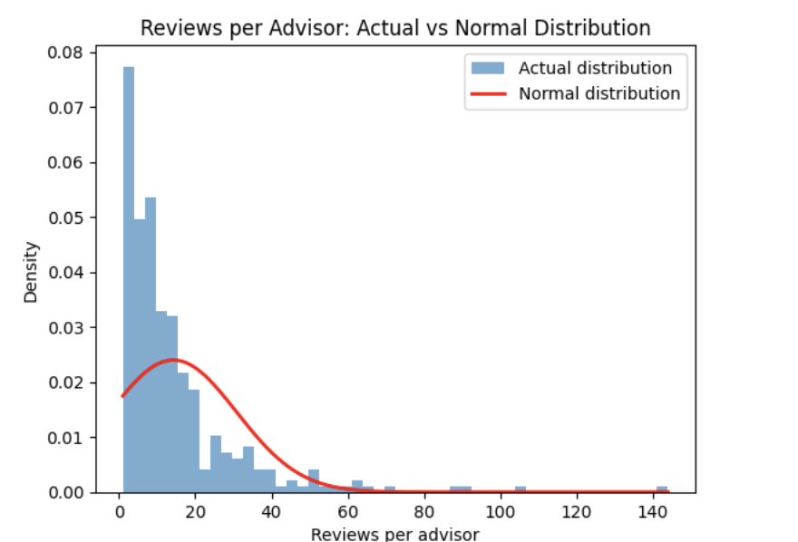
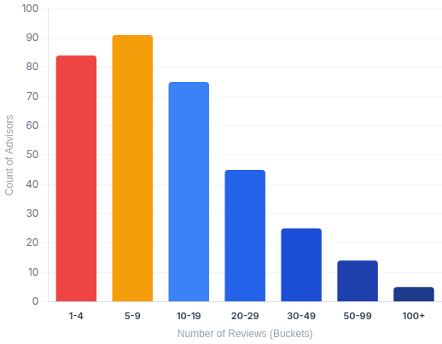
Review Coverage is Long-Tailed: Many Advisors Have Low Data
Key Statistics
Distribution Stats:
Median reviews per advisor: 9
90th percentile: 33 (Max: 144)
Prevalence of Low-Data Advisors:
18.3% have <3 reviews
24.8% have <5 reviews
51.6% have <10 reviews (Majority)
Derived Insights
Cannot score all advisors equally → confidence-aware scoring required
Low-data advisors need directional / substitute reporting
Review volume must influence score reliability, not score value
Enables High / Medium / Low confidence tiers
EDA Milestone Report
|
Slide 3

Slide 4

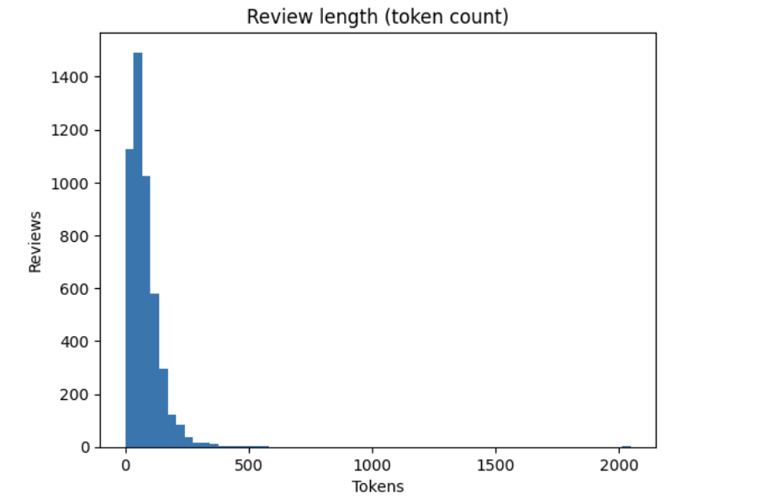
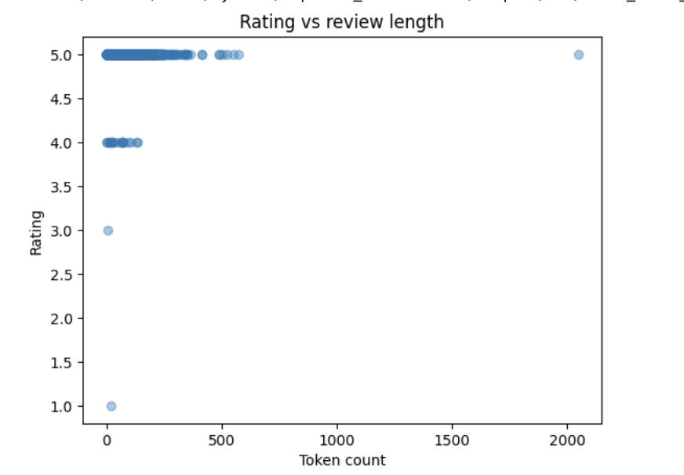

Review Text is Rich Enough to Extract Relationship Signals
Key Insights
Token Count Distribution
After cleaning: 4,731 reviews retained (almost all kept)
Typical review length:
Median token count: 63
Mean token count: ~76
Long tail up to 2,048 tokens
Short-text noise exists but manageable:
Before cleaning: 11.65% under 20 tokens
After cleaning: ~9.96% under 20 tokens
Ratings don’t vary with length → text contains nuance that ratings ignore
Rating vs. Token Count
Product Implication
• We can extract relationship dimensions and recommendations from text reliably
• We should weight insights by text richness + sample size.
EDA Milestone Report
|
Slide 4

Slide 5
Next Steps:
From EDA → NLP Representation → Robust Scoring
1
Choose the best NLP representation (KR 1.2)
Test & Compare: Baseline (TF-IDF + n-grams) vs. Advanced (Embeddings)
Selection Criteria: Stability under resampling, interpretability for insights, and production scalability
2
Build score robustness + confidence tiers (KR 1.3)
Methodology: Create multi-dimensional advisor scores using bootstrap/subsampling
Quantification: Measure score stability and define confidence intervals
Governance: Define rules for when scoring is reliable vs. substitute reporting
3
Convert scores → recommendations (Objective 2)
Deliverables: Dimension-level strengths/gaps and firm benchmarking
Context: Incorporate industry trends and automated logic for low-data cases
EDA Milestone Report
|
Slide 5

Slide 6
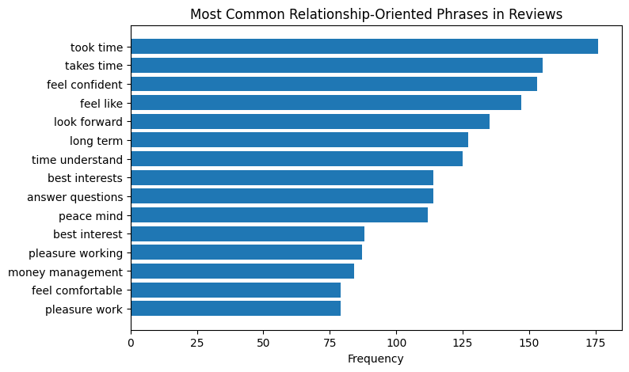
Next Steps:
From EDA → NLP Representation → Robust Scoring
1
Choose the best NLP representation (KR 1.2)
Test & Compare: Baseline (TF-IDF + n-grams) vs. Advanced (Embeddings)
Selection Criteria: Stability under resampling, interpretability for insights, and production scalability
2
Build score robustness + confidence tiers (KR 1.3)
Methodology: Create multi-dimensional advisor scores using bootstrap/subsampling
Quantification: Measure score stability and define confidence intervals
Governance: Define rules for when scoring is reliable vs. substitute reporting
3
Convert scores → recommendations (Objective 2)
Deliverables: Dimension-level strengths/gaps and firm benchmarking
Context: Incorporate industry trends and automated logic for low-data cases
EDA Milestone Report
|
Slide 6

