Slide 1
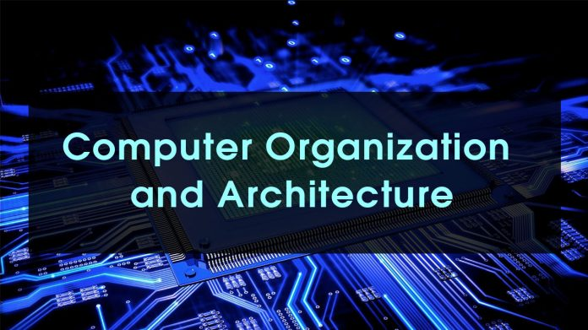
Instructor Name: Tassadaq Nawaz

Slide 2
Project idea
The idea of project is to use the basic computer (Morris Mano) to get the four instructions from the user and 10 memory locations, and the program will deal with it as hexadecimal number from the user side and the program will convert it to binary then it will separate each part of it, and it should have the interface to be more usable and readable by the user
We will start the program form the input to get the tracing system.

Slide 3
Scope of project
The scope of project is to increase our knowledge about the basic computer (Morris Mano) and make everything we study to be related by analyzing the instruction and tracing it.

Slide 4
The programming language are used
Her we have many programming language that can deal with it but in our case, we thought about web development (HTML, CSS & java scripts )

Slide 5
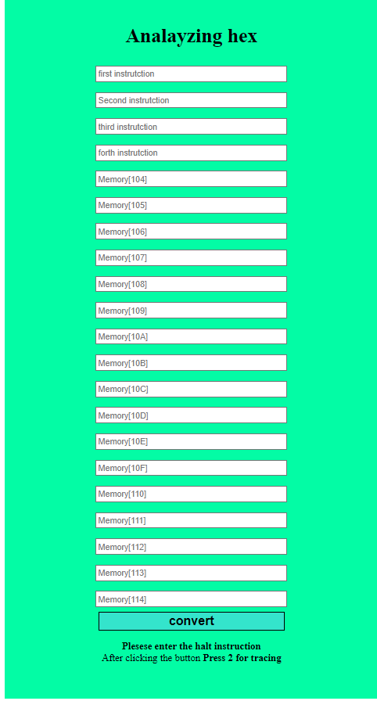
First step
In this step we create the 4-input field that can get the instructions from user

Slide 6
Second step
When we collect the instructor then we will convert it from hexadecimal to binary number as shown below
Instruction in binary
I Bit
Opcode
Address
Instruction Category
Addressing mode

Slide 7
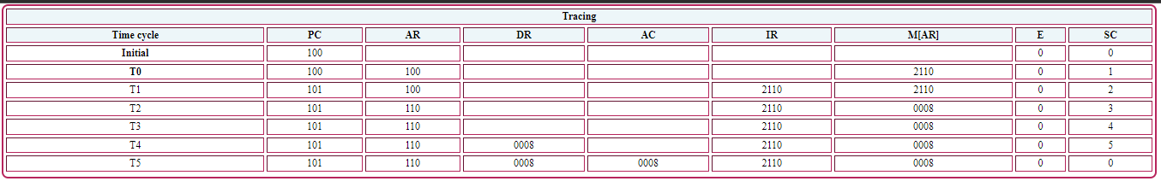
Third step
The program will take the opcode and I bit (binary number) and the memory address then it will flow up the flowchart that then it will record the change at flowing register PC, AR, DR, AC, IR and M[AR]
The Initial of PC is 100 the register will increase up to finish all instruction

Slide 8
Conclusion
To summarize the things, we get the input from the user, and we analyze then we will be tracing it .

Slide 9
Thank you for listening

