Slide 1
Student management system
Group C

Slide 2
What is it about ?
A simple database that can be used by student affairs to store student data electronically .

Slide 3
Main Feature :
Data will be saved even when you close the program .

Slide 4
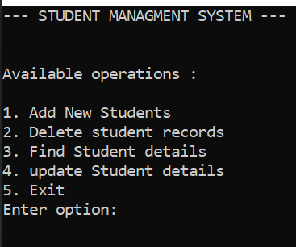
Program Features :
Add new student :
this feature will let the user to add student details
Delete student records :
this feature will let the user to Delete Specific
student details by Student ID.

Slide 5
Cont’d
Find student details :
this feature will let the user to search about
Specific student details the by Student ID or
phone number.
Update student details :
this feature will let the user to update Student details
by Student ID .

Slide 6
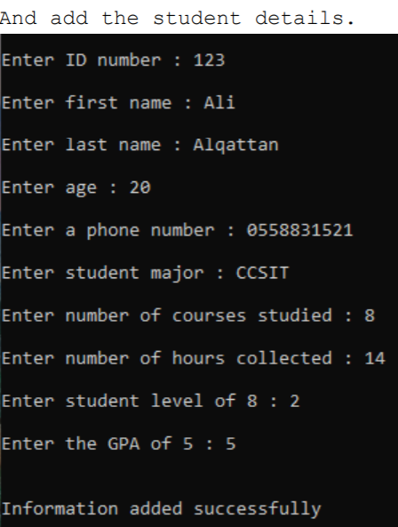
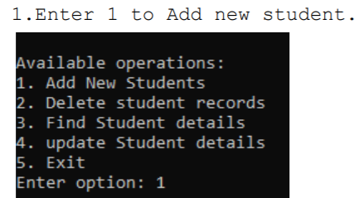
Implementation :
1. Add new student

Slide 7
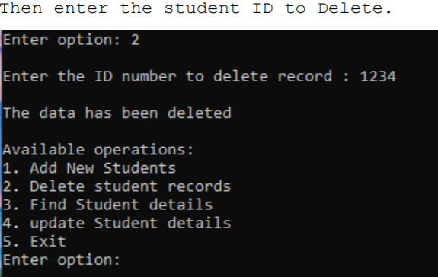
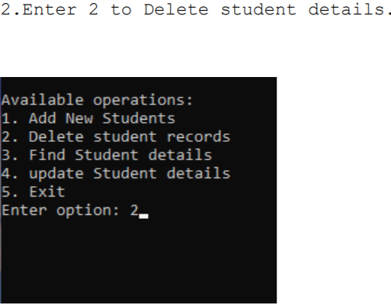
2. Delete student records

Slide 8
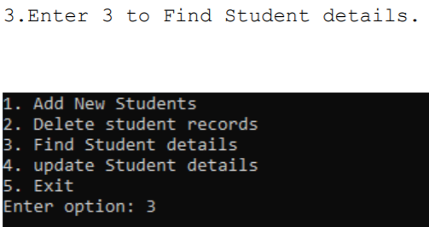
3. Find student details

Slide 9
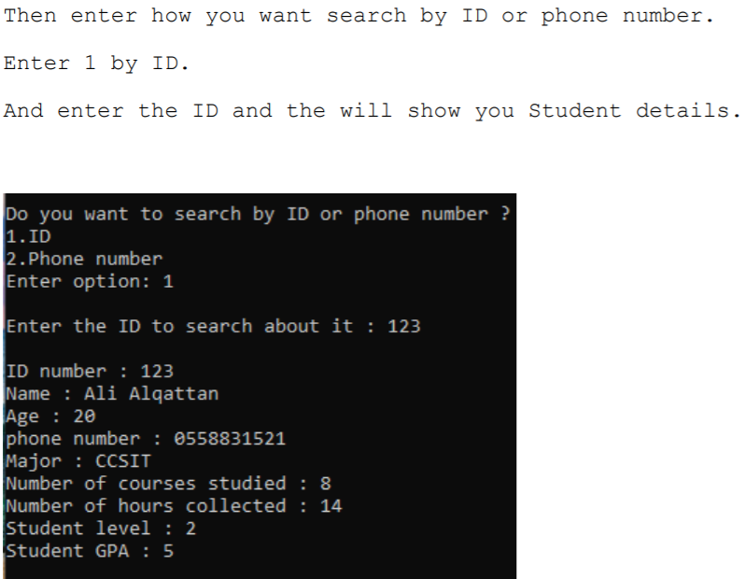
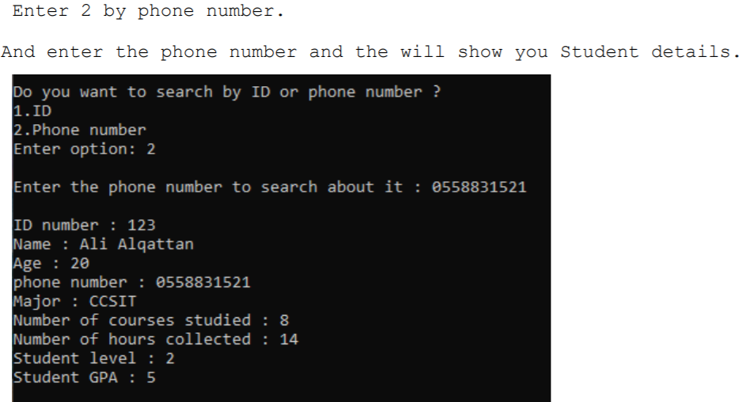
Cont’d

Slide 10
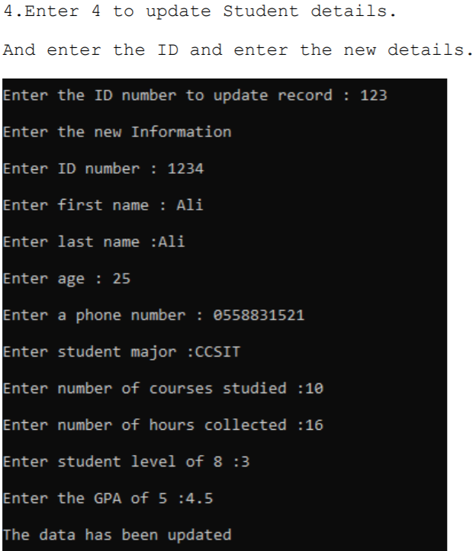
4. Update student details

Slide 11
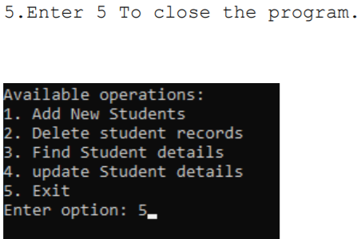
5. Exit

Slide 12
Thank you

Slide 13
Members :
Ali Alqattan - 219022038
Abdulrahman Al-Majed - 219021871
Abdullah Al-Bader - 219022083
Osama Al-Khatib - 219022774

