Slide 1

Deep Learning-based Online Alternative Product Recommendations at Scale Mingming Guo, Nian Yan, Xiquan Cui, San He Wu, Unaiza Ahsan, Rebecca West and Khalifeh Al Jadda
Presented To:
MR. ANNAJIAT Alim Rasel
Senior Lecturer,
Department of computer science and engineering,
Brac university.
PRESENTED BY:
Ayesha Akter - 21166014
Israt Jahan Dristy - 21166046
Md. Ashfaqul Haque – 21166016
CSE 712 (Group - 14)

Slide 2
abstract
A good alternative recommendation system is necessary for having a better consumer experience in E-commerce System.
For recommendation both textual product data and customer behavior data has been analyzed.
Build a Siamese Network with Bidirectional LSTM system providing 12% increasing conversion rate at A/B test.
kNN computation task has been used for scaling throughout the entire product catalog and accelerated by NMSLIB

Slide 3





INTRODUCTION
Recommender systems are pervasive in ecommerce and other web systems. Alternative product recommendation is an important way to help customers easily find the right products and speed up their buying decision process. 2 main ways-
First is a content-based recommendation approach.
Second way is to leverage customer behavior to find alternative products in the style of item-to-item collaborative filtering
Problem Formulation

Slide 4
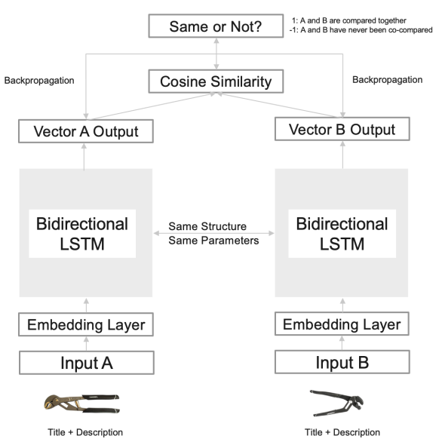
Deep Learning Embedding Approach
Acquiring Data :
Siamese with LSTM
Product ID | Product Title | Product Description
‘12345678’ | Air Compressor | This compressor offers a solid cast iron, twin cylinder compressor pump for extreme durability.
Table 1. Product Textual Data
Product ID | Product ID | Co-compared
12345678’’ ‘’ | ‘87654321’ | 1
32187654’ | ‘54321876’ | 1
Table 2. Co-compared Example

Slide 5
Deep Learning Embedding Approach(Cont.)
Creating Training Data & Train the Model:
Scalable Recommendation Generation:
generate millions of embeddings based on
product titles and descriptions.
choose NMSLIB library to
conduct heavy kNN computations because it has high performance in both recall and queries per second.
Fig 2 : connected graph
How many data points | How many products What’s the time | period (year)
331900 | 65684 | 1
Table 3 : training Data statics

Slide 6
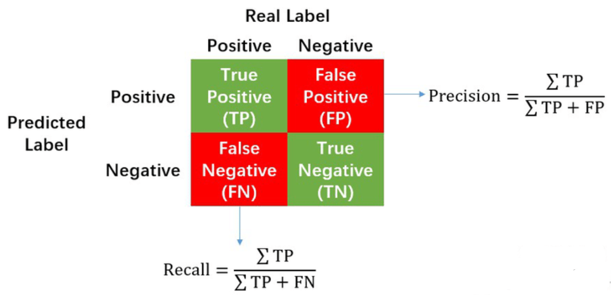
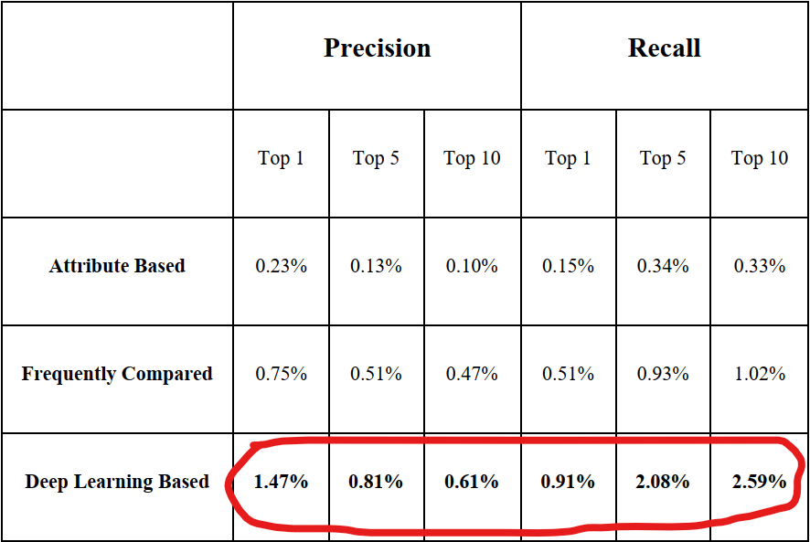
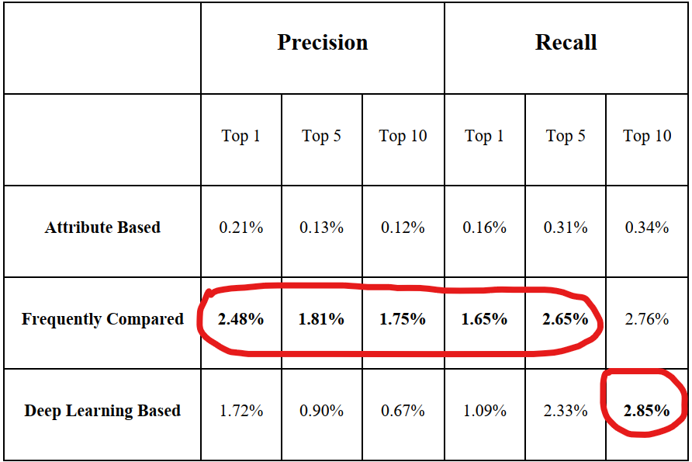
Performance
3 Way Evaluation:
Attribute Based (content based)
Frequently compared (Browser behavior based)
Deep Learning Based (0.8 threshold)
Offline Evaluation:

Slide 7

conclusion
Online A/B testing:
having 12% higher conversion rate at purchase
Conversion rate=
(no. of purchase)/(no. of visits)
Conclusion:
Improved user recommendation system.
Improvement Area:
LSTM replaced with BERT
NMSLIB -CPU (200,000 Queries per second)
replaced with
Faiss -GPU (1,500,000 Queries per second)

