Slide 1

Early Detection of Sexual Predators in Chats
Authors :Matthias Vogt,Ulf Leser, Alan Akbik
Presented by :
Israt Jahan Dristy (21166046)
Md. Ashfaqul Haque (21166016)
Group - 06

Slide 2
Introduction
Online grooming denotes the process where a so called sexual predator establishes an emotional connection with a minor online to systematically solicit and exploit them for sexual purposes.
An important risk that children face today is online grooming
Prior work has sought to automatically identify grooming chats, but only after an incidence has already happened in the context of legal prosecution.
In this work, instead investigate this problem from the point of view of prevention. They define and study the task of early sexual predator detection (eSPD) in chats.

Slide 3
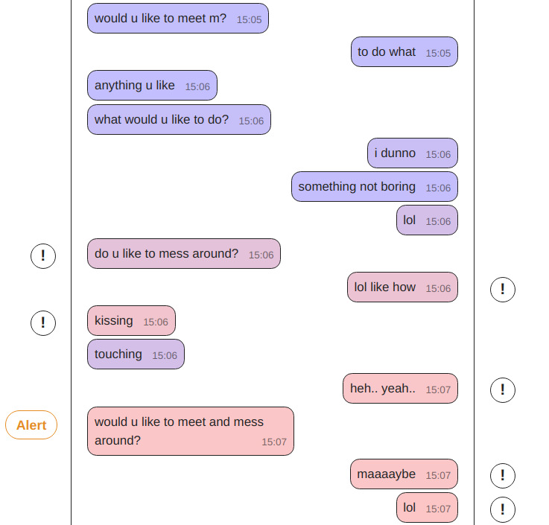
Objective
On each new message, the analysis is updated to reflect the level of risk. Finally, an alert is triggered as the risk-threshold is passed.
The goal is to detect such (alert in chat) risk as early as possible
Fig : Visualization of chat messages and early sexual predator detection (eSPD).

Slide 4
The Steps Of Working
1)Introduce the problem of eSPD and formally define it.
2)Survey available datasets, analyze their limitations, and build a new combined dataset called PANC as a best-effort for evaluating eSPD.
3)Propose a task setup to evaluate eSPD, focusing on the trade-off between earliness and accuracy.
4)Present strong baselines for eSPD using a two-tier approach.
5)Compare their models to previous research in conventional SPD settings and find that two of them outperform the current state of the art.
6)Provide an extensive discussion of the limitations of their models and the available data.

Slide 5
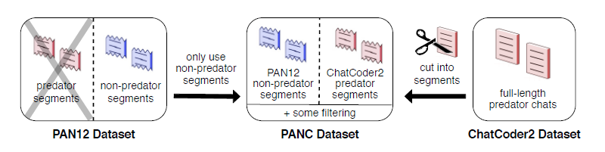
Evaluation Step
Task definition:
Figure 2: Creating PANC from PAN12 and CC2.

Slide 6
Evaluation Step
2.Evaluation metrics for eSPD
3.Accuracy of warnings →.Earliness of warnings
→ The PANC dataset
6.Baseline approach: Two-Tier eSPD →Tier 1: Classifying sliding windows
-→Tier 2: Classifying chat prefixes
7.Hyperparameters.

Slide 7
Experiments
1) Evaluate the baseline approach in their eSPD task setup using the proposed metrics for warning earliness, accuracy, and Flatency.
2)Compare three different eSPD systems: SBERT-large, SBERT-base, and SMobileBERT,
3)Do fine-tune each of BERT models on PANC and VTPAN.
4)In the evaluation, they have always reported the mean of the resulting measures together with standard deviation
5)They fine-tune BERTbase and MobileBERT using the TensorFlow Lite Model Maker Library and BERTlarge using flair

Slide 8
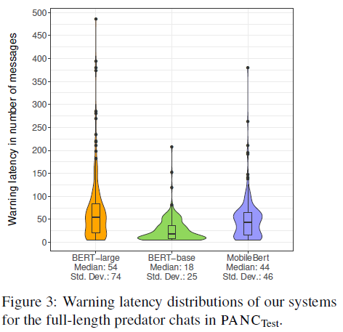
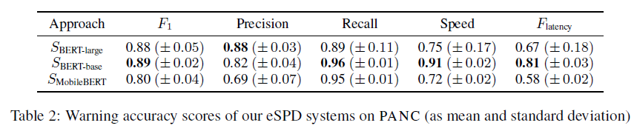
Experimental Results

Slide 9
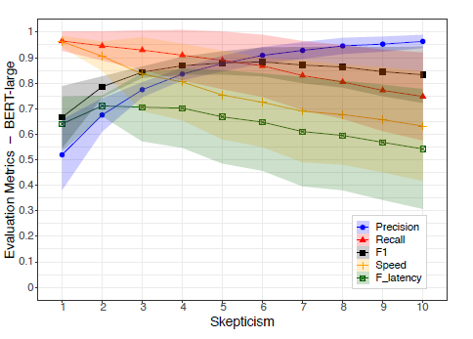
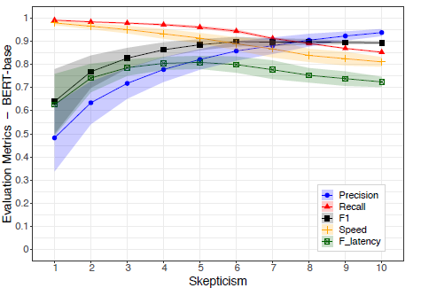
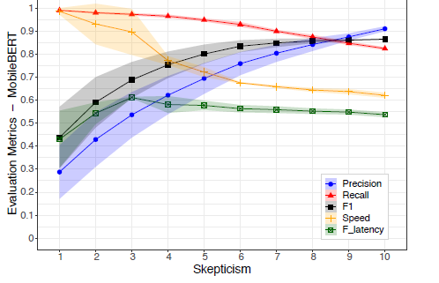
Experimental Results
Figure 4: Impact of master classifiers skepticism s for our eSPD systems SBERT-large, SBERT-base, andSMobileBERT. Dots and lines are the mean across different runs and the shaded area is the standard deviation

Slide 10
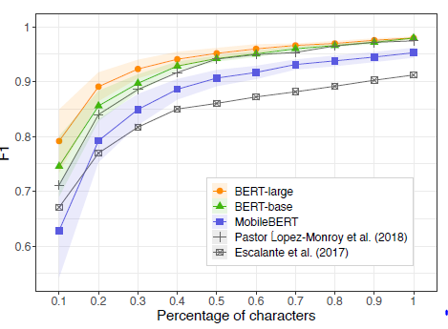
Discussion
They discuss several issues that must be considered before planning to apply an algorithm like the ones presented in this work in practice.
Due to the lack of publicly available datasets, They could not test models on complete negative chats.
Figure 5: Our BERT models vs. SOTA on VTPAN classifying 10%, 20%, . . . of characters of segments

Slide 11
Conclusion
Defined the problem of early sexual predator detection (eSPD) in online chats and proposed an evaluation setup for this task.
At this end, They assembled the PANC dataset, which, albeit having clear limitations, in our mind is the currently best effort possible with the data available
They also showed that a baseline built on current BERT-based language models achieves strong results on this dataset, and beats previous methods in related settings. Notably, results are only modestly impacted or models that can run on mobile devices.

Slide 12
Thank you

