Slide 1


ML Classifier Comparative Performance Analysis of Prediction on Cervical Cancer
Presented by :
MD. Ashfaqul Haque
Authors :
MD. Ashfaqul Haque
Israt Jahan Dristy
Shihab Sharar
Annajiat Alim Rasel

Slide 2
Introduction
Deadliest disease
Fourth most common among women in the world.
This mainly develops in a woman’s cervix and human papillomavirus infection
No symptoms at early stage
Early stage identification treating is worthwhile
Comparison of Classifiers at making predictions

Slide 3
Dataset Analytics
Source: ‘Hospital Universitario de Caracas', Venezuela
records of 858 patients with 36 feature columns
Biopsy represents patients has cervical cancer (1) or not (0).
Fig. 1 Distributed age plot.
Fig. 2 Biopsy positive (1) or negative (0) plot.

Slide 4
Dataset Analytics
Fig. 3 Age and first sexual intercourse plotting with Biopsy, Cytology & Schiller.
Fig. 4 No. of pregnancies with no. of sexual partners plot.

Slide 5

Methodology

Slide 6
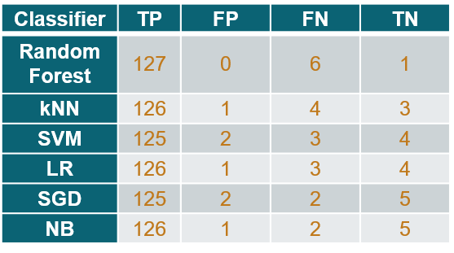
Result and Discussion
Classifier | precision | recall | f1-score | Acc
Random Forest | 100 | 95.48 | 97.69 | 95.52
kNN | 99.21 | 96.92 | 98.05 | 96.26
SVM | 98.42 | 97.65 | 98.03 | 96.26
LR | 99.21 | 97.67 | 98.43 | 97.01
SGD | 98.42 | 98.42 | 98.42 | 97.014
NB | 99.21 | 98.43 | 98.82 | 97.76
Table -1
Table -2

Slide 7
Conclusion
Severe state cervical cancer -difficult to cure
Make accurate predictions
Provide early treatment
Lots of missing values – patients don’t share all personal.

Slide 8
Future scope
Missing values makes difficult to have understanding of impactful features.
Apply explanation techniques on features.
Train on other datasets.

