Slide 1
AWARE-AI Hackathon 2026
Drive a robot with your muscles
⏱ 24-Hour Build Challenge · Myo armband → Clearpath Jackal
1 / 18

Slide 2
Schedule
Thursday · [DATE TBD]
[TIME]
Kickoff: intro, install check, first drive
Friday · [DATE TBD]
8:30 am
Breakfast, hacking starts
12:00 pm
Lunch
5:00 pm
Hacking ends · judged runs · dinner
5:00–6:30 pm
Presentations
2 / 18

Slide 3
What You'll Build
Myo Armband
Your Controller
Command Bridge
Jackal Sim
(EMG + IMU)
(features · model · logic)
((v, w) at 20 Hz)
(courses · lidar · score)
Read your muscles, decide a forward speed v and turn rate w, and drive a Clearpath Jackal through timed courses.
Then keep it drivable when the link to the robot gets slow and lossy.
(v, w) is the whole contract: any language, any model, any idea.
3 / 18

Slide 4
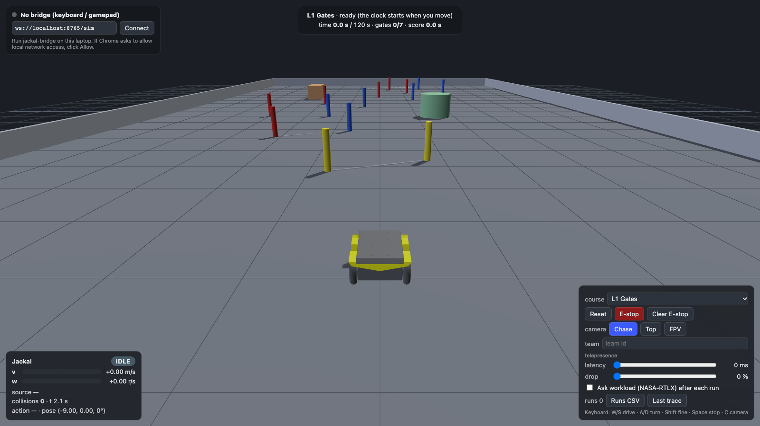
The Jackal Simulator
Runs in your browser · MuJoCo, real Jackal dimensions
180-beam lidar · your controller can read it
Chase · Top · FPV cameras
HUD · speed, source, collisions, deadman
Logs every run · Runs CSV + 20 Hz trace
ahrtlab.github.io/Hackathon · or offline: jackal-bridge --serve-site
4 / 18

Slide 5
The Twist: Telepresence
Real robots are driven over real networks. Commands arrive late, and some never arrive.
Latency
Packet drop
Workload
0 – 1000 ms
0 – 50 %
NASA-RTLX
every command is delayed
some commands are lost
how hard was that, really?
Judges will also run your controller under a degraded link. Test with the latency / drop sliders early. A controller that only works on a perfect connection isn't finished.
5 / 18

Slide 6
The Hackathon Pipeline
1
Stream — myo_lsl_publisher.py sends Myo_EMG + Myo_IMU to LSL (no dongle)
2
Look & record — lsl-web-viewer shows the signals and records labeled training takes
3
Features & model — RMS, MAV, zero crossings… then a classifier or a proportional map
4
Controller — copy controller_template.py, fill in my_input() and step() → (v, w)
5
Drive — through jackal-bridge into the sim: gates, collisions, score
6 / 18

Slide 7
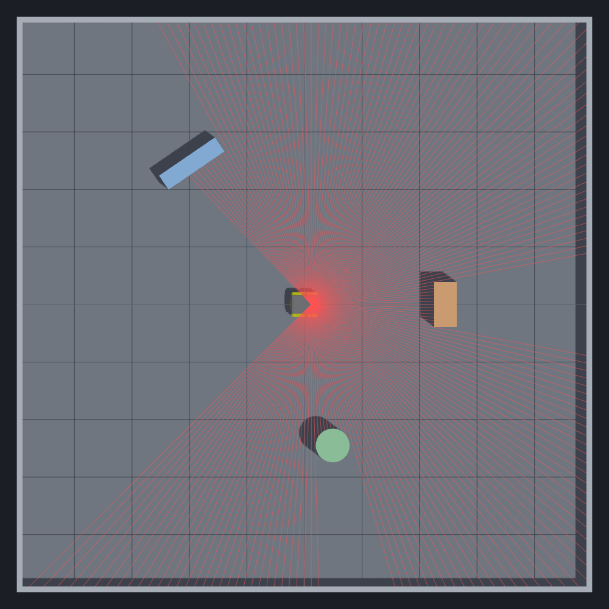
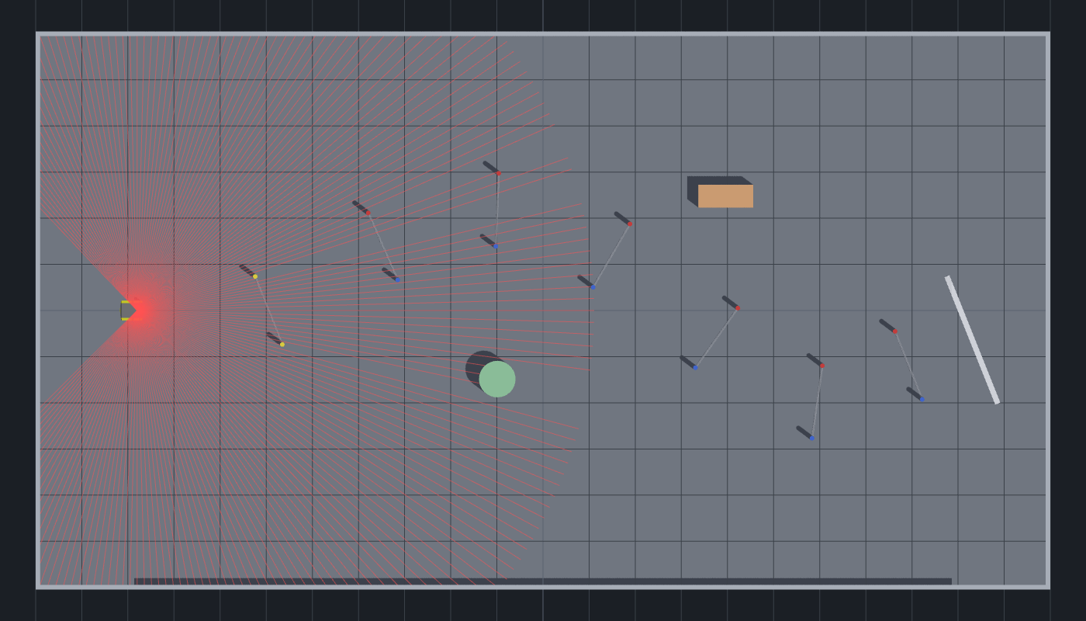
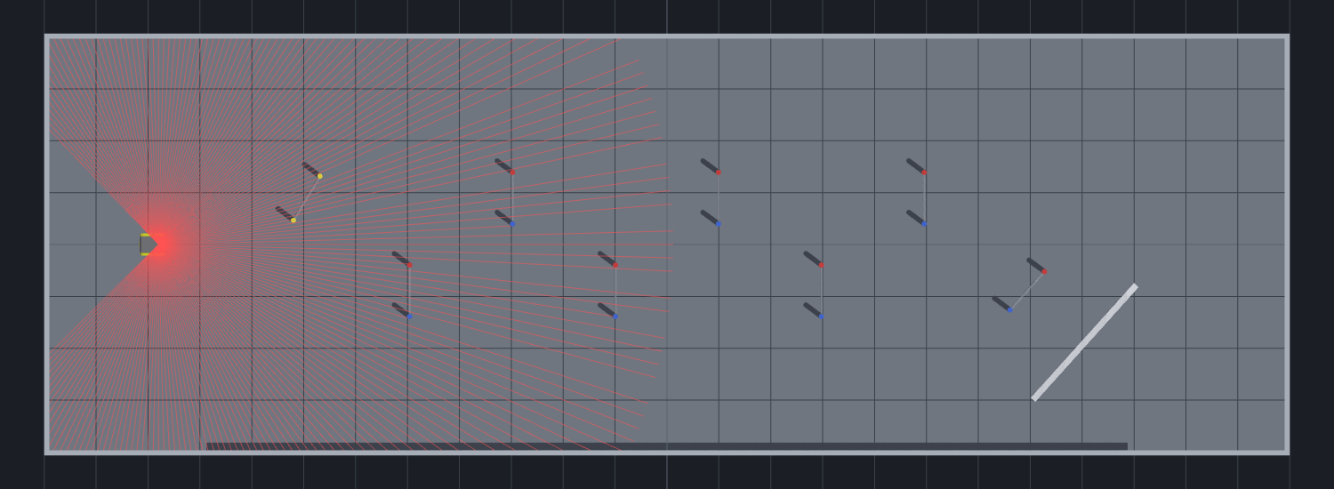
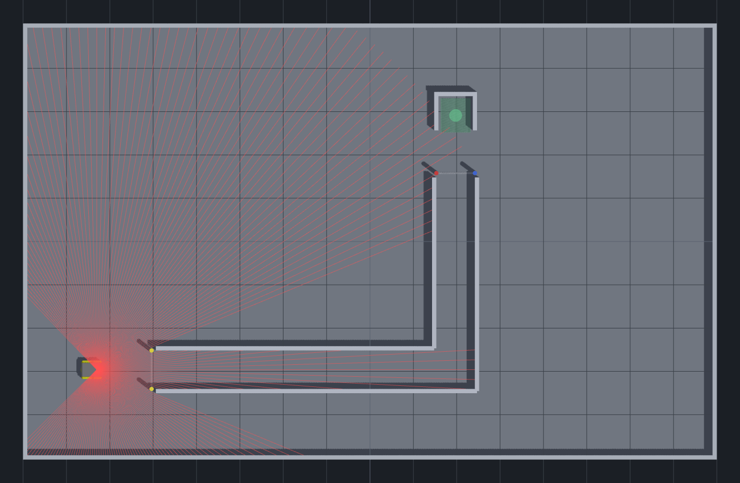
The Courses
L0 Sandbox free driving, a few obstacles
L1 Gates 7 gates in order · 120 s
L2 Slalom 8 alternating gates · 120 s
L3 Corridor + Dock narrow corridor, park in the dock · 150 s
Practice on all of them; judged runs are on L1–L3.
7 / 18

Slide 8
How a Run Is Scored
score = time + 5 s × collisions + 10 s × missed gates
lower is better
The clock starts when the robot first moves
Gates in order: the next one glows yellow; keep the left post on your left
Finish: cross the line (L3: stop inside the dock for 1 s)
Time limit: run out and it's a DNF
8 / 18

Slide 9
The Rules Your Controller Lives By
Deadman: 250 ms
No command for 250 ms → the robot stops. Send at a steady 20 Hz.
Limits
v ≤ 2.0 m/s, w ≤ 4.0 rad/s (clamped). The robot ramps; it doesn't jump.
One driver at a time
First sender wins; another takes over after 1 s of silence.
E-stop
"estop": true latches a stop; reset clears it.
9 / 18

Slide 10
Requirements
A person drives with the Myo (EMG and/or IMU); no keyboard or gamepad in judged runs
✓
Everything runs live, in real time, through jackal-bridge
✓
Assistance is welcome (e.g. lidar keeps you off walls), but no autopilot or pre-planned route
✓
Any language, any ML framework (the bridge speaks plain JSON)
✓
10 / 18

Slide 11
Deliverables
Judged Runs
1
Your controller, driven by a teammate, on L1–L3. Best score per course counts. Plus one run under a degraded link.
Presentation (~5 min)
2
Your approach, what the signals told you, results (scores, CSVs), and what you learned.
11 / 18

Slide 12
Judging Rubric (100 pts + 10 bonus)
Driving Performance
30 pts
Creativity & Novelty
25 pts
Control & User Experience
25 pts
Presentation Quality
20 pts
★ Up to +10 bonus: degraded-link robustness, cross-user calibration, multi-modal, technical depth
12 / 18

Slide 13
Scoring Breakdown: Driving Performance (30 pts)
Judges look for:
✓
The sim's score on L1–L3 (time + collision and gate penalties)
✓
Completing courses at all: a slow finish beats a DNF
✓
Smooth, deliberate control: few deadman stops, no oscillation
✓
Consistency: repeatable runs, not one lucky one
✓
How much the score degrades under latency / drop
13 / 18

Slide 14
Scoring: Creativity & Control / UX
Creativity & Novelty (25 pts)
Control & UX (25 pts)
• Original mapping from muscles to motion
• Proportional speed, gestures, IMU steering…
• Smart assistance (lidar) that keeps the human in charge
• "Wow factor"
• Easy to learn: a new driver is up in minutes
• Quick calibration for a new user
• Clear feedback: the driver knows what it will do
• Fails safe: stops when the signal is lost
14 / 18

Slide 15
Bonus Points (up to +10)
Bonus category | Points
Robust under a degraded link (300 ms latency, 10 % drop) | +3
Cross-user: a new driver, calibrated in ≤ 2 min | +3
Multi-modal (EMG + IMU) or shared-control assistance | +2
Exceptional technical depth | +2
★ Bonus points are awarded on top of the 100-point base score by the judges.
15 / 18

Slide 16
Getting Started
1
Install: conda env create -f environment.yml && conda activate jackal
2
Sim + bridge: jackal-bridge --serve-site --open
3
First drive: python …/examples/keyboard_teleop.py
4
Myo: python …/examples/myo_lsl_publisher.py then lsl-web-viewer --open
5
Build: copy controller_template.py and make it yours
Everything, step by step: events/2026-aware-ai-jackal/STUDENT_GUIDE.md
16 / 18

Slide 17
Tips for Success
Start with the fake Myo — fake_myo_lsl.py lets you build the pipeline without the armband
Record training data early — lsl-web-viewer saves labeled takes as CSV
Simple first — two reliable commands beat six flaky ones
Always send at 20 Hz — or the deadman stops you; resend the last value
Turn the latency slider on early — don't discover it at judging
Test with a teammate — who didn't calibrate it. Then: myo_check.py --off
17 / 18

Slide 18
Build Something Amazing
Good luck!
Repo: github.com/AHRTLab/Hackathon
Sim: ahrtlab.github.io/Hackathon
Contact: jrheee@rit.edu
18 / 18

