Slide 1
EMG On-Ramp
What your Myo is actually measuring
⏱ 15 minutes · no background needed
1 / 16

Slide 2
Why Understand the Signal?
Your code only sees numbers
Intent before motion
Fewer surprises
8 streams of numbers, 200 times a second. Knowing what they mean is how you turn them into a good command.
Muscle activity starts ~50–100 ms before the hand actually moves. That is the head start EMG gives a controller.
Noise, fatigue and a shifted band all look like “my classifier broke.” Recognise them and you can fix them.
2 / 16

Slide 3
Where the Signal Comes From
Brain
Motor neurons
Muscle fibres
Electric field
Myo
decides to move
fire spikes
contract
reaches the skin
8 electrodes
Motor unit = one motor neuron + all the muscle fibres it controls. It fires all-or-none.
More force = more motor units switched on, each firing faster.
Surface EMG = the sum of all those tiny electrical spikes, seen through skin and fat.
So: it is a crowd's noise, not a single voice. Its loudness is the information.
3 / 16

Slide 4
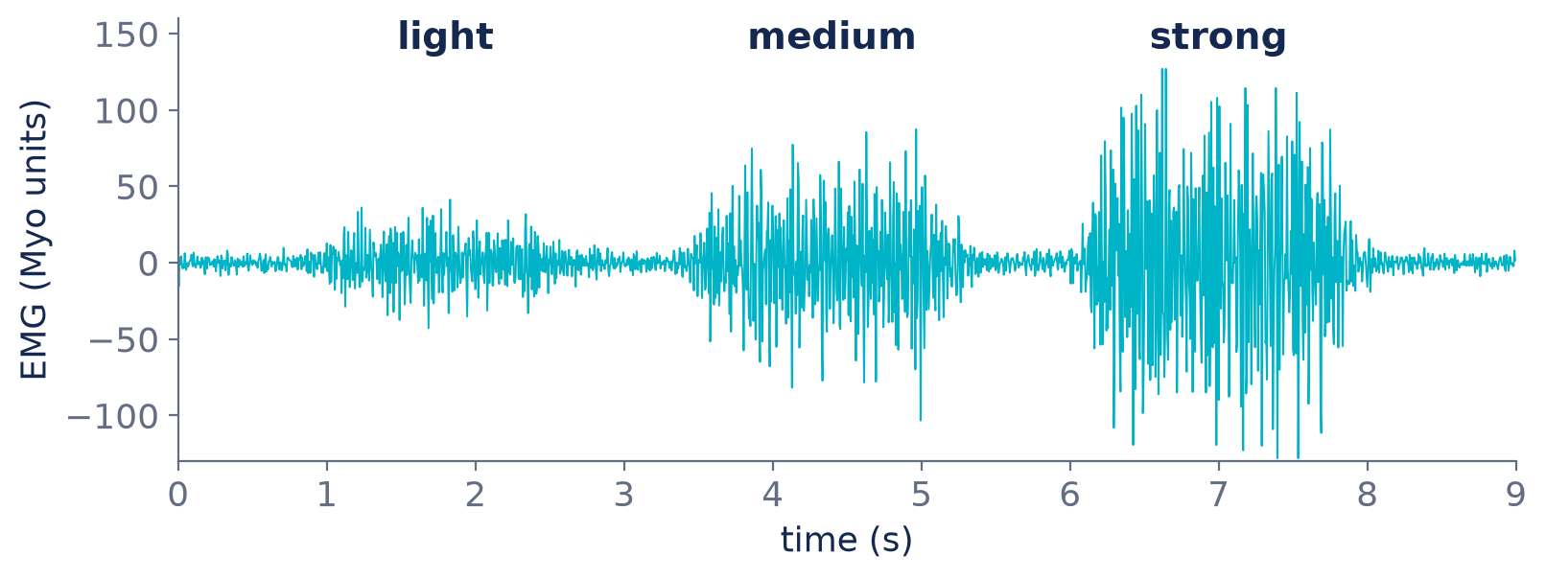
More Effort, Bigger Signal
Amplitude tracks effort. A light squeeze, a medium one and a hard one: the signal gets larger and denser as more motor units join in.
Simulated signal at the Myo's 200 Hz, for illustration.
4 / 16

Slide 5
Reading Raw EMG
It looks like noise — and statistically it is: random-looking, centred on zero.
The sign means nothing — +80 and −80 are the same amount of activity.
One sample tells you nothing — always look at a window of samples (e.g. the last 200 ms).
Loudness is the information — how big the wiggles are over a window = how hard the muscle works.
Where it is loud is the information too — which of the 8 channels light up = which muscles = which gesture.
5 / 16

Slide 6
Meet the Myo Armband
8 EMG channels · electrode pods around the forearm
1
200 Hz · 200 samples per second per channel
8
2
8-bit values · −128 … 127, unitless (not µV)
7
forearm
(cross-section)
3
Dry electrodes · no gel: needs a snug fit and ~2 min to settle
Plus an IMU · orientation, acceleration, rotation at 50 Hz
6
4
5
On LSL · Myo_EMG, Myo_IMU, Myo_Events (arm sync)
■ palm side (flexors) ■ back (extensors)
which pod sits where depends on how the band is worn
6 / 16

Slide 7
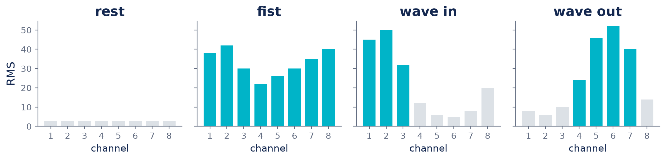
Different Gestures, Different Channels
A gesture is a pattern across the 8 channels, not a single number.
Rotate the band and the pattern rotates too: calibrate for each person and each fitting.
Illustrative patterns, not measured data. See your own in lsl-web-viewer.
7 / 16

Slide 8
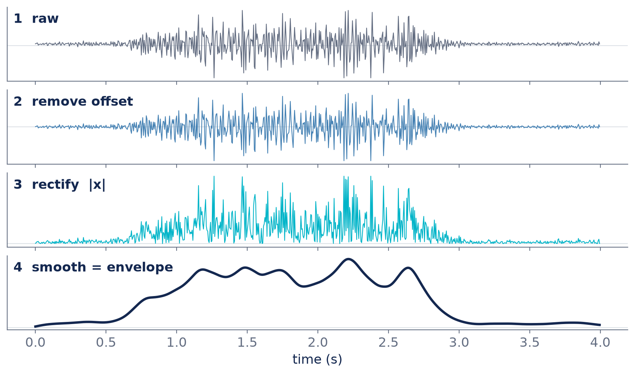
From Raw Signal to Envelope
1
Raw
what the Myo sends
2
Remove offset
subtract the mean, so rest sits at 0
3
Rectify
take |x|: negative wiggles count as activity too
4
Smooth
low-pass or a moving average: a slow “how hard” curve
That curve can drive speed directly.
8 / 16

Slide 9
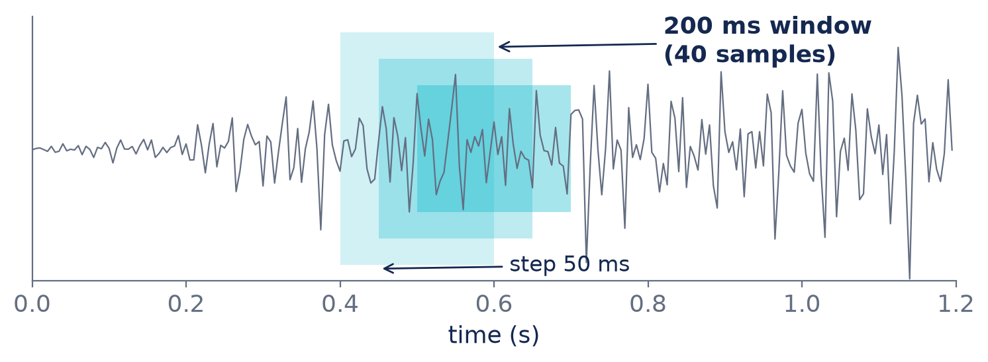
Windows and Features
Feature | Tells you
RMS / MAV | how hard (amplitude)
WL waveform length | how busy the signal is
ZC zero crossings | a rough frequency
SSC slope sign changes | high-frequency content
Every 50 ms: take the last 200 ms (40 samples) of each channel, compute a few features.
8 channels × 4 features = 32 numbers describing “what the arm is doing right now.” That vector is what a classifier sees.
At 200 Hz the Myo only captures up to 100 Hz, so amplitude features (RMS, MAV, WL) work best.
9 / 16

Slide 10
Two Ways to Turn EMG Into (v, w)
Proportional
Gesture classification
• Envelope → speed directly
• Smooth and fast to build
• Squeeze harder = go faster
• Needs per-person calibration
• e.g. myo_emg_example.py
• Features → classifier → a class
• fist / wave in / wave out / rest
• Each class = a command
• Needs labeled training data
• LDA or SVM is a great start
★ Mix them: the class picks the direction, the envelope picks the speed.
10 / 16

Slide 11
Calibration: Every Arm Is Different
1
Rest — relax for a few seconds: each channel's baseline
2
Max — a firm (not painful) contraction for each gesture you use
3
Normalise — (x − rest) / (max − rest) → 0 … 1 per channel
4
Deadband — treat < ~15 % as zero, so resting noise doesn't drive the robot
5
Redo it — new person, band moved, or after a break
11 / 16

Slide 12
What Goes Wrong (and the Fix)
You see | Likely cause | Fix
Big noise on every channel | loose band, dry skin | tighten (sizing clips); wait 2 min
Spikes when the arm moves | motion artefacts | steady arm; filter; ignore short spikes
Wrong gesture detected | band rotated since calibration | re-sync and recalibrate
Signal creeps up over time | fatigue | rest breaks; recalibrate
Two gestures look the same | crosstalk between muscles | more distinct gestures; better features
Robot creeps at rest | rest isn't zero | deadband after calibration
12 / 16

Slide 13
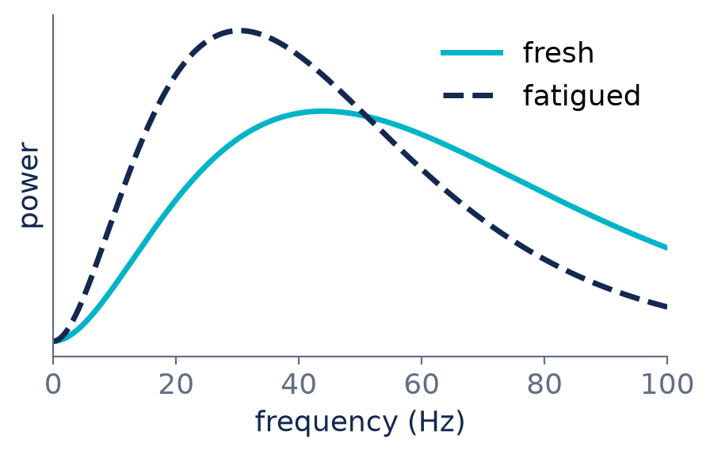
Fatigue Changes the Signal
Same force, bigger signal: tired muscles recruit more units
Lower frequencies: the spectrum shifts down (median frequency drops)
Your thresholds drift: what was “medium” at 9 am is “hard” at 3 pm
Plan for it: short breaks, quick recalibration, relative (normalised) features
13 / 16

Slide 14
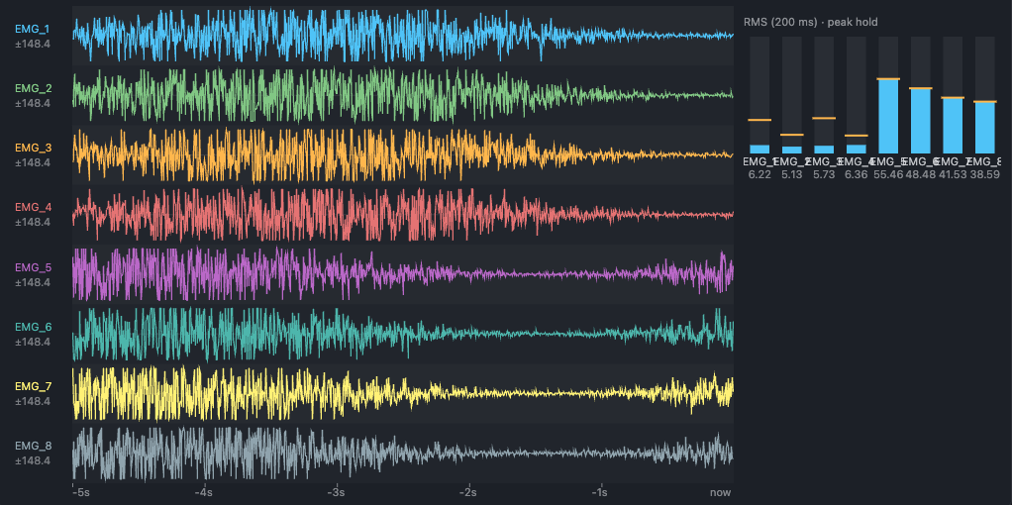
Try It Now (10 minutes)
1
Stream: python examples/myo_lsl_publisher.py (or fake_myo_lsl.py)
2
Look: lsl-web-viewer --open, tick Myo_EMG
3
Play: relax, fist, wave in, wave out. Which bars move?
4
Record: label a few 5 s takes of each gesture
lsl-web-viewer: live traces + RMS bars (fake Myo shown)
5
Drive: python examples/myo_emg_example.py
14 / 16

Slide 15
Numbers to Remember
8
200 Hz
±128
channels
sample rate
value range
200 ms
20 Hz
250 ms
feature window
send commands
deadman stop
15 / 16

Slide 16
Questions?
Go look at your own muscles.
Setup: STUDENT_GUIDE.md · Smallest controller: examples/myo_emg_example.py
Deeper dive: electromyography.pptx on the 2026-bioradio branch
github.com/AHRTLab/Hackathon
16 / 16

