Slide 1
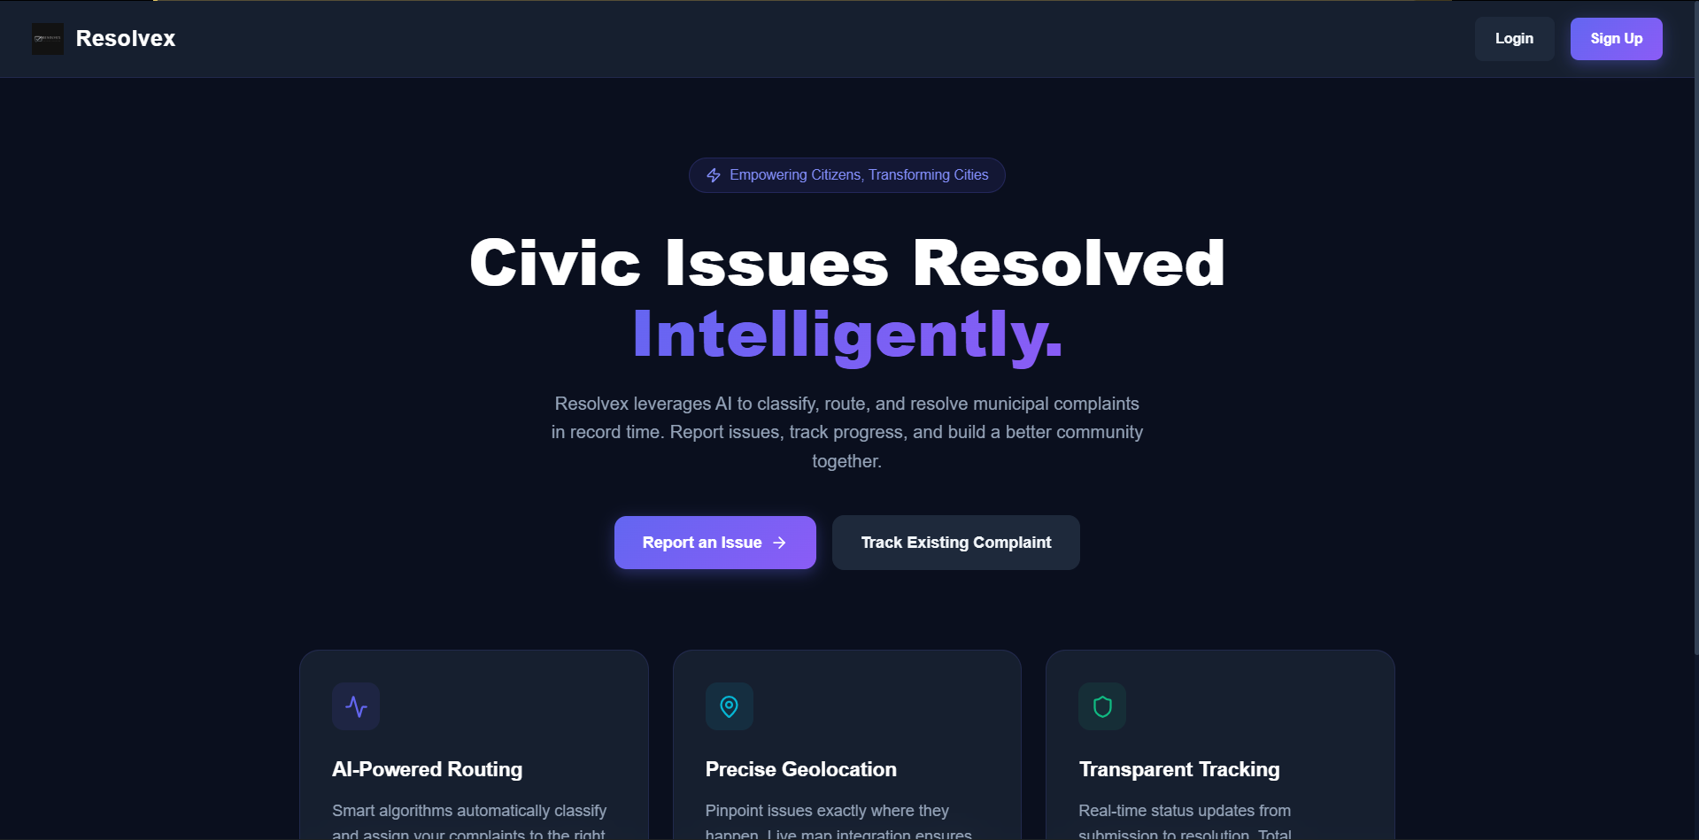
RESOLVEX
Civic Problem Management System
Empowering Citizens · Transforming Cities · Powered by AI
Full-Stack Web Application | React + Node.js + MongoDB + AI
Presented by: Amit Saini | MCA | Kurukshetra University
Notes:
SLIDE 1 — TITLE SLIDE
Project Name: Resolvex – Civic Problem Management System
What to say:
Good morning/afternoon everyone. Today I am going to present my project called Resolvex.
Resolvex is a web application that helps citizens report civic problems like broken roads,
street lights not working, sewage overflow, etc. The system uses Artificial Intelligence (AI)
to automatically understand the type of problem and send it to the right government department.
Key points to mention:
- This is a full-stack web application (both frontend and backend are built)
- It uses modern technologies: React, Node.js, MongoDB
- It has AI integration using Google Gemini API
- It has three types of users: Citizen, Admin, and Department
Technologies used:
- Frontend: React.js (a JavaScript library for building user interfaces)
- Backend: Node.js with Express.js (server-side programming)
- Database: MongoDB (a NoSQL database to store all data)
- AI: Google Gemini API (used for auto-classifying complaints)
- Real-time updates: Socket.io (for live notifications)
- Maps: Leaflet.js (for showing location on map)

Slide 2
01 / PROBLEM STATEMENT
The Problem We Are Solving
🚧
📋
🏛️
📊
No Easy Way to Report
Manual & Slow Process
Wrong Department Assignment
No Data or Accountability
Citizens have no simple digital platform to report civic problems like potholes, broken streetlights, or water leaks.
Most cities still use paper forms or phone calls. There is no tracking system, so citizens never know what happened to their complaint.
Complaints often go to the wrong department because there is no automatic routing system — causing delays.
Authorities have no dashboard or analytics to see which areas have the most problems or which departments are slow.
Notes:
SLIDE 2 — PROBLEM STATEMENT
What to say:
Let me explain why I built this project. These are the four main problems that exist in most Indian cities today.
Problem 1 – No Easy Way to Report:
Most citizens have no digital way to report a problem. They have to visit a government office,
make a phone call, or just hope that someone notices the problem. This is very inconvenient.
Problem 2 – Manual and Slow Process:
Even if someone reports a problem, the process is done on paper or through phone.
There is no tracking. Citizens do not know if their complaint is being worked on or ignored.
Problem 3 – Wrong Department Assignment:
A road problem should go to the Roads Department. A water problem should go to Water Supply.
But without a smart system, complaints often go to the wrong place, causing unnecessary delays.
Problem 4 – No Data or Accountability:
Government authorities have no way to see the big picture — which areas need the most attention,
which departments are fast or slow, how many complaints are resolved on time.
This is exactly what Resolvex solves — it is a complete digital solution for civic complaint management.

Slide 3
02 / PROJECT OBJECTIVE & KEY FEATURES
What Resolvex Does
🤖 AI Auto-Classification
📍 Location Pinning on Map
🔔 Real-Time Notifications
Automatically identifies the type and category of a complaint using Google Gemini AI.
Citizens can pin the exact location of the problem on an interactive map powered by Leaflet.js.
Live updates are sent to citizens when their complaint status changes — no refresh needed.
📈 Admin Analytics Dashboard
🏢 Department Management
📧 Email Verification
Admins see charts, KPI cards, SLA breach alerts, and complete complaint history.
Admin can create departments and assign complaints directly to the right department.
New users verify their email before they can use the system — ensures security.
Notes:
SLIDE 3 — OBJECTIVES & KEY FEATURES
What to say:
The main goal of Resolvex is to provide a simple, smart, and transparent system for civic complaint management.
Let me explain each feature:
1. AI Auto-Classification:
When a citizen types a complaint, they can click "Analyze & Auto-Classify".
The system sends the text to Google Gemini AI, which reads it and tells us:
What category is this? (roads, water, sanitation, etc.) and what priority level? (low, medium, high)
This saves time and reduces human error.
Library used: Google Generative AI (npm package: @google/generative-ai)
2. Location Pinning on Map:
The citizen can open a live interactive map and click anywhere to pin the exact location of the problem.
This helps the department know exactly where to go.
Library used: Leaflet.js + React-Leaflet
3. Real-Time Notifications:
When an admin or department updates the complaint status, the citizen gets a live notification
without refreshing the page. This is done using WebSockets.
Library used: Socket.io
4. Admin Analytics Dashboard:
The admin sees a complete overview — total complaints, how many are pending, resolved,
how many SLA deadlines were missed, etc. Charts are shown for visual understanding.
Library used: Recharts
5. Department Management:
Admin can create new departments (like Roads Dept., Water Dept.) and assign complaints to them.
Each department sees only their assigned complaints.
6. Email Verification:
When someone signs up, they get an email with a verification link.
Only verified users can log in. This prevents fake accounts.
Library used: Nodemailer

Slide 4
03 / TECHNOLOGY STACK
Languages & Libraries Used
⚛️ FRONTEND (Client Side)
🟢 BACKEND (Server Side)
• React.js: JavaScript library to build the user interface (UI). Uses components and hooks.
• Vite: Fast development build tool for React. Replaces Create React App.
• React Router: Manages navigation between pages (Login, Dashboard, etc.) without page reload.
• Axios: Sends HTTP requests from the browser to the backend server (GET, POST, PUT, DELETE).
• Socket.io-client: Connects to server for real-time notifications and live updates.
• Leaflet.js: Shows interactive maps so users can pin exact problem locations.
• Recharts: Creates beautiful charts and graphs in the Admin analytics dashboard.
• Framer Motion: Adds smooth animations and transitions to UI elements.
• react-hot-toast: Shows small notification popups (toast messages) to the user.
• Node.js: Runtime environment — runs JavaScript on the server side.
• Express.js: Framework for Node.js that handles API routes and HTTP requests.
• Mongoose: Library to define data models (schemas) for MongoDB and run queries easily.
• MongoDB: NoSQL database — stores users, complaints, departments as JSON-like documents.
• JWT (jsonwebtoken): Creates secure tokens for login — used for authentication.
• Socket.io: Server-side real-time communication with clients (push notifications).
• Multer + Cloudinary: Handles image/video file uploads and stores them on Cloudinary CDN.
• Nodemailer: Sends emails for account verification and password reset.
• Google Gemini AI: AI API for auto-classifying complaint category, priority, suggestions.
Notes:
SLIDE 4 — TECHNOLOGY STACK
What to say:
Now let me explain the technologies I used to build Resolvex.
The application has two parts:
FRONTEND (what the user sees in the browser):
- React.js: This is the main JavaScript library used to build the website's user interface.
It works with "components" — reusable pieces of UI like buttons, forms, cards.
- Vite: This is a modern build tool that makes React development very fast.
- React Router: This manages navigation. When you click "Dashboard" it shows the dashboard
WITHOUT refreshing the whole page.
- Axios: This sends requests to the backend server. For example, when you log in,
Axios sends your email and password to the server and gets back a token.
- Socket.io-client: This keeps a live connection with the server.
So when someone updates your complaint, you get a notification instantly.
- Leaflet.js: This shows a real interactive map (using OpenStreetMap data).
- Recharts: Used in the admin panel to show bar charts and pie charts.
- Framer Motion: Adds smooth animations to make the UI feel premium.
BACKEND (what runs on the server):
- Node.js: JavaScript running on the server — the backbone of the backend.
- Express.js: A framework that makes it easy to create API routes.
E.g., POST /api/auth/login handles login requests.
- MongoDB: Database. All complaints, users, departments are stored here.
It stores data in a flexible JSON-like format called BSON.
- Mongoose: Makes working with MongoDB easier by defining schemas (data structure).
- JWT: JSON Web Tokens. After login, the server gives a token.
The browser sends this token with every request to prove identity.
- Multer + Cloudinary: When a user uploads a photo of the problem,
Multer handles the file and Cloudinary stores it on the cloud.
- Nodemailer: Sends emails. Used for email verification and password reset.
- node-cron: Runs a background job every hour to check if any complaints have
missed their SLA (deadline) and marks them as "SLA Breached".
- Google Gemini AI: The AI brain. It reads the complaint text and tells us
the category, priority, and gives suggestions.
Language used: JavaScript (for both frontend and backend — this is called a full-stack JavaScript application)

Slide 5
04 / SYSTEM ARCHITECTURE
How the System Works
🖥️ FRONTEND (React + Vite)
⚡ BACKEND (Node.js + Express)
🗄️ DATABASE (MongoDB Atlas)
• User Interface (UI) • 3 Role-based Dashboards • Interactive Maps (Leaflet) • Real-time Notifications • Charts (Recharts) • Runs at: localhost:5173
• REST API Server • JWT Authentication • Role-based Access Control • AI Classification (Gemini) • File Upload (Multer+Cloudinary) • Socket.io Real-time • Cron Jobs (SLA Monitor) • Runs at: localhost:5000
• Users Collection • Complaints Collection • Departments Collection • Notifications Collection • Stores all app data • Cloud-hosted (Atlas)
→
→
External Services: Cloudinary (image storage) · Google Gemini AI (classification) · Nodemailer (email) · OpenStreetMap (maps)
Notes:
SLIDE 5 — SYSTEM ARCHITECTURE
What to say:
The Resolvex system has three main parts working together:
1. FRONTEND (React + Vite):
This is what the user sees in their browser. It is built using React.js.
When you open the website, you see the landing page, login page, dashboards, etc.
The frontend communicates with the backend by sending API requests (HTTP requests).
It runs on port 5173 during development.
2. BACKEND (Node.js + Express):
This is the brain of the application. It is a REST API server.
- When a user logs in, the backend checks the username/password and sends back a JWT token.
- When a complaint is submitted, the backend saves it to the database.
- The backend also communicates with external services like Gemini AI and Cloudinary.
- Socket.io runs here to send real-time notifications.
- A cron job runs every hour to automatically check if any complaint has crossed its SLA deadline.
It runs on port 5000 during development.
3. DATABASE (MongoDB):
All data is stored here — user accounts, complaints, departments, notifications.
MongoDB is a NoSQL database, meaning data is stored as flexible JSON-like documents.
We use MongoDB Atlas (cloud version) so the database is always online.
External Services:
- Cloudinary: Stores uploaded images and videos (like proof photos of road damage)
- Google Gemini AI: Classifies complaints automatically
- Nodemailer: Sends emails for verification and password reset
- OpenStreetMap: Provides the map tiles for the Leaflet map component

Slide 6
05 / USER ROLES
Three Types of Users
👨‍💼 CITIZEN
⚙️ ADMIN
🏢 DEPARTMENT
✓ Register & verify email
✓ Report new complaints (with photos/videos)
✓ AI auto-classify complaints
✓ Pin problem location on map
✓ Track status of own complaints
✓ Upvote & comment on complaints
✓ View complaint timeline
✓ Update personal profile
✓ View all system complaints
✓ Assign complaints to departments
✓ Update complaint status
✓ Manage all users (block/unblock)
✓ Create & manage departments
✓ View analytics & charts
✓ Monitor SLA breaches
✓ Full system overview dashboard
✓ View complaints assigned to their dept
✓ Accept or reject a complaint
✓ Update work progress
✓ Upload proof images
✓ Mark complaint as complete/resolved
✓ View department performance stats
✓ Get real-time notifications
Notes:
SLIDE 6 — USER ROLES
What to say:
Resolvex has three types of users. Each has a different level of access and responsibility.
1. CITIZEN (the general public):
Any person can register as a citizen. After email verification, they can:
- Report a new complaint (for example: "There is a big pothole on Main Street")
- Upload photos or videos as proof
- Use AI to auto-classify the complaint
- Pin the location on the map
- Track the status of their complaint in real-time
- Upvote complaints reported by others (to show priority)
- Add comments or questions
2. ADMIN (the government administrator):
The admin manages the entire system. They can:
- See ALL complaints from all citizens
- Assign a complaint to the correct department
- Update status of any complaint
- Block or unblock user accounts
- Create new departments (like "Roads Department", "Electricity Board")
- See analytics charts and SLA breach reports
3. DEPARTMENT (government department staff):
Each department sees ONLY the complaints assigned to them. They can:
- Accept or reject a new complaint assignment
- Update the work progress ("In Progress")
- Upload proof photos of the work being done
- Mark a complaint as "Resolved" or "Completed"
- See how many complaints they resolved and their performance
This role-based system ensures data security — a citizen cannot see admin data,
and a department cannot see another department's work.

Slide 7
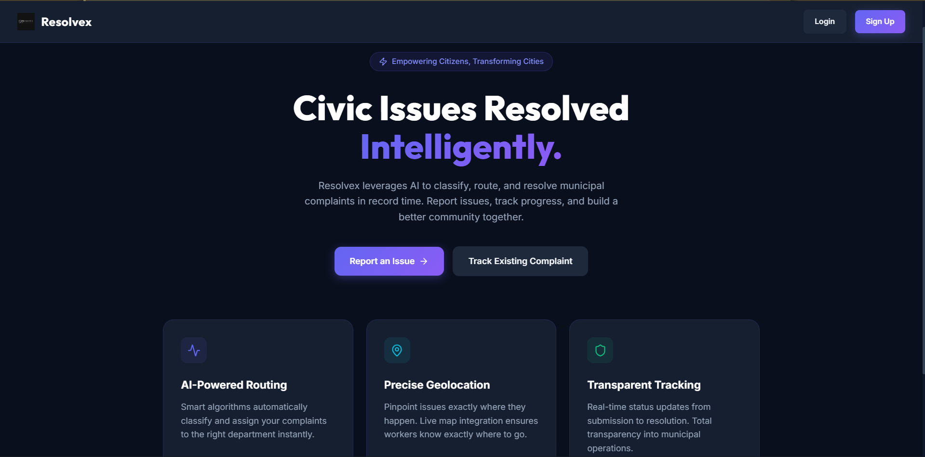
06 / APPLICATION SCREENS
Landing Page — Home Screen
Citizens are welcomed with a modern hero section featuring AI-Powered Routing · Precise Geolocation · Transparent Tracking
Notes:
SLIDE 7 — LANDING PAGE
What to say:
This is the landing page — the first screen a user sees when they open Resolvex.
What you can see:
- The heading says: "Civic Issues Resolved Intelligently."
- There is a tagline: "Empowering Citizens, Transforming Cities"
- Two main buttons: "Report an Issue" and "Track Existing Complaint"
- Three feature highlights at the bottom:
1. AI-Powered Routing — The system automatically sends the complaint to the right department
2. Precise Geolocation — Citizens pin the exact location on a map
3. Transparent Tracking — Citizens can track their complaint status in real-time
Design:
- Dark theme with purple accents — looks modern and professional
- Built using React.js components
- The buttons use Framer Motion for smooth hover animations
- Fully responsive (works on mobile and desktop)

Slide 8
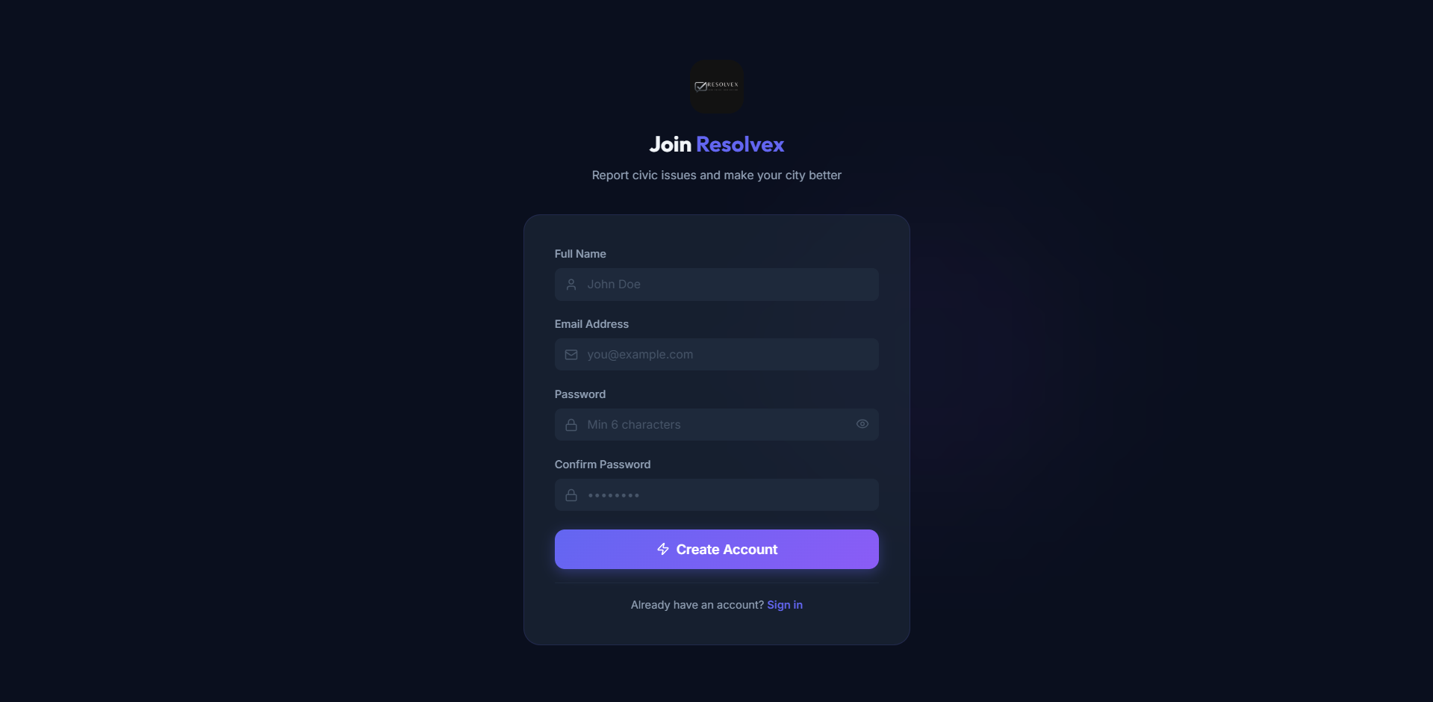
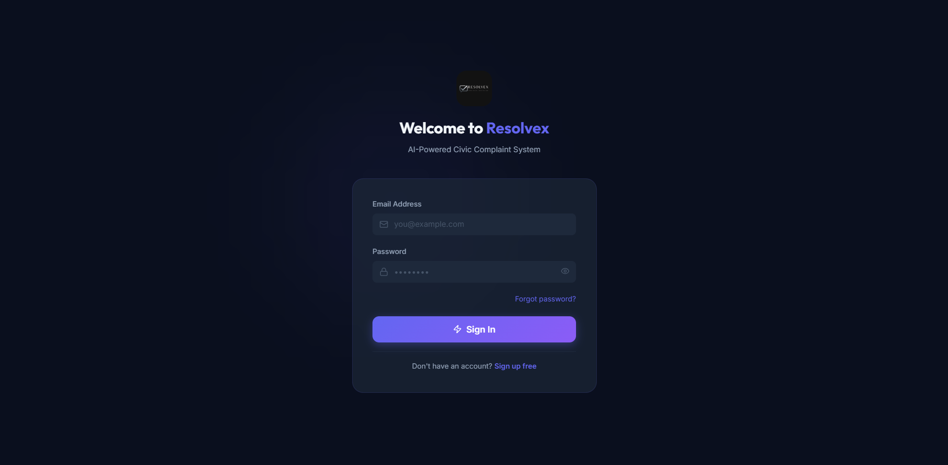
07 / AUTHENTICATION SCREENS
Login & Sign Up
SIGN UP — Create Account
LOGIN — Sign In to Your Account
Notes:
SLIDE 8 — AUTHENTICATION SCREENS
What to say:
These two screens handle user authentication — signing up and logging in.
LEFT — SIGN UP PAGE:
- New users fill in: Full Name, Email Address, Password, Confirm Password
- They click "Create Account"
- After registration, a verification email is sent to their email address
- The account is only activated after clicking the link in that email
- This prevents spam and fake accounts
RIGHT — LOGIN PAGE:
- Existing users enter Email and Password
- They click "Sign In"
- The server checks the credentials and returns a JWT (JSON Web Token)
- This token is saved in the browser's localStorage
- Every future request to the server includes this token to prove identity
Security features:
- Passwords are hashed using bcrypt before storing in the database
(meaning even if someone reads the database, they cannot see the real password)
- JWT tokens expire after a set time (automatic logout)
- If a token is invalid or expired, the server sends a 401 Unauthorized error
and the user is redirected to the login page
Library used:
- JWT: jsonwebtoken package on the backend
- Password hashing: bcryptjs package
- Token stored in: localStorage in the browser

Slide 9
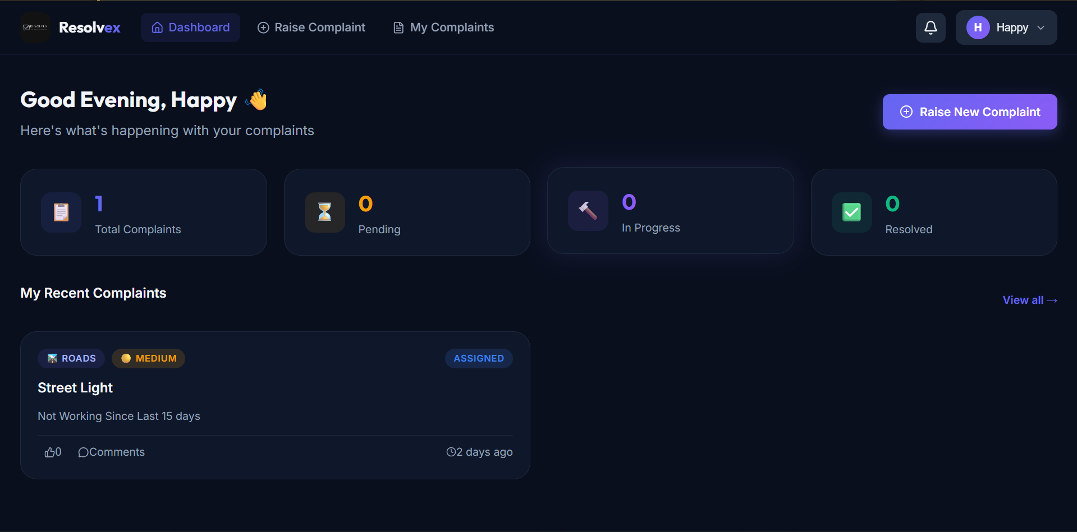
08 / CITIZEN PANEL
Citizen Dashboard
Citizens see: Total Complaints · Pending · In Progress · Resolved — with recent complaints list and Quick 'Raise New Complaint' button
Notes:
SLIDE 9 — CITIZEN DASHBOARD
What to say:
After logging in as a citizen, this is the dashboard they see.
What you can see on screen:
- A personalized greeting: "Good Evening, Happy 👋"
- Four summary cards at the top:
• Total Complaints — how many complaints they have submitted total
• Pending — waiting to be assigned to a department
• In Progress — department is currently working on it
• Resolved — problem has been fixed
- "My Recent Complaints" section — shows their latest submitted complaints
with title, category, priority level, status badge, and submission time
- "Raise New Complaint" button — prominent purple button in the top right corner
for quick access to submit a new complaint
This dashboard gives the citizen a quick overview of all their civic complaints at a glance.
How it works technically:
- When the citizen logs in, the browser makes a GET request to /api/complaints (with JWT token)
- The server returns only the complaints belonging to that citizen
- The counts (pending, in progress, resolved) are calculated from this data
- The UI updates automatically using React state

Slide 10
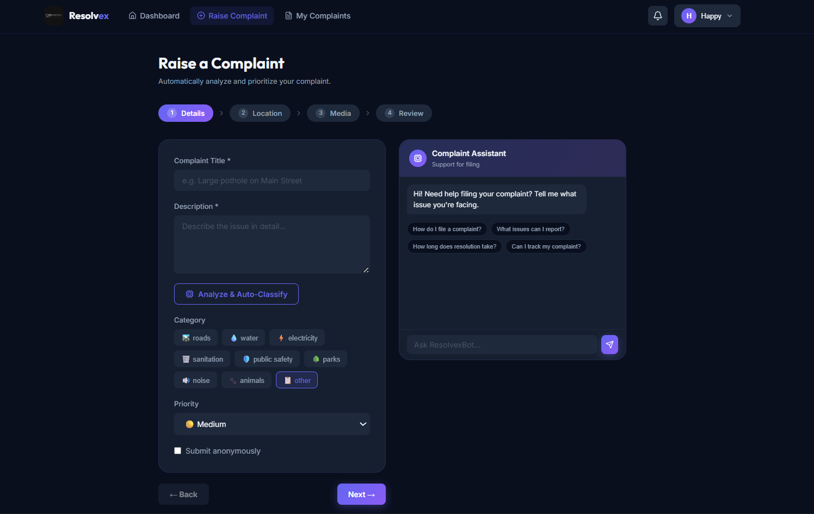
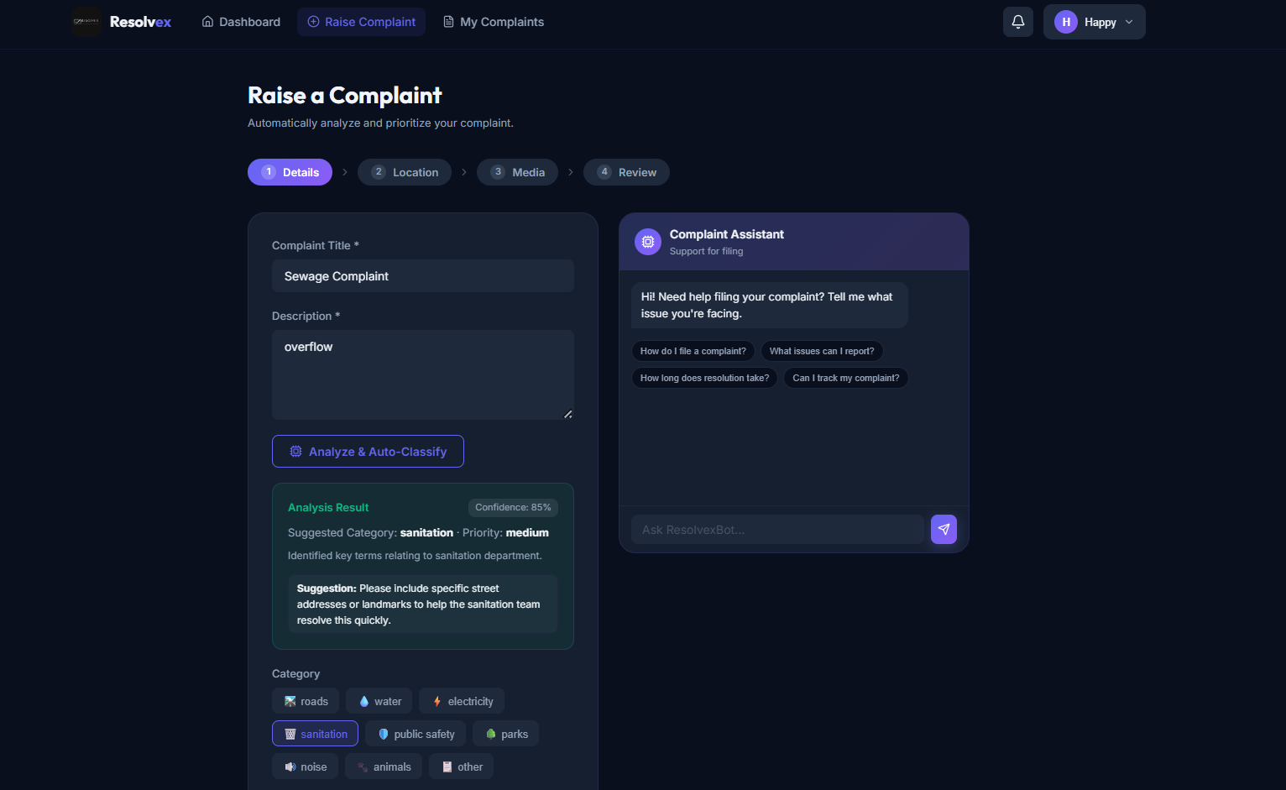
09 / RAISE A COMPLAINT
Complaint Form — Step 1: Details & AI Classification
STEP 1: Fill complaint details + AI Chatbot Assistant
AI Analyzes complaint: Confidence 85%, Category: Sanitation, Priority: Medium
Notes:
SLIDE 10 — RAISE A COMPLAINT (Details & AI)
What to say:
This is the "Raise a Complaint" form. It has 4 steps:
Step 1: Details → Step 2: Location → Step 3: Media → Step 4: Review
LEFT SCREENSHOT — Empty form:
- The citizen types:
• Complaint Title (e.g., "Sewage Complaint")
• Description (e.g., "overflow")
• Category (roads, water, electricity, sanitation, etc.)
• Priority (low, medium, high)
• Option to submit anonymously (checkbox)
- On the RIGHT side is the "Complaint Assistant" — an AI chatbot powered by Google Gemini
The citizen can ask questions like:
"How do I file a complaint?" or "How long does resolution take?"
The AI chatbot answers these questions in simple language.
- There is an "Analyze & Auto-Classify" button
When clicked, the AI reads the complaint title and description and automatically suggests:
→ Category (e.g., Sanitation)
→ Priority level (e.g., Medium)
RIGHT SCREENSHOT — After AI classification:
- The AI analyzed "Sewage Complaint - overflow" and shows:
• Confidence: 85%
• Suggested Category: Sanitation
• Priority: Medium
• Suggestion: "Please include specific street addresses or landmarks to help the sanitation team resolve this quickly."
This saves the citizen time and ensures complaints are categorized correctly.
How it works technically:
- When the user clicks "Analyze & Auto-Classify", Axios sends a POST request to /api/ai/classify
- The backend calls Google Gemini API with the complaint text
- Gemini returns: category, priority, confidence score, and suggestion text
- The frontend displays this result and pre-fills the category and priority fields

Slide 11
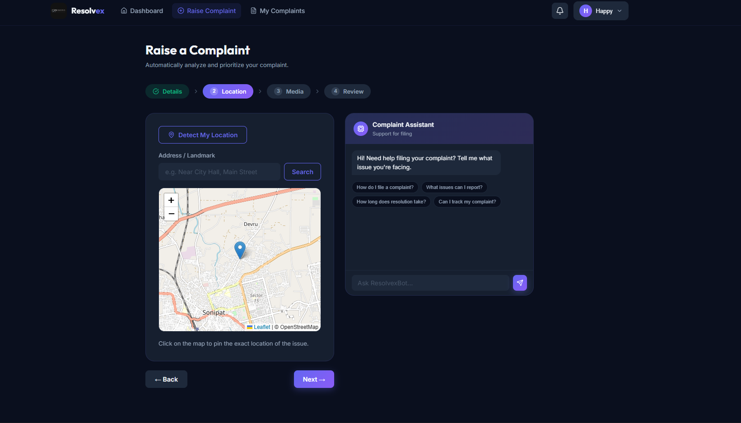
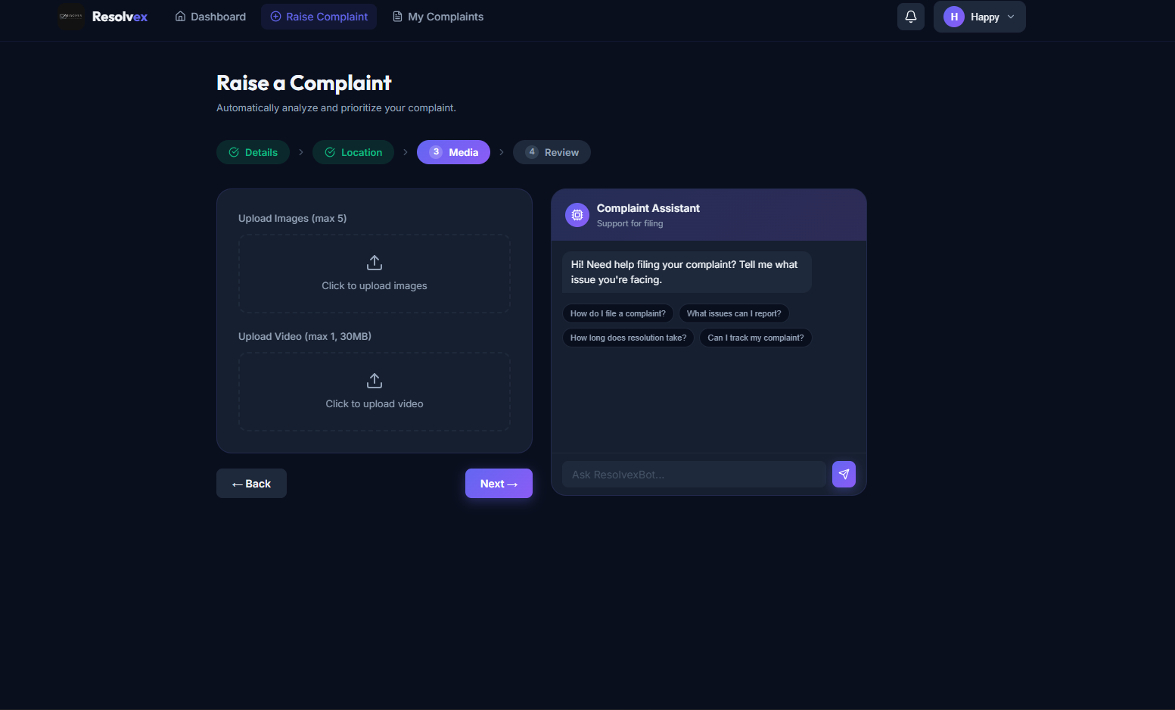
10 / RAISE A COMPLAINT
Step 2: Location Pin & Step 3: Upload Media
STEP 2: Pin exact location on Leaflet interactive map
STEP 3: Upload images (max 5) and videos (max 1, 30MB) as proof
Notes:
SLIDE 11 — LOCATION PIN & MEDIA UPLOAD
What to say:
After filling the details, the citizen moves to Step 2 and Step 3.
LEFT — STEP 2: LOCATION:
- A real interactive map appears (powered by Leaflet.js using OpenStreetMap tiles)
- The citizen can:
• Click "Detect My Location" — automatically detects GPS coordinates
• Search for a location by typing an address
• Click anywhere on the map to drop a pin at the exact location of the problem
- The map uses the Leaflet library which is free and open-source
- The coordinates (latitude and longitude) are saved with the complaint
- This helps the department know EXACTLY where to go
RIGHT — STEP 3: MEDIA UPLOAD:
- The citizen can upload:
• Up to 5 images as proof (photos of the broken road, damaged light, etc.)
• 1 video (maximum 30MB)
- This gives visual evidence to the authorities so they can understand the severity
How it works technically:
- Images/videos are sent as multipart/form-data (file upload format)
- The backend uses Multer middleware to handle the uploaded files
- Files are then uploaded to Cloudinary (a cloud storage service)
- Cloudinary gives back a URL for each file, which is saved in MongoDB
- When viewing the complaint, these URLs are used to display the images/videos

Slide 12
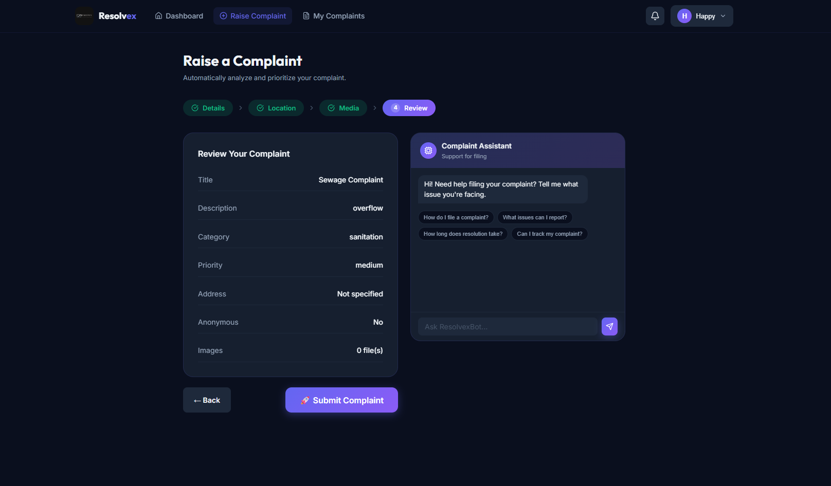
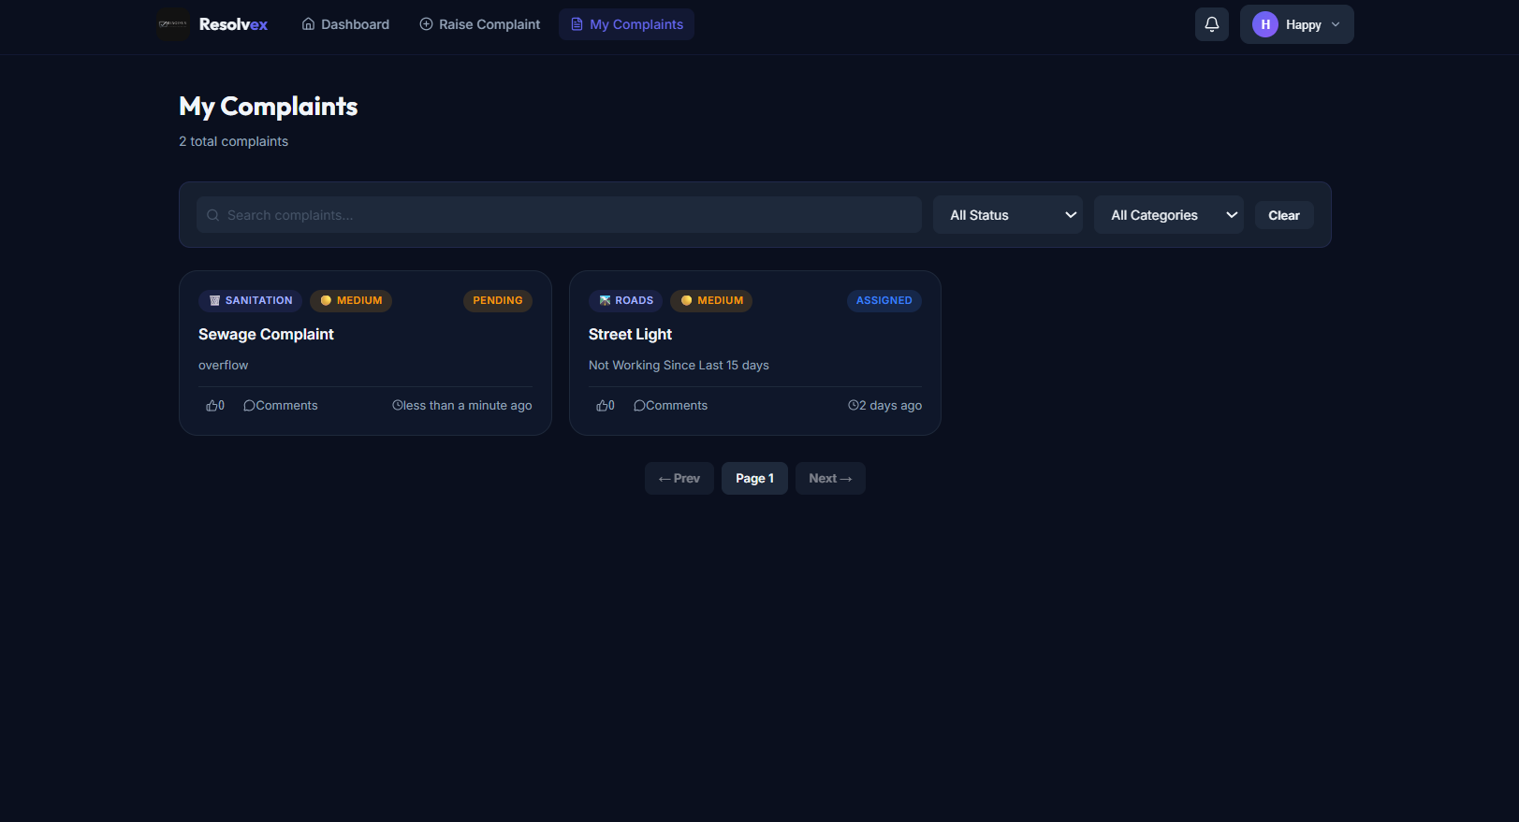
11 / COMPLAINT WORKFLOW
Step 4: Review & Submit | My Complaints List
STEP 4: Review all details before final submission
MY COMPLAINTS: View all submitted complaints with status and filters
Notes:
SLIDE 12 — REVIEW & SUBMIT + MY COMPLAINTS
What to say:
LEFT — STEP 4: REVIEW YOUR COMPLAINT:
Before submitting, the citizen sees a complete summary of their complaint:
- Title: Sewage Complaint
- Description: overflow
- Category: Sanitation (AI-classified)
- Priority: Medium
- Address: Not specified
- Anonymous: No
- Images: 0 file(s)
If everything looks correct, they click "Submit Complaint" (purple button).
The complaint is saved to the database with status = "Pending".
RIGHT — MY COMPLAINTS:
After submitting, the citizen can view all their complaints in the "My Complaints" page.
- Shows a list of complaint cards
- Each card shows: Category badge, Priority badge, Status badge, Title, Description, time
- In this example: "Sewage Complaint" (Pending) and "Street Light" (Assigned)
- The citizen can search complaints or filter by Status and Category
Status badge colors:
- PENDING = orange (waiting for admin to assign)
- ASSIGNED = blue (assigned to a department, not yet started)
- IN PROGRESS = yellow (department is working on it)
- RESOLVED = green (problem is fixed)

Slide 13
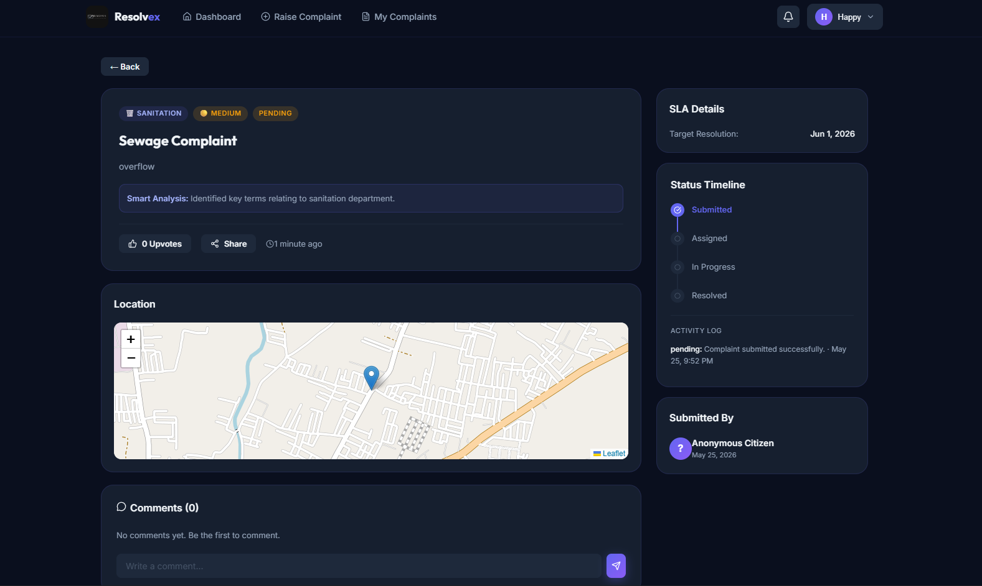
12 / COMPLAINT DETAIL
Complaint Detail View with Timeline & Map
AI Smart Analysis · Location Map · Status Timeline (Submitted → Assigned → In Progress → Resolved) · SLA Details · Comments Section
Notes:
SLIDE 13 — COMPLAINT DETAIL VIEW
What to say:
When a citizen clicks on any complaint in their list, they see this detailed view.
What you can see:
Left Panel:
- Complaint title, category, priority, and status badges at the top
- "Smart Analysis" box — shows the AI's analysis (e.g., "Identified key terms relating to sanitation department")
- Upvote button — other citizens can upvote if they have the same problem
- Share button
- Location Map — shows exactly where the problem is on Leaflet map with a pin
- Comments Section — citizens and authorities can leave comments
Right Panel:
- SLA Details: Shows the target resolution date (e.g., Jun 1, 2026)
SLA = Service Level Agreement — the maximum time allowed to resolve a complaint
- Status Timeline: A step-by-step tracker showing:
1. Submitted (✓ completed — highlighted in purple)
2. Assigned (pending)
3. In Progress (pending)
4. Resolved (pending)
- Activity Log: Shows "pending: Complaint submitted successfully · May 25, 9:52 PM"
- Submitted By: Shows "Anonymous Citizen" (because anonymous was selected)
This gives citizens full transparency into their complaint's journey.

Slide 14
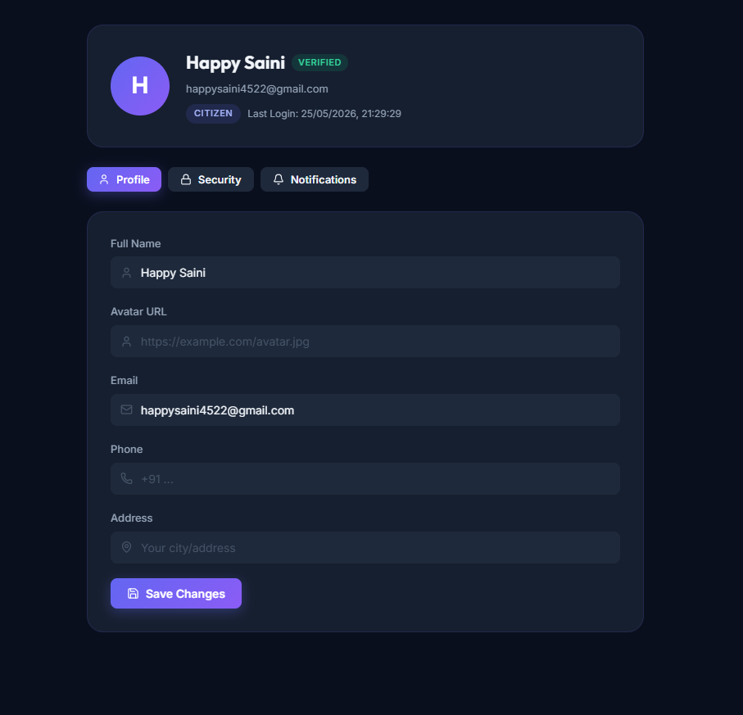
13 / USER PROFILE
Citizen Profile Management
Citizens can update Full Name · Avatar URL · Phone · Address — with tabs for Profile, Security, and Notification preferences
Notes:
SLIDE 14 — CITIZEN PROFILE
What to say:
The Profile page allows citizens to manage their account information.
What you can see:
- Top section shows: Name (Happy Saini), Verified badge (green), email, role (CITIZEN), last login time
- Three tabs:
1. Profile — update personal information
2. Security — change password
3. Notifications — manage notification preferences
Profile form fields:
- Full Name
- Avatar URL (link to a profile picture)
- Email (shown but typically not editable)
- Phone number
- Address (city/area)
- "Save Changes" button to update
How it works technically:
- GET /api/auth/me — fetches current user data when the page loads
- PUT /api/auth/profile — sends updated data to the server
- The server validates the data and updates the user in MongoDB
- A success toast notification appears after saving

Slide 15
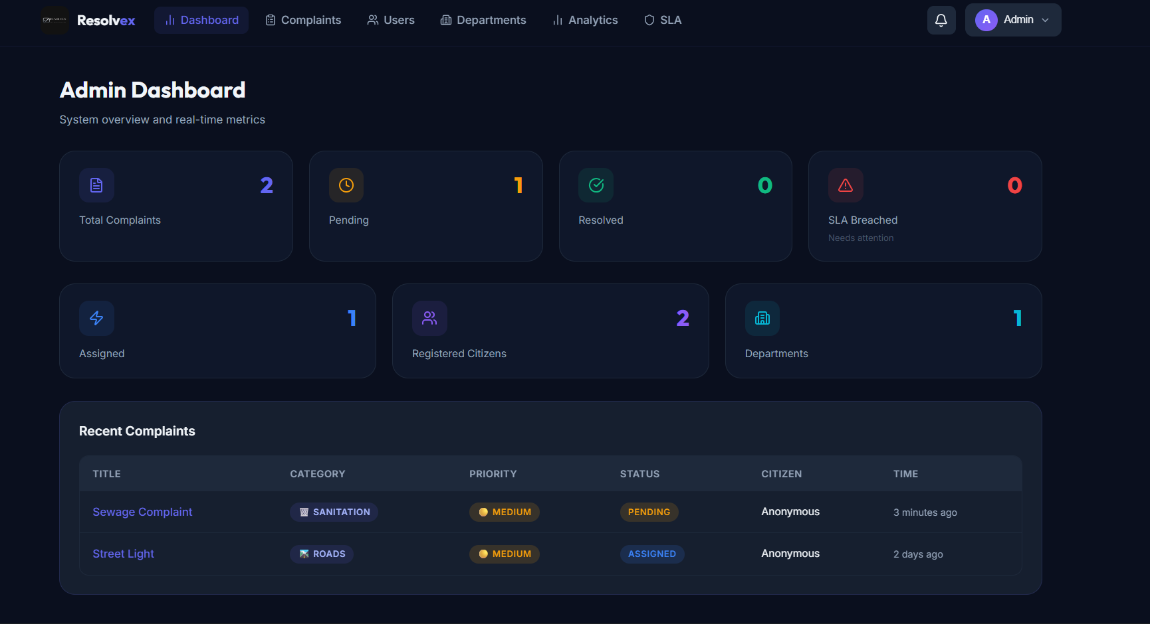
14 / ADMIN PANEL
Admin Dashboard — System Overview
Admin sees: Total Complaints · Pending · Resolved · SLA Breached · Assigned · Registered Citizens · Departments — plus Recent Complaints table
Notes:
SLIDE 15 — ADMIN DASHBOARD
What to say:
When the admin logs in, they see this comprehensive Admin Dashboard.
What you can see:
Top row of KPI cards (Key Performance Indicators):
- Total Complaints: 2
- Pending: 1 (yellow — needs attention)
- Resolved: 0
- SLA Breached: 0 (red — complaints that missed the deadline)
Second row of cards:
- Assigned: 1
- Registered Citizens: 2
- Departments: 1
Bottom section — Recent Complaints table:
Shows the latest complaints with columns:
Title | Category | Priority | Status | Citizen | Time
For example:
- "Sewage Complaint" | Sanitation | Medium | PENDING | Anonymous | 3 minutes ago
- "Street Light" | Roads | Medium | ASSIGNED | Anonymous | 2 days ago
The admin can navigate to different sections using the top navigation bar:
Dashboard | Complaints | Users | Departments | Analytics | SLA
How it works:
- GET /api/admin/dashboard — fetches all these numbers from the server
- Only users with role="admin" can access this page
- If a citizen tries to access /admin/dashboard, they get redirected (Protected Route)

Slide 16
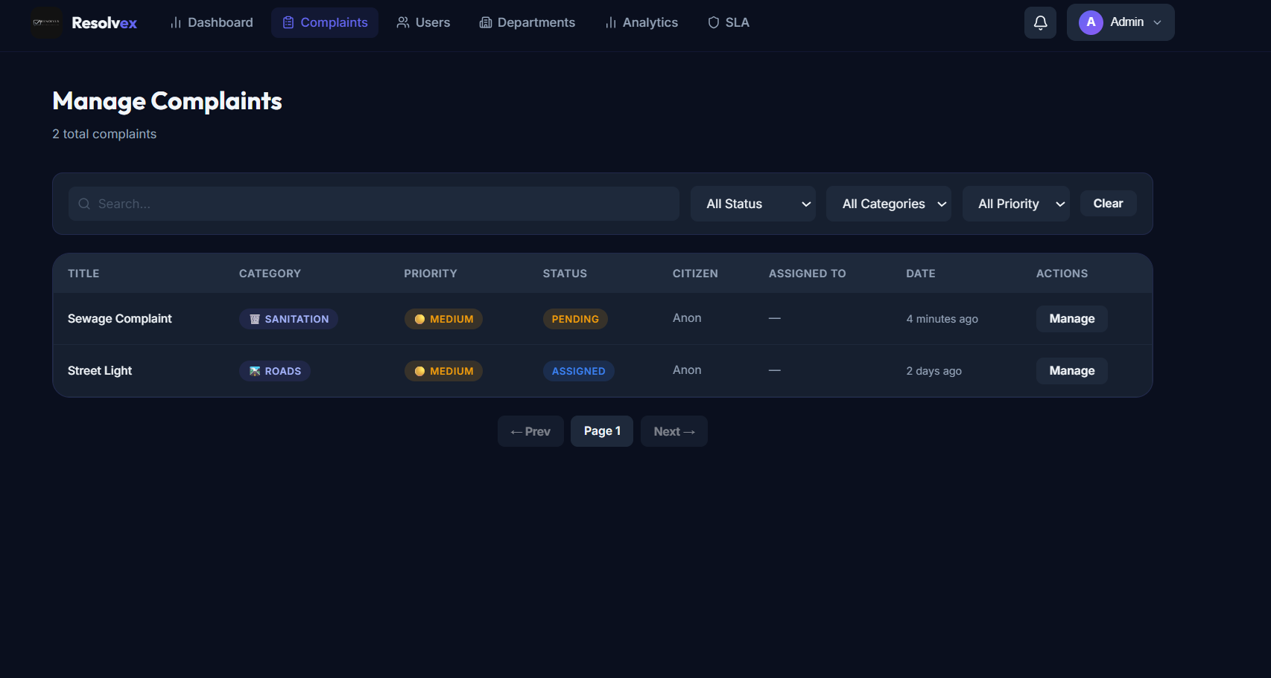
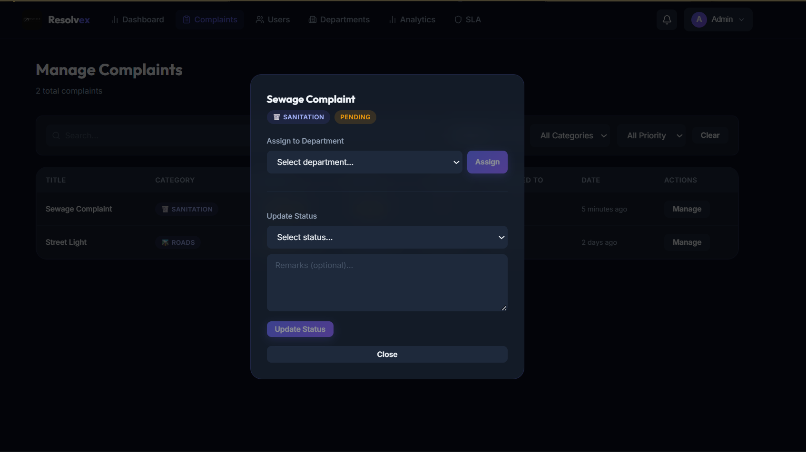
15 / ADMIN PANEL
Admin — Manage Complaints & Assign to Departments
Manage Complaints: Search + Filter by Status/Category/Priority
Manage Modal: Assign Department + Update Status + Remarks
Notes:
SLIDE 16 — ADMIN MANAGE COMPLAINTS
What to say:
LEFT — MANAGE COMPLAINTS PAGE:
The admin sees all complaints in a clean table with columns:
Title | Category | Priority | Status | Citizen | Assigned To | Date | Actions
- There is a Search bar to find specific complaints
- Filters: "All Status", "All Categories", "All Priority" — dropdown filters
- Each row has a "Manage" button
RIGHT — MANAGE COMPLAINT POPUP:
When the admin clicks "Manage" on a complaint (e.g., Sewage Complaint):
A popup modal appears with two sections:
1. "Assign to Department":
- Dropdown to select which department should handle this complaint
- "Assign" button — sends the complaint to that department
- The department receives a real-time notification via Socket.io
2. "Update Status":
- Dropdown to change status (pending, assigned, in_progress, resolved, rejected)
- Optional Remarks text box to add a note
- "Update Status" button
This gives the admin full control over each complaint's workflow.
How it works technically:
- PUT /api/complaints/:id/assign — assigns to a department
- PUT /api/complaints/:id/status — updates the status
- When assigned, Socket.io emits a "notification" event to the department's connected client
- A notification record is also saved in the Notifications collection in MongoDB

Slide 17
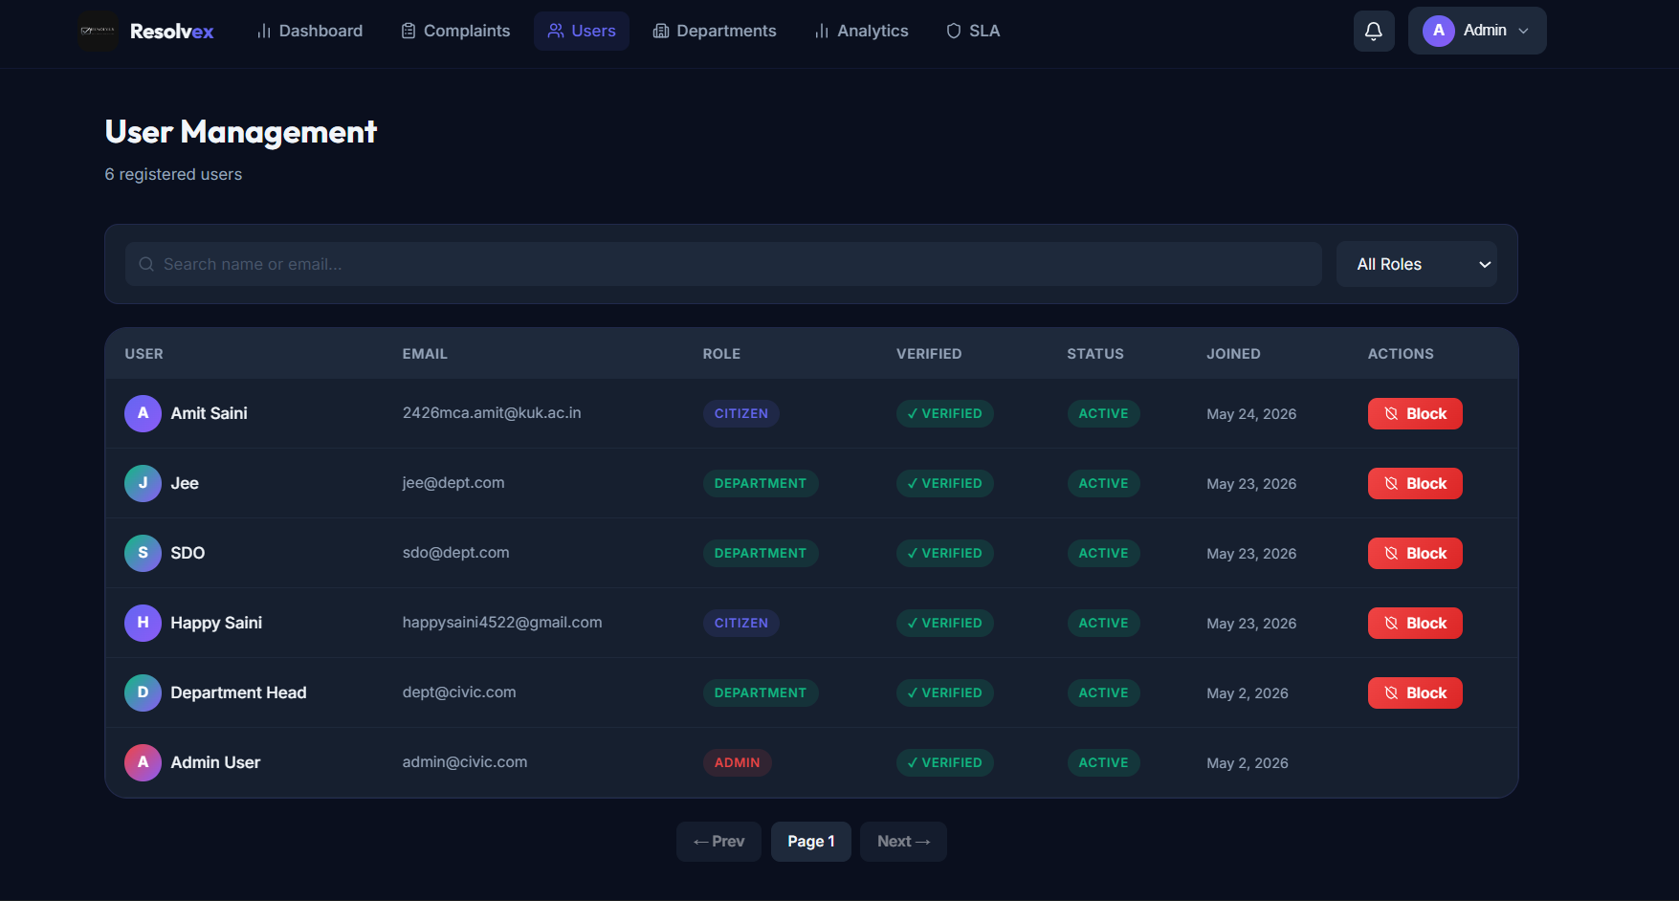
16 / ADMIN PANEL
Admin — User Management
Admin can view all users: Name · Email · Role · Verified Status · Active Status · Join Date — with Block/Unblock action
Notes:
SLIDE 17 — USER MANAGEMENT
What to say:
The "Users" section in the admin panel shows all registered users.
What you can see in the table:
Columns: User (avatar + name) | Email | Role | Verified | Status | Joined | Actions
Users visible:
1. Amit Saini — Citizen — Verified — Active — May 24, 2026 — [Block]
2. Jee — Department — Verified — Active — May 23, 2026 — [Block]
3. SDO — Department — Verified — Active — May 23, 2026 — [Block]
4. Happy Saini — Citizen — Verified — Active — May 23, 2026 — [Block]
5. Department Head — Department — Verified — Active — May 2, 2026 — [Block]
6. Admin User — Admin — Verified — Active — May 2, 2026 — (no block button for admin)
Actions:
- "Block" button (red) — if the admin blocks a user, that user cannot log in anymore
- Search bar to find users by name or email
- Filter by role: All Roles / Citizen / Department / Admin
This gives the admin complete control over who can use the system.
How it works technically:
- GET /api/admin/users — fetches all users (admin only)
- PUT /api/admin/users/:id/block — toggles the isBlocked field in MongoDB
- The login system checks isBlocked — if true, the server rejects the login

Slide 18
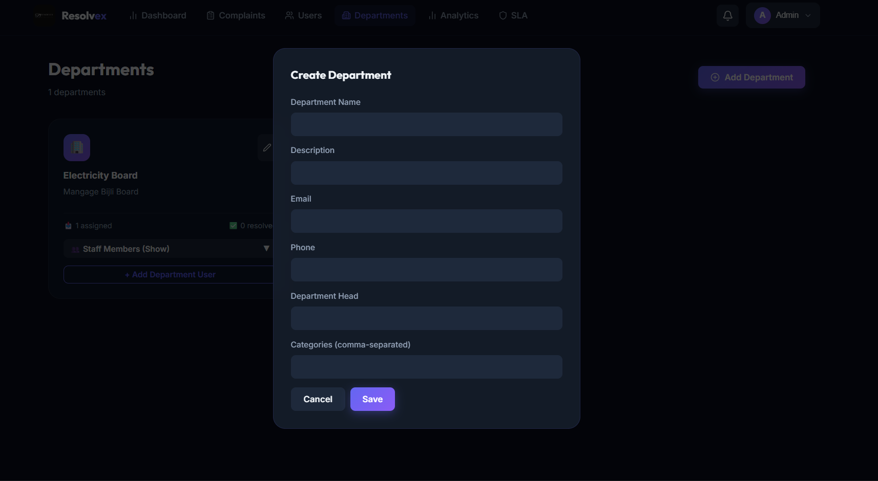
17 / ADMIN PANEL
Admin — Department Management
Admin creates departments (Name, Description, Email, Phone, Head, Categories) — shown in Department cards with assigned/resolved count + staff members
Notes:
SLIDE 18 — DEPARTMENT MANAGEMENT
What to say:
The "Departments" section allows the admin to manage all government departments.
LEFT side — Existing department card:
- "Electricity Board" — with description "Manage Bijli Board"
- Shows: 1 assigned complaint | 0 resolved
- "Staff Members (Show)" dropdown to see which users belong to this department
- "+ Add Department User" button to add a staff member to this department
RIGHT side — Create Department modal:
When the admin clicks "+ Add Department", a popup appears with fields:
- Department Name (e.g., Sanitation Department)
- Description
- Email (department contact email)
- Phone
- Department Head (name of the head person)
- Categories (comma-separated, e.g., "sanitation, water, roads")
This determines which types of complaints can be assigned to this department
The admin then clicks "Save" to create the department.
How it works technically:
- POST /api/admin/departments — creates a new department (admin only)
- The categories field is important — it tells the system which types of complaints
this department can handle
- GET /api/admin/departments — lists all departments
- PUT /api/admin/departments/:id — updates department info

Slide 19
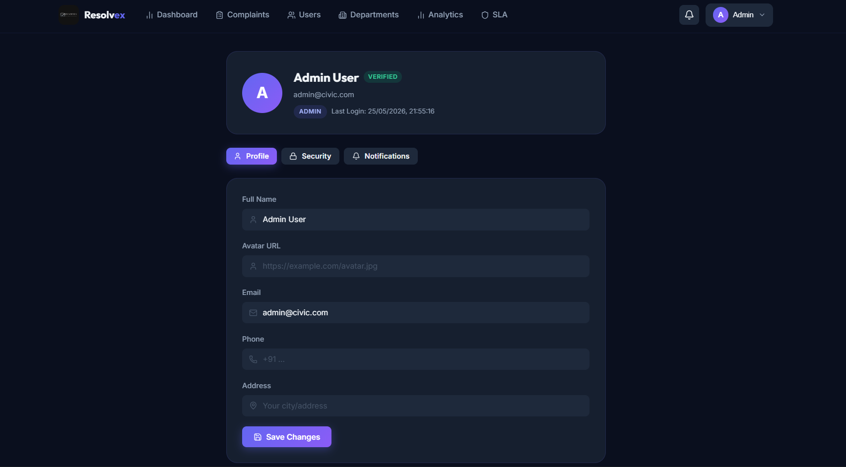
18 / ADMIN PANEL
Admin Profile & Account Settings
Admin account shows ADMIN role badge — Profile, Security, and Notifications tabs — same interface as citizen profile
Notes:
SLIDE 19 — ADMIN PROFILE
What to say:
The Admin also has a profile page to manage their own account details.
What you can see:
- Top card: "Admin User" with VERIFIED badge, email: admin@civic.com
- Role badge: ADMIN (orange color)
- Last Login time shown
Three tabs:
1. Profile — update name, avatar URL, phone, address
2. Security — change password
3. Notifications — manage alert preferences
This is the same reusable Profile component used by both citizens and admins.
The only difference is the role badge displayed.
Note about the code:
- The same React component (<Profile />) works for both Citizen and Admin
- It uses the data from the JWT token to determine the user's role
- The backend validates the JWT and only allows the user to update their own profile

Slide 20
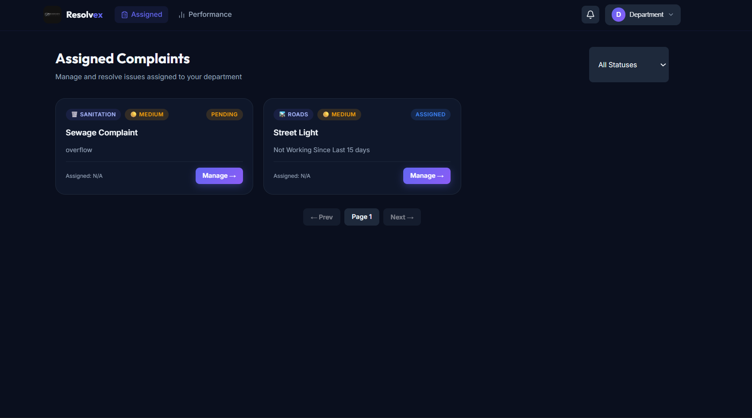
19 / DEPARTMENT PANEL
Department — Assigned Complaints View
Department staff see only their assigned complaints — can Accept, Reject, Update Progress, Upload Proof Photos, and Mark as Complete
Notes:
SLIDE 20 — DEPARTMENT PANEL
What to say:
When a department staff member logs in, they see the "Assigned Complaints" page.
What you can see:
- Heading: "Assigned Complaints"
- Subtitle: "Manage and resolve issues assigned to your department"
- Filter: "All Statuses" dropdown to filter complaints by status
Complaint cards visible:
1. "Sewage Complaint" — Sanitation | Medium | PENDING
- Description: overflow
- Assigned: N/A (just assigned, not yet accepted)
- "Manage →" button
2. "Street Light" — Roads | Medium | ASSIGNED
- Description: Not Working Since Last 15 days
- Assigned: N/A
- "Manage →" button
When the department clicks "Manage →", they can:
- Accept the complaint (starts the resolution process)
- Reject it (if it was wrongly assigned)
- Update progress (add notes, upload proof images)
- Mark as complete (when the work is done)
This ensures accountability — department staff are responsible for their assigned complaints.
The top navigation bar shows only:
- Assigned (their complaints)
- Performance (their stats)
This is different from the Admin who sees all sections.
How it works:
- GET /api/department/assigned — returns only complaints assigned to this department
- PUT /api/department/complaints/:id/accept — accepts the complaint
- PUT /api/department/complaints/:id/complete — marks as resolved

Slide 21
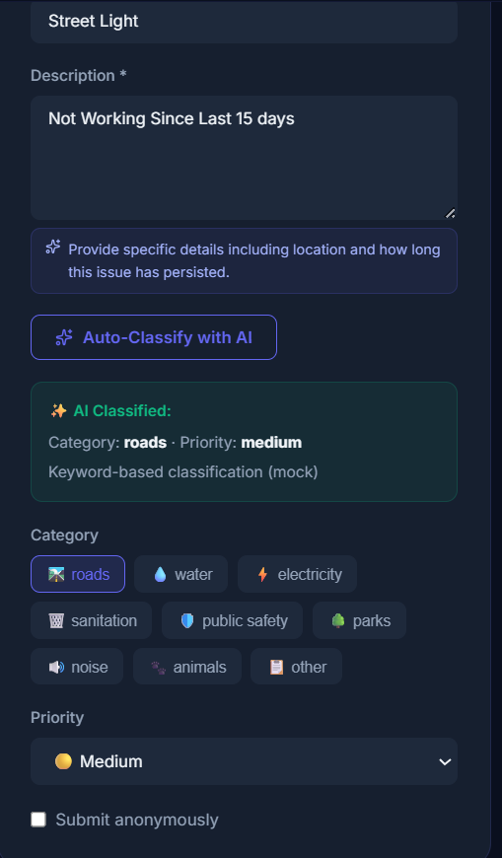
20 / AI INTEGRATION
AI Features — Powered by Google Gemini
🤖 AI Capabilities
✦ Auto-classify category
✦ Suggest priority level
✦ Confidence score (85%)
✦ Give improvement tips
✦ AI Chatbot assistant
✦ Answer citizen queries
✦ Works via /api/ai/*
✦ Powered by Gemini API
Notes:
SLIDE 21 — AI FEATURES
What to say:
One of the most exciting features of Resolvex is the AI integration using Google Gemini.
There are THREE AI-powered features:
1. AUTO-CLASSIFY (screenshot left):
This is shown in the "Raise Complaint" form.
The old version had a simple "Auto-Classify with AI" button.
When clicked, the AI reads the title and description and returns:
- Category: roads (keyword-based classification)
- Priority: medium
This helps ensure complaints are correctly categorized every time.
2. ADVANCED CLASSIFICATION (screenshot center):
In the newer version, "Analyze & Auto-Classify" gives a more detailed result:
- Confidence: 85% (how sure the AI is)
- Suggested Category: Sanitation
- Priority: Medium
- Suggestion text: "Please include specific street addresses or landmarks
to help the sanitation team resolve this quickly."
This is much more helpful for the department who will handle the complaint.
3. AI CHATBOT ASSISTANT:
On the complaint form, there is a "Complaint Assistant" chatbot panel.
Citizens can ask questions like:
- "How do I file a complaint?"
- "What issues can I report?"
- "How long does resolution take?"
- "Can I track my complaint?"
The chatbot responds using Gemini AI.
API Routes for AI:
- POST /api/ai/classify — classifies a complaint (category + priority + confidence)
- POST /api/ai/suggest — gives improvement suggestions for complaint description
- POST /api/ai/chatbot — chatbot conversation endpoint
Technology:
- Package: @google/generative-ai (official Google Gemini Node.js SDK)
- If the API key is missing, the system falls back to a mock/rule-based response
so the app still works even without the AI key

Slide 22
21 / DATABASE DESIGN
MongoDB Data Models (Collections)
👤 User
📝 Complaint
🏢 Department
🔔 Notification
• name, email, password (hashed)
• role: citizen | admin | department
• isVerified (email verified?)
• isBlocked, phone, address
• verificationToken, resetToken
• lastLogin, createdAt
• title, description, category
• priority: low | medium | high
• status: pending | assigned | ...
• citizen (User ref), assignedTo (Dept ref)
• location: { lat, lng, address }
• images[], videos[], upvotes[]
• comments[], timeline[], slaDeadline
• aiSuggestion, isAnonymous
• name, description, email, phone
• categories[] (types handled)
• head (User ref), members[] (User refs)
• totalAssigned, totalResolved
• user (User ref)
• title, message
• type (status_update, assigned, etc.)
• isRead (boolean)
• complaintId (Complaint ref)
• createdAt
Notes:
SLIDE 22 — DATABASE DESIGN
What to say:
The application uses MongoDB as its database.
MongoDB stores data in "collections" — each collection is like a table in a traditional database.
There are four main collections:
1. USER Collection:
- Stores all user accounts (citizens, admins, department staff)
- Key fields: name, email, password (stored as a hash — never plain text), role, isVerified, isBlocked
- verificationToken and resetToken are temporary tokens for email verification and password reset
- lastLogin tracks when the user last logged in
2. COMPLAINT Collection:
- The most important collection
- Stores all civic complaints
- Key fields: title, description, category, priority, status
- citizen refers to the User who submitted it (using MongoDB ObjectId reference)
- assignedTo refers to the Department handling it
- location stores latitude, longitude, and address
- images[] and videos[] store Cloudinary URLs of uploaded media
- upvotes[] stores user IDs who upvoted (so each user can only upvote once)
- comments[] stores all comments with timestamp
- timeline[] stores every status change event with timestamp
- slaDeadline is calculated based on complaint priority:
High priority = 3 days | Medium = 7 days | Low = 14 days
3. DEPARTMENT Collection:
- Stores all government departments
- categories[] defines which types of complaints this department handles
- members[] links to User accounts belonging to this department
4. NOTIFICATION Collection:
- Every status change, assignment, or update creates a notification record
- isRead tracks whether the user has read the notification
- The Socket.io system also pushes real-time notifications immediately
Library used: Mongoose (defines the schema/structure and handles all database queries)

Slide 23
22 / API DESIGN
REST API Routes
🔑 AUTH (/api/auth)
📋 COMPLAINTS (/api/complaints)
⚙️ ADMIN (/api/admin)
🏢 DEPT + 🔔 NOTIF + 🤖 AI
POST /register — Create account
POST /login —a Get JWT token
GET /verify-email/:token — Verify email
POST /forgot-password — Send reset email
POST /reset-password/:token — Reset password
GET /me — Get my profile (protected)
PUT /profile — Update profile (protected)
GET / — List complaints (protected)
POST / — Create complaint (citizen)
GET /:id — Get single complaint
PUT /:id/status — Update status
PUT /:id/assign — Assign dept (admin)
POST /:id/upvote — Toggle upvote
POST /:id/comment — Add comment
GET /heatmap — Map data
GET /dashboard — Analytics overview
GET /complaints — All complaints
GET /users — All users
PUT /users/:id/block — Block user
GET /departments — List departments
POST /departments — Create dept
GET /sla — SLA breach report
GET /analytics — Detailed charts
GET /dept/assigned — My complaints
PUT /dept/:id/accept — Accept
PUT /dept/:id/progress — In progress
PUT /dept/:id/complete — Mark done
GET /notifications — My notifications
PUT /notifications/read-all — Mark all read
POST /ai/classify — AI classify
POST /ai/chatbot — AI chatbot
Notes:
SLIDE 23 — REST API ROUTES
What to say:
The backend of Resolvex is built as a REST API.
REST API means: the frontend sends HTTP requests (GET, POST, PUT, DELETE) to the server,
and the server sends back a JSON response.
There are 5 main API groups:
1. AUTH (/api/auth):
Handles user registration, login, email verification, password reset, and profile management.
The most important: POST /login — returns a JWT token after successful login.
2. COMPLAINTS (/api/complaints):
Handles everything related to complaints.
- POST / — creates a new complaint (only citizens can do this)
- PUT /:id/assign — admin assigns complaint to a department
- POST /:id/upvote — toggle upvote on a complaint
- GET /heatmap — returns location data for all complaints (used for the map view)
3. ADMIN (/api/admin):
Admin-only routes.
- GET /dashboard — returns KPI numbers (total, pending, resolved, SLA breached)
- GET /analytics — detailed data for charts
- GET /sla — complaints that missed their deadline
4. DEPARTMENT (/api/department):
Department-only routes.
- GET /assigned — returns only complaints assigned to MY department
- PUT /:id/progress — updates status to "in progress", can upload proof images
5. NOTIFICATIONS (/api/notifications):
- GET / — returns my notifications list
- PUT /read-all — marks all as read
6. AI (/api/ai):
- POST /classify — sends complaint text to Gemini, returns category/priority/confidence
- POST /chatbot — processes chatbot messages using Gemini
Security:
- All protected routes use JWT middleware (the "protect" function)
- Role-based routes use "authorize('admin')" or "authorize('citizen')" middleware
- If a citizen tries to call an admin route → 403 Forbidden

Slide 24
23 / ADVANCED FEATURES
Real-Time Notifications & SLA Monitoring
⚡ Real-Time Notifications (Socket.io)
⏰ SLA Monitoring (node-cron)
Socket.io creates a persistent WebSocket connection between browser and server.
SLA = Service Level Agreement
When admin assigns a complaint → department gets instant notification.
A maximum time limit to resolve each complaint:
When department updates status → citizen gets instant notification.
• High Priority → 3 days
Notification bell icon shows unread count (live updated).
• Medium Priority → 7 days
No page refresh needed — updates appear automatically.
• Low Priority → 14 days
The SLA deadline is set when a complaint is submitted.
How it works:
1. User logs in → browser connects to Socket.io server
node-cron runs a job EVERY HOUR automatically:
2. User joins their personal 'room' (based on user ID)
1. Find all unresolved complaints
3. Server emits 'notification' event to the specific room
2. Check if today > slaDeadline
4. Browser receives event and updates UI instantly
3. If yes → mark complaint as 'SLA Breached'
5. Notification is also saved in MongoDB for history
4. Admin sees breach count on dashboard
This ensures departments are held accountable
for resolving complaints on time.
Notes:
SLIDE 24 — REAL-TIME NOTIFICATIONS & SLA MONITORING
What to say:
Resolvex has two very important advanced features:
1. REAL-TIME NOTIFICATIONS (Socket.io):
What is Socket.io?
Socket.io is a library that creates a special type of connection called WebSocket.
Unlike normal HTTP (where the browser asks for data), WebSocket keeps a permanent
connection open so the SERVER can push data to the browser any time.
How it works in Resolvex:
- When a user logs in, their browser connects to the Socket.io server
- The user is added to a "room" based on their user ID
- Example: If admin assigns a complaint to the Electricity Board department:
→ Server emits event to Electricity Board's room: "You have a new complaint!"
→ The department's notification bell icon updates INSTANTLY
→ They don't need to refresh the page
- Similarly, when the department updates the status to "In Progress":
→ The citizen gets an instant notification
→ Notification count increases in real-time
2. SLA MONITORING (node-cron):
What is SLA?
SLA means Service Level Agreement — a promise that a complaint will be resolved
within a certain time limit.
In Resolvex:
- High priority complaint: must be resolved in 3 days
- Medium priority: 7 days
- Low priority: 14 days
What is node-cron?
node-cron is a package that runs code automatically at scheduled times.
Like a timer that goes off every hour.
Every hour, the cron job:
1. Finds all unresolved complaints
2. Compares today's date with the slaDeadline
3. If the deadline has passed → marks complaint as "SLA Breached"
4. The admin sees this on their dashboard with a red alert
This automatic monitoring means the admin doesn't have to manually check every complaint.

Slide 25
24 / CHALLENGES & LEARNING
Challenges Faced & What I Learned
🔐 JWT Role-Based Auth
🤖 AI Integration
⚡ Real-Time with Socket.io
Setting up different access levels for Citizen, Admin, and Department was complex. Learned to use middleware functions (protect, authorize) to guard each route.
Integrating Google Gemini API required understanding prompt engineering. Had to handle cases where AI key is missing — built a fallback mock response system.
Making notifications appear instantly without page refresh was challenging. Learned about WebSocket rooms and event-based communication.
📁 File Upload Pipeline
🗓️ SLA Cron Jobs
📱 Responsive UI
Handling image/video uploads involved Multer (local), then Cloudinary (cloud). Had to manage file size limits and handle upload errors gracefully.
Running background tasks automatically every hour using node-cron. Had to ensure the cron job doesn't run multiple times simultaneously.
Building a UI that works on both desktop and mobile required careful CSS layout planning using flexbox and grid, along with framer-motion animations.
Notes:
SLIDE 25 — CHALLENGES & LEARNING
What to say:
Building Resolvex was a great learning experience. Let me share the main challenges I faced:
1. JWT Role-Based Authentication:
The hardest part was making sure each type of user can only access their own pages.
A citizen should NOT be able to access the admin dashboard.
I learned to write middleware functions that check the JWT token and user role before
allowing access to each API route.
2. AI Integration:
Integrating Google Gemini was new for me. I had to learn how to write a good "prompt"
(the instruction you send to the AI) so it returns a structured JSON response.
I also built a fallback system — if the API key is missing, the system uses simple
keyword-based classification instead, so the app works even without the AI.
3. Real-Time Notifications with Socket.io:
Making data appear on screen WITHOUT refreshing the page was a new concept.
I learned about WebSockets, event emitters, and how to organize users into "rooms"
so notifications go to the right person.
4. File Upload Pipeline:
Uploading photos required two steps: first Multer reads the file from the request,
then sends it to Cloudinary and gets back a URL. I had to handle errors at each step.
5. SLA Cron Jobs:
Running automatic background tasks was new. node-cron runs my SLA check function
every hour without any user triggering it.
6. Responsive UI:
Making the interface look good on both large monitors and small screens was tricky.
I used CSS flexbox and grid for layouts, and added animations with Framer Motion.

Slide 26
25 / CONCLUSION
Summary & Future Scope
✅ What Was Accomplished
🚀 Future Scope
• Complete full-stack web application built from scratch
• Mobile app (React Native) for citizens
• Three role-based dashboards (Citizen, Admin, Department)
• Advanced AI analytics — predict complaint hotspots
• AI-powered complaint classification using Google Gemini
• SMS notifications (via Twilio or SMS Gateway)
• Real-time notifications using Socket.io WebSockets
• Multilingual support (Hindi, regional languages)
• Interactive Leaflet maps for location pinning
• Public complaint heatmap visible to all citizens
• Secure JWT authentication with email verification
• Department performance rating system
• SLA monitoring with automated cron jobs
• File uploads via Multer + Cloudinary
• Integration with government portals (DigiLocker, etc.)
• Admin analytics dashboard with KPI cards
• Offline mode support (PWA)
• RESTful API with role-based access control
• Voice-based complaint submission
• Responsive modern UI with dark theme
• Automated department auto-assignment using AI
Notes:
SLIDE 26 — CONCLUSION & FUTURE SCOPE
What to say:
Let me now summarize what I have built and what can be done in the future.
WHAT WAS ACCOMPLISHED:
I successfully built a complete full-stack civic complaint management system from scratch.
The key achievements are:
- Three separate dashboards for Citizen, Admin, and Department users
- AI integration using Google Gemini for auto-classification
- Real-time notifications using Socket.io (WebSockets)
- Interactive maps using Leaflet.js
- Secure login system with email verification (JWT + Nodemailer)
- Automatic SLA monitoring using node-cron
- File uploads to Cloudinary
- Full REST API with role-based access control
- Clean, modern, responsive UI with dark theme and animations
FUTURE SCOPE:
There are many ways to improve and expand this project:
1. Mobile App: Build a React Native app so citizens can report issues directly from their phone.
2. AI Hotspot Prediction: Use historical complaint data to predict which areas are likely
to have problems, so authorities can take proactive action.
3. SMS Notifications: Send SMS updates to citizens who don't have smartphones.
4. Multilingual Support: Add Hindi and regional language support so more people can use the system.
5. Voice-Based Complaint: Let citizens speak their complaint instead of typing —
the AI converts speech to text and submits the complaint.
6. Auto-Assignment: Currently admin assigns complaints manually.
In the future, AI can automatically assign based on complaint category and department availability.
CLOSING STATEMENT:
Resolvex shows how modern web technologies and AI can be combined to solve real-world civic problems.
This project taught me full-stack development, API design, real-time communication,
cloud services, and AI integration — all in one project.
Thank you for listening. I am happy to answer any questions.

Slide 27
THANK YOU
Resolvex — Civic Issues Resolved Intelligently
Presented by: Amit Saini | MCA | Kurukshetra University
GitHub: https://github.com/AHSAINI0405/Civic-Problem-Resolvex.git
Live Link: https://civic-problem-resolvex.vercel.app/
Notes:
SLIDE 27 — THANK YOU
What to say:
Thank you for your attention!
Project: Resolvex — Civic Problem Management System
Technology: React.js + Node.js + MongoDB + Google Gemini AI + Socket.io
Key Takeaways:
1. This is a real-world, production-ready web application
2. It solves a genuine civic problem faced by millions of Indian citizens
3. AI makes the system smarter and easier to use
4. Real-time notifications make it transparent and trustworthy
5. The role-based system ensures security and accountability
I am now happy to take any questions you may have about:
- The technology used
- How any specific feature works
- The database design
- The AI integration
- Challenges I faced
- How to set up and run the project
Thank you!

