Slide 1


Slide 2
Forms of Education

Slide 3
What can they be?
Dialog training
Learning through the game
Block modular training system
Etc

Slide 4
Dialog training principle:
The primary purpose of dialogue is to learn
Dialogue must be a two-sided project
It is imperative that each participant comes to the dialogue with complete honesty and sincerity.
In interreligious, interideological dialogue we must not compare our ideals with our partner’s practice
Each participant needs to describe her/himself

Slide 5
Dialog training principle:
Participants must not come to the dialogue with any preconceptions as to where the points of disagreement lie
Dialogue can take place only between equals—both coming to learn
Dialogue can only take place on the basis of mutual trust.
Participants in dialogue should have a healthy level of criticism toward their own traditions.
To understand another religion or ideology one must try to experience it from within

Slide 6
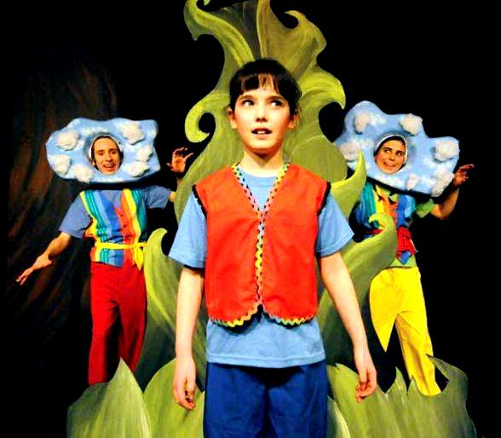
Learning through the game
This form of education is most often focused on children as children quickly learn all the rules of the English language in a playful way

Slide 7

Block modular training system
This form is the standard of education in all Russian schools and similar institutions

Slide 8

Etc.

