Slide 1
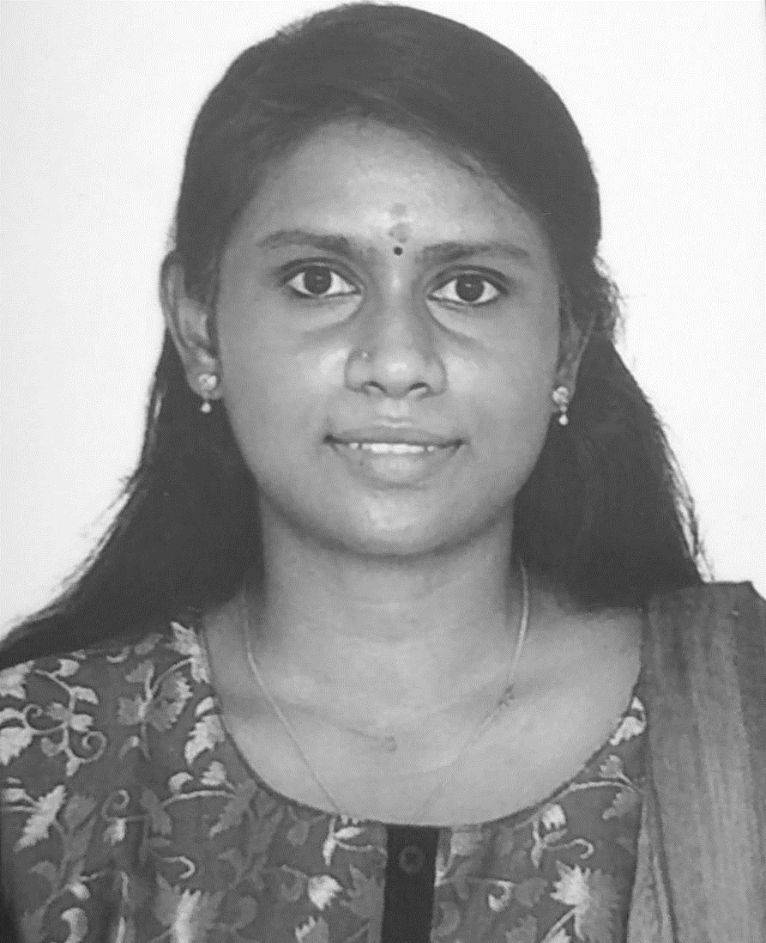
Priya P – Lead Developer – Full Stack
Primary Skills
Java, jQuery, Angular.JS, React.JS, Spring MVC
Android, React Native
CMS: Web sphere portal server, Liferay
Big Data technologies – Hadoop, HBase, MapReduce
Overview
Strong Experience in Web Application Development, Mobile Application Development and Java
Extensive experience in development of web Application using jQuery and React.JS.
Strong experience in development of Android Application and React Native.
Strong experience in developing web services like REST, SOAP and JSON concepts and its implications.
Good experience in working on BigData technologies
Strong in solution design using - Service Oriented Architecture, Headless and Microservices.
Well versed with Software Development Life Cycle, mature in designing applications with multi-tier architecture and have expertise in ‘message-based communication’ between distributed systems
Well versed with Quality Assurance best practices, design solutions to be feature-rich and efficient, performance always being a parameter

Slide 2






Priya P – Lead Developer
Brands worked for
Overview
Designed and developed a ticket booking system using Spring framework and jQuery for ODEON
Designed and developed a Portal for user data management and partner management using WebSphere portal for Exide Life.
Developed a kiosk based online purchase tool using Spring framework for Sears
Developed realtime data analytics report for Reliance Jio using Big Data technologies
Developed mobile solutions on React Native and Android for brands like Reliance Jio, Singer, Sears.

Slide 3
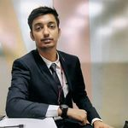
Ishan Rai – Full Stack Developer
Primary Skills
DOT Net Framework , Dot Net Core
Angular , Chart JS , SignalR
Architecture : Microservices ,Monolith
Cloud : Azure web services(Azure PASS services)
Analytic Tools : Power BI
Overview
Strong Experience in Web Application Development using Angular and C#
Extensive experience in development of web Application using Angular .
Strong experience in developing web services like REST, SOAP and JSON concepts and its implications.
Good experience in working on analytic tools like Power BI
Have been working continuously on creating creative and interactive notification using SignalR to bridge the gap between client and server
Strong in solution design using - Service Oriented Architecture, Headless and Microservices.
Well versed with Software Development Life Cycle, mature in designing applications with multi-tier architecture and have expertise in ‘message-based communication’ (Service Bus and Service Fabric) between distributed systems
Good amount of experience of working on Event driven systems
Well versed with Quality Assurance best practices, design solutions to be feature-rich and efficient, performance always being a parameter

Slide 4





Ishan Rai – Full Stack Developer
Brands worked for
Overview
Designed and developed a Real Time Bag Management system for Lufthansa
Designed and developed a wen application to manage Trade and Promotions for P&G
Developed a real time feed back management system for office
Developed real time data analytics report for sales order for Balsam hills
Developed an AR application for ticket scan using HoloLens
Developed an inhouse application for Mindtree to track the records of employees in a particular domain(CTO)
Designed and Developed an application to handle raw bills and give a tax alert for Imperial Brands

Slide 5
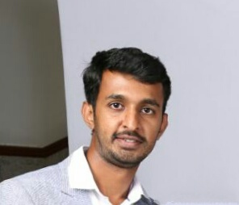
Nischal Gowda - Scrum Master
Primary Skills
Product Management, Scrum Master, Process Optimization, Prototyping & Wireframes, Process flows/Use cases, SQL, BI
Overview
8+ years of experience in providing Digital Transformation and Enterprise solutions to customers with expertise in areas of e- Commerce/Retail, Artificial Intelligence, Finance & Insurance.
Highly experienced in managing the product through the complete lifecycle (Concept to market and after market).
6+ Years of experience in pure Commerce/ Retail and have worked as a Products Owner for 2 Commerce sites for end to end implementation which has around 2 Million user visits in a month
Worked as Product Owner and Scrum Master for the Digital Transformation activities with Singer, a premier Consumer Durable retailer and provided Solutions and managed backlogs for the new Commerce platform, Process Optimization on Order fulfilment, Automating Hire Purchase by integrating with Finance systems etc.

Slide 6



Nischal Gowda - Scrum Master
Brands worked for
Overview
Initiated & lead digital marketing activities, SEO optimization to increase the organic traffic and conversion rates for commerce sites
Provided Solutions on AI Chat Bots integrated with the IT Helpdesk which reduced the number of Inflow tickets by 70 %
Worked on a Solution for the integrating a Opensource Manual Chat Solution with an AI Chat Bot which can be integrated with any CRM System.

Slide 7
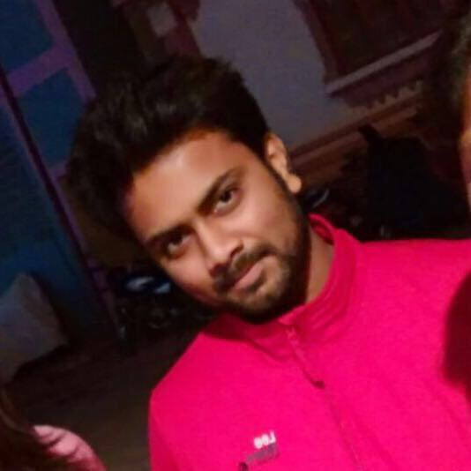
Vikram R - Cloud DevOps Engineer
Primary Skills
DevOps Tools Chain: Jenkins, GIT, Bitbucket, Maven, Docker, Kubernetes, Skaffold, Ansible, Sceptre, Grafana, Prometheus
Android, React Native
Automation Tools/Utilities: Selenium, Cucumber, Appium, TestNG
Programming Languages: Core Java, Basic SQL, Bash, Perl
Overview
9+ years of hands-on experience includes Cloud devops, Automating the process of software delivery and deployments and QA Automation.
Experience in Migrating on premise B2B applications to private or public cloud.
Experienced in Building and Automating CICD Jenkins/Jules pipelines for B2B applications to deploy on Private and Public cloud, which includes designing, development and implementation.
Experience in building Docker Images and push it on Jfrog nexus artifactory.
Experience in containerizing applications then deploy, administer and monitor containerized apps on public and private Kubernetes Cluster.
Experience in Infrastructure automation using Sceptre.

Slide 8



Vikram R - Cloud DevOps Engineer
Brands worked for
Overview
Experience in AWS resources like EC2, S3, Code Deploy, ASG, EKS, VPC, Cloud Watch, Route 53, ELB.
Experience to SCM tool Git.
Experience in working on build automation tool Maven.
Experience in working on continuous integration tool Jenkins.
Extensive experience in Test Automation using SELENIUM 2.0 and APPIUM.
Experience in developing Hybrid Framework (Page Object Model and Data Driven Framework), Behavior Driven Development (BDD) with Cucumber Framework and Keyword Driven Framework using JAVA.
Experience in TestNG and JUnit Test Frameworks in Java.

Slide 9
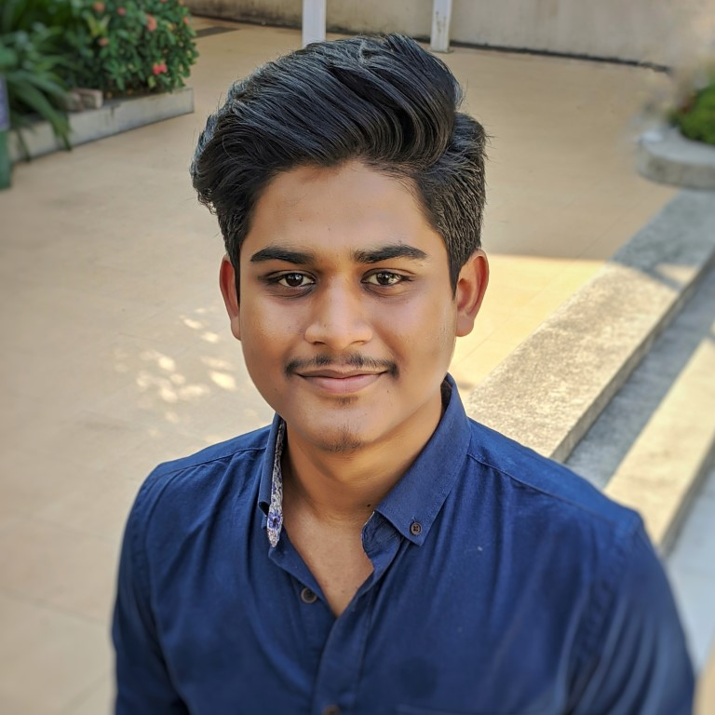
Arghya Ghosh – Full Stack Developer
Primary Skills
Frameworks: ASP.NET, .Net Core, MSSQL, MongoDB, SignalR, ReactJS, Redux
Architecture: Microservices ,Monolith
Cloud: Azure – Webjobs, Function Apps, Service Bus, Active Directory, Data Factory, App Service, Load Balancer, Notification Hub
Tools: Git, Azure CI/CD
Overview
Strong Experience in Developing Multi-Tenant SAAS Web application.
Extensive experience in development of web Application using ReactJS and .Net Core .
Strong experience in developing web services using REST principles.
Good experience in working on version control tools and CI/CD with Git, AzureCI/CD, Jenkins,
Have been working on creating real time Instant Messaging Application using SignalR.
Strong in solution design using - Microservices.
Well versed with Software Development Life Cycle, mature in designing applications with multi-tier architecture and have expertise in ‘message-based communication’ (Service Bus and Service Fabric) between distributed systems
Good amount of experience of working on Event driven systems with MediatR pattern.
Well versed with Quality Assurance best practices, design solutions to be feature-rich and efficient, performance always being a parameter

Slide 10
Arghya Ghosh– Full Stack Developer
Brands worked for
Overview
Designed and developed a Multi-Tenant SAAS Application
Designed and developed in house applications and scripts to reduce manual work by operation teams
Optimized application performance with multiple code and database optimizations.

