Slide 1
Databases and SQL an introduction
Denis Khryashchev / Huy T. Vo
(many slides were derived from Prof. Freire’s)

Slide 2
Agenda
Why study databases?
Why use databases?
Introduction to Relational Databases
Representing structured data with the Relational Model
Accessing and querying data using SQL

Slide 3
Why study databases?
Databases used to be specialized applications, now they are a central component in computing environments
Knowledge of a database concept is essential for computer scientists, software engineers, and anyone who needs to manipulate data

Slide 4
Why study databases?
Databases are everywhere, even when you don't see them: most activities involve data
Banking + credit cards: all transactions
Airlines: reservations, schedules
Universities: registration, grades
Sales: customers, products, purchases
Manufacturing: production, inventory, orders, supply chain
Human resources: employee records, salaries, tax deductions
Web sites: front end to information stored in databases; e.g., Google, YouTube, Flickr, Amazon…
Scientific research, e.g., studying the environment, cities, …
Data need to be managed

Slide 5
Why study databases?
Data are valuable:
E.g., bank account records, tax records, student records, your videos and photos…
Data must be protected - no matter what happens whether we have machine crashes, disk crashes, hurricanes/floods;
They also need to be protected from people

Slide 6
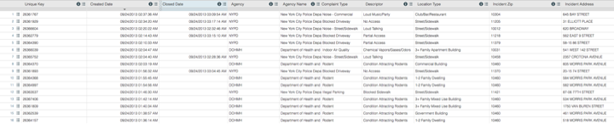
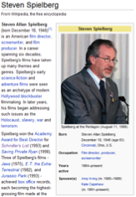

Why study databases?
Data are often structured:

Slide 7
Why study databases?
Data are often structured
We can exploit this regular structure to store data efficiently
Data should be retrieved in useful ways (that is, we can use a query language)

Slide 8
Why study databases?
Because the database field has made a number of contributions to basic computer science
Databases are behind many of important contributions and impact that CS has had
Find, gather, analyze and understand data, e.g., Banks, human genome, e-commerce
Understand concepts and apply to different problems and different areas, e.g., Big Data
Because DBMS software is highly successful as a commercial technology (Oracle, DB2, MS SQL Server…)
Because DB research is highly active and very interesting!
Lots of opportunities to have practical impact

Slide 9
Why study databases?
Big data platforms use the structured query language of databases (SQL)
both human and machine “readable”
A common interface for accessing data, e.g. an abstraction layer for computer applications to deal with data

Slide 10
Database Systems: the Basics

Slide 11

Databases and Database Management Systems
Database (DB) is an integrated collection of data
Models real-world objects
Entities (e.g., people, residence, Christmas cards)
Relationships (e.g., John Doe lives on 123 Elm St)
Captures structure — allows data to be queried
A Database (Management) System (DBMS) is a software suite designed to store and manage databases
Provides environment that is both convenient and efficient to use
Address all complications discussed

Slide 12
Storing Data: Database vs. File System
Once upon a time database applications were built on top of file systems…
But this has many drawbacks:
Data redundancy, inconsistency and isolation
Multiple file formats, duplication of information in different files
Difficulty in accessing data: need to write a new program to carry out each new task, e.g., search people by zip code or last name; update telephone number
Integrity problems: integrity constraints (e.g., num_residence = 1) become part of program code -- hard to add new constraints or change existing ones
Atomicity of updates
Failures may leave database in an inconsistent state with partial updates carried out, e.g., John and Mary get married, add new residence, update John’s entry, and database crashes while Mary’s entry is being updated…

Slide 13
Storing Data: Database vs. File System
Concurrent access by multiple users
Needed for performance: can you imagine if only 1 person at a time could buy a ticket from Delta?
Uncontrolled concurrent access can lead to inconsistencies, e.g., the same seat could be sold multiple times…
There are 3 seats left; I buy 2 seats; John buys 3 seats at the same time
If I hit enter 1st there will be 1 seat left; if John is faster there will be 0; but 5 seats have been sold and we will fight at the airport!
Database systems offer solutions to all the above problems

Slide 14
Why use Database Systems?
Data independence and efficient access
Easy + efficient access through declarative query languages and optimization
Data integrity and security
Safeguarding data from failures and malicious access
Concurrent access
Reduced application development time
Uniform data administration
When should you not use a database?
Notes:
overhead, initial cost, no concurrency necessary and simple applications

Slide 15
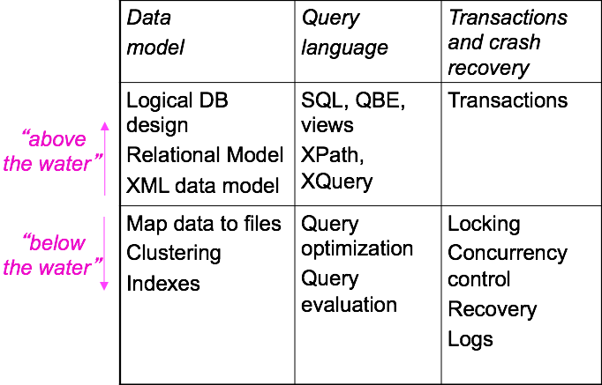
What’s in a DBMS?
Notes:
QBE = Query by Example, John Connor, 10, Sarah Connor, 29 example

Slide 16
Designing a database: The Conceptual Model
What are the entities and relationships among these entities in the application?
What information about these entities and relationships should we store in the database?
What are the integrity constraints or business rules that hold?
Different applications have different needs, and different perspectives – even to model the same object
billing department:
patient(id, name, insurance, address)
visit(patientId, procedure, date, charge)
in-patient:
patient(id, name, age, address)
alergies(id, alergies)
prescription(patientId, date, medicine)
Notes:
Entity-relationship model is often used for database design and it is later translated into the relational model, which is used for storage and processing. In the figure, patient and prescription are entities; entities have attributes, e.g., patients have an id, name and age; takes is a relationship between patients and prescriptions: a patient may take several prescriptions, and a given prescription may be taken by several patients.
Note that is important that different entities can be distinguished. For example, two patients may have the same name, but we should be able to tell them apart. Often ids are used to uniquely identify entities. In the ER model, these “unique” identifiers are called “keys”. In an ER diagram, keys are represented as underlined attributes.

Slide 17
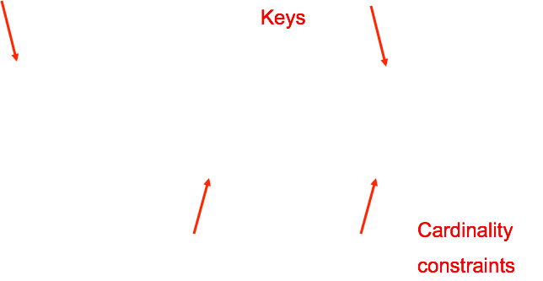
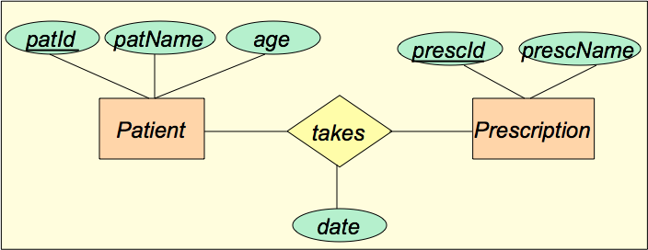
The Entity Relationship (ER) Data Model
A data model is a collection of concepts for describing data, relationships, semantics and constraints
Notes:
Entity-relationship model is often used for database design and it is later translated into the relational model, which is used for storage and processing. In the figure, patient and prescription are entities; entities have attributes, e.g., patients have an id, name and age; takes is a relationship between patients and prescriptions: a patient may take several prescriptions, and a given prescription may be taken by several patients.
Note that is important that different entities can be distinguished. For example, two patients may have the same name, but we should be able to tell them apart. Often ids are used to uniquely identify entities. In the ER model, these “unique” identifiers are called “keys”. In an ER diagram, keys are represented as underlined attributes.

Slide 18
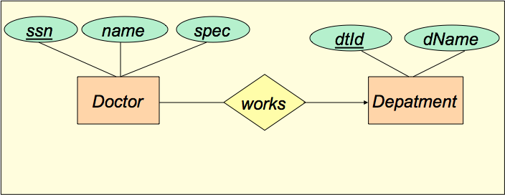
ER: Another Example
A department has many doctors, but a doctor can only work in one department

Slide 19
Relational Data Model
ER used for conceptual design is then mapped into the relational model
The relational model of data is the most widely used model today
Main concept: relation, basically a table with rows and columns
Every relation has a schema, which describes the columns, or fields
A schema is a description of a particular collection of data, using a given data model
Patient(patientId : int, patientName : str, age : int)
Takes(patientId : int, prescId, prescDate : date)
Prescription(prescId : int, presName : str)

Slide 20
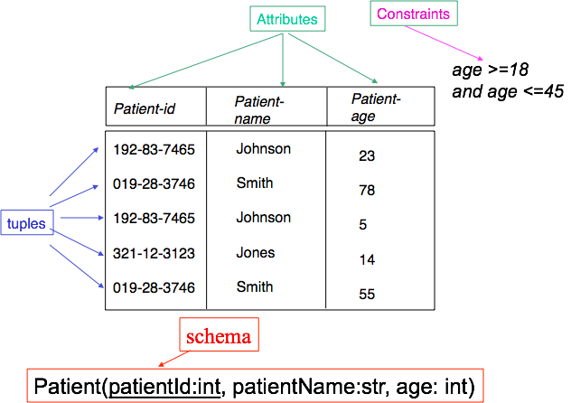
Relational Model: Terminology

Slide 21
Pitfalls in Relational Database Design
Find a “good” collection of relation schemas
Bad design may lead to
Repetition of information inconsistencies!
E.g., keeping people and addresses in a single file
Inability to represent certain information
E.g., a doctor that is both a cardiologist and a pediatrician
Design Goals:
Avoid redundant data
Ensure that relationships among attributes are represented
Ensure constraints are properly modeled: updates check for violation of database integrity constraints

Slide 22
Query Languages
Query languages: Allow manipulation and retrieval of data from a database
Queries are posed with respect to data model
Operations over objects defined in data model
Relational model supports simple, powerful QLs:
Strong formal foundation based on logic
Allows for optimization
Query Languages != programming languages
QLs support easy, efficient access to large data sets
QLs not expected to be “Turing complete”
QLs not intended to be used for complex calculations
Notes:
Queries come from relational algebra (projections, selections, cartesian products)
Turing Incompleteness -> SQL limitations = number of columns must be specified, no dynamic columns.

Slide 23
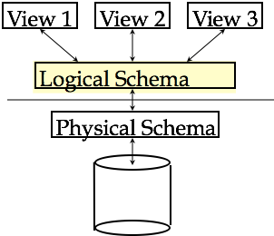
Level of Abstraction
Many views, single conceptual (logical) schema and physical schema
Views describe how users see the data
Logical schema defines logical structure
Physical schema describes the files and indexes used

Slide 24
Example: University Catalog
Physical schema:
Students stored in id order
Index on last name
Logical schema:
Students (sid: string, name: string, login: string, age: integer, gpa: real)
Courses (cid: string, cname: string, credits: integer)
Enrolled (sid : string, cid: string, grade: string)
External Schema (View):
Course_info (cid: string, enrollment: integer)
Notes:
Let’s move on to DBMS qualities and functions

Slide 25
Data Independence
Applications insulated from how data is structured and stored
Logical data independence: Protection from changes in logical structure of data
Changes in the logical schema do not affect users as long as their views are still available
Physical data independence: Protection from changes in physical structure of data
Changes in the physical layout of the data or in the indexes used do not affect the logical relations
One of the most important benefits of using DBMS!
Notes:
Physical Oracle SQL on Windows migrate to MySQL on Linux

Slide 26
Storage and Indexing
The DB administrator designs the physical structures
Nowadays, database systems can do (some of) this automatically
File structures: sequential, hashing, clustering, single or multiple disks, etc.
Indexes:
Select attributes to index
Select the type of index
Storage manager is a module that provides the interface between the low-level data stored in the database and the application programs and queries submitted to the system:
interaction with the file manager
efficient storing, retrieving and updating of data
Notes:
Sequential – one file after another, Hashing – mapping the address / file names to a hashed value, resolve collisions with linked lists / buckets (tables), clustering – multiple servers

Slide 27
Query Optimization and Evaluation
DBMS must provide efficient access to data
In an emergency, can't wait 10 minutes to find patient allergies
Declarative queries are translated into imperative query plans
Declarative queries — logical data model
Imperative plans — physical structure
Relational optimizers aim to find the best imperative plans (i.e., shortest execution time)
In practice they avoid the worst plans…
Notes:
Two tables, selection of two attributes, one per table, cartesian then projection != projection then cartesian

Slide 28
Transaction: an Execution of a DB program
Key concept is transaction, which is an atomic sequence of database actions (reads/writes)
Each transaction, executed completely, must leave the DB in a consistent state if DB is consistent when the transaction begins
Ensuring that a transaction (run alone) preserves consistency is ultimately the programmer’s responsibility!
Transaction-management component ensures that the database remains in a consistent (correct) state despite system failures (e.g., power failures and operating system crashes) and transaction failures
DBMS ensures atomicity (all-or-nothing property)

Slide 29
Concurrency Control
Concurrent execution of user programs is essential for good DBMS performance
But interleaving actions of different user programs can lead to inconsistency
e.g., nurse and doctor can simultaneously edit a patient record
DBMS ensures such problems don’t arise: users can pretend they are using a single-user system

Slide 30

Databases make these folks happy…
End users
DBMS vendors: $20B+ industry
DB application programmers
Database administrator (DBA)
Designs logical /physical schemas
Handles security and authorization
Data availability, crash recovery
Database tuning as needs evolve

Slide 31
Summary
DBMS used to maintain and query (large) structured datasets
Benefits include recovery from system crashes, concurrent access, quick application development, data integrity and security
Levels of abstraction give data independence

Slide 32
Common Database Model
Relational
Semi-structured/XML
Object-oriented
Object-relational
Hierarchical
Network
…
Notes:
Relational – collection of relations, Semi-structured/XML – data marked with tags, Object-Oriented – analogous of OOP classes, polymorphism, encapsulation, Object-Relational, Hierarchical – Tree-like, single parent, Network – tree-like with multiple parents.

Slide 33
Why Study the Relational DB Model?
Extremely useful and simple
Single data-modeling concept: relations = 2-D tables
Allows clean yet powerful manipulation languages
Most widely used model
Vendors: IBM, Microsoft, Oracle
Open source: MySQL
Some competitors: object-oriented model, semi-structured (XML) model
A synthesis emerging:
Object-relational model: Informix Universal Server, UniSQL, O2, Oracle, DB2
XML-enabled databases: Oracle, DB2, SQLServer

Slide 34
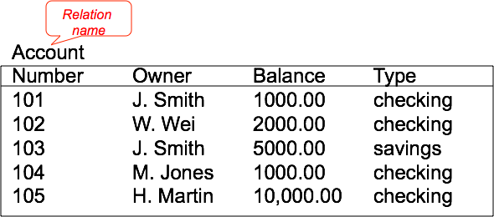
Example: A Relation
The Account relation keeps track of bank accounts. Facts about real-world entities: J. Smith owns a checking account whose number is 101 and balance is 1000.00

Slide 35
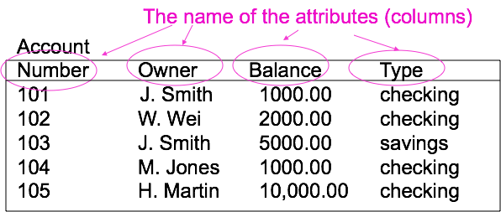
Example: Attributes of a Relation
Attribute domains:
Number must be a 3-digit number
Owner must be a 30-character string
Type must be “checking” or “savings”

Slide 36
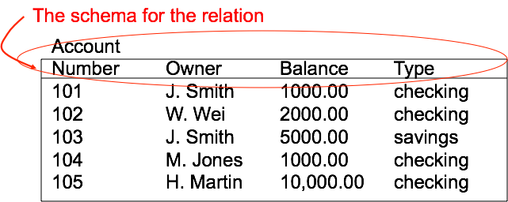
Example: Relation Schema
The schema sets the structure of the relation---it is the definition of the relation.
Note: the schema specifies more information than what is shown, e.g., keys, constraints…

Slide 37
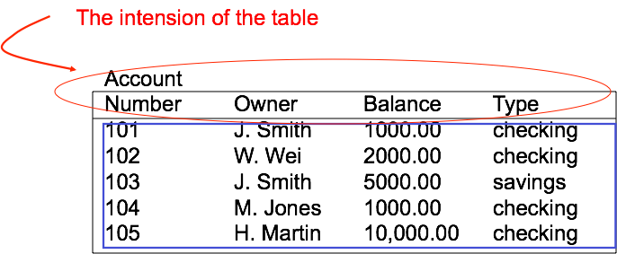



Terminology of Relational Database
rows/tuples
Orders of tuples is irrelevant. Relation is a set!

Slide 38
Why do we “need” this model?
Why not use tables defined in Java or C?
The relational model provides physical independence
Tables can be stored in many different ways, but they have the same logical representation
Operations can be expressed in relational algebra
Table-oriented operations — simple
Limited set of operations is a strength: queries can be automatically optimized

Slide 39
Relational Database
A database consists of multiple relations
Information is distributed among relations. E.g.:
account: information about accounts
deposit: information about deposits into accounts
check : information about checks
What would happen if we stored all information in a single table?
repetition of information (e.g., two customers own an account, two deposits on the same account)
the need for null values (e.g., represent a customer without an account)

Slide 40

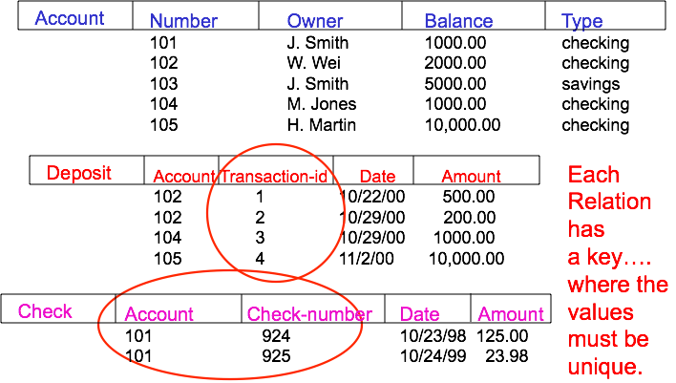
Example: Relational Database
Notes:
Why do we need primary keys?

Slide 41
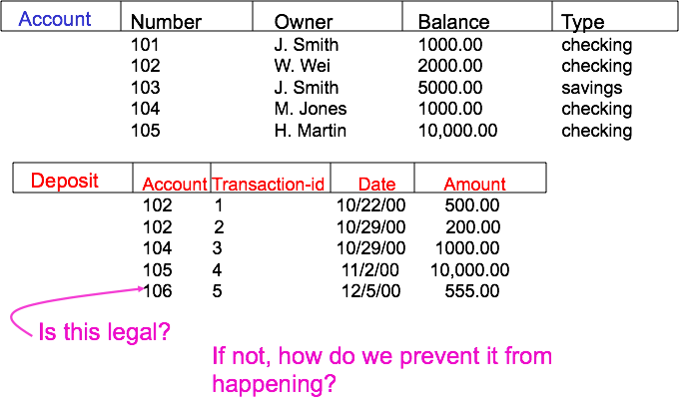
Example: Relational Database

Slide 42
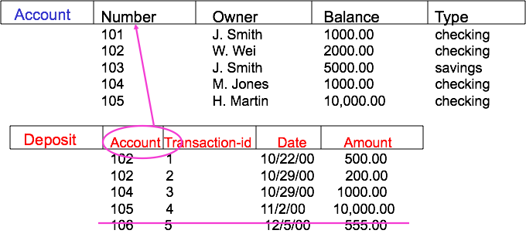
Example: Relational Database
We say that Deposit.Account is a foreign key that references Account.Number. If the DBMS enforces this constraint we say we have referential integrity.

Slide 43
Primary Key vs. Unique
There can be only one PRIMARY KEY for a relation, but several UNIQUE attributes
No attribute of a PRIMARY KEY can ever be NULL in any tuple. But attributes declared UNIQUE may have NULL’s, and there may be several tuples with NULL.

Slide 44
Relational Model vs. XML
Relations: Schema must be fixed in advance XML: Does not require predefined, fixed schema
Relations: Rigid flat table structure XML: Flexible hierarchical structure (defined by regular expressions)
Relations: Easy to understand, simple query language XML: Can be harder to understand, more complex query language
Relations: Ordering of data not relevant (tuple ordering or attribute ordering) XML: Ordering forced by document format, may or may not be relevant
Relations: Transmission and sharing can be problematic XML: Designed for easy representation and exchange
Relations: "Native" data model for all current widely-used commercial DBMSs XML: "Add-on," often implemented on top of relations

Slide 45
Structured Query Language (SQL)

Slide 46

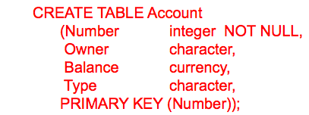
What is SQL?
SQL = data manipulation + data definition + control
Data manipulation: ad-hoc queries and updates
Data definition: creation of tables and views
Control: assertions to protect data integrity

Slide 47
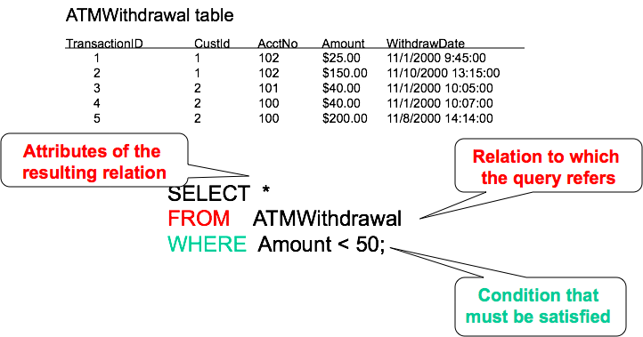
SQL in Action

Slide 48
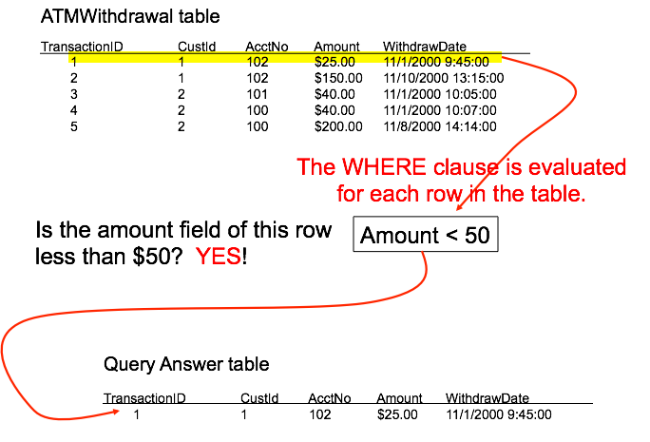

Slide 49
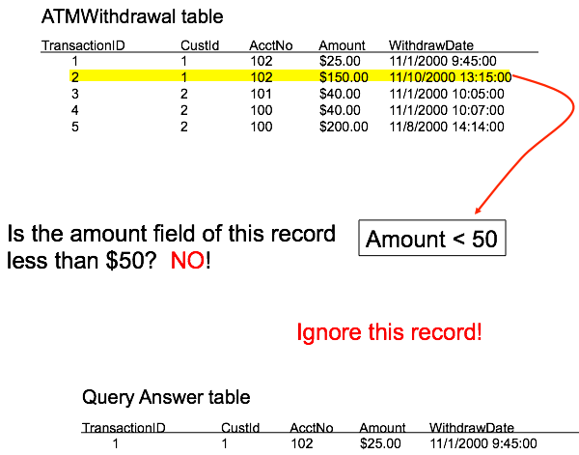

Slide 50
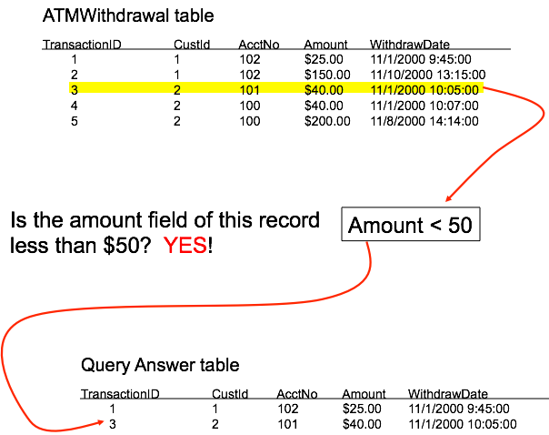

Slide 51
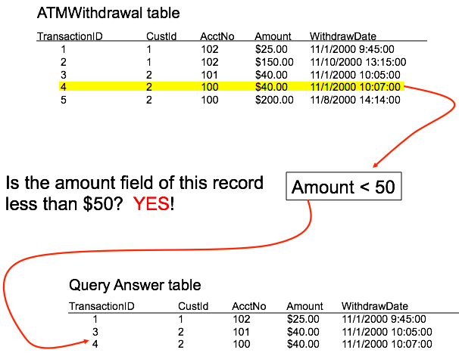

Slide 52
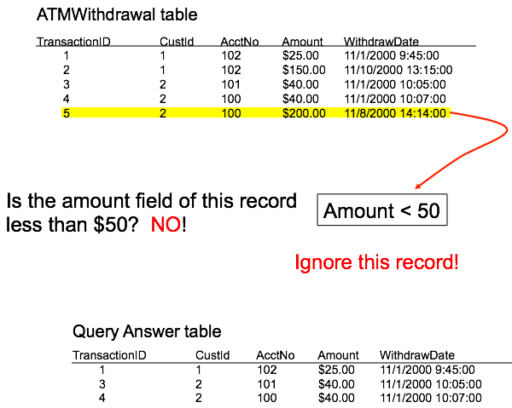

Slide 53
Conditions in the WHERE clause
Conditions evaluate to a Boolean value: TRUE or FALSE (and also UNKNOWN…)
Expressions built with comparison operators: =, <>,<, >, <=, and >=
E.g., Amount = 50; Amount <> 50
Values to be compared can be
Attributes of relations in FROM clause
Constraints
Arithmetic expressions, e.g., Amount < Credit - Balance
Expressions composed with logical connectives: and, or, not
E.g., Amount < 50 and CustID <> 1
Notes:
Or nested Queries

Slide 54
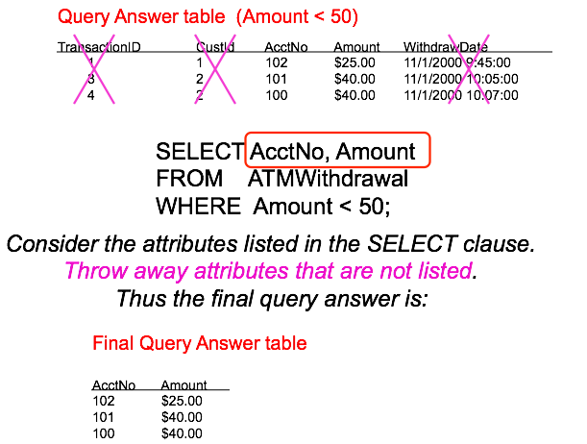
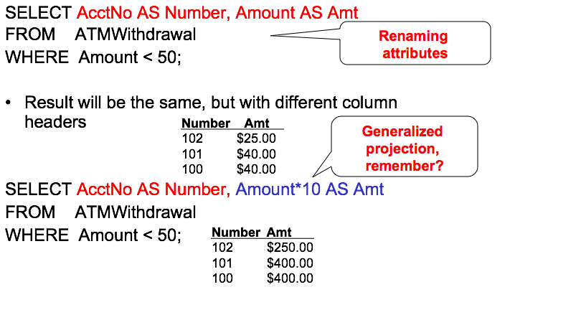
Projection in SQL
Generalized
Projection

Slide 55
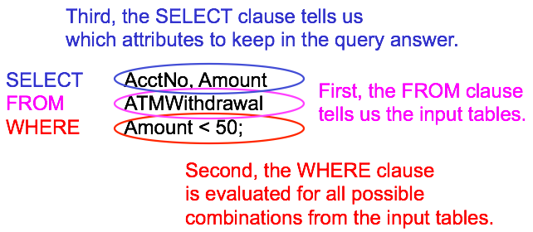
How is an SQL query evaluated?

Slide 56
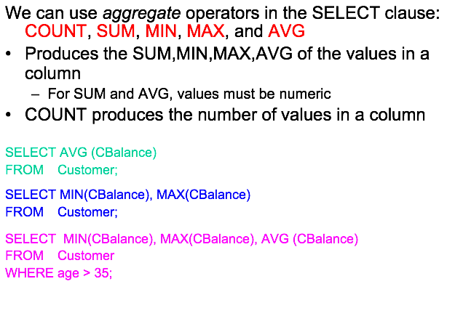
More extensions: aggregation

Slide 57
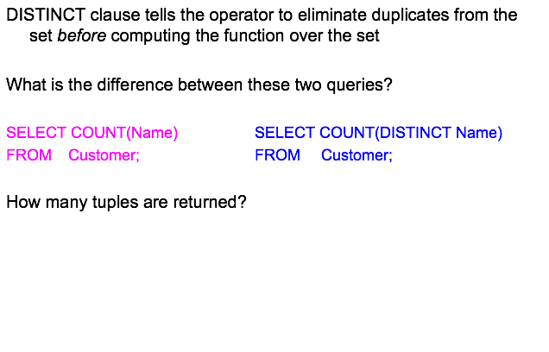
More extensions: aggregation

Slide 58
and even more!
Clauses:
ORDER BY
GROUP BY
HAVING
LIMIT
Operators:
Date/time
GIS (vendor-specific, e.g. PostGIS)

Slide 59
SQL: The Many Versions
Watch out: database products may differ in which features of SQL they supports
There are two major standards:
ANSI
SQL92 = SQL2
SQL3: many new features
Recursion, triggers, objects
Vendor-specific dialects
Include ANSI, and most of SQL2
Some of SQL3

Slide 60
Thank you!

