Slide 1


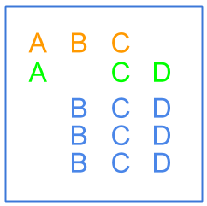
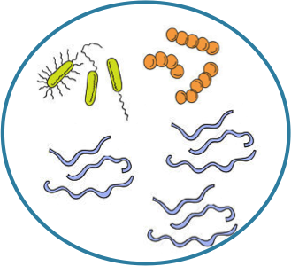

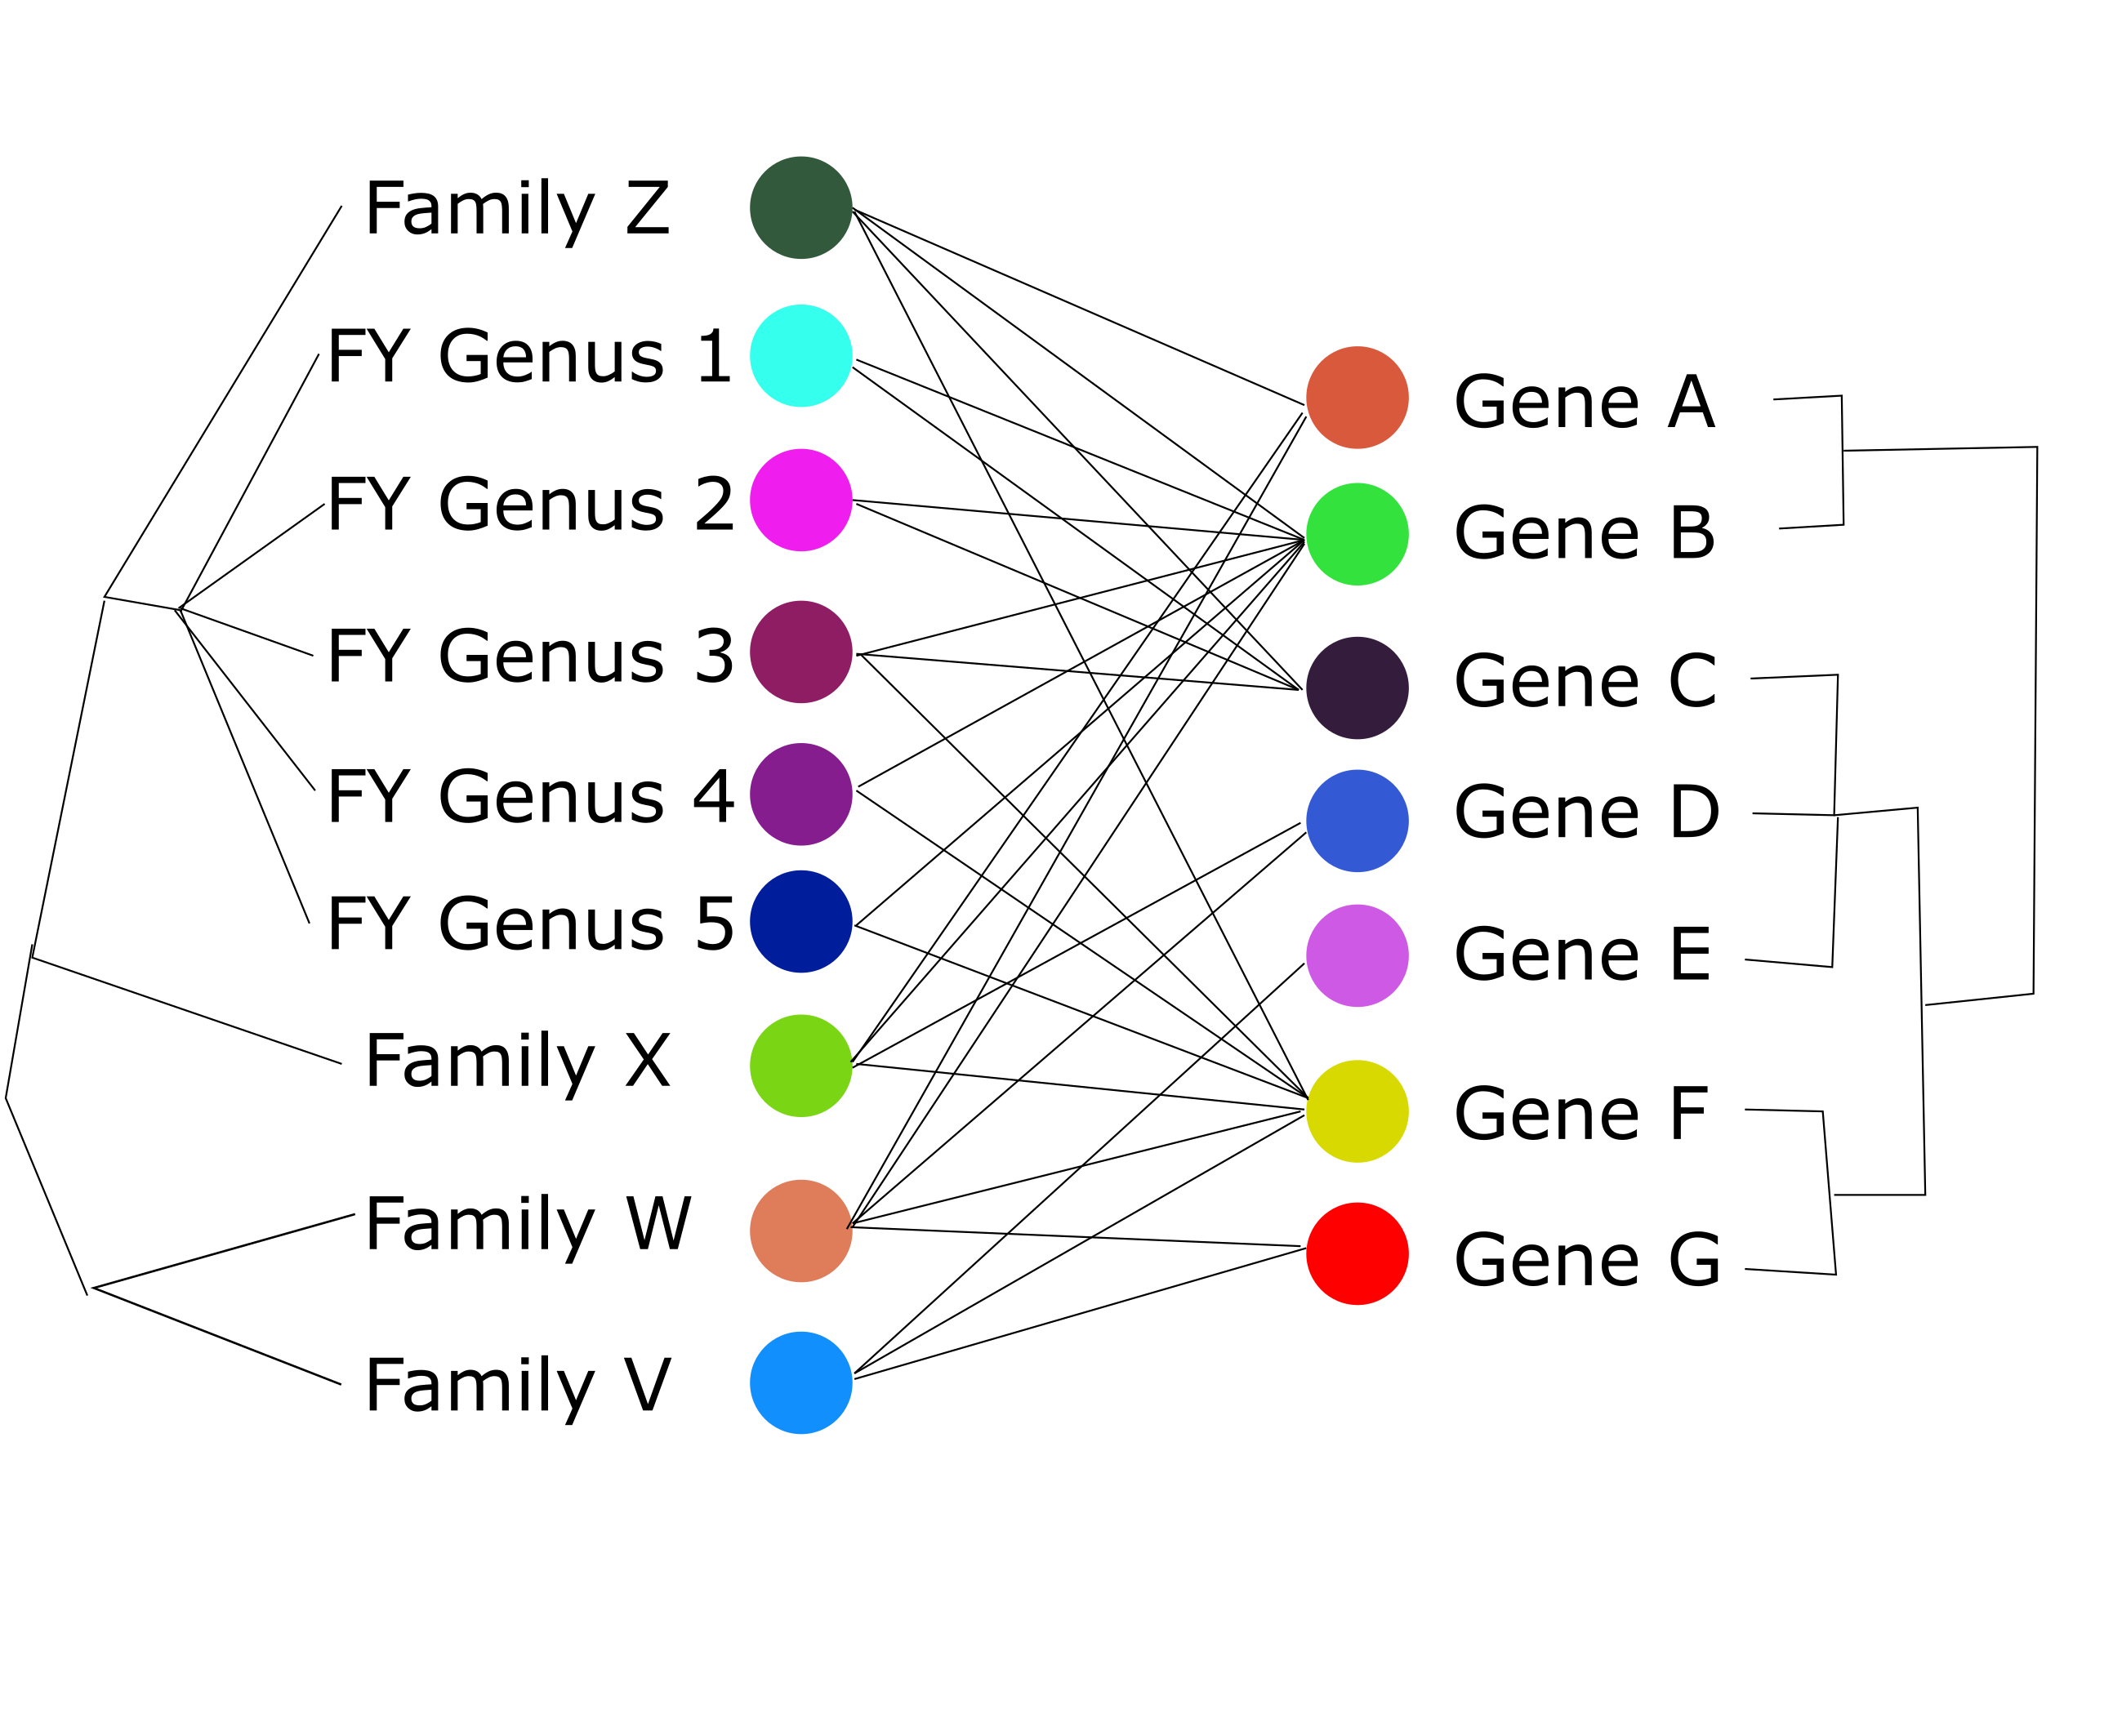
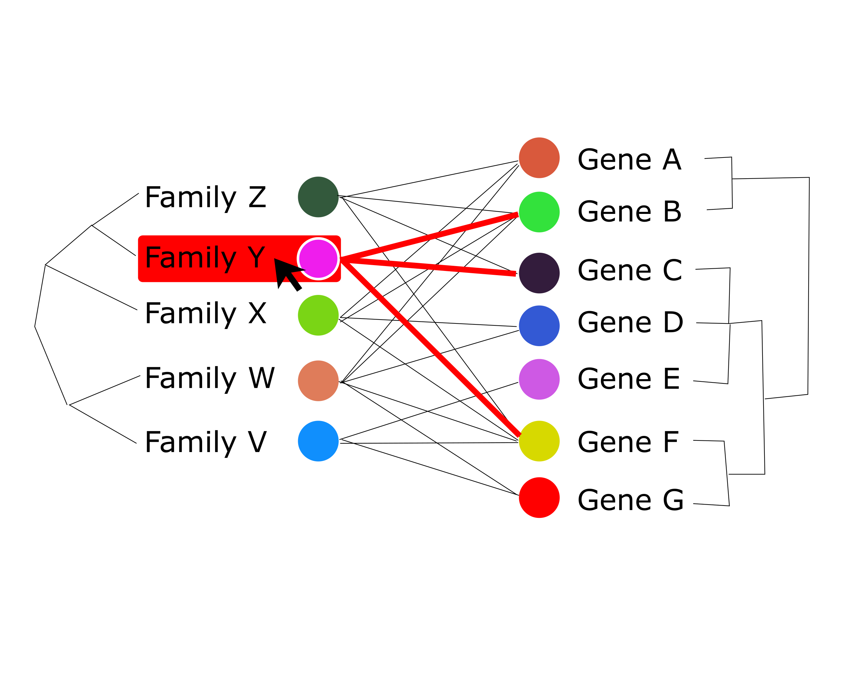
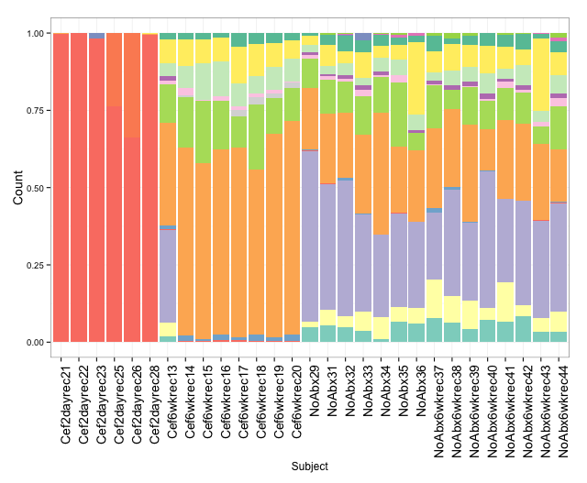
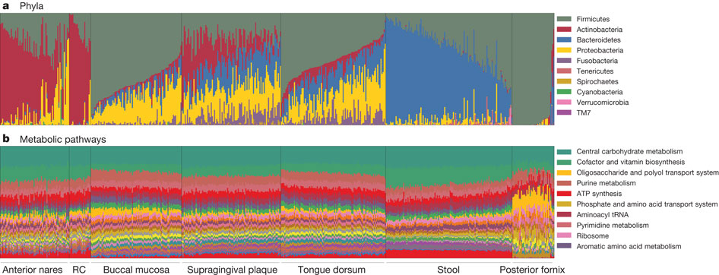
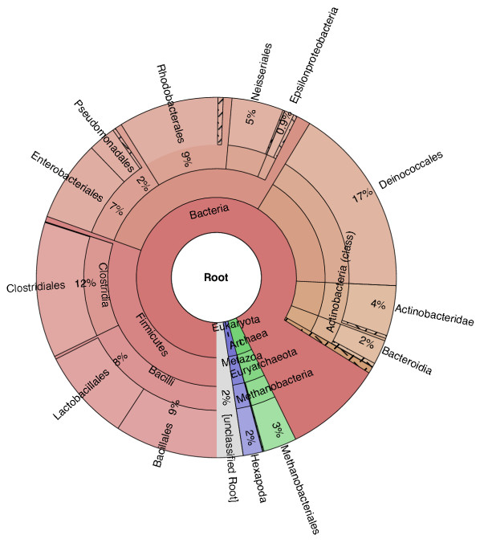
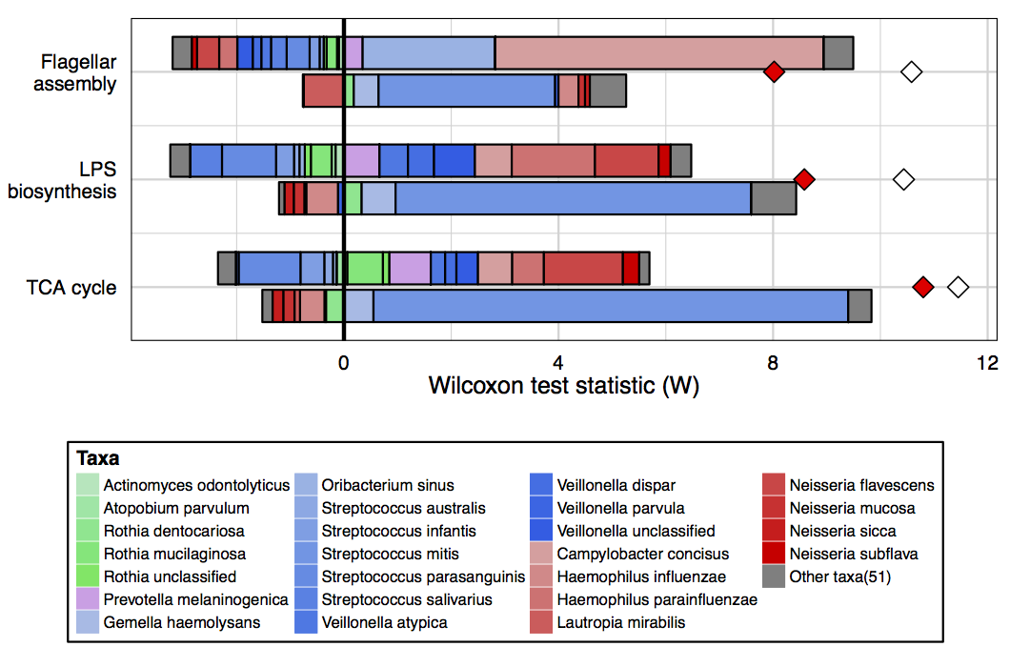
Exploratory data analysis of taxonomic and functional metagenomic data
Alex Eng, Will Gagne-Maynard, Colin McNally, Cecilia Noecker
Approach and Results
Motivation and Problem
Example dataset: gut microbiota following antibiotic treatment
New technologies enable detailed profiling of the taxonomic and functional composition of microbial communities and the variation in these across different environments.
Typical questions to ask about these datasets:
What are the functional differences across samples?
What taxonomic variation accounts for those differences?
Are taxa or functions more variable?
Are particular taxa or functions associated with different study groups?
Our tool allows researchers to upload a dataset and interactively explore these questions.
Antibiotics
Samples from 2 days and 6 weeks following
Control
Species/Taxa
Genes/Functions
Sample
1
2A 4B 5C 4D
Something about how the data was stored(tree structure) + the use of bipartite graph as a dashboard
Sample
2
4A 3B 4C 1D
Challenges and Previous Work:
Compositional data
Stacked bar plots are standard visualization
Summarizing by hierarchies of taxa and functions
Previous example: Krona plots
Complex relationships between taxa and functions
Previous example: FiShTaCo differential contributions
References
Theriot et al (2014) Nature Communications
HMP Consortium (2012) Nature
Treangen et al (2013) Genome Biology
Manor et al (2015) in preparation

