Slide 1
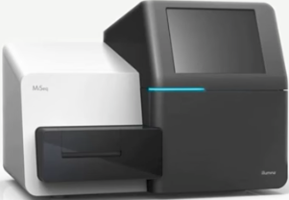
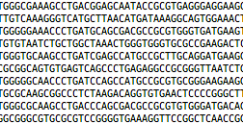
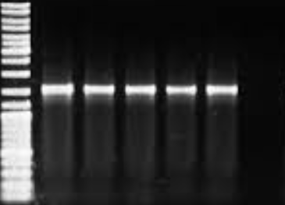
Data Collection
iMAP: Integrated Microbiome Data Analysis Pipeline
Sampling & DNA Sequencing
Gathering materials &
Profiling metadata
Pre-Processing
& Quality control
Sequence processing & taxonomic classification
OTU clustering & taxonomy assignment
Demultiplexed reads
Gather required materials
Get demultiplexed reads (FastQ files)
Get sample metadata
Clone iMAP repository
Install required software
Download reference DBs
Verify folders and files
Read inspection
Review per sample read depth
Review read length
Merge forward & reverse Reads
Review, screen and filter by sequence length
Pick representative sequences
Cluster OTUs & assign conserved taxonomy
Phylotypes approach
OTU clusters approach
Phylogeny approach
Quality control of raw reads
Review base-call quality
Trim and filter poor reads
Remove retained phiX reads
Align to reference 16S rRNA gene alignment
Review, screen & filter by sequence length
Remove poor alignments & chimeras
DNA sequencing
Preliminary analysis
OTU abundance
Alpha diversity
Beta diversity
Library Preparation
Explore the metadata
Inspect uniformity of sample identifiers
Review experimental variables
Review missing data
Phylogenetic annotation
Upload trees to iTOL viewer
Prepare annotation files
Add annotation files to the tree
Manage trees interactively
Export annotated tree
Classify sequences with reference taxonomy classifiers
Remove non-bacterial
Estimate error rate
Remove mock sequences
DNA Extraction
Sampling & Recording
Sample metadata
Progress Report 1
Metadata profiling
Progress Report 2
Pre-processing
Progress Report 3
Sequence-processing
Progress Report 4
Preliminary analysis
Field & Wet Lab
Review-As-You-Go (RAYG): Progress Reports Summarizing Bioinformatics Analysis and Exploratory Visualization

Slide 2
Data Collection
iMAP: Integrated Microbiome Data Analysis Pipeline
Sampling & DNA Sequencing
Gathering materials &
Profiling metadata
Pre-Processing
& Quality control
Sequence processing & taxonomic classification
OTU clustering & taxonomy assignment
Demultiplexed reads
Gather required materials
Get demultiplexed reads (FastQ files)
Get sample metadata
Clone iMAP repository
Install required software
Download reference DBs
Verify folders and files
Read inspection
Review per sample read depth
Review read length
Merge forward & reverse Reads
Review, screen and filter by sequence length
Pick representative sequences
Cluster OTUs & assign conserved taxonomy
Phylotypes approach
OTU clusters approach
Phylogeny approach
Quality control of raw reads
Review base-call quality
Trim and filter poor reads
Remove retained phiX reads
Align to reference 16S rRNA gene alignment
Review, screen & filter by sequence length
Remove poor alignments & chimeras
DNA sequencing
Preliminary analysis
OTU abundance
Alpha diversity
Beta diversity
Library Preparation
Explore the metadata
Inspect uniformity of sample identifiers
Review experimental variables
Review missing data
Phylogenetic annotation
Upload trees to iTOL viewer
Prepare annotation files
Add annotation files to the tree
Manage trees interactively
Export annotated tree
Classify sequences with reference taxonomy classifiers
Remove non-bacterial
Estimate error rate
Remove mock sequences
DNA Extraction
Sampling & Recording
Sample metadata
Progress Report 1
Metadata profiling
Progress Report 2
Pre-processing
Progress Report 3
Sequence-processing
Progress Report 4
Preliminary analysis
Field & Wet Lab
Review-As-You-Go (RAYG): Progress Reports Summarizing Bioinformatics Analysis and Exploratory Visualization

