Slide 1



Statistics for biological data

Slide 2



Statistics for biological data
Course instructors
Mark Dunning
Bsc, Msc, PhD
m.j.dunning@sheffield.ac.uk
Aya Elwazir
MBChB, Msc
aymelwazir1@sheffield.ac.uk
Timothy Freeman
Bsc, Msc
tmfreeman1@sheffield.ac.uk

Slide 3
Statistics for biological data
Course materials
https://sbc.shef.ac.uk/stats-in-r/practical.nb.html

Slide 4
Statistics for biological data
Course Objectives
Introduction to statistics
1. Contingency tables & testing for categorical variables
2. Normality testing & Descriptive statistics
3. Testing for continuous variables
Lots of practice!

Slide 5
Statistics for biological data
Introduction
Aya Elwazir
Teaching assistant of medical genetics, FOMSCU
PhD student, University of Sheffield

Slide 6
What is statistics?
Collecting
Organizing
Interpreting
Analysing

Slide 7

Research question & hypotheses
Does taking aspirin every day affect the risk of having a heart attack?
No
Yes
Yes
Daily aspirin
does NOT affect
risk of heart attack
Daily aspirin
affects
risk of heart attack
Daily aspirin
reduces
risk of heart attack
Reject
Two-tailed
One-tailed
Null hypothesis (H₀)
Alternative hypothesis (H₁)
Alternative hypothesis
(H₁)

Slide 8






Hypothesis testing: population & sample
Generalized
Population
Results
Representative
Sample
Random sample
Independent
Proper sample size
Type I & Type II errors
Not Representative

Slide 9


Hypothesis testing: Type I & II errors
Population
(reality)
H₁: Aspirin affects risk
H₀: Aspirin doesn’t affect risk
H₁: Aspirin
affects risk
Type I error
(false positive)
(observed)
H₀: Aspirin
doesn’t affect
risk
Type II error
(false negative)
Sample

Slide 10
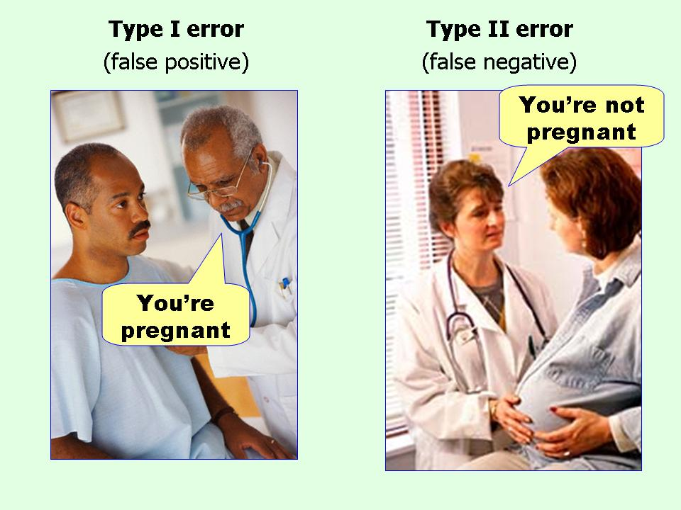
Hypothesis testing: Type I & II errors
Source: Effect Size FAQs

Slide 11

Hypothesis testing: P value
Statistics test the null hypothesis
H₀: Aspirin doesn’t affect risk
Assuming the null hypothesis is true
How likely is an observed effect due to chance??
p = probability of chance
Totally unlikely
Totally
likely
0
0.05
1
<5% probability that results are due to chance

Slide 12
Hypothesis testing: P value
Remember
‘Statistical analyses can never prove the truth of a hypothesis, but rather merely provide evidence to support or refute it’
(Whitely & Ball, 2002)
How is P value calculated?
Significance tests
Choice of test depends on type of data

Slide 13



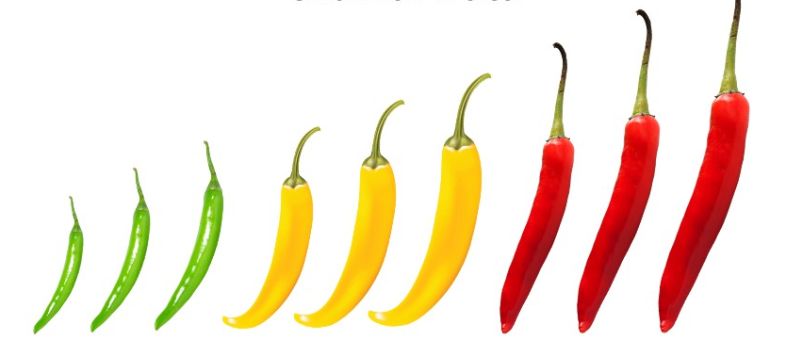
Types of data
Numeric
Categorical
Continuous
Discrete
Nominal
Ordinal
Age
RBCs
Smoking status
Severity

Slide 14

Statistics for biological data
Course Objectives
Introduction to statistics
1. Contingency tables & testing for categorial variables
2. Normality testing & Descriptive statistics
3. Testing for continuous variables
Lots of practice!

