Slide 1
Fundamentals of Computer networks labs and practices
Dr.Haitham A. El-Ghareeb Computer Networks Fundamentals

Slide 2
Internet Lab
Basics of Computer Networks

Slide 3
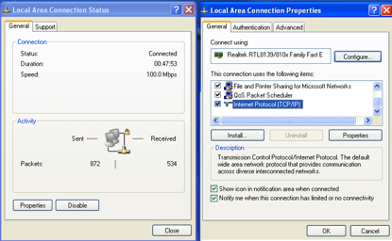
Configuring TCP/IP Protocol
View the installed networking components and protocols:

Slide 4
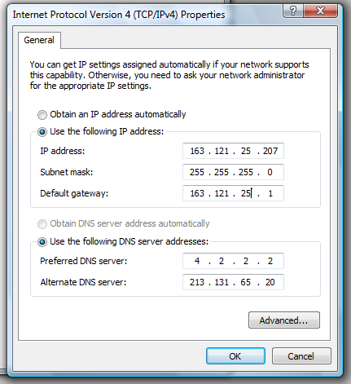
Assign IP address manually
Set IP address
Set Subnet mask
Set IP default-Gateway
Set DNS server
Notes:
1) Go to Start and click on Control Panel. 2) Control Panel window will appear. Double click on Network Connections. 3) Network Connections window will appear. Right click correct Local Area Connection by identifying correct network card and click Properties. 4) Select Internet Protocol (TCP/IP). Click on Properties.

Slide 5
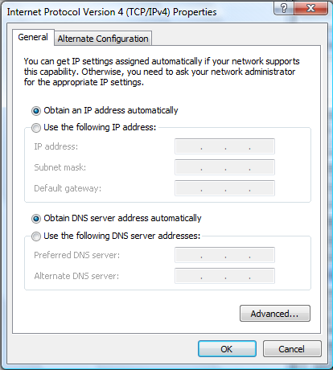
Assign IP address Automatic
The Device get the IP address through the DHCP Server.

Slide 6
ipconfig
ipconfig is a command line utility in Microsoft Windows.
ipconfig allows you to get the IP address information of a Windows computer
MAC Address
IP address
Default gateway
Subnet mask
DNS server
Notes:
C:\Users\nour>ipconfig
Windows IP Configuration
Ethernet adapter Local Area Connection:
Connection-specific DNS Suffix . :
Link-local IPv6 Address . . . . . : fe80::df8:969c:fdbf:cb4%9
IPv4 Address. . . . . . . . . . . : 163.121.12.207
Subnet Mask . . . . . . . . . . . : 255.255.255.0
Default Gateway . . . . . . . . . : 163.121.12.1
--------------------------------------------------------------------------------------------------
C:\Users\rania>ipconfig /all
Windows IP Configuration
Host Name . . . . . . . . . . . . : rania
Primary Dns Suffix . . . . . . . :
Node Type . . . . . . . . . . . . : Hybrid
IP Routing Enabled. . . . . . . . : No
WINS Proxy Enabled. . . . . . . . : No
Ethernet adapter Local Area Connection:
Connection-specific DNS Suffix . :
Description . . . . . . . . . . . : Broadcom NetXtreme 57xx Gigabit Controlle
r
Physical Address. . . . . . . . . : 00-13-72-A5-12-FE
DHCP Enabled. . . . . . . . . . . : No
Autoconfiguration Enabled . . . . : Yes
Link-local IPv6 Address . . . . . : fe80::df8:969c:fdbf:cb4%9(Preferred)
IPv4 Address. . . . . . . . . . . : 163.121.12.207(Preferred)
Subnet Mask . . . . . . . . . . . : 255.255.255.0
Default Gateway . . . . . . . . . : 163.121.12.1
DNS Servers . . . . . . . . . . . : 4.2.2.2
213.131.65.20
NetBIOS over Tcpip. . . . . . . . : Enabled

Slide 7
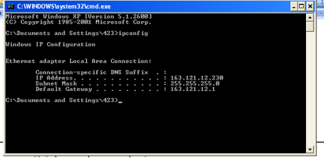
TCP/IP Configuration
>ipconfig //give detail on your network settings

Slide 8
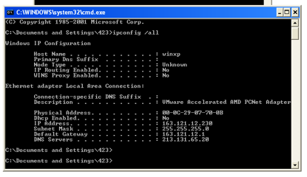
TCP/IP Configuration
>ipconfig /all

Slide 9
TCP/IP Configuration
ipconfig /all
This is the main network tool. Using without parameters gives you basic information about your network. With the all parameters, a more detailed information about DNS, DHCP, and other network settings appears.
ipconfig /renew
This command renews the IP that a DHCP server has assigned to your computer. This is the command that Windows uses when it tells you that is trying to solve a problem with the network.
ipconfig /flushdns
Your computer has a table with the names of computers and their corresponding IP addresses. This command will remove all the entries on that table. It’s very useful if you change your DNS servers.
ipconfig /displaydns
This command display the content of the table we were talking before.

Slide 10
APIPA
Automatic Private IP Addressing
APIPA feature, when installed – will automatically assign an IP to a computer if it is:
Configured to obtain IP address automatically from DHCP
And there is no DHCP server present or the DHCP server is not available
IANA (Internet Assigned Numbers Authority) has reserved private IP addresses in the range of 169.254.0.0 – 169.254.355.355

Slide 11
Internet Services
The World Wide Web: HTTP
File Transfer: FTP
Electronic Mail service: IMAP, POP3, SMTP
Naming Service: DNS
Telnet Service

Slide 12
Web Servers and Clients
Web Servers
IIS: Internet Information Services
Apache Web server
Web Clients
Browsers

Slide 13
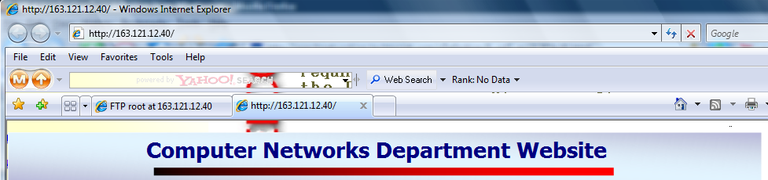
Browser as a web client
Use Internet Browser as WEB client.

Slide 14
Dealing with FTP protocol
We need to have :
FTP Server
User account
Home Directory
Permission
FTP Client

Slide 15
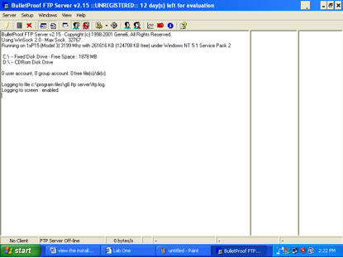
Bullet Proof FTP Server

Slide 16
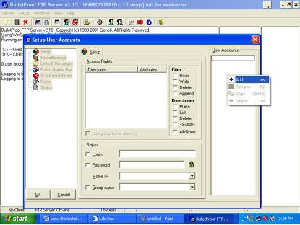
Add User Account
Add user account: Setup→account

Slide 17
FTP Client
CMD
Internet Explorer
Third Party Program (Cute FTP)

Slide 18
FTP Client CMD
ftp >open ip //enter username and password
get filename // download file& save in the current directory
mget filename1 filename2 //download multi files
put file name
hash // to see progress bar during process of download
disconnect //close session
bye // close ftp service

Slide 19
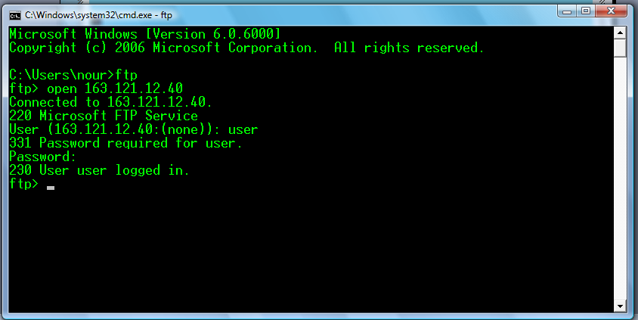
MS Windows built-in FTP client
open
ls
cd
bin
get
mget
Put
bye
Try these commands

Slide 20
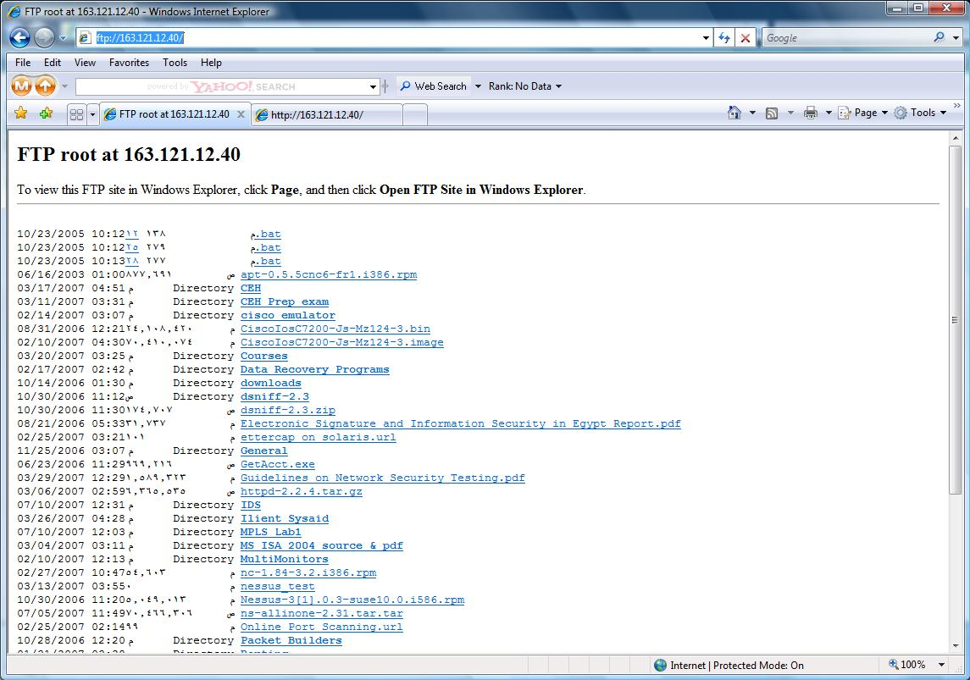
Browser as a FTP client

Slide 21
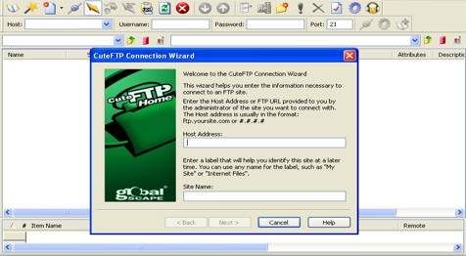
Cute FTP Client

Slide 22
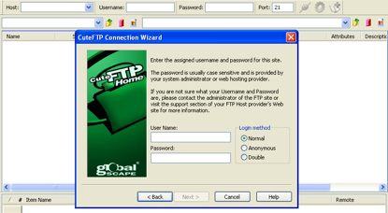
host address : IP of FTP server

Slide 23
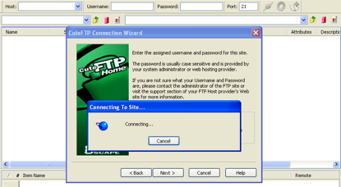
user name and password of client which created on server

Slide 24
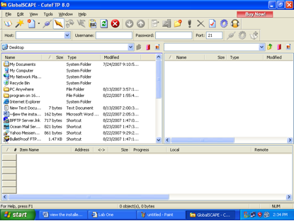
Drag & drop from server to Desktop

Slide 25
Naming Services
DNS

Slide 26

URL
URL is Universal Resource Locator
Protocol : HTTP or FTP

Slide 27
DNS
At the beginning they use Hosts file
It maps the IP addresses to host names
It is found at “C:\Windows\System32\drivers\etc”
Then they make DNS Server to centralize the Domain Name Servers.
Servers are used to convert the addresses we see and read into IP addresses and vice-versa.

Slide 28
nslookup
With this tool you can check your DNS servers. For example, imagine you are experiencing a problem with your current DNS and it cannot resolve the address www.helghareeb.me
You can test it with nslookup and use other DNS servers to try to resolve the address.
This program can inform about a PC name given his IP address.

Slide 29
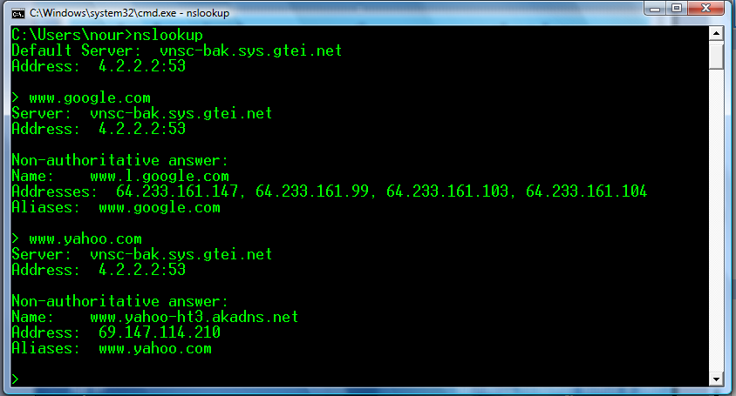
nslookup

Slide 30
Remote Administration
Remote Desktop

Slide 31
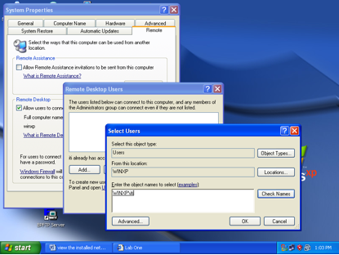
Windows Built-in Remote Desktop

Slide 32
TCP/IP Labs
Advanced Commands

Slide 33
ARP
This tool handles the resolution of a IP to a physical address.
The command gives a list of IPs and physical addresses on your local network.
Run the following command to view the contents of the arp cache
c:\>arp -a
To add a static entry write the command
c:\>arp -s 157.55.85.212 00-aa-00-62-c6-09
To delete the arp cache write the command
c:\>arp -d

Slide 34
Routing Table Commands
To view the local routing table, write the command
C:/>route print
To add a route to the routing table, write the command
C:\>route add 157.0.0.0 mask 255.0.0.0 157.55.80.1
To add a default route, write the command
C:\>route add 0.0.0.0 mask 0.0.0.0 163.121.25.1
The "metric" switch can be added to the end of the last commands to differentiate between the routes to the same destinations
To delete a certain route, write the command
C:\>route delete 157.0.0.0

Slide 35
Ping Command
To check the connectivity with a remote host
C:\>ping 163.121.25.40
To continue ping operation, just add the switch "-t”
C:\>ping 163.121.25.40 –t
c:\>ping -t 163.121.25.40
To control the size of pinging packets, just add the switch "-l” followed by the required packet size
C:\>ping 163.121.25.40 -l 2000
To control the number of pinging packets, just add the switch "-n" followed by the required packet number
C:\>ping 163.121.25.40 -n 7

Slide 36
Ping, Tracert, PathPing
ping
The easiest way to know if one of your computers is connected to the network.
tracert
Informs about the route to a remote host. The problem about tracert is that this uses a specific port that can be blocked in the route.
If you want to know if you can establish a connection between you and a router port use:
pathping
A better version of tracert that gives you statics about packet lost and latency.

Slide 37
Opened Ports and Sessions
netstat -nab
With this basic command, you can know every open port on your computer and the executable that has the port opened. In Windows 7 this command needs Administration rights (Click Start, type cmd, right click cmd.exe and click Run as administrator.)
netstat -r
Display the routing table

Slide 38
Port Scanning
LAN Port Scanner

Slide 39
Windows Networking
Advanced Commands

Slide 40
Advanced Commands
To quickly reset your NIC back to DHCP with no manual settings, run this command:
netsh int ip reset all
To quickly generate a text summary of your system, run this command:
systeminfo | more
To see all network connections your client has open, run this command:
net use
To see your routing table, run either of these commands:
route print
netstat –r

Slide 41
Advanced Commands
Need to run a trace, but don’t have Netmon or Wireshark, and aren’t allowed to install either one? Run this command:
netsh trace start capture=yes tracefile=c:\capture.etl
netsh trace stop
To quickly open a port on the firewall, run this command, changing the name, protocol, and port to suit. This example opens syslog:
netsh firewall set portopening udp 161 syslog enable all
To add an entry to your routing table that will be permanent, run the route add command with the –p option. Omitting that, the entry will be lost at next reboot:
route add 0.0.0.0 mask 0.0.0.0 172.16.250.5 –p
Here’s a simple way to see all open network connections, refreshing every second:
netstat –ano 1
You can use the shutdown to shutdown or reboot a machine, including your own, in a simple scheduled task like this:
shutdown –r –t 0 –m \\localhost

Slide 42
Basic Wireless Router Configuration
3Com Router

Slide 43
Network Cabling
Ethernet Cabling

Slide 44
Wireshark
Network Analysis Tool

