Slide 1
GPA1-B
1/7/2025
Andreena Brown

Slide 2
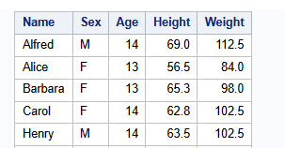

Slide 3
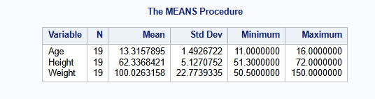

Slide 4
