Slide 1
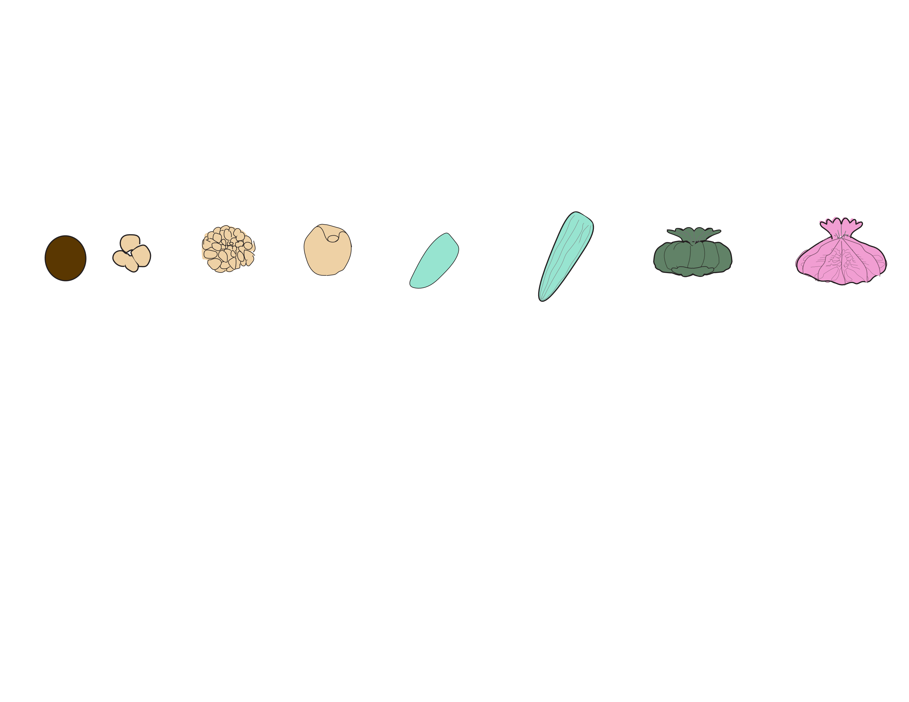
EMBRYOS
METAMORPHOSED POLPYS
ATTACHED RECRUITS
EGGS
LARVAE
Hours Post-Fertilization (hpf)
1
5
38
65
93
163
183
231
255
Respirometry
Cell Density
Size
Metabolomics
Gene Expression
Symbiodiniaceae ITS2
Notes:
Add example pictures at each stage

Slide 2
EMBRYOS
METAMORPHOSED POLYPS
ATTACHED RECRUITS
EGGS
LARVAE
Hours Post-Fertilization (hpf)
1
5
38
65
93
163
183
231
255
Respirometry
Cell Density
Size
Metabolomics
Gene Expression
Bacterial 16S
Symbiodiniaceae ITS2
Notes:
Add example pictures at each stage

Slide 3


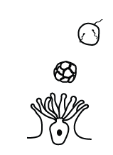
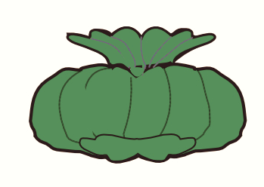
Capacity for Autotrophy
Symbiont population growth
Photosynthetic rates
Nitrogen cycling
Fixed carbon
Nutrient cycling
Epidermis
Transport & signaling
Respiration & C Metabolism
Gastrodermis
Nutritional Exchange
Membrane transport
Cell signaling & communication
Regulation of cell density
Ion transport
Growth & Photosynthesis
Symbiont Acquisition
Demand for Autotrophy
Development, growth & calcification
Host respiratory demand
Depletion of energy reserves
Metabolism of photosynthates
Vertical
Transmission
Horizontal
Transmission

Slide 4
Vertical
Transmission
Capacity for Autotrophy
Symbiont population growth
Photosynthetic rates
Nitrogen cycling
Demand for Autotrophy
Development, growth & calcification
Host respiratory demand
Depletion of energy reserves
Metabolism of photosynthates
Nutritional Exchange
Membrane transport
Cell signaling & communication
Regulation of cell density
Ion transport

