Slide 1
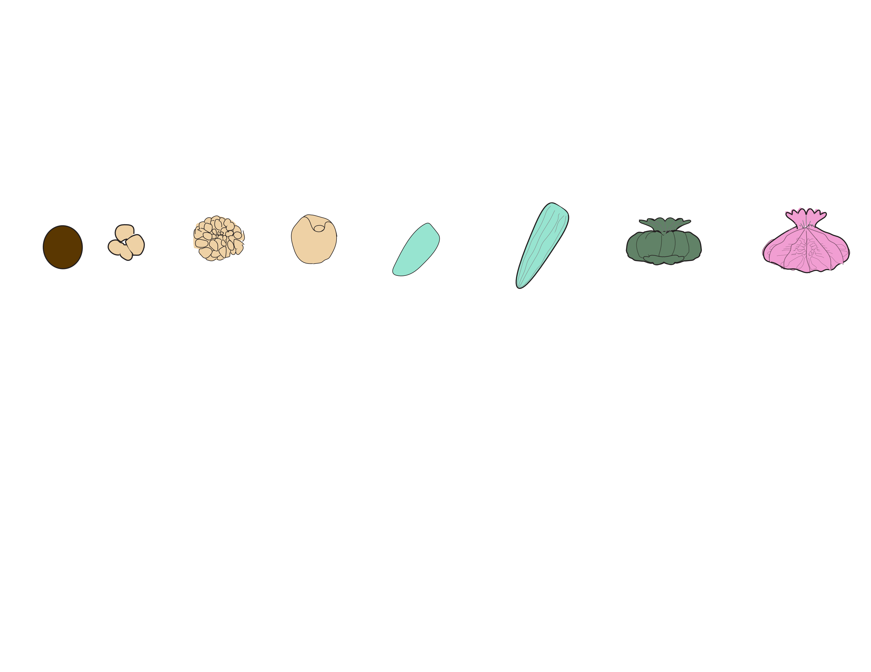
EGGS
EMBRYOS
LARVAE
METAMORPHOSED POLYPS
ATTACHED RECRUITS
Hours Post-Fertilization (hpf)
1
5
38
65
93
163
183
231
255
Respirometry
Cell Density
Size
Metabolomics
Gene Expression
Bacterial 16S
Symbiodiniaceae ITS2
Notes:
Add example pictures at each stage

Slide 2


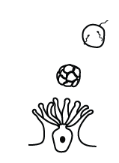
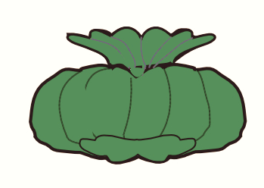
Capacity for Autotrophy
Symbiont population growth
Photosynthetic rates
Nitrogen cycling
Fixed carbon
Epidermis
Nutrient cycling
Transport & signaling
Respiration & C Metabolism
Gastrodermis
Nutritional Exchange
Membrane transport
Cell signaling & communication
Regulation of cell density
Ion transport
Growth & Photosynthesis
Symbiont Acquisition
Demand for Autotrophy
Development, growth & calcification
Host respiratory demand
Depletion of energy reserves
Metabolism of photosynthates
Vertical
Transmission
Horizontal
Transmission

Slide 3
Vertical
Transmission
Symbiont Growth
Photosynthetic Rates
Could edit this to show actual movement of peaks
Energy Demand
Cell Signaling & Transport
Photosynthate Metabolism
Central Metabolism

