Slide 1
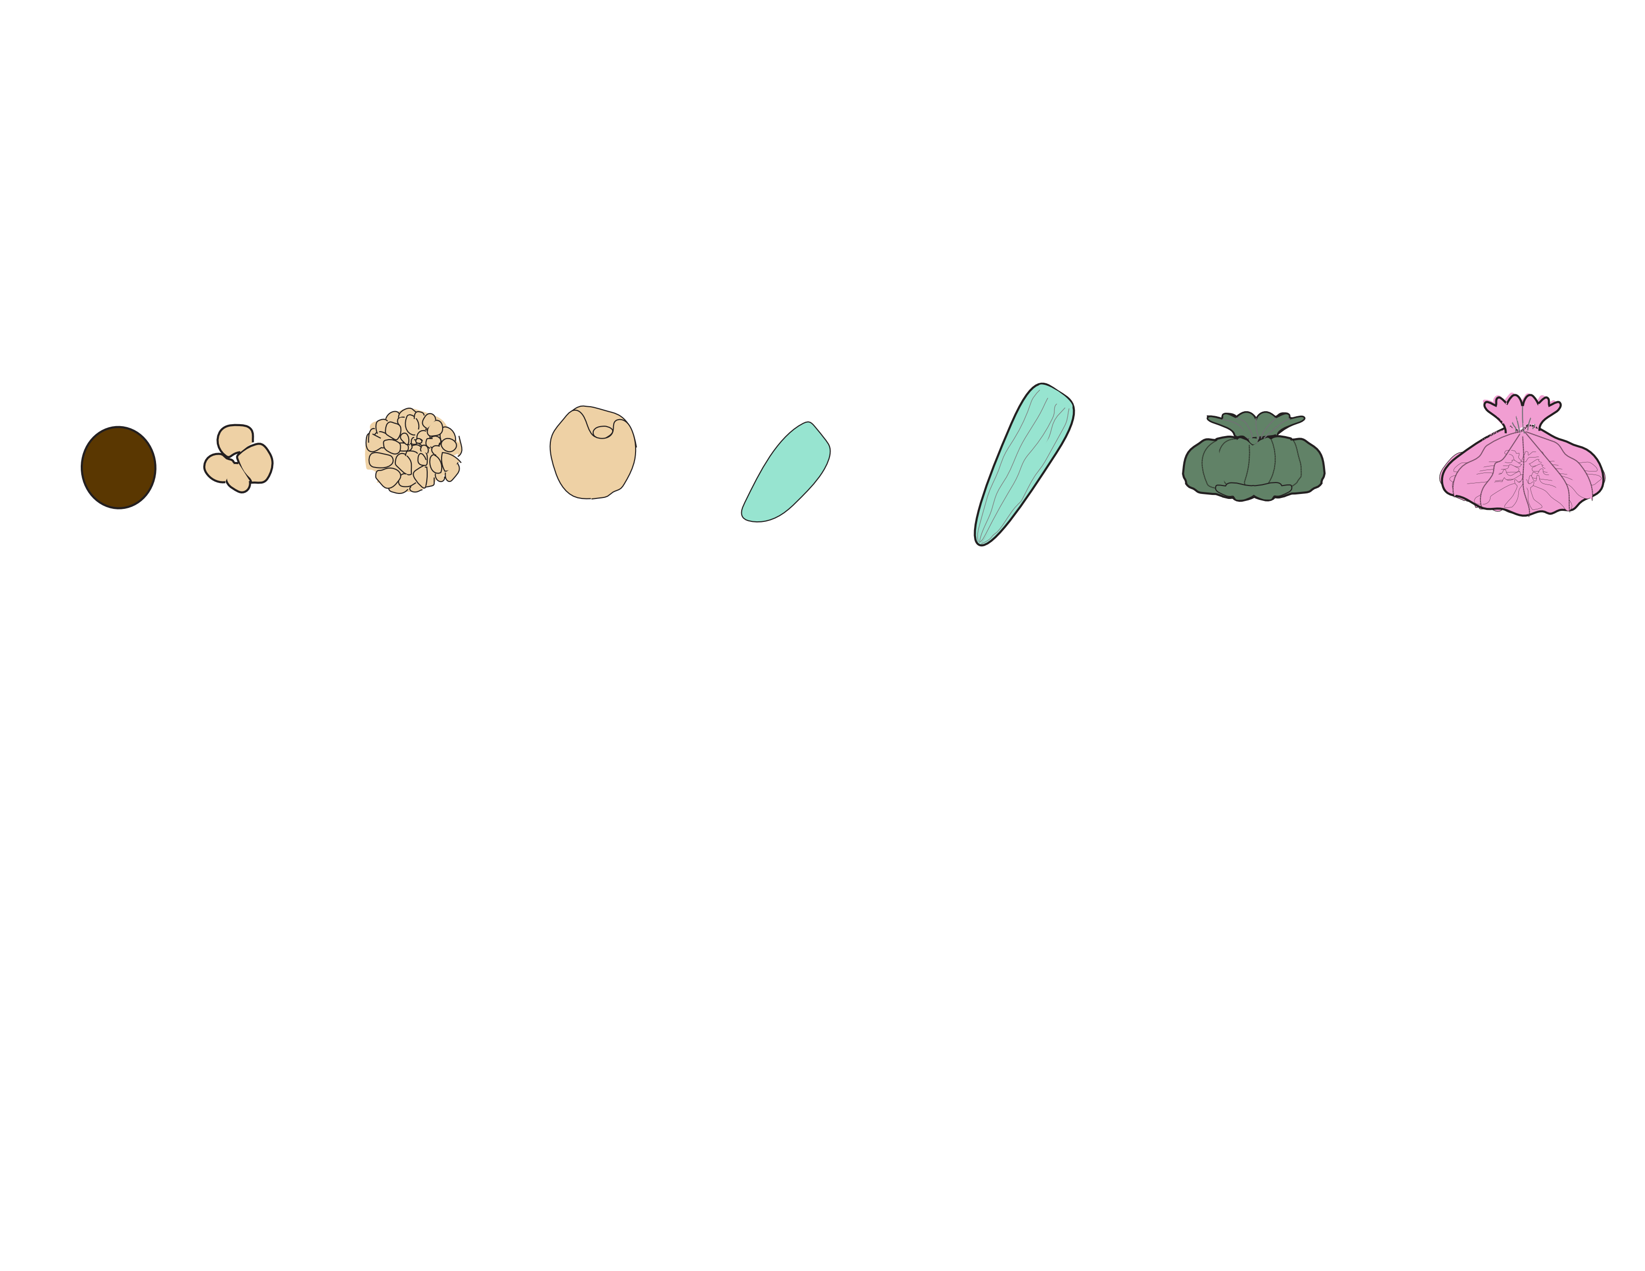
EMBRYOS
METAMORPHOSED POLPYS
ATTACHED RECRUITS
EGGS
LARVAE
Hours Post-Fertilization (hpf)
1
5
38
65
93
163
183
231
255
Respirometry
Cell Density
Size
Metabolomics
Gene Expression
Symbiodiniaceae ITS2
Notes:
Add example pictures at each stage

Slide 2
EMBRYOS
METAMORPHOSED POLYPS
ATTACHED RECRUITS
EGGS
LARVAE
Hours Post-Fertilization (hpf)
1
5
38
65
93
163
183
231
255
Respirometry
Cell Density
Size
Metabolomics
Gene Expression
Bacterial 16S
Symbiodiniaceae ITS2
Notes:
Add example pictures at each stage

