Slide 1
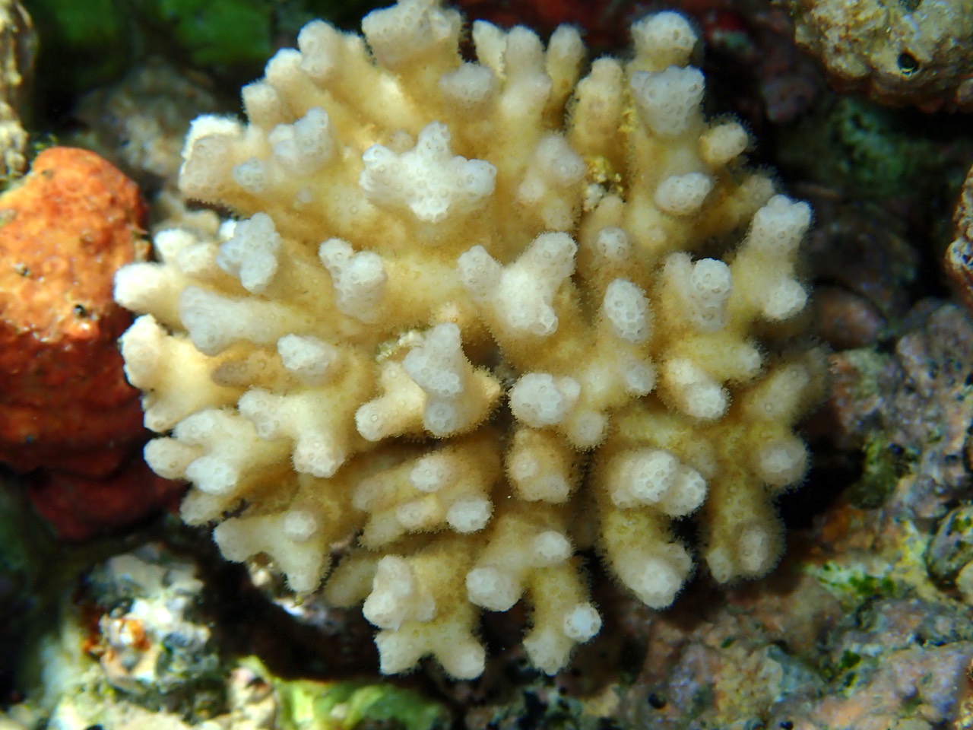
A
B
D
E
C
F
+6

