Slide 1
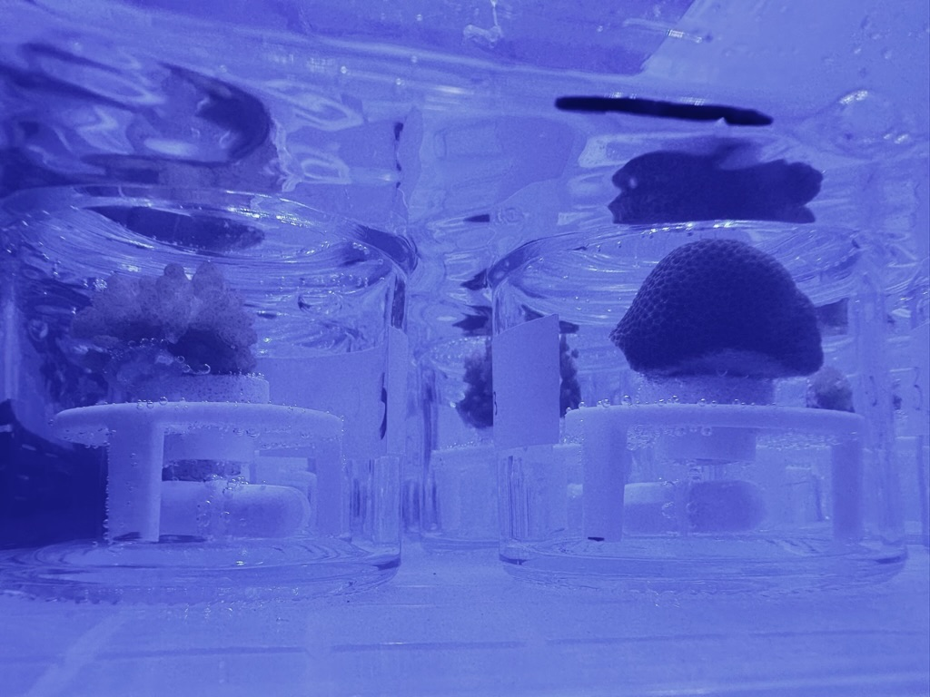
How does temperature stress affect symbiotic nutritional exchange in larvae and recruits?
¹³C bicarbonate label
4 h incubation at treatment
Methods as in Huffmyer et al. 2024
Species | Life Stage | Treatments | Sample Size | Total Samples
Pocillopora meandrina | Recruit | 27, 30, 33°C | n=4-5 per treatment | 15
Pocillopora meandrina | Larvae | 27, 30, 33°C | n=6 per treatment | 18
Acropora hyacinthus | Recruit | 27, 30, 33°C | n=5-6 per treatment | 16
Controls (both species) |  | Dark control | n=4 per species | 8
 |  |  | TOTAL | 57

