Slide 1
Git Crash Course
VGDev Fall 2015
Alexander Huynh

Slide 2
Agenda
What is Git?
Why should I Git?
How do I Git?

Slide 3

What is Git?
Version control system
Allows easy collaboration on same stuff

Slide 4


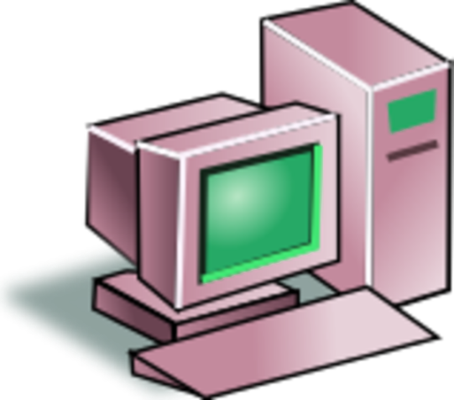


What is Git?

Slide 5
Why should I Git?
Widely used in industry
Makes collaboration easy
Needed to pass your classes

Slide 6
Getting Git
Account on GitHub
Software on your machine

Slide 7
Git in a nutshell
Remote Repository
push
Local Repository
commit
Staging Area
add
clone
&
pull
Working Directory

Slide 8
Git in a nutshell
Remote Repository
init
Local Repository
Staging Area
Working Directory

Slide 9
Initializing a Repository (Locally)
Makes a new repo
Adds files to your machine
Does not add repo to your GitHub

Slide 10

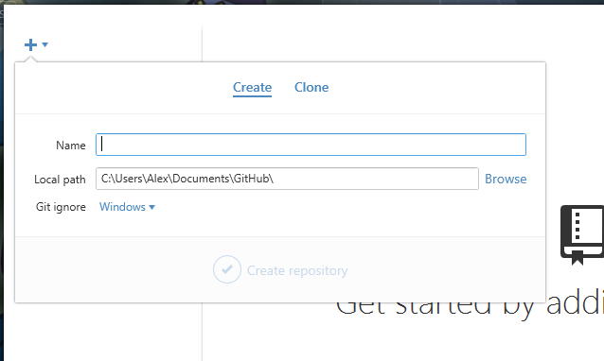
Initializing a Repository (Locally)
Git Shell:
$ git init
Git GUI:

Slide 11
Git in a nutshell
Remote Repository
Local Repository
Staging Area
Working Directory

Slide 12
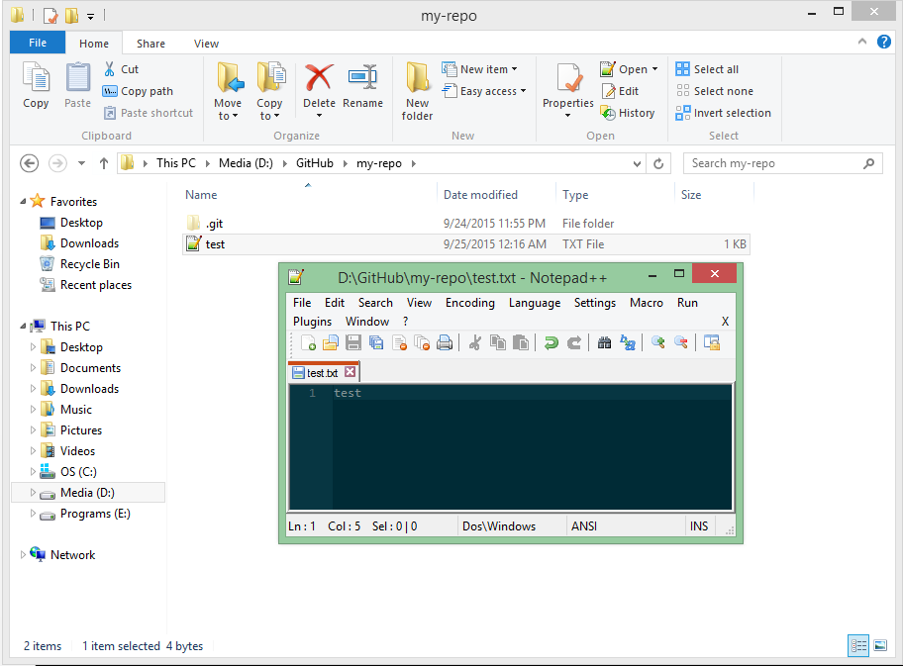
Working Directory
Make a new text file in your working directory.

Slide 13
Git in a nutshell
Remote Repository
Local Repository
Staging Area
add
Working Directory

Slide 14
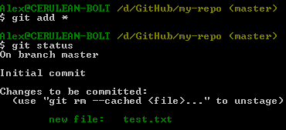
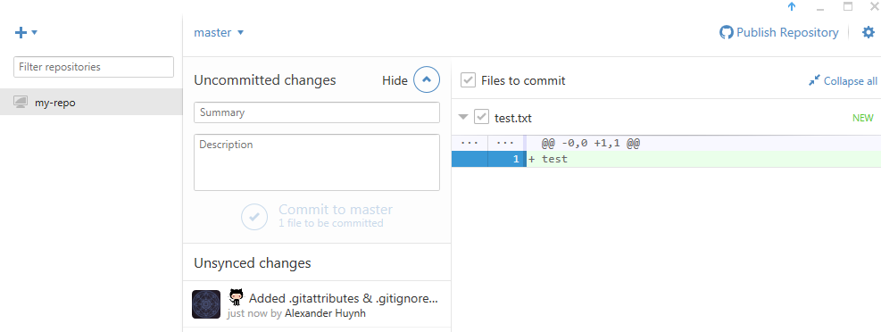
Adding to the Staging Area
Git Shell:
$ git add *
$ git status
Git GUI:

Slide 15
Git in a nutshell
Remote Repository
Local Repository
commit
Staging Area
Working Directory

Slide 16

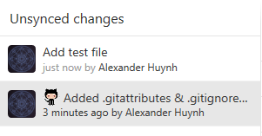
Committing to Local Repository
Git Shell:
$ git commit –m “Add test file”
Git GUI:

Slide 17
Git in a nutshell
Remote Repository
Local Repository
Staging Area
Working Directory

Slide 18
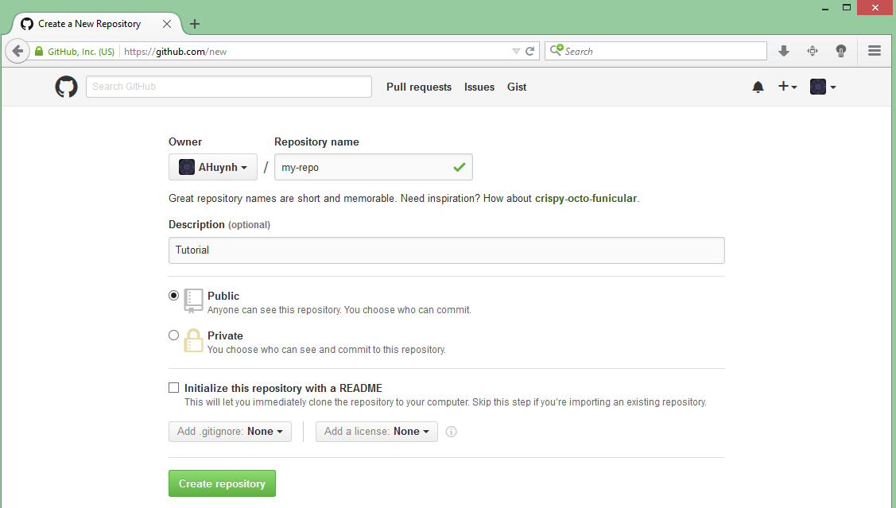
Creating a Remote Repository
1
2
3

Slide 19
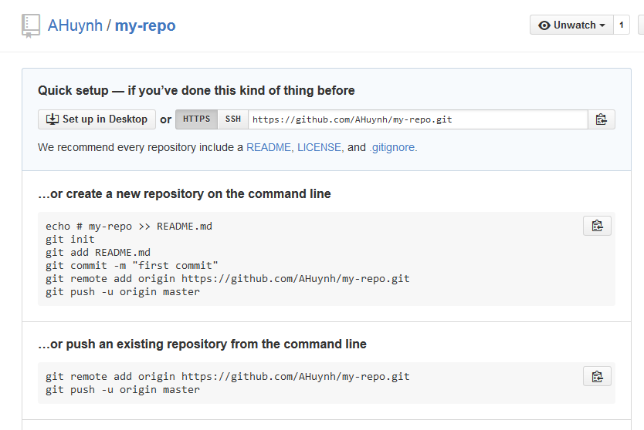
Creating a Remote Repository

Slide 20
Git in a nutshell
Remote Repository
push
Local Repository
Staging Area
Working Directory

Slide 21
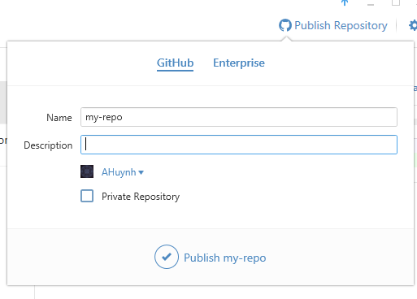
Pushing to Remote Repository
Git Shell:
$ git remote add origin https://github.com/AHuynh/my-repo.git
$ git push -u origin master
Git GUI:

Slide 22
Making Some Changes
Remote Repository
Local Repository
Staging Area
Working Directory

Slide 23
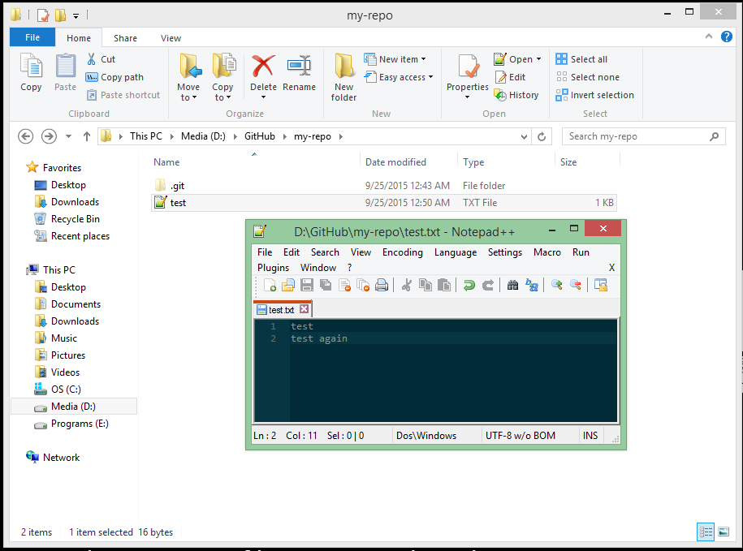
Working Directory
Make a change to your file, or add another file!

Slide 24
Adding Your Changes
Remote Repository
push
Local Repository
commit
Staging Area
add
Working Directory

Slide 25
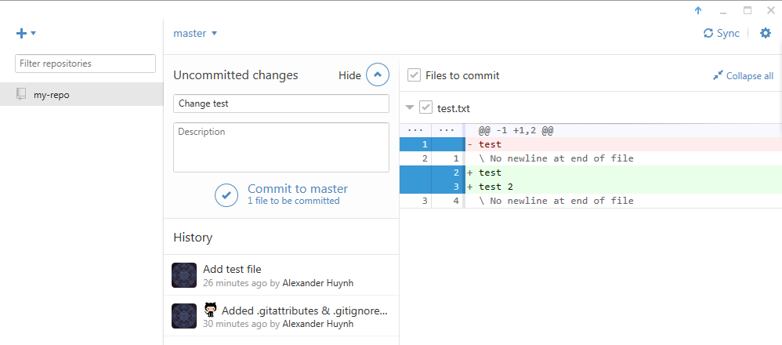
Adding Your Changes
Git Shell:
$ git pull
$ git add *
$ git status
$ git commit –m “Add more text to test.txt”
$ git push
Git GUI:
2
1

Slide 26
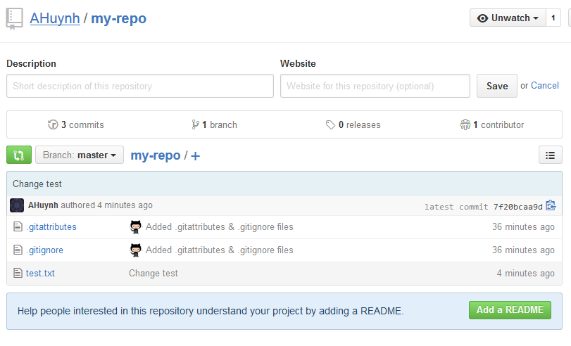
Success

Slide 27


Slide 28


Forking

Slide 29
Forking a Repository
Make a copy of an existing repo
Does not add files to your machine
Copies the repo to your GitHub

Slide 30

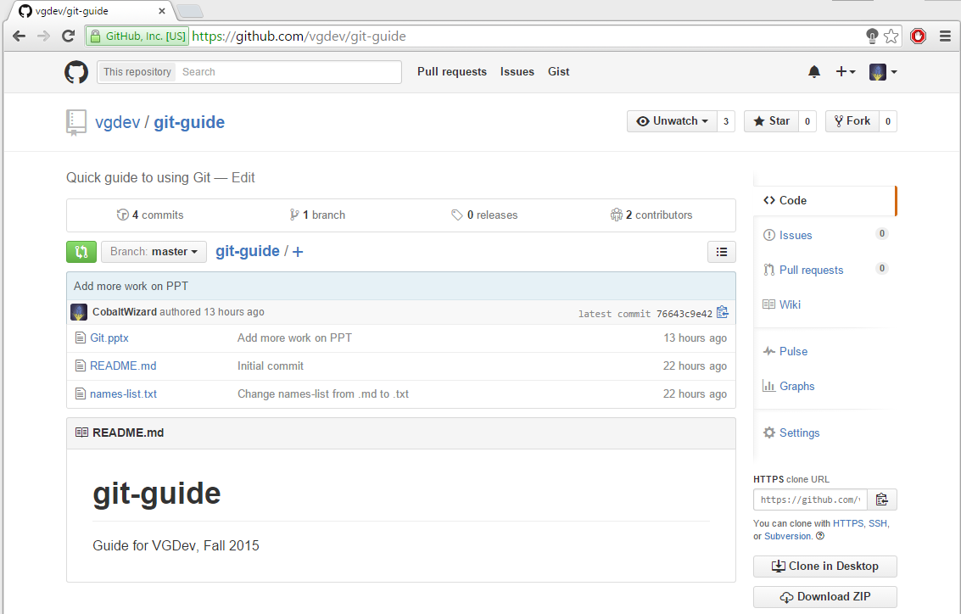
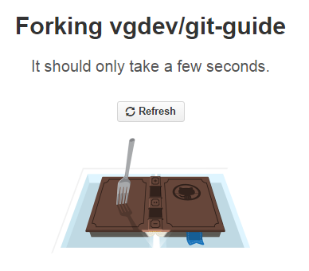
Forking a Repository
https://github.com/vgdev/git-guide

Slide 31

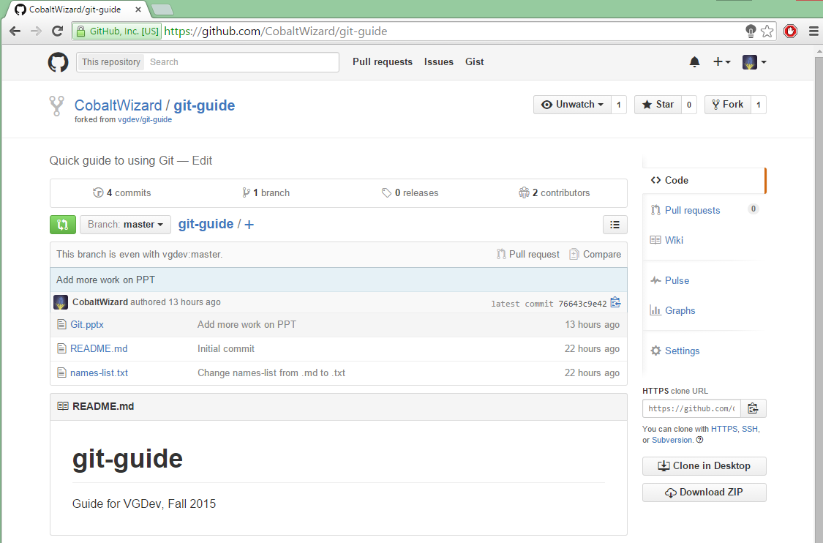
Forking a Repository
https://github.com/CobaltWizard/git-guide

Slide 32
Git in a nutshell
Remote Repository
clone
Local Repository
Staging Area
Working Directory

Slide 33
Cloning a Repository
Make a local copy of an existing repo
Adds files to your machine
Does not add repo to your GitHub
if it wasn’t there already

Slide 34
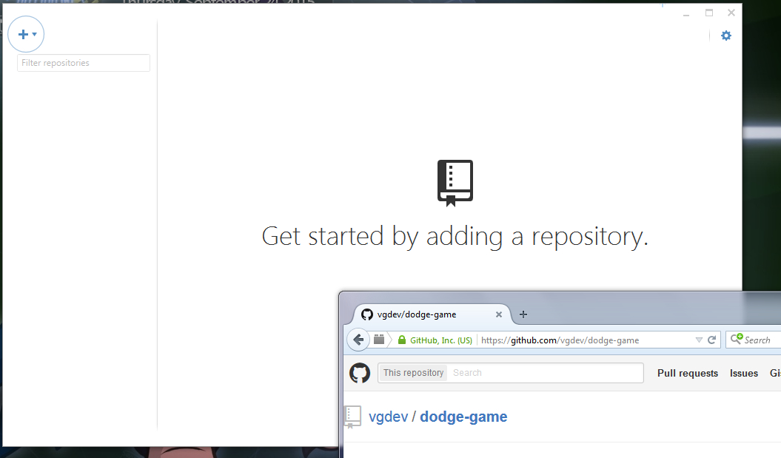
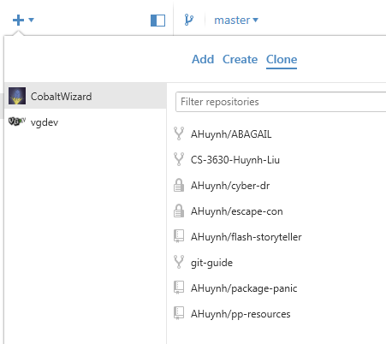
Cloning a Repository
Git Shell:
$ git clone https://github.com/CobaltWizard/git-guide
Git GUI:
Drag & Drop

Slide 35
Making Some Changes
Remote Repository
Local Repository
Staging Area
Working Directory

Slide 36
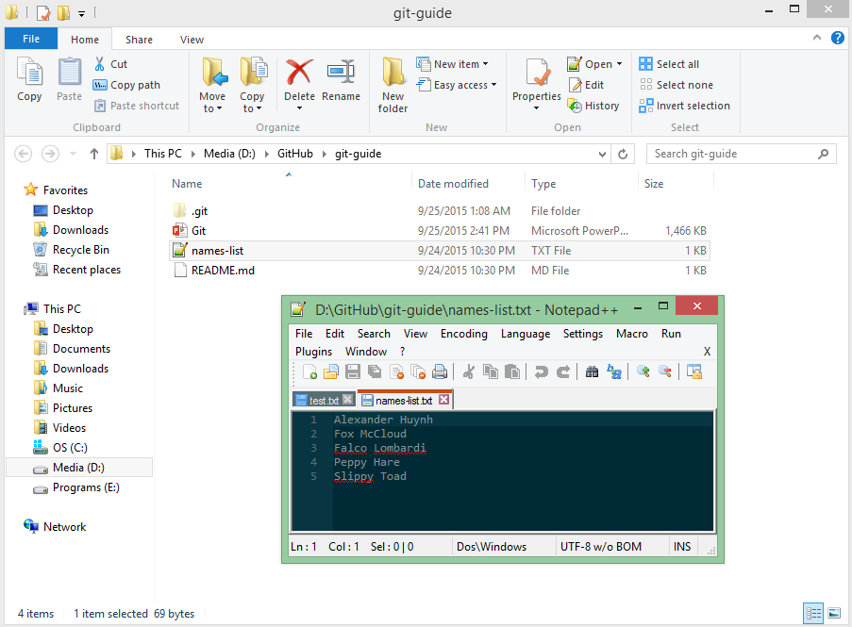
Making Some Changes
Make a change to names-list.txt

Slide 37
Adding Your Changes
Remote Repository
push
Local Repository
commit
Staging Area
add
Working Directory

Slide 38
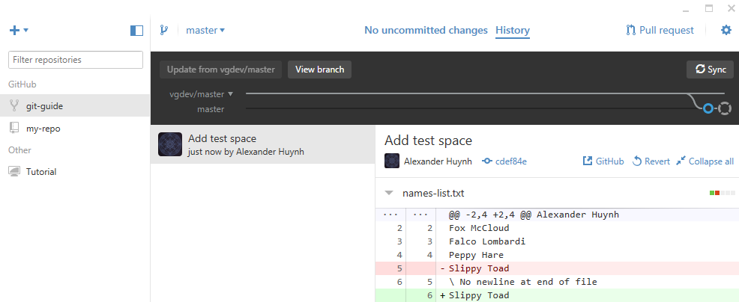
Adding Your Changes
Git Shell:
$ git pull
$ git add *
$ git status
$ git commit –m “Add my name to names-list.txt”
$ git push
Git GUI:

Slide 40
Pull Request

Slide 41
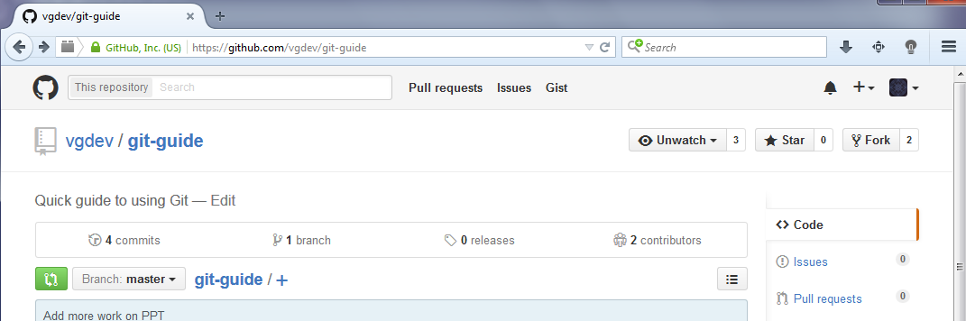
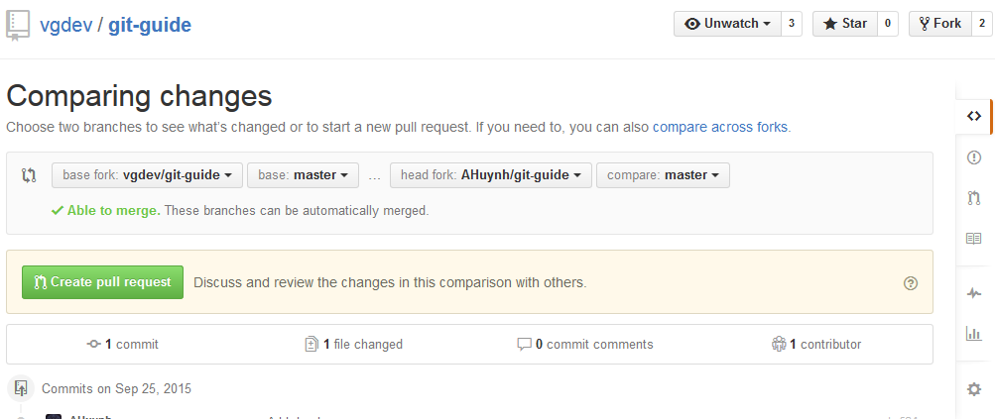
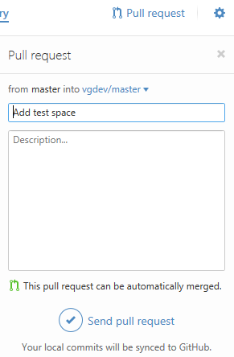
Pull Request
Git Shell:
https://github.com/vgdev/git-guide
1
Git GUI:
2

Slide 42
Pull Request

Slide 43
Pull Request
pull
pull

Slide 44

Getting Updates
Git Shell:
$ git remote add upstream https://github.com/vgdev/git-guide
$ git remote –v
$ git pull upstream master
Git GUI:

Slide 45
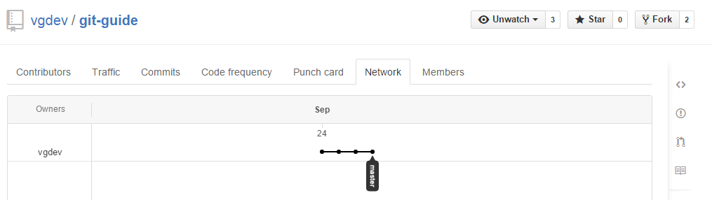
Getting Updates

Slide 46

Now you know how to Git
…at least a little bit.

