Slide 1
Git Crash Course

Slide 2
Agenda
What is Git?
Why should I Git?
How do I Git?

Slide 3

What is Git?
Version control system
Allows easy collaboration on same stuff

Slide 4





What is Git?

Slide 5
Why should I Git?
Widely used in industry
Makes collaboration easy
Needed to pass your classes

Slide 6
Getting Git
Account on GitHub
Software on your machine

Slide 7
Git in a nutshell
Remote Repository
push
Local Repository
commit
Staging Area
add
clone
&
pull
Working Directory

Slide 8
Git in a nutshell
Remote Repository
init
Local Repository
Staging Area
Working Directory

Slide 9
Initializing a Repository (Locally)
Makes a new repo
Adds files to your machine
Does not add repo to your GitHub

Slide 10

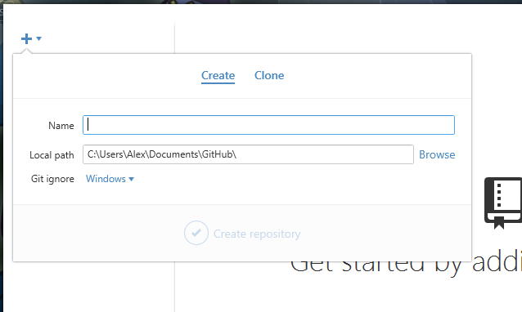
Initializing a Repository (Locally)
Git Shell:
$ git init
Git GUI:

Slide 11
Git in a nutshell
Remote Repository
Local Repository
Staging Area
Working Directory

Slide 12
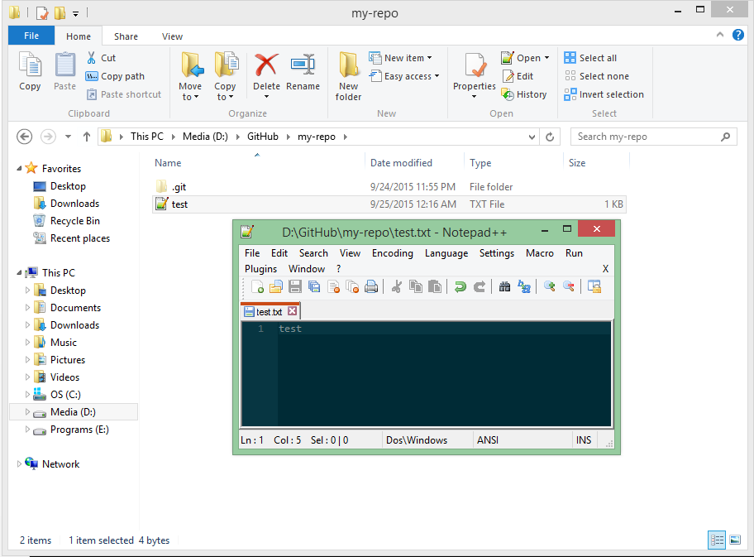
Working Directory
Make a new text file in your working directory.

Slide 13
Git in a nutshell
Remote Repository
Local Repository
Staging Area
add
Working Directory

Slide 14
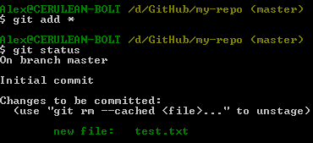
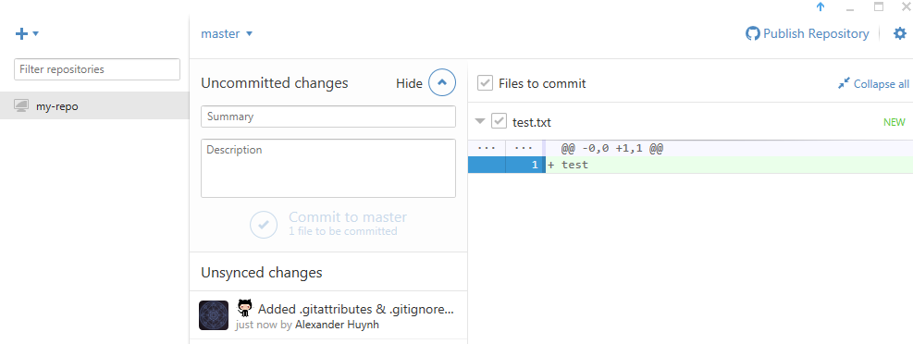
Adding to the Staging Area
Git Shell:
$ git add *
$ git status
Git GUI:

Slide 15
Git in a nutshell
Remote Repository
Local Repository
commit
Staging Area
Working Directory

Slide 16

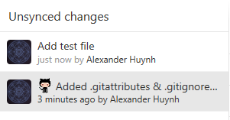
Committing to Local Repository
Git Shell:
$ git commit –m “Add test file”
Git GUI:

Slide 17
Git in a nutshell
Remote Repository
Local Repository
Staging Area
Working Directory

Slide 18
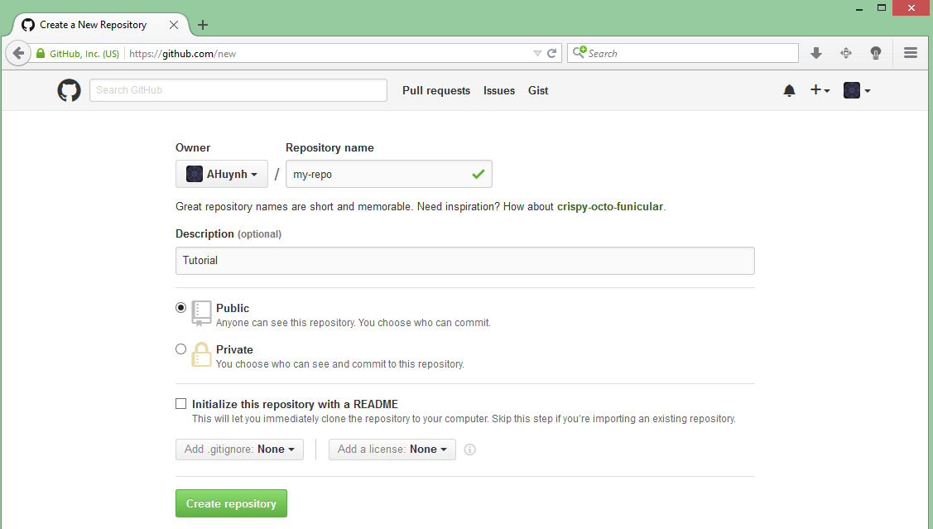
Creating a Remote Repository
1
2
3

Slide 19
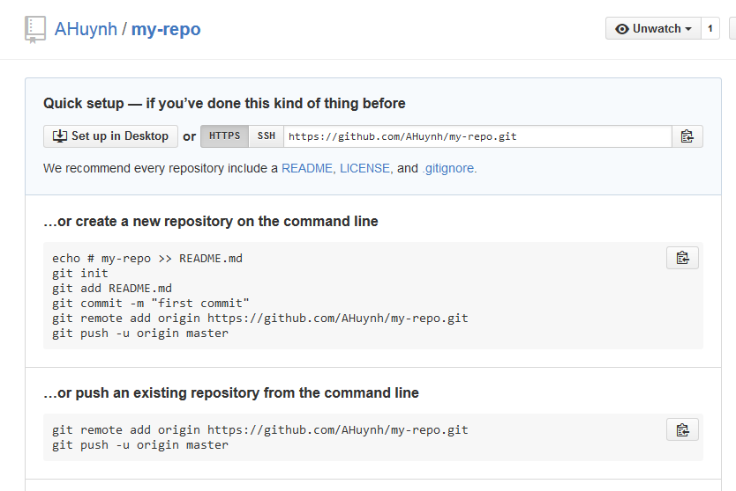
Creating a Remote Repository

Slide 20
Git in a nutshell
Remote Repository
push
Local Repository
Staging Area
Working Directory

Slide 21
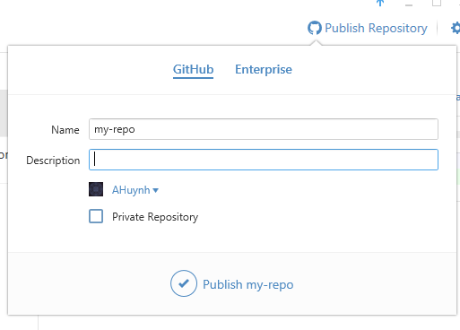
Pushing to Remote Repository
Git Shell:
$ git remote add origin https://github.com/AHuynh/my-repo.git
$ git push -u origin master
Git GUI:

Slide 22
Making Some Changes
Remote Repository
Local Repository
Staging Area
Working Directory

Slide 23
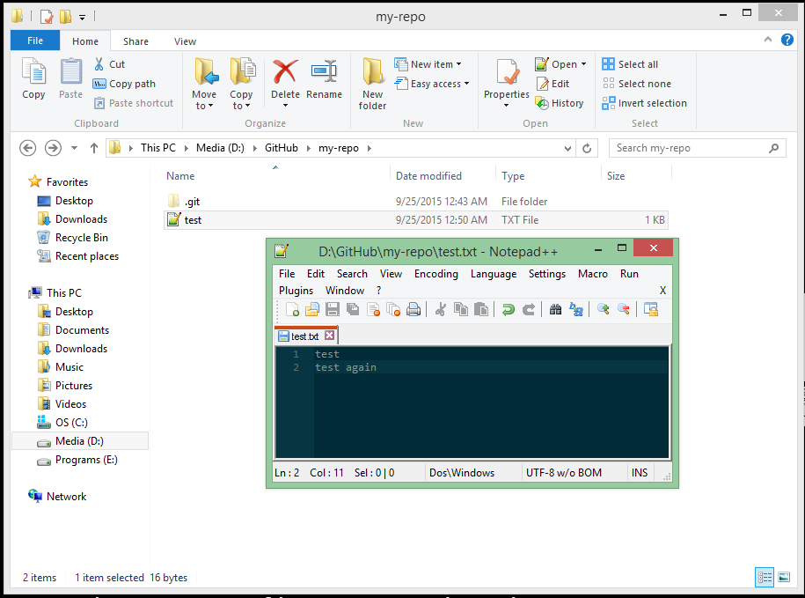
Working Directory
Make a change to your file, or add another file!

Slide 24
Adding Your Changes
Remote Repository
push
Local Repository
commit
Staging Area
add
Working Directory

Slide 25
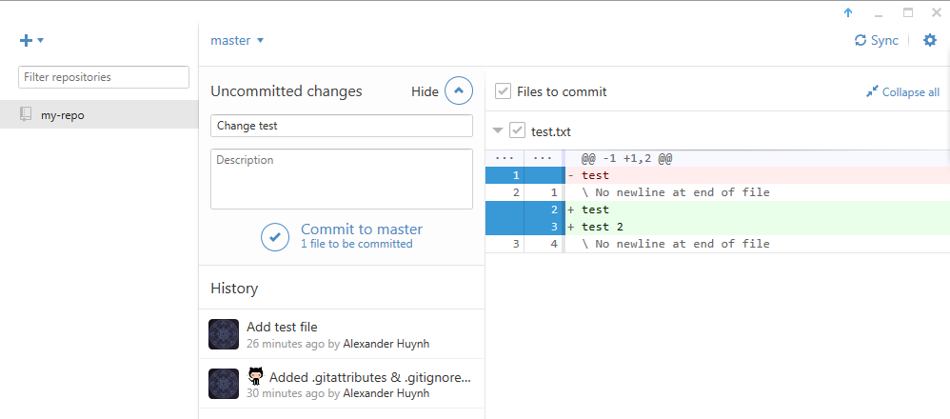
Adding Your Changes
Git Shell:
$ git pull
$ git add *
$ git status
$ git commit –m “Add more text to test.txt”
$ git push
Git GUI:
2
1

Slide 26
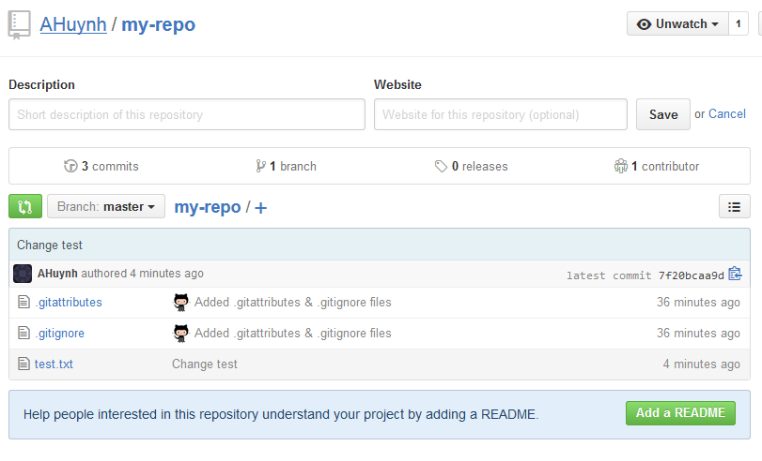
Success

Slide 27


Slide 28


Forking

Slide 29
Git in a nutshell
Remote Repository
Local Repository
Staging Area
clone
&
pull
Working Directory

Slide 30
Cloning a Repository
Make a copy of an existing repo
Adds files to your machine
Does not add repo to your GitHub

Slide 31
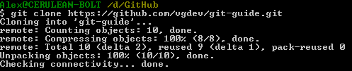
Cloning a Repository
https://github.com/vgdev/git-guide
$ git clone https://github.com/vgdev/git-guide

Slide 32
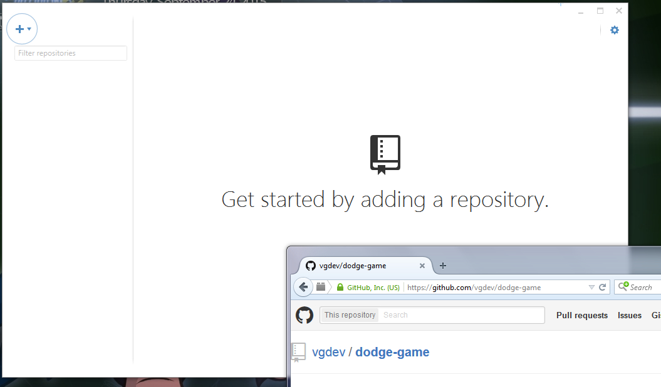
Cloning a Repository
https://github.com/vgdev/git-guide
Drag & Drop

Slide 33
Git in a nutshell
Remote Repository
push
Local Repository
commit
Staging Area
add
clone
&
pull
Working Directory

