Slide 1

Introduction to Machine Learning
Hands-on Online Training on Data Science
KNOWLEDGE AND SKILLS FORUM

Slide 2


What is Machine Learning
Machine learning is a type of artificial intelligence (AI) that enables computers to learn and make decisions without being explicitly programmed.
Using algorithms that iteratively learn from data, machine learning allows computers to find hidden insights without being explicitly programmed where to look.

Slide 3

Think And Learn Like A Baby

Slide 4
Machine Learning vs. Statistics vs. Computer Science
 | Machine Learning | Statistics | Computer Science
Objective | Focuses on learning from data to make predictions or decisions without being explicitly programmed. It prioritizes prediction accuracy and generalizability. | Aims to infer properties of an underlying distribution from a data sample. It emphasizes understanding and interpreting data and probabilistic models. | Focuses on the creation and application of algorithms to manipulate, store, and communicate digital information.
Methodologies | Typically uses complex models (like neural networks) and large amounts of data to train models for prediction. Utilizes both supervised and unsupervised learning methods. | Often employs simpler, more interpretable models. Focuses on hypothesis testing, experimental design, estimation, and mathematical analysis. | Involves algorithm design, data structures, computation theory, computer architecture, software development, and more.
Validation | Measures model performance through methods like cross-validation and seeks to improve generalization to unseen data. | Validates models using methods such as confidence intervals, p-values, and hypothesis tests to quantify uncertainty. | Uses formal methods for verifying correctness, analyzing computational complexity, and proving algorithmic bounds.
Primary Concern | Creating models that can learn from and make decisions or predictions based on data. | Drawing valid conclusions and quantifying uncertainty about observed data and underlying distributions. | Creating efficient algorithms and data structures to solve computational problems.

Slide 5
Types of Machine Learning
Three Types of Problems
Supervised
Unsupervised
Reinforcement
Notes:
Coin: that’s a quarter, that’s a dime
Unsupervised: That’s a cluster, that’s another cluster
Renforcement:

Slide 6
Supervised
Trained using labeled examples
Desired output is known
Methods include classification, regression, etc.
Uses patterns to predict the values of the label on additional unlabeled data
Algorithms:
Linear regression
Logistic regression
K-Nearest Neighbors (KNN)
Decision Trees and Random Forests
Support Vector Machines
Naive Bayes
Neural Networks

Slide 7
Unsupervised
Used against data that has no historical labels
Desired output is unknown
Goal is to explore the data and find some structure within the data
Algorithms
Anomaly detection
K-means clustering
Hierarchical clustering
DBSCAN
Principal Component Analysis (PCA)
Neural Networks
Notes:
Unsupervised learning works well on transactional data. For example, it can identify segments of customers with similar attributes who can then be treated similarly in marketing campaigns. Or it can find the main attributes that separate customer segments from each other. Popular techniques include self-organizing maps, nearest-neighbor mapping, k-means clustering and singular value decomposition. These algorithms are also used to segment text topics, recommend items and identify data outliers.

Slide 8
Reinforcement
Algorithm discovers through trial and error which actions yield the greatest rewards.
Three primary components:
the agent (the learner or decision maker),
the environment (everything the agent interacts with)
actions (what the agent can do).
Objective: the agent chooses actions that maximize the expected reward over a given amount of time.
Algorithms
Markov Decision Process
Q-Learning
Deep Q Network (DQN)
Notes:
The agent will reach the goal much faster by following a good policy. So the goal in reinforcement learning is to learn the best policy.

Slide 9
Why use it?
Machine learning based models can extract patterns from massive amounts of data which humans cannot do because
We cannot retain everything in memory or we cannot perform obvious/redundant computations for hours and days to come up with interesting patterns.
“Humans can typically create one or two good models in a week; machine learning can create thousands of models in a week” (Thomas H. Davenport)
Solve problems we simply could not before

Slide 10
Use Cases
Email spam filter
Recommendation systems
Self driving car
Finance
Image Recognition
Competitive machines

Slide 11
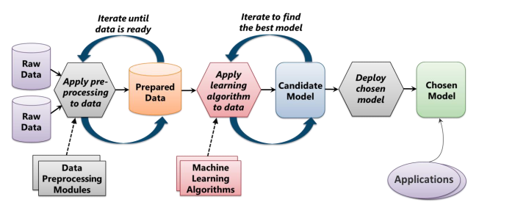
Typical Machine Learning Process
Source: INTRODUCING AZURE MACHINE LEARNING, pg. 5

Slide 12
To give Credit, or not to give credit
You are asked by your boss while working at Big Bank Inc. to develop an automated decision maker on whether to give a potential client credit or not.

Slide 13
What is the question?
What question are we trying to answer here? What problem are we looking to solve?
Notes:
In WWII, Allied bombers were key to strategic attacks, yet these lumbering giants were constantly shot down over enemy territory. The planes needed more armor, but armor is heavy. So extra plating could only go where the planes were being shot the most.
A man named Abraham Wald, a Jewish mathematician who’d been locked out of university positions and ultimately fled the persecution in his own home country of Hungary, was brought in to oversee the operation. He started with a simple diagram—the outline of a plane—and he marked bullet holes corresponding to where each returning bomber had been shot. The result was the anatomy of common plane damage. The wings, nose, and tail were blackened with bullet holes, so these were the spots that needed more armor.

Slide 14
Selecting Data
Feature
An individual measurable property of a phenomenon being observed
Best found through industry experts

Slide 15
Selecting Data
Feature Extraction
Feature extraction is a general term for methods of constructing combinations of the variables to get around certain problems while still describing the data with sufficient accuracy.
Analysis with a large number of variables generally requires a large amount of memory and computation.
Reducing the amount of resources required to describe a large set of data

Slide 16
Selecting Data
PCA (Principal ComponentAnalysis)
We have a huge list of different features
Many of them will measure related properties and so will be redundant
Summarize with less features

Slide 17
Preparing Data
Cleaning
Units
Missing Values
Metadata

Slide 18
Developing Model
What is the problem being solved?
What is the goal of the model?
Minimize error on the “training” data
Training data is the data used to train the model (all of it but the part we removed)
Notes:
Draw on board

Slide 19
Developing Model
Linear Model
Relationships are modeled using linear predictor functions whose unknown model parameters are estimated from the data
Complex way of saying the model draws a line between two categories (classification) or to estimate a value (regression)
Linear regression the most common form of linear model

Slide 20
Developing Model
Non-linear Model
A nonlinear model describes nonlinear relationships in experimental data
The parameters can take the form of an exponential, trigonometric, power, or any other nonlinear function
Notes:
Draw example on board, why ever use linear then?

Slide 21
DEVELOPING MODEL
​ | Overfitting​ | Bias​
Definition​ | Overfitting occurs when a model fits the data more than is warranted. It captures the noise along with the underlying pattern in the data.​ | Bias is error from erroneous assumptions in the learning algorithm. High bias can cause an algorithm to miss relevant relations between features and target outputs.​
Consequence​ | Overfitting leads to a smaller error on the training data set but a larger one on unseen data, reducing the model's ability to generalize.​ | High bias often leads to underfitting, where the model oversimplifies the data and doesn't capture its complexity.​
Example​ | Creating a very complex decision tree that classifies each training instance perfectly, but performs poorly on unseen data.​ | Fitting a quadratic dataset using a linear model – the model will consistently fail to capture the true relationship and make errors.​
Overfitting vs. Bias in Machine Learning

Slide 22
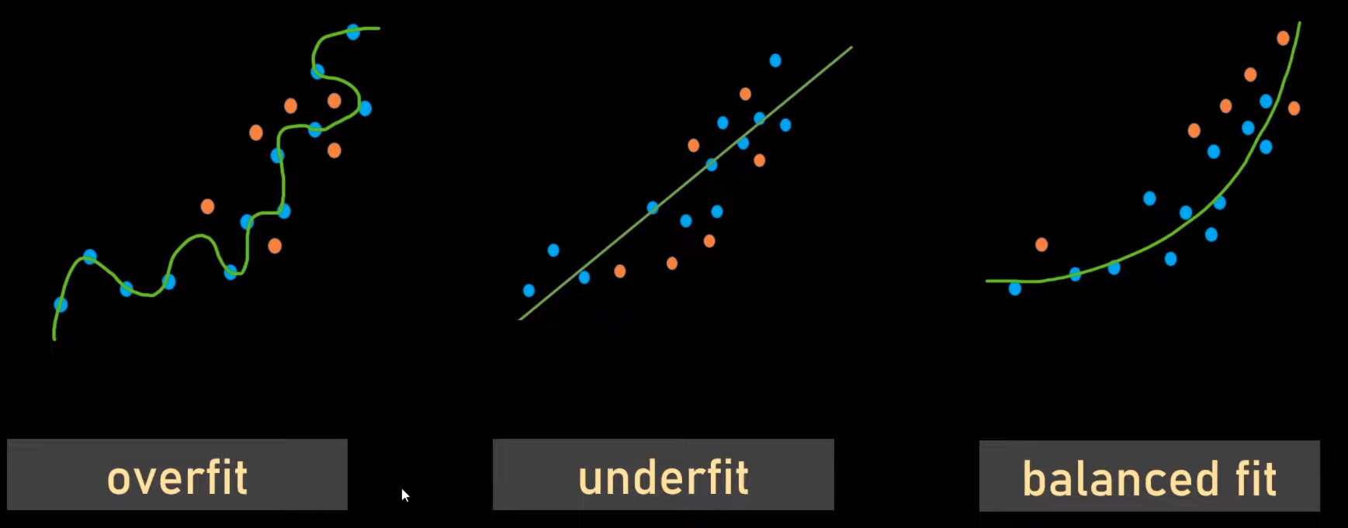
DEVELOPING MODEL
Overfitting vs. Bias in Machine Learning​

Slide 23
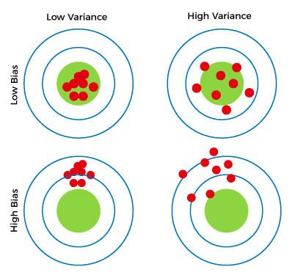
Combinations of Bias-Variance

Slide 24
Developing Model
Rule Addition
Minimize error on the “training” data
AND make sure that error in the “unseen” data is close to error in the “training” data
Notes:
Draw example on board

Slide 25
Developing a model
Keep it Simple
Go for simpler models over more complicated models
Generally, the fewer parameters that you have to tune the better
Cross-Validation
K-fold cross validation is a great way to estimate error on training data
Regularization
Can sometimes help penalize certain sources of overfitting.
LASSO
Forces the sum of the absolute value of coefficients to be less than a fixed value
Effectively choosing a simpler model
Notes:
More data

Slide 26
Developing a model
Data Snooping or Data Dredging
It's a form of bias that arises when you make decisions based on the same data you've used to train and test your model.
“If a data set has affected any step in the learning process, its ability to access the outcome has been compromised”
Experimenting
Reuse of the same data set to determine quality of model
Once a data set has been used to test the performance of a data set, it should be considered contaminated
Source: Learning From Data, pg. 173

Slide 27
Interpreting Results
Validation
Cross validation
Test set
Once the test set has been used, you must find new data!

