Slide 1



Slide 2

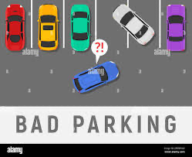
PROBLEM
With the heavy traffic and congestion in Riyadh, parking has become one of the major daily challenges
Many drivers park their cars incorrectly or randomly, such as stopping in non-designated areas or occupying two spaces instead of one
These behaviors not only cause inconvenience to other drivers but also waste valuable parking spaces and increase overall traffic issues.

Slide 3
MAWQIF
We developed a smart system based on Computer Vision.
The main challenge was a classification problem, where the system needs to distinguish between correct and incorrect parking
Our solution automatically detects violations such as:
Cars parked outside the lines
Cars occupying more than one space
It then sends an instant notification, reducing manual effort and improving the organization of parking spaces

Slide 4
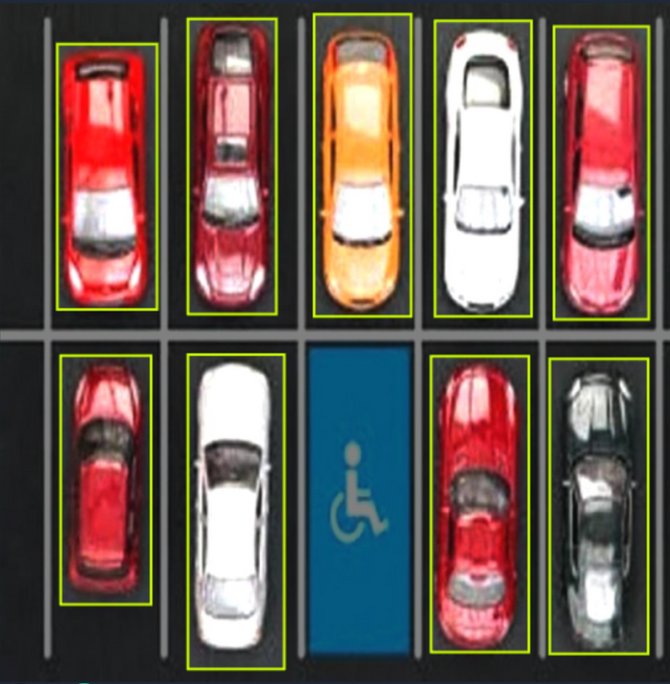
DATASET
VISION
we used the Parking Computer Vision Dataset from Roboflow with 689 images of parking areas.
The annotation process was done through Roboflow’s labeling tool, which allowed us to clearly define where each car is located in the scene.
We split the dataset into:
70% Training – to train the model.
20% Validation – to monitor and fine-tune performance.
10% Testing – to evaluate accuracy on unseen data.

Slide 5
THANK YOU

