Slide 1
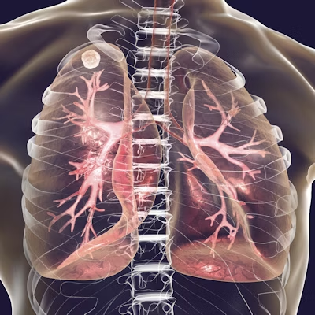
AI-Based Tuberculosis Classification in Chest X-rays
Team Members
20BD1A050E Beetoju Mallesh
20BD1A050P Ginuga Vikas Reddy
20BD1A0516 Meradakonda Arun Sai
20BD1A051A Muriki Akash

Slide 2
CONTENT
Introduction
Literature Survey
Existing System
Proposed System
Hardware Requirements
Software Requirements
Design
Uml Use-Case Diagram
Sequence Diagram
Class Diagram
Screenshots
Benefits
Future Scope
Conclusion
References

Slide 3
INTRODUCTION
Tuberculosis (TB) remains a global health challenge, with millions of people affected by this infectious disease each year. Early and accurate diagnosis is crucial for effective treatment and the prevention of its spread.
In recent years, artificial intelligence (AI) has emerged as a powerful tool in the field of medical imaging, revolutionizing the way we detect and diagnose diseases. One such application is the use of AI in classifying tuberculosis in chest X-rays.
This project represents a significant advancement in the field of medical imaging and healthcare. By harnessing the capabilities of AI and machine learning, we aim to develop a robust and reliable system for the early detection and classification of tuberculosis from chest X-ray images.

Slide 4
LITERATURE SURVEY
Deep learning for tuberculosis detection from chest X-rays: a comparative study"
Year of Publication: 2020 by Computers in Biology and Medicine, 104103 (2020)
Comparative analysis of deep learning models for TB detection in chest X-rays.
Evaluation of various model architectures to identify the most effective approach.
The study titled "Comparative analysis of deep learning models for TB detection in chest X-rays" conducted a comprehensive examination of different deep learning models with the primary objective of improving tuberculosis (TB) detection accuracy in chest X-ray images.
This study played a vital role in advancing the field of automated TB detection from chest X-rays by conducting a rigorous comparative analysis of deep learning models.
Ref: https://www.elsevier.com/journals/computers-in-biology-and-medicine/0010-4825/guide-for-authors

Slide 5
2. "Tuberculosis detection on chest X-rays using CNN and traditional machine learning classifiers"
Year of Publication: 2019 by Proceedings of the 2019 IEEE/RSJ International Conference on Intelligent Robots and Systems (IROS), 5149-5154 (2019)
LITERATURE SURVEY(contd..)
This study explores the combination of convolutional neural networks (CNNs) with traditional machine learning classifiers for tuberculosis detection, highlighting the potential benefits of hybrid approaches.
CNNs are typically used for feature extraction, capturing patterns, and representations in the input images.
CNNs are trained on the prepared datasets to extract relevant features from the chest X-ray images.
The features extracted by the CNNs are then used as input for the traditional machine learning classifiers.
Ref:https://www.ieee-ras.org/about-ras/ras-calendar/event/1141-iros-2019-international-conference-on-intelligent-robots-and-systems

Slide 6
LITERATURE SURVEY (contd..)
3. "A mobile-based deep learning model for automated detection of tuberculosis using chest X-ray images"
Year of Publication: 2019 by Computers in Biology and Medicine, 104, 104153 (2019)
These studies represent various aspects of AI-based tuberculosis classification in chest X-rays, from model architectures to ensemble methods and explainability, showcasing the ongoing advancements in this field.
Researchers investigate the effectiveness of different architectural choices, such as the depth and width of neural networks, to determine which configurations yield the best results.
. These studies delve into different aspects of the field, from model architectures to ensemble methods and explainability, showcasing the continuous advancements and growing complexity in the pursuit of accurate TB diagnosis using artificial intelligence.
Ref:https://www.sciencedirect.com/science/article/pii/S2667102623000438

Slide 7
LITERATURE SURVEY (contd..)
4. "Tuberculosis detection in chest radiographs using a deep convolutional neural network"
Year of Publication: 2017 by Neurocomputing, 267, 557-563 (2017)
Deep CNNs are a class of neural networks particularly well-suited for image analysis tasks. They are known for their ability to automatically learn and extract hierarchical features from images.
In this research, deep CNNs are employed as the primary tool for automating TB detection from chest X-ray images.
The deep CNNs are trained to recognize subtle patterns and abnormalities indicative of TB infection, such as infiltrates, cavities, and nodules, directly from the X-ray images.
Performance metrics such as accuracy, sensitivity (true positive rate), specificity (true negative rate), and area under the receiver operating characteristic (ROC-AUC) curve are utilized to quantify the model's effectiveness in TB detection.
Ref:https://sciendo.com/article/10.21307/ijssis-2017-773

Slide 8
EXISTING SYSTEM
Manual Evaluation: Currently, radiologists and medical practitioners visually inspect chest X-ray images for signs of tuberculosis, such as abnormal lung patterns, infiltrates, or nodules. This process involves a subjective evaluation, which can be influenced by the experience and expertise of the healthcare provider.
Time-Consuming: Manual evaluation of chest X-rays is a time-consuming process, which can result in delays in diagnosing and initiating treatment for TB patients. Timely diagnosis is crucial to prevent the spread of the disease.
Training Requirements: Training radiologists and healthcare professionals to accurately interpret chest X-rays for TB detection is a resource-intensive and ongoing process. It requires continuous education and skill development.
False Positives and Negatives: Human-based interpretations may lead to false positives (incorrectly diagnosing TB when it's not present) or false negatives (failing to detect TB when it is present), which can have significant clinical and public health implications.

Slide 9
PROPOSED SYSTEM
Image Processing and Preprocessing: The proposed system will begin with the acquisition and preprocessing of chest X-ray images. This step ensures that the images are of high quality and suitable for AI analysis.
Deep Learning Algorithms: The core of the system will involve state-of-the-art deep learning algorithms, such as convolutional neural networks (CNNs). These neural networks will be trained on a vast dataset of labeled chest X-ray images, including both TB-positive and TB-negative cases.
Feature Extraction: The deep learning model will automatically extract relevant features from the chest X-ray images. These features may include patterns, textures, and abnormalities associated with TB.
Classification: The AI model will be designed to classify chest X-ray images into two categories: TB-positive or TB-negative. It will make predictions based on the extracted features and learned patterns, providing a binary classification result.

Slide 10

HARDWARE REQUIREMENTS
System: i5 processor
Hard disk: 500GB
RAM: 4GB

Slide 11





SOFTWARE REQUIREMENTS
Pycharm 2023.1.4
Python 3.9.0
Numpy 1.24.3
TensorFlow 23.2.1
MatPlotLib 3.8.0

Slide 12
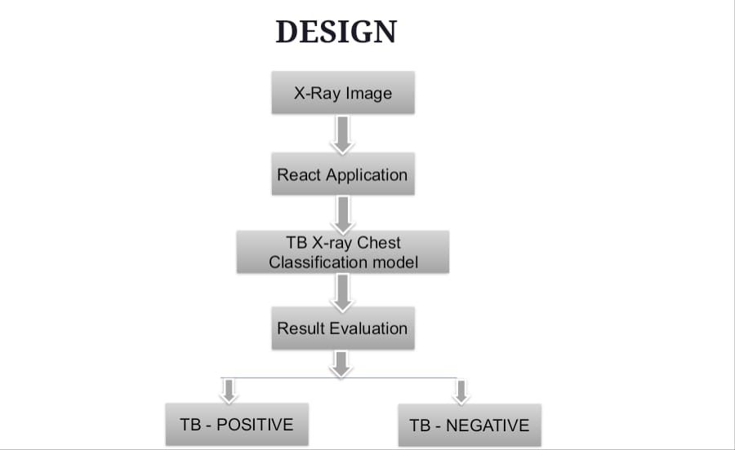

Slide 13
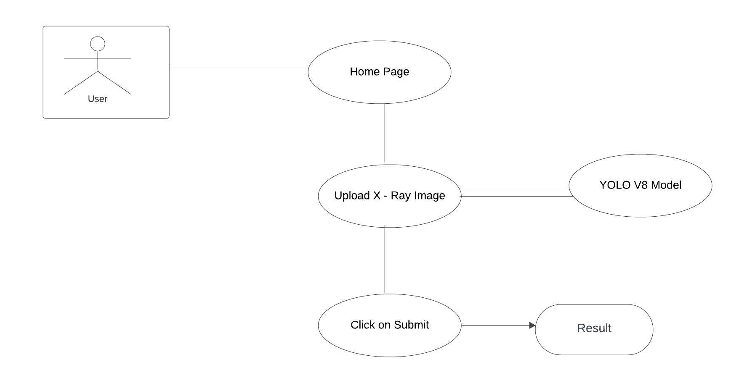
UML USE-CASE DIAGRAM

Slide 14
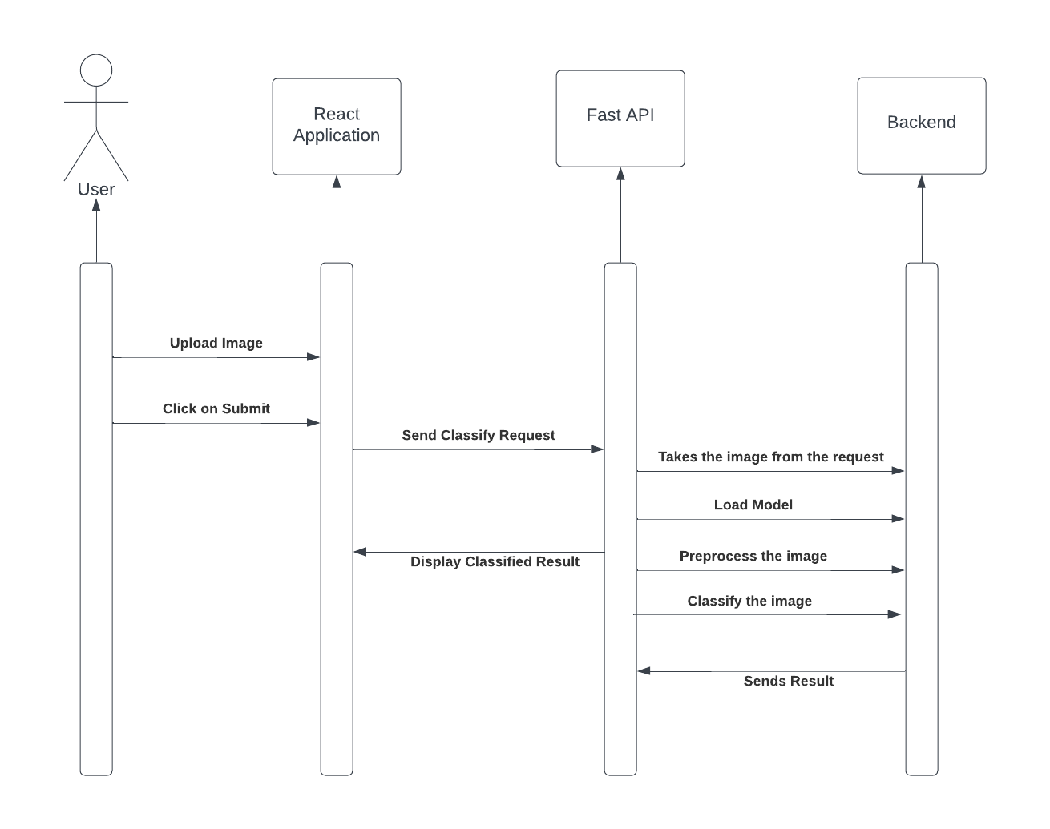
SEQUENCE DIAGRAM

Slide 15
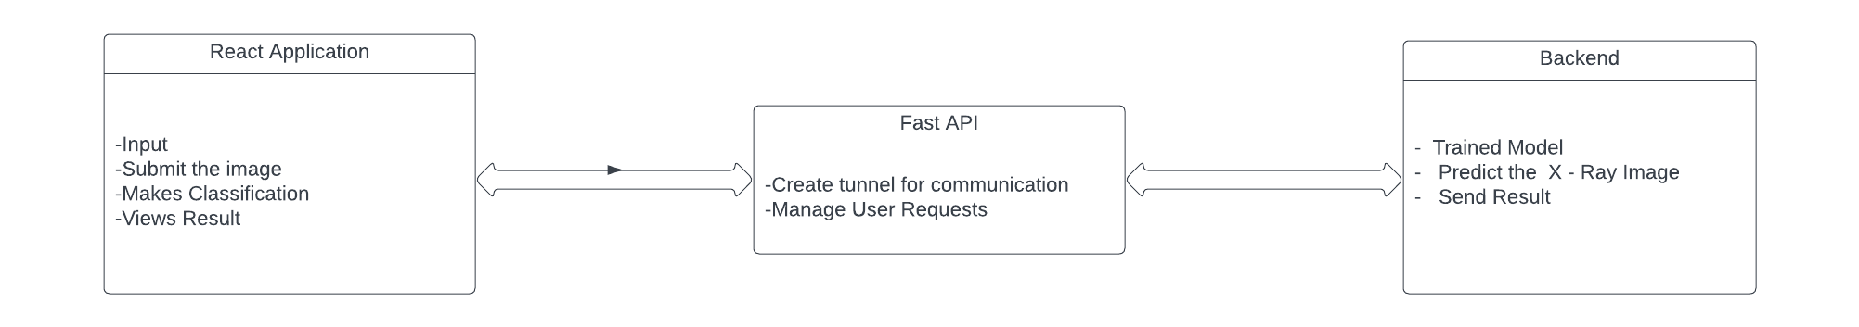
CLASS DIAGRAM

Slide 16

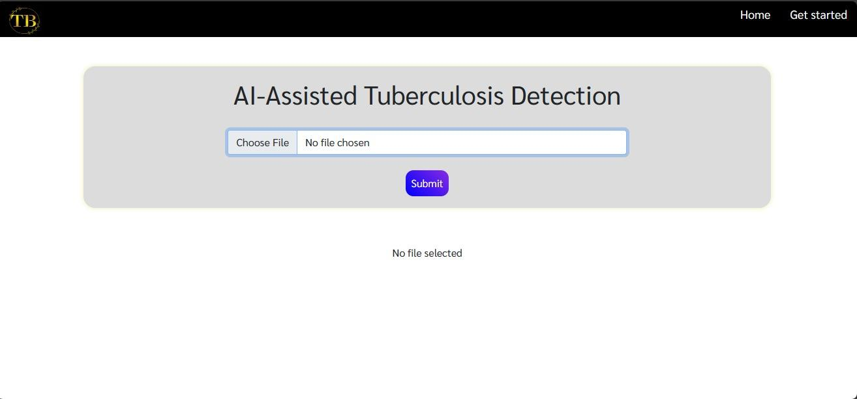
SCREENSHOTS

Slide 17
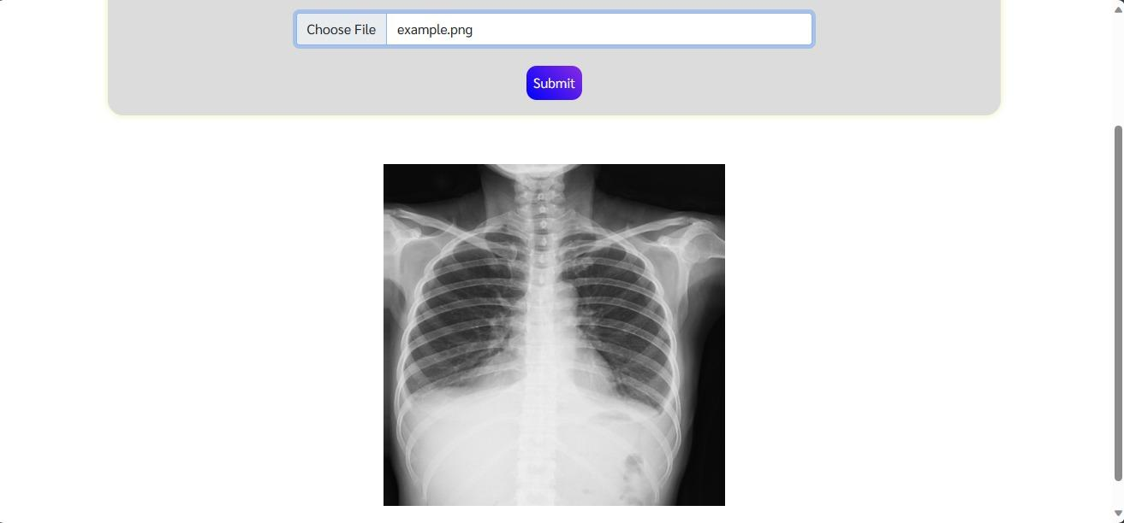
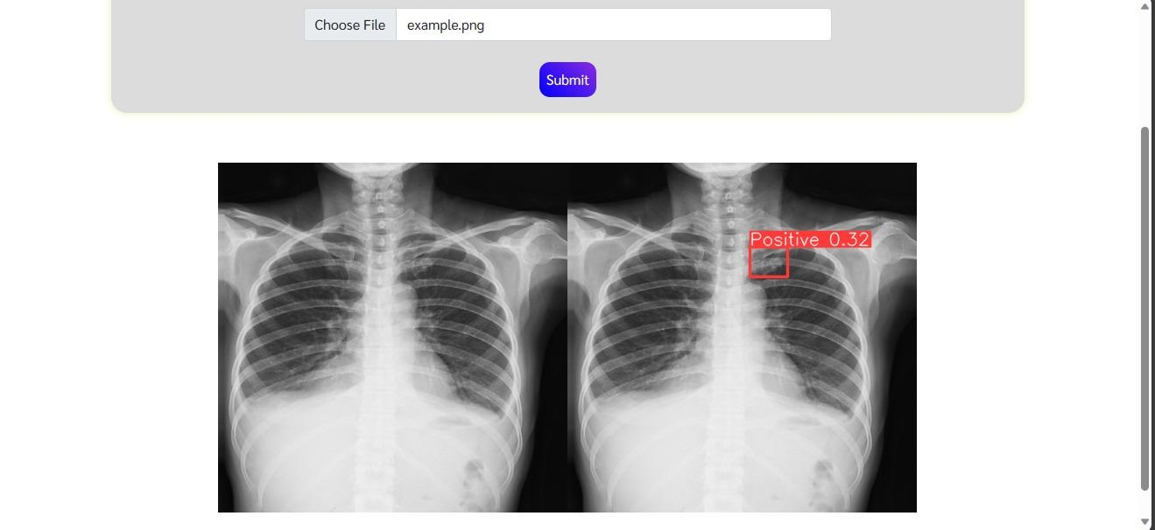
SCREENSHOTS

Slide 18
BENEFITS
Improved Diagnostic Accuracy: AI-based systems can significantly enhance the accuracy of TB diagnosis in chest X-rays, reducing the rate of false positives and false negatives. This ensures that patients receive the appropriate treatment promptly, leading to better health outcomes.
Early Detection: The AI system can detect TB at an earlier stage of infection, allowing for earlier intervention. Early detection is crucial for preventing the spread of the disease to others and minimizing the severity of TB-related complications.
Reduced Workload for Healthcare Professionals: By automating the image analysis process, the workload on radiologists and healthcare professionals is reduced. This allows them to focus on more complex cases, improving overall healthcare efficiency.
Faster Diagnosis: AI can provide rapid and real-time analysis of chest X-ray images, accelerating the diagnostic process. Faster diagnosis means quicker initiation of treatment, which is vital for controlling TB transmission.
Increased Accessibility: AI-based systems can be deployed in regions with limited access to healthcare professionals, extending TB diagnosis capabilities to underserved populations.

Slide 19
CONCLUSION
AI algorithms improve accuracy in Tuberculosis classification from chest X-rays.
The project enables swift identification of Tuberculosis cases through real-time analysis, facilitating prompt intervention and treatment.
Integration into existing healthcare systems ensures efficient workflows and contributes to enhanced patient management.
AI models are designed to perform robustly across diverse demographics, imaging techniques, and geographic regions.
The project emphasizes responsible and ethical implementation, addressing patient privacy and adhering to established guidelines for trust and acceptance in the medical community.

Slide 20
FUTURE SCOPE
Enhanced Accuracy: Future developments could focus on refining AI algorithms to achieve higher accuracy in Tuberculosis classification from chest X-rays, reducing false positives and negatives for more reliable diagnoses.
Real-Time Diagnosis: Advancements may aim to enable real-time analysis of chest X-rays, providing quicker results and facilitating prompt intervention and treatment for patients with Tuberculosis.
Integration with Healthcare Systems: The integration of AI-based Tuberculosis classification systems with existing healthcare infrastructure could streamline processes, allowing seamless incorporation into clinical workflows for improved patient management.
Diverse Dataset Handling: Research efforts might concentrate on developing AI models capable of effectively handling diverse datasets, considering variations in demographics, imaging techniques, and geographical factors to ensure robust performance across different populations.
Ethical Considerations and Patient Privacy: As AI technologies advance, there will be an increased focus on addressing ethical concerns and ensuring patient privacy.

Slide 21
REFERENCES
"Deep Learning Approaches for Tuberculosis Detection in Chest X-rays: A Comprehensive Review" (2023)
"A Comparative Study of Convolutional Neural Networks for Tuberculosis Classification in Chest Radiographs" (2022)
"AI-Based Tuberculosis Screening: Recent Advances and Future Prospects" (2021)
"Transfer Learning for Automated Tuberculosis Detection in Chest X-rays" (2020)
"Implementing AI-Based Tuberculosis Diagnosis in Clinical Practice: A Case Study" (2019)
"AI for Global Health: Enhancing Tuberculosis Detection in Resource-Constrained Settings" (2018)
"Ethical Considerations in AI-Based Tuberculosis Diagnosis from Chest X-rays" (2017)
"Real-World Deployment of AI-Based Tuberculosis Classification: Challenges and Insights" (2016)
"Evaluation Metrics for AI-Based Tuberculosis Detection in Chest X-rays: A Comparative Analysis" (2015)

Slide 22
REFERENCES (contd..)
10. "Framework for the Integration of AI-Based Tuberculosis Diagnosis into Public Health Systems" (2014)
11. "Automated Tuberculosis Detection Using Deep Learning and Transfer Learning Approaches" (2013)
12. "A Survey of Machine Learning and Deep Learning Applications for Tuberculosis Detection in Medical Imaging" (2012)
13. "Computer-Aided Detection of Pulmonary Tuberculosis in Chest Radiographs: A Review" (2011)
14. "Performance Evaluation of Convolutional Neural Networks for Tuberculosis Screening in Chest Radiographs" (2010)
15. "Machine Learning Approaches for Tuberculosis Detection in Chest Radiographs: A Comprehensive Study" (2009)

Slide 23


