Slide 1

Chen, Yizhou, et al. "Improving Smart Contract Security with Contrastive Learning-based Vulnerability Detection." Proceedings of the IEEE/ACM 46th International Conference on Software Engineering. 2024.
汇报人：罗振坤

Slide 2

Background and significance of the thesis
论文背景与意义
论文解决方法
The paper introduces Clear, a Contrastive Learning Enhanced Automated Recognition
approach for SCVs. Clear captures fine-grained correlation information among contracts using a contrastive learning model, generating correlation labels to guide training. It combines this correlation with semantic contract information to improve SCV detection.
Smart contract vulnerabilities (SCVs) are a major threat to blockchain transaction security. Existing deep learning methods for mitigating this threat treat each contract independently, ignoring correlations between contracts. This oversight results in suboptimal performance.

Slide 3
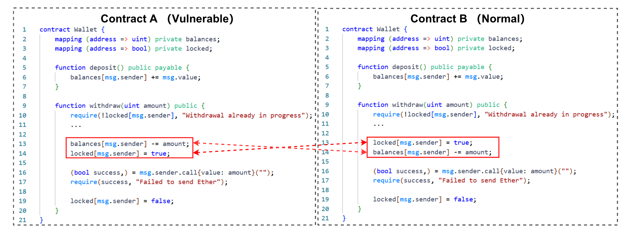
Background and significance of the thesis-Example

Slide 4
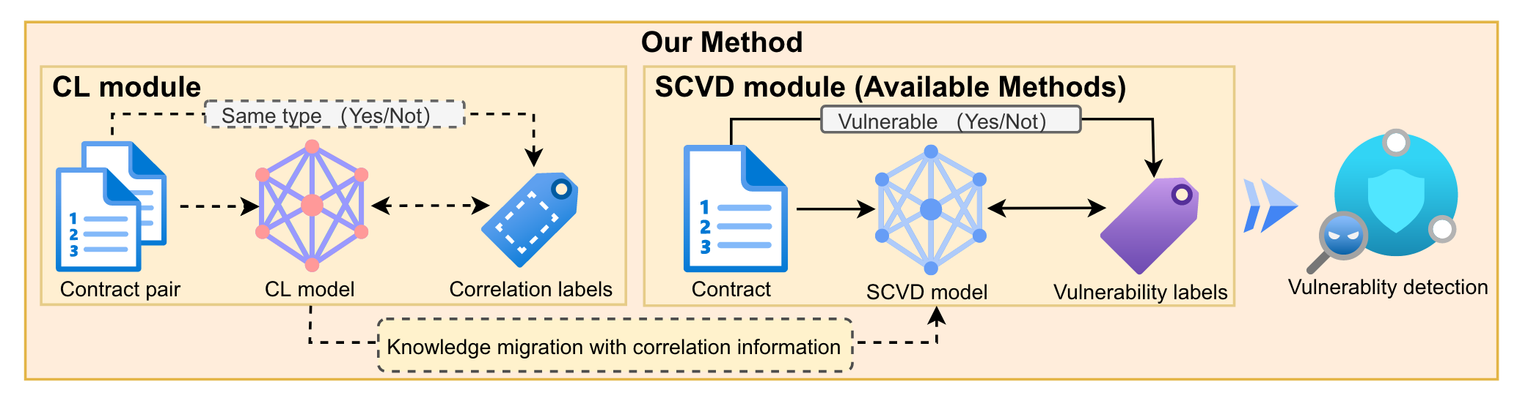
METHODOLOGY
Data Sampling: We sample pairs of contracts from the dataset and assign a correlation label to each pair. This label indicates how the contracts are related and guides the CL model's training.
Contrastive Learning: We develop a CL model that includes a module for enhancing context and a Transformer-based module for learning features. The model uses contrastive loss to learn the relationships between contract pairs based on the provided labels.
Vulnerability Detection: We fine-tune the Transformer model from the previous step and combine its outputs with the CL model's results. A fully connected neural network then uses this combined information to detect vulnerabilities in smart contracts.

Slide 5
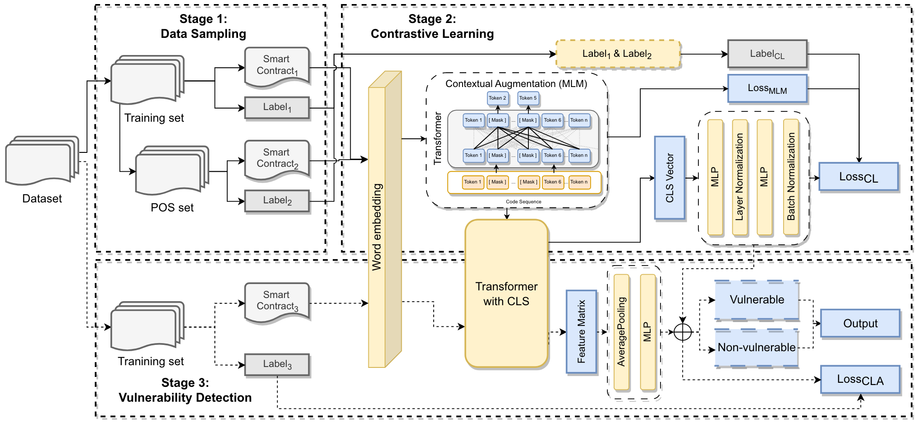
METHODOLOGY

Slide 6
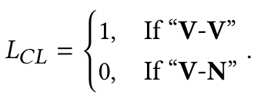
METHODOLOGY-Data Sampling
Our strategy focuses on three types of contract pair relationships: "V-V" (Vulnerable-Vulnerable), "V-N" (Vulnerable-Nonvulnerable), and "N-N" (Nonvulnerable-Nonvulnerable). We prioritize "V-V" and "V-N" relationships because they help identify common vulnerabilities and differences, which are key for SCV detection. "N-N" relationships are less useful for this purpose.

Slide 7
METHODOLOGY-Contrastive Learning
This section is divided into two main parts:
1. Contextual Augmentation
Masked Language Model (MLM)
2. Feature Learning
Transformer Model. The output corresponding to the [CLS] token (CLS vector) captures the global semantic information of the contract.

Slide 8
METHODOLOGY-Shortcomings
1. While avoiding "N-N" relationships reduces some bias, there might still be inherent biases in the sampling strategy or dataset, which could affect the model's generalization to nonvulnerable contracts.
2. The model learns existing patterns from the training data, which may not generalize well to different types of smart contracts, requiring retraining or fine-tuning for different contexts.

