Slide 1
23CSE461-Full Stack Frameworks
AI Chatbot for College Students
Case study Review
Professor – T Senthil Kumar ( CSE)

Slide 2
Team Members
Name | Roll Number | Personal Email | Official Email | Phone Number
Bharath Senthilkumar | CB.SC.U4CSE23013 | bharath17082005@gmail.com | cb.sc.u4cse23013@cb.students.amrita.edu | 8778788665
Prajith Maharaja | CB.SC.U4CSE23135 | notprajith@gmail.com | cb.sc.u4cse23135@cb.students.amrita.edu | 9080960556
Sandheep | CB.SC.U4CSE23144 |  | cb.sc.u4cse23144@cb.students.amrita.edu | 8903993757

Slide 3
About the product
An intelligent, full-stack AI chatbot designed for exam preparation (UPSC, GATE, CAT, NEET, JEE).
Uses a Socratic pedagogical strategy to guide students toward answers rather than providing direct solutions.
Features a dedicated "Exam Mode" that simulates strict invigilation and exam-specific constraints.

Slide 4
Products Compared
vs. Standard Chatbots (e.g., ChatGPT): Unlike generic bots, this system accesses specific Previous Year Question (PYQ) databases and avoids hallucinations by using RAG (Retrieval-Augmented Generation).
vs. Traditional LMS: Moves beyond static content delivery to provide dynamic, personalized study scheduling and active recall enforcement.

Slide 5
Features of the product
Exam Mode: Toggles the AI persona to be strict and concise, focusing on high-yield keywords.
Smart Scheduling: Automated study planners with reminders for weak topics.
PYQ Integration: Retrieval of specific past paper questions for practice.

Slide 6
Reports
Generates Student Progress Reports highlighting strengths and weak areas based on chat interactions.
Provides Topic Coverage Analytics to ensure the student has completed the syllabus.

Slide 7
Functional and Non functional Requirements of the project
Functional: The system must accurately retrieve past questions, enforce the Socratic dialogue method, and manage user schedules.
Non-Functional: Low-latency responses (real-time chat), data privacy (secure student records), and scalability (handling multiple exam databases).

Slide 8
Why the product is important for users?
The Problem: Students preparing for competitive exams (UPSC, GATE, NEET) often struggle with overwhelming syllabi and inefficient time management without personal guidance.
The Solution: We are building an AI-driven "Smart Tutor" that uses the Socratic method (teaching by asking) to ensure deep understanding rather than just rote memorization.
Key Innovation: Unlike static apps, this system offers a strict "Exam Mode" and automated, adaptive scheduling to simulate real exam environments.
User Impact: It acts as a 24/7 mentor that transforms passive reading into active recall, keeping students disciplined and exam-ready.

Slide 9
AI Role in the product
Intelligent Pedagogical Agent (The Socratic Brain)
The AI does not just retrieve data; it analyzes the student's query to understand intent. It uses Prompt Engineering to enforce the "Socratic Method"—generating guiding questions to lead the student to the answer instead of providing it directly.
Context-Aware Retrieval (RAG Pipeline)
AI uses Vector Embeddings to semantically index thousands of Previous Year Question (PYQ) papers. This allows the system to fetch specific questions (e.g., "Find a hard Thermodynamics question from GATE 2022") rather than generic internet answers.
Adaptive Scheduling & Personalization
The AI tracks user performance to identify "weak zones.“ It uses Spaced Repetition Algorithms to dynamically alter the study schedule, reminding students to review specific topics right before they are likely to forget them.
Dynamic Persona Simulation
The AI manages "State" to switch personalities instantly. It transitions from a Supportive Mentor (verbose, encouraging) in Study Mode to a Strict Invigilator (concise, time-bound) in Exam Mode.

Slide 10
Algorithms and Technology Stack
Retrieval-Augmented Generation (RAG):
Scenario: Used when a student asks a specific question from a past exam (e.g., "Show me a hard questions on Thermodynamics from GATE 2021").
Purpose: To fetch ground-truth data from uploaded PDF question papers instead of relying on the AI's general training, preventing "hallucinations."
Aspect: Combines Vector Search with LLMs.
Transformer Architecture (LLM):
Scenario: Used for the "Socratic Method" dialogue and "Exam Mode" persona switching.
Purpose: It understands the context and intent of the user. It decides whether to be a supportive tutor (Study Mode) or a strict invigilator (Exam Mode).
Aspect: Deep Learning (DL) / Natural Language Processing (NLP).

Slide 11
Algorithms and Technology Stack
Cosine Similarity & K-Nearest Neighbors (KNN):
Scenario: Searching the database for relevant study materials.
Purpose: Converts the student's query into a mathematical vector and finds the closest matching content from the syllabus or previous year papers.
Aspect: Vector Embeddings / Semantic Search.
Spaced Repetition Algorithm (SM-2 Variant):
Scenario: Adaptive Scheduling.
Purpose: Mathematically calculates the "forgetting curve" for each student. If a student struggles with a topic, the algorithm schedules a review sooner (e.g., 1 day); if they excel, it pushes the review later (e.g., 7 days).
Aspect: Adaptive Learning Heuristics

Slide 12
Building Data
Data Sourcing (The Raw Material):
Official Repositories: Aggregating official PDF versions of Previous Year Question (PYQ) papers and syllabus documents from official bodies (e.g., IIT-KGP for GATE, NTA for NEET).
Open Educational Resources (OER): Integrating standard verified reference materials (NCERTs, Standard Textbooks) for concept explanation.
Data Ingestion Pipeline (Processing):
OCR & Extraction: Using Python libraries (like PyPDF2 or LlamaParse) to convert scanned exam papers into machine-readable text.
Semantic Chunking: Breaking down massive textbooks and question banks into smaller, manageable "chunks" (e.g., individual questions or single concepts) to ensure precise retrieval.

Slide 13
List of Companies working on the same problem
Embibe (Bengaluru, India)
URL: embibe.com
Relevance: A direct competitor that uses deep data analytics and AI to track student behavior and predict exam scores for JEE/NEET.
Khan Academy / Khanmigo (USA & India)
URL: khanacademy.org
Relevance: Their AI tutor, "Khanmigo," is the closest benchmark for the Socratic Method (teaching by asking), though it lacks specific Indian exam contexts.

Slide 14
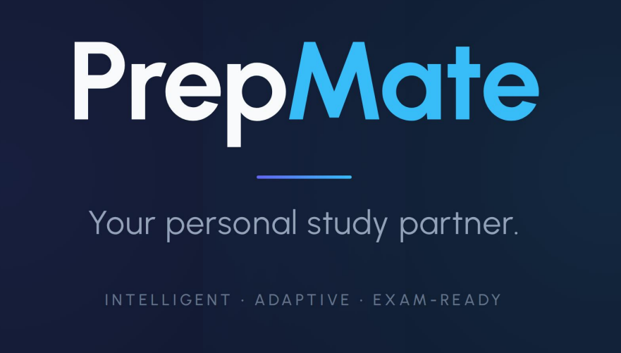
Product Name, Slogan, Logo

Slide 15
Market Stratergy and Overview
Target Users:
Competitive Exam Aspirants: Students preparing for high-stakes Indian exams (UPSC, GATE, JEE, NEET, CAT).
Self-Learners: Individuals who cannot afford expensive coaching institutes and need a structured, disciplined study plan.
Repeaters: Students re-attempting exams who need to identify and fix specific weak areas from previous attempts.
Problem Statement:
Passive Learning: Most students passively read textbooks, which leads to poor retention. They lack the "active recall" enforced by a teacher.
Strategy Gap: Students have access to content (books/videos) but lack a personalized strategy and daily schedule to manage the vast syllabus.
Lack of Feedback: Without constant testing, students don't realize they are weak in a topic until the actual exam day.
Client / Industry Targeted:
Primary Industry: The EdTech & E-Learning Sector (specifically the Test Prep market, valued at over $10 Billion in India).
B2C Model: Direct-to-student subscription service (SaaS) for personalized tutoring.
B2B Opportunities: Partnership with Coaching Institutes and Schools to provide the chatbot as an "AI Teaching Assistant" for after-hours support.

Slide 16
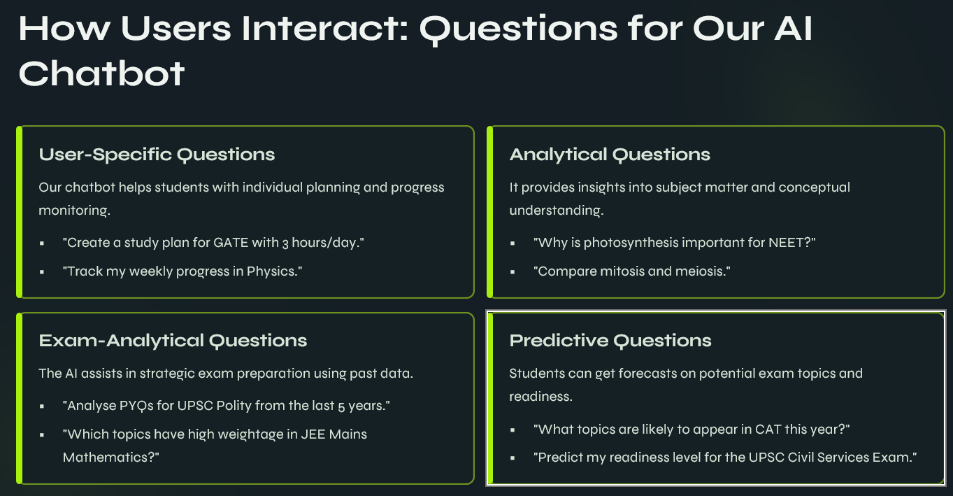
Why the product is important for users?

Slide 17
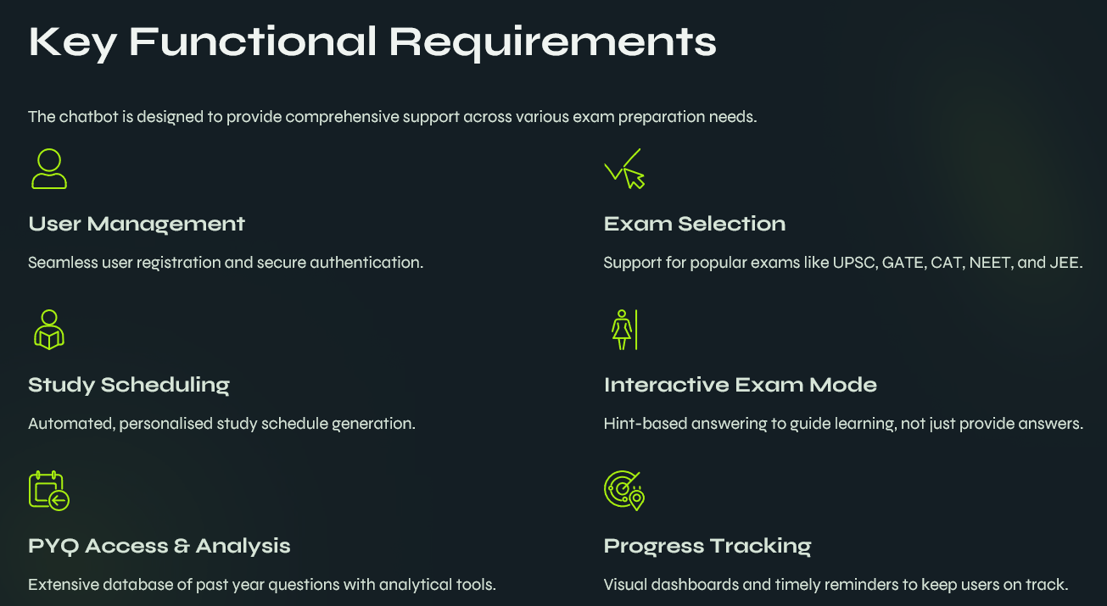

Slide 18
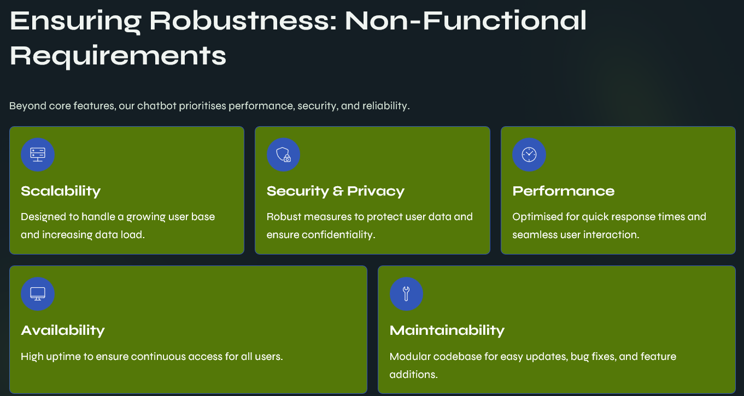

Slide 19
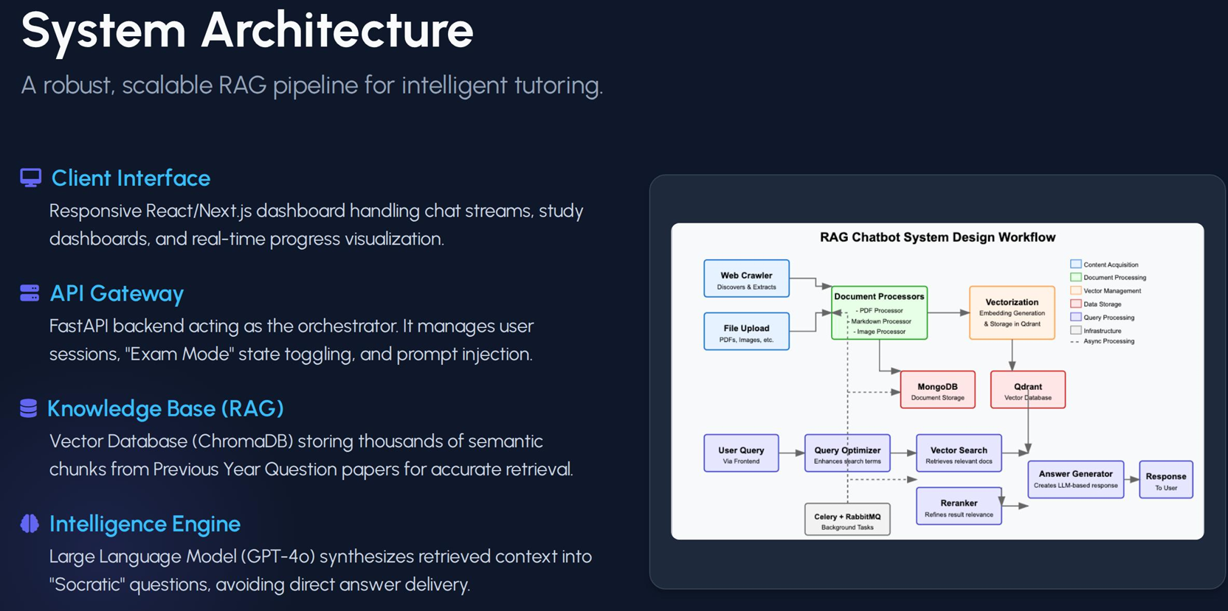

Slide 20
List of similar products in the market
1. Embibe
URL: embibe.com
Core Features:
Score Prediction: Uses AI to predict the exact percentile a student will get based on their current performance.
Behavioral Tracking: Tracks how much time a student wastes on a question or if they are "guessing" answers.
Video Content: A vast library of 3D animated videos for science concepts.
Number of Users: 500+ Million attempts recorded (approx. 10M+ registered users).
Limitations:
Complexity: The dashboard is extremely analytics-heavy, which can overwhelm average students.
Passive Learning: While it tracks behavior, it does not use the Socratic Method (teaching by questioning). It primarily delivers content and tests rather than acting as a conversational tutor.

Slide 21
List of similar products in the market
2. Khan Academy (Khanmigo)
URL: khanacademy.org/khanmigo
Core Features:
True Socratic Method: The AI is strictly instructed not to give answers but to ask guiding questions (exactly like your PrepMate concept).
Writing Coach: Helps students write essays by giving feedback on structure rather than writing it for them.
Number of Users: 150+ Million learners worldwide (Khanmigo is a newer subset).
Limitations:
US-Centric: The content and exam logic are tailored for SAT/AP exams, not Indian competitive exams like JEE/UPSC/GATE.
No "Exam Mode": It lacks the strict, time-bound "Invigilator Persona" required for high-stakes Indian entrance exams.

Slide 22

My product features
The Problem: Students preparing for competitive exams (UPSC, GATE, NEET) often struggle with overwhelming syllabi and inefficient time management without personal guidance.
The Solution: We are building an AI-driven "Smart Tutor" that uses the Socratic method (teaching by asking) to ensure deep understanding rather than just rote memorization.
Key Innovation: Unlike static apps, this system offers a strict "Exam Mode" and automated, adaptive scheduling to simulate real exam environments.
User Impact: It acts as a 24/7 mentor that transforms passive reading into active recall, keeping students disciplined and exam-ready.

Slide 23
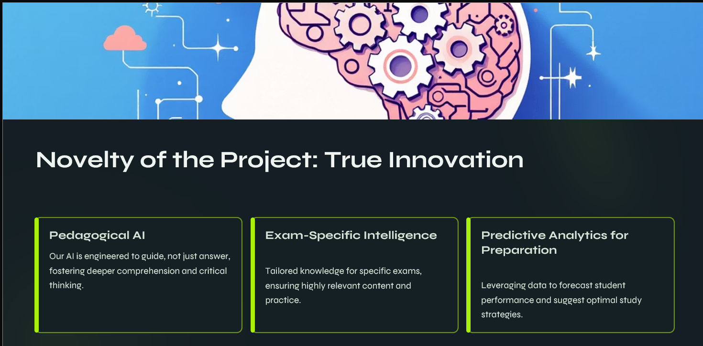

Slide 24
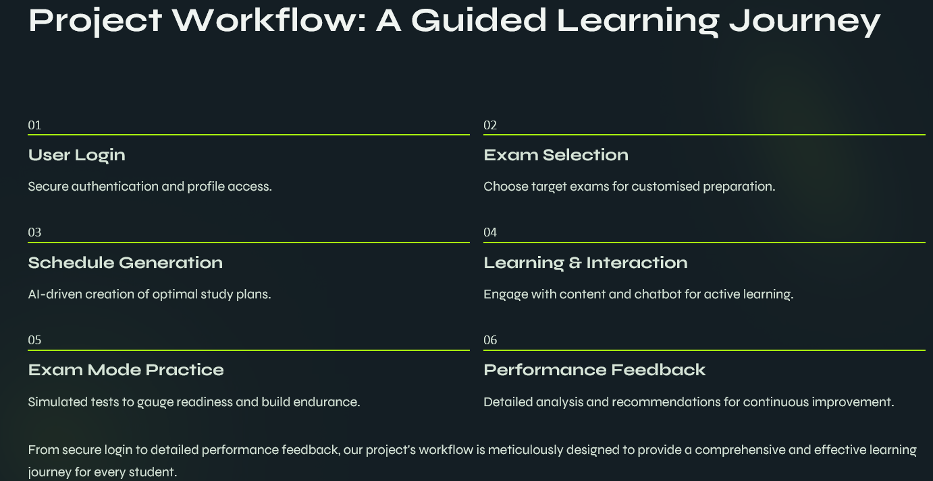

Slide 25
Modules, Reports, Forms & Tables
Modules with Explanation
User Management – Handles registration, login, profiles, and exam preferences
AI Chatbot Module – Provides Socratic learning and doubt-solving using LLMs
Exam Mode Module – Simulates real exam conditions with timed responses
PYQ Retrieval Module – Fetches relevant previous year questions using RAG
Analytics & Reports – Tracks performance, strengths, and weak areas
Admin Module – Manages users, content, and system monitoring
Reports with Purpose
Student Progress Report – Measures learning improvement
Topic Coverage Report – Ensures syllabus completion
Exam Performance Report – Evaluates exam readiness
PYQ Practice Report – Tracks accuracy on past questions
System Usage Report – Monitors platform engagement
Forms
User Management – Registration, Login, Profile Update
Chatbot – Query Input, Feedback
Exam Mode – Exam Setup, Answer Submission
PYQ Module – Question Filter Form
Reports – Report Generation & Download
Admin – User & Content Management
Database Tables
Users, Roles – User Management
Chat History – Chatbot Module
PYQ Database, Vector Embeddings – PYQ Retrieval
Exam Sessions, Exam Responses – Exam Mode
Performance Metrics, Reports – Analytics
AuditLogs – Admin Module

Slide 26
Expected Output
End-to-End System Workflow
Login & Dashboard
Student logs in and selects target exam
Dashboard shows study plan, weak topics, and progress summary
Study Mode – Socratic Chat
Interactive chatbot asks guiding questions
Encourages active recall instead of direct answers
PYQ Retrieval
Filter PYQs by exam, year, subject, and difficulty
Questions fetched using RAG to avoid hallucinations
Exam Mode Simulation
Timer-enabled, strict invigilator persona
Concise responses with exam-like constraints
Reports & Analytics
Visual progress reports and topic coverage
AI-updated study schedule using spaced repetition

Slide 27
If your product need to change to Mobile stack what will be changes required?
Frontend
Replace Angular web UI with Flutter / React Native
Optimize chat UI, exam timer, and dashboards for small screens
Add offline access for saved PYQs and study plans
Backend
Existing Node.js + Express APIs remain unchanged
Add API optimization for low bandwidth and mobile latency
AI & Data Layer
AI models (LLM, RAG, scheduling algorithms) stay on cloud
Mobile app communicates securely via REST / GraphQL APIs
Mobile-Specific Features
Push notifications for study reminders and exam alerts
Device-based authentication (biometrics, OTP)
Background sync for analytics and reports
Deployment
Publish apps on Google Play Store / Apple App Store
Use Firebase / AWS SNS for notifications

Slide 28
If your product can become a devops solutions how it can be done?
Containerization
Package frontend, backend, and AI services using Docker
Ensures consistent deployment across environments
CI/CD Pipeline
Automate build, test, and deployment using GitHub Actions / Jenkins
Enables faster feature updates and AI model versioning
Microservices Architecture
Separate services for chatbot, RAG retrieval, scheduling, and analytics
Improves scalability and fault isolation
Cloud Infrastructure
Deploy on AWS / Azure / GCP using auto-scaling
Use managed databases and storage for PYQ datasets
Monitoring & Logging
Implement Prometheus, Grafana, ELK stack
Track system health, latency, and user activity

Slide 29
What is your proposed solution for integrating this product to cloud?
Cloud Platform
Deploy application on AWS / Azure / GCP
Use cloud-native services for scalability and reliability
Application Deployment
Host frontend on Cloud Storage + CDN
Deploy backend APIs and AI services using Docker & Kubernetes
AI & Data Services
Run LLM, RAG pipeline, and scheduling algorithms on cloud compute
Store PYQs, embeddings, and chat history in managed databases
Security & Access
Use IAM, HTTPS, and encrypted storage for data protection
Role-based access for students and admins
Scalability & Availability
Auto-scaling to handle peak exam-time traffic
Load balancers ensure high availability

Slide 30
List of White papers/research papers published related to this product
Selected Research Papers (Journal / Conference / ArXiv)
How to Build an Adaptive AI Tutor using Knowledge Graph-Enhanced RAG — adaptive ITS with RAG + LLM foundations relevant to educational chatbots.
Battling Botpoop using GenAI for Higher Education — RAG chatbot deployed in real learning environment, focusing on reducing low-quality output.
Enhancing Critical Thinking in Education by means of a Socratic Chatbot — Socratic questioning with LLMs to promote reflection and active learning.
EduChat: A Large-Scale LLM-based Chatbot System for Intelligent Education — educational chatbot integrating LLM responses for personalized support.
Promoting Student Engagement with GPTutor — study on generative AI-powered tutoring systems in educational settings.
Interacting with Educational Chatbots: A Systematic Review — overview of conversational agents in learning contexts.
Journals & Conferences to Reference
IEEE Transactions on Learning Technologies – publishes research on technologies supporting human learning.
Education and Information Technologies – covers studies on intelligent educational systems including chatbots.
Smart Learning Environments – systematic AI in tutoring systems research.
Relevant Research Labs / Groups
ACM SIGAI (Special Interest Group on Artificial Intelligence) – promotes interdisciplinary AI research, including educational AI.
Institute for Intelligent Systems (University of Memphis) – developers of AutoTutor, an early dialog-based ITS with research insights on conversational tutoring.
CARNEGIE MELLON University – Project LISTEN / RoboTutor – long-term research on intelligent tutoring and adaptive learning systems.

Slide 31
Cost of the product
Software & Platform Costs
Frontend (Web / Mobile UI)
Angular / Flutter: Open Source (₹0)
Backend (Node.js, Express)
Open Source: ₹0
AI & Processing Costs
LLM API / Model Hosting
Cloud-hosted LLM (OpenAI / Azure / open-source LLaMA):
₹5,000 – ₹20,000 / month (based on usage)
RAG Pipeline & Vector Search
Embedding generation + retrieval processing
₹3,000 – ₹8,000 / month
Database & Storage
MongoDB Atlas (Chat logs, users, reports)
₹2,000 – ₹5,000 / month
Vector Database (FAISS / Pinecone / Weaviate)
₹3,000 – ₹7,000 / month
Cloud Storage (PYQ PDFs, reports)
₹1,000 – ₹3,000 / month
Hardware / Cloud Infrastructure
Cloud Compute (CPU/GPU instances)
₹5,000 – ₹15,000 / month
Load Balancer & Auto-Scaling
₹2,000 – ₹4,000 / month
Visualization & Monitoring
Dashboards & Analytics
Chart libraries: Open Source
Monitoring (Logs, Metrics)
₹1,000 – ₹2,000 / month
Estimated Total Cost
Prototype / Academic Version:
₹10,000 – ₹15,000 / month
Production-Scale Version:
₹25,000 – ₹40,000 / month

Slide 32
Our Product is unique Because
It Teaches, Not Just Answers
Uses the Socratic Method to guide students through questions, ensuring deep understanding instead of rote memorization.
Exam-Realistic AI Behavior
Features a strict Exam Mode that simulates real invigilation with time limits and concise responses.
Hallucination-Free Learning
Uses Retrieval-Augmented Generation (RAG) with verified PYQ databases, ensuring accurate and trustworthy answers.
Truly Personalized Preparation
Adapts study plans using spaced repetition based on individual weaknesses and performance.
Built for High-Stakes Indian Exams
Designed specifically for UPSC, GATE, JEE, NEET, CAT, unlike generic global chatbots.

