Slide 1
When is the agent worth its tokens?
TIGERGRAPH AGENTIC GRAPHRAG HACKATHON · APPLICATION WALKTHROUGH
RAG · GraphRAG · Agentic
Agentic GraphRAG on TigerGraph: one question, three pipelines, one graph, one LLM
0.98
0.40×
39 / 0
Agentic exact match (RAG 0.59)
of RAG's median tokens
wins over RAG / losses
[Team name] · [Presenter]
Notes:
Open with the question, not the technology: is an agent worth what it costs? Our answer is measured per question type. On the 100 public questions the agentic pipeline scores 0.98 exact match against 0.59 for plain RAG, and spends 40% of RAG's median tokens. It was right on 39 questions RAG got wrong and wrong on none RAG got right. Everything on these slides is the running application or its run files.

Slide 2
Three pipelines, one controlled experiment
PIPELINE 01
PIPELINE 02
PIPELINE 03
RAG
GraphRAG
Agentic GraphRAG
Vector search (Q5) over 16,669 chunks, top-10, then answer. The control: no graph, no loop.
Shared intent parser, exactly one graph query (Q1–Q4), then answer. The graph without the loop.
Intent parse, entity linking, necessity routing, graph tools, evidence check, re-query when needed, answer verification.
What stays the same
Same LLM for all three: nvidia/nemotron-3-super-120b-a12b, temperature 0.
Same answer prompt byte for byte, same scorer, same TigerGraph graph and bge-large-en-v1.5 embeddings.
Every graph fix goes to GraphRAG too, so Agentic − GraphRAG measures the loop and GraphRAG − RAG the graph.
Notes:
This is an ablation. RAG removes the graph, GraphRAG removes the loop, Agentic has both. Because the LLM, prompt, scorer and graph are shared, any difference in accuracy or cost comes from the method alone.

Slide 3
How a question flows through the agent
1
2
3
4
5
6
Intent parse
›
Entity linking
›
Routing
›
Graph tools
›
Evidence check
›
Answer, verify
LLM tool call: operation, anchors, filters
gazetteer over graph vocabularies; 0 tokens
necessity check: direct route (one query) or the loop
GSQL Q1–Q5 on TigerGraph
groundedness; re-query on failure
shared prompt; checked against graph rows
The TigerGraph knowledge graph
2,951
2,187
16,669
11,343
Wikipedia documents
Olympic events
chunks with embeddings
relationships
Vertices: Document, OlympicEvent, Games, Sport, Venue, Chunk, one Embedding type per model. Edges: DESCRIBES, AT_GAMES, IN_SPORT, HELD_AT, PREV/NEXT_EDITION, HAS_CHUNK, HAS_EMBEDDING.
Notes:
The agent is a LangGraph orchestrator over five installed GSQL queries: Q1 lookup, Q2 count-where, Q3 argmax, Q4 traversal, Q5 hybrid vector search. Entity linking costs no tokens: it matches the question against the graph's own vocabularies. The router decides from the parsed and linked question whether one query is enough. A fully specified lookup or count takes the direct route; anything else enters the investigation loop.

Slide 4
The application, screen by screen
Build · Search · Dashboard · Benchmarks · Eval table · History · Settings. Every screenshot is the running app against the live TigerGraph graph.
Notes:
From here, each slide is one screen of the running application with what it shows and why it matters.

Slide 5
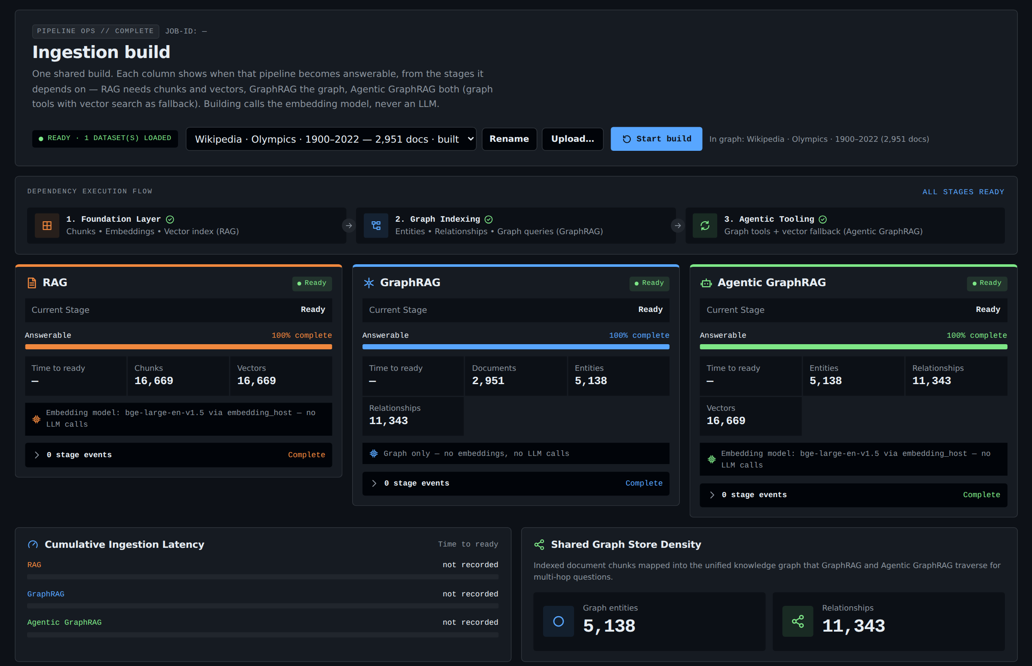
Build: one ingestion, three readiness lines
One build, three columns. Each pipeline turns ready when the stages it depends on finish: RAG needs chunks and vectors, GraphRAG the graph, Agentic both.
Live graph state. 2,951 documents, 5,138 entities, 11,343 relationships and 16,669 vectors, read from TigerGraph.
No LLM in ingestion. Infobox parsing is deterministic; only the embedding model runs.
Safe rebuilds. Datasets are tracked, so a rebuild replaces only its own data; a fresh install adopts an existing graph.
Notes:
The Build screen loads a corpus into the shared graph and streams progress per pipeline. It shows when each pipeline can answer, not just a single progress bar. Building never calls an LLM, so it costs no tokens.

Slide 6
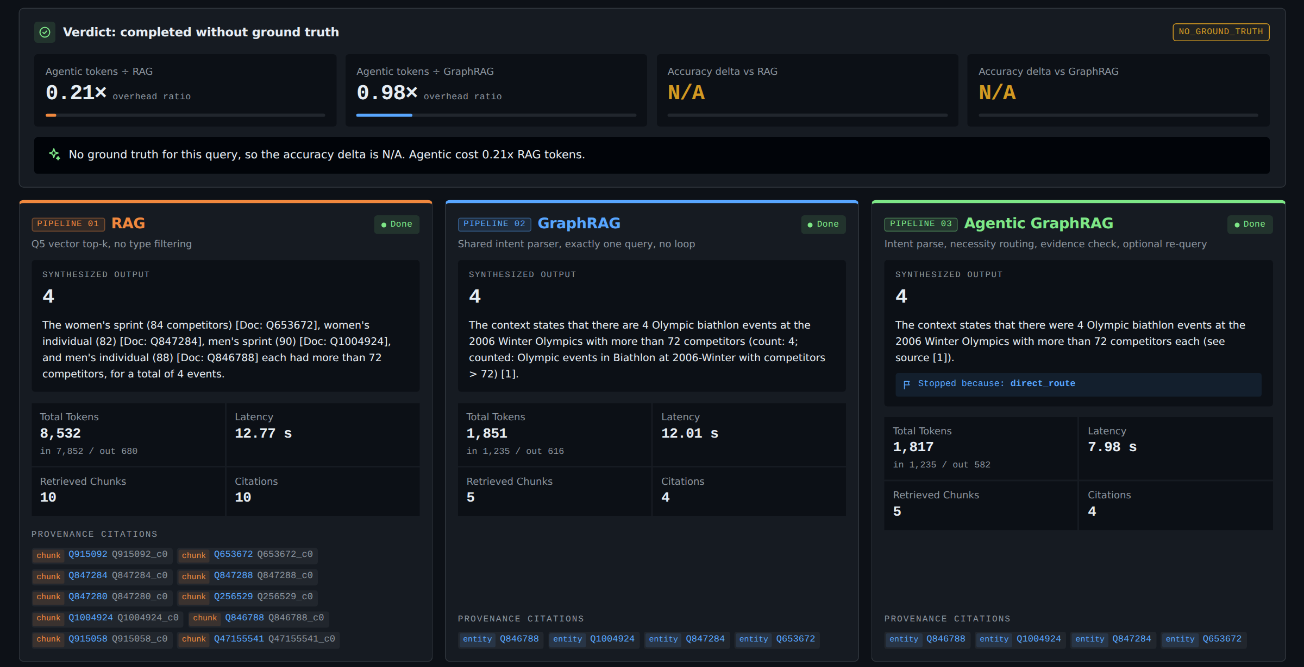
Search: a count answered on the direct route
“How many biathlon events at the 2006 Winter Olympics had more than 72 competitors?”
0.21×
Agentic tokens ÷ RAG on this question
All three say 4, but RAG reads 10 chunks (8,532 tokens) to get there.
Agentic: 1,817 tokens, one Q2 count-where on the graph, with each counted event cited.
Verdict strip compares cost and accuracy across pipelines for every question.
Notes:
A count is where structure matters: RAG can only count what it happens to retrieve. Here it got lucky, but at 4.7 times the tokens. The agent's router sends a fully specified count straight to one graph query, so it is both exact and cheap.

Slide 7
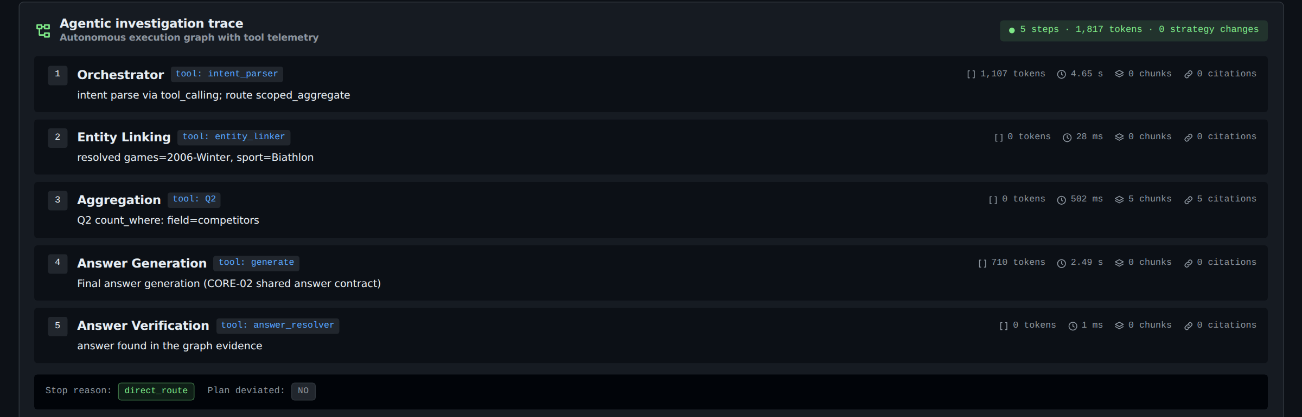
The agent's trace for the count: 5 steps, no loop
Orchestrator parses the intent (route scoped_aggregate).
Entity linking resolves 2006-Winter and Biathlon from the graph's vocabularies, at 0 tokens.
Aggregation runs Q2 count-where on competitors and returns the counted events.
Answer verification confirms the answer is in the graph evidence. Stop reason: direct_route.
Notes:
Every agent step is recorded with its tool, tokens, latency, chunks and citations. The stop reason is explicit. A judge can see exactly why the answer is 4 and what it cost.

Slide 8
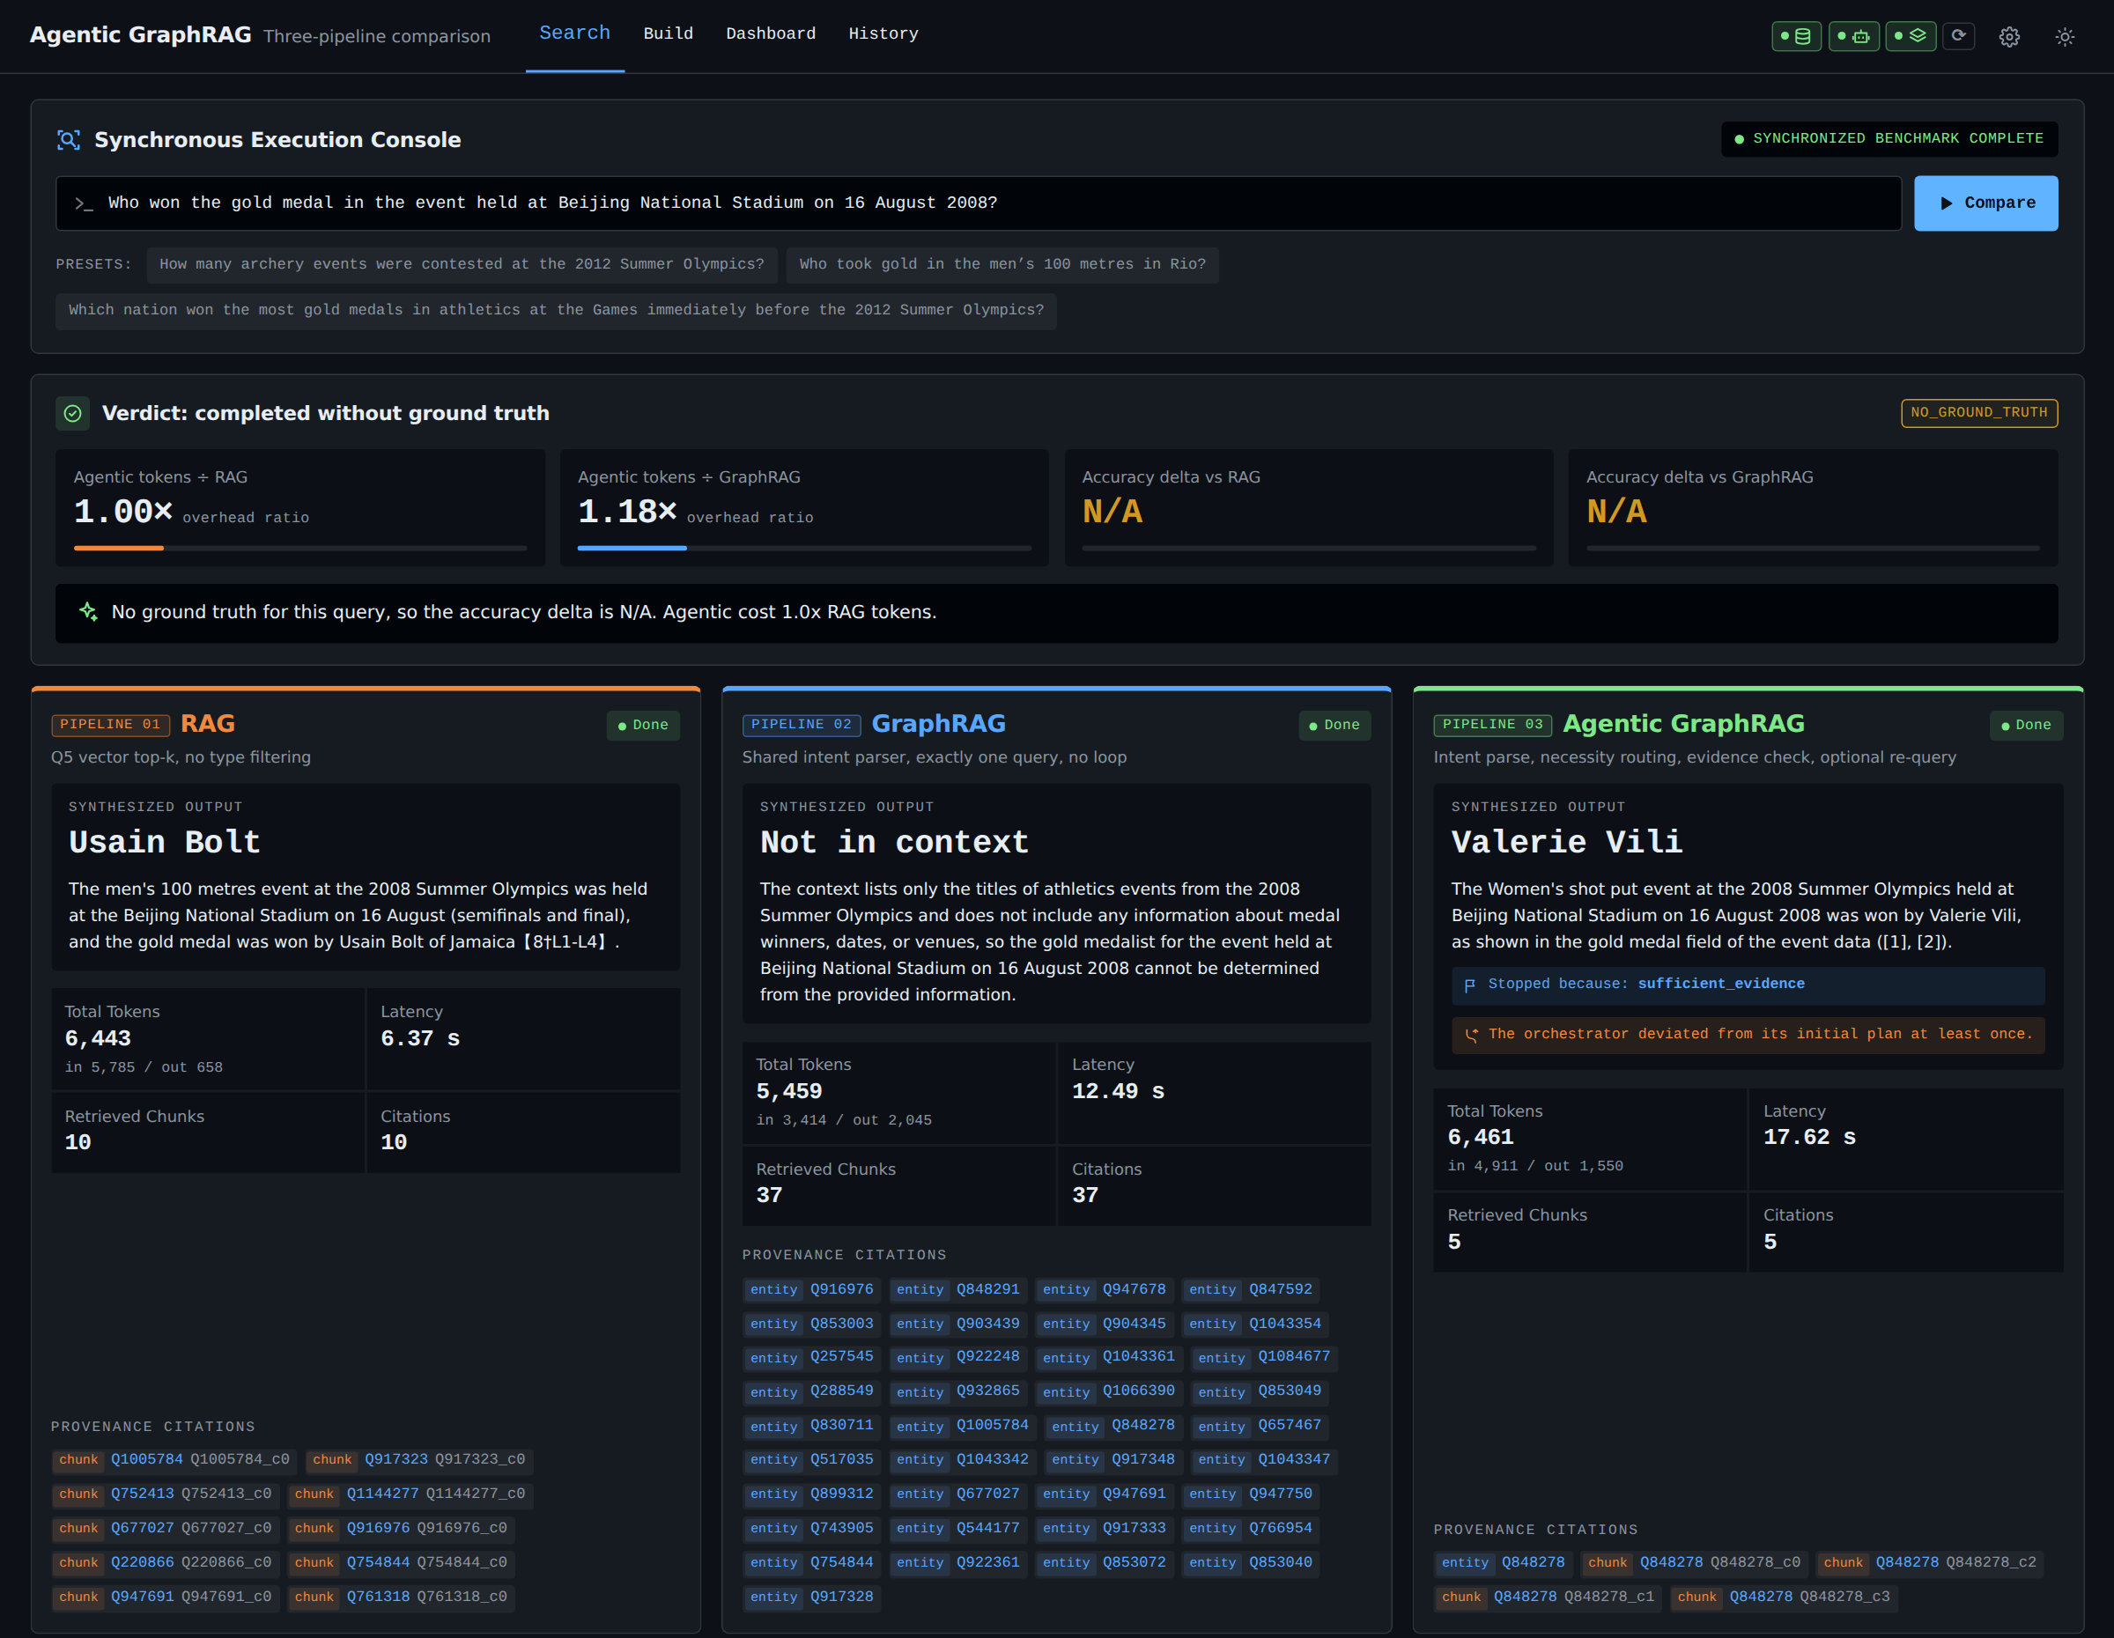
Search: a multi-hop question only the agent solves
“Who won the gold medal in the event held at Beijing National Stadium on 16 August 2008?”
RAG
Usain Bolt
wrong: the 100 m was also that day, but not the event asked
GraphRAG
Not in context
one query, no loop: cannot chain venue → day → winner
Agentic
Valerie Vili
correct: women's shot put, cited to the event page
Notes:
This is the case the agent exists for. The question names a venue and a day, not an event. RAG retrieves a plausible chunk and answers with the wrong event. GraphRAG runs one query and has nothing to chain. The agent finds the 37 events at the venue, narrows them to the one on 16 August, and answers Valerie Vili, at roughly the same token cost as RAG.

Slide 9
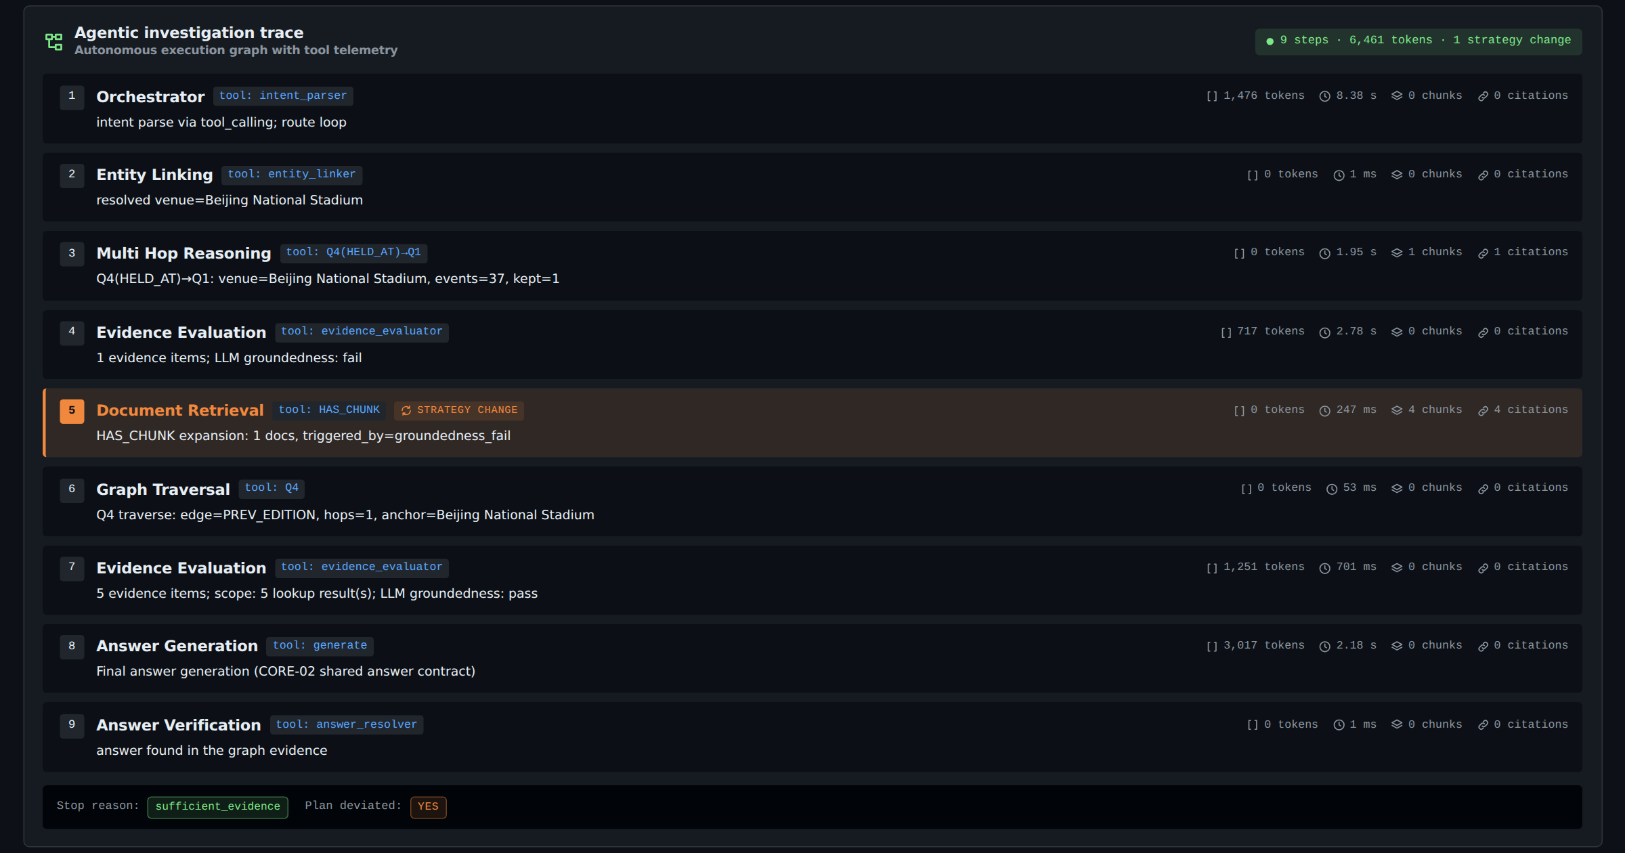
The agent changes strategy when the evidence is weak
Step 3, multi-hop: Q4 HELD_AT then Q1: 37 events at the venue, narrowed to 1 by the date.
Step 4, evidence check: groundedness fails on the row alone.
Step 5, strategy change: fetches the event page's text (HAS_CHUNK) instead of guessing.
Step 7: evidence passes; answer generated and verified against the graph.
Stop reason: sufficient_evidence, plan deviated: yes. 9 steps, 6,461 tokens.
Notes:
The highlighted step is a strategy change: the agent judged its evidence insufficient and went to the document text. The trace makes the agent's reasoning auditable, which is what the evidence and explainability criterion asks for.

Slide 10
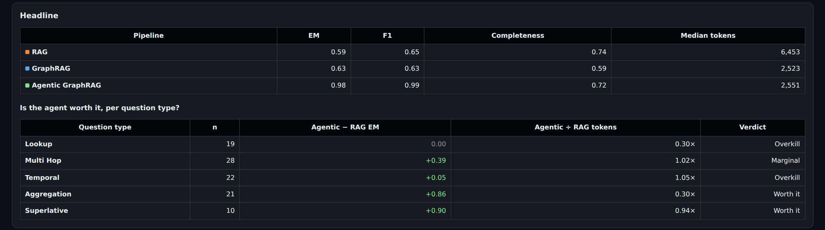
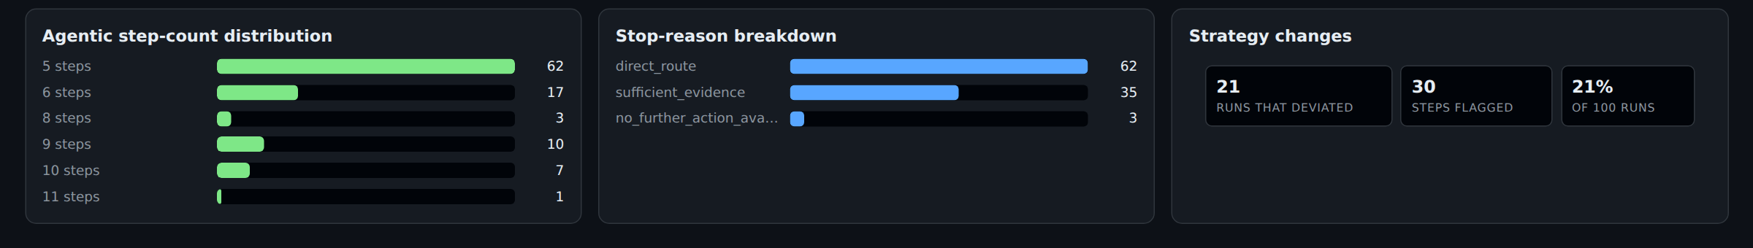
Dashboard: is the agent worth it, per question type?
Headline: Agentic EM 0.98 and F1 0.99 against RAG 0.59 / 0.65, at 2,551 median tokens vs 6,453.
Worth it on aggregation (+0.86 EM at 0.30× tokens) and superlatives (+0.90).
Overkill on single-fact lookups: RAG is already exact, so the router keeps those cheap (0.30×).
Notes:
The dashboard answers the guidebook's question directly: for each question type, the accuracy gap over RAG and its token cost, with a verdict. The bottom row shows the routing in practice: 62 of 100 questions ended on the direct route, and 21 runs changed strategy.

Slide 11
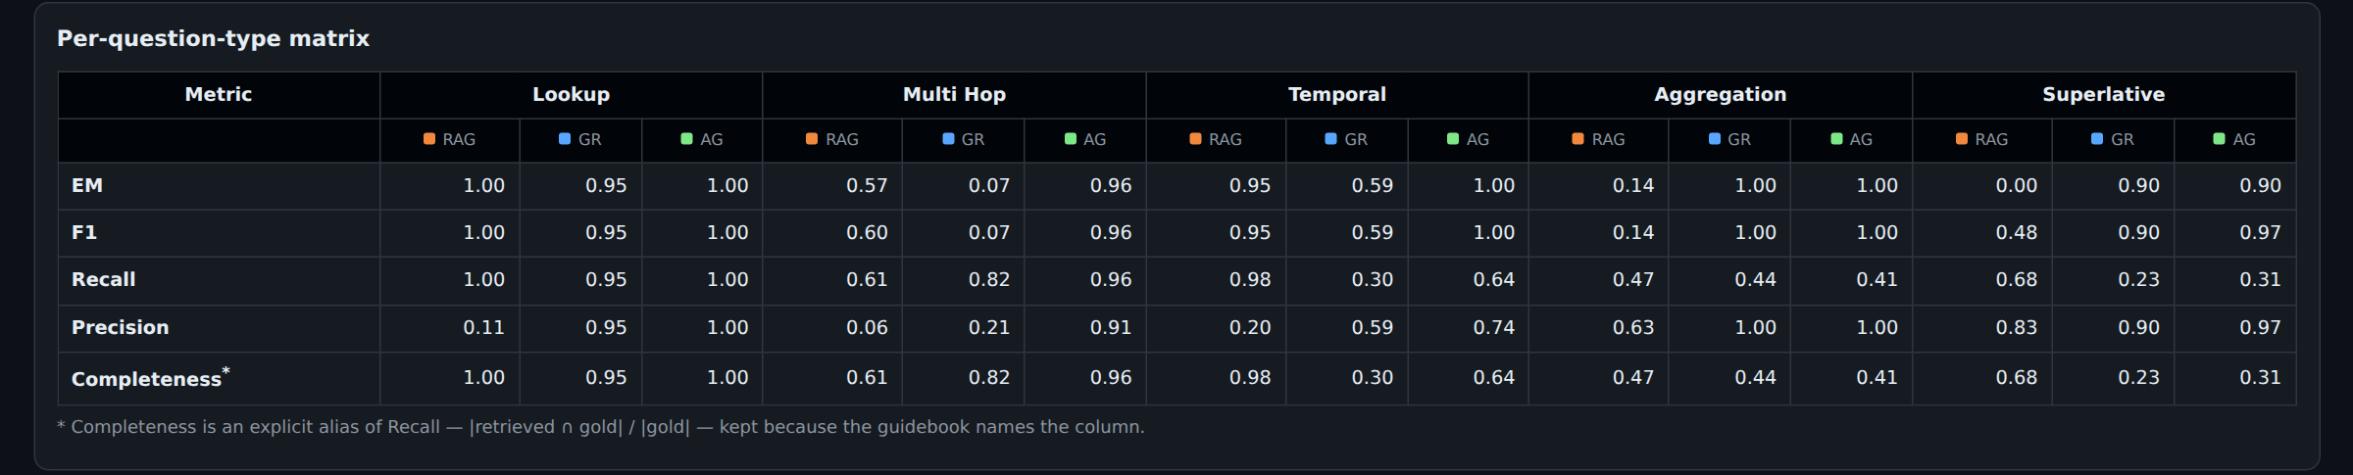
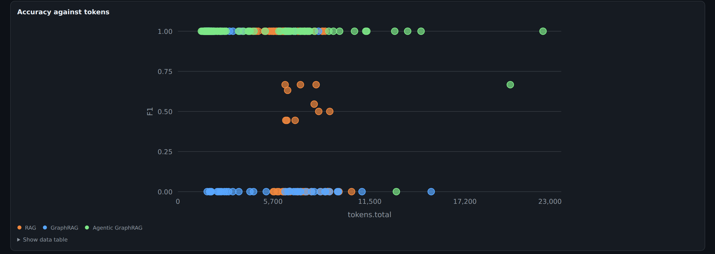
Per-type matrix and accuracy against cost
Multi-hop: Agentic 0.96 vs GraphRAG 0.07. The loop, not the graph alone, turns structure into answers.
Every point is one question: green (Agentic) sits at F1 1.0 on the left, at low token cost.
Notes:
The matrix gives EM, F1, recall, precision and completeness per type and pipeline. The scatter plots every question by tokens and F1, so the cost of each answer is visible, not just the average.

Slide 12
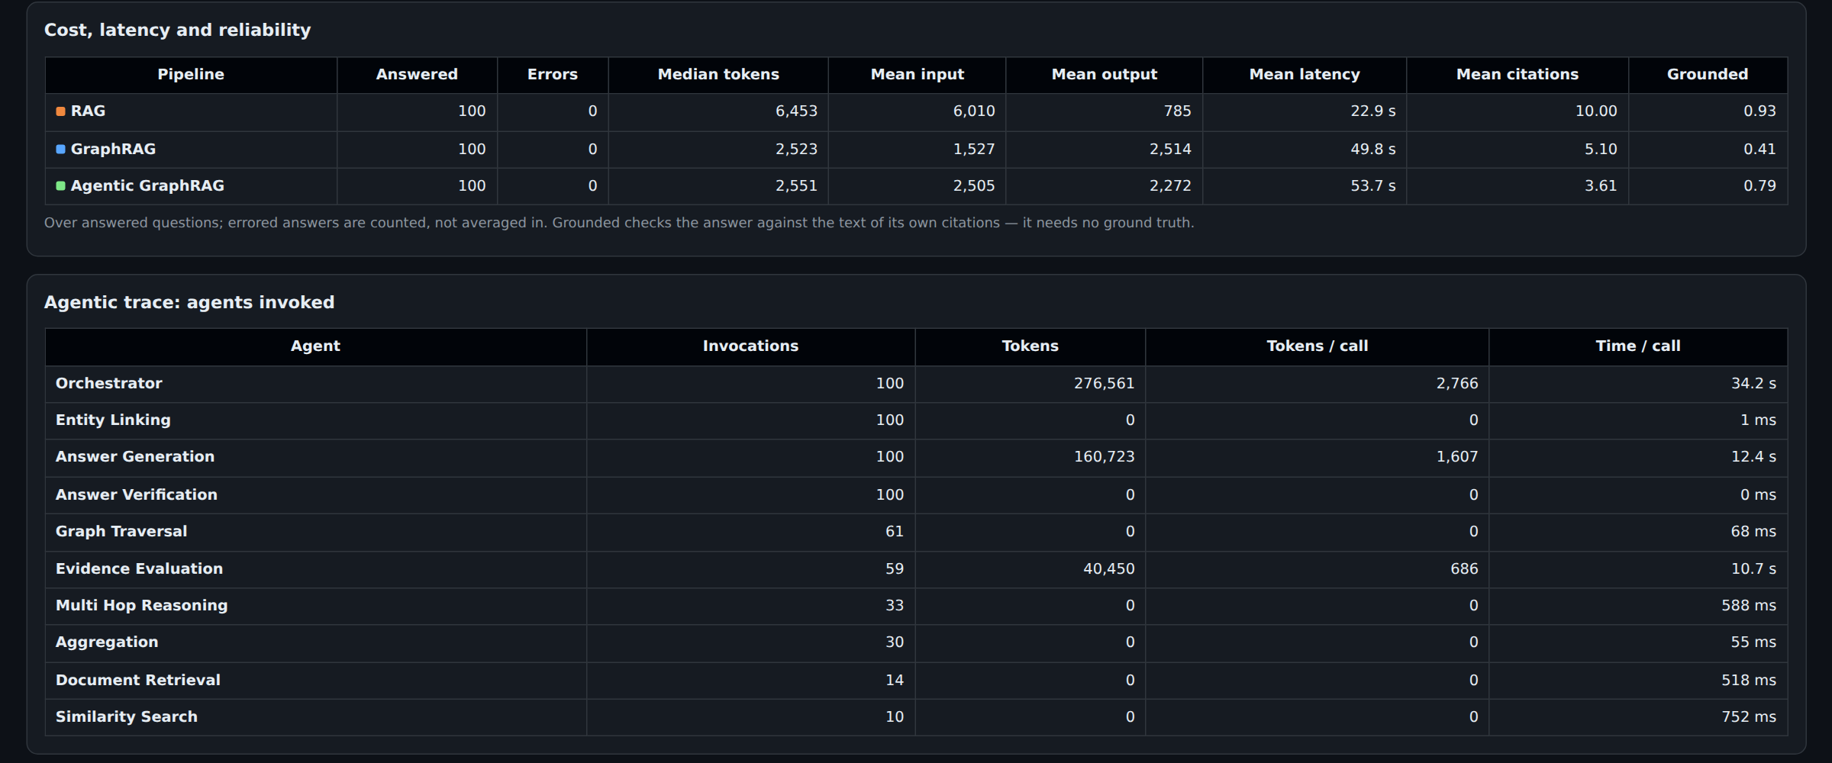
Cost, reliability and the agents that ran
0 errors in 300 pipeline answers on the final run.
Grounded checks each answer against the text of its own citations: it needs no gold answer, so it also works on the hidden set.
Agents invoked: entity linking, graph traversal, aggregation and verification cost 0 tokens; only the orchestrator, evidence evaluation and answer generation call the LLM.
Notes:
Most agents are deterministic graph calls. Token spend concentrates in three LLM steps, which is why the agent is cheaper than RAG overall.

Slide 13
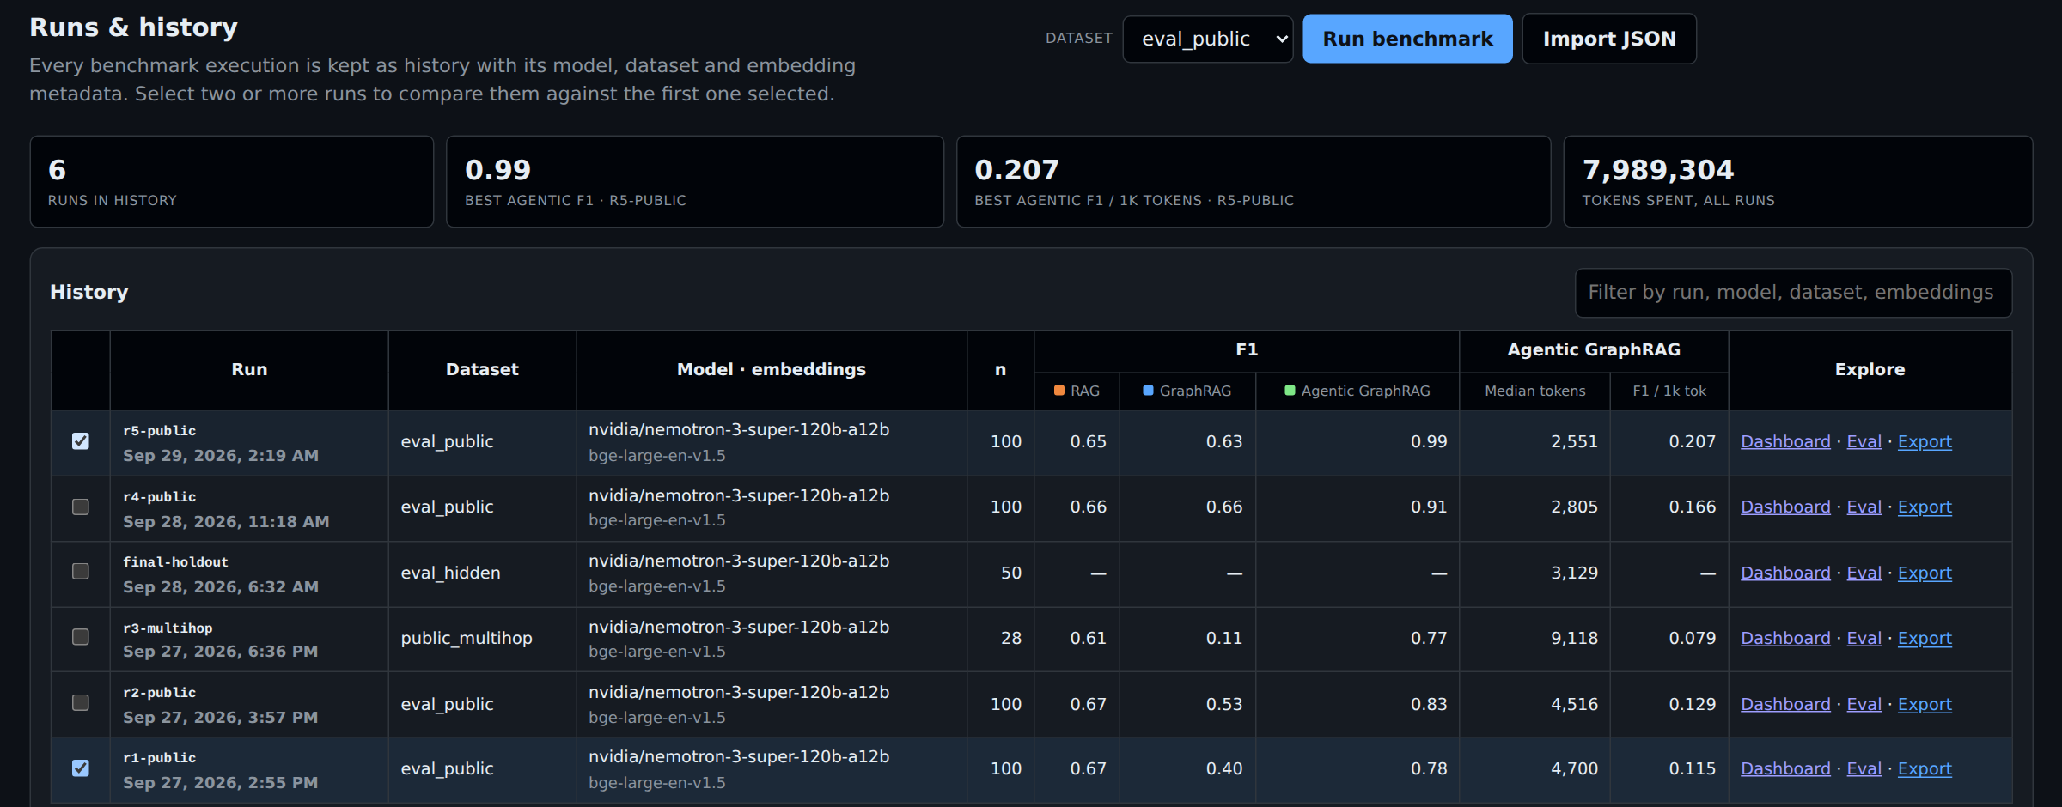
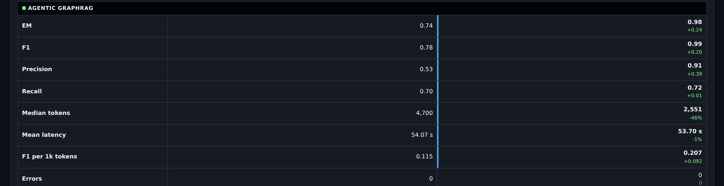
Benchmarks: every run kept, any two compared
Run benchmark runs a question set through all three pipelines from the UI; runs resume after interruption.
History keeps every run with its model, dataset and embedding configuration.
Compare: r1 → r5 for Agentic: EM 0.74 → 0.98, median tokens 4,700 → 2,551 (−46%).
Export gives the submission JSON with every answer, citation and trace.
Notes:
Each improvement came from a named root cause found in the traces, and RAG, which no fix touched, stayed flat at 0.59 to 0.62. That is how we know the gains are real and not tuning to the benchmark.

Slide 14
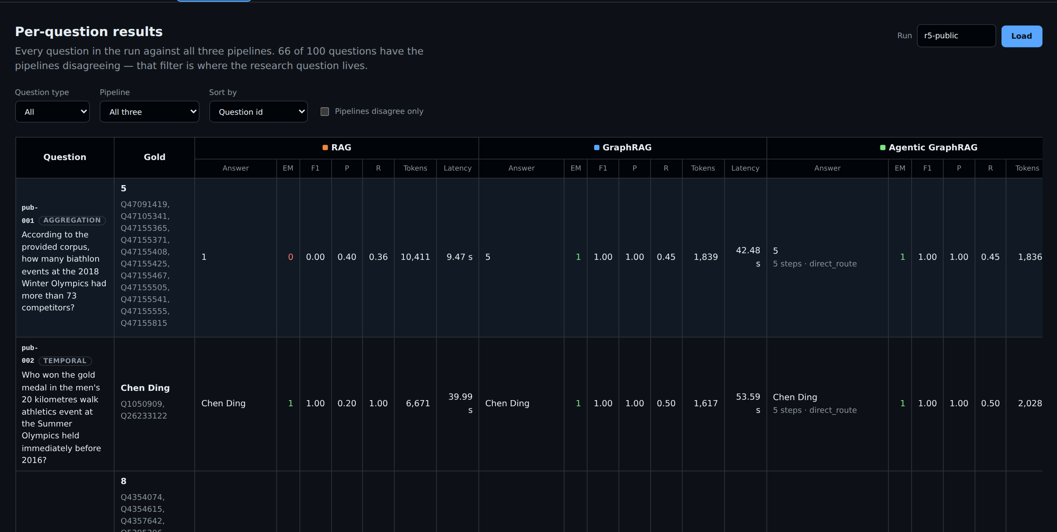
Eval table: every question, all three pipelines
Each row is one question with its gold answer and all three pipelines side by side: answer, EM, F1, precision, recall, tokens, latency.
Agentic answers also show their steps and stop reason (here: 5 steps, direct_route).
Filter by question type or pipeline, or to where the pipelines disagree: 66 of 100 questions.
Notes:
The eval table is where the research question lives: the disagreement filter shows exactly where the methods differ, question by question.

Slide 15
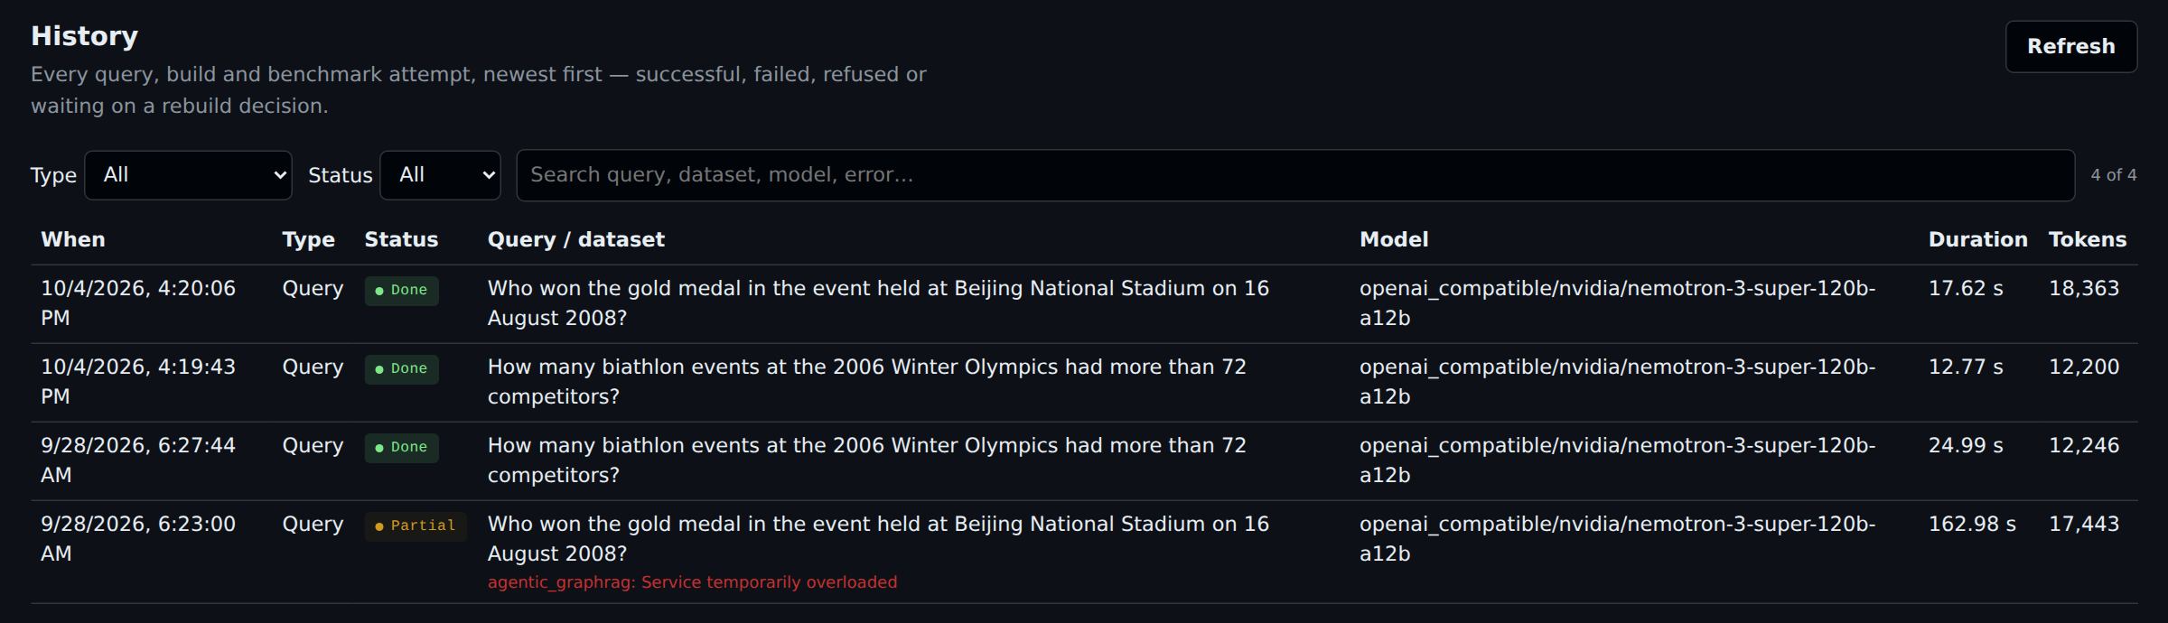
History: every query, build and benchmark attempt
Everything is logged, successful, failed, refused or waiting on a rebuild decision, with model, duration and tokens.
Nothing is hidden: the partial answer from a provider overload on 28 Sep is recorded, not retried silently.
Notes:
History is the audit log of the application. It records every attempt, including the ones that failed, so the evaluation team can see the system's real behaviour.

Slide 16
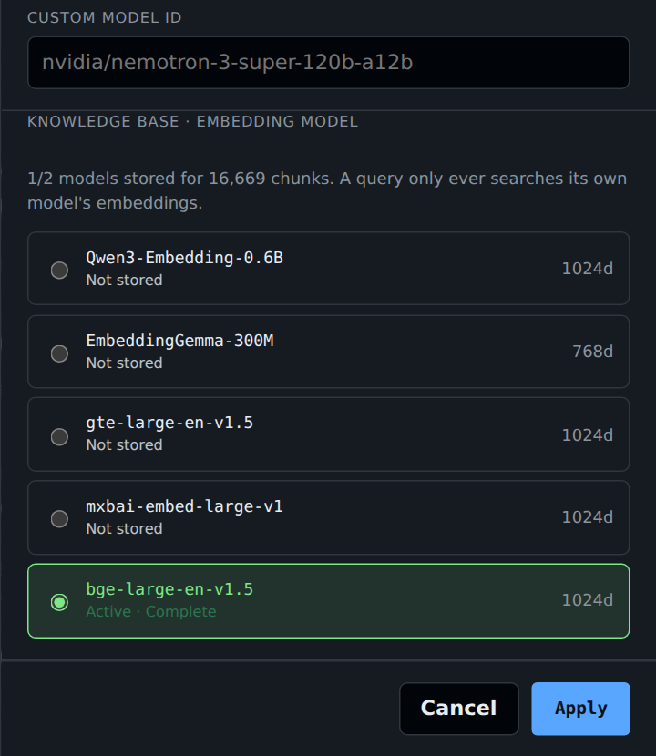
Settings: switch the LLM or embedding model safely
LLM provider and model switch at runtime (NVIDIA NIM, Gemini, Groq); the same model always serves all three pipelines.
Five embedding models, each in its own TigerGraph vertex type with its own vector index.
A query only searches its own model's vectors: a model without complete embeddings is refused, never silently mixed.
Switching re-embeds in the background (replace or parallel) and can resume after a failure.
Notes:
Embedding switching is a guarded operation: per-model vertex types mean two 1024-dimension models are never treated as interchangeable, and a half-built index can never answer a query.

Slide 17
Results on the 100 public questions
0.98 / 0.99
Agentic EM / F1
0.59 / 0.65
RAG EM / F1 (the control)
2,551
Agentic median tokens (RAG 6,453)
0 errors · 62% of questions on the direct route (EM 1.00)
Notes:
The agent leads where structure matters (aggregation, superlatives, multi-hop) and ties RAG on single facts and dates. It is not always better; it pays where it should and costs less where the router skips the loop. The hidden set (50 questions) was run once; it has no gold answers, so we report cost and grounding for it.

Slide 18
Built to be rerun and trusted
1
Reproducible
2
Reliable
make reproduce: build, public and hidden runs, report and export; every run file carries its configuration.
Resumable batches; transient graph and LLM failures retried and recorded, never turned silently into a wrong answer.
3
Not overfitted
4
Tested
No question templates and no question-type reads in the answer path, enforced by tests; RAG never moved.
About 600 backend and 59 frontend tests; the UI is checked in a real browser.
Notes:
A few points to land: every run file carries its configuration, so a result is never separated from its conditions. Runs resume question by question. And a test fails if anyone reads the question type or adds a question template in the answer path.

Slide 19
Limits and next steps
Known limits
Next steps
The intent parse can vary between runs at temperature 0; the one open public miss is this.
A venue day shared by several events, with no sport named, has no single answer.
Round 2 has only a first step: infobox vs text conflicts are flagged, facts are not versioned.
The demo app is open (no sign-in); a public deployment needs a proxy with authentication.
Ask back when a question matches several events.
A second intent parse when the operation and the linked anchors disagree.
Facts with source and date; supersession and source authority for Round 2.
Authentication at a reverse proxy for a public deployment.
Notes:
Be honest here; judges respect it. The remaining weak spot is ambiguity, and the right behaviour there is to ask back instead of guessing.

Slide 20
The agent pays where structure matters
Not always better: exact on counts, superlatives and dates, 0.96 on multi-hop, at 40% of RAG's tokens. Questions?
Repository: [repository link] · Demo video: [link]
[Team name]
Notes:
Close on the thesis in one sentence, then take questions. Likely questions: Is the comparison fair? Same LLM, same prompt byte for byte, same scorer; GraphRAG gets every graph fix too. Did you tune on the public set? No prompt was tuned; RAG, which no fix touched, stayed at 0.59 to 0.62. Why is the agent's grounding lower than RAG's? Count answers cite a count row with no prose; verification reports graph support separately (90 of 100). Hidden set? Run once; outputs in submission/; no gold, so cost and grounding only.

