Slide 1
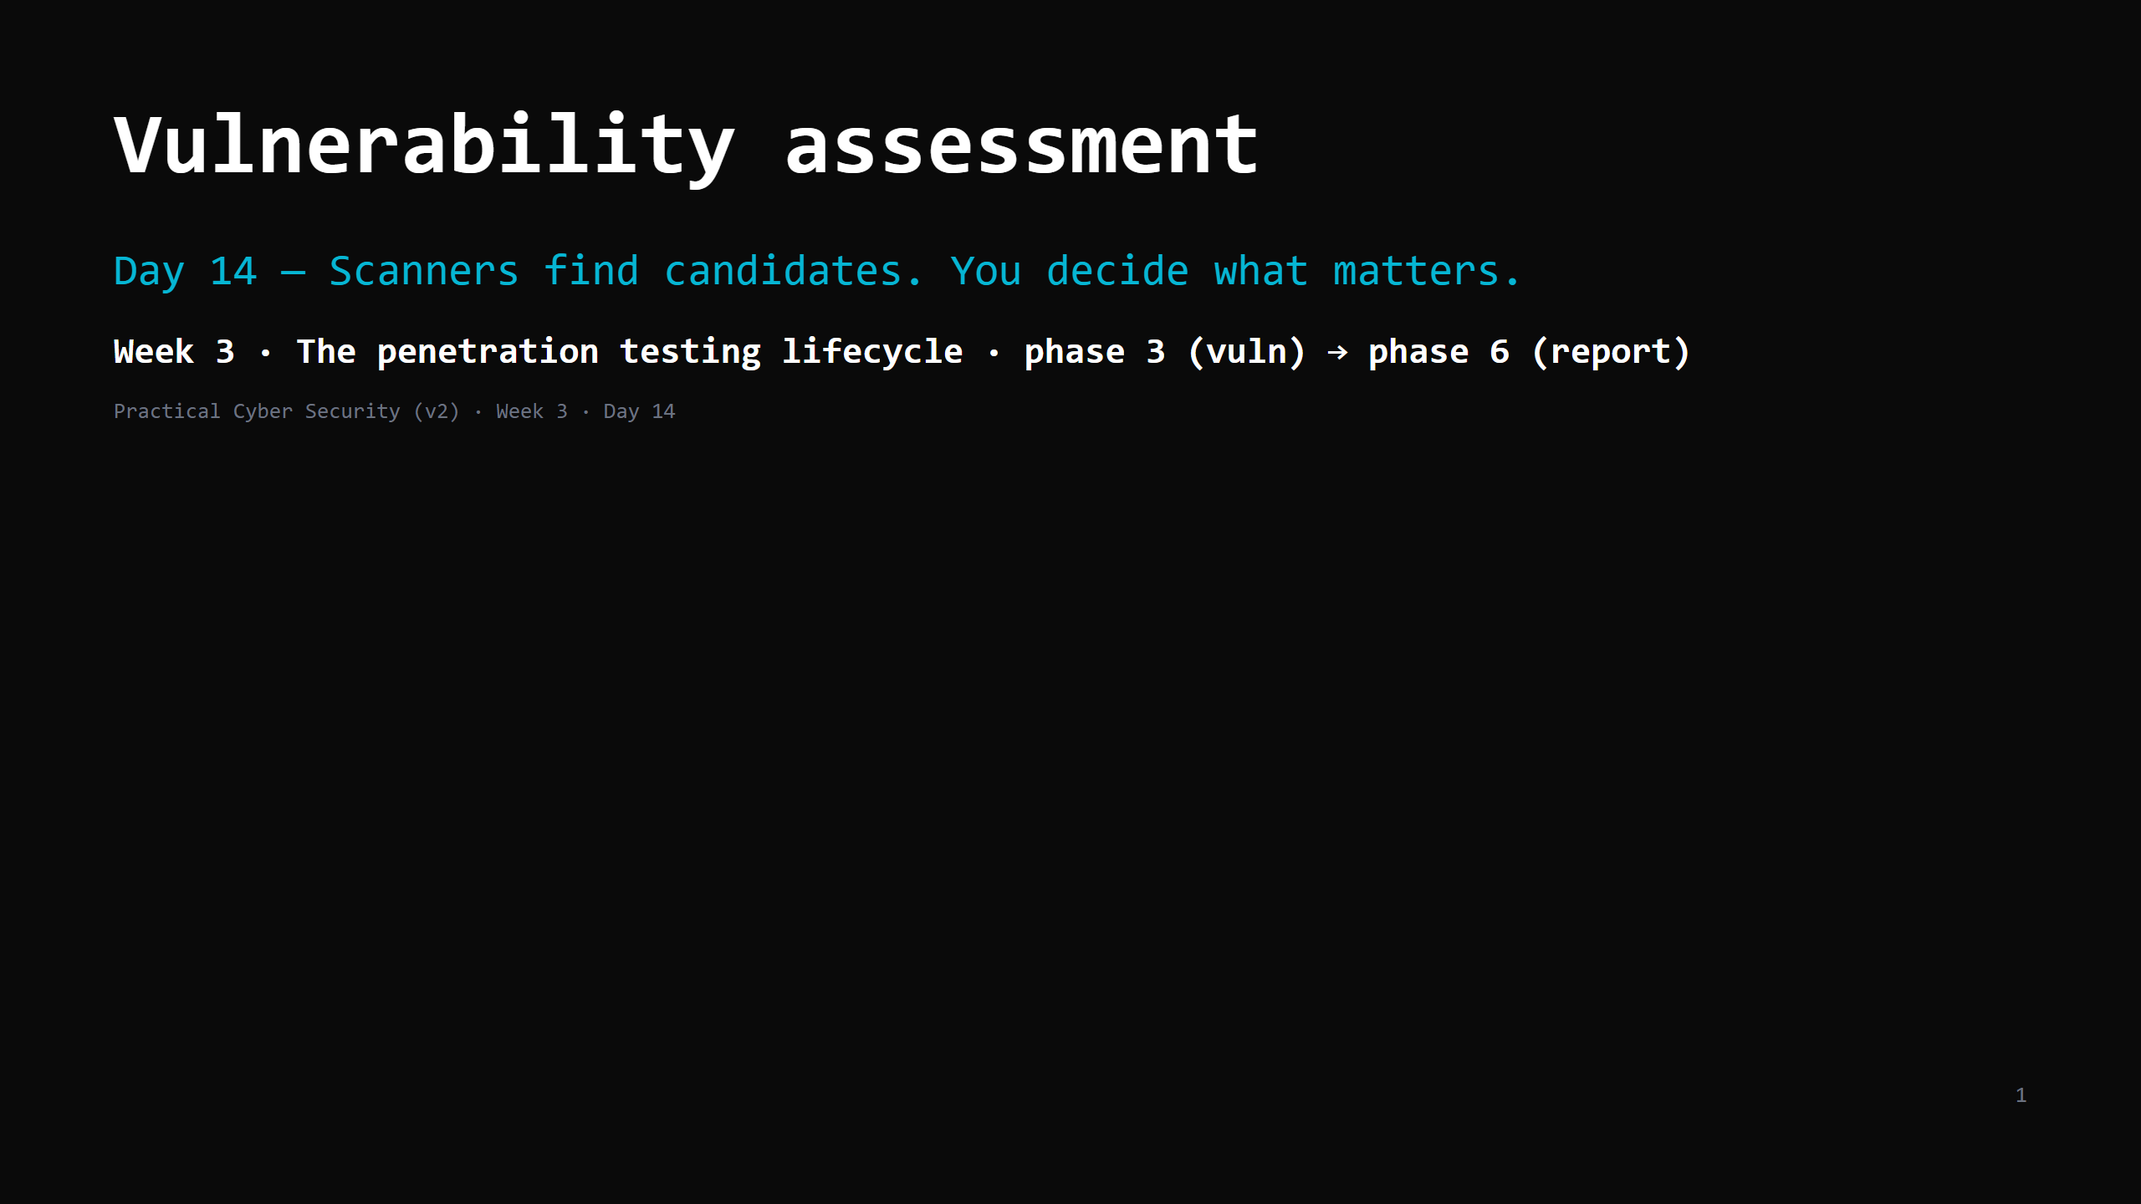
Notes:
RUN SHEET (~85 min). 00:00 Journey check + hook (two 9.8s, one matters) 4 00:04 The pipeline 5 00:09 CVE & the NVD 7 00:16 CVSS — reading the vector 10 00:26 DO: decode 2 CVSS vectors 5 00:31 "Is there a public exploit?" 7 00:38 DO: run a vuln scanner on the lab 16 00:54 From scan output to a ranked findings list 9 01:03 The report trap + writing a finding 6 01:09 Attack <-> defence 4 01:13 Wrap + artifact + homework 4 CUT FIRST IF SHORT: CVSS Scope/temporal detail; the report-writing slide to "a finding = title + severity + evidence + repro + impact + fix". NEVER CUT: the pipeline, CVSS AV/PR/UI basics, the exploitability question (KEV/Exploit-DB), the ranked findings table, "more findings != better report". ANALOGY (kitchen / inspector): the scanner = a junior who flags EVERYTHING on the checklist ("extinguisher expired! chipped plate! walk-in 1 degree warm!"). The assessor = the senior who says "the expired extinguisher by the fryer could kill someone; the plate is a note." ETHICS: scan only <LAB_HOST> (in the ROE). Metasploitable2 is the target.

Slide 2
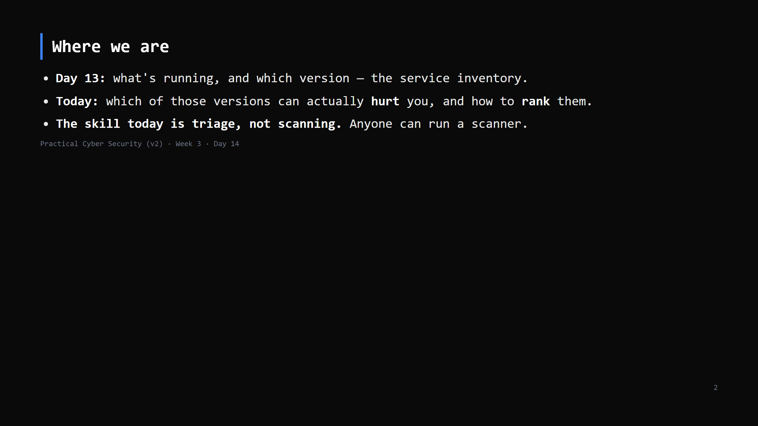
Notes:
Journey Check. This is the pivot from "I found things" to "here's what to fix first" — the part a client actually pays for.

Slide 3
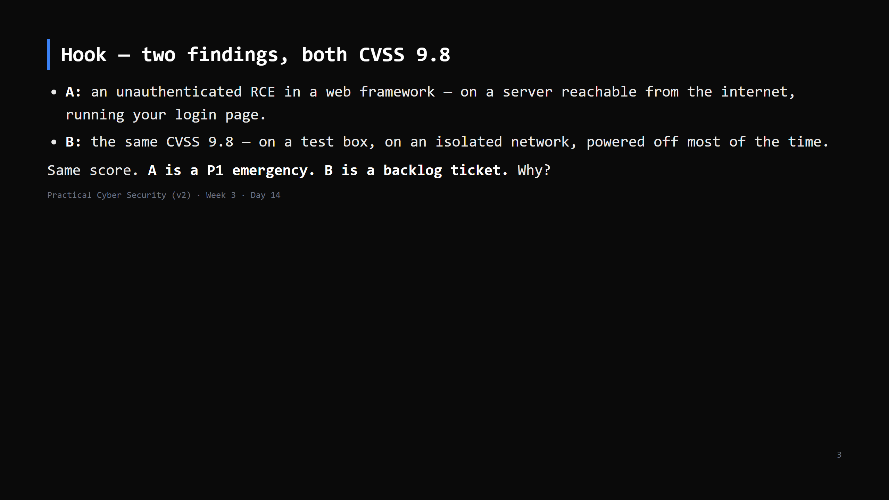
Notes:
The number is the same; the RISK is not. CVSS has no idea where the box is, whether it's exposed, whether anyone's exploiting it, or what's behind it. That context is your job.

Slide 4
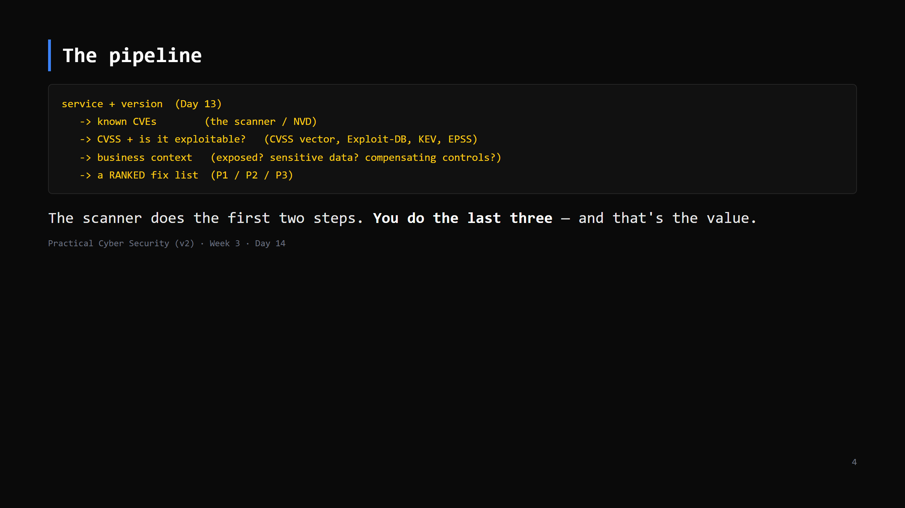
Notes:
Put this on the board. Every finding walks this path. A scanner that stops at step 2 gives you a list; you turn it into a plan.

Slide 5
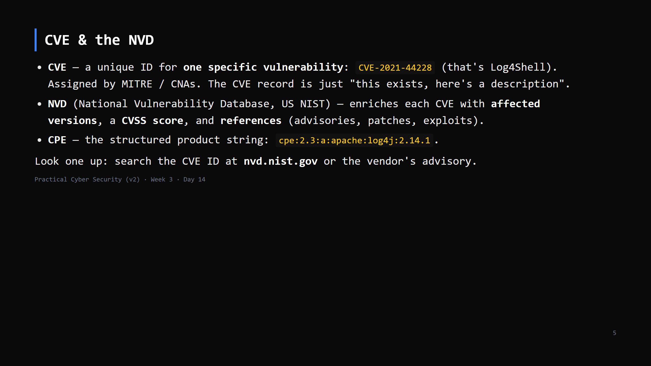
Notes:
Your Day 13 banner ("Apache httpd 2.4.49") -> search "Apache 2.4.49 CVE" -> CVE-2021-41773 (path traversal -> RCE). That lookup is the everyday move. Vendor advisories are often more accurate than NVD on "are WE affected" (config matters).

Slide 6
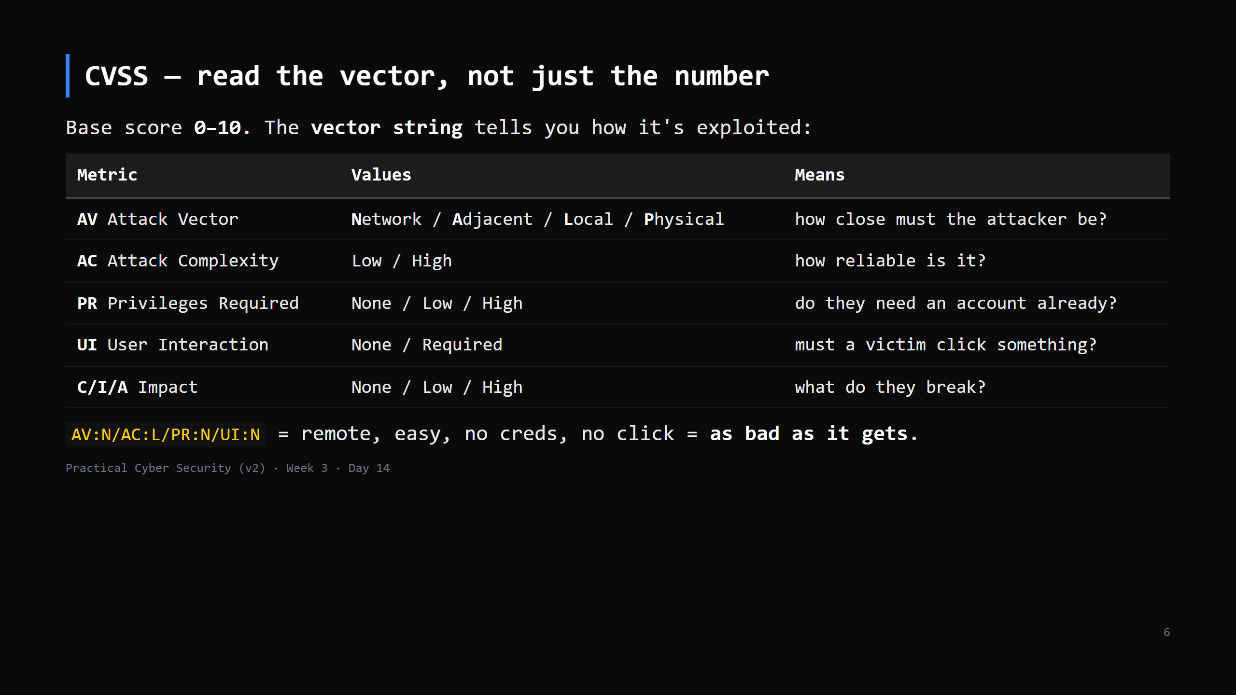
Notes:
Bands: 0.1-3.9 Low, 4.0-6.9 Medium, 7.0-8.9 High, 9.0-10.0 Critical. The number is a rough triage aid. It is NOT risk: no exposure, no "exploited in the wild", no asset value. Temporal/Environmental metrics exist to add some of that — most people ignore them. CUT Scope + temporal detail first if short.

Slide 7
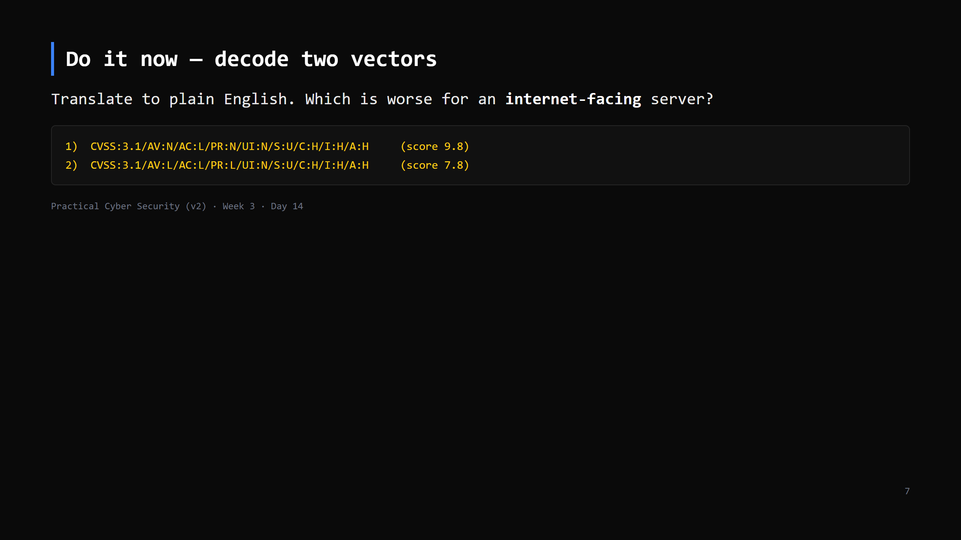
Notes:
5 min. 1) Network, low complexity, no privileges, no user interaction, full C/I/A impact -> a remote unauthenticated attacker fully owns it. Critical everywhere. 2) LOCAL access, needs some privileges already -> the attacker must ALREADY be on the box with an account. That's a privilege-escalation bug (Day 7). Bad, but not the front-door emergency #1 is. For an internet-facing box, #1 is the fire.

Slide 8
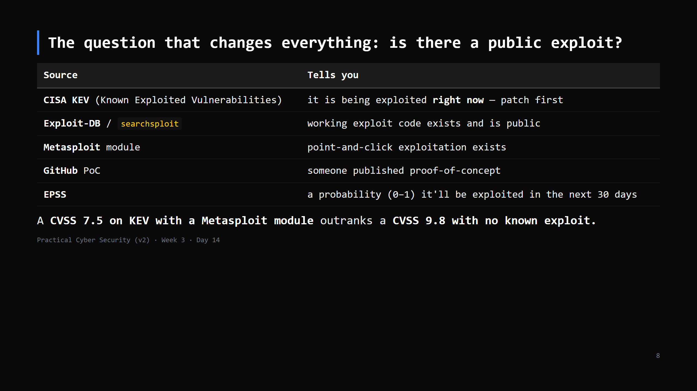
Notes:
KEV is the single best free prioritisation list — CISA only adds things with confirmed in-the-wild exploitation. `searchsploit apache 2.4.49` on Kali is the everyday check. "No public exploit yet" doesn't mean safe — it means less urgent than the ones that do.

Slide 9
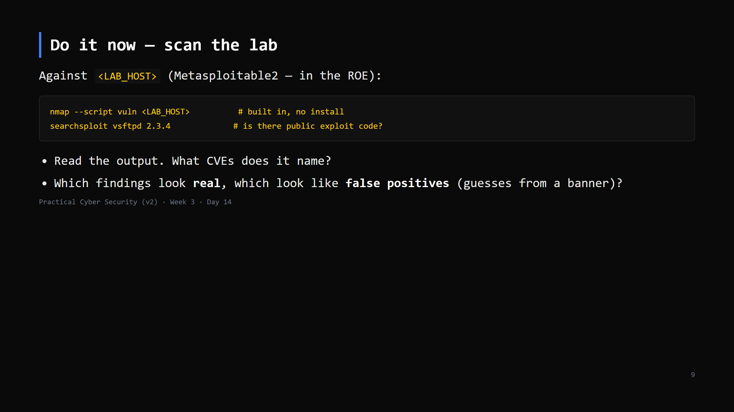
Notes:
16 min. `--script vuln` runs NSE vuln-category scripts — decent, noisy, and it WILL produce false positives (it often flags things based on version alone without confirming). That's the lesson: the scanner is a candidate generator. If Nuclei is installed: `nuclei -u http://<LAB_HOST>` for the web side. OpenVAS is heavier - optional, instructor demo. No lab? assets/sample-vulnscan.txt.

Slide 10
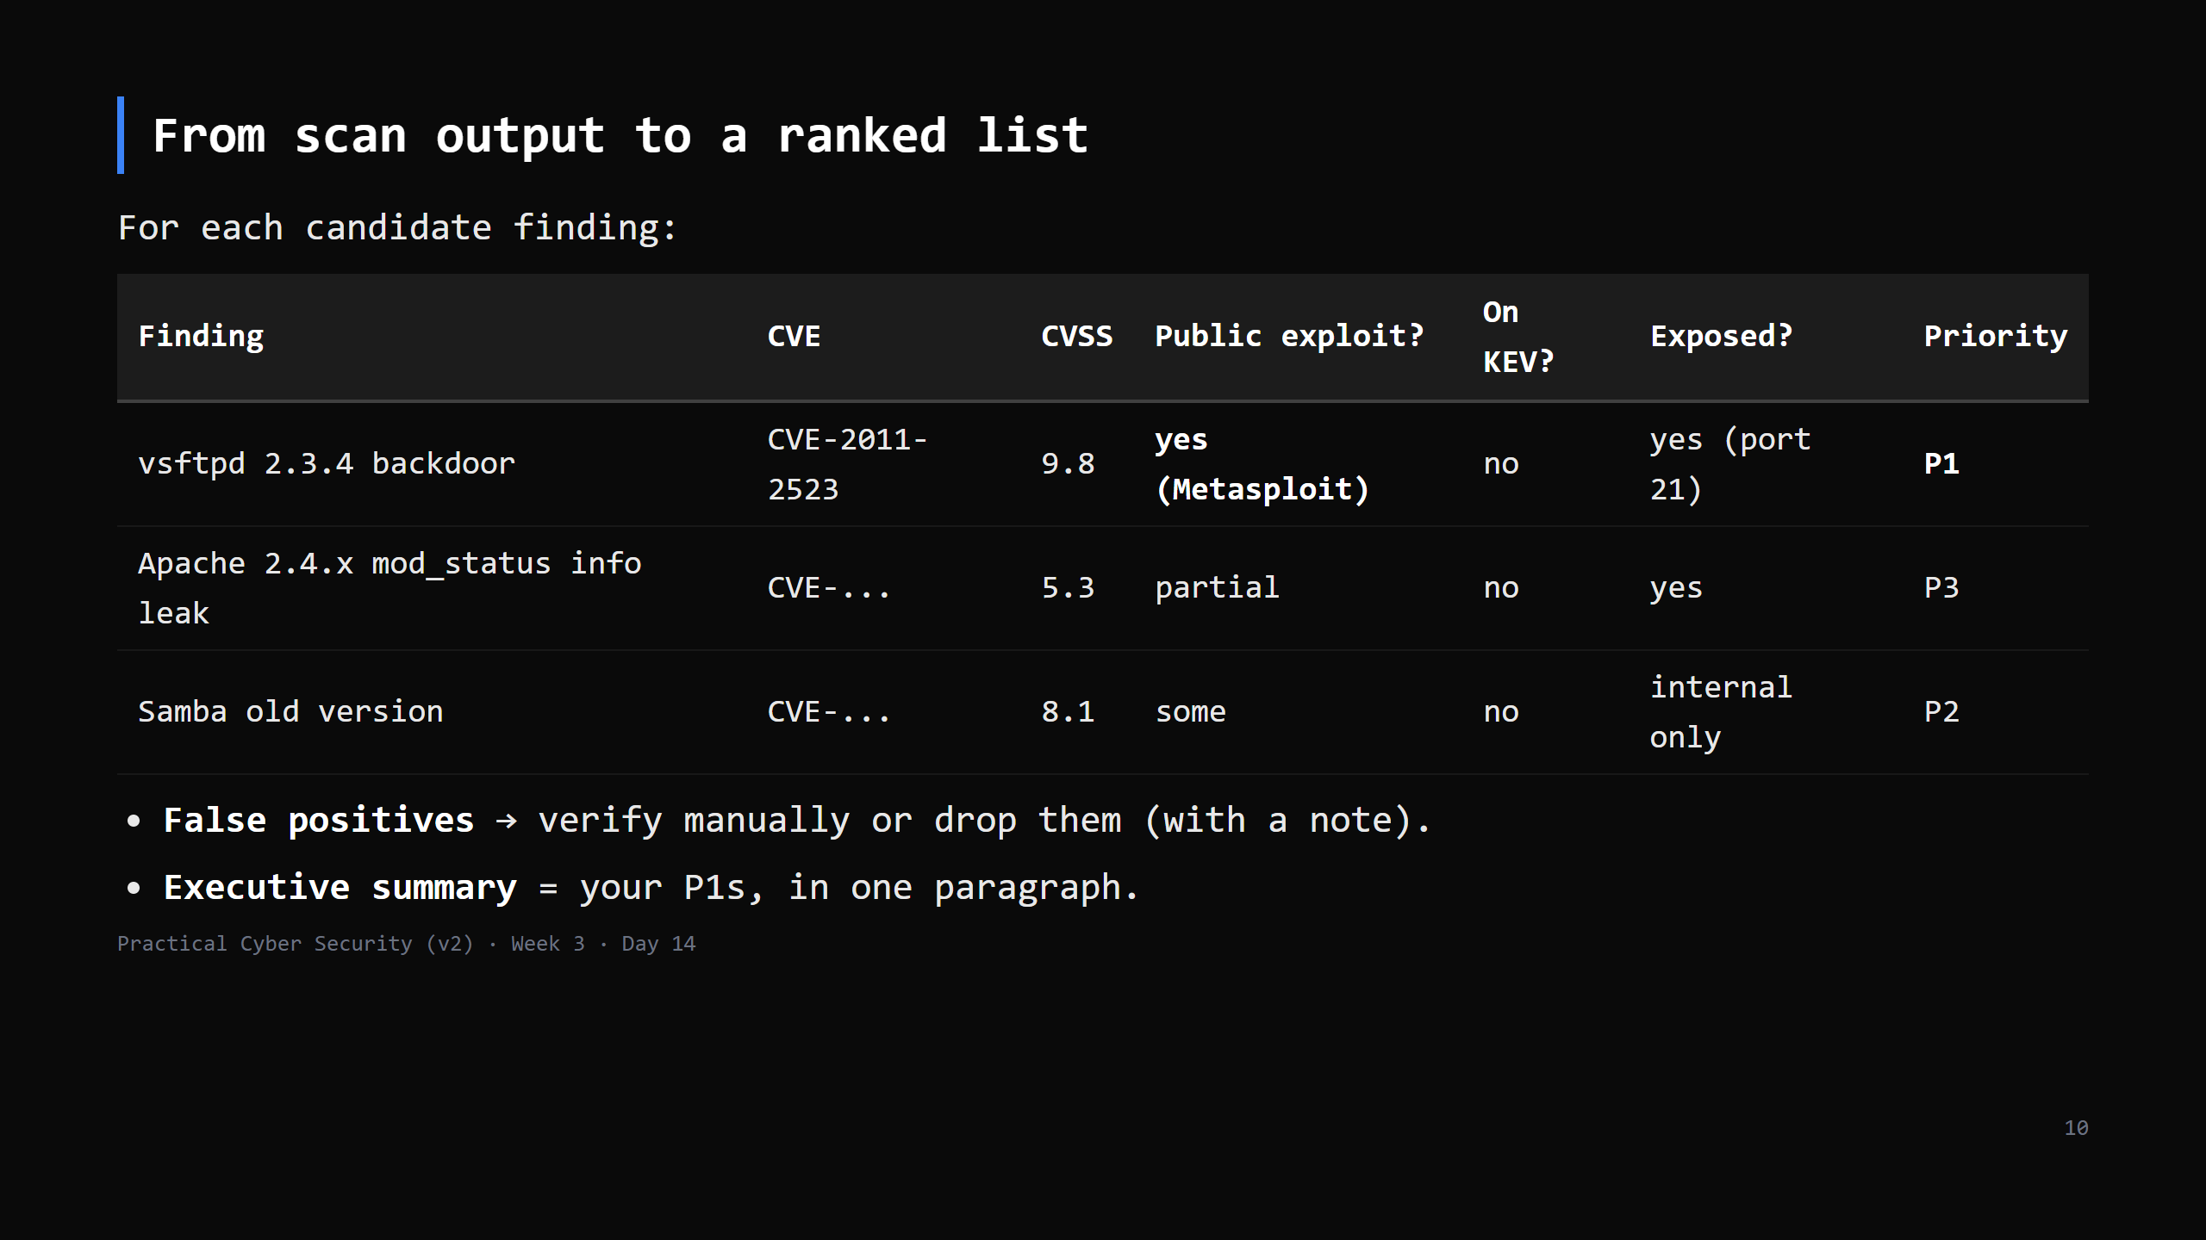
Notes:
This table is the artifact and the seed of the Week 3 assignment. The columns after "CVSS" are what a scanner can't do for you. Priority is a judgement: CVSS + exploit availability + exposure + what's behind it.

Slide 11
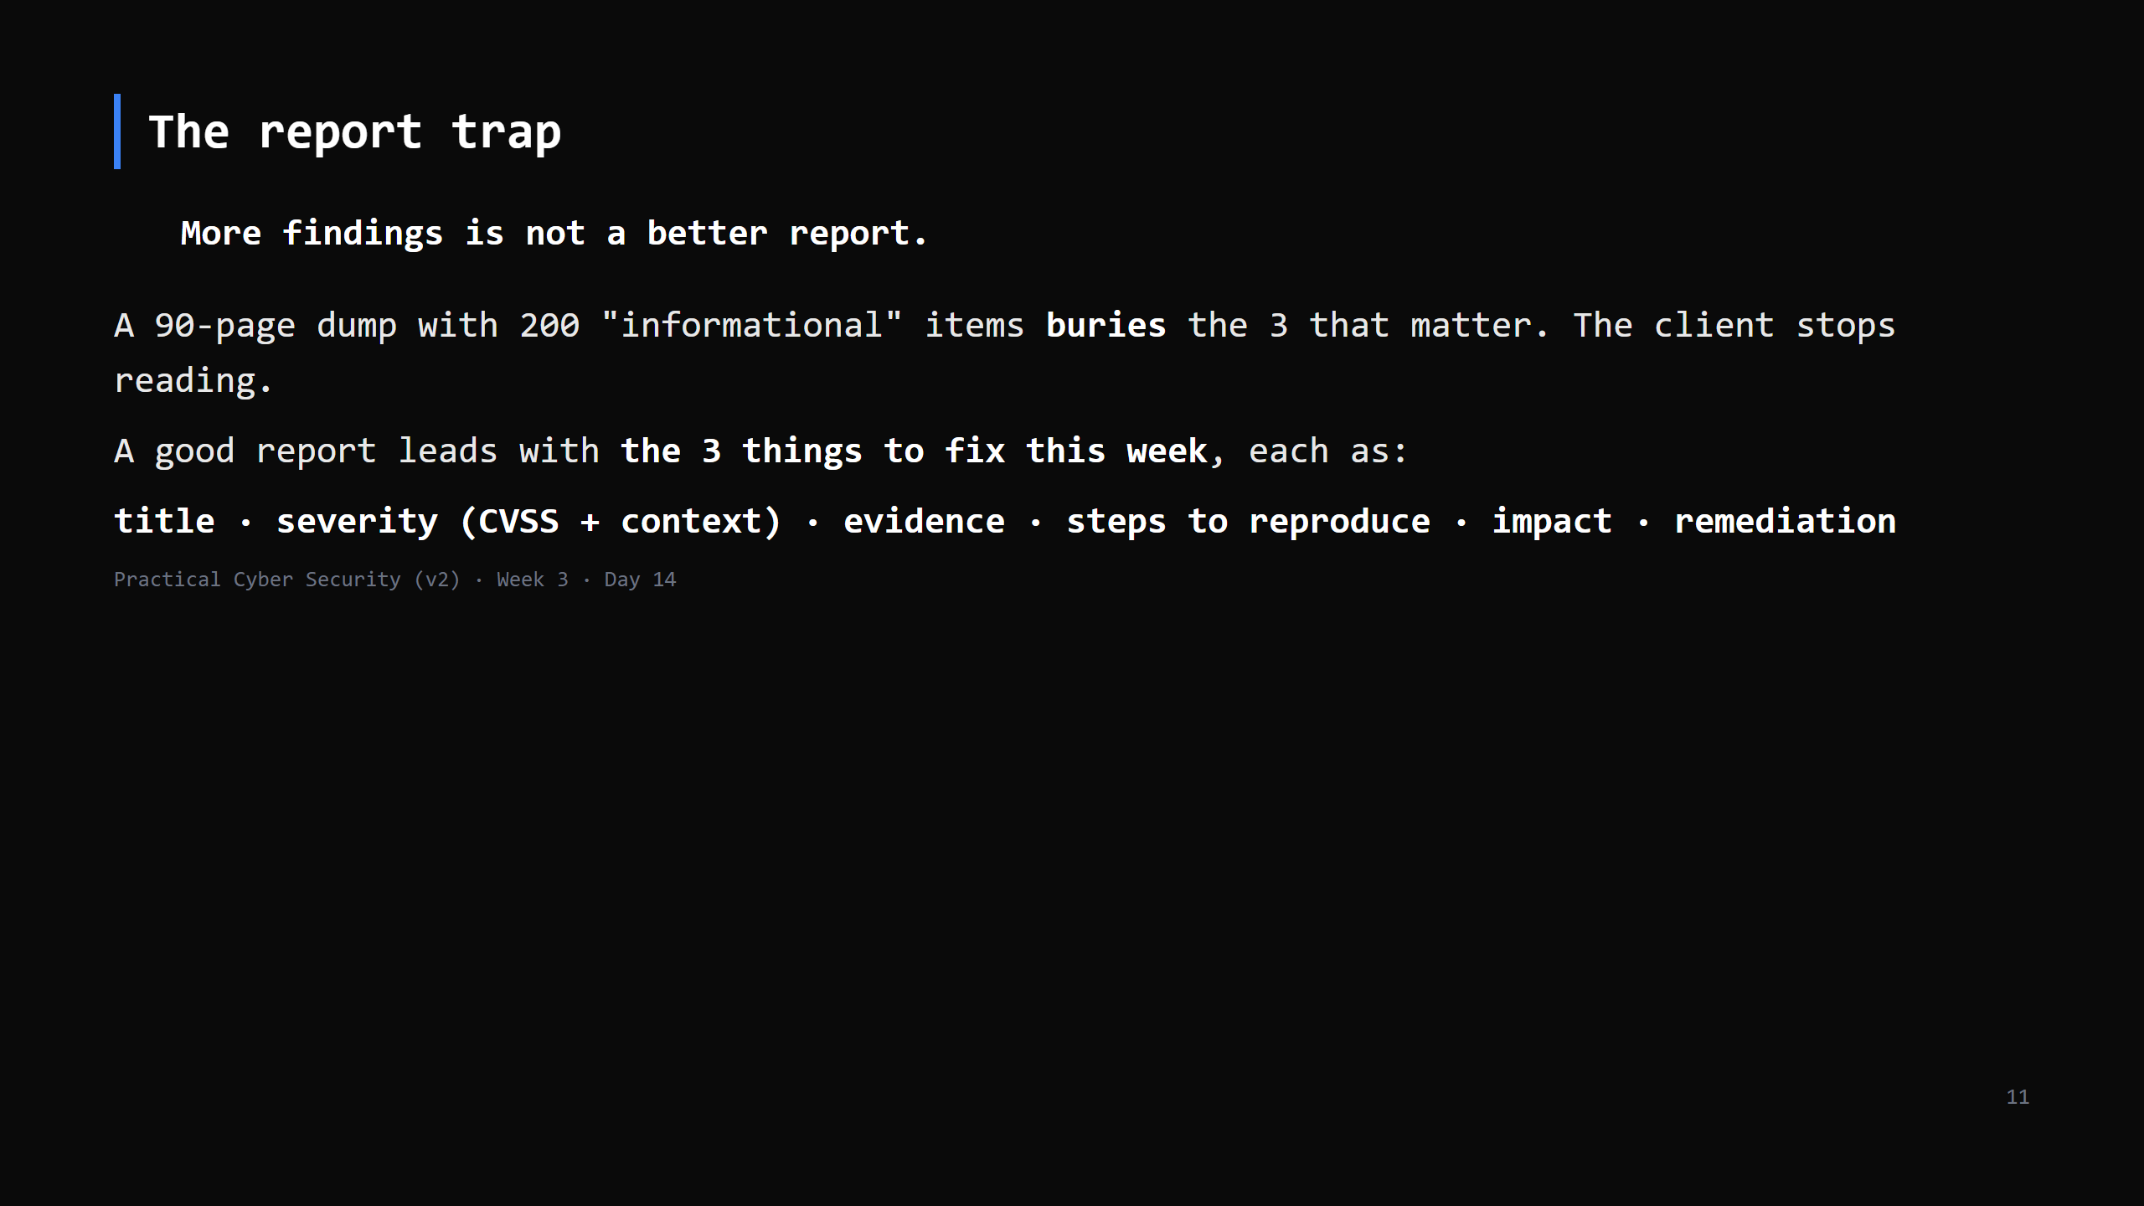
Notes:
The Day 14 trap. Junior testers pad reports to look thorough. Senior testers make the client's decision easy: "fix these 3 now, these 5 this month, the rest is hygiene." CUT this slide to the "a finding = ..." line if short.

Slide 12
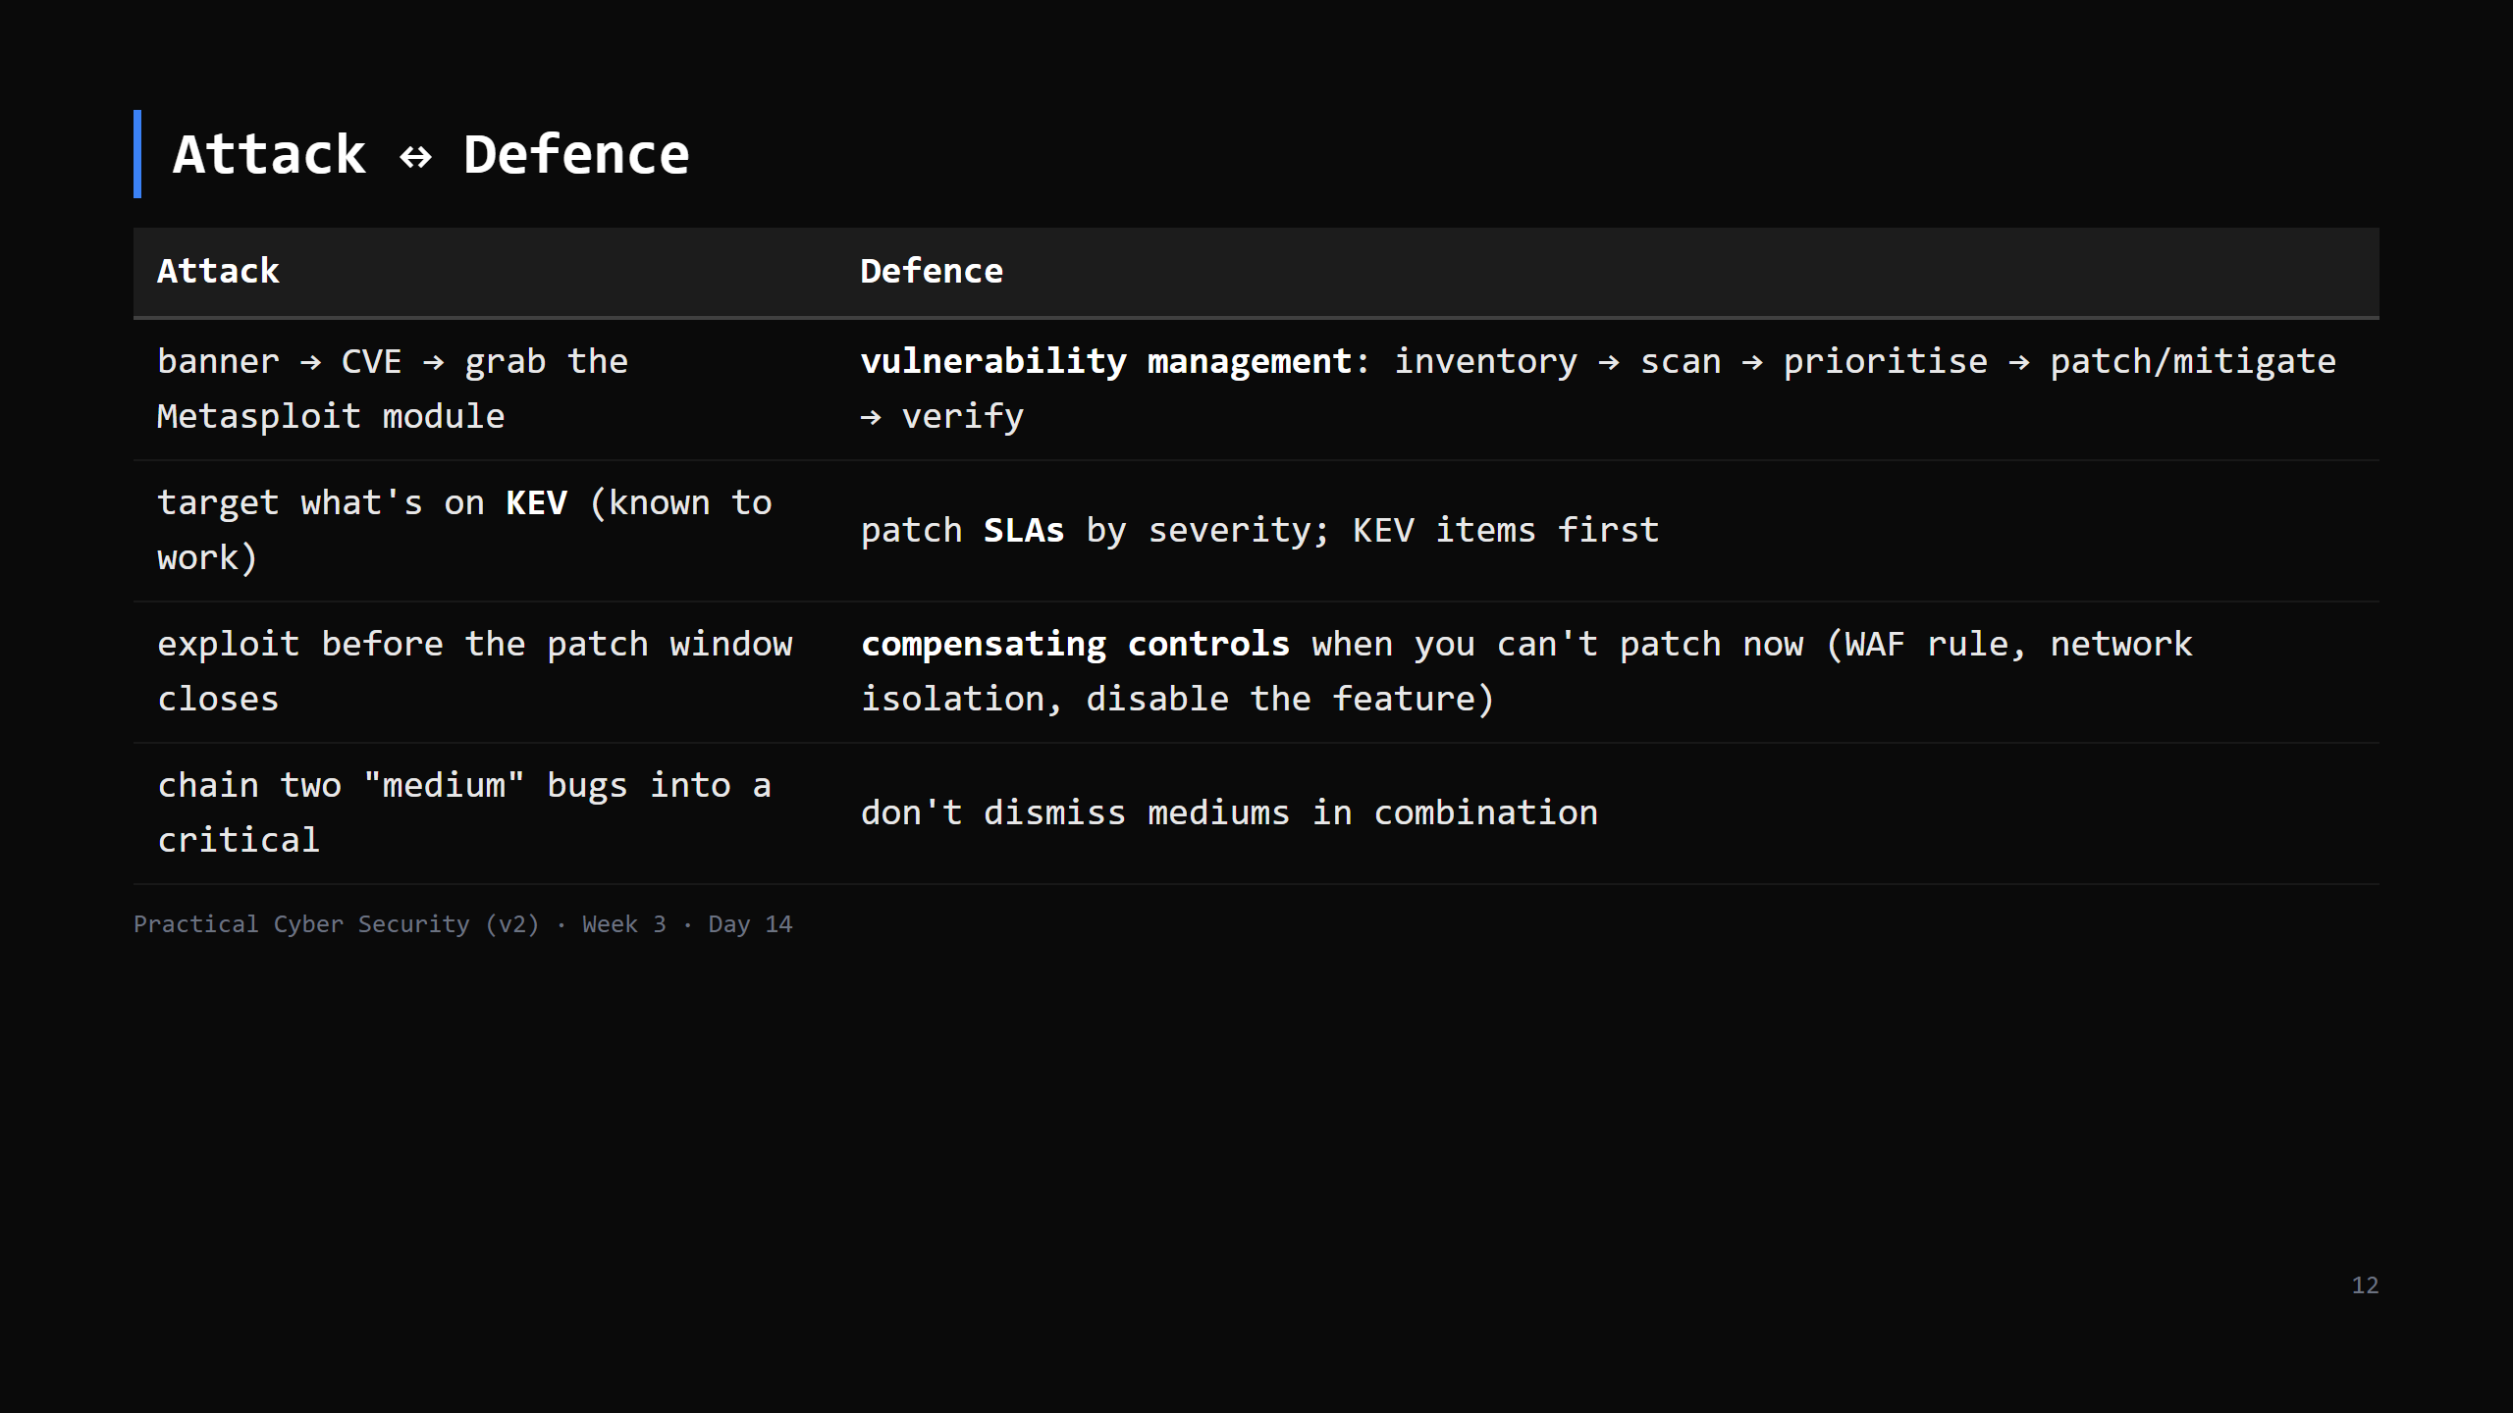
Notes:
Real orgs can't patch everything instantly - the discipline is a *program*: know what you have, scan regularly, fix by risk, and verify the fix landed. KEV gives you the "do these first" list for free.

Slide 13
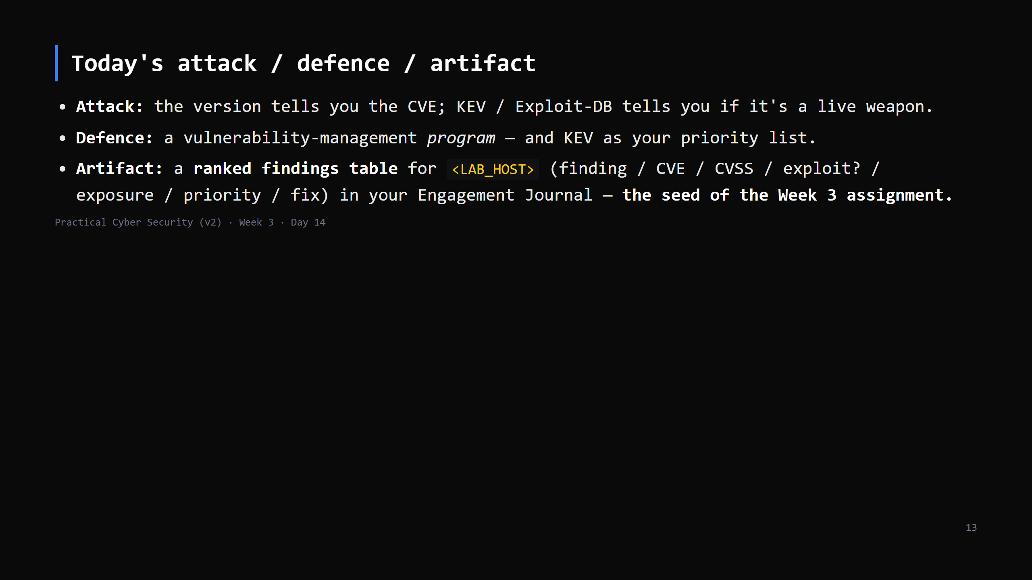

Slide 14
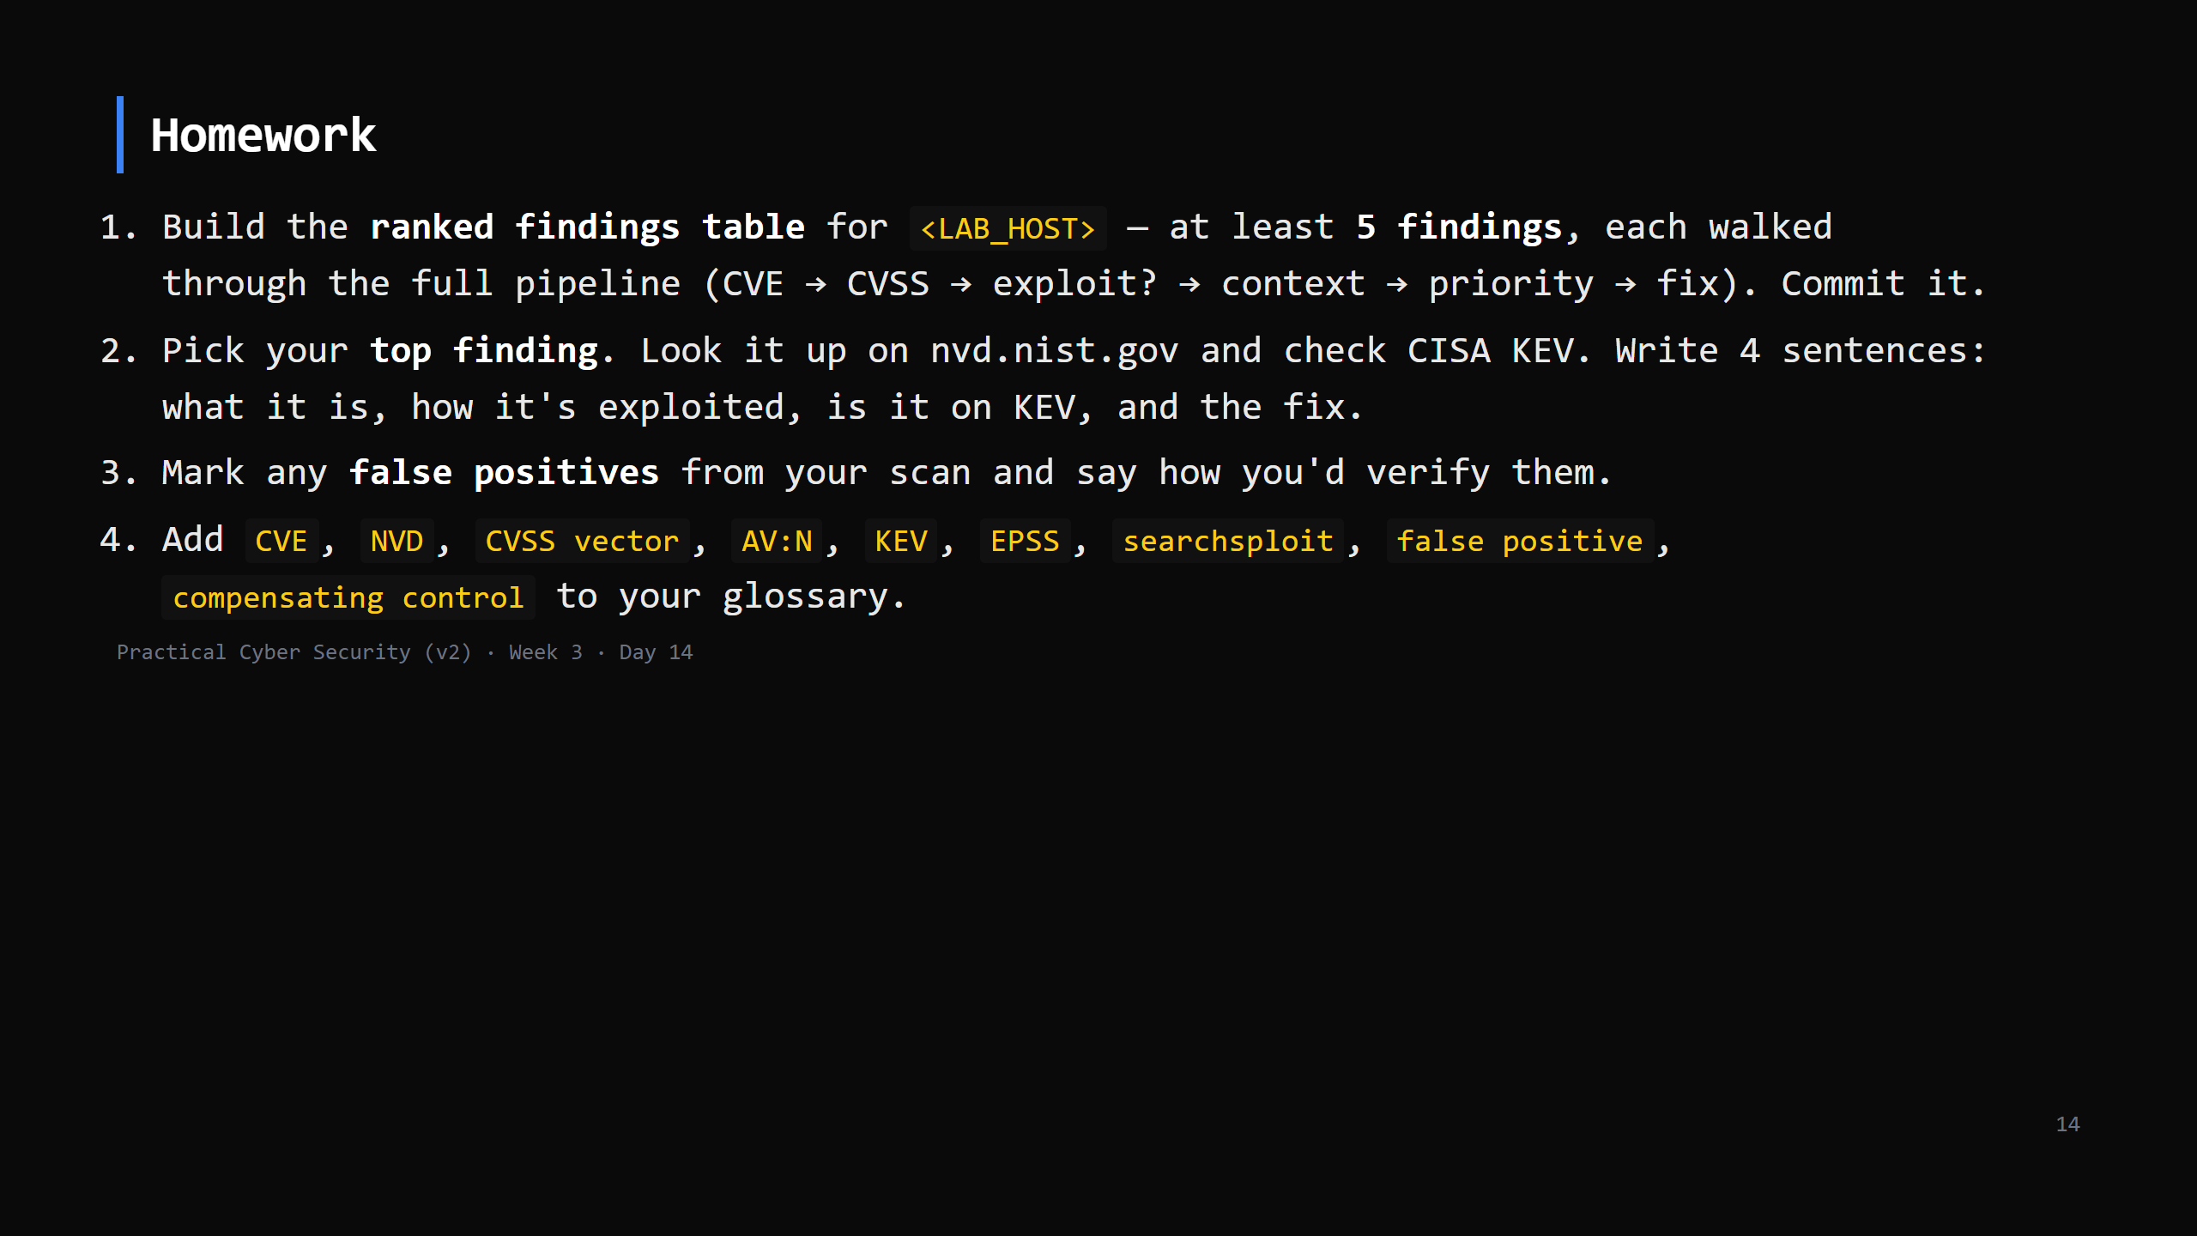
Notes:
Due start of Day 15 (the practice day). This table becomes Week 3 assignment Part A.

Slide 15
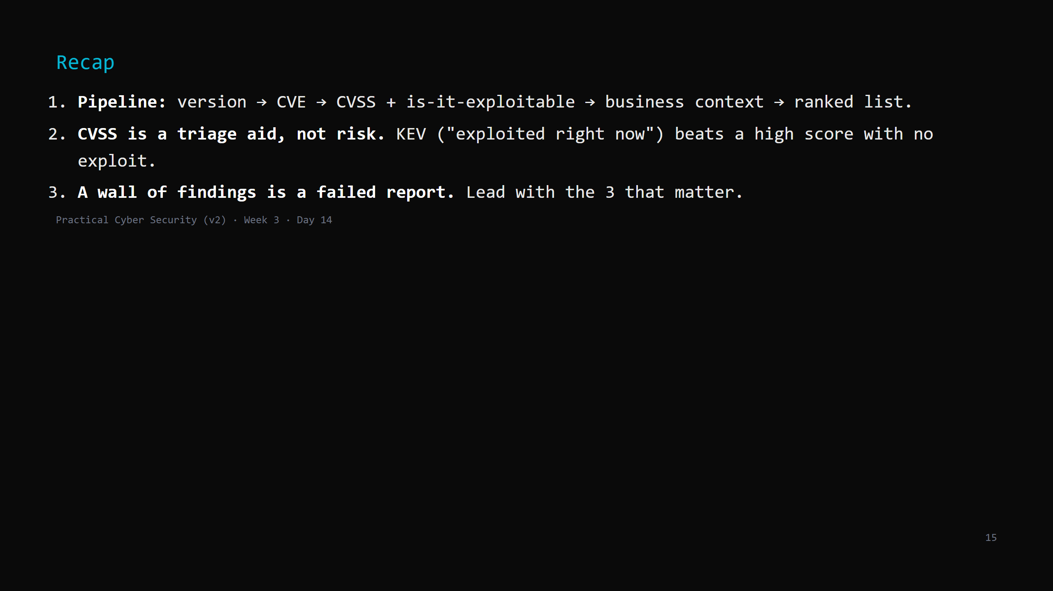
Notes:
Say the three lines. Tomorrow: the practice day - you run the whole lifecycle end to end (recon -> scan -> vuln -> proof) on a fresh target, coached, and write it up. Plus the Week 3 assignment brief.

