Slide 1
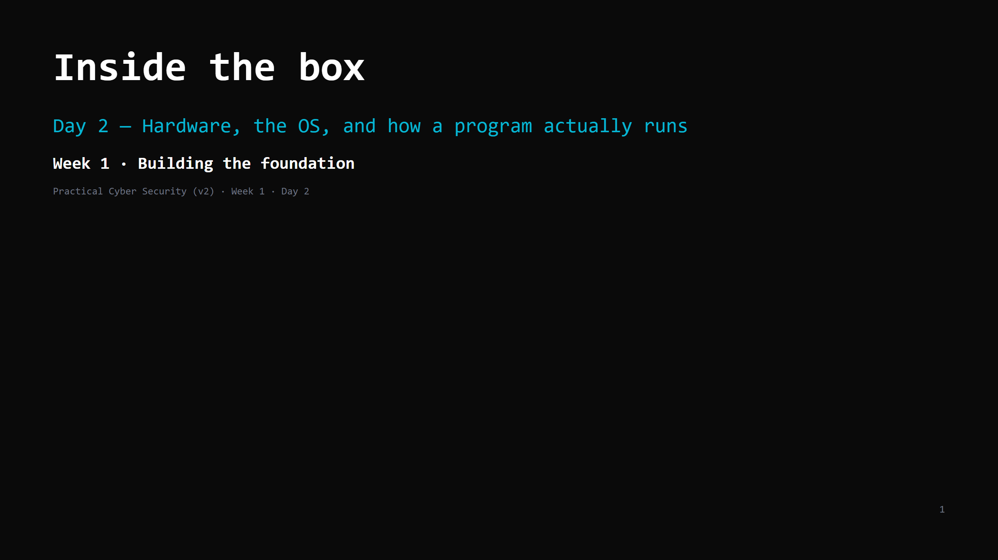
Notes:
RUN SHEET (~86 min planned): 00:00 Journey check + hook (htop on the projector) 5 00:05 The hardware that matters: CPU / RAM / disk 13 00:18 Program vs process 10 00:28 Source code -> running process 7 00:35 WHY A BUG BECOMES CONTROL (the peak — teach fresh) 12 00:47 The OS as referee + user/kernel + isolation 14 01:01 Hands-on: your own machine 18 01:19 Wrap + homework 5 CUT FIRST IF SHORT: the "interpreted languages" sub-point; the "referee is a defence" slide (fold into recap). Instructor-only crash demo can be dropped for the recording. NEVER CUT: program vs process, the "bug becomes control" seed, the hands-on steps 1-3. ONE ANALOGY all lesson: kitchen — chef=CPU, counter=RAM, pantry=disk, head chef on the pass=OS, walk-in freezer=kernel mode. Do not introduce a second analogy.

Slide 2
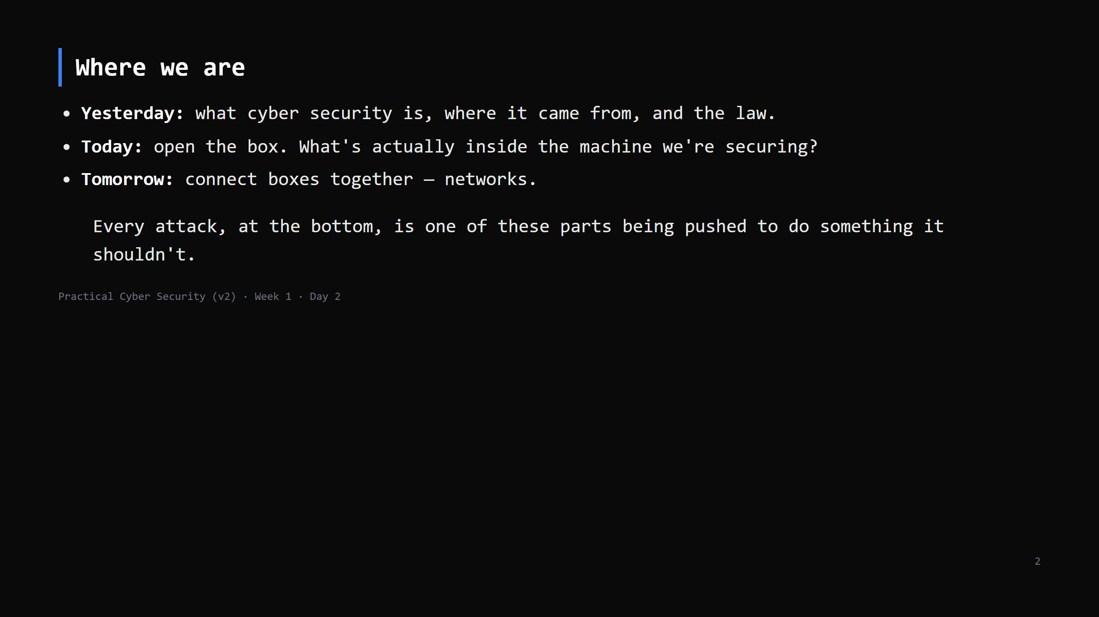
Notes:
The "Learning Journey Check" — do this every day. Yesterday / Today / Tomorrow, one line each. It stops students feeling lost in the sequence.

Slide 3
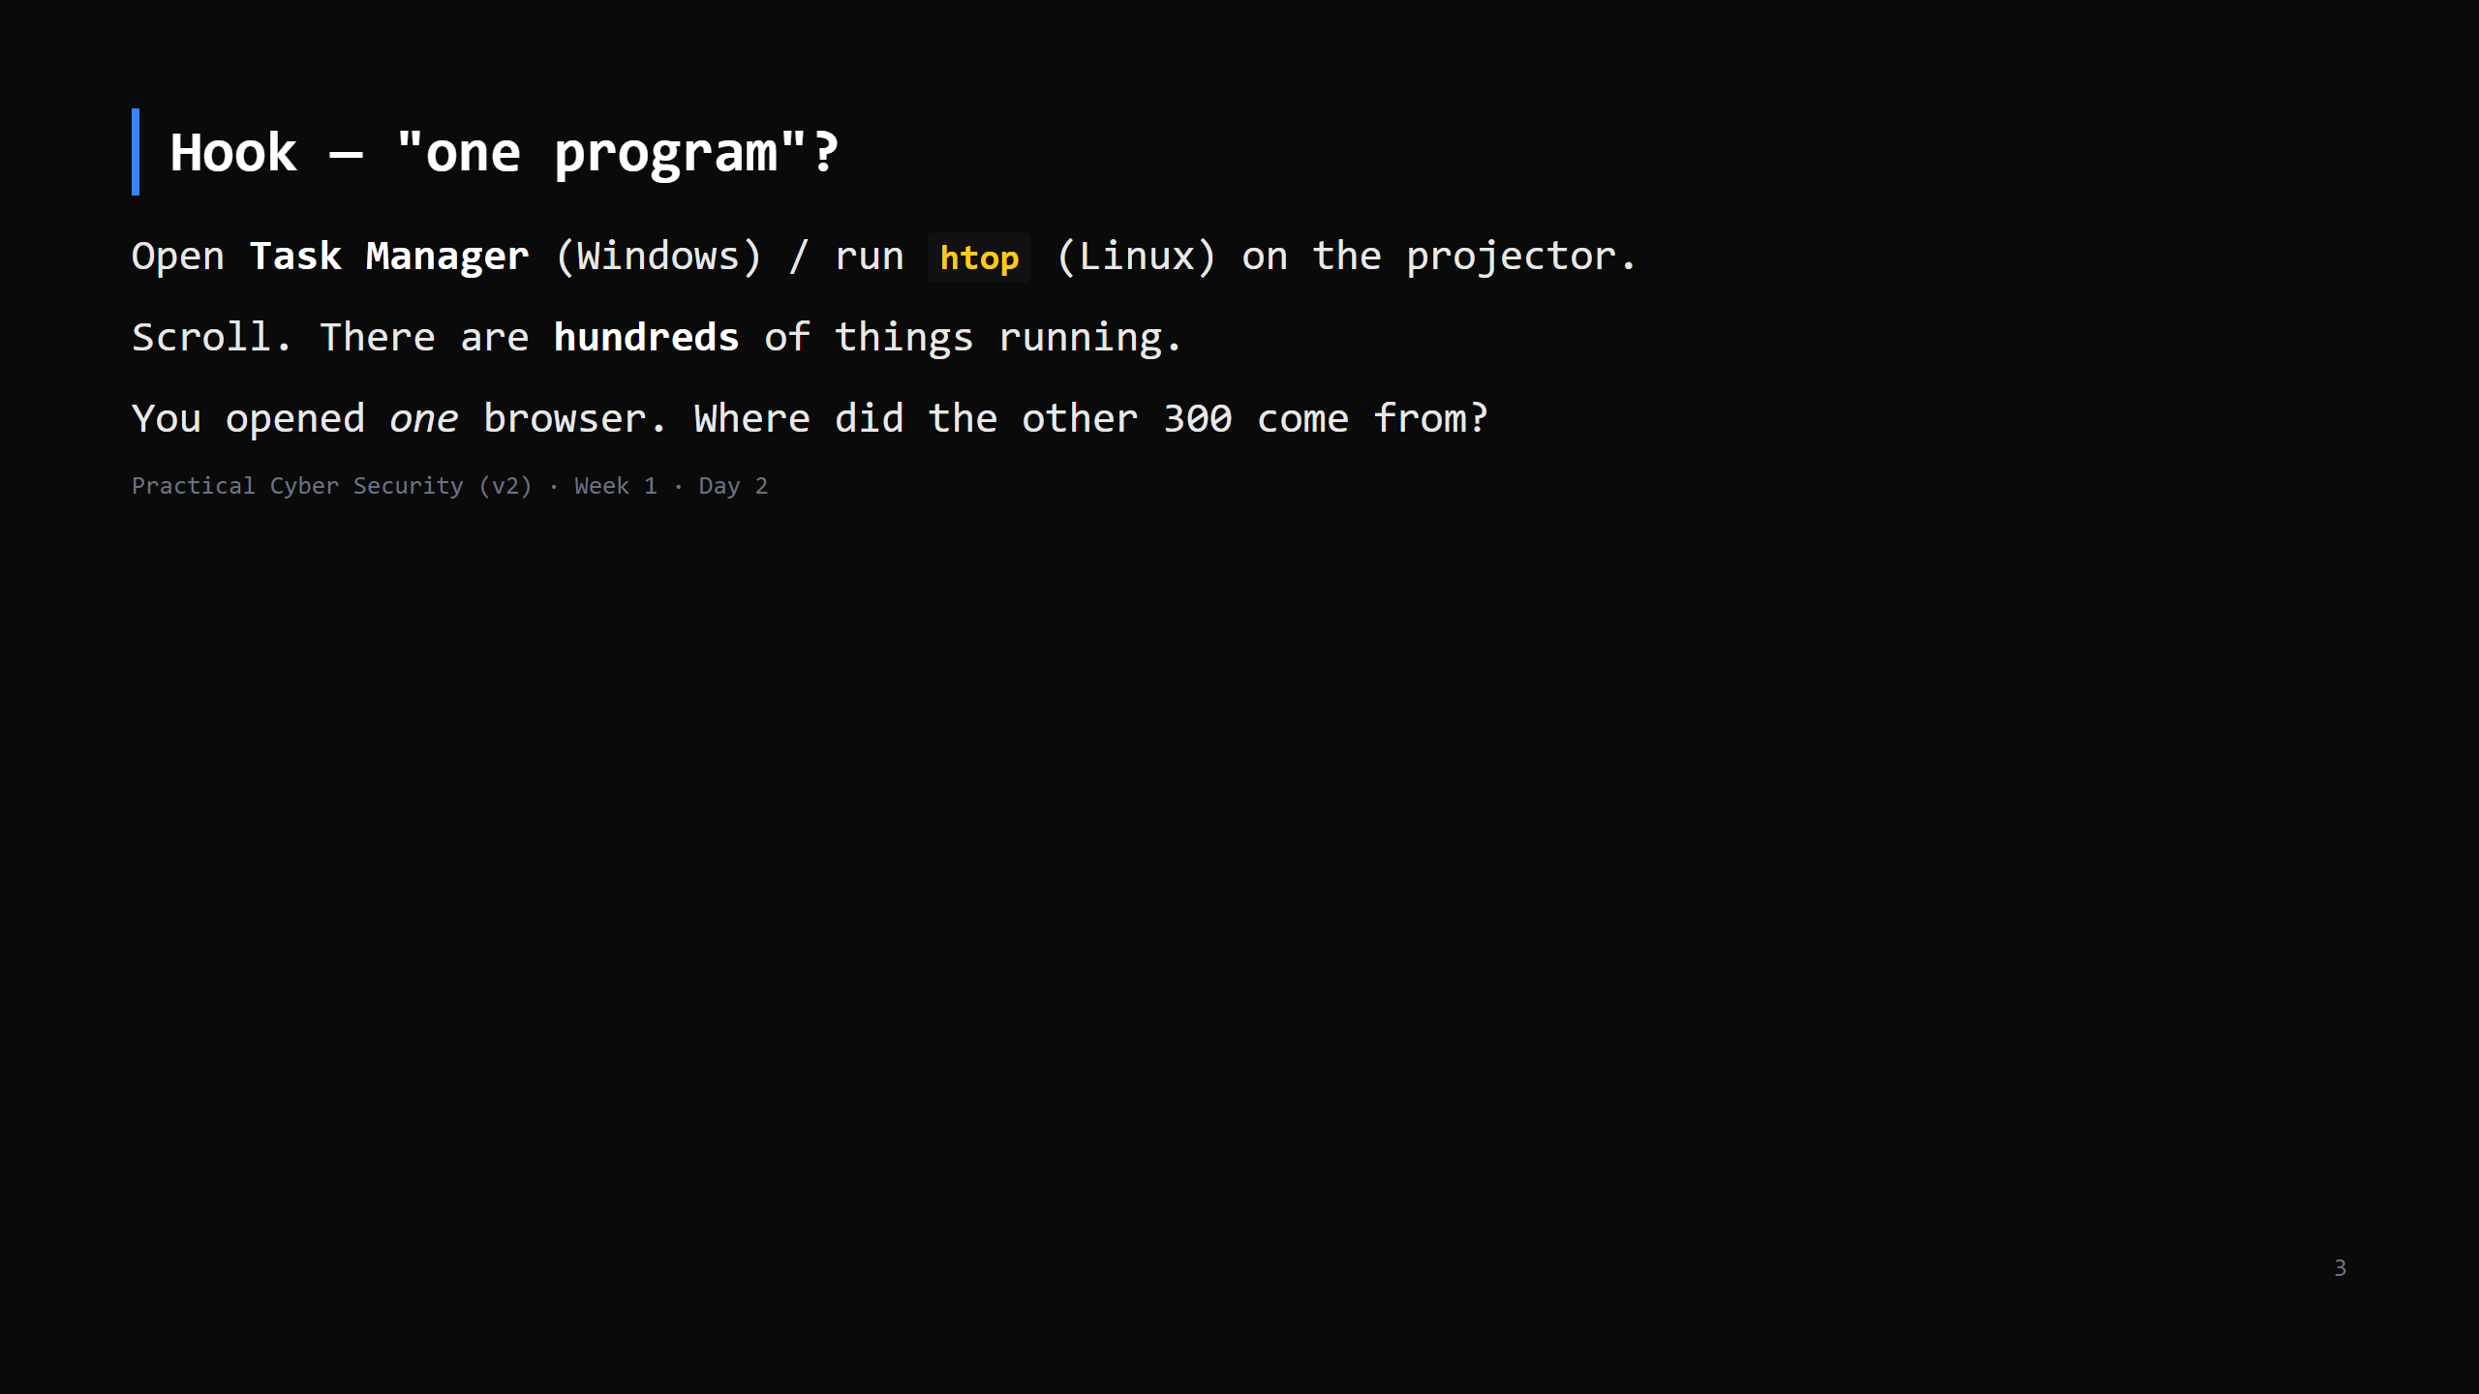
Notes:
Let it sit. Sort by memory. Point at how many entries there are. The answer — processes, and the OS juggling them — is the whole lesson. Don't answer yet.

Slide 4
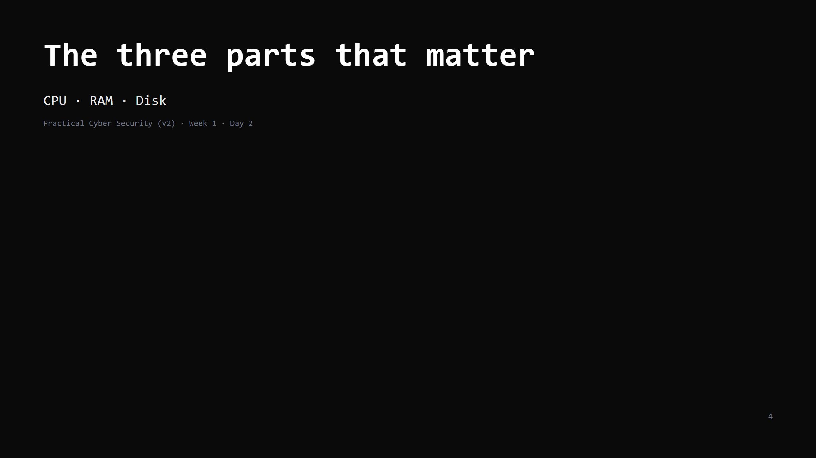
Notes:
There's more in a computer (GPU, network card, buses) but for security reasoning these three are what you need. Keep it to three.

Slide 5
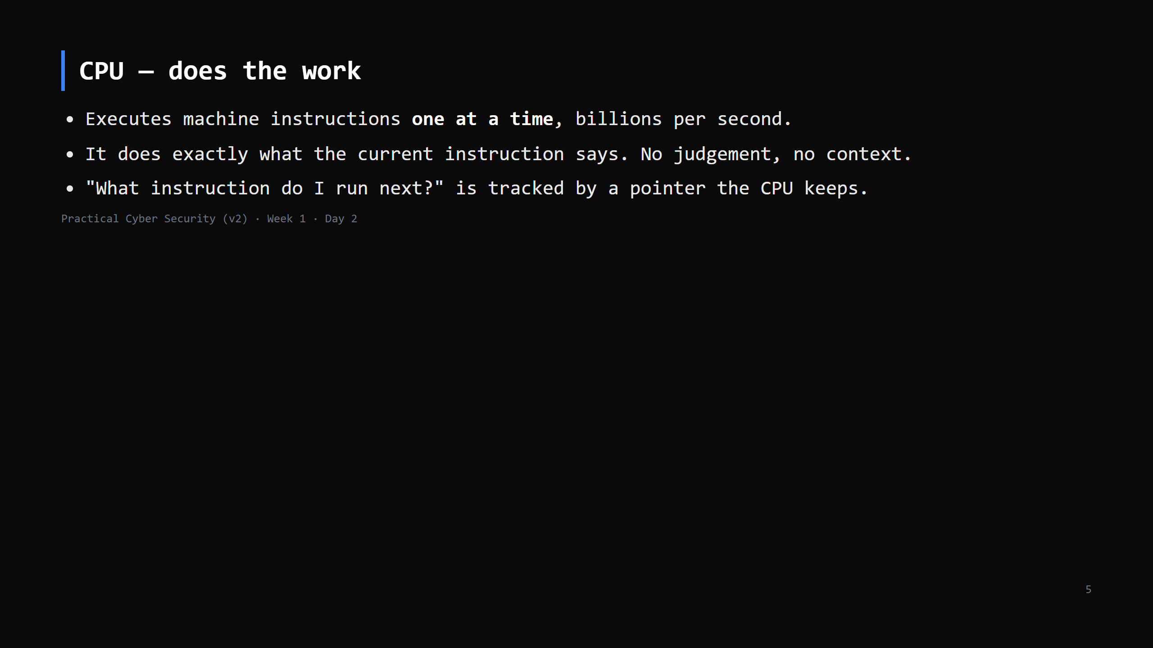
Notes:
The CPU is dumb and fast and obedient. That obedience is why "if I can change what instruction comes next, I control the machine" (slide later). The "next instruction" pointer is the instruction pointer / program counter. Name it lightly.

Slide 6
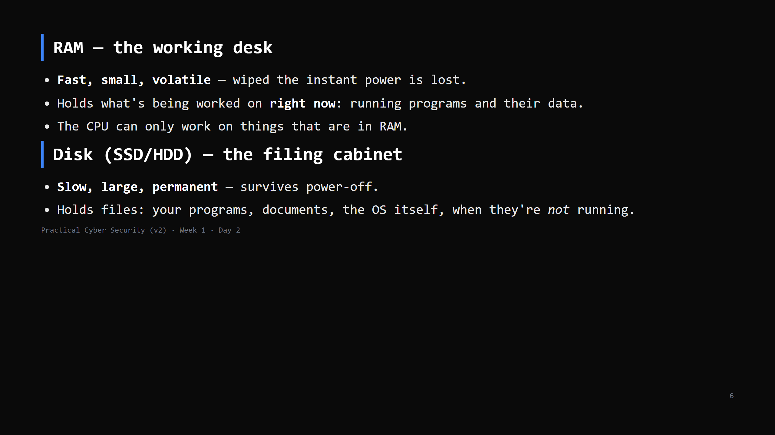
Notes:
MISCONCEPTION TO KILL: "RAM and storage are the same thing." They are not. "8 GB of RAM" is not "8 GB of files." Closing a laptop lid vs shutting down: RAM contents are what you lose on shutdown. Analogy we reuse: kitchen. CPU = chef. RAM = the counter you're actively working on. Disk = the pantry. You fetch ingredients from the pantry to the counter to cook.

Slide 7
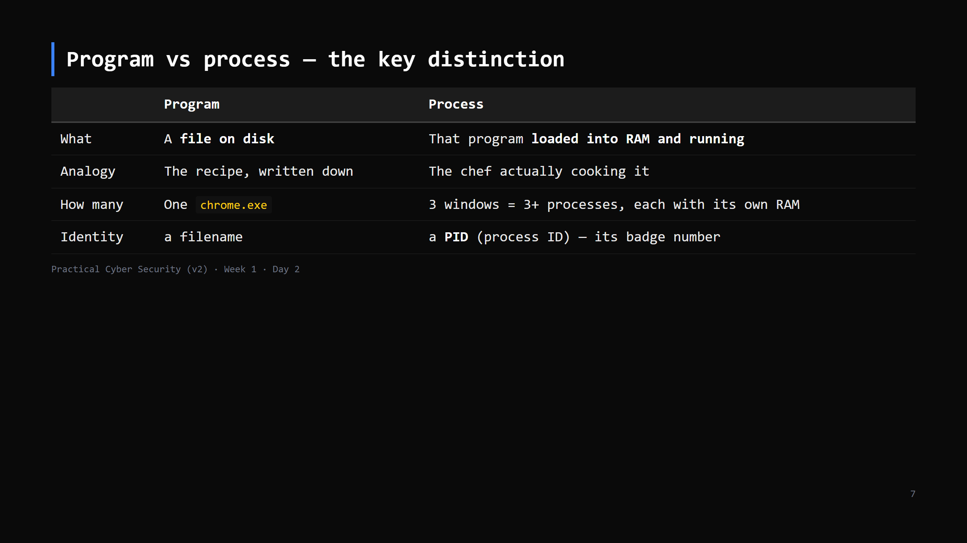
Notes:
This is the single most important distinction of the day. Say it three ways. A program does nothing. It's inert text on disk. It only "does" anything when the OS turns it into a process. Killing a process doesn't delete the program. Deleting the program doesn't stop a running process. MISCONCEPTION: "I closed the window so the program stopped." Sometimes the process keeps running in the background. Show one in Task Manager.

Slide 8
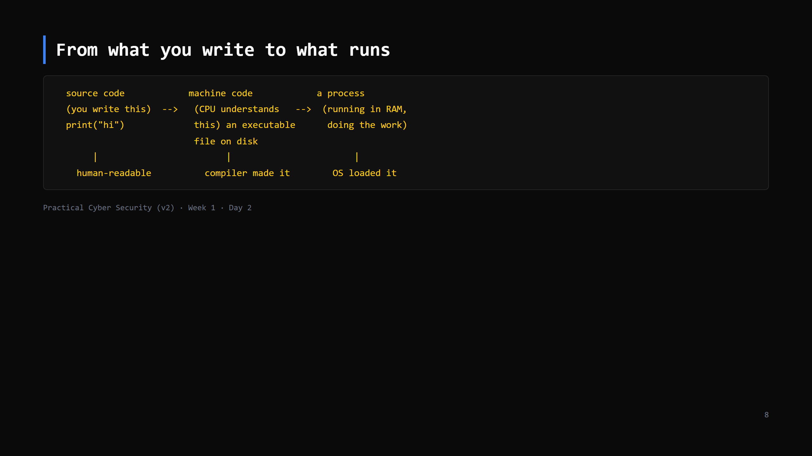
Notes:
Step through it: 1. You write source code — English-ish, for humans. 2. A COMPILER translates it into machine code — raw CPU instructions — and writes an executable file to disk (e.g. a .exe, or an ELF binary on Linux). 3. You run it: the OS reads that file, copies it into RAM, lays out its memory, points the CPU at the first instruction. Now it's a process. Interpreted languages (Python, JavaScript): there's no compile-to-exe step you see — the Python interpreter is itself a running process that reads your script line by line. CUT the interpreted-languages point first if short.

Slide 9
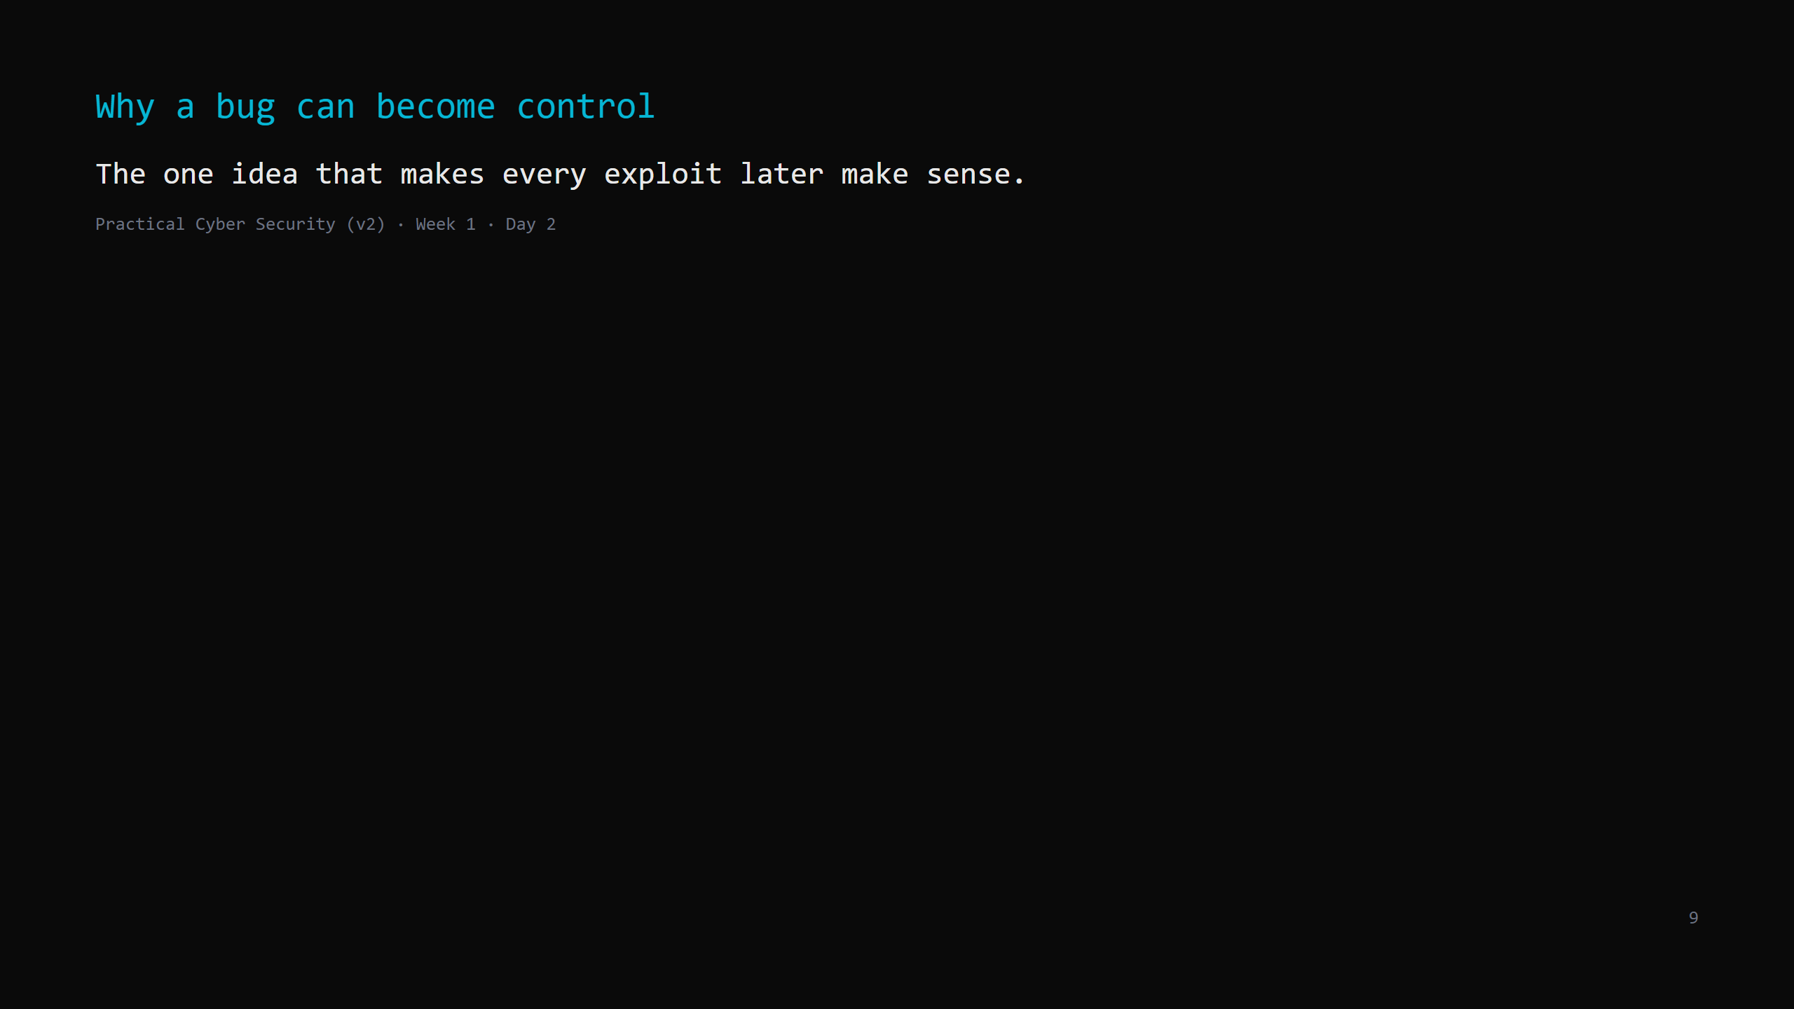
Notes:
This is the intellectual peak of the lesson — teach it now, while the room is fresh, not at the end. Budget ~12 minutes. Slow right down.

Slide 10
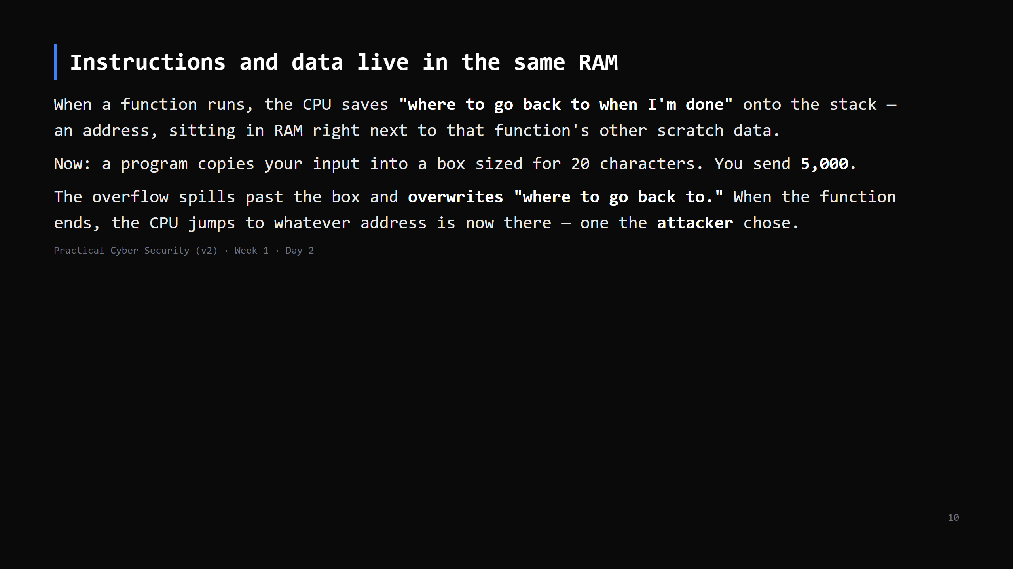
Notes:
Draw it: a row of boxes on the board. [ input box (20) ][ ...other stuff... ][ where-to-go-back ]. Scribble the input box overflowing rightward into "where-to-go-back". We are NOT exploiting anything today. The takeaway is one sentence, say it twice: "a crash bug and 'the attacker runs their code' are usually the SAME bug — that's why memory-safety bugs are treated as critical." This is a "buffer overflow". They'll hear the term; they don't need more than this today.

Slide 11
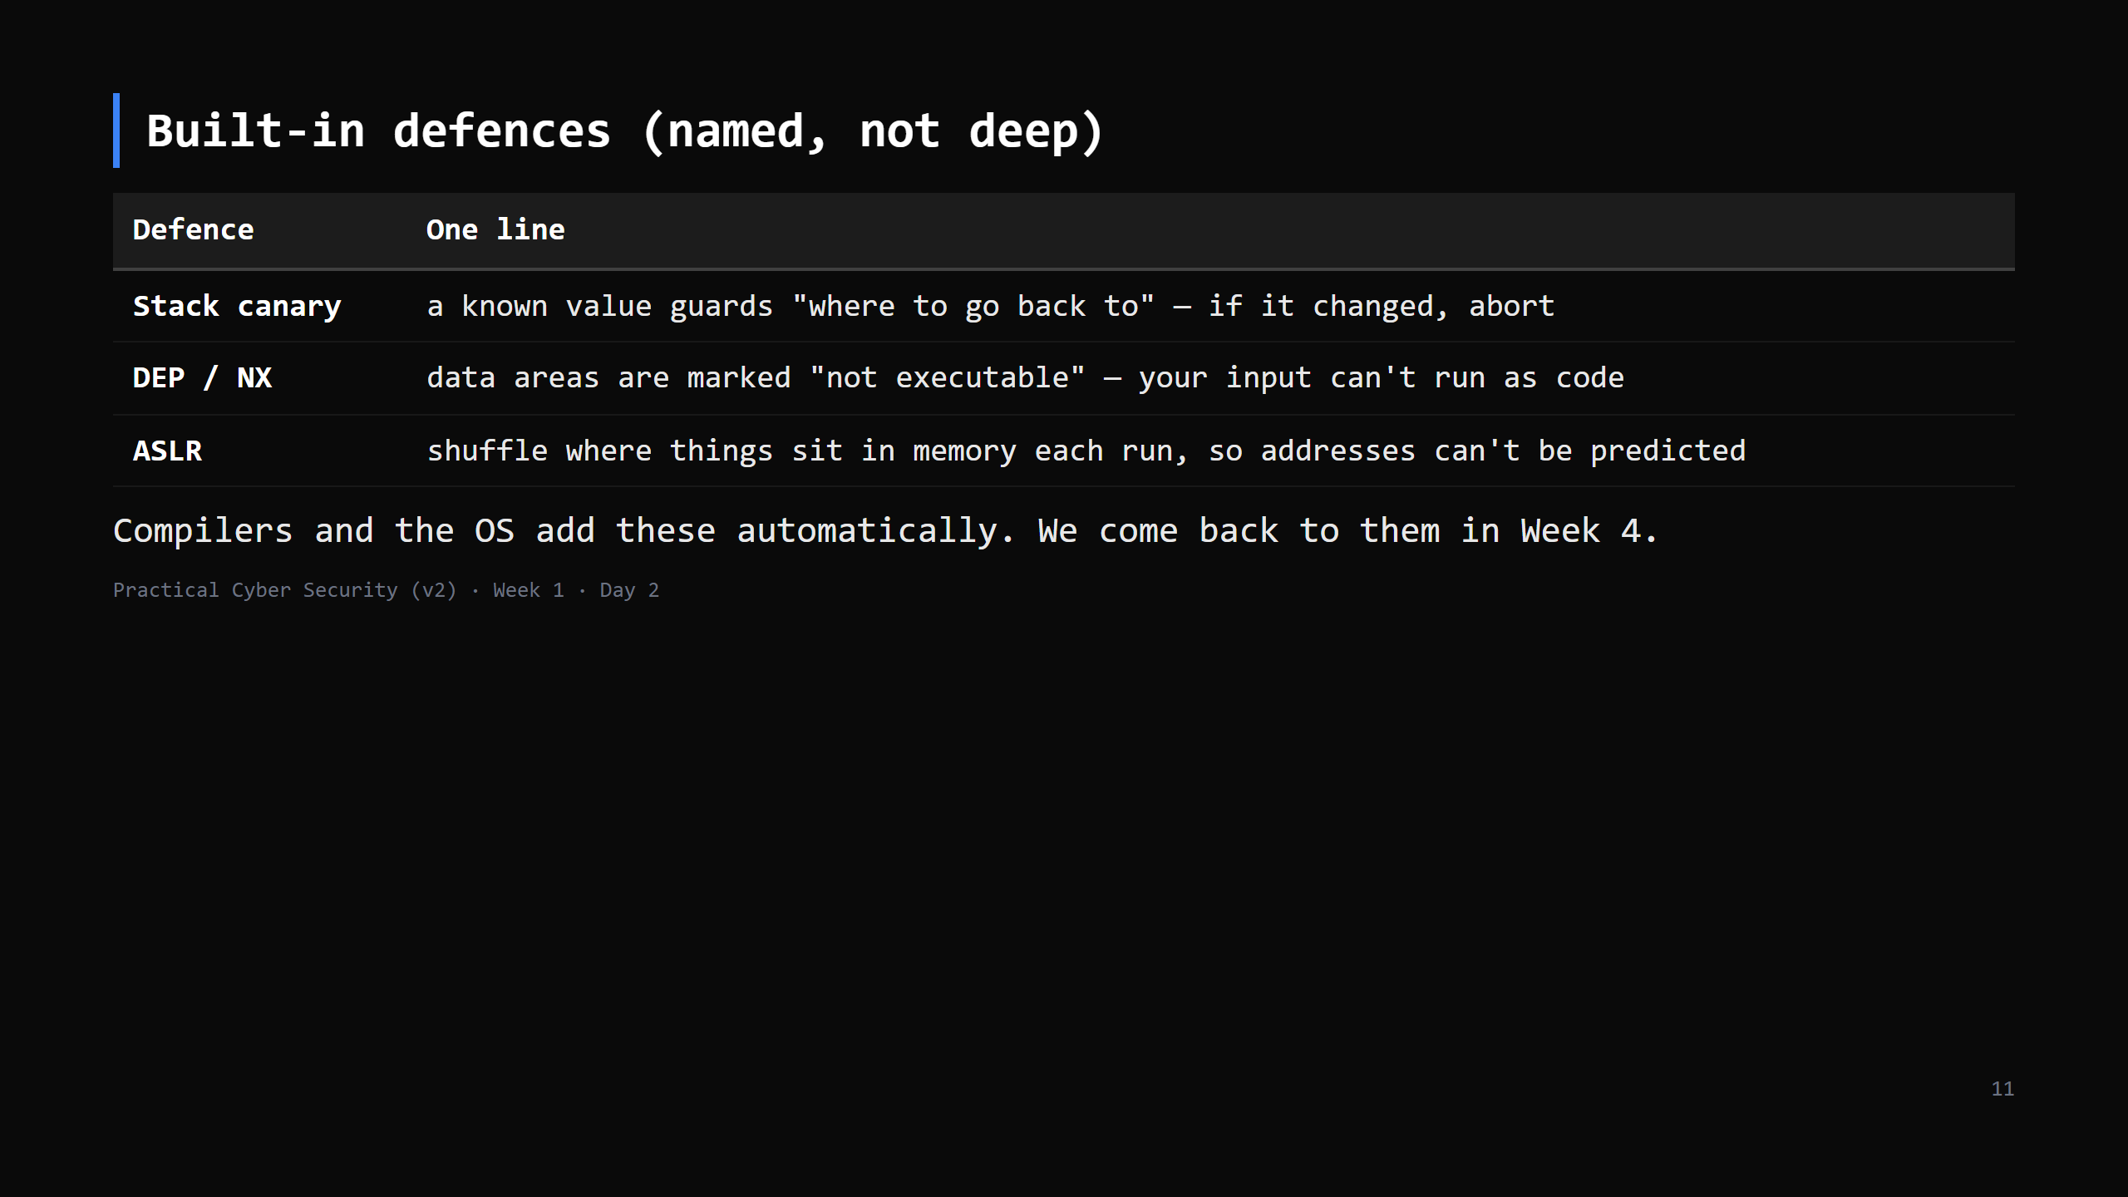
Notes:
One line each. The point isn't the mechanism — it's that defence is layered and already built in. Don't let a keen student pull you into ROP/bypasses; "Week 4".

Slide 12
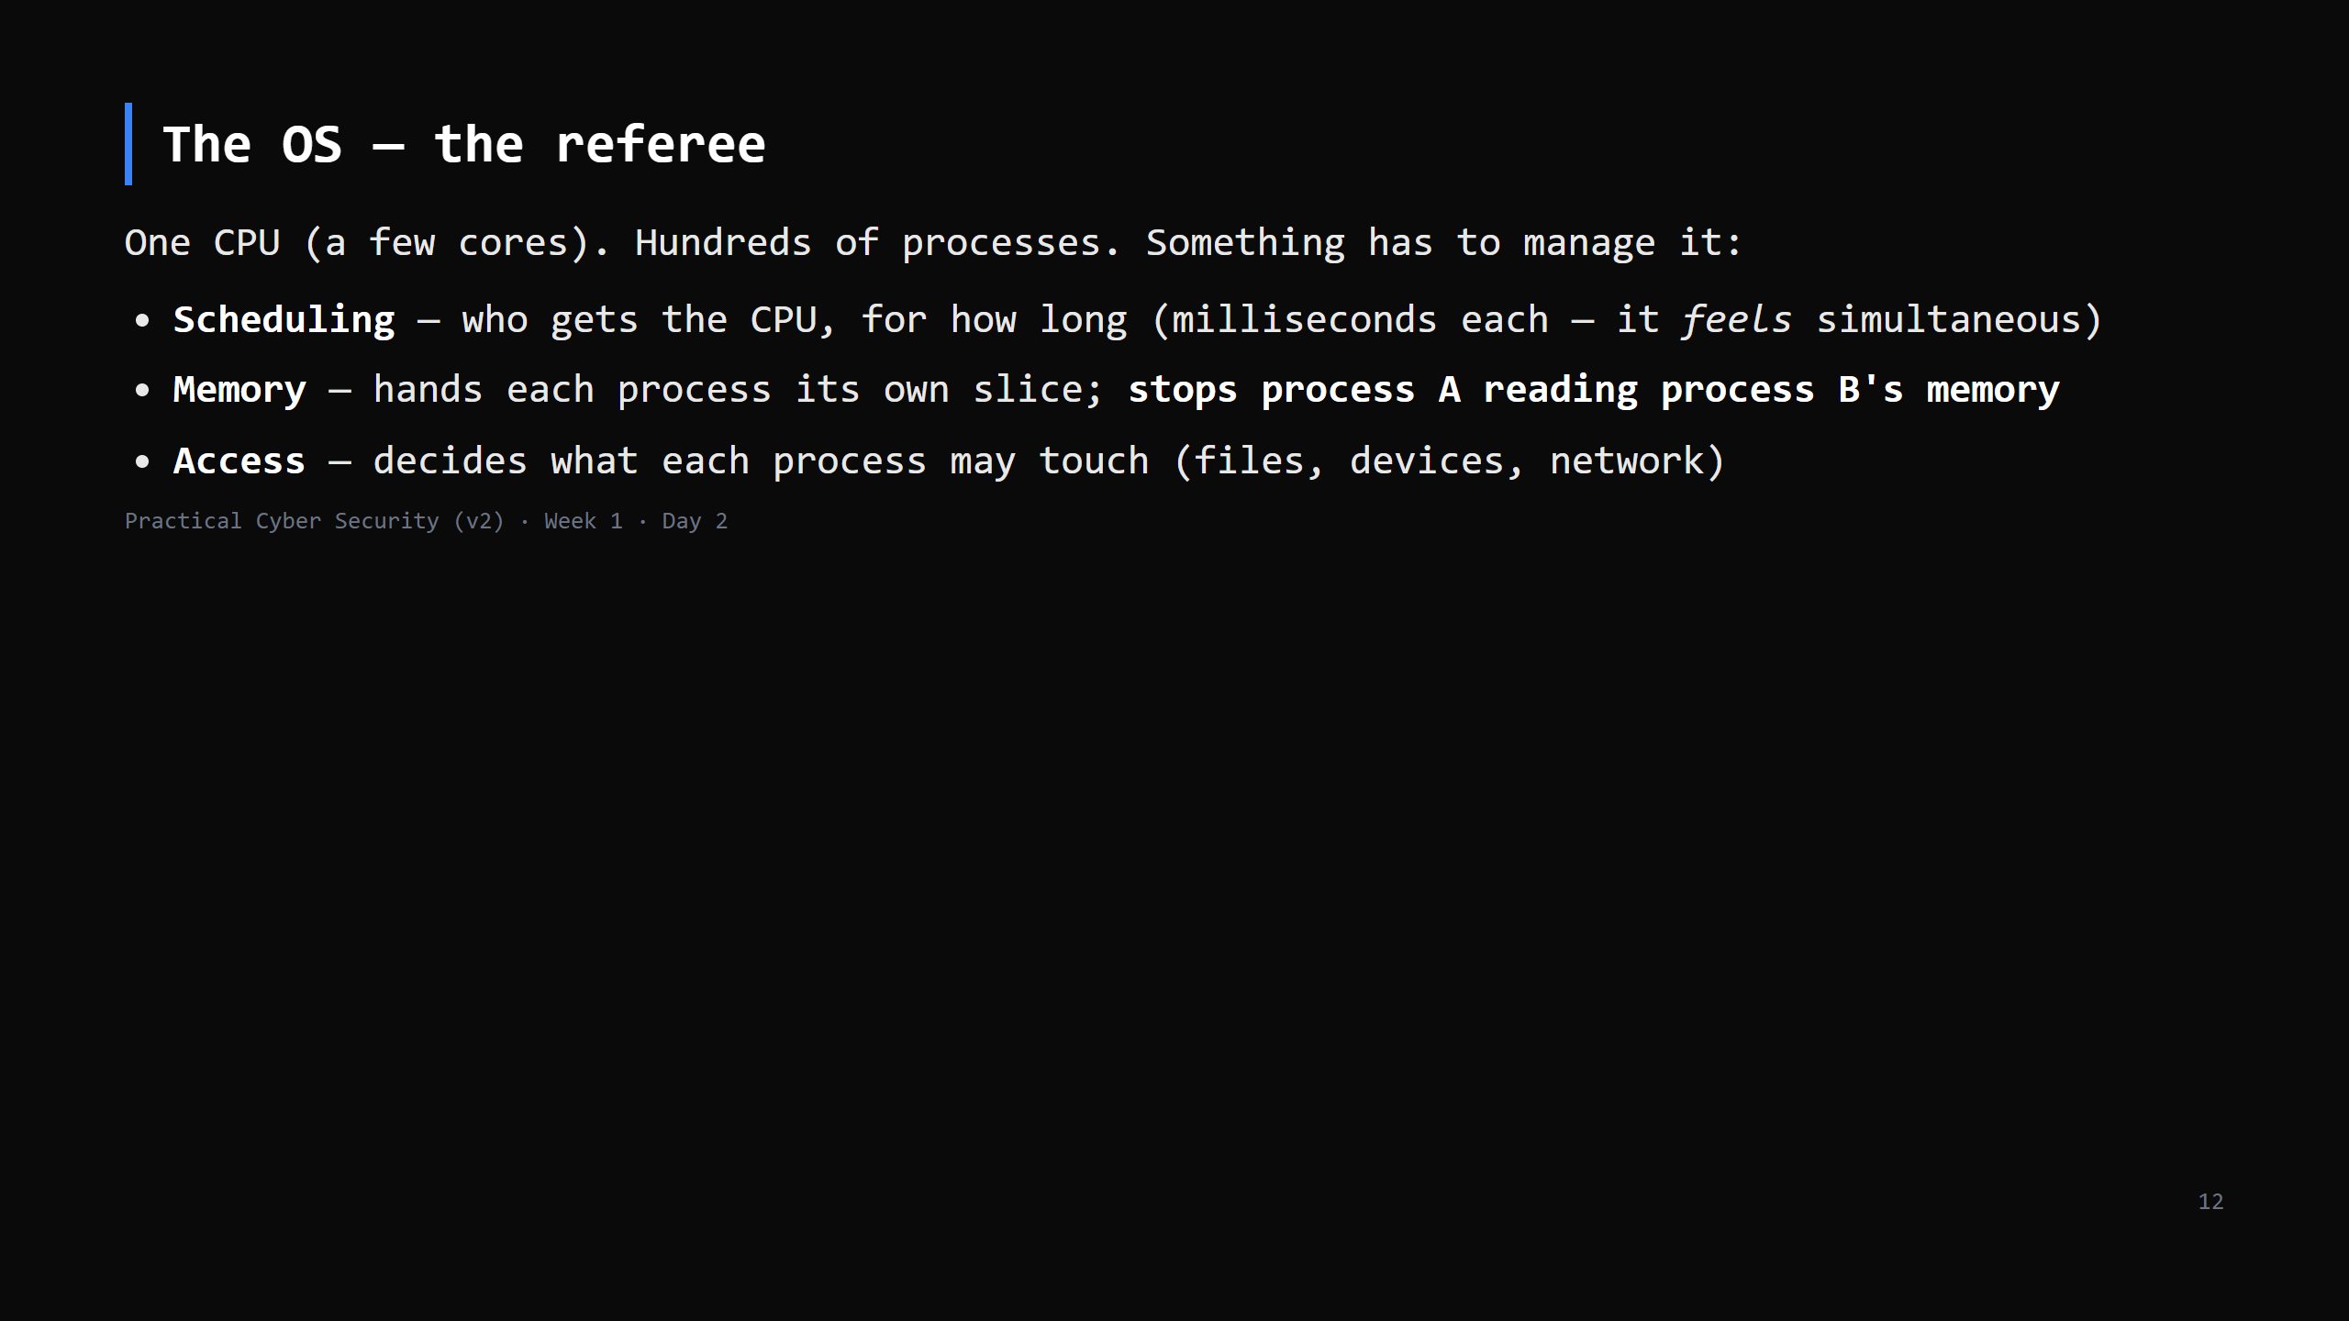
Notes:
Extend the kitchen: the OS is the head chef running the pass — deciding who cooks what, when, and keeping each cook at their own station. This referee role is why the OS is the layer attackers most want to control and defenders most want to harden — Week 2 is all about it.

Slide 13
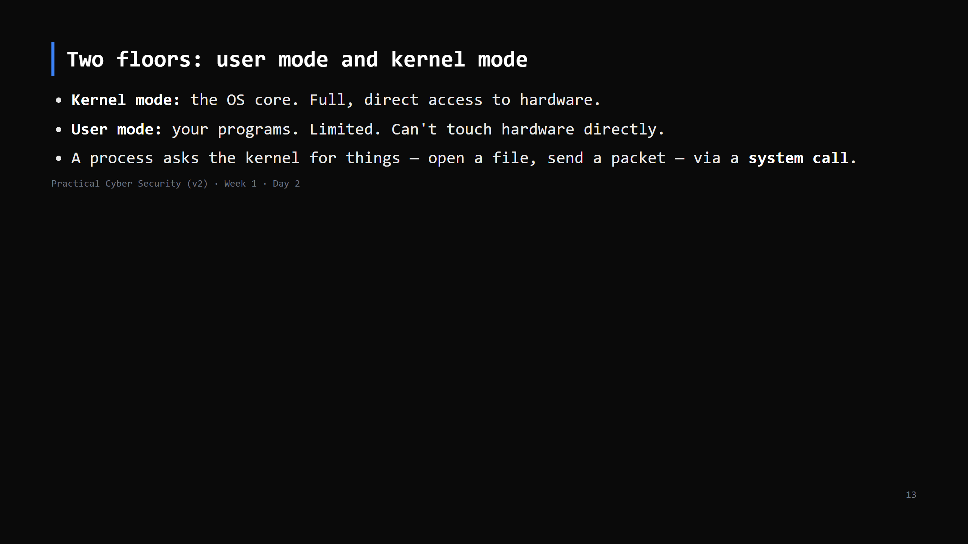
Notes:
Stay in the kitchen: line cooks (user mode) can't walk into the walk-in freezer / dry store (kernel mode) — they call out an order to the person who can (a system call). One analogy all lesson: chef=CPU, counter=RAM, pantry=disk, head chef on the pass=OS, freezer=kernel. Why it matters: attacker code stuck in user mode is limited to what that user can do.

Slide 14
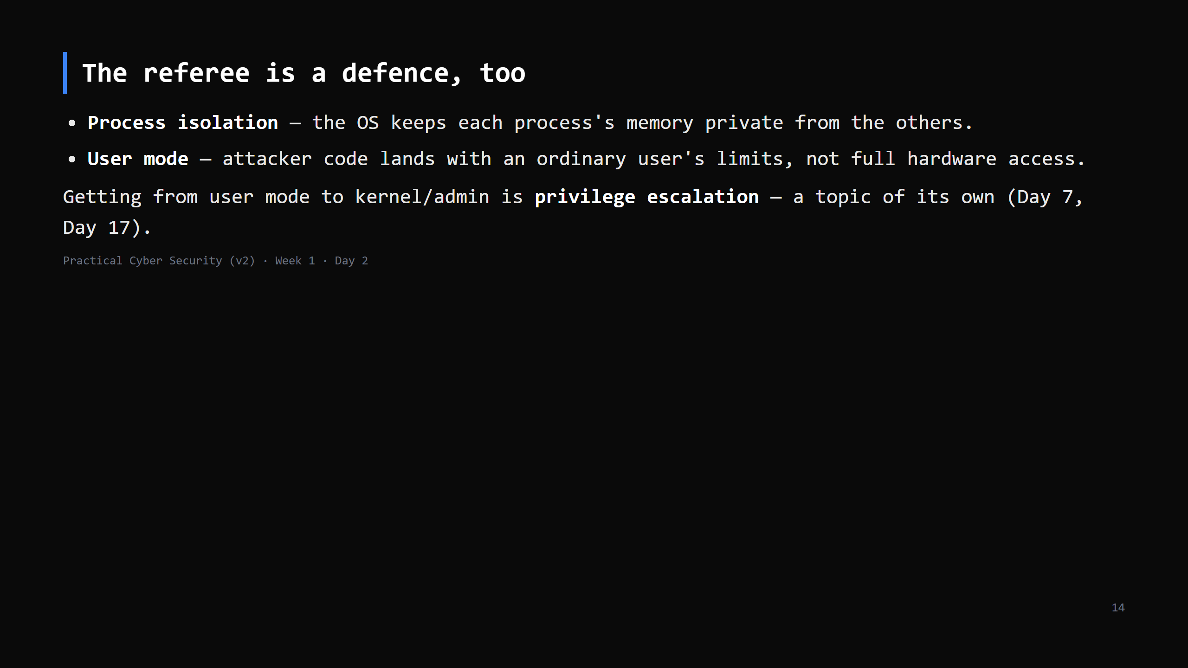
Notes:
Ties the OS section back to the "defences" idea. Isolation + least privilege are the two biggest structural defences and both come from the OS. Forward-ref privilege escalation.

Slide 15
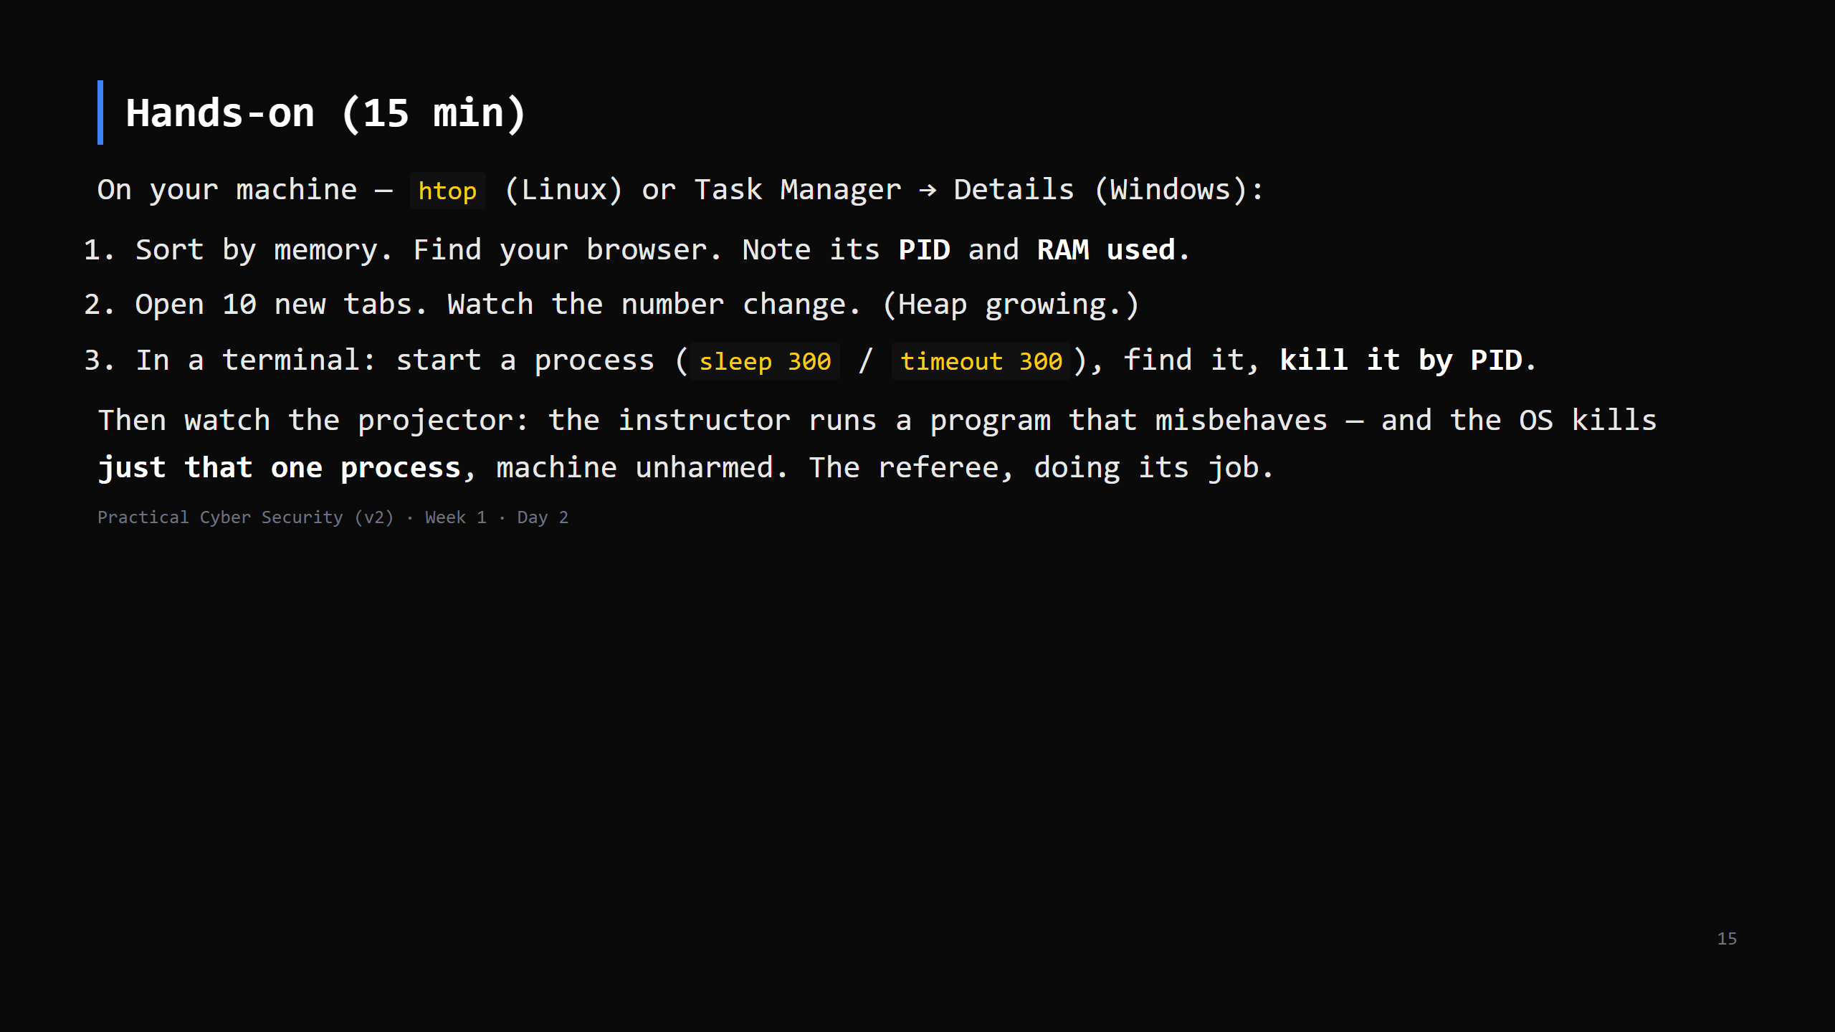
Notes:
Students do steps 1-3 (all three, everyone). Step 4 is INSTRUCTOR-ONLY on the Linux projector machine — `python3 assets/crash.py` reads address 0 and segfaults cleanly on Linux; on Windows it often surfaces as a catchable OSError, so don't have students run it. Pre-flight the night before and record assets/crash-demo.mp4 as the fallback. Windows students: Task Manager -> Details tab shows PID; right-click -> End task.

Slide 16
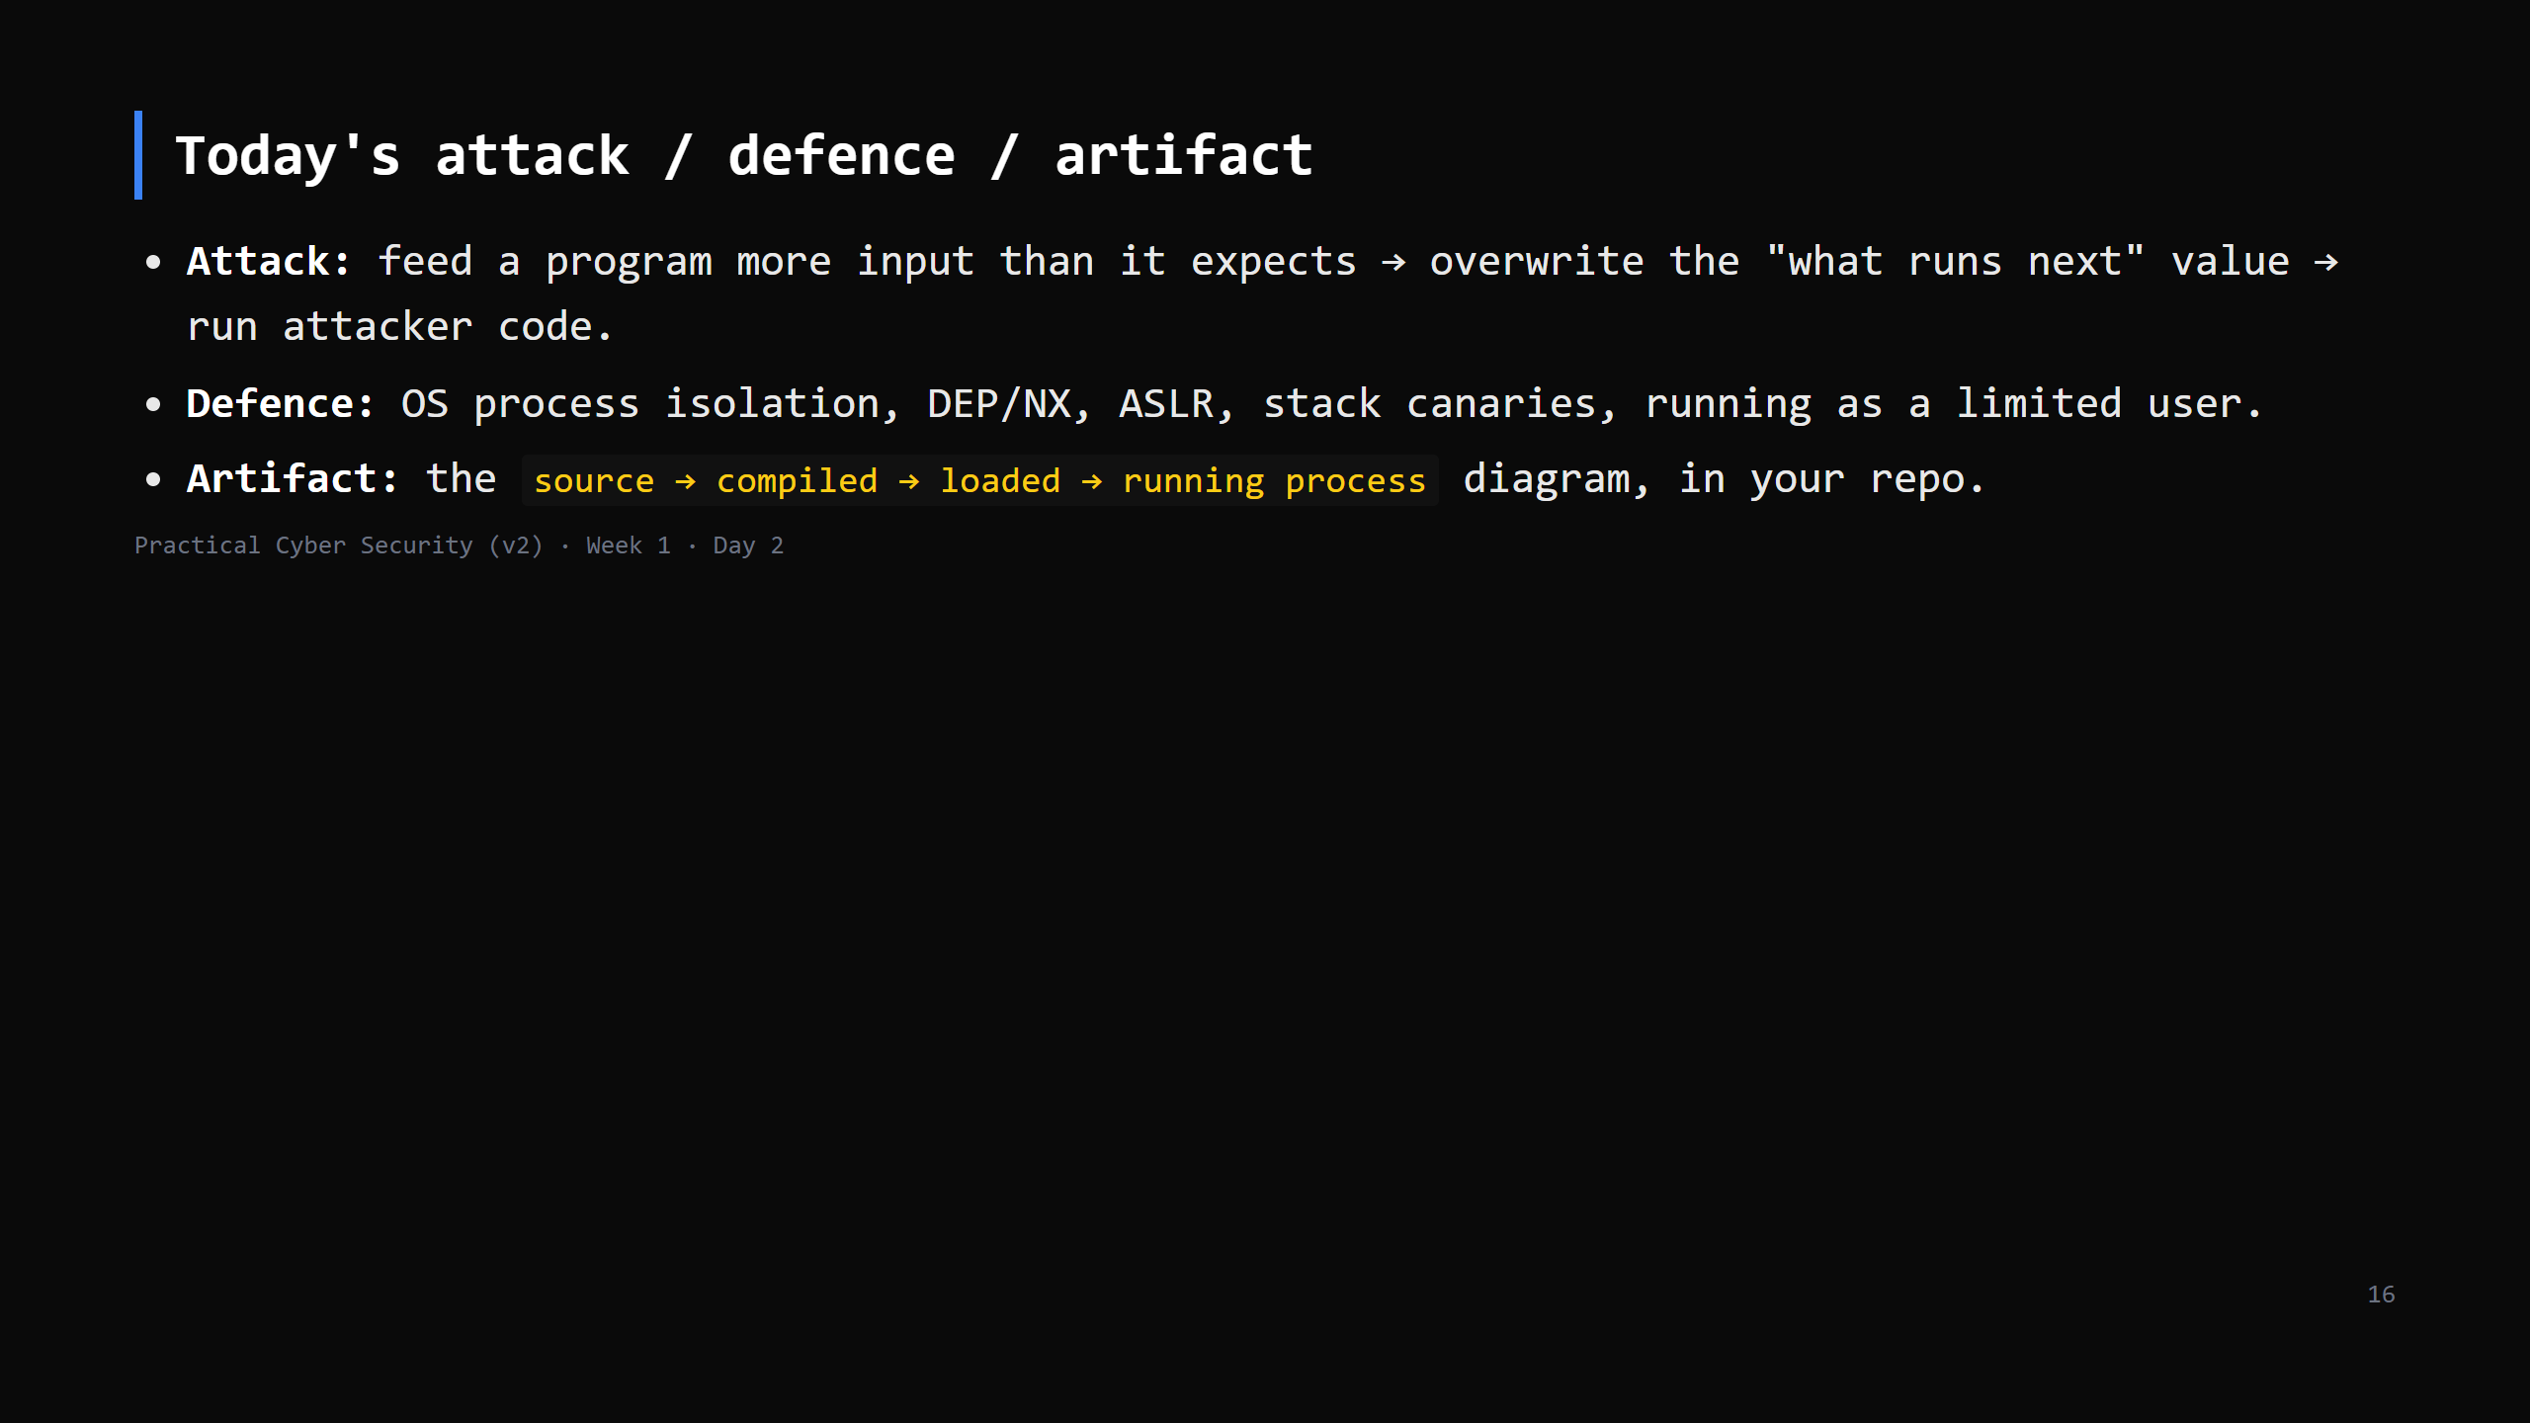
Notes:
The daily ritual. Three lines into the repo before they leave.

Slide 17
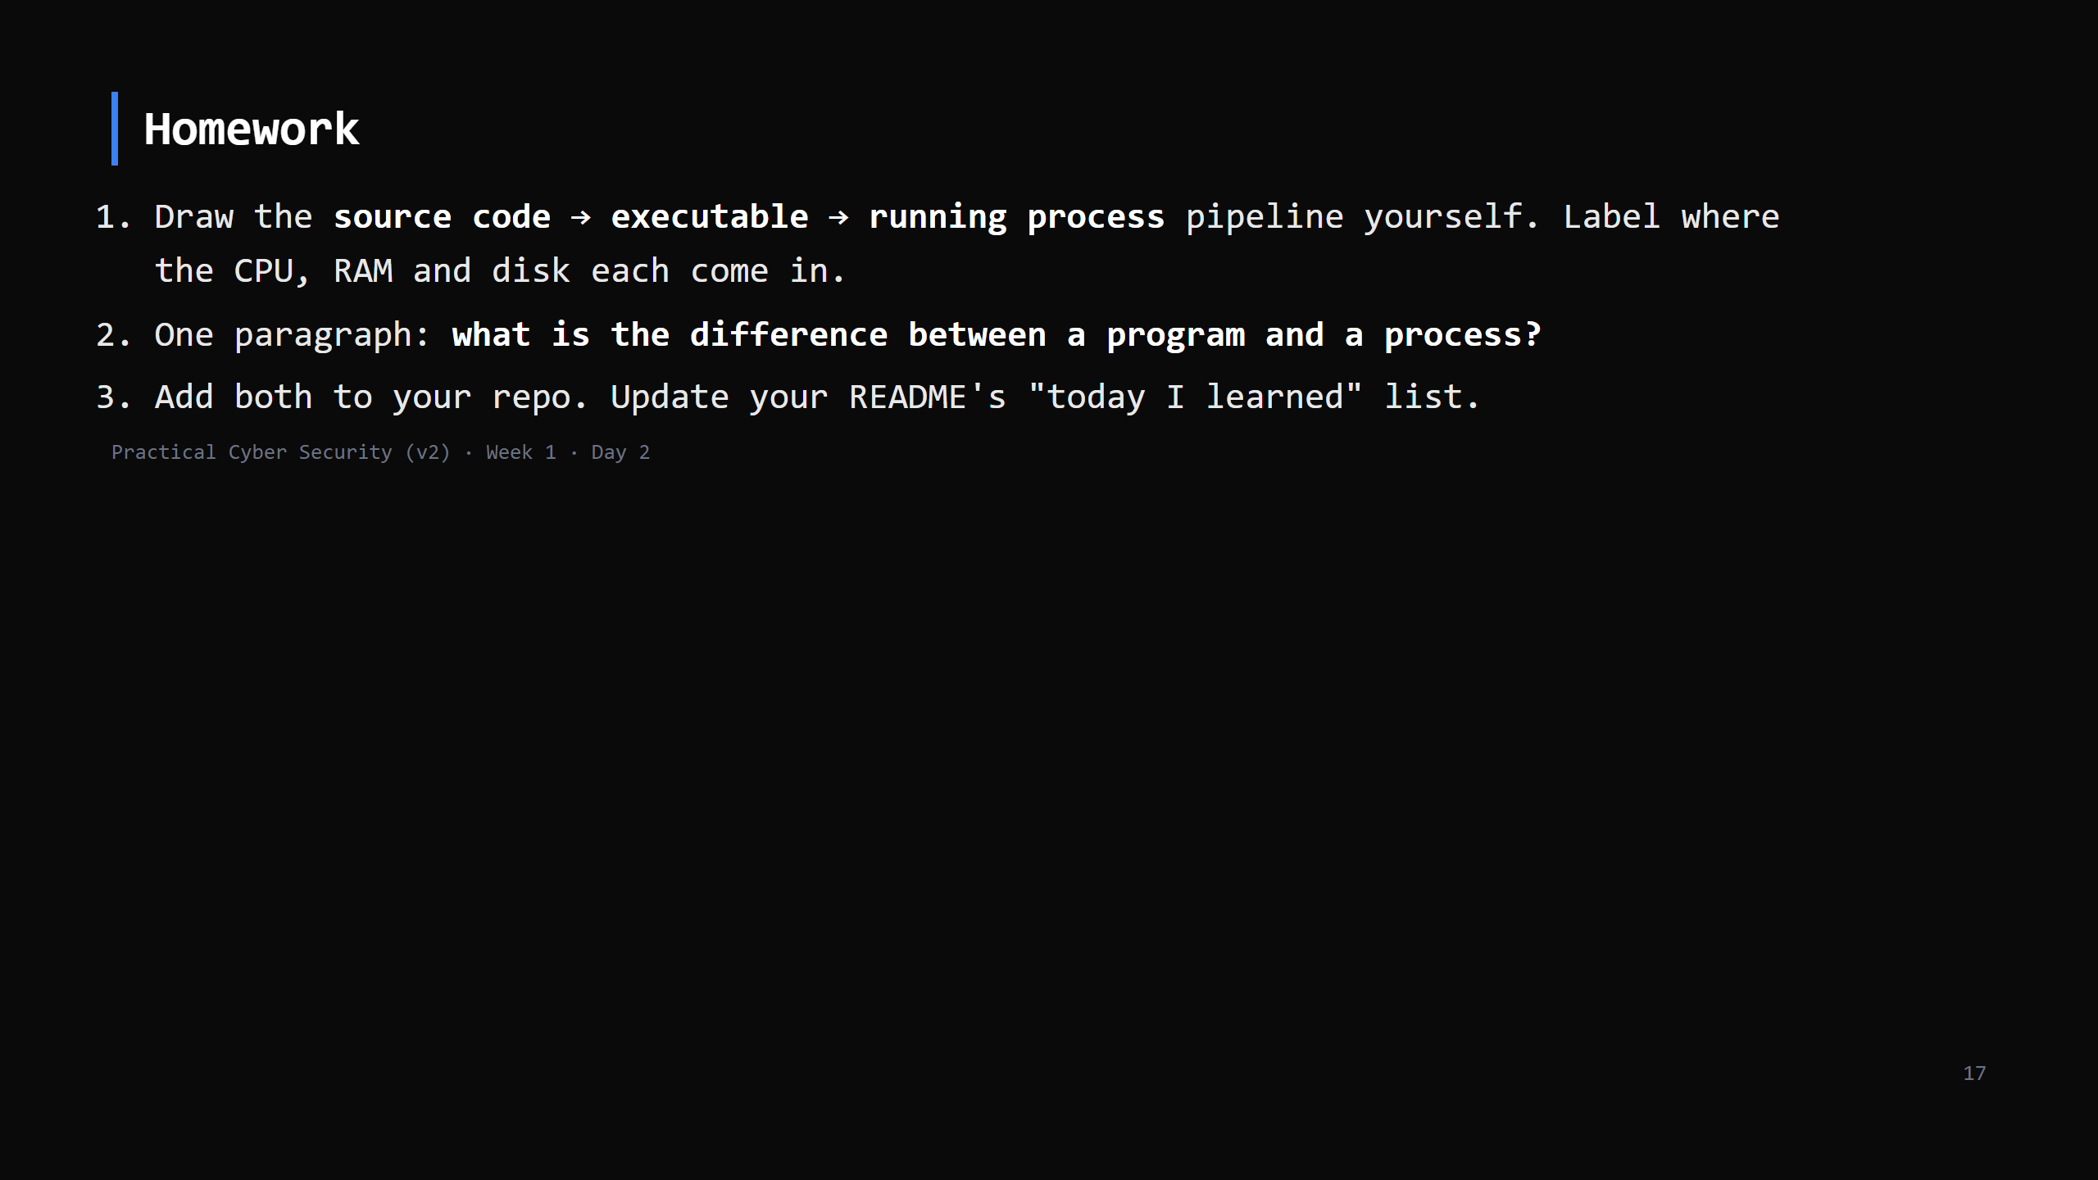
Notes:
Due start of Day 3. Checklist grading in the week-1 student pack.

Slide 18
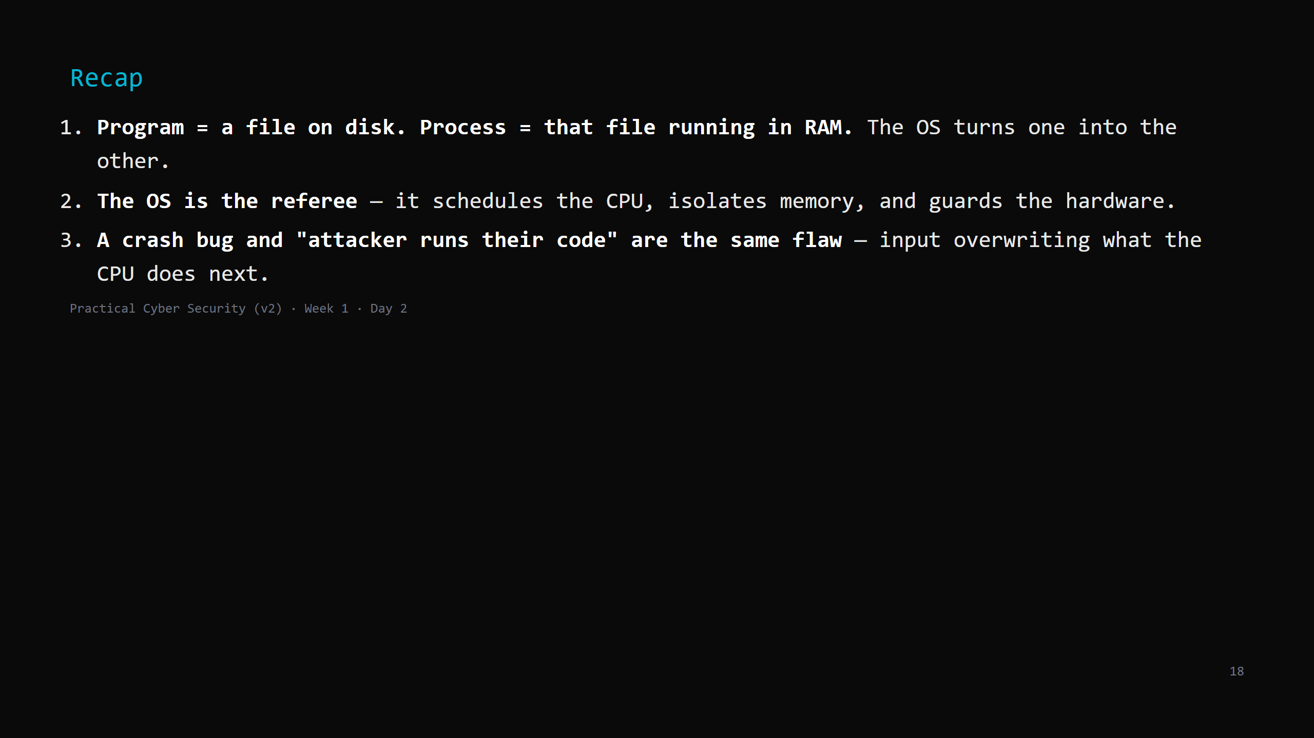
Notes:
Say these verbatim, then dismiss. Tomorrow: your machine stops being alone — how two computers find each other and talk. Networks.

