Slide 1
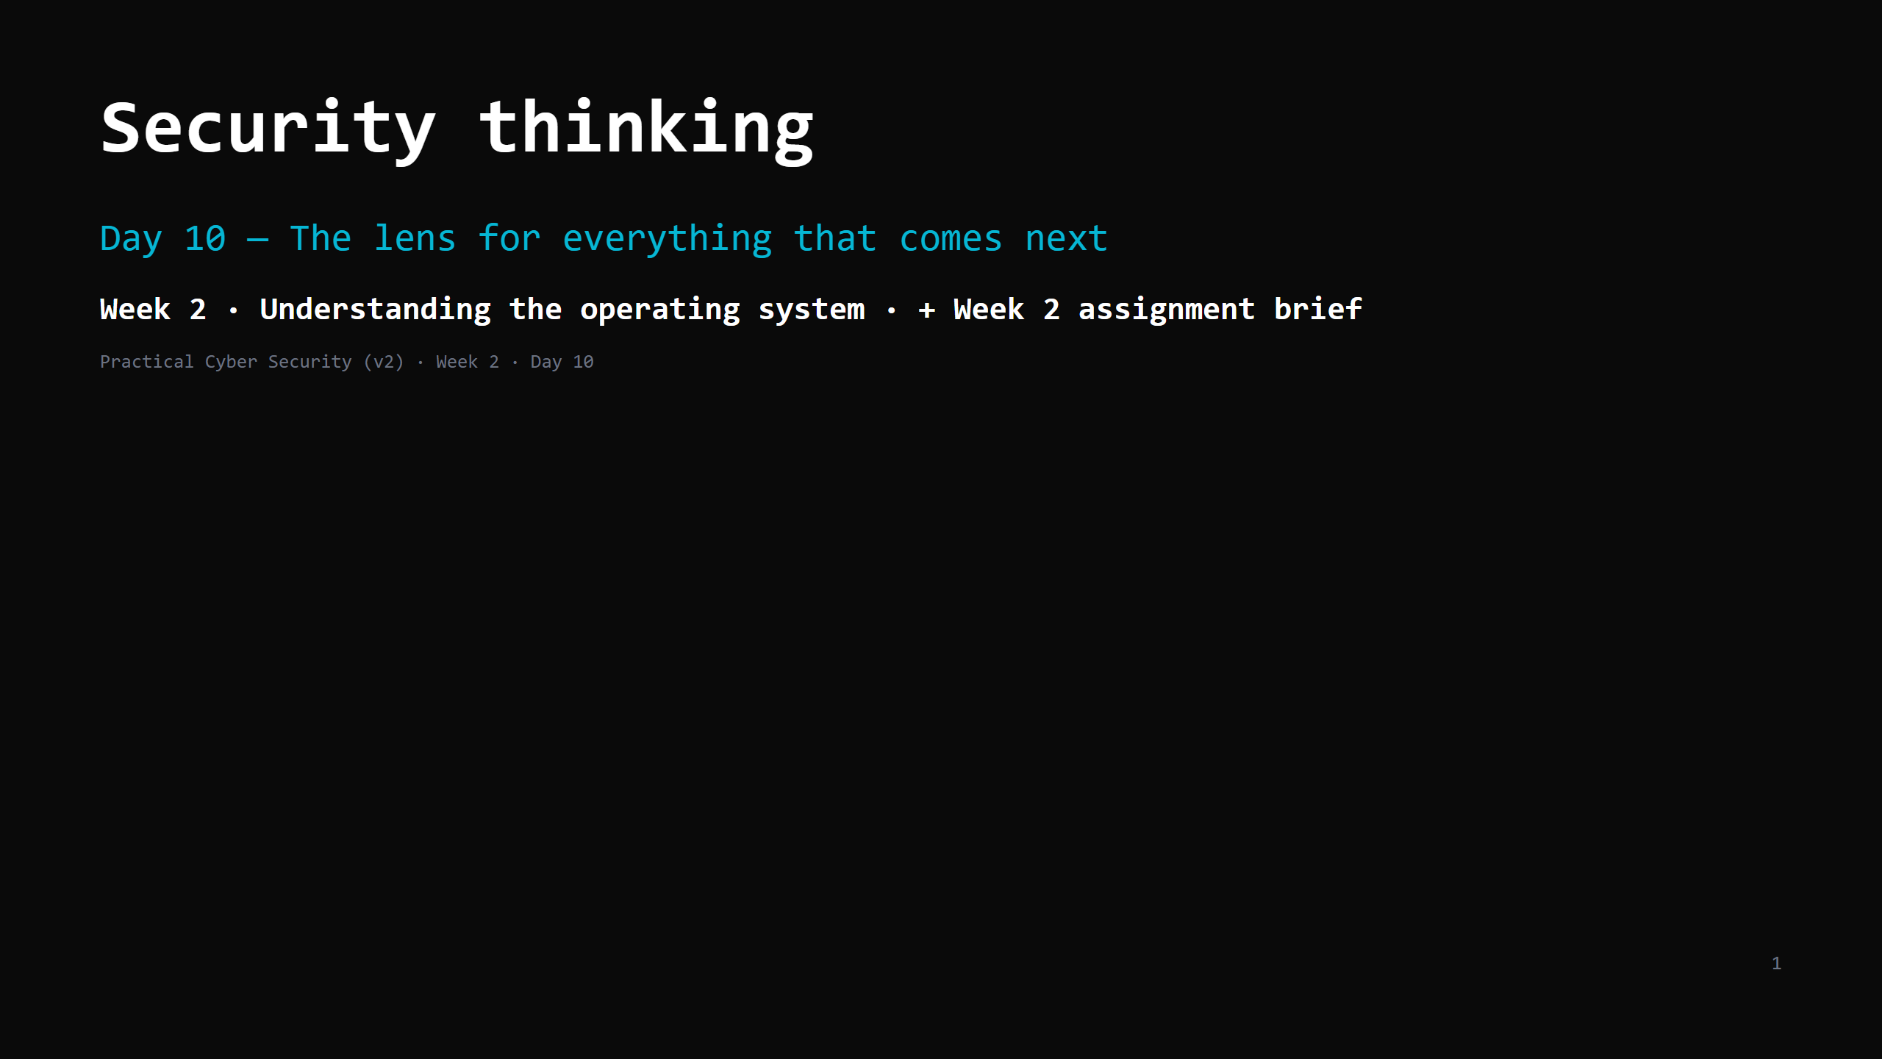
Notes:
RUN SHEET (~84 min). This is a CONCEPTS day — the design's "cap theory ~20 min" bends here, so the mitigation is: every concept slide is its bullets and nothing more, the "rank" DO breaks it up, and the 18-min threat-model exercise is the real centre. Don't lecture. 00:00 Journey check + hook (attack this app) 4 00:04 The vocabulary, precisely 7 00:11 Risk = likelihood x impact 5 00:16 DO: rank 4 findings on the grid 5 00:21 Threat actors & motivation 4 00:25 Attack surface & trust boundaries 5 00:30 The defender's principles (name the 5, move on) 4 00:34 Threat modelling — the method (4 Qs + STRIDE) 6 00:40 DO: threat-model an app together 18 00:58 Wrap + artifact 3 01:01 WEEK 2 ASSIGNMENT BRIEF 17 01:18 Recap 3 CUT FIRST IF SHORT: the "rank 4 findings" DO (do 2); the threat-actors slide to the table only. NEVER CUT: threat/vuln/risk/exploit definitions; the untrusted-input question; the threat-model exercise; the assignment brief. ANALOGY (kitchen): threat modelling = a health-and-safety walkthrough of the kitchen — what's valuable, who'd want to harm it, where are the ways in, what's the cheapest control at each.

Slide 2
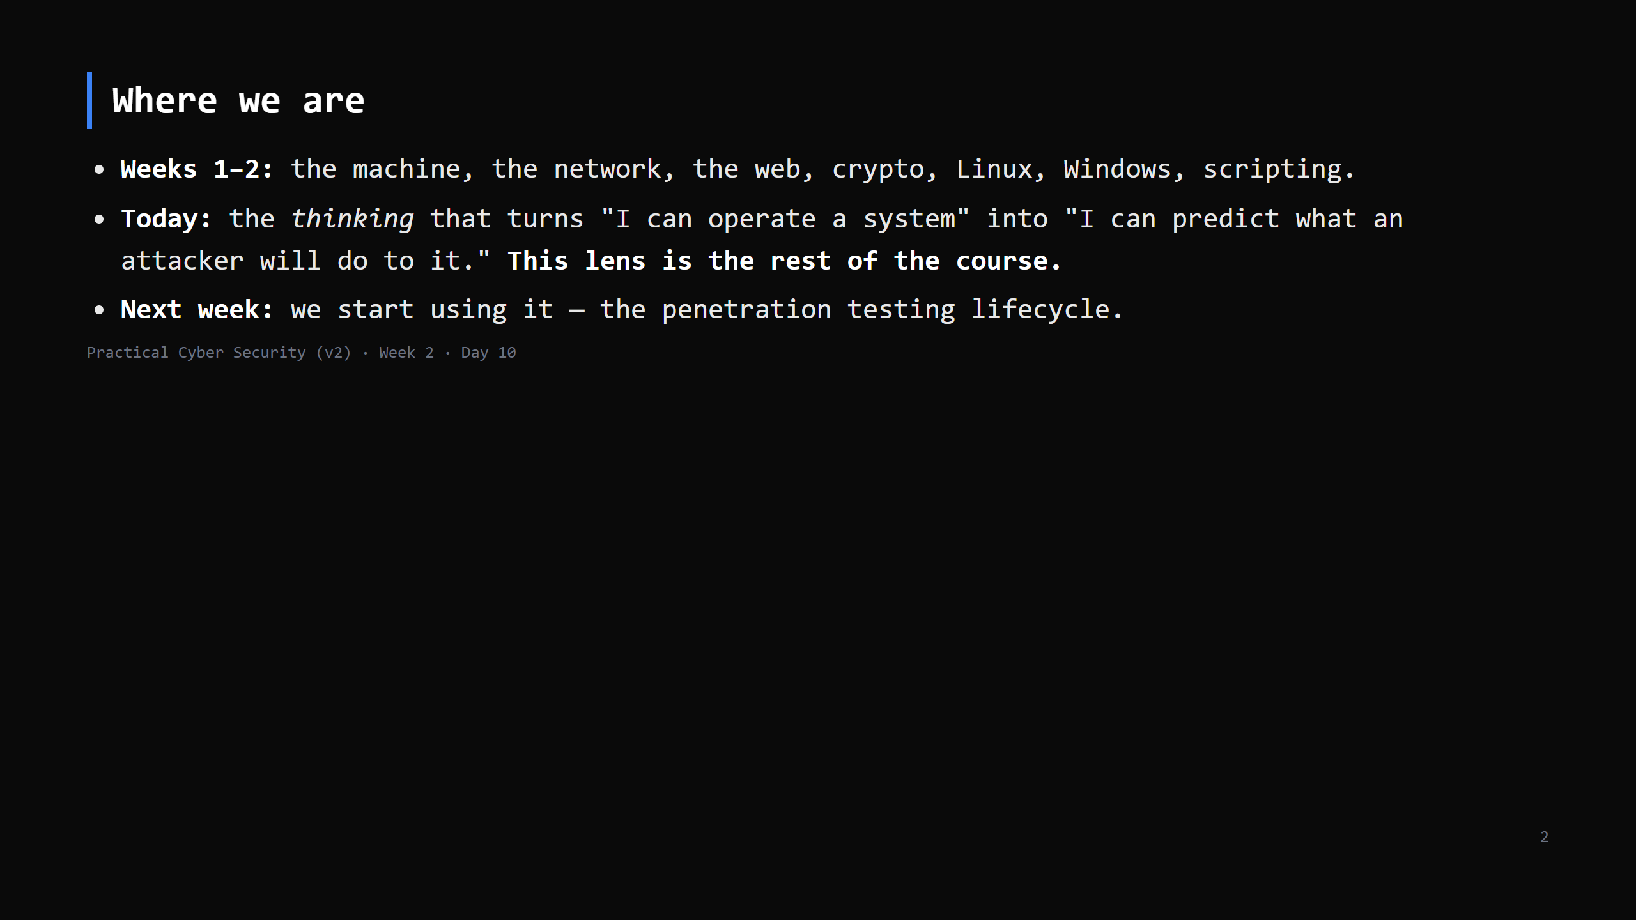
Notes:
Journey Check. Say it plainly: today is less hands-on, more "how to think". But it's the day that makes Weeks 3-4 make sense.

Slide 3
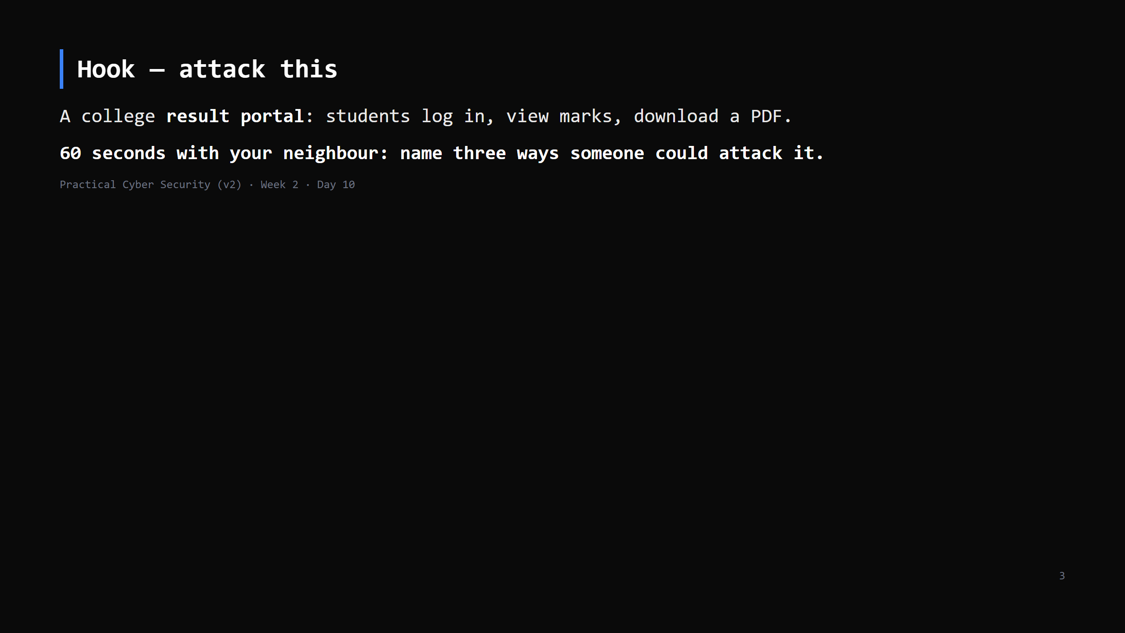
Notes:
Take 4-5 answers. You'll get: guess passwords, see someone else's marks by changing the URL, fake a login page, take it down before results day, SQL injection, insider changes a grade. "You just did threat modelling. Today we make it systematic."

Slide 4
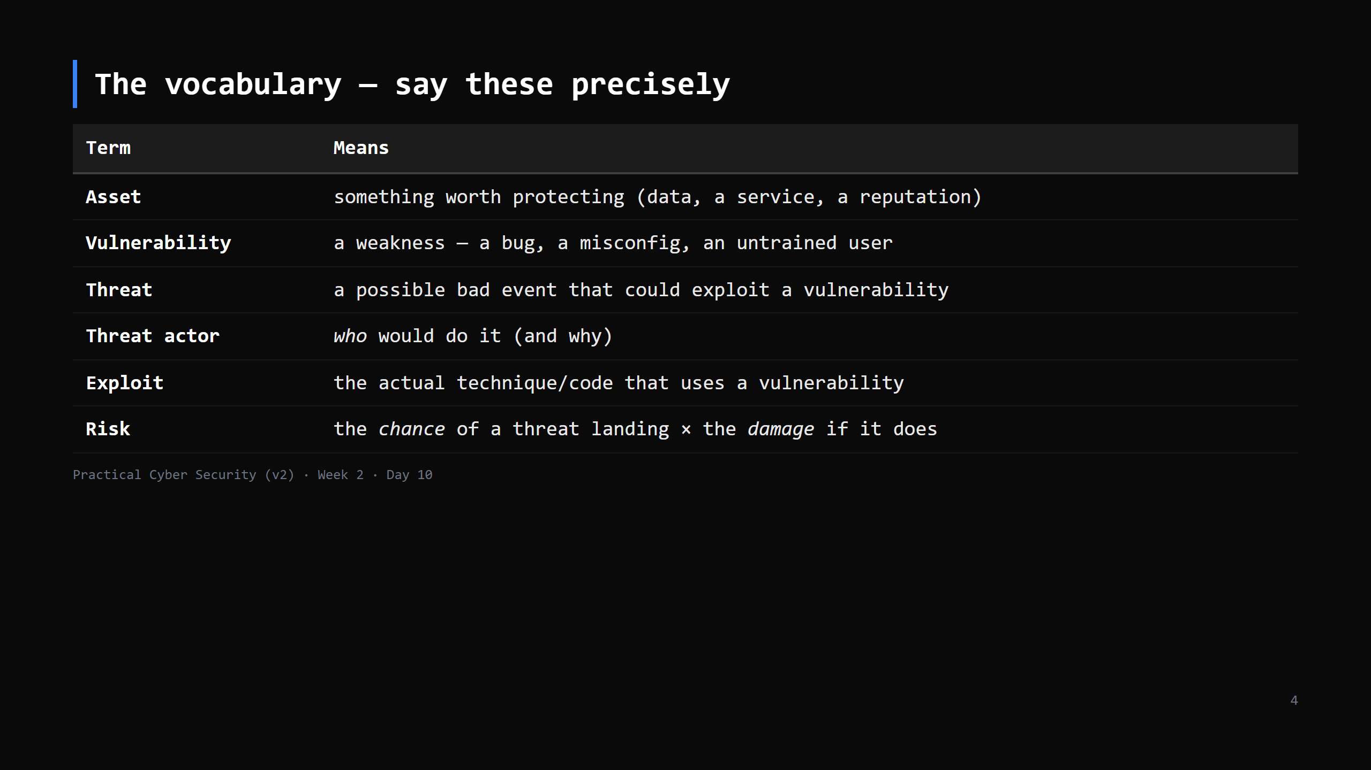
Notes:
The distinction that matters: a vulnerability with no threat that can reach it, or no asset behind it, is not meaningful risk. And a tiny vulnerability on a critical asset can be top priority. Risk is the thing you actually manage — not the raw bug count.

Slide 5
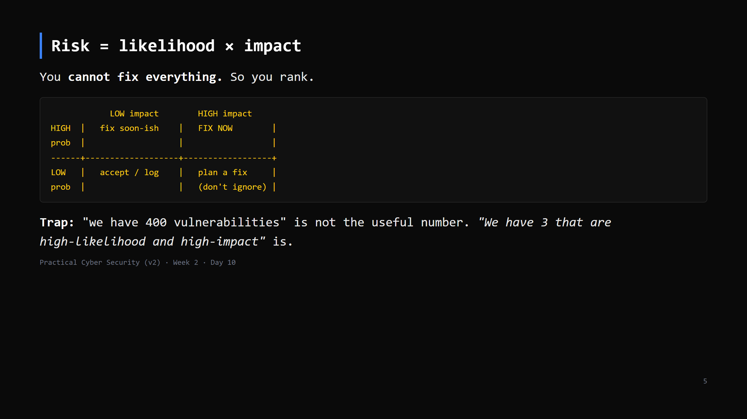
Notes:
This is the Day 10 trap, spelled out. Vuln count != risk. Where a finding sits on this grid decides whether you drop everything or write it in a backlog. Day 14 (vulnerability assessment) is this grid applied to scanner output.

Slide 6
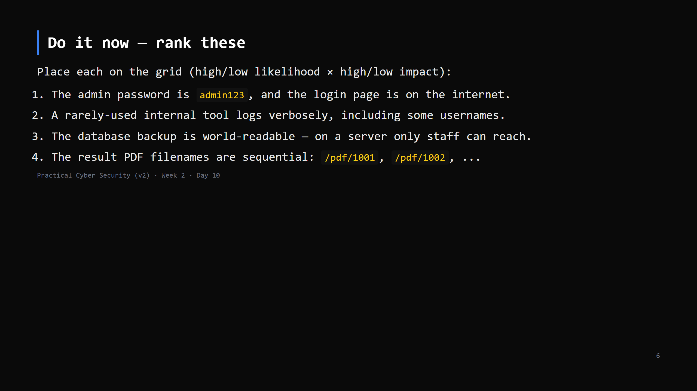
Notes:
5 min. Rough answers: 1 = HIGH/HIGH (fix now). 2 = LOW/LOW (log it). 3 = LOW-likelihood but HIGH-impact (plan a fix; depends how trusted "staff" are). 4 = HIGH/HIGH if marks are sensitive (trivial to enumerate). Argue #3 and #4 — that's the point.

Slide 7
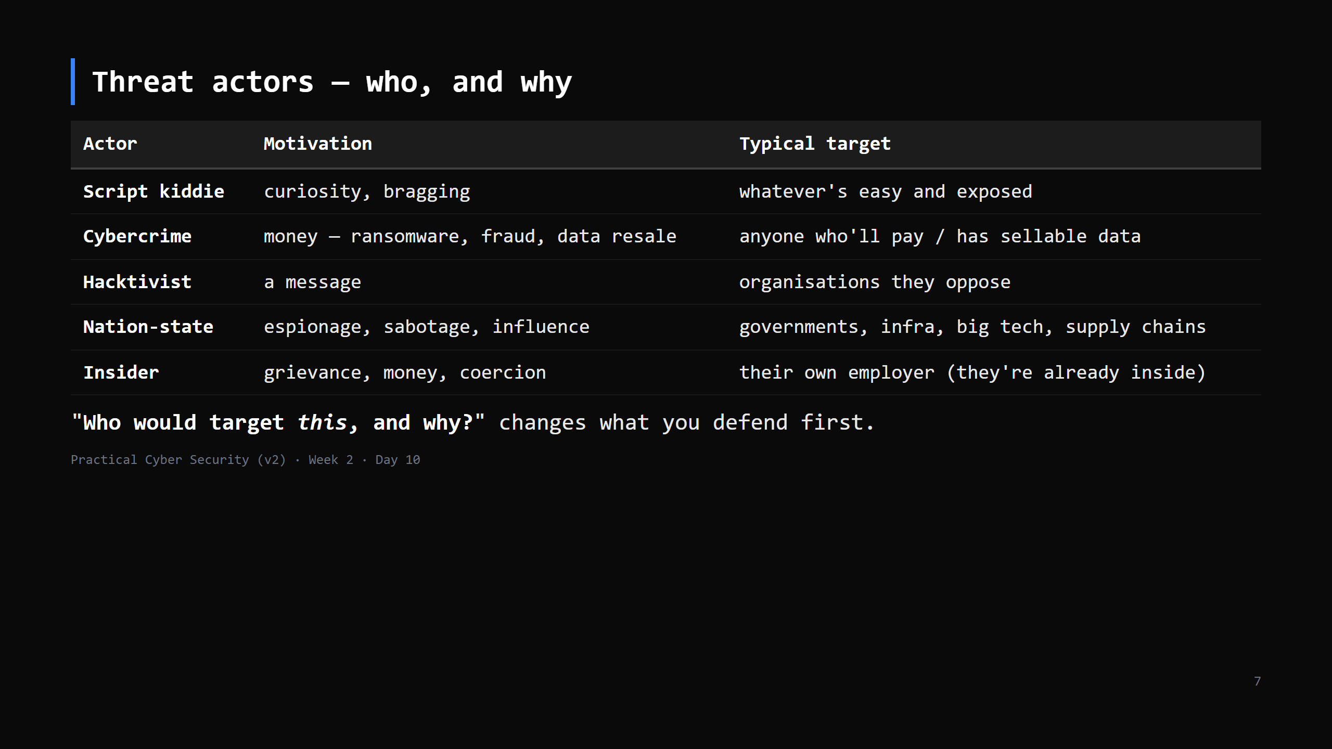
Notes:
A student result portal: mostly cybercrime (creds resale) and insiders (grade changes) and kiddies. Not nation-state. That focuses effort. CUT to 3 min if short — the point is "match defences to realistic actors, not movie hackers".

Slide 8
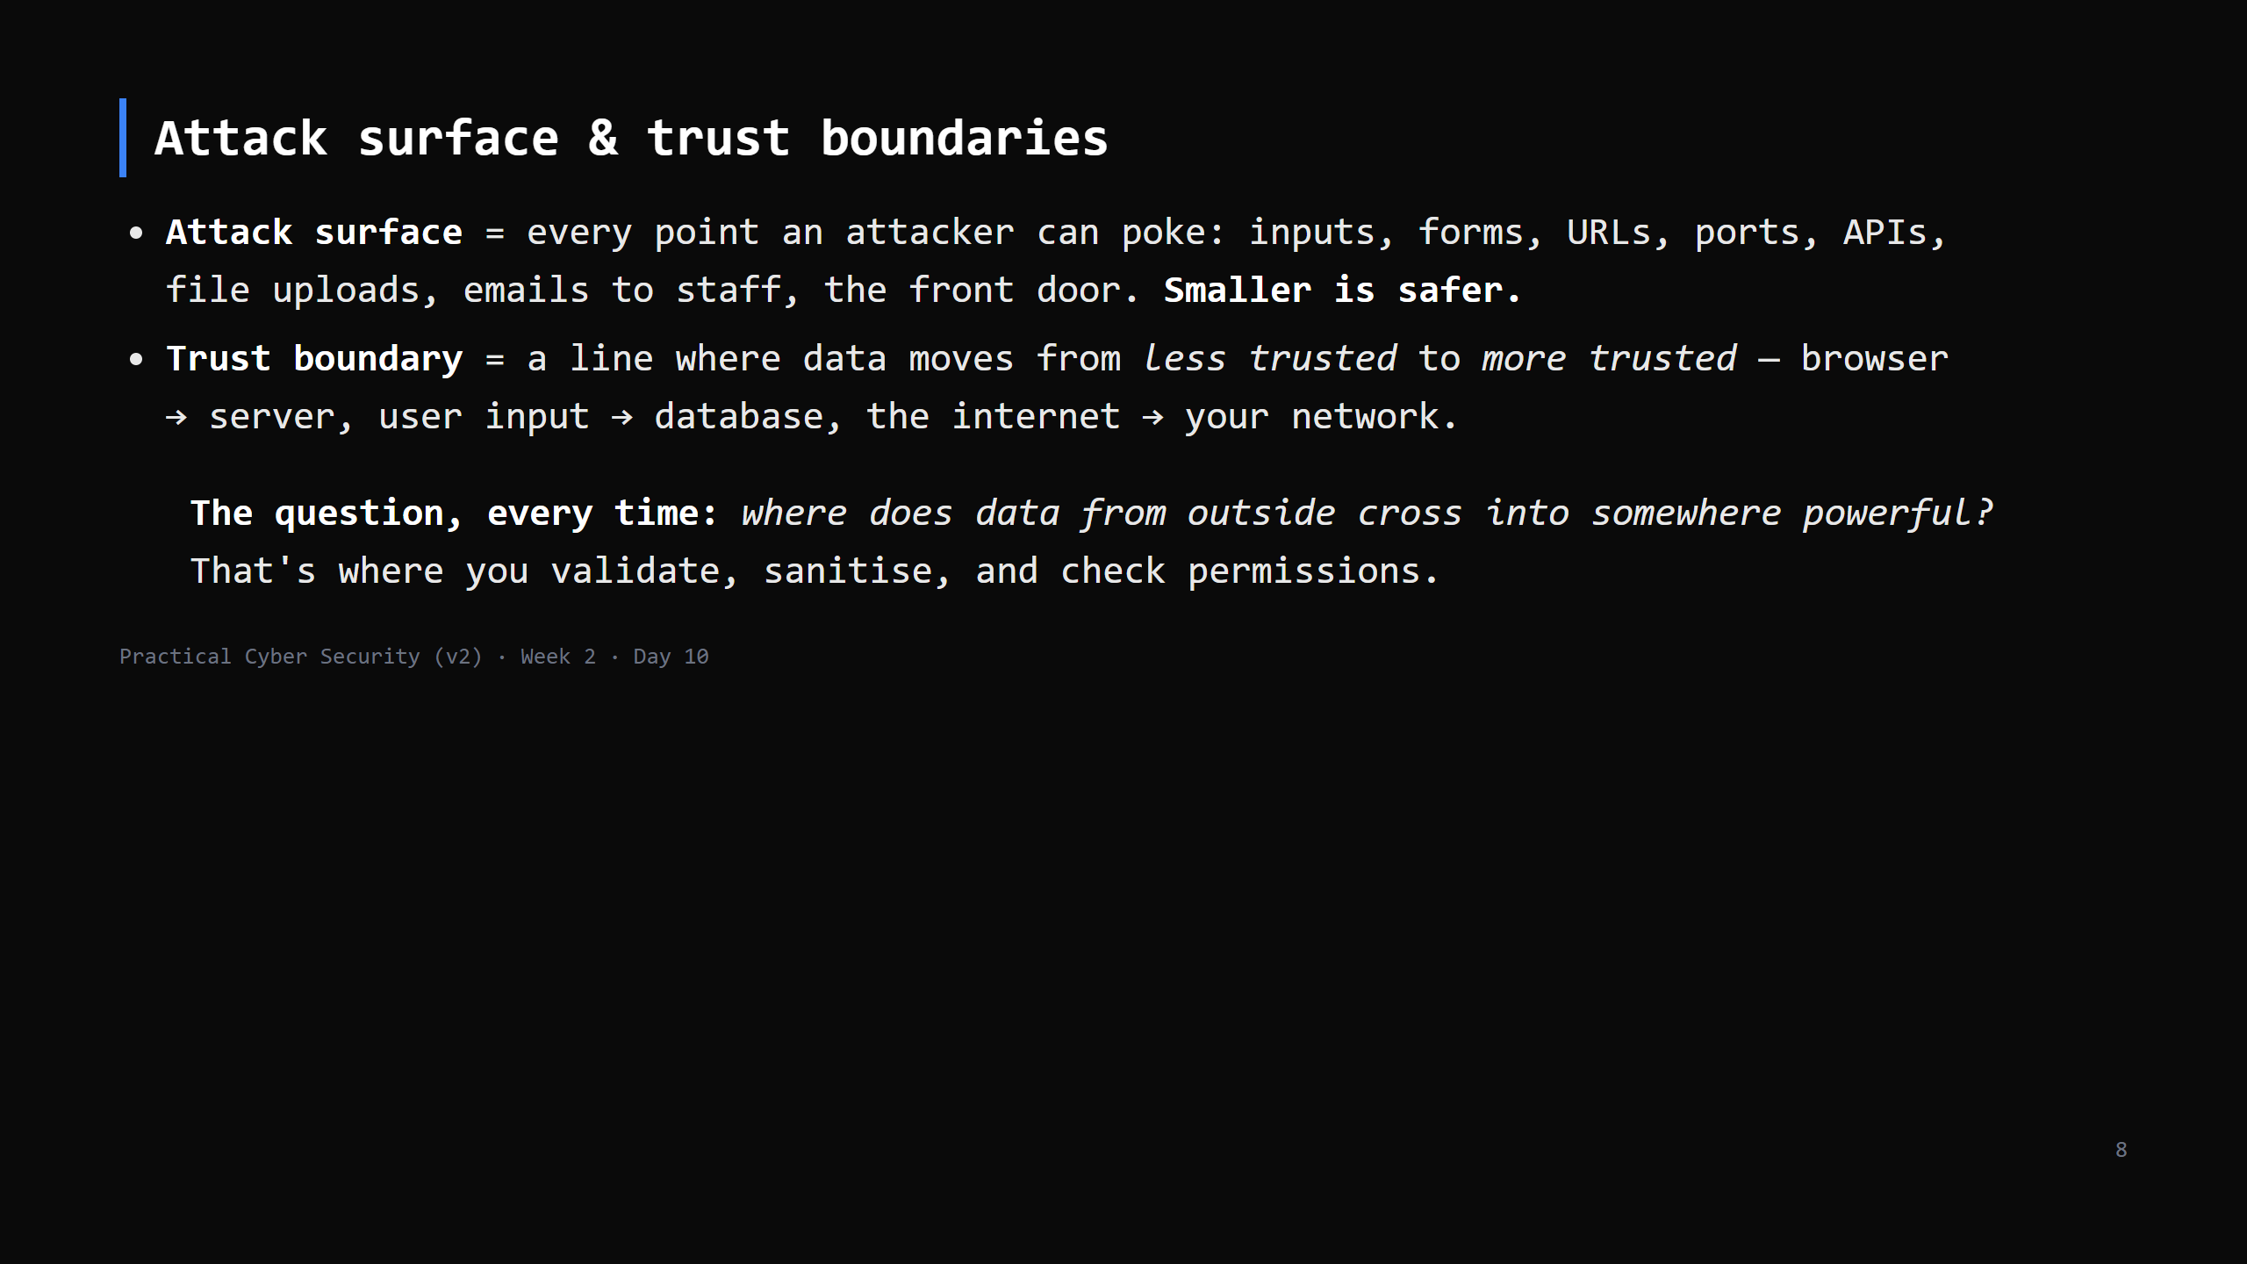
Notes:
This is THE recurring question of the whole course — the "untrusted input" lens. Every injection (Day 16), every overflow (Day 2), every SSRF is "untrusted data reached something powerful without being checked at the boundary".

Slide 9
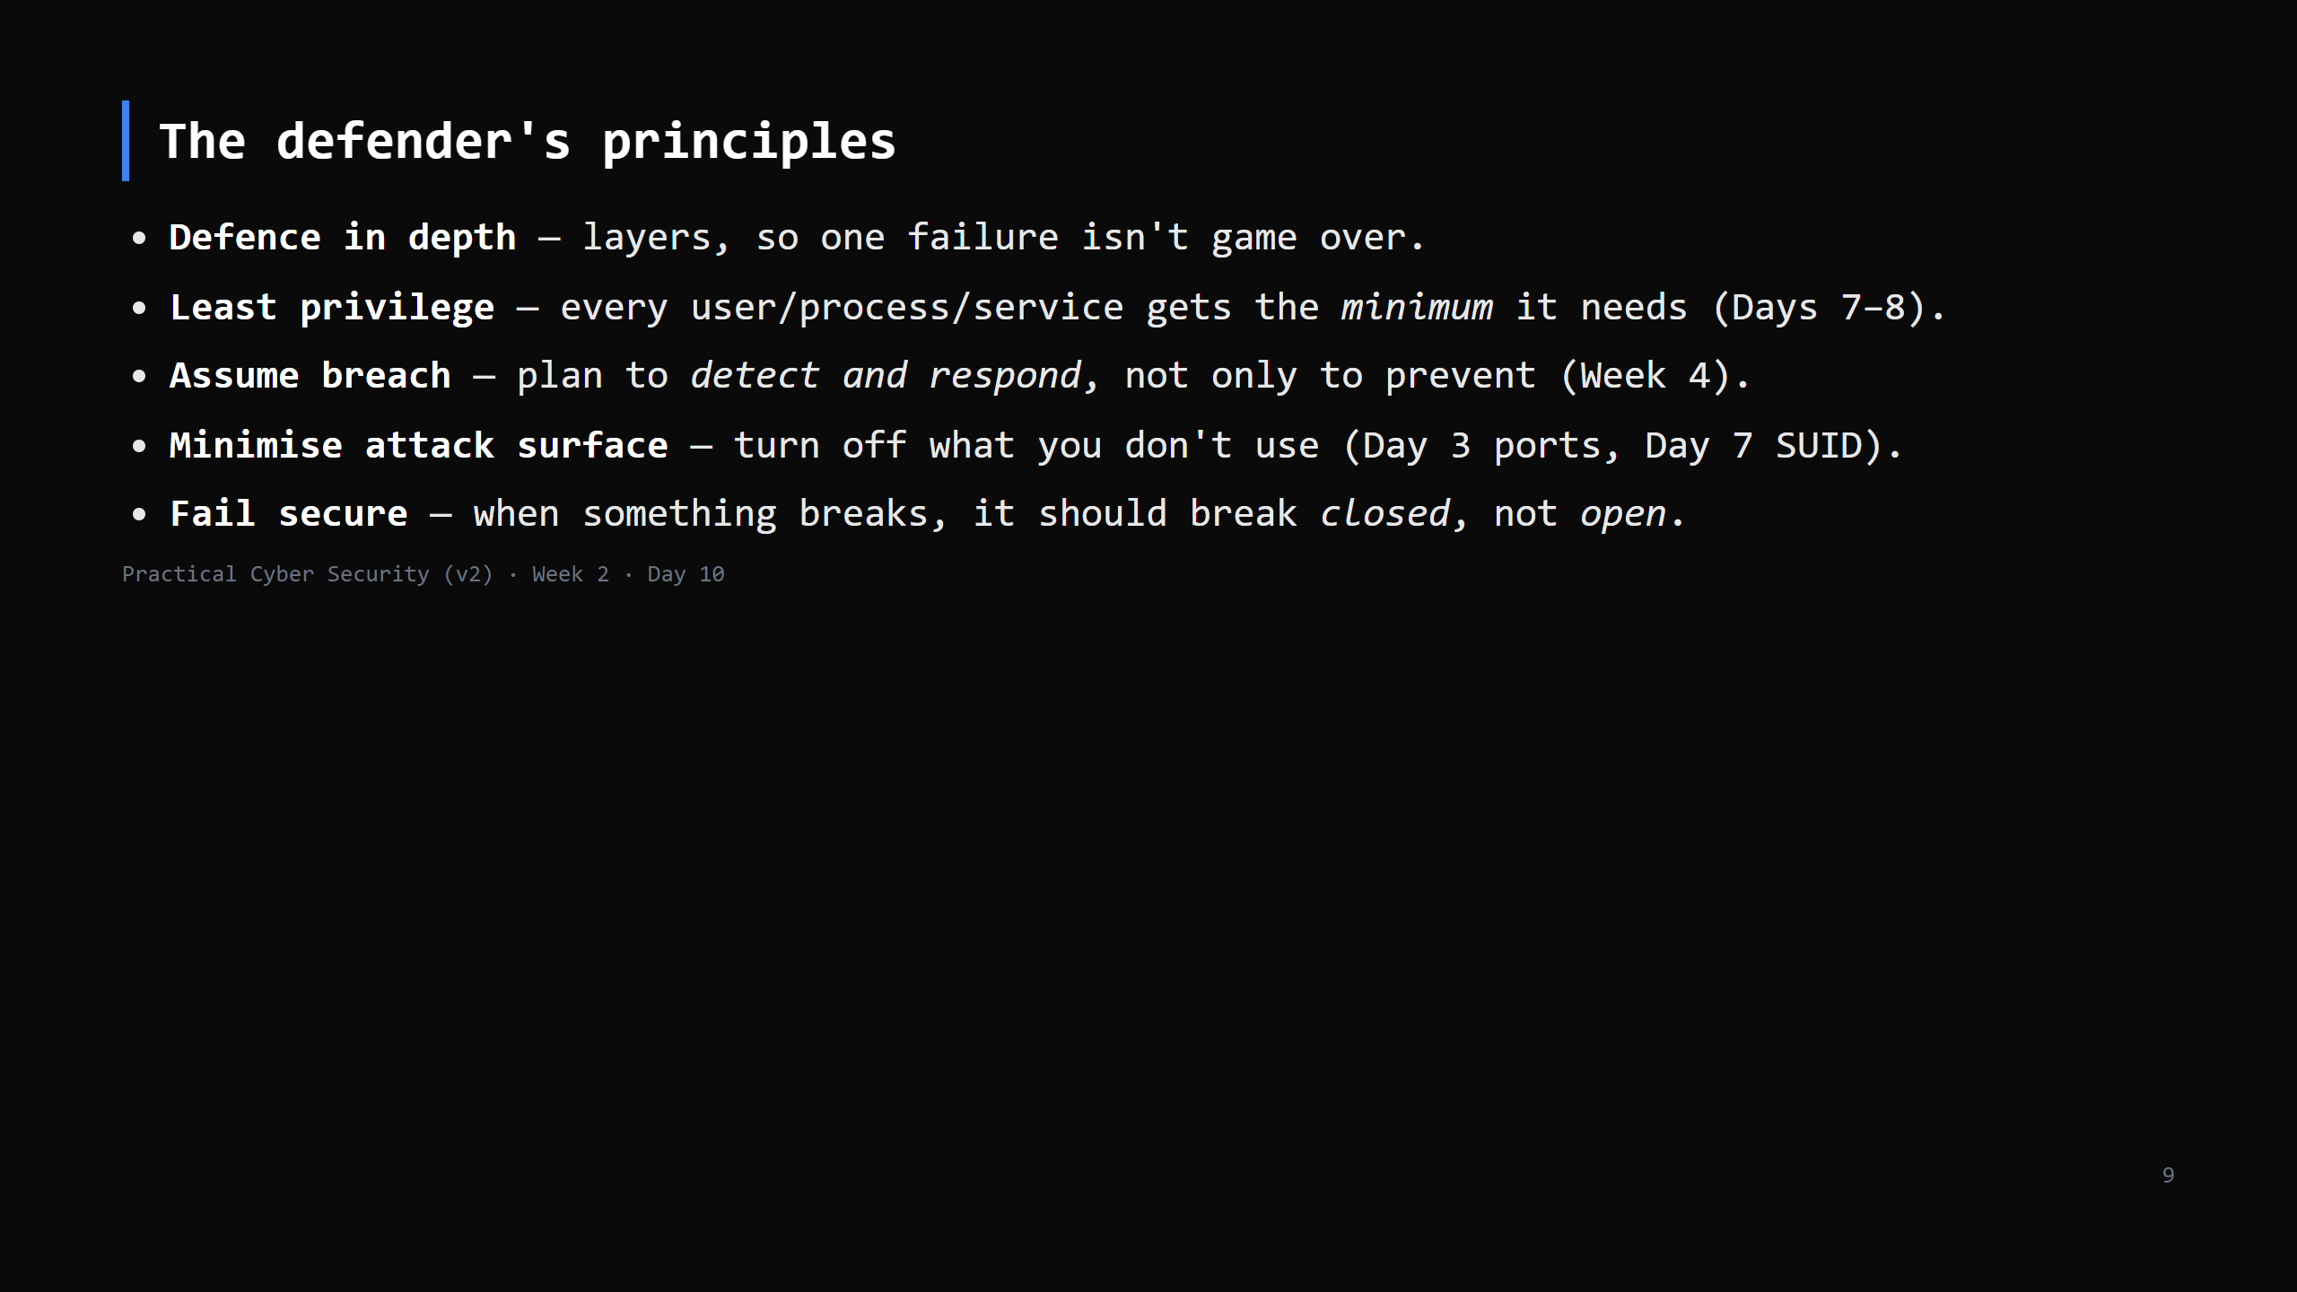
Notes:
Each of these has already shown up: least privilege (Linux/Windows), close unused ports (networking), assume breach (why we do IR). Today we name them as a set.

Slide 10
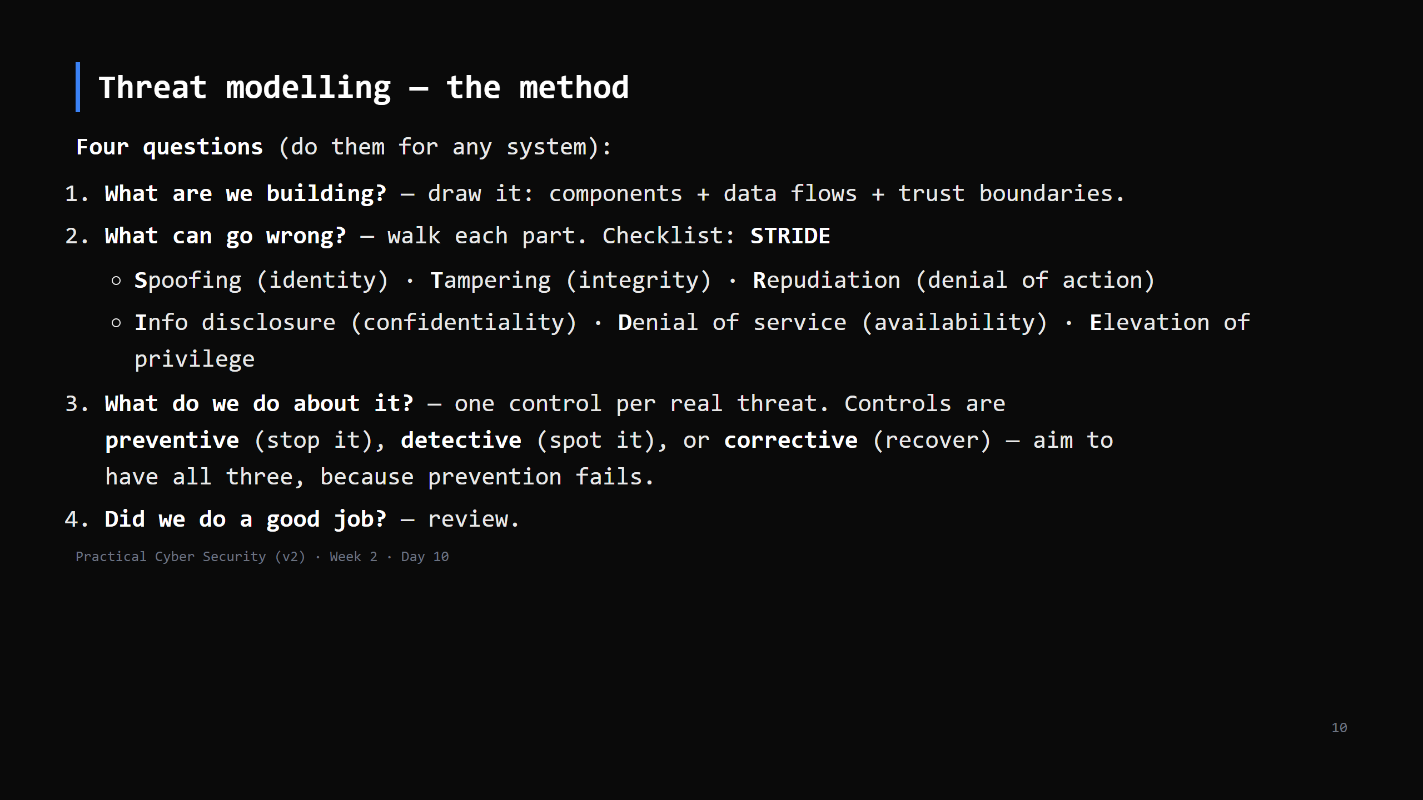
Notes:
STRIDE maps to CIA + two extras. It's a "what can go wrong" prompt so you don't miss a category. Keep it lightweight — we're not doing a 40-page document. Control types: also "mitigate / transfer / accept / avoid" as the risk-treatment choices — name them if asked; "accept" is a valid documented decision for low risk.

Slide 11
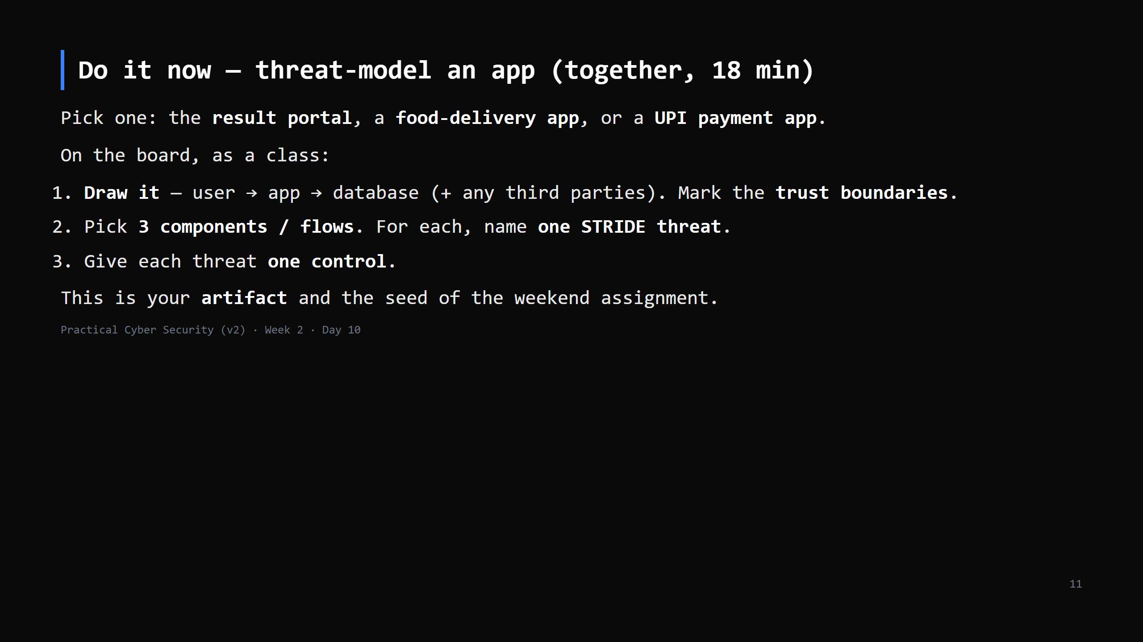
Notes:
18 min. You drive the drawing; students call out threats. Push for concrete: not "hacking" but "the login form doesn't rate-limit, so an attacker sprays passwords" -> control: lockout + MFA. Everyone writes the finished model into their repo as day10/threat-model.md.

Slide 12
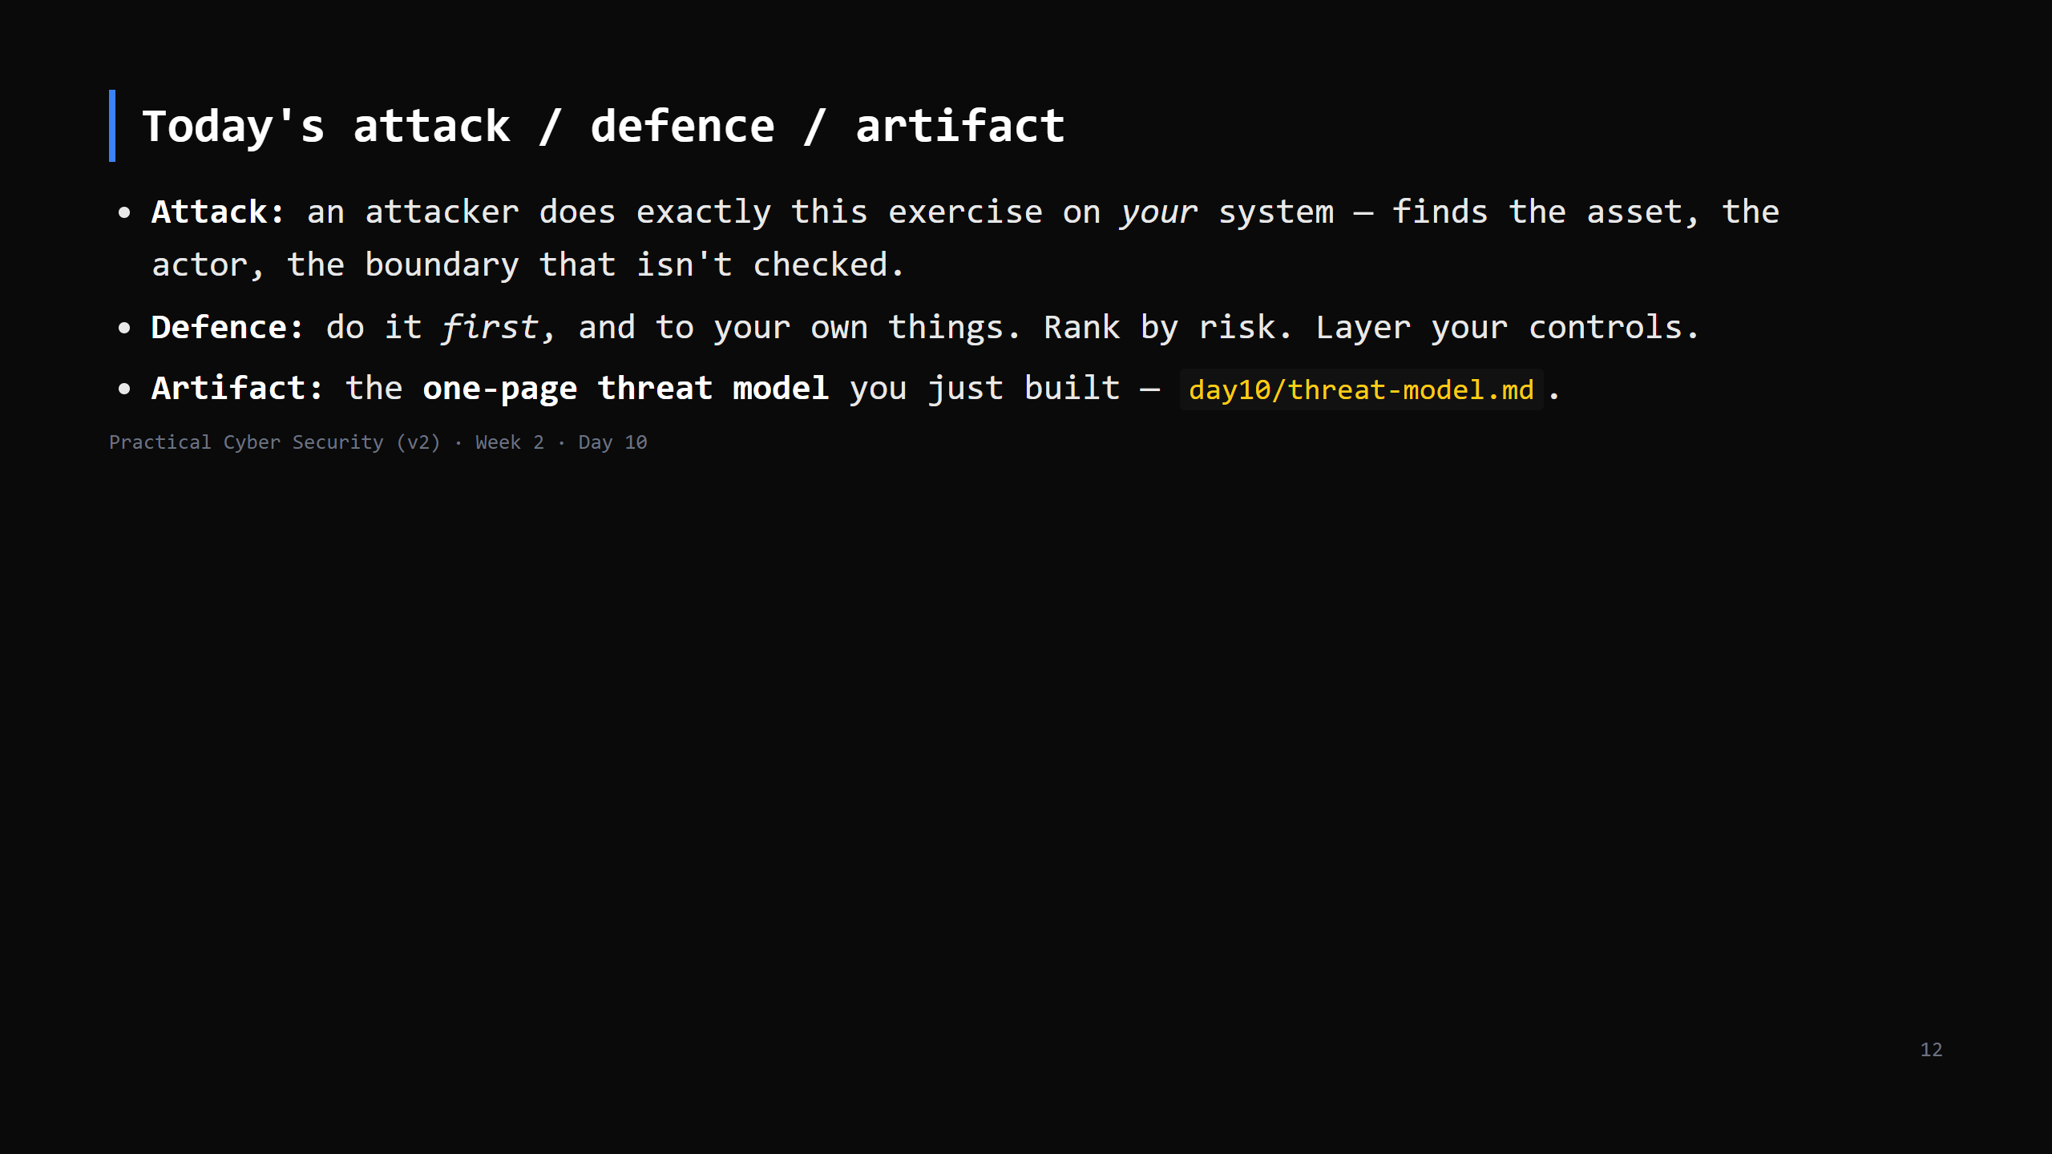

Slide 13
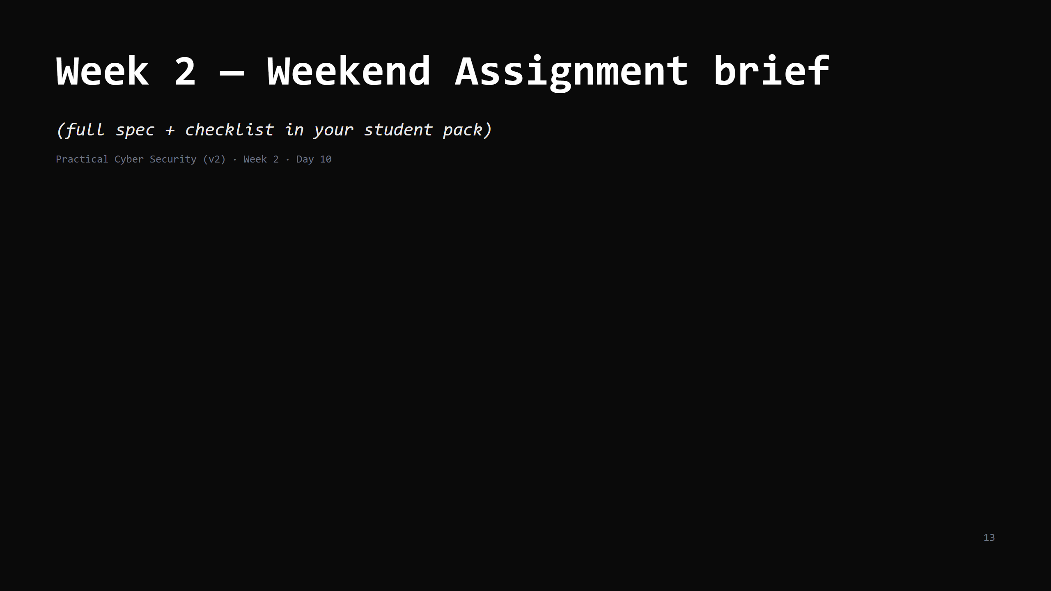

Slide 14
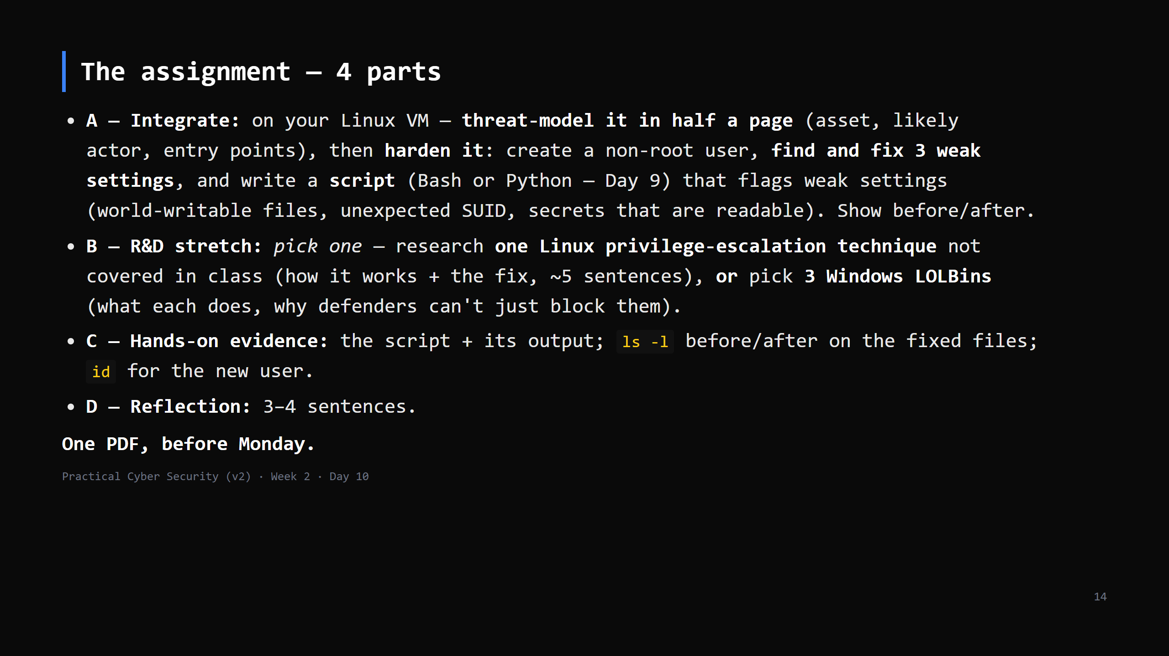
Notes:
Walk each part ~3 min. Part A is the whole week (Days 6-9) in one task. Part B is the stretch. Emphasise: the SCRIPT is the point of Part A — it's Day 9 applied. Test only your own VM.

Slide 15
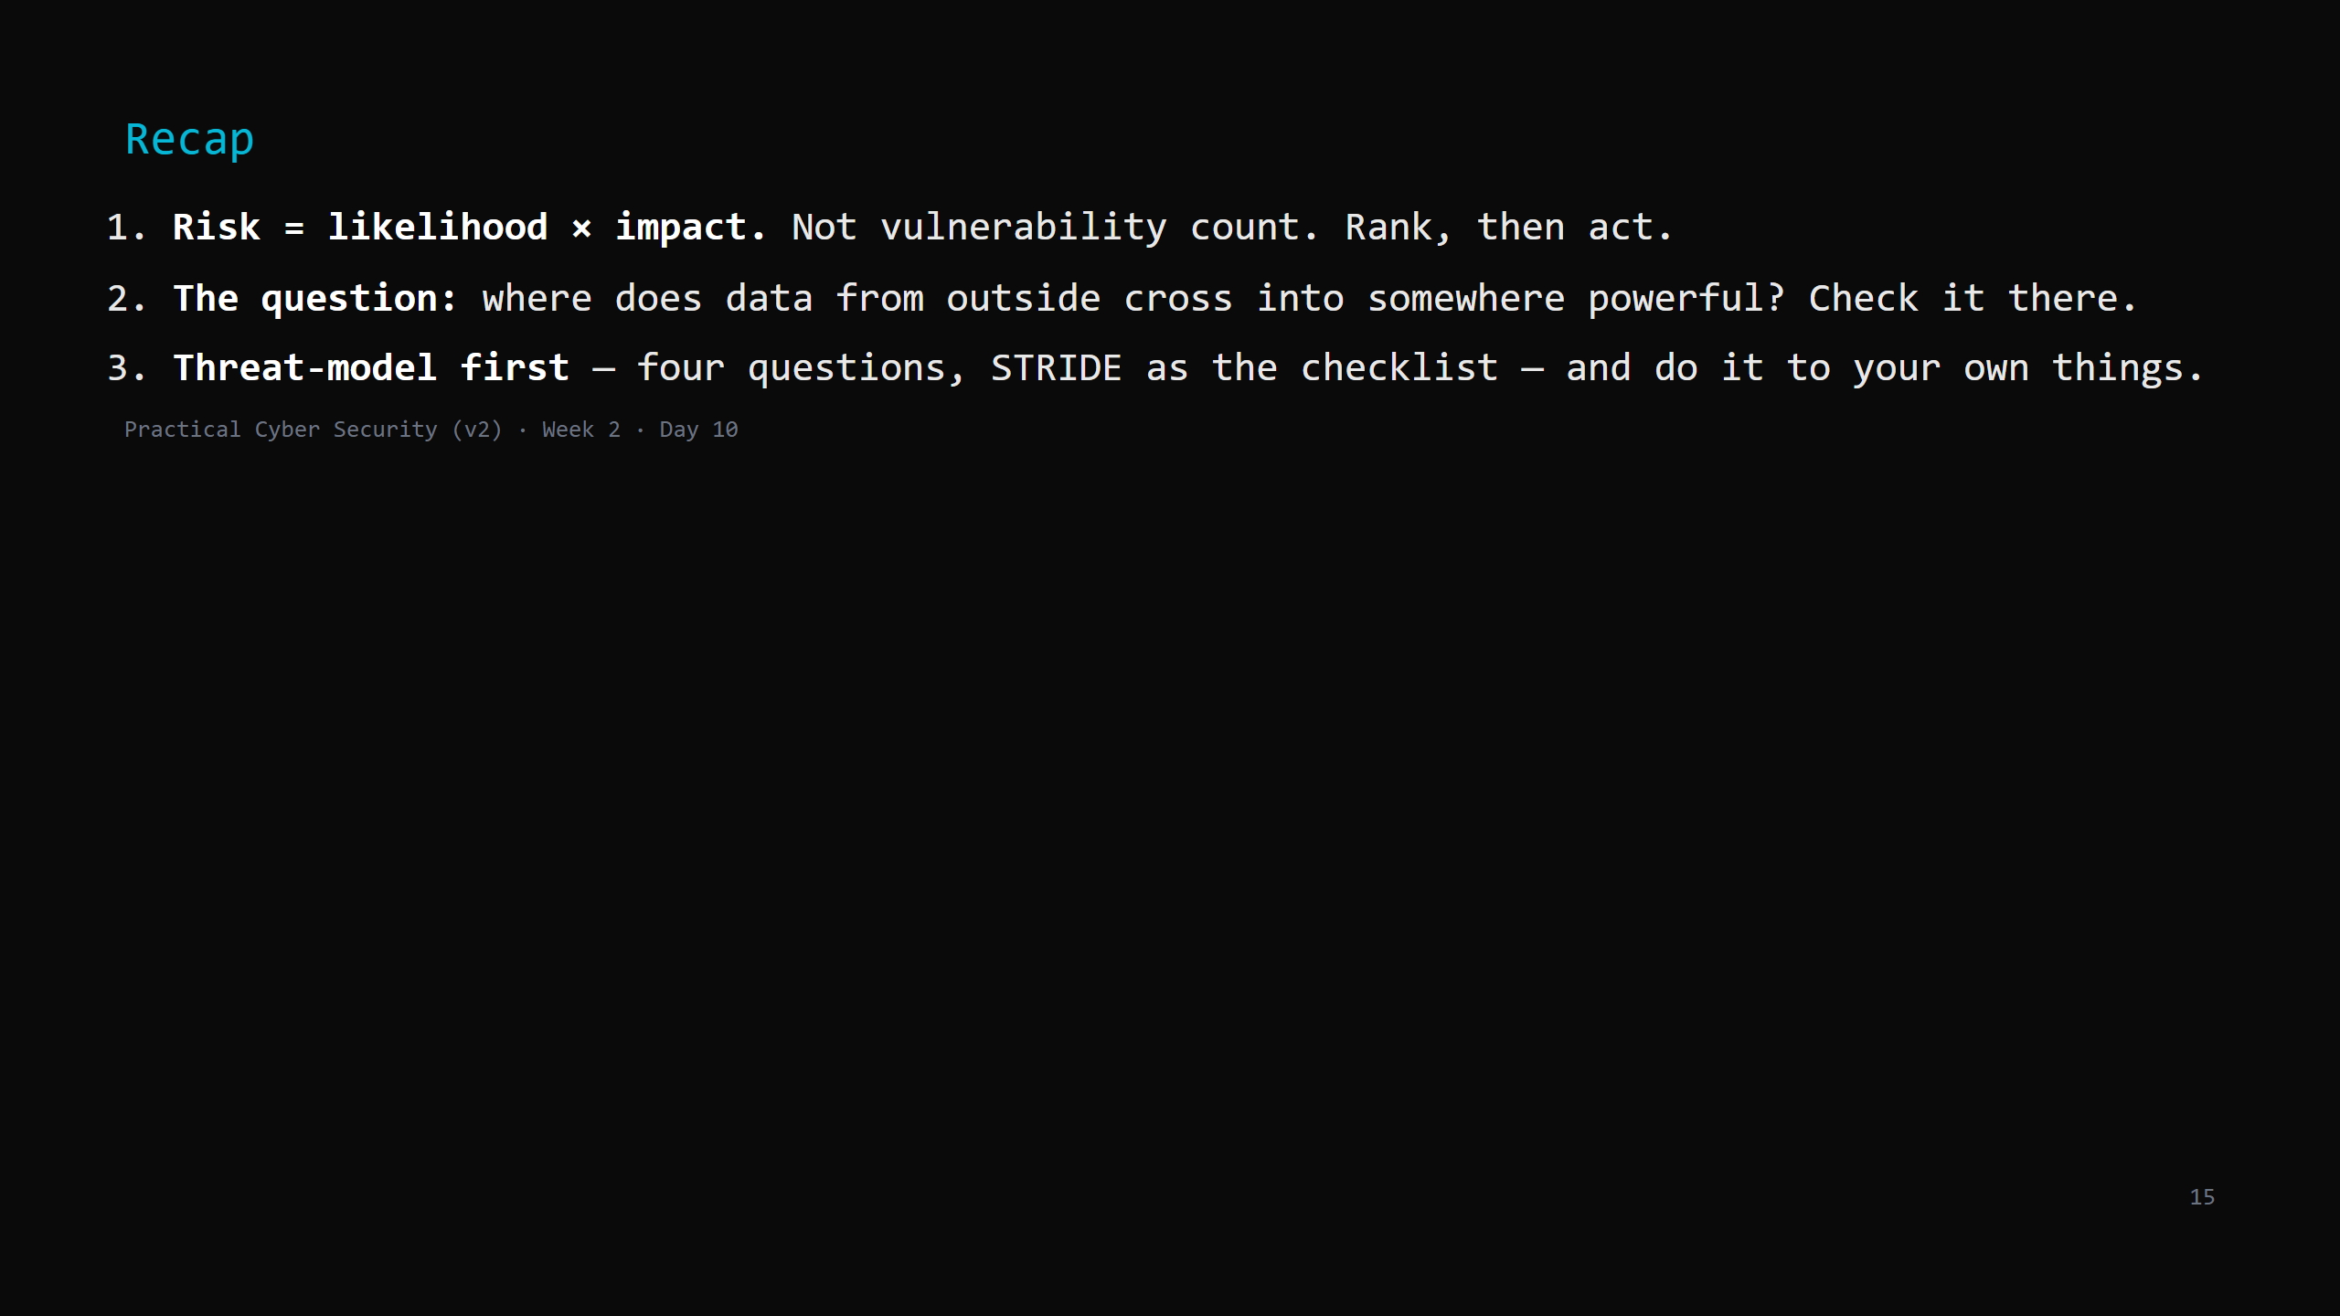
Notes:
Say the three lines. That's Week 2 done. Monday: Week 3 — the penetration testing lifecycle. You stop reasoning about attacks and start (safely, in the lab) doing them.

