Slide 1
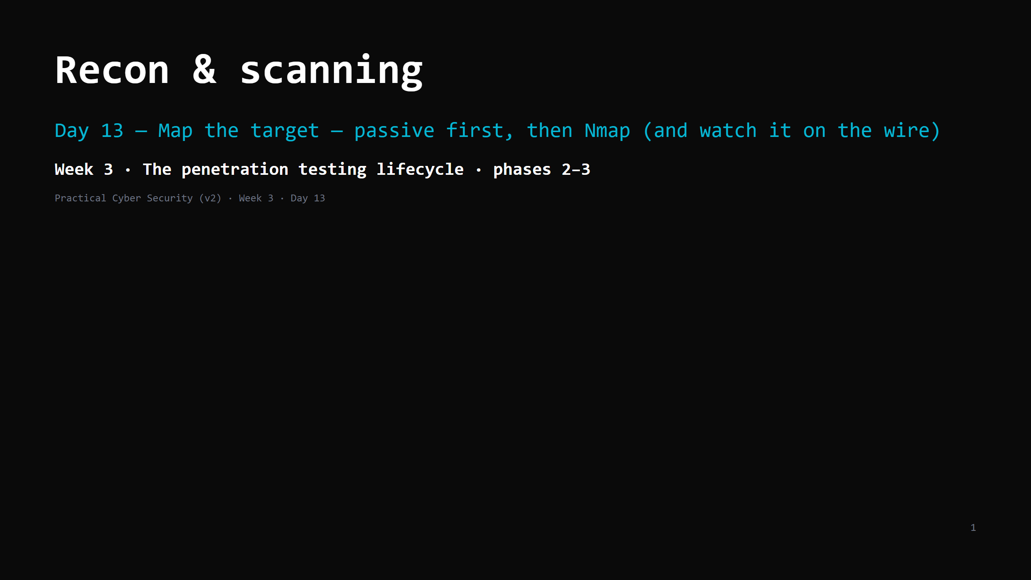
Notes:
RUN SHEET (~85 min). Wireshark gets installed today. 00:00 Journey check + hook (what's public about a domain) 4 00:04 Passive vs active 4 00:08 Passive recon — OSINT sources 10 00:18 DO: passive recon on a permitted domain 8 00:26 Active scanning — the idea 5 00:31 Nmap — the one tool worth learning well 12 00:43 DO: nmap the lab + watch it in Wireshark 18 01:01 From scan output to an asset list 6 01:07 Attack <-> defence 6 01:13 Wrap + artifact + homework 4 CUT FIRST IF SHORT: OS detection / timing detail on the Nmap slide; the "from output to asset list" slide to a 2-min demo. NEVER CUT: passive-before-active, the OSINT sources, nmap -sV -sC + reading output, the Wireshark watch, the service inventory artifact. ANALOGY (kitchen / health inspector): recon = walk the outside first — read the sign, check public records, look in the windows, note the delivery schedule — before touching anything. Scanning = walk up and try every door handle (and the neighbours hear you rattling them). ETHICS: passive recon only on the instructor-permitted domain. Active scans only on <LAB_HOST> (in the ROE) or scanme.nmap.org (the Nmap project explicitly allows scanning it).

Slide 2
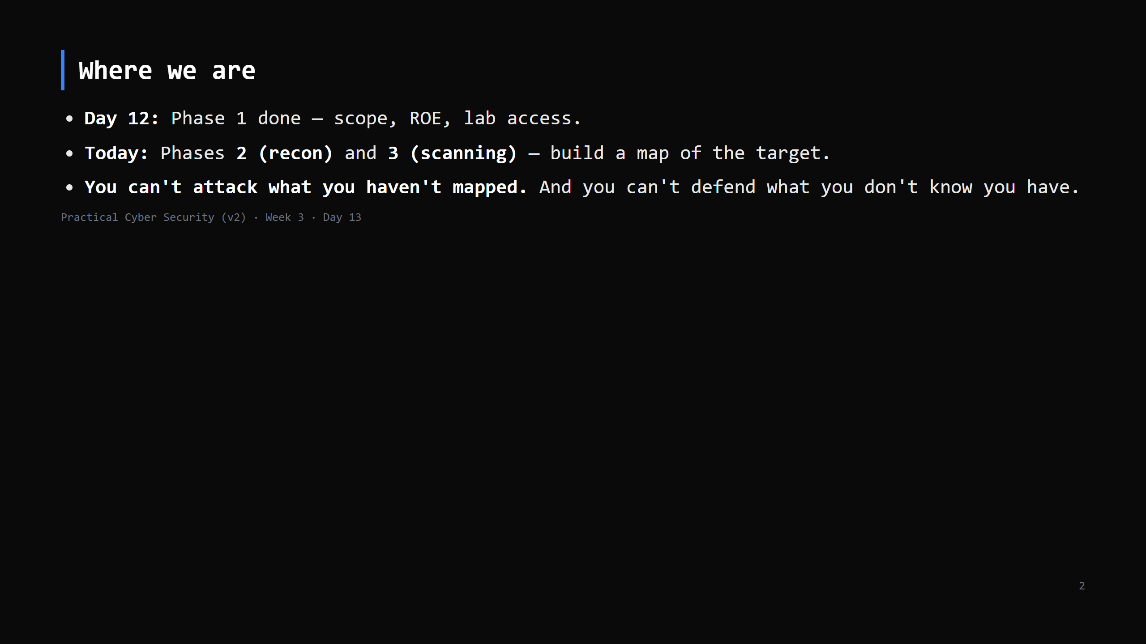
Notes:
Journey Check. The service inventory you build today is the input to Days 14-16.

Slide 3
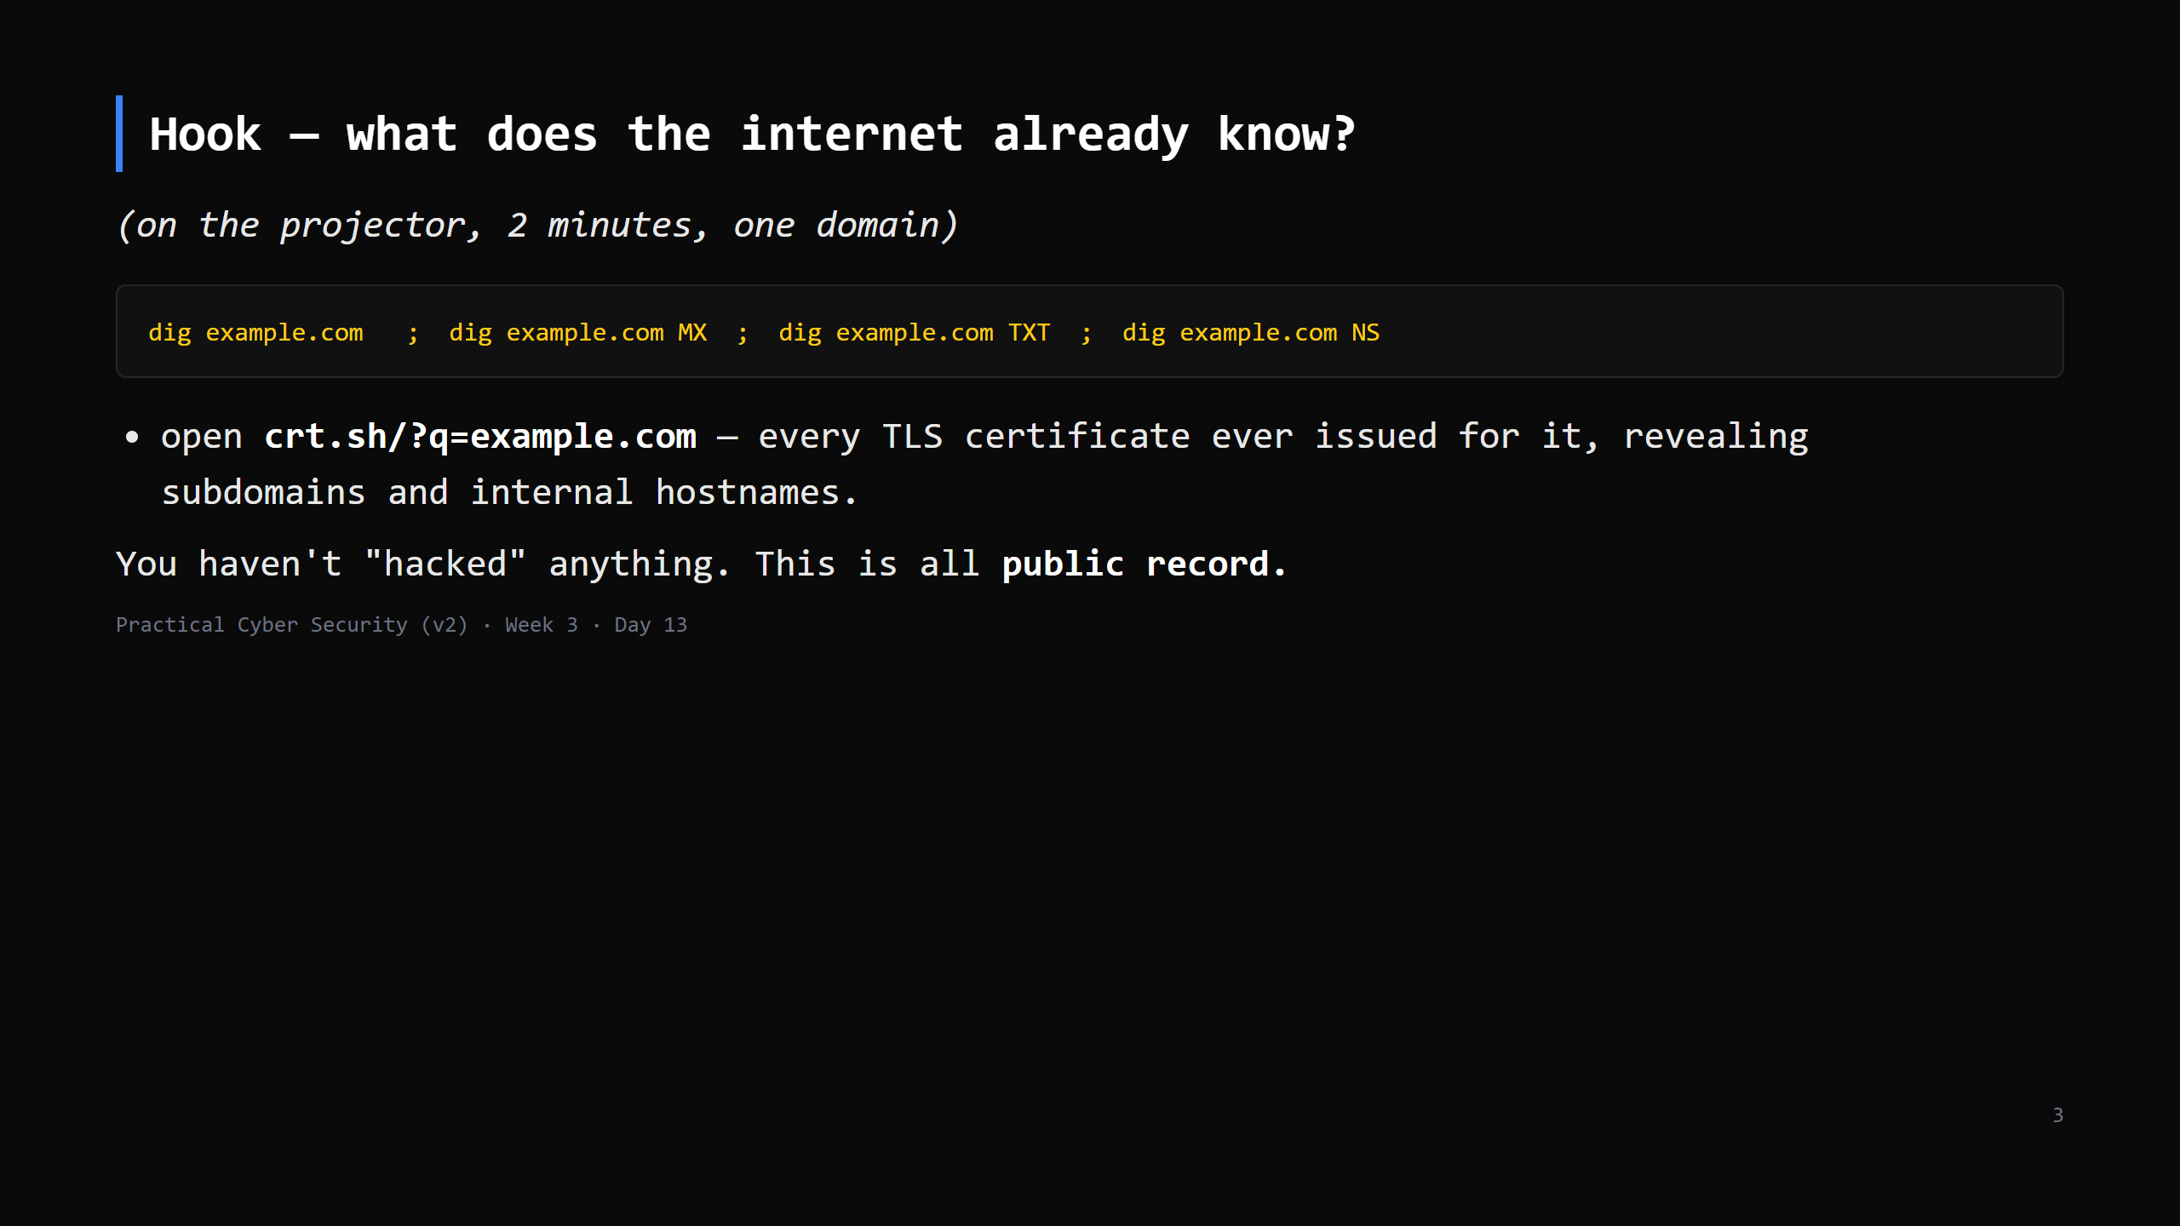
Notes:
`dig <domain> ANY` used to dump everything but most resolvers now refuse it (RFC 8482) — ask for the record types you want. TXT = SPF (sending IPs) + verification records; NS/MX = the DNS and mail providers. crt.sh (Certificate Transparency logs) is the single most useful passive source — it leaks hostnames like dev.example.com, vpn.example.com, jira.internal.example.com that the org never advertised. Do this live.

Slide 4
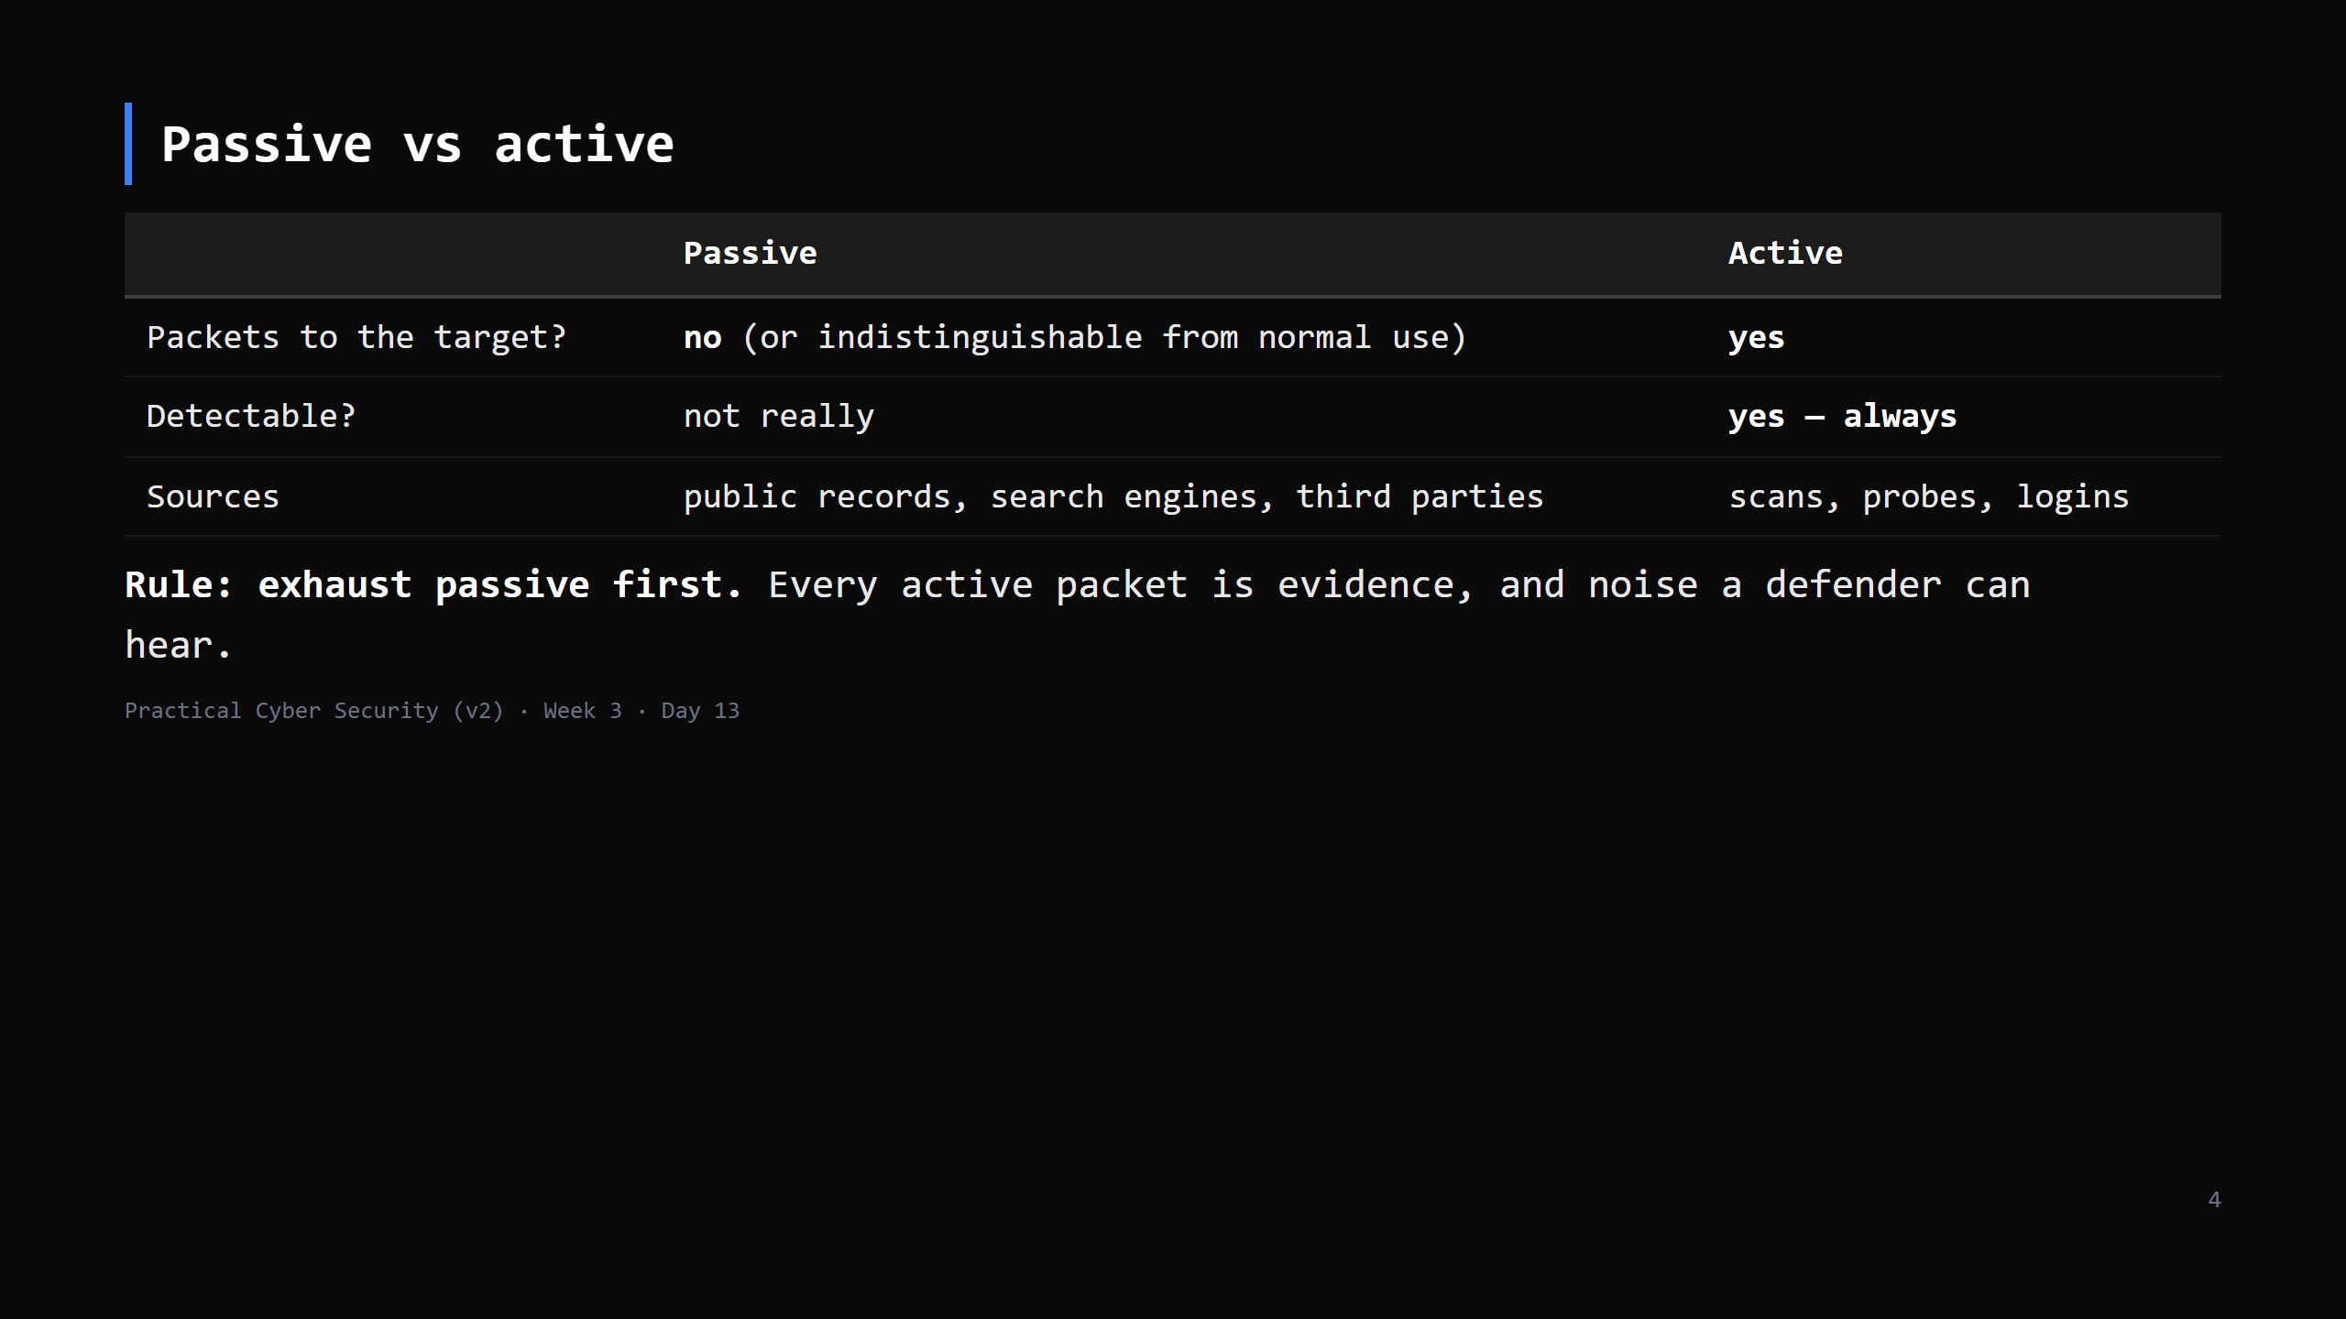
Notes:
Passive keeps you invisible and (for public data) generally legal to gather. Active is where scope and authorization matter — you're now touching someone's system.

Slide 5
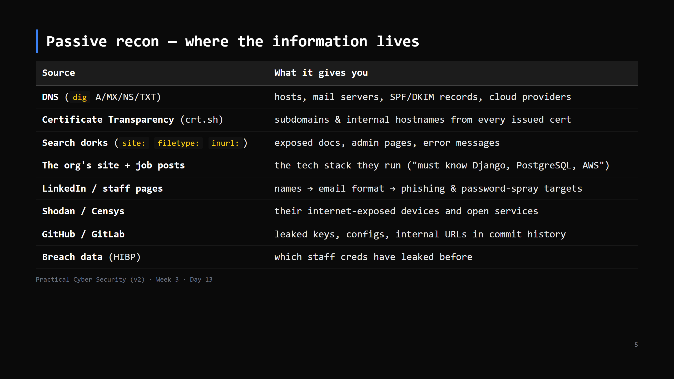
Notes:
The mindset: an attacker builds a picture of the org — its people, its tech, its exposure — before sending a single packet. Job ads are goldmines for the tech stack.

Slide 6
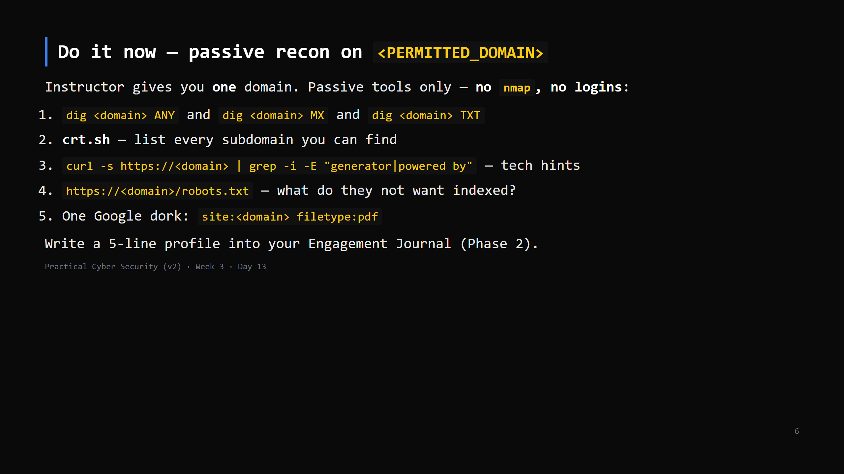
Notes:
8 min. Use a domain you control or one that's clearly OK (the college's public site, or example.com). This is passive - it does not need to be in the pentest scope, but keep it sane and don't enumerate people aggressively.

Slide 7
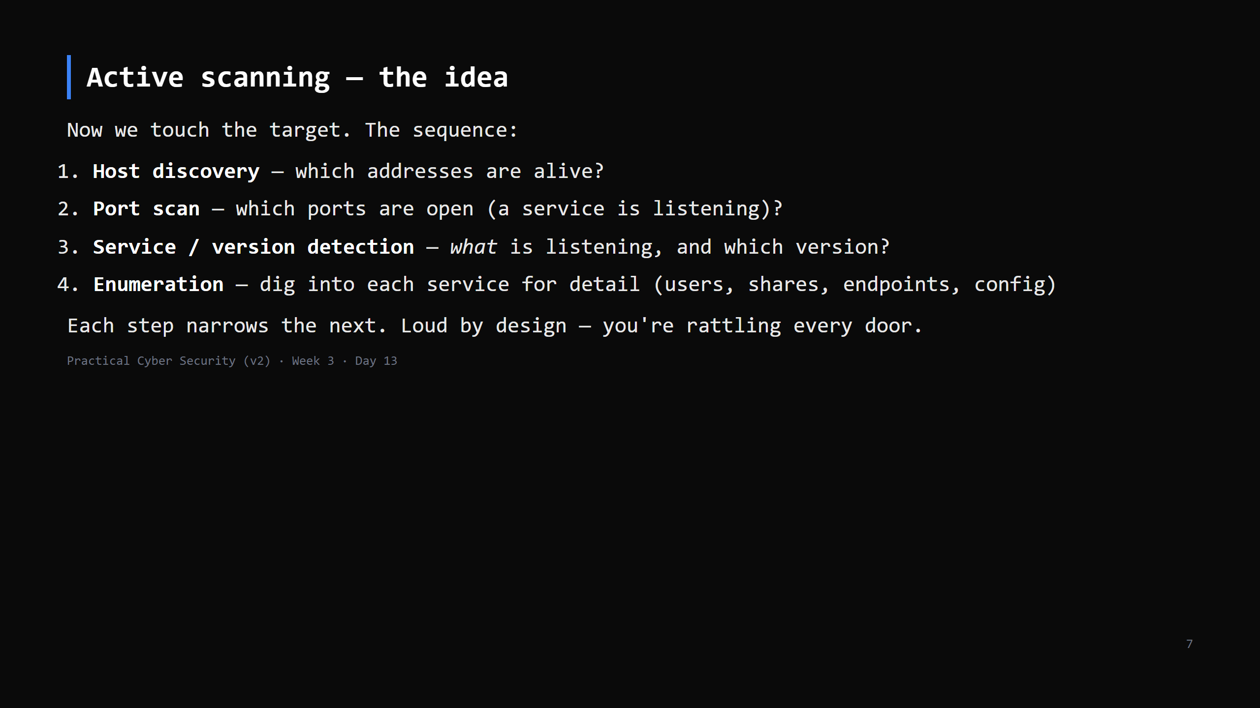
Notes:
Version detection (step 3) is the pivot to Day 14: "Apache 2.4.49" -> look up its CVEs. Enumeration (step 4) is service-specific and continues all week.

Slide 8
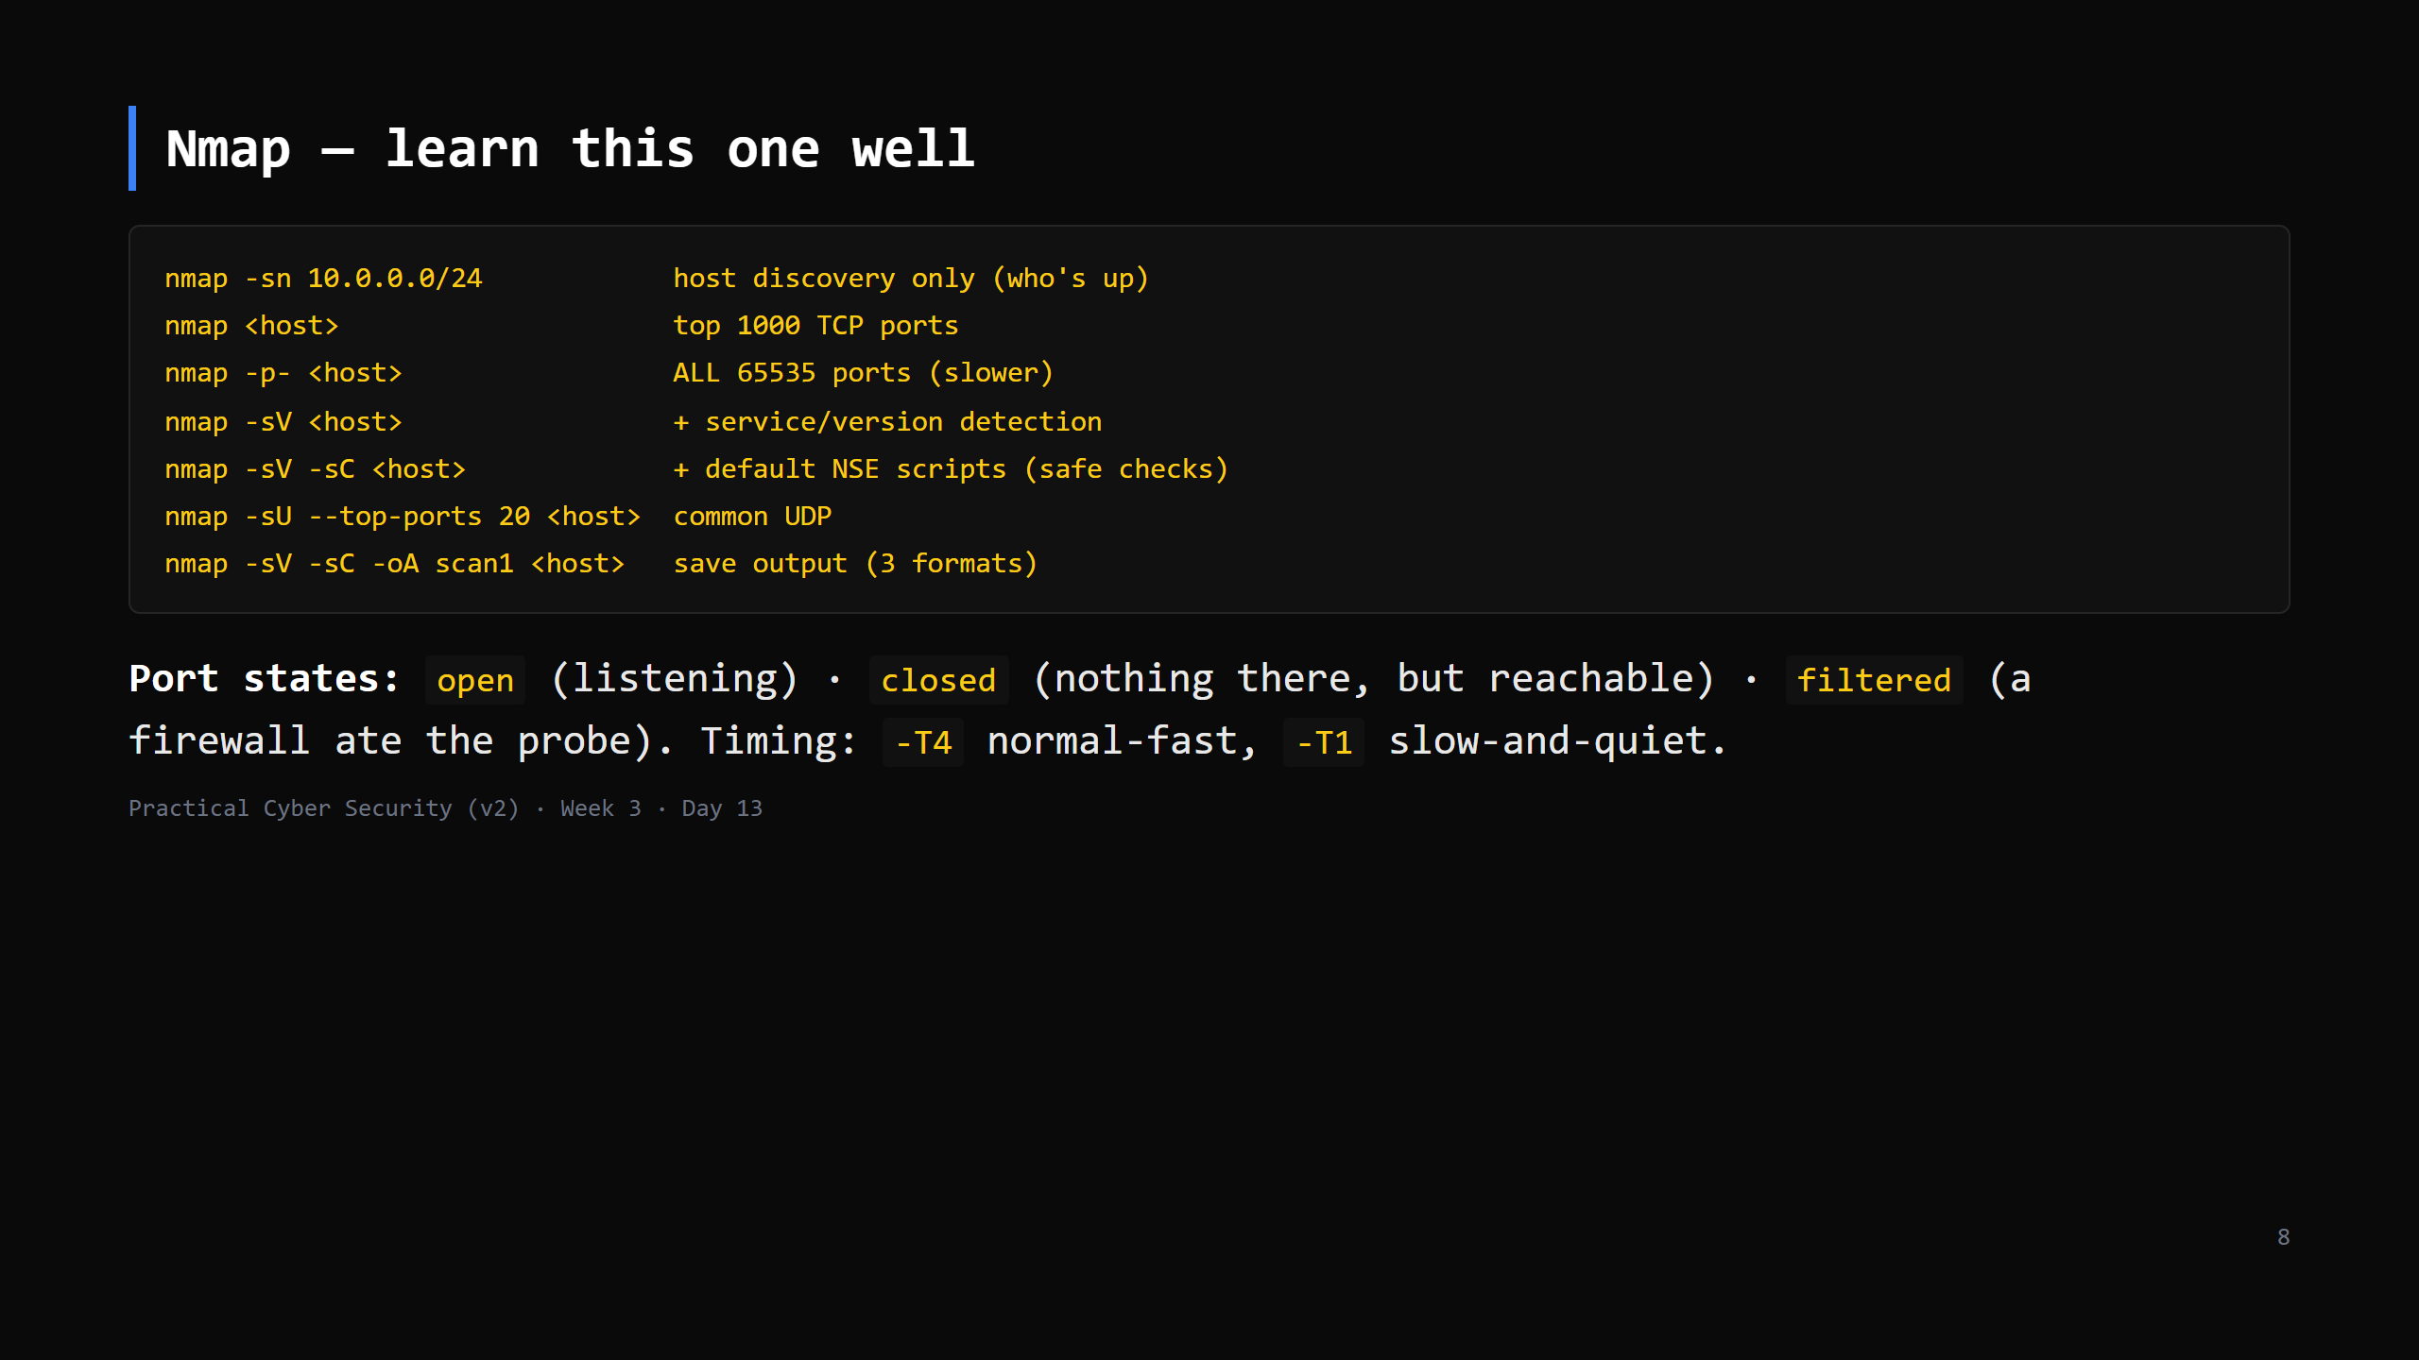
Notes:
`-sV -sC -oA` is the everyday combo. `-sS` (SYN) is the default when run as root; `-sT` (full connect) otherwise. Don't drill every flag - `-sV`, `-sC`, `-p`, `-oA`, `-T` cover 95%. `-O` (OS detection) and NSE categories are a "look it up" (Day 6 lesson: --help / man). CUT the OS/timing detail first if short.

Slide 9
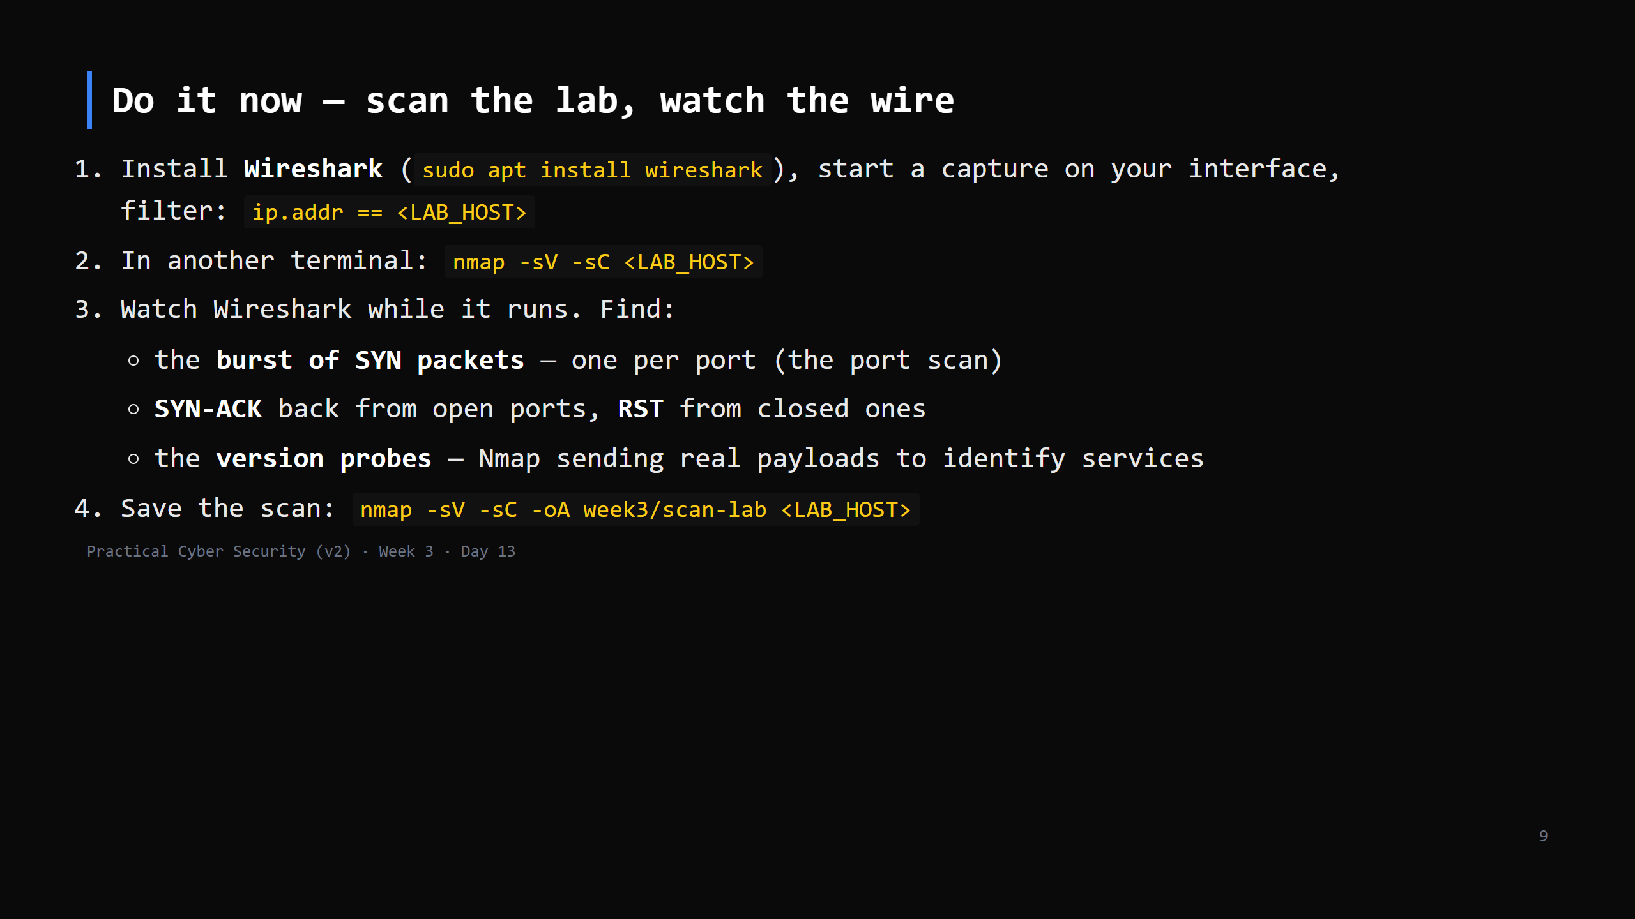
Notes:
18 min. This is THE blue-team bridge - "here is what a scan looks like from the defender's chair". A default scan is hundreds of packets in seconds; utterly obvious in a capture or an IDS. No lab? scanme.nmap.org is explicitly OK to scan (be gentle - one scan). Wireshark install: the "should non-root capture?" prompt -> Yes, add your user to `wireshark` group, log out/in (or use sudo for today).

Slide 10
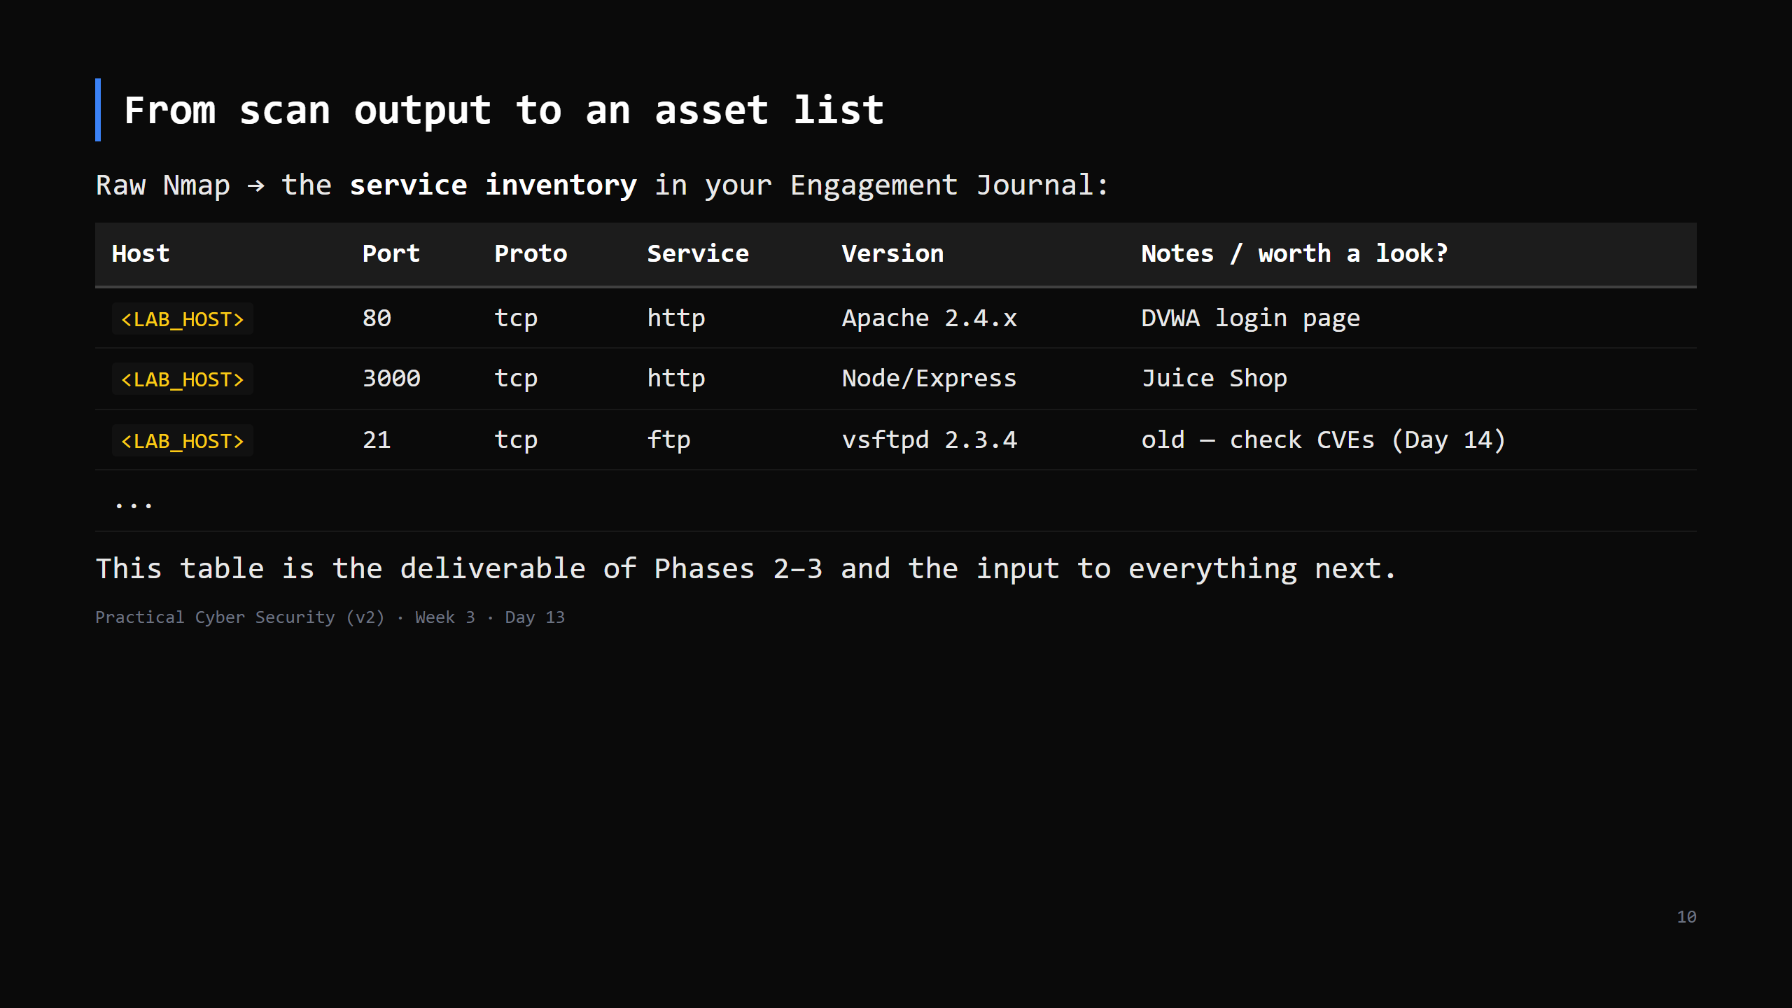
Notes:
The skill: not "run nmap" but "turn 200 lines of output into a prioritised list of things to investigate". Old version numbers and unusual services rise to the top.

Slide 11
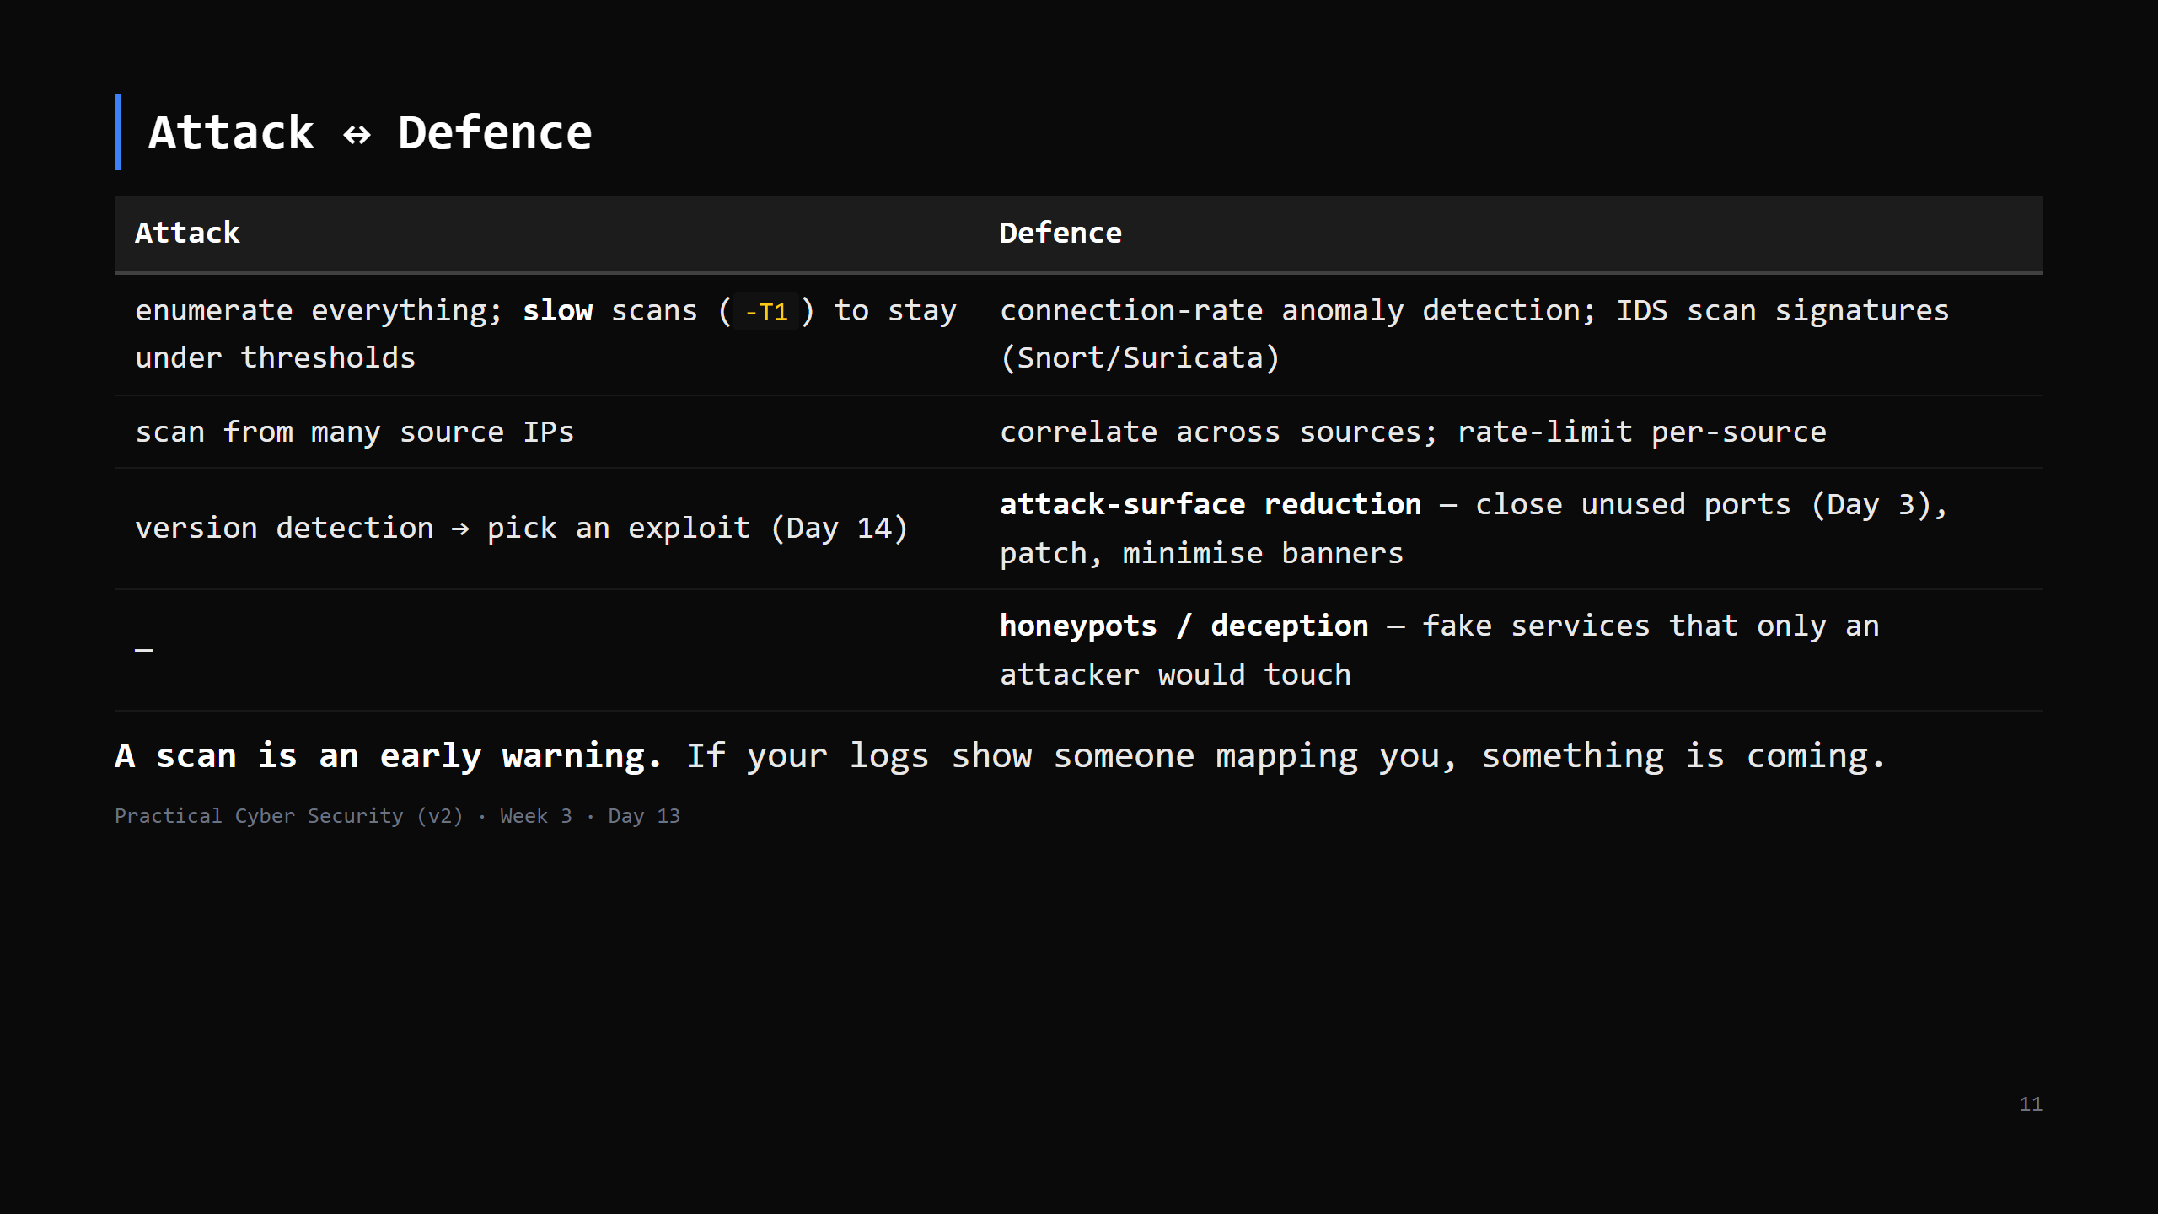
Notes:
The two Day 13 traps, addressed: (1) "harmless" - unauthorized scanning has been prosecuted; stay in scope. (2) "undetectable" - it is one of the loudest things you can do. A pentester scans openly *because they're authorised*; an attacker who wants stealth pays a big speed cost.

Slide 12
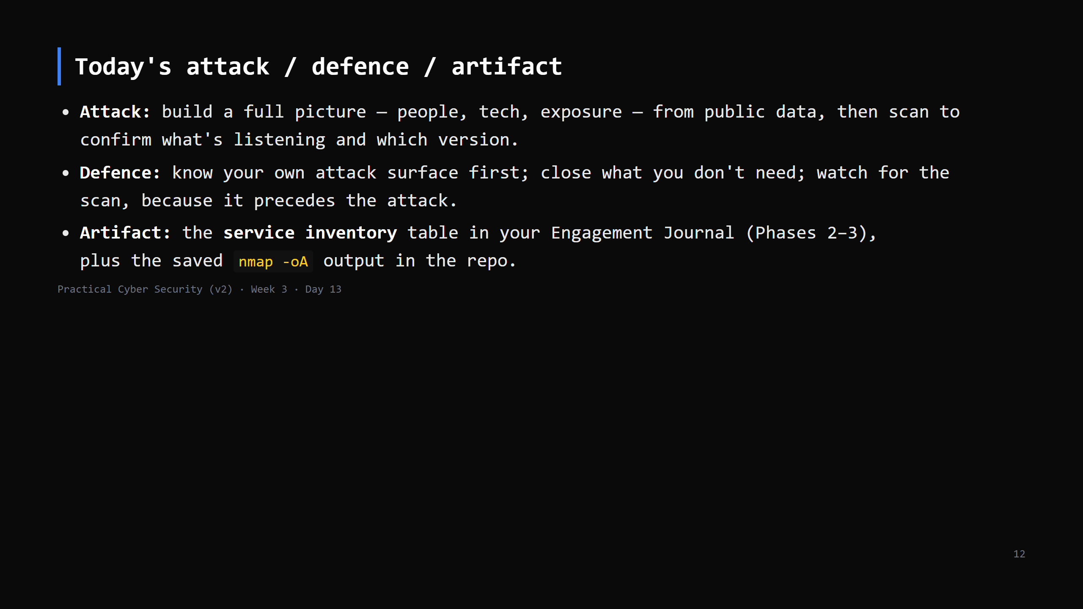

Slide 13
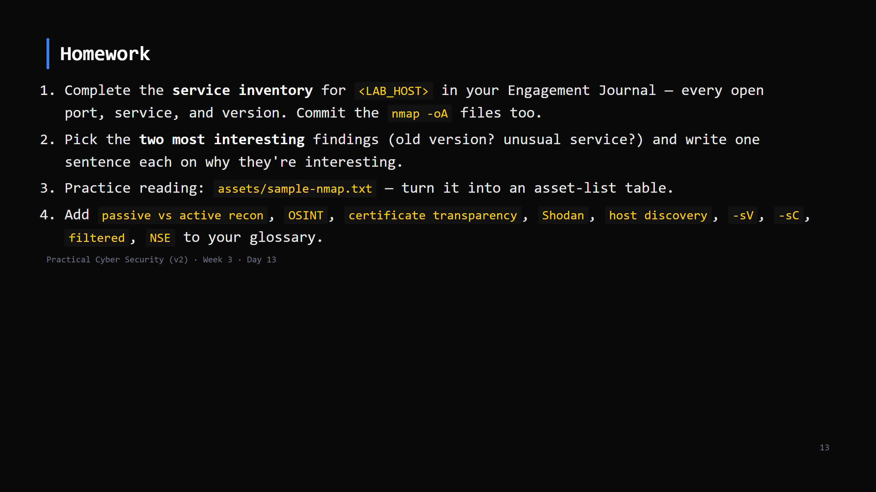
Notes:
Due start of Day 14.

Slide 14
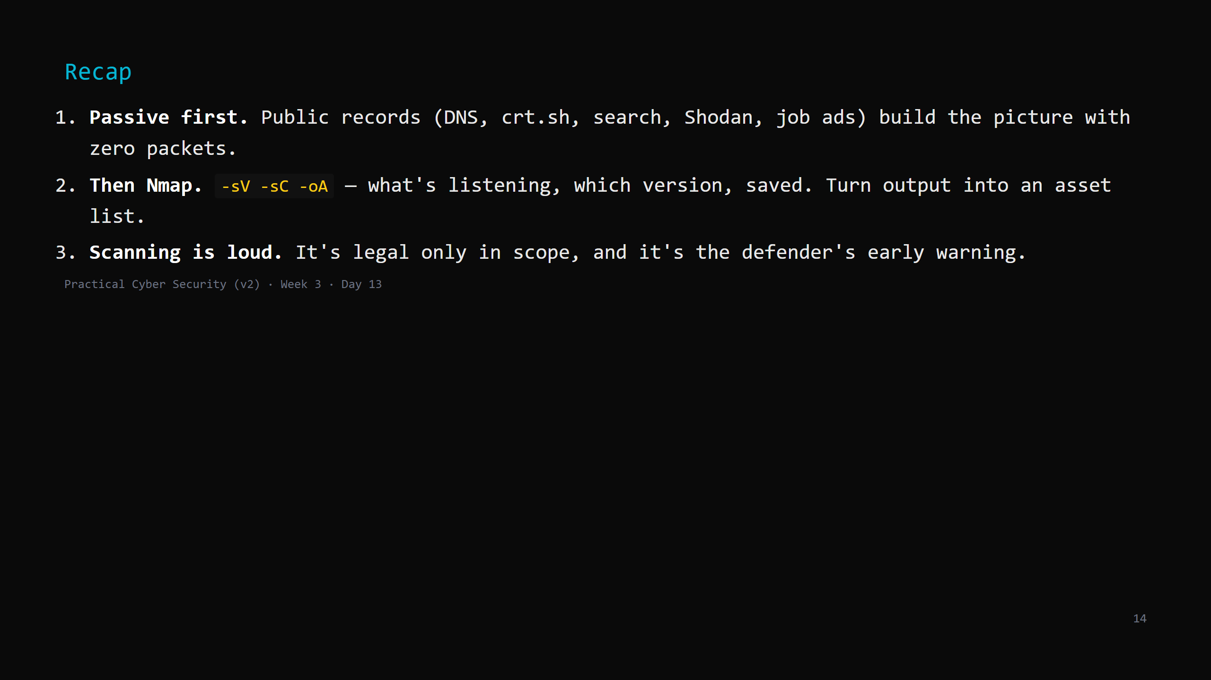
Notes:
Say the three lines. Tomorrow: take the versions from your inventory and turn them into a ranked list of real weaknesses - vulnerability assessment.

