Slide 1
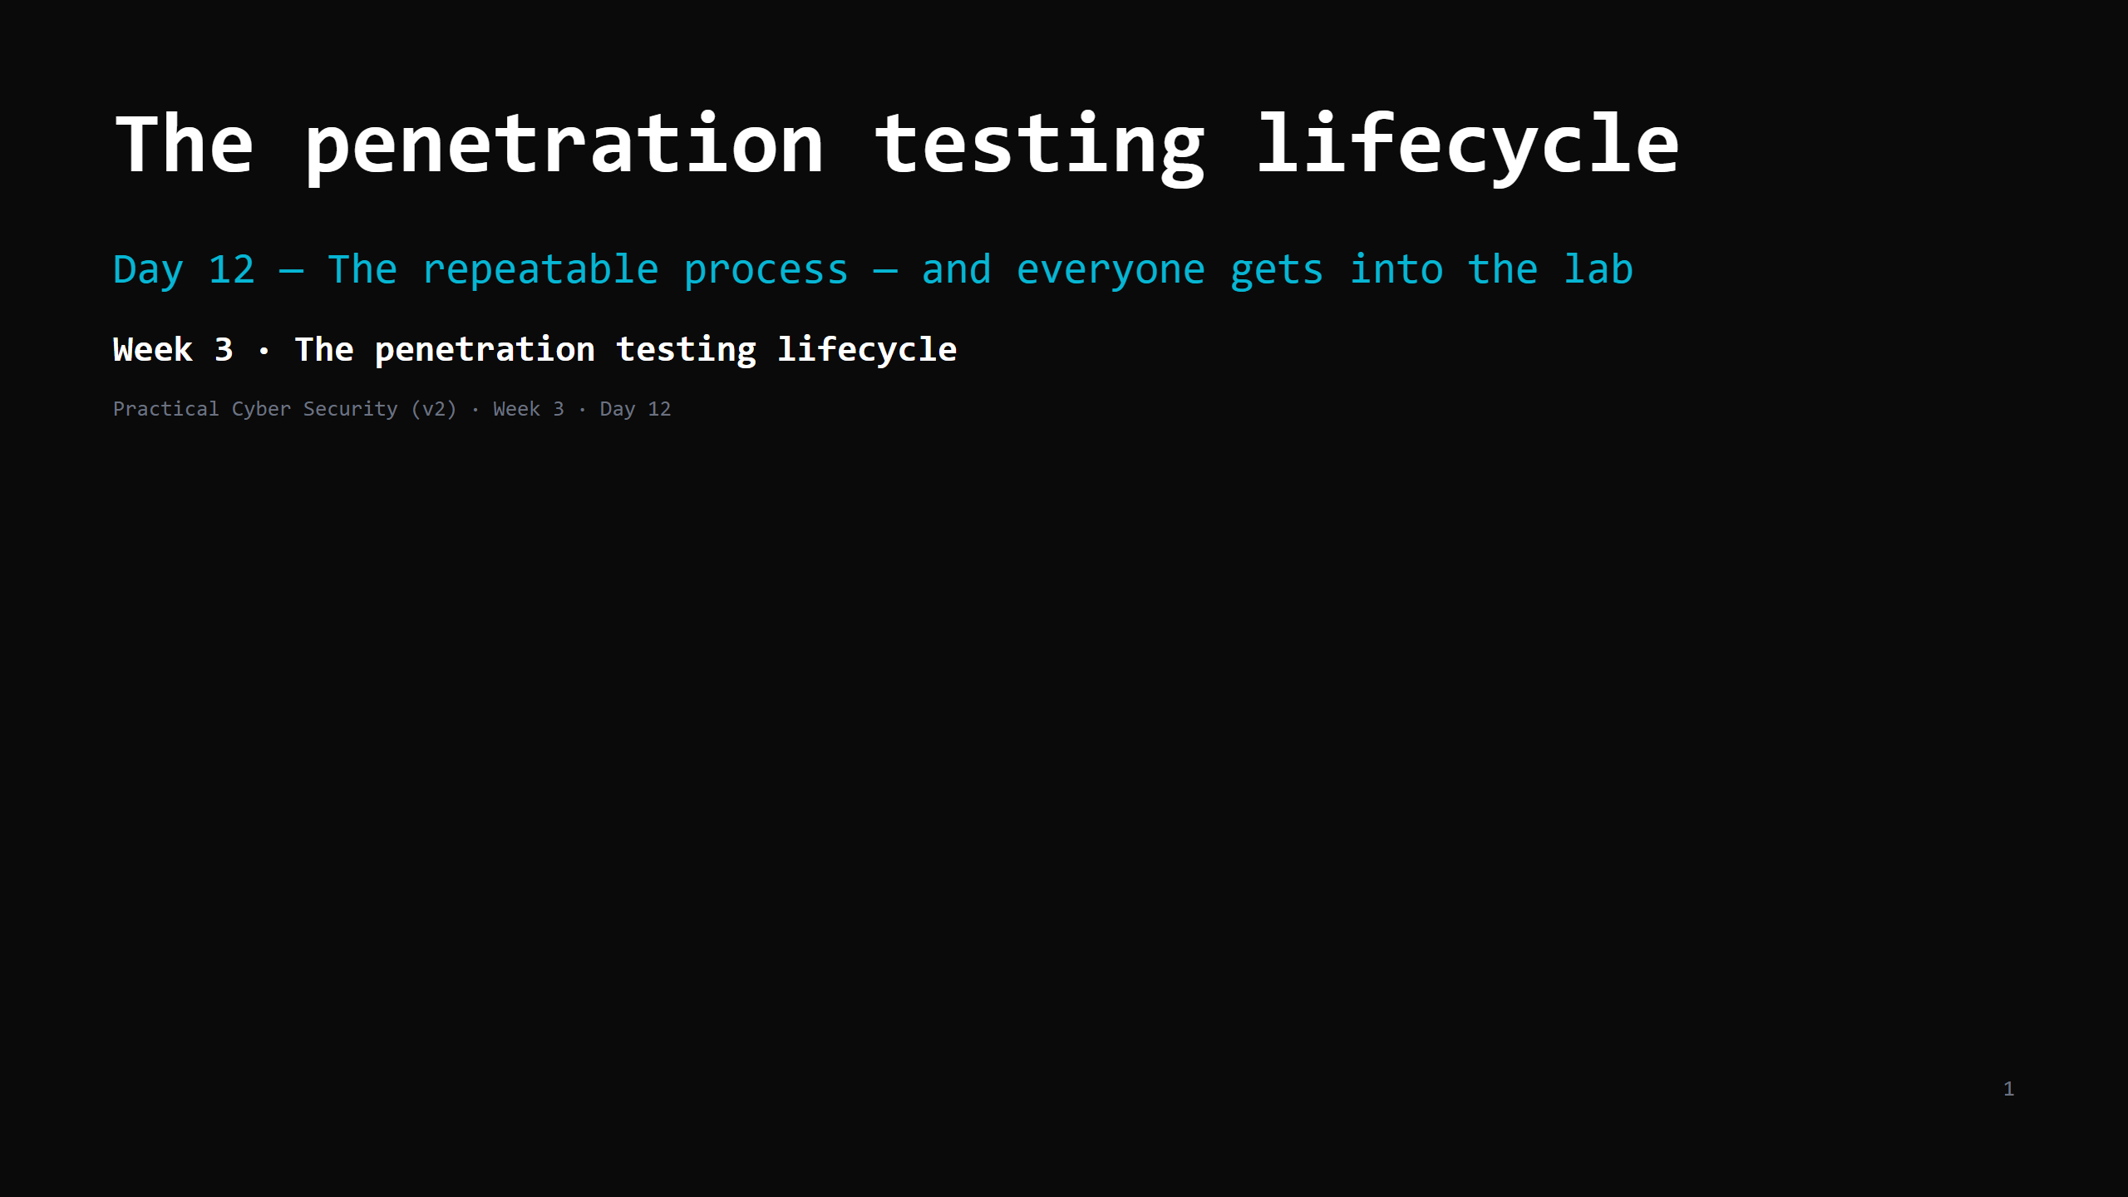
Notes:
RUN SHEET (~85 min). The lab-connect DO is the big one and the Day 12 GATE.
00:00 Journey check + hook (burglar vs inspector) 4
00:04 What a penetration test is (and isn't) 5
00:09 The lifecycle — the 6 phases 10
00:19 Phase 1: scope, ROE, authorization 10
00:29 DO: write a mock ROE for the class engagement 10
00:39 The reporting mindset 7
00:46 The Engagement Journal 4
00:50 Blue team's view — kill chain / MITRE ATT&CK 6
00:56 DO: connect to the lab (the GATE) 18
01:14 Wrap + artifact + homework 6
CUT FIRST IF SHORT: the kill-chain slide to 3 min; the ROE DO to a 5-min fill of 3 fields.
NEVER CUT: the 6 phases, scope/ROE/authorization, the lab connect, the Engagement Journal.
ANALOGY (kitchen): a pentester = a hired health inspector with WRITTEN permission to try to
break in, who then reports exactly how — with photos and fixes. Not a burglar. The one
difference between them is a signed piece of paper.
LAB: this is the GATE, but most students already built their lab as Day 11 homework — today
is mostly VERIFY, not build. Anyone who didn't finish, or is on a Mac/ARM laptop, goes on the
shared Kali; fix their own lab in office hours.

Slide 2
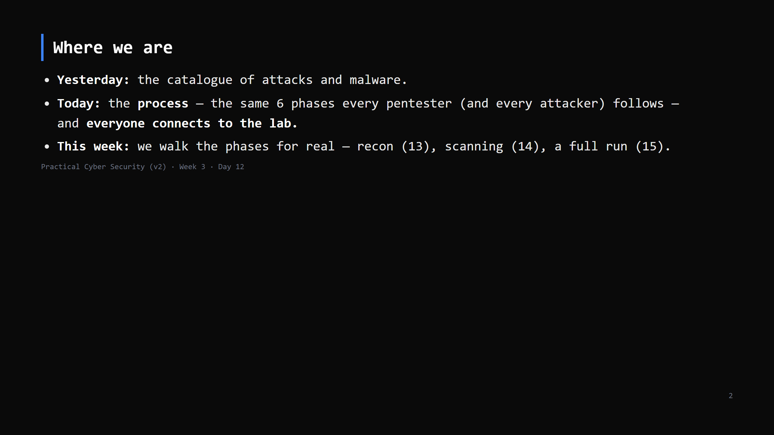
Notes:
Journey Check. Week 3's spine: offense is a PROCESS, not improvisation. Learn the process once,
apply it forever.

Slide 3
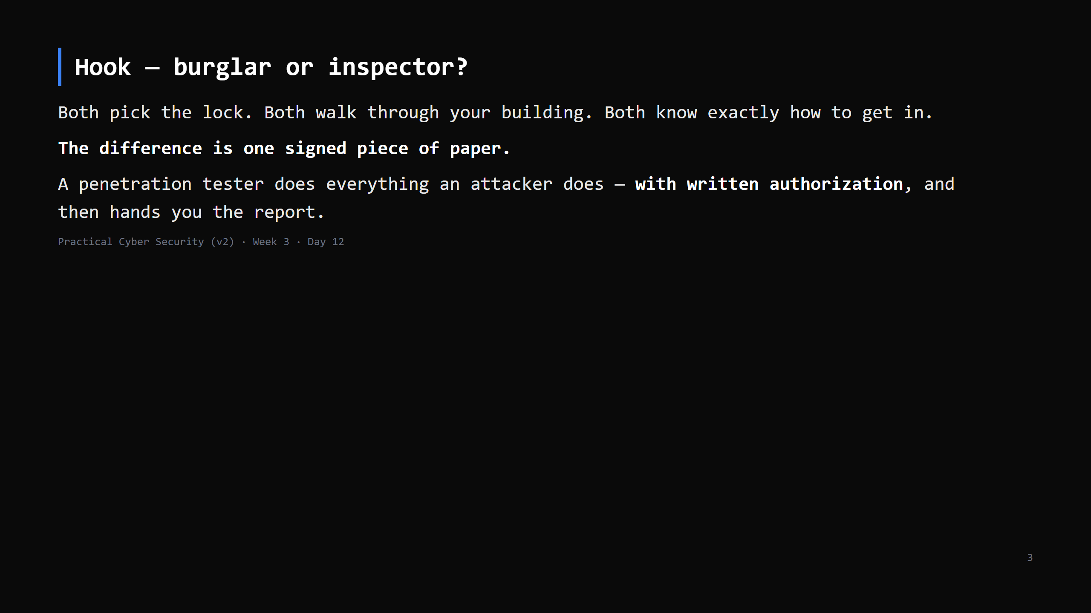
Notes:
Callback to Day 1 (white/grey/black hat; "no scope, no test"). Today that line becomes an
actual document you write.

Slide 4
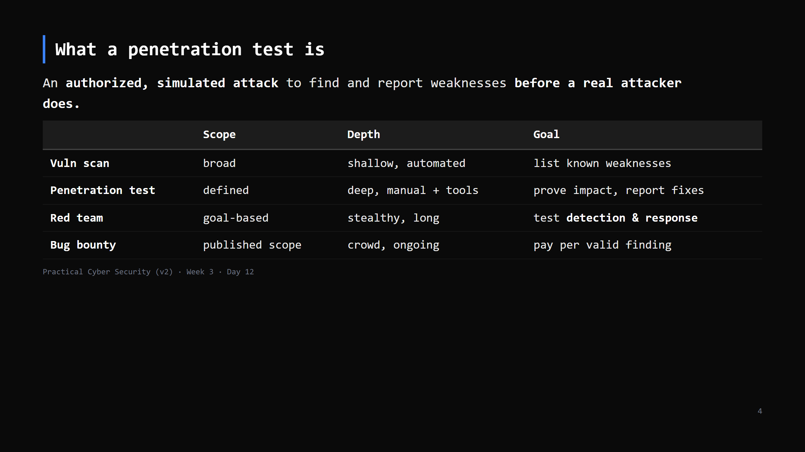
Notes:
Students conflate these. A pentest is time-boxed, scoped, and its DELIVERABLE is the report.
Red team is quieter and measures whether the blue team notices. We're learning pentest.

Slide 5
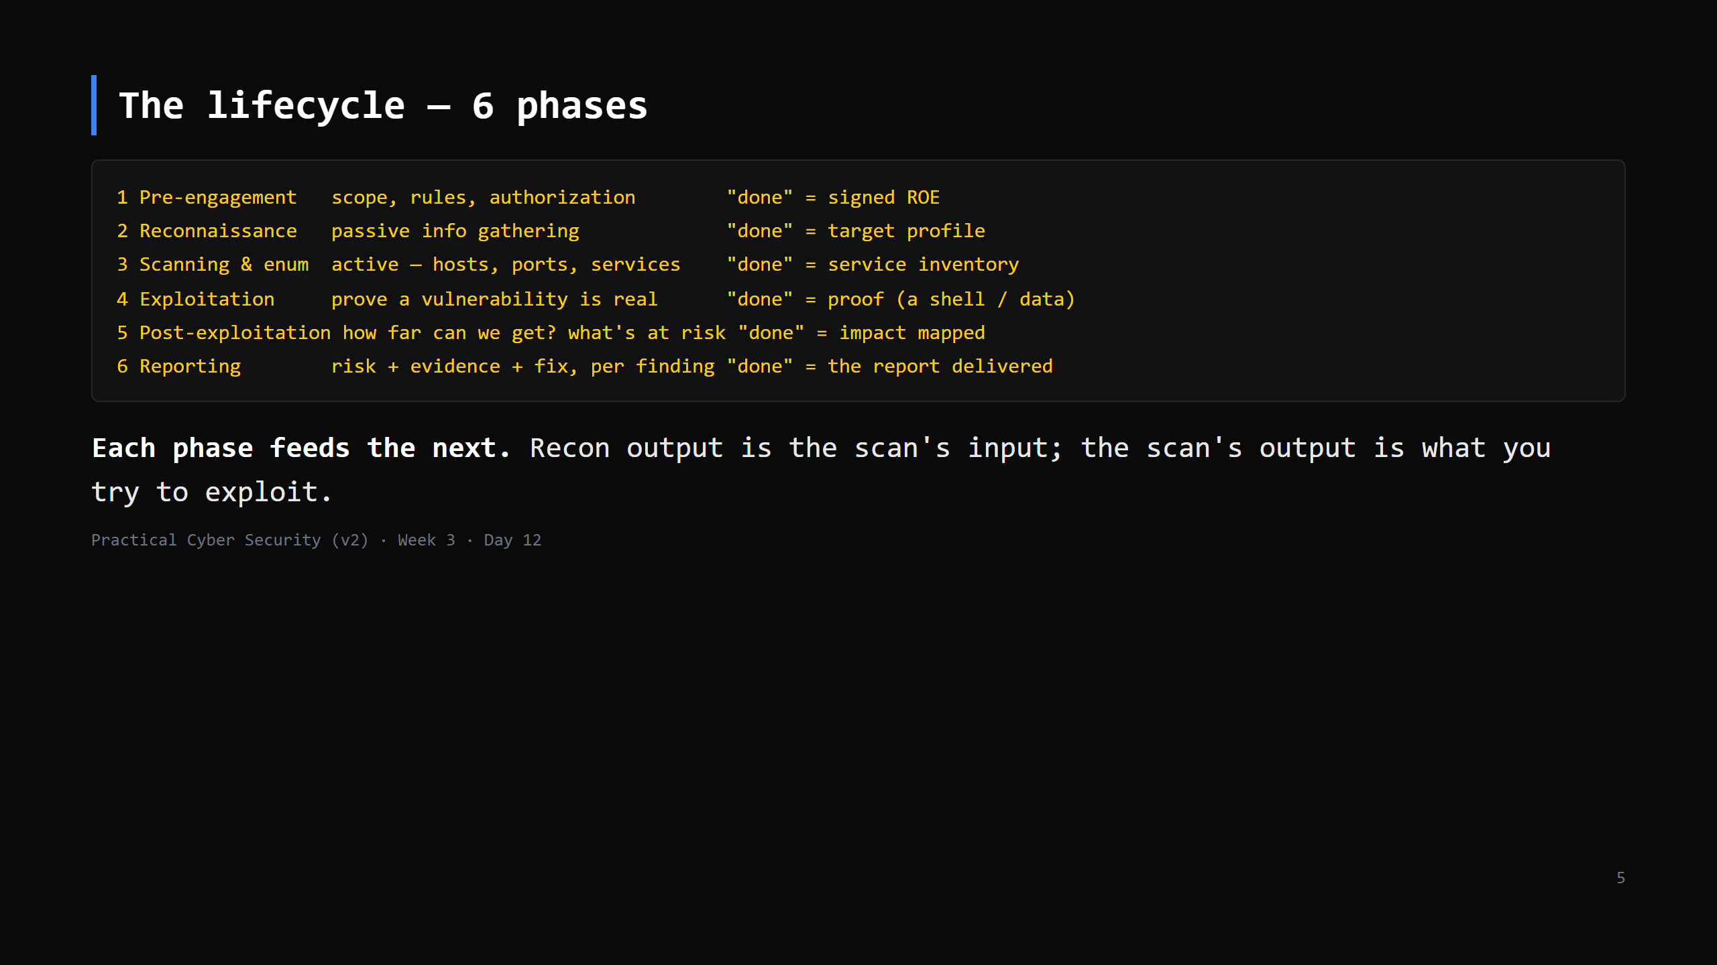
Notes:
This is the map for all of Week 3-4. Put it on the board and tick phases off across the week:
today = phase 1, Day 13 = 2-3, Day 14 = 3 (vuln side), Day 15 = 1-4, Day 16-17 = 4-5, Day 19
= the defender's mirror.
Names vary (PTES, OSSTMM, NIST) — the shape is the same.

Slide 6
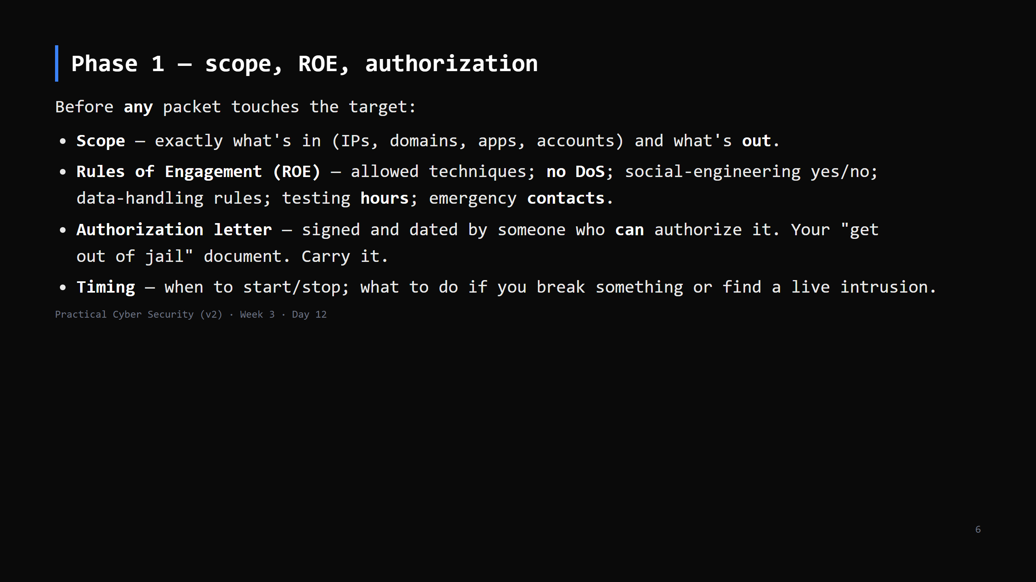
Notes:
"No scope, no test" from Day 1 is now a checklist. The authorization letter is not optional and
not an email thread — it's a signed document naming the systems and the dates.
If a real pentest finds evidence of an ACTUAL breach, you stop and escalate immediately — that's
in the ROE.

Slide 7
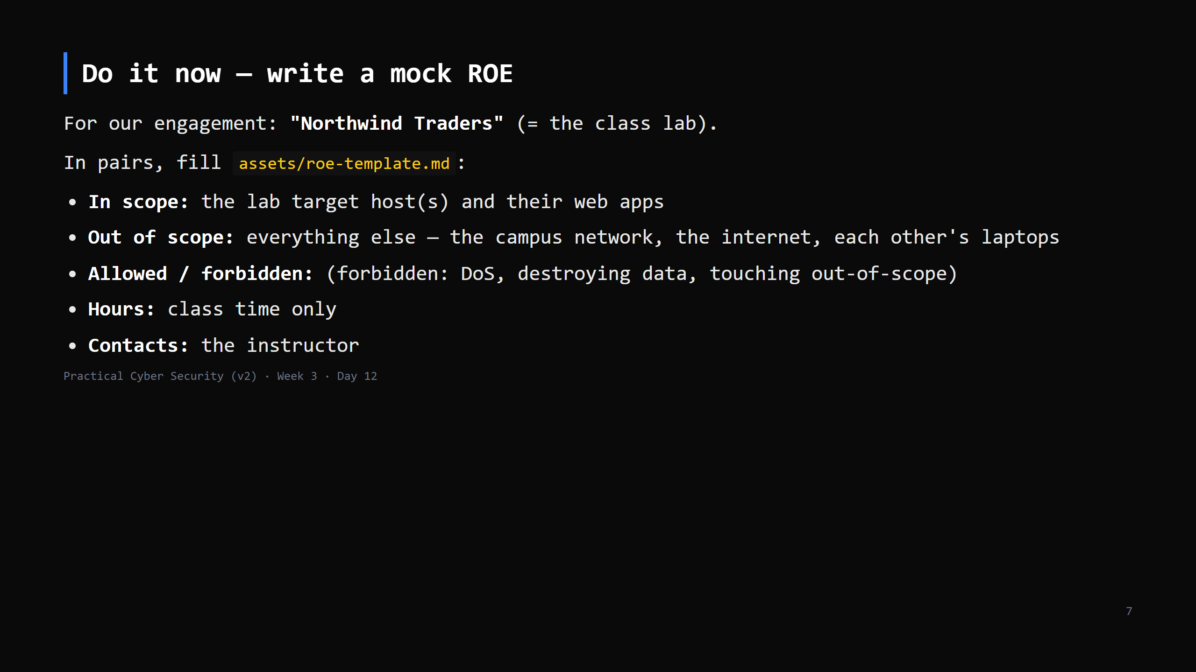
Notes:
10 min. This is a real deliverable pentesters write. Emphasise the OUT-of-scope list — that's
what keeps you legal. "Each other's laptops" being explicitly out of scope matters.
CUT to 5 min if behind: just fill in-scope / out-of-scope / forbidden.

Slide 8
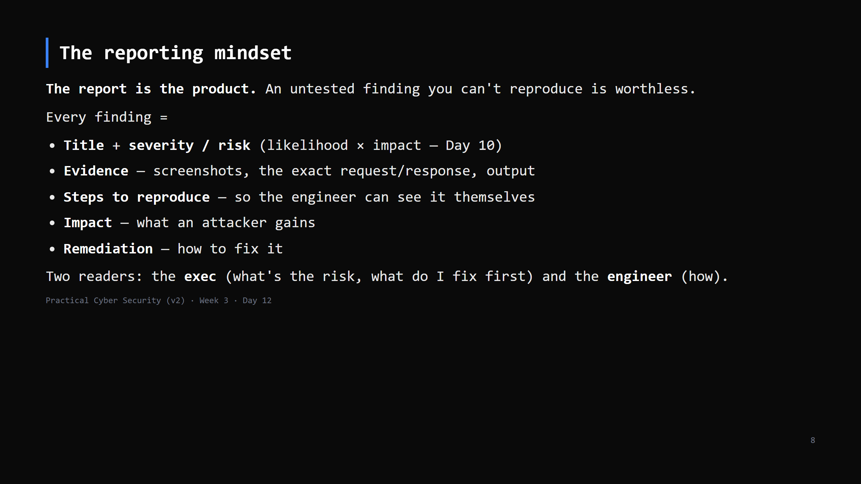
Notes:
Start the report on day one, not the night before it's due. The Engagement Journal (next slide)
IS the running draft.
A finding without reproduction steps gets dismissed as "works on my machine".

Slide 9
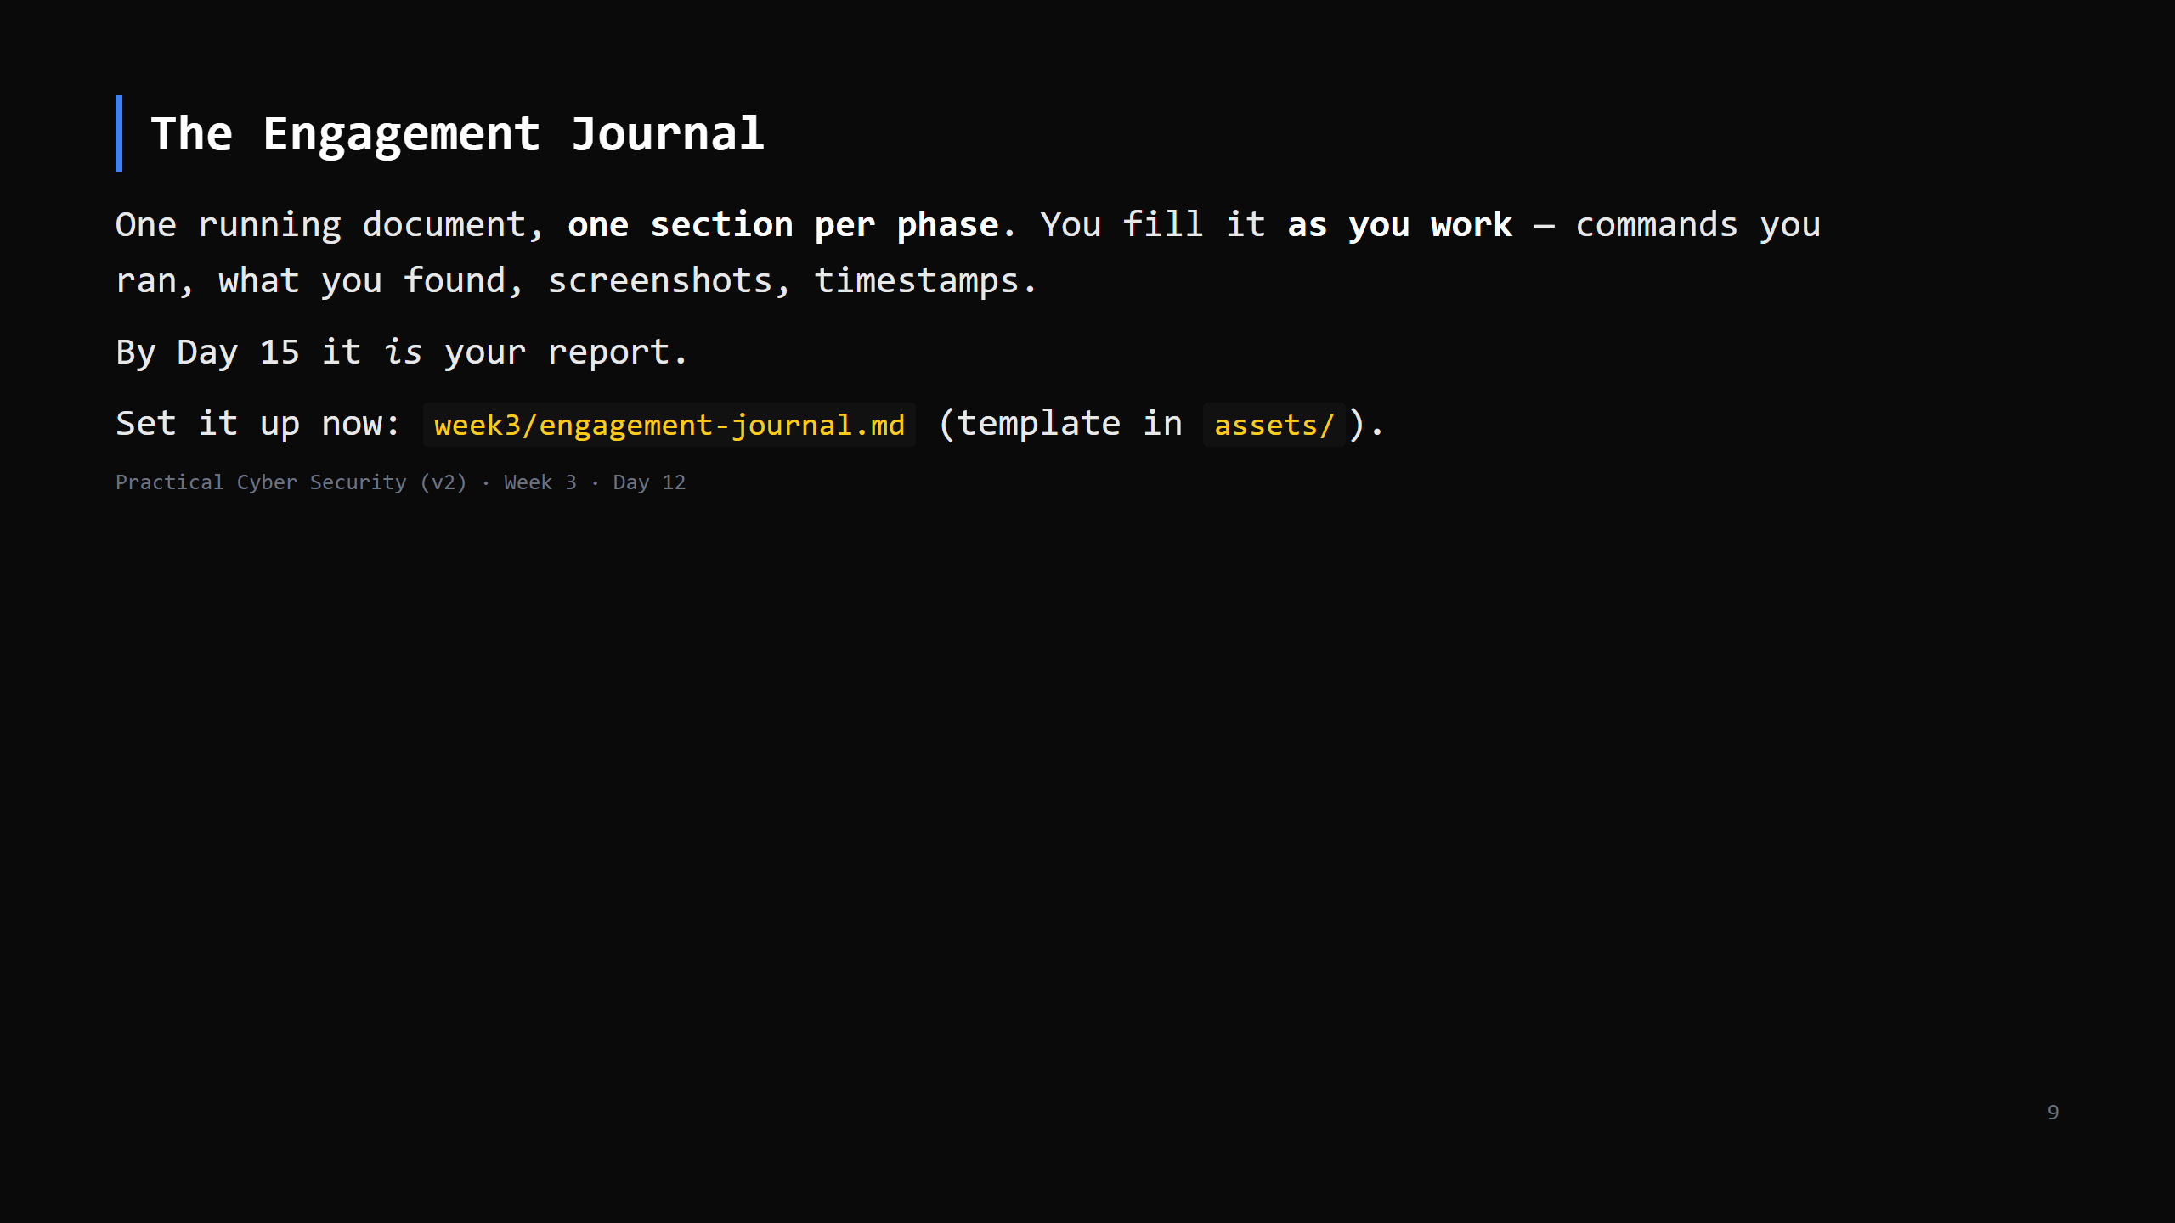
Notes:
This mirrors the Northwind Traders "Engagement Journal" model. Non-negotiable habit: if you
did it and it's not in the journal, it didn't happen. Timestamp everything (matters for the
blue team's timeline later — Day 19).

Slide 10
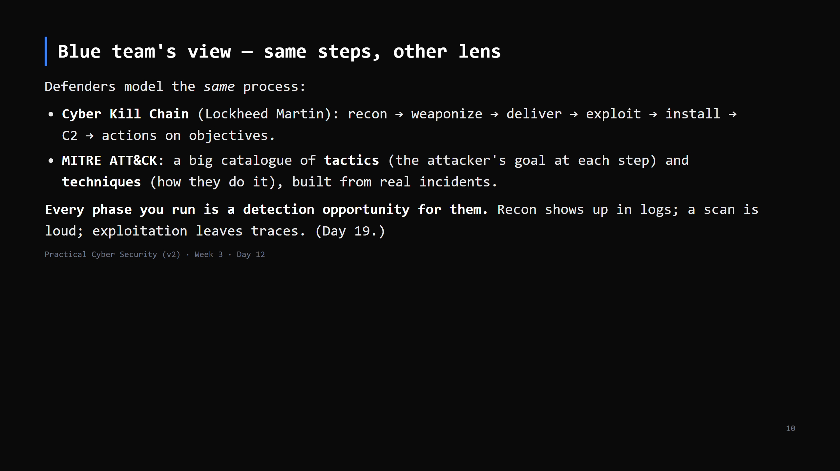
Notes:
The point: offense and defense are the same map read from opposite ends. ATT&CK technique IDs
(T1566 phishing, T1046 network scanning...) are how SOC teams and pentesters talk to each other.
CUT to 3 min: "defenders have their own name for this process — the kill chain and MITRE
ATT&CK — and every step you take, they can potentially see."

Slide 11
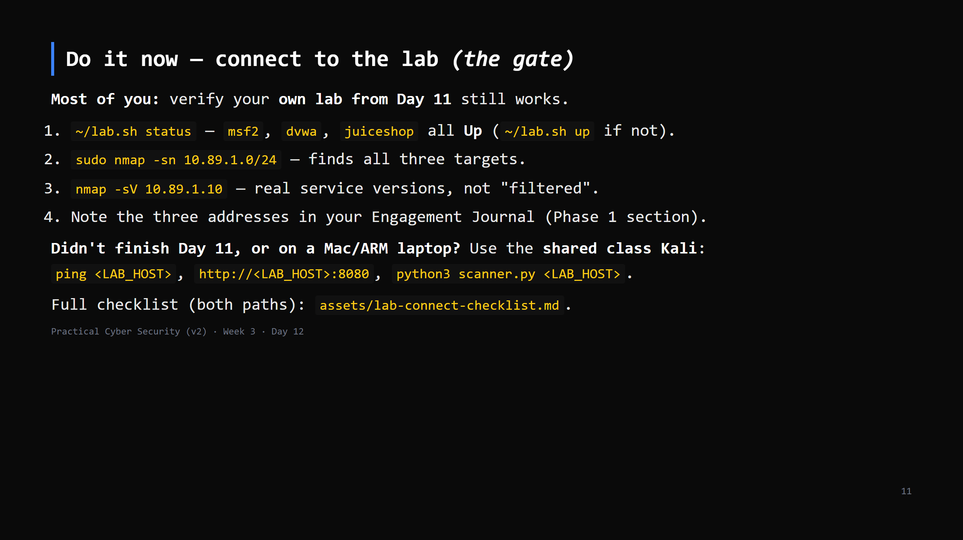
Notes:
18 min — THE GATE, but lighter than it looks: most students already have a working lab from
Day 11 homework, so this is a VERIFY pass (5-8 min), not a first connect. Spend the saved time
on stragglers: shared-Kali onboarding for anyone who didn't finish Day 11 or can't run WSL2.
Containers don't 'snapshot' like a VM - point 5 in the checklist is the reset instead: the
targets are disposable, `podman rm -f <name>` + the one build command from Day 11's guide
gets back to clean in under a minute. Say that explicitly so nobody hunts for a snapshot button.
Nobody starts Day 13 without lab access.

Slide 12
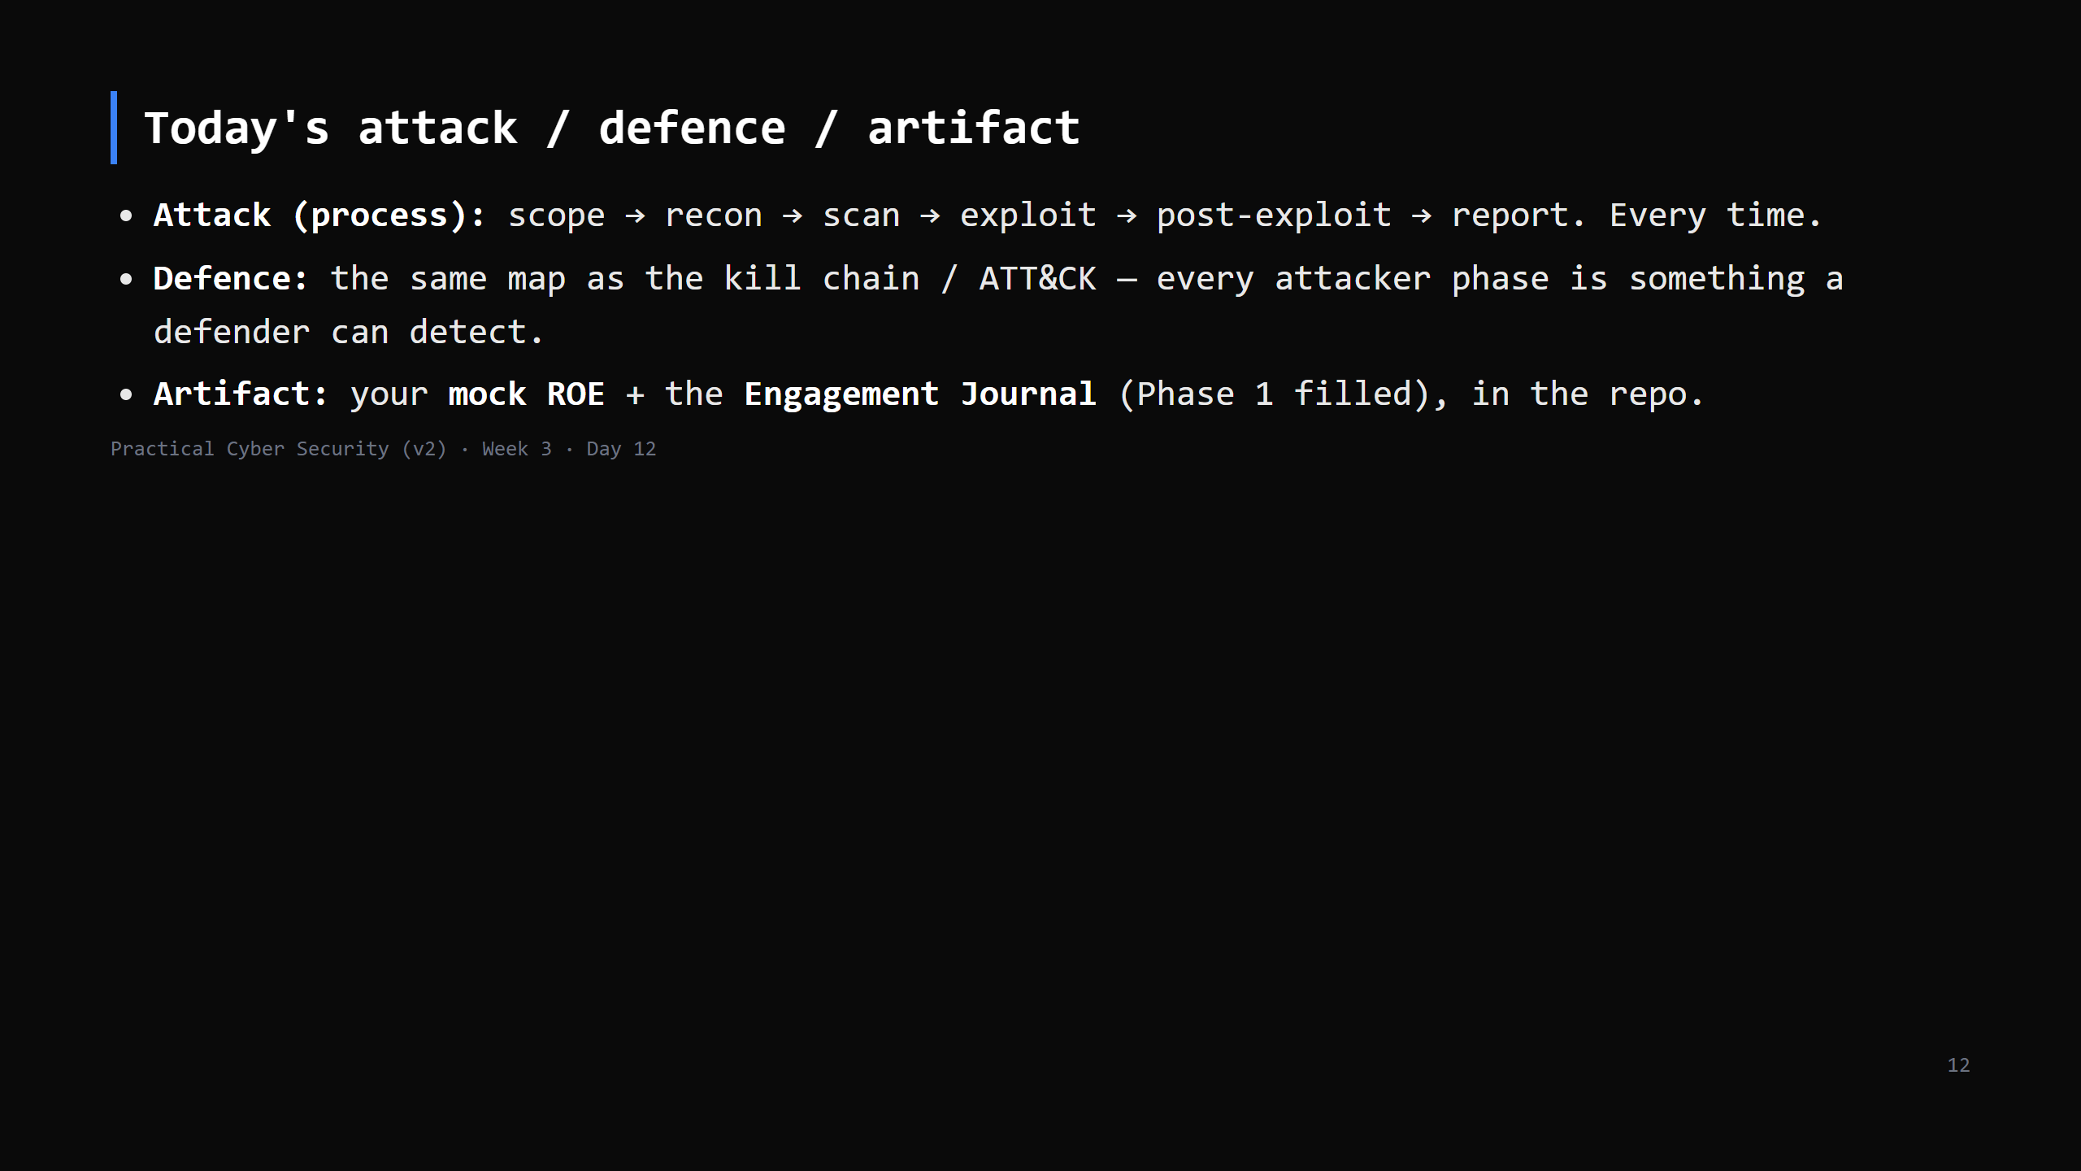

Slide 13
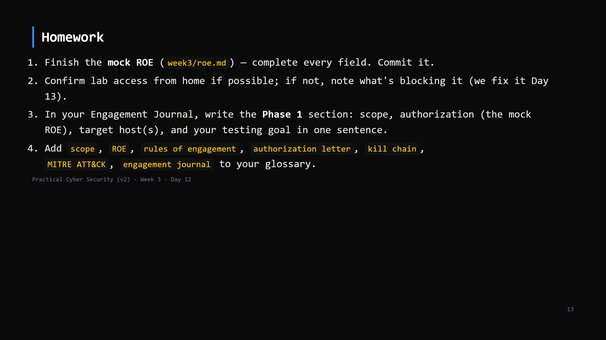
Notes:
Due start of Day 13.

Slide 14
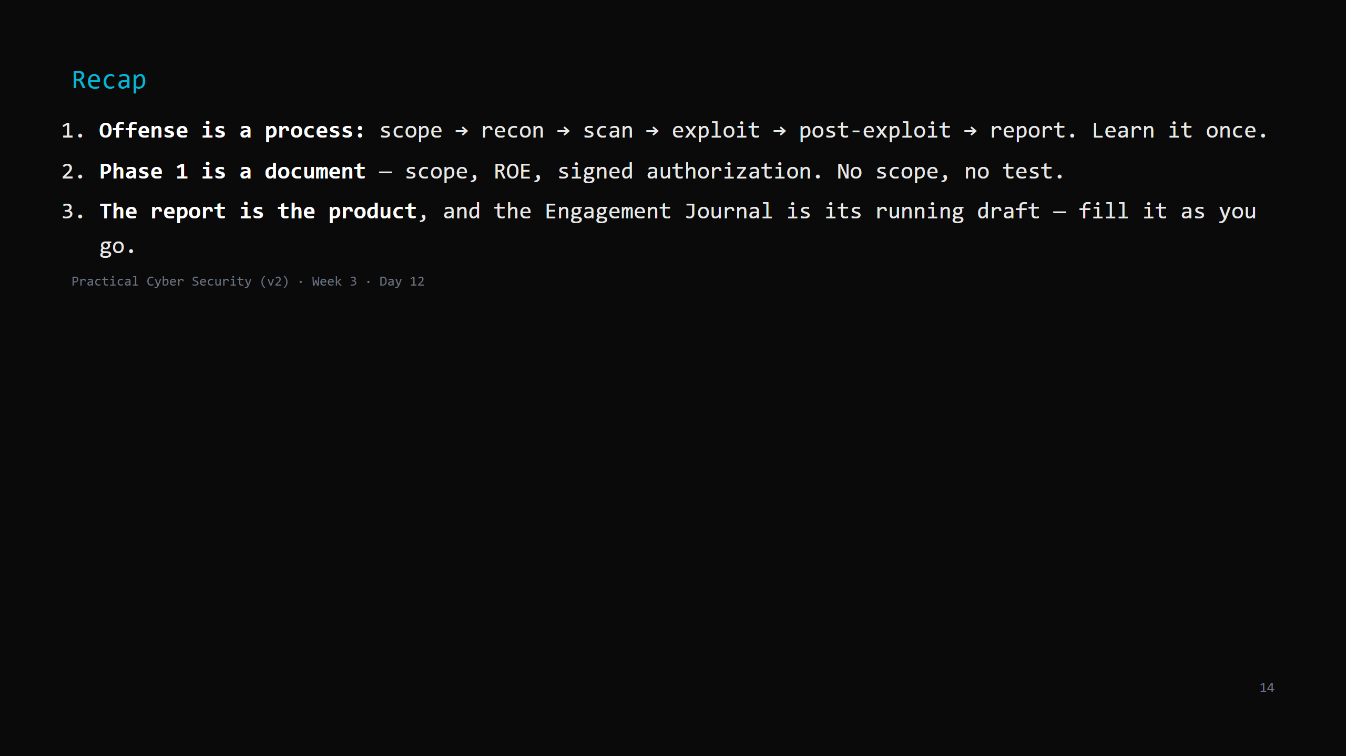
Notes:
Say the three lines. Tomorrow: Phase 2 and the start of Phase 3 — reconnaissance and scanning.
You map the target from the outside, then knock on every door with Nmap.

