Slide 1
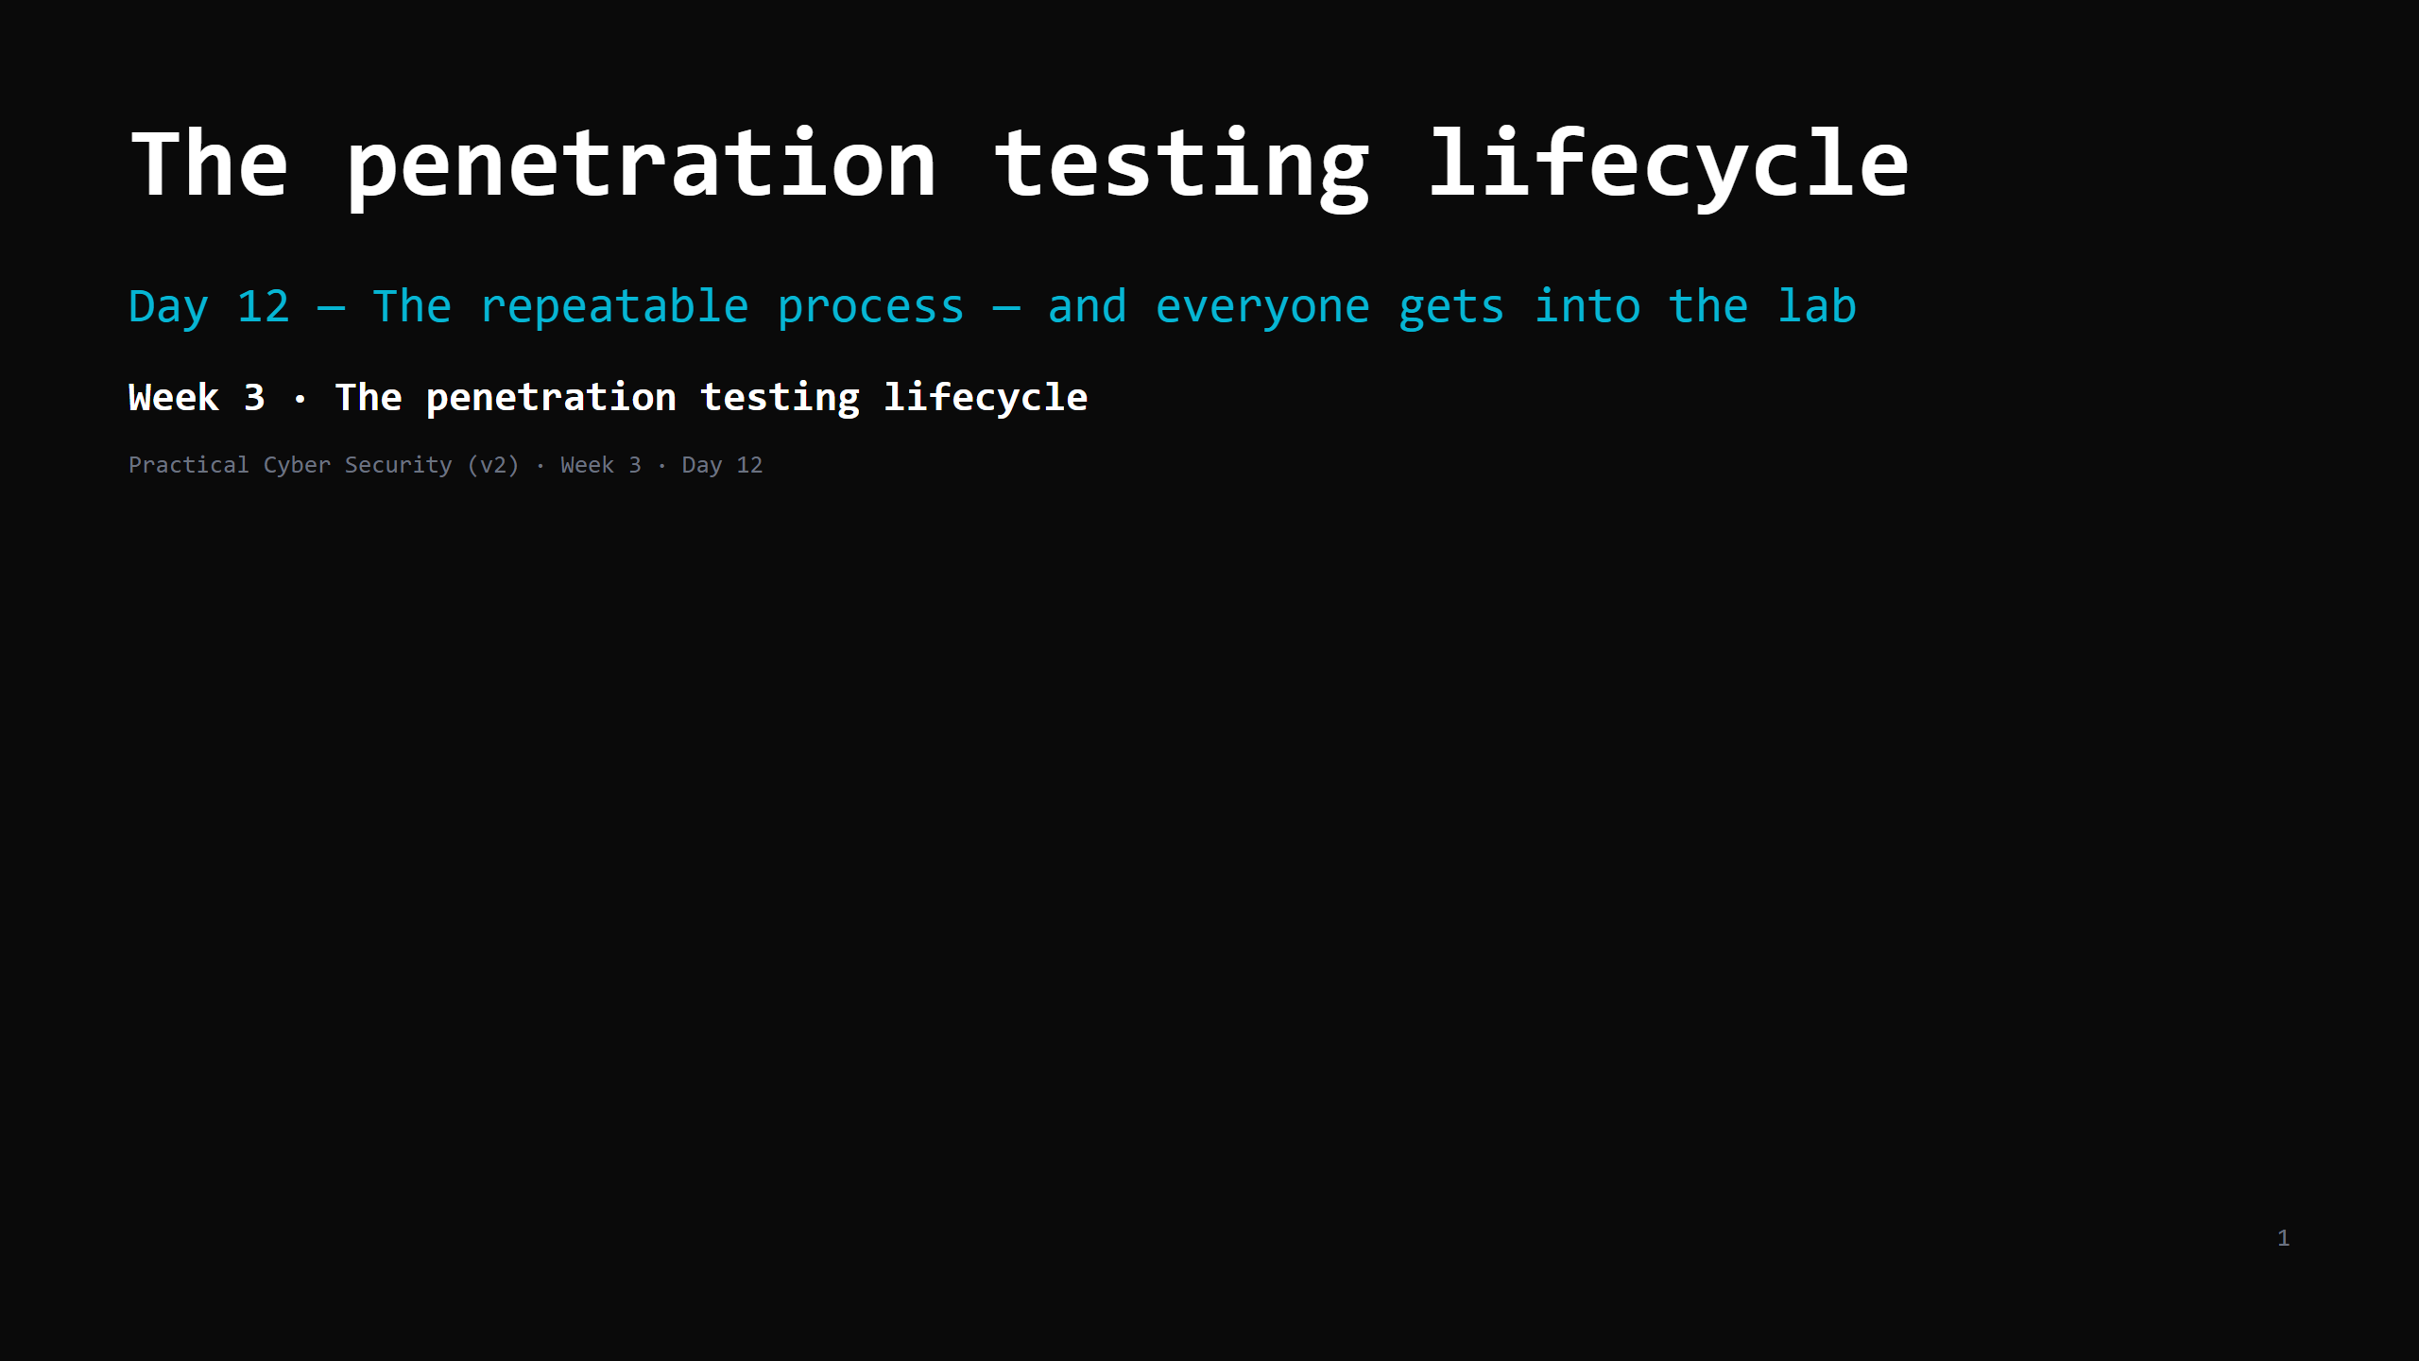
Notes:
RUN SHEET (~85 min). The lab-connect DO is the big one and the Day 12 GATE. 00:00 Journey check + hook (burglar vs inspector) 4 00:04 What a penetration test is (and isn't) 5 00:09 The lifecycle — the 6 phases 10 00:19 Phase 1: scope, ROE, authorization 10 00:29 DO: write a mock ROE for the class engagement 10 00:39 The reporting mindset 7 00:46 The Engagement Journal 4 00:50 Blue team's view — kill chain / MITRE ATT&CK 6 00:56 DO: connect to the lab (the GATE) 18 01:14 Wrap + artifact + homework 6 CUT FIRST IF SHORT: the kill-chain slide to 3 min; the ROE DO to a 5-min fill of 3 fields. NEVER CUT: the 6 phases, scope/ROE/authorization, the lab connect, the Engagement Journal. ANALOGY (kitchen): a pentester = a hired health inspector with WRITTEN permission to try to break in, who then reports exactly how — with photos and fixes. Not a burglar. The one difference between them is a signed piece of paper. LAB: this is the GATE. Every student must reach the lab targets and snapshot today. Stragglers go on the shared Kali; fix their own VM after.

Slide 2
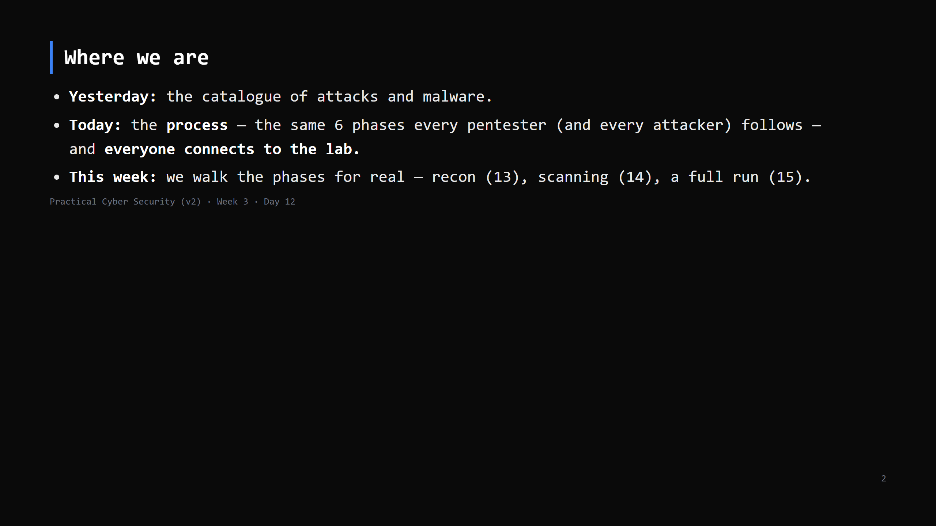
Notes:
Journey Check. Week 3's spine: offense is a PROCESS, not improvisation. Learn the process once, apply it forever.

Slide 3
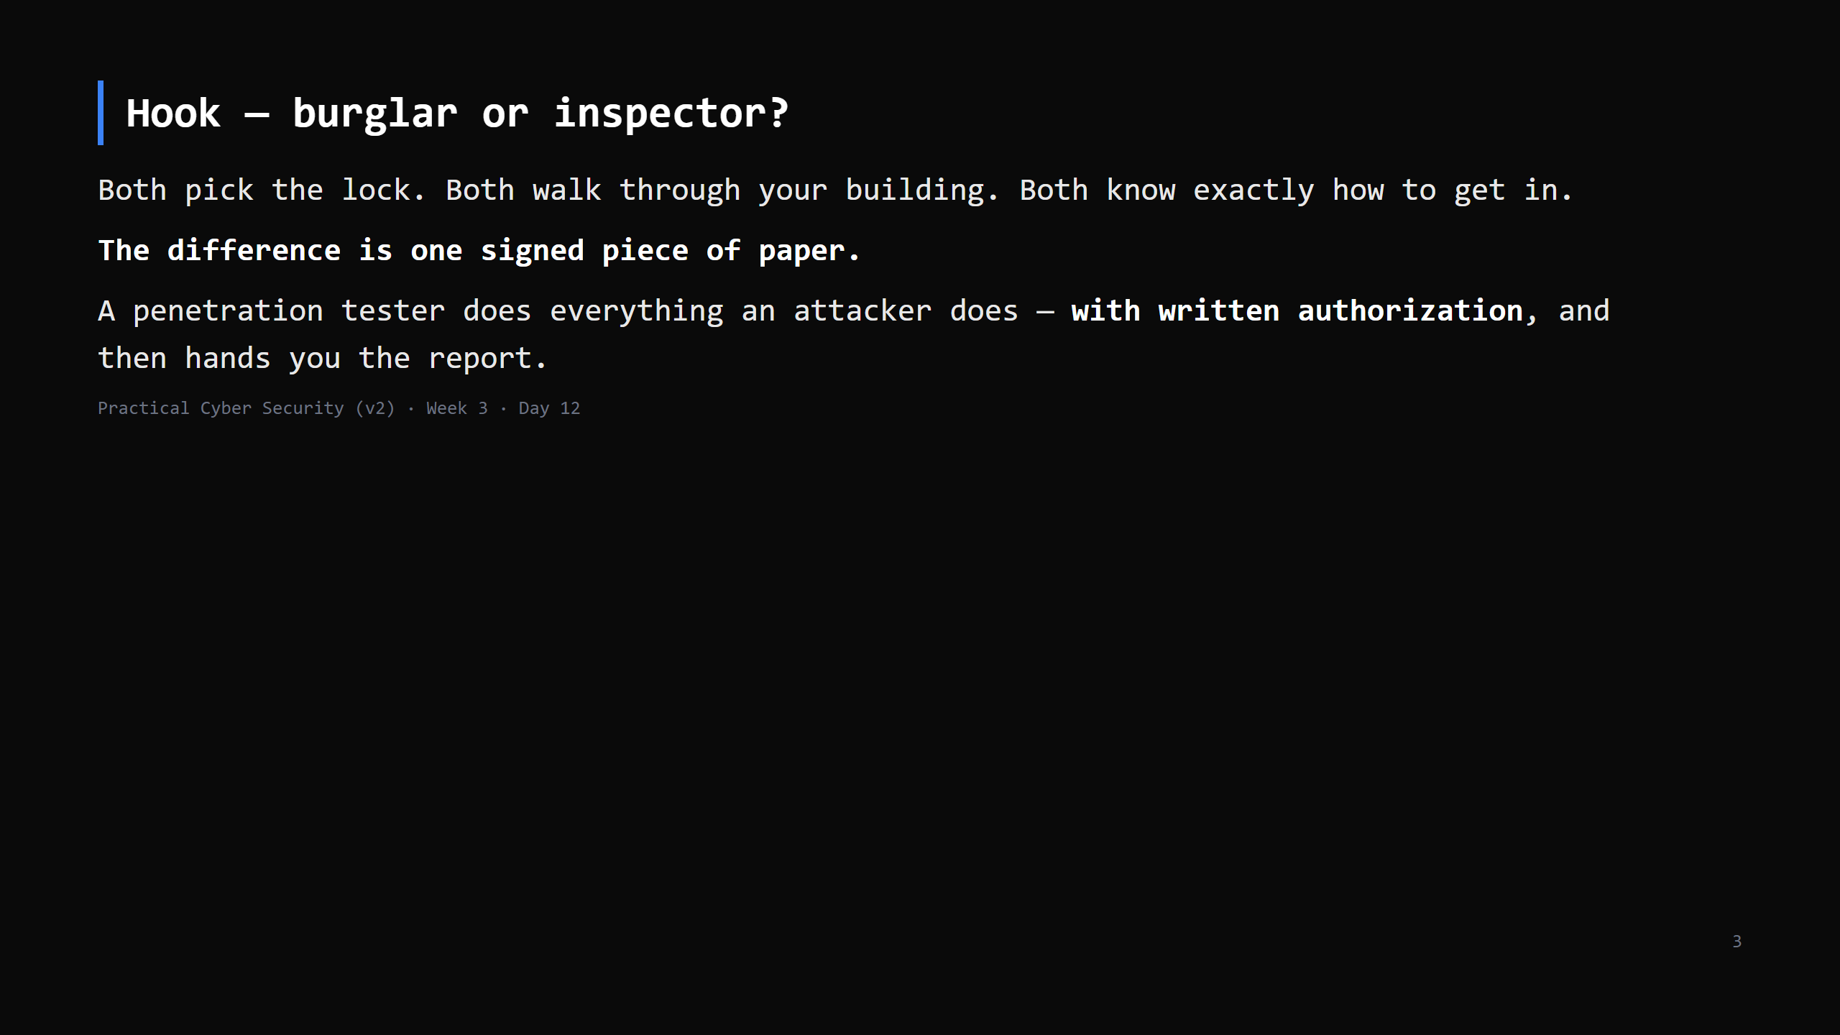
Notes:
Callback to Day 1 (white/grey/black hat; "no scope, no test"). Today that line becomes an actual document you write.

Slide 4
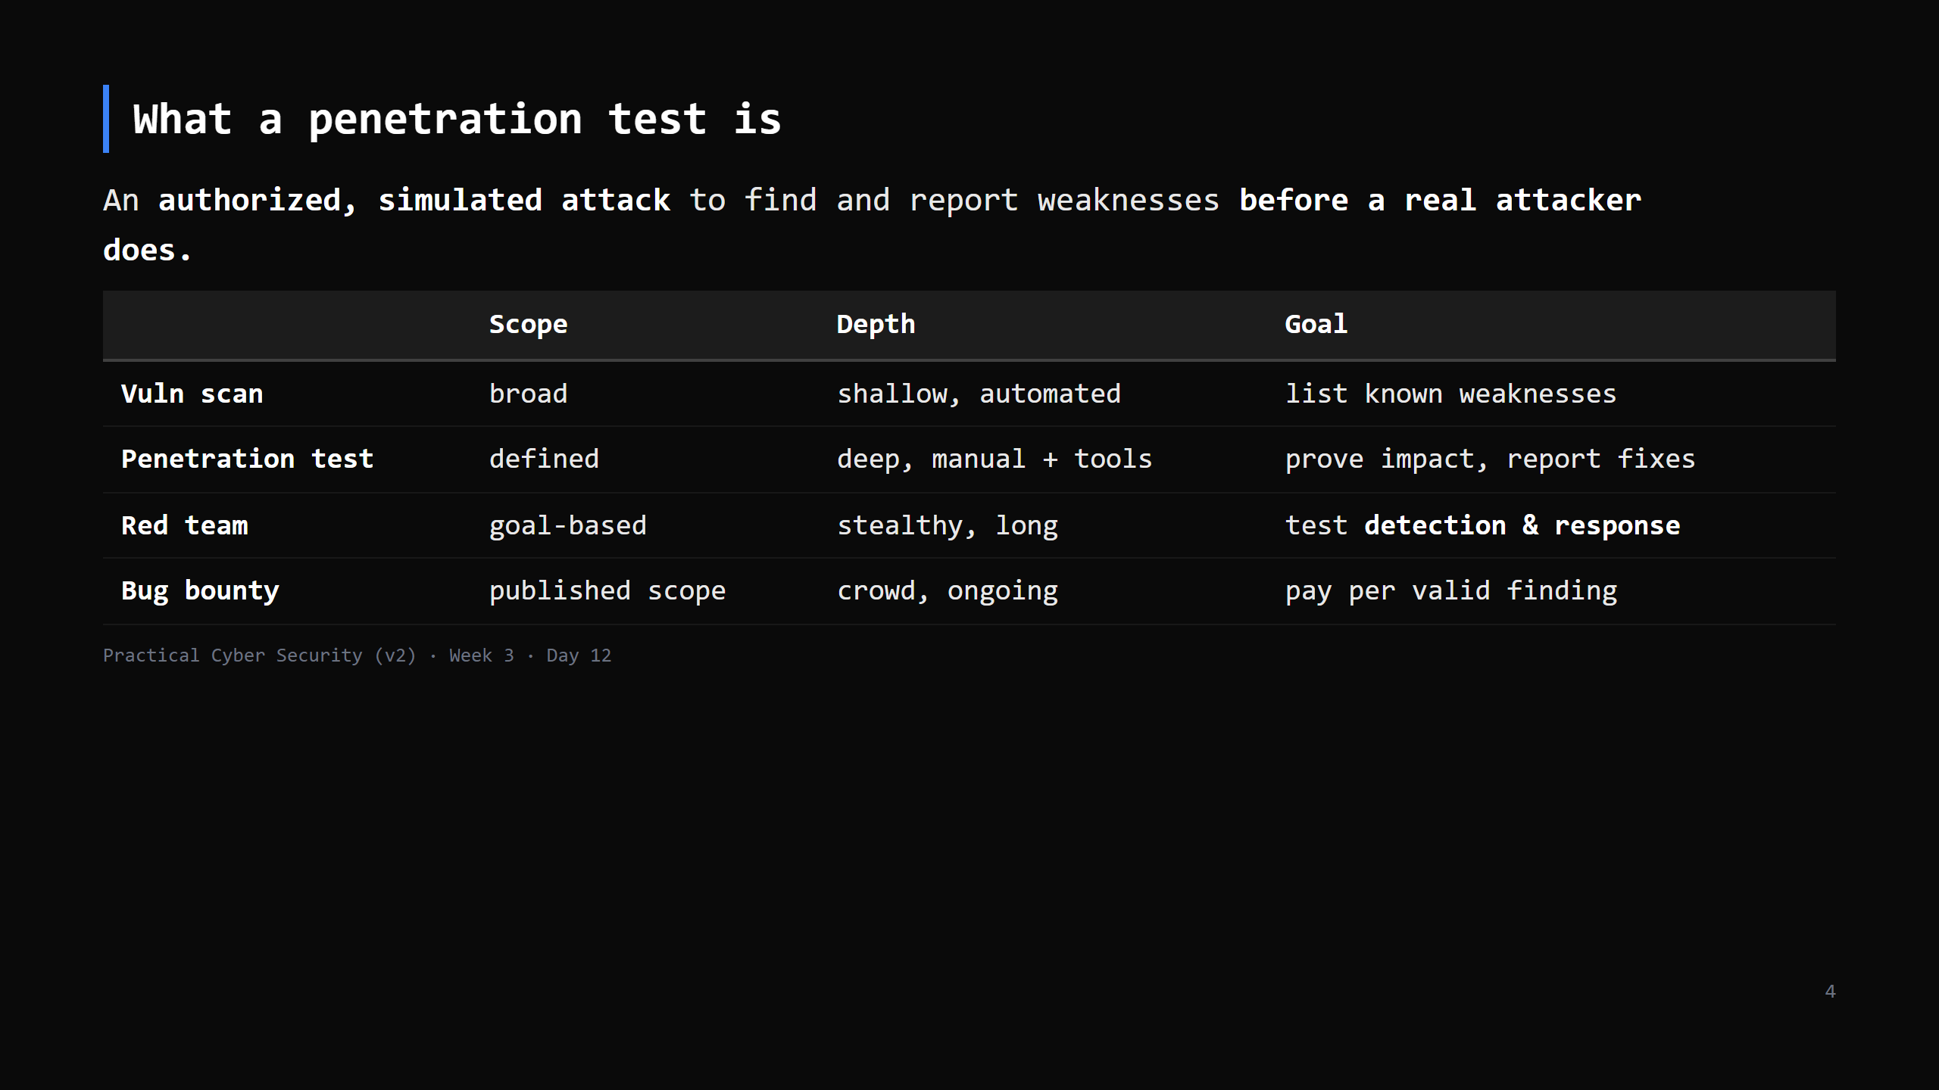
Notes:
Students conflate these. A pentest is time-boxed, scoped, and its DELIVERABLE is the report. Red team is quieter and measures whether the blue team notices. We're learning pentest.

Slide 5
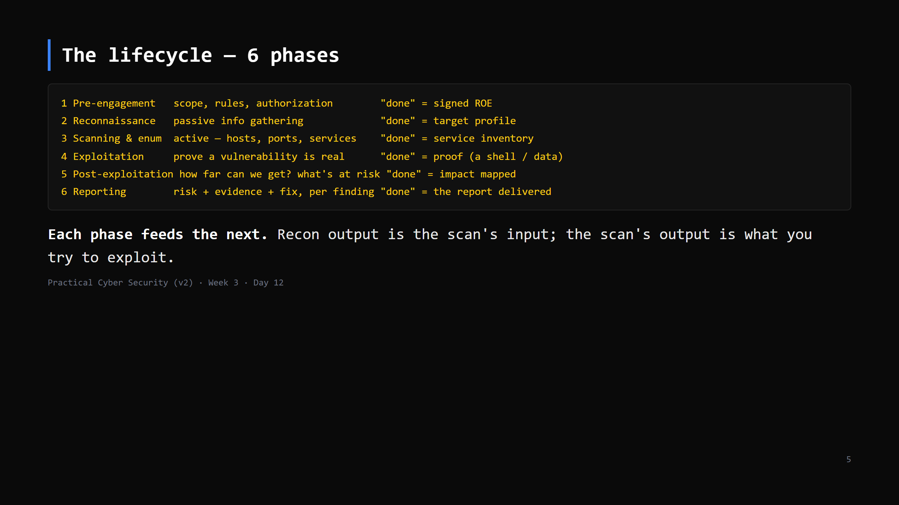
Notes:
This is the map for all of Week 3-4. Put it on the board and tick phases off across the week: today = phase 1, Day 13 = 2-3, Day 14 = 3 (vuln side), Day 15 = 1-4, Day 16-17 = 4-5, Day 19 = the defender's mirror. Names vary (PTES, OSSTMM, NIST) — the shape is the same.

Slide 6
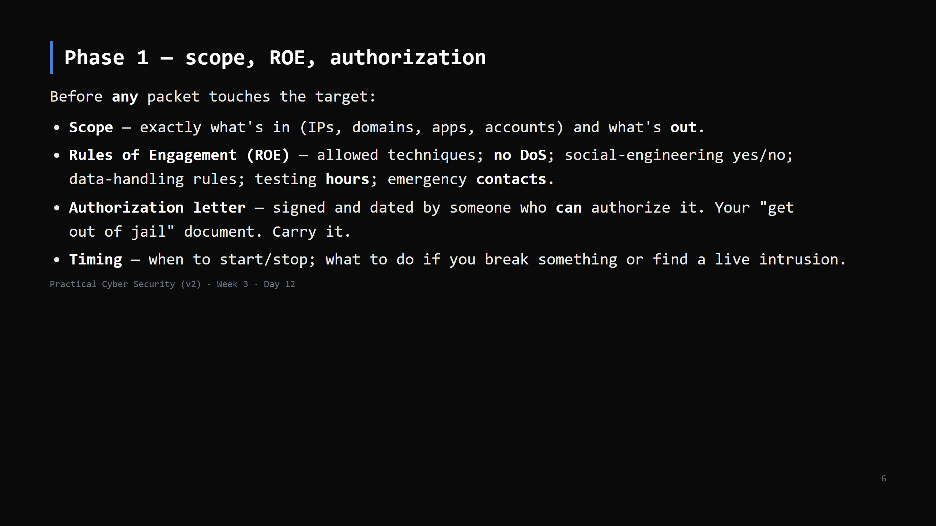
Notes:
"No scope, no test" from Day 1 is now a checklist. The authorization letter is not optional and not an email thread — it's a signed document naming the systems and the dates. If a real pentest finds evidence of an ACTUAL breach, you stop and escalate immediately — that's in the ROE.

Slide 7
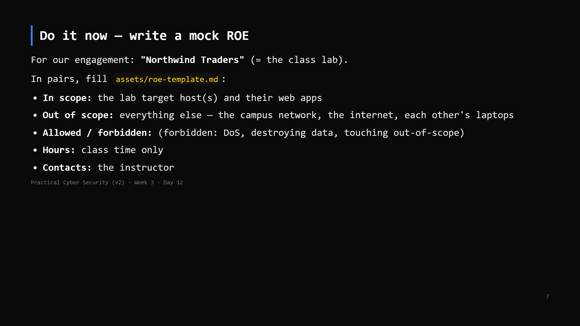
Notes:
10 min. This is a real deliverable pentesters write. Emphasise the OUT-of-scope list — that's what keeps you legal. "Each other's laptops" being explicitly out of scope matters. CUT to 5 min if behind: just fill in-scope / out-of-scope / forbidden.

Slide 8
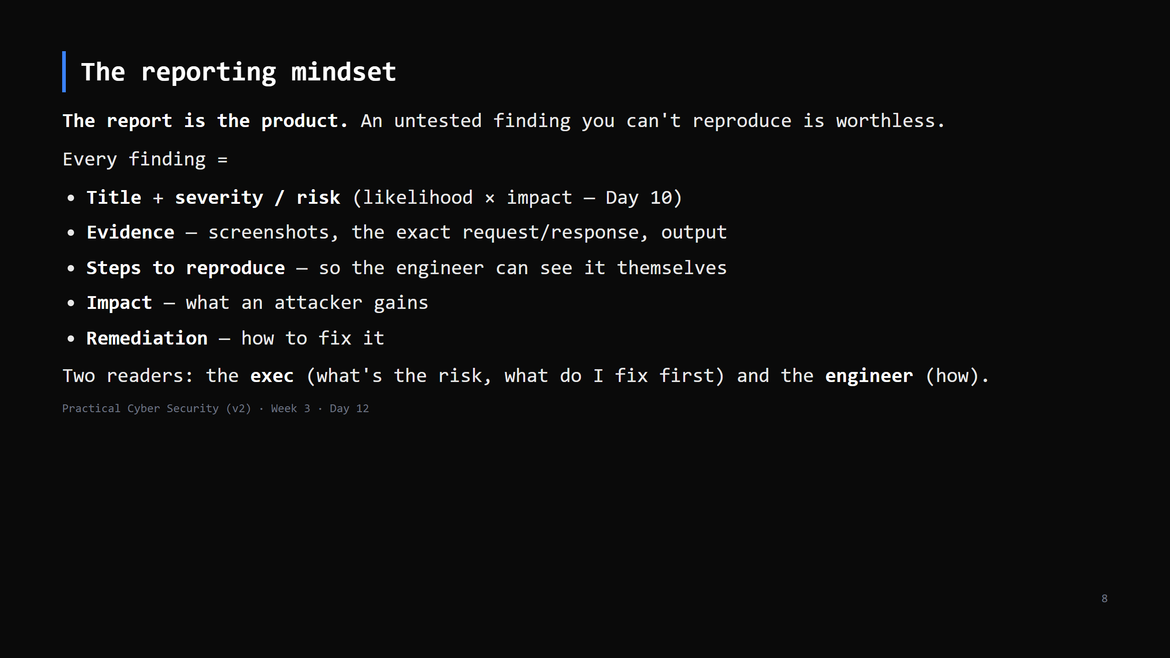
Notes:
Start the report on day one, not the night before it's due. The Engagement Journal (next slide) IS the running draft. A finding without reproduction steps gets dismissed as "works on my machine".

Slide 9
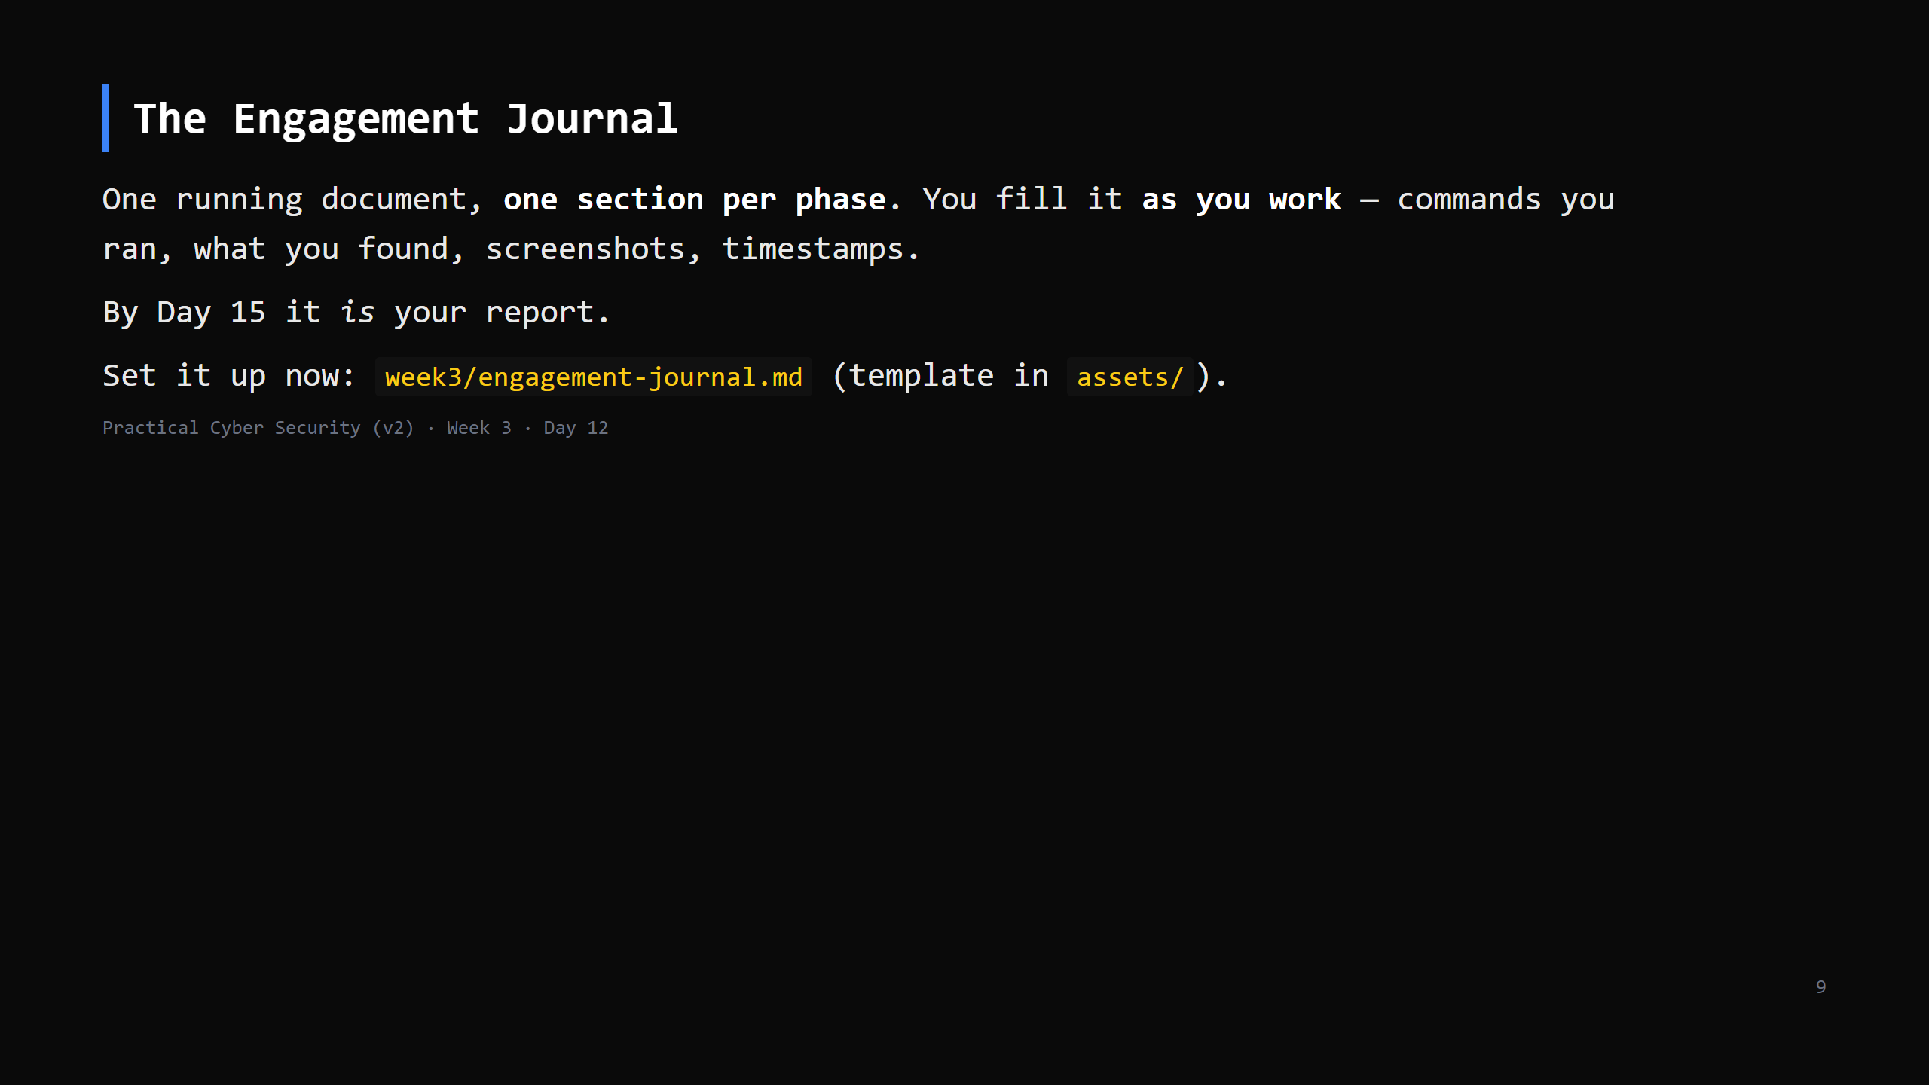
Notes:
This mirrors the Northwind Traders "Engagement Journal" model. Non-negotiable habit: if you did it and it's not in the journal, it didn't happen. Timestamp everything (matters for the blue team's timeline later — Day 19).

Slide 10
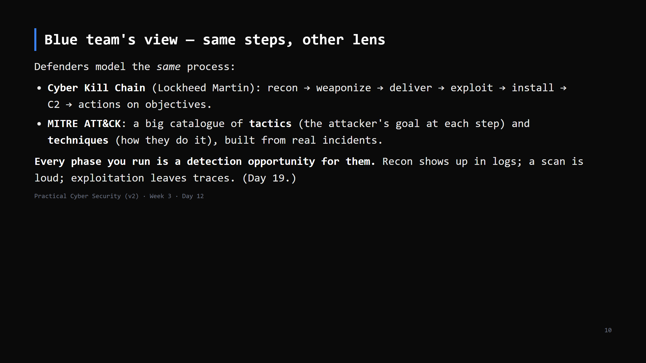
Notes:
The point: offense and defense are the same map read from opposite ends. ATT&CK technique IDs (T1566 phishing, T1046 network scanning...) are how SOC teams and pentesters talk to each other. CUT to 3 min: "defenders have their own name for this process — the kill chain and MITRE ATT&CK — and every step you take, they can potentially see."

Slide 11
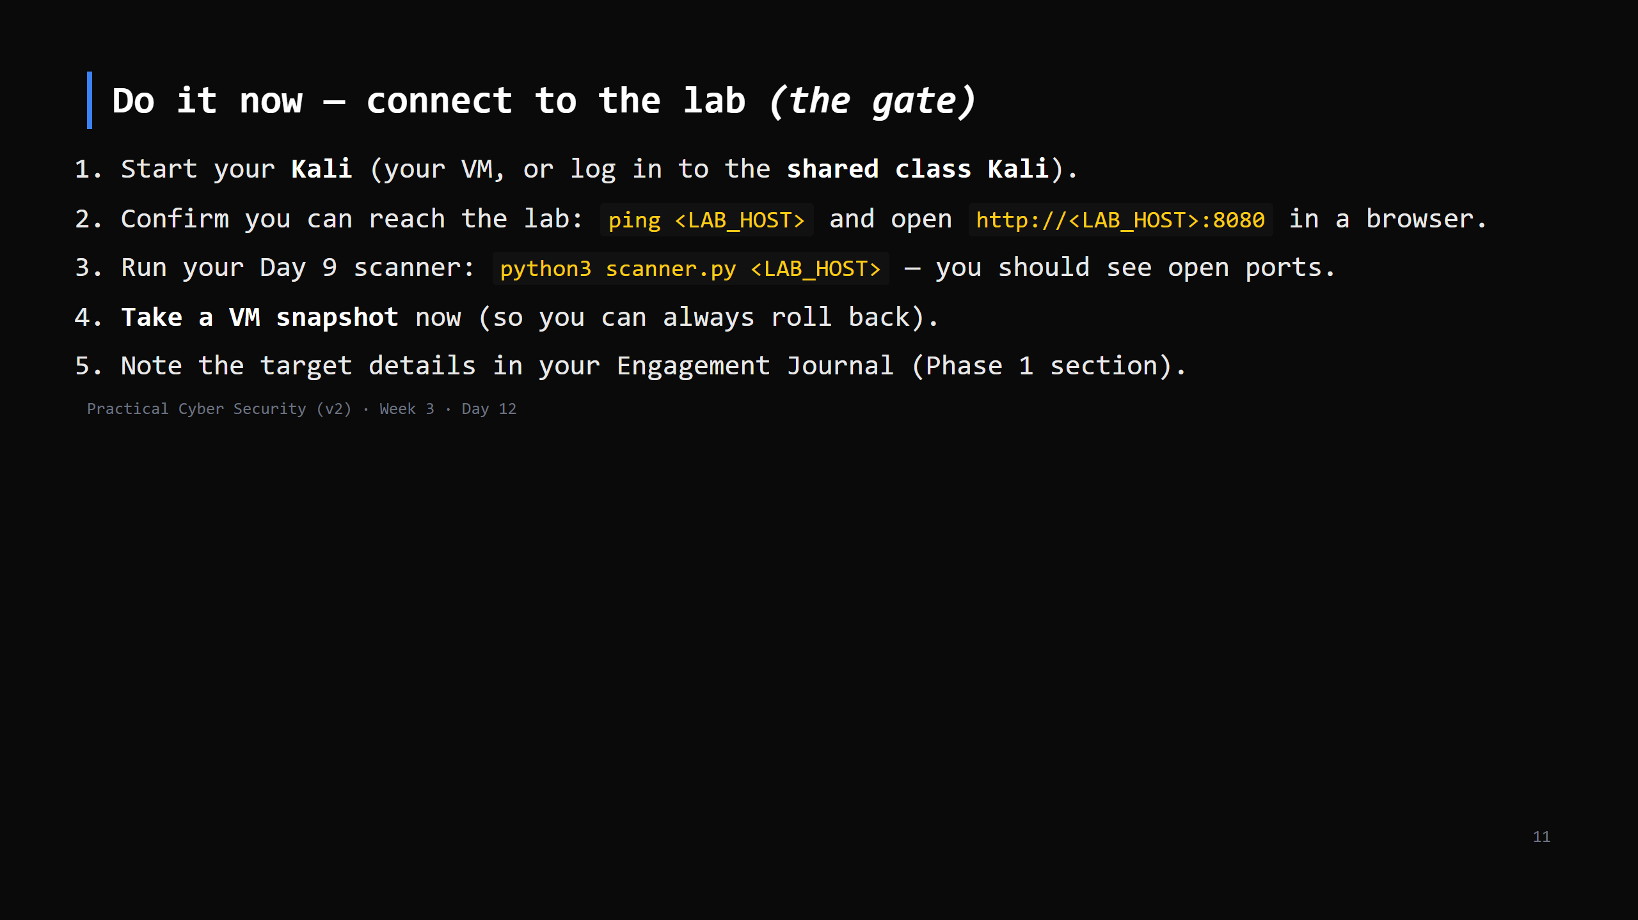
Notes:
18 min — THE GATE. Everyone must finish this. Checklist in assets/lab-connect-checklist.md. Stragglers: put them on the shared Kali for today, sort their own VM in office hours. Nobody starts Day 13 without lab access. If ICMP is blocked, `curl -I http://<LAB_HOST>:8080` or the scanner is the reachability test.

Slide 12
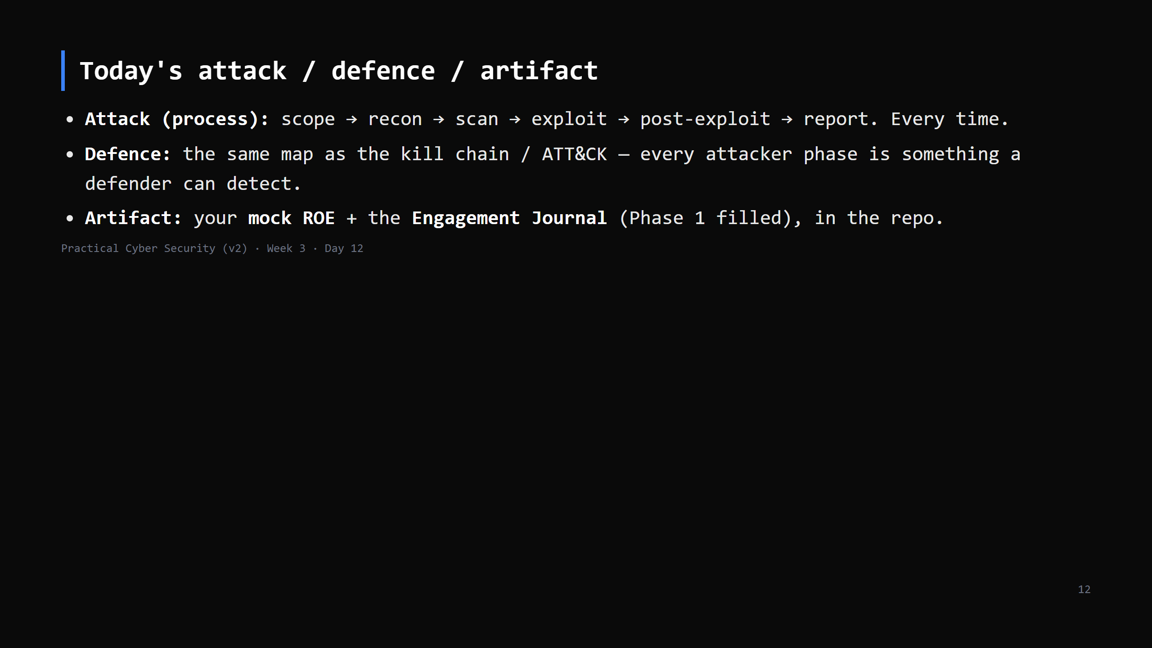

Slide 13
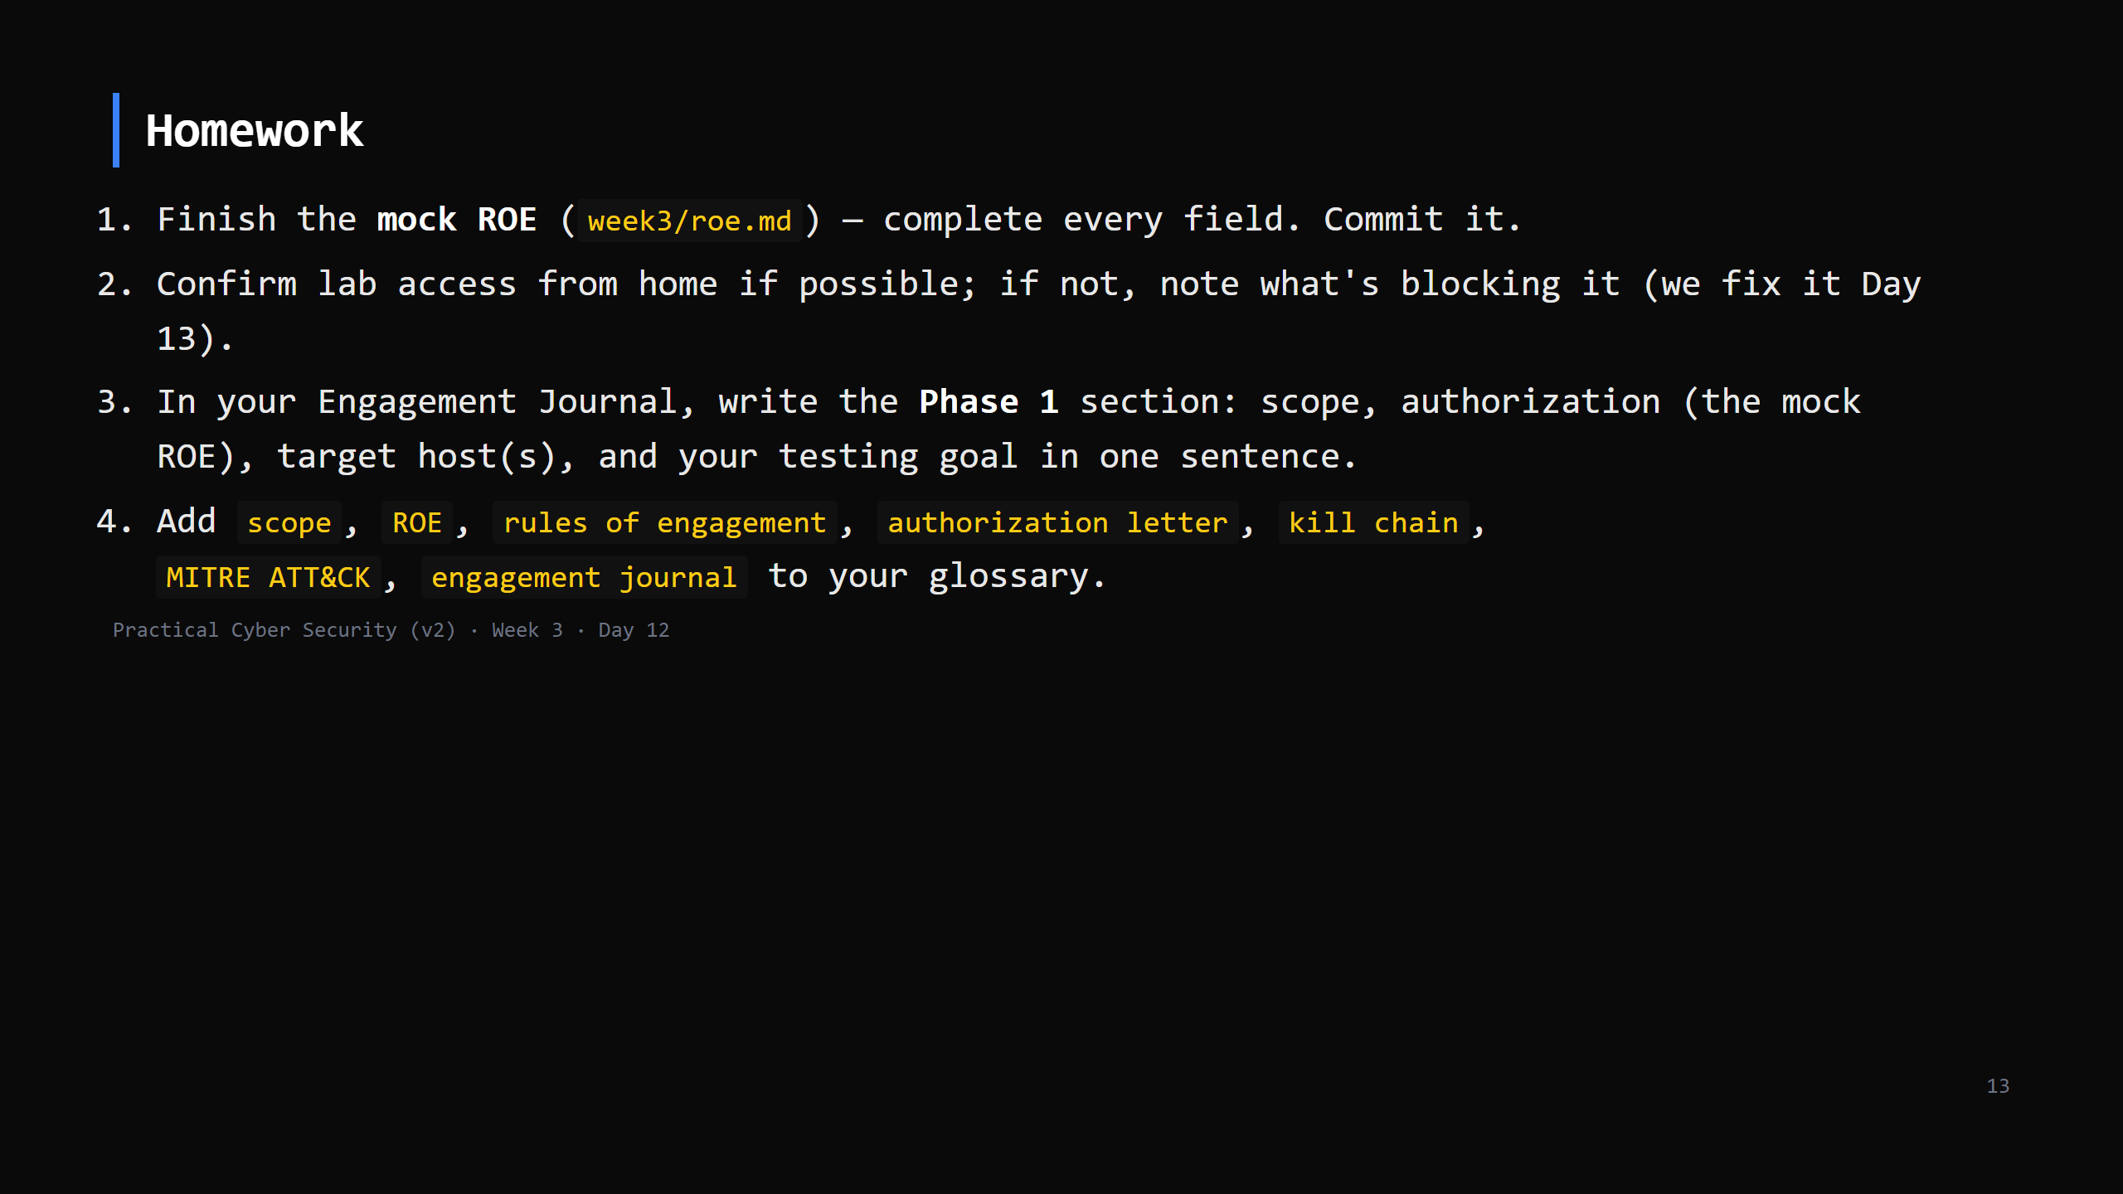
Notes:
Due start of Day 13.

Slide 14
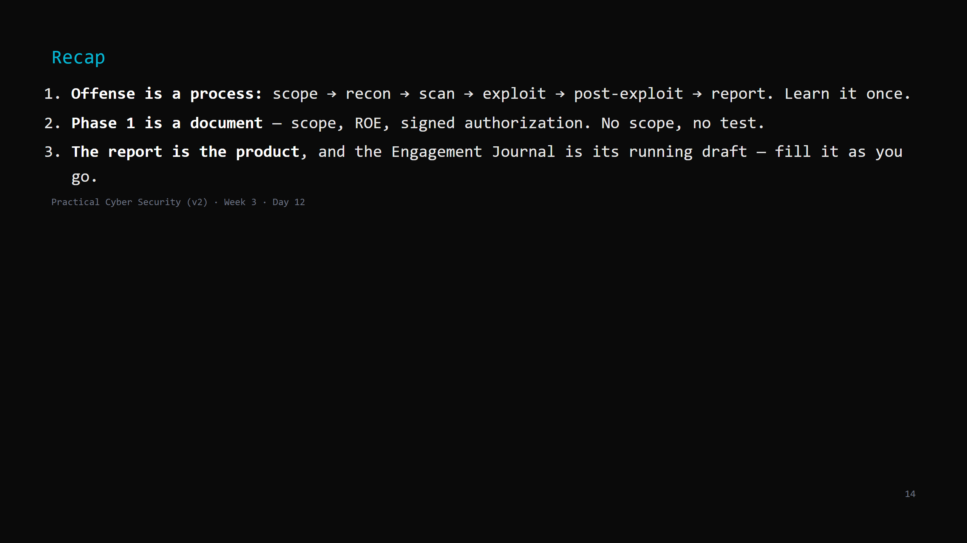
Notes:
Say the three lines. Tomorrow: Phase 2 and the start of Phase 3 — reconnaissance and scanning. You map the target from the outside, then knock on every door with Nmap.

