Slide 1
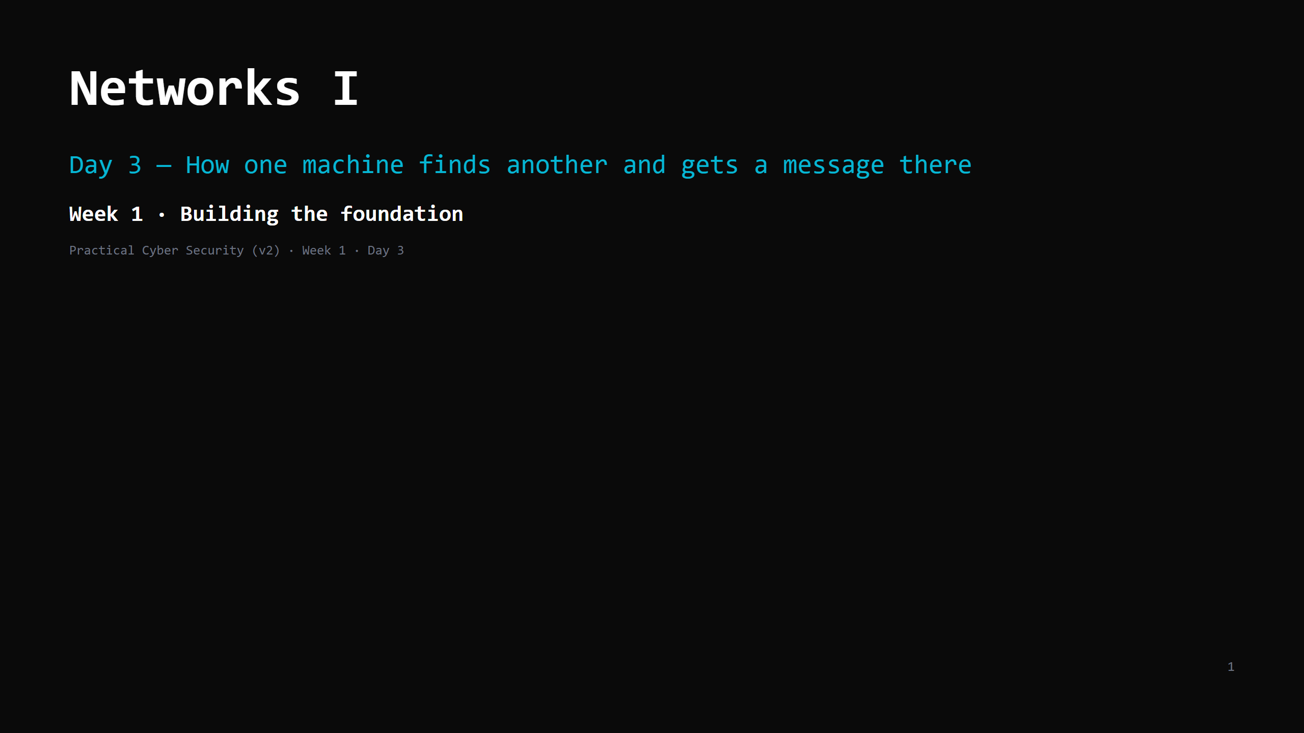
Notes:
RUN SHEET (~90 min). Hands-on is INTERLEAVED — four short "do it now" beats, ~15 min total.
00:00 Journey check + traceroute hook (projector) 5
00:05 The problem (the roadmap) 2
00:07 IP — the street address 6
00:13 DO: find your IP + gateway 5
00:18 DHCP — where that number came from (live diagram) 2
00:20 Private vs public IP 3
00:23 NAT — one public address for the house 7
00:30 MAC — the local label 6
00:36 DO: find your MAC 3
00:39 Ports + client/server 8
00:47 DO: what's listening on your machine 6
00:53 A packet, put together 4
00:57 The 4-layer model 4
01:01 The journey + DO: ping/traceroute 9
01:10 Attack <-> defence (ARP spoof, scanning, sniffing) 8
01:18 What a firewall actually does (live diagram) 2
01:20 Wrap + homework 6
CUT FIRST IF SHORT: firewall slide -> one sentence; DHCP slide -> one sentence; 4-layer
slide -> one sentence; ARP-spoof detail (keep the name); the ping "do it now".
NEVER CUT: the three addresses (IP/MAC/port), NAT, at least two "do it now" beats.
LIVE DIAGRAMS (folder archify/ — open every file in its own browser tab BEFORE class; each has
view buttons that step through the story, and a light/dark toggle for the projector):
01-three-addresses.html -> "The problem" slide, again on the Port slide (client/server view)
02-packet-journey-nat.html -> NAT slide
03-packet-layers.html -> "A packet, put together" + "The 4-layer model"
04-dhcp-lease.html -> DHCP slide
05-firewall-decision.html -> firewall slide
ONE ANALOGY (sanctioned extension of the kitchen): the POSTAL / DELIVERY system — the kitchen
now orders supplies and ships out orders. Parcel=packet, street address=IP, next-leg label=MAC,
department name=port, sorting office=router, front desk=NAT. Phone calls arrive tomorrow (TCP).

Slide 2
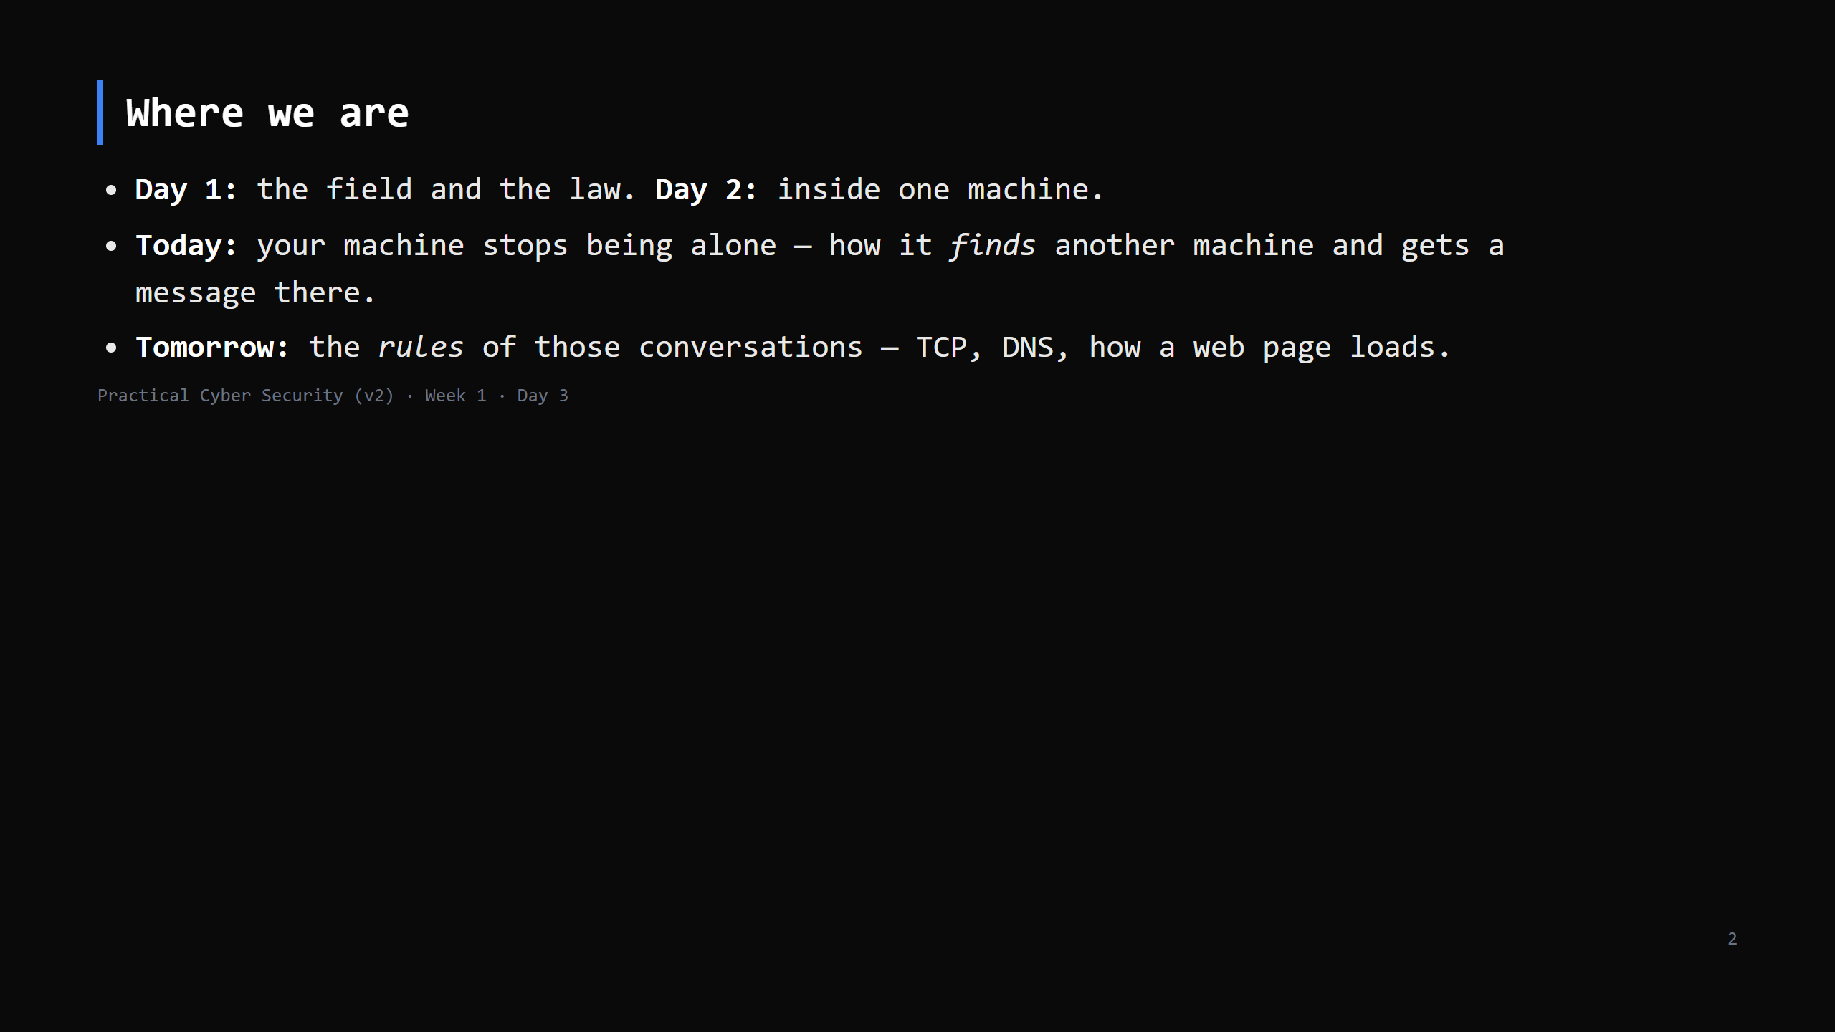
Notes:
Learning Journey Check — one line each. Yesterday / Today / Tomorrow.

Slide 3
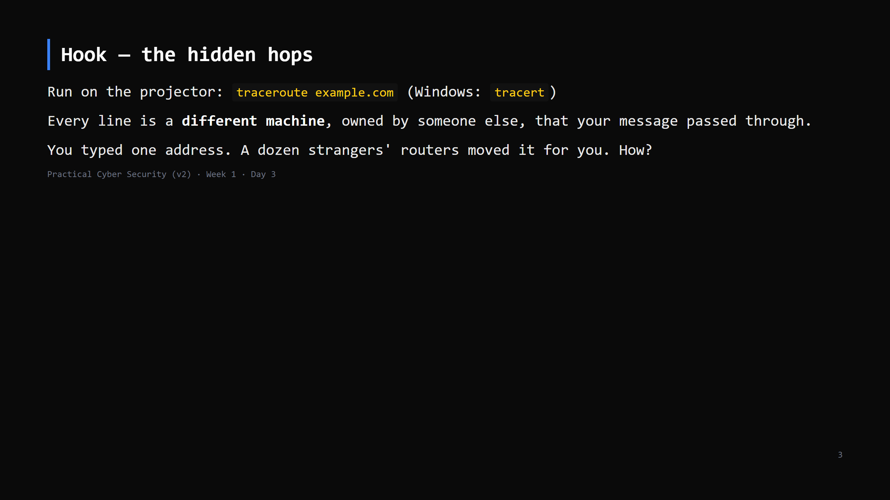
Notes:
Let the output scroll. Point at 3-4 hops. "You don't own any of these. They forwarded your
packet because that's the deal that makes the internet work."
Some hops show * * * — "that one chose not to answer; the packet still went through."
Don't explain traceroute's mechanism yet (it's a Day 4 TTL thing) — just "these are real
machines in the path."

Slide 4
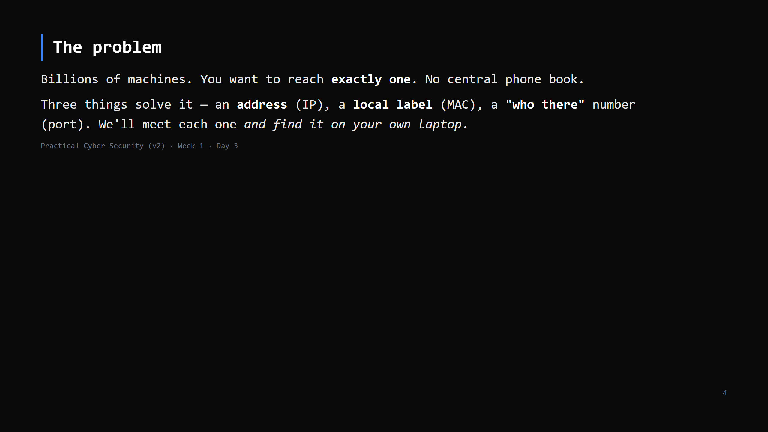
Notes:
Keep this to ~2 min. It's the roadmap for the next section. Then straight into IP.
LIVE DIAGRAM: archify/01-three-addresses.html, view "Three jobs" — one pass, 30 seconds, just
so they have seen the three labels side by side before we take them one at a time.

Slide 5
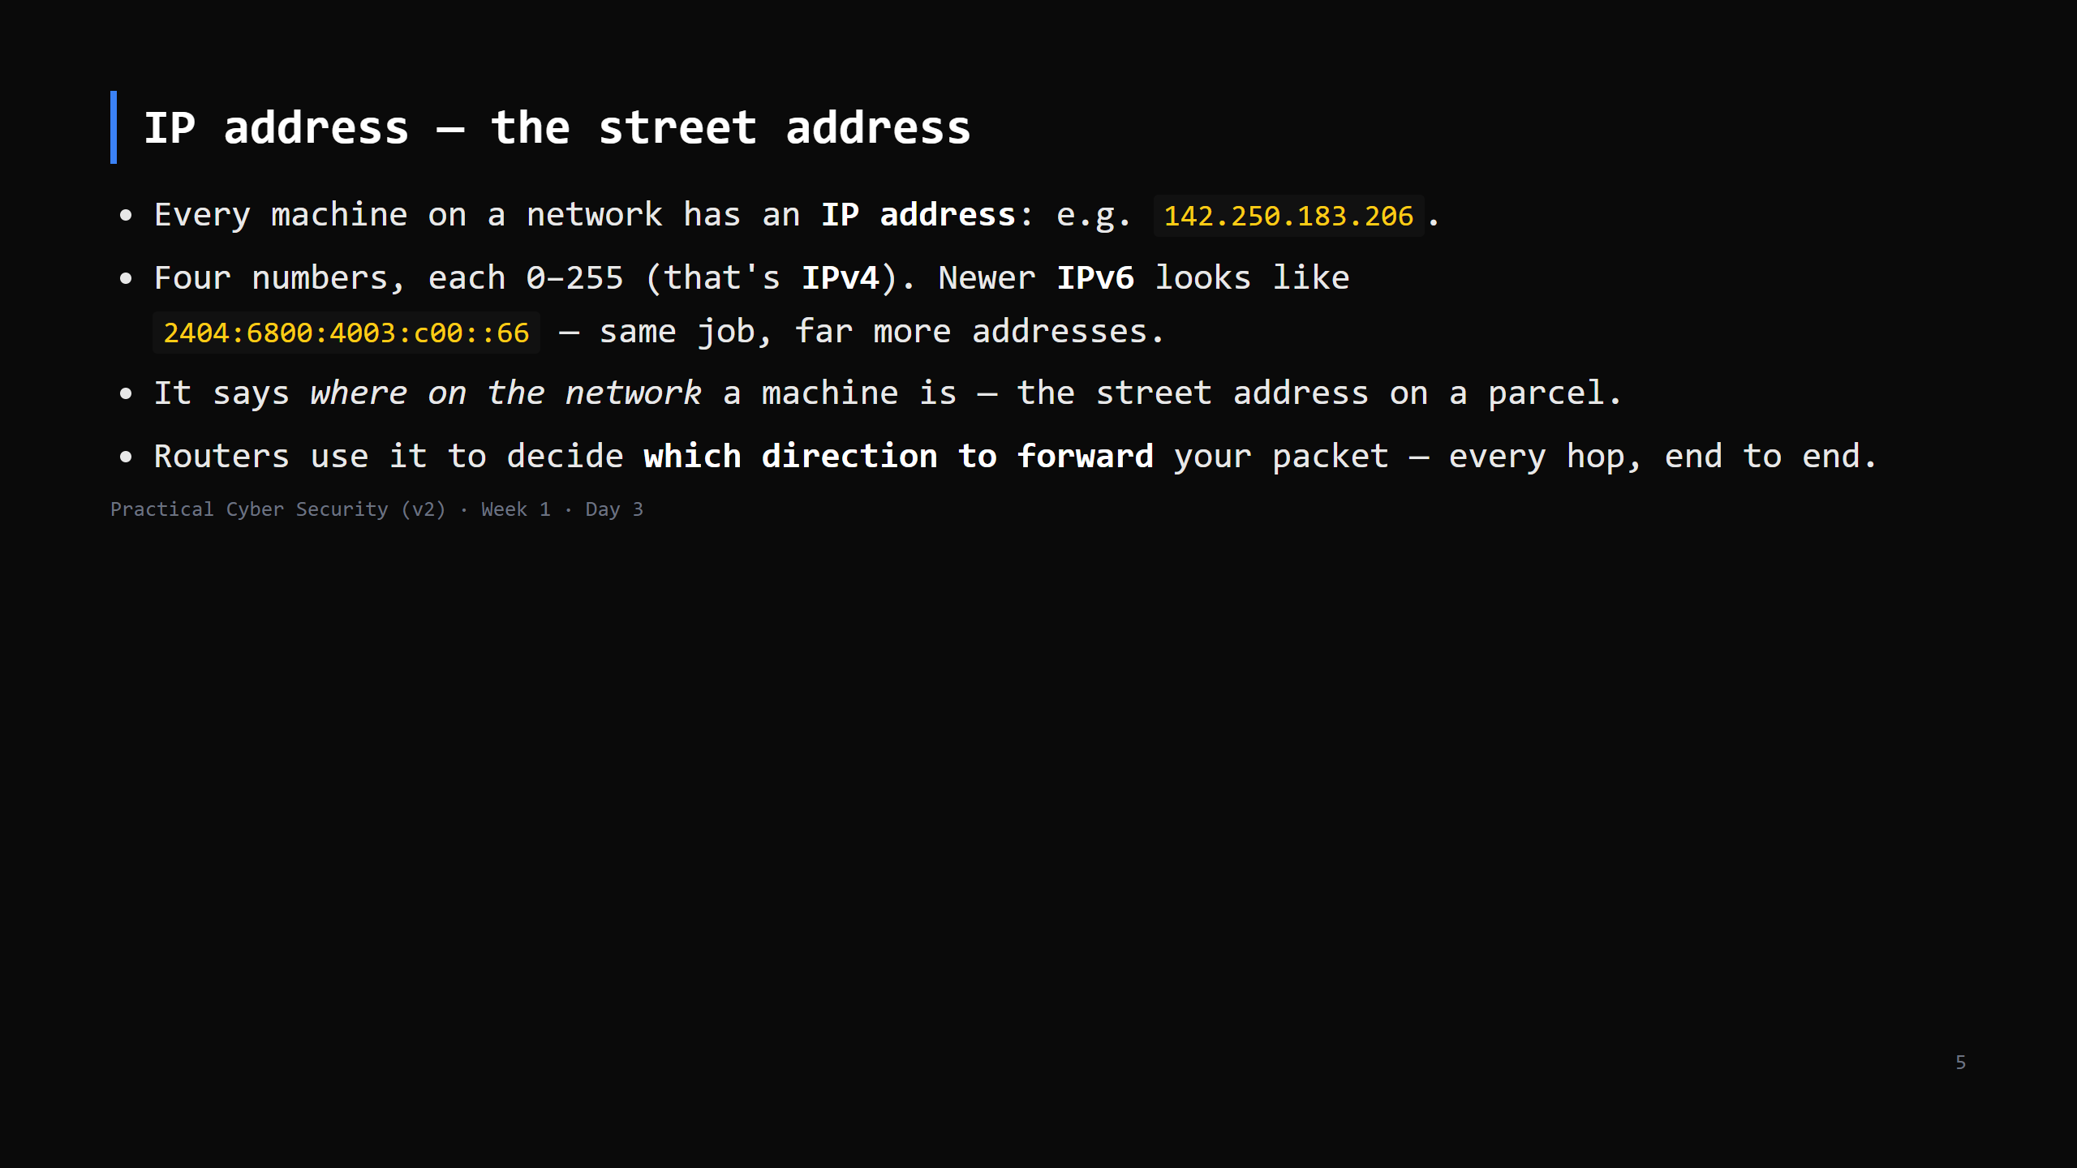
Notes:
No subnetting, no binary today. The model: "IP = where you are, used for routing, unchanged
the whole journey." IPv6 = one sentence, don't let them panic at the long ones.

Slide 6
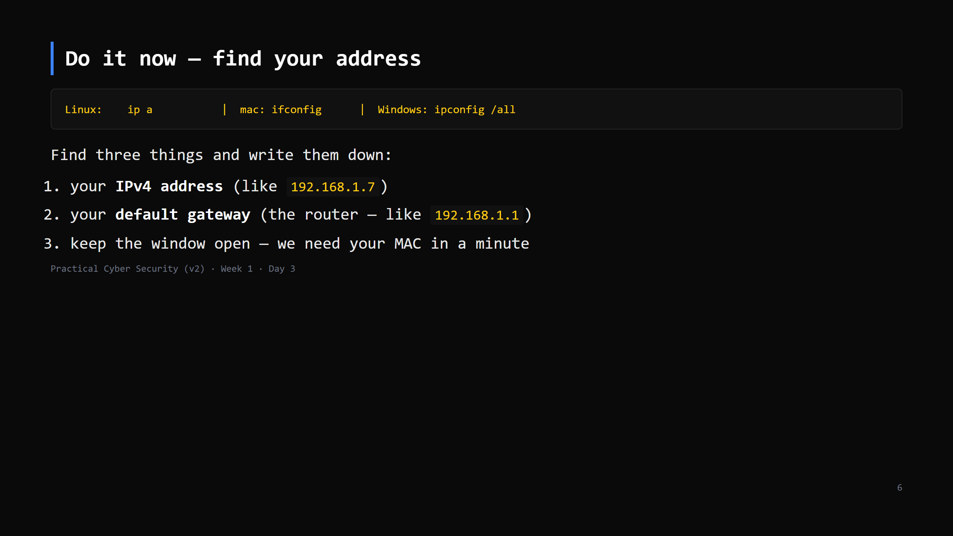
Notes:
90 seconds. Walk the room. Almost everyone: 192.168.x.x or 10.x.x.x, gateway usually .1 or .254.
Ask two students to call theirs out — note they're similar/identical. That's the slide after
next. First: "who typed that number in?" Nobody. Next slide.

Slide 7
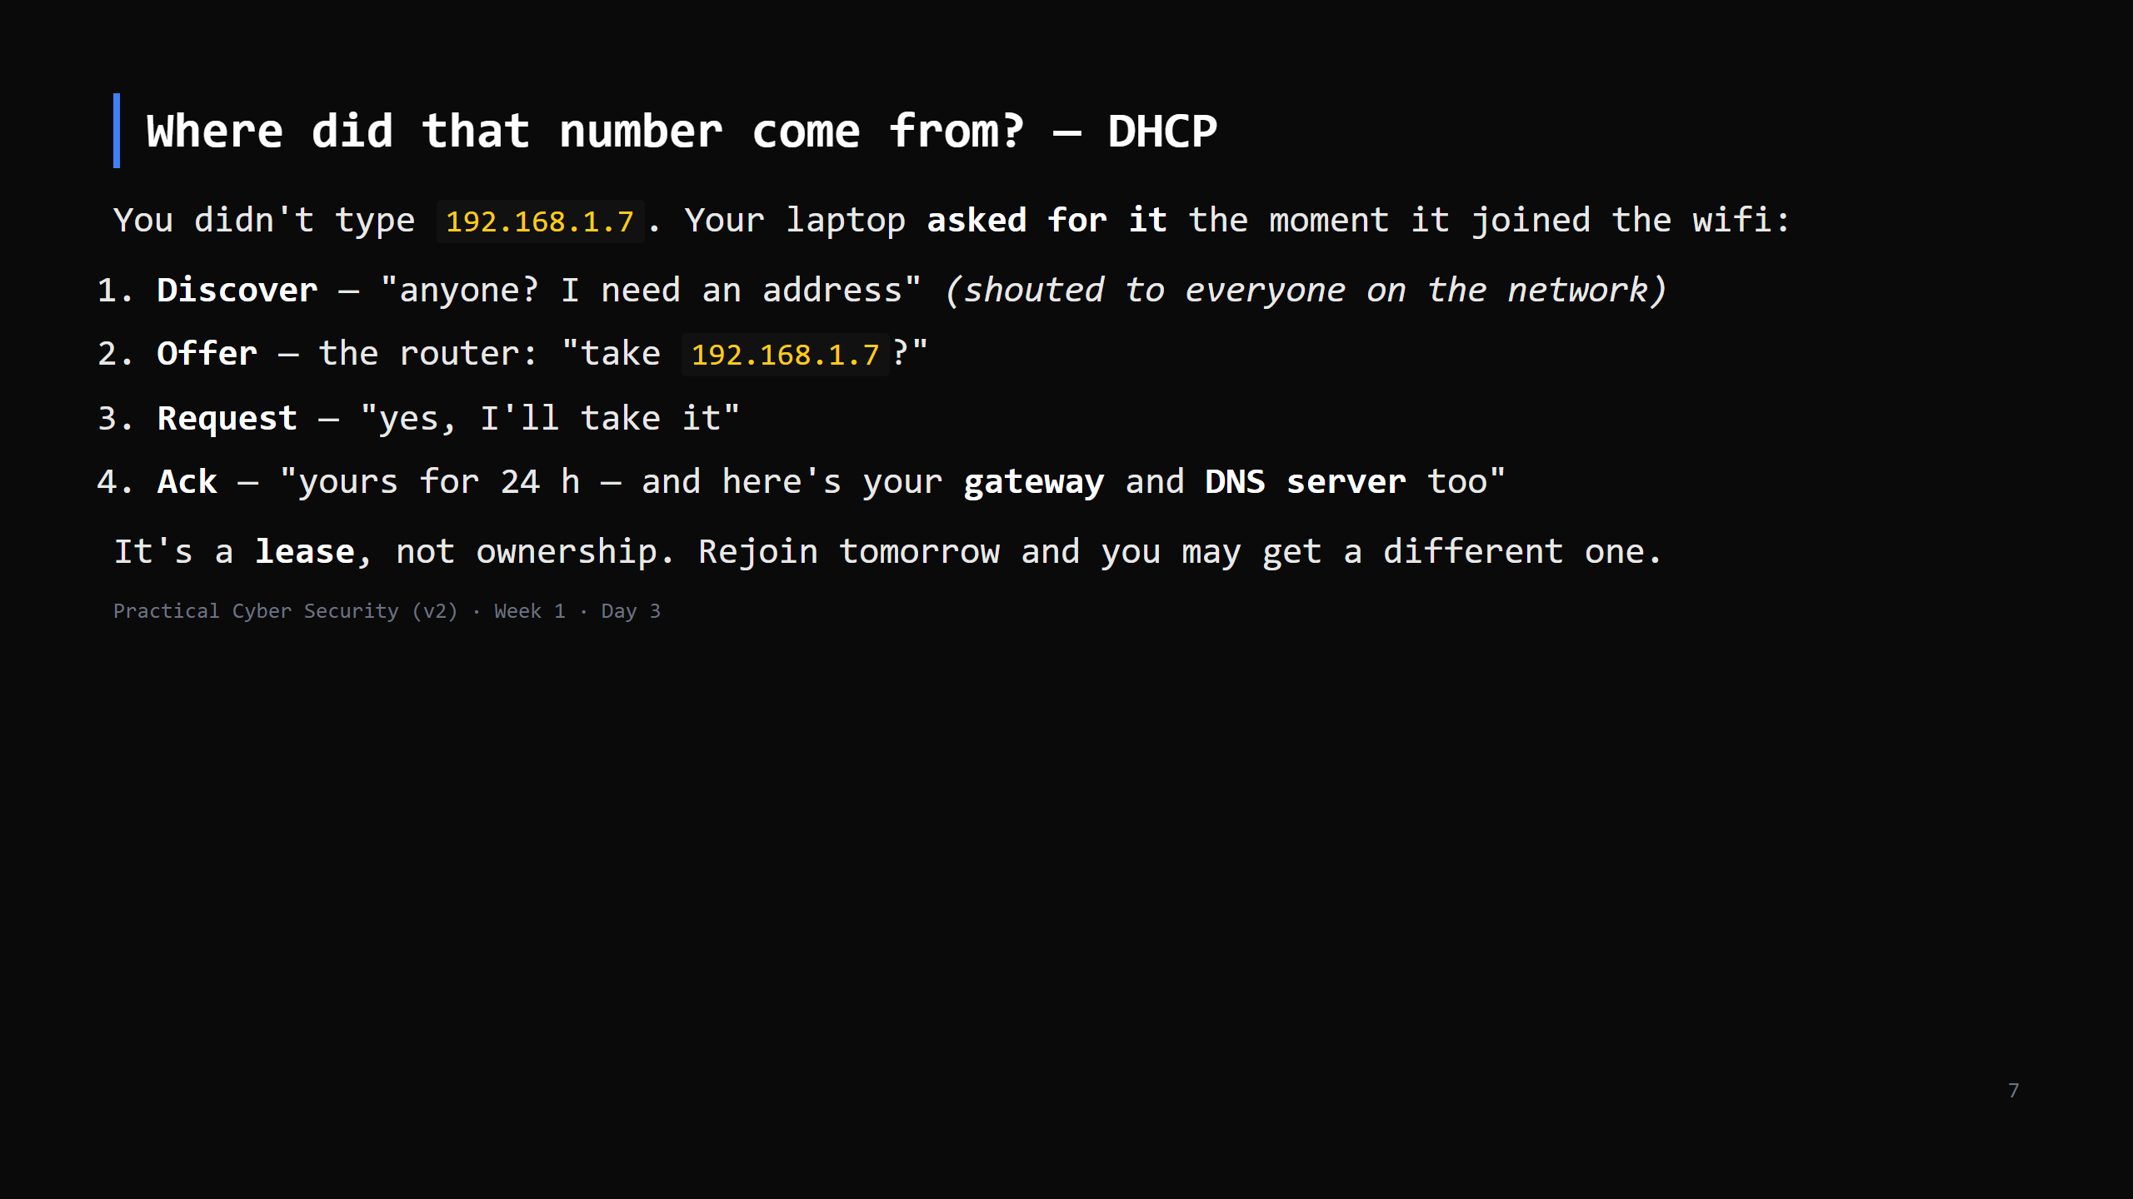
Notes:
LIVE DIAGRAM: archify/04-dhcp-lease.html — click through the 3 views (~2 min).
The point: nobody configured your laptop. The router's DHCP service handed out the IP, the
gateway (.1) AND the DNS server in one go — that is why "find your gateway" just worked.
169.254.x.x = DISCOVER got no answer (broken wifi, not a broken laptop).
Security hook for later: a rogue DHCP server on the LAN can hand out a lying gateway — same
family as ARP spoofing on the attack slide.
CUT to one sentence if short: "the router leased you that address automatically."

Slide 8
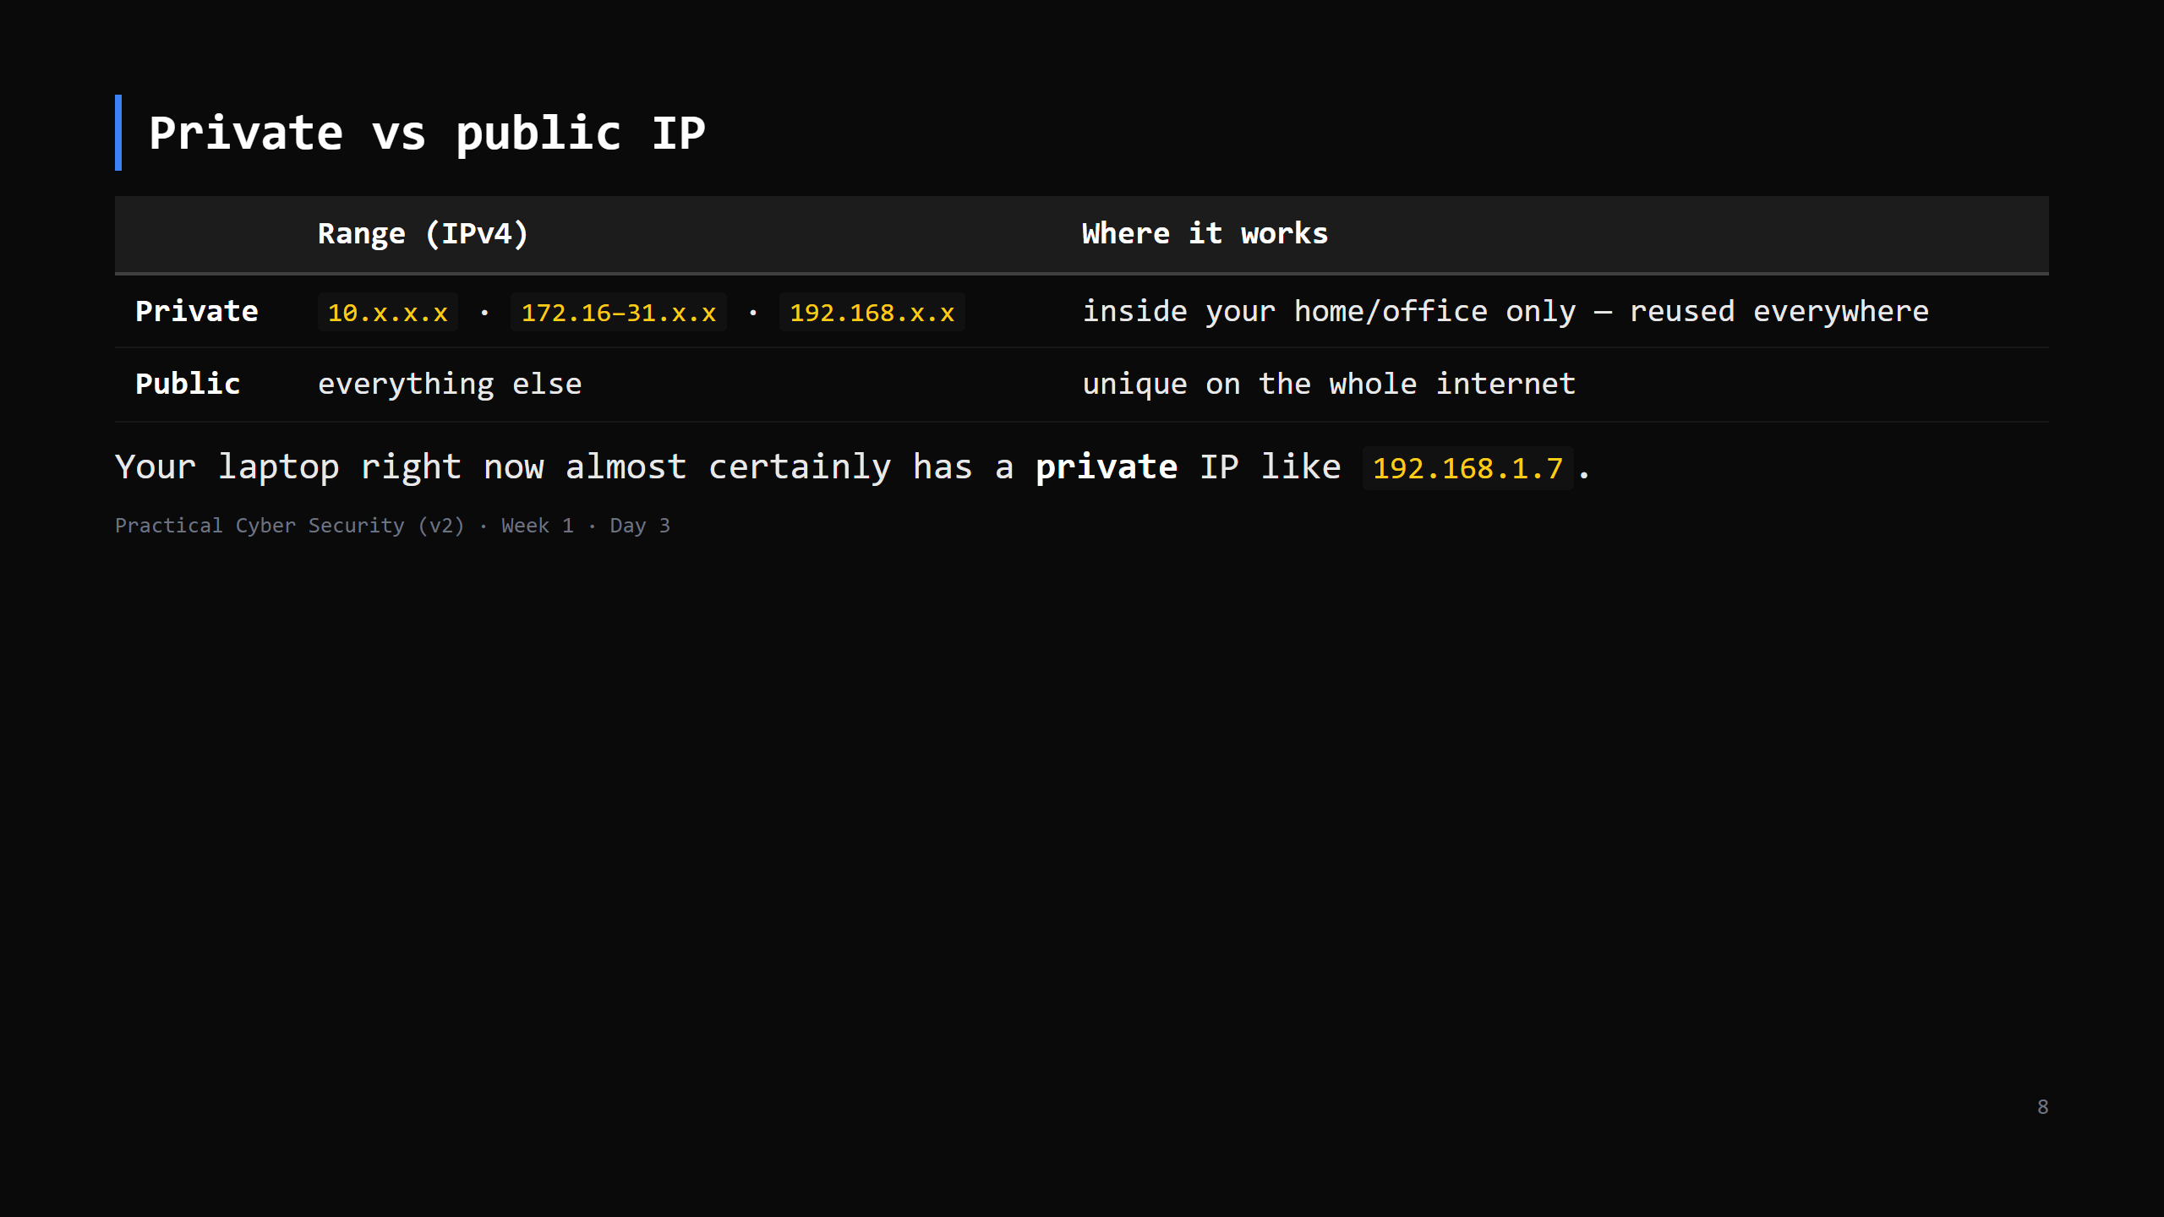
Notes:
Analogy: private IP = "flat 3, second floor" — meaningless without the building. Millions of
homes have a 192.168.1.7. Public IP = the building's actual street address, unique globally.
This sets up NAT on the next slide.

Slide 9
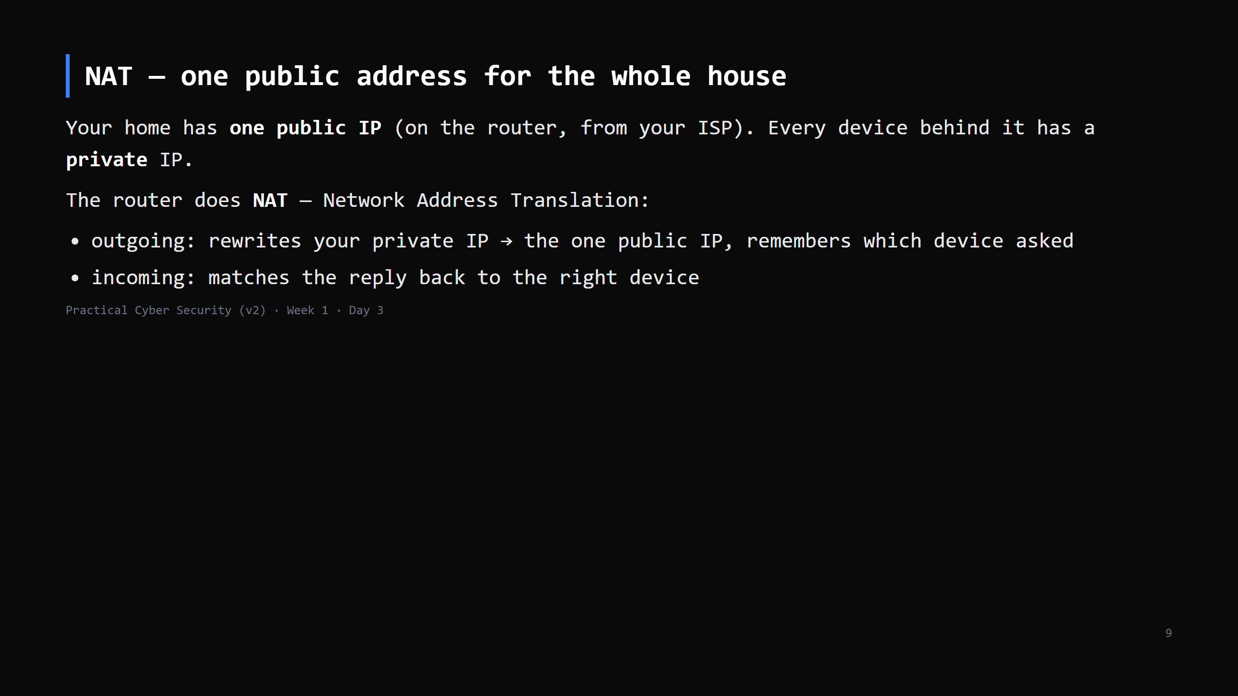
Notes:
This is why whatsmyip.com shows a different address than `ipconfig` — the site sees the
router's public IP; ipconfig shows your laptop's private one. THAT is the Day 3 "trap" —
call it out explicitly, it's the homework question.
Analogy: the whole household sends mail via one front-desk address; the front desk (router)
keeps a log so replies get to the right person.
LIVE DIAGRAM: archify/02-packet-journey-nat.html — 3 views: inside the home / NAT boundary /
reply returns. Use the "Reply returns" view to answer "how does the reply find MY laptop?"
Security note for later: NAT accidentally hides internal devices — not a firewall, but it
means the internet can't directly address your laptop.

Slide 10
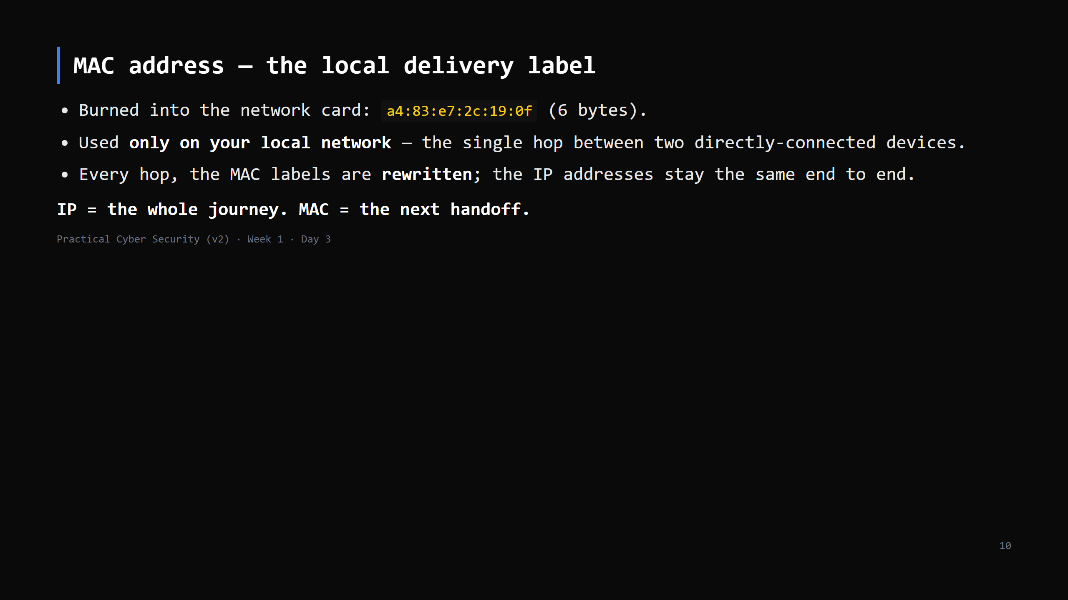
Notes:
Analogy: the parcel's street address (IP) never changes. At each sorting office they slap on a
new "put on truck 7 / hand to postie Ravi" label (MAC) for the next leg.
ARP = how a device learns "which MAC has IP 192.168.1.1" — one line now, matters at the attack slide.
MISCONCEPTION: "my MAC identifies me on the internet." No — stripped at the first hop. Websites never see it.

Slide 11
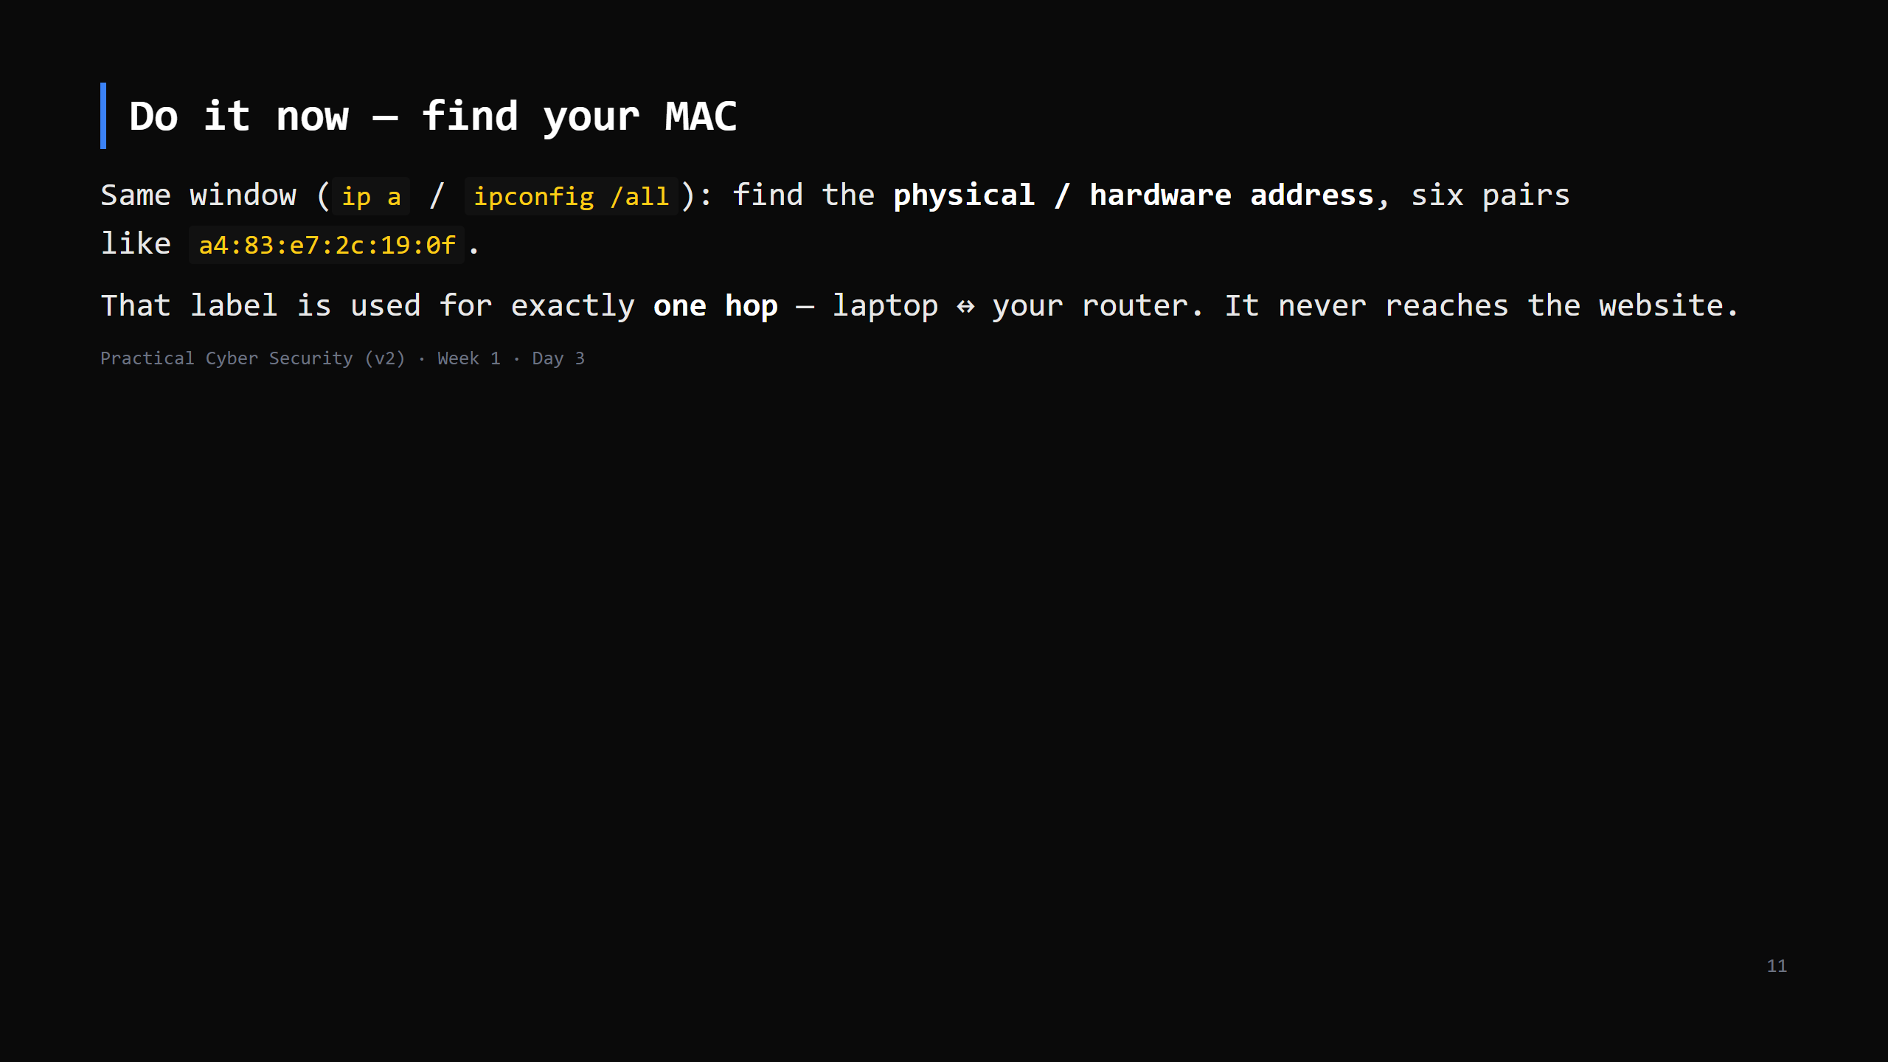
Notes:
30 seconds. On `ip a` it's the "link/ether" line. Windows: "Physical Address".
Point out the first half identifies the maker (Intel/Apple/etc.) — the OUI.

Slide 12
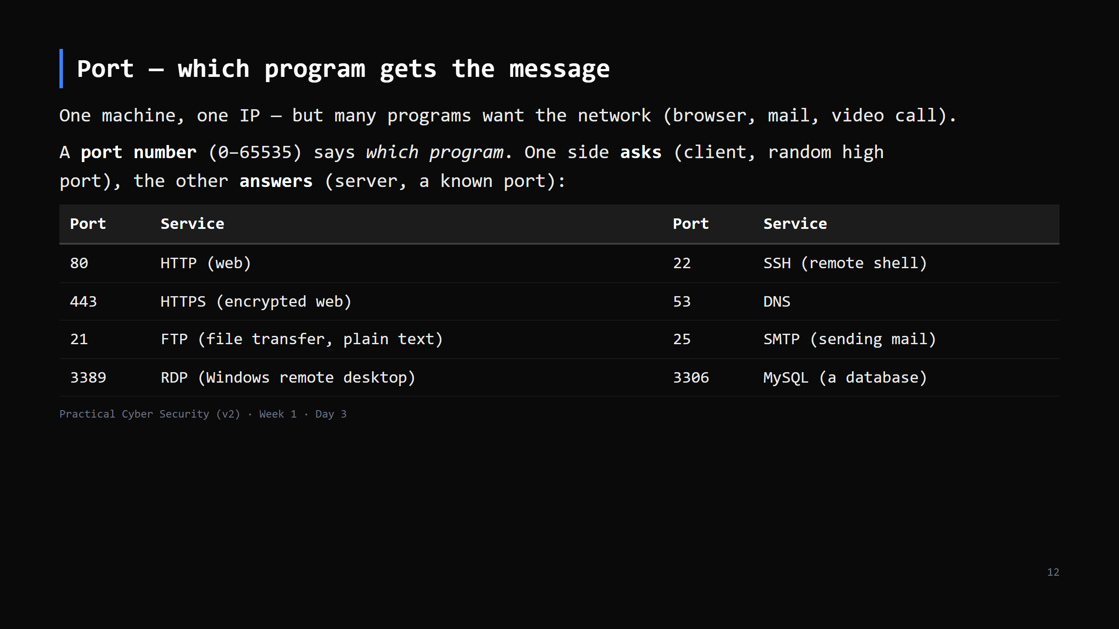
Notes:
Analogy: IP gets the parcel to the building; the port is the department name on it.
Rows 3-4 are for RECOGNITION only — don't explain them. Students meet FTP/SSH properly on
Day 13 when Nmap finds them; RDP/MySQL are "things that should never face the internet."
LIVE DIAGRAM: archify/01-three-addresses.html, view "Client and server" — the browser's
random source port vs the server's fixed 443. 30 seconds.
CLIENT/SERVER (a must-land): the client opens the conversation and picks a random source port
so it can match the reply; the server sits listening on a fixed, known port. "Listening on a
port" = a process (Day 2! it has a PID) told the OS "give me anything arriving for port 80."

Slide 13
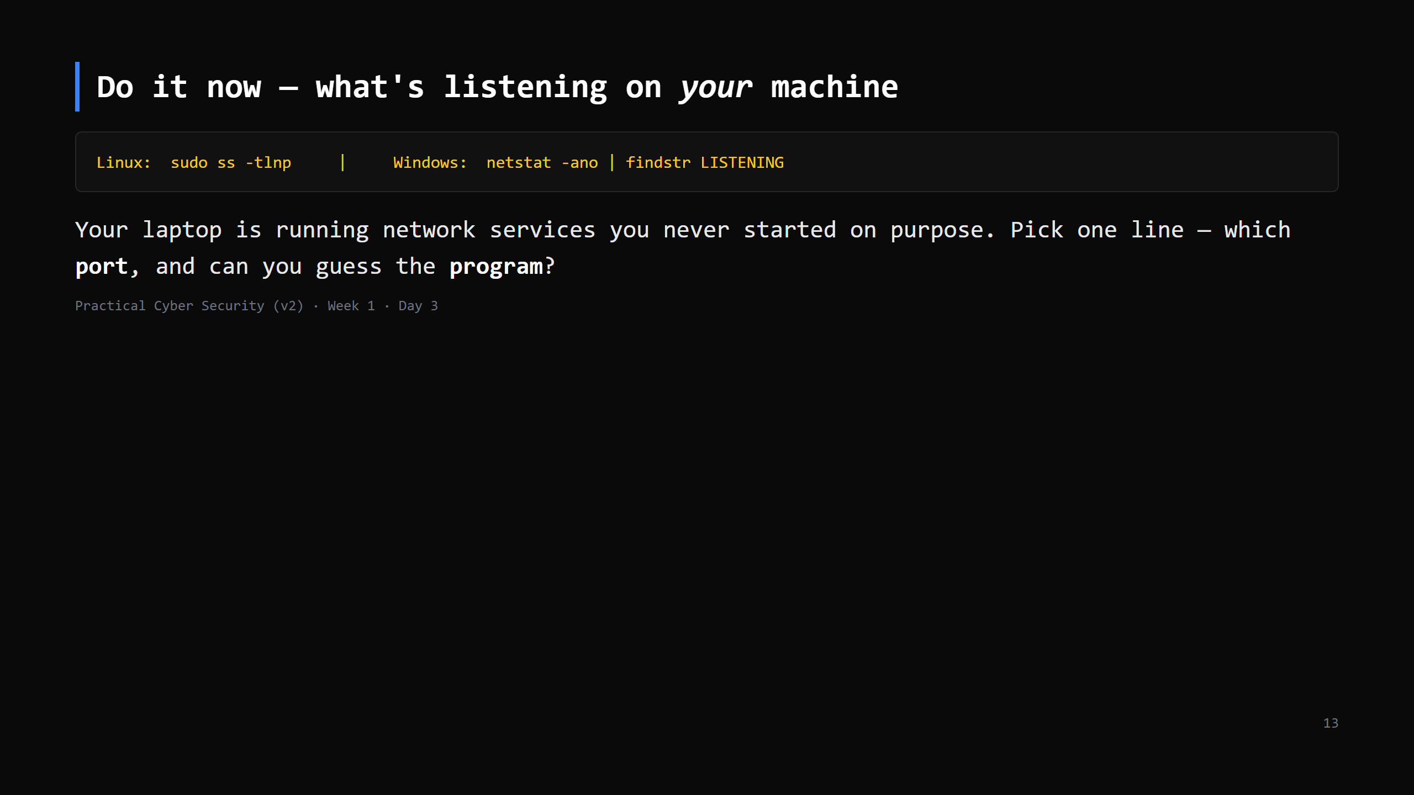
Notes:
2-3 min incl. discussion. Common: :53 (DNS stub), :631 (printing/CUPS), sometimes :22, :5353
(mDNS). Windows shows lots — map a PID to a name via Task Manager.
The point: every open port is a door. Attackers scan for exactly these (forward-ref Day 13).
Needs sudo/admin for the program-name column.

Slide 14
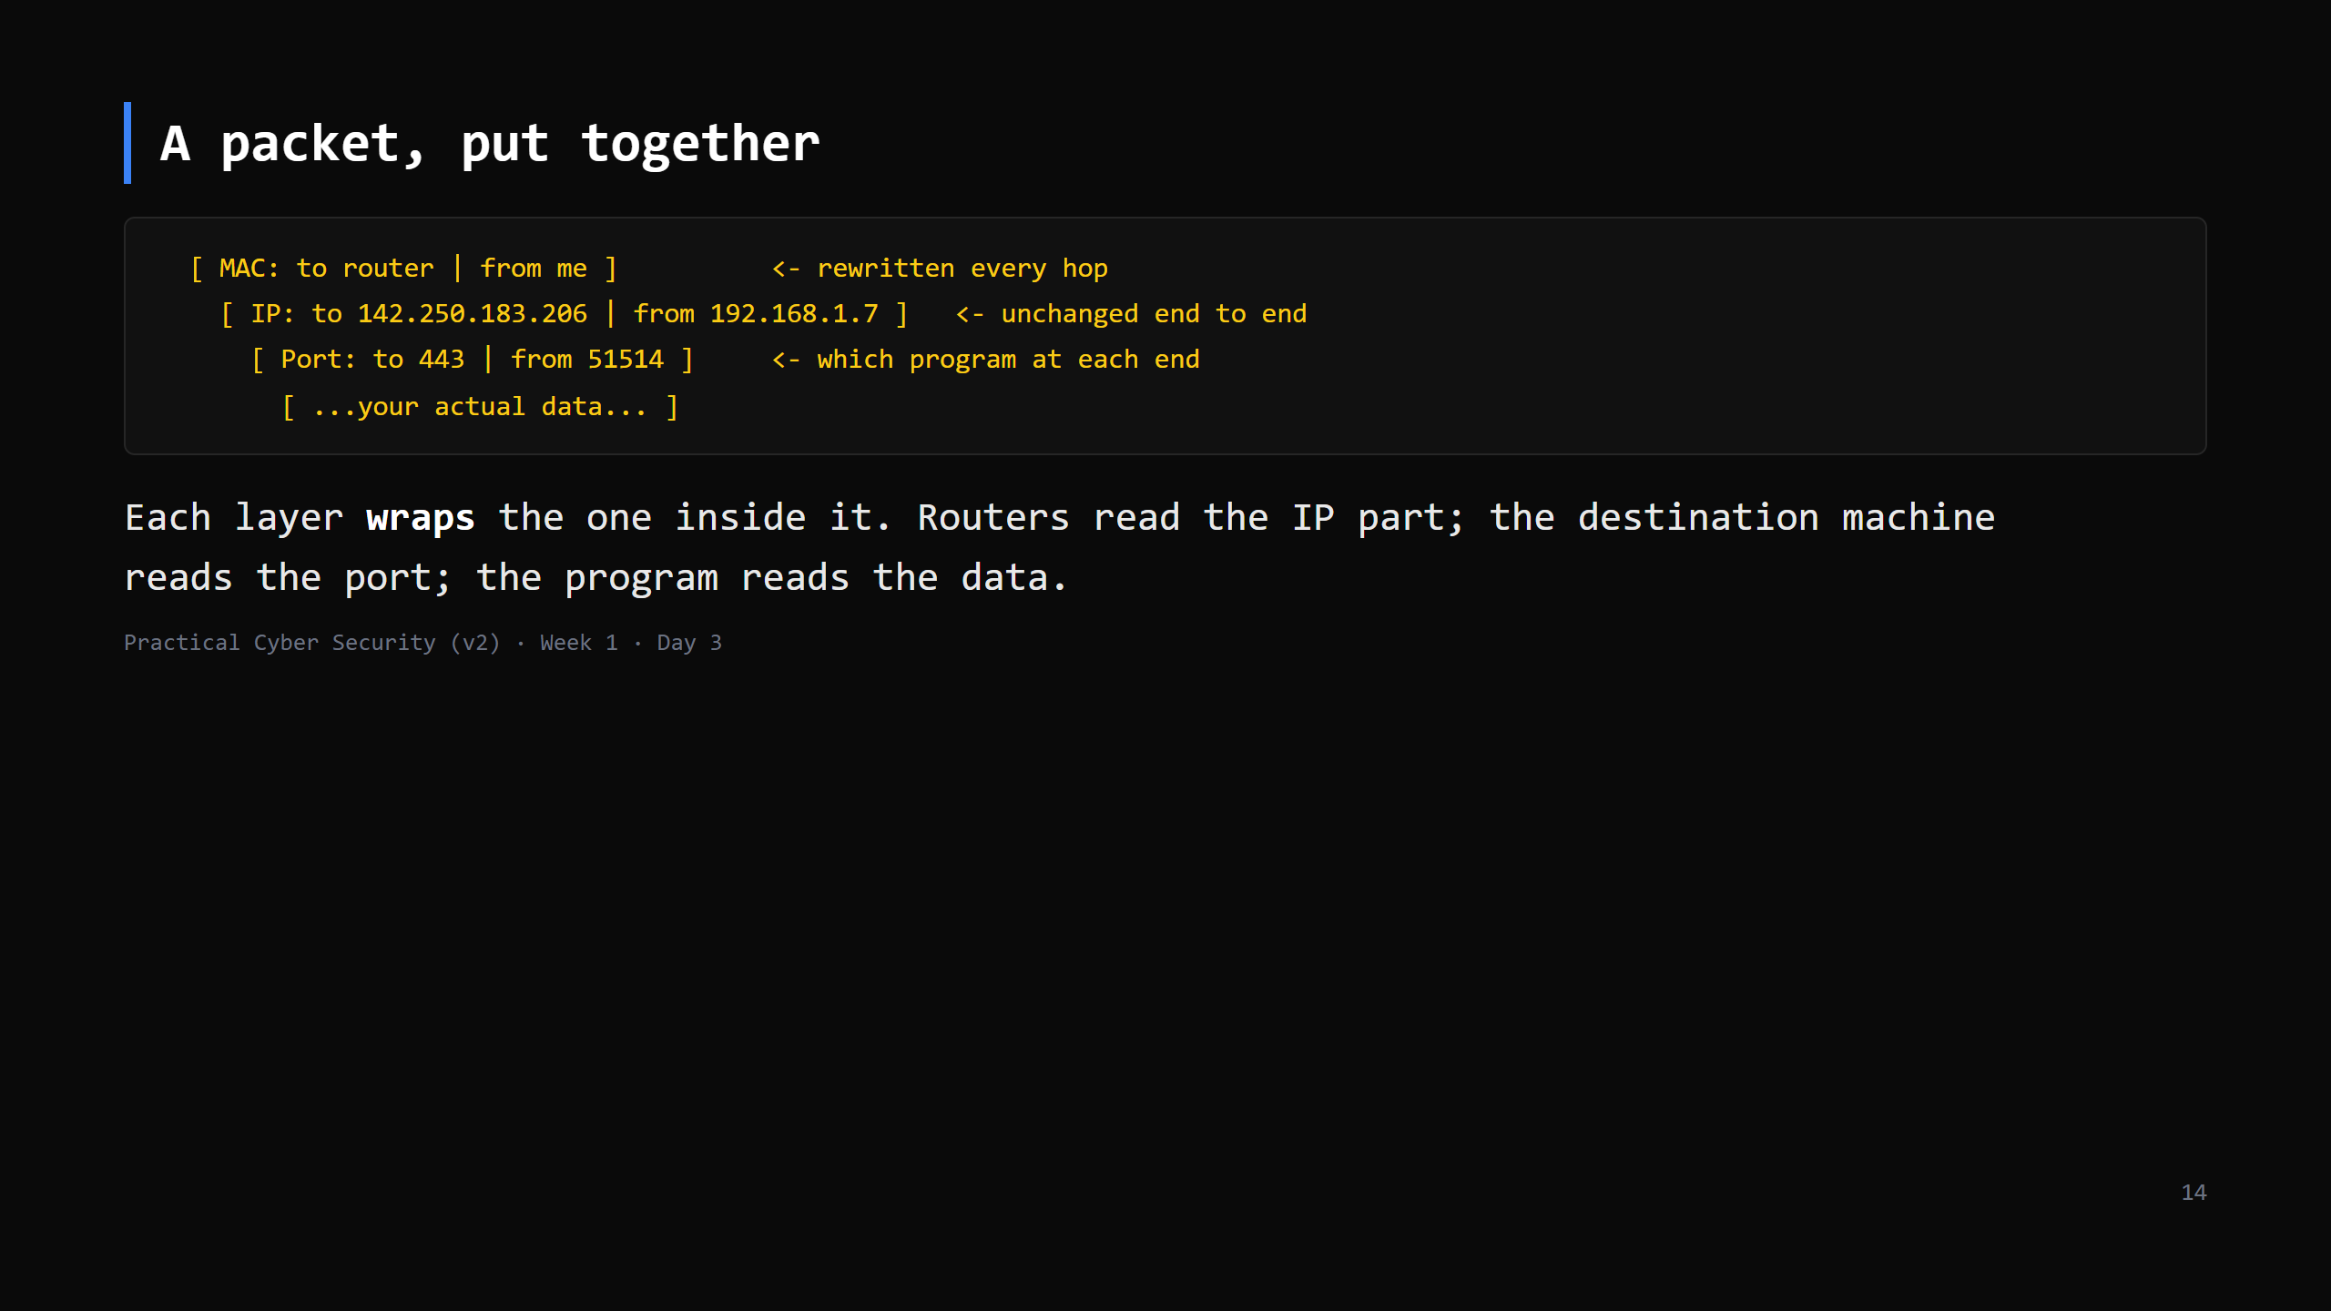
Notes:
This is the "envelopes inside envelopes" idea. Draw it as nested boxes on the board.
The source port (51514) is a random high number your OS picks so it can match the reply.
Don't say "encapsulation" unless asked — but that's the word.
LIVE DIAGRAM: archify/03-packet-layers.html, view 1 "Wrap the message" — same numbers as this
slide (51514 -> 443). Leave the tab open; views 2 and 3 belong to the next slide.

Slide 15
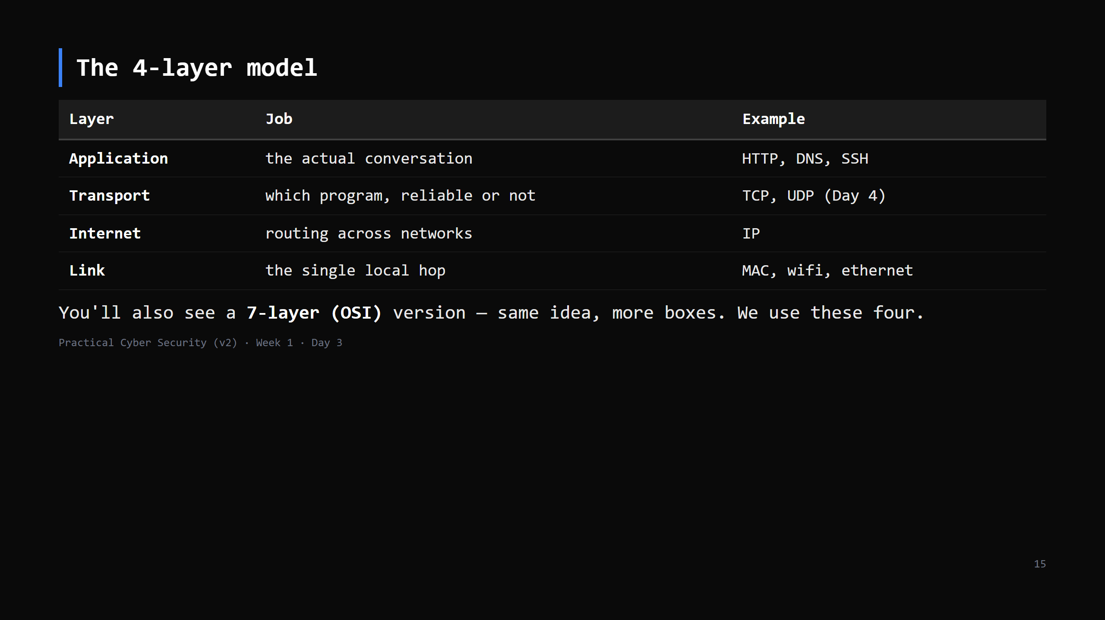
Notes:
Per the course standard: teach the 4-layer model, mention OSI-7 once, move on.
Map it back to the packet slide: each row = one of the envelopes.
LIVE DIAGRAM: archify/03-packet-layers.html, views 2 "At a router" (MAC swapped, IP kept) and
3 "Deliver to process" (port -> OS -> the PID from Day 2). Then read the "Class check" card
aloud — those three questions ARE the exit check.
CUT-TO-ONE-SENTENCE if short: "messages are built in layers — link, internet, transport,
application — each wrapping the next; we'll meet transport tomorrow."

Slide 16
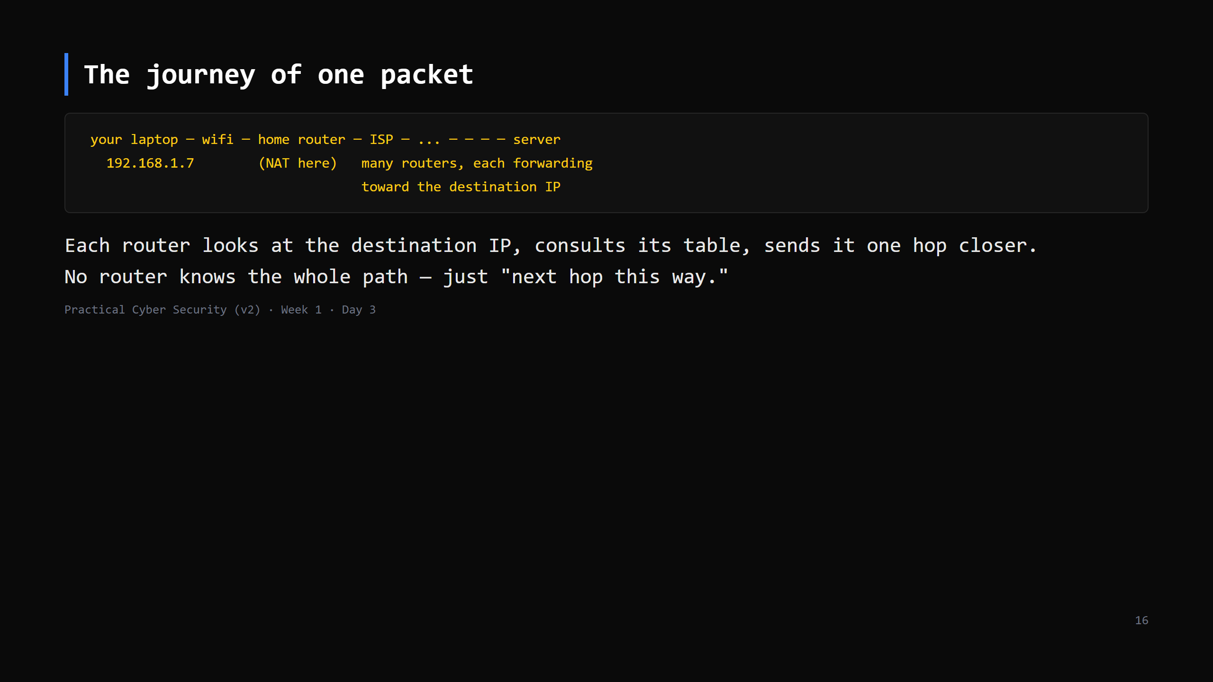
Notes:
Callback to the traceroute hook: every line you saw was one of those forwarding routers.
"Hop by hop, best effort" — nobody guarantees delivery at this layer (that's TCP's job, Day 4).

Slide 17
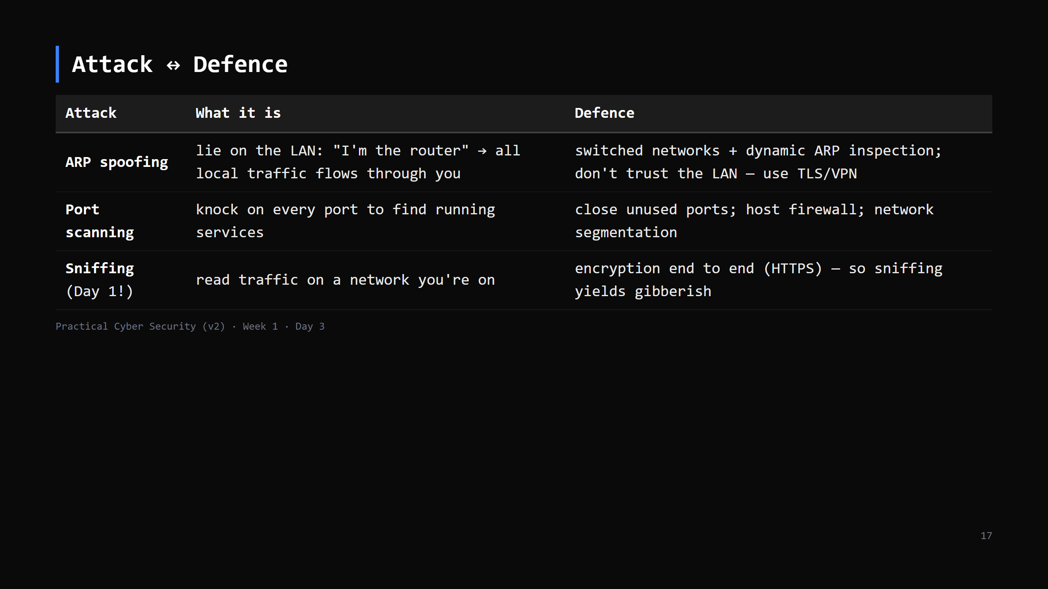
Notes:
Tie it together: the Day 1 trailer worked because attacker + victim were on the SAME LAN and
the login was plain HTTP. ARP spoofing is how you'd get in the middle even on a switch.
The fix that actually scales isn't "secure the LAN perfectly" — it's "assume the network is
hostile and encrypt anyway." That's the whole reason for tomorrow's HTTPS lesson.
"Host firewall" in the port-scanning row — next slide makes that concrete.

Slide 18
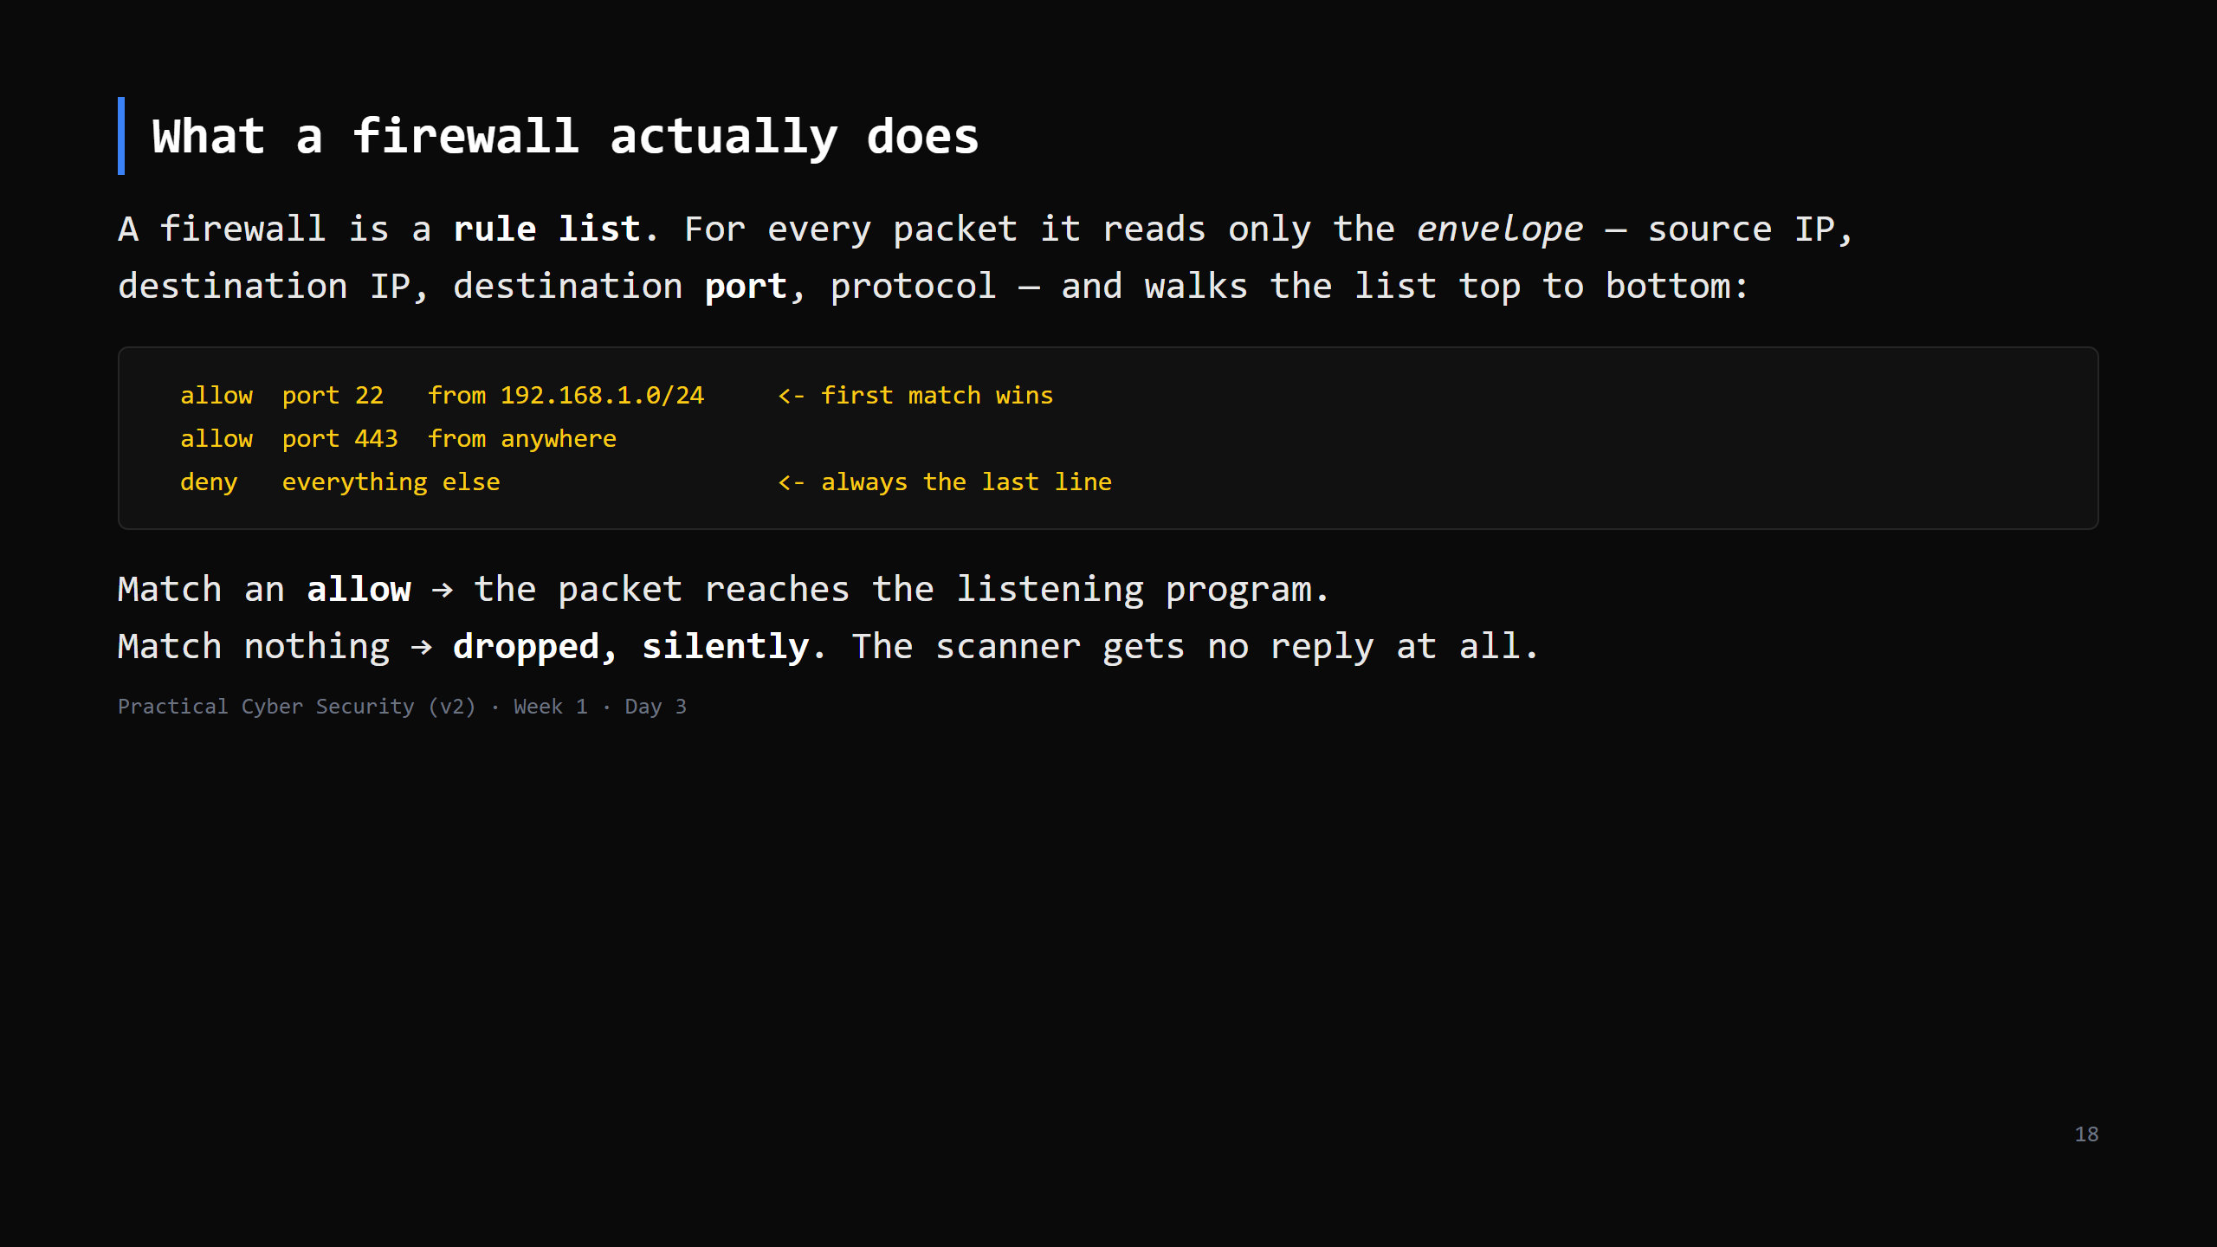
Notes:
LIVE DIAGRAM: archify/05-firewall-decision.html — 3 views: arrives / allowed / dropped (~2 min).
This is the "host firewall" from the port-scanning row made concrete. It does NOT read your
data and does NOT know whether the data is malicious — it only decides which doors open for
whom. NAT is not a firewall (teacher notes). "Filtered" in Nmap on Day 13 = this DROP branch.
CUT to one sentence if short: "a firewall is a list of which ports open for which addresses;
everything else is dropped silently."

Slide 19
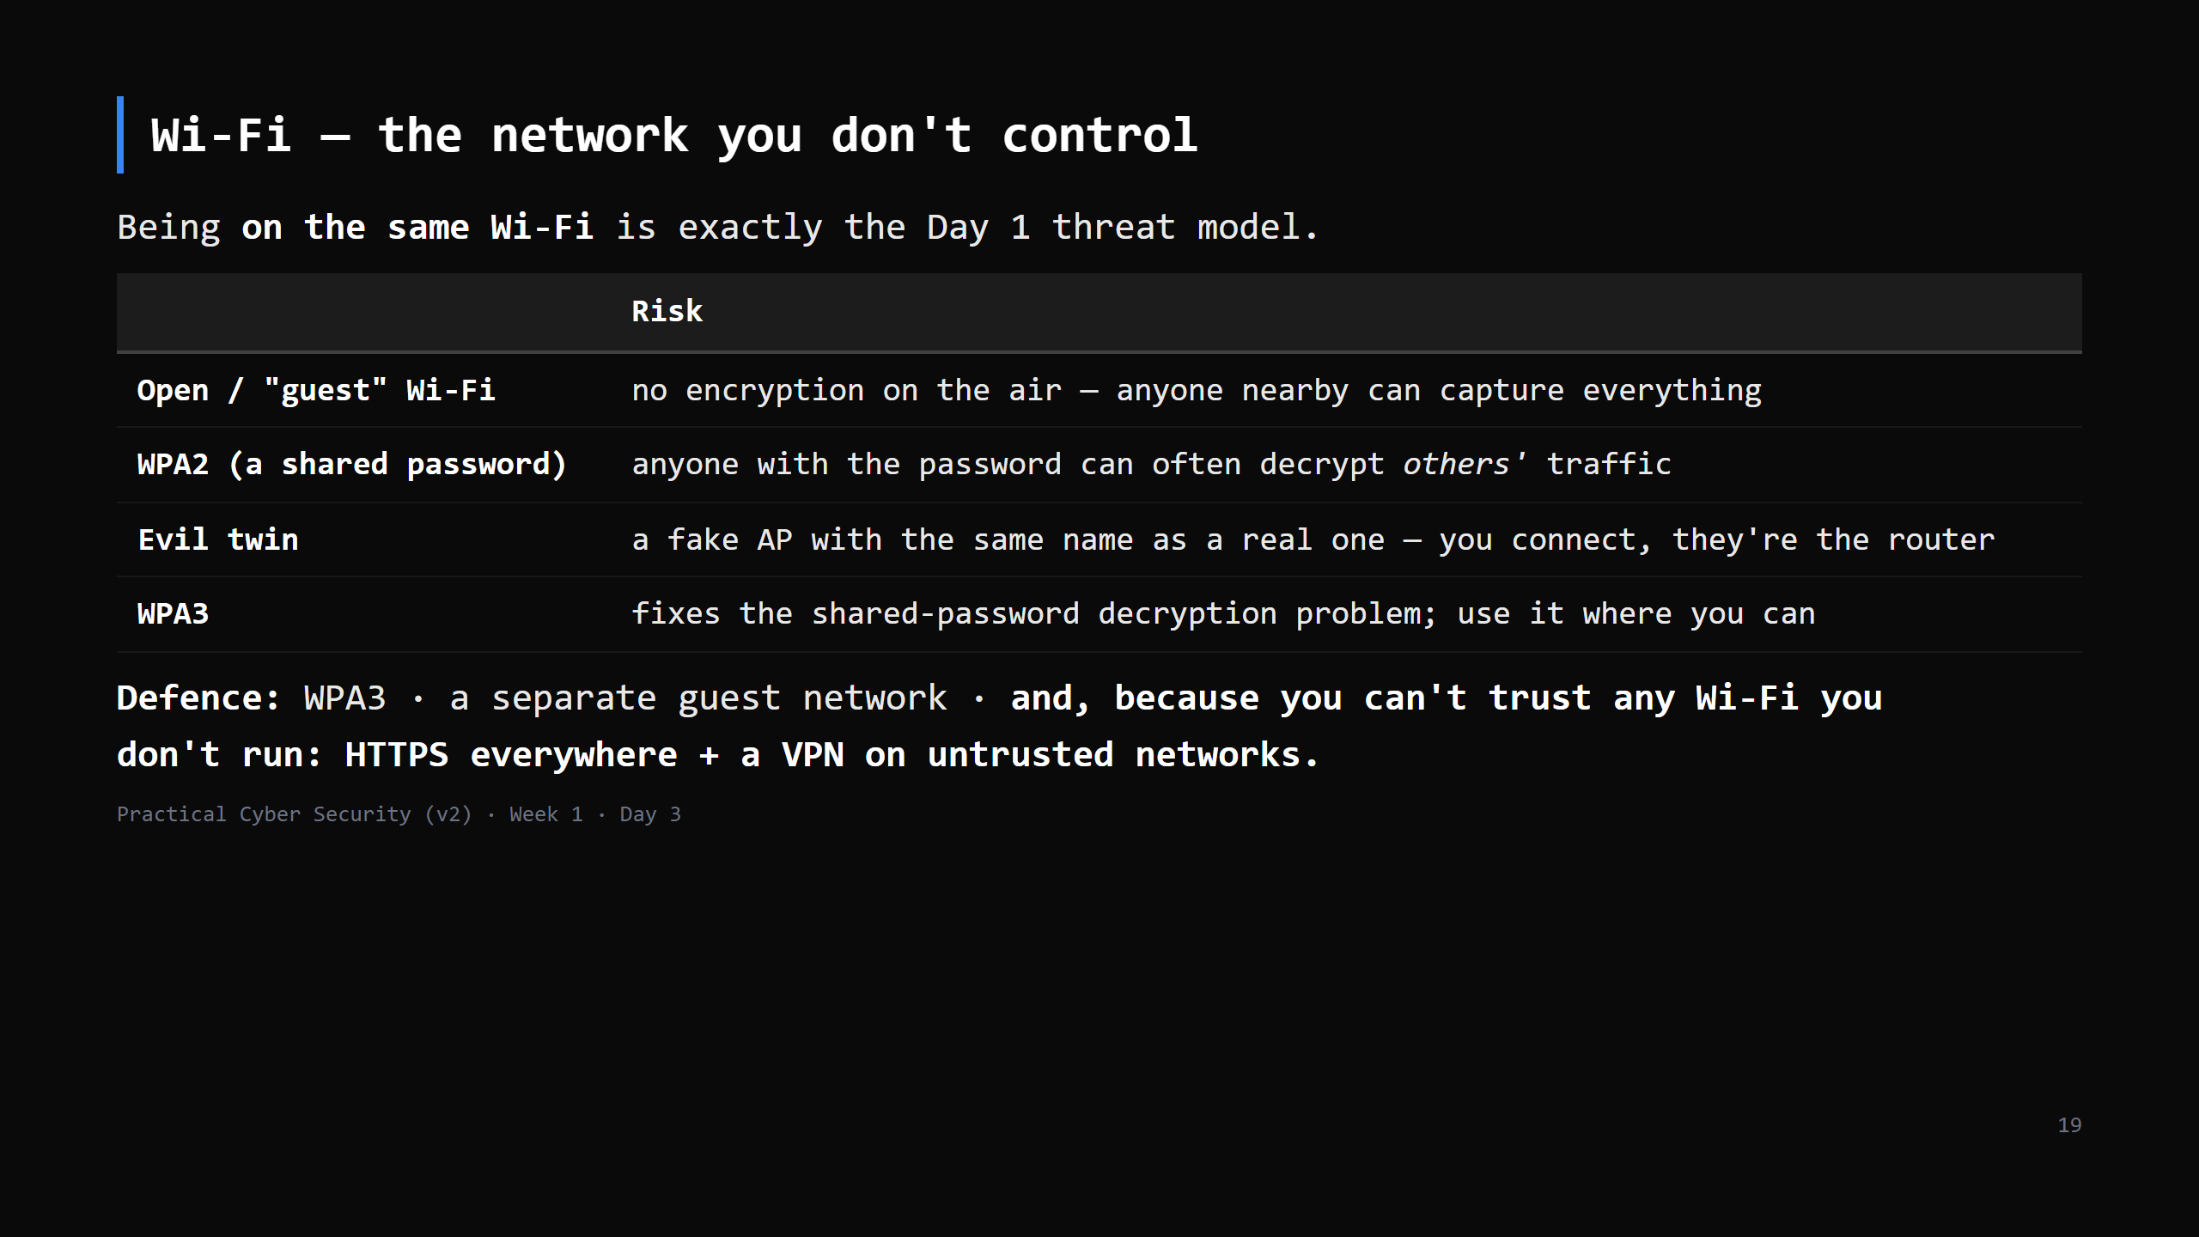
Notes:
This closes the loop on the Day 1 trailer (a Wi-Fi sniff). The point for students: "coffee
shop Wi-Fi" is not a safe place to log into anything over plain HTTP, and even WPA2 home Wi-Fi
isn't private from a housemate who has the password. WPA3's SAE handshake gives per-session
keys. Enterprise Wi-Fi (802.1X / WPA2-Enterprise) is per-user — name it, don't detail it.
CUT to 2 min if behind — the one line to keep: "you can't trust Wi-Fi you don't run; encrypt anyway."

Slide 20
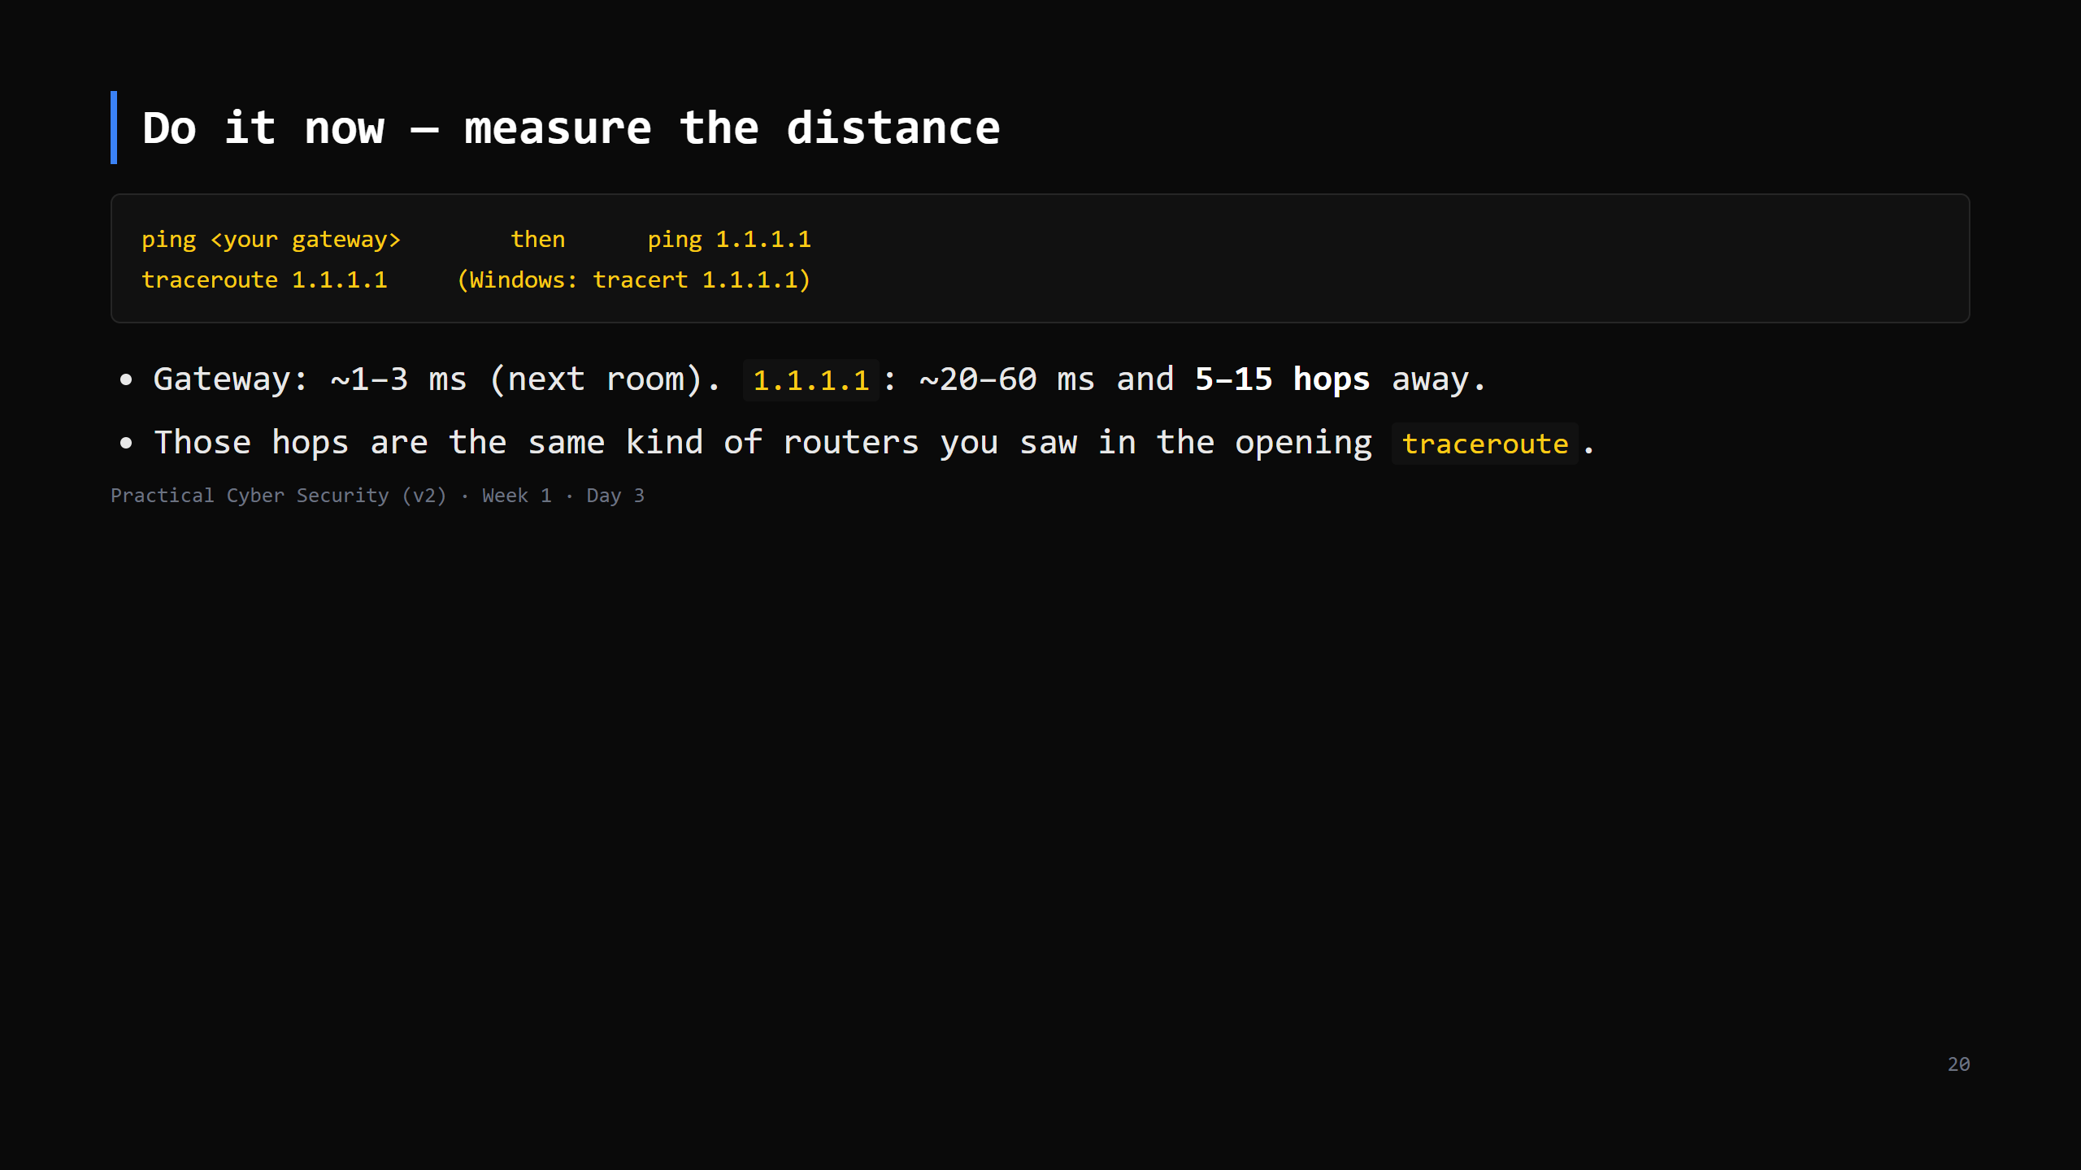
Notes:
3-4 min. ping to 1.1.1.1 may be blocked on locked-down wifi — note it, move on, the web still
works because that's TCP not ICMP.
This is the fourth and last "do it now". Total hands-on across the lesson ~15 min, interleaved.

Slide 21
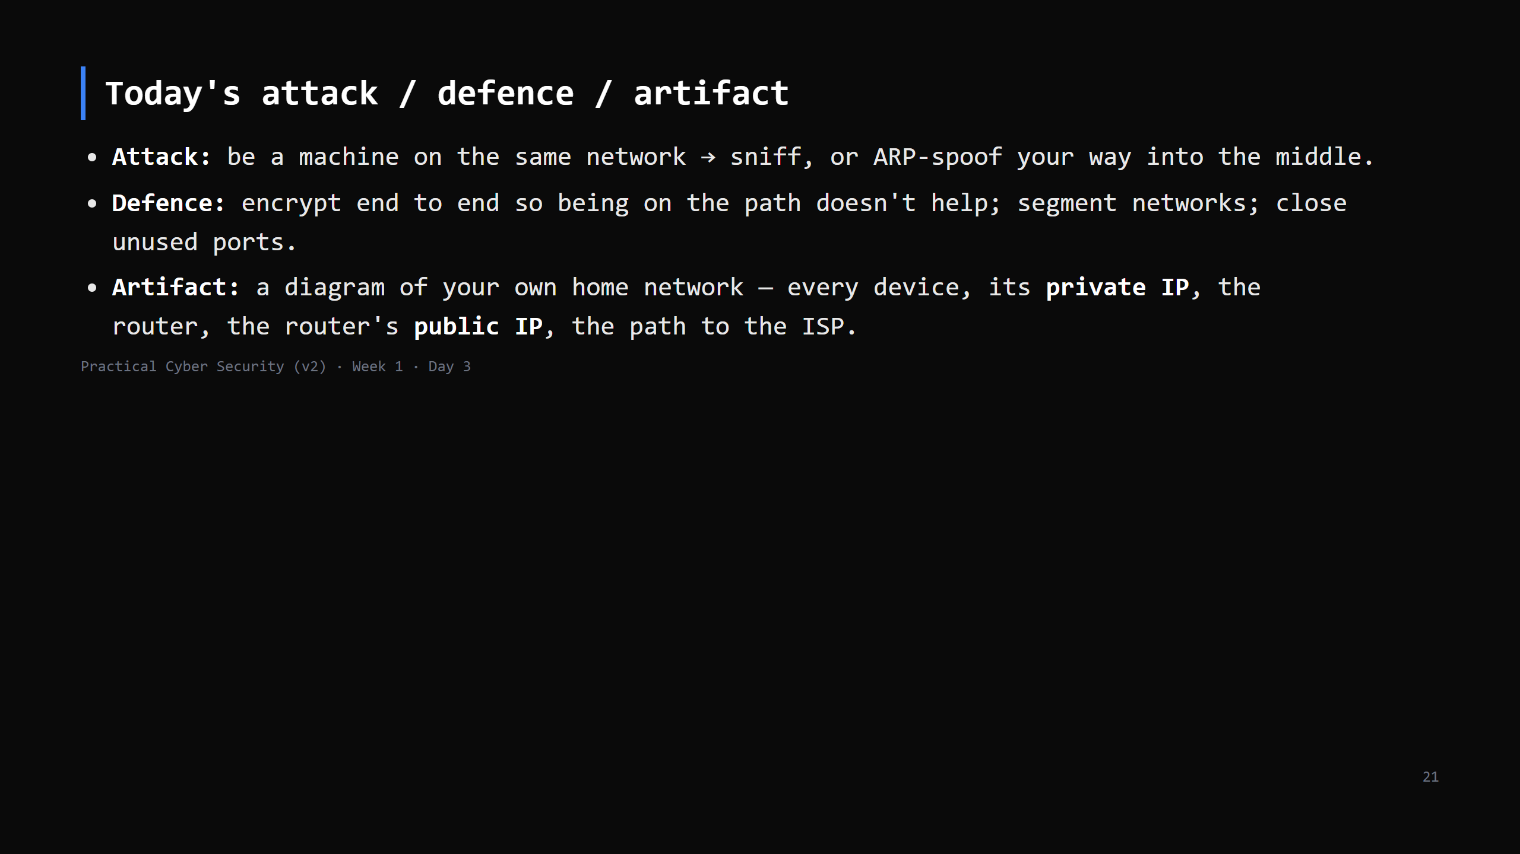
Notes:
Three lines into the repo.

Slide 22
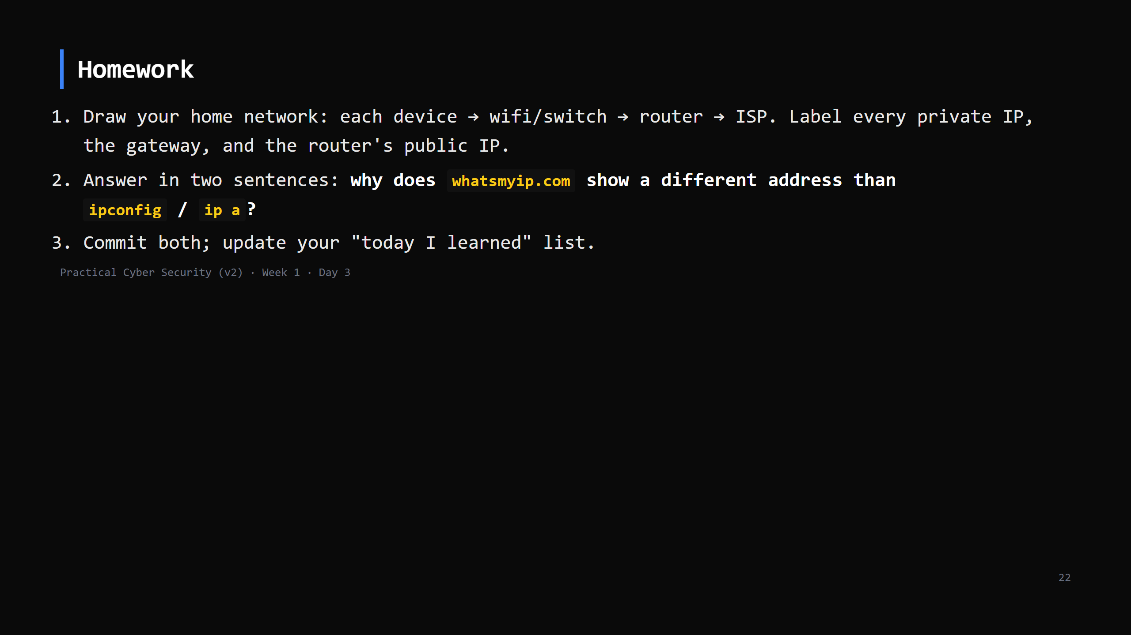
Notes:
Due start of Day 4. Checklist grading in the week-1 student pack.

Slide 23
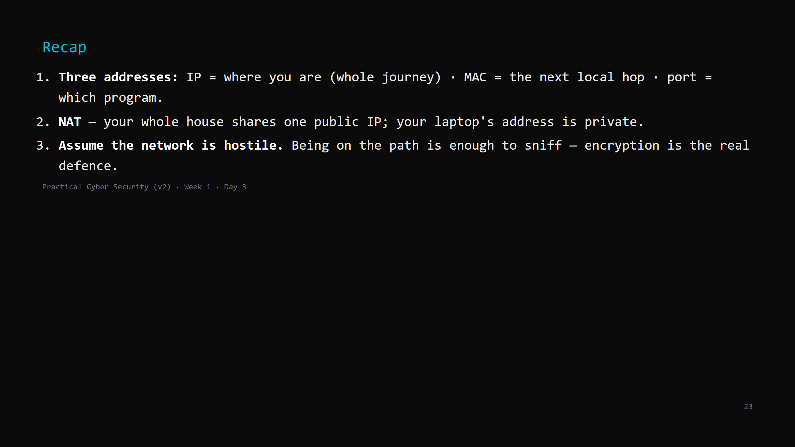
Notes:
Say the three lines. Then: tomorrow we give these packets rules — TCP's handshake, DNS turning
names into IPs, and the full story of loading a web page.

