Slide 1
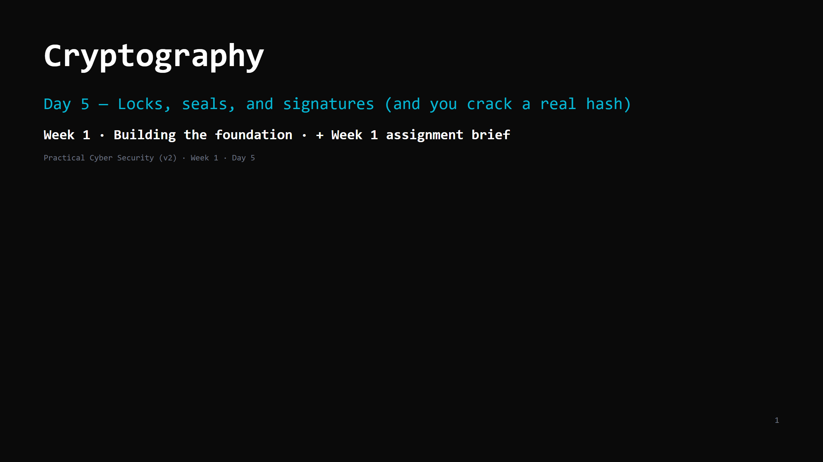
Notes:
RUN SHEET (~88 min). Hands-on INTERLEAVED. Assignment brief is the last block.
00:00 Journey check + hook (crack a hash on the projector) 4
00:04 What crypto is: four goals, three types, three jobs 7
00:11 Job 1: encryption / symmetric 6
00:17 Asymmetric / public key — solves key exchange 8
00:25 DO: inspect a real certificate 4
00:29 Job 2: hashing — one-way, tamper-evident 8
00:37 DO: sha256 a file, flip one byte 4
00:41 Password storage done right (the trap) 7
00:48 DO: crack hashes with a wordlist 10
00:58 Job 3: signatures + the TLS handshake in 4 steps 6
01:04 Attack <-> defence + "don't roll your own" 5
01:09 Wrap + artifact (the 5-primitives table) 3
01:12 WEEK 1 ASSIGNMENT BRIEF 16
CUT FIRST IF SHORT: the cert "do it now" (show one on the projector instead); the sha256 flip
(describe it); the signatures detail (keep "private signs, public verifies, a cert is a CA's
signature on a name").
NEVER CUT: hash != encryption; salt + slow hash for passwords; the crack "do it now";
the assignment brief.
ANALOGY (sanctioned extension of the postal system): locks and seals on the mail.
symmetric = a box with one key both sides copied · asymmetric = a padlock anyone can snap
shut but only the owner's key opens · hash = a tamper-evident wax seal · signature = a signet-ring stamp.

Slide 2
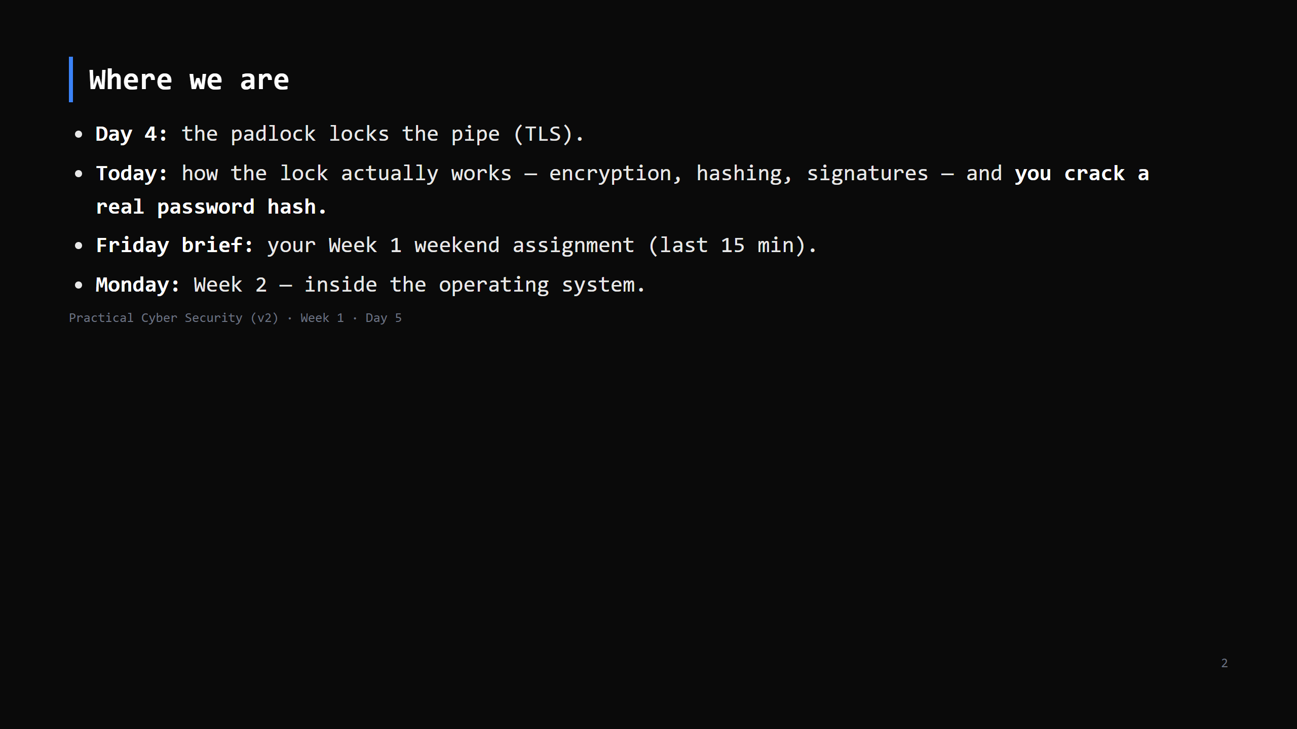
Notes:
Learning Journey Check. Flag the assignment brief is coming at the end.

Slide 3
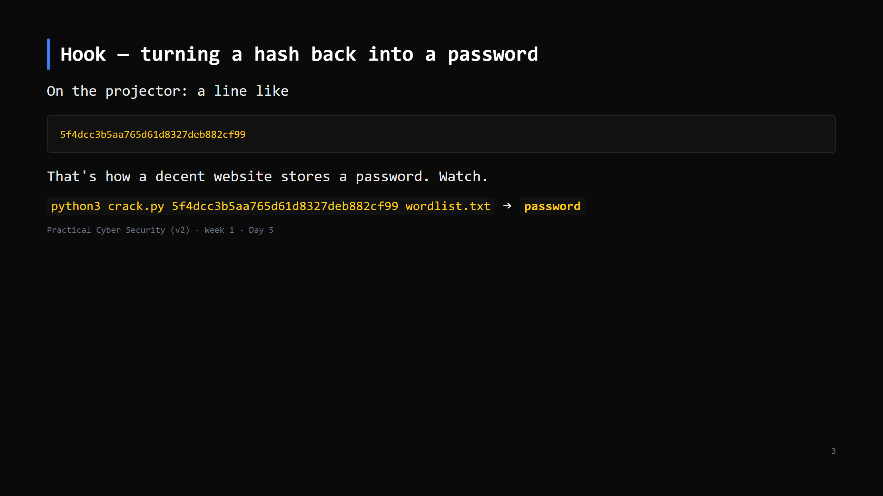
Notes:
~1 minute. Run crack.py against an unsalted MD5 of "password". It falls instantly.
SAY: "if the site did it properly this would have taken years, not a second. Today you learn
the difference — and you do this yourself in 40 minutes."
Full student crack session is the "do it now" later; this is just the teaser.

Slide 4
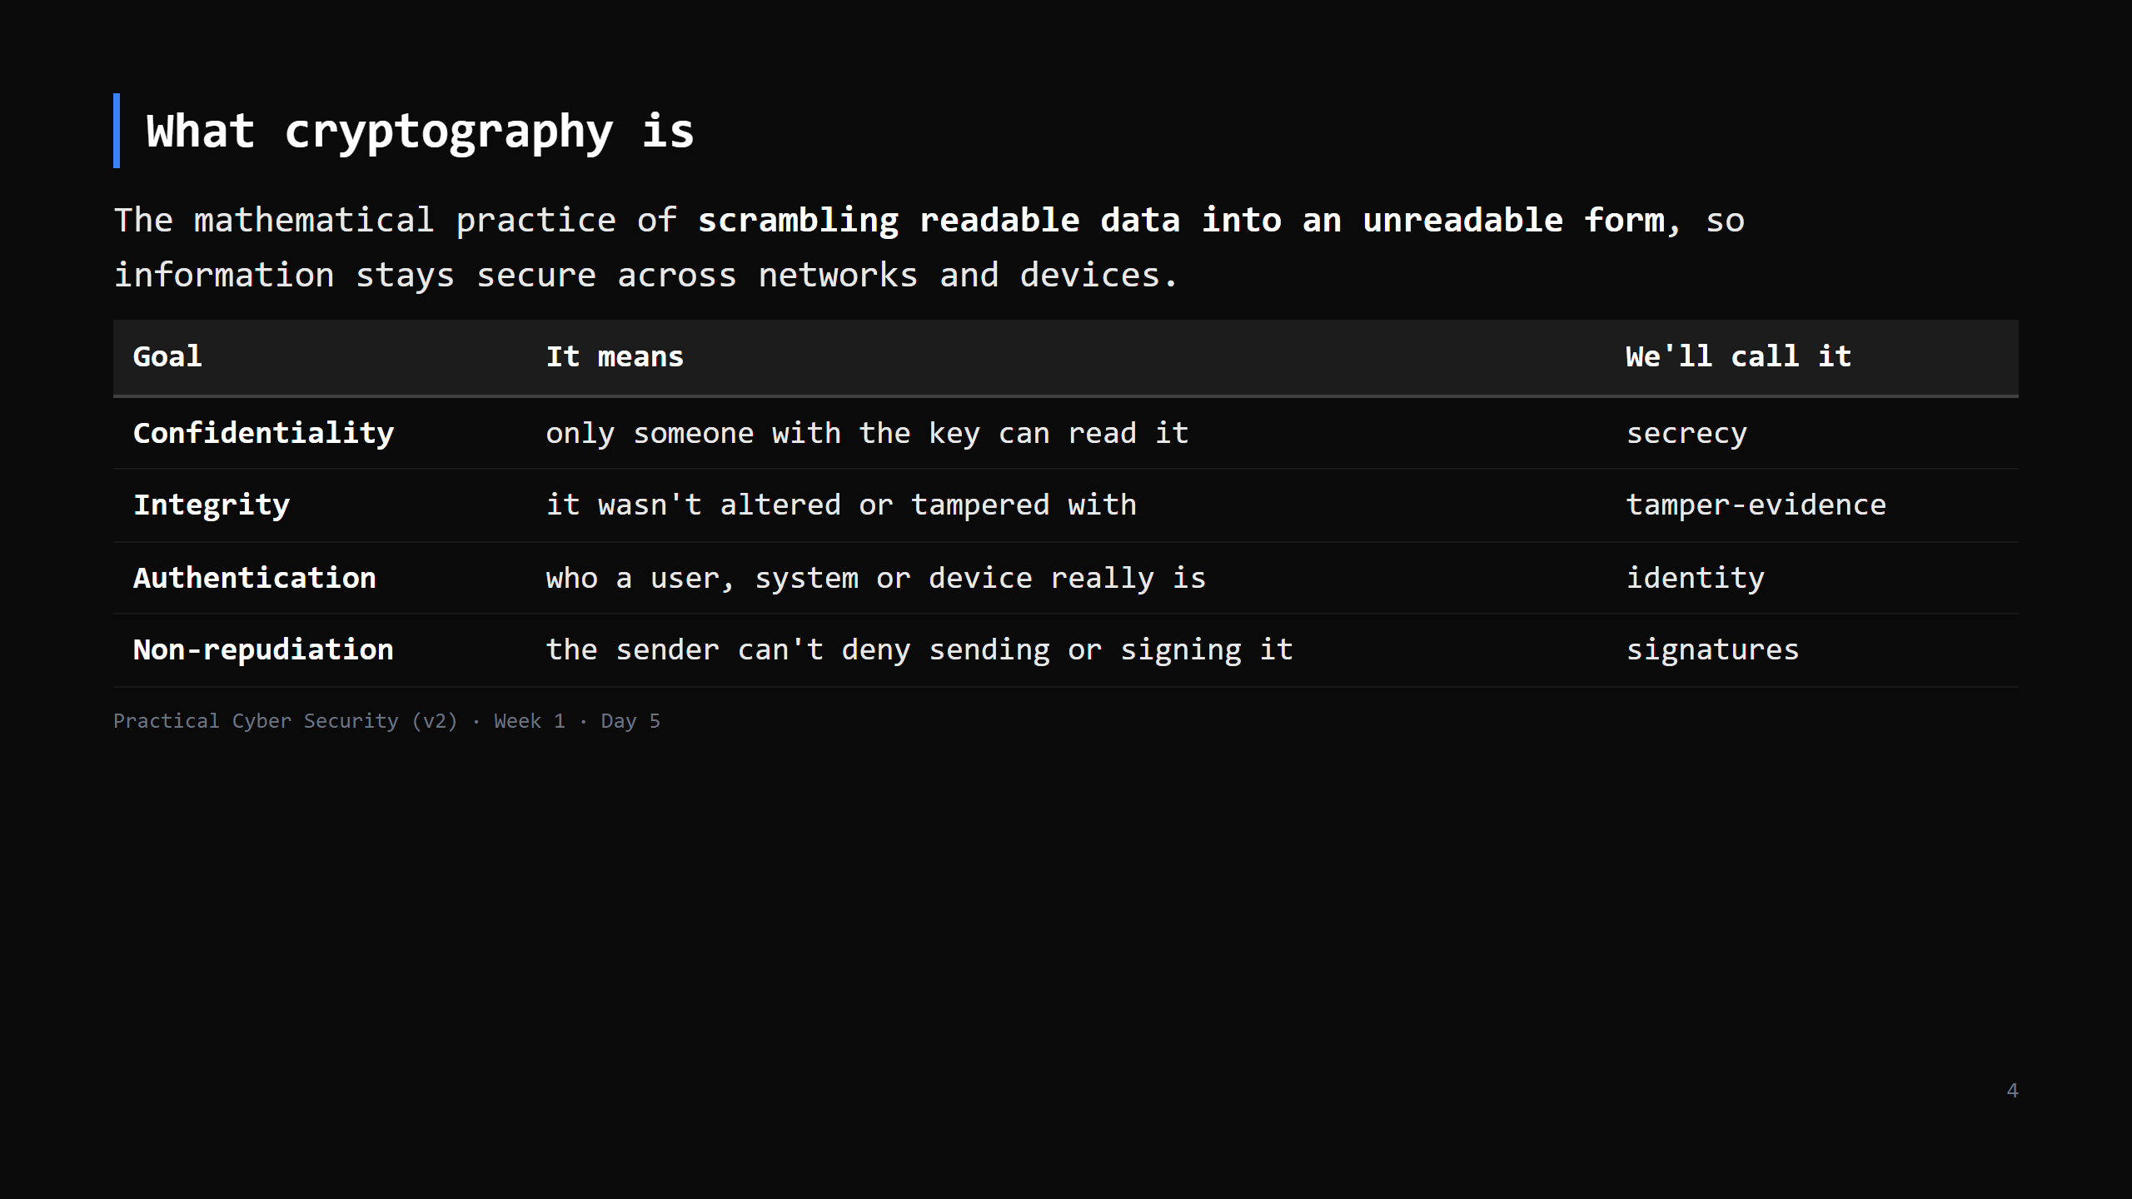
Notes:
Set the vocabulary before the tools. Four goals; the next-but-one slide groups them as the
"three jobs" we'll use all day (authentication + non-repudiation both live under "identity").
Non-repudiation = a signature is proof it was YOU; you can't later say "that wasn't me".
Careful with "scrambling": encryption and signatures fit it; a hash does not (one-way, no key) --
we make that point on the hashing slide.

Slide 5
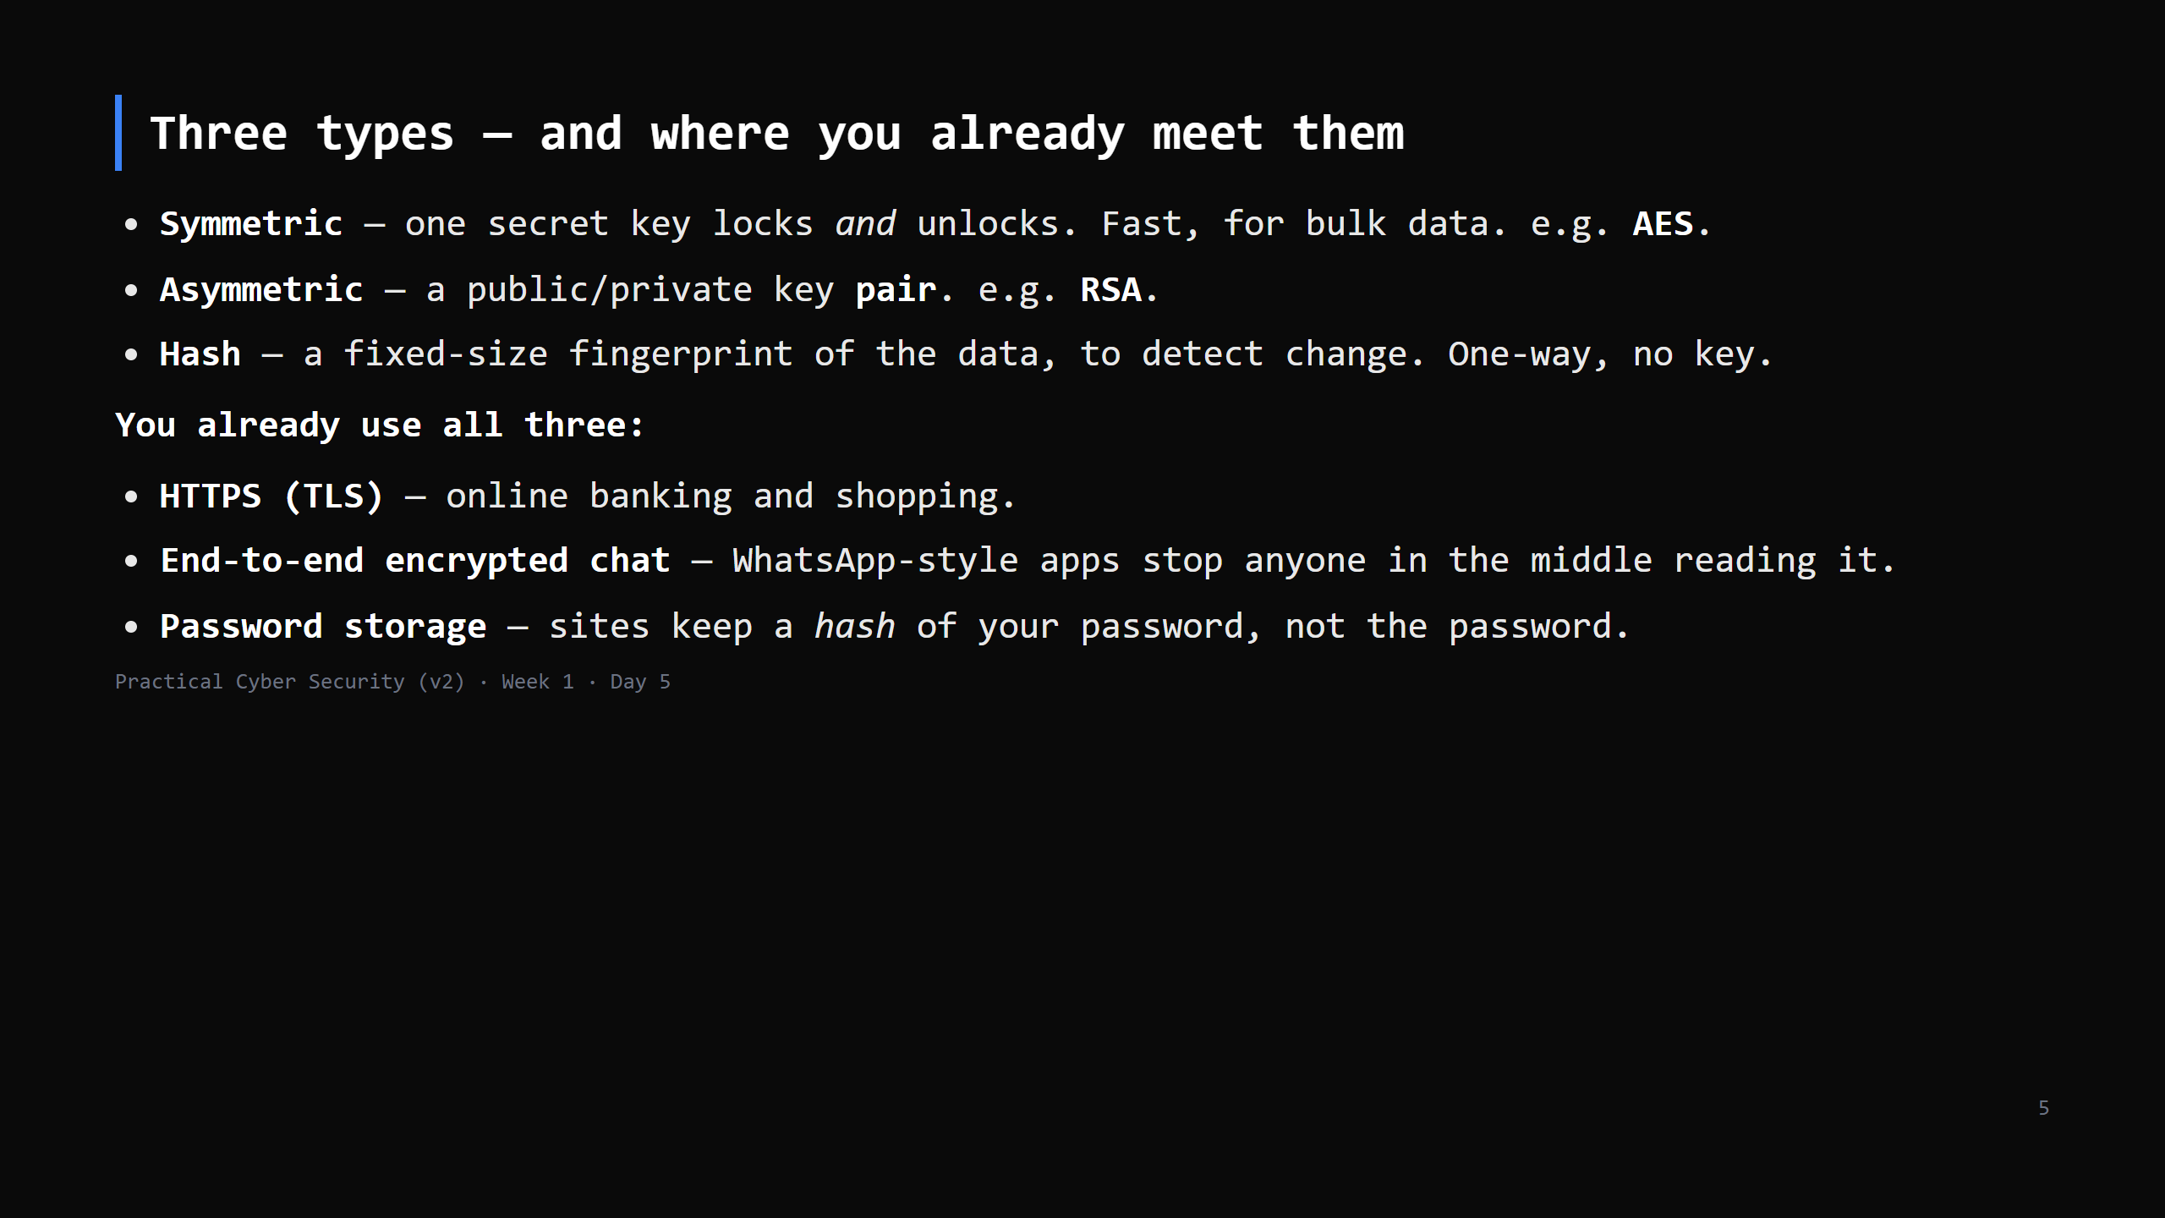
Notes:
Quick overview, ~2 min -- each type gets its own slide next. Two things to say out loud so the
overview isn't misleading: (1) "public key encrypts, private key decrypts" is the encryption
direction; signing runs the OTHER way (private signs, public verifies) -- Job 3 slide.
(2) A plain hash is not enough for passwords -- salted + SLOW hash, two slides on. Don't let
"hash = password storage" stand alone.

Slide 6
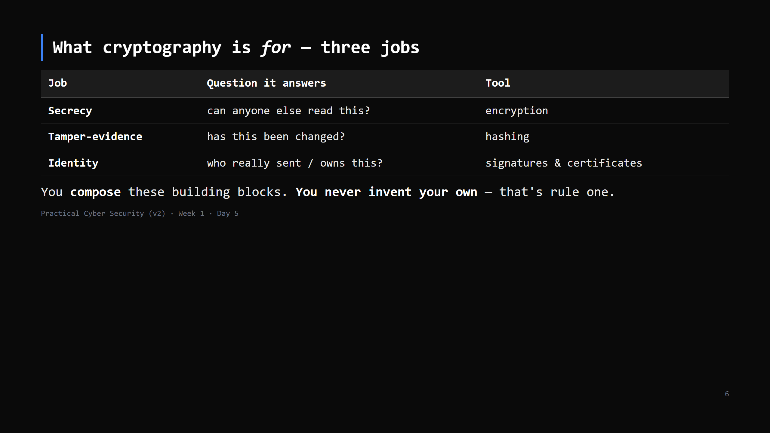
Notes:
Bridge from the previous slides: these three are the four goals grouped -- secrecy =
confidentiality, tamper-evidence = integrity, identity = authentication + non-repudiation.
Every secure system is some mix of these three. TLS (Day 4) uses all three at once.
"Don't roll your own crypto" — we'll come back to why at the end. Say it now so it sinks in.

Slide 7
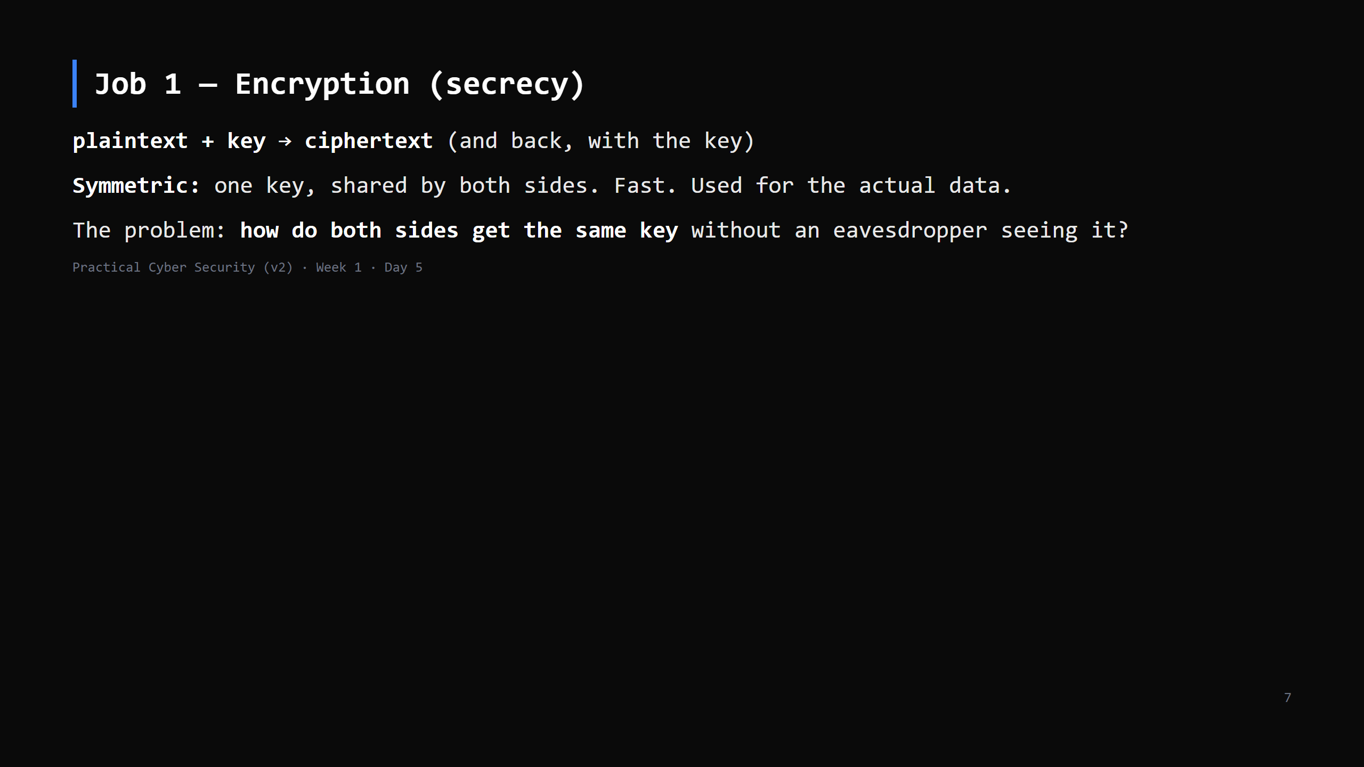
Notes:
Analogy: a lockbox both sides have a copy of the key to. Great — but how did the second person
get a copy of the key without it being intercepted? That's THE problem asymmetric crypto solves.
AES is the symmetric cipher to name (don't teach internals).

Slide 8
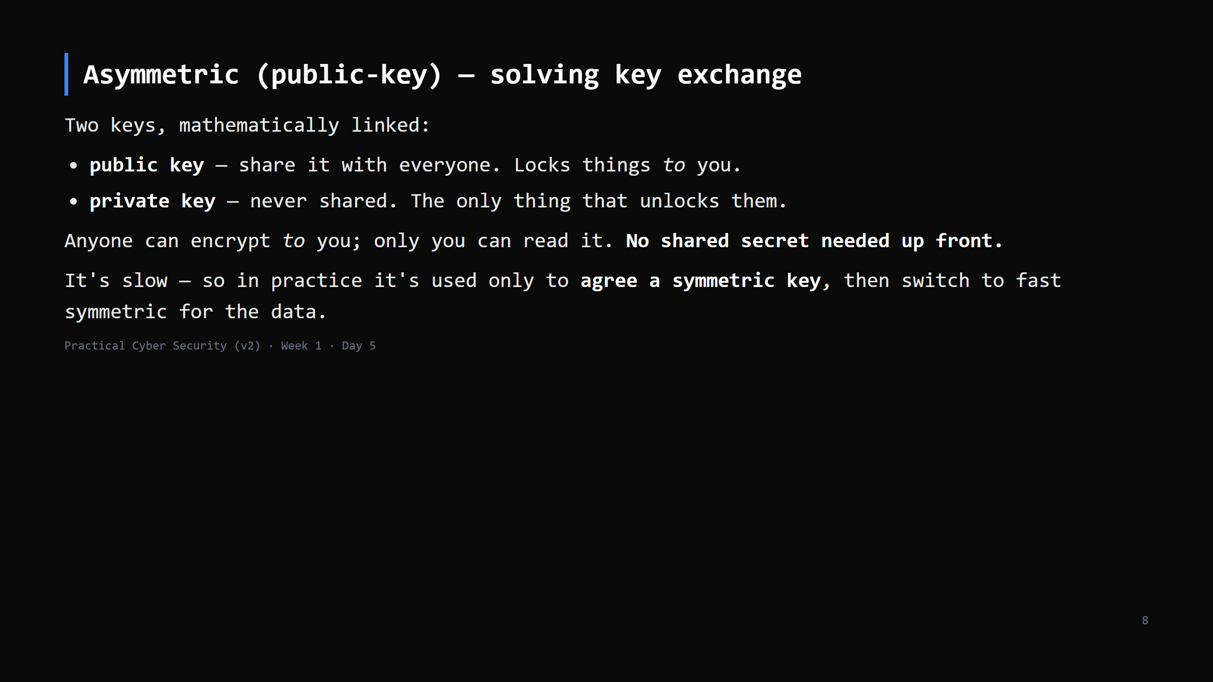
Notes:
Analogy: you hand out open padlocks with your name on them (public key). Anyone snaps one shut
on a box and ships it; only your key (private) opens it.
RSA and ECDH/Elliptic-curve are the names. The "agree a symmetric key then switch" is exactly
the TLS handshake — callback at the signatures slide.

Slide 9
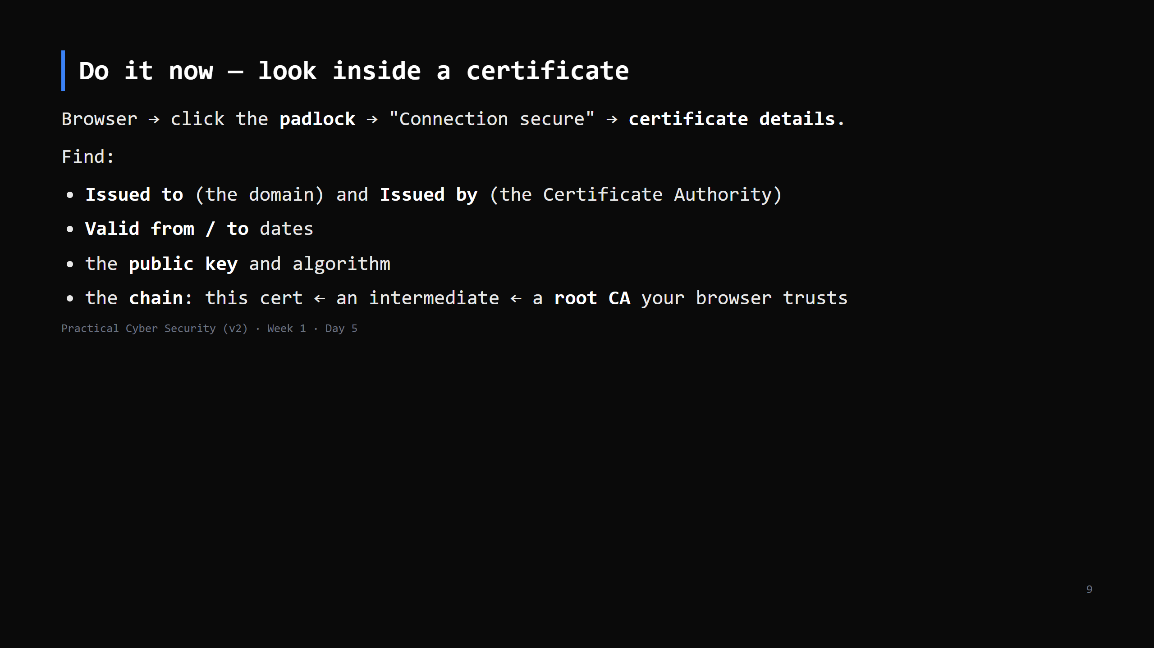
Notes:
3-4 min. Chrome: padlock -> Connection is secure -> Certificate is valid. Firefox similar.
The chain is the point: your browser ships with ~150 trusted root CAs; everything descends
from one of those by signatures. Forward-ref: if a school proxy is intercepting TLS, the
issuer here will be the proxy, not a public CA — real "who do you trust" example.

Slide 10
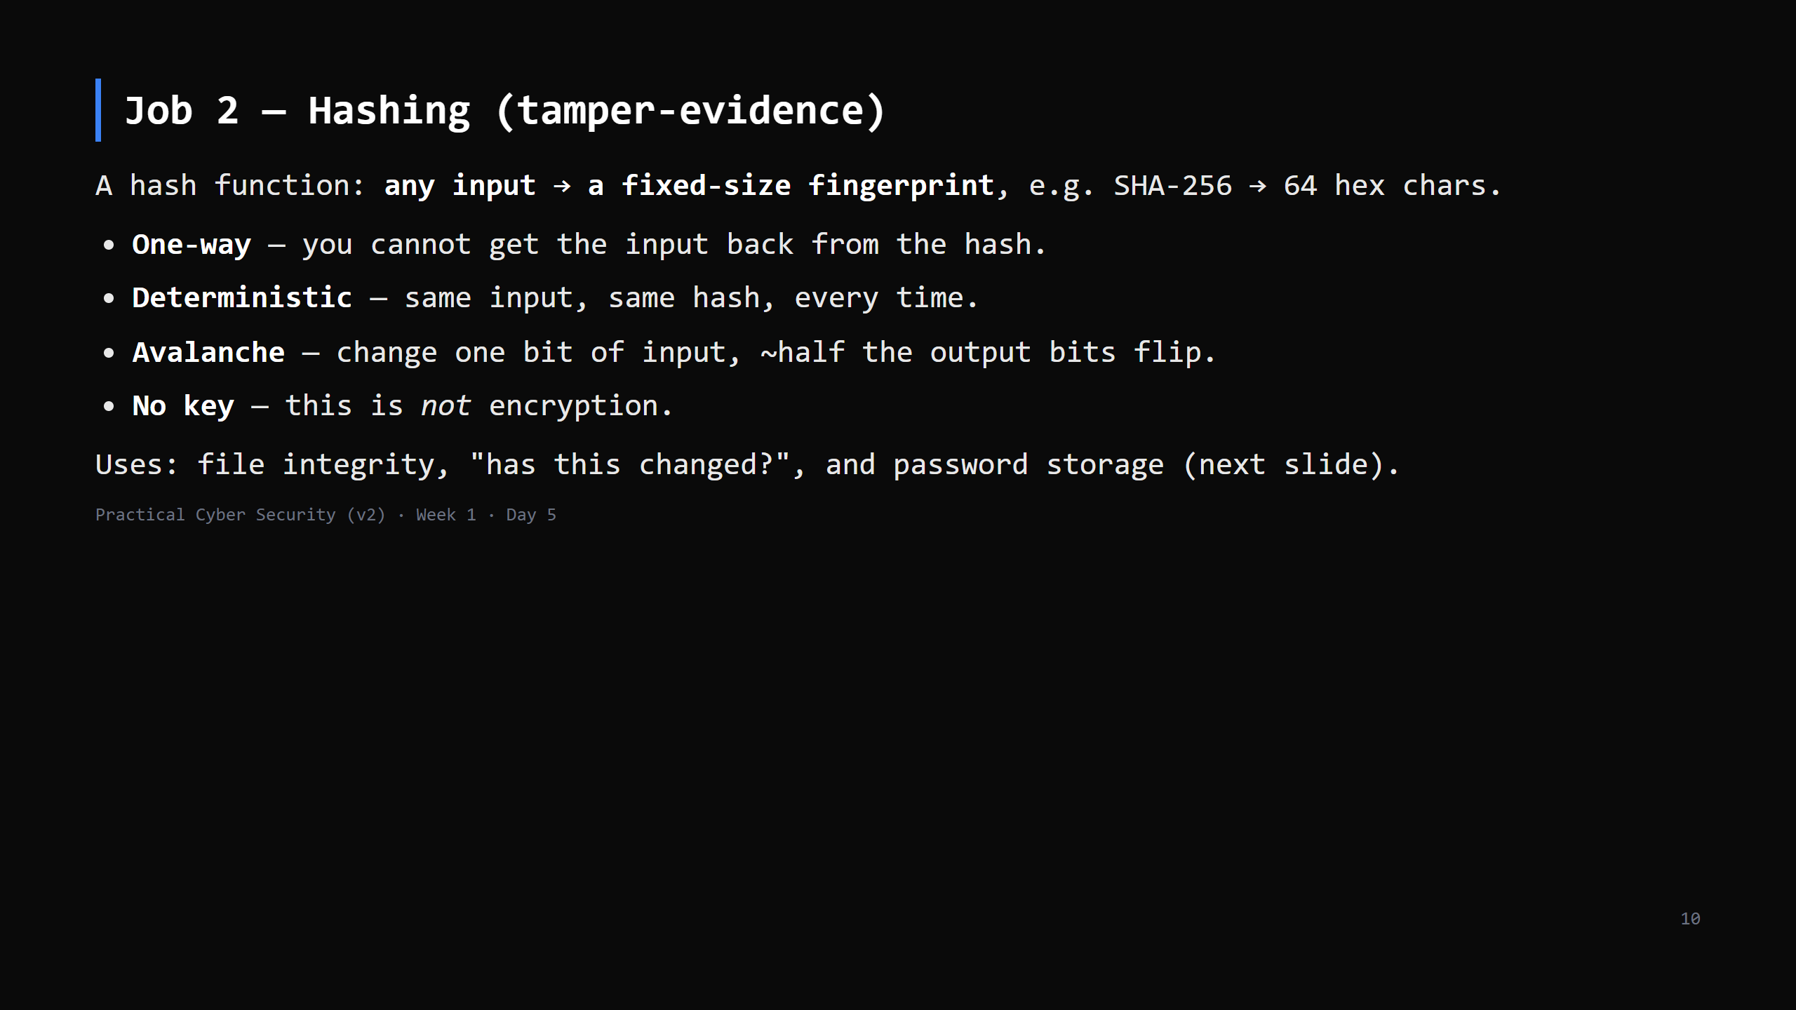
Notes:
The "no key, can't reverse" point is the one students miss. Encryption is a locked box you can
open with the key. A hash is a paper shredder — deterministic, but there's no un-shredder.
SHA-256 good; MD5 and SHA-1 are broken (collisions) — name them as "don't use".

Slide 11
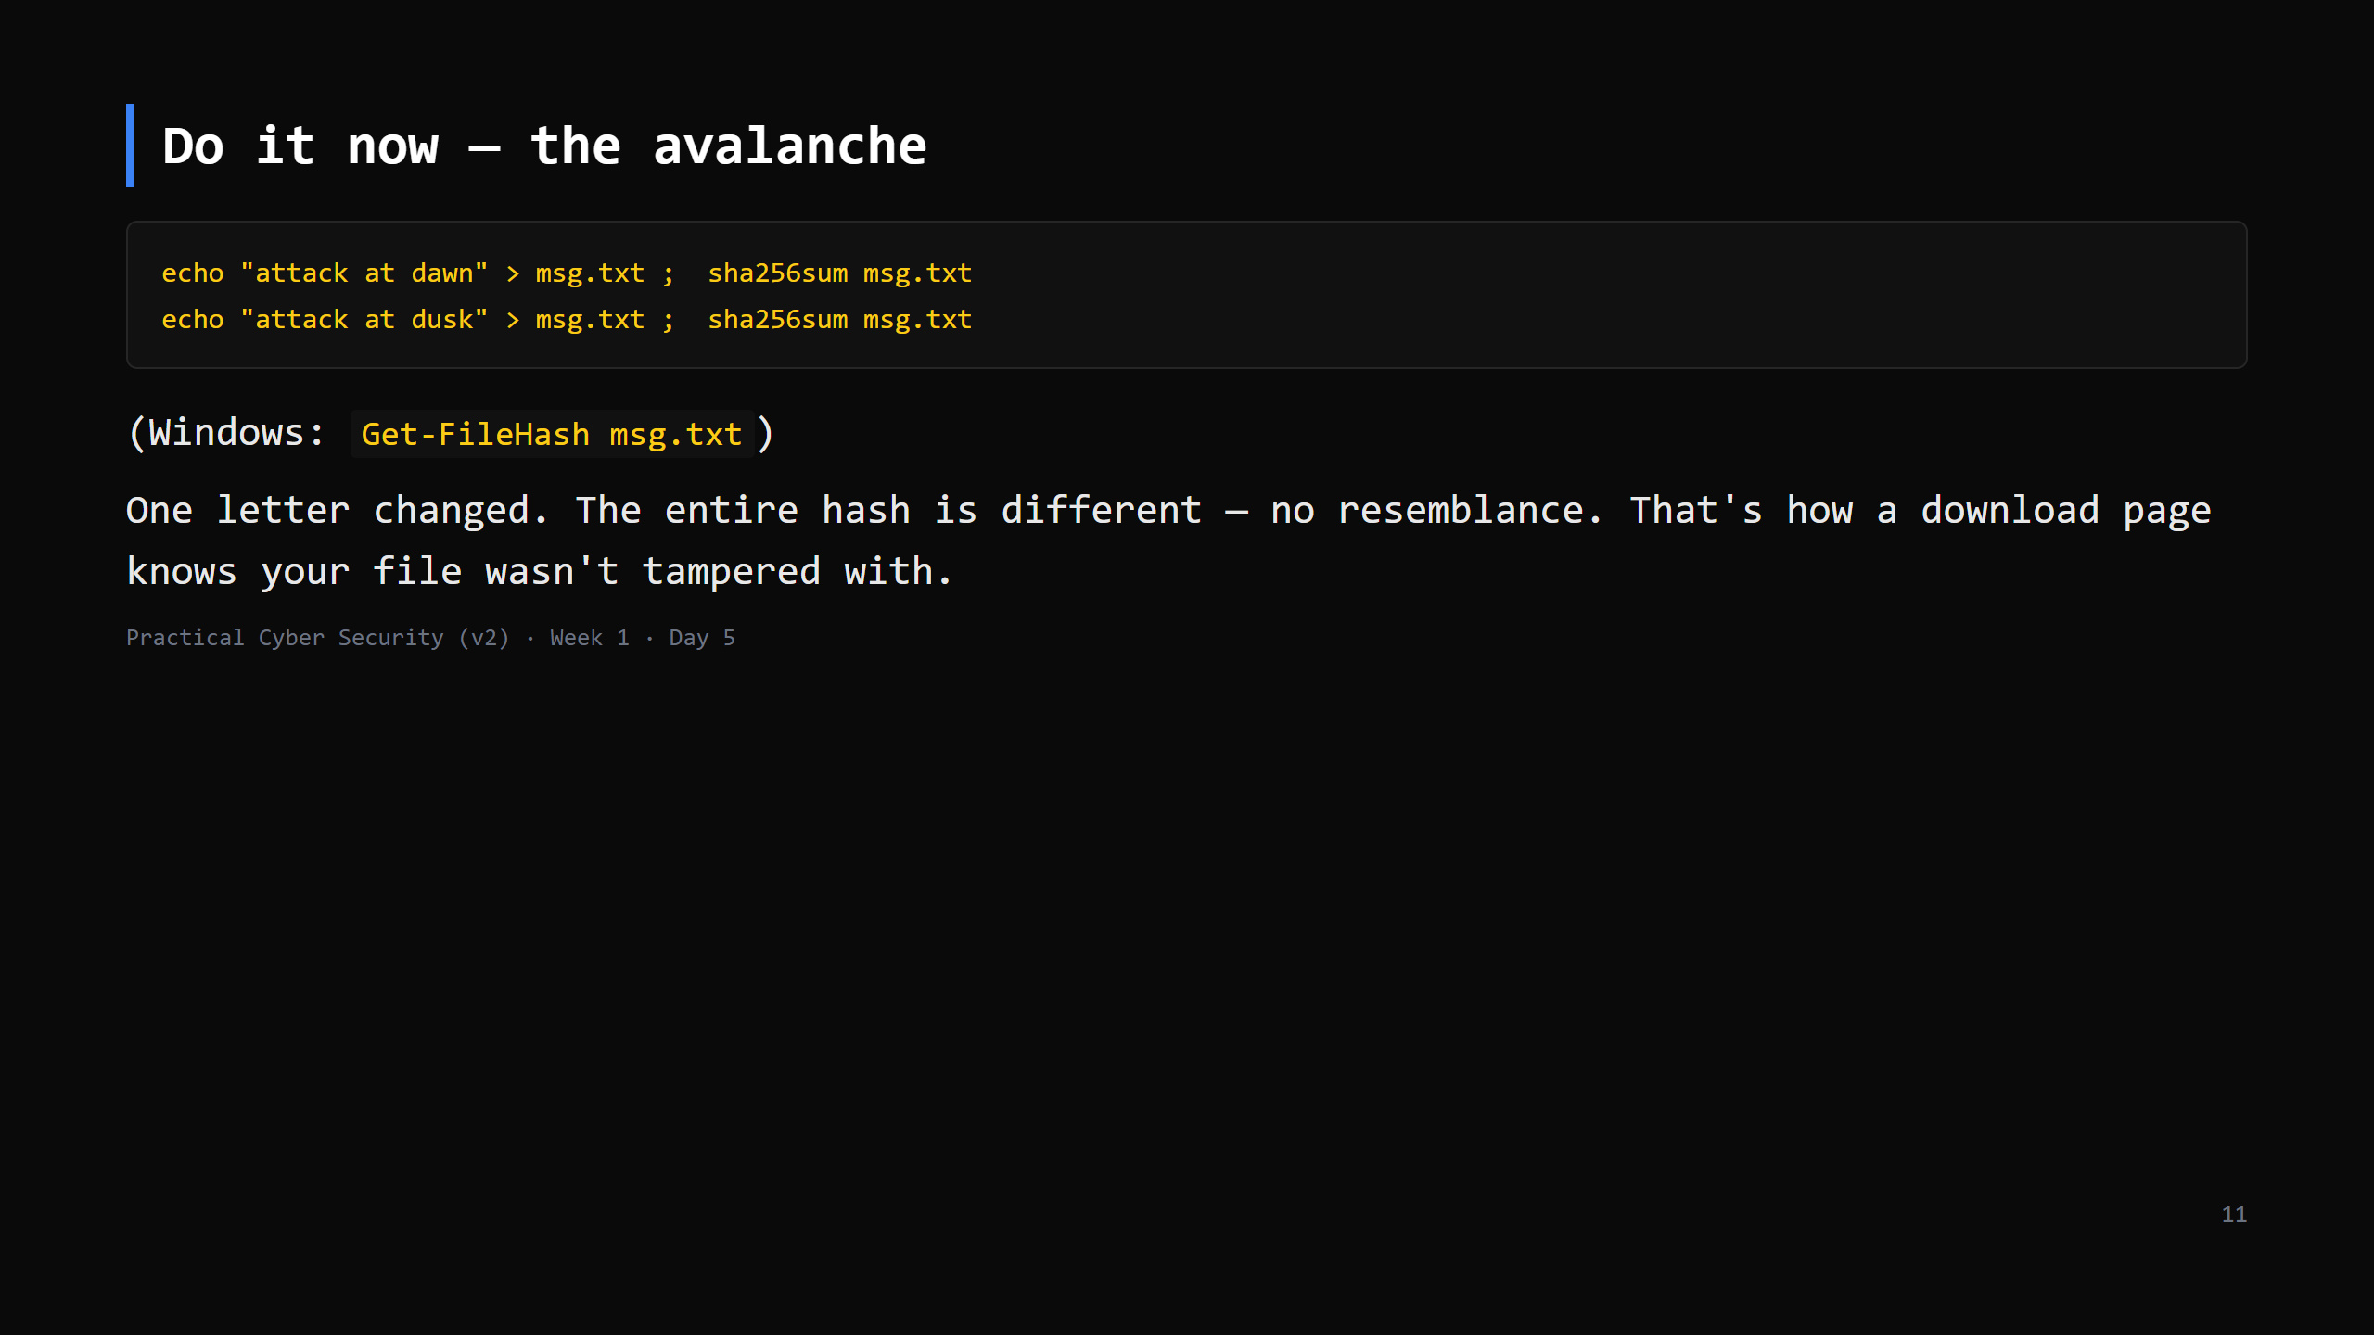
Notes:
2-3 min. Point at the two hashes side by side: not "a bit different" — completely different.
This is why a hash is a good tamper detector.

Slide 12
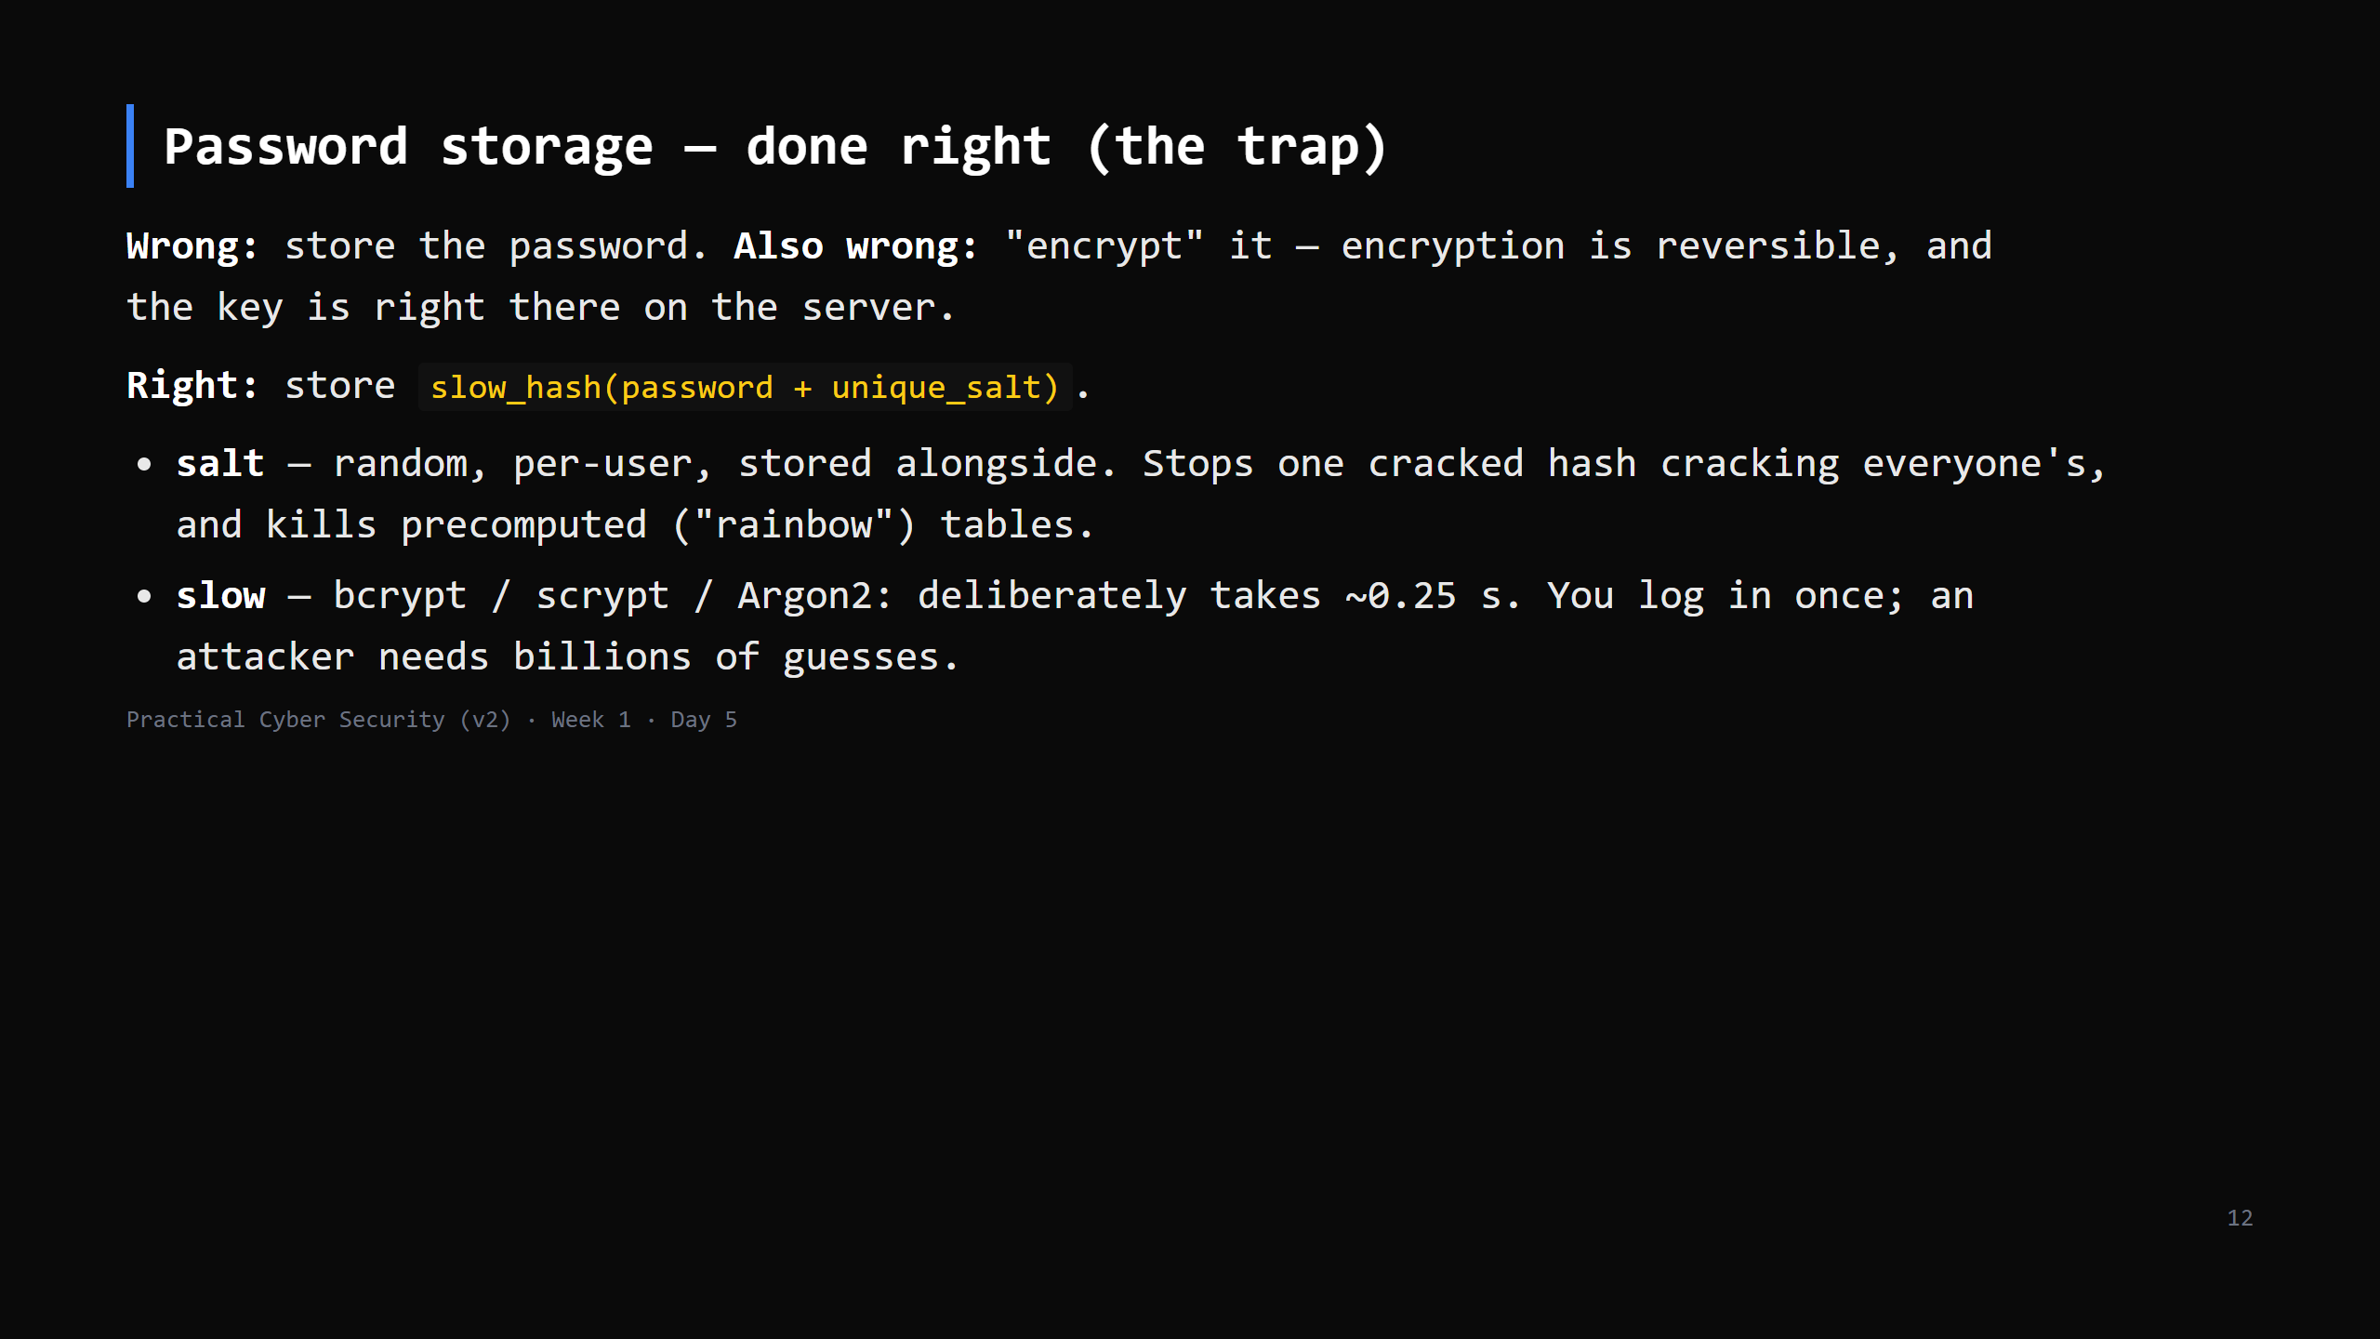
Notes:
THE DAY 5 TRAP: "we encrypt the passwords." No — you HASH them, salted and slow. If you can
email a user their forgotten password, you're doing it wrong.
Fast hash (MD5/SHA-256 alone) of a password = crackable at billions/sec on a GPU. Slow hash
= thousands/sec. That factor is the whole game.

Slide 13
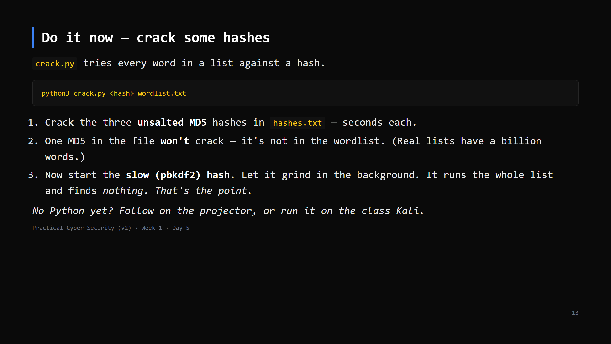
Notes:
10 min. hashes.txt: MD5 of "password"/"iloveyou"/"qwerty123" (all in wordlist.txt), one MD5
NOT in the list, and one pbkdf2 (salted, 600k iters) that also isn't crackable here.
Start the pbkdf2 run, then talk over it for ~2 min; it ends with "not found".
crack.py is pure stdlib -- works anywhere Python 3 is installed (proper Python setup is Day 9).
Real tools (hashcat / john + rockyou) are on the class Kali for the keen -- don't teach flags today.

Slide 14
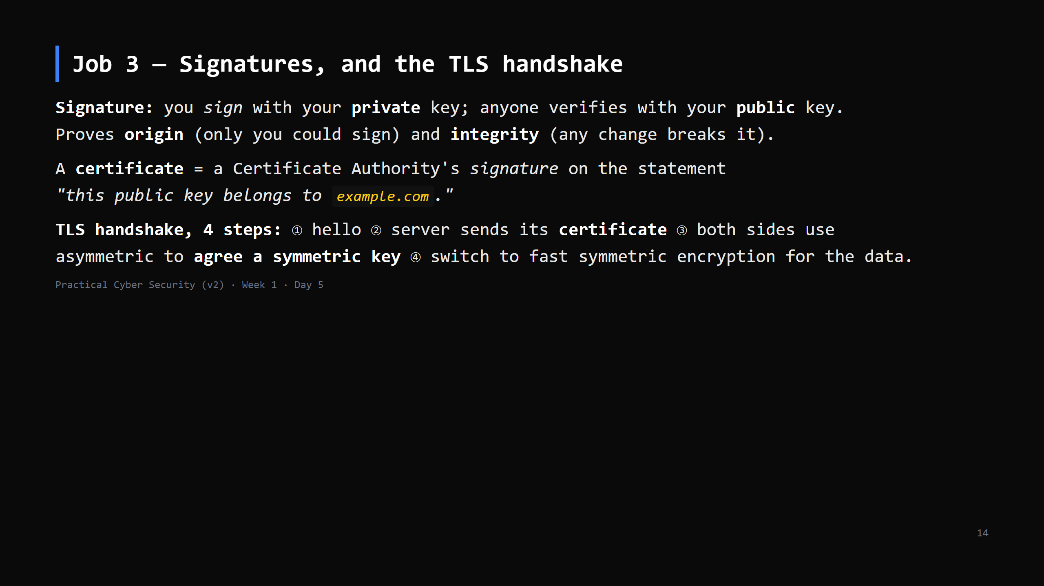
Notes:
This ties the whole day together: asymmetric (step 3) + certificate/signature (step 2) +
symmetric (step 4) + and TLS also hashes each record for integrity. All three jobs, one protocol.

Slide 15
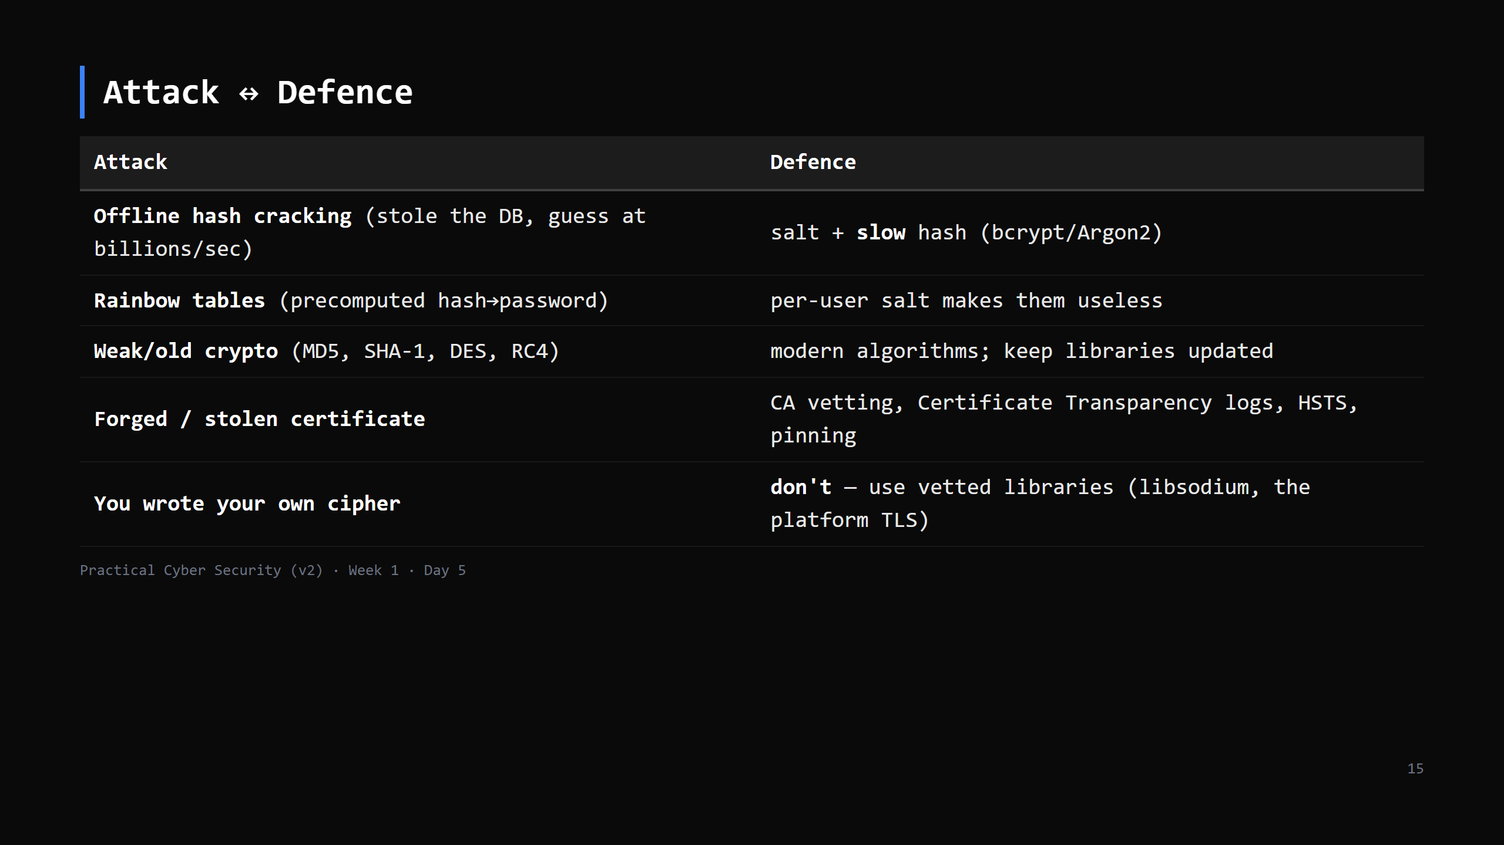
Notes:
"Don't roll your own crypto": every home-made cipher in history has been broken, usually fast.
The algorithms are public and battle-tested; the danger is in implementation. Use the library.

Slide 16
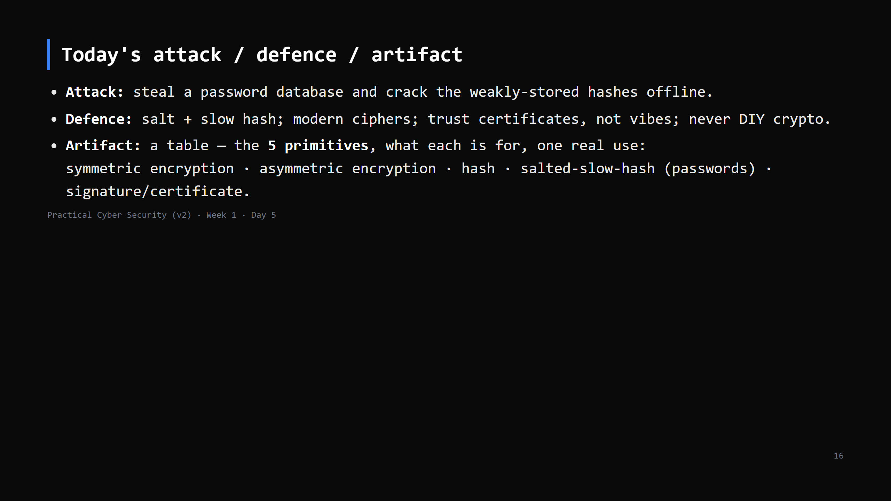
Notes:
Three lines into the repo. The 5-primitives table is the keeper.

Slide 17
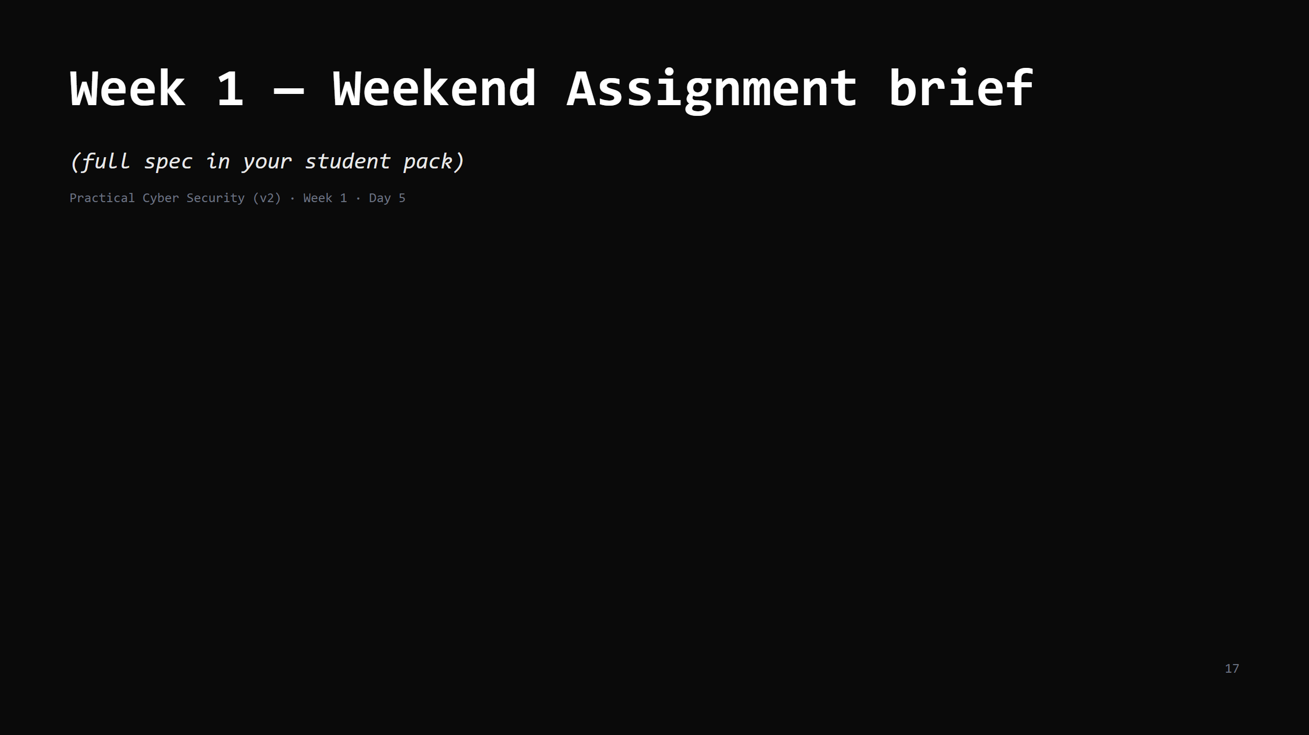

Slide 18
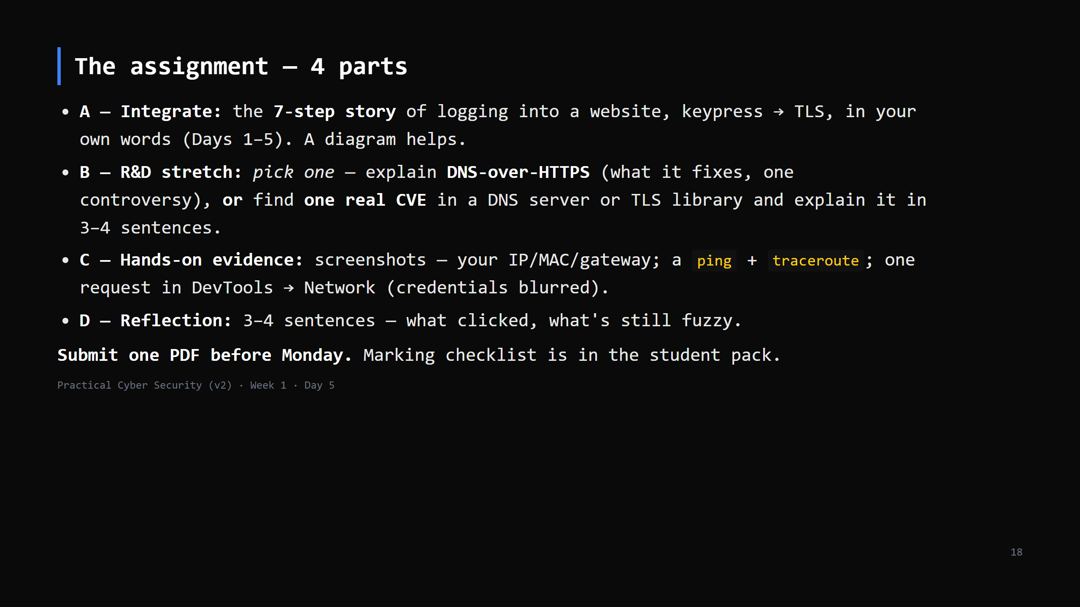
Notes:
Walk each part for ~3 min. Part A = tonight's homework, expanded. Part B is where strong
students stretch. Emphasise: your own words, blur credentials, one PDF.
Take questions. Then dismiss with the recap.

Slide 19
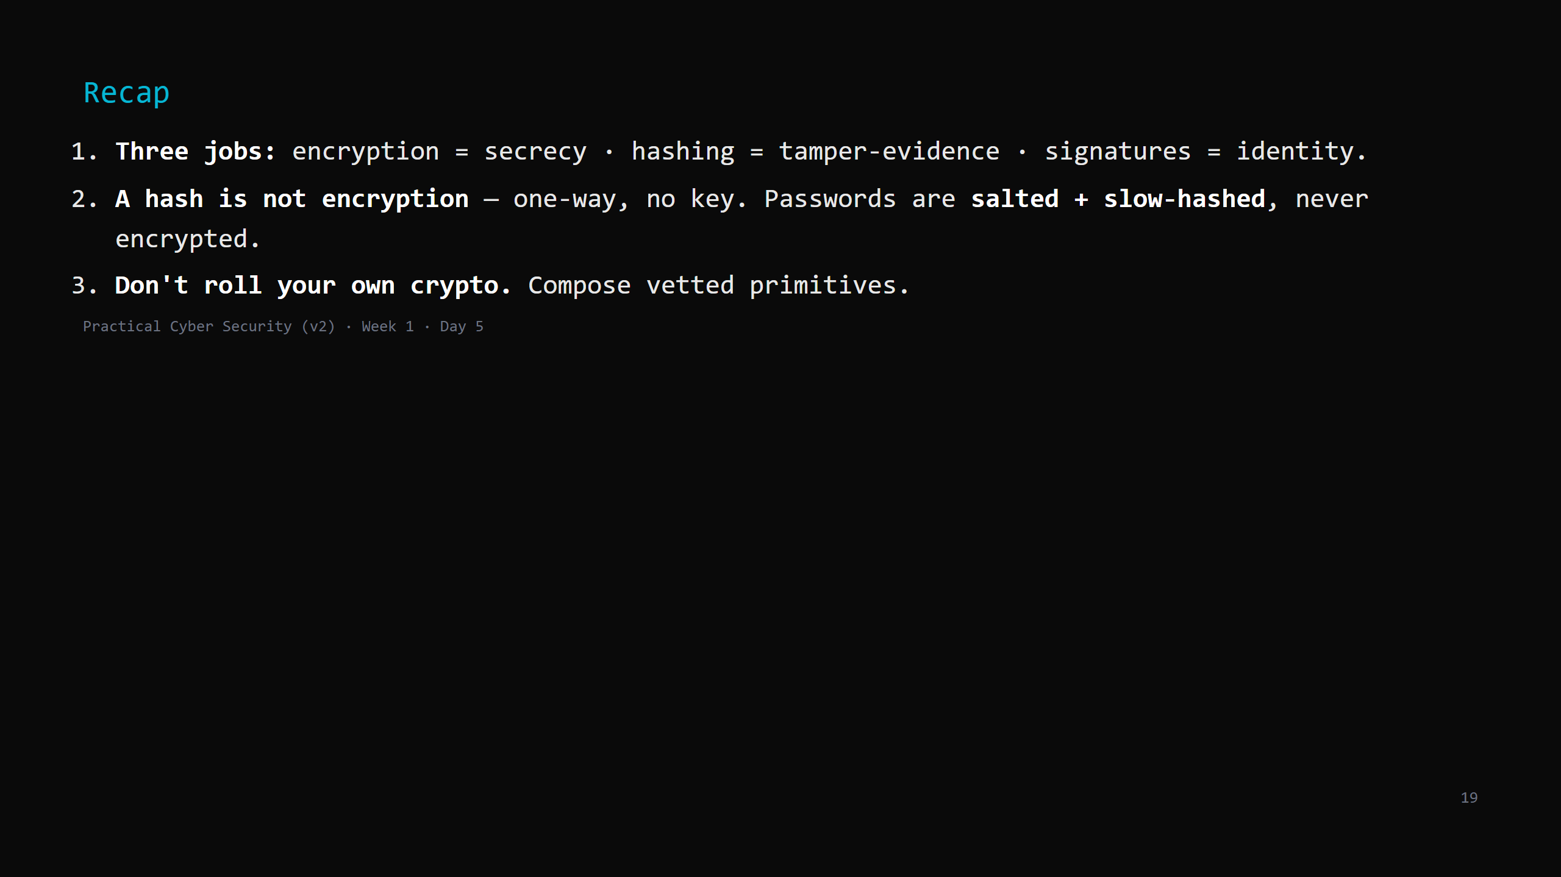
Notes:
Say the three lines. Monday: Week 2 opens the operating system — the layer that decides
"who can do what" on a machine.

