Slide 1
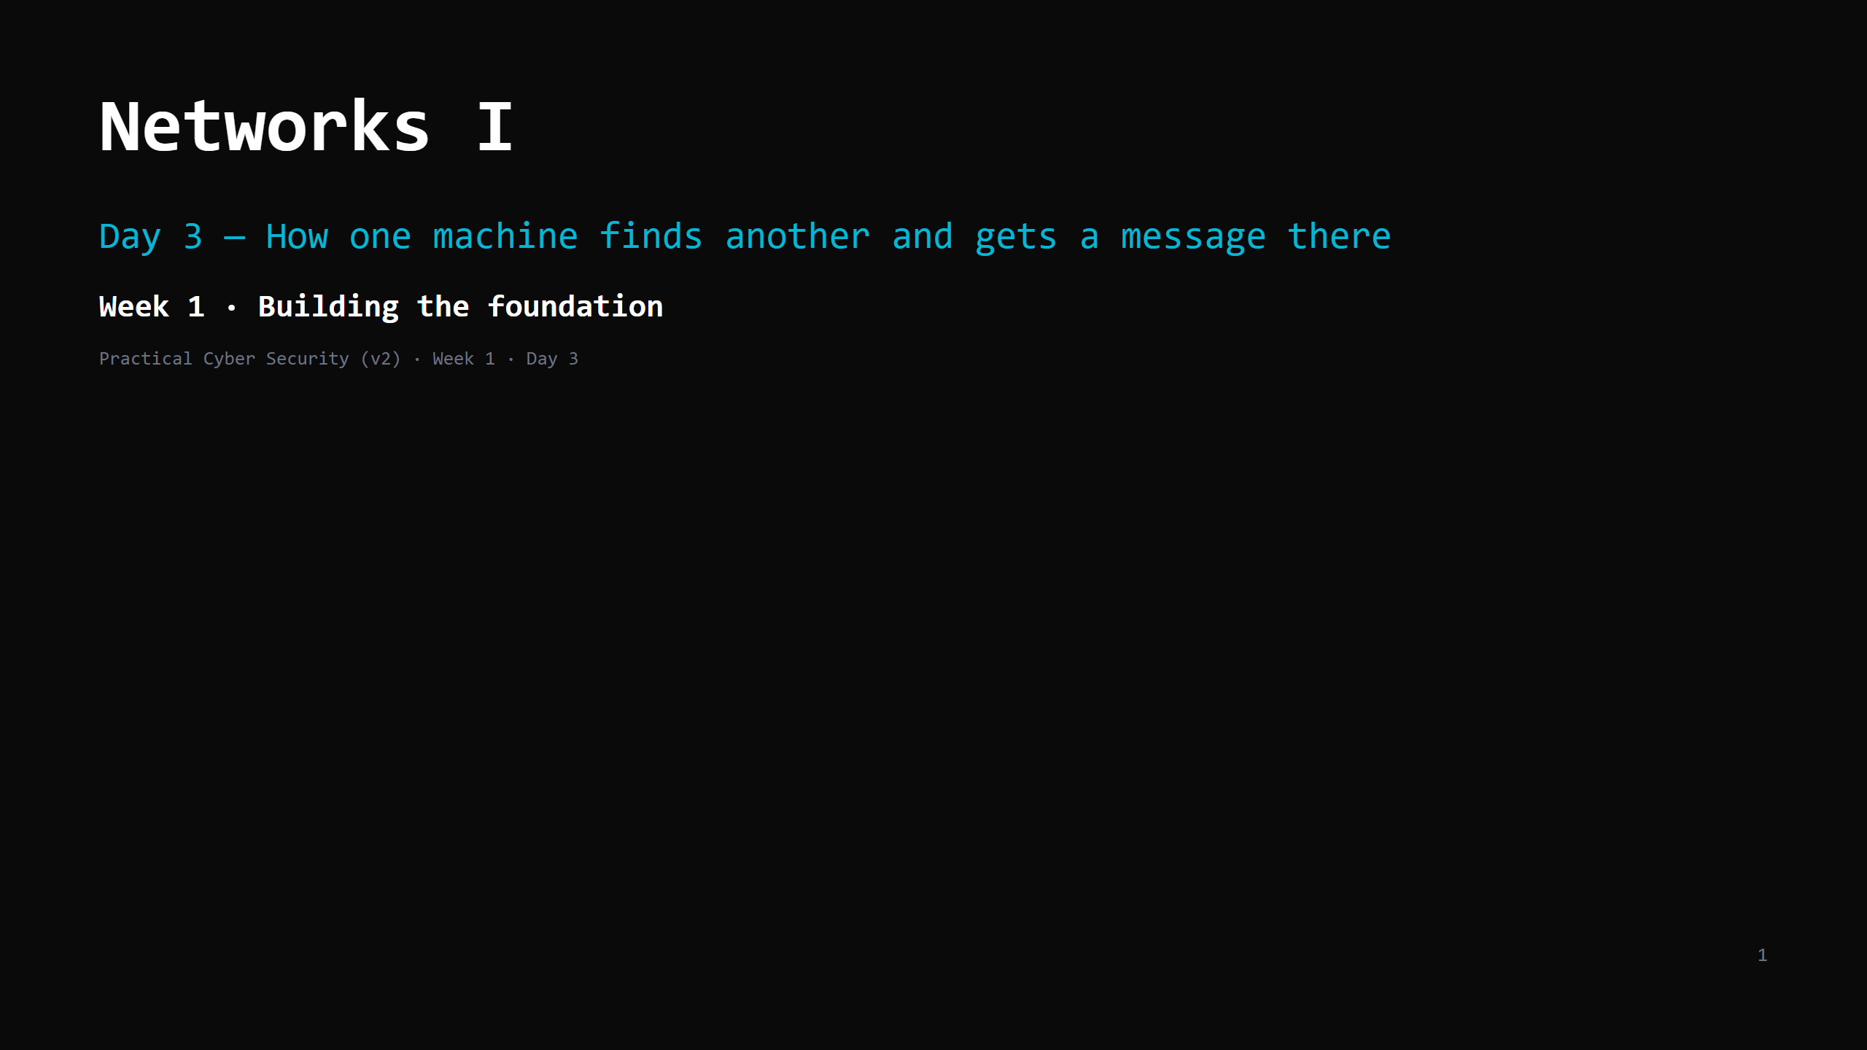
Notes:
RUN SHEET (~90 min). Hands-on is INTERLEAVED — four short "do it now" beats, ~15 min total. 00:00 Journey check + traceroute hook (projector) 5 00:05 The problem (the roadmap) 2 00:07 IP — the street address 6 00:13 DO: find your IP + gateway 5 00:18 Private vs public IP 3 00:21 NAT — one public address for the house 7 00:28 MAC — the local label 6 00:34 DO: find your MAC 3 00:37 Ports + client/server 8 00:45 DO: what's listening on your machine 6 00:51 A packet, put together 4 00:55 The 4-layer model 4 00:59 The journey + DO: ping/traceroute 9 01:08 Attack <-> defence (ARP spoof, scanning, sniffing) 8 01:16 Wrap + homework 6 CUT FIRST IF SHORT: 4-layer slide -> one sentence; ARP-spoof detail (keep the name); the ping "do it now". NEVER CUT: the three addresses (IP/MAC/port), NAT, at least two "do it now" beats. ONE ANALOGY (sanctioned extension of the kitchen): the POSTAL / DELIVERY system — the kitchen now orders supplies and ships out orders. Parcel=packet, street address=IP, next-leg label=MAC, department name=port, sorting office=router, front desk=NAT. Phone calls arrive tomorrow (TCP).

Slide 2
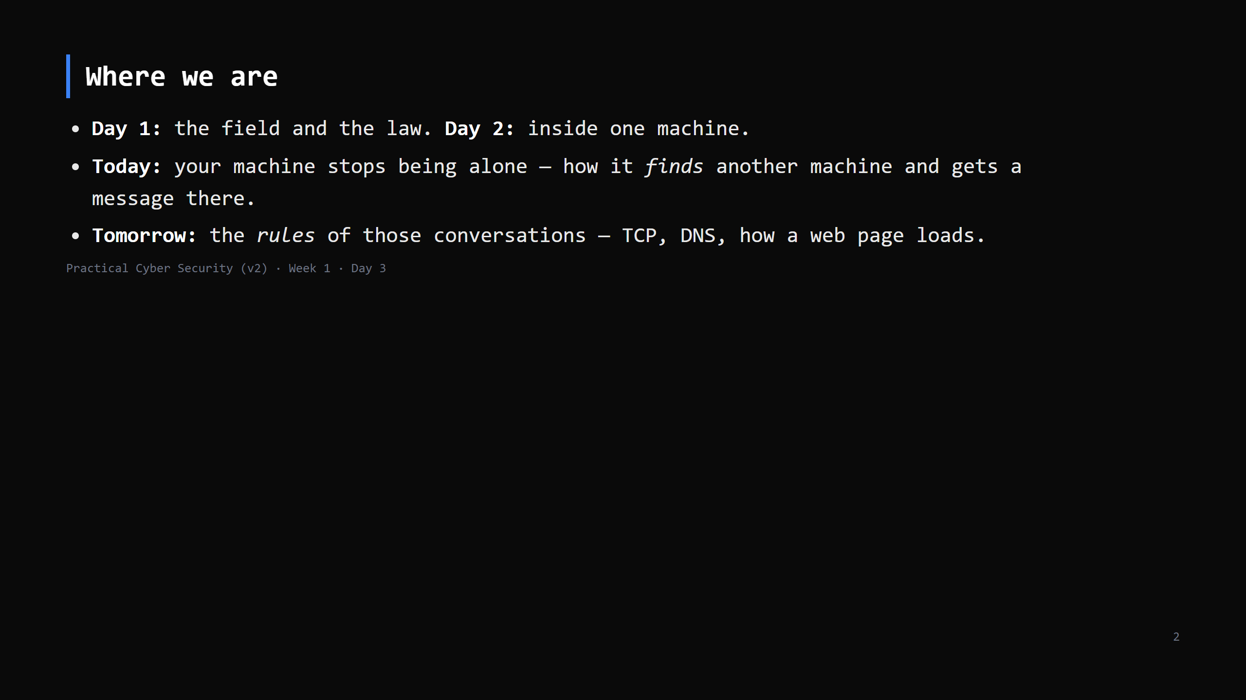
Notes:
Learning Journey Check — one line each. Yesterday / Today / Tomorrow.

Slide 3
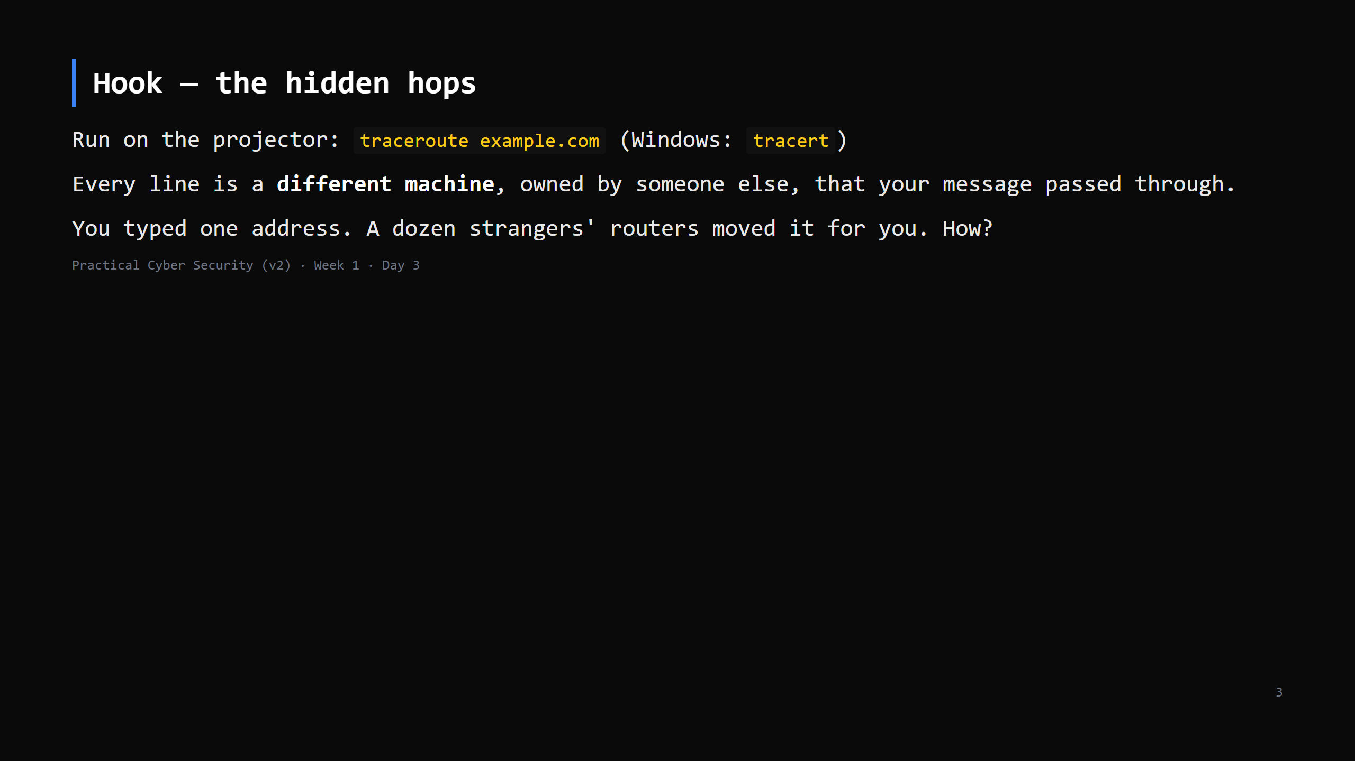
Notes:
Let the output scroll. Point at 3-4 hops. "You don't own any of these. They forwarded your packet because that's the deal that makes the internet work." Some hops show * * * — "that one chose not to answer; the packet still went through." Don't explain traceroute's mechanism yet (it's a Day 4 TTL thing) — just "these are real machines in the path."

Slide 4
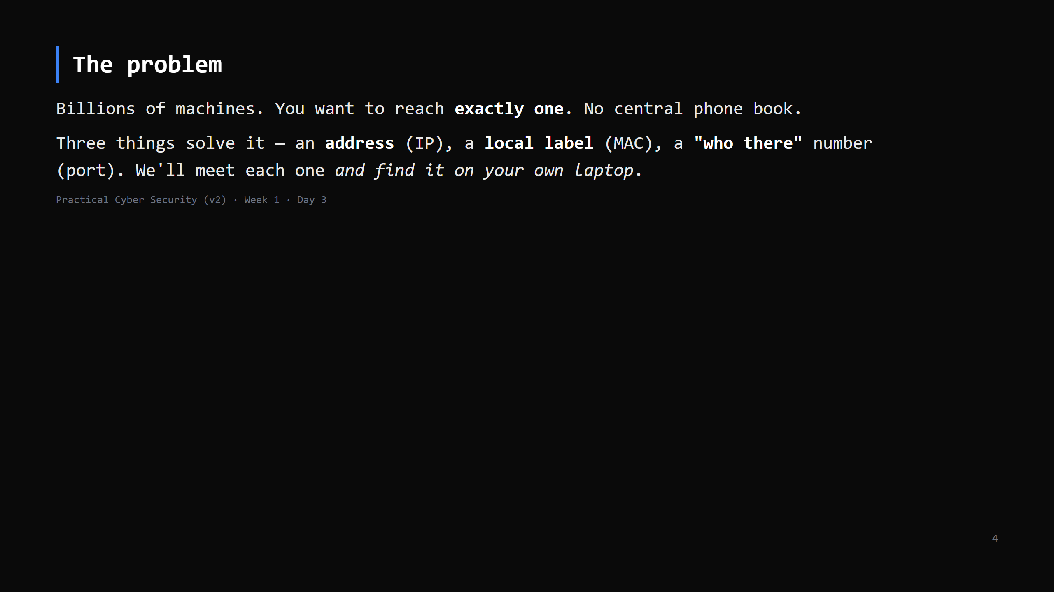
Notes:
Keep this to ~2 min. It's the roadmap for the next section. Then straight into IP.

Slide 5
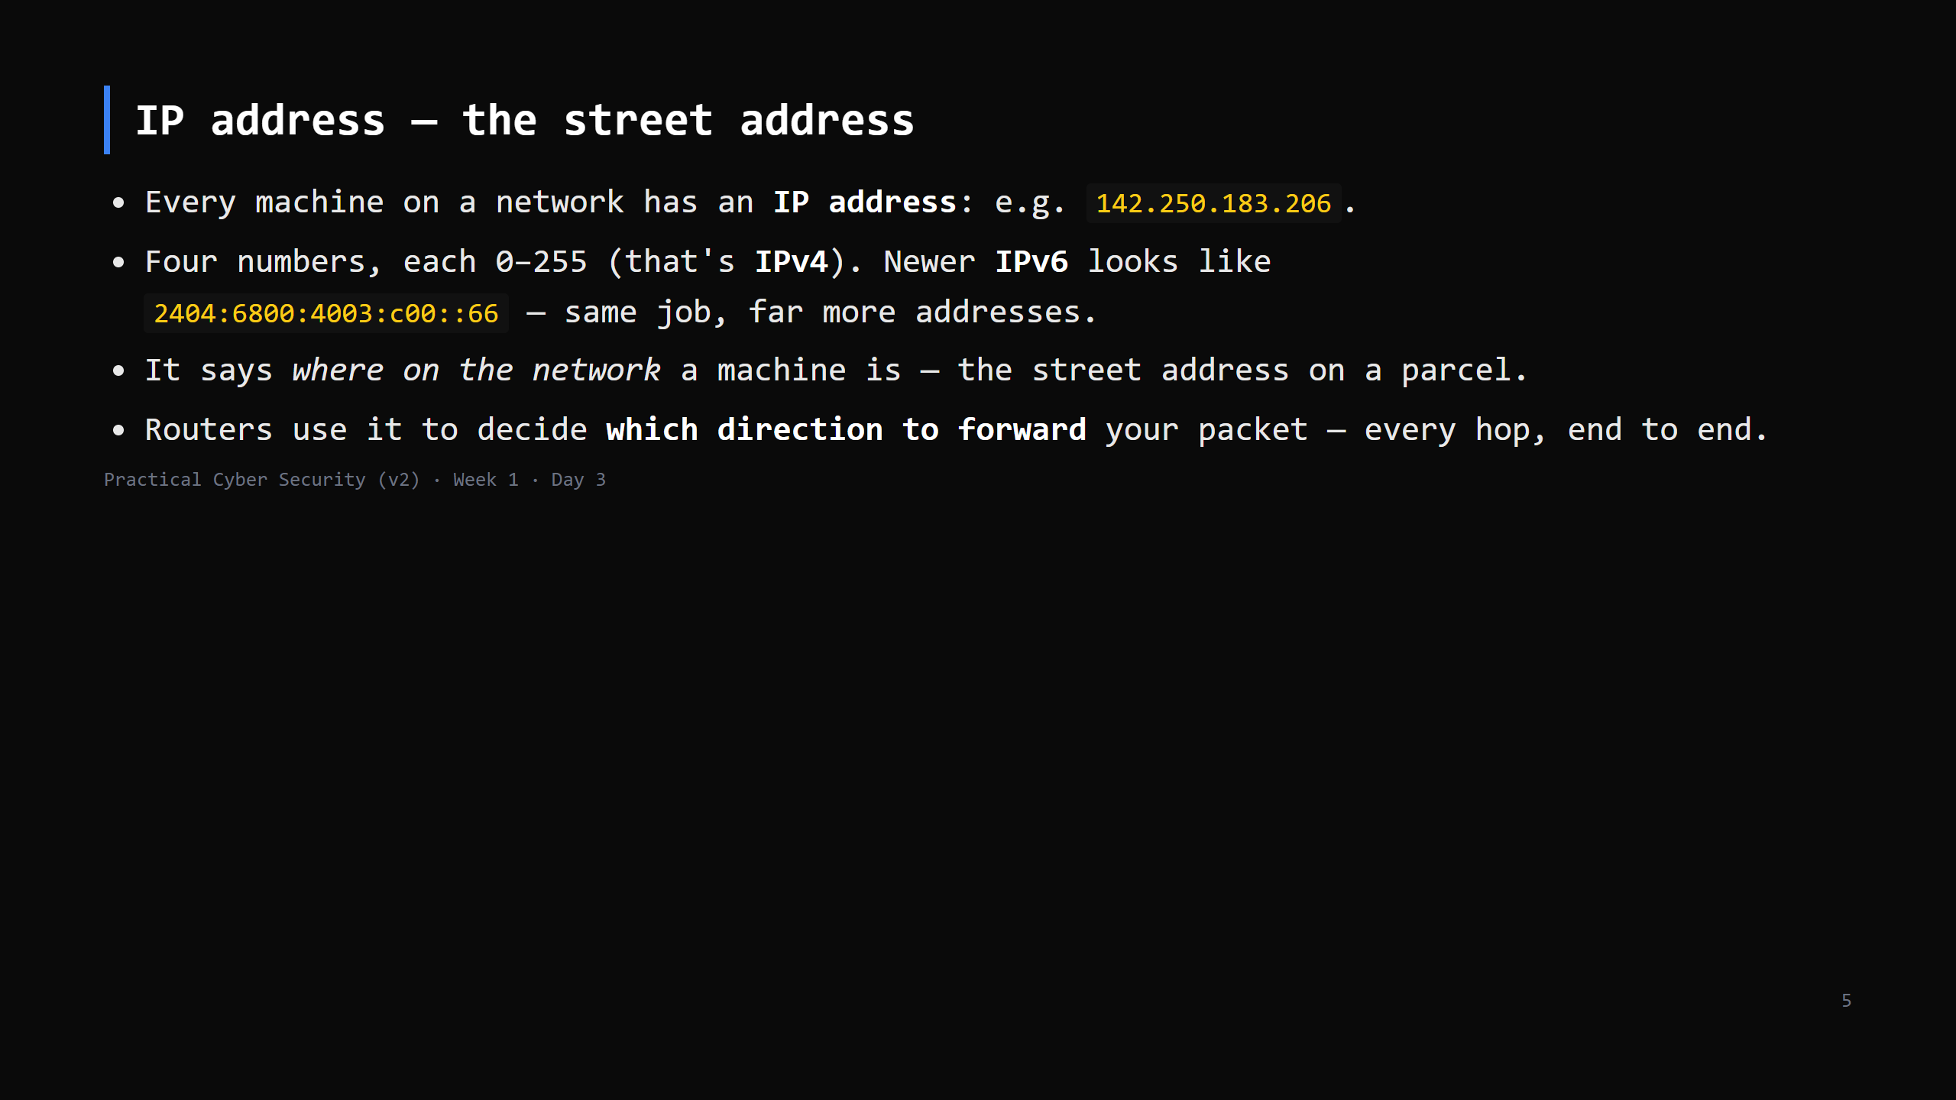
Notes:
No subnetting, no binary today. The model: "IP = where you are, used for routing, unchanged the whole journey." IPv6 = one sentence, don't let them panic at the long ones.

Slide 6
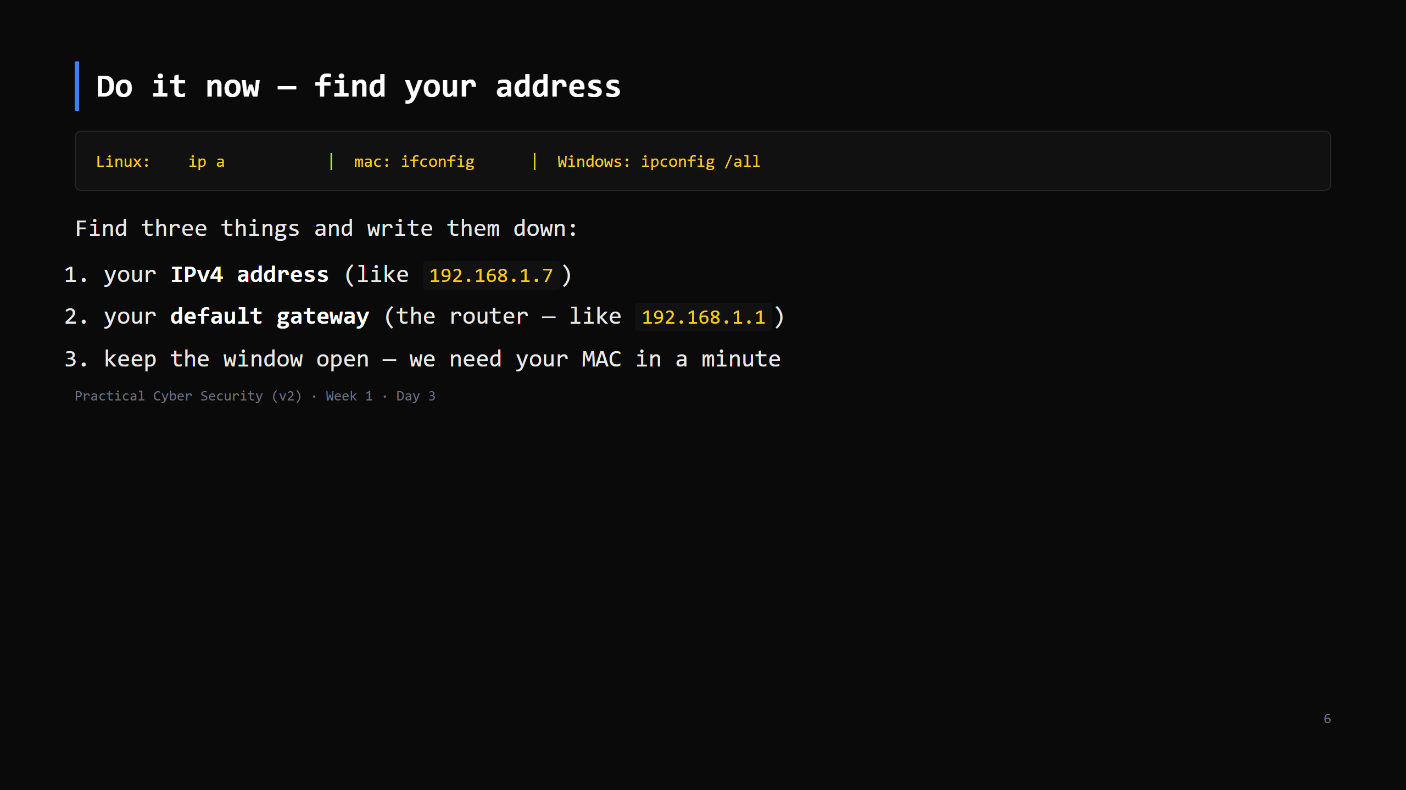
Notes:
90 seconds. Walk the room. Almost everyone: 192.168.x.x or 10.x.x.x, gateway usually .1 or .254. Ask two students to call theirs out — note they're similar/identical. That's the next slide.

Slide 7
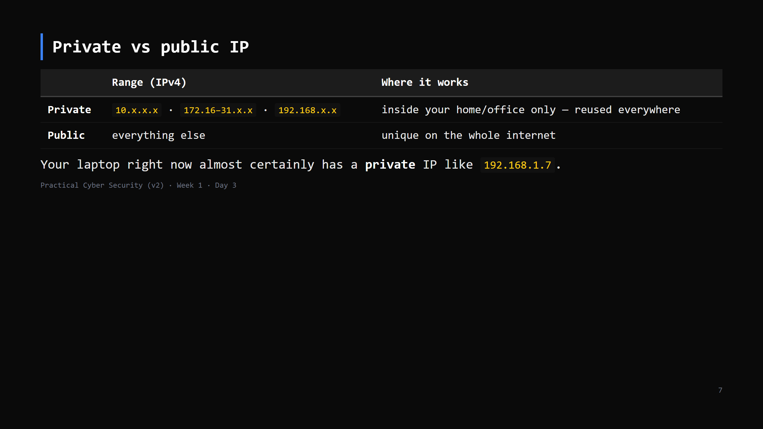
Notes:
Analogy: private IP = "flat 3, second floor" — meaningless without the building. Millions of homes have a 192.168.1.7. Public IP = the building's actual street address, unique globally. This sets up NAT on the next slide.

Slide 8
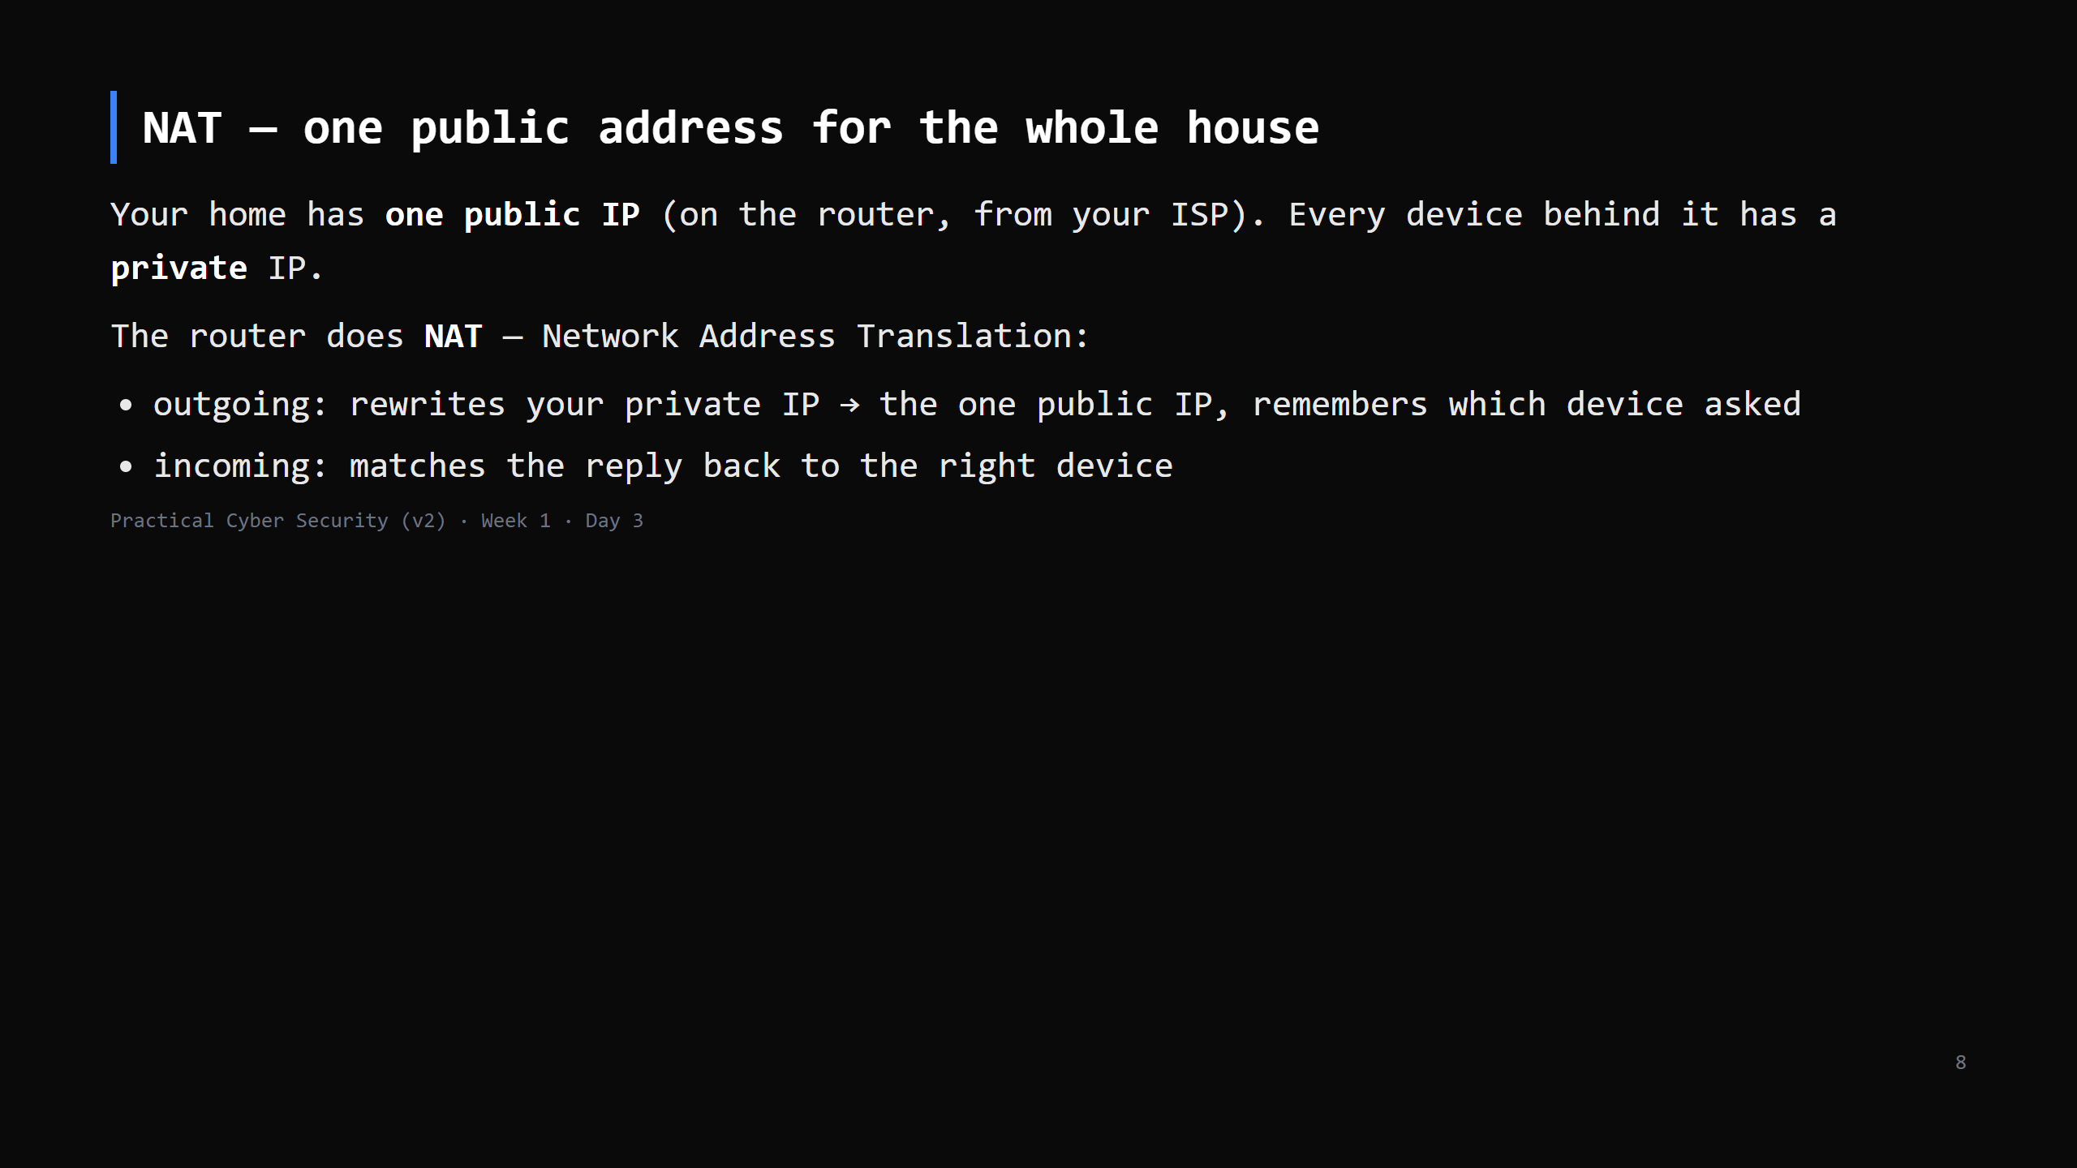
Notes:
This is why whatsmyip.com shows a different address than `ipconfig` — the site sees the router's public IP; ipconfig shows your laptop's private one. THAT is the Day 3 "trap" — call it out explicitly, it's the homework question. Analogy: the whole household sends mail via one front-desk address; the front desk (router) keeps a log so replies get to the right person. Security note for later: NAT accidentally hides internal devices — not a firewall, but it means the internet can't directly address your laptop.

Slide 9
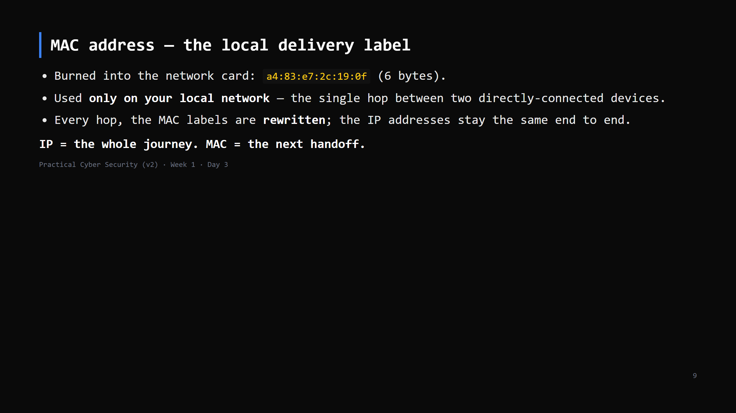
Notes:
Analogy: the parcel's street address (IP) never changes. At each sorting office they slap on a new "put on truck 7 / hand to postie Ravi" label (MAC) for the next leg. ARP = how a device learns "which MAC has IP 192.168.1.1" — one line now, matters at the attack slide. MISCONCEPTION: "my MAC identifies me on the internet." No — stripped at the first hop. Websites never see it.

Slide 10
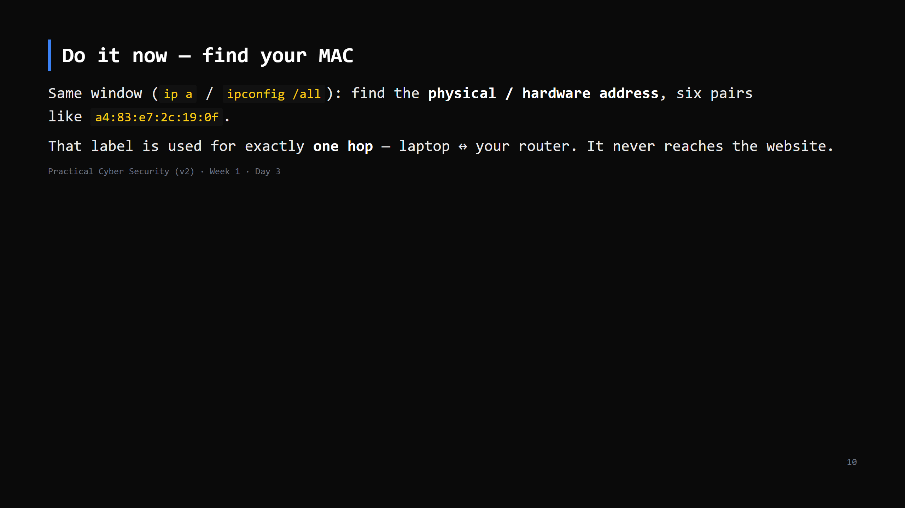
Notes:
30 seconds. On `ip a` it's the "link/ether" line. Windows: "Physical Address". Point out the first half identifies the maker (Intel/Apple/etc.) — the OUI.

Slide 11
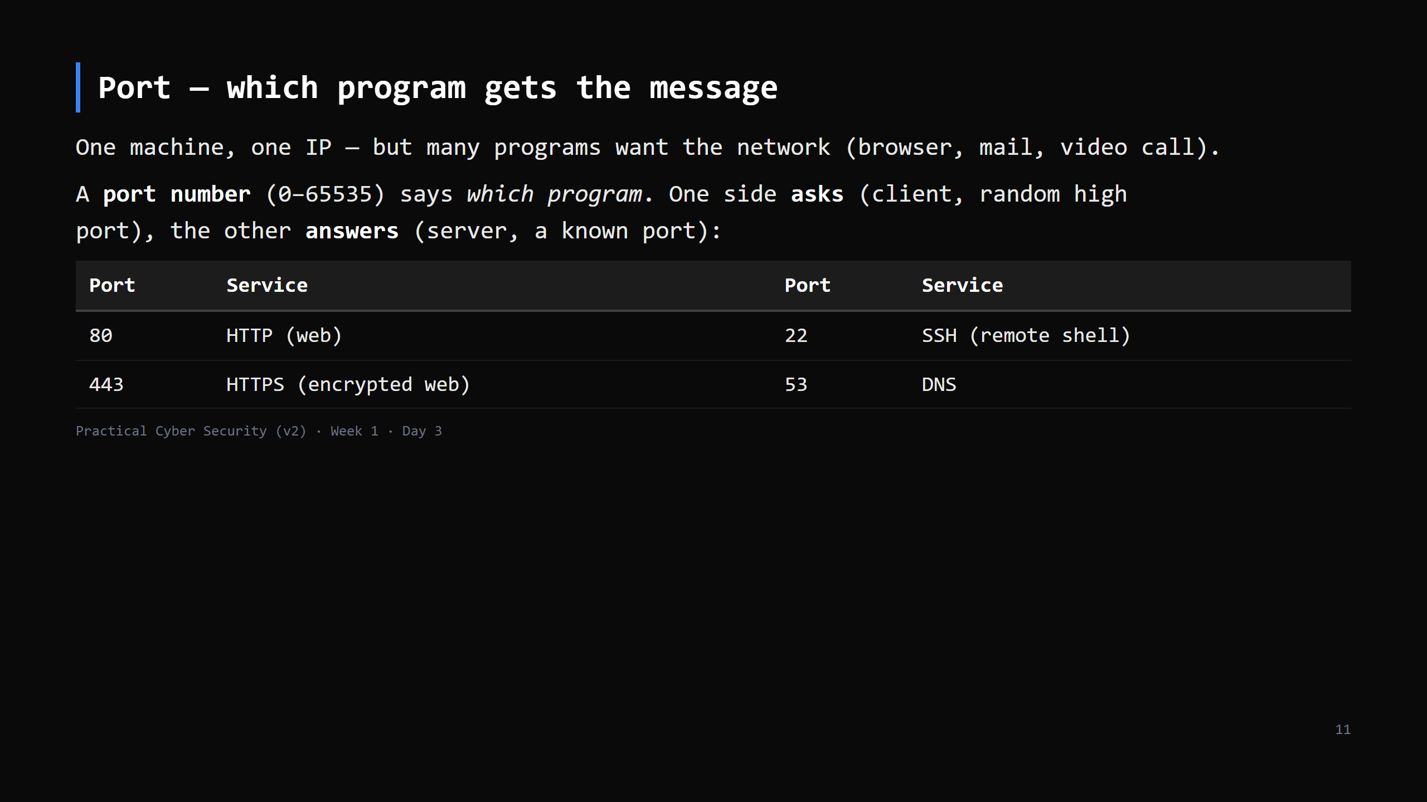
Notes:
Analogy: IP gets the parcel to the building; the port is the department name on it. CLIENT/SERVER (a must-land): the client opens the conversation and picks a random source port so it can match the reply; the server sits listening on a fixed, known port. "Listening on a port" = a process (Day 2! it has a PID) told the OS "give me anything arriving for port 80."

Slide 12
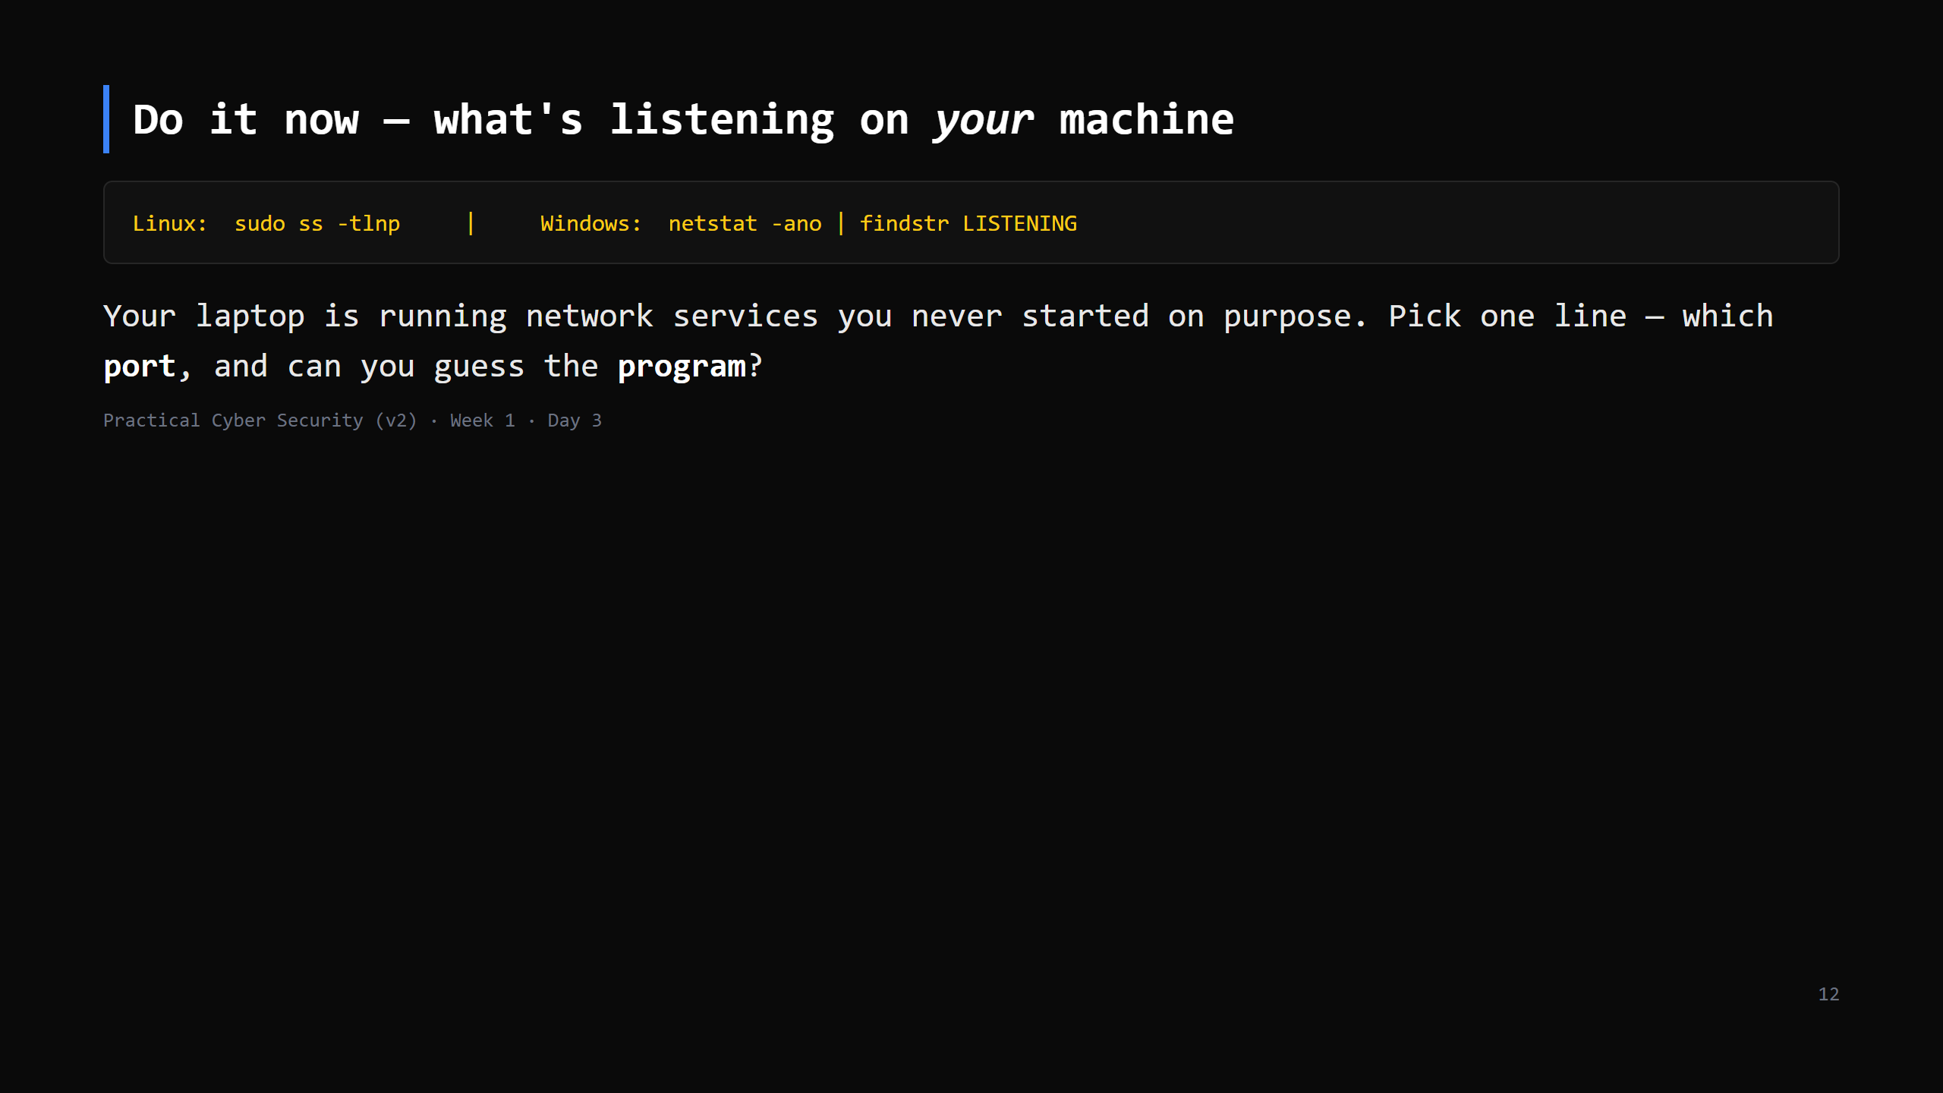
Notes:
2-3 min incl. discussion. Common: :53 (DNS stub), :631 (printing/CUPS), sometimes :22, :5353 (mDNS). Windows shows lots — map a PID to a name via Task Manager. The point: every open port is a door. Attackers scan for exactly these (forward-ref Day 13). Needs sudo/admin for the program-name column.

Slide 13
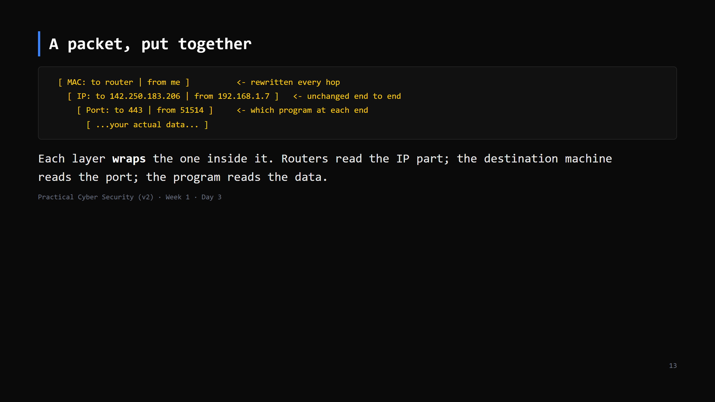
Notes:
This is the "envelopes inside envelopes" idea. Draw it as nested boxes on the board. The source port (51514) is a random high number your OS picks so it can match the reply. Don't say "encapsulation" unless asked — but that's the word.

Slide 14
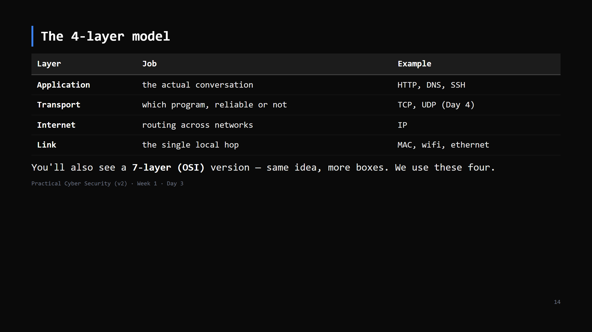
Notes:
Per the course standard: teach the 4-layer model, mention OSI-7 once, move on. Map it back to the packet slide: each row = one of the envelopes. CUT-TO-ONE-SENTENCE if short: "messages are built in layers — link, internet, transport, application — each wrapping the next; we'll meet transport tomorrow."

Slide 15
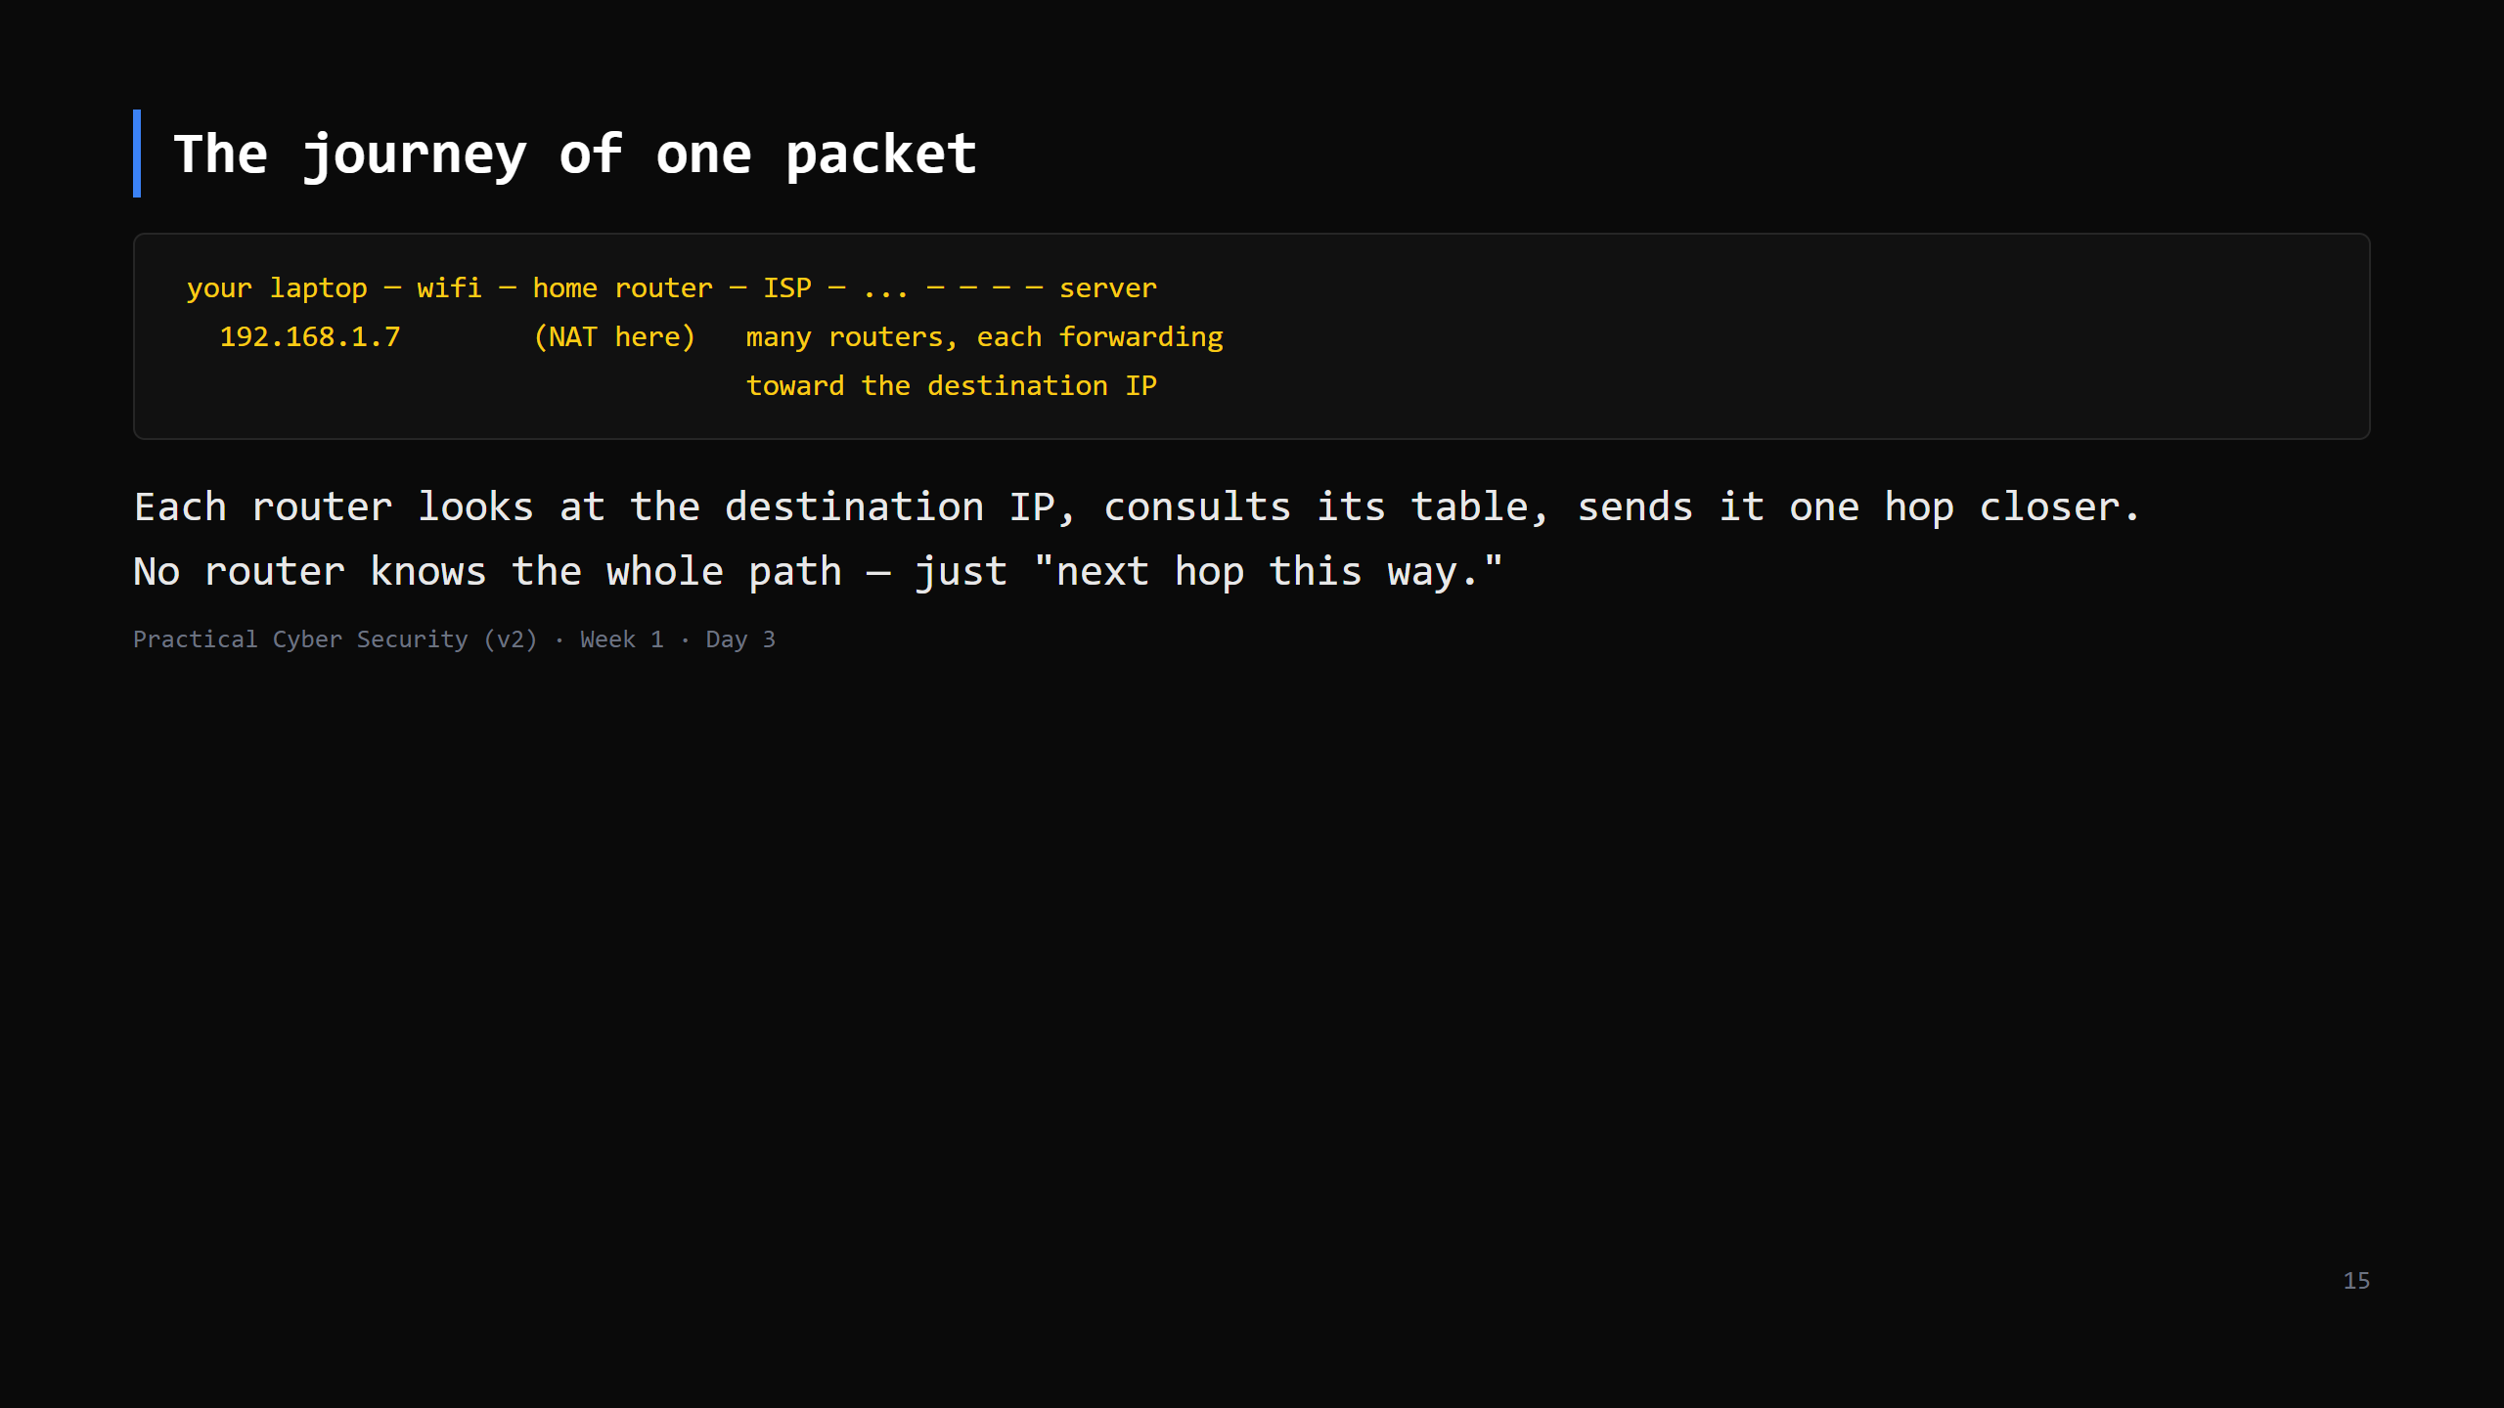
Notes:
Callback to the traceroute hook: every line you saw was one of those forwarding routers. "Hop by hop, best effort" — nobody guarantees delivery at this layer (that's TCP's job, Day 4).

Slide 16
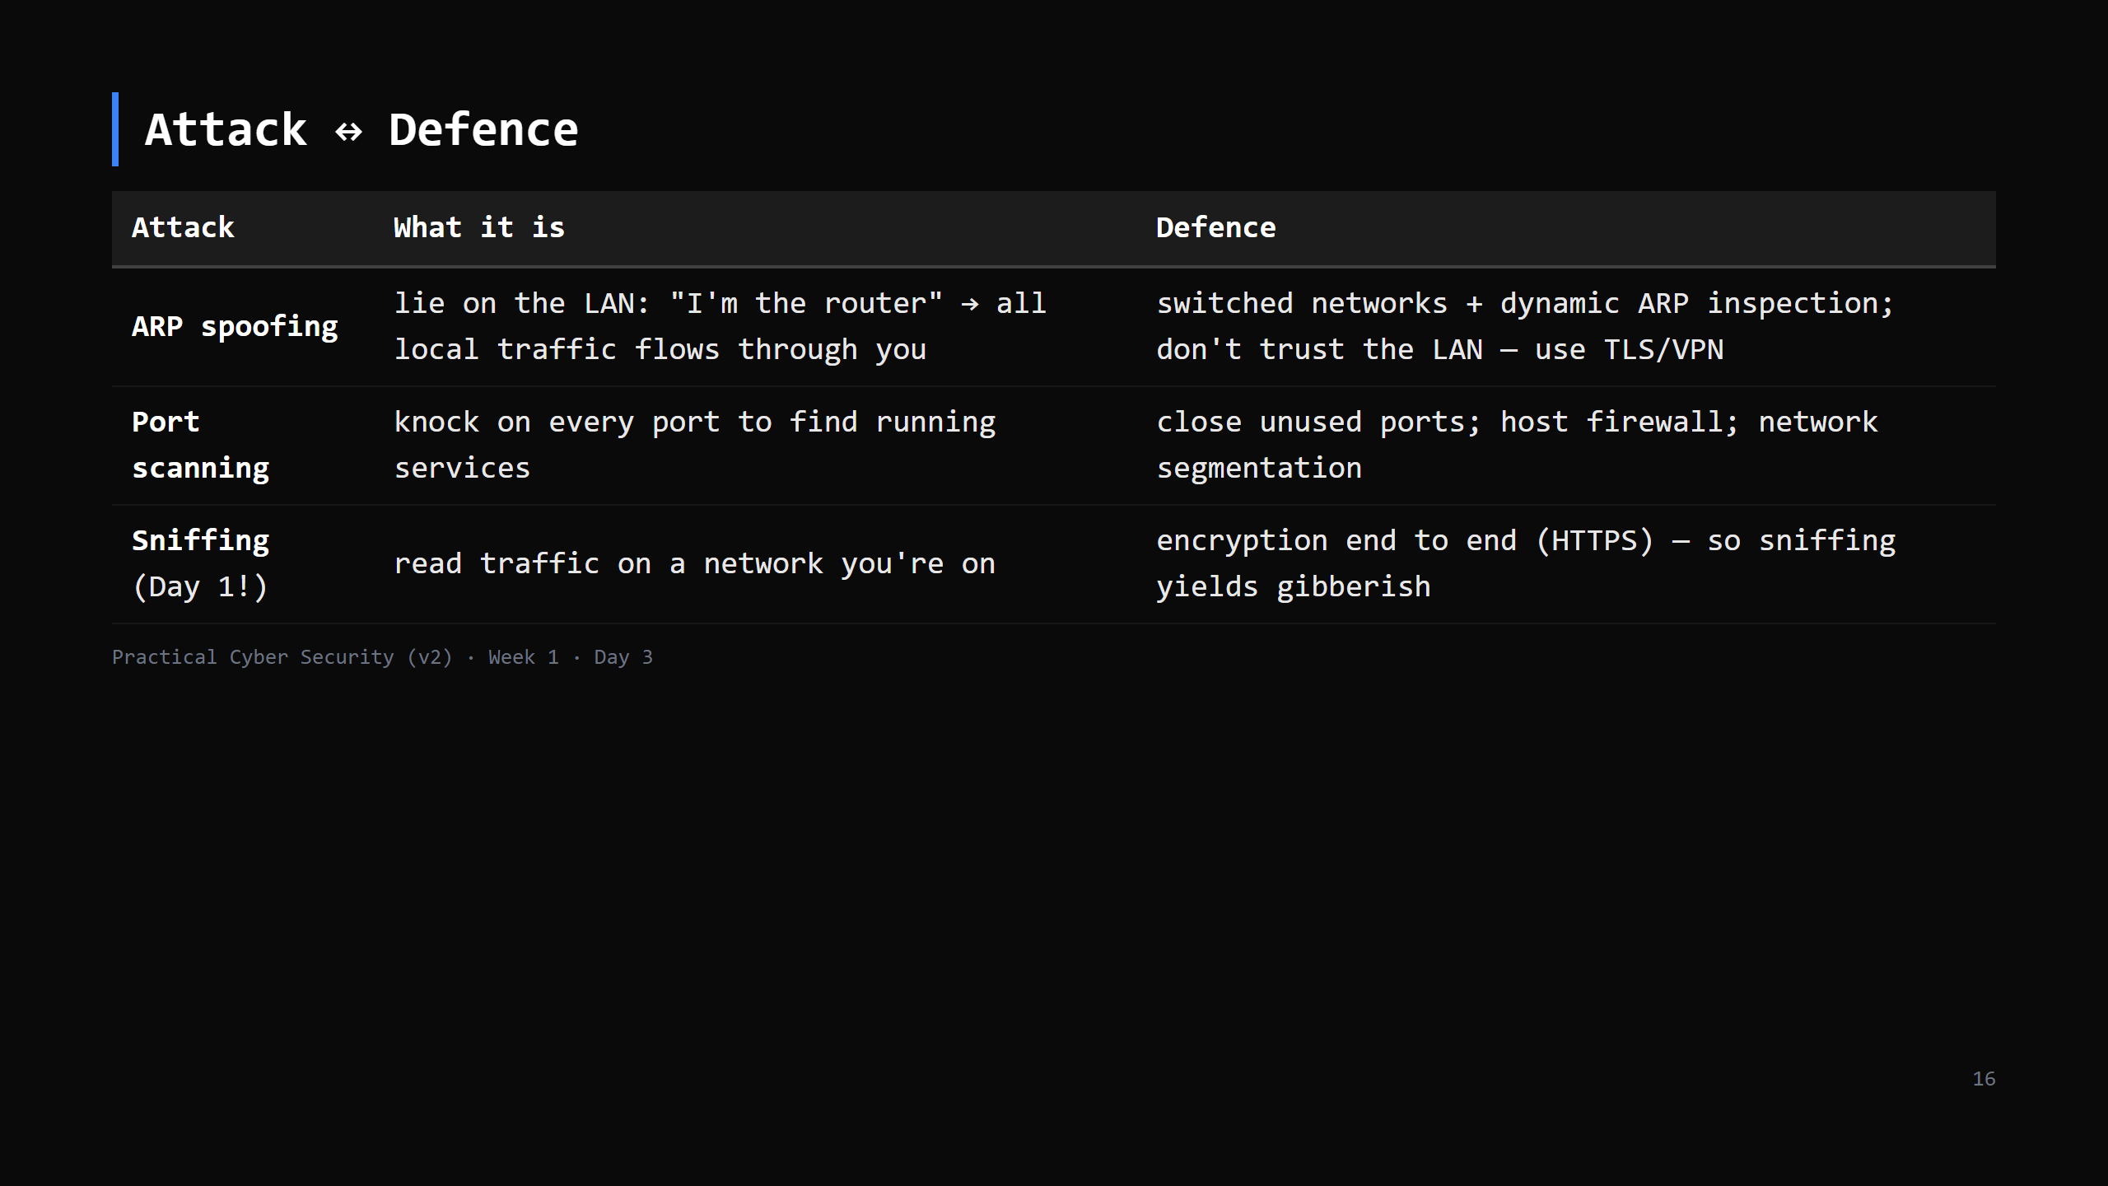
Notes:
Tie it together: the Day 1 trailer worked because attacker + victim were on the SAME LAN and the login was plain HTTP. ARP spoofing is how you'd get in the middle even on a switch. The fix that actually scales isn't "secure the LAN perfectly" — it's "assume the network is hostile and encrypt anyway." That's the whole reason for tomorrow's HTTPS lesson.

Slide 17
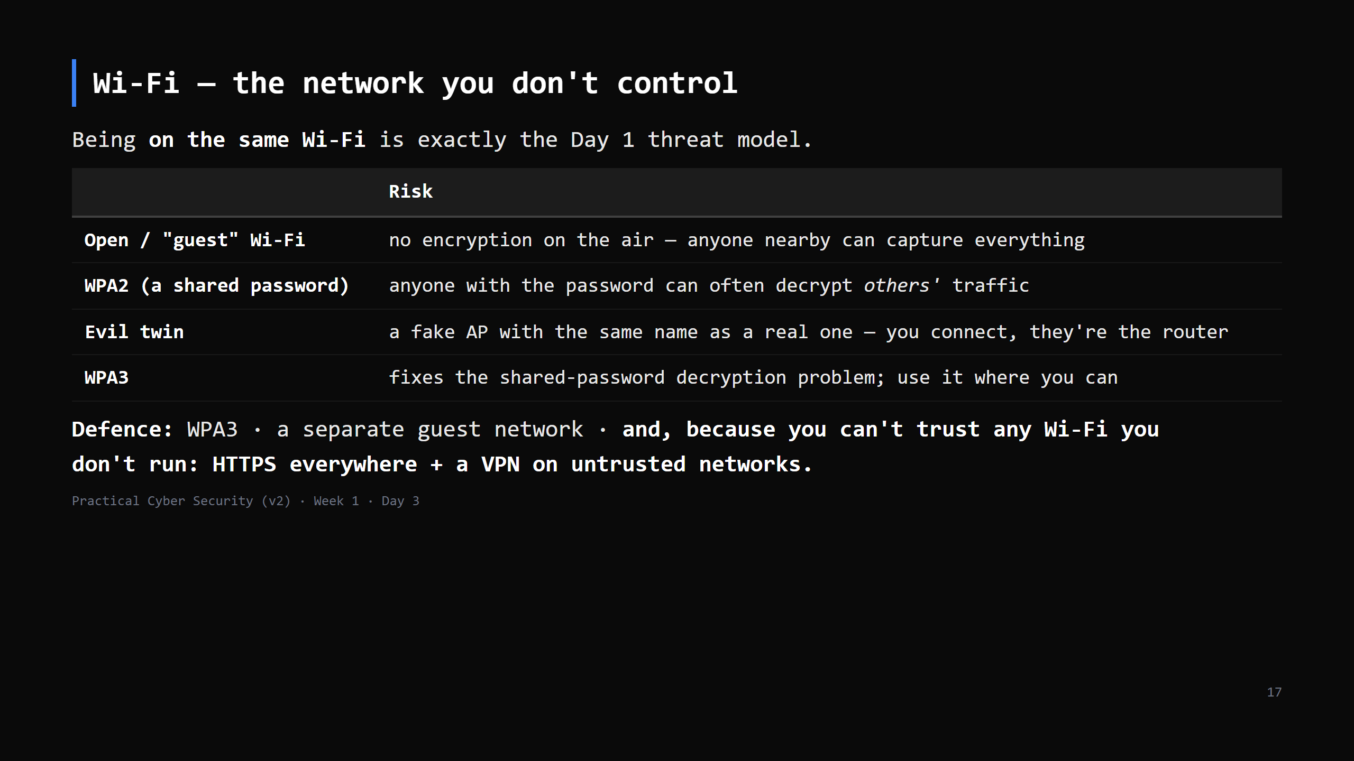
Notes:
This closes the loop on the Day 1 trailer (a Wi-Fi sniff). The point for students: "coffee shop Wi-Fi" is not a safe place to log into anything over plain HTTP, and even WPA2 home Wi-Fi isn't private from a housemate who has the password. WPA3's SAE handshake gives per-session keys. Enterprise Wi-Fi (802.1X / WPA2-Enterprise) is per-user — name it, don't detail it. CUT to 2 min if behind — the one line to keep: "you can't trust Wi-Fi you don't run; encrypt anyway."

Slide 18
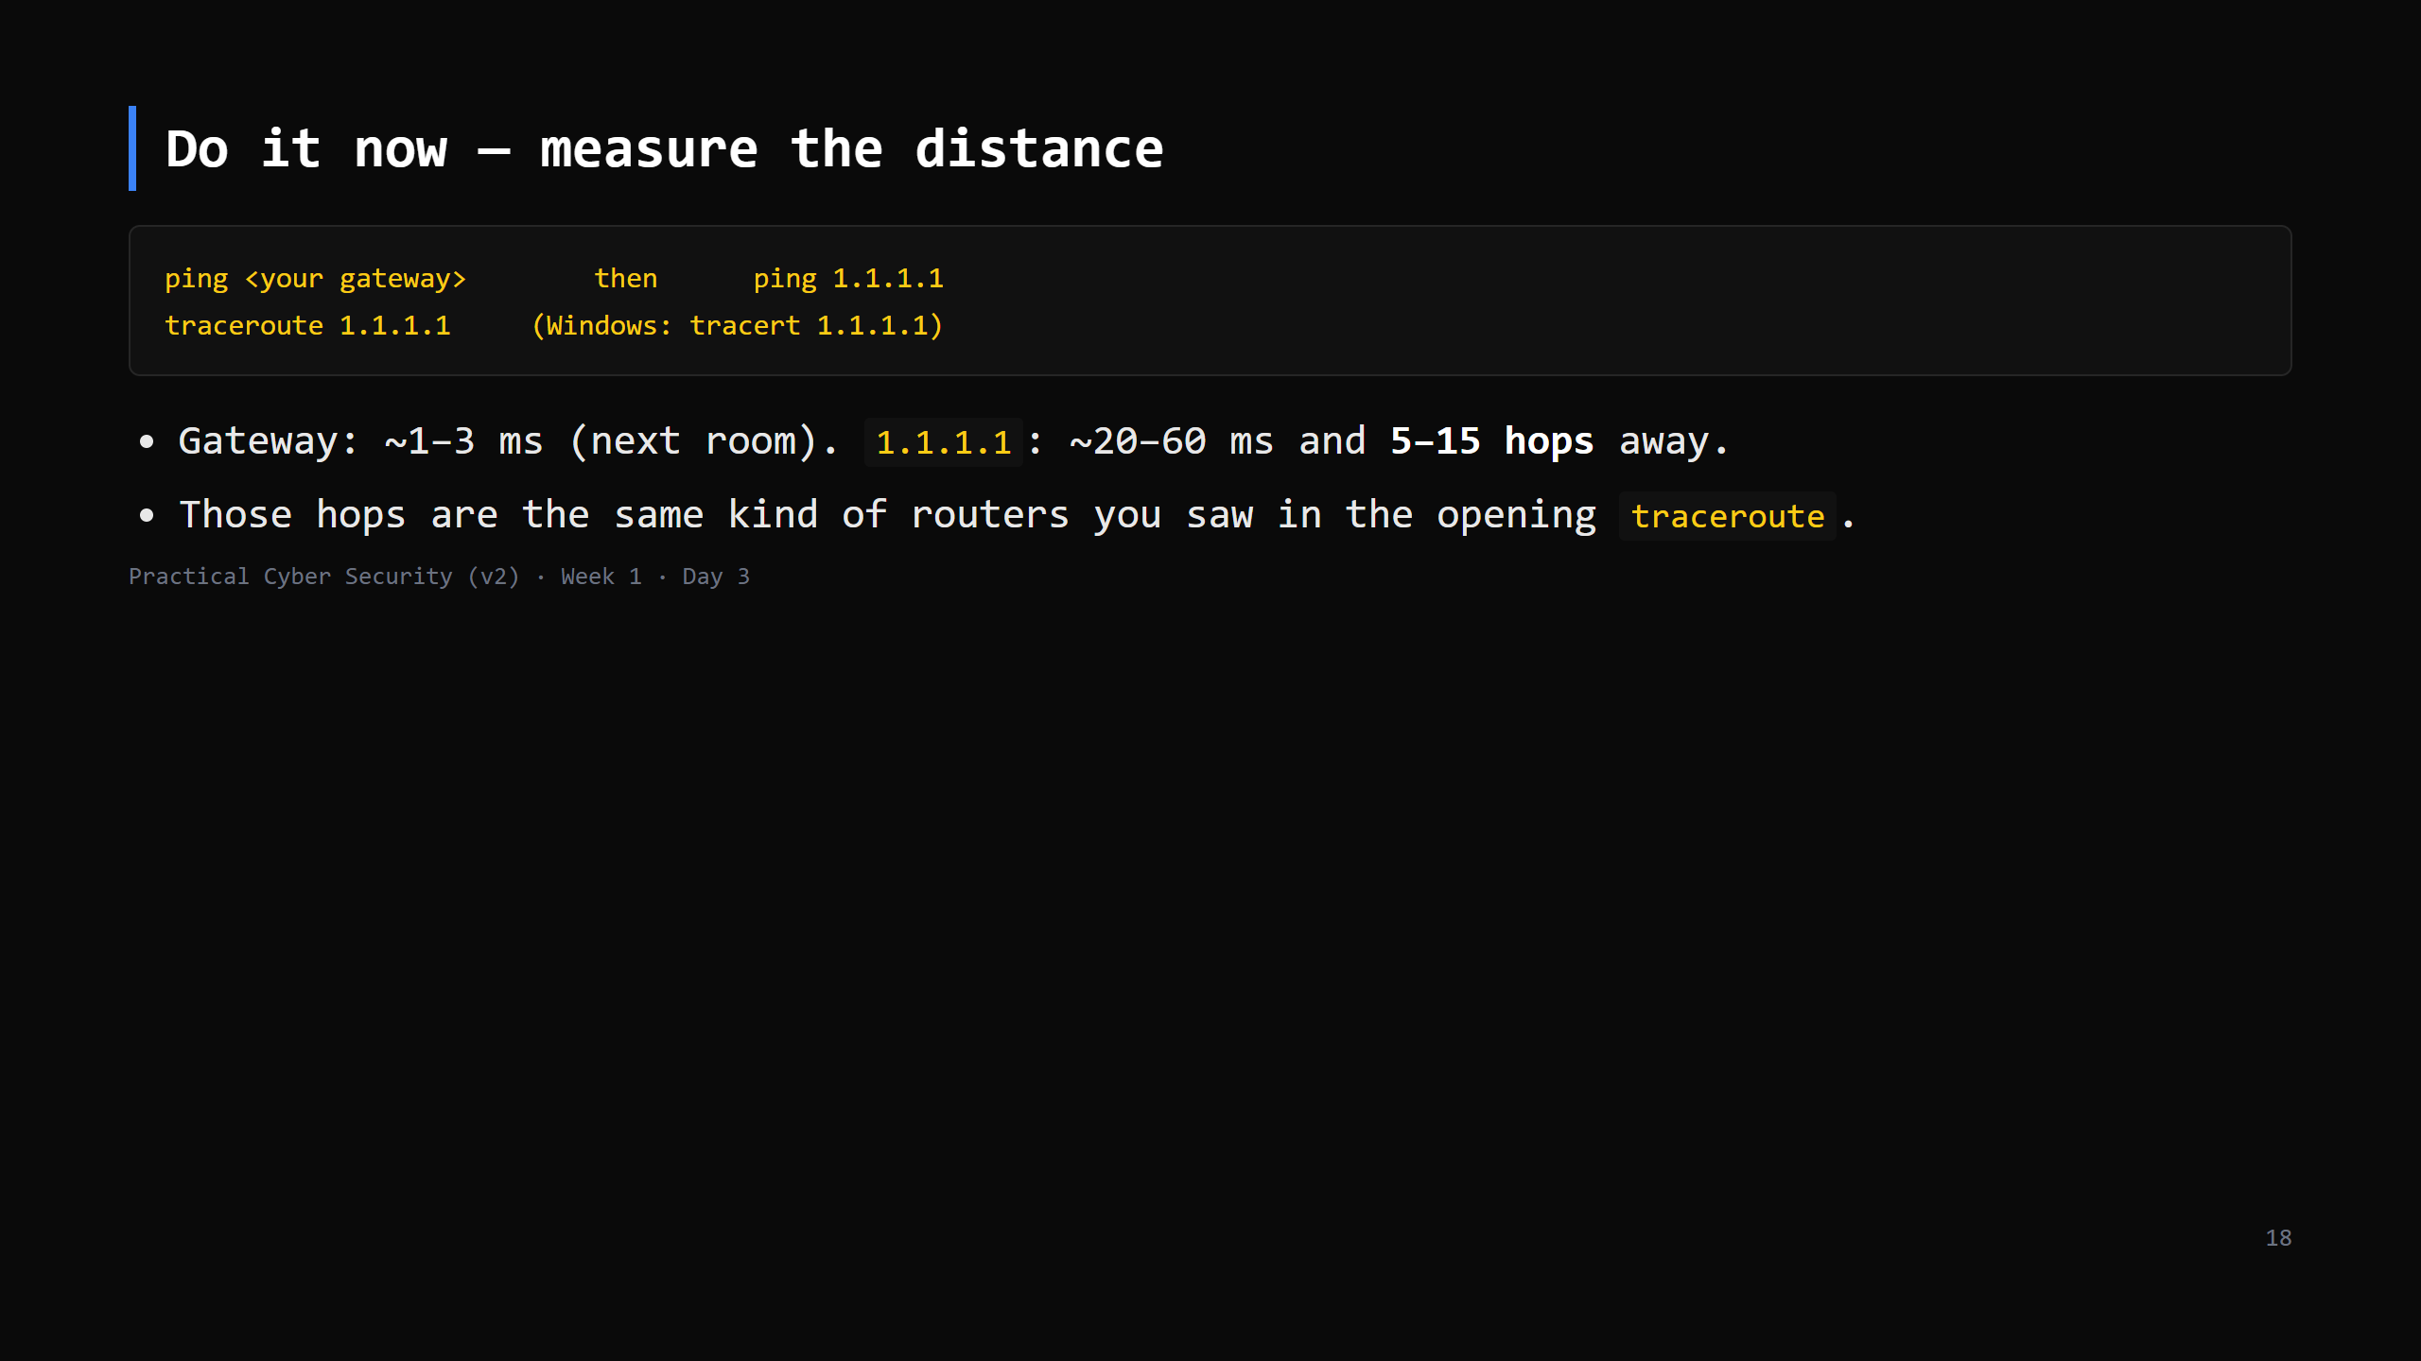
Notes:
3-4 min. ping to 1.1.1.1 may be blocked on locked-down wifi — note it, move on, the web still works because that's TCP not ICMP. This is the fourth and last "do it now". Total hands-on across the lesson ~15 min, interleaved.

Slide 19
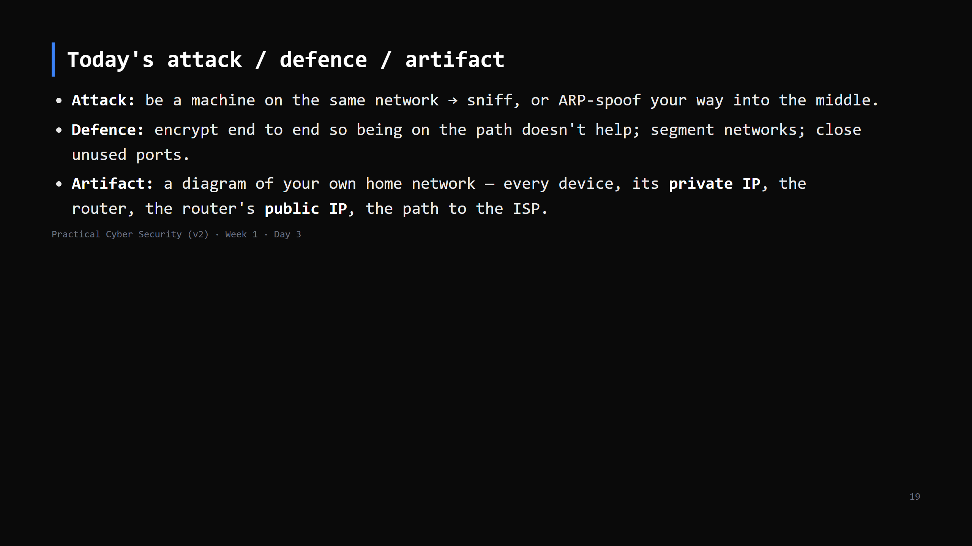
Notes:
Three lines into the repo.

Slide 20
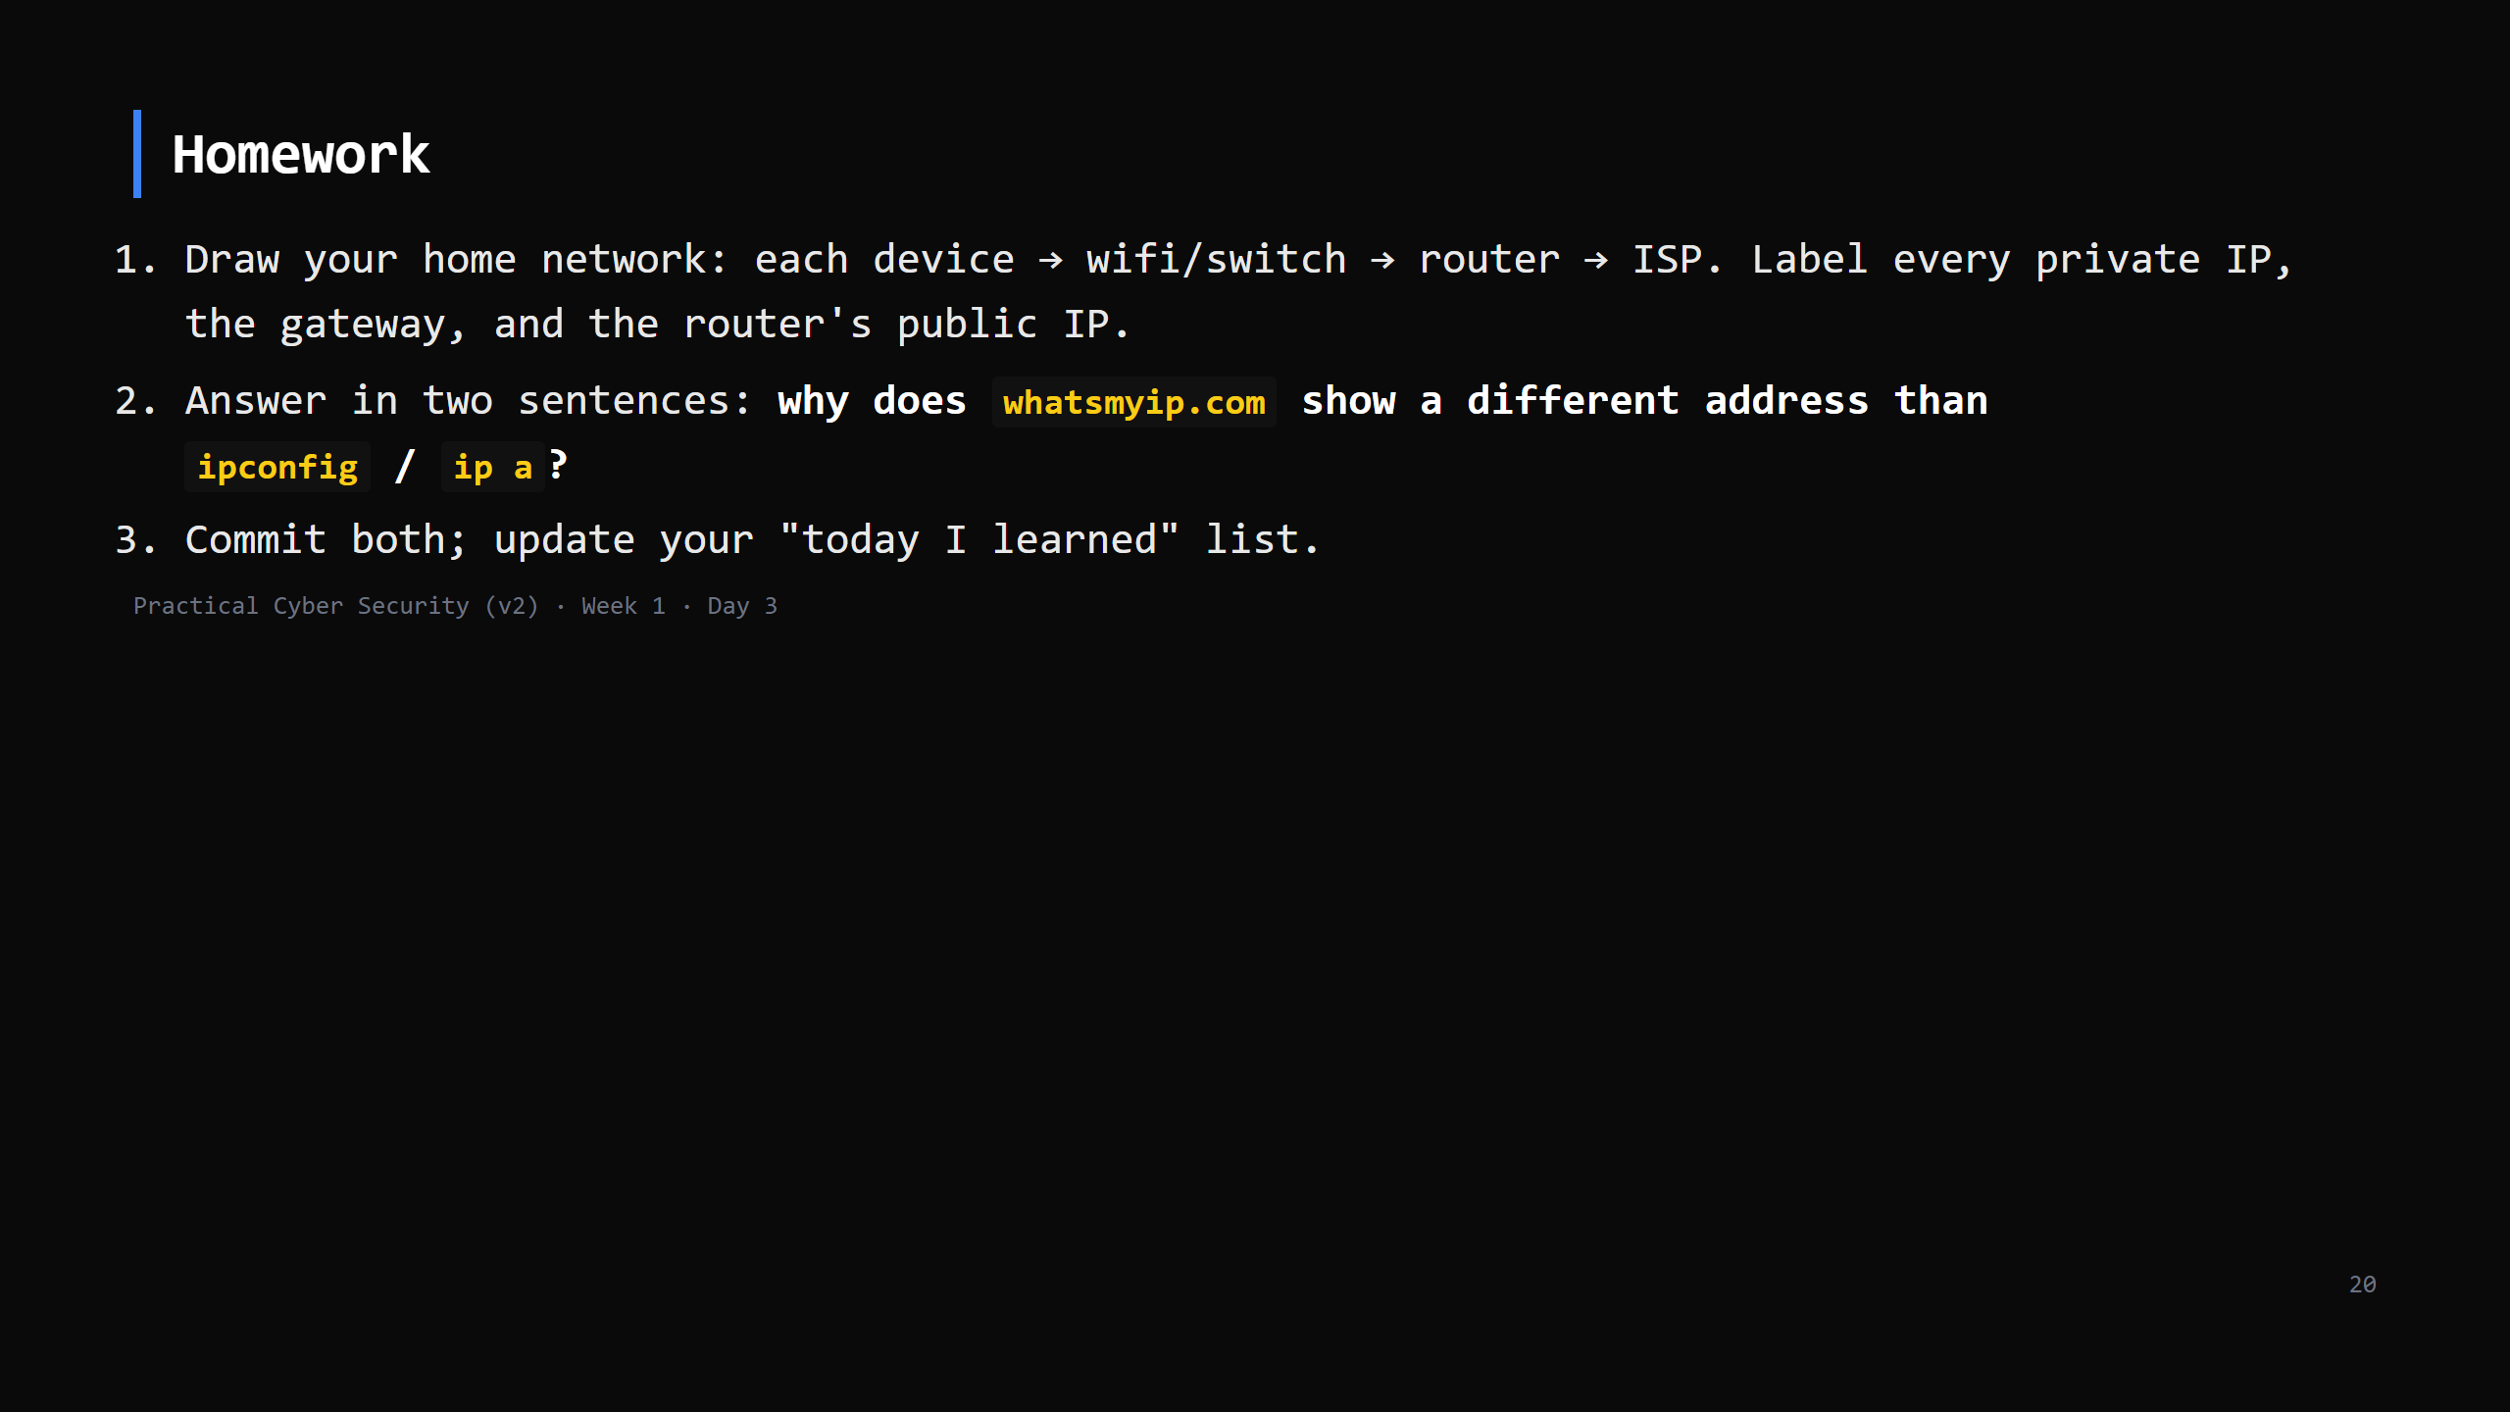
Notes:
Due start of Day 4. Checklist grading in the week-1 student pack.

Slide 21
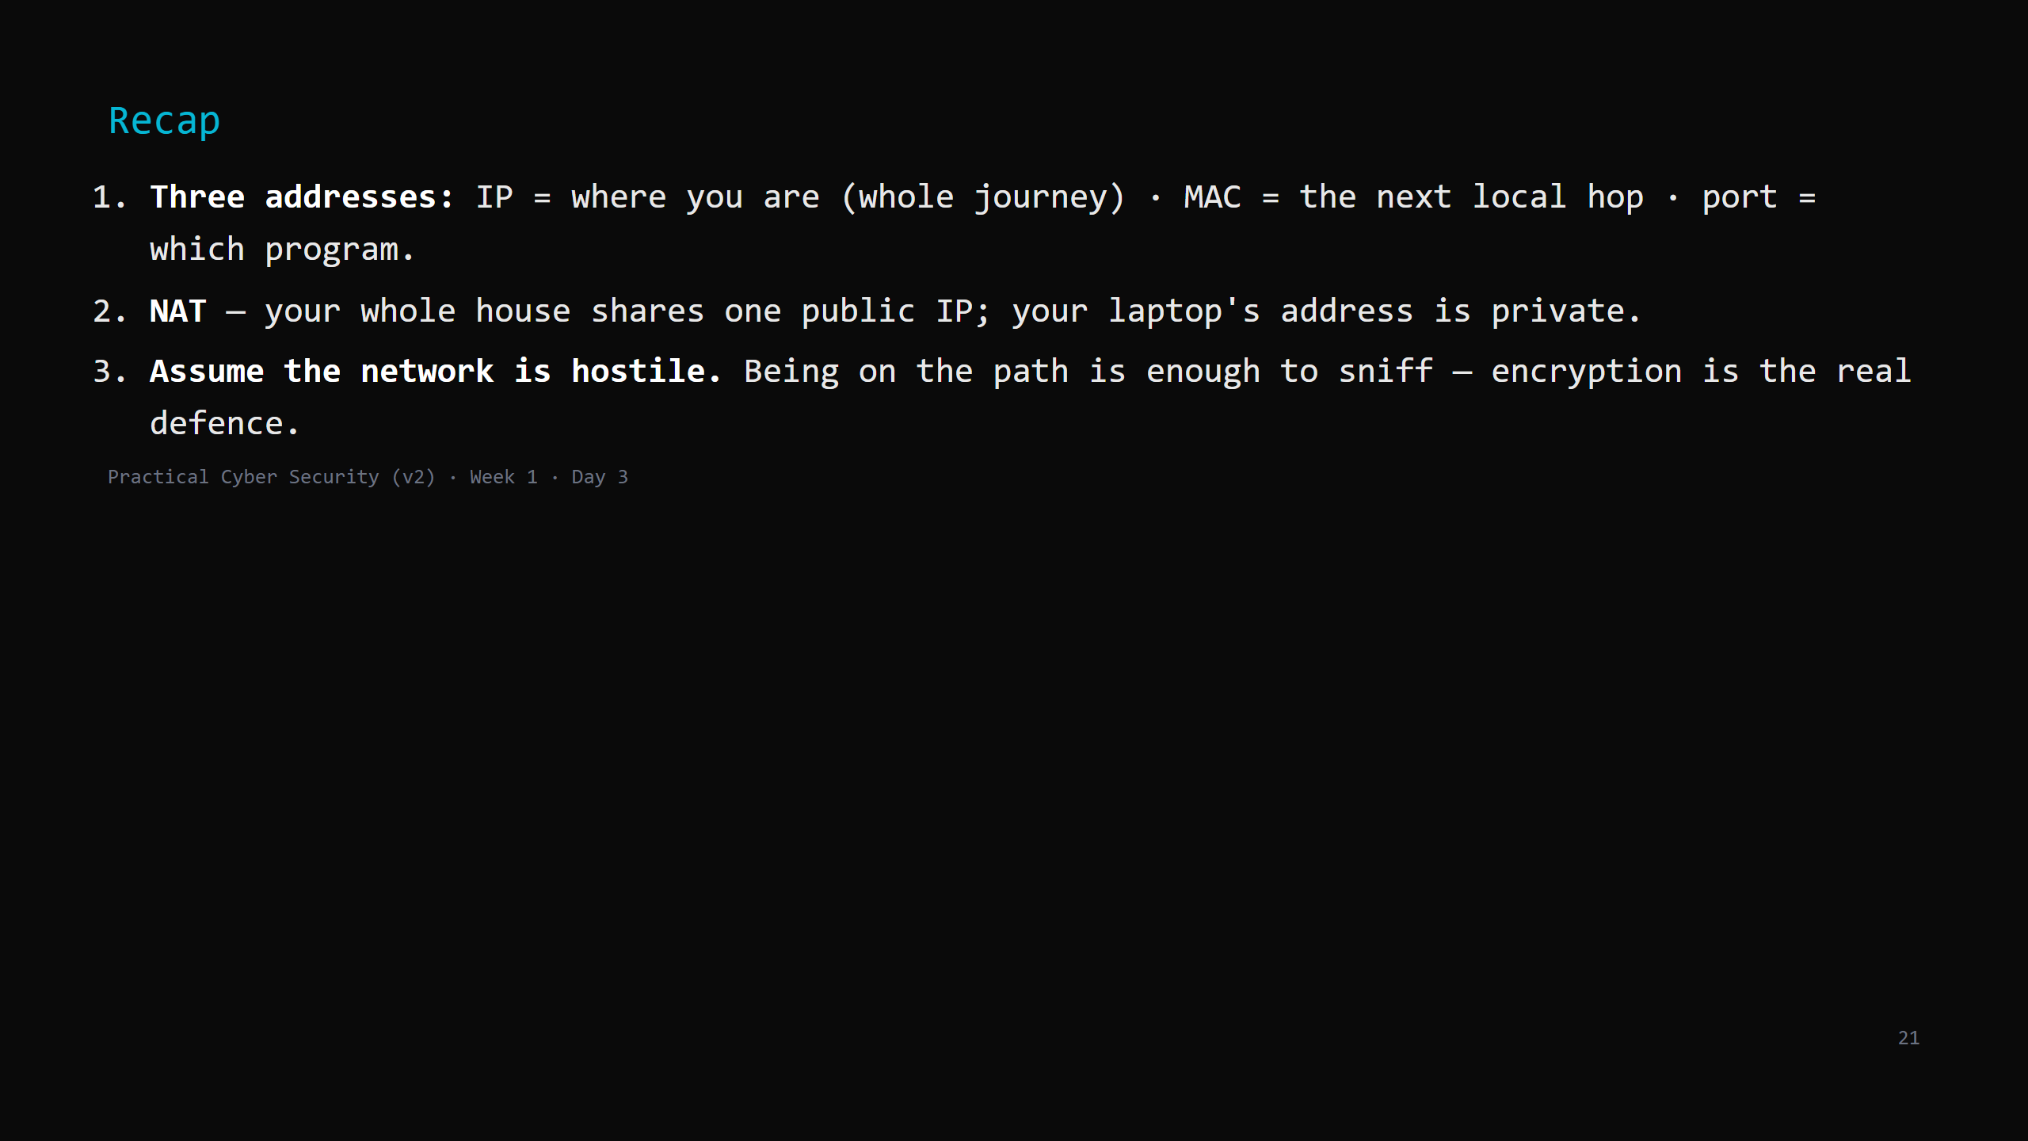
Notes:
Say the three lines. Then: tomorrow we give these packets rules — TCP's handshake, DNS turning names into IPs, and the full story of loading a web page.

