Slide 1
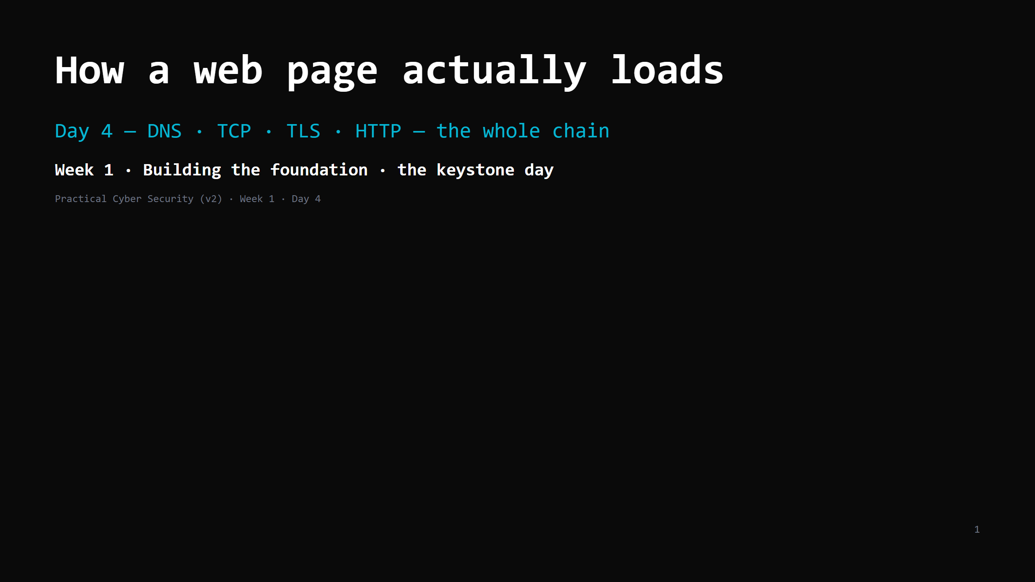
Notes:
RUN SHEET (~84 min). THIS IS A TWO-PART DAY — it carries ~2 days of material. Treat it as such: PART 1 — the chain (DNS -> TCP -> TLS). target: DONE by minute 40. PART 2 — HTTP + the attacks + DevTools. >>> MID-POINT GATE at minute 40: if TLS isn't finished, you are behind. Recovery: skip the netcat "do it now" and the render slide, compress HTTP request+response to ONE slide, go straight to the chain diagram -> attack<->defence (table only) -> DevTools. HTTP-by-hand and the full attack detail become homework/reading. DO NOT cut DevTools. 00:00 Journey check + hook (curl -v on the projector) 4 ┐ 00:04 The chain — the 7 steps (the day's map) 3 │ 00:07 Step 1: DNS — names to numbers 7 │ PART 1 00:14 DO: dig / nslookup 4 │ (DNS+TCP+TLS, 00:18 Step 2: TCP — the reliable phone call 8 │ done by :40) 00:26 DO: watch the handshake in curl -v 3 │ 00:29 Step 3: TLS — locking the line + what it does NOT give 9 ┘ 00:38 Step 4: HTTP — request slide + response slide 11 ┐ 00:49 DO: hand-craft an HTTP request (netcat / ps1) 6 │ PART 2 00:55 Steps 5-6 render (1 line) + the chain diagram 3 │ (HTTP + attacks 00:58 Attack <-> defence 9 │ + DevTools) 01:07 DO: DevTools -> Network on a real login 6 │ 01:13 Wrap + homework 5 ┘ CUT FIRST IF SHORT: the render/repeat slide (say one sentence); the UDP line; the netcat "do it now" (do a full read of curl -v instead); the "look-alike site" attack row. NEVER CUT: the DNS->TCP->TLS->HTTP order, what TLS does NOT give, the chain diagram, DevTools. ANALOGY (sanctioned): the PHONE CALL. DNS = asking the operator / directory for the number. TCP handshake = "hello?… hello.… ok, go ahead." TLS = switching to a scrambler both ends share. HTTP = the actual conversation.

Slide 2
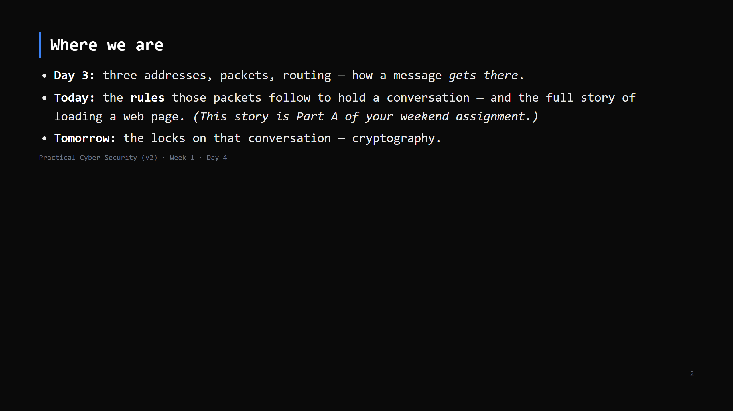
Notes:
Learning Journey Check. Flag loudly that today's "7-step story" is the assignment — they should take notes with that in mind.

Slide 3
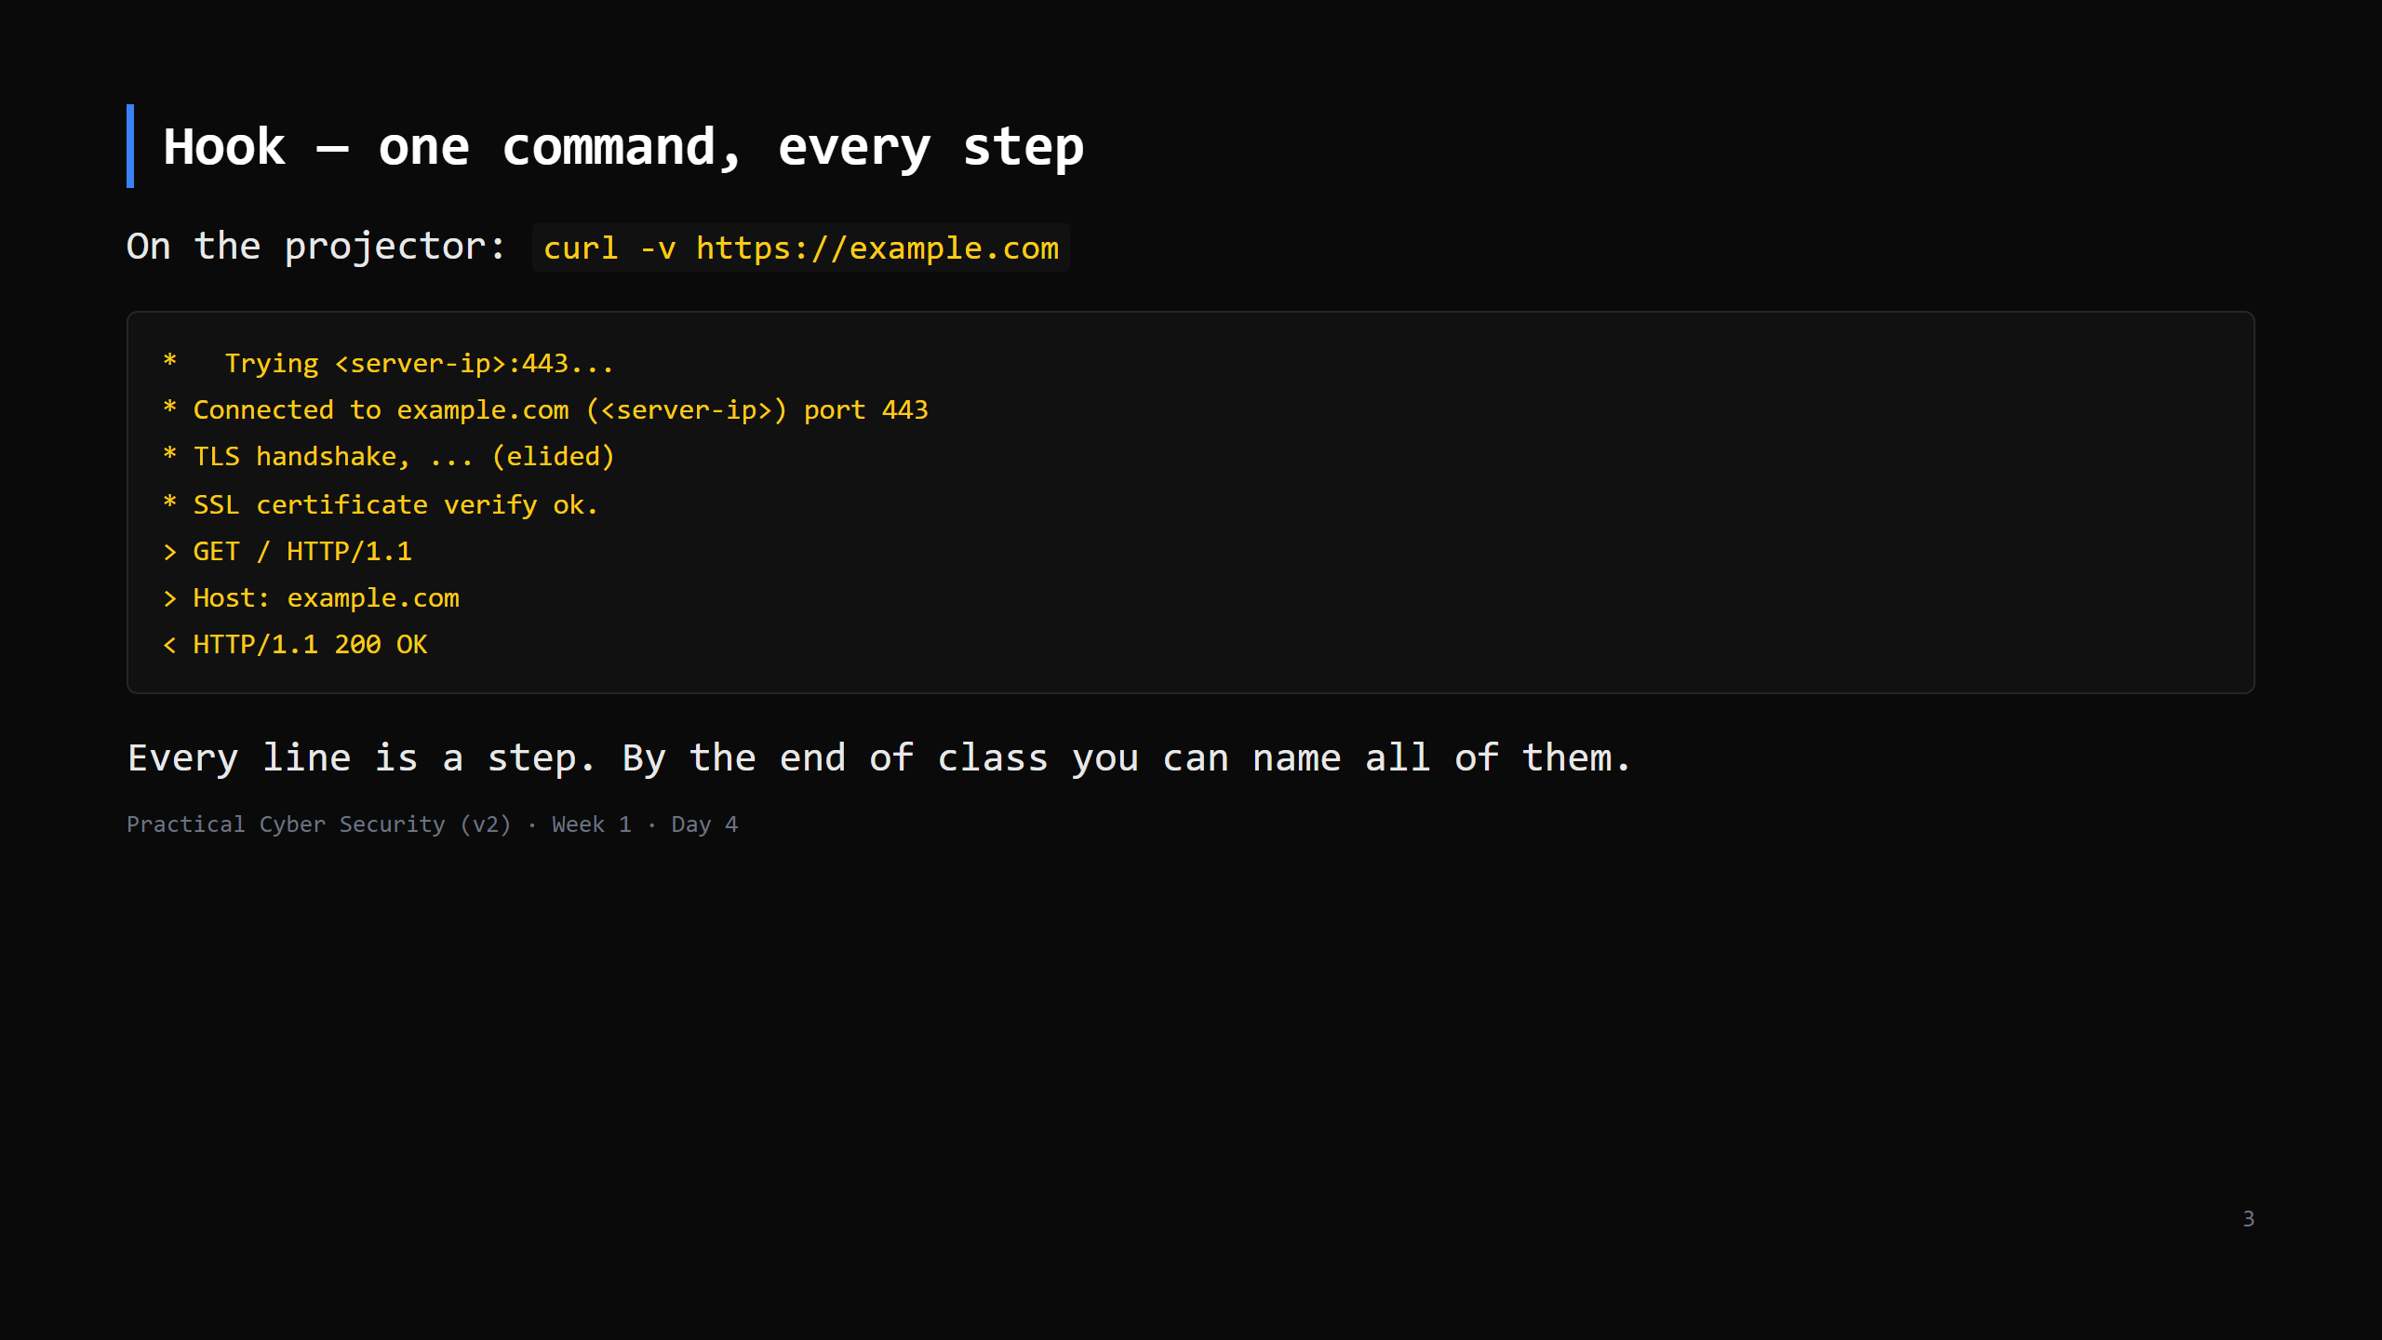
Notes:
The real output is longer; this is trimmed for the slide. The IP you see won't match any number on a slide — sites move — so don't read a specific IP aloud. Don't decode it yet. Just: "name lookup, then connect, then a lock, then a request, then a reply." Those are the four sections of today. Don't decode it yet. Just: "name lookup, then connect, then a lock, then a request, then a reply." Those are the four sections of today.

Slide 4
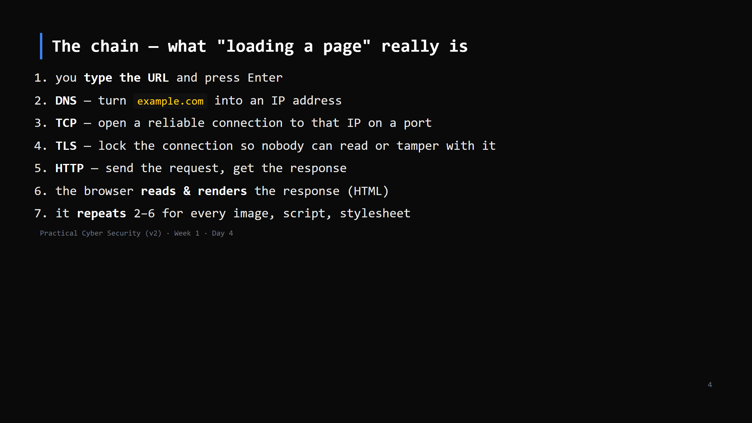
Notes:
This slide is the map for the whole day AND the shape of the assignment (7 steps). Put them on the board and tick them off as you go. Every web attack later "lives" on one of these steps.

Slide 5
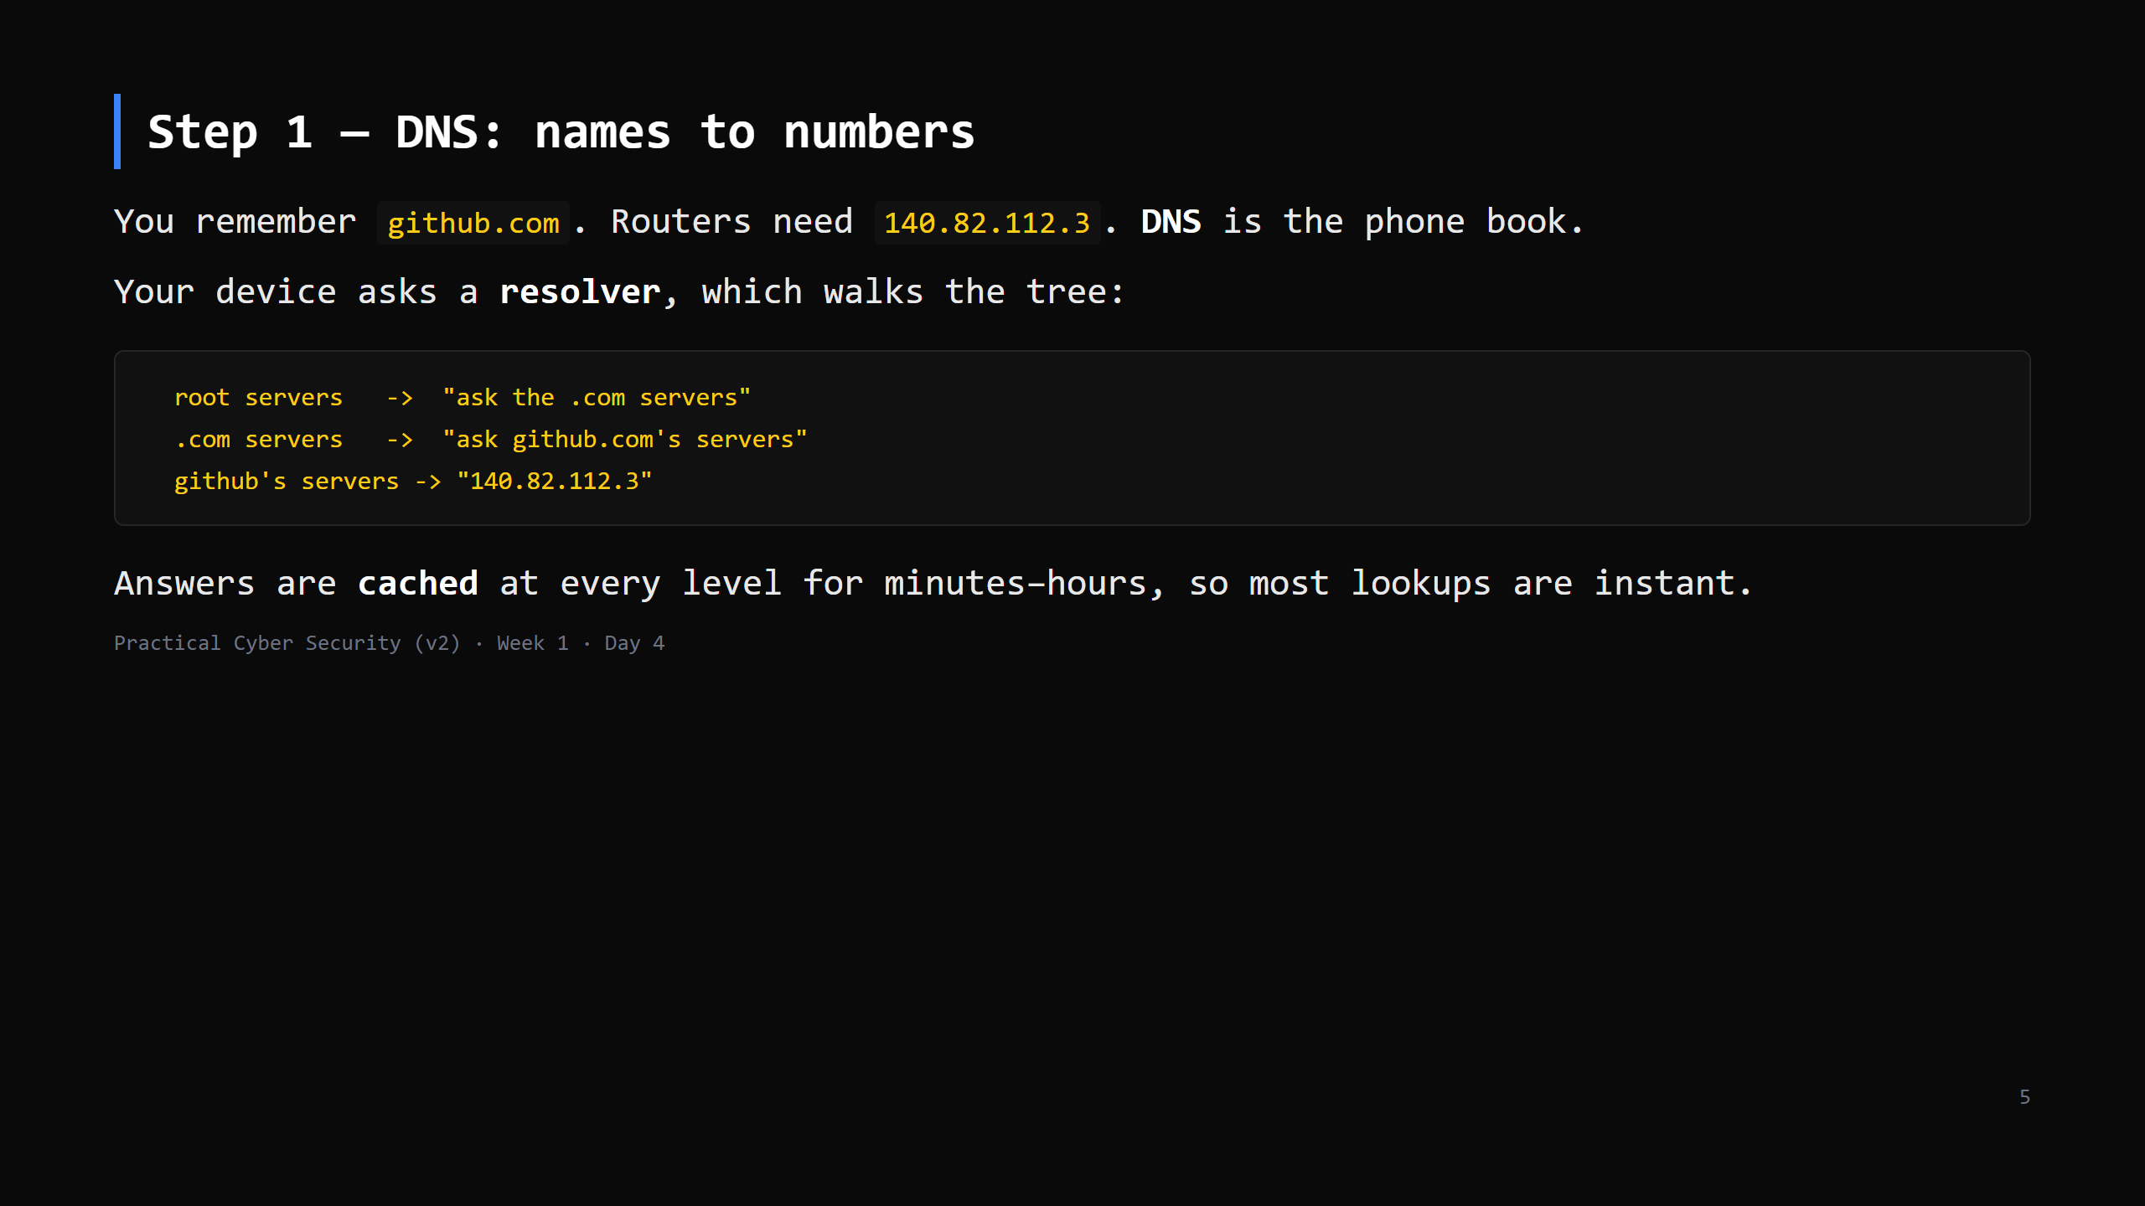
Notes:
Analogy: asking the operator for a number. First time it's a few hops; after that everyone who asked recently has it memorised (cache). Keep it to: resolver -> root -> TLD -> authoritative -> answer, plus caching. No record-type zoo (A, AAAA, MX, TXT) beyond naming A = "name to IPv4".

Slide 6
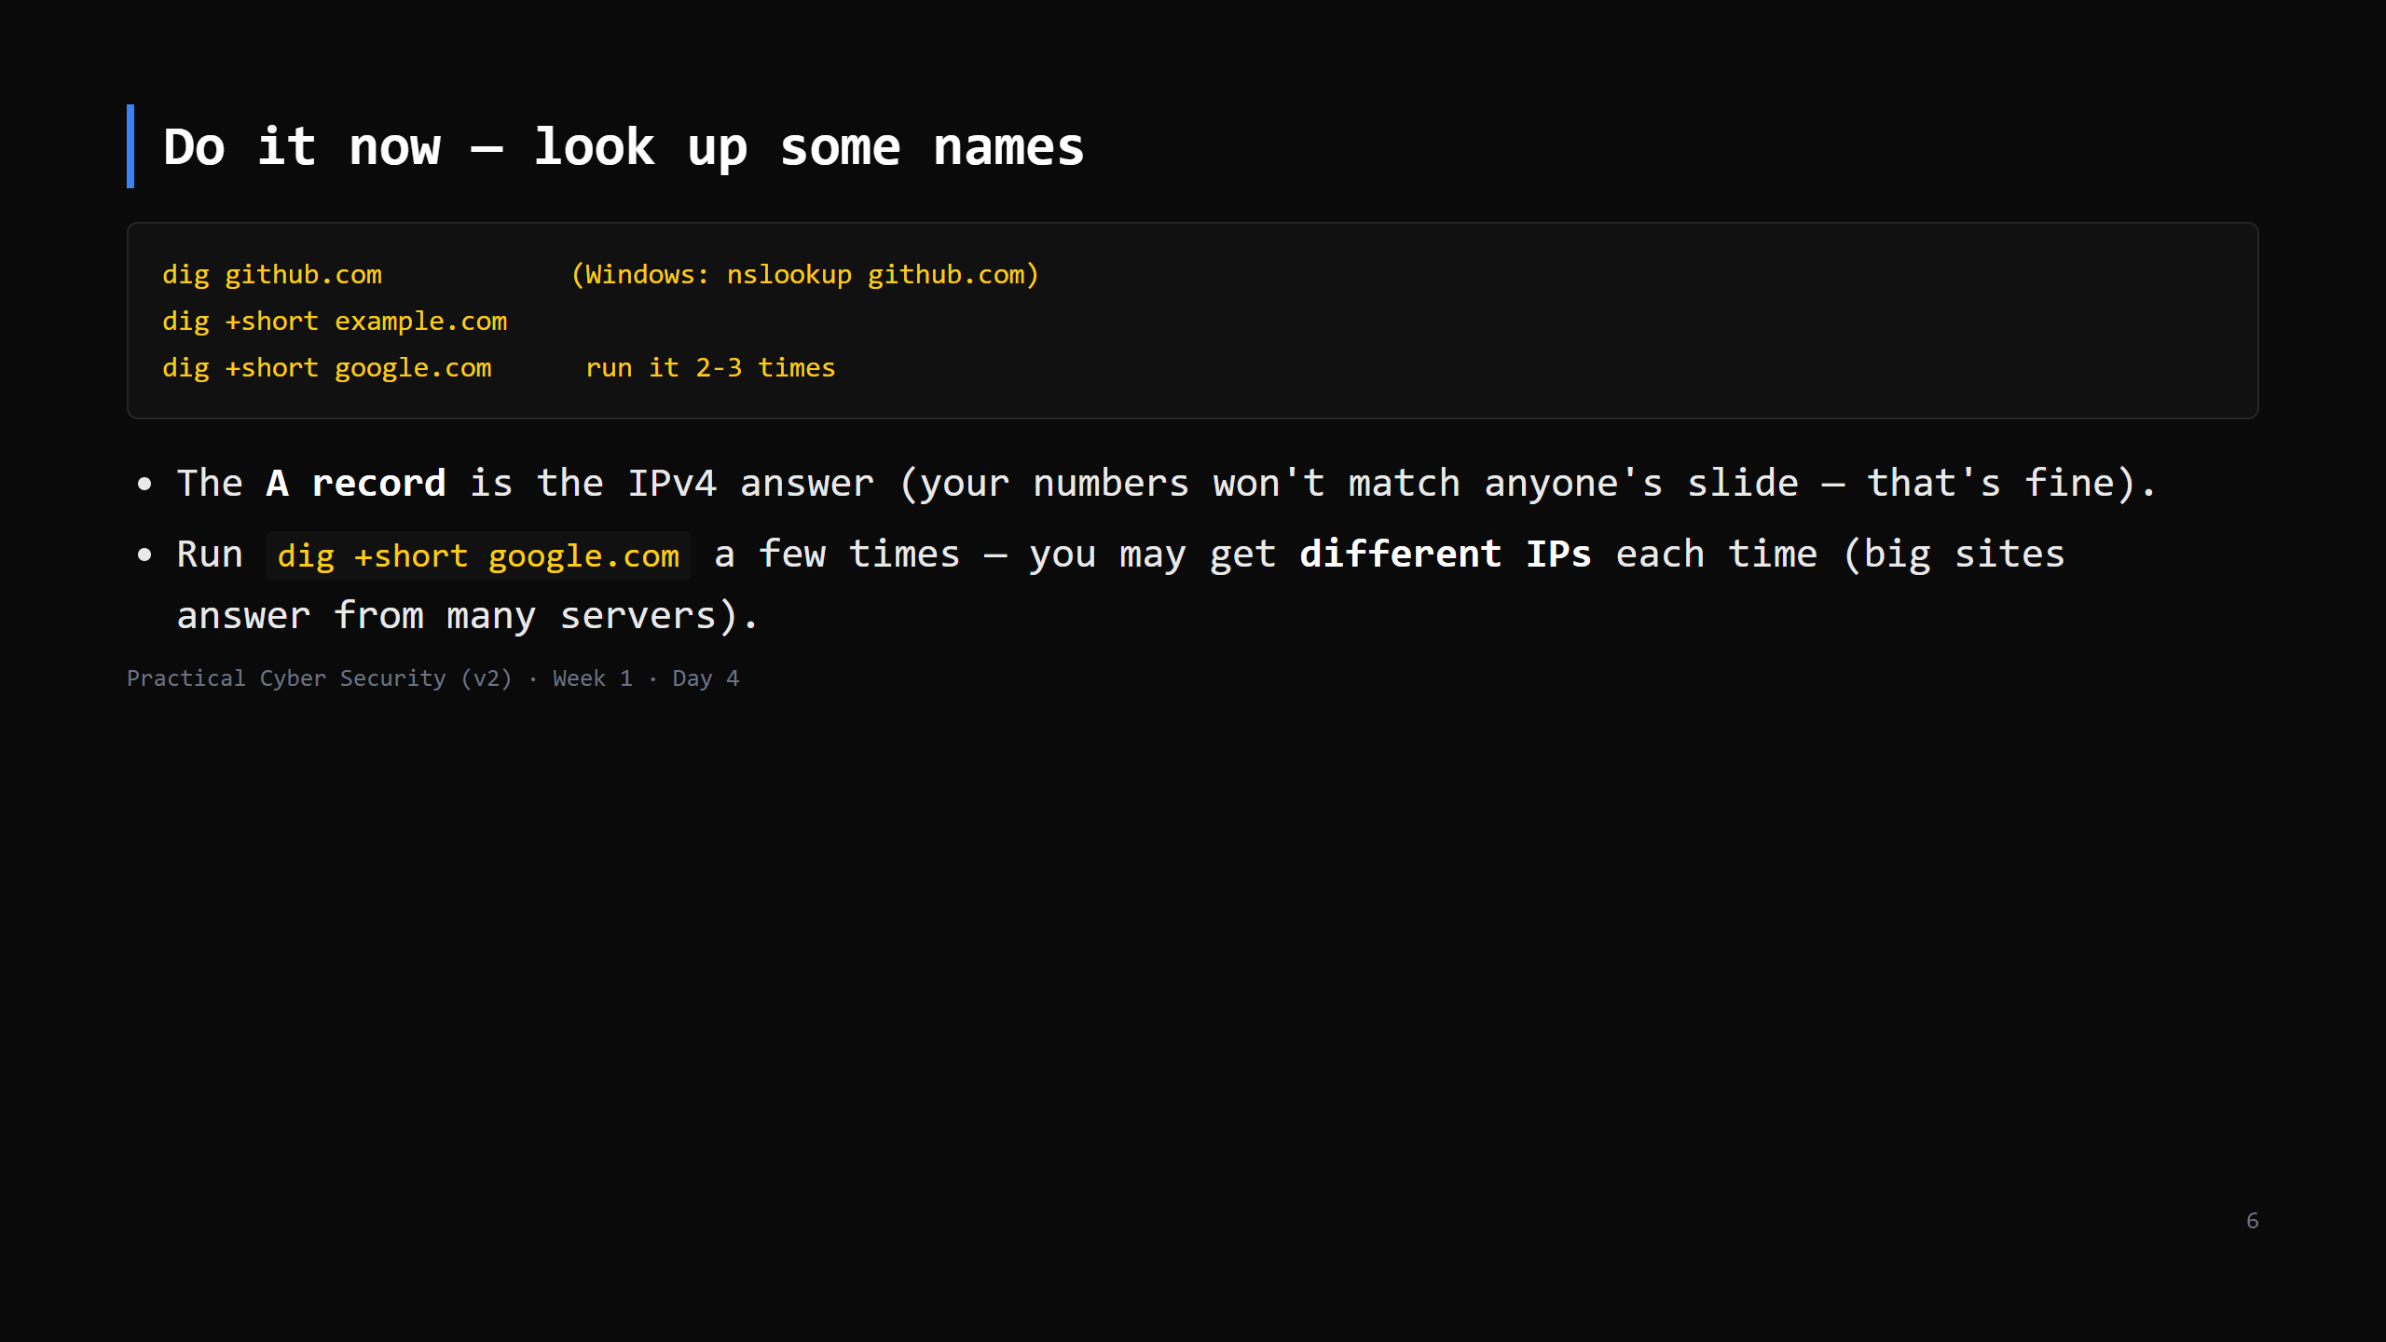
Notes:
2-3 min. On Windows nslookup output is chattier — the "Non-authoritative answer" is the cached one. Point out TTL in `dig` full output = how long the answer may be cached.

Slide 7
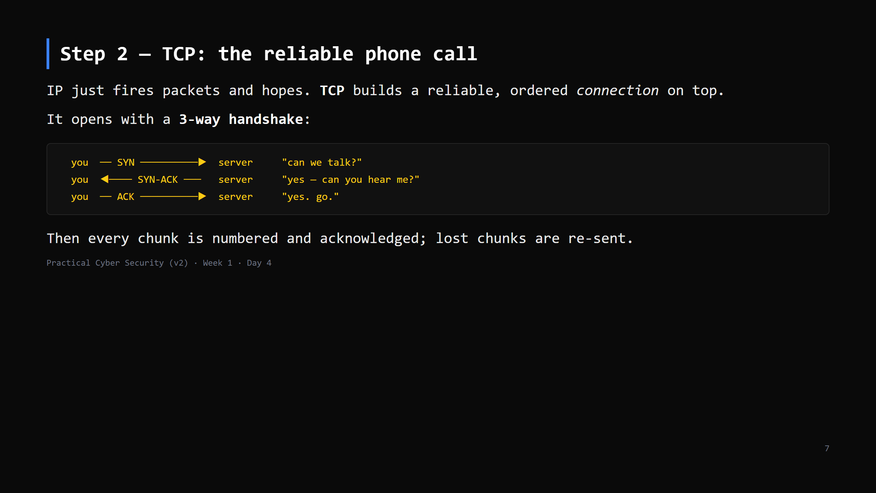
Notes:
Analogy: "hello?… hello, I can hear you.… great, go ahead." Only after that do you talk. Contrast UDP in one line: no handshake, no re-sends — "shout it and hope." Used for DNS, video calls, games, where speed beats perfection. CUT the UDP line first if short.

Slide 8
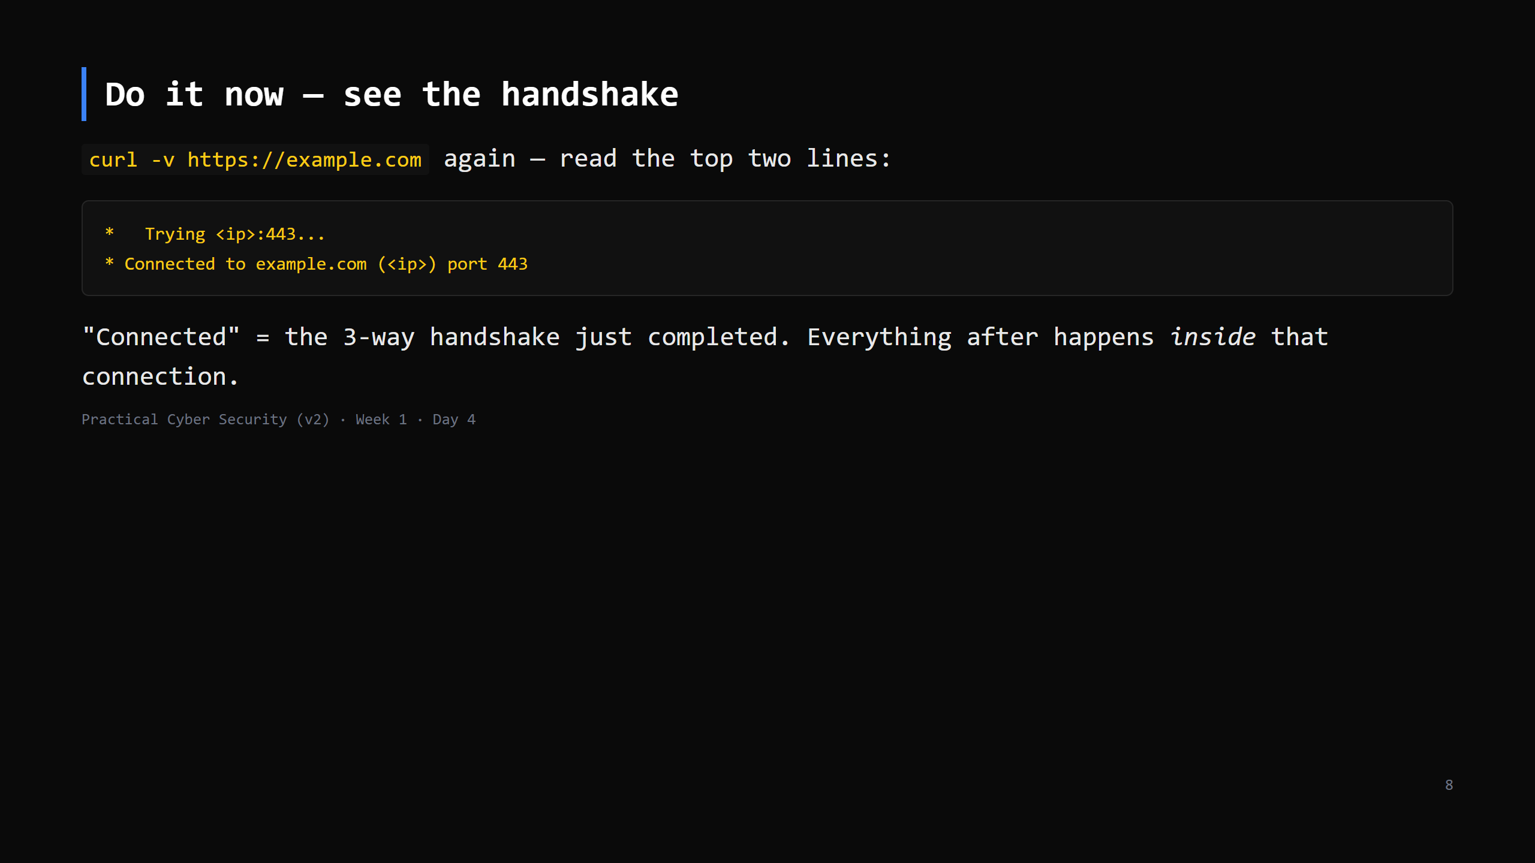
Notes:
1-2 min. If you ran Wireshark you'd see the literal SYN / SYN-ACK / ACK — that's Day 13. For now curl's "Connected" line is the marker.

Slide 9
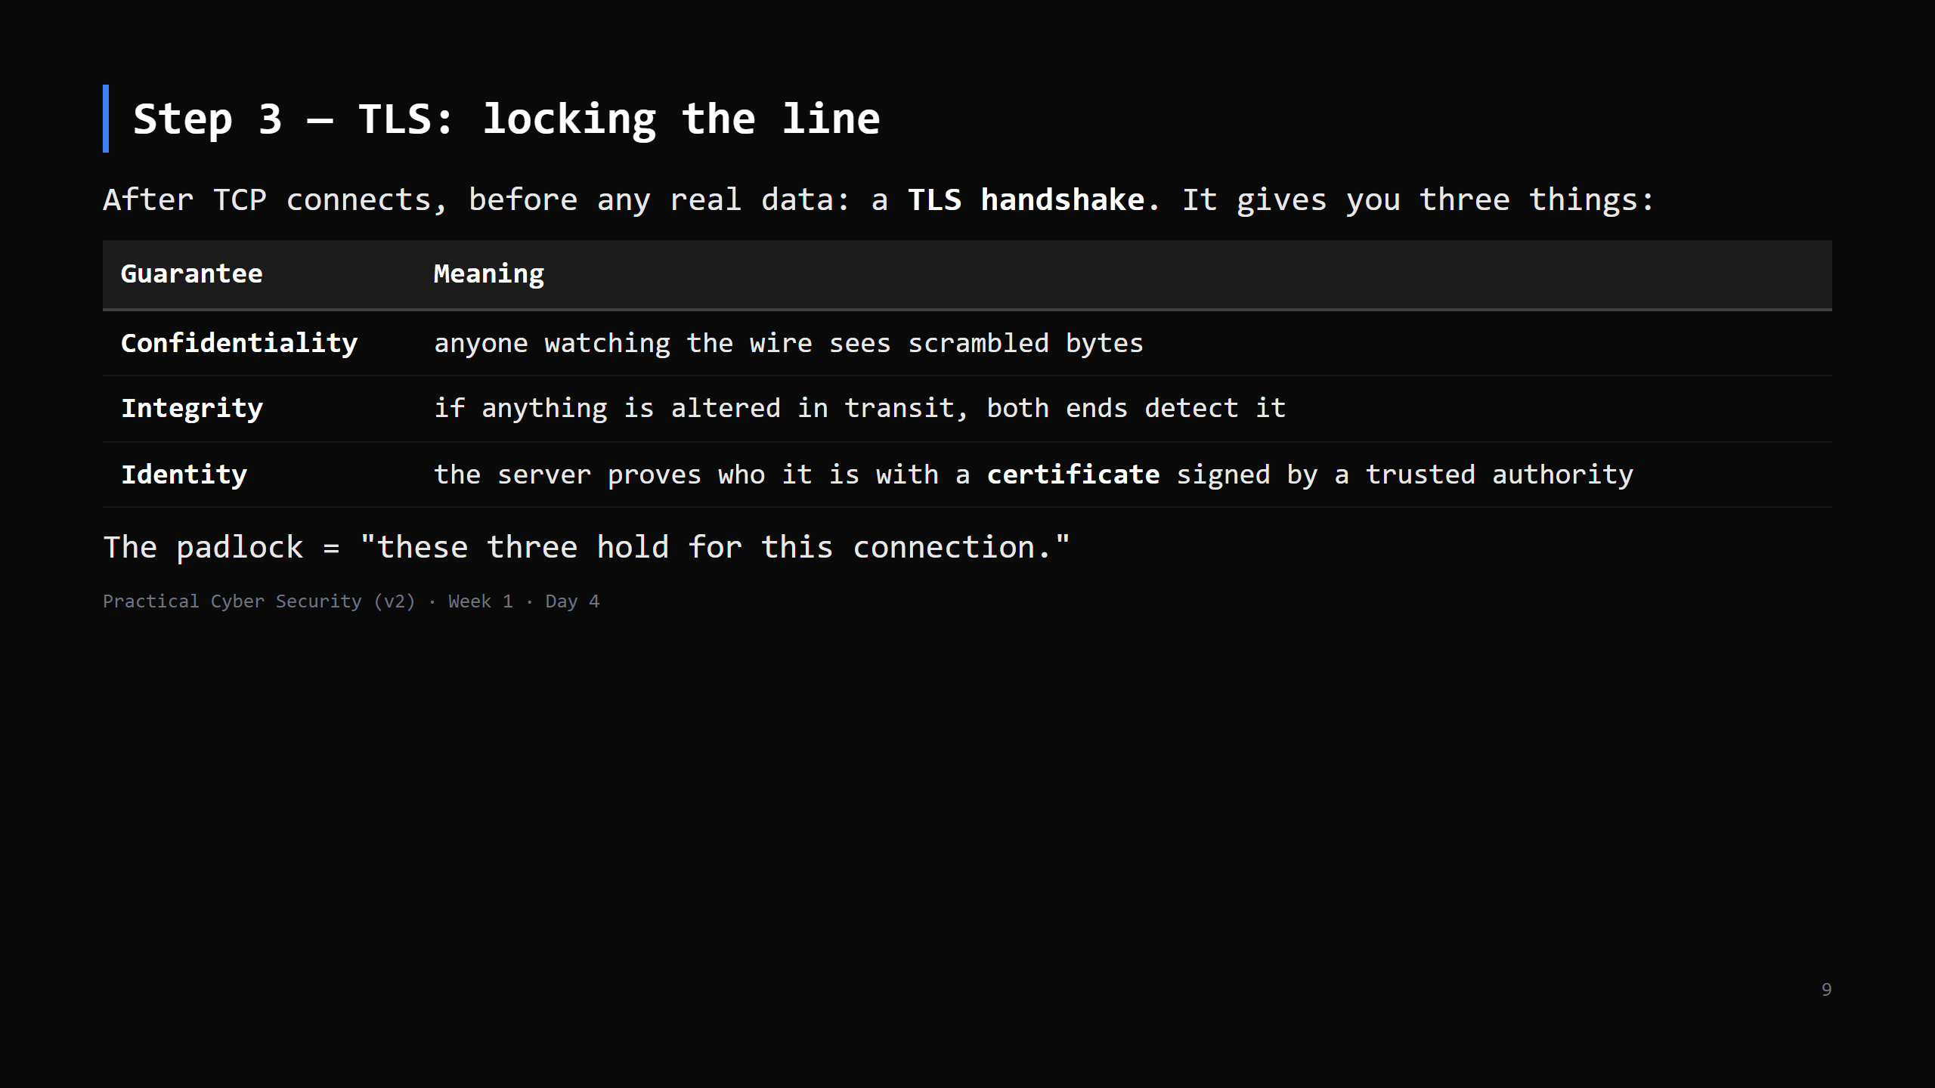
Notes:
Analogy: both ends switch on a scrambler only they can un-scramble; and the server shows ID before you trust it. Certificate detail is Day 5 — today just "a trusted third party vouched for this name."

Slide 10
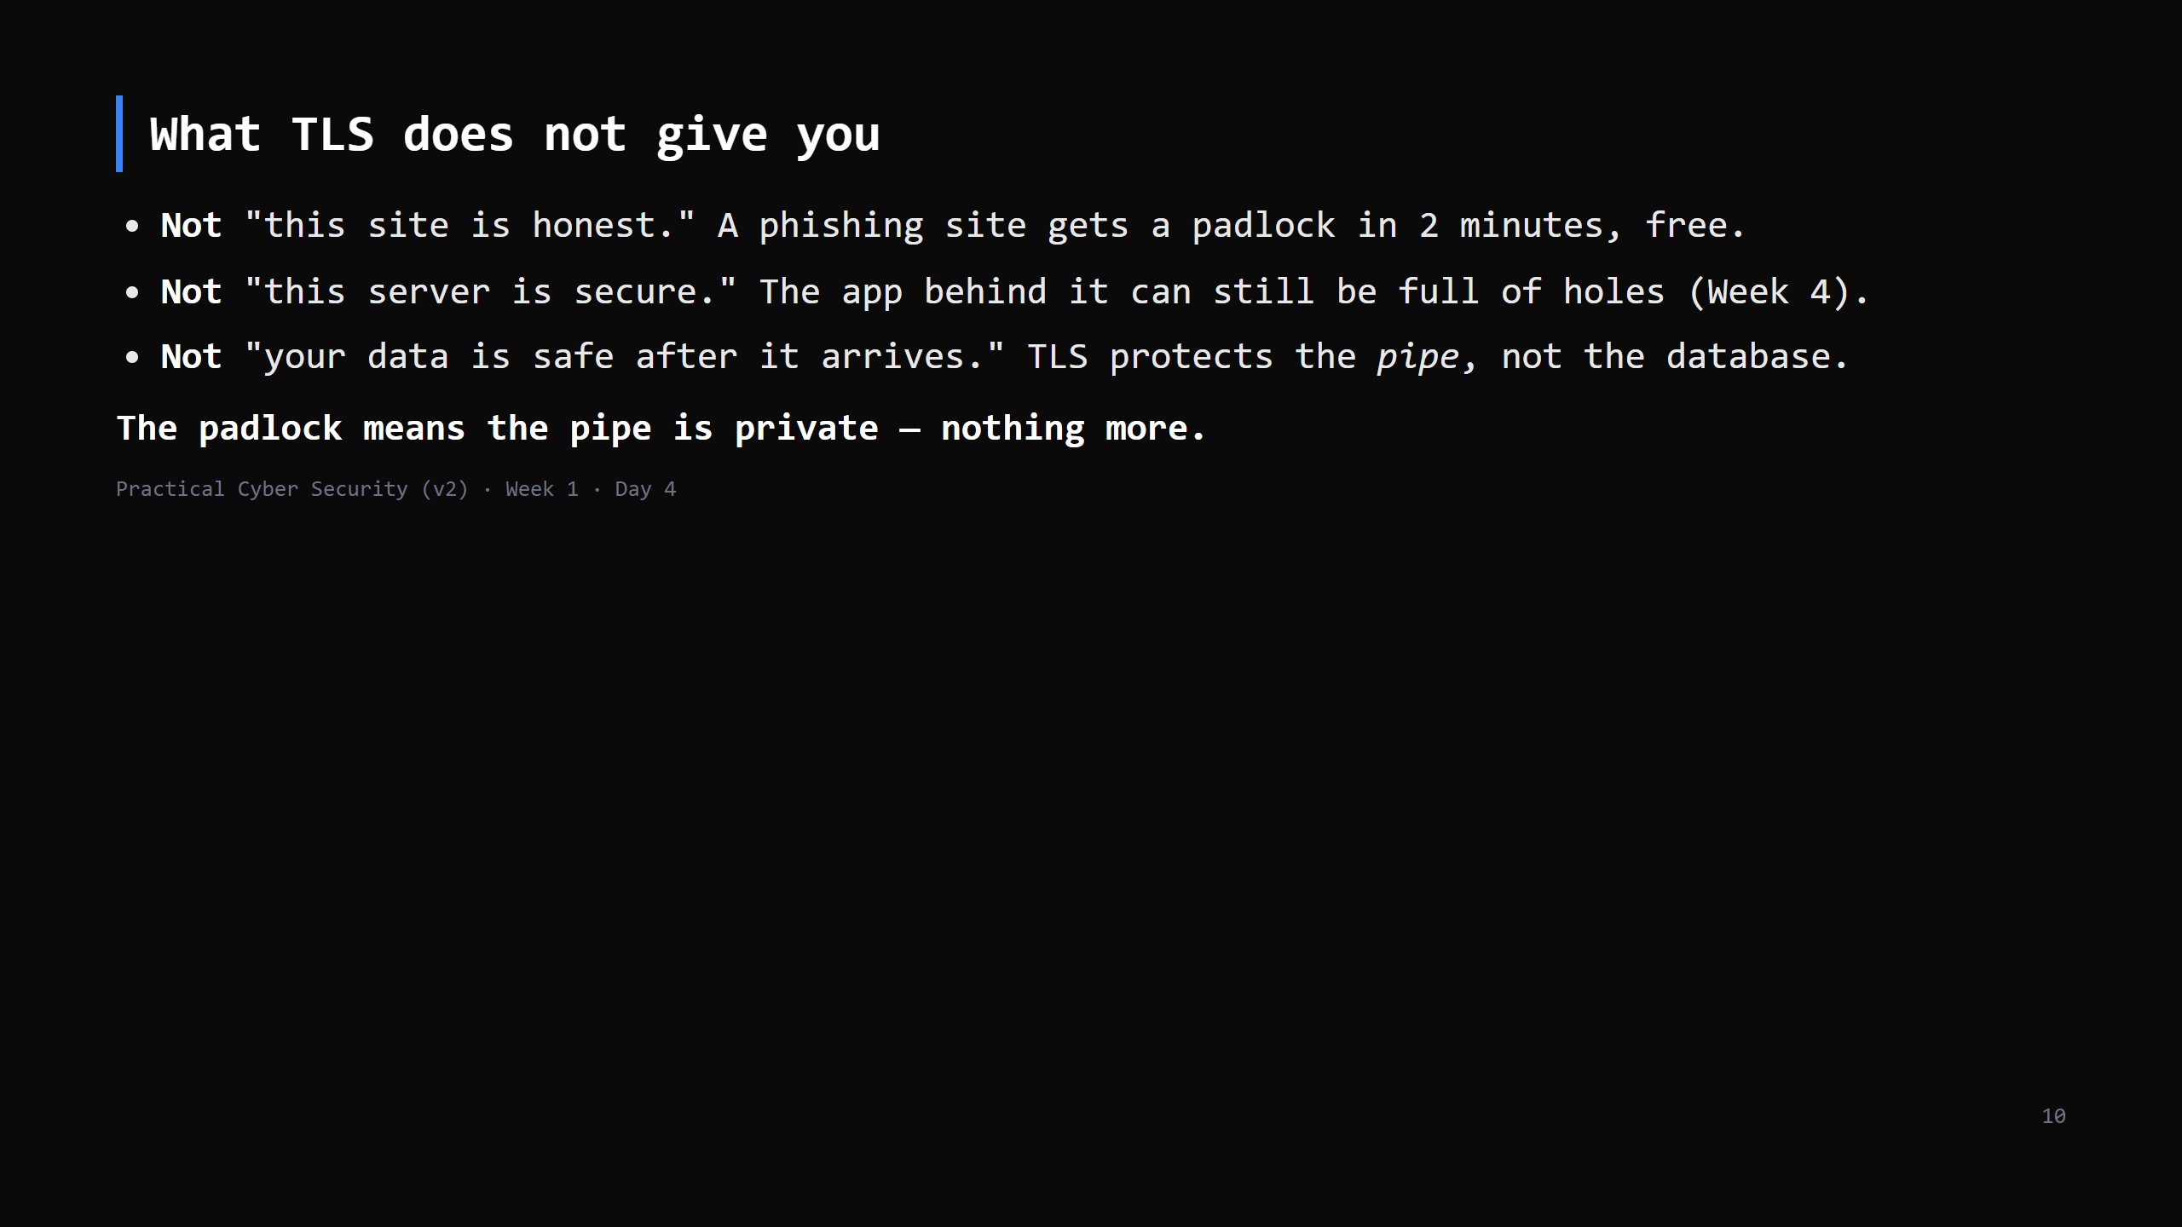
Notes:
THIS is the Day 4 trap and it's important. Students equate padlock = trustworthy. Say it twice. Most phishing today is HTTPS. TLS answers "is anyone listening / tampering / is this the right server" — never "should I trust this business."

Slide 11
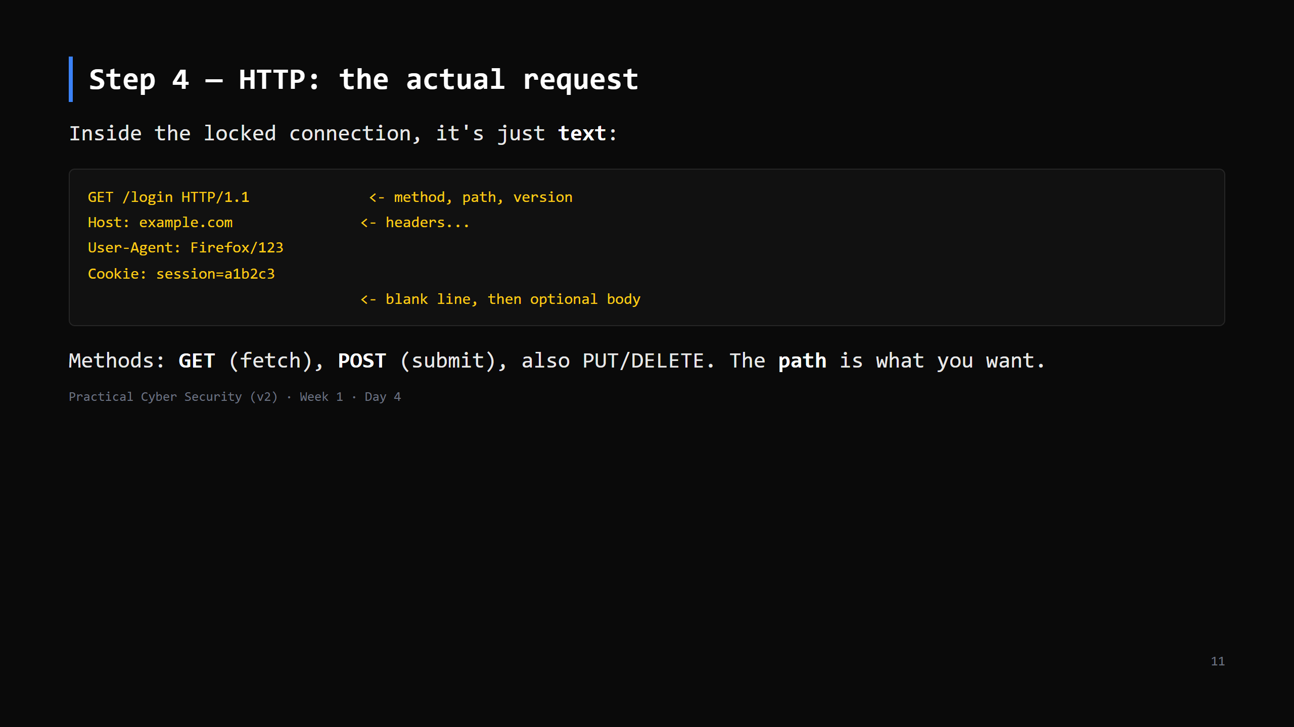
Notes:
It really is plain text — that's why hand-crafting it (next "do it now") works. The Cookie header is the one to flag: it's how the server knows "this is the same logged-in person" across requests. Remember it for the attack slide.

Slide 12
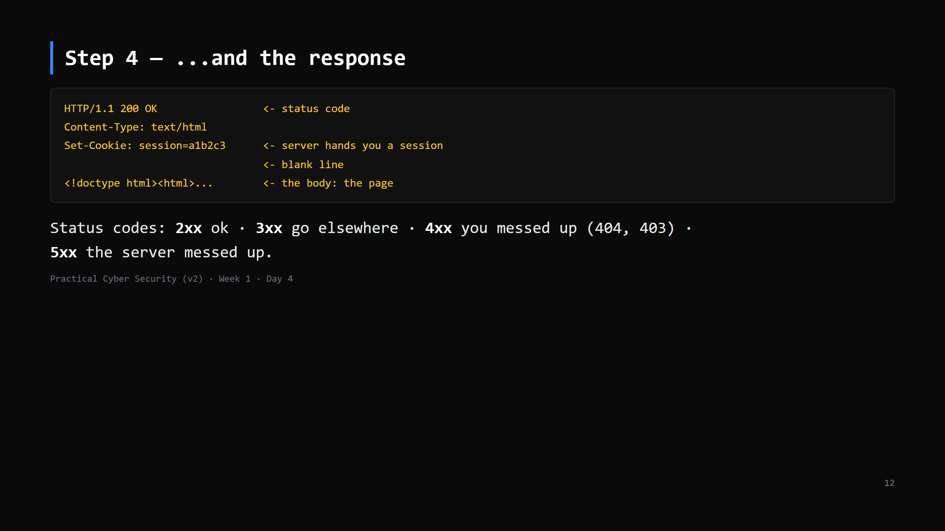
Notes:
`Set-Cookie` on the response is the server saying "wear this badge on every future request." That badge = the session. Whoever holds it IS you, to the server. Attack slide.

Slide 13
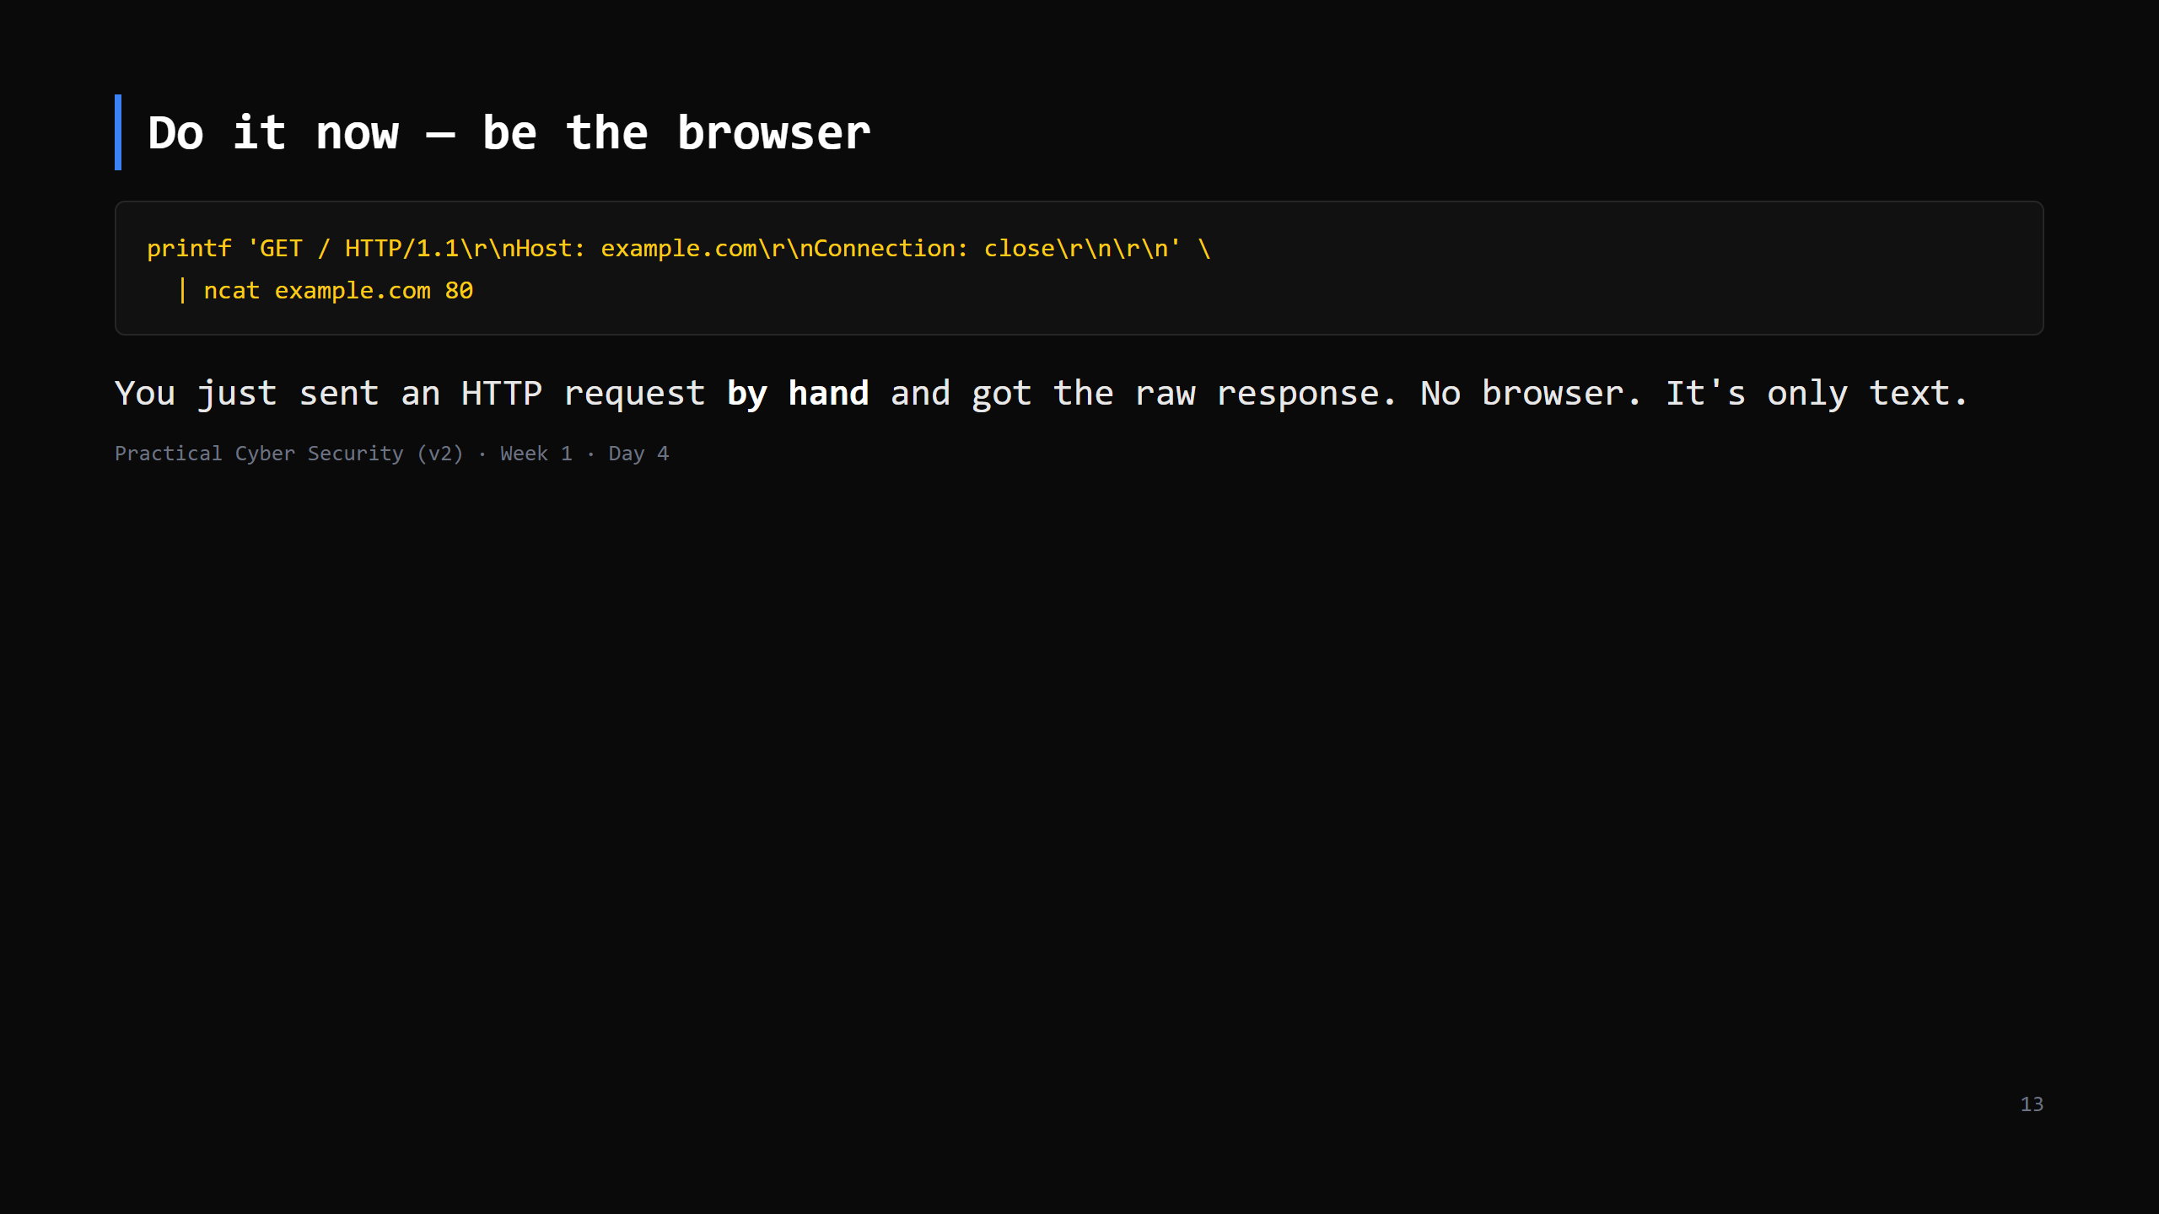
Notes:
5 min. Windows: install ncat (part of Nmap) or use PowerShell: $c=[Net.Sockets.TcpClient]::new('example.com',80); ... (script in assets/http_by_hand.ps1) This must be plain HTTP (port 80) — over 443 you'd get TLS binary garbage, which is the point: "see? without the lock it's readable; with it, it's not." Expected: a 200 or a 301 redirect to https. Reading a redirect is a fine outcome.

Slide 14
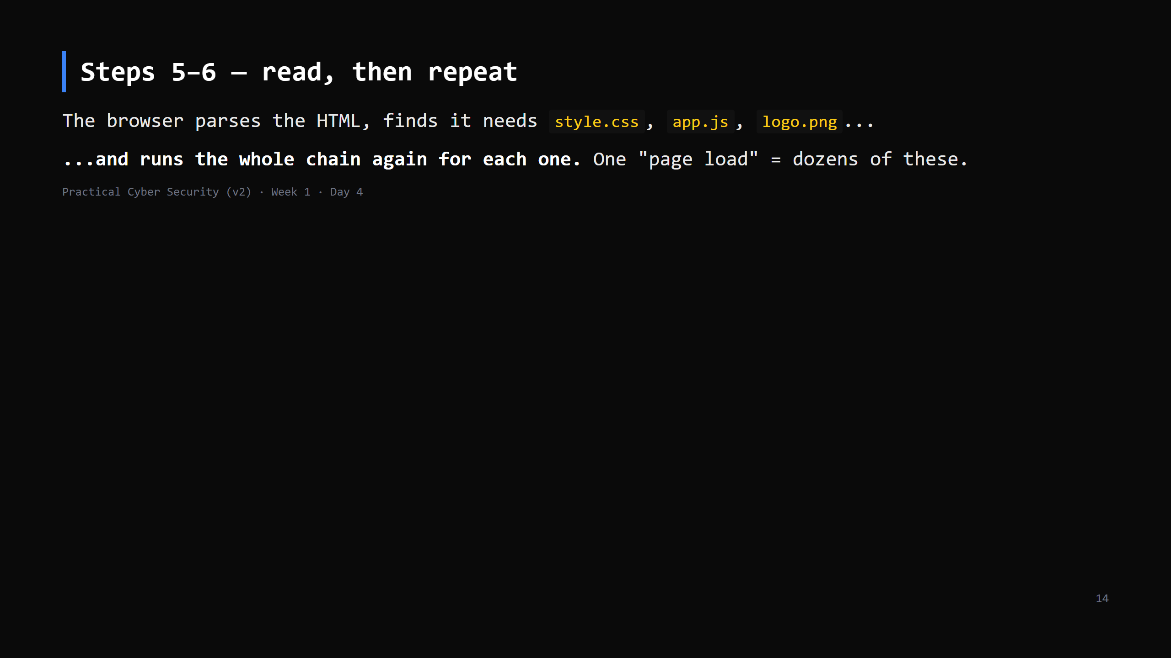
Notes:
30 seconds. Just so "7 steps" doesn't feel too clean — a real page is the chain, fanned out. CUT this slide first if short.

Slide 15
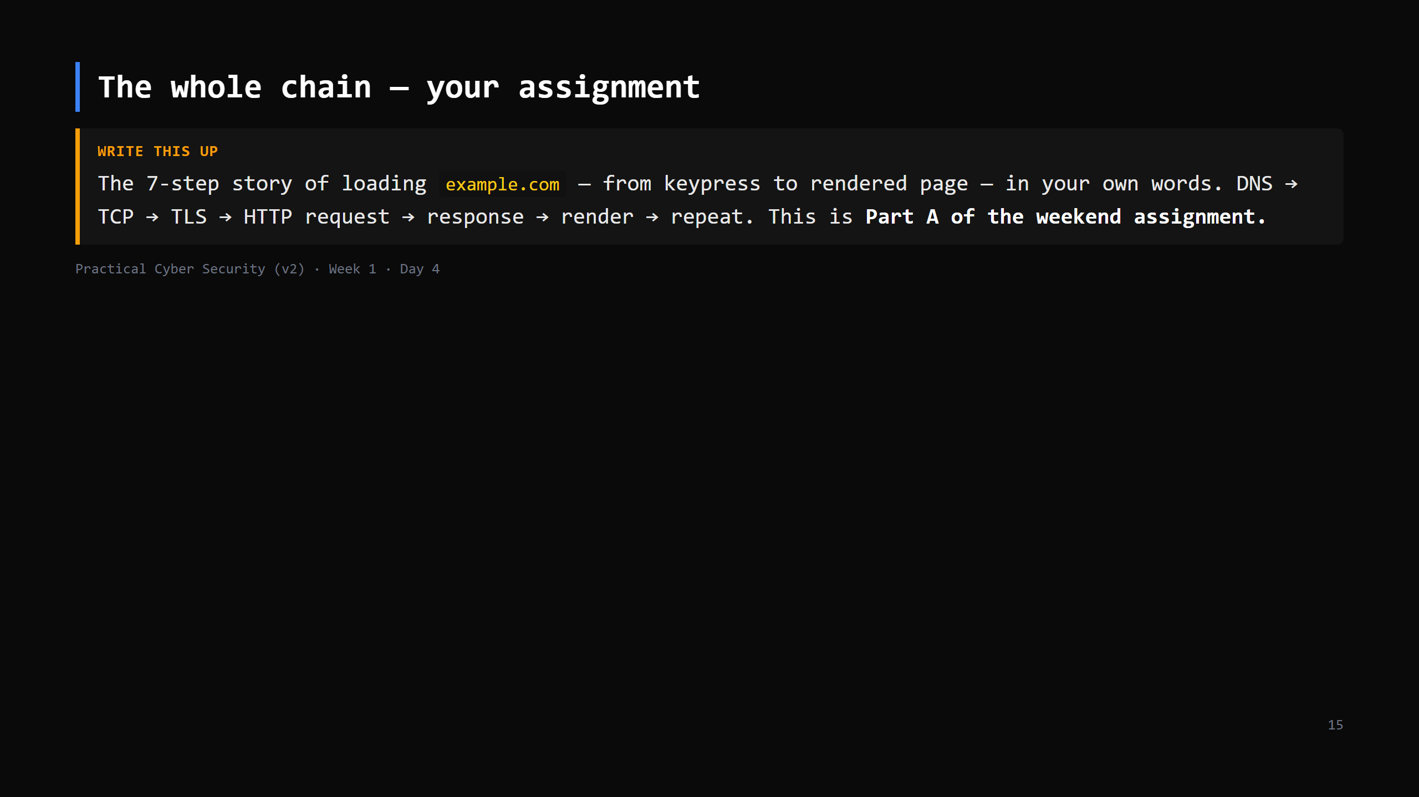
Notes:
Point at the board where the 6 steps have been ticked off all lesson. Tell them tonight's homework is the first draft of this; Friday's briefing turns it into the full assignment.

Slide 16
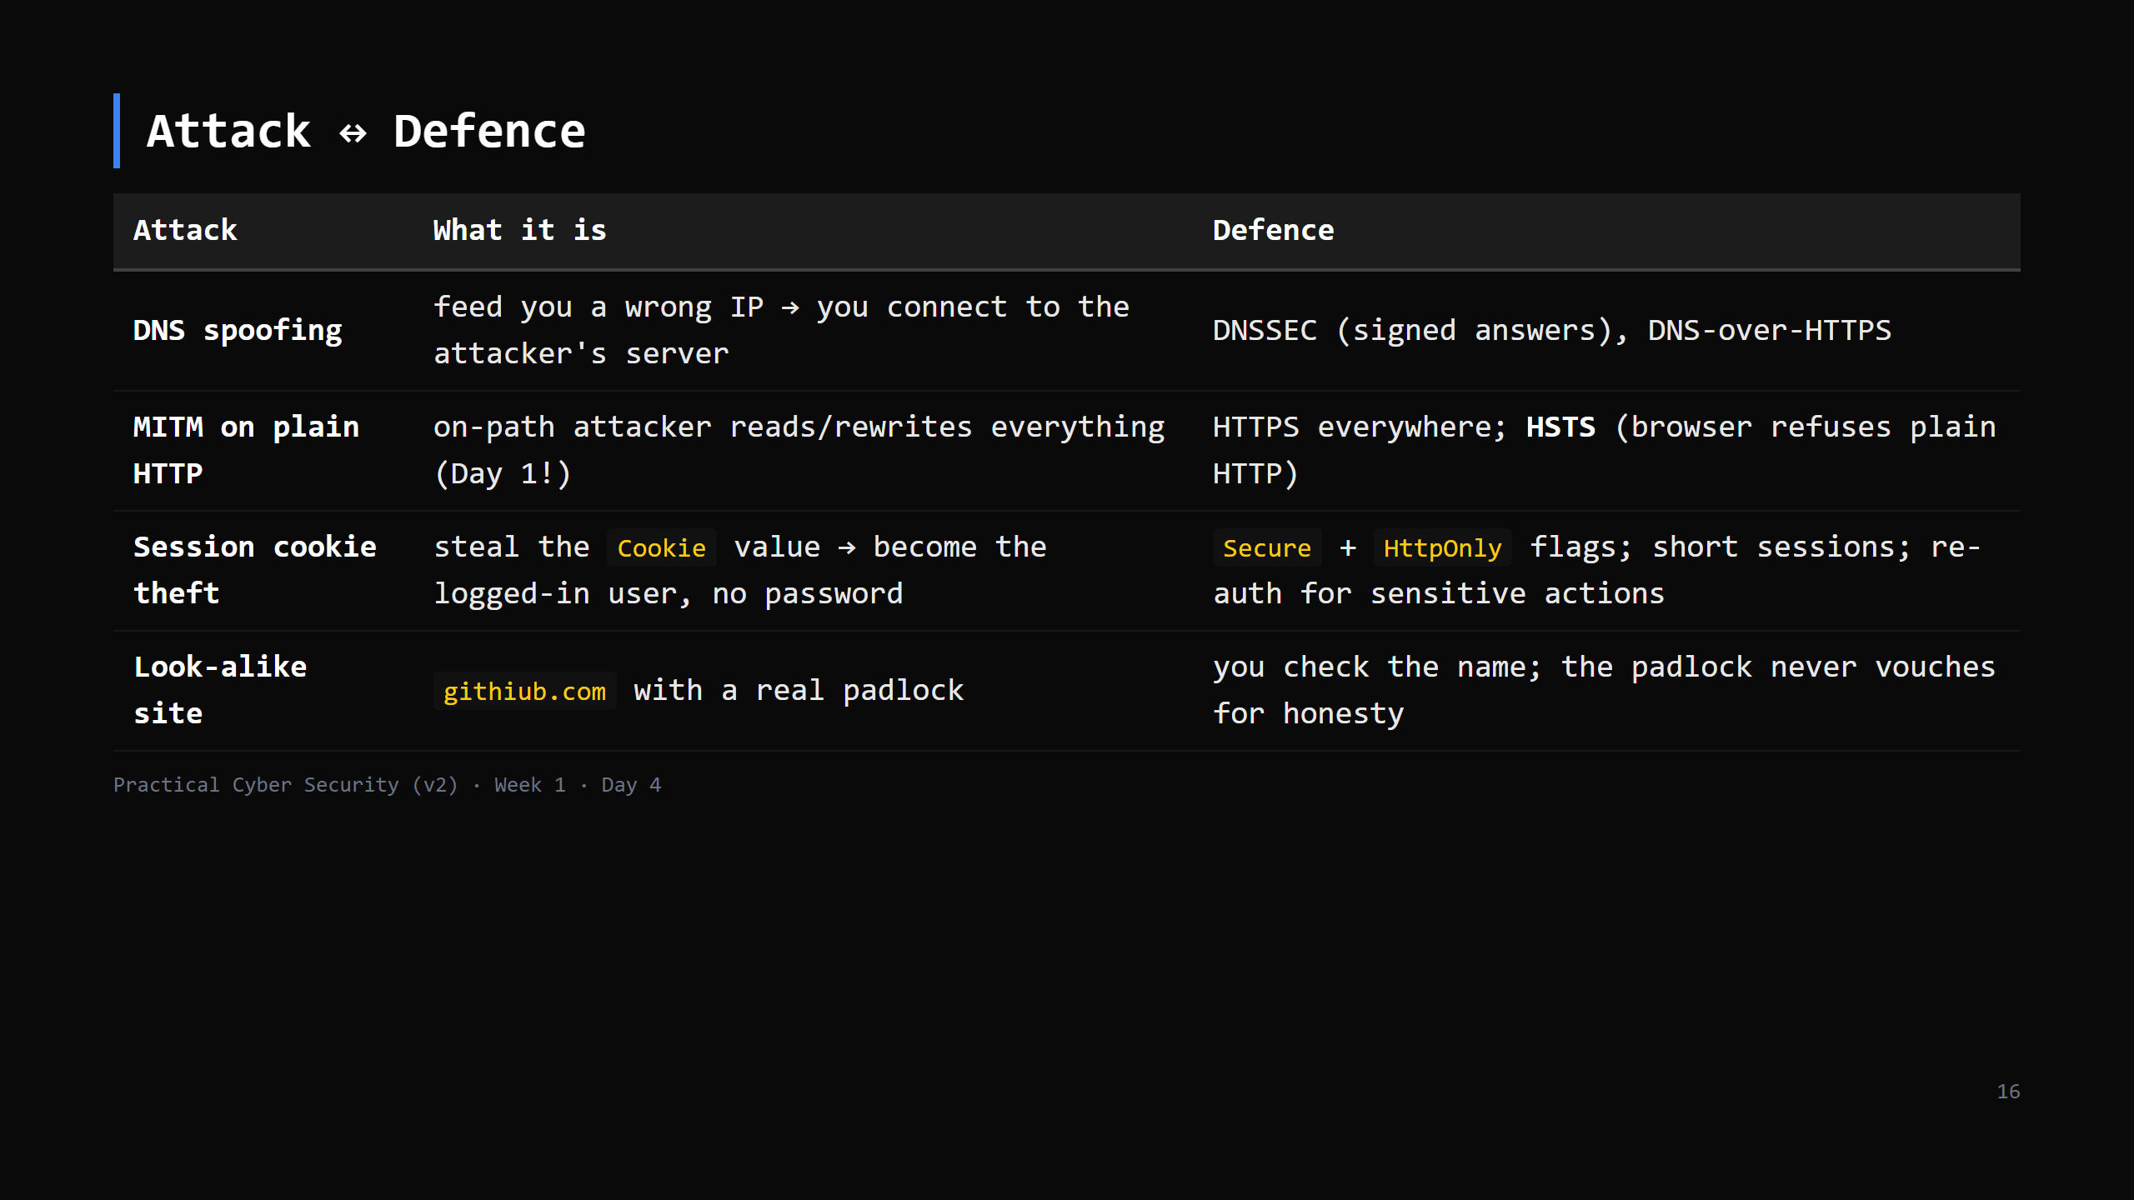
Notes:
Tie together: the Day 1 sniff = MITM on plain HTTP. The cookie theft one lands hardest — "the password isn't the crown jewel; the session is." forward-ref Day 16 (web attacks).

Slide 17
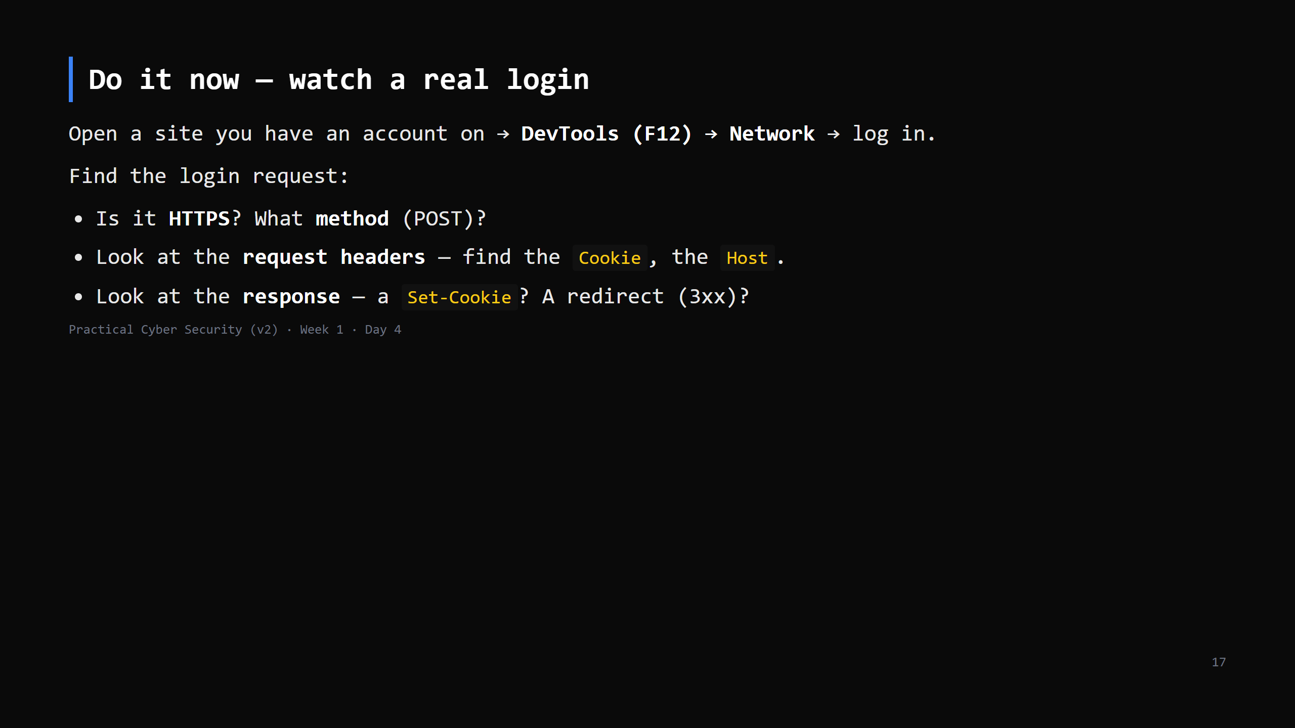
Notes:
6 min, the payoff of the whole day — every concept, live, on a site they use. Tell them NOT to paste passwords into the class chat / screenshots for homework — blur creds. Chrome & Firefox both: F12 -> Network, tick "Preserve log", then log in.

Slide 18
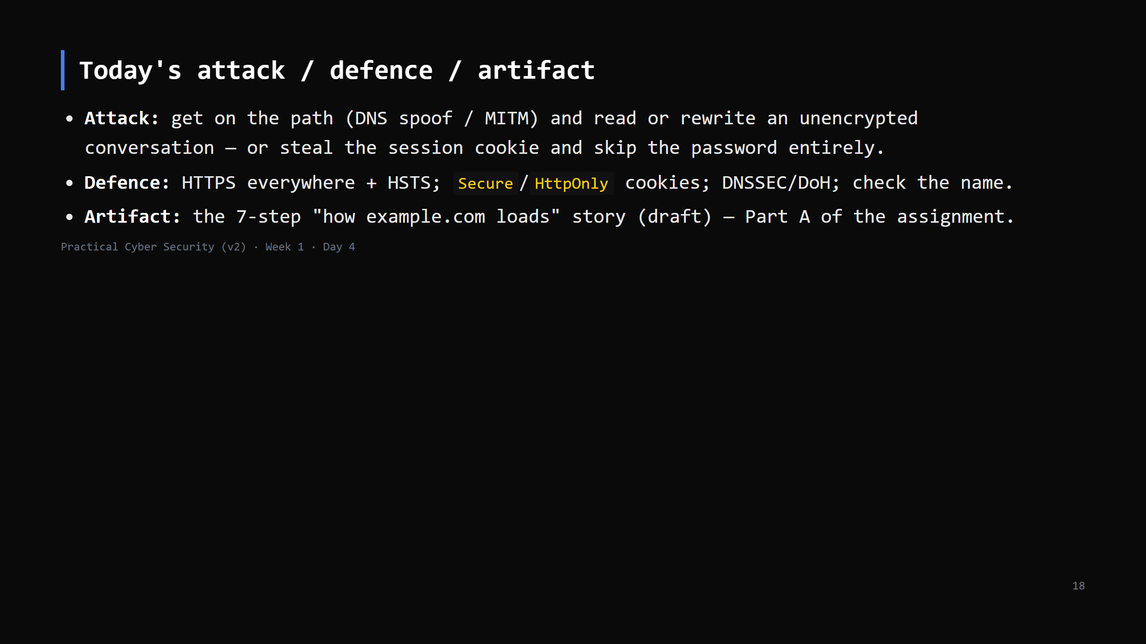

Slide 19
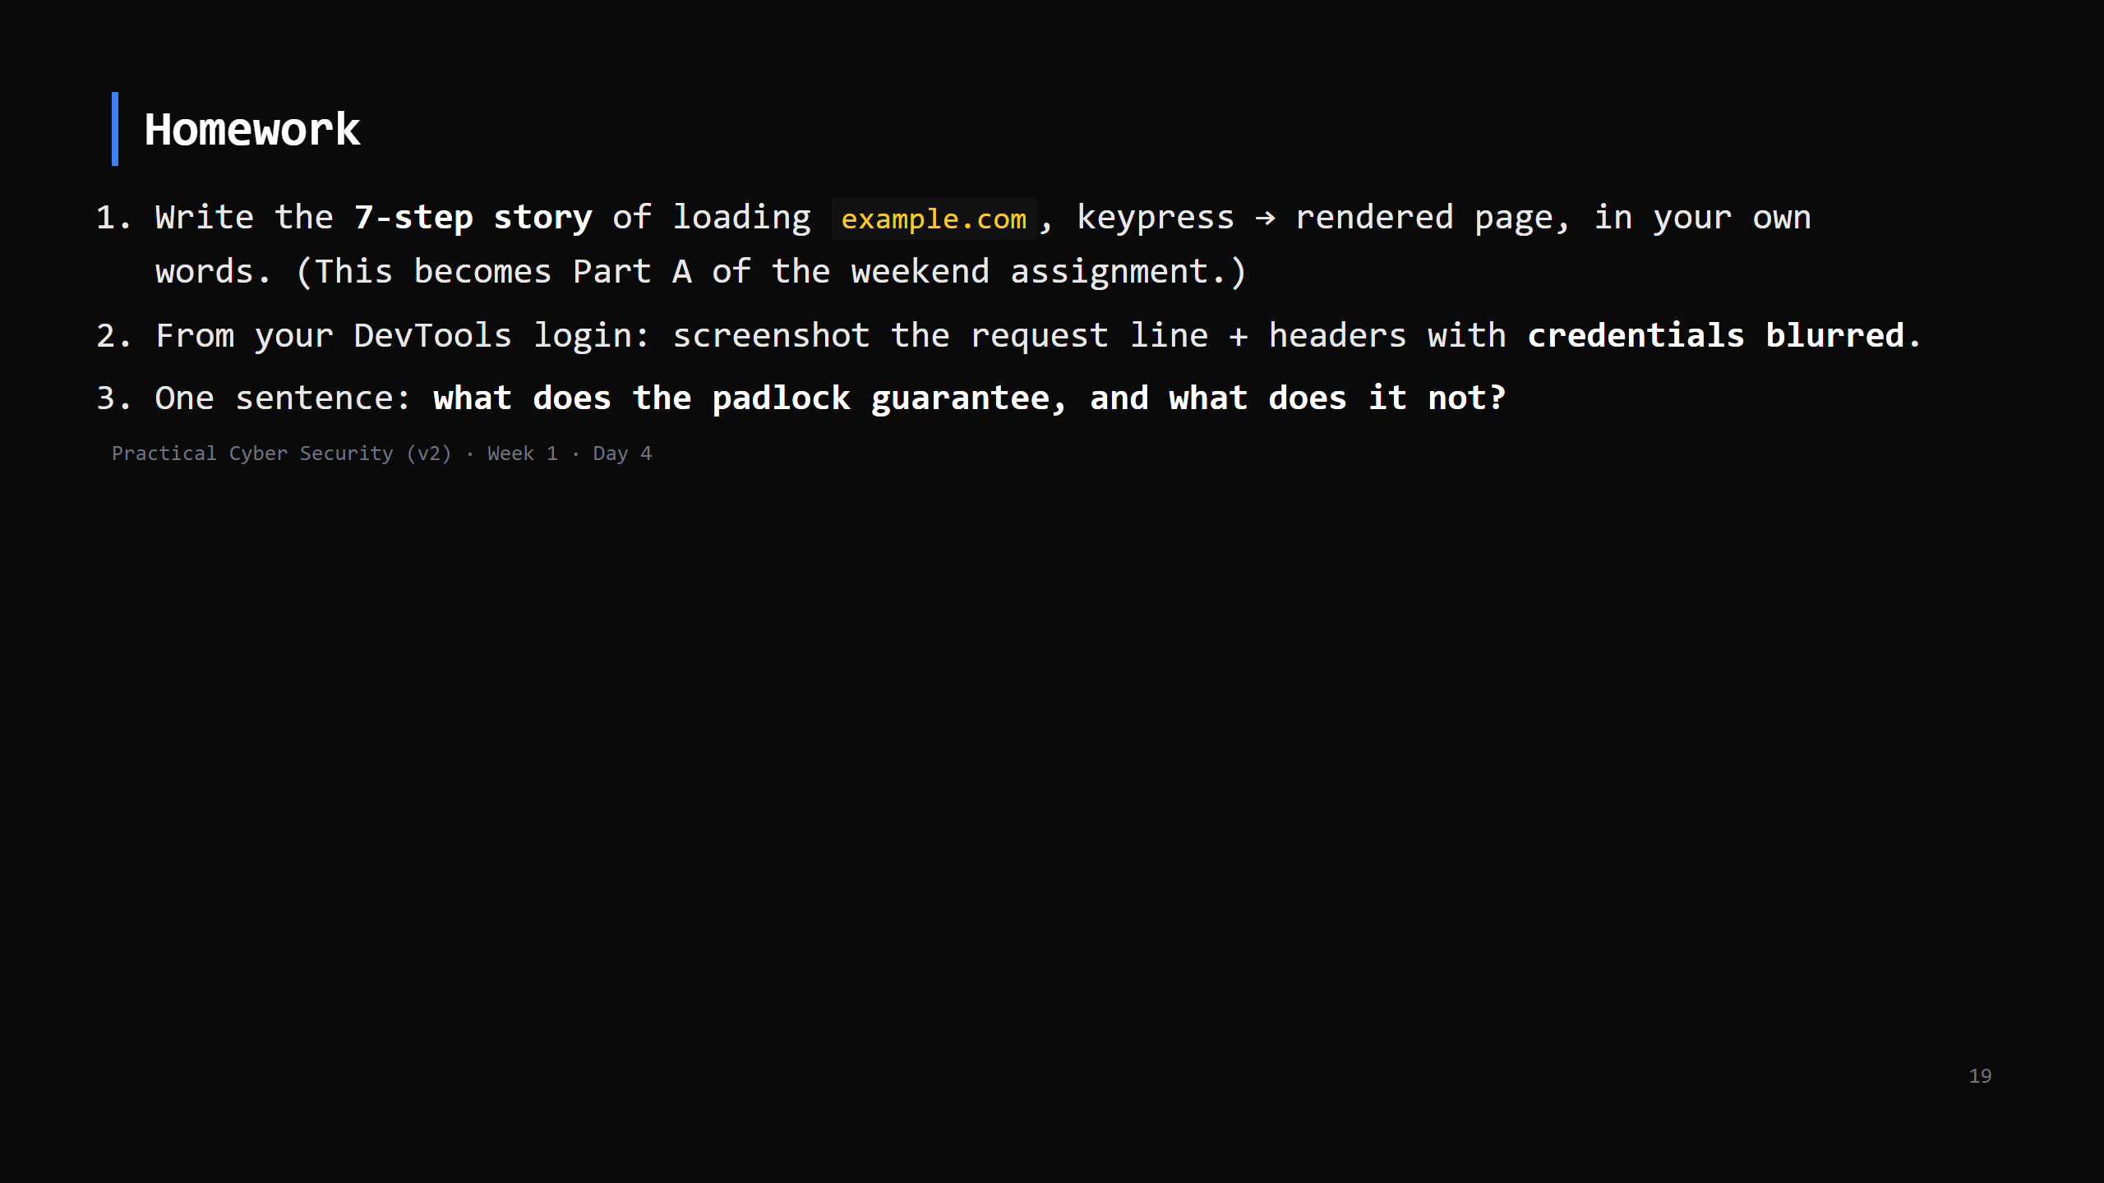
Notes:
Due start of Day 5. Day 5 (Friday) briefs the full weekend assignment.

Slide 20
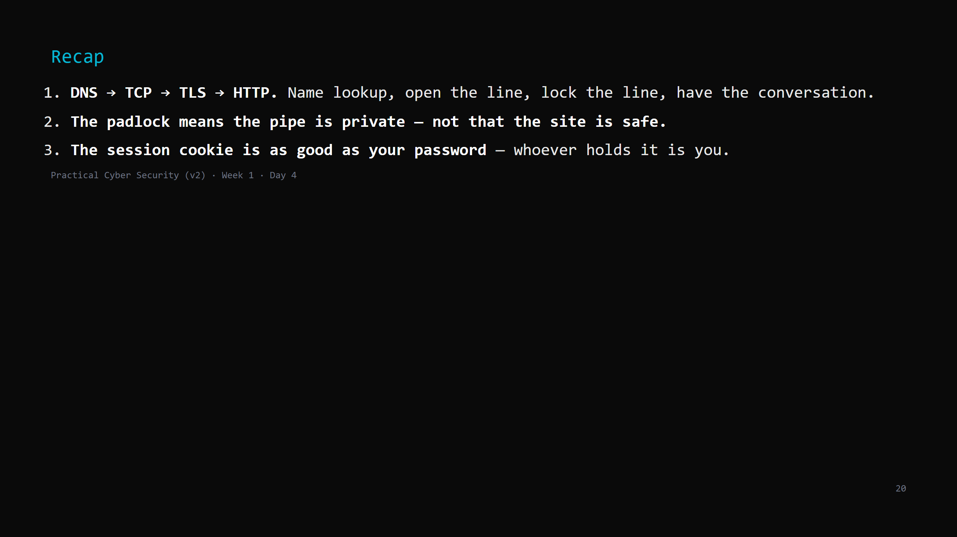
Notes:
Say the three lines. Tomorrow: how the lock actually works — hashing, keys, certificates — and you'll crack a password hash yourself.

