Slide 1
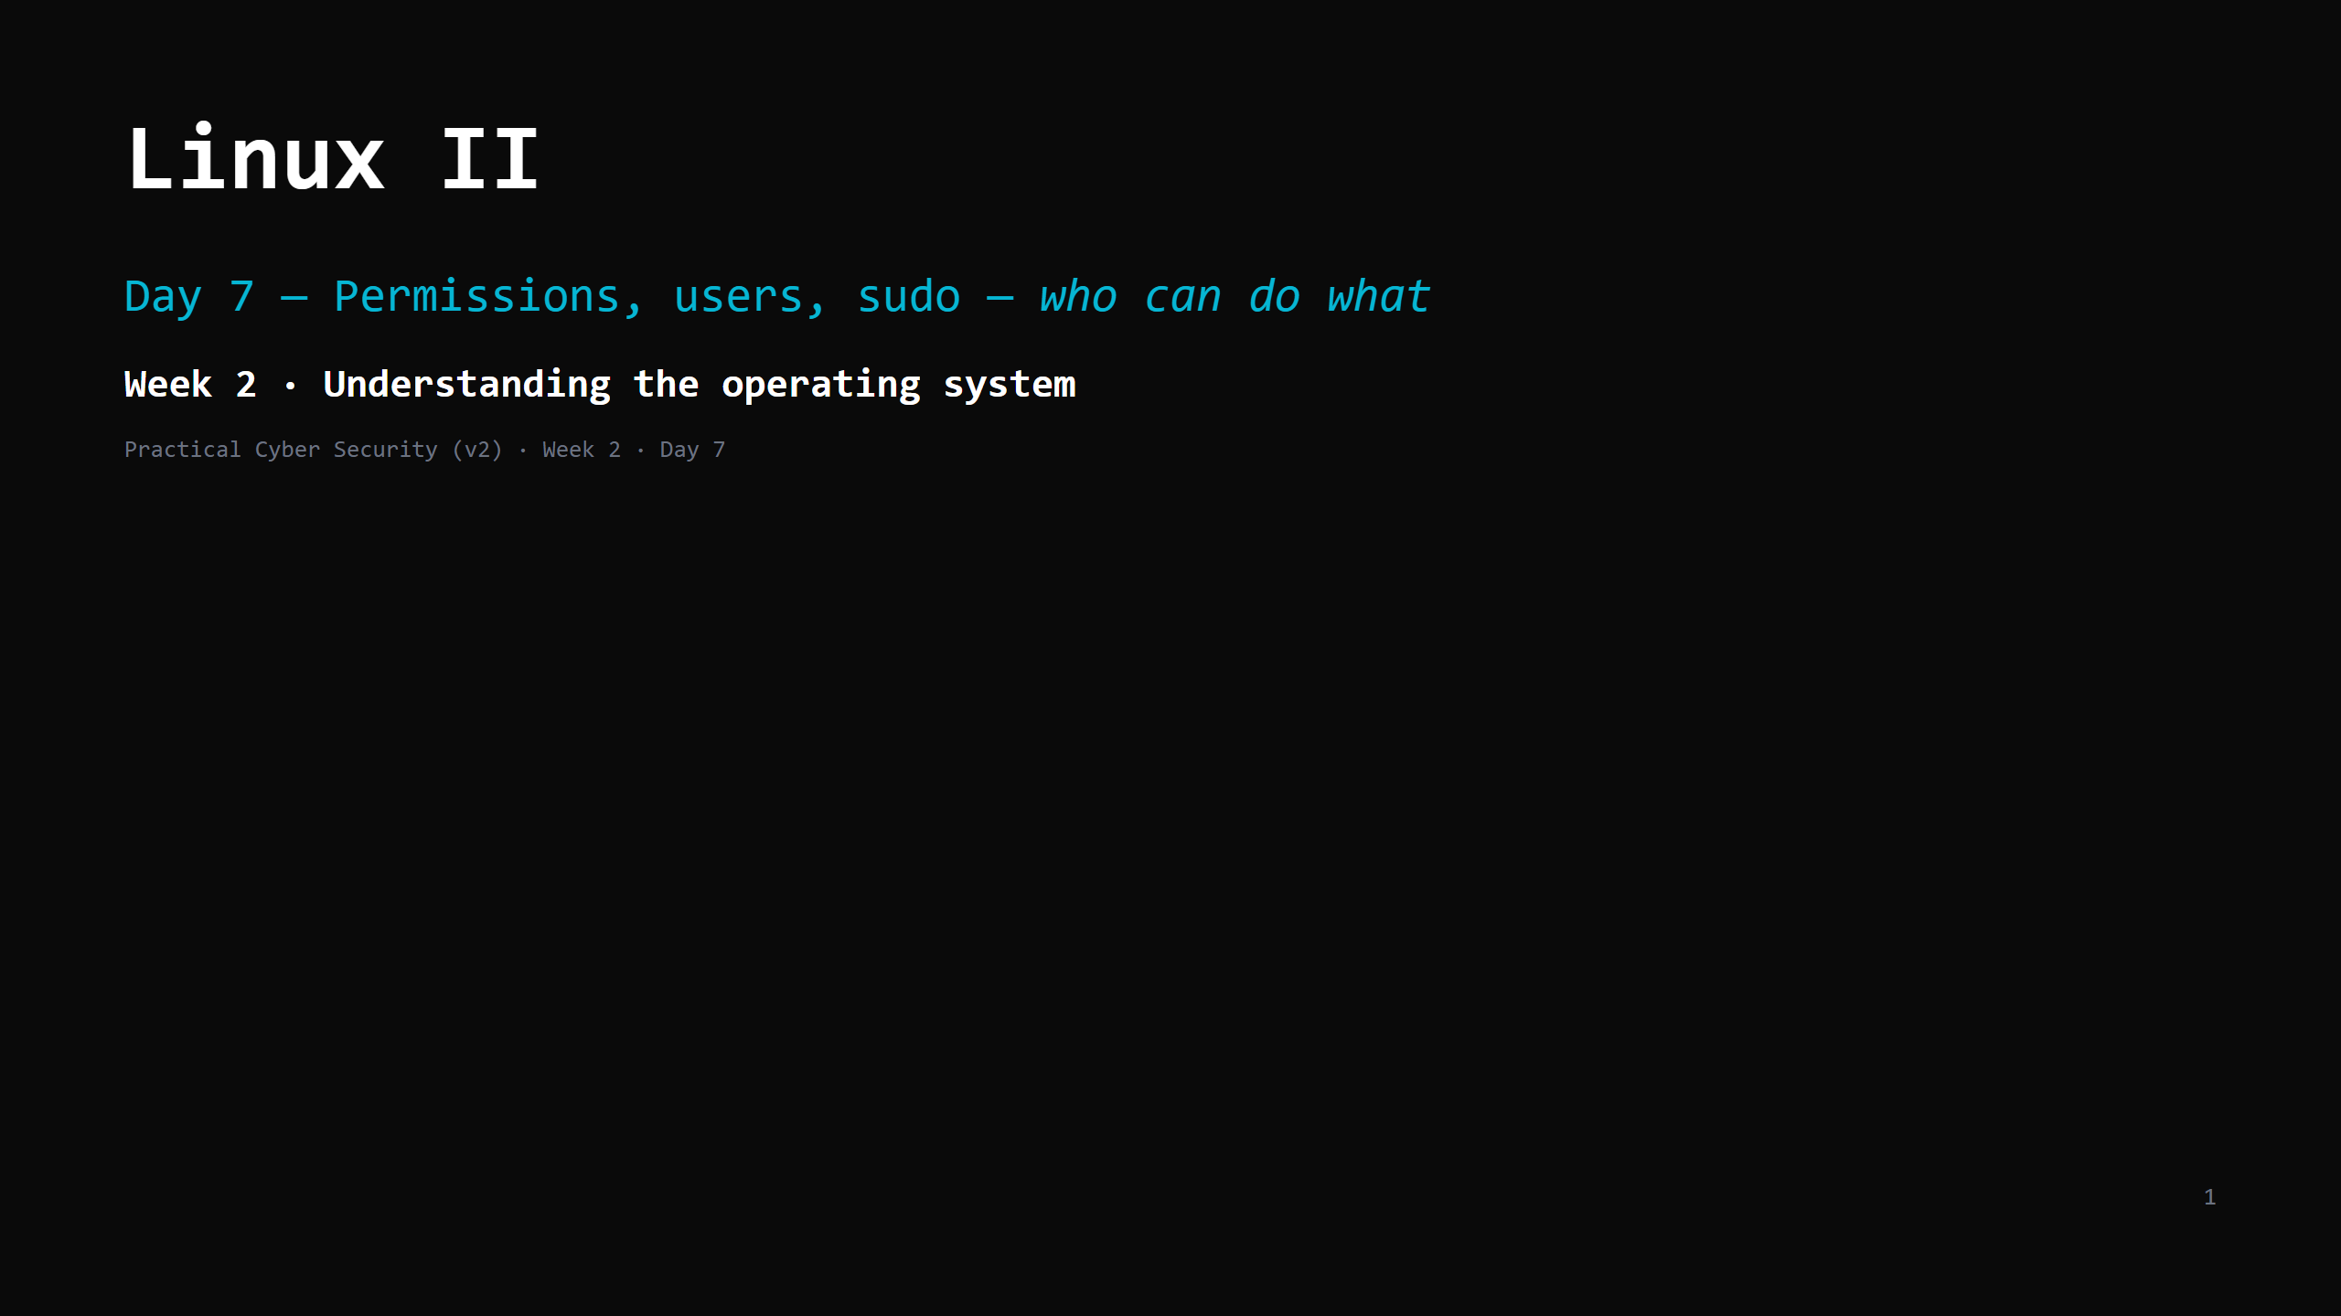
Notes:
RUN SHEET (~85 min). Hands-on INTERLEAVED — skills day. 00:00 Journey check + hook (why can't I write /etc/passwd?) 4 00:04 The permission triple 8 00:12 DO: read permissions 5 00:17 Owner / group / everyone else 6 00:23 chmod / chown 8 00:31 DO: break perms, then fix them 7 00:38 root and sudo 8 00:46 DO: sudo -l, sudo vs no-sudo 4 00:50 Processes & services (quick recall of Day 2) 6 00:56 cron — scheduled jobs 5 01:01 Privilege escalation — the crack in the model 9 01:10 Attack <-> defence 5 01:15 Wrap + artifact + homework 5 CUT FIRST IF SHORT: the cron slide (name it, one line); the processes/services slide (Day 2 recall). NEVER CUT: reading rwx, chmod (symbolic + numeric), root vs sudo, the priv-esc concept, the artifact. ANALOGY (kitchen): permissions = the KEY CABINET. Every file/door has labels for owner / group / everyone saying who may look (r), change (w), enter or run (x). root = the master key. sudo = "borrow the master key for one job — and it's written in the logbook." NO real exploitation today — priv-esc is a CONCEPT here; the hands-on version is Day 17.

Slide 2
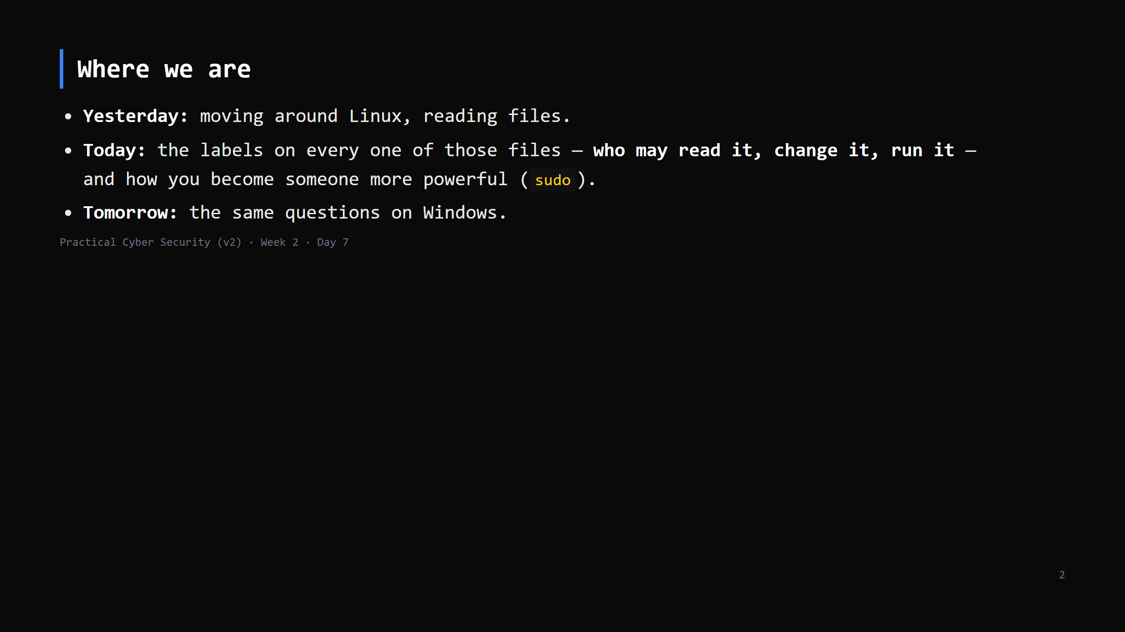
Notes:
Learning Journey Check. This is THE access-control day. The whole week's lens — "who can do what" — is literally on screen today as rwx bits.

Slide 3
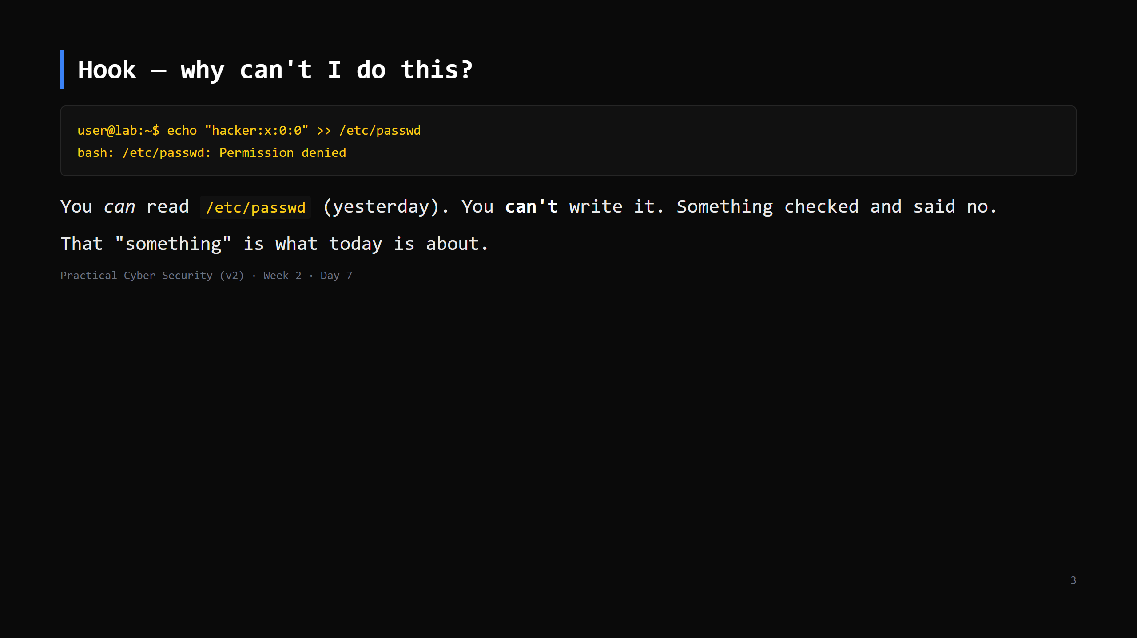
Notes:
Run it live — the denial is the point. "Yesterday cat worked. Now >> fails. Same file. What changed? Nothing — you were always only allowed to read it. Today you can see the rule."

Slide 4
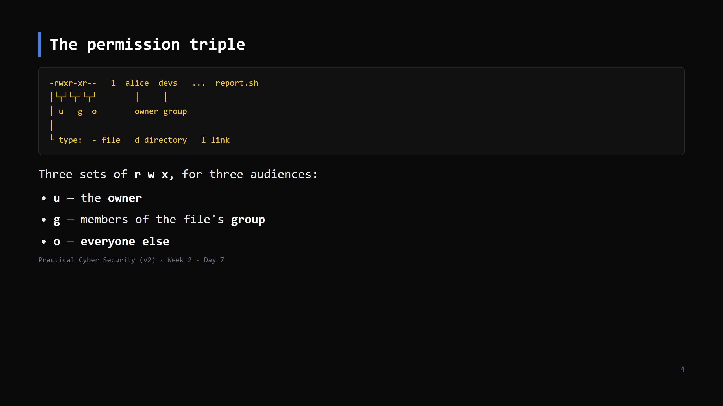
Notes:
Read it left to right. First char = type. Then user's rwx, group's rwx, other's rwx. r = read contents / list a directory w = change contents / add-remove files in a directory x = execute (a file) / enter + traverse (a directory) <- the dir case surprises people So `-rwxr-xr--` = owner: read+write+run · group: read+run · others: read only.

Slide 5
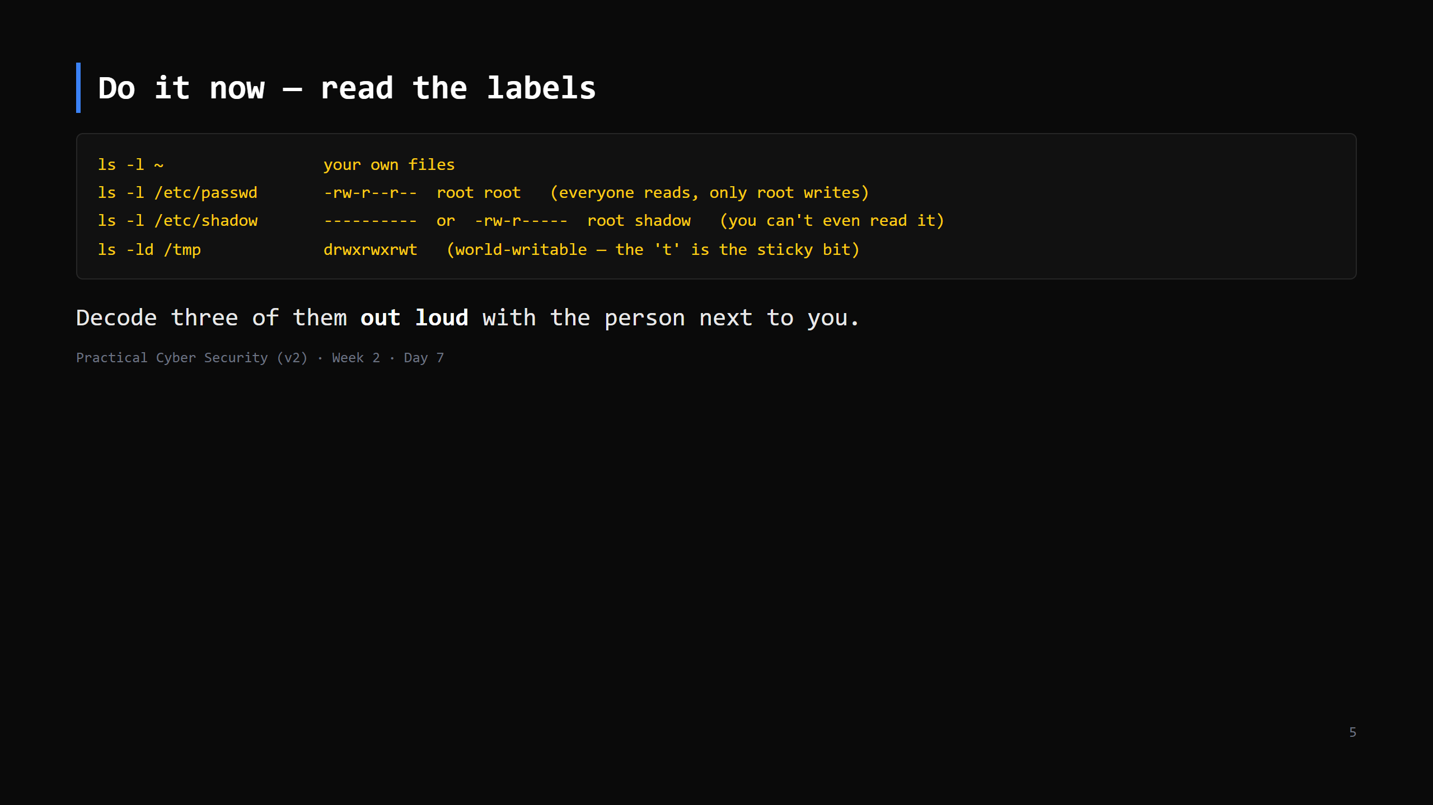
Notes:
5 min. /etc/shadow (password hashes) being unreadable to you is the payoff of the hook. /tmp being drwxrwxrwt: anyone can create files, but the sticky bit 't' means you can only delete your OWN. Note it, don't dwell.

Slide 6
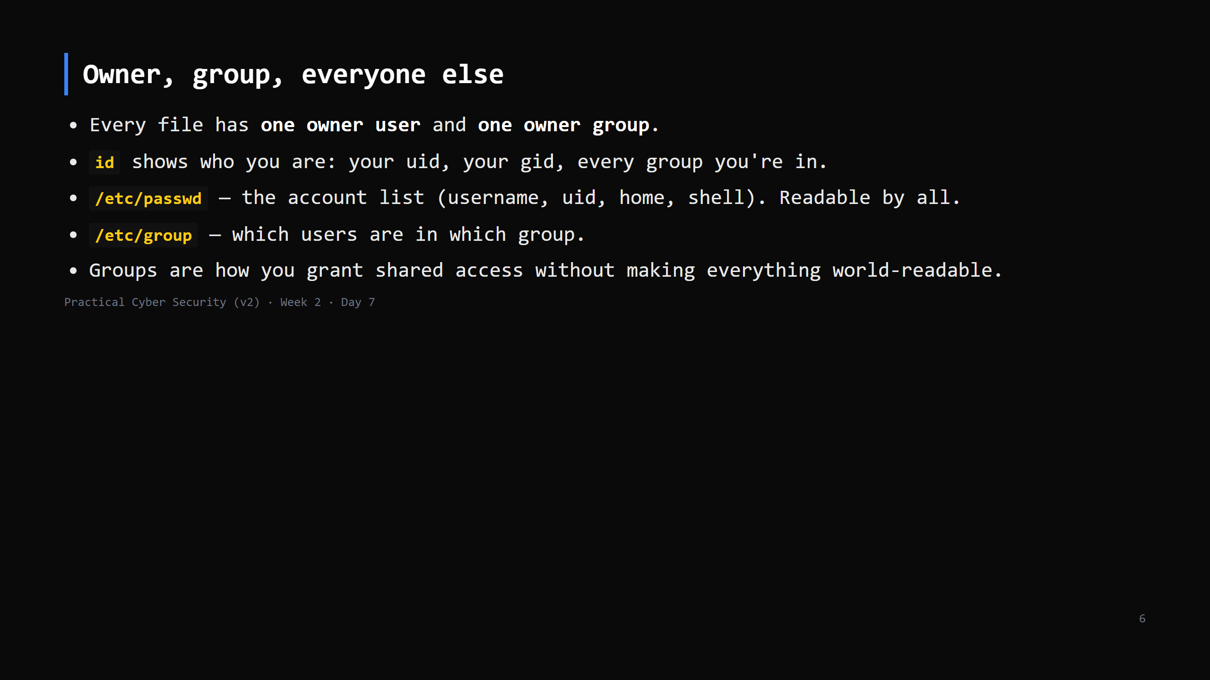
Notes:
`id` output: uid=1000(alice) gid=1000(alice) groups=1000(alice),27(sudo),... — the `sudo` group membership is what lets alice use sudo at all. Preview. /etc/passwd fields are colon-separated (Day 6 `cut -d:`): name:x:uid:gid:comment:home:shell. The `x` = "password is in /etc/shadow".

Slide 7
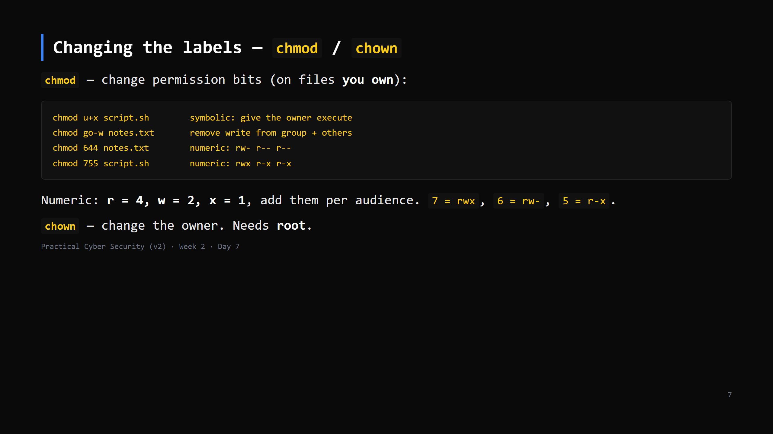
Notes:
Symbolic for quick edits, numeric for setting a whole mode. Make them do 644 and 755 by hand: "read-write for me, read for everyone" and "everyone can run it, only I can edit it". chown needs root because otherwise you could give your files away to frame someone, or grab someone else's.

Slide 8
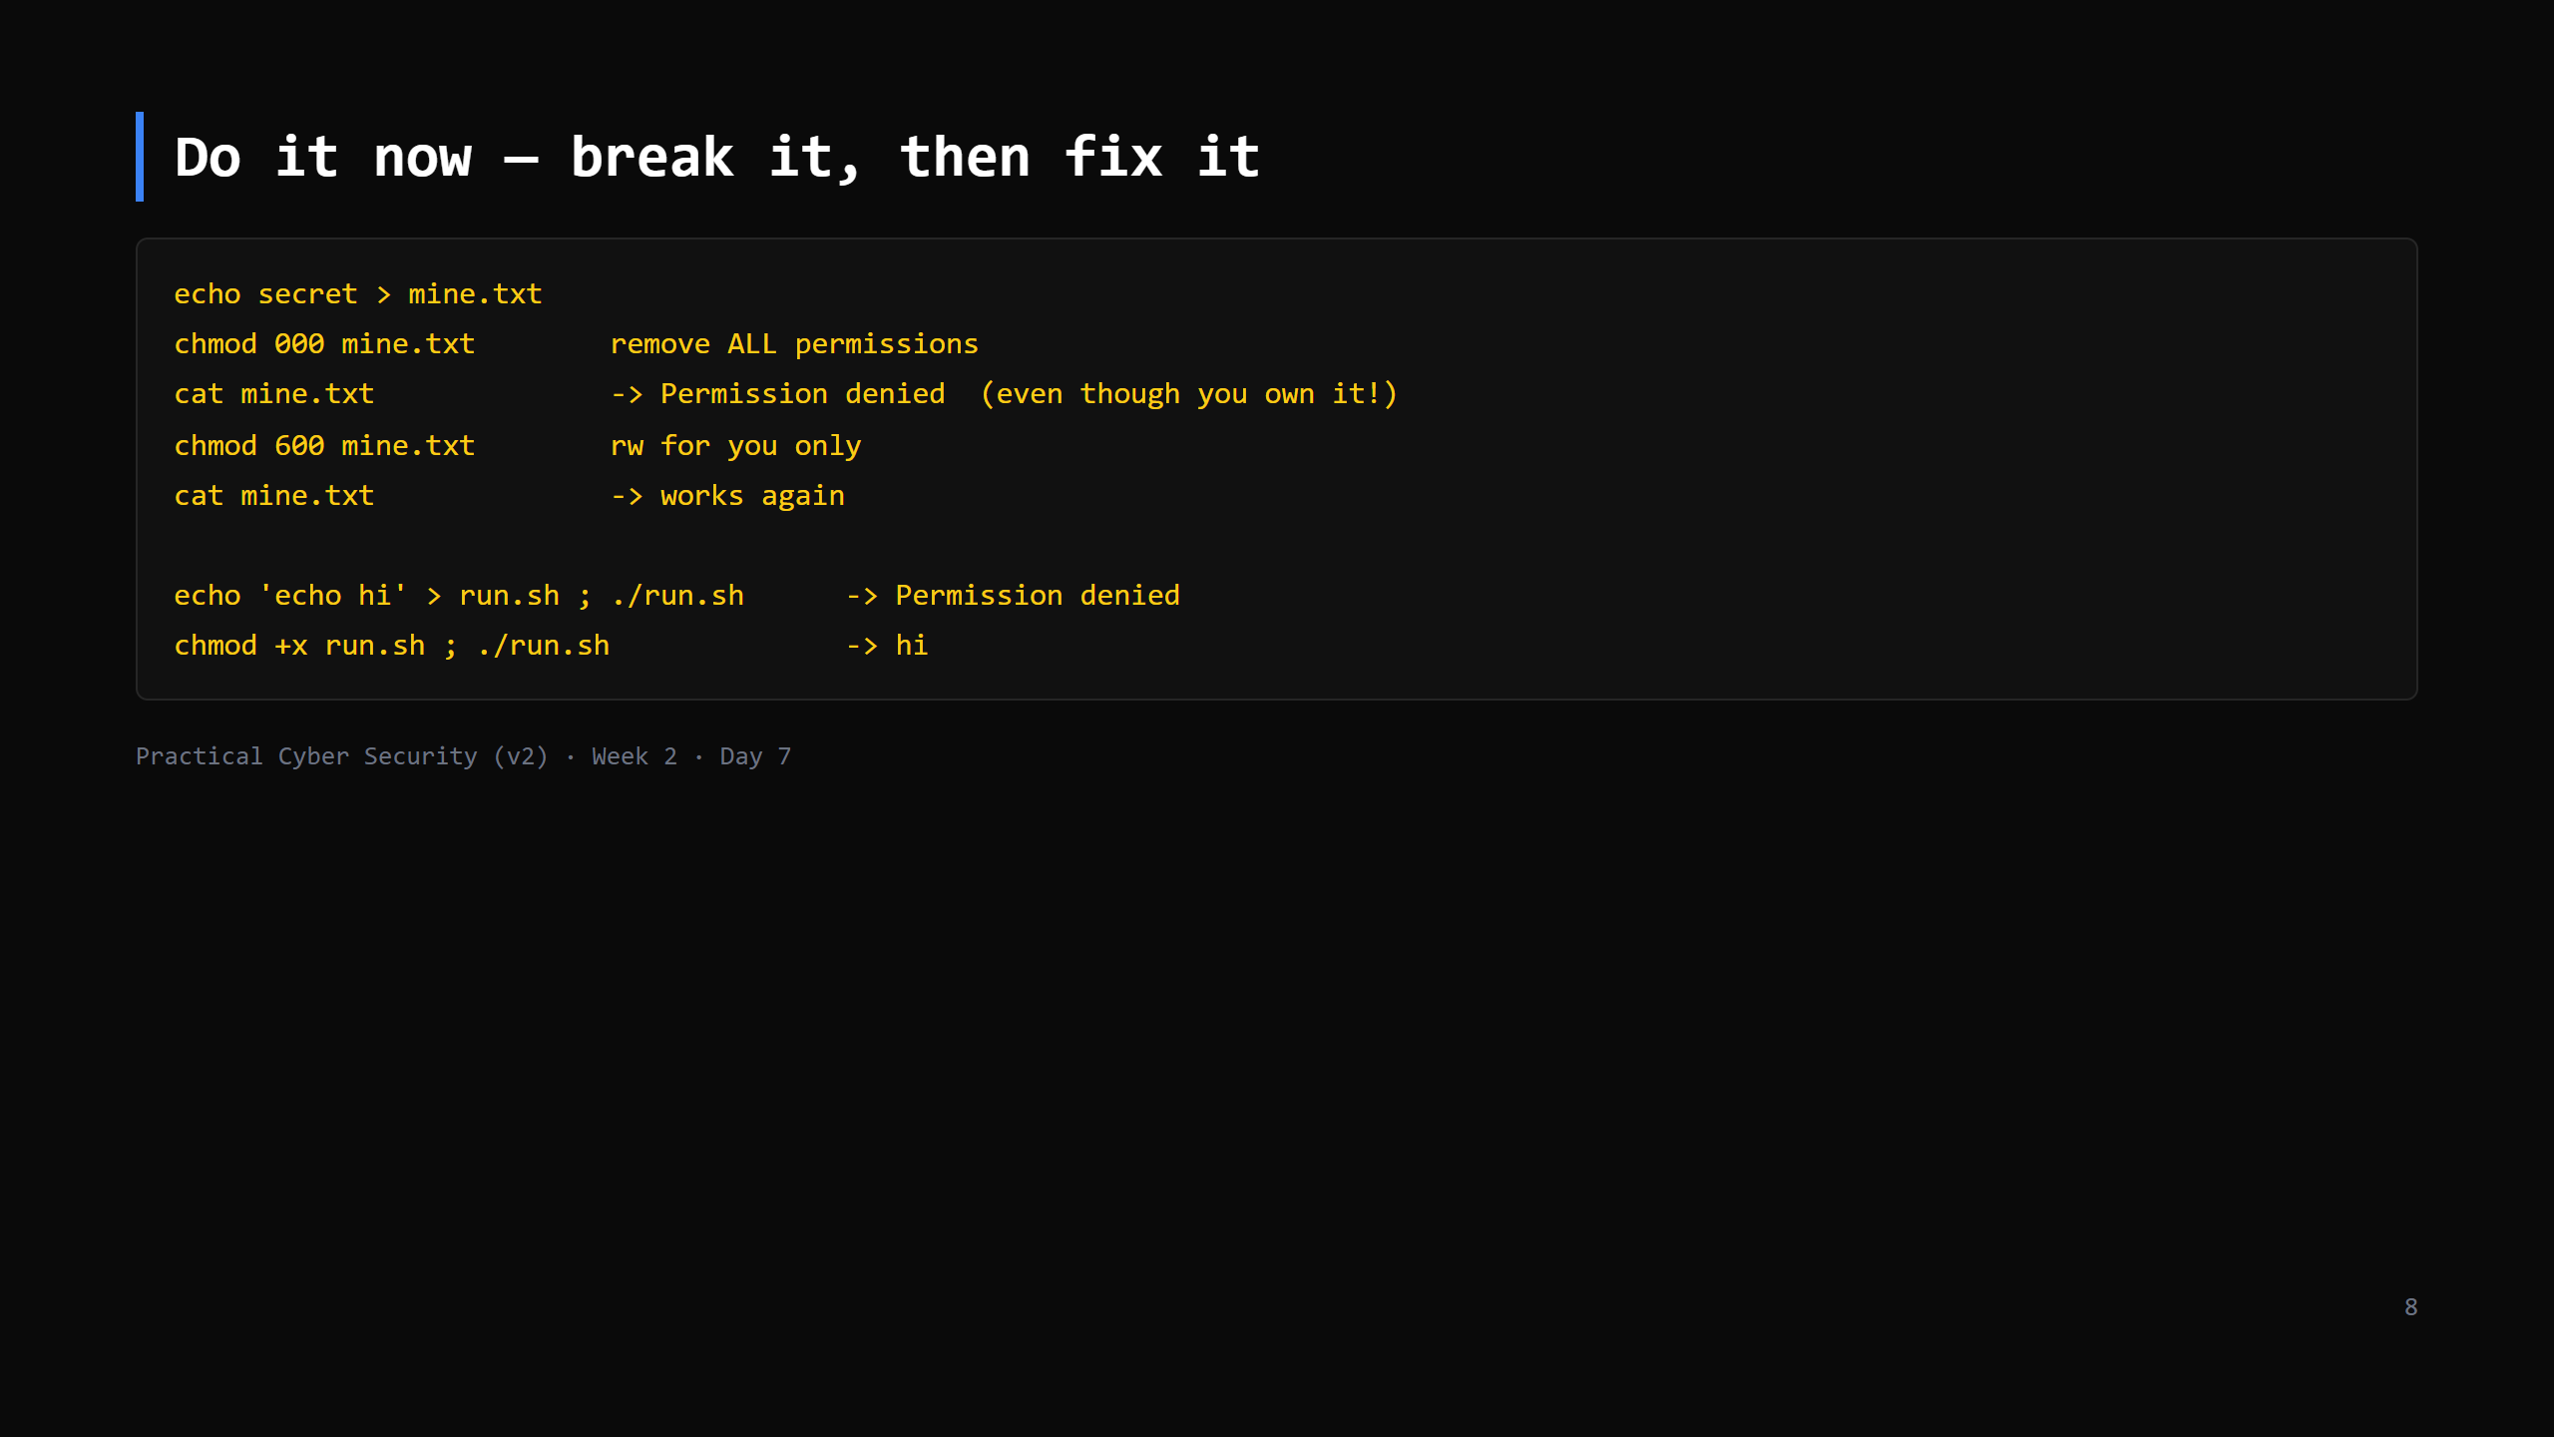
Notes:
7 min. Two lessons: (1) even the owner is bound by the bits — the OS doesn't make an exception. (2) a script needs +x to run; setting +x doesn't run it, it just permits it (Day 2 misconception).

Slide 9
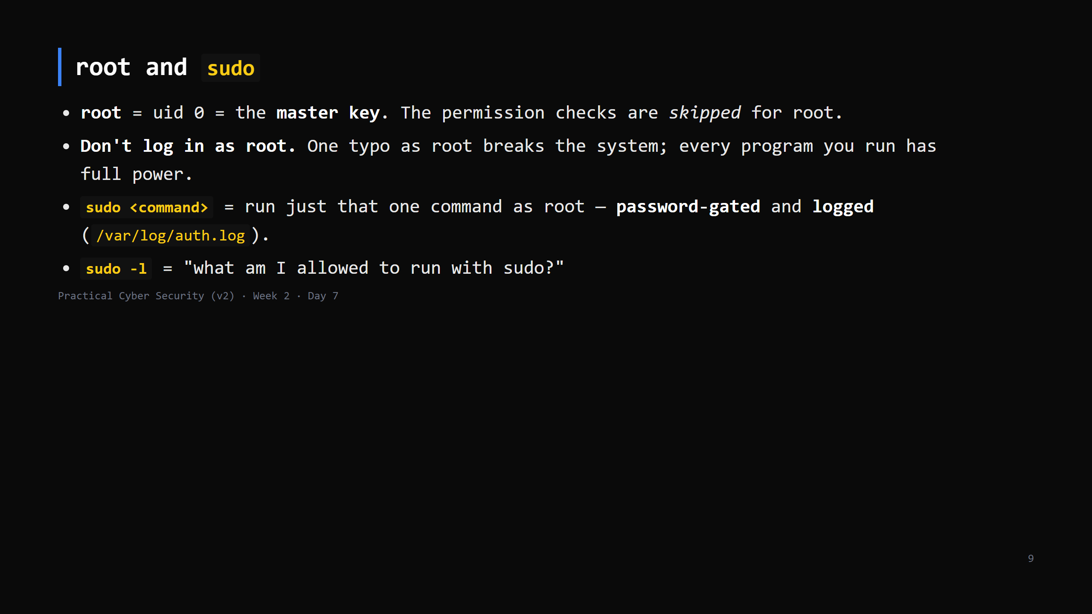
Notes:
The `#` prompt = root, `$` = normal user (Day 6). Least privilege in practice: you spend your day as a normal user and borrow power for the 3 commands that need it. Analogy: the master key lives in the manager's office; you sign the logbook, take it for one job, bring it back.

Slide 10
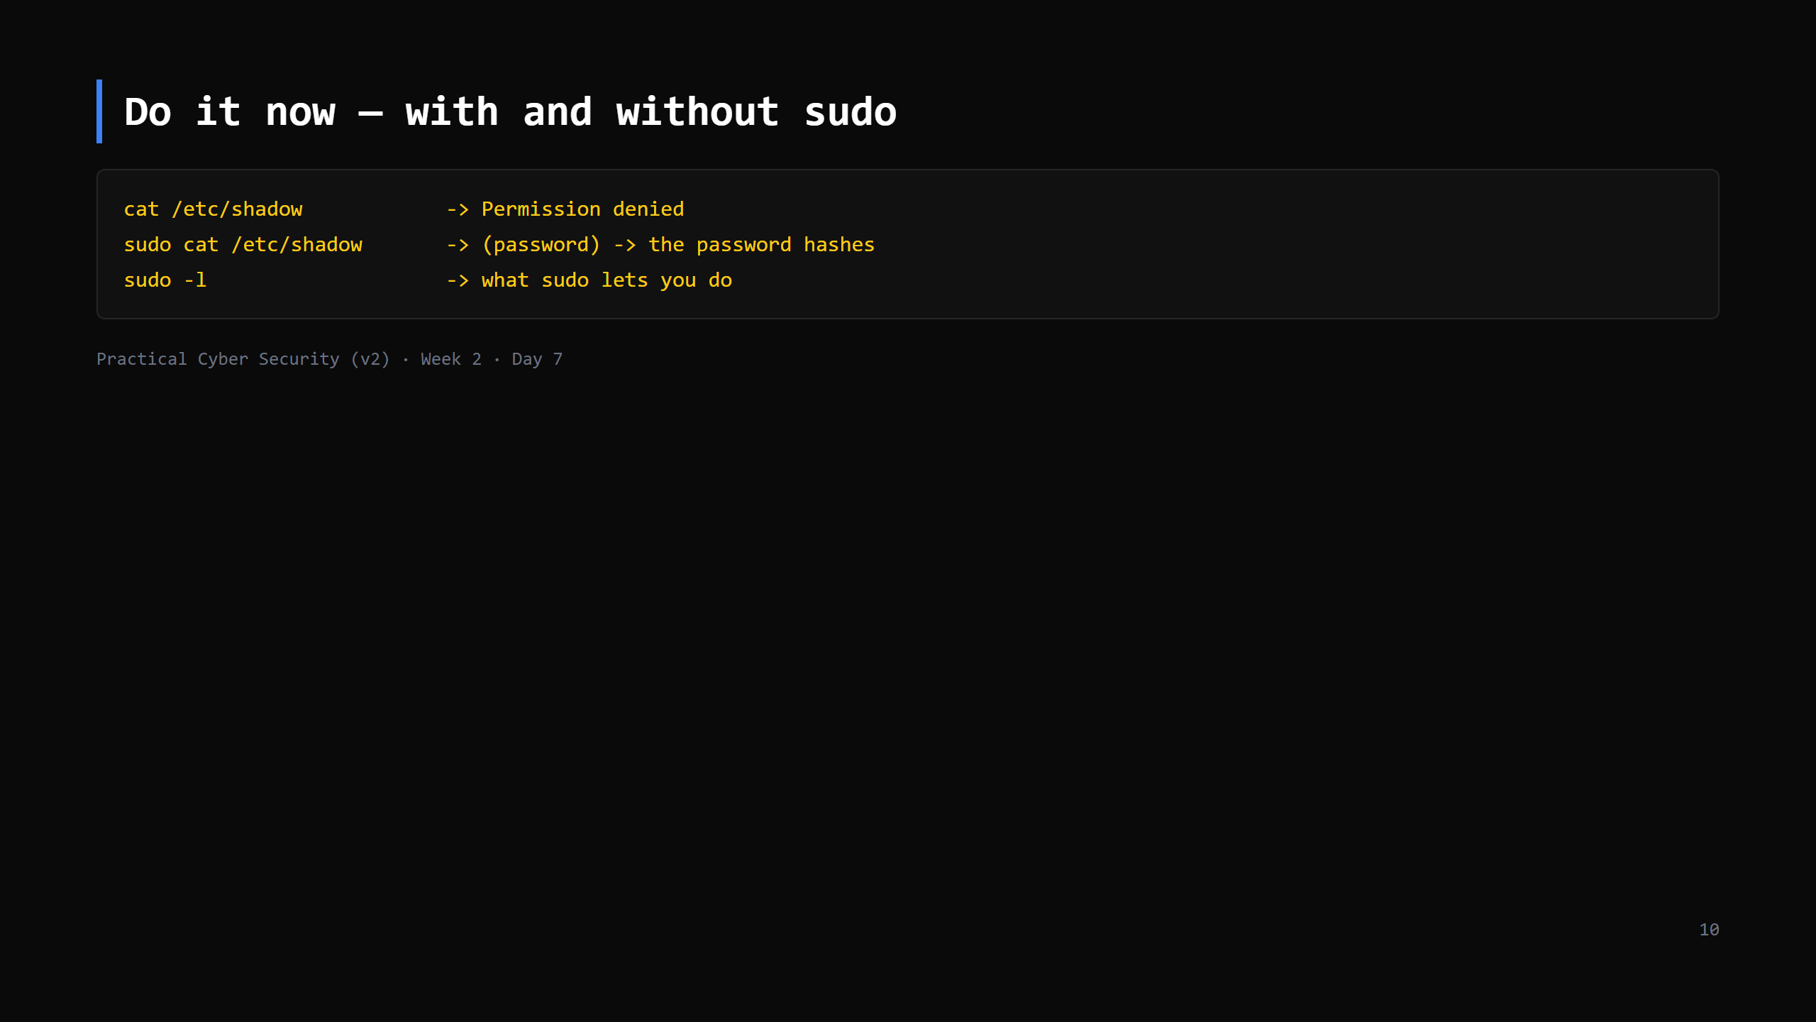
Notes:
4 min. On a PERSONAL VM students have sudo. On the shared class box they may not — then this is an instructor demo on the projector. Point at a /etc/shadow line: user:$6$salt$hash:... — the $6$ = SHA-512 crypt. Callback to Day 5 (salted + slow). This is the file `hashcat` targets after a breach.

Slide 11
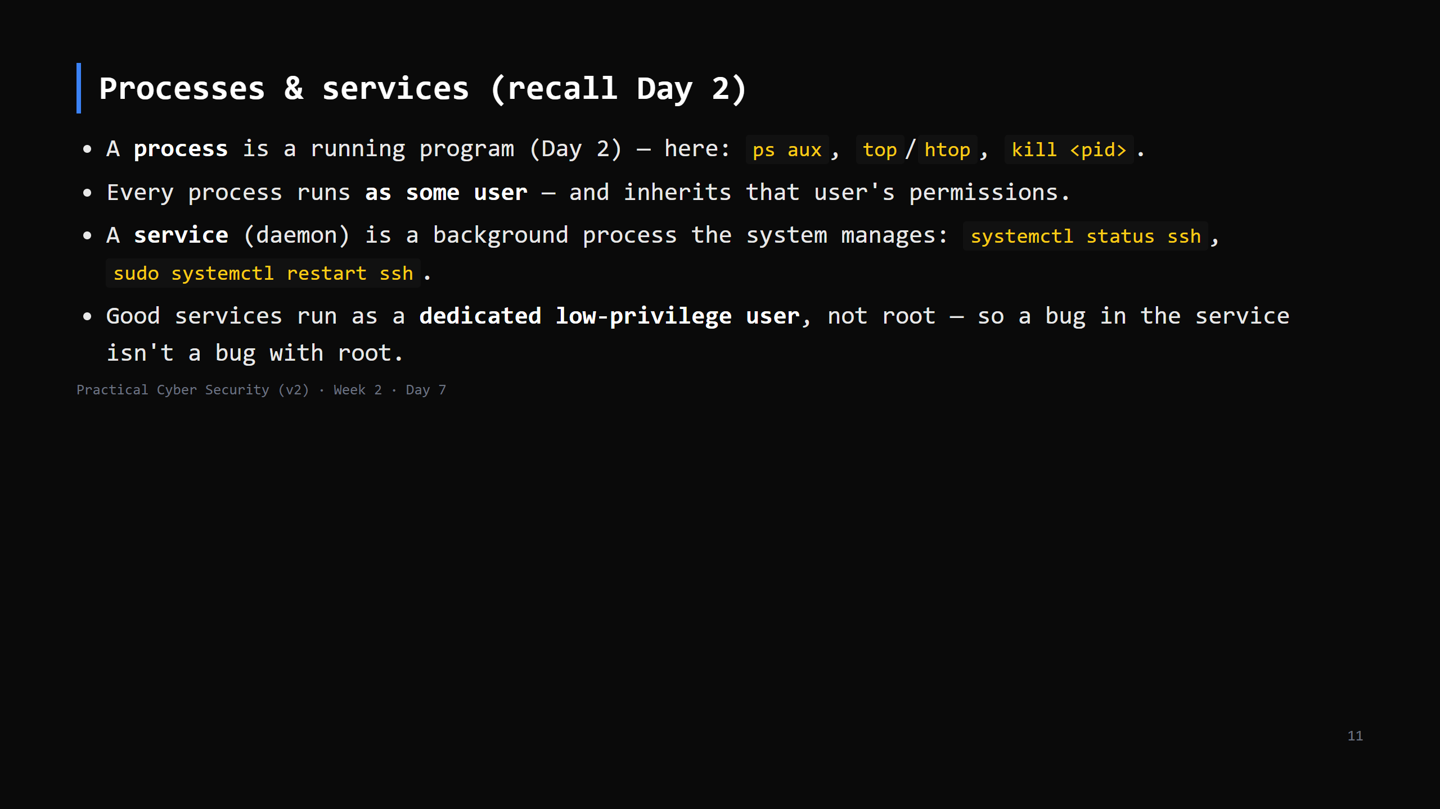
Notes:
Quick — this is recall, not new. The one new security idea: "runs as which user?" decides how bad a compromise of that program is. Web server running as root = very bad. CUT to one line if short: "processes and services each run AS a user; that user's power is their power."

Slide 12
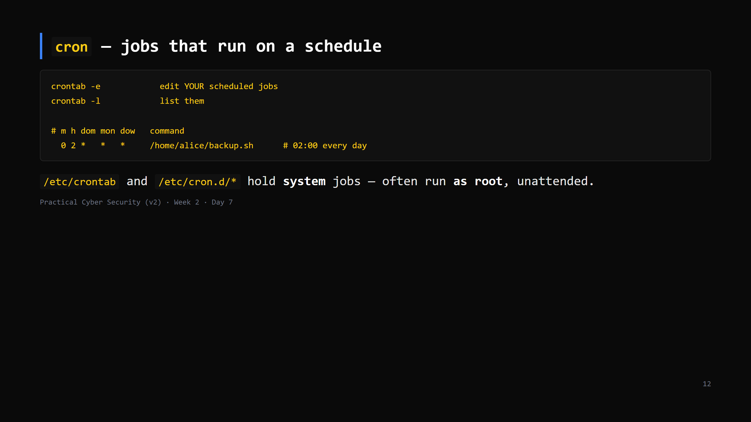
Notes:
Five time fields: minute, hour, day-of-month, month, day-of-week. `*` = every. The security angle (next slide): if root's cron runs a script that YOU can edit, you just got root to run your code. Note it here, land it next slide. CUT FIRST IF SHORT — name cron, one example, move on.

Slide 13
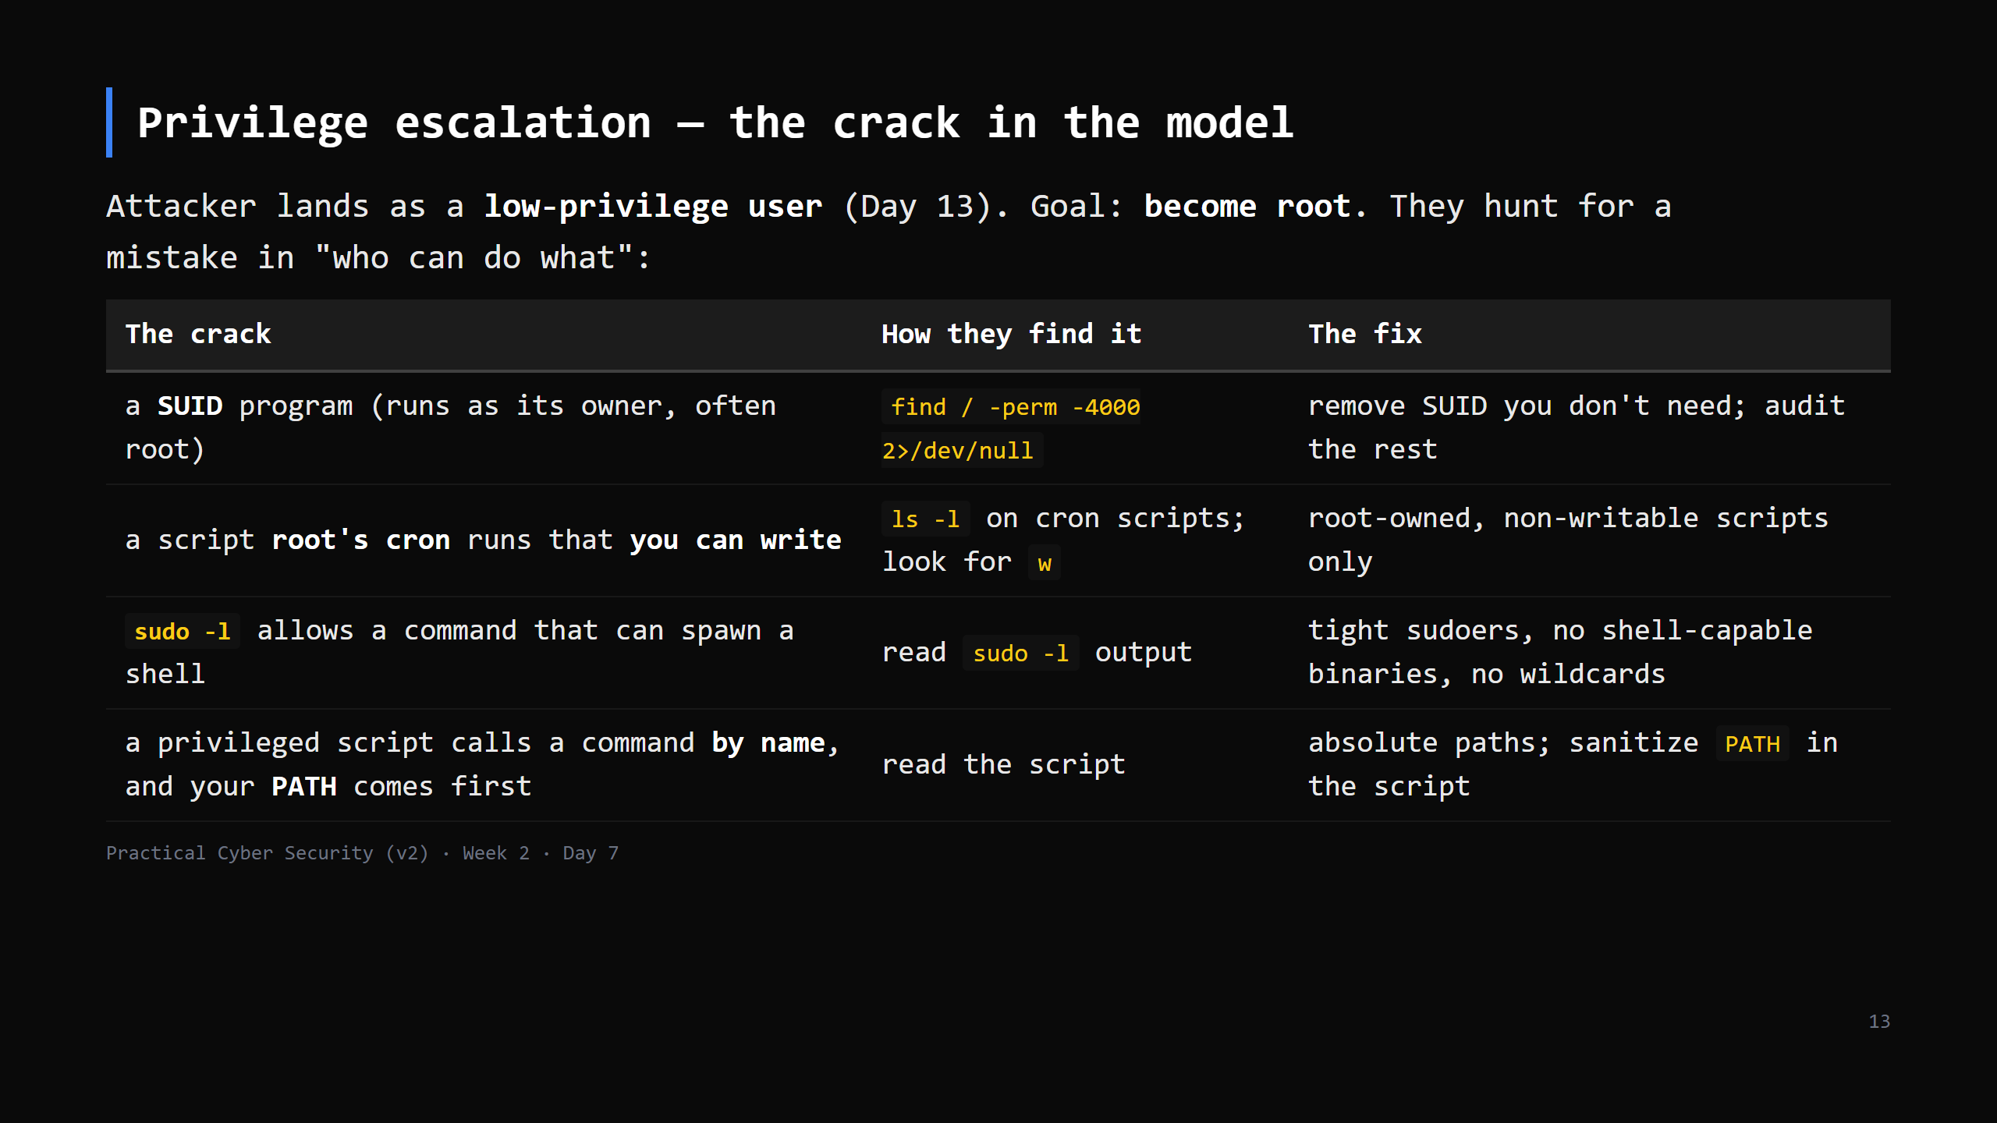
Notes:
CONCEPT ONLY today — we don't exploit anything. Day 17 is the hands-on version. The unifying idea: root gave something away — an over-powerful binary, a writable file it trusts, a too-broad sudo rule. Every one is a least-privilege failure. `2>/dev/null` throws away the "permission denied" noise (Day 6).

Slide 14
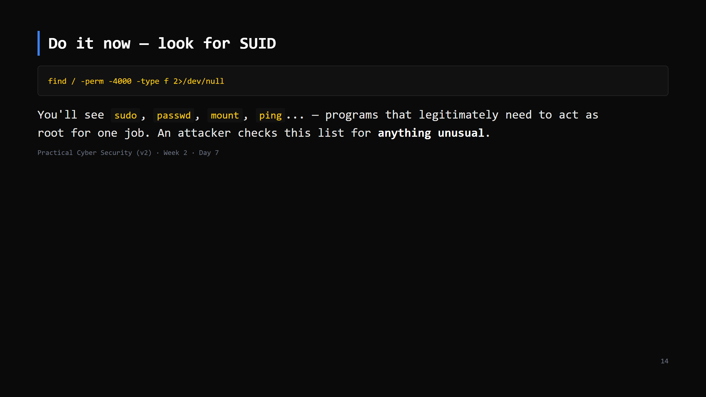
Notes:
2-3 min (folds into the priv-esc block). passwd is SUID-root so a normal user can update their own hash in /etc/shadow (which only root can write). That's the legitimate use of SUID. "Unusual" = a copy of bash, vim, find, python with the SUID bit = instant root. GTFOBins is the reference (don't teach it, just name it).

Slide 15
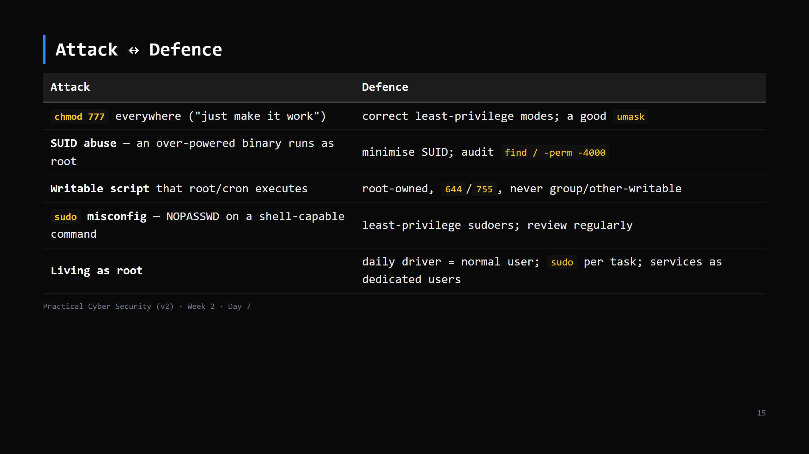
Notes:
`chmod 777` is the Day 7 trap — say it plainly: it is never a fix, it is a vulnerability you just created. If something "needs 777", the real problem is wrong ownership.

Slide 16
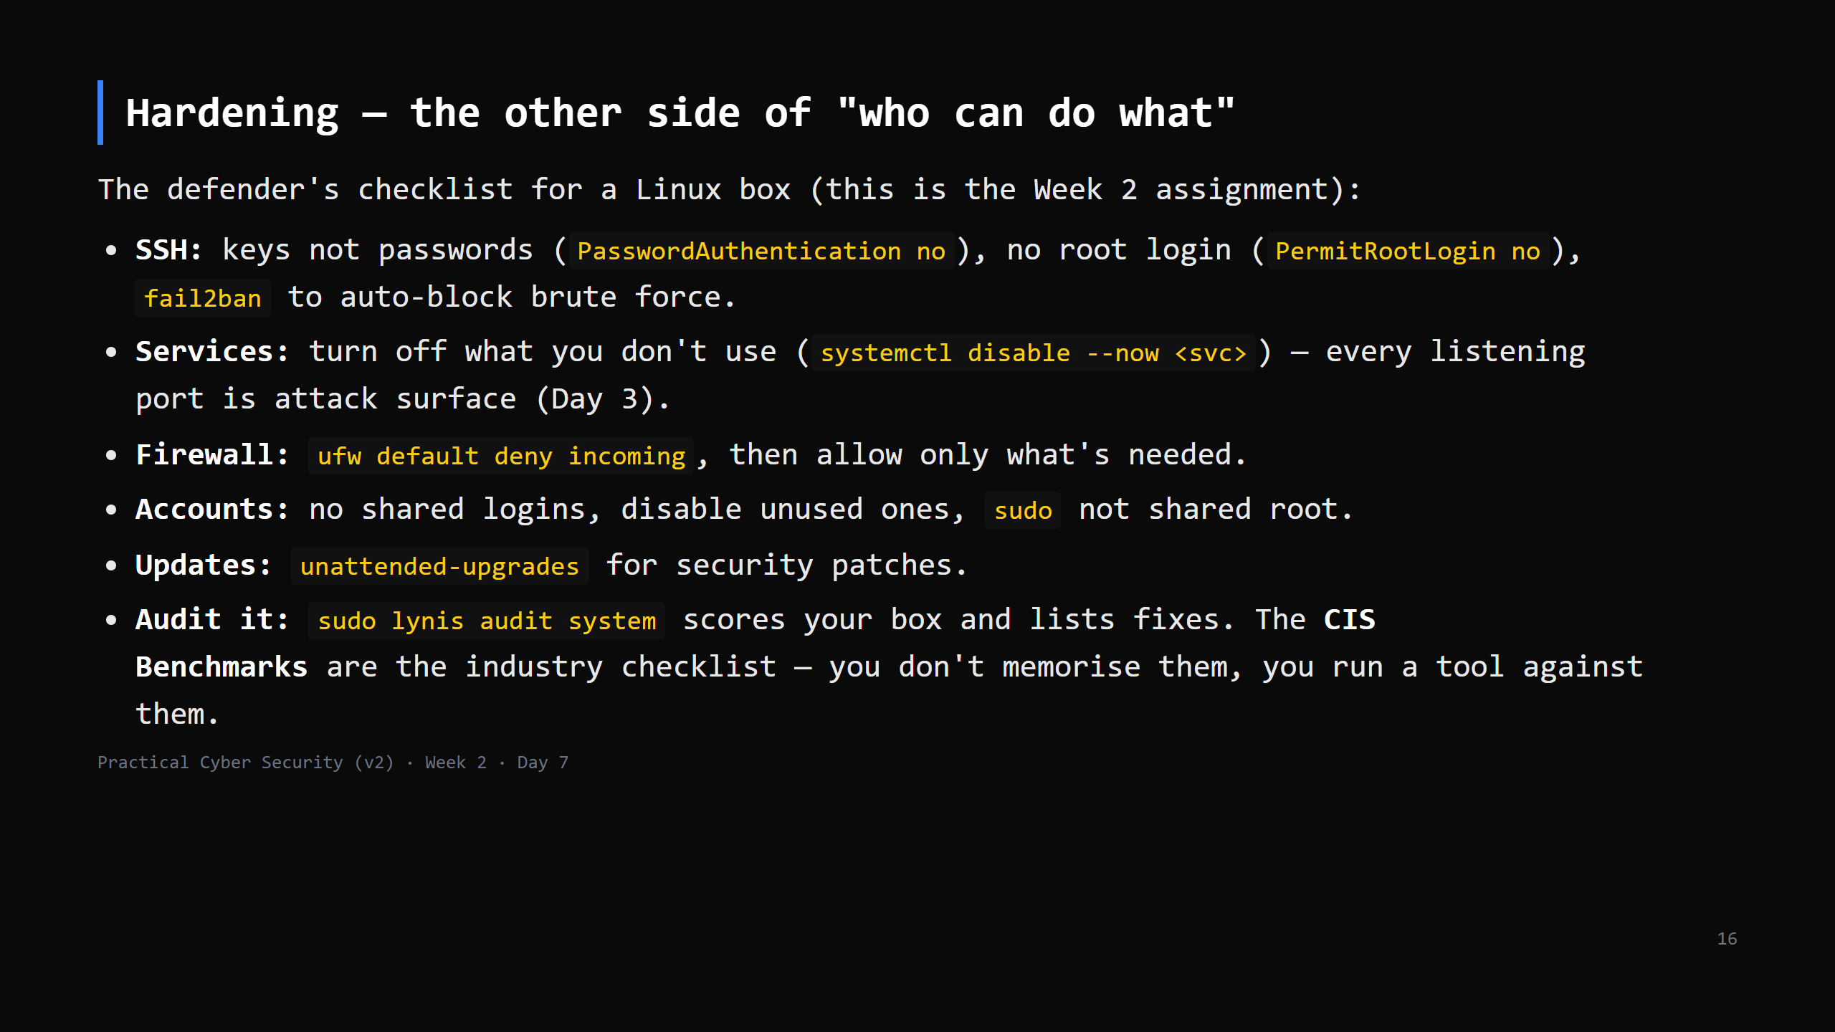
Notes:
This is the "do it to your own things first" lesson made concrete. The Week 2 weekend assignment asks students to harden their VM and write a script that flags weak settings — this slide is the checklist for that. `lynis` is free and its output IS a to-do list. CUT to the SSH + firewall + "run lynis" lines if behind.

Slide 17
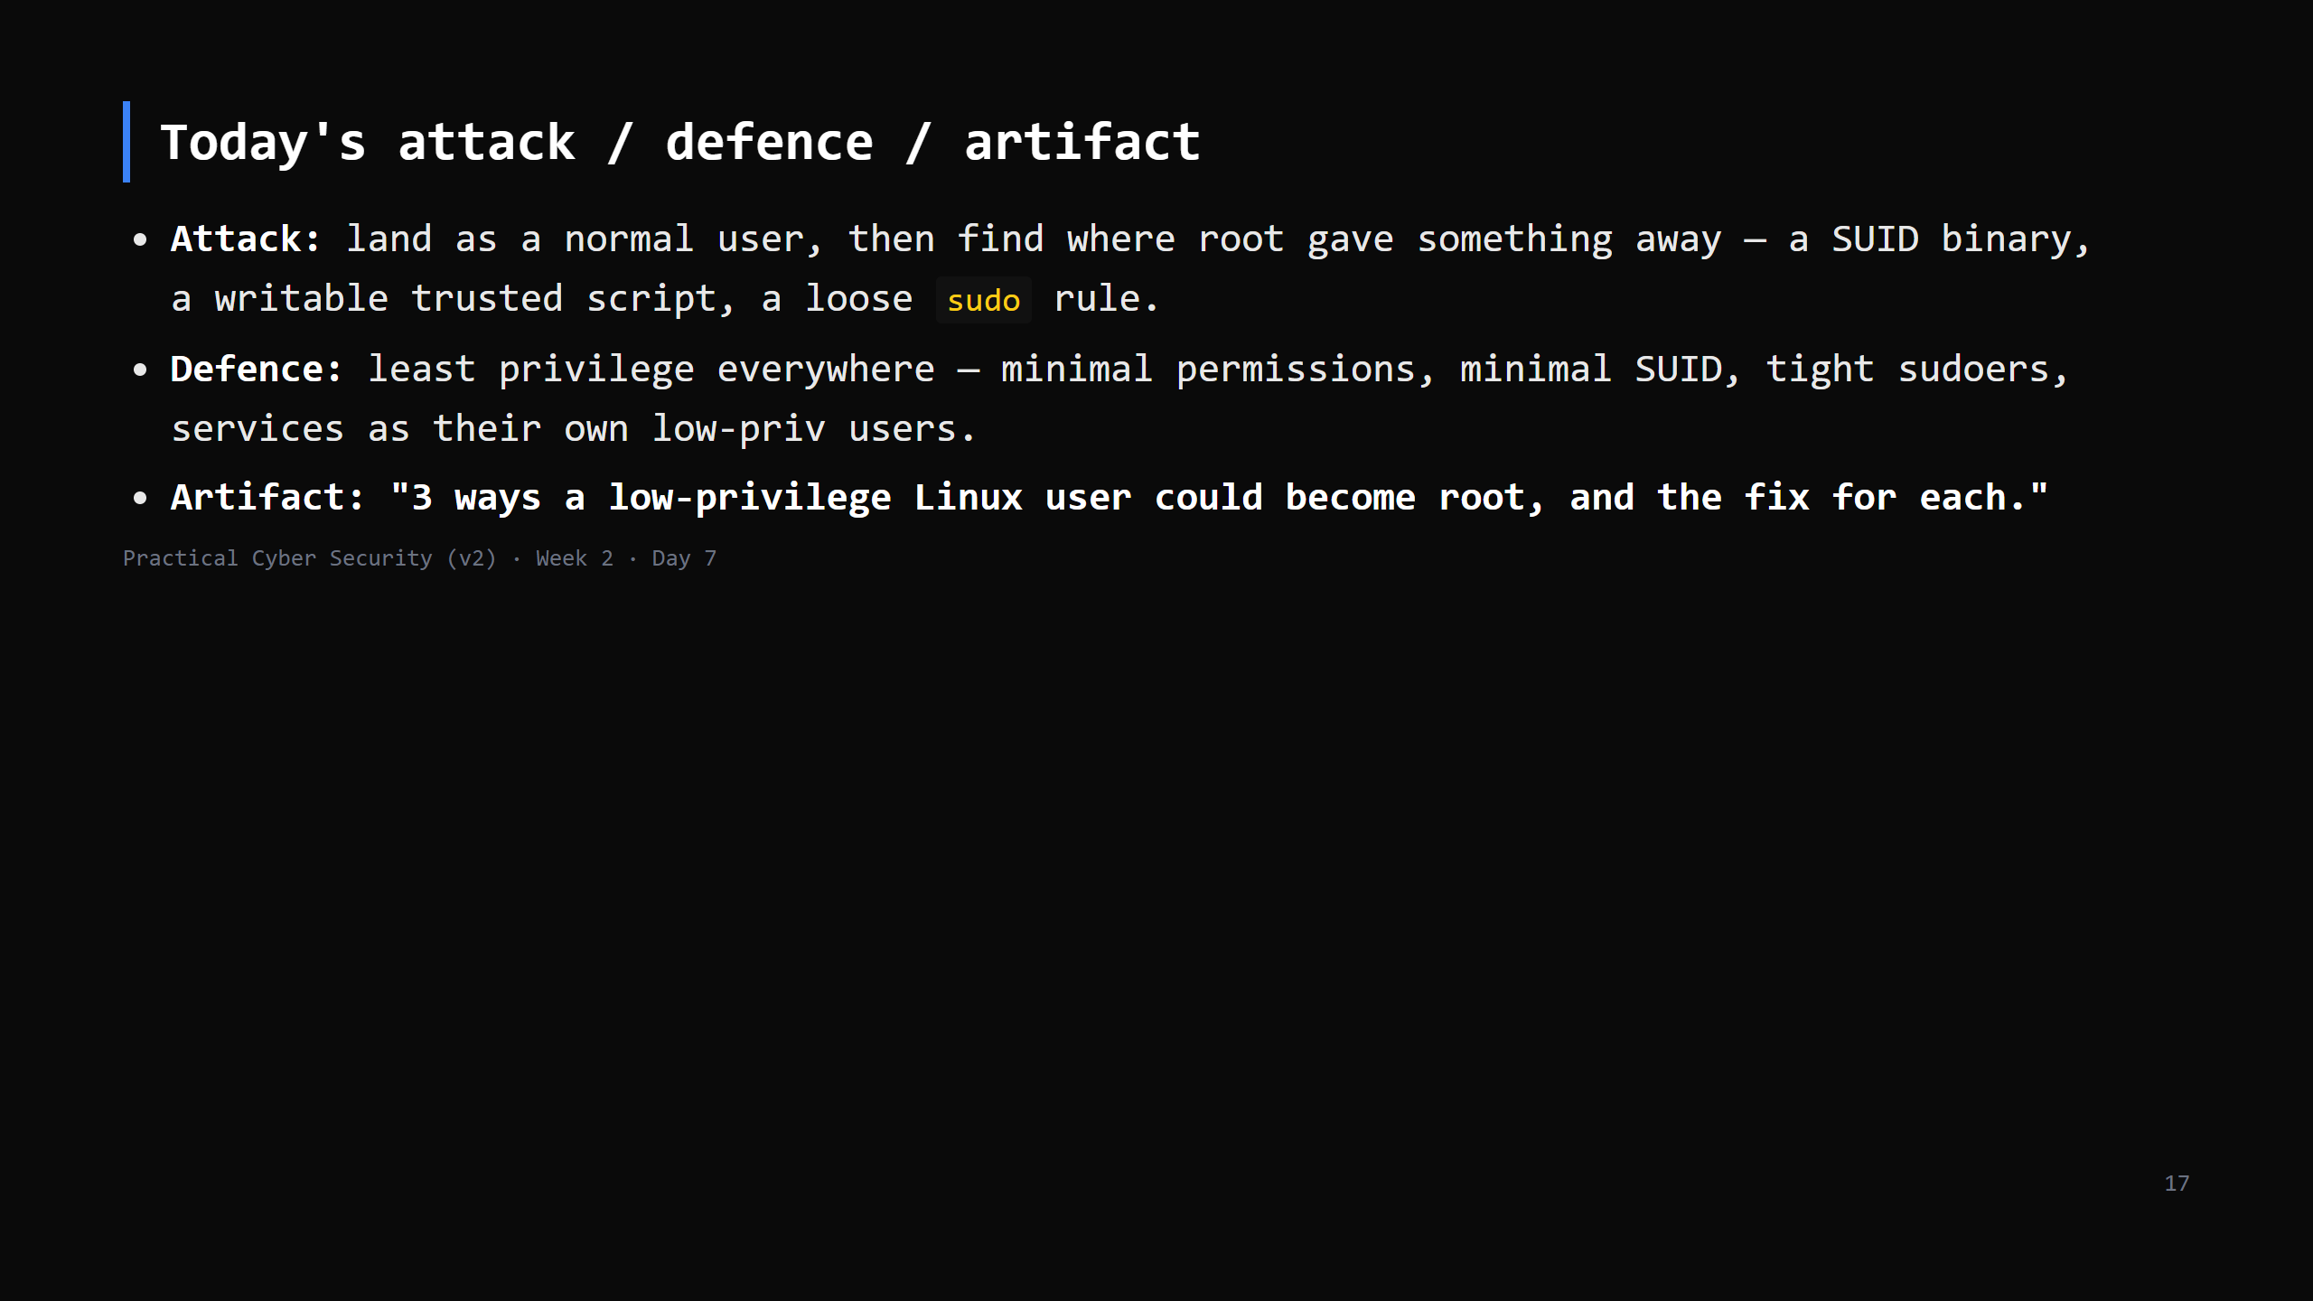

Slide 18
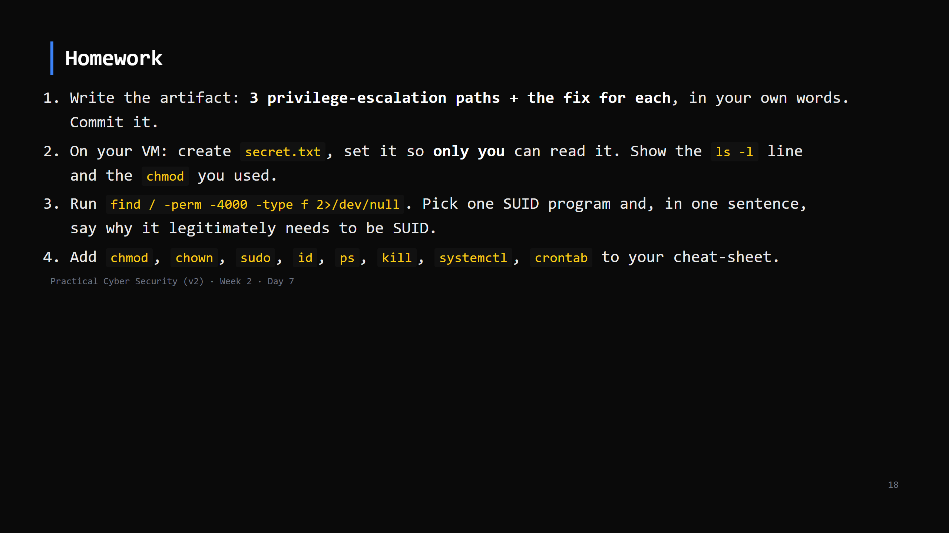
Notes:
Due start of Day 8. Checklist grading in the week-2 student pack.

Slide 19
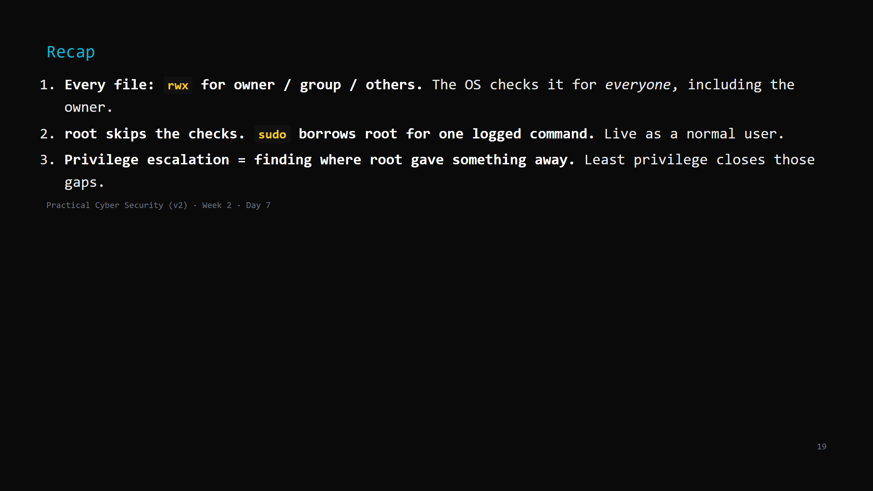
Notes:
Say the three lines. Tomorrow: Windows asks the same "who can do what" — with different words (tokens, ACLs, the registry) and Active Directory tying many machines together.

