Slide 1
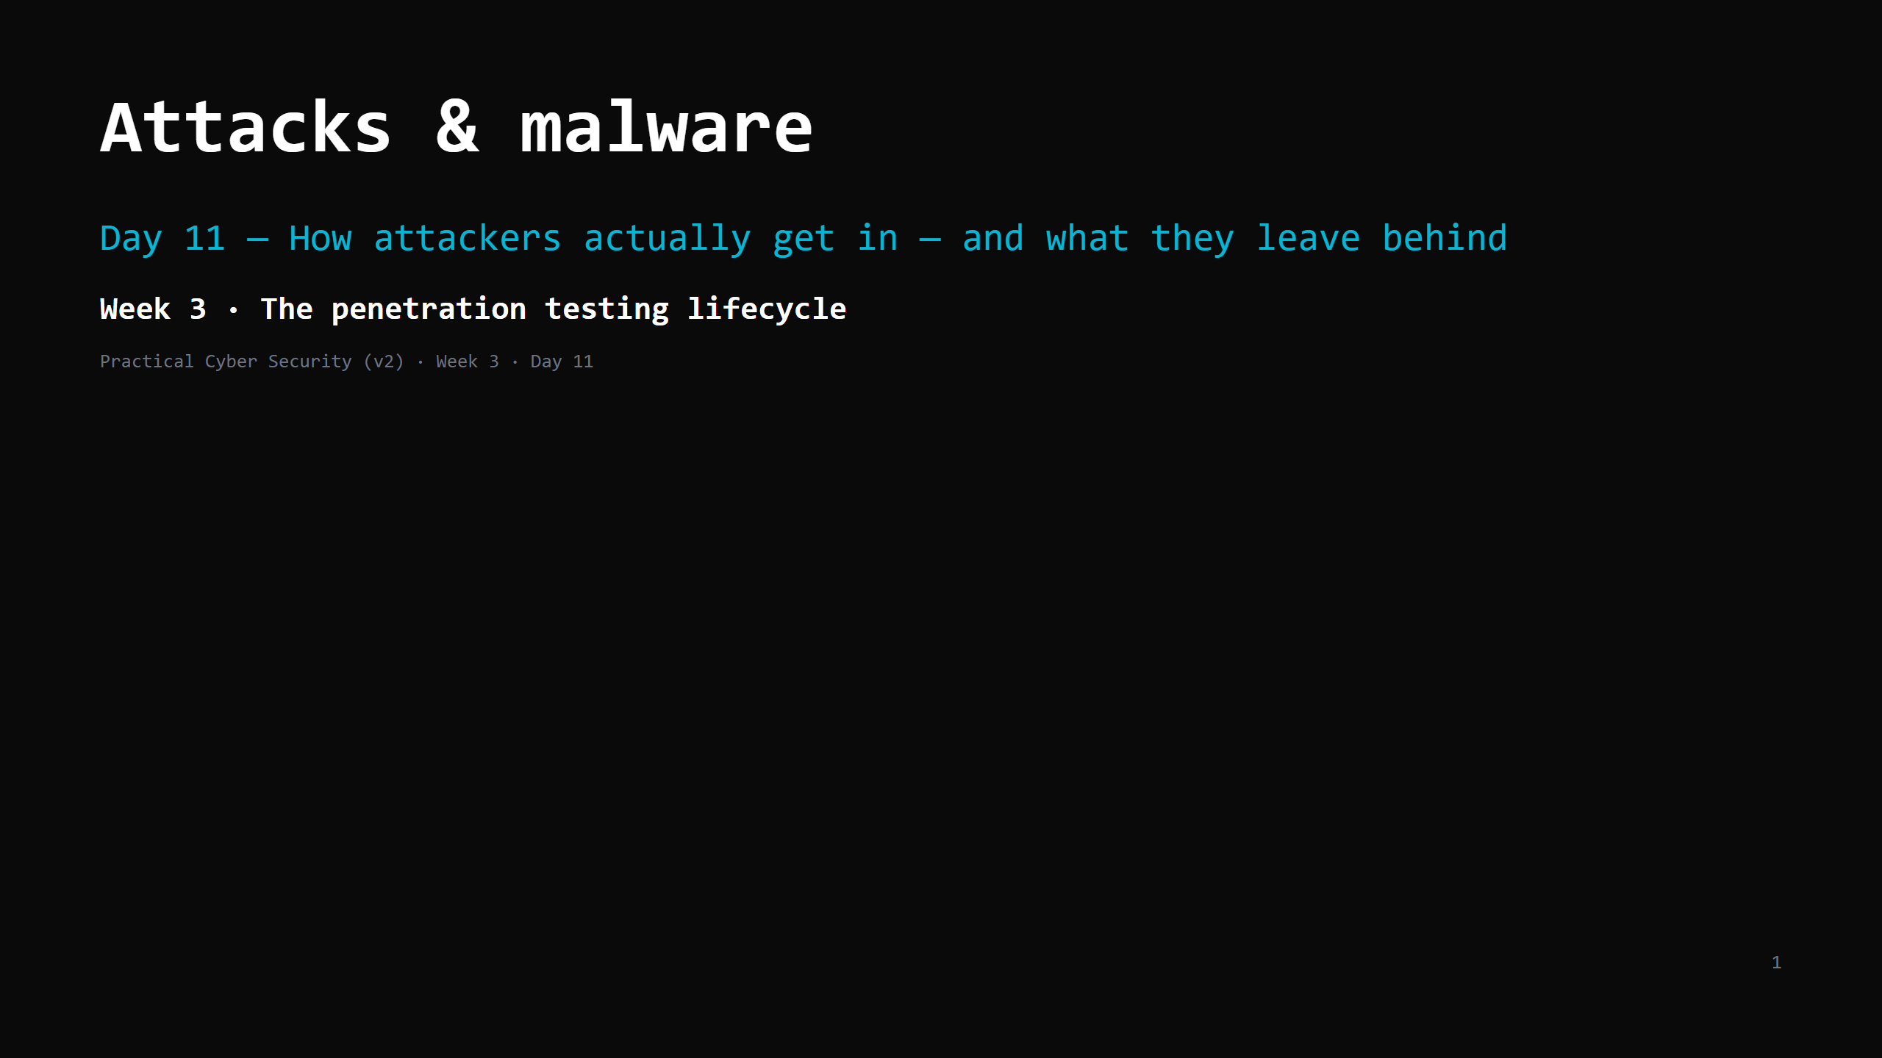
Notes:
RUN SHEET (~85 min). Hands-on: phishing dissection, HIBP, a connection-log analysis. 00:00 Journey check + hook (spot the phish) 4 00:04 The short list — how attackers get in 5 00:09 Social engineering & phishing (#1) 9 00:18 DO: dissect a phishing email 8 00:26 Credential attacks 7 00:33 DO: check yourself on HIBP 4 00:37 Malware families — by behaviour, not "virus" 10 00:47 DO: spot the C2 beacon in a connection log 8 00:55 MITM, DoS/DDoS, supply chain 6 01:01 Attack <-> defence: the 6 ways in (the artifact) 6 01:07 "We'd notice" — dwell time 4 01:11 Wrap + homework 4 CUT FIRST IF SHORT: MITM/DoS/supply-chain slide to 3 min (mostly callbacks); the HIBP DO. NEVER CUT: the short list, phishing anatomy + the dissection DO, the malware behaviour taxonomy, the 6-ways-in table, dwell time. ANALOGY (kitchen): the ways a thief gets into the restaurant — talks past the host (phishing), uses a copied key (stolen creds), the back door nobody fixed (unpatched), a window left open (misconfig), a poisoned delivery (supply chain), jamming the phone lines (DoS). Malware = what they bring in or leave behind.

Slide 2
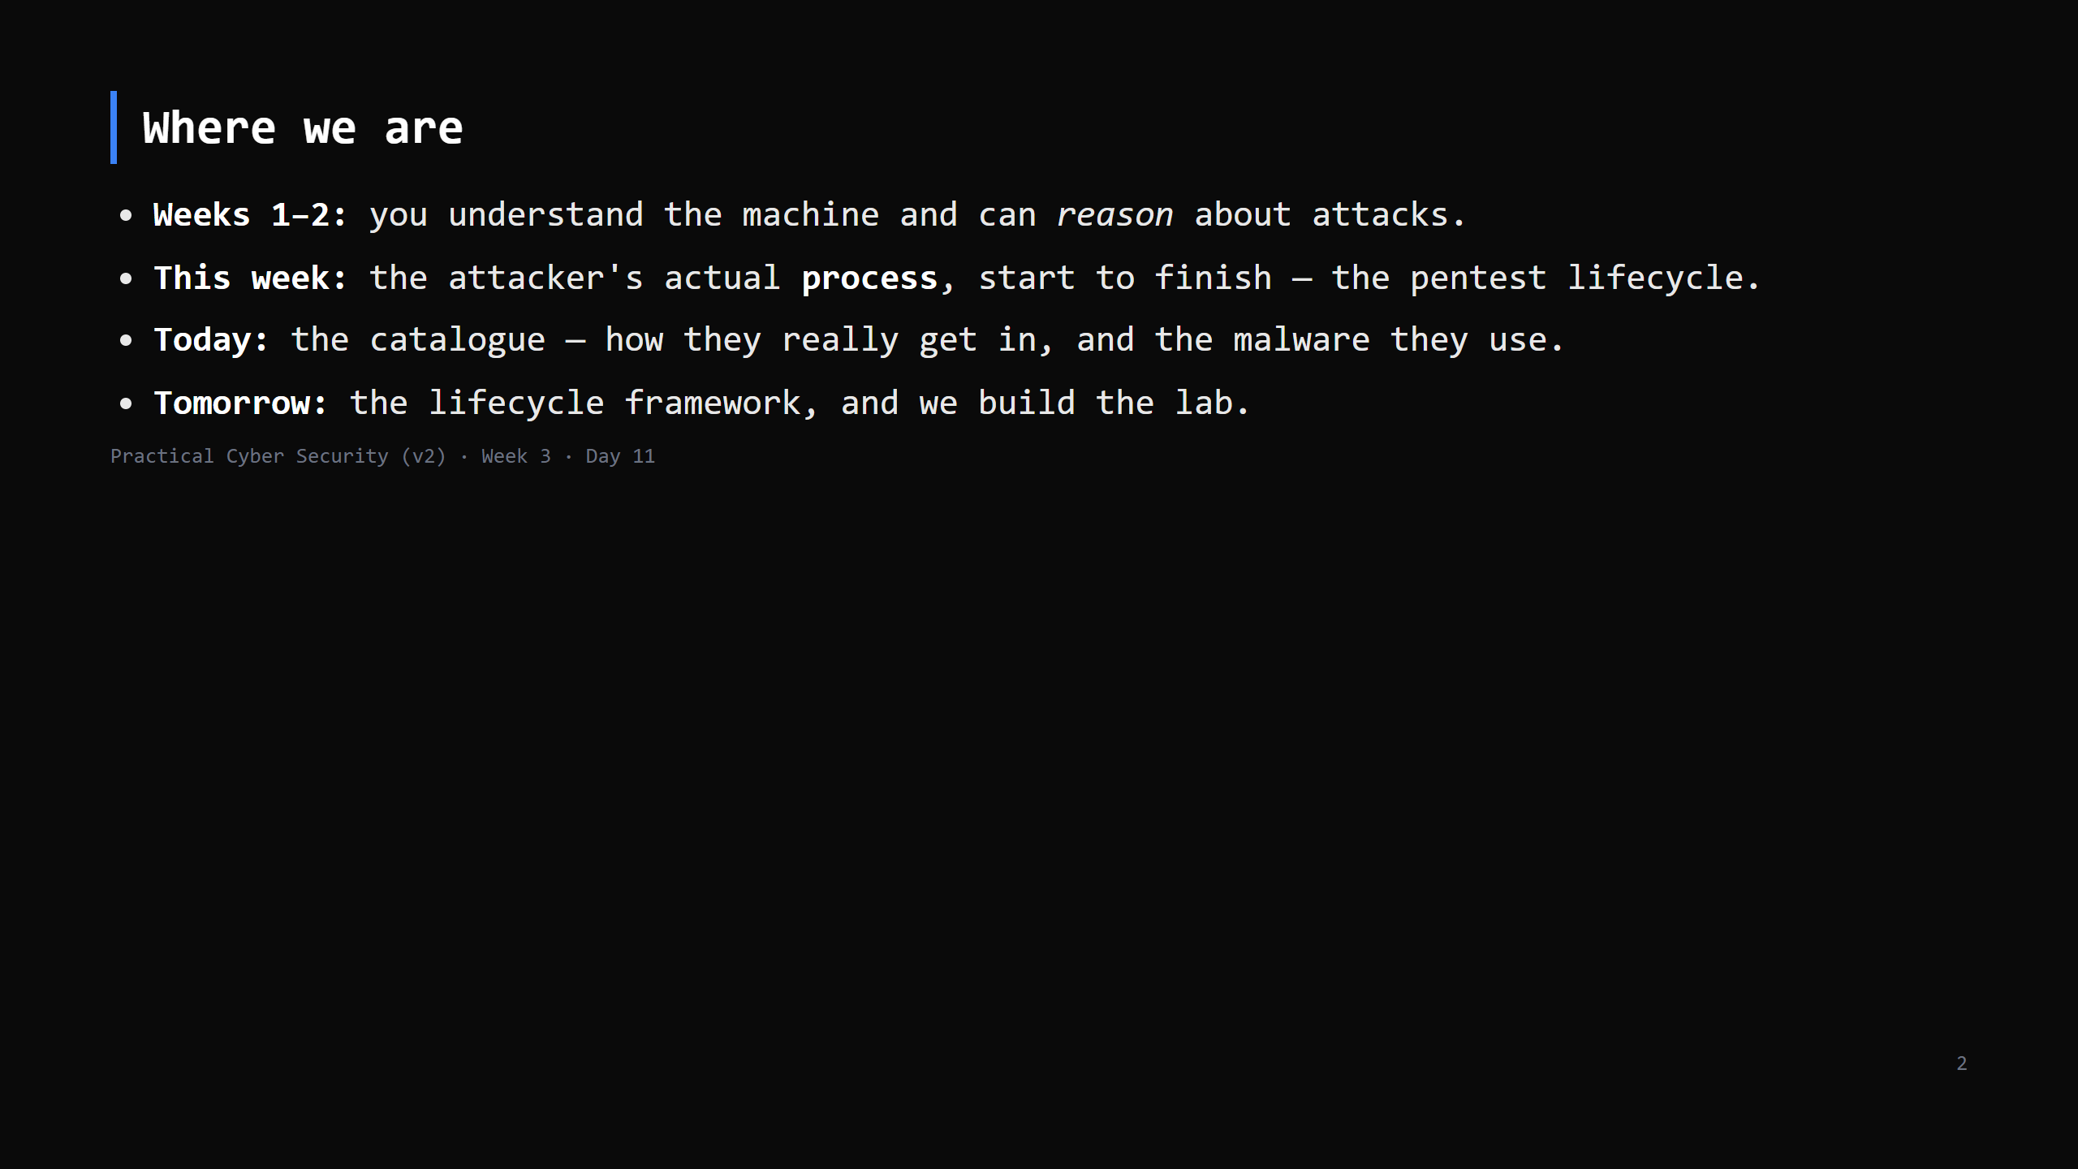
Notes:
Journey Check. Week 3 opens. Frame: "movie hacking" is rare. Real breaches are boring and repeatable — that's good news, because boring and repeatable can be defended.

Slide 3
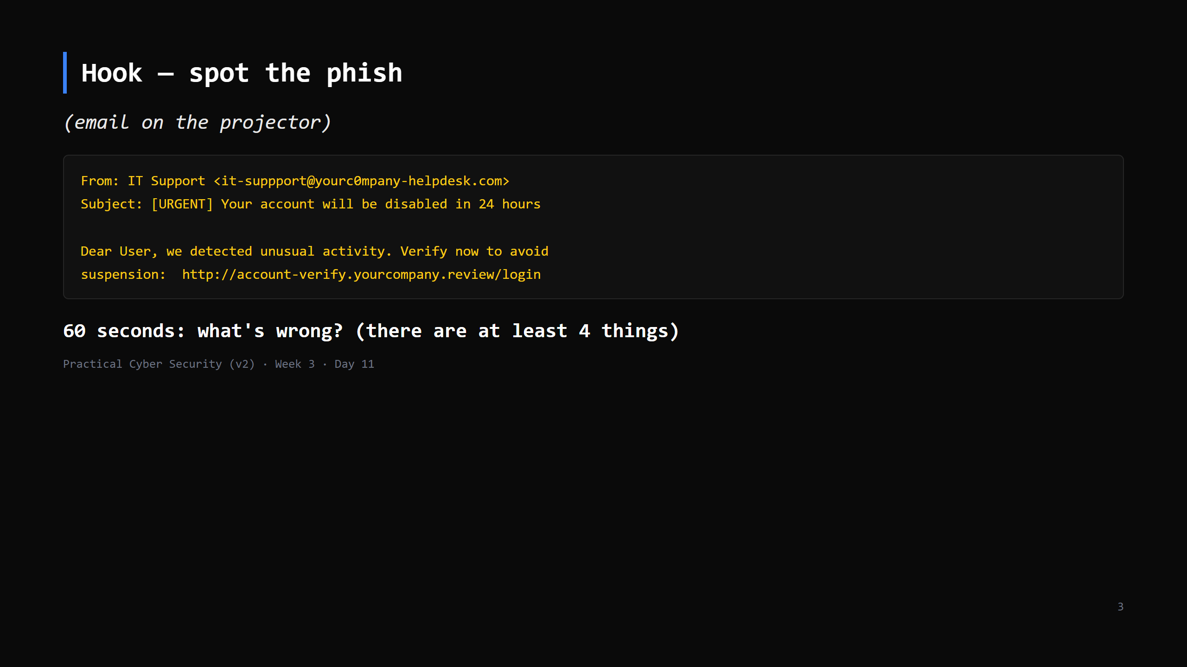
Notes:
Answers: misspelled "suppport"; lookalike domain (yourc0mpany, .review TLD); manufactured urgency + fear; the link text vs where it goes; generic "Dear User". Take shouts, then move on.

Slide 4
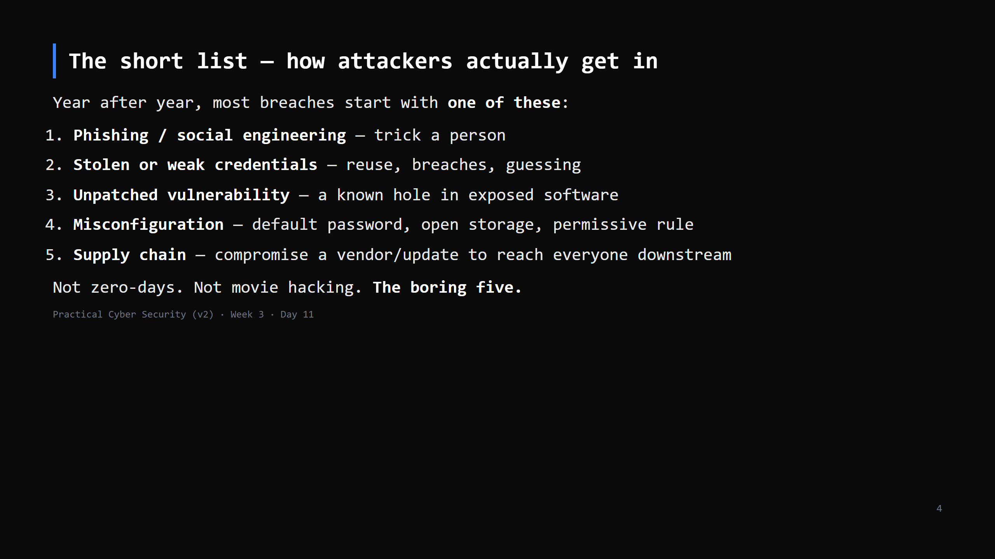
Notes:
This is the mental model for the whole week. When you assess a system (Days 12-15) or defend one (Week 4), you're mostly working this list. Everything today is a variety of one of these.

Slide 5
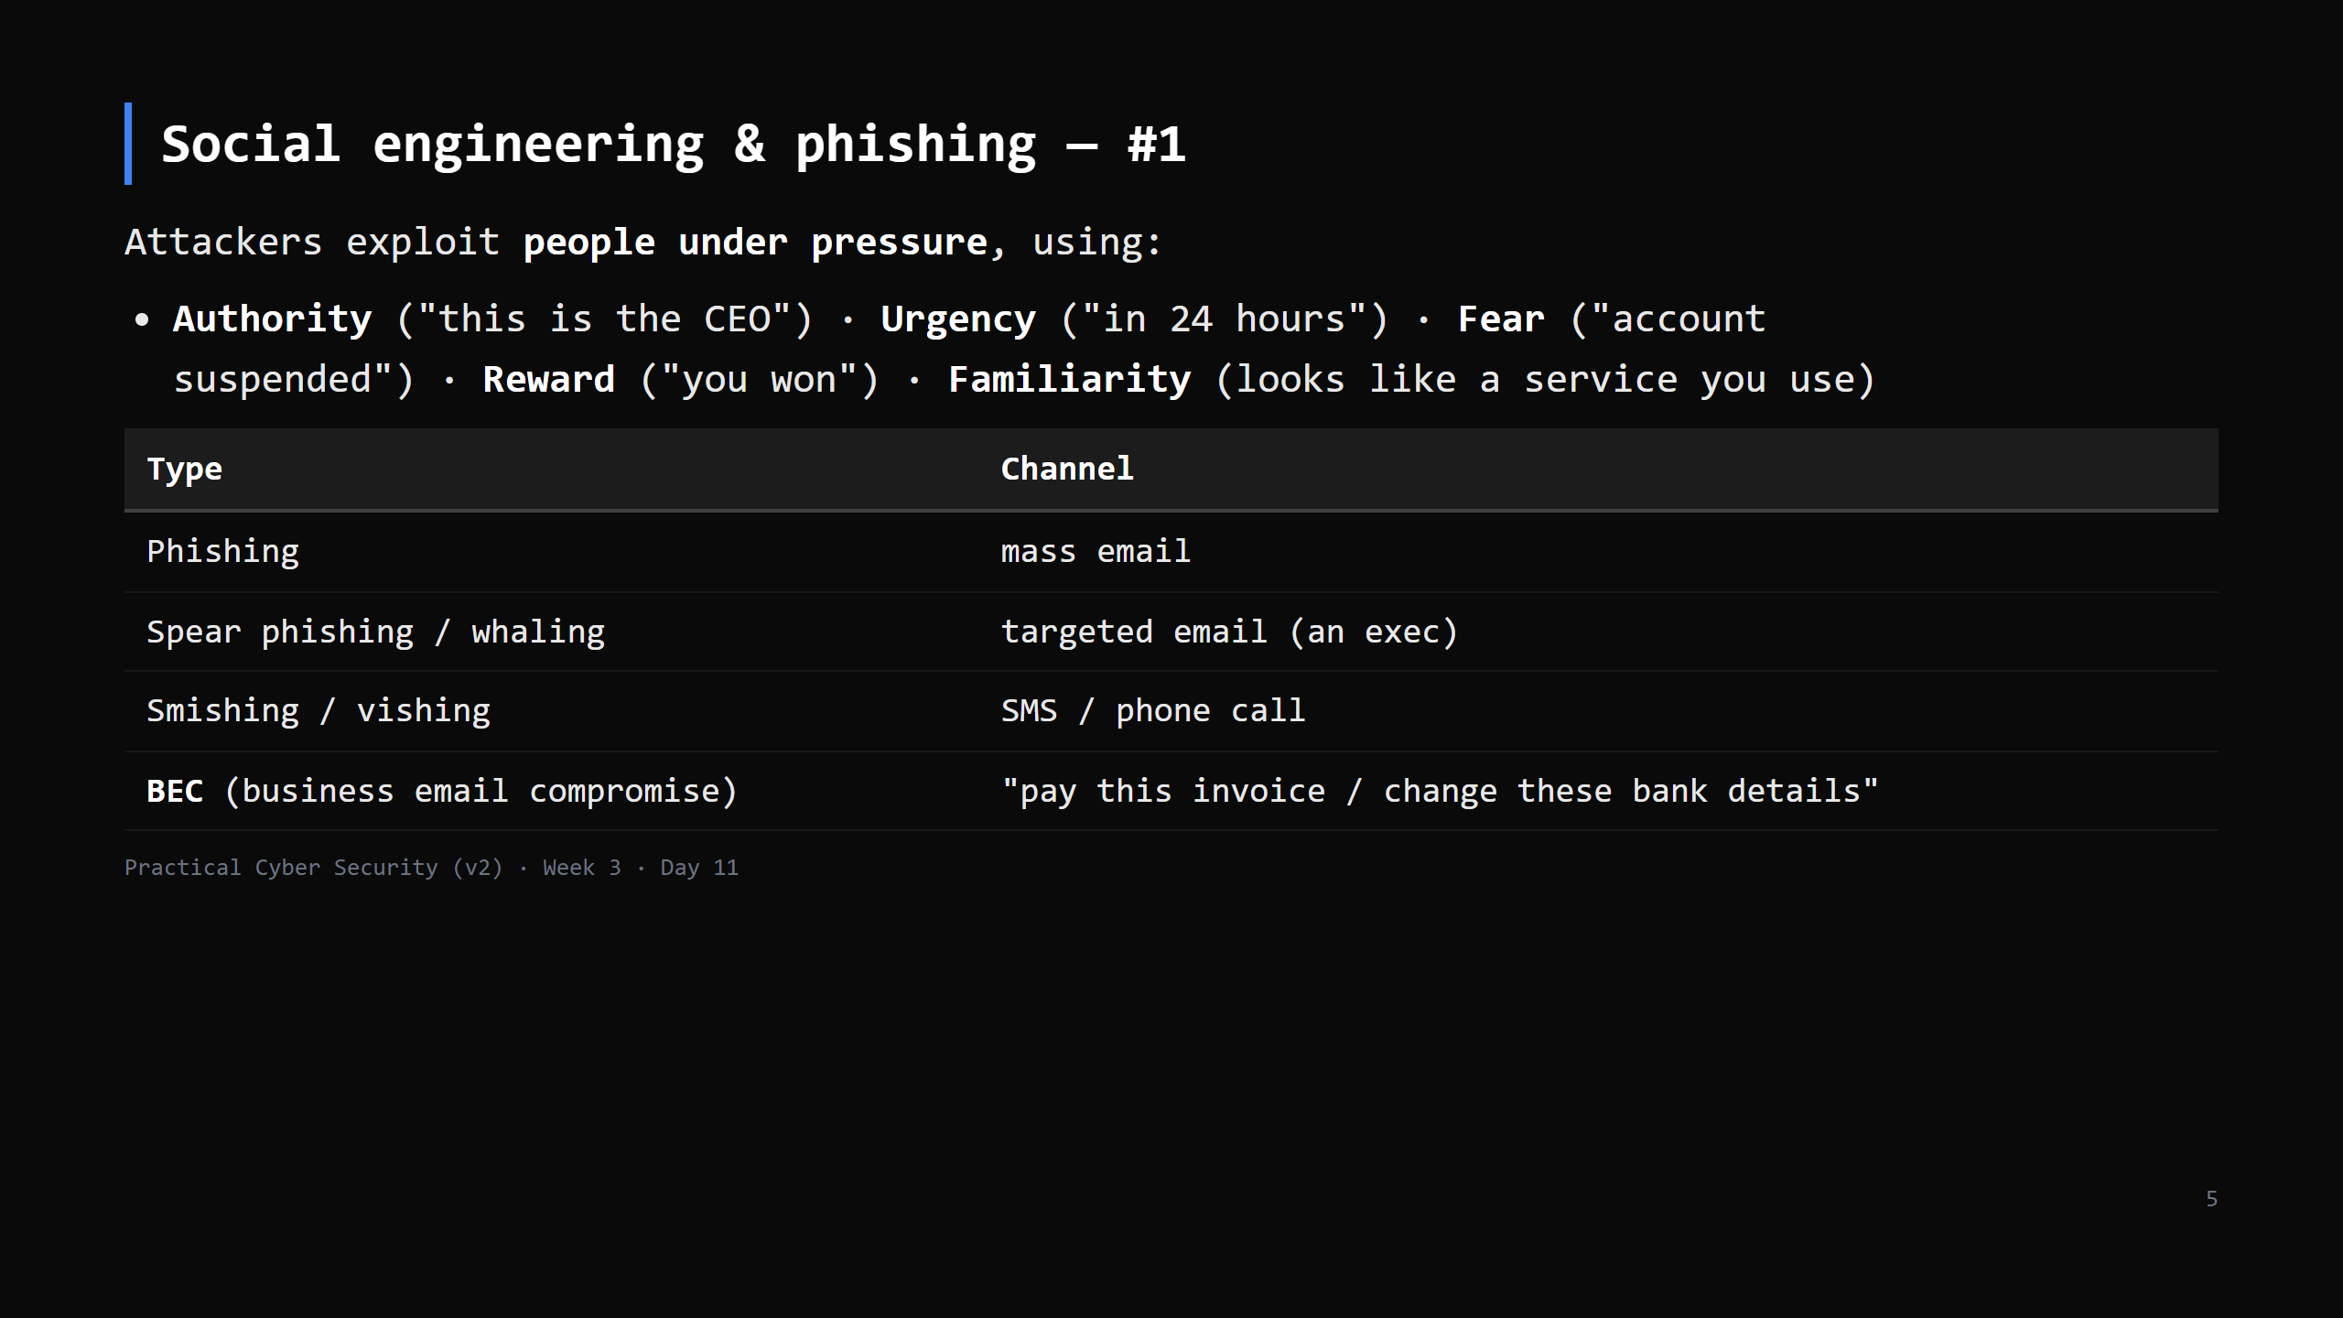
Notes:
Phishing works on everyone — it's not about intelligence, it's about catching someone busy, stressed, or distracted. BEC has no malware at all — pure social engineering — and causes enormous financial losses.

Slide 6
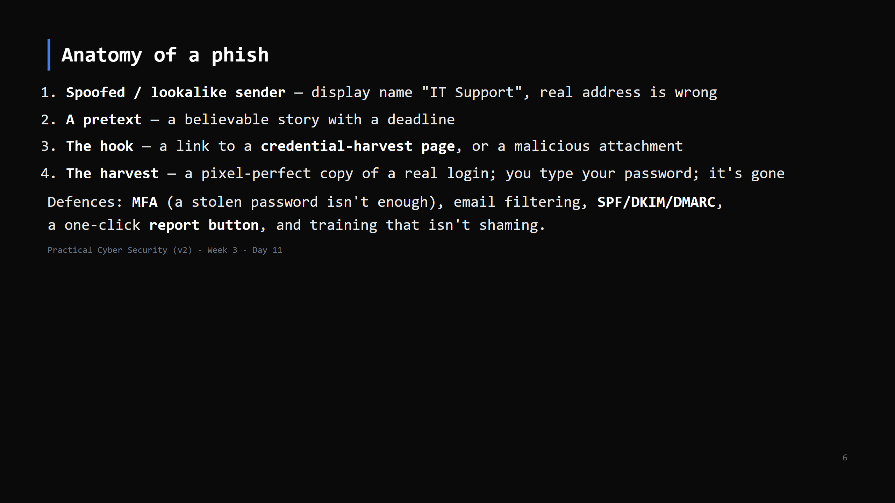
Notes:
MFA is the single highest-value control here — it breaks step 4.

Slide 7
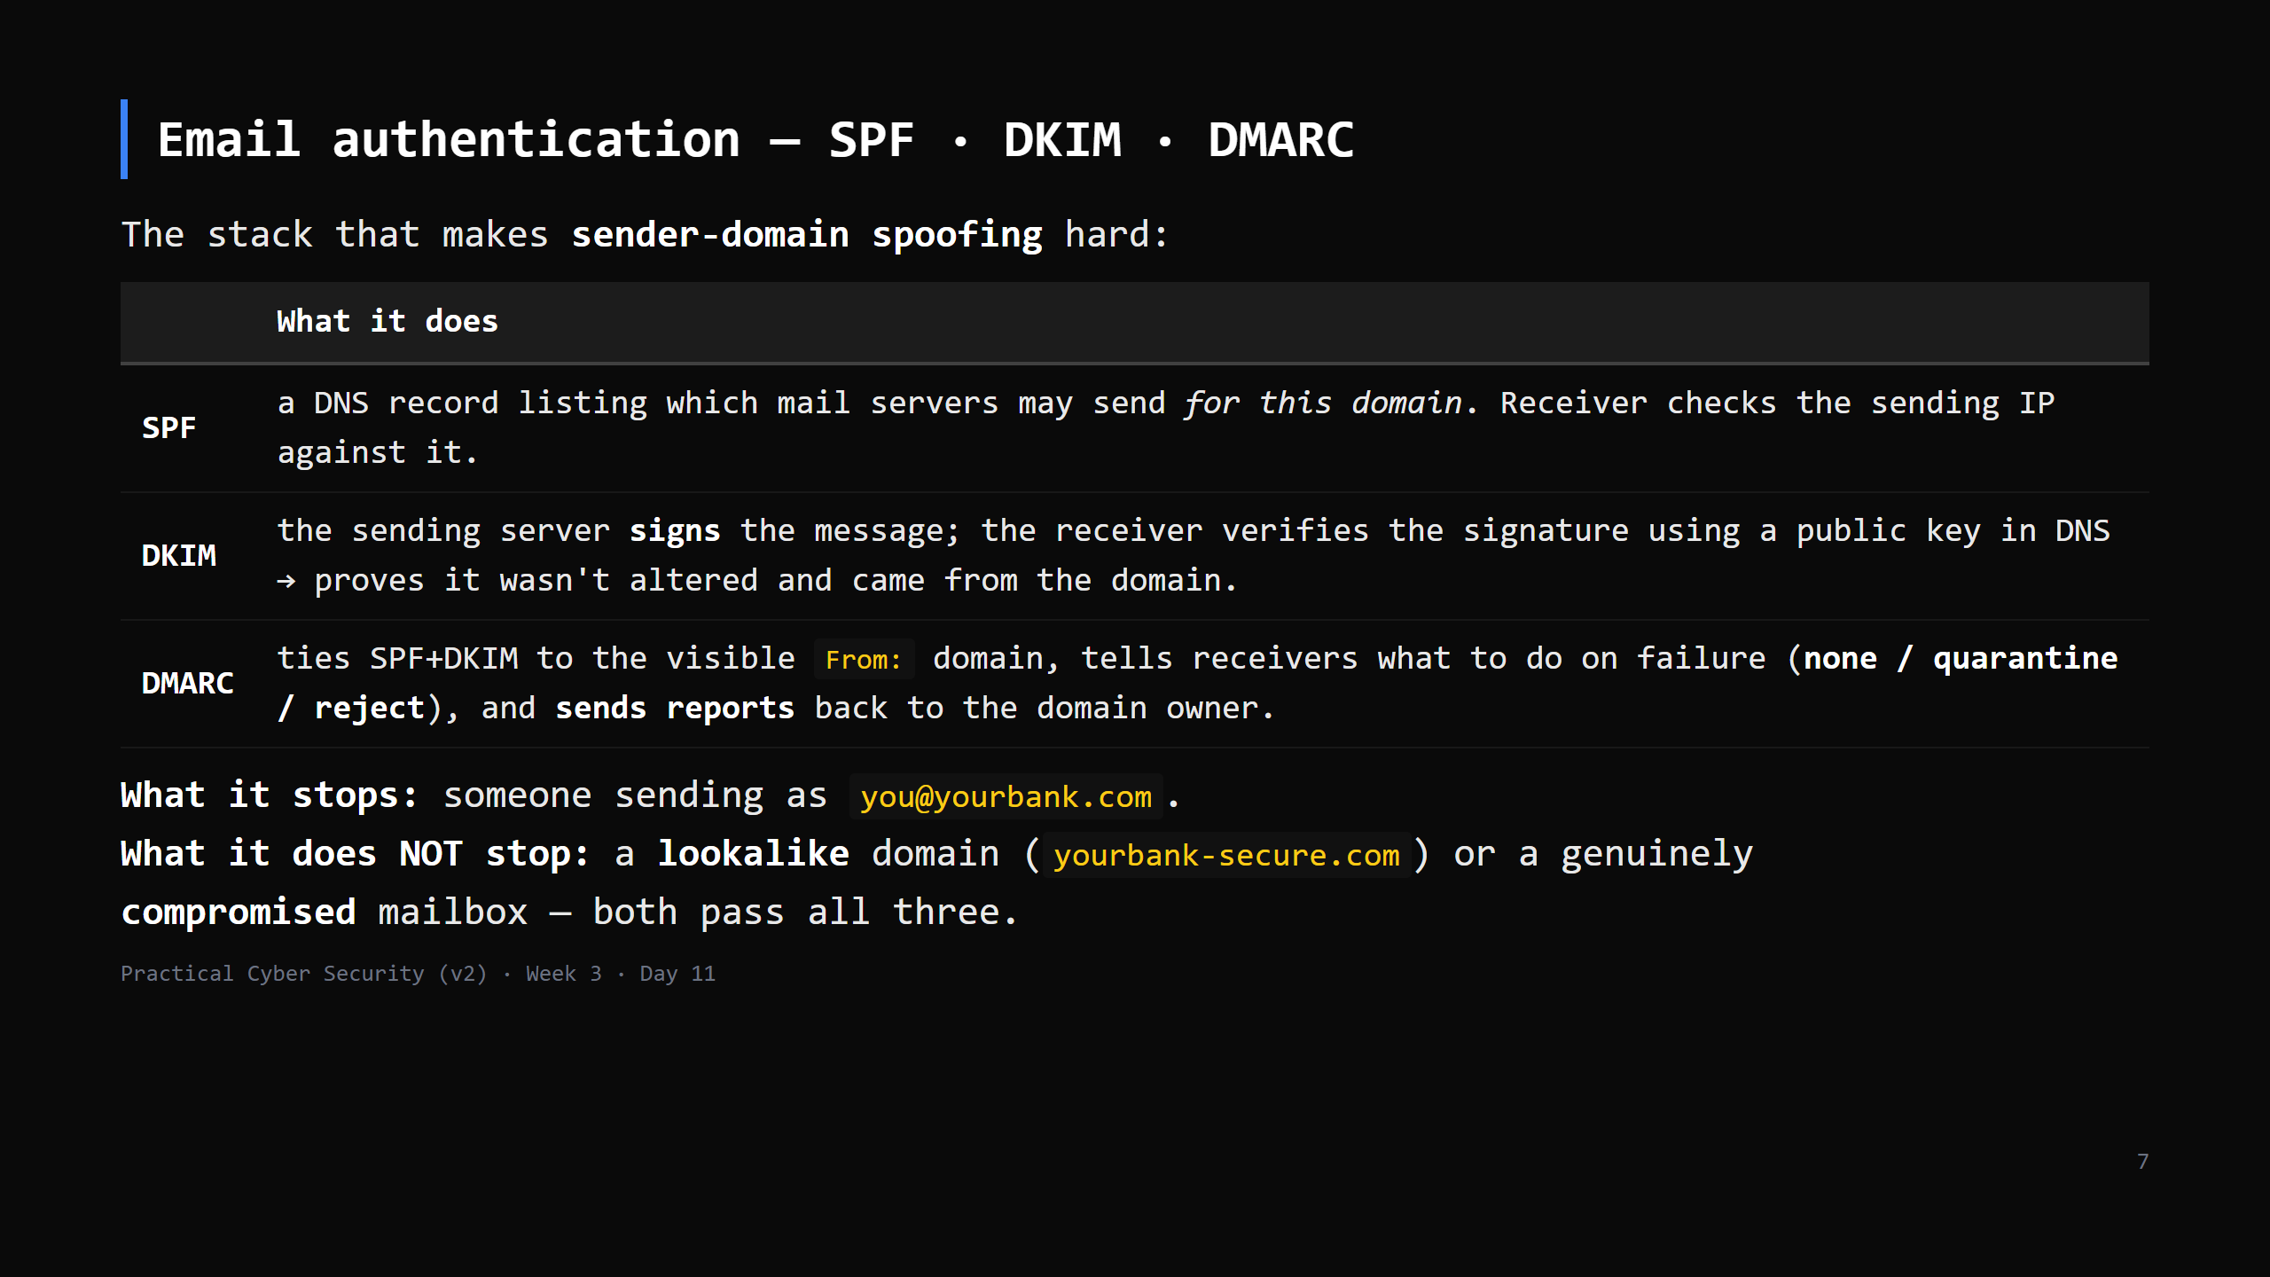
Notes:
Reading a header: `Received:` chain shows the real path; `Authentication-Results:` shows spf=pass/fail, dkim=pass/fail, dmarc=pass/fail. The Day-11 phish dissection asset asks about exactly these fields. Most SOC L1 work is triaging reported phish — this is the check they run. CUT to the one-line summary if behind: "SPF/DKIM/DMARC stop domain spoofing, not lookalikes or a hacked account."

Slide 8
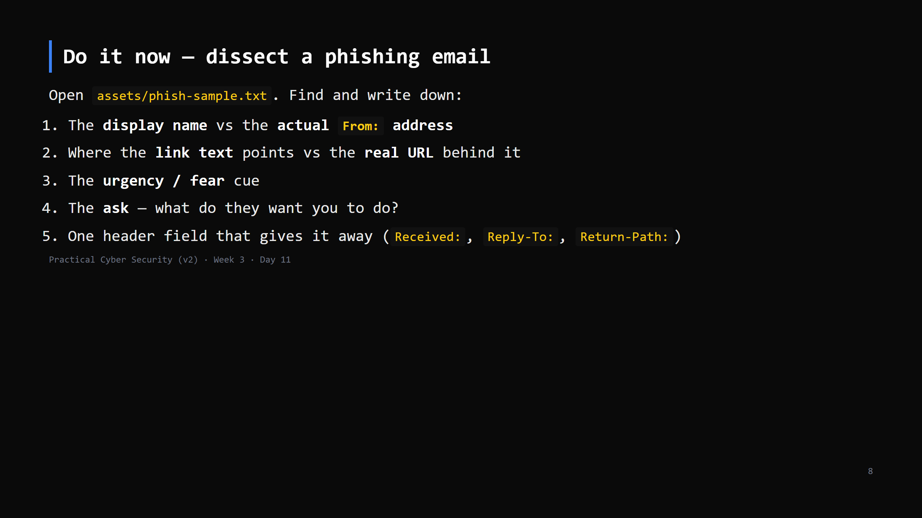
Notes:
8 min. The sample is a defanged real-style phish with full headers. Walk the Received chain — it originated somewhere unrelated to the claimed sender. Reply-To often differs from From in BEC. This is exactly what a SOC analyst does on an alert (Day 19).

Slide 9
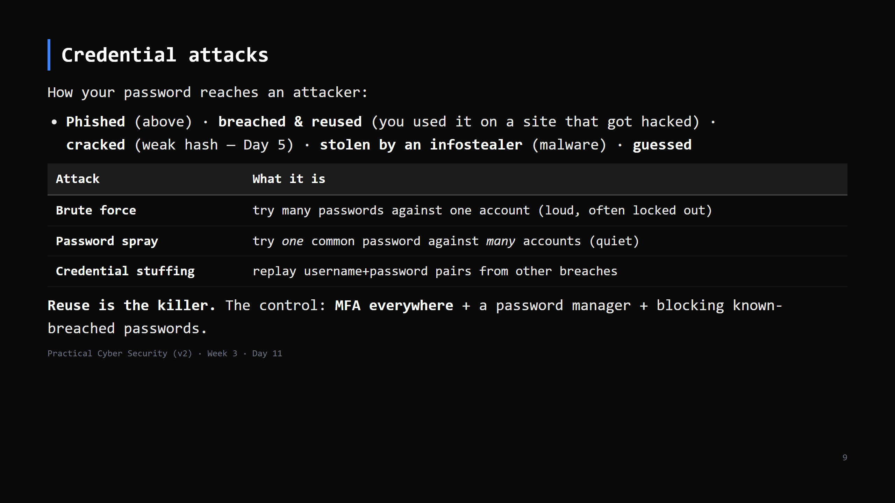
Notes:
Credential stuffing is why "but my password is strong" doesn't save you — if you reused it and the other site leaked, attackers just log in. MFA is the fix that actually scales.

Slide 10
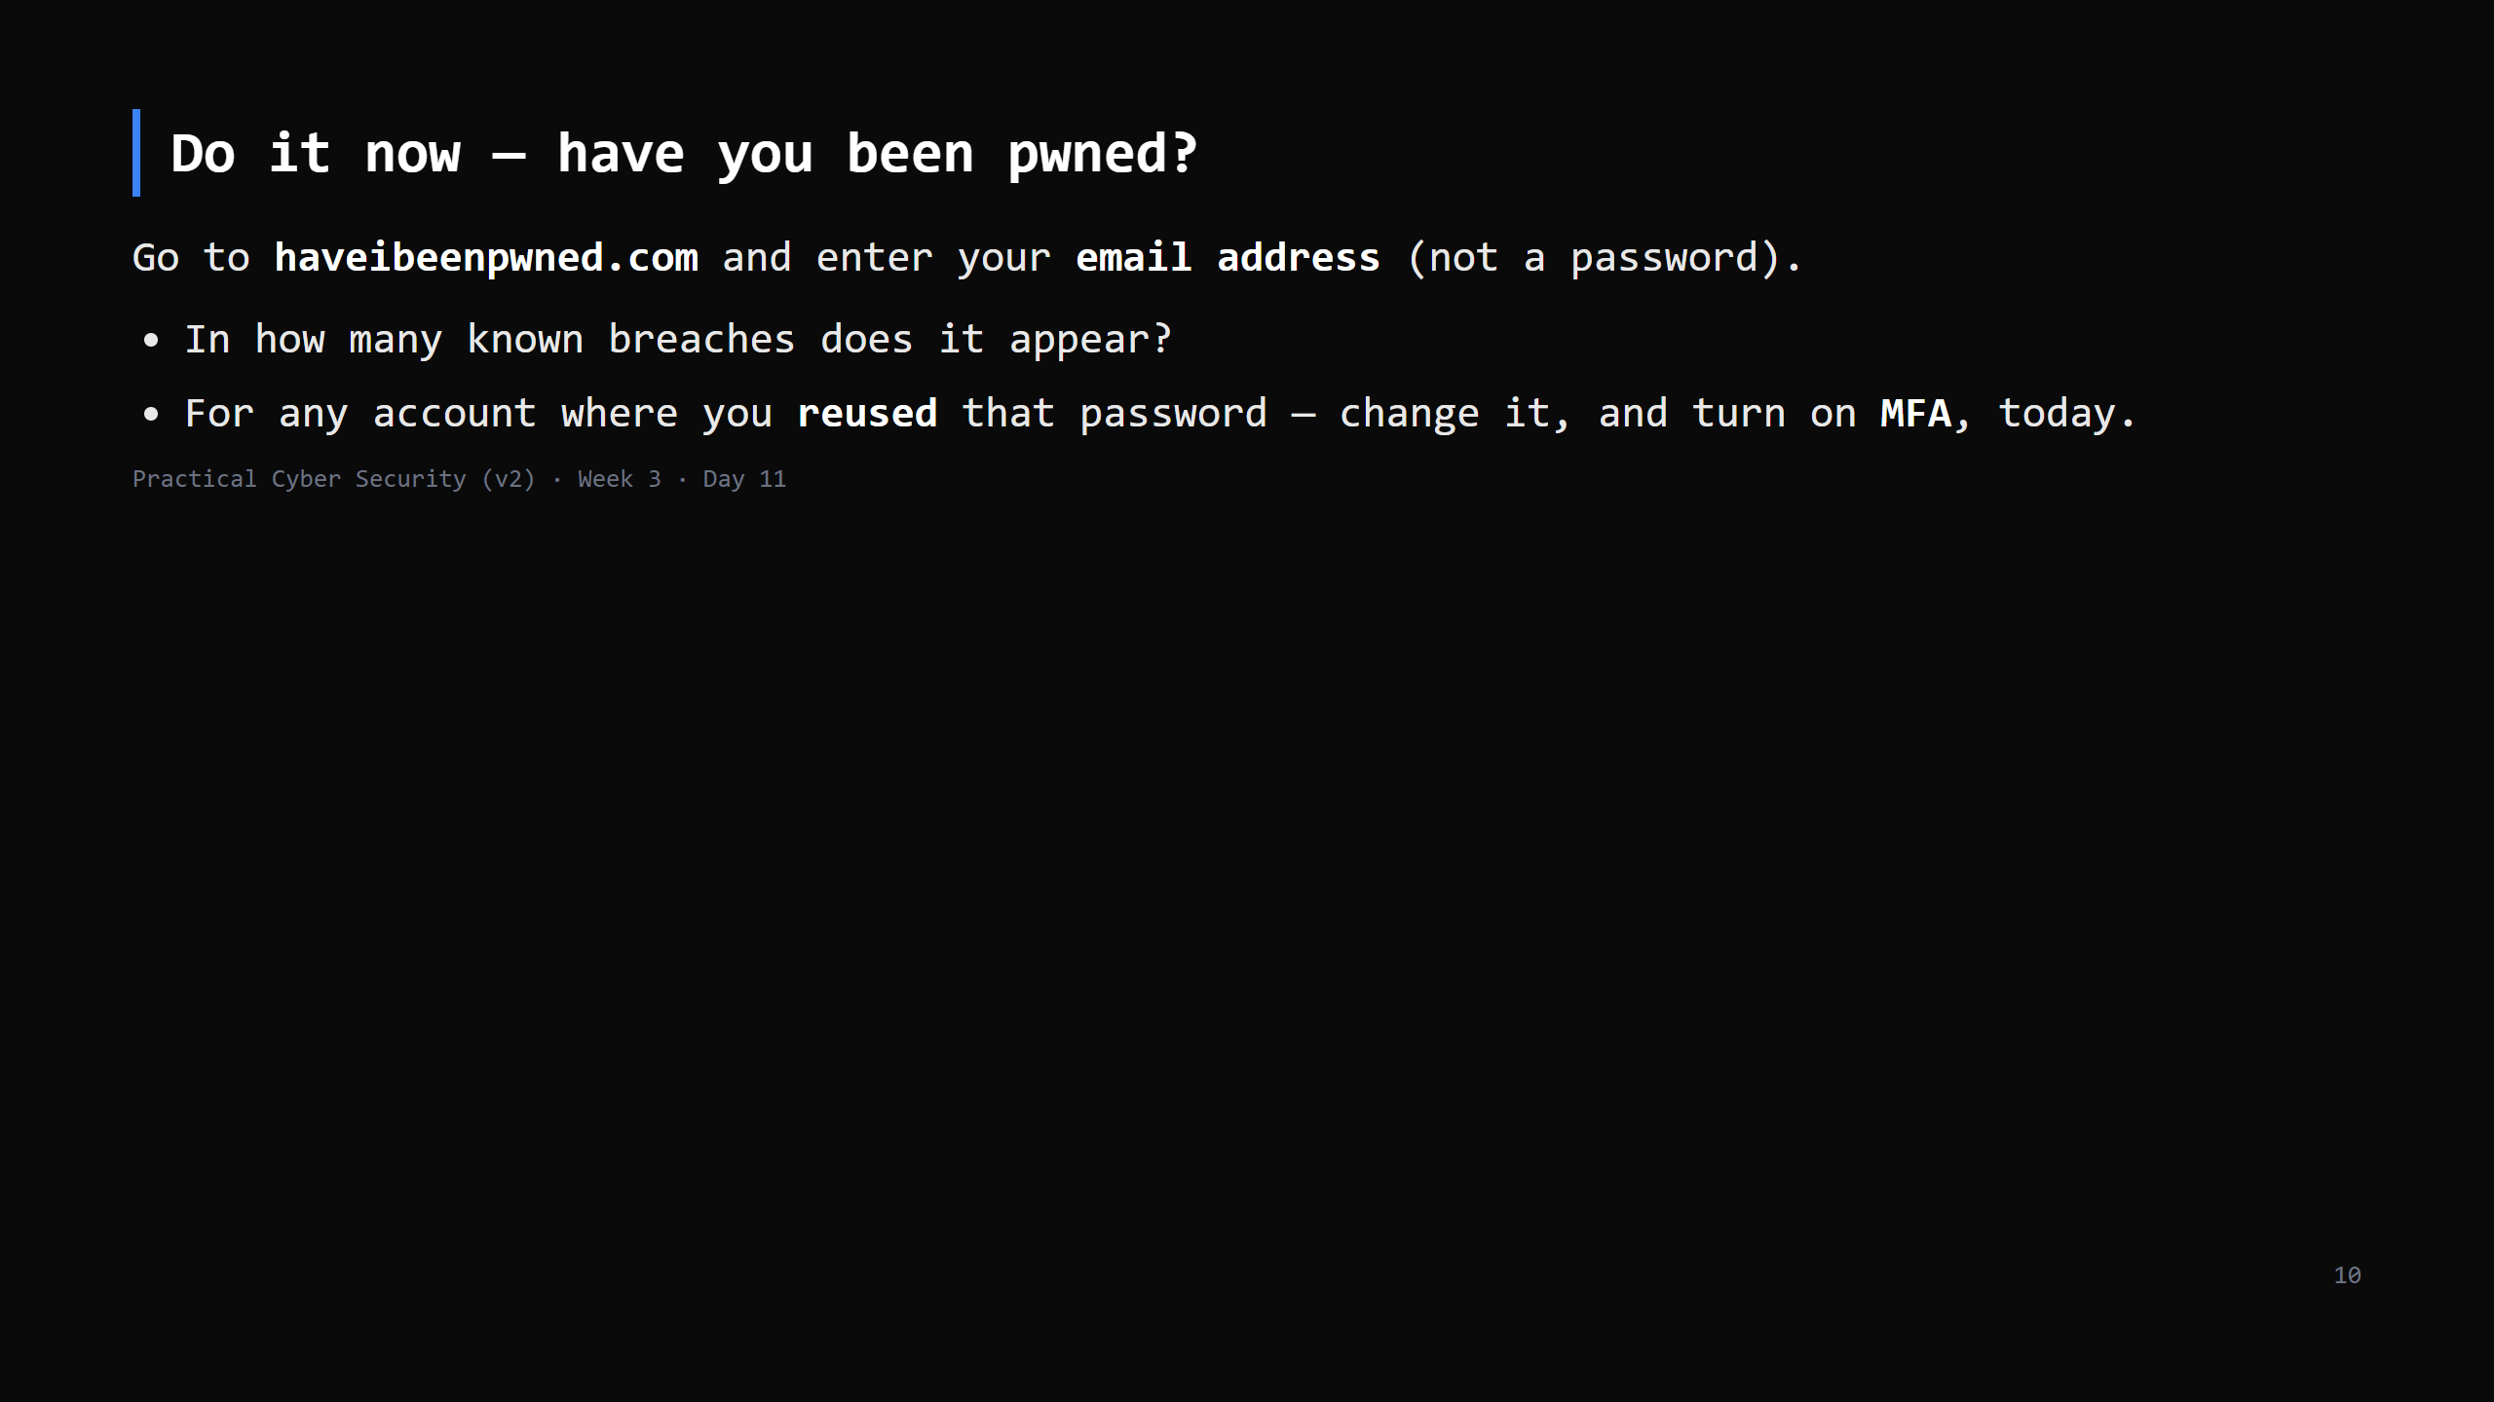
Notes:
4 min. HIBP is Troy Hunt's breach-aggregation service — safe, reputable, no password entry. Most students will have 2-10 hits. Make the action concrete: the reused ones are the danger. CUT this DO first if short — but it lands hard, try to keep it.

Slide 11
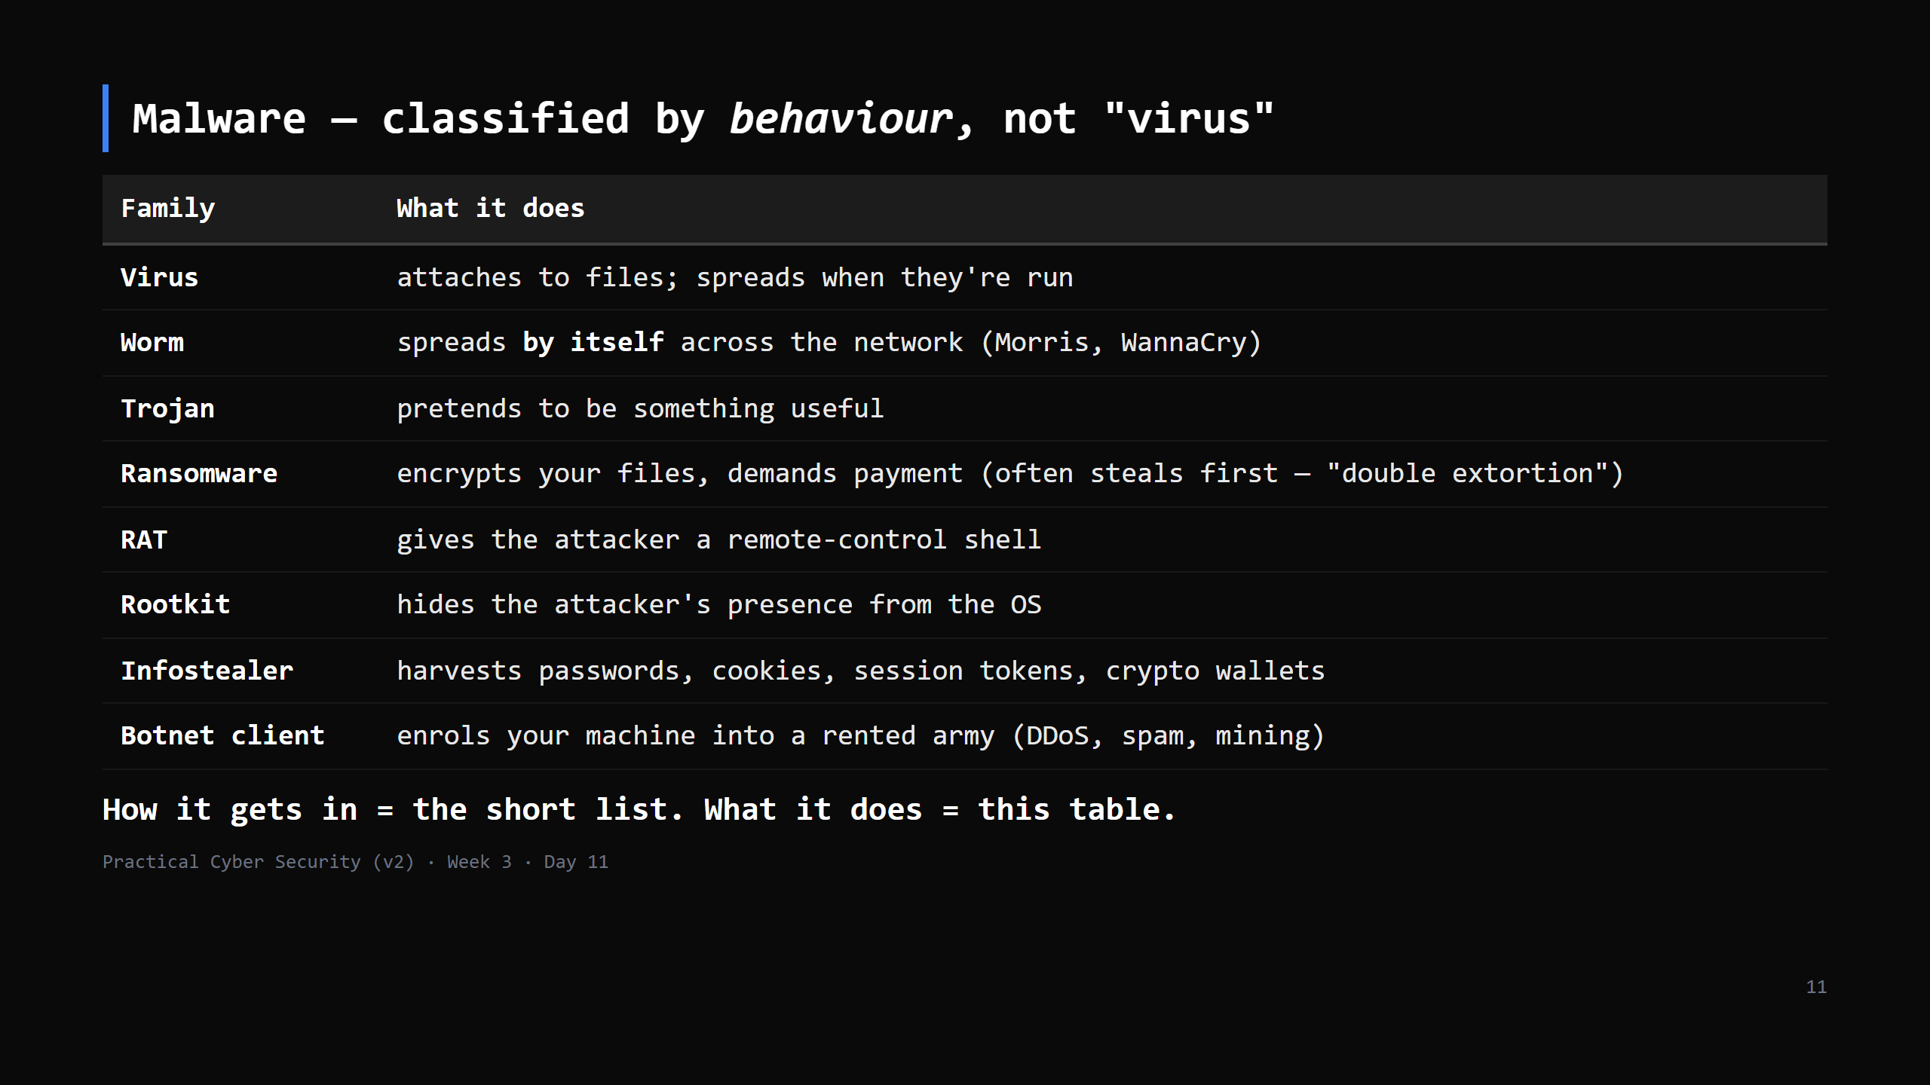
Notes:
The Day 11 TRAP: "malware = virus". Virus is one small category. Modern crime is ransomware + infostealers + RATs. Separate DELIVERY (phishing/exploit/supply chain) from PAYLOAD (this table) — a phish can deliver any of these.

Slide 12
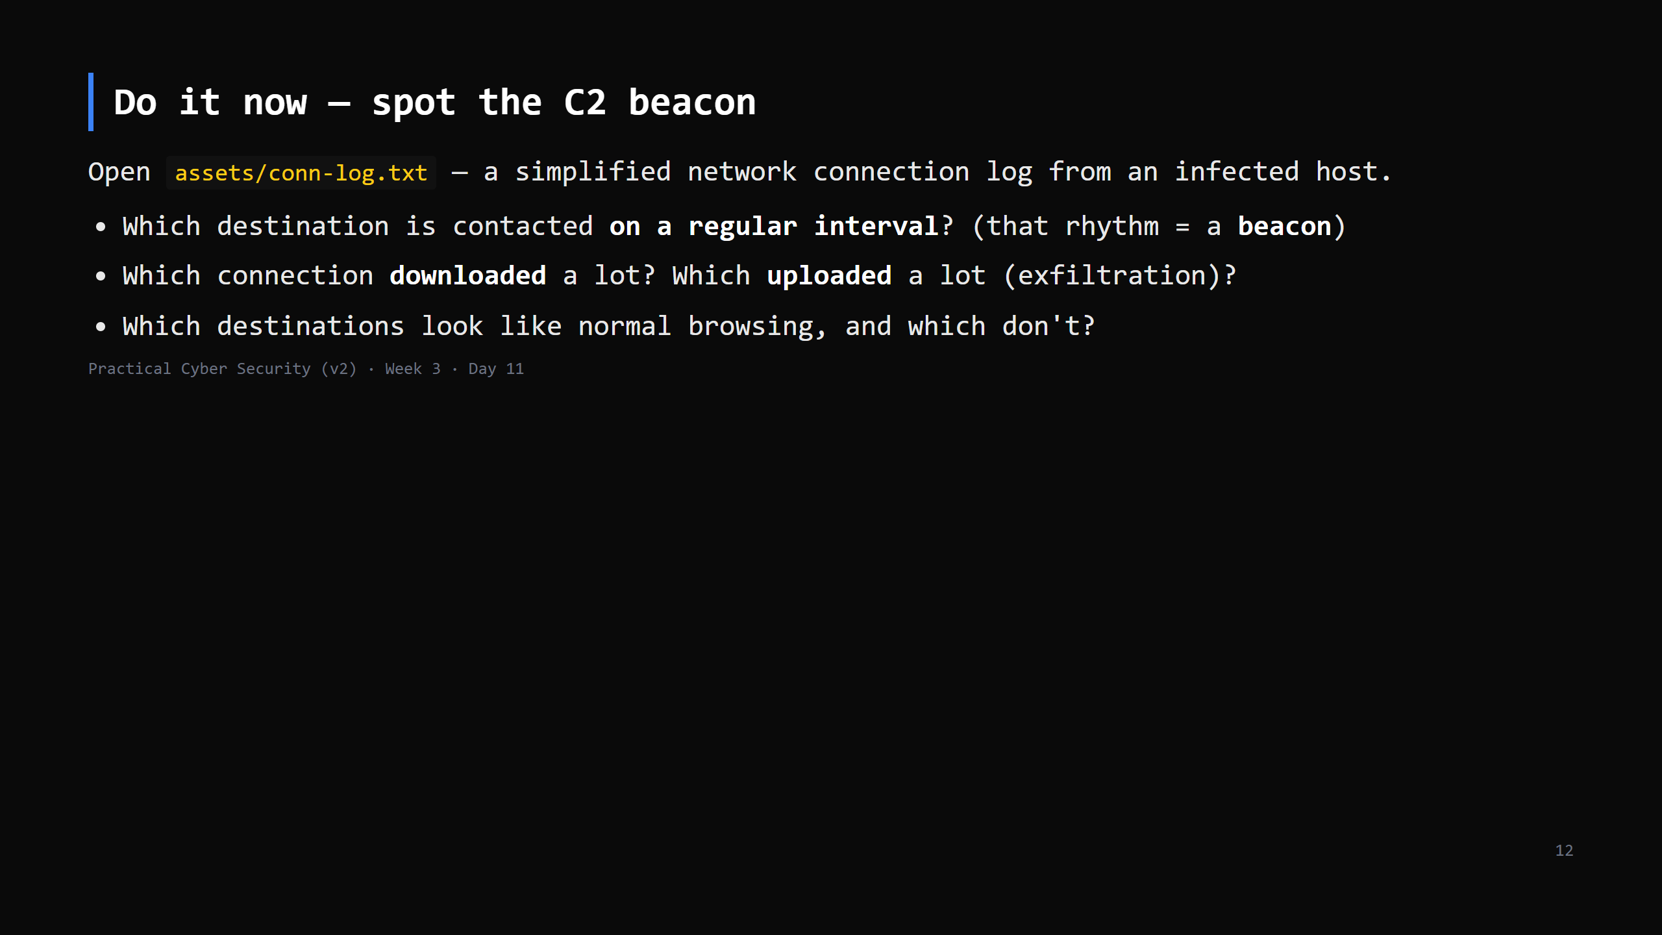
Notes:
8 min. The log has: normal web traffic + one host contacted every ~60s (the C2 beacon) + one big download (the payload) + one big upload to an odd host (exfil). On Day 13 you'll see this live in Wireshark. Today: the pattern. This is the bridge to Blue team.

Slide 13
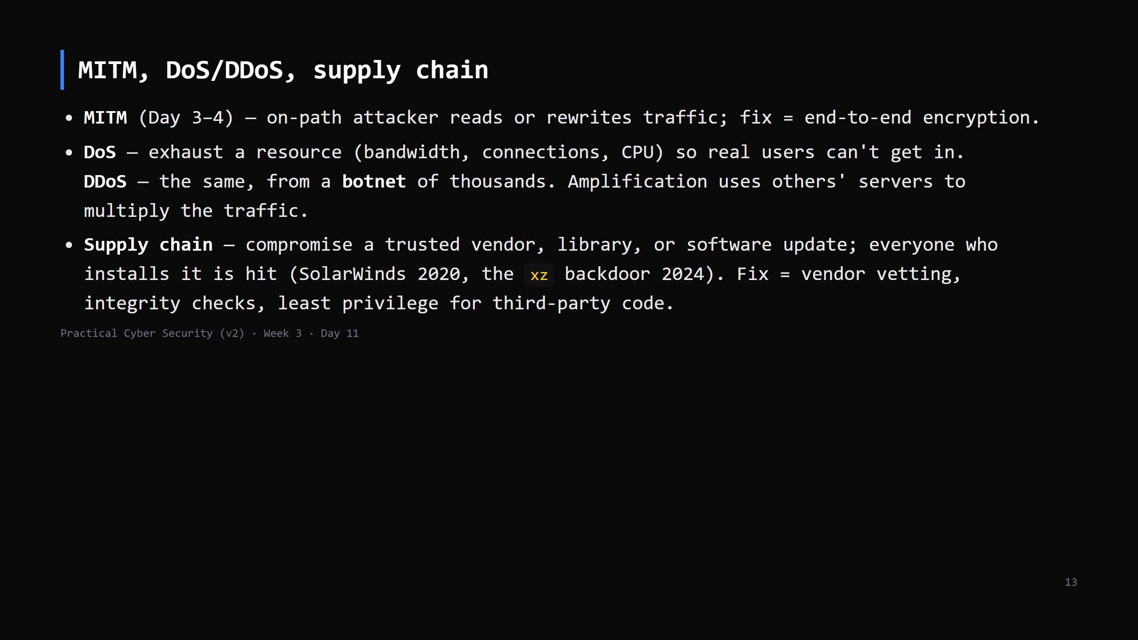
Notes:
Mostly callbacks — keep it brisk. Supply chain is the scariest because the malicious code arrives *signed and trusted*. CUT to 3 min if behind.

Slide 14
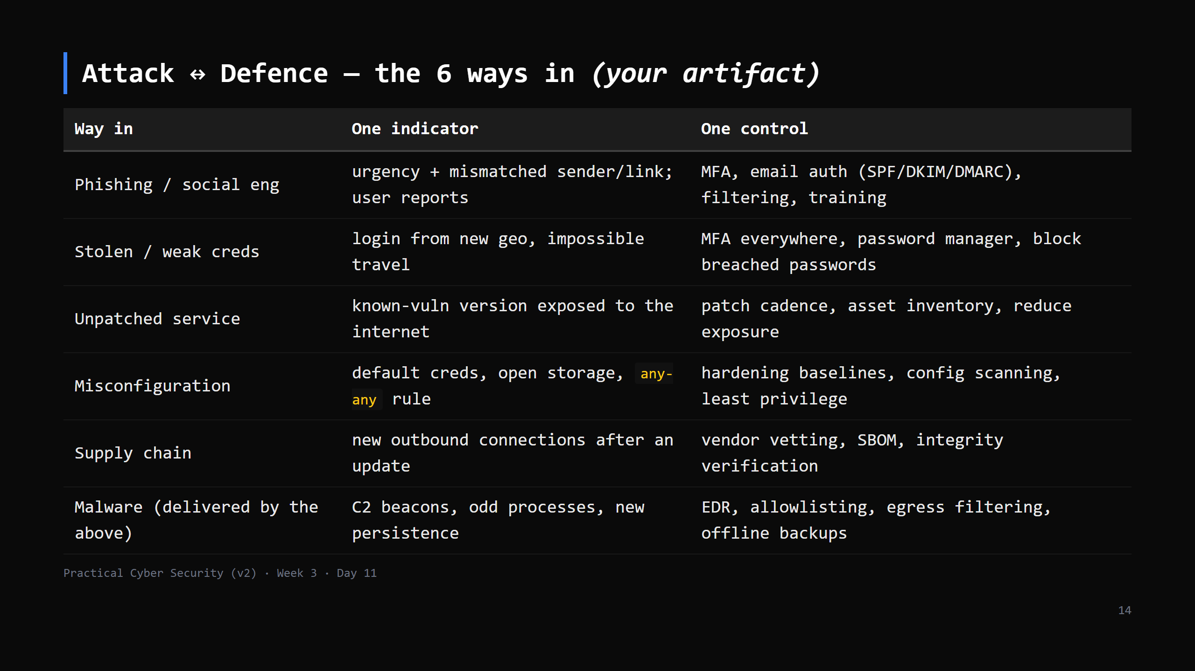
Notes:
This table IS the artifact. Students copy it, in their own words, to day11/ways-in.md. Every Week-4 defence day maps back to a row here.

Slide 15
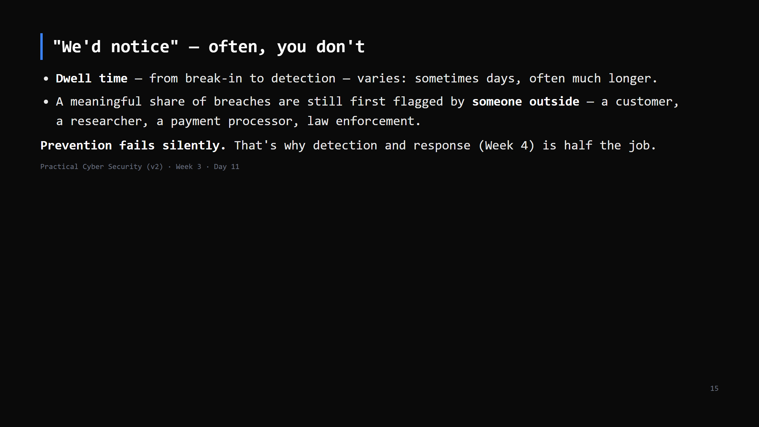
Notes:
The second Day 11 trap. The shape is what matters, not a number: attackers can be inside a long time unnoticed, and orgs frequently learn from a third party. Reporting has improved year on year — say "varies, often longer than you'd think", not a hard stat.

Slide 16
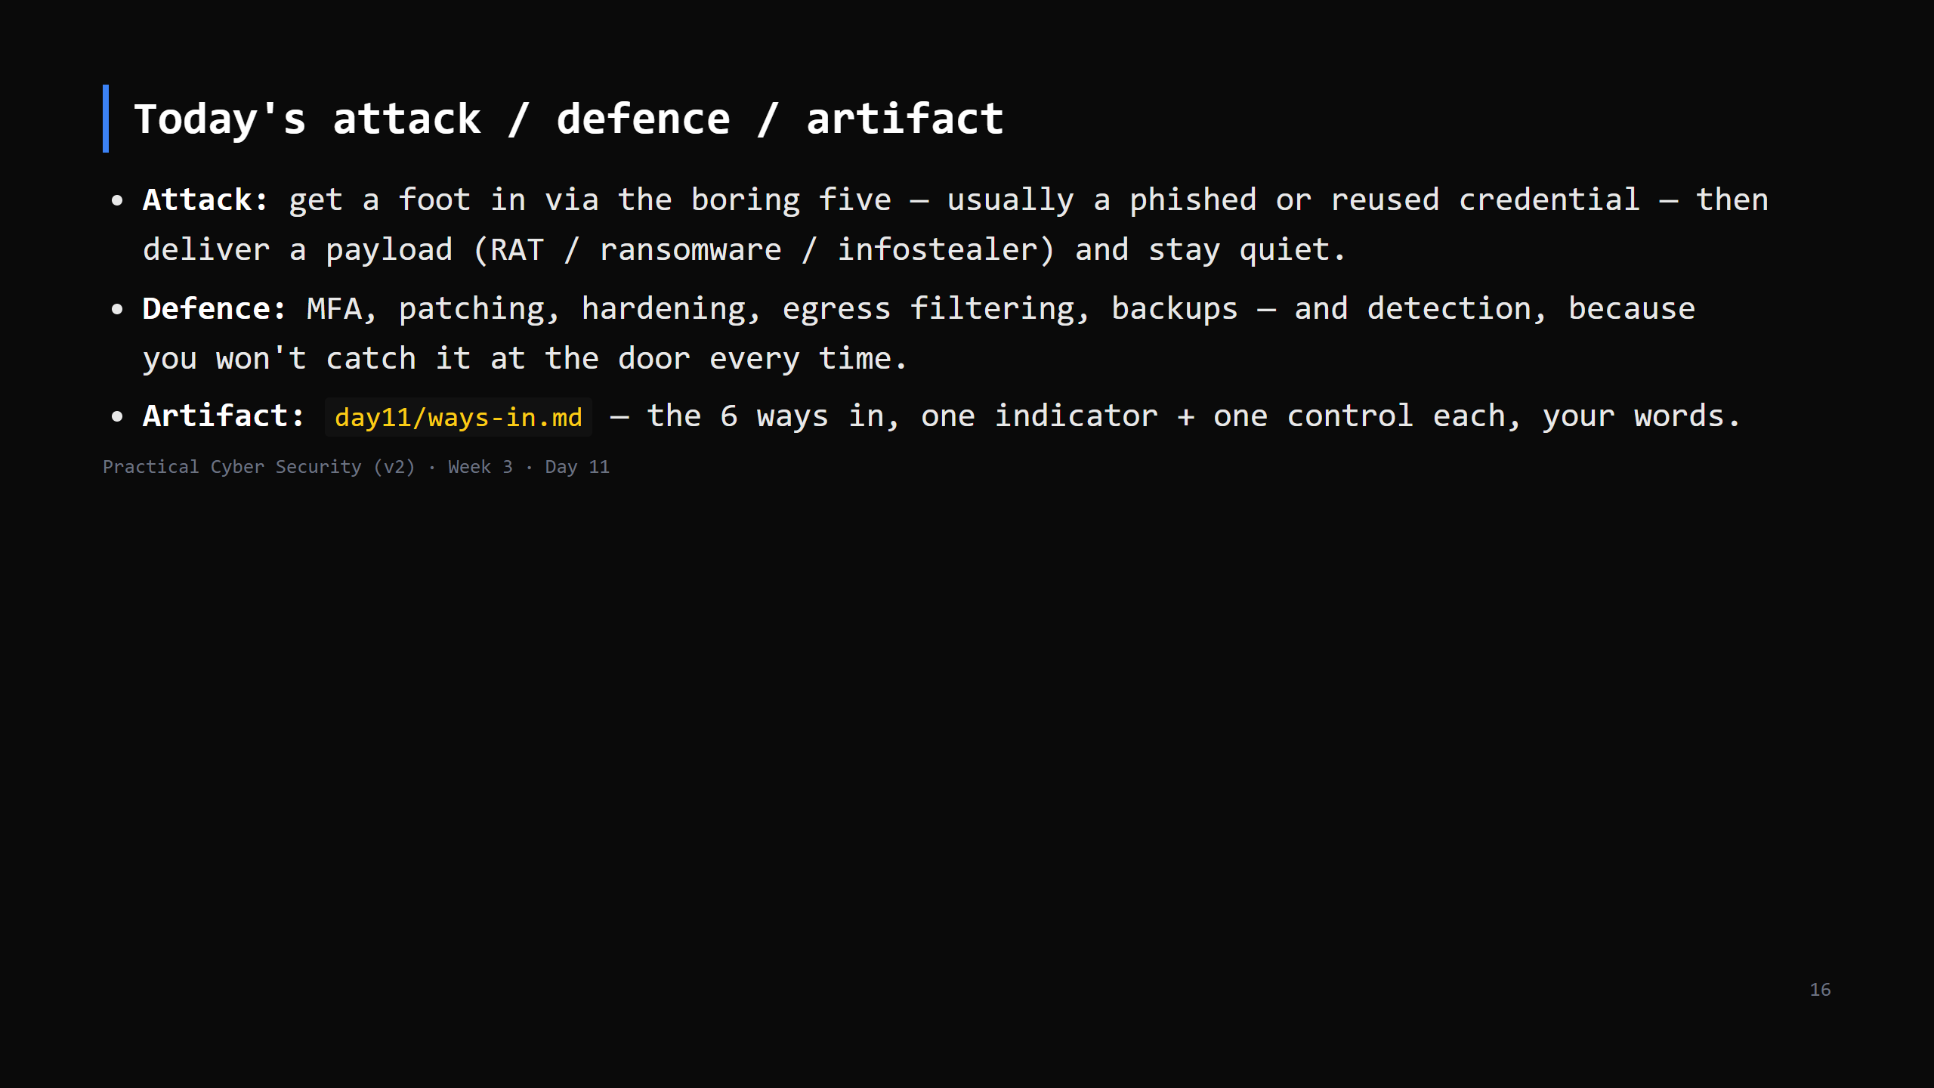

Slide 17
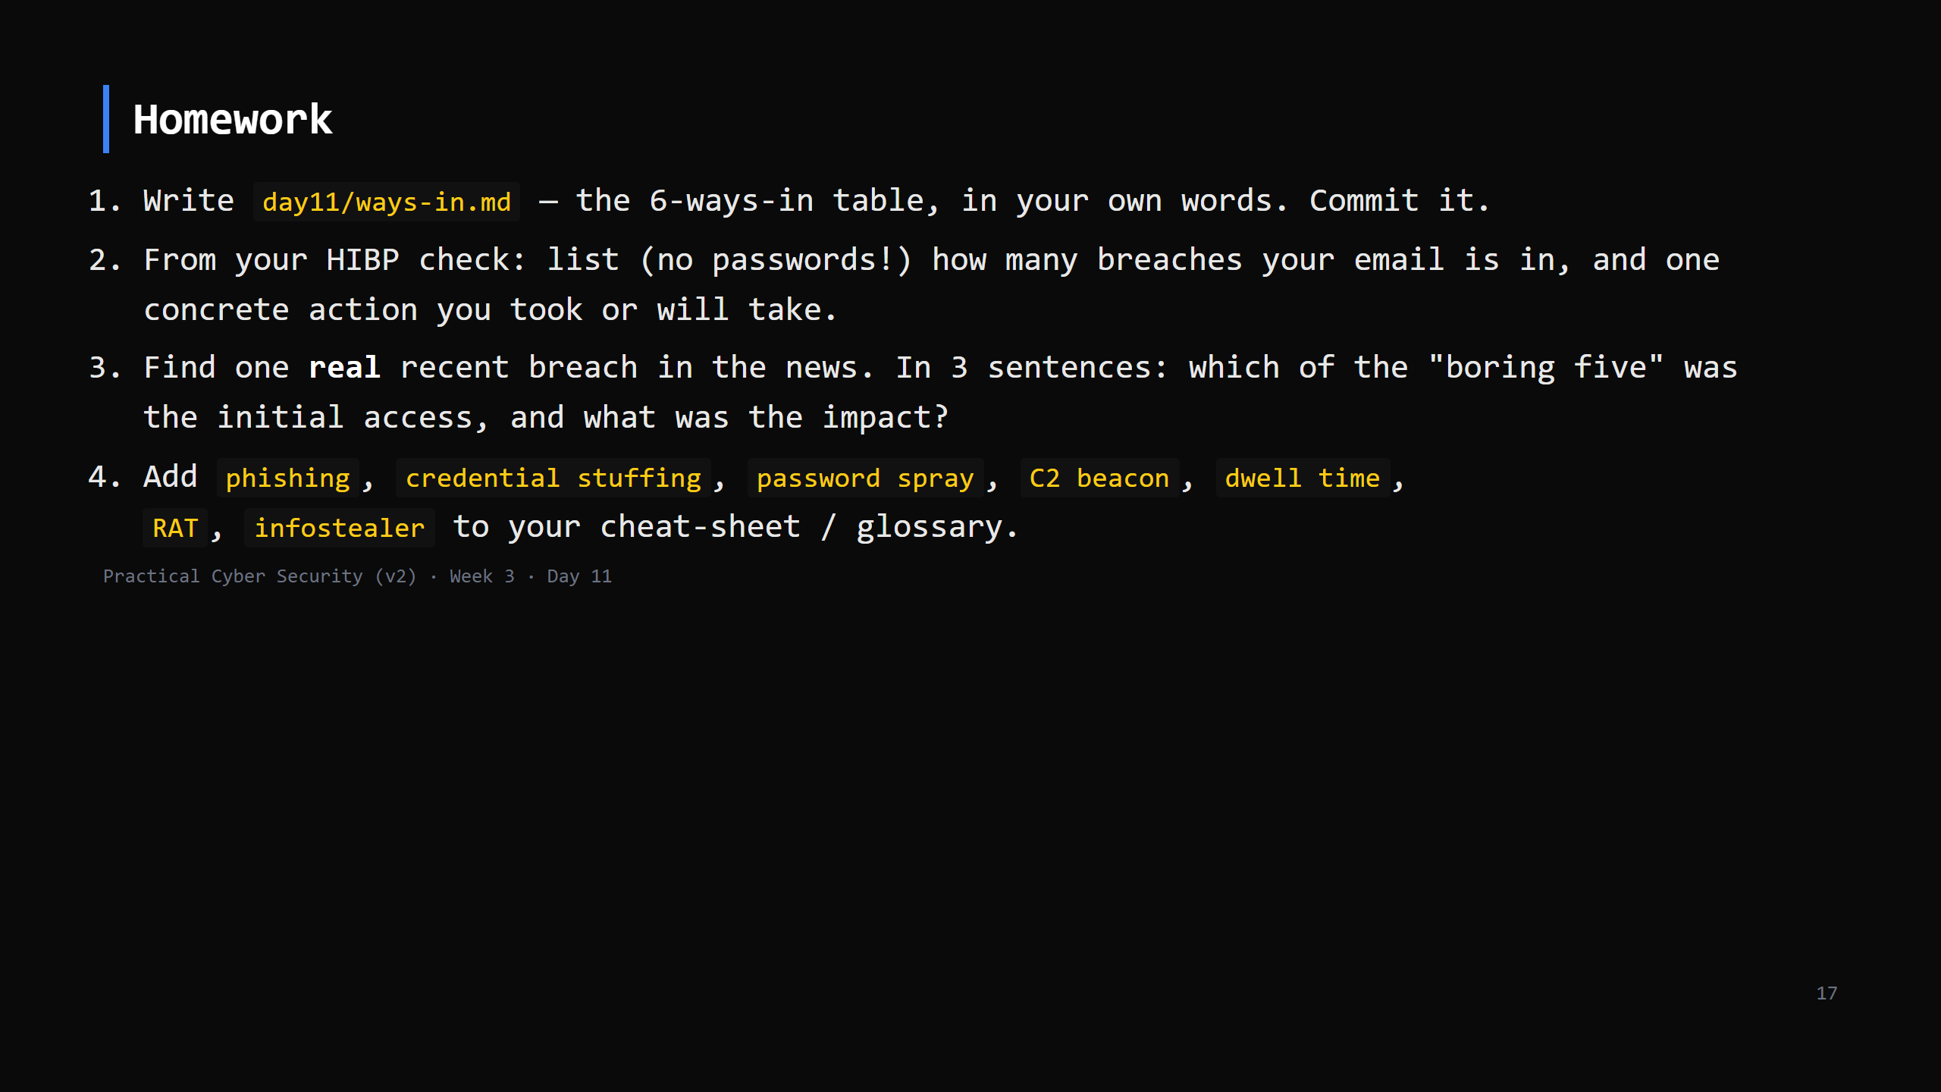
Notes:
Due start of Day 12.

Slide 18
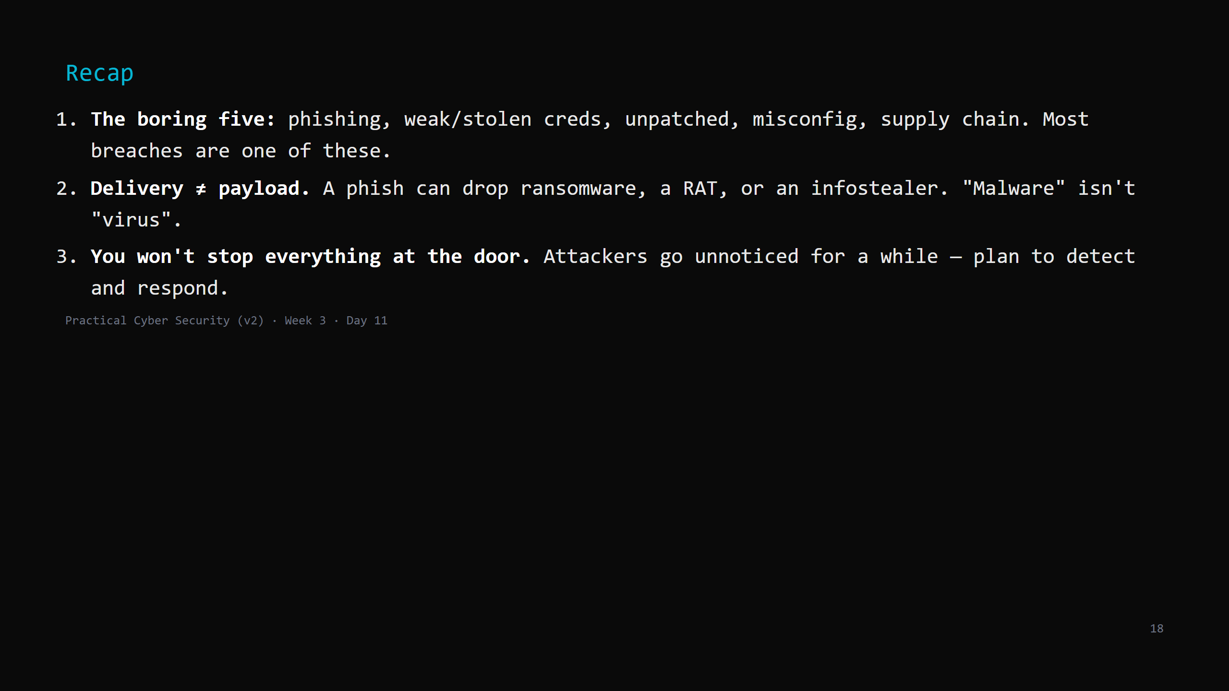
Notes:
Say the three lines. Tomorrow: we turn "here are the attacks" into "here is the repeatable process an attacker (and a pentester) follows" — the lifecycle — and we stand up the lab.

