Slide 1
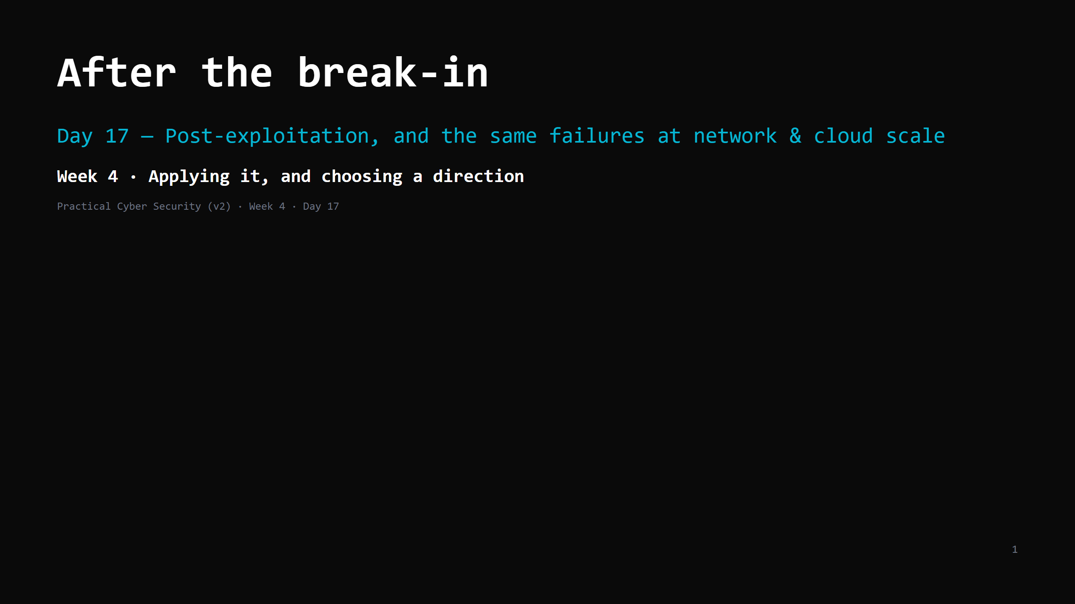
Notes:
RUN SHEET (~85 min). TWO-PART DAY — two disciplines. Treat it as such: PART 1 — post-exploitation (through the attack-chain artifact). target: DONE by minute 48. PART 2 — infrastructure + cloud. >>> MID-POINT GATE at minute 48: if the priv-esc DO ran long and you're not at "the attack chain" slide, drop persistence/lateral/pivot to a 90-second name-check, do the attack chain, then Part 2 becomes: infra = a 4-min bullet run, shared responsibility (full), the bucket/IAM DO is homework. NEVER cut shared responsibility or the attack-chain artifact. 00:00 Journey check + hook (low-priv -> root in 20s) 4 ┐ 00:04 What a shell is + the post-ex goals 5 │ 00:09 Privilege escalation 10 │ PART 1 00:19 DO: shell -> linpeas -> priv-esc on Metasploitable2 16 │ (post-ex, 00:35 Persistence / lateral movement / pivoting 8 │ done by :48) 00:43 The attack chain + detection opportunities 7 ┘ 00:50 Infrastructure security 8 ┐ 00:58 Cloud security — shared responsibility 8 │ PART 2 01:06 DO: fix an open bucket / IAM policy 10 │ (infra + cloud) 01:16 Attack <-> defence + wrap + homework 4 ┘ CUT FIRST IF SHORT: persistence/lateral/pivot slide to 4 min; infra slide to a 4-min bullet run. NEVER CUT: privilege escalation + the priv-esc DO, the attack-chain-with-detection artifact, shared responsibility, the bucket/IAM DO. ANALOGY (kitchen): post-ex = you're inside after hours. Get the master key (priv-esc), prop a door for later (persistence), move kitchen -> office -> safe (lateral movement), use the restaurant's van to reach the warehouse (pivoting). Cloud = a chain of restaurants sharing one supplier who says "we lock the building; what's in your unit is your problem". ETHICS: Metasploitable2 / assigned lab target only (the ROE). Post-ex stays on that box.

Slide 2
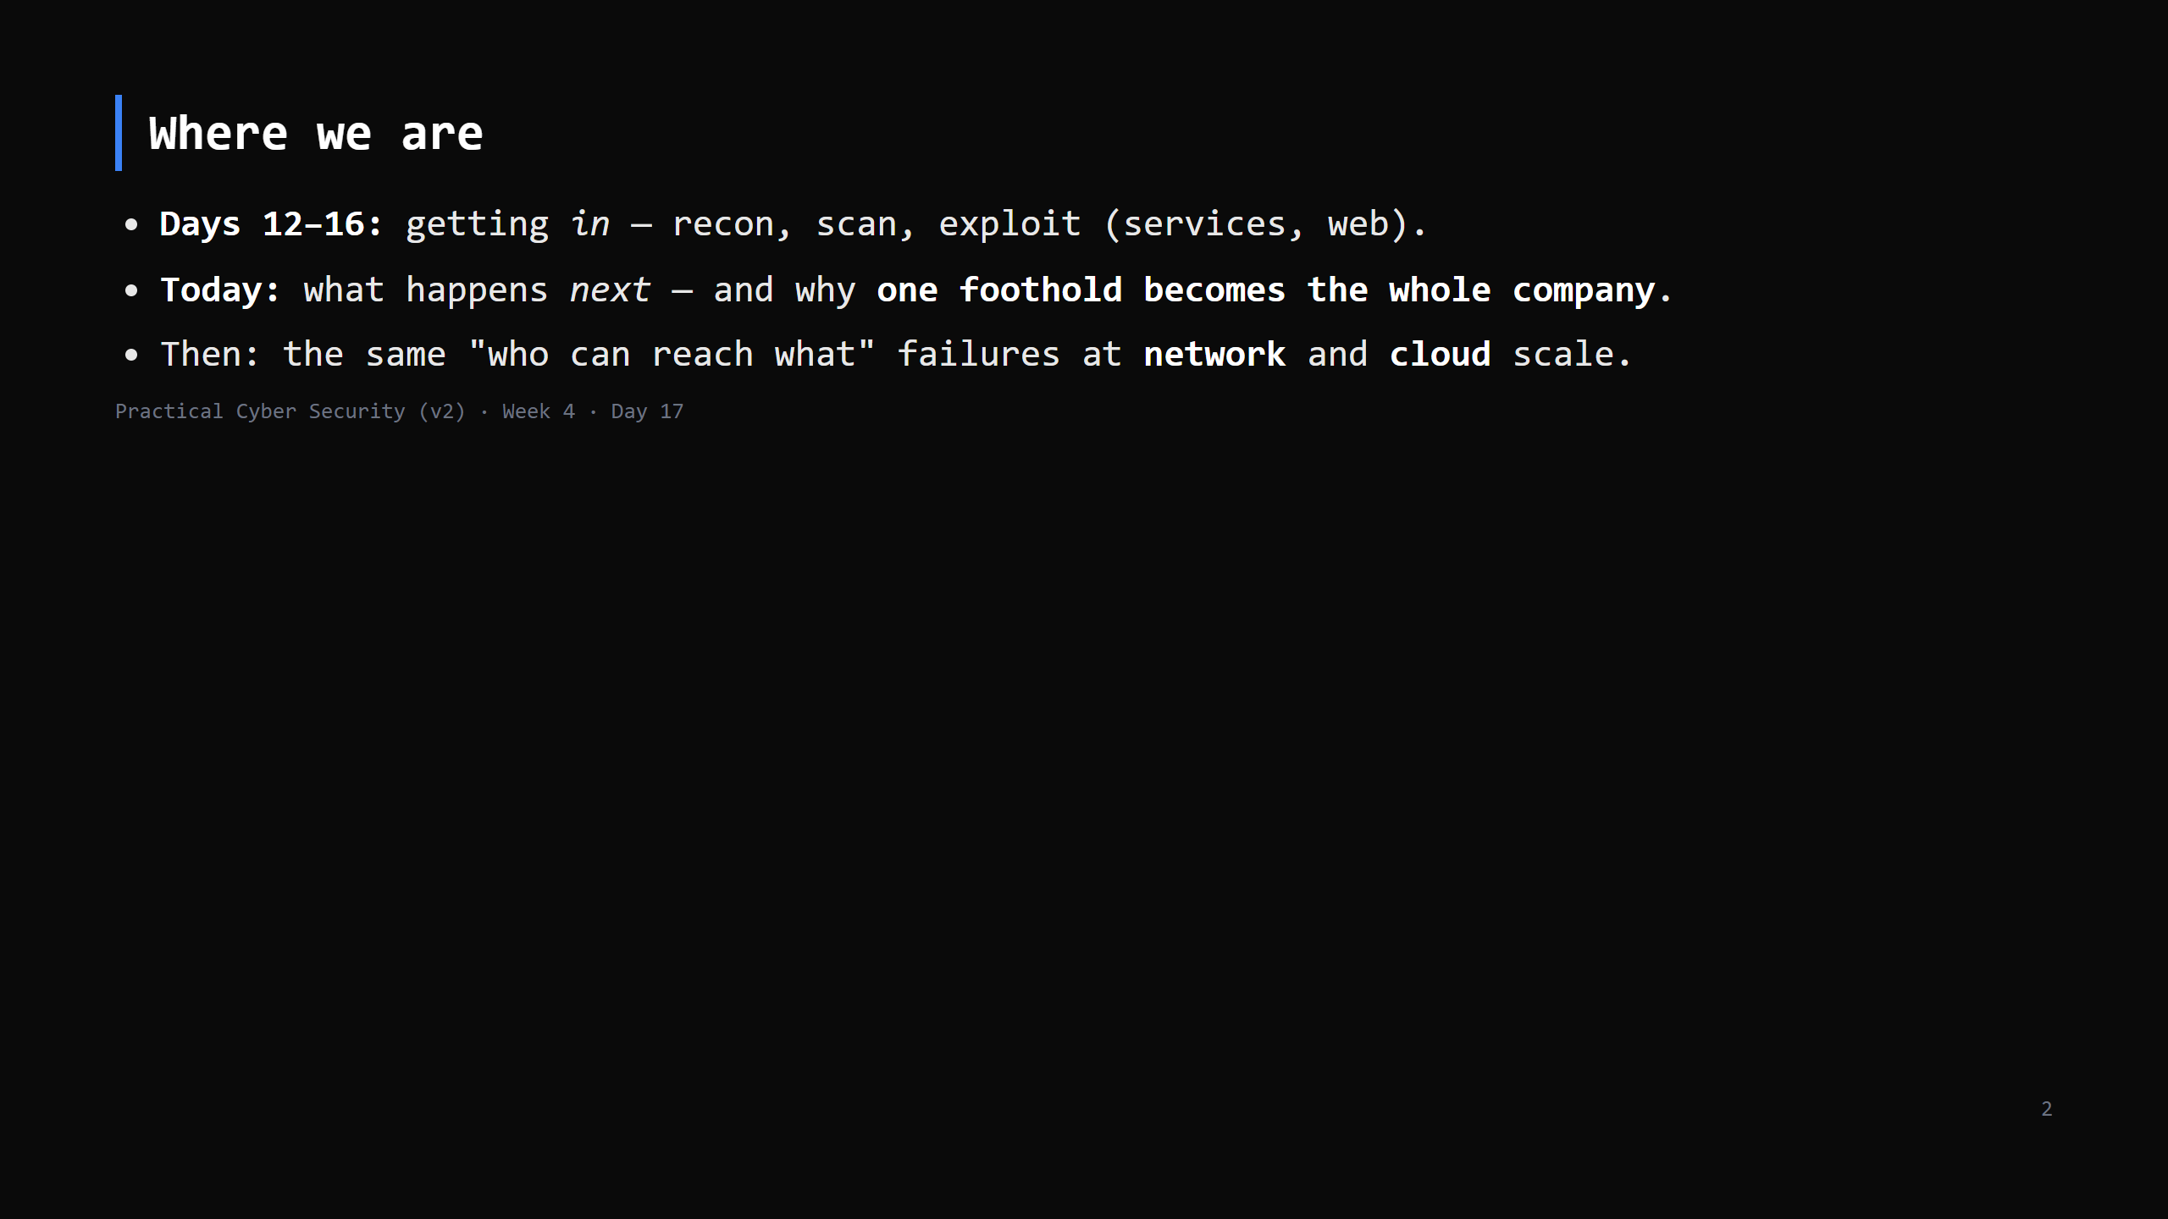
Notes:
Journey Check. Getting a shell is the START of the interesting part, not the end. This is lifecycle Phase 5 (post-exploitation).

Slide 3
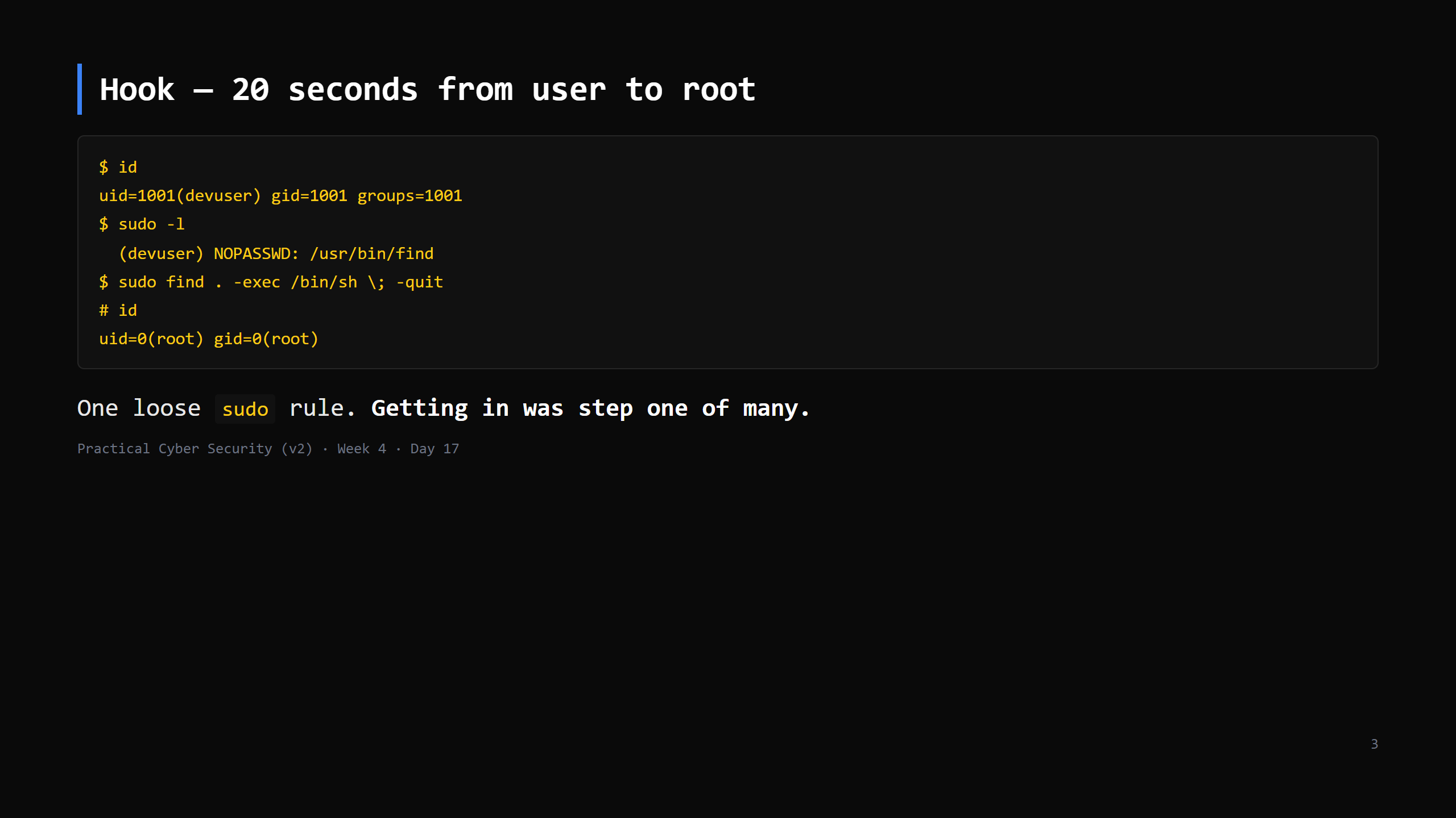
Notes:
`find` can run commands (`-exec`), and `sudo` runs it as root -> instant root shell. This is a GTFOBins classic (Day 7). Land it: "the exploit got them a low-priv shell; THIS is how it becomes game over."

Slide 4
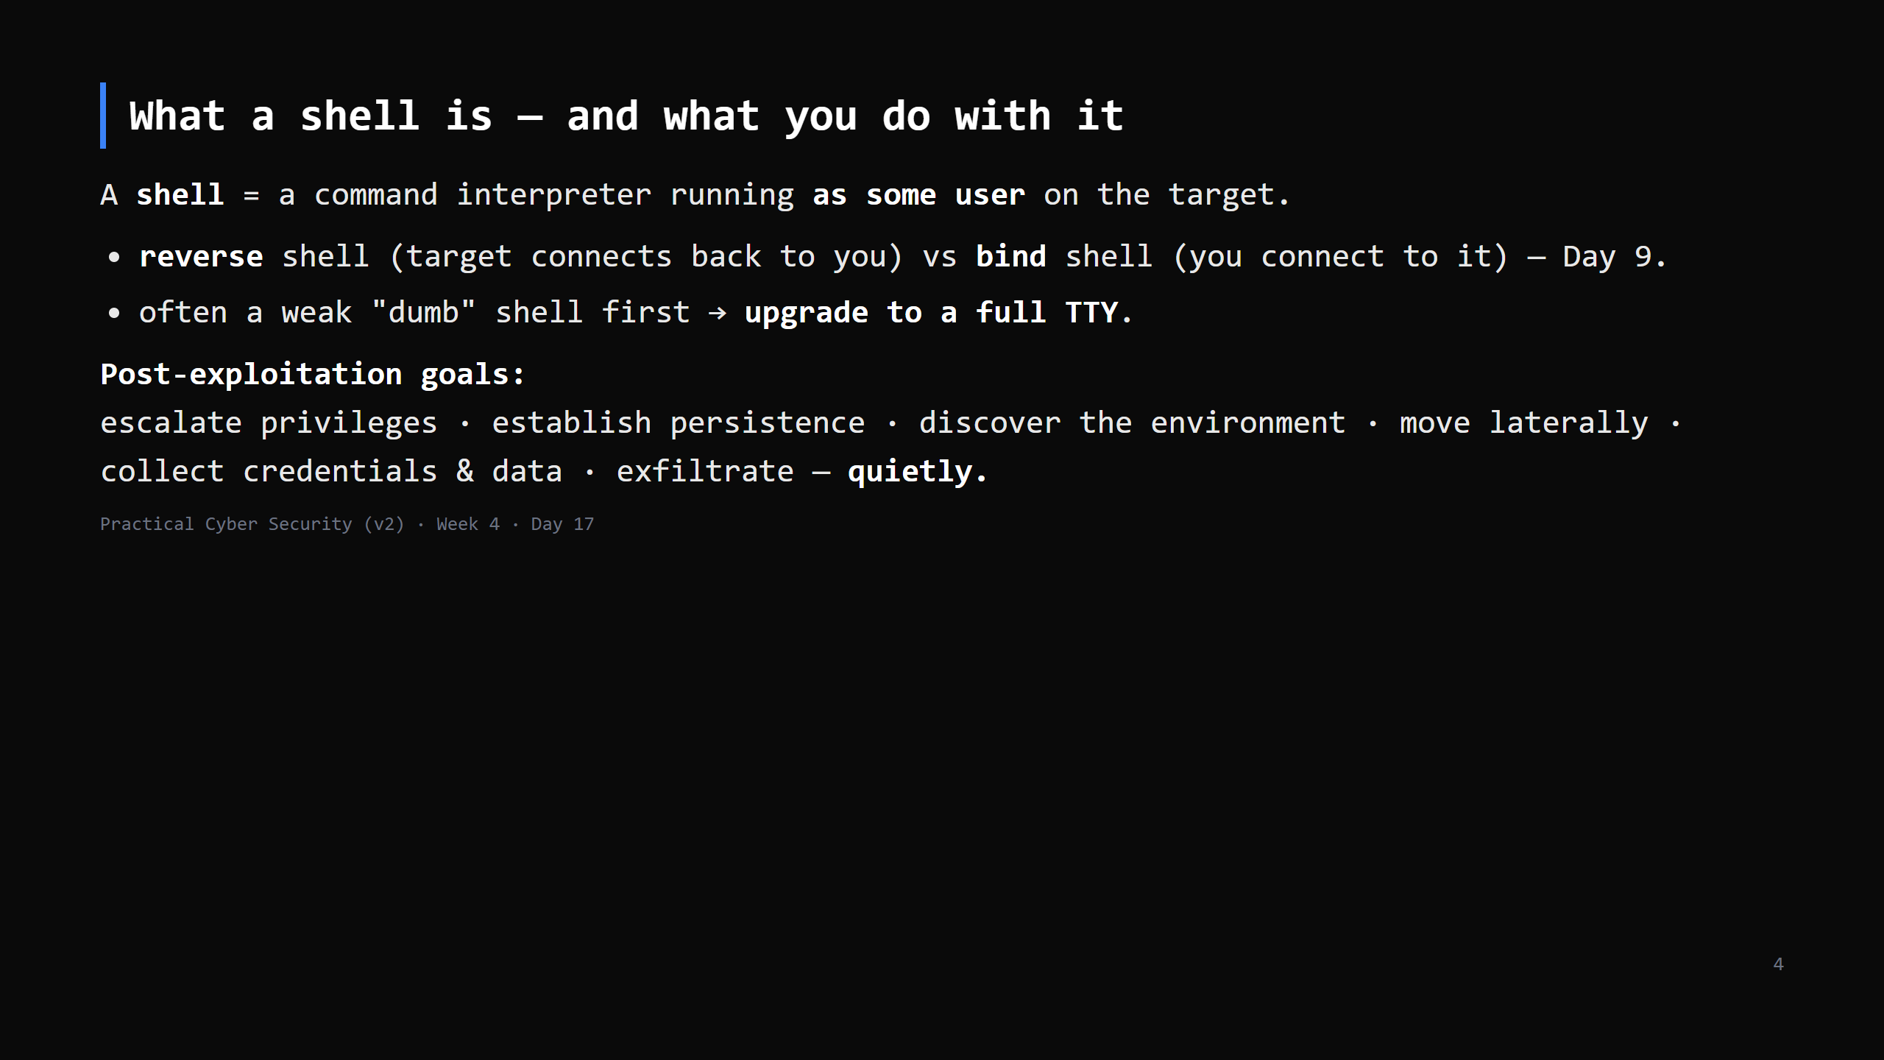
Notes:
Metasploit gives you a `meterpreter` session (a feature-rich agent) or a plain `shell`. The goals list = the rest of today. "Quietly" = the whole reason Day 19 (Blue team) exists.

Slide 5
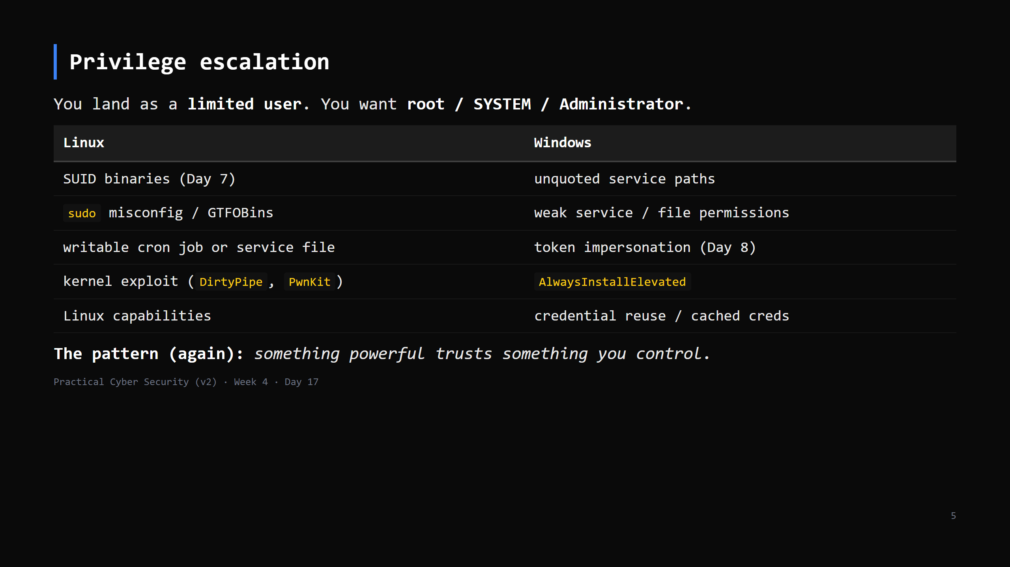
Notes:
Tools automate the hunt: `linpeas.sh` / `linenum.sh` (Linux), `winPEAS` / `PowerUp` (Windows). They dump everything interesting; you spot the path. Kernel exploits are last resort (can crash the box).

Slide 6
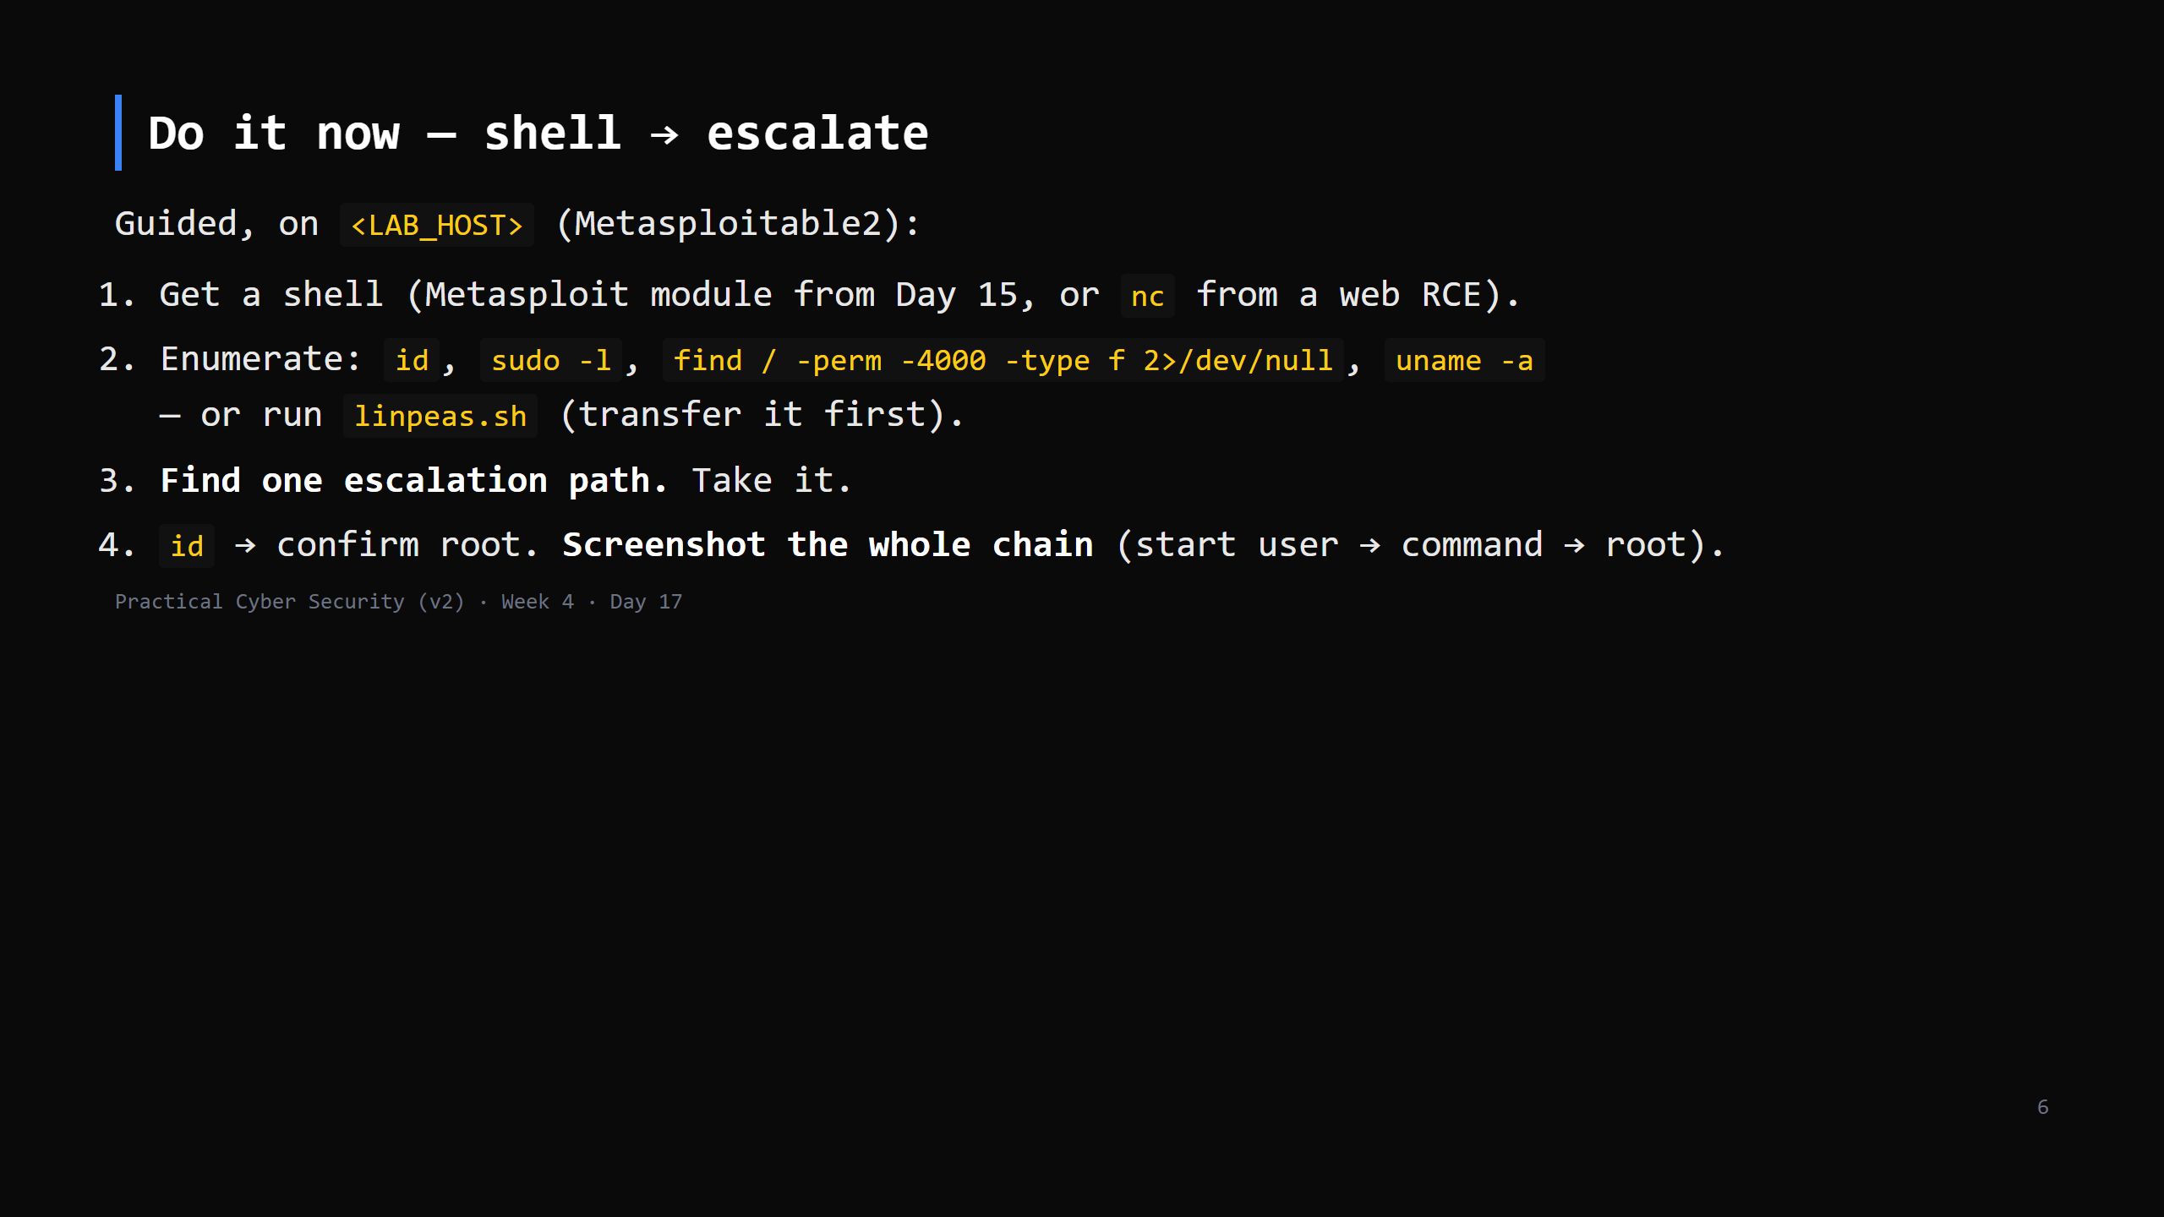
Notes:
16 min. Metasploitable2 has many paths: the `distcc`/`udev`/`nfs` routes, an old kernel, world-writable cron. Coach the same way as Day 15. linpeas: `wget http://<your-kali>/linpeas.sh` on the target (host it with `python3 -m http.server`). Non-root -> root is the proof. This is Phase 5 of the engagement journal.

Slide 7
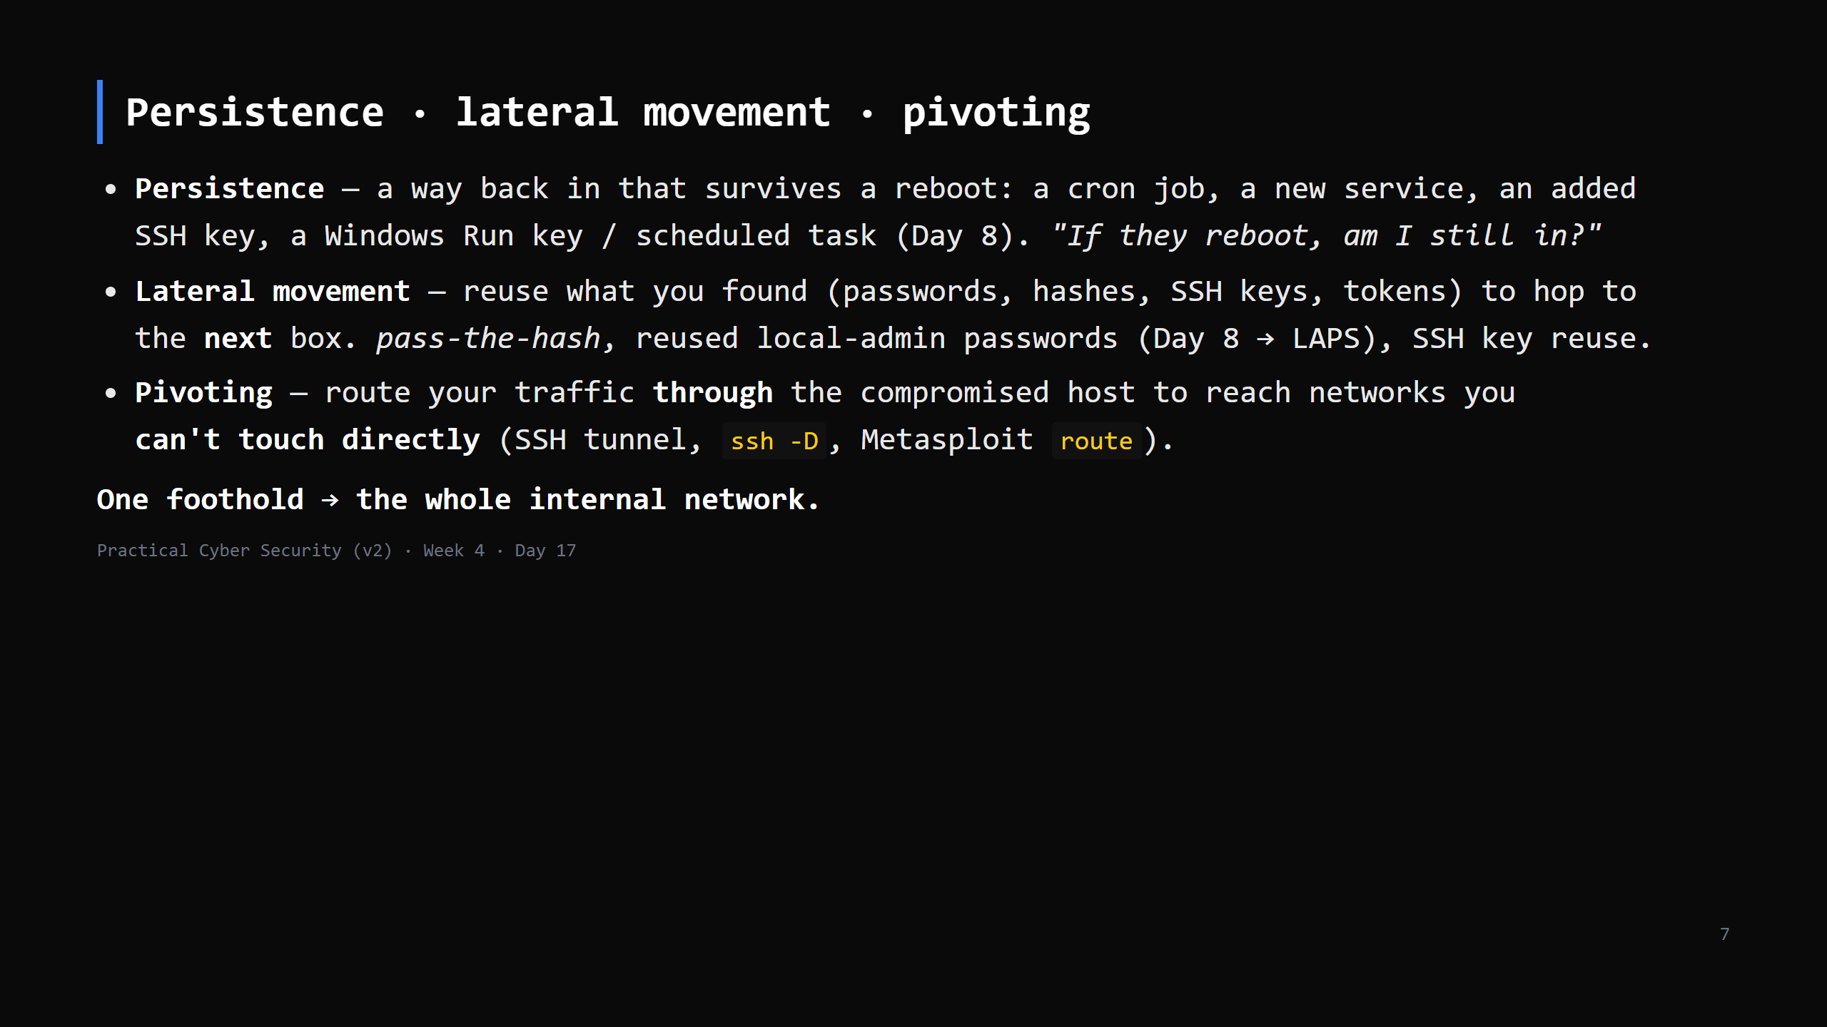
Notes:
This is why a flat internal network is dangerous - one workstation compromise reaches the database, the DC, everything. Segmentation (next) breaks the chain. CUT to 4 min if behind - name the three, one line each.

Slide 8
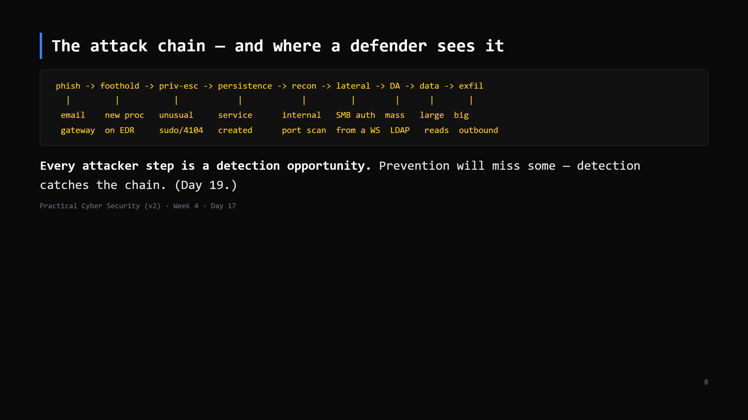
Notes:
THIS IS THE ARTIFACT. Students draw their own version: the chain + one thing a SOC could see at each step. It's the bridge from Red to Blue and the reason "assume breach" (Day 10) matters.

Slide 9
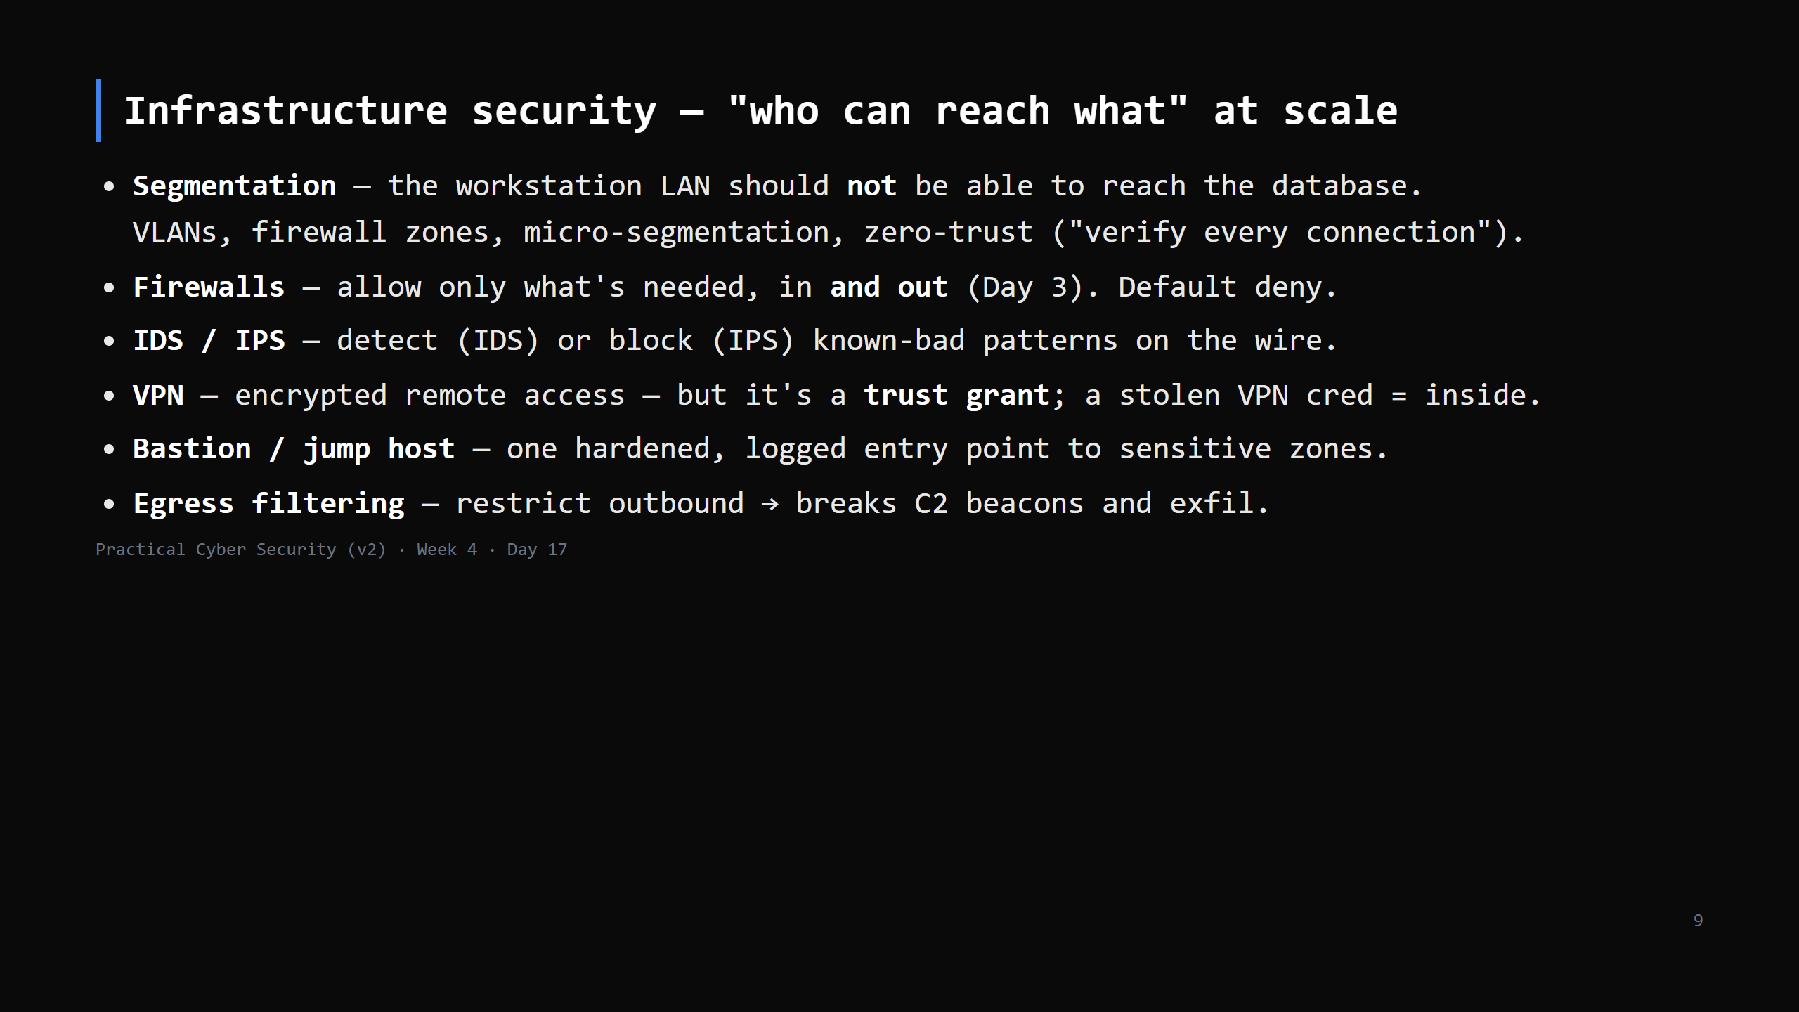
Notes:
The theme: the internal network is not "trusted" just because it's internal (assume breach). Segmentation is the single highest-value control against lateral movement. CUT to a 4-min bullet run if behind.

Slide 10
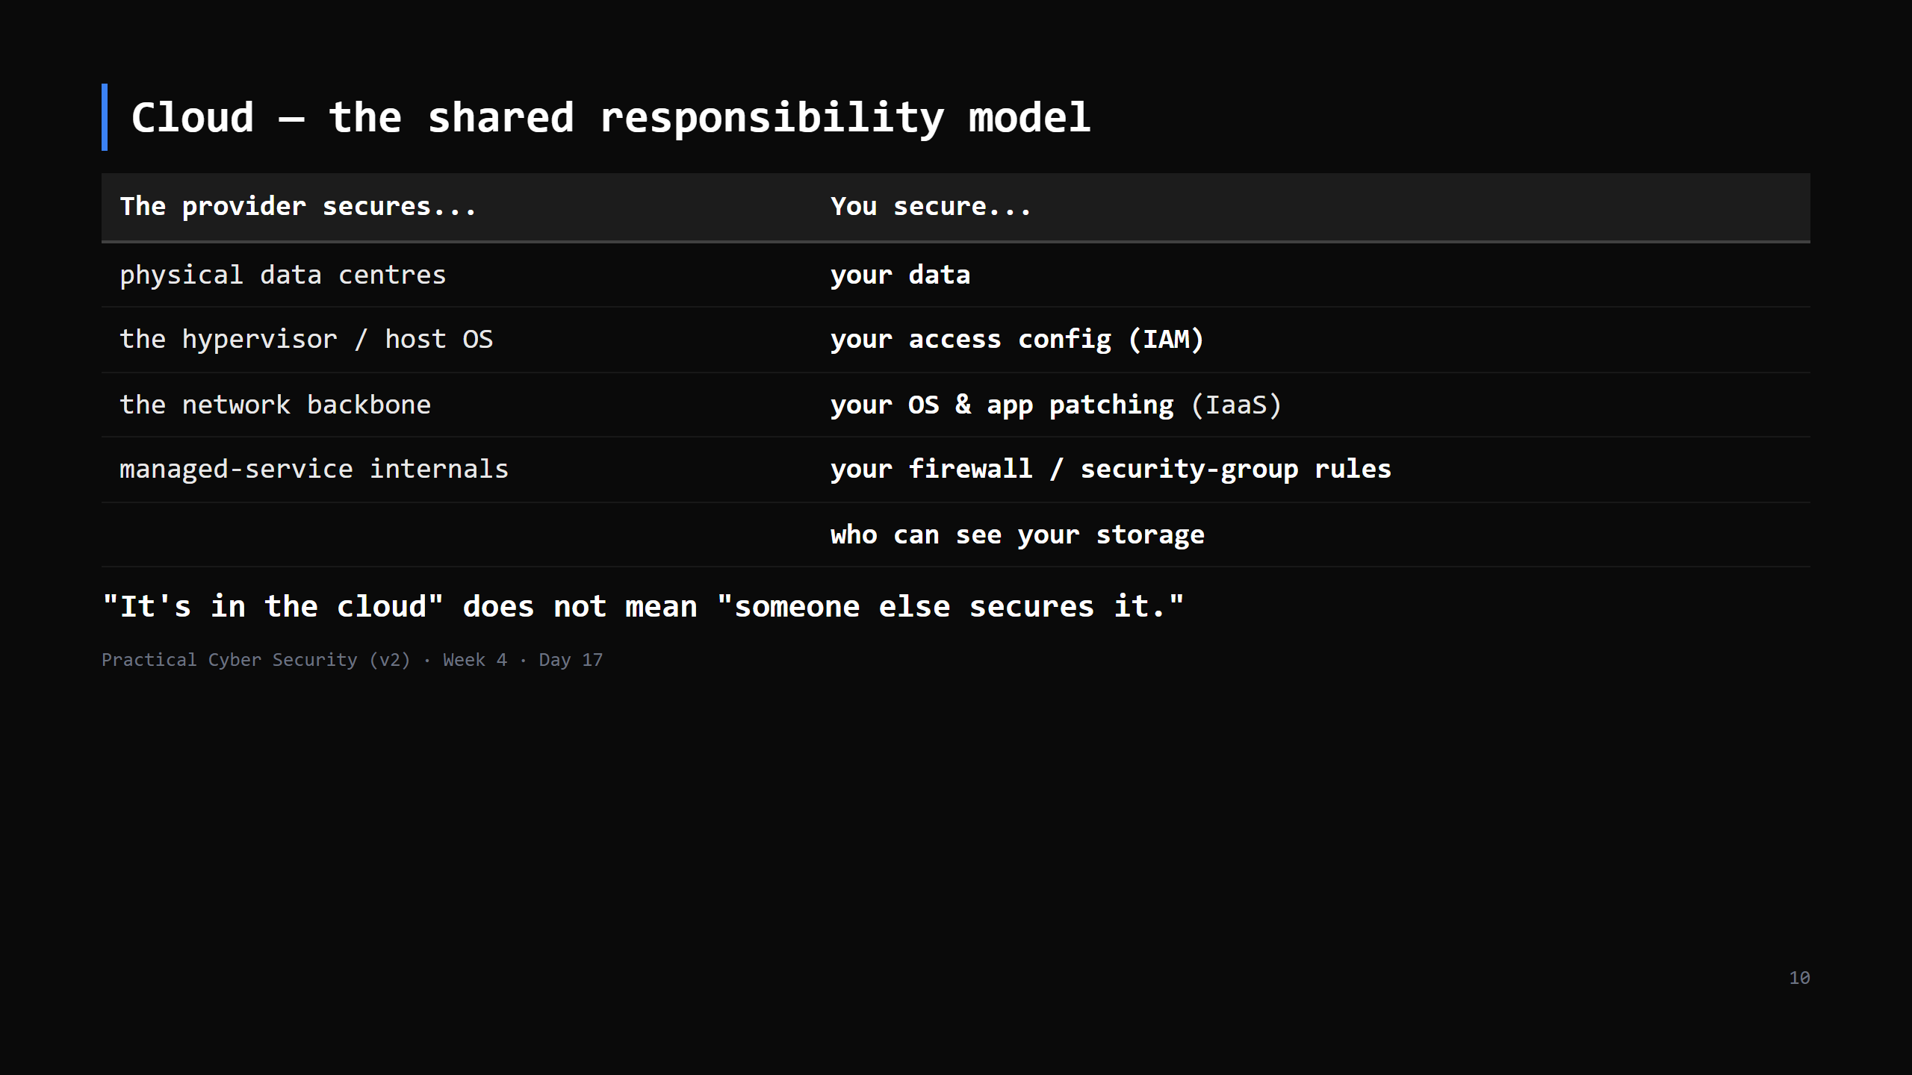
Notes:
The split shifts by service model: with a managed database (PaaS) the provider patches the DB; with a VM (IaaS) you do. The CONSTANT is: identity, access config, and data are always yours.

Slide 11
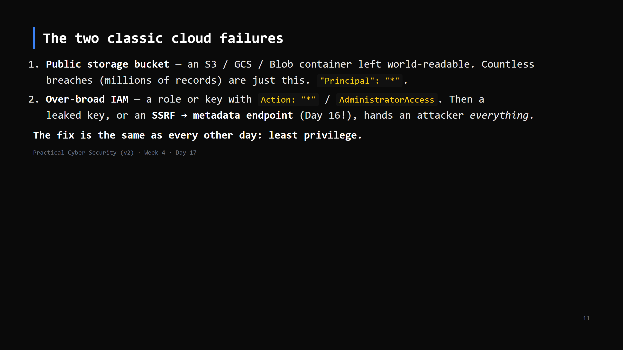
Notes:
SSRF callback: `http://169.254.169.254/latest/meta-data/iam/security-credentials/` returns temporary creds for whatever role the instance has. If that role is over-privileged, the SSRF becomes account takeover. IMDSv2 mitigates; least-privilege roles are the real fix.

Slide 12
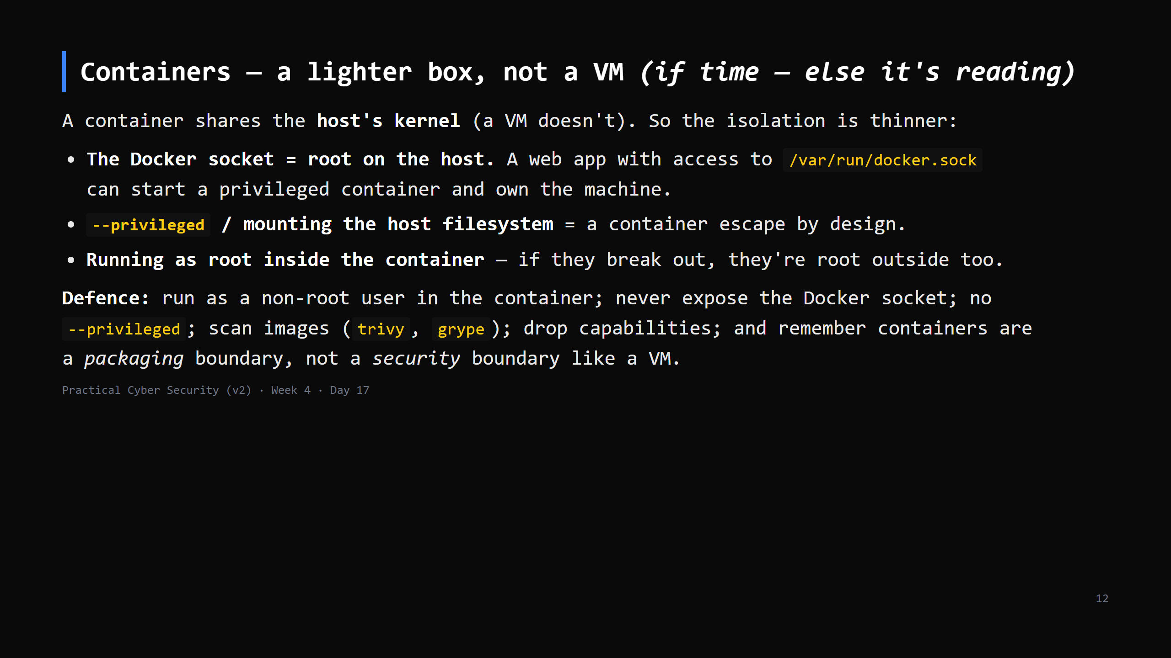
Notes:
This whole lab runs on containers (DVWA, Juice Shop) — point that out. The one idea to land: "a container is not a VM; the kernel is shared; treat it like a process with extra packaging." Kubernetes adds RBAC, network policies, admission control — name it as "the same questions at cluster scale", Day 20 careers has a cloud/container path. CUT ENTIRELY if behind — it's marked as reading; the homework points at it.

Slide 13
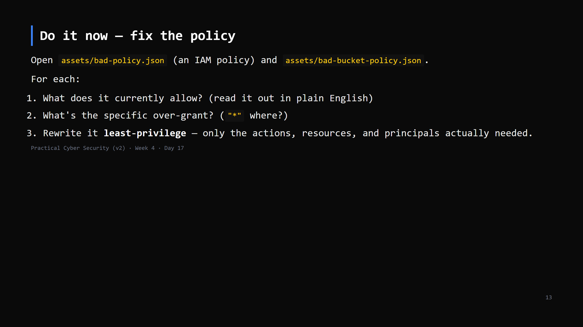
Notes:
10 min, paper exercise (no cloud account needed). If you have LocalStack / MinIO set up, do it live against a real bucket. Answer key in teacher-notes. The skill: reading a policy and spotting "this grants far more than the app needs".

Slide 14
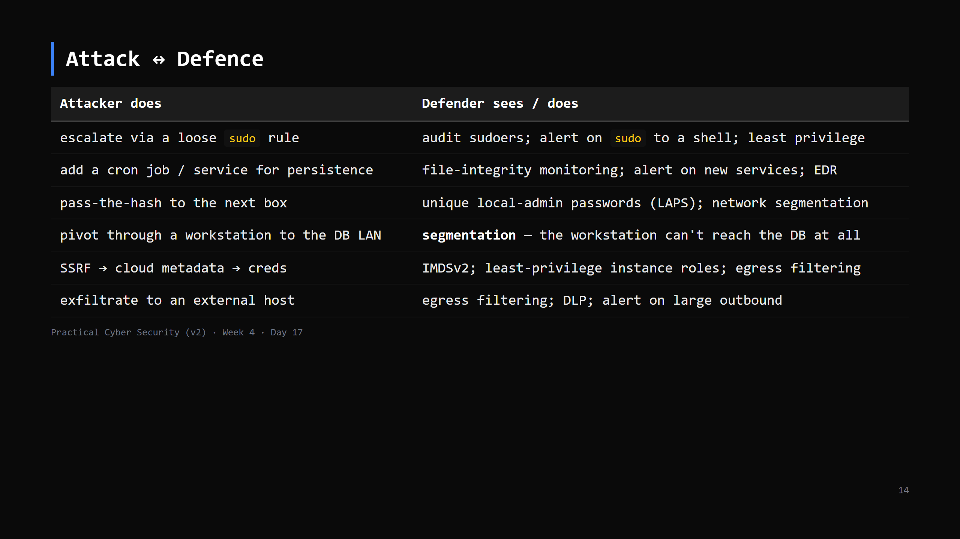
Notes:
The through-line: least privilege + segmentation + monitoring. Every row is one of those three.

Slide 15
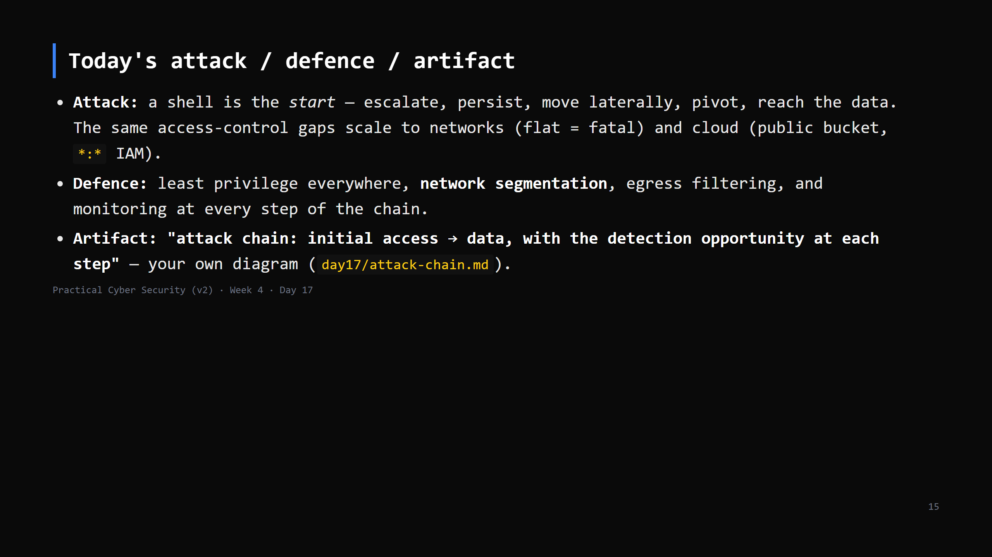

Slide 16
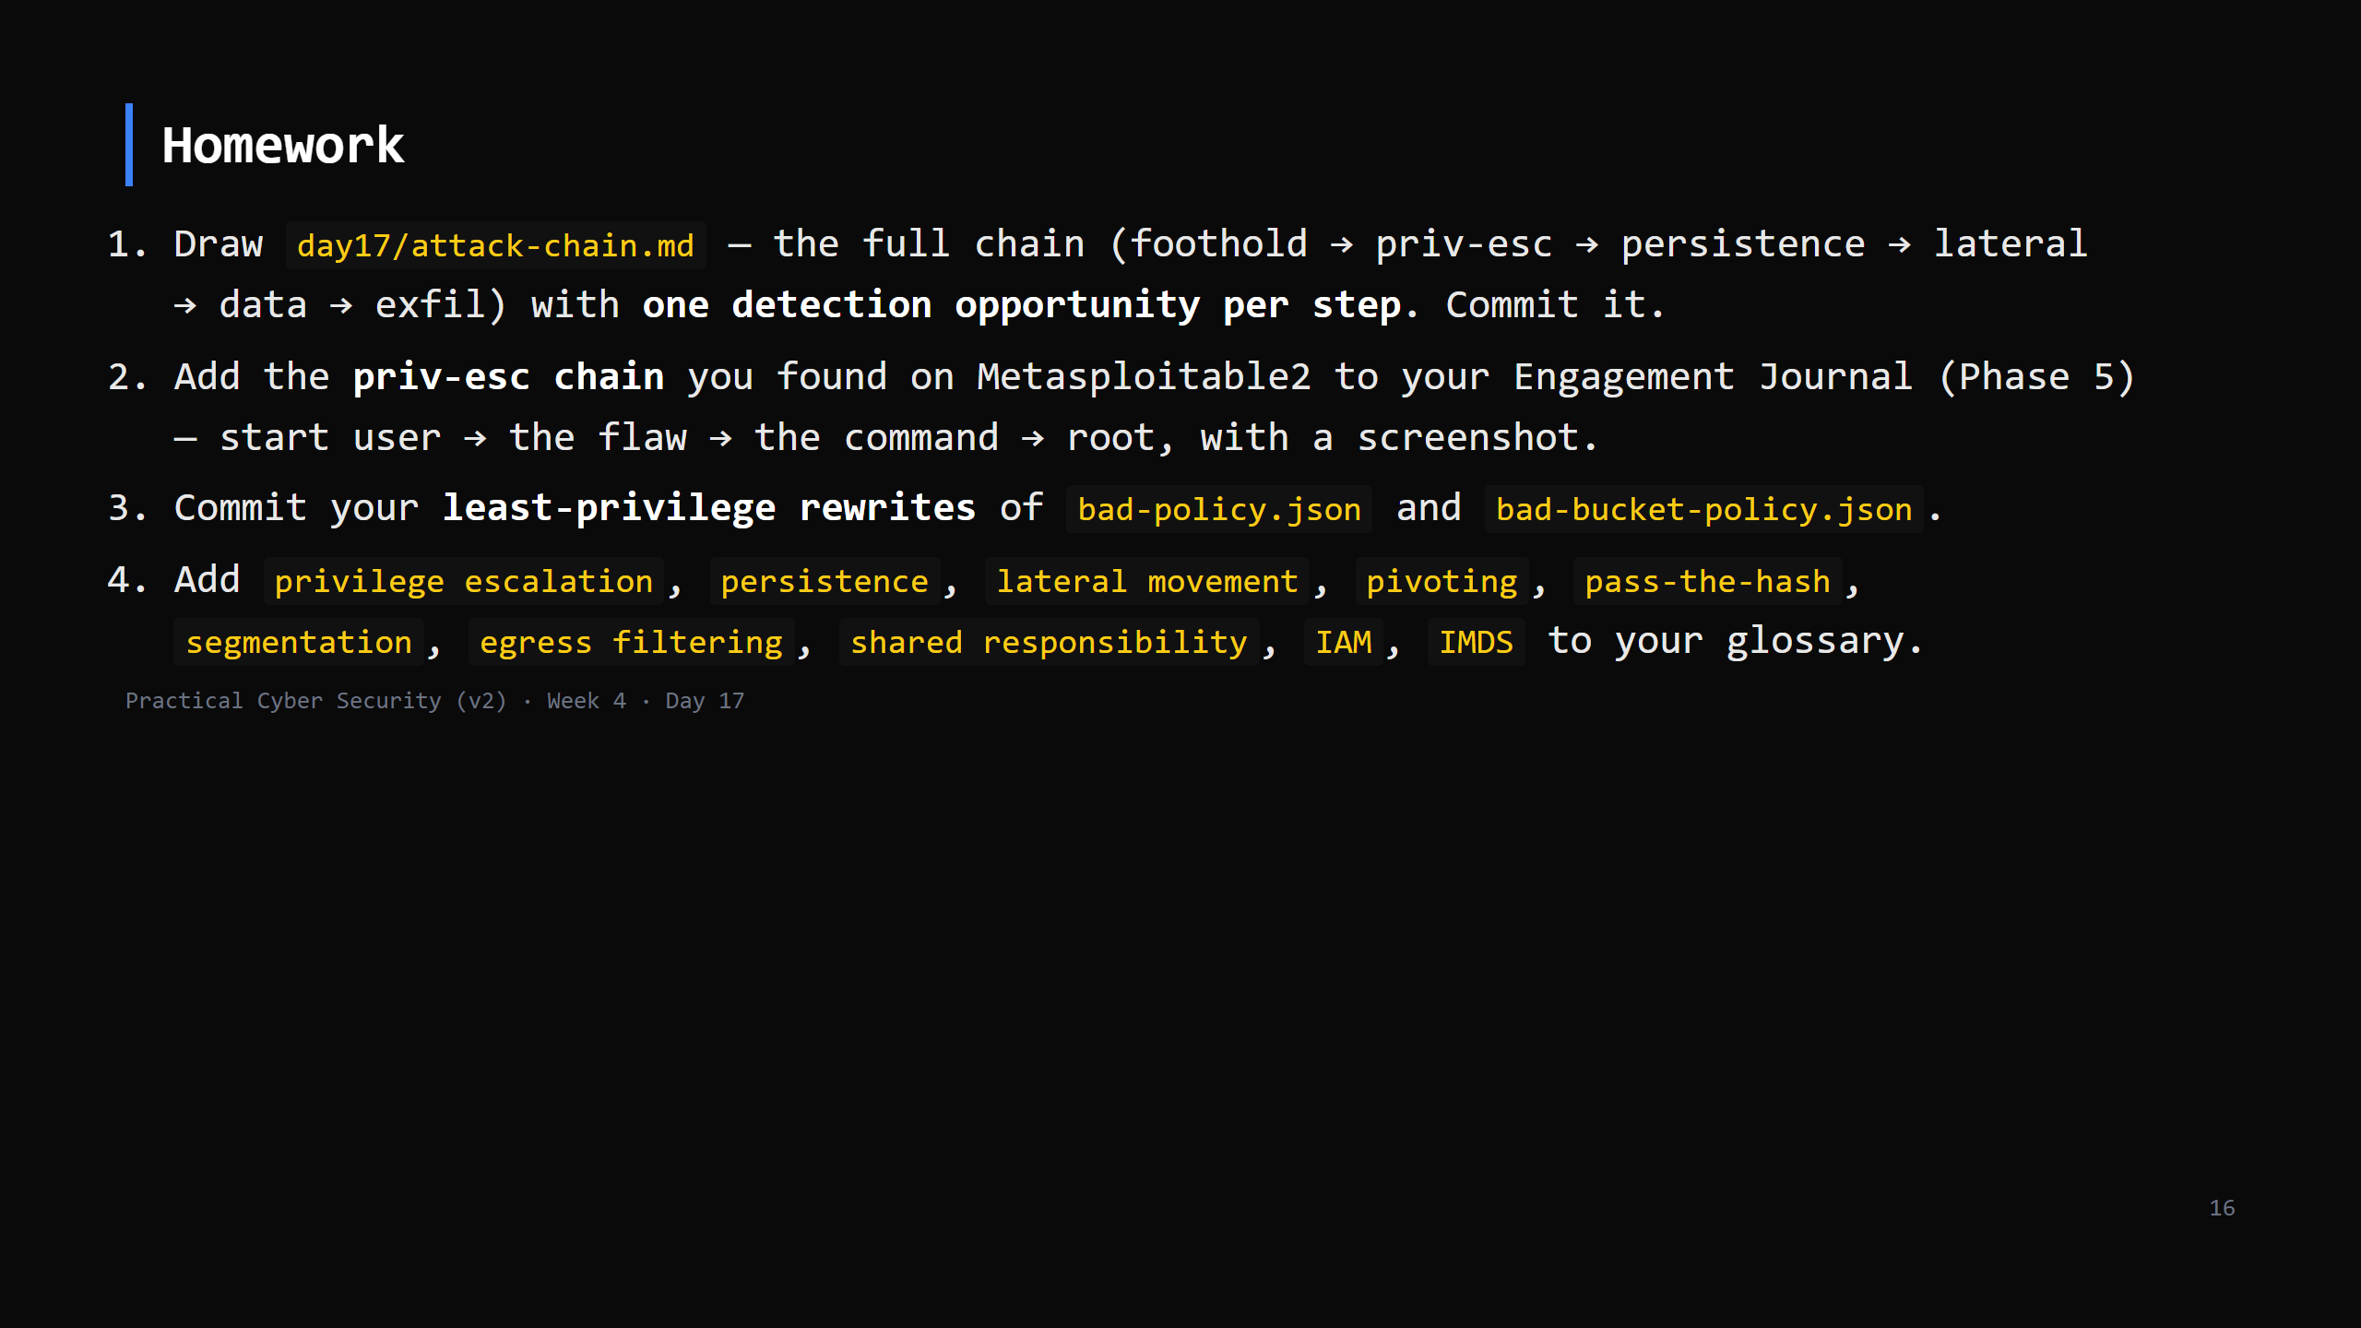
Notes:
Due start of Day 18.

Slide 17
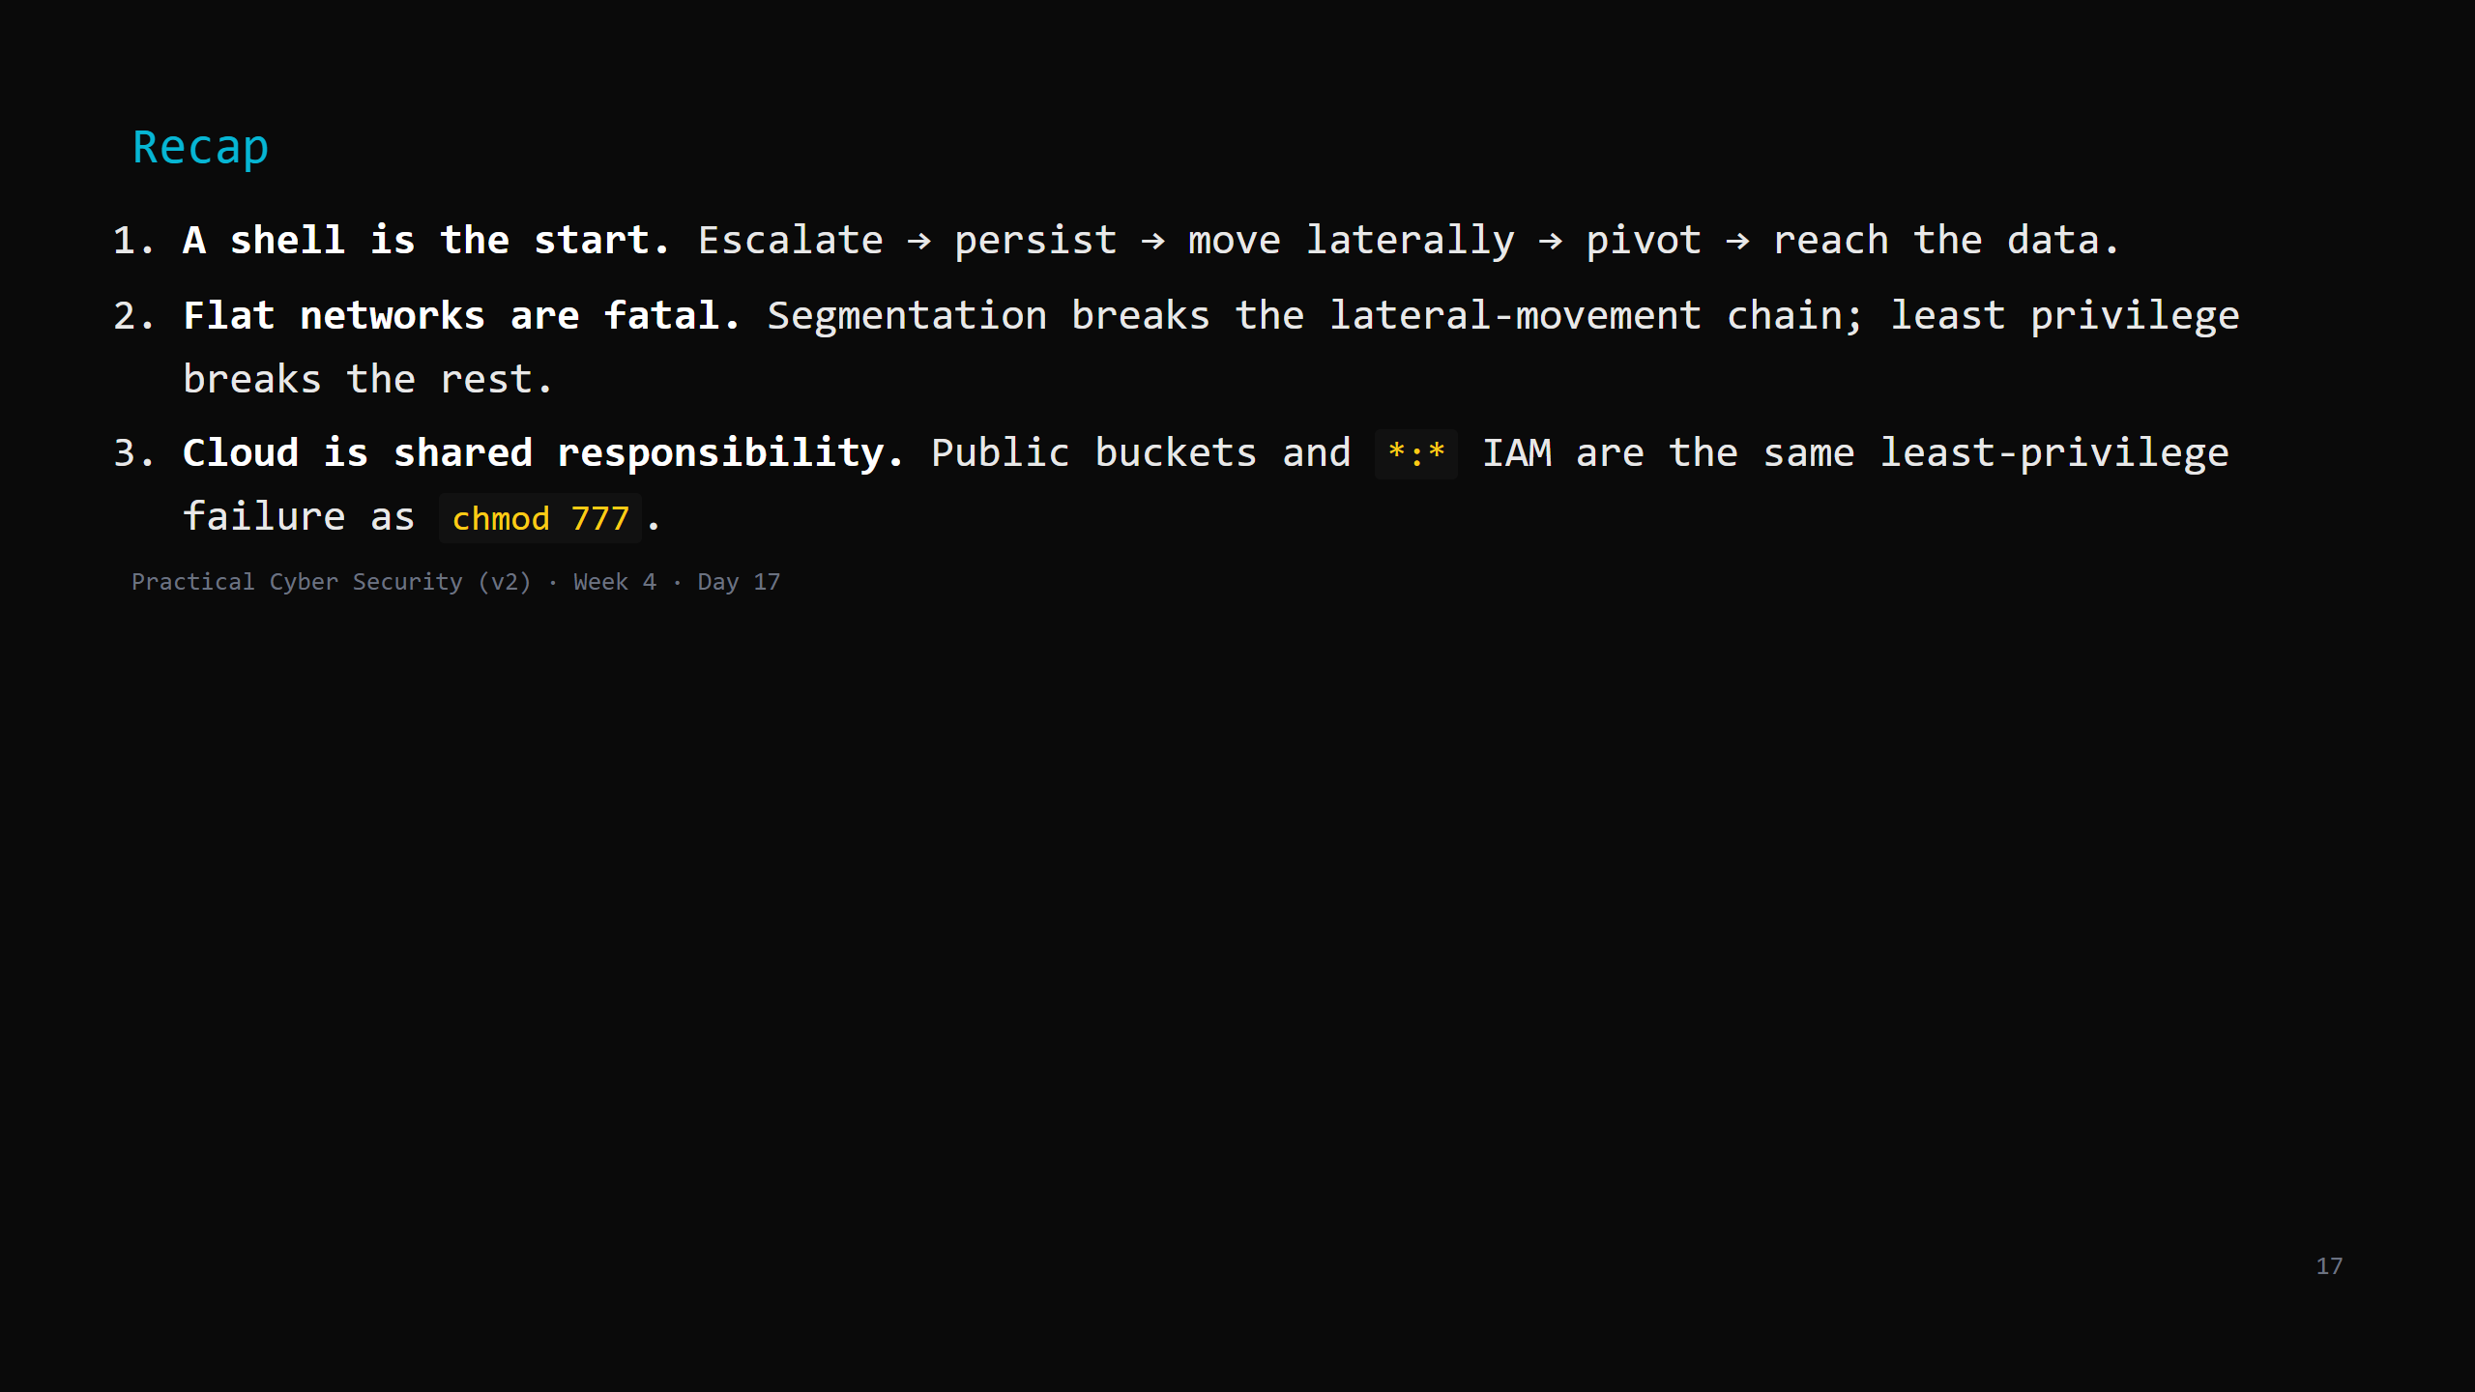
Notes:
Say the three lines. Tomorrow: the newest frontier - AI and cyber security. AI as a target, a weapon, and a defender's tool. You'll prompt-inject a vulnerable app.

