Slide 1
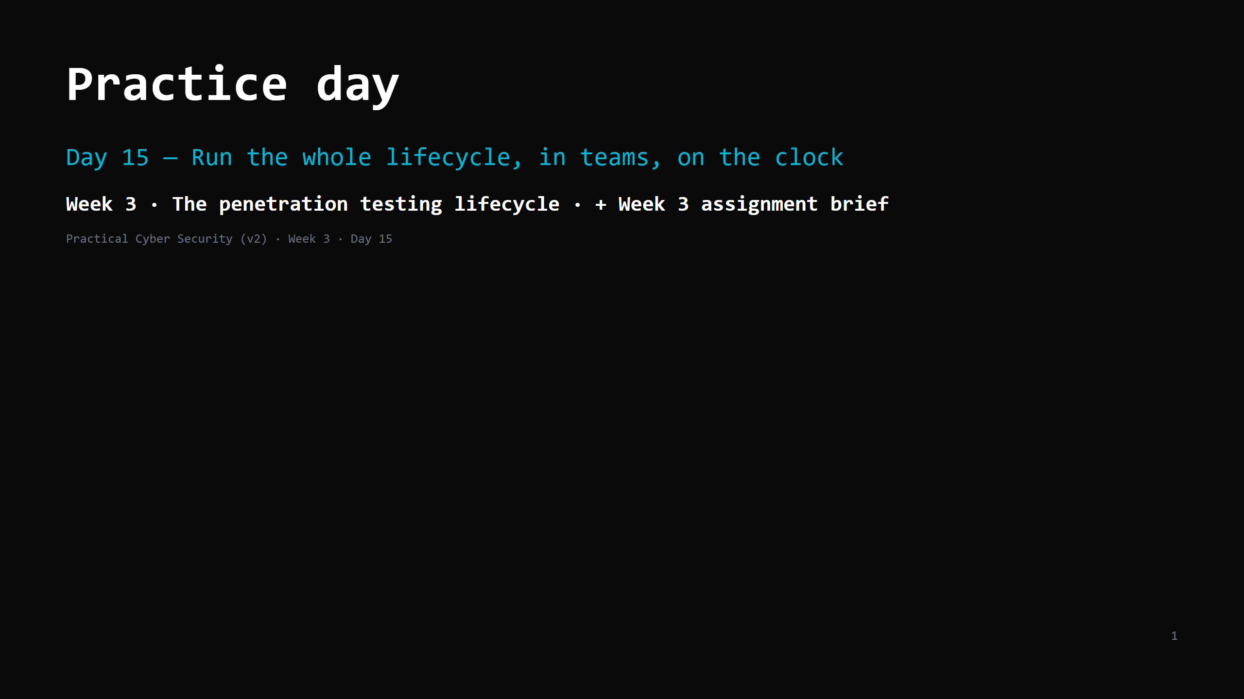
Notes:
RUN SHEET (~90 min). This is a DOING day — teacher circulates, doesn't lecture. 00:00 Today's plan + rules 6 00:06 The one-page playbook 7 00:13 Worked mini-example on the projector 8 00:21 TEAM RUN (coached) — phases 1-4 -> proof captured 42 01:03 Write the mini report (each student) 12 01:15 WEEK 3 ASSIGNMENT BRIEF 12 01:27 Recap 3 CUT / FLEX: the worked example can drop to 5 min; the team run can borrow from the write-up if most teams are close; never cut the assignment brief. ANALOGY (kitchen / inspector): today is the real inspection — full walkthrough, on the clock, and you file the report. ETHICS: same ROE as Day 12. Only the target assigned to your team. Snapshot before you exploit. SAFETY: exploitation today is COACHED and limited to getting ONE proof. Deep exploitation is Days 16-17.

Slide 2
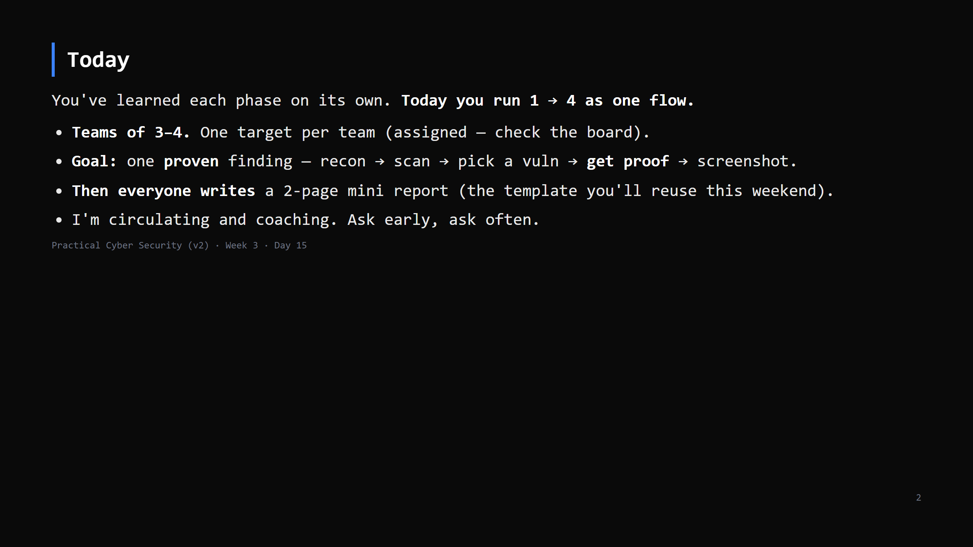
Notes:
Assign targets: mix of DVWA (web), Metasploitable2 (services), Juice Shop (web). Teams that finish early: get a SECOND finding, or help a stuck team explain their approach.

Slide 3
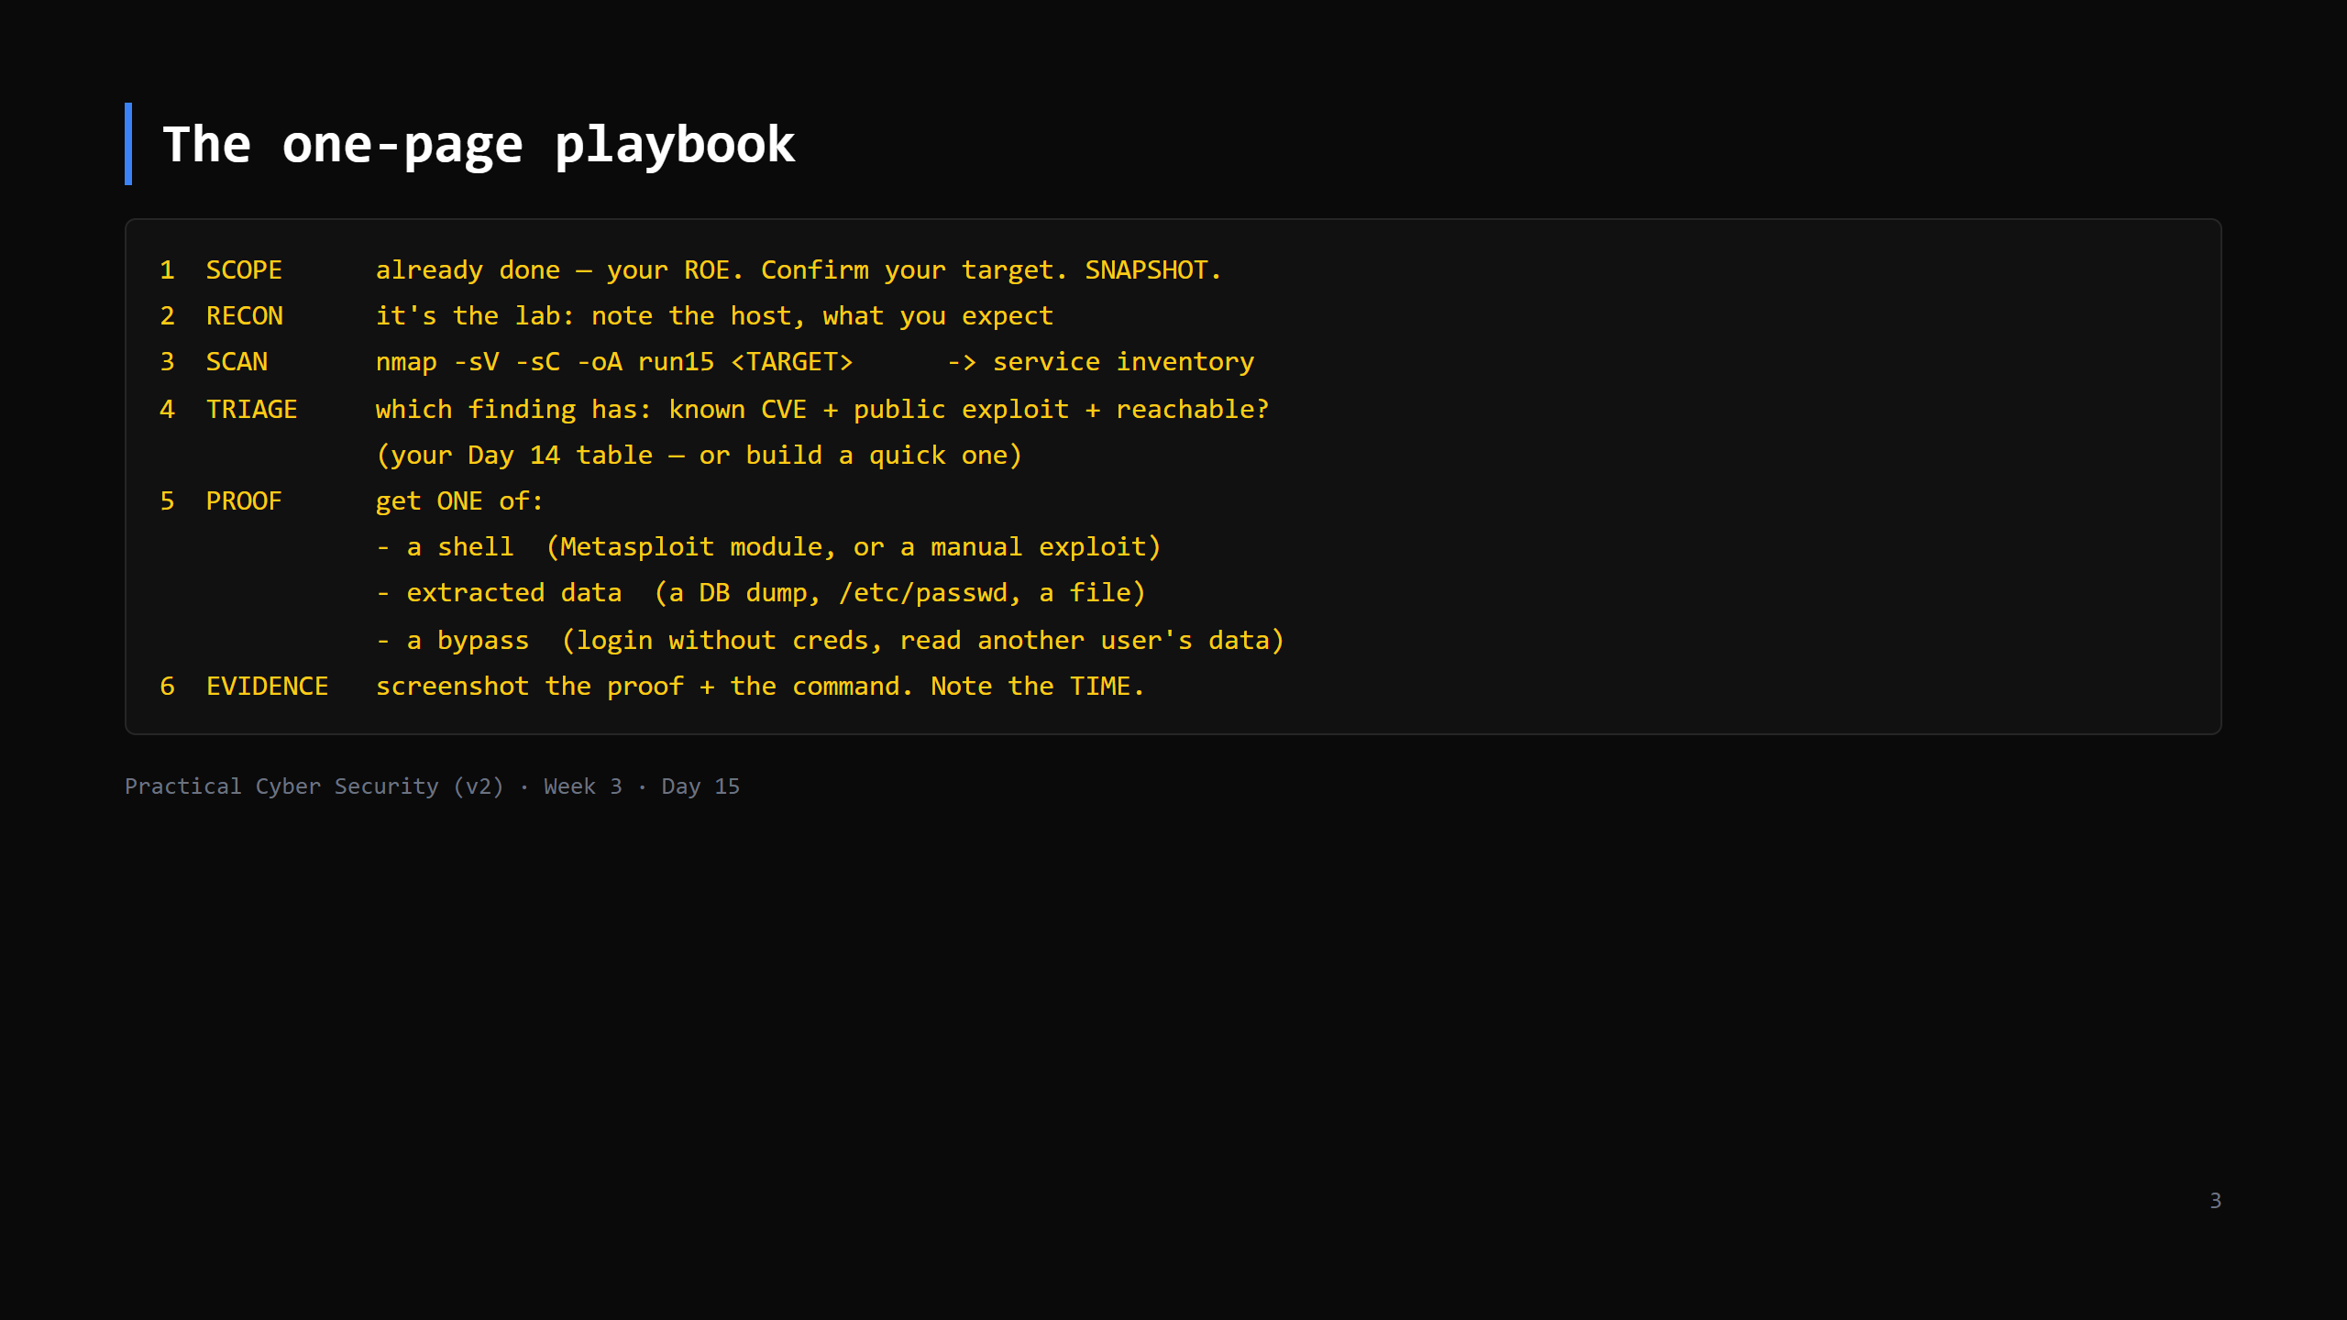
Notes:
Keep the goal small: ONE proof. Not "own everything". The report needs one clean, reproducible finding, not five half-finished ones. Metasploitable2 easy wins: vsftpd 2.3.4 backdoor, Samba usermap, distcc, UnrealIRCd. DVWA/Juice Shop: SQLi login bypass, reflected XSS (full web is Day 16).

Slide 4
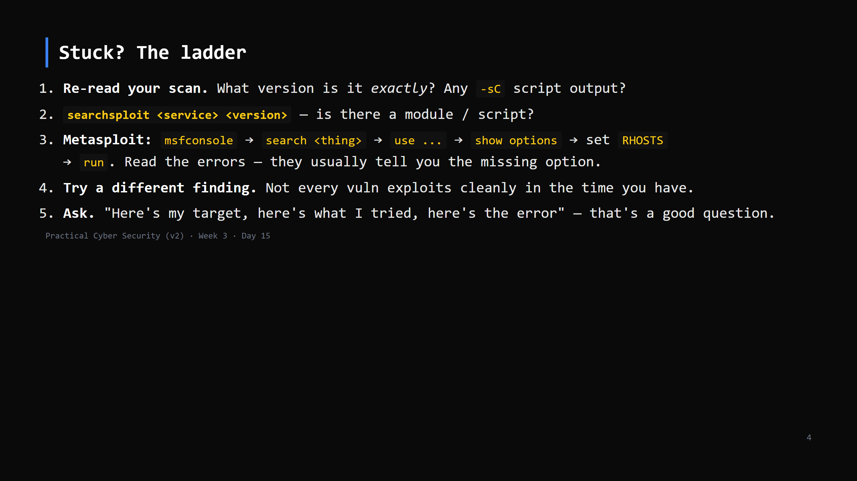
Notes:
Common blockers: RHOSTS not set; wrong port (RPORT); needs `set LHOST <your-kali-ip>` for a reverse shell; the service isn't actually the vulnerable version. Coach, don't solve.

Slide 5
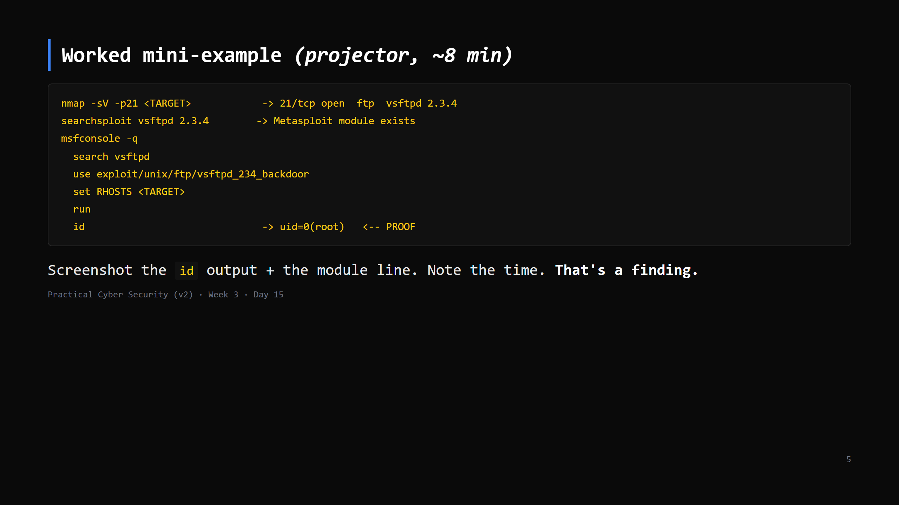
Notes:
Do this live, fast, once. Then "now you — and yours might be Samba, or SQLi, or a file read. The SHAPE is the same: scan -> match -> exploit -> prove -> screenshot."

Slide 6
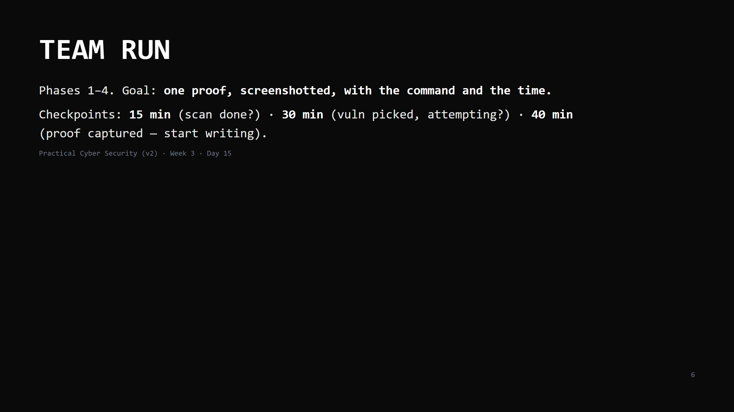
Notes:
42 minutes. Circulate constantly. Call the checkpoints out loud. At 40 min, anyone with a proof starts the write-up; anyone still stuck gets you at their table. Every team should leave with at least one screenshot of proof. If a team truly can't, hand them the vsftpd/Samba easy win and walk them through it — the report matters more than the struggle today.

Slide 7
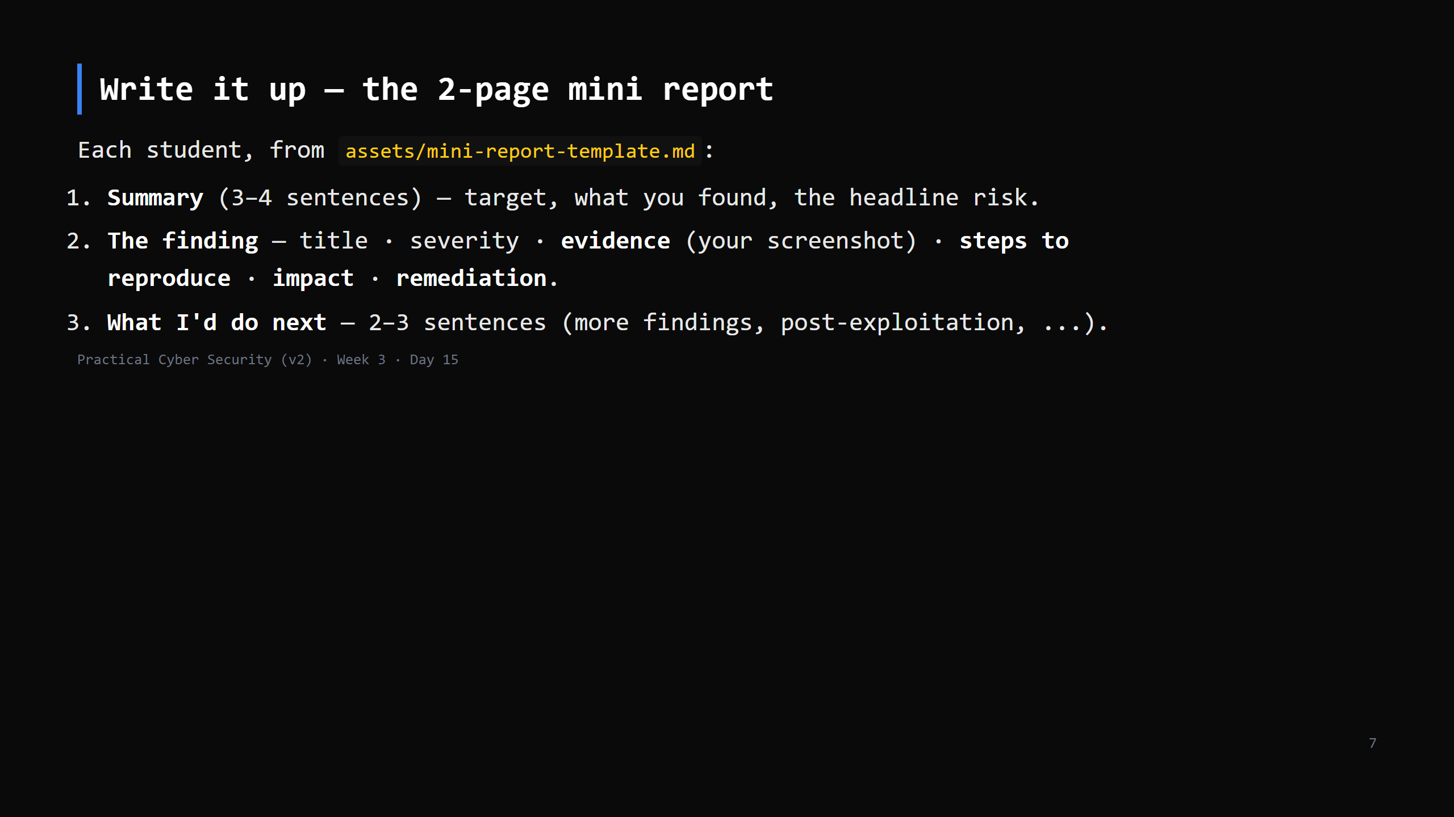
Notes:
12 min. This is individual, not per-team — everyone writes their own. It's the template for the weekend assignment, so getting the shape right now saves them Saturday. "Steps to reproduce" is the bit juniors skip and the bit that makes a report useful.

Slide 8
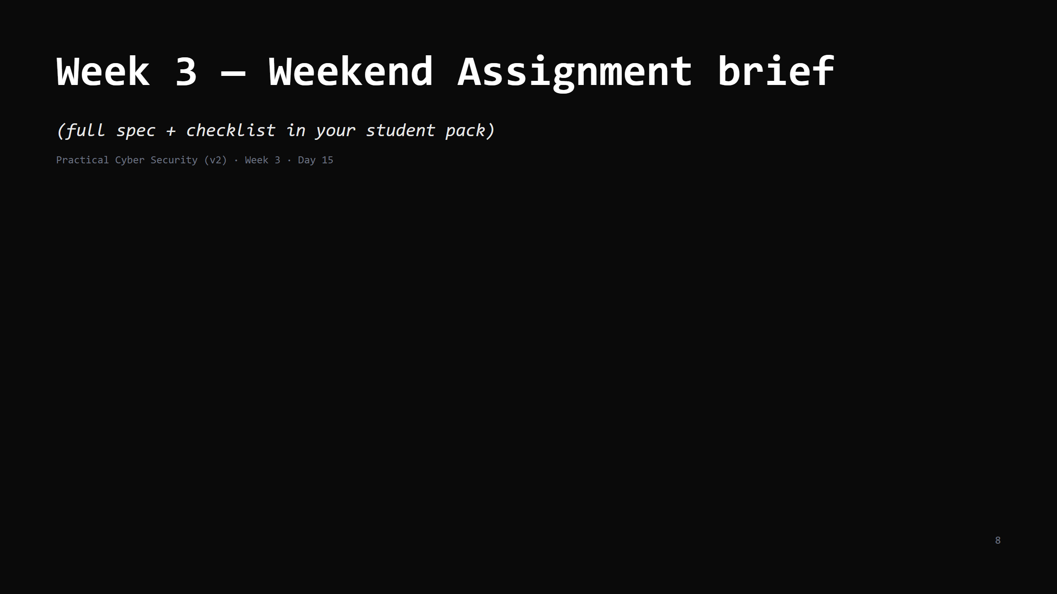

Slide 9
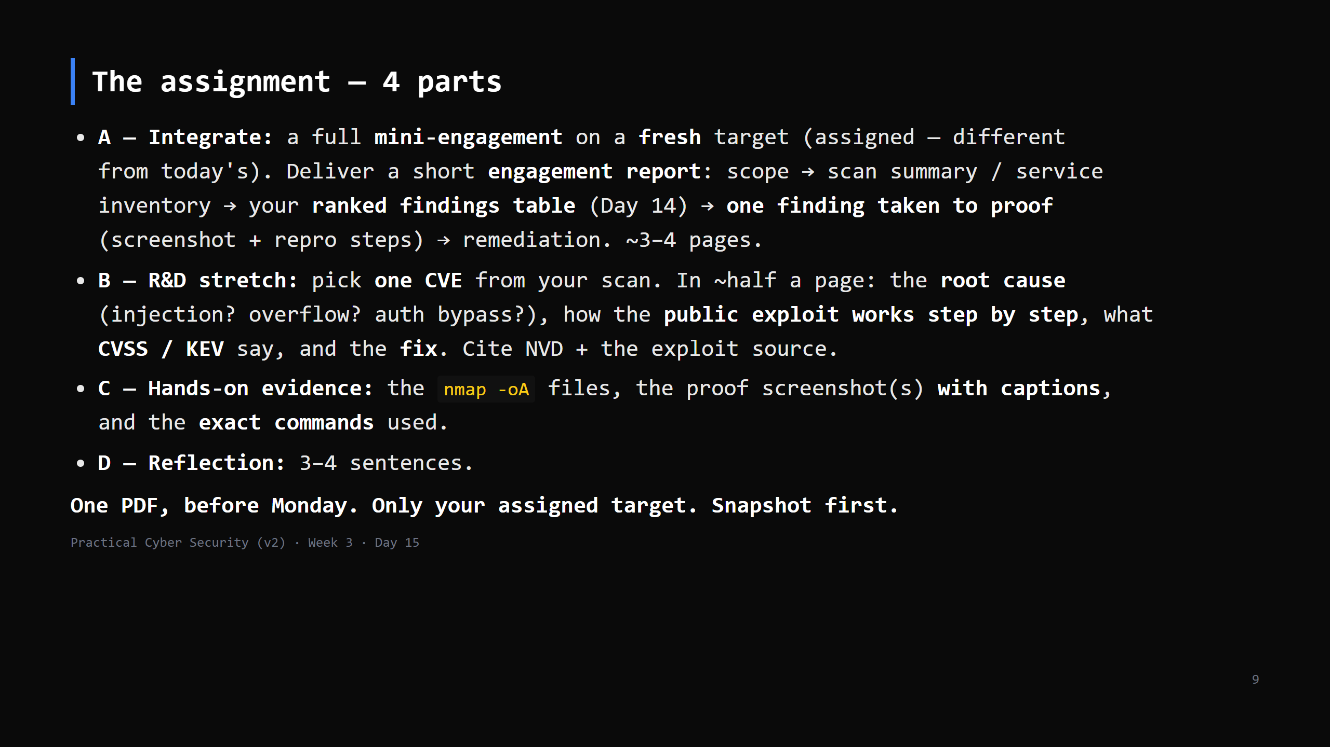
Notes:
Walk each part ~3 min. Part A = today's exercise, done solo, written properly. Part B is the "understand the exploit, don't just run it" stretch. Emphasise: reproducible commands, captioned evidence, and STAY IN SCOPE.

Slide 10
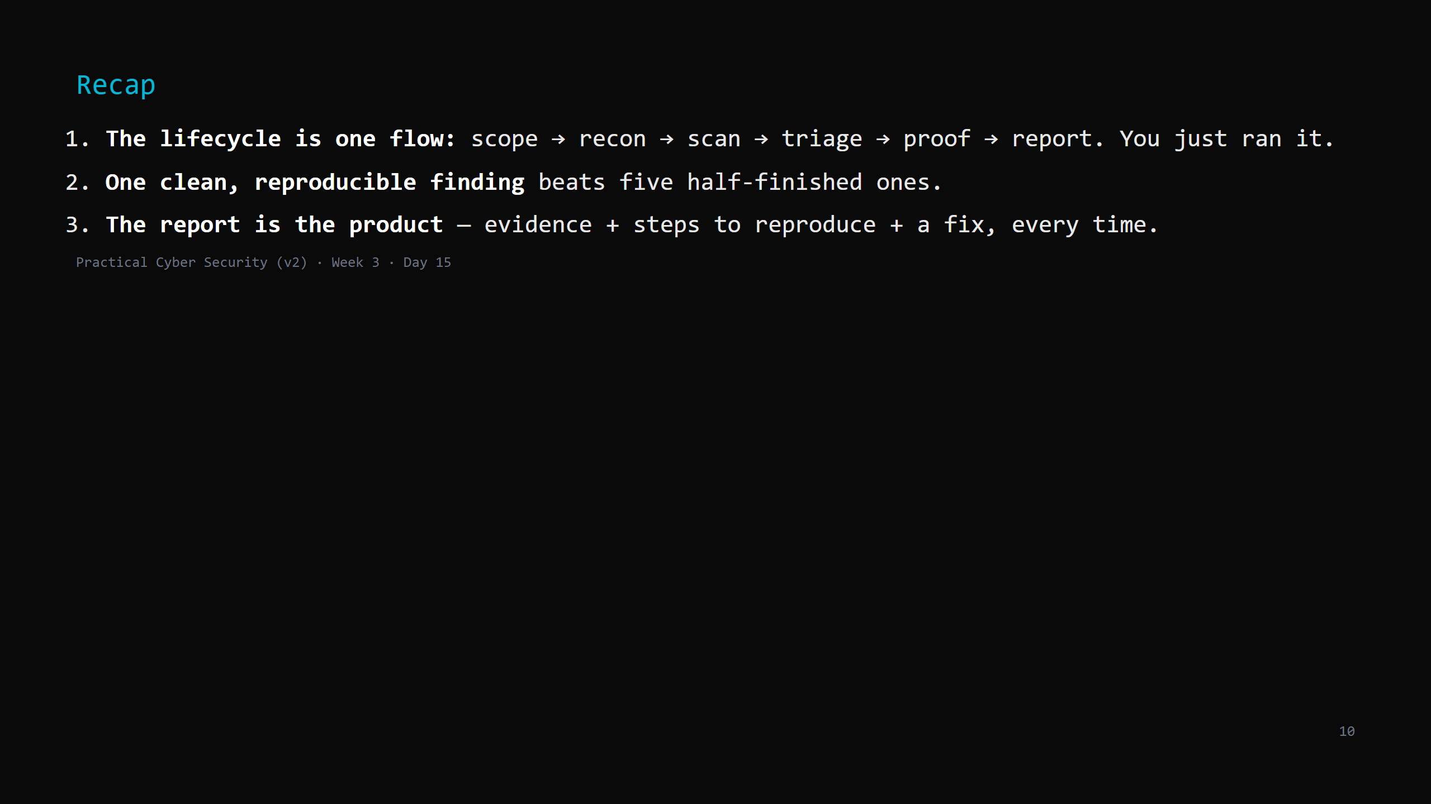
Notes:
Say the three lines. That's Week 3. Monday: Week 4 opens — web exploitation. You take the "SQLi login bypass" you may have glimpsed today and do the OWASP Top 10 properly.

