Slide 1
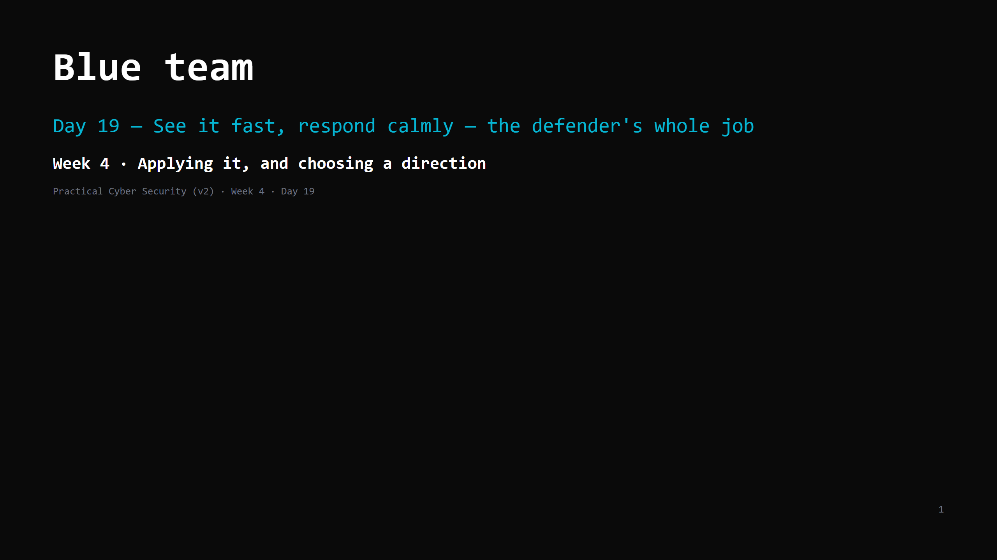
Notes:
RUN SHEET (~85 min). Two DOs: log analysis, then a tabletop. 00:00 Journey check + hook (the attack chain, in the logs) 4 00:04 Prevention fails — so what's the job 4 00:08 Logs are ground truth 7 00:15 SIEM — the concept 5 00:20 IOCs vs TTPs (the Pyramid of Pain) 6 00:26 Windows / AD event IDs a SOC watches 4 00:30 The IR lifecycle 6 00:36 DO: analyse the log set -> IOCs + timeline 22 00:58 Containment done right (the trap) 5 01:03 DO: 15-min ransomware tabletop 15 01:18 Wrap + artifact + homework 4 CUT FIRST IF SHORT: the AD event-IDs slide to 2 min; the tabletop to 10 min. NEVER CUT: logs-as-ground-truth, IOC vs TTP, the IR lifecycle, the log-analysis DO, "contain != pull the plug". ANALOGY (kitchen): the SOC = the security office watching the camera feeds and the door logs. Detection = noticing the back door opened at 3am. IR = the practiced response: confirm it's real, lock the affected room (not the whole building), find the way in and close it, check nothing's left behind, restock, debrief. "Pull the plug" = torching the building - you lose the footage and tip off the intruder.

Slide 2
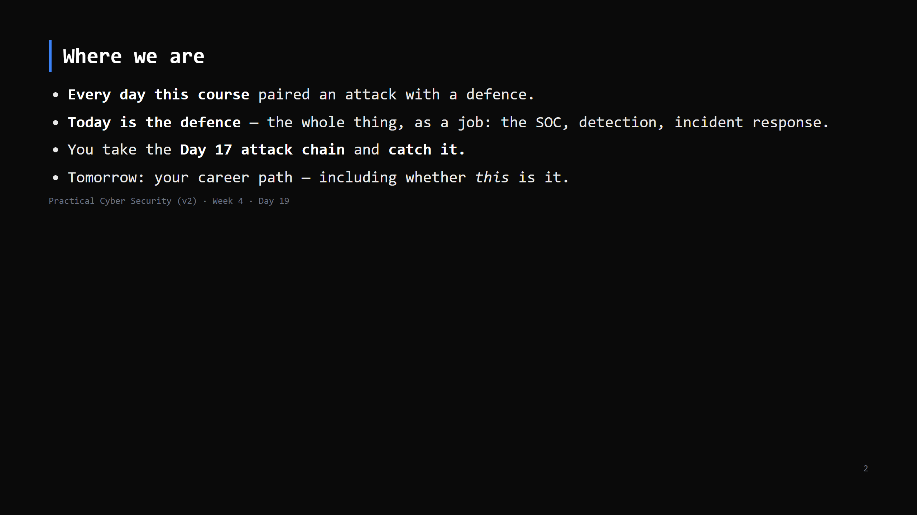
Notes:
Journey Check. This is the defensive payoff of the entire course. Every attack you learned shows up here as something to detect.

Slide 3
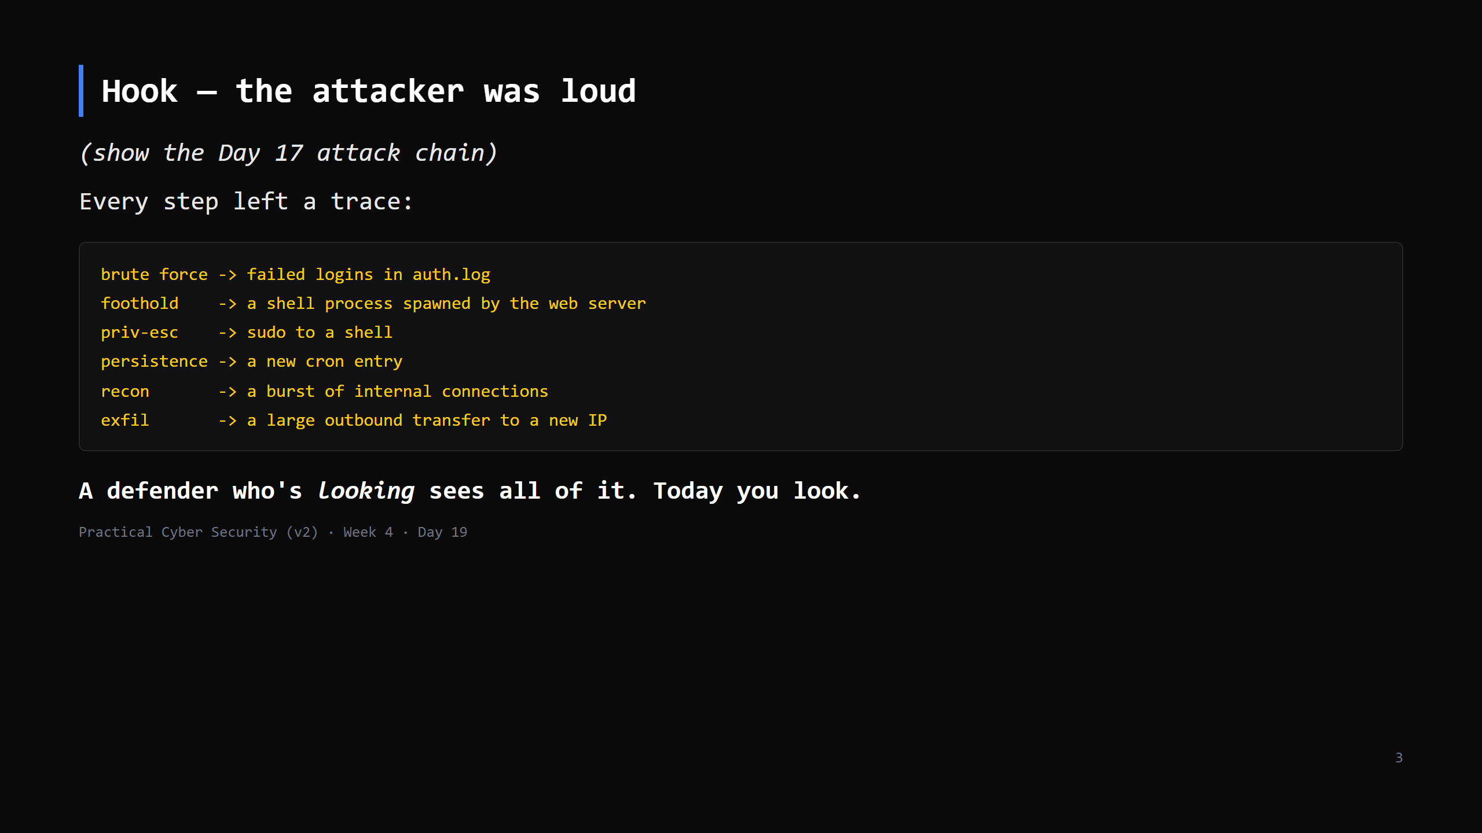
Notes:
The framing: attackers aren't invisible - they're just usually unwatched. The Blue team's job is to watch the right things and know what "wrong" looks like.

Slide 4
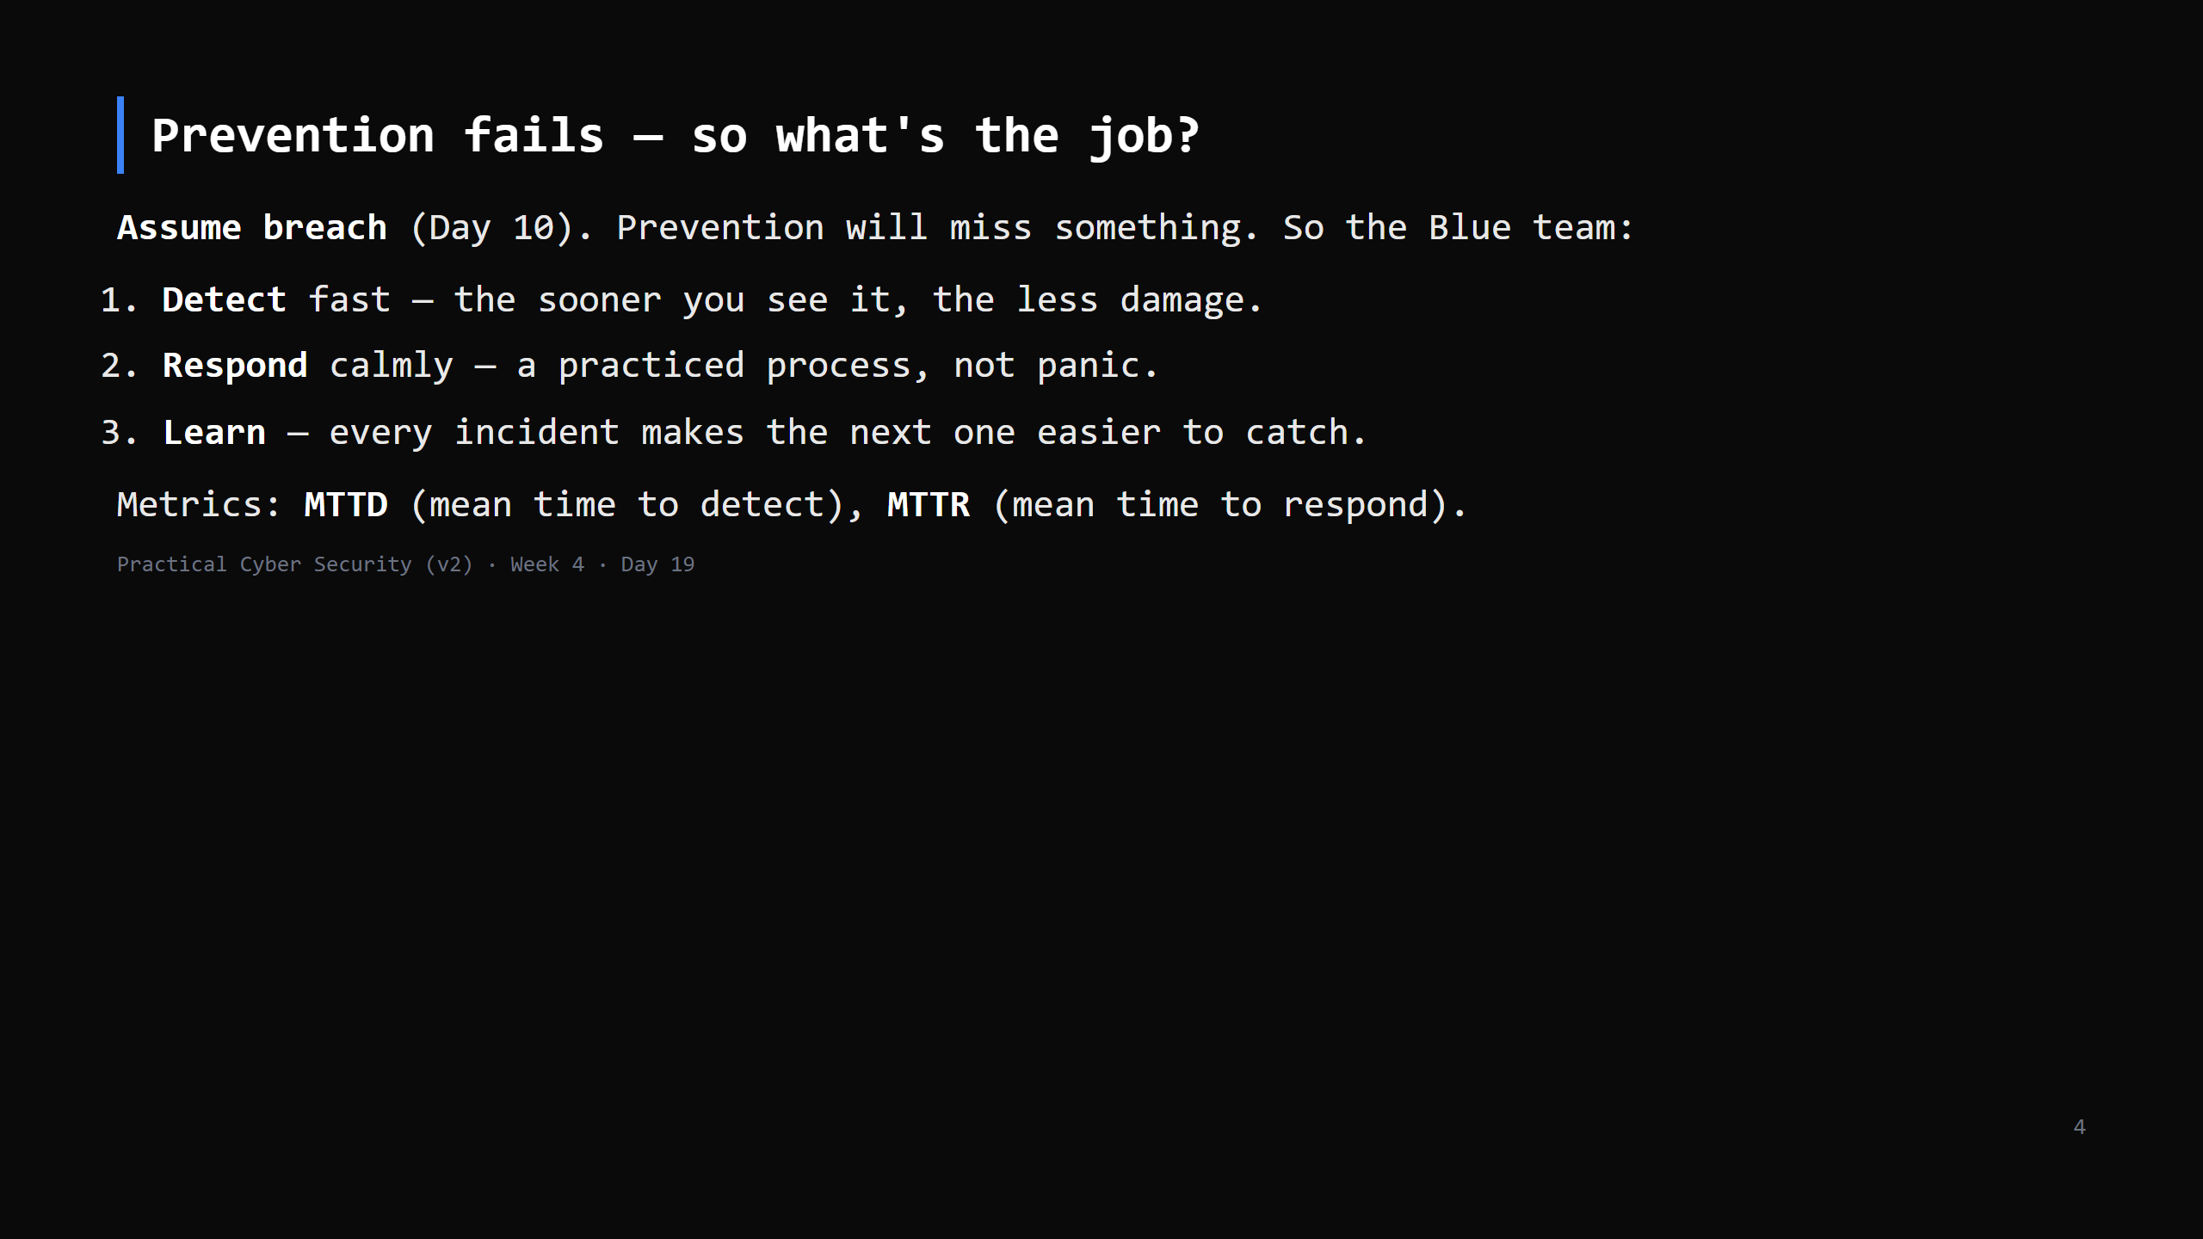
Notes:
This reframes "we got breached" from "we failed" to "prevention did its job for the 99, this is the 1, now execute the plan". That mindset shift is half of being good at Blue.

Slide 5
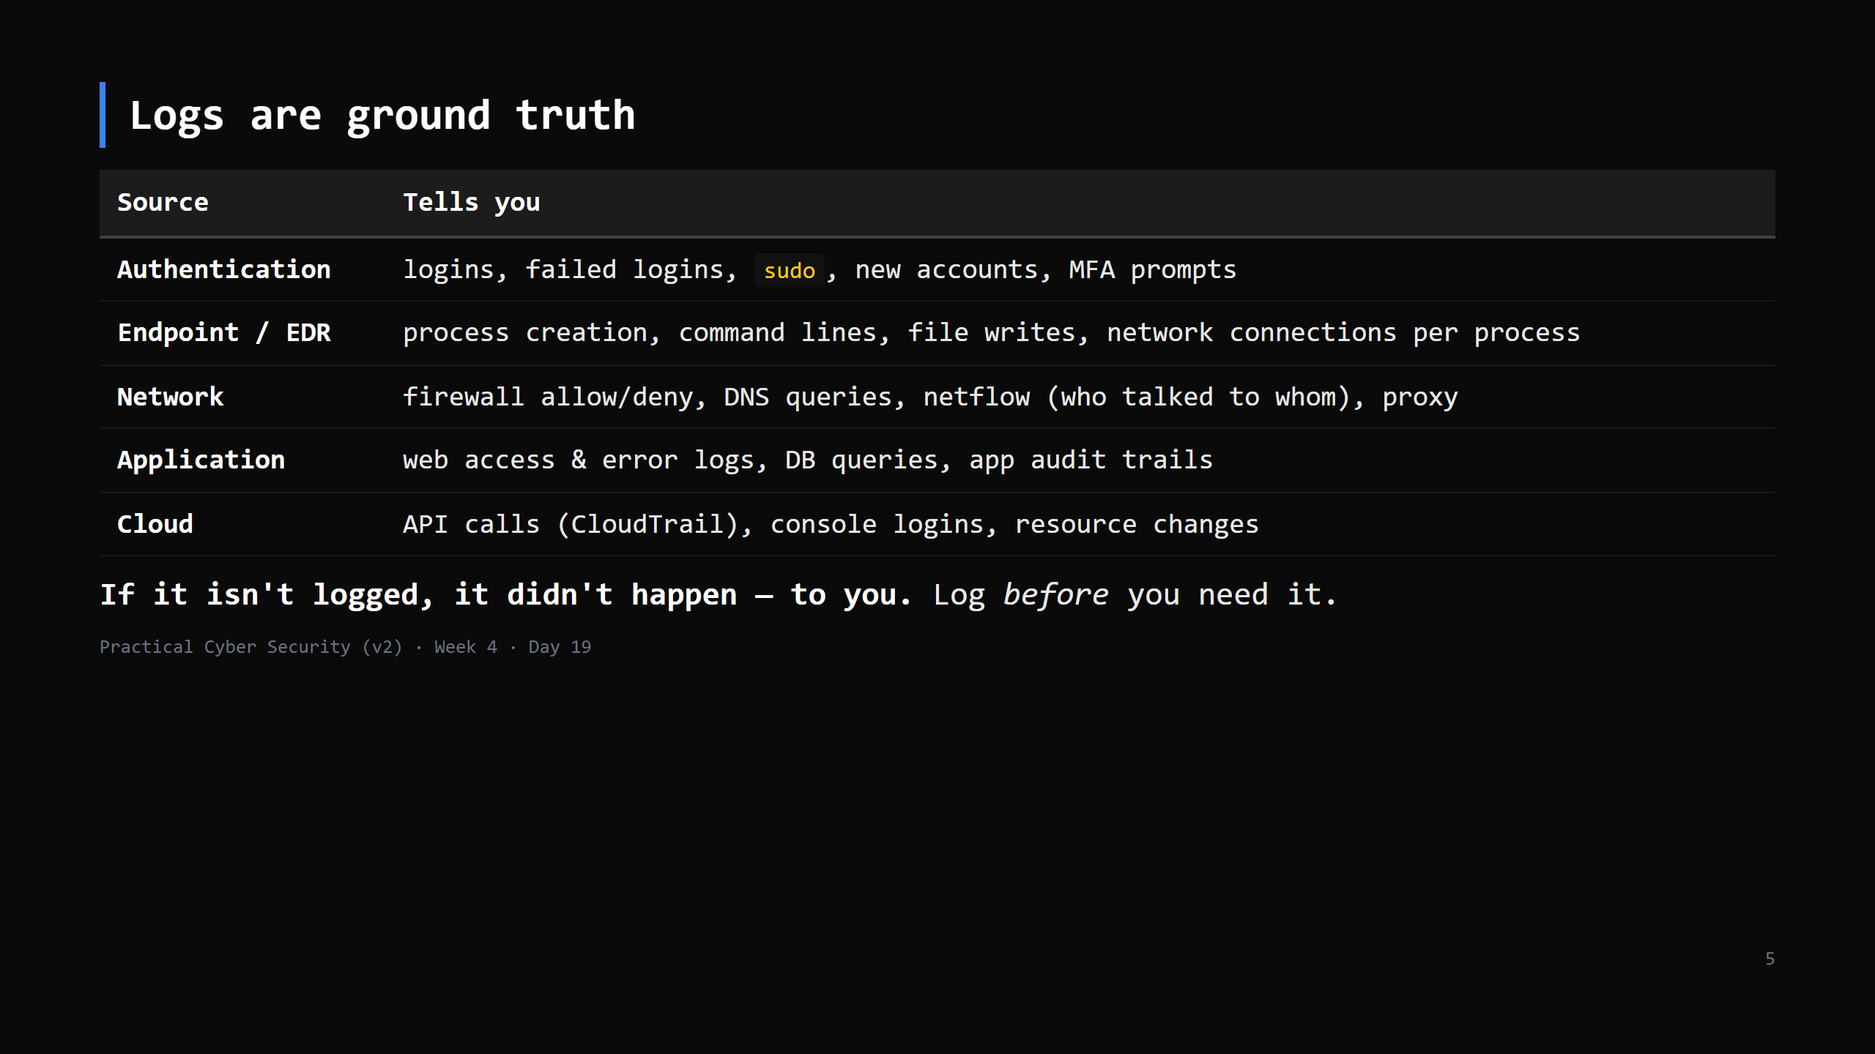
Notes:
The recurring failure in real incidents: "we don't have logs for that time period / that system / that action". Logging + retention is a Prepare-phase decision.

Slide 6
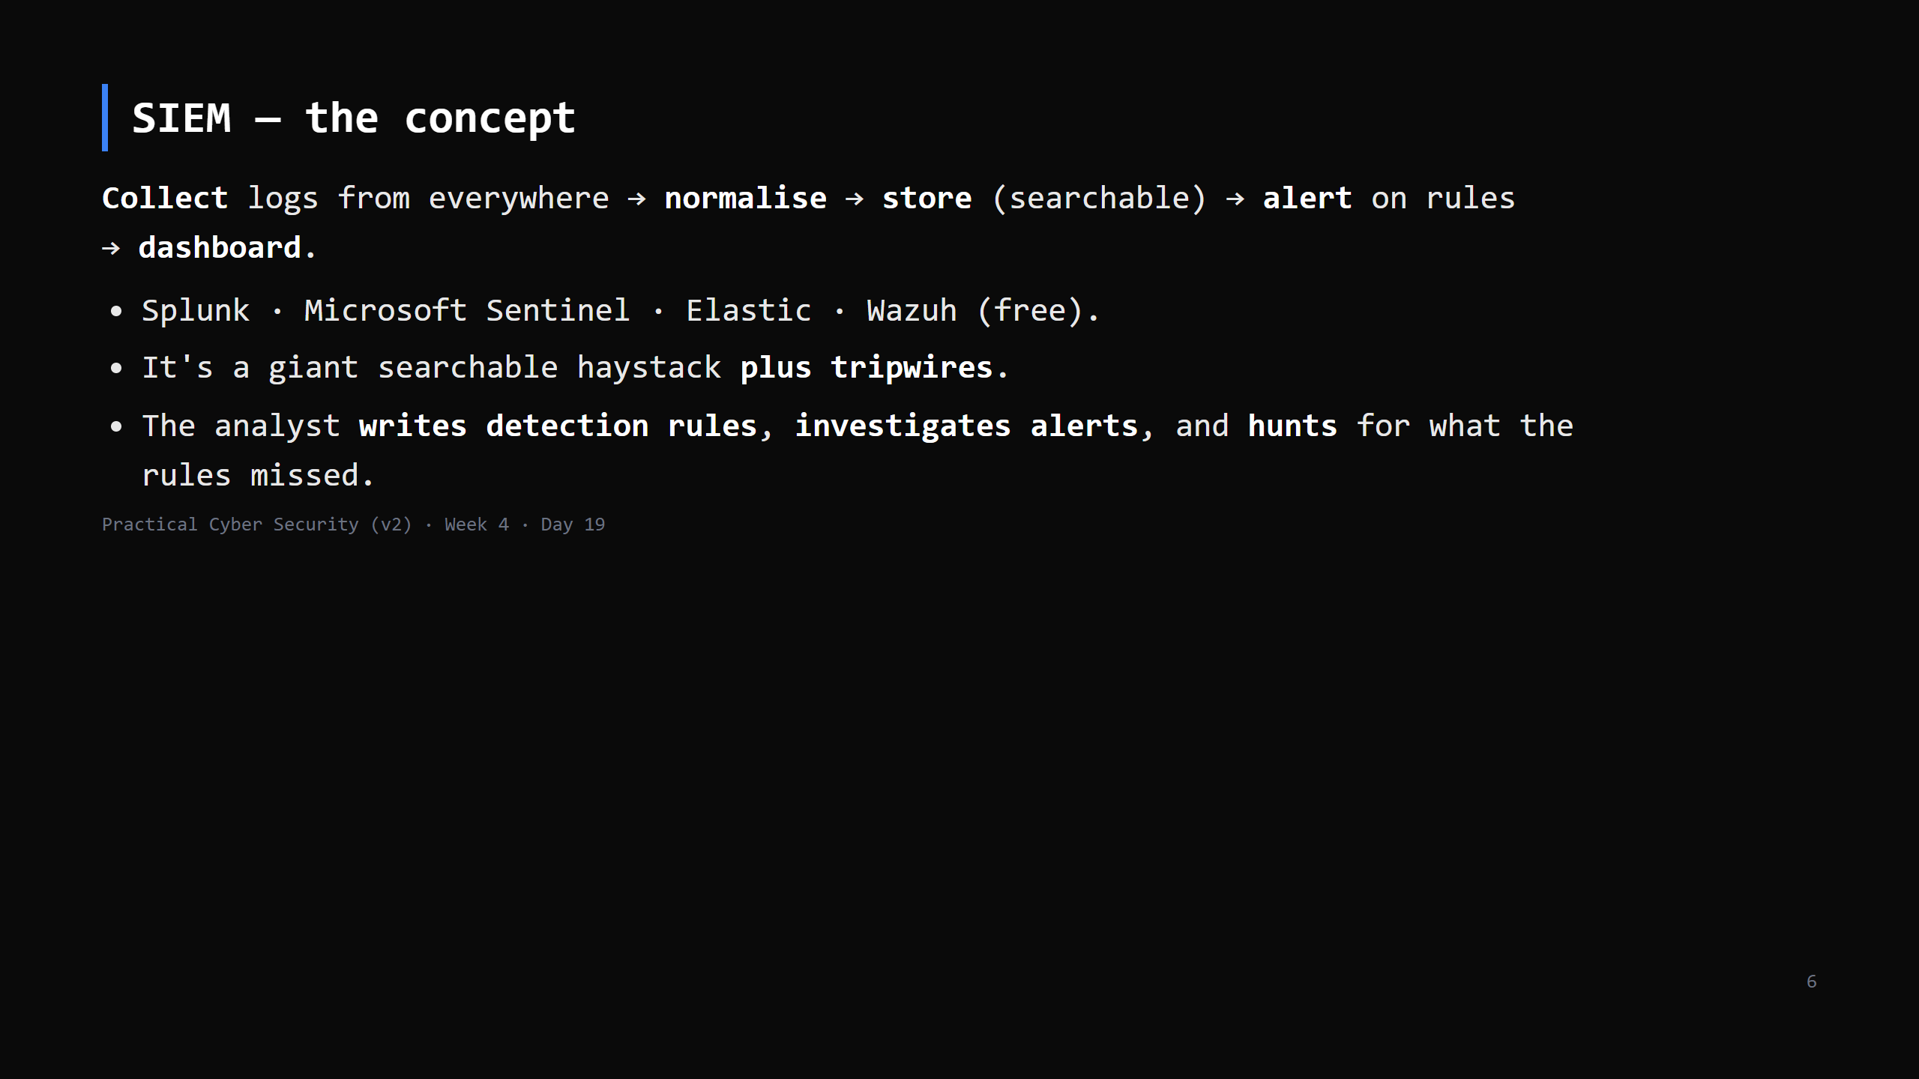
Notes:
"We bought a SIEM" != "we have detection". A SIEM with no tuned rules is expensive storage. The value is the analyst + the rules + the tuning. Detection-as-code: Sigma is a vendor-neutral rule format.

Slide 7
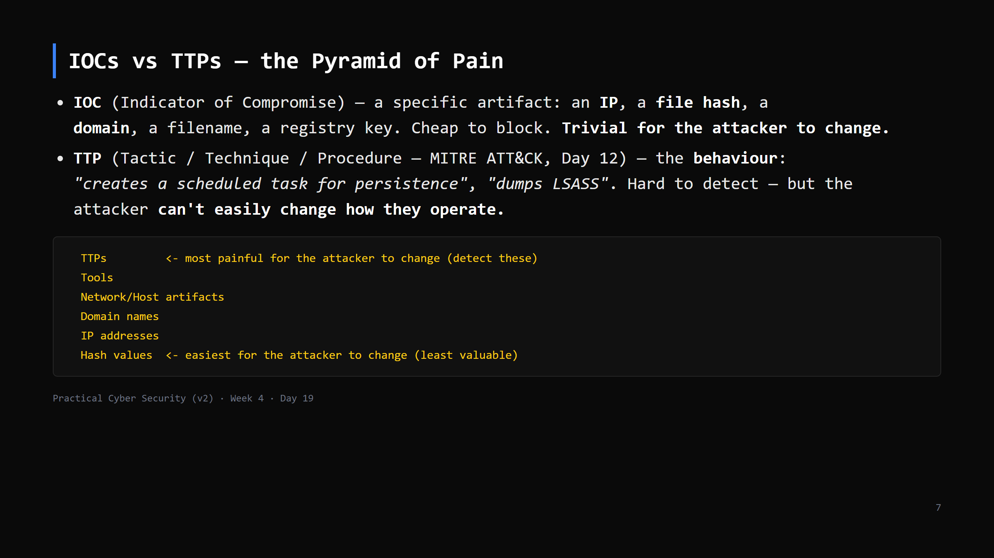
Notes:
David Bianco's Pyramid of Pain. Blocking a hash stops today's sample; detecting "process X spawned a shell" stops the whole technique. Mature SOCs move UP the pyramid.

Slide 8
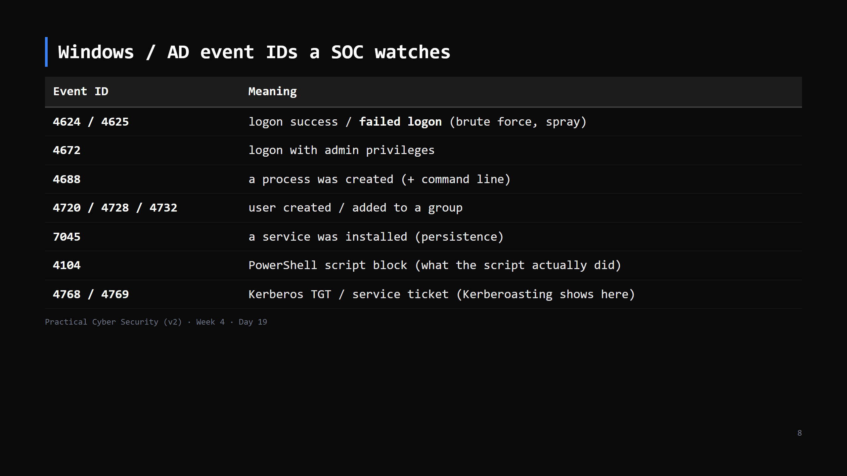
Notes:
These are the ones on a SOC dashboard. You don't memorise them - you know "there IS an event for logons, for new services, for process creation" and you look them up. CUT to 2 min: "Windows logs a numbered event for every security-relevant action; 4625 failed logon and 4688 process creation are the two to know".

Slide 9
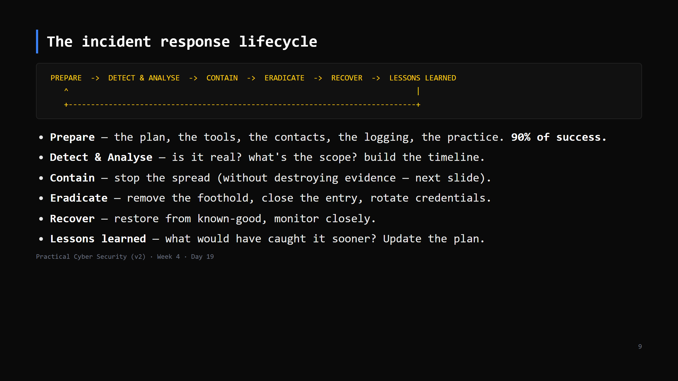
Notes:
NIST SP 800-61 / SANS PICERL. It's a LOOP. "Prepare" is where you win or lose - the incident is not the time to figure out who has authority to disconnect a server.

Slide 10
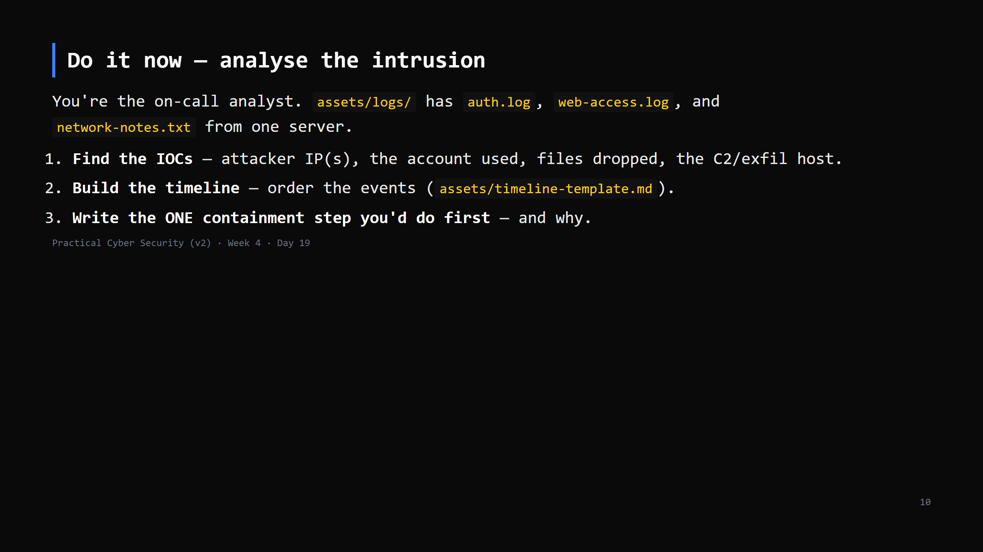
Notes:
22 min. Work in pairs. The bundle contains: SSH brute force -> a successful login as a service account -> wget of a webshell -> a cron persistence entry -> an internal port scan -> a large exfil to an external IP. `grep` + a text editor is all they need. Answer key + the full timeline in teacher-notes.

Slide 11
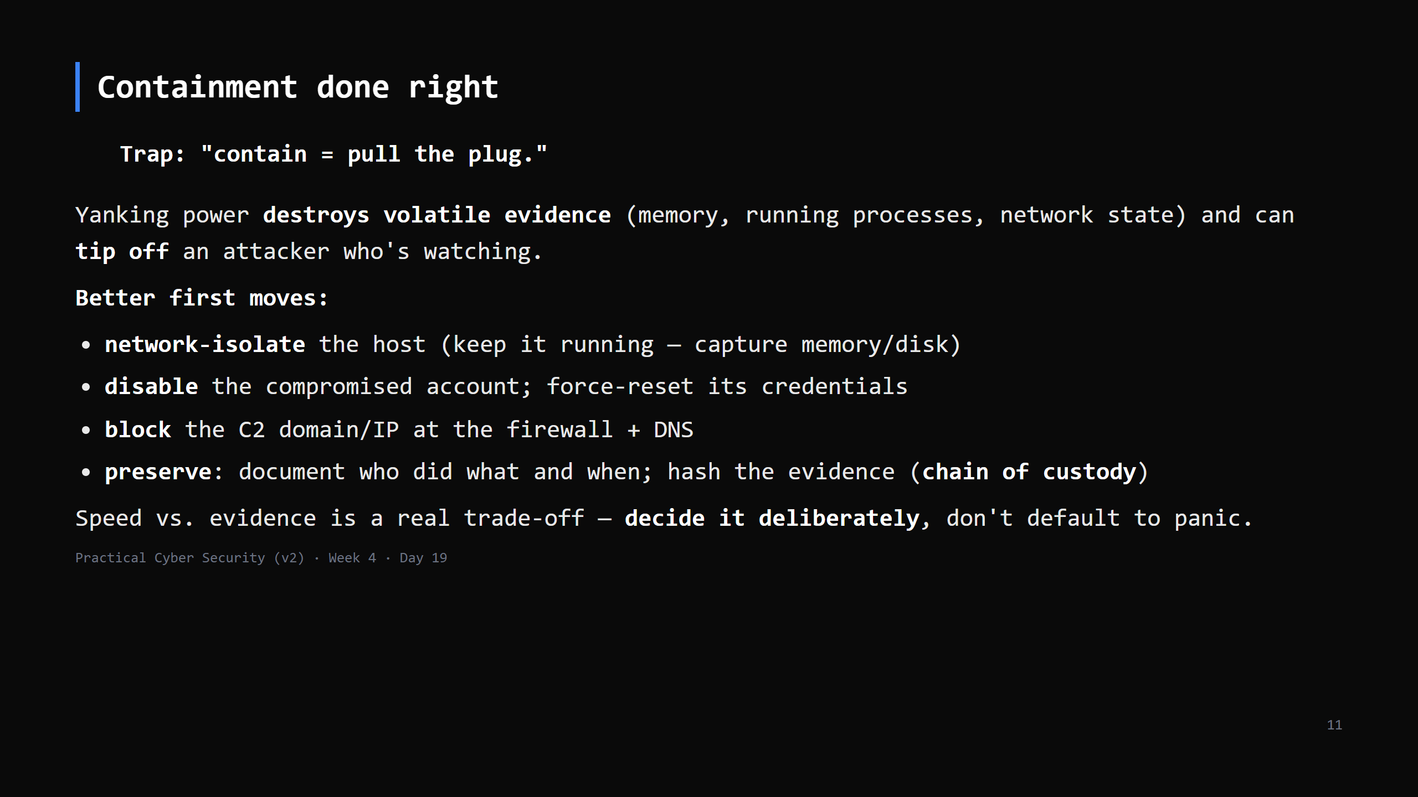
Notes:
"Isolate, don't obliterate." Ransomware actively encrypting is the one case where fast shutdown may be right - and even then, isolate first if you can. Chain of custody matters if it goes to court or insurance.

Slide 12
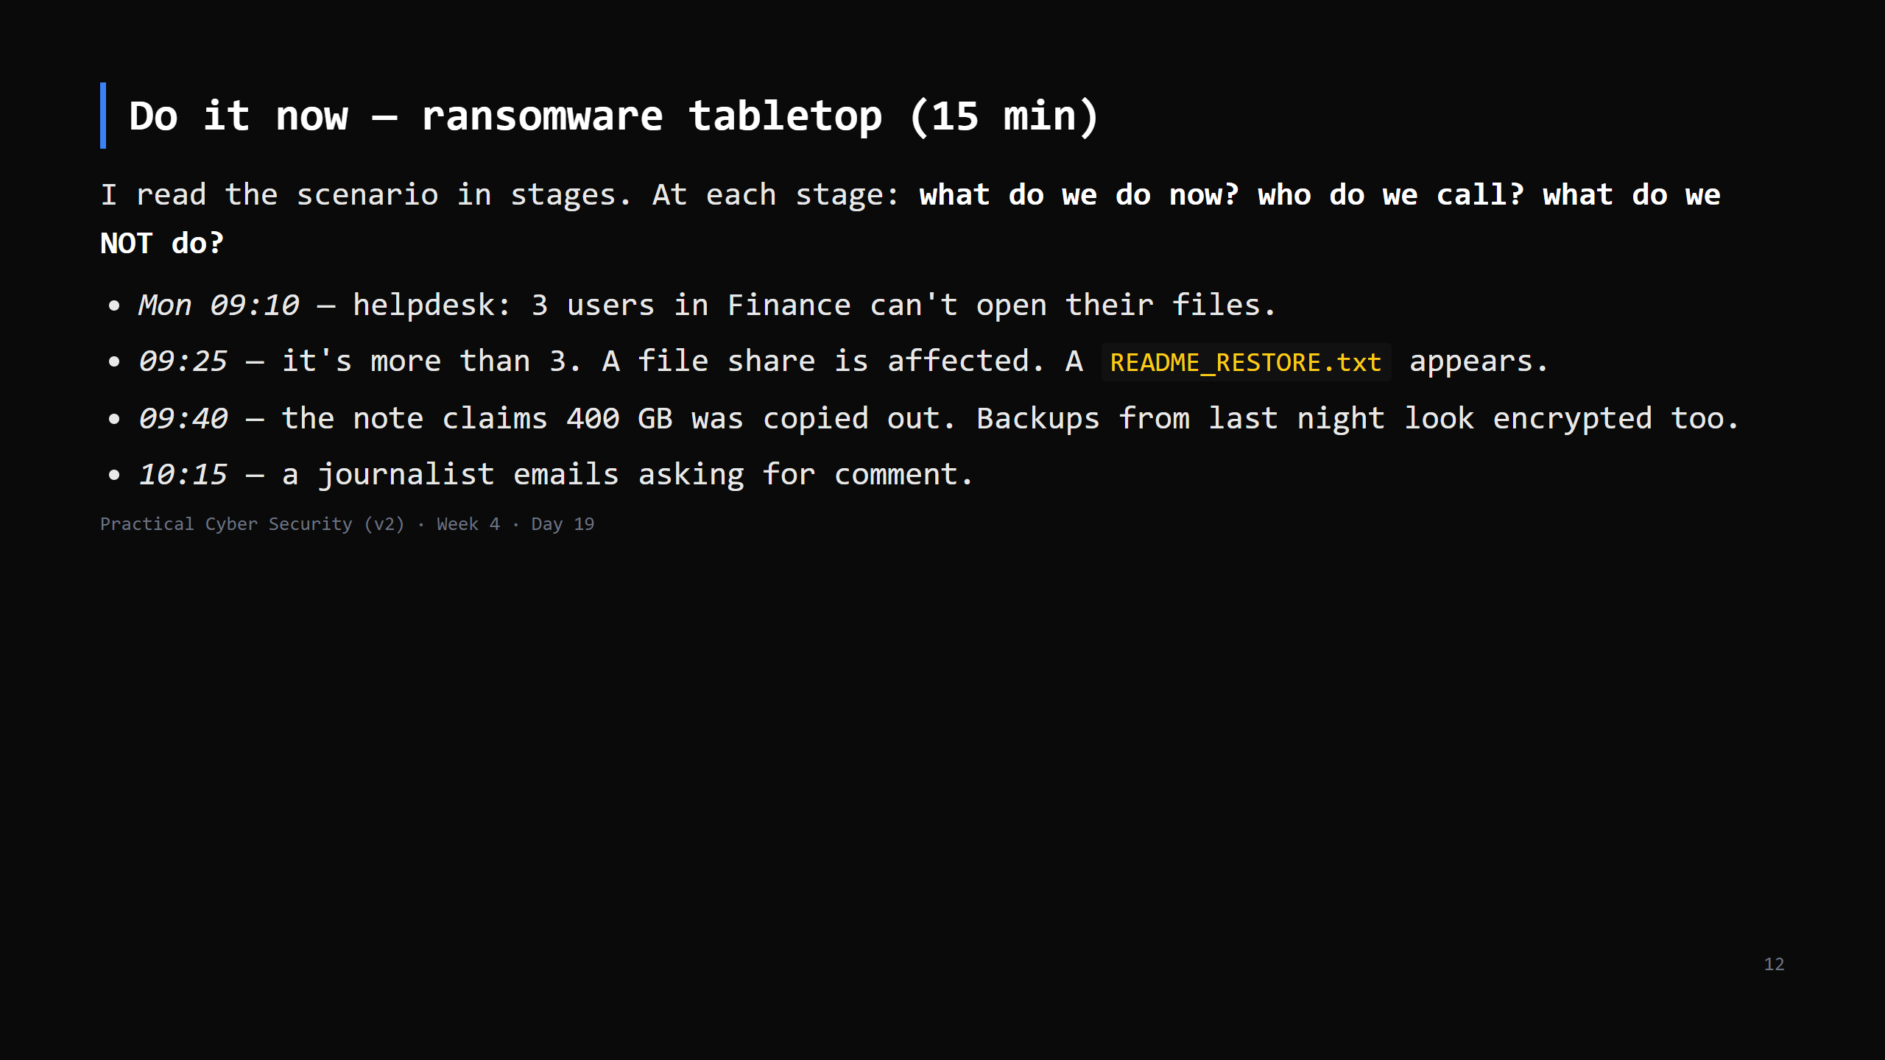
Notes:
No right answers - practice the calm and the sequence. Push for: declare an incident, convene the team, isolate affected segments, check backup integrity (offline copies?), engage legal + comms + (maybe) law enforcement + insurer, DON'T pay reflexively, DON'T talk to the press without comms. This is Prepare paying off - or not. CUT to 10 min if behind - do the first 3 stages.

Slide 13
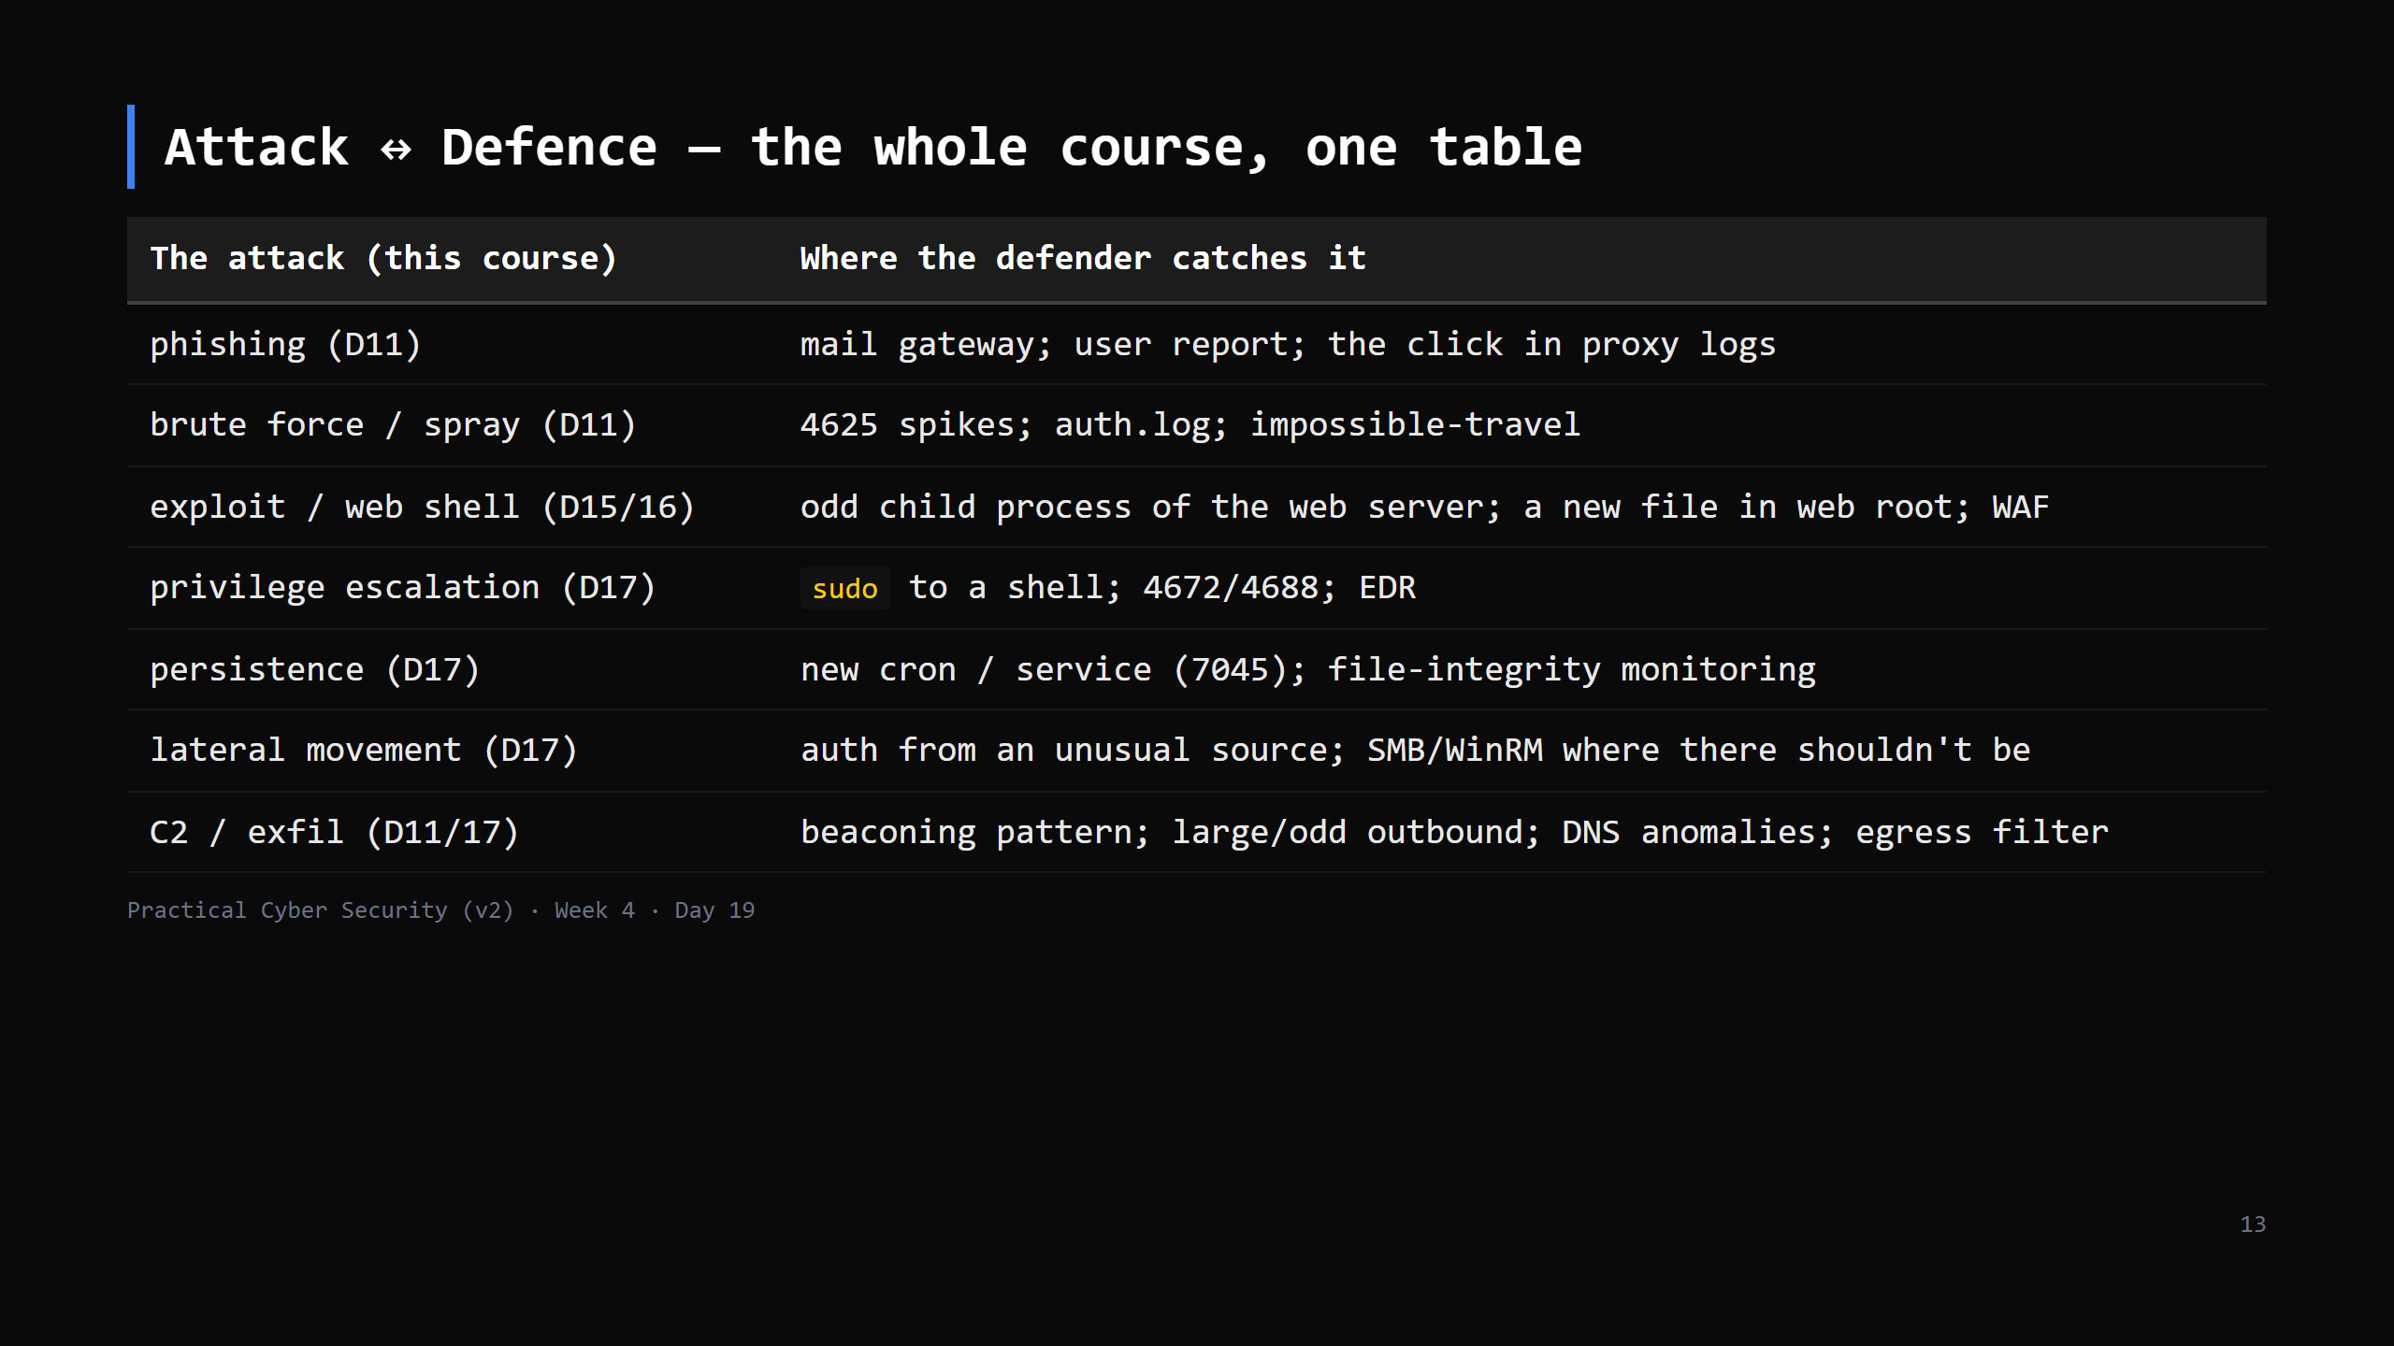
Notes:
This is the payoff slide. Every attack has a tell. The Blue team's craft is knowing the tells and building the detections. Point back across the whole course.

Slide 14
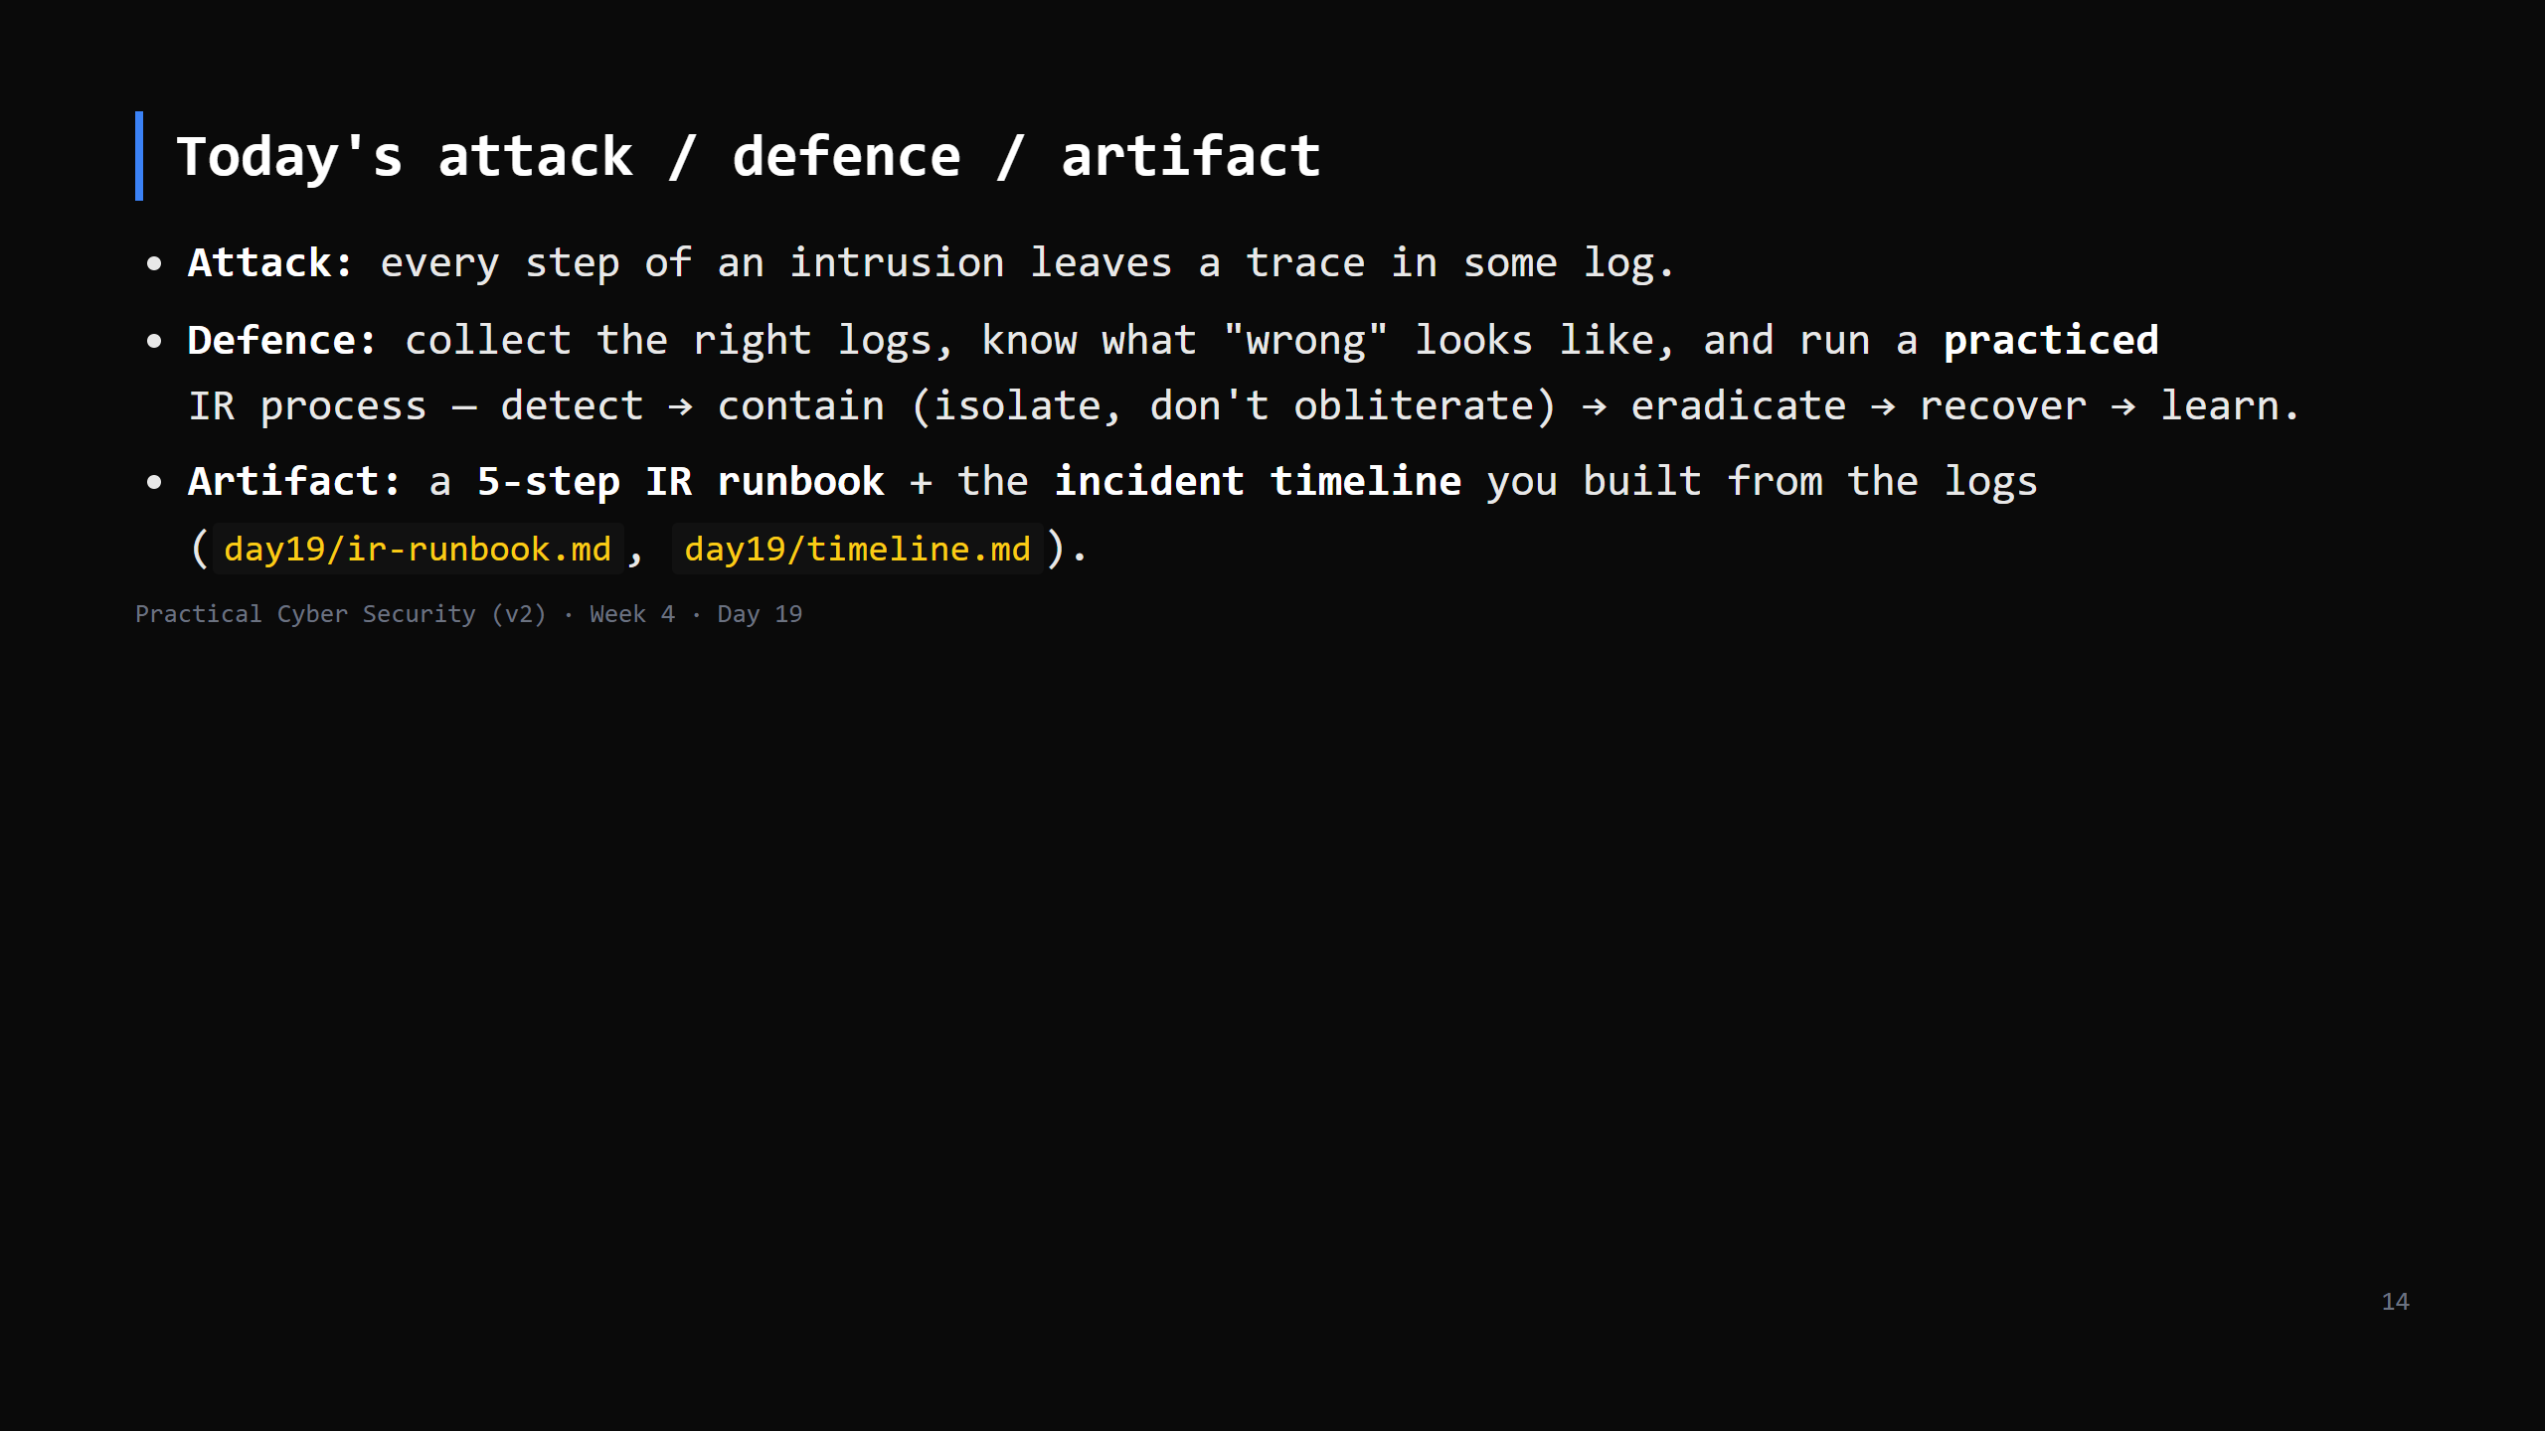

Slide 15
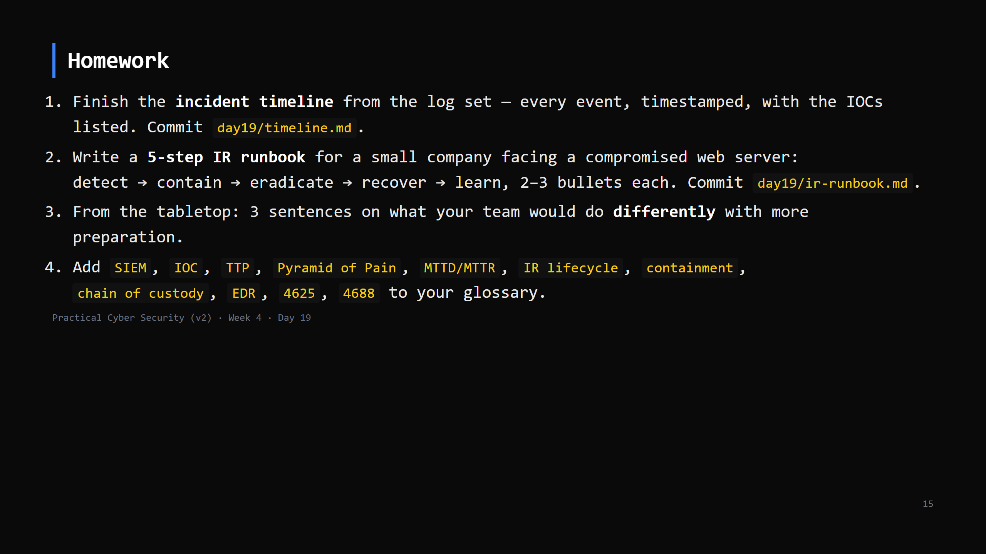
Notes:
Due start of Day 20 (careers + capstone).

Slide 16
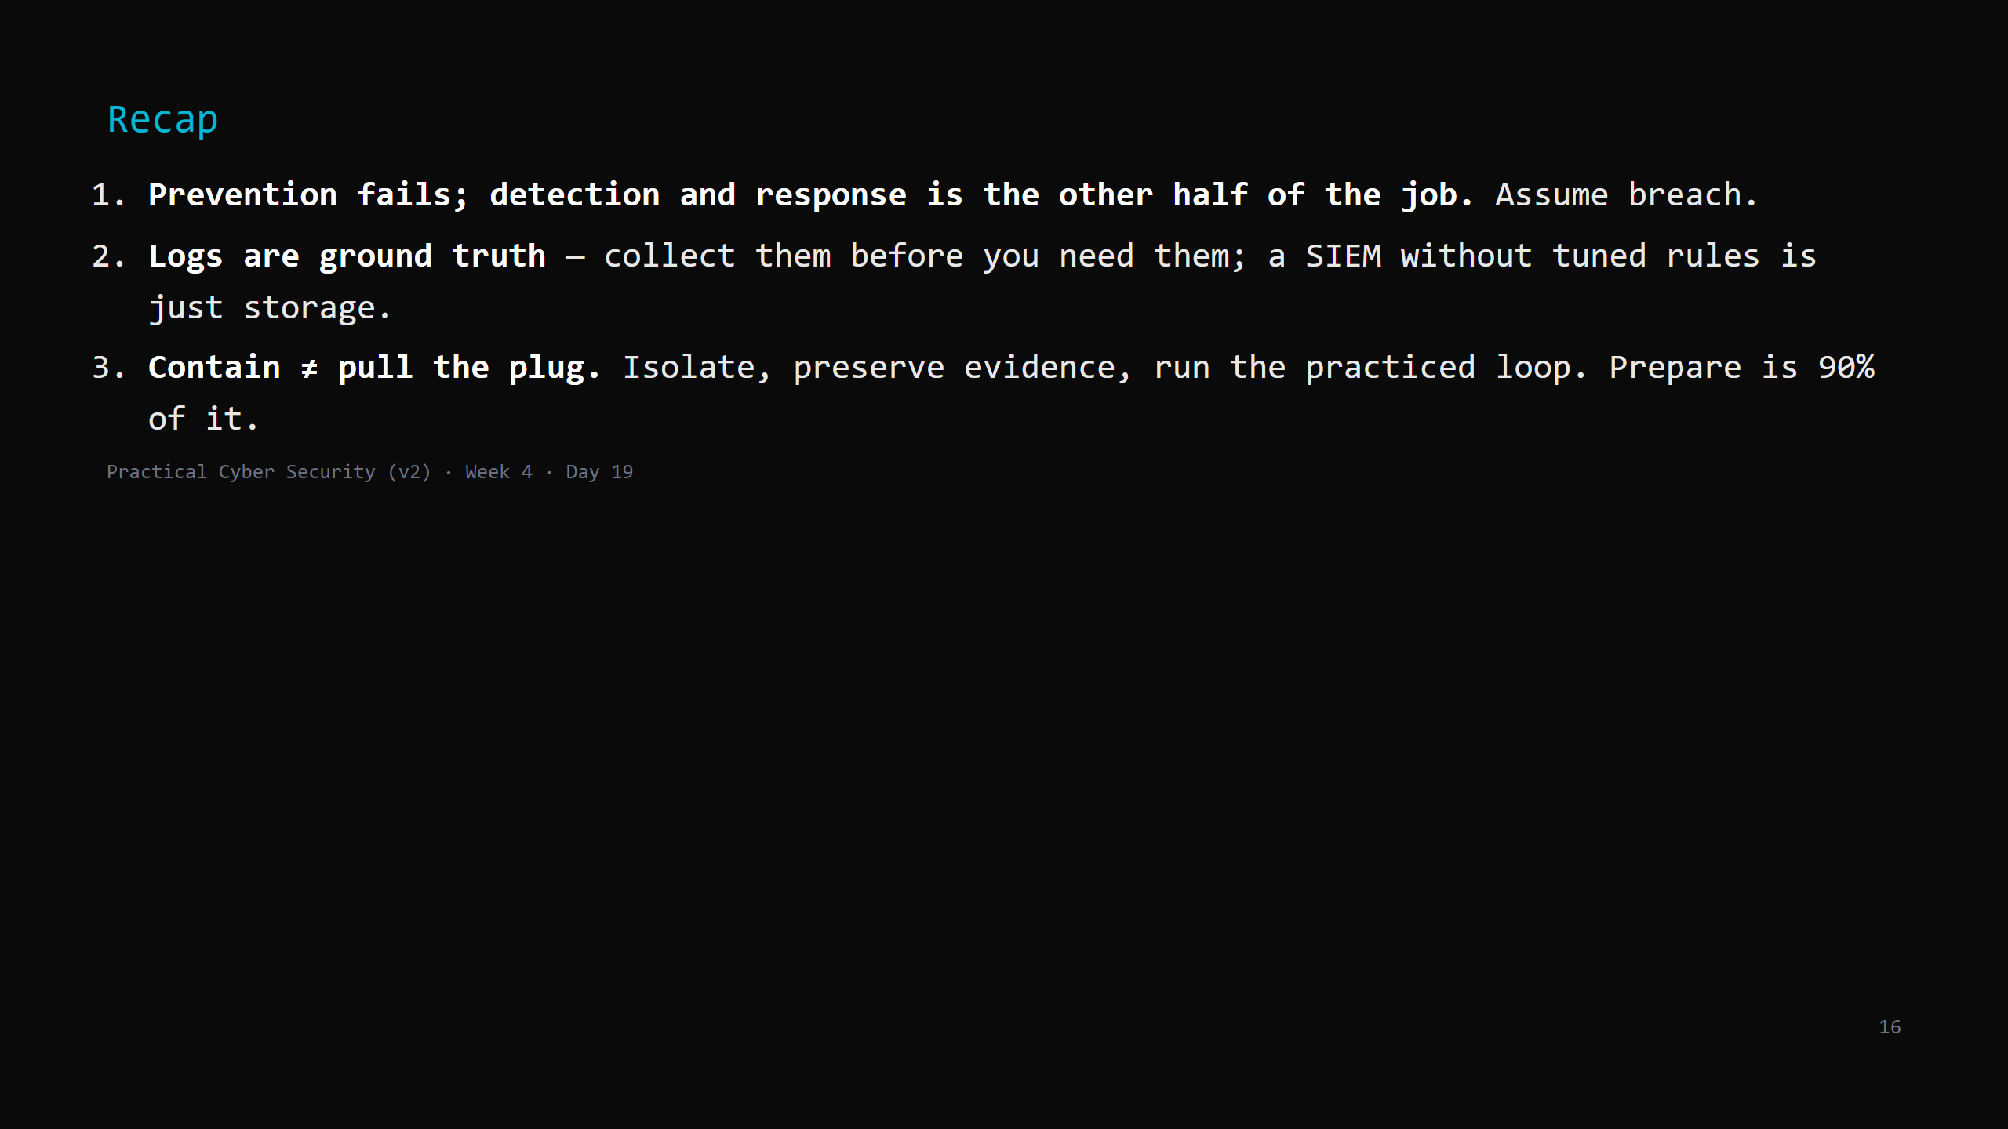
Notes:
Say the three lines. Tomorrow: the last day. Which of these lit you up - the Red days or the Blue day? Careers, specialisations, the cert ladder, and the capstone brief.

