Slide 1
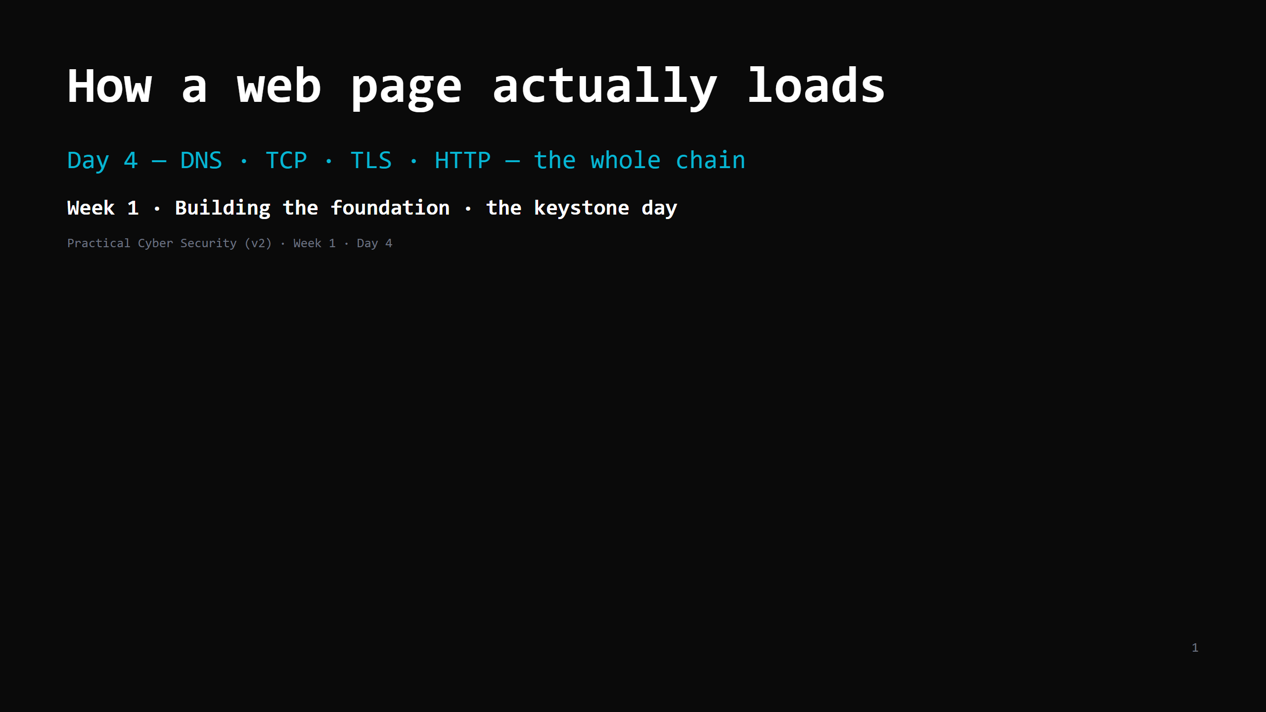
Notes:
RUN SHEET (~84 min). THIS IS A TWO-PART DAY — it carries ~2 days of material. Treat it as such:
PART 1 — the chain (DNS -> TCP -> TLS). target: DONE by minute 40.
PART 2 — HTTP + the attacks + DevTools.
>>> MID-POINT GATE at minute 40: if TLS isn't finished, you are behind.
Recovery: skip the netcat "do it now" and the render slide, compress HTTP request+response
to ONE slide, go straight to the chain diagram -> attack<->defence (table only) -> DevTools.
HTTP-by-hand and the full attack detail become homework/reading. DO NOT cut DevTools.
00:00 Journey check + hook (curl -v on the projector) 4 ┐
00:04 The chain — the 7 steps (the day's map) 3 │
00:07 Step 1: DNS — names to numbers 7 │ PART 1
00:14 DO: dig / nslookup 4 │ (DNS+TCP+TLS,
00:18 Step 2: TCP — the reliable phone call 8 │ done by :43)
00:26 DO: watch the handshake in curl -v 3 │
00:29 UDP — shout it and hope (live diagram) 3 │
00:32 Step 3: TLS — locking the line + what it does NOT give 9 ┘
00:41 Step 4: HTTP — request slide + response slide 11 ┐
00:52 DO: hand-craft an HTTP request (netcat / ps1) 6 │ PART 2
00:58 Steps 5-6 render (1 line) + the chain diagram 3 │ (HTTP + attacks
01:01 Attack <-> defence 9 │ + DevTools)
01:10 DO: DevTools -> Network on a real login 6 │
01:16 Wrap + homework 5 ┘
With the UDP slide in, the MID-POINT GATE is minute 43; cut UDP and it is back to minute 40.
CUT FIRST IF SHORT: the render/repeat slide (say one sentence); the UDP slide (one sentence on
the TCP slide instead); the netcat "do it now" (do a full read of curl -v instead); the
"look-alike site" attack row.
NEVER CUT: the DNS->TCP->TLS->HTTP order, what TLS does NOT give, the chain diagram, DevTools.
LIVE DIAGRAMS (folder archify/ — open every file in its own browser tab BEFORE class; each has
view buttons that step through the story, and a light/dark toggle for the projector):
04-page-load-chain.html -> "The chain" slide (the map), and again at the whole-chain slide
01-dns-resolution.html -> Step 1 DNS
02-tcp-handshake.html -> Step 2 TCP
03-tcp-vs-udp.html -> UDP slide
ANALOGY (sanctioned): the PHONE CALL. DNS = asking the operator / directory for the number.
TCP handshake = "hello?… hello.… ok, go ahead." TLS = switching to a scrambler both ends share.
HTTP = the actual conversation.

Slide 2
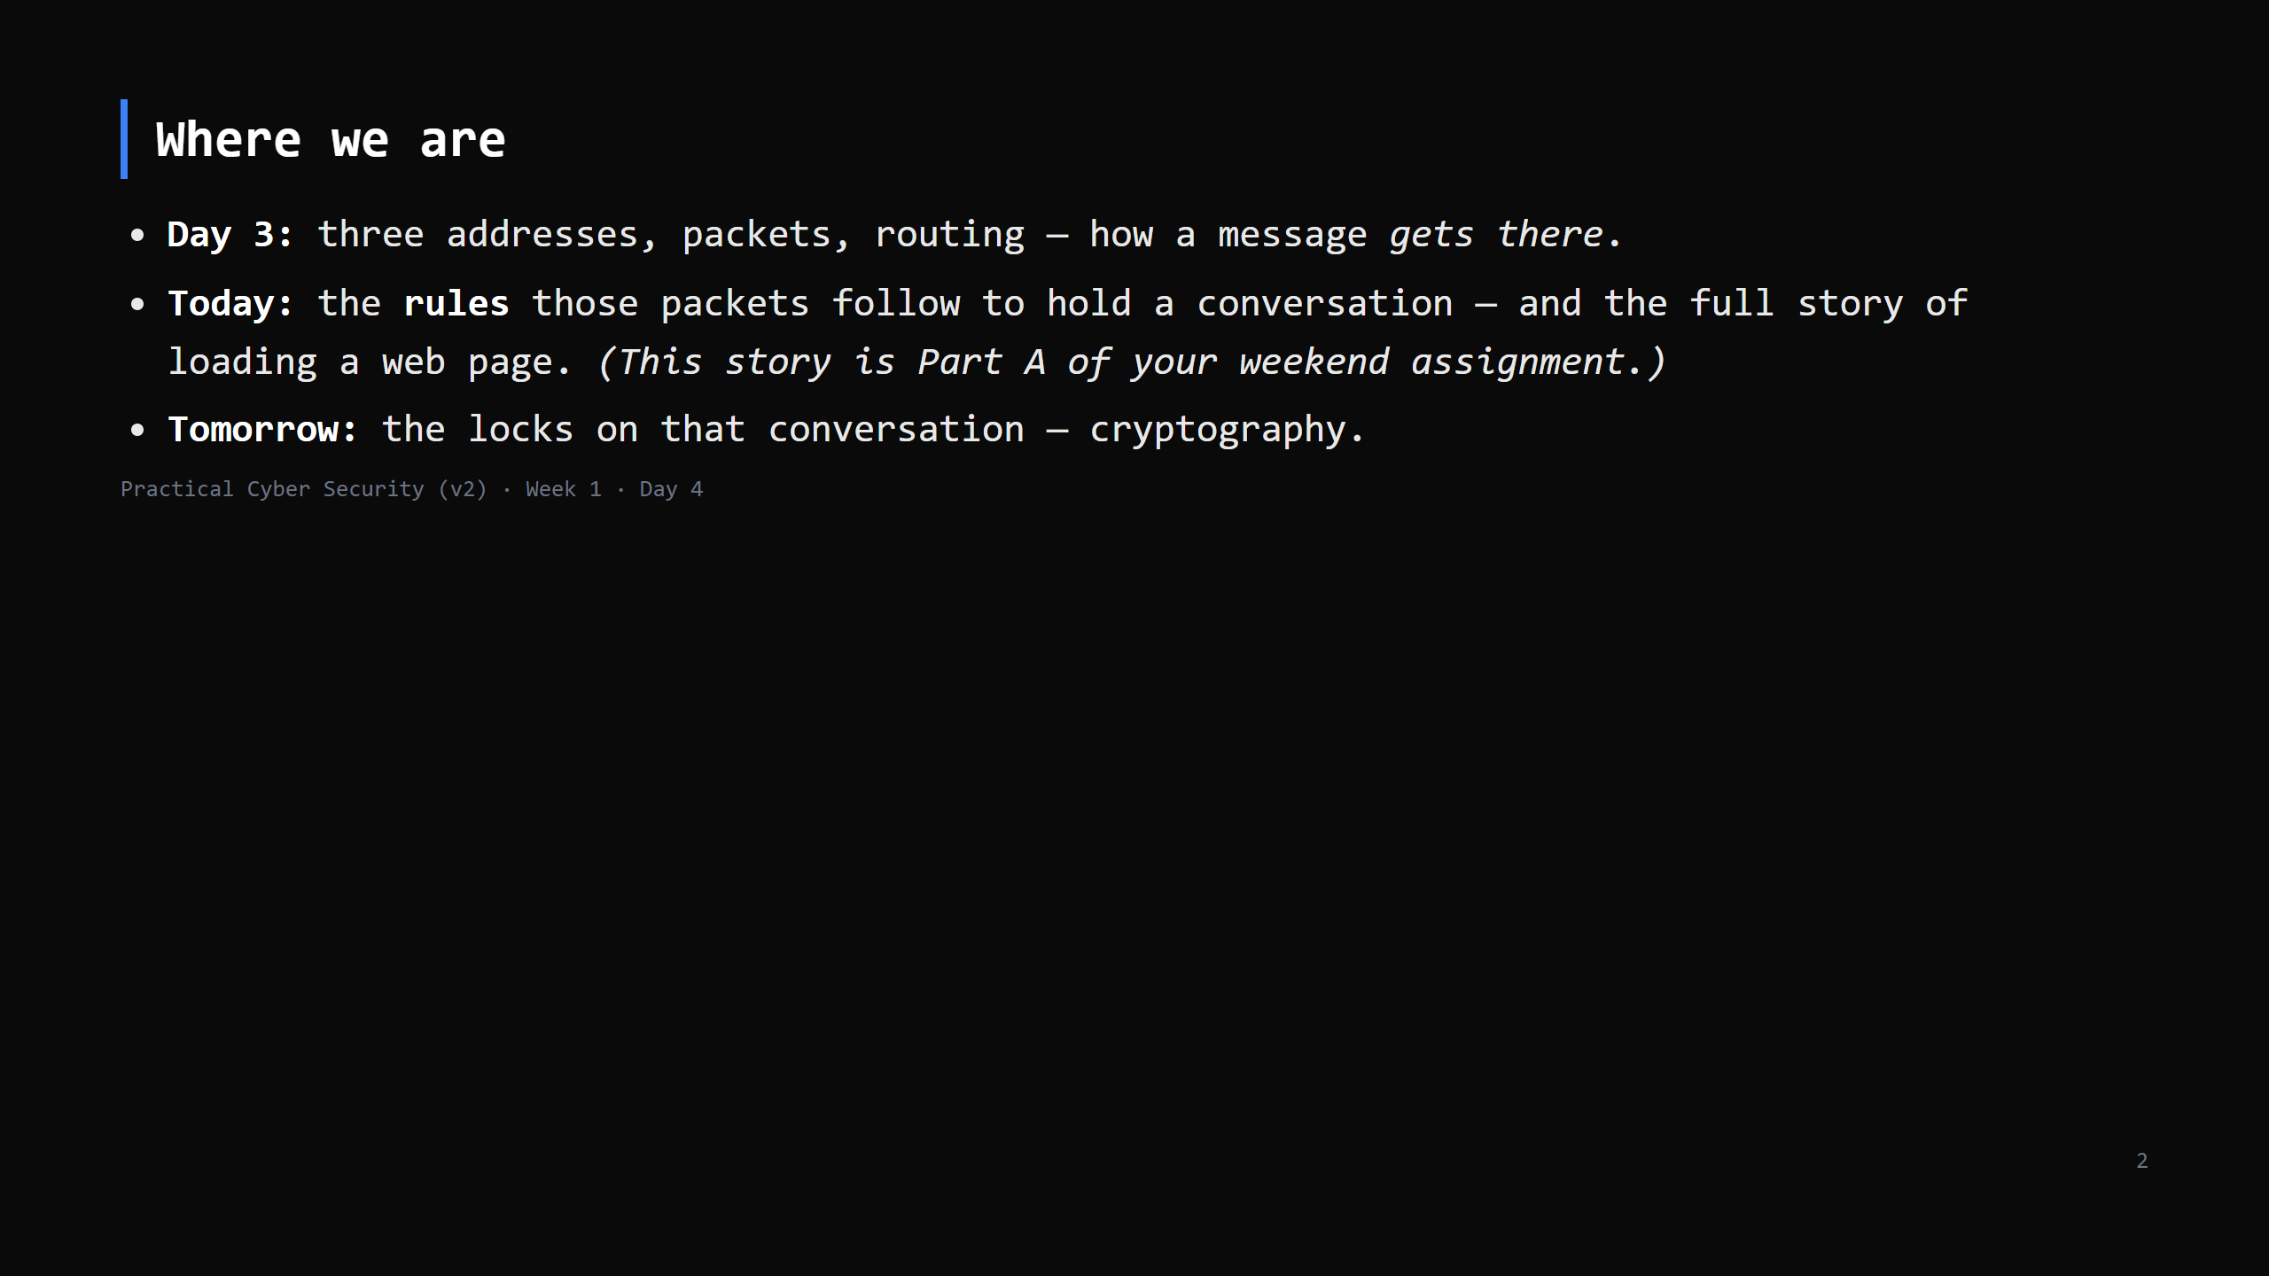
Notes:
Learning Journey Check. Flag loudly that today's "7-step story" is the assignment — they should
take notes with that in mind.

Slide 3
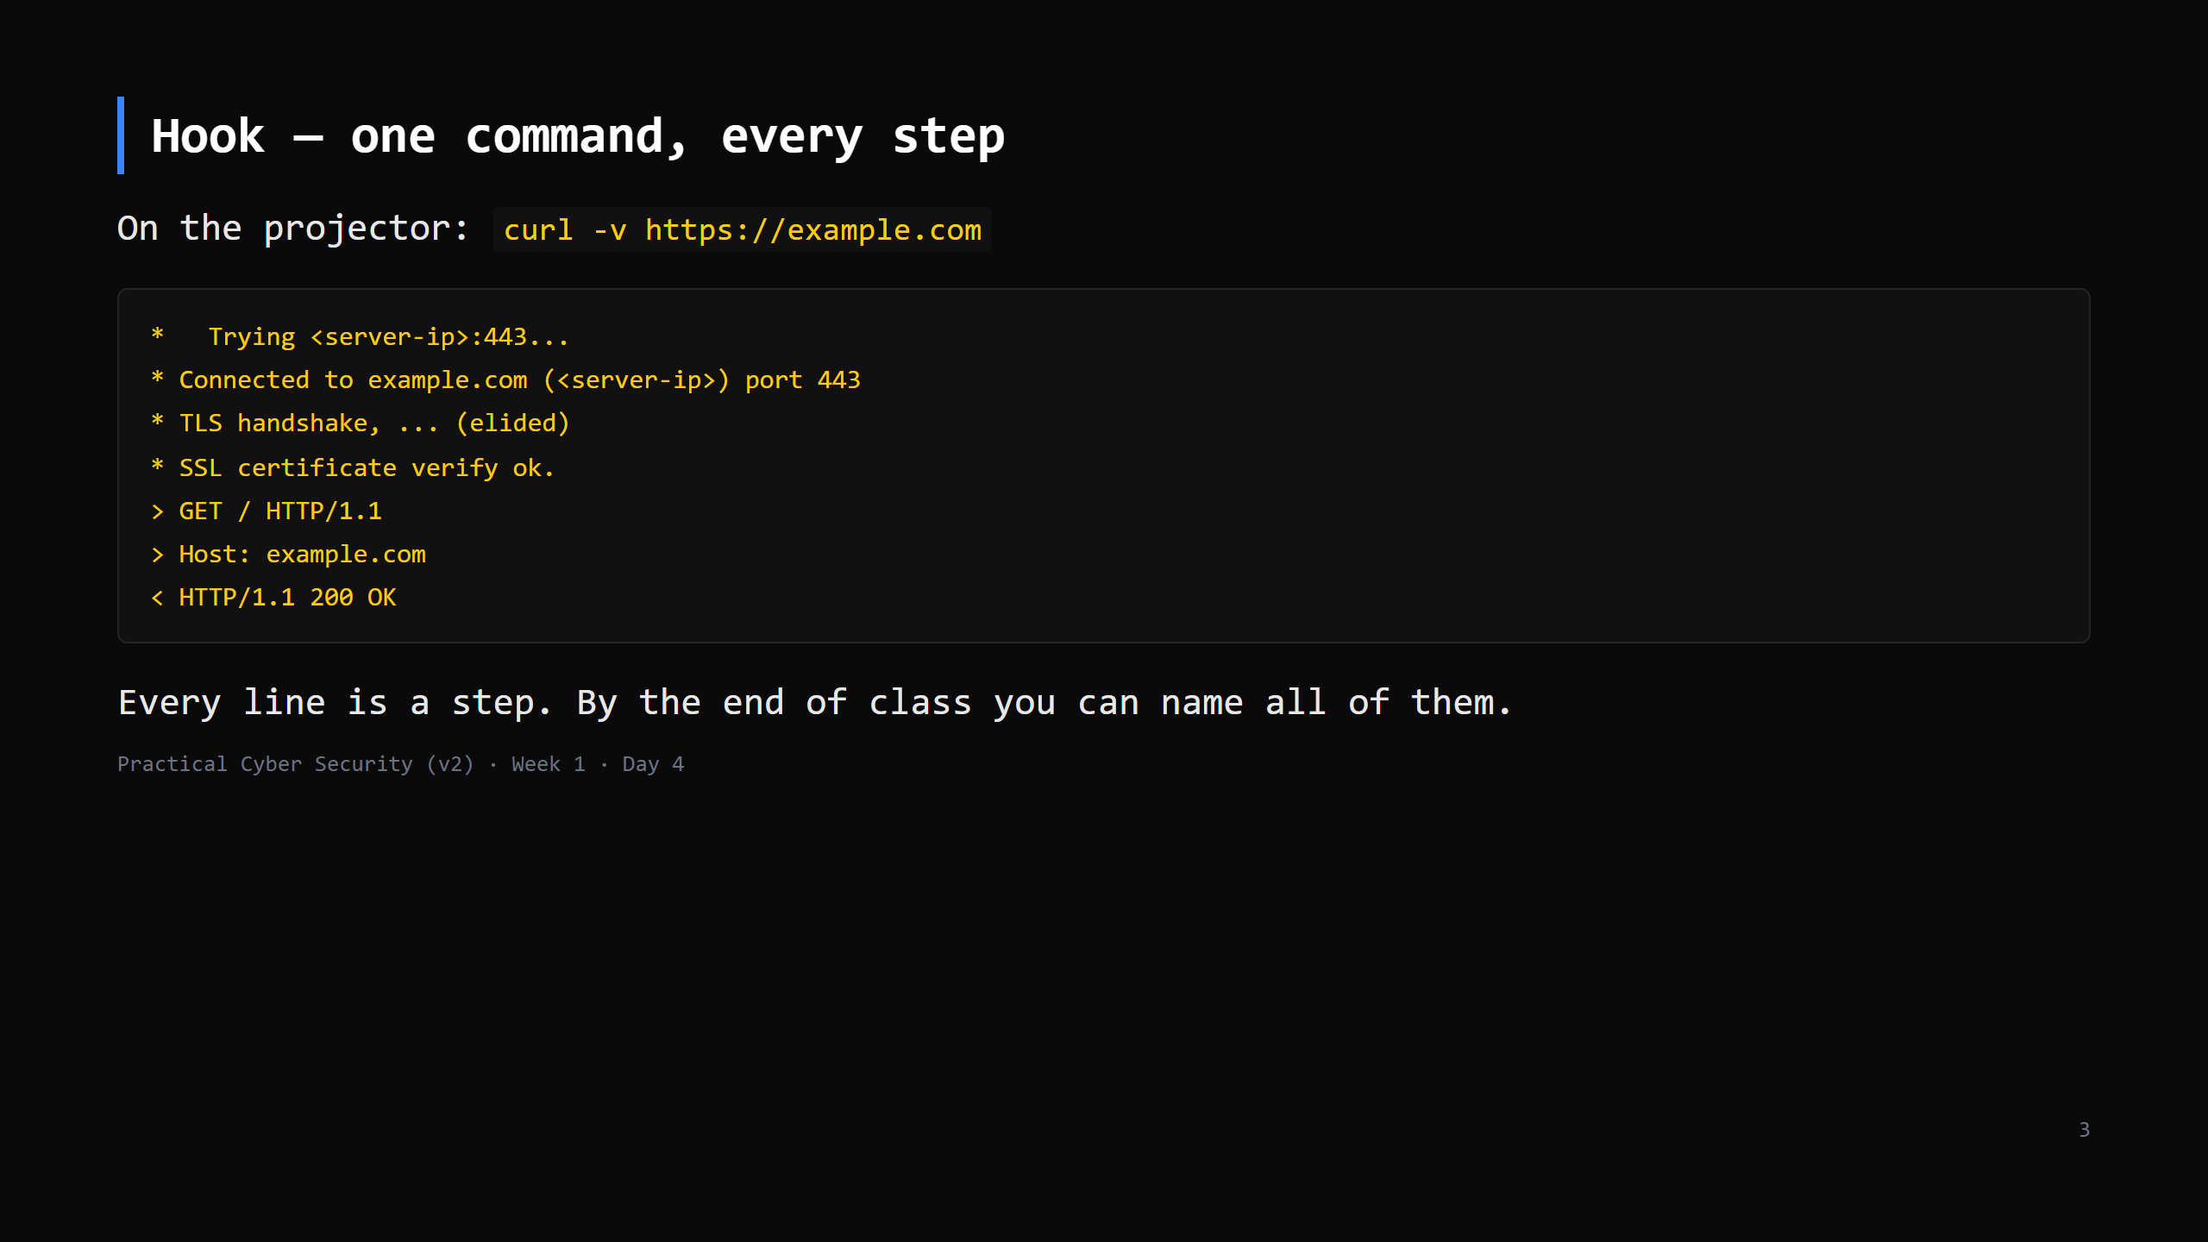
Notes:
The real output is longer; this is trimmed for the slide. The IP you see won't match any
number on a slide — sites move — so don't read a specific IP aloud.
Don't decode it yet. Just: "name lookup, then connect, then a lock, then a request, then a
reply." Those are the four sections of today.
Don't decode it yet. Just: "name lookup, then connect, then a lock, then a request, then a
reply." Those are the four sections of today.

Slide 4
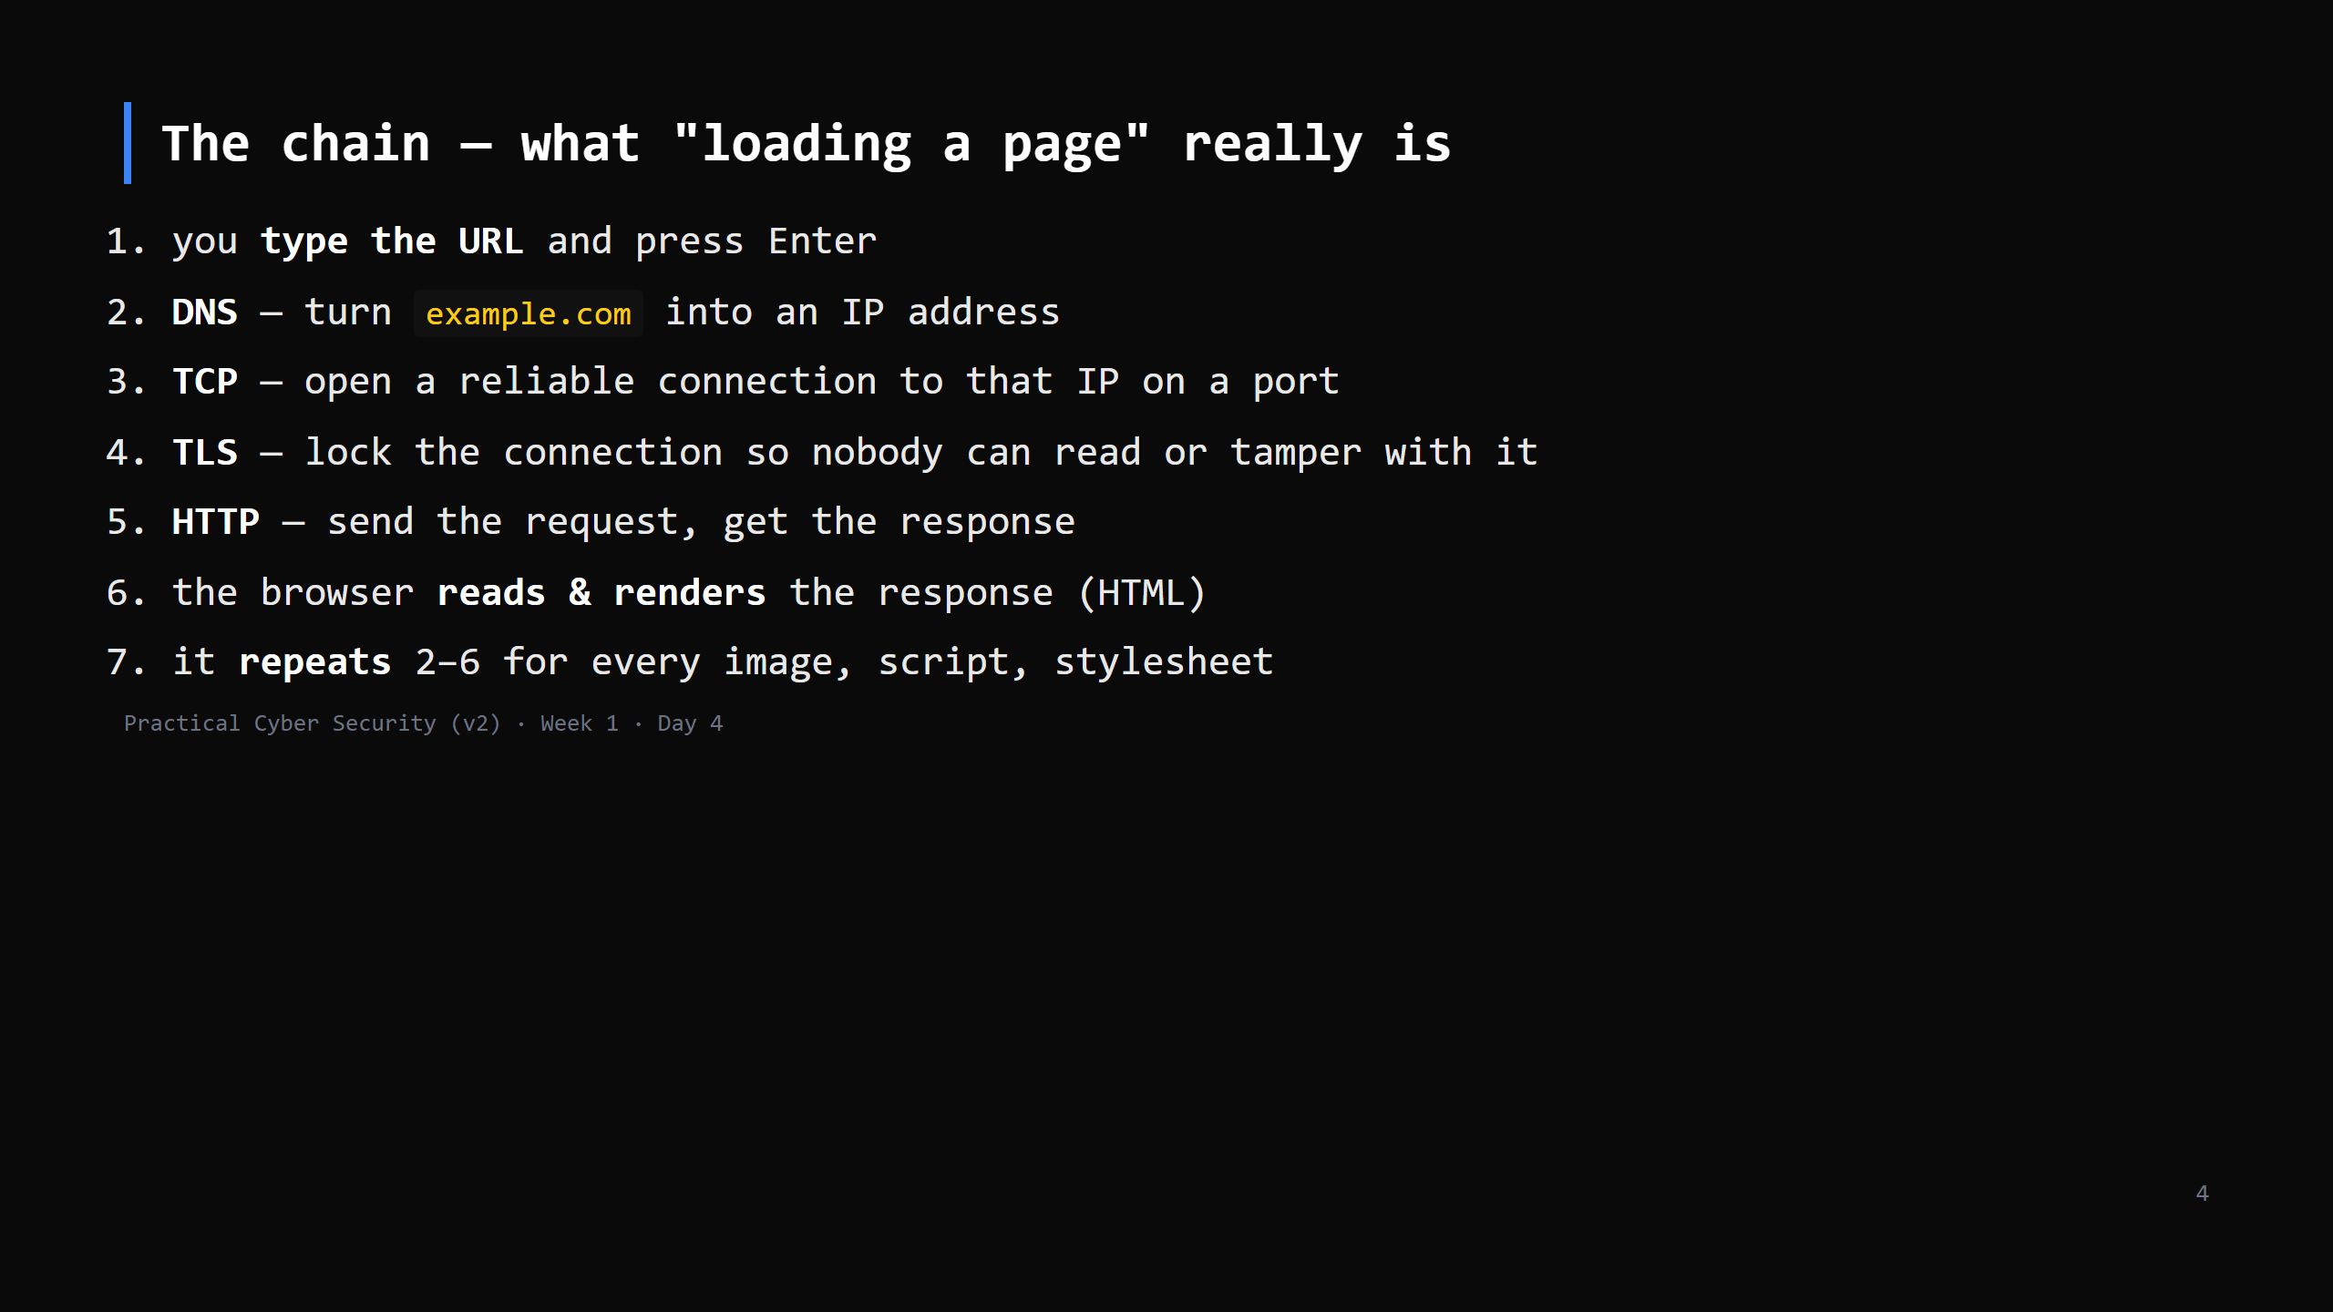
Notes:
This slide is the map for the whole day AND the shape of the assignment (7 steps). Put them on
the board and tick them off as you go. Every web attack later "lives" on one of these steps.
LIVE DIAGRAM: archify/04-page-load-chain.html — play the trace once, no clicking through the
views yet (60 seconds). "Five boxes. We do one at a time." Same tab comes back at :58.

Slide 5
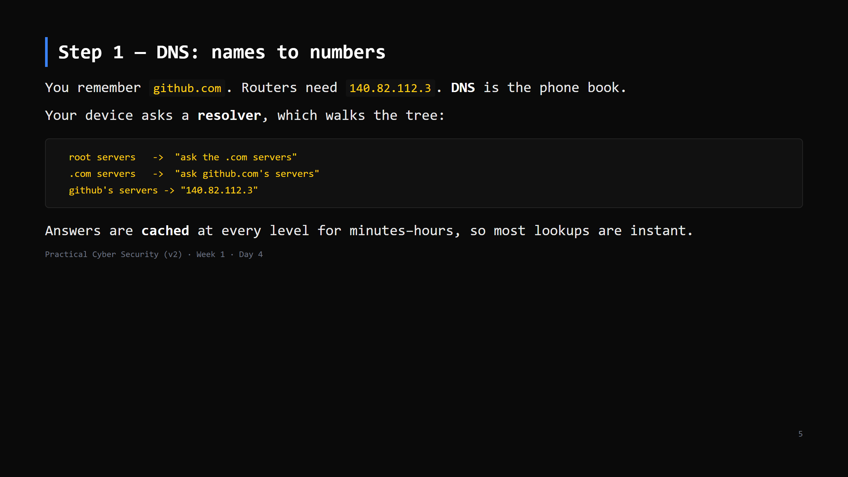
Notes:
Analogy: asking the operator for a number. First time it's a few hops; after that everyone
who asked recently has it memorised (cache).
Keep it to: resolver -> root -> TLD -> authoritative -> answer, plus caching. No record-type
zoo (A, AAAA, MX, TXT) beyond naming A = "name to IPv4".
LIVE DIAGRAM: archify/01-dns-resolution.html — 3 views: ask the resolver / walk the tree /
cache the answer. The must-land point is view 1: YOUR laptop does not walk the tree, the
resolver does. The third "Class check" question sets up DNS spoofing on the attack slide.

Slide 6
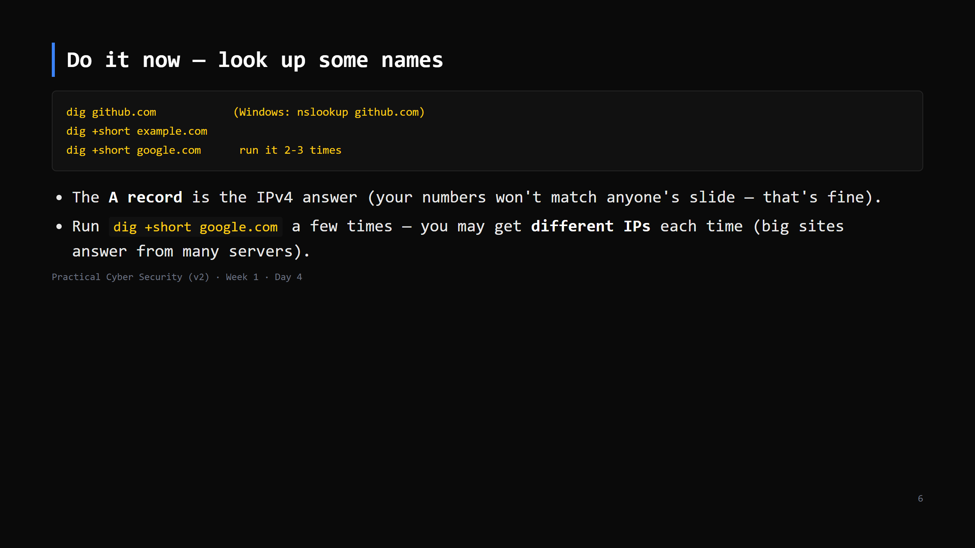
Notes:
2-3 min. On Windows nslookup output is chattier — the "Non-authoritative answer" is the cached
one. Point out TTL in `dig` full output = how long the answer may be cached.

Slide 7
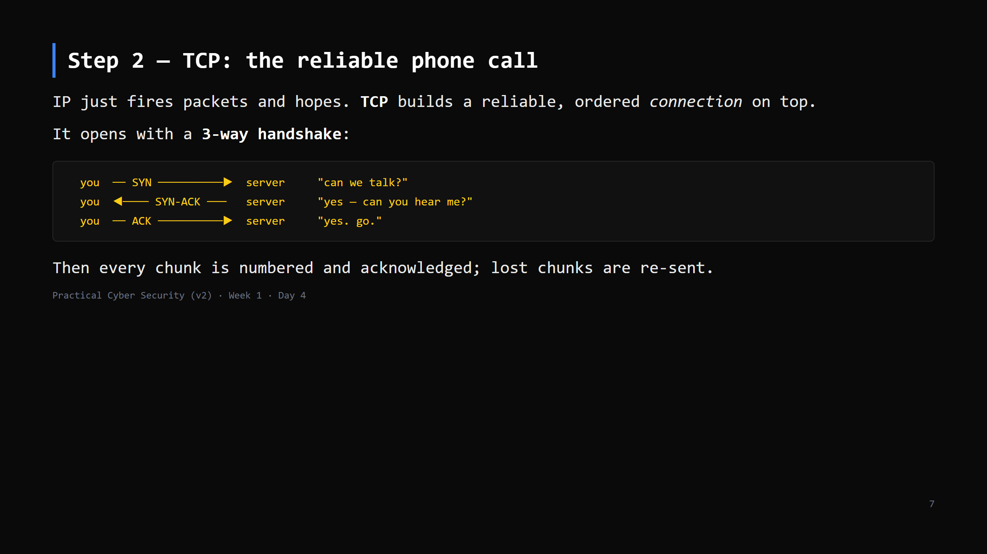
Notes:
Analogy: "hello?… hello, I can hear you.… great, go ahead." Only after that do you talk.
LIVE DIAGRAM: archify/02-tcp-handshake.html — 3 views: handshake / numbered + acknowledged /
a lost chunk. View 3 is the one the ASCII on this slide cannot show: chunk #2 vanishes, no
ACK comes back, the sender re-sends. "That is the whole difference from IP."
UDP gets its own slide after the "do it now". If you are cutting it: one line here — "UDP =
no handshake, no re-sends, shout it and hope; DNS, video calls, games."

Slide 8
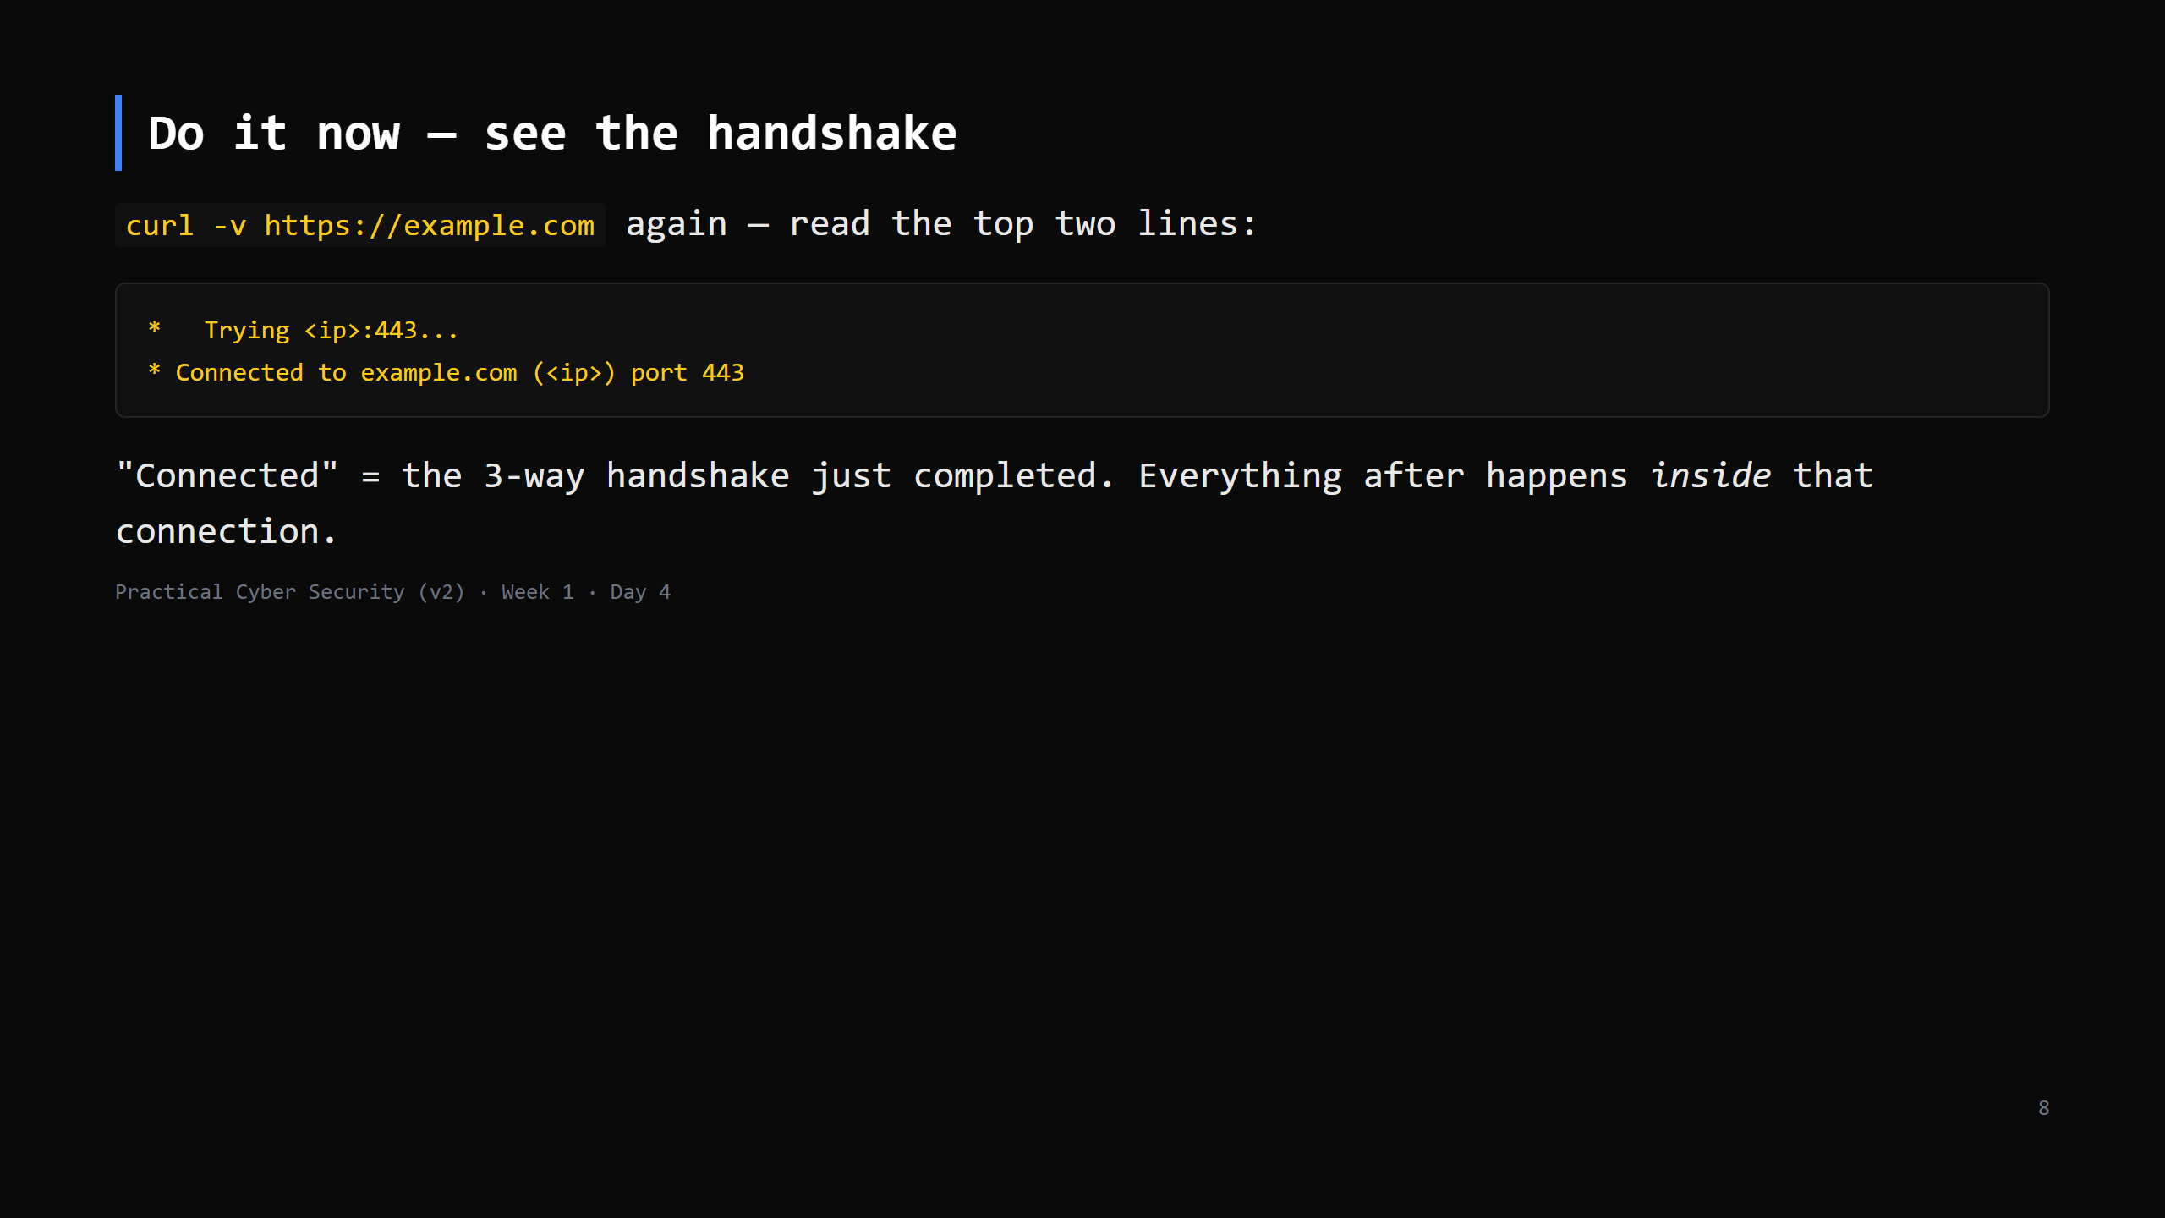
Notes:
1-2 min. If you ran Wireshark you'd see the literal SYN / SYN-ACK / ACK — that's Day 13. For
now curl's "Connected" line is the marker.

Slide 9
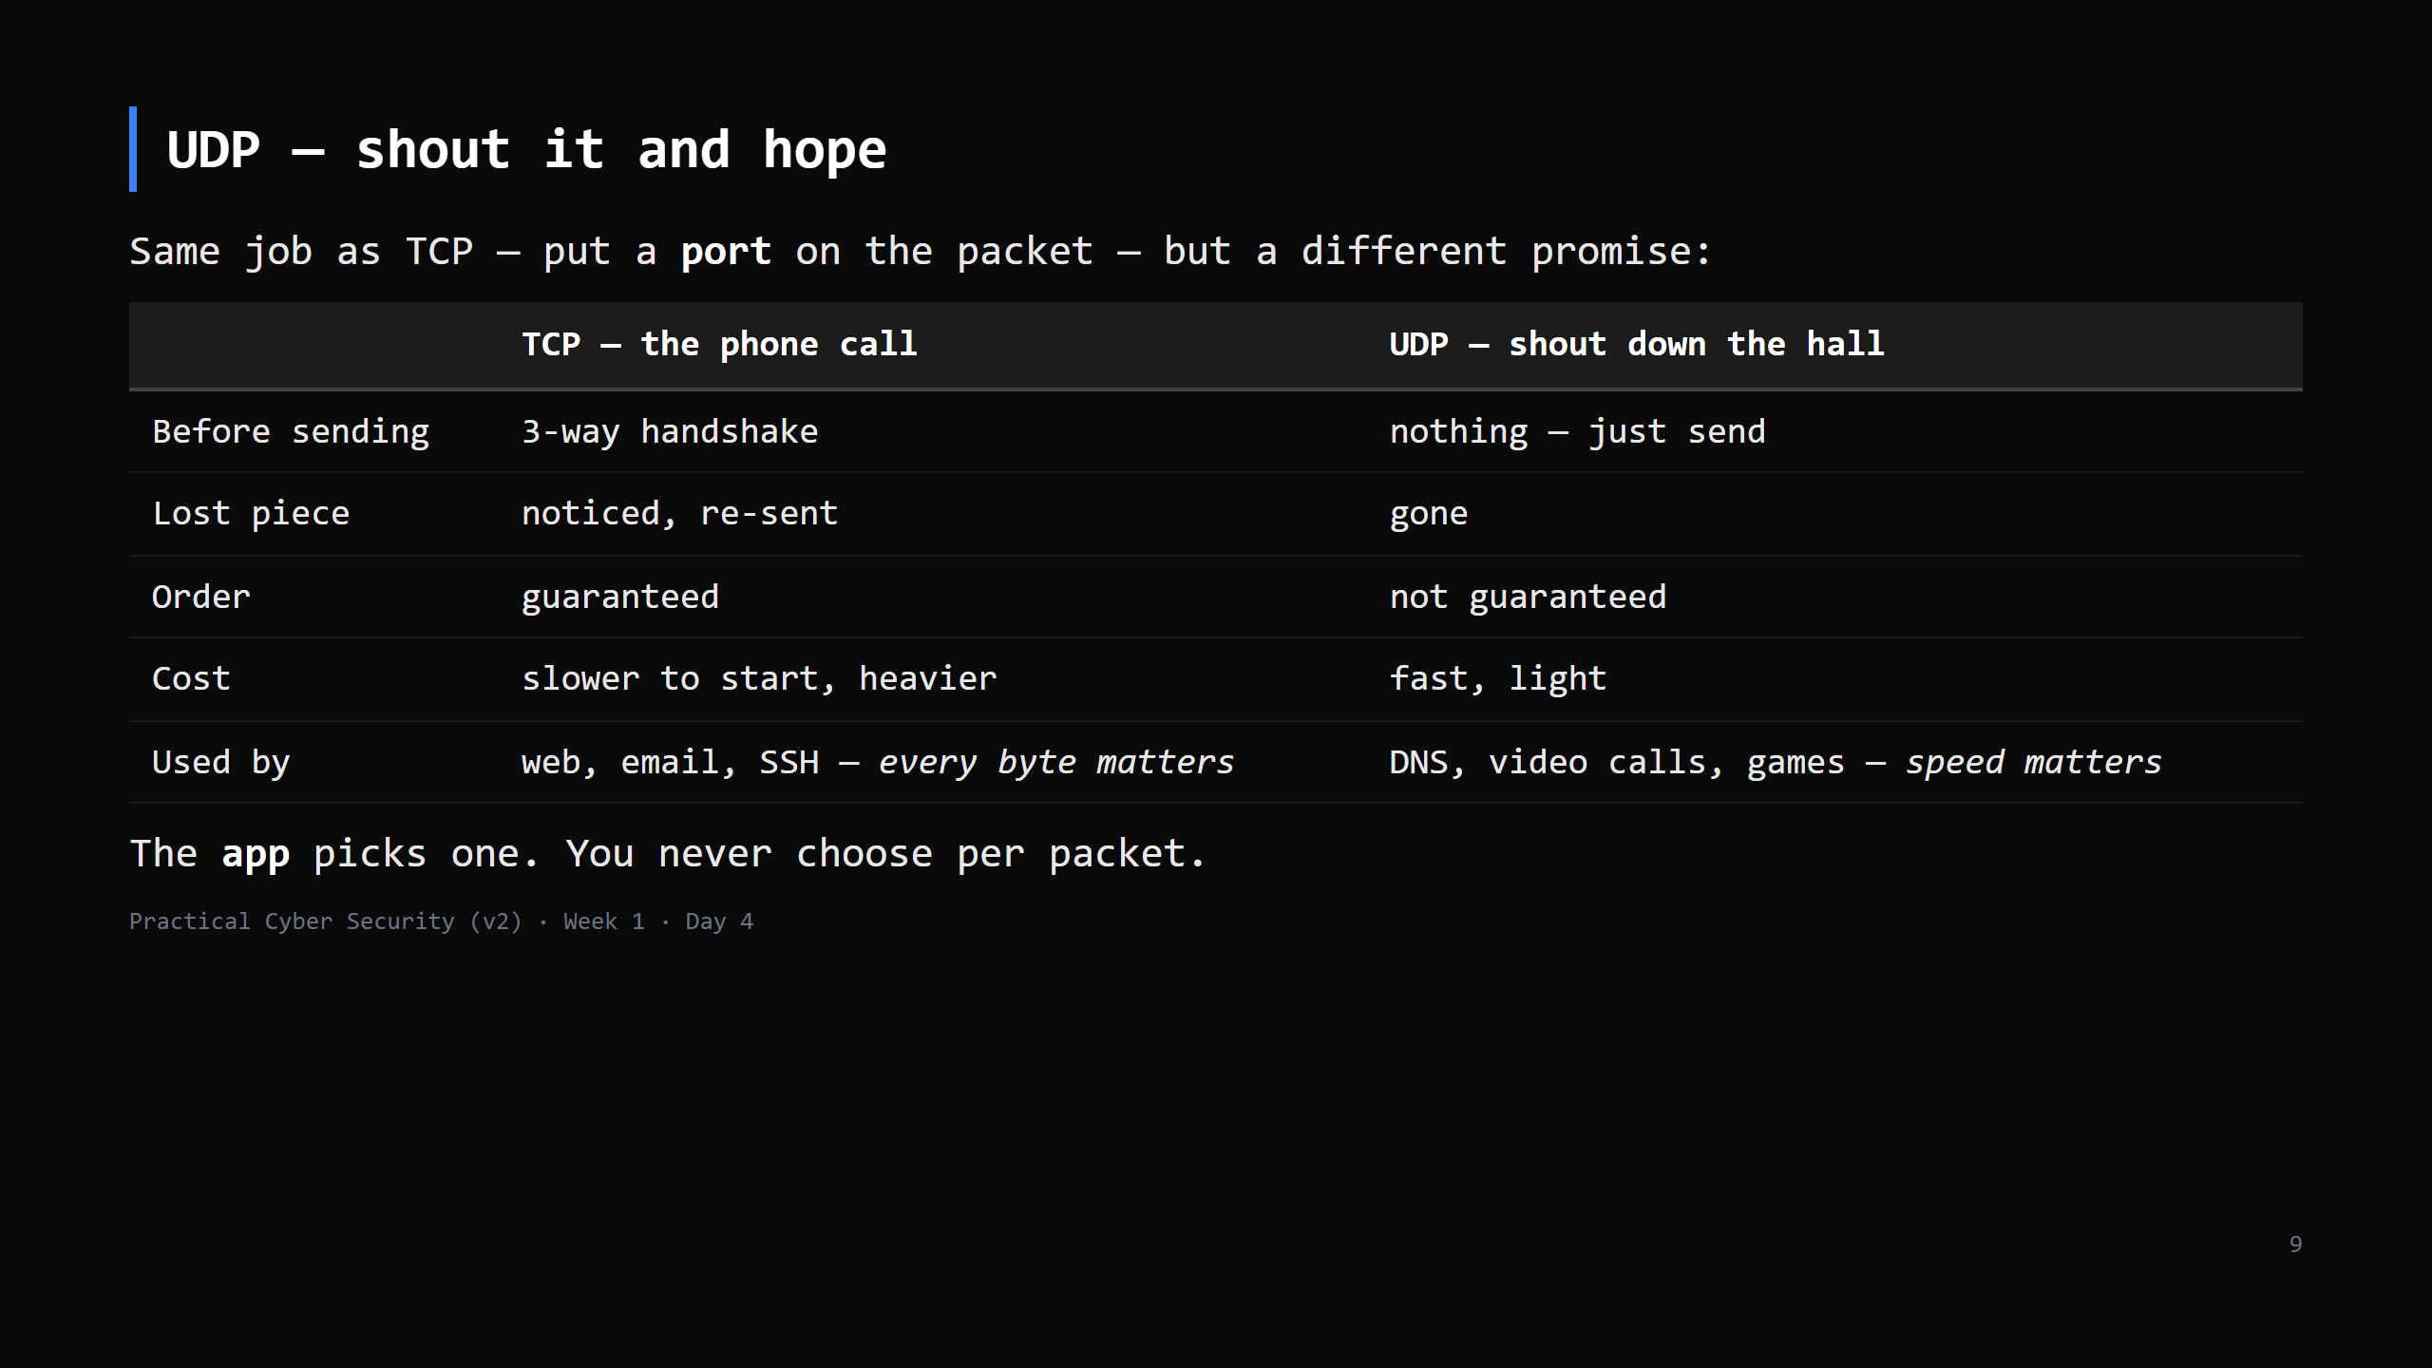
Notes:
LIVE DIAGRAM: archify/03-tcp-vs-udp.html — top row TCP, bottom row UDP, same sender and
receiver. Play the trace: TCP goes through the handshake box first; UDP skips straight across.
The two questions that make it land: "A bank page: TCP or UDP? Why?" and "Zoom dropped one
frame — should it be re-sent?" (No: by the time it arrives it's old. Skip it.)
Ask "why does DNS use UDP?" — one tiny question; a handshake would triple the wait.
If asked about QUIC / HTTP/3: HTTP on top of UDP with reliability rebuilt on top (FAQ).
CUT to one sentence on the TCP slide if short.

Slide 10
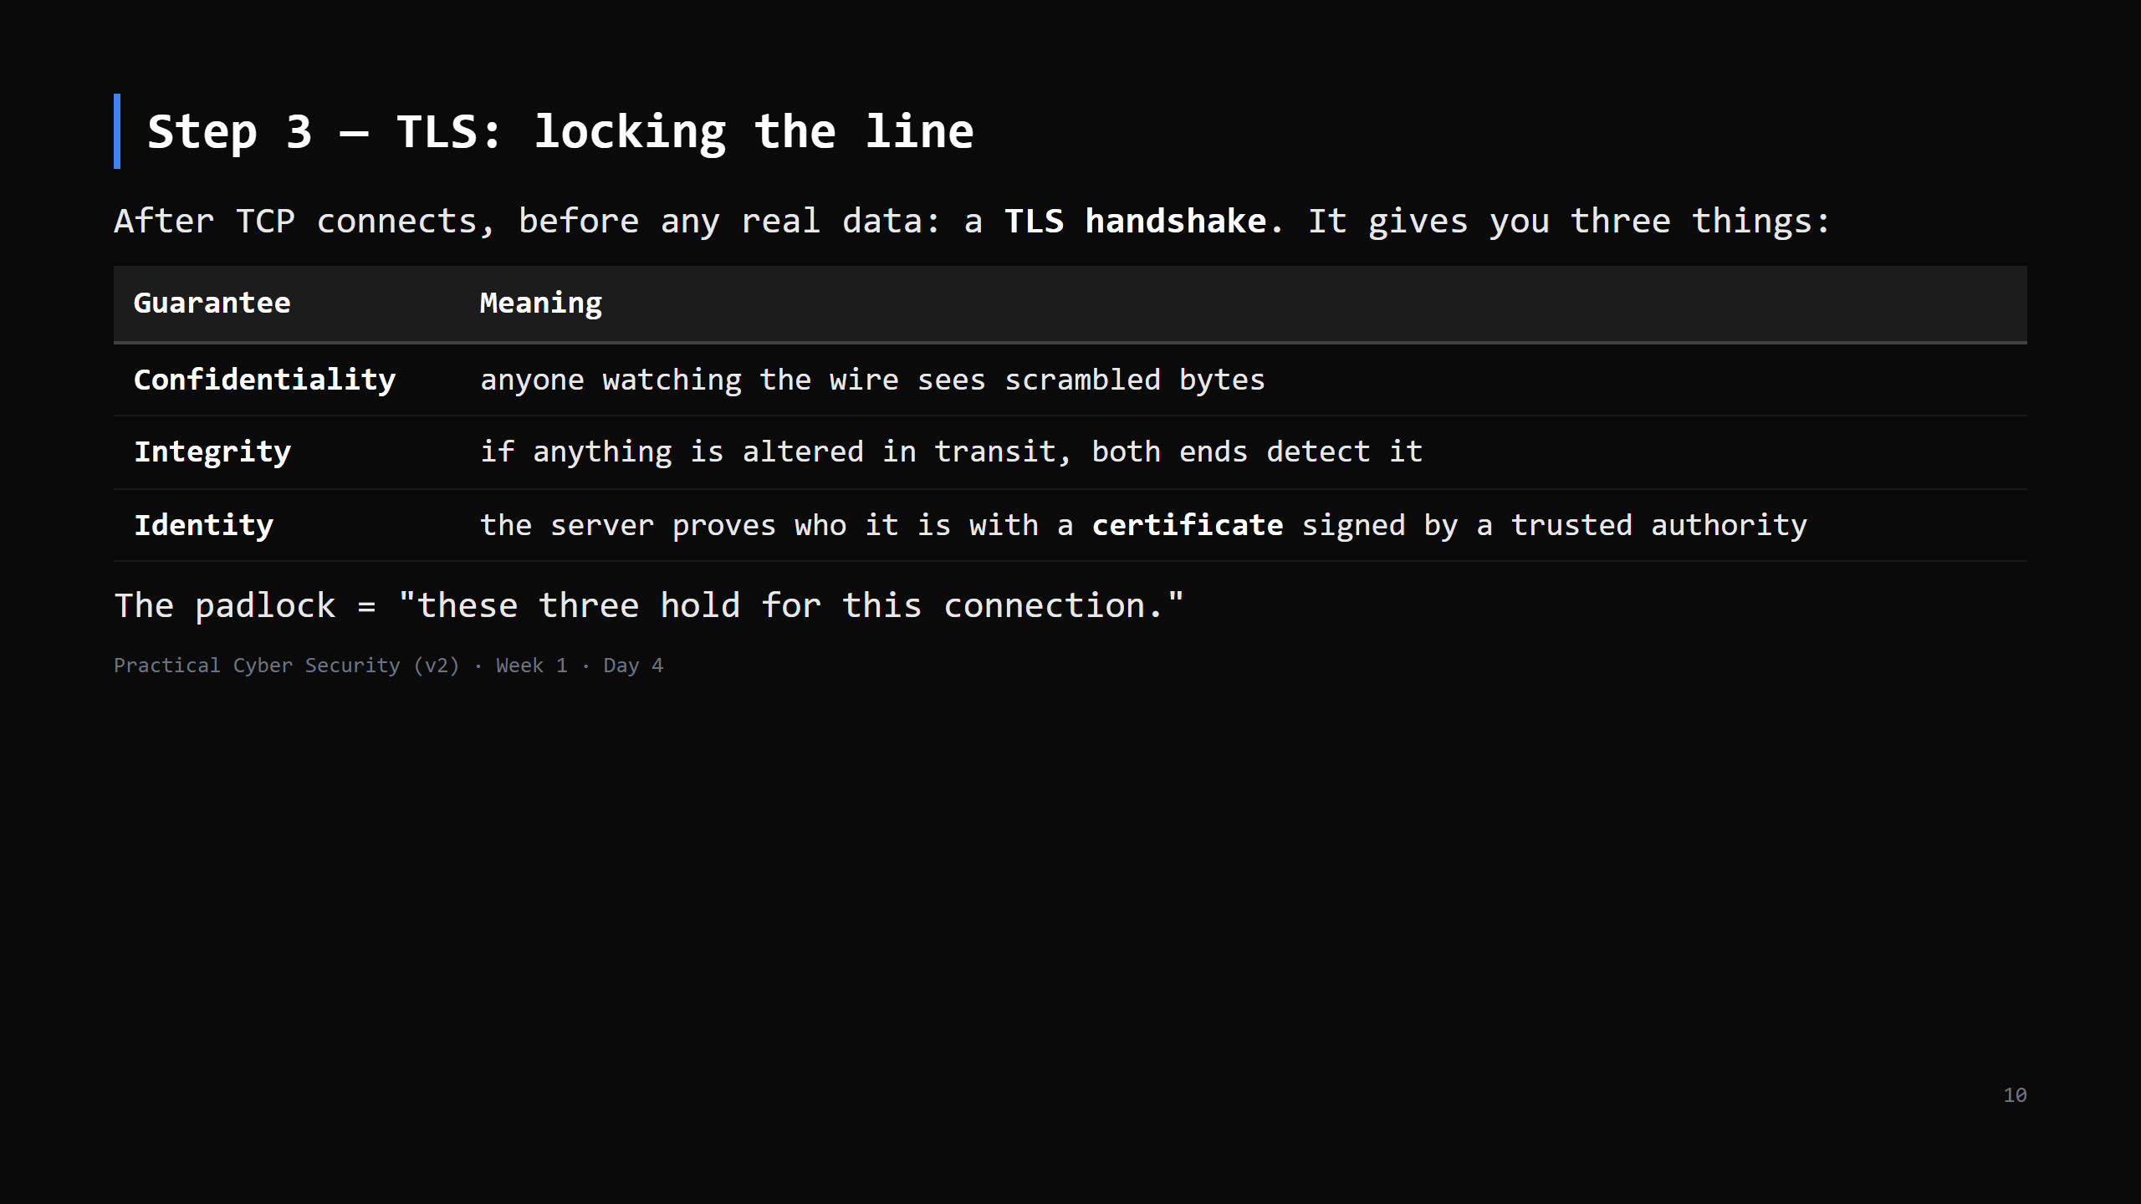
Notes:
Analogy: both ends switch on a scrambler only they can un-scramble; and the server shows ID
before you trust it. Certificate detail is Day 5 — today just "a trusted third party vouched
for this name."

Slide 11
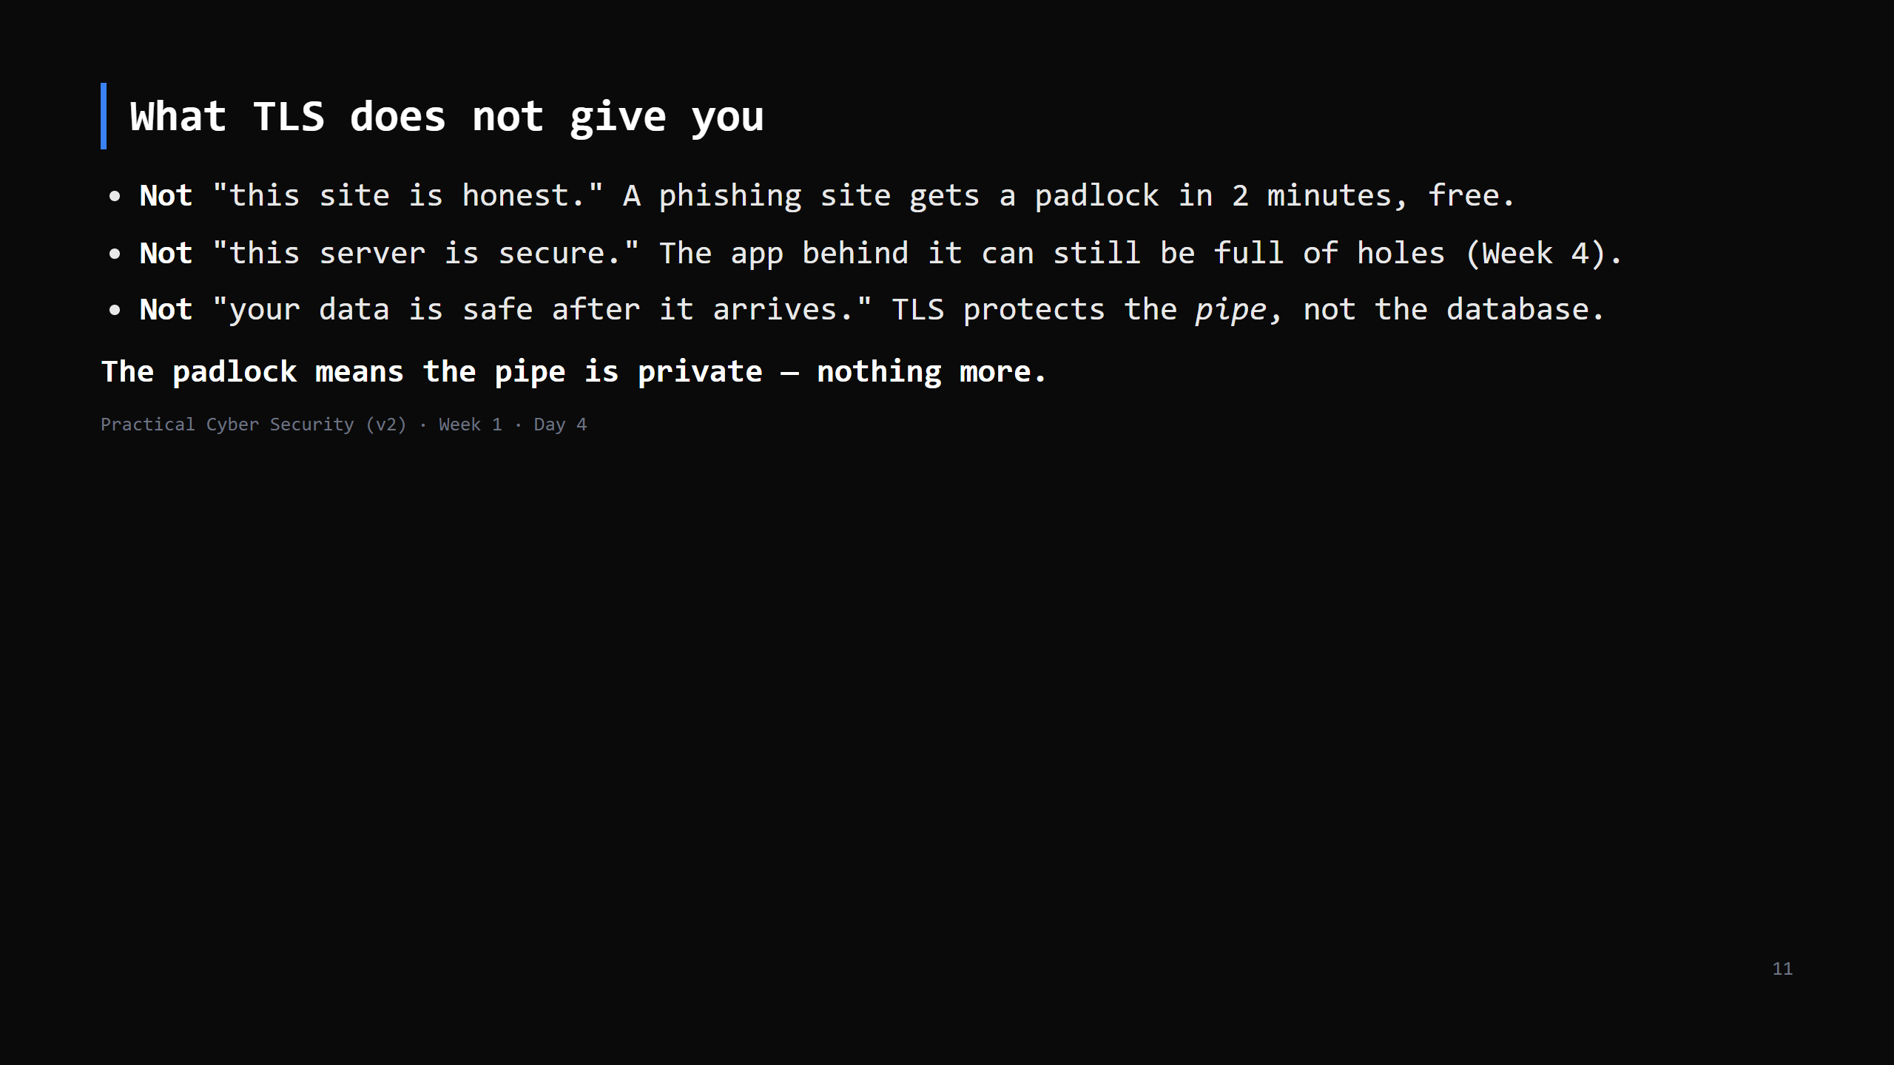
Notes:
THIS is the Day 4 trap and it's important. Students equate padlock = trustworthy. Say it twice.
Most phishing today is HTTPS. TLS answers "is anyone listening / tampering / is this the right
server" — never "should I trust this business."

Slide 12
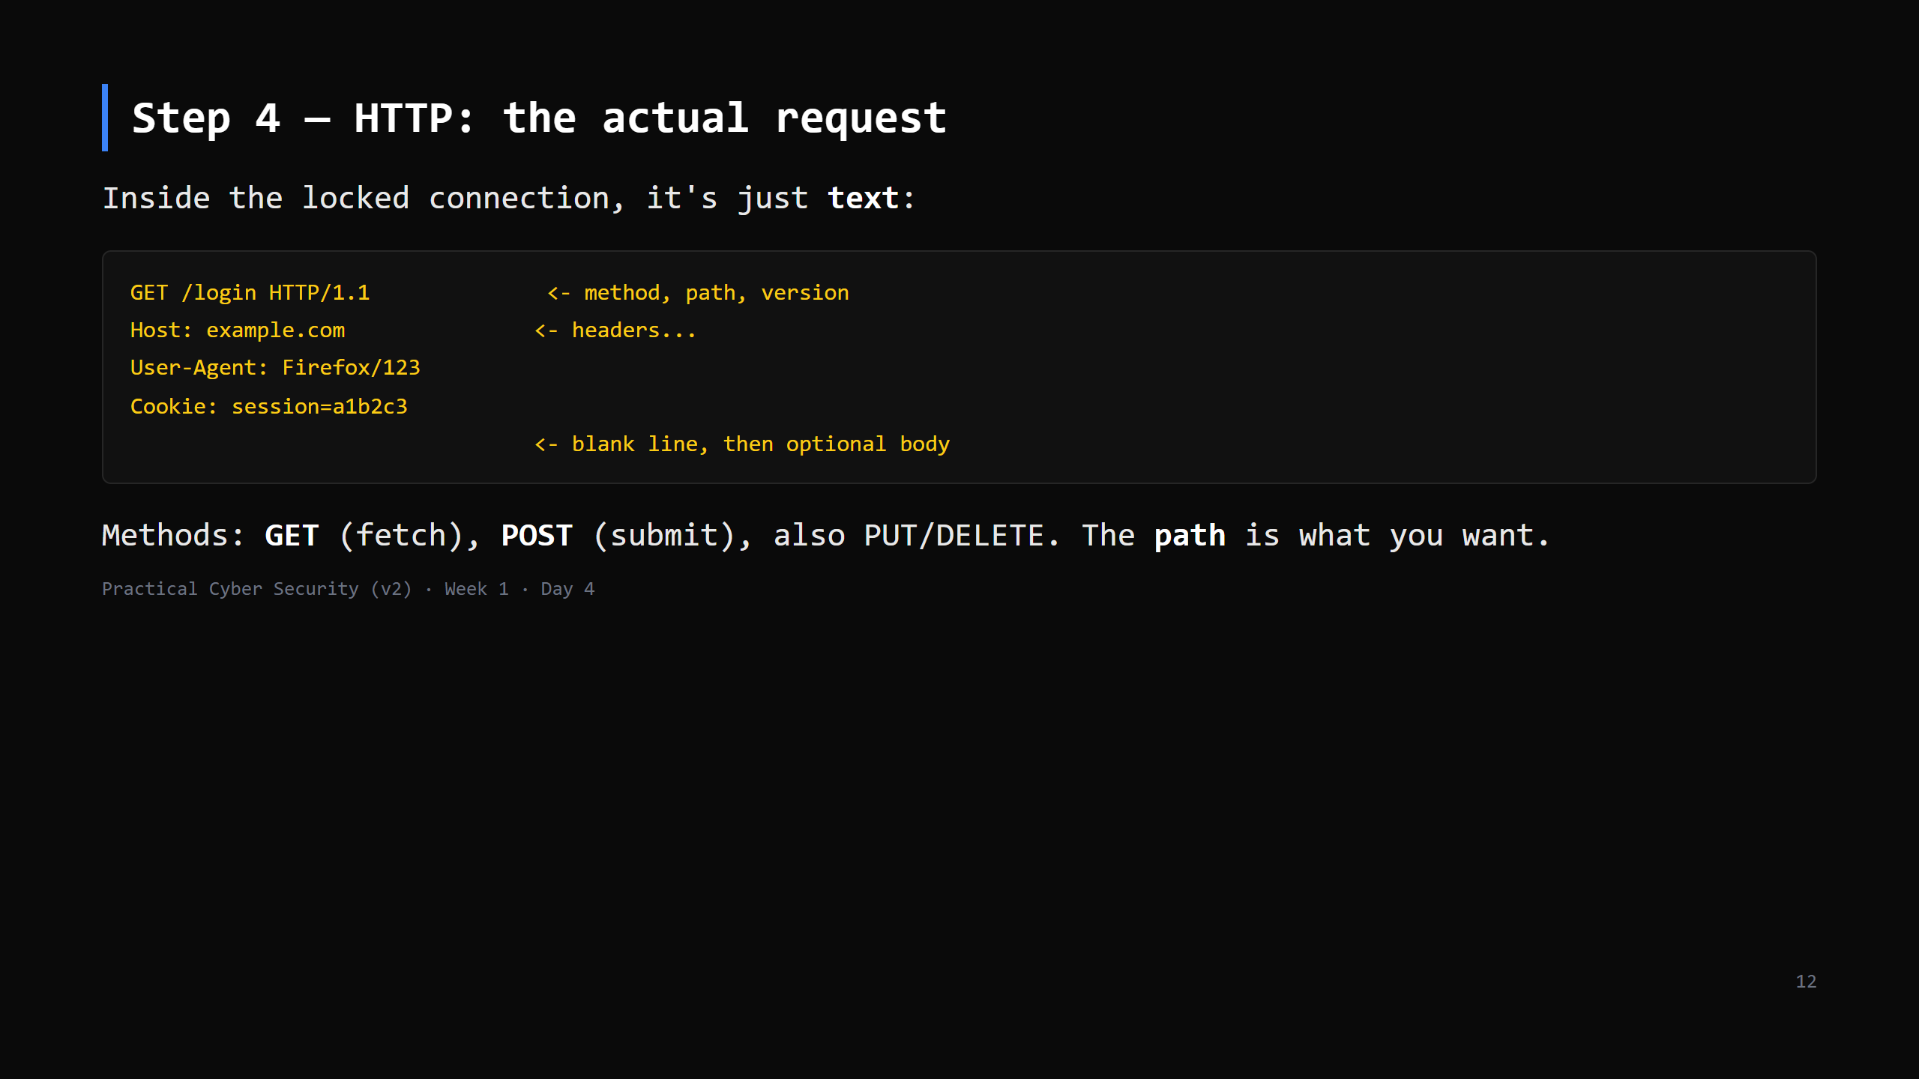
Notes:
It really is plain text — that's why hand-crafting it (next "do it now") works.
The Cookie header is the one to flag: it's how the server knows "this is the same logged-in
person" across requests. Remember it for the attack slide.

Slide 13
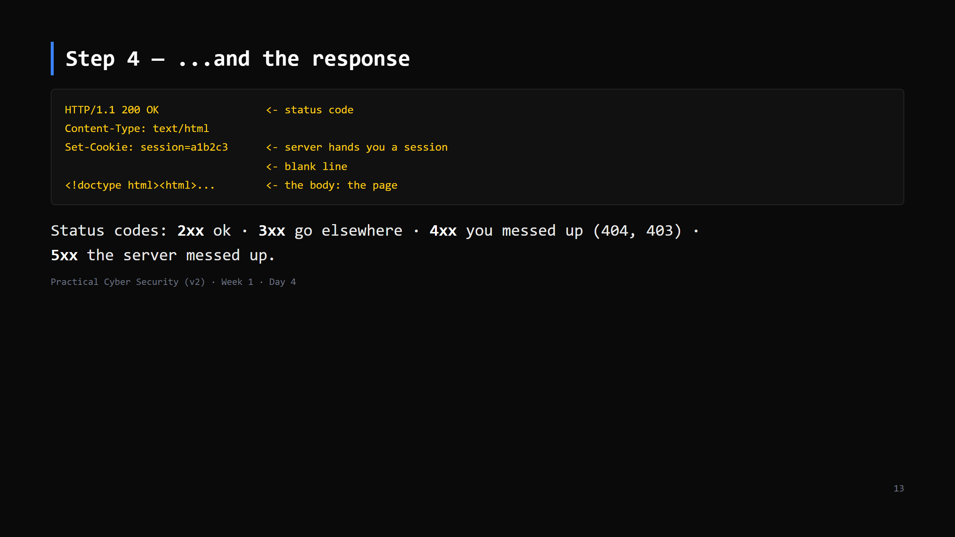
Notes:
`Set-Cookie` on the response is the server saying "wear this badge on every future request."
That badge = the session. Whoever holds it IS you, to the server. Attack slide.

Slide 14
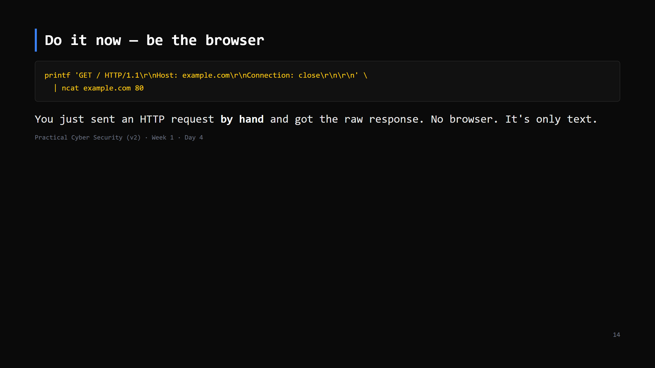
Notes:
5 min. Windows: install ncat (part of Nmap) or use PowerShell:
$c=[Net.Sockets.TcpClient]::new('example.com',80); ... (script in assets/http_by_hand.ps1)
This must be plain HTTP (port 80) — over 443 you'd get TLS binary garbage, which is the point:
"see? without the lock it's readable; with it, it's not."
Expected: a 200 or a 301 redirect to https. Reading a redirect is a fine outcome.

Slide 15
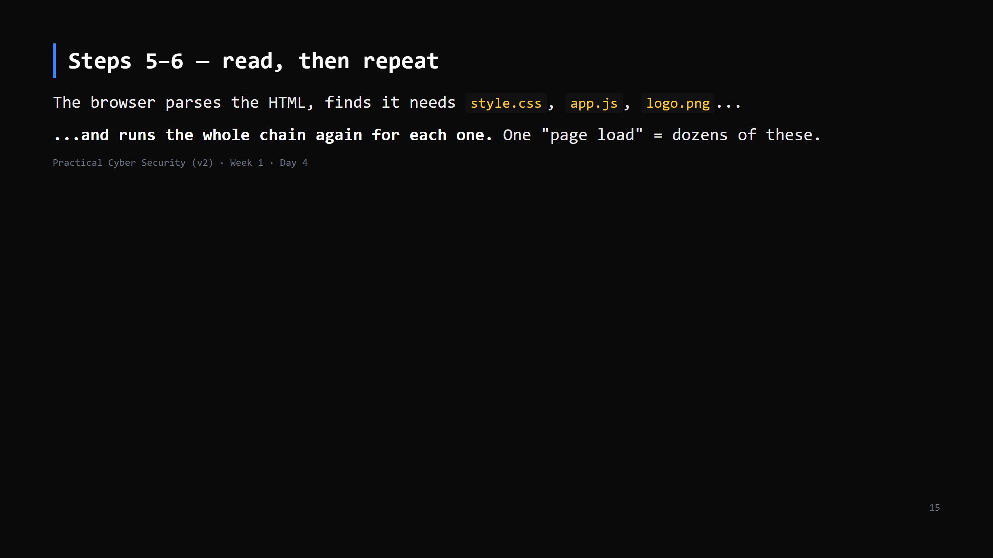
Notes:
30 seconds. Just so "7 steps" doesn't feel too clean — a real page is the chain, fanned out.
CUT this slide first if short.

Slide 16
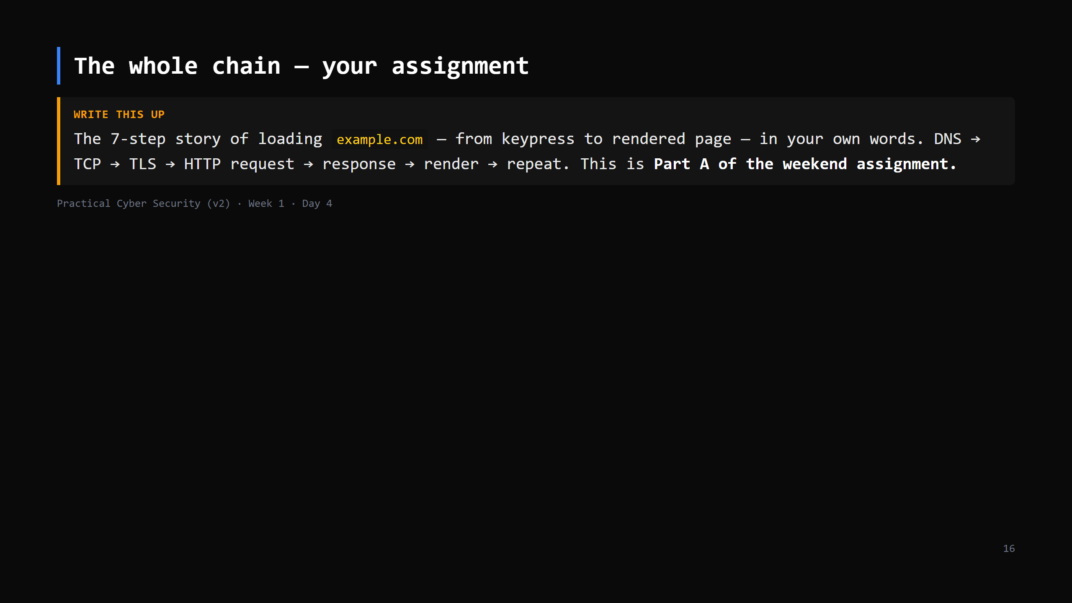
Notes:
Point at the board where the 6 steps have been ticked off all lesson. Tell them tonight's
homework is the first draft of this; Friday's briefing turns it into the full assignment.
LIVE DIAGRAM: archify/04-page-load-chain.html again — NOW click through the 4 views in order
(find / connect + lock / talk / render + repeat). The "7 steps" card on the right is the
assignment, word for word. Read the "Class check" card aloud — the padlock question is the
Day 4 trap.

Slide 17
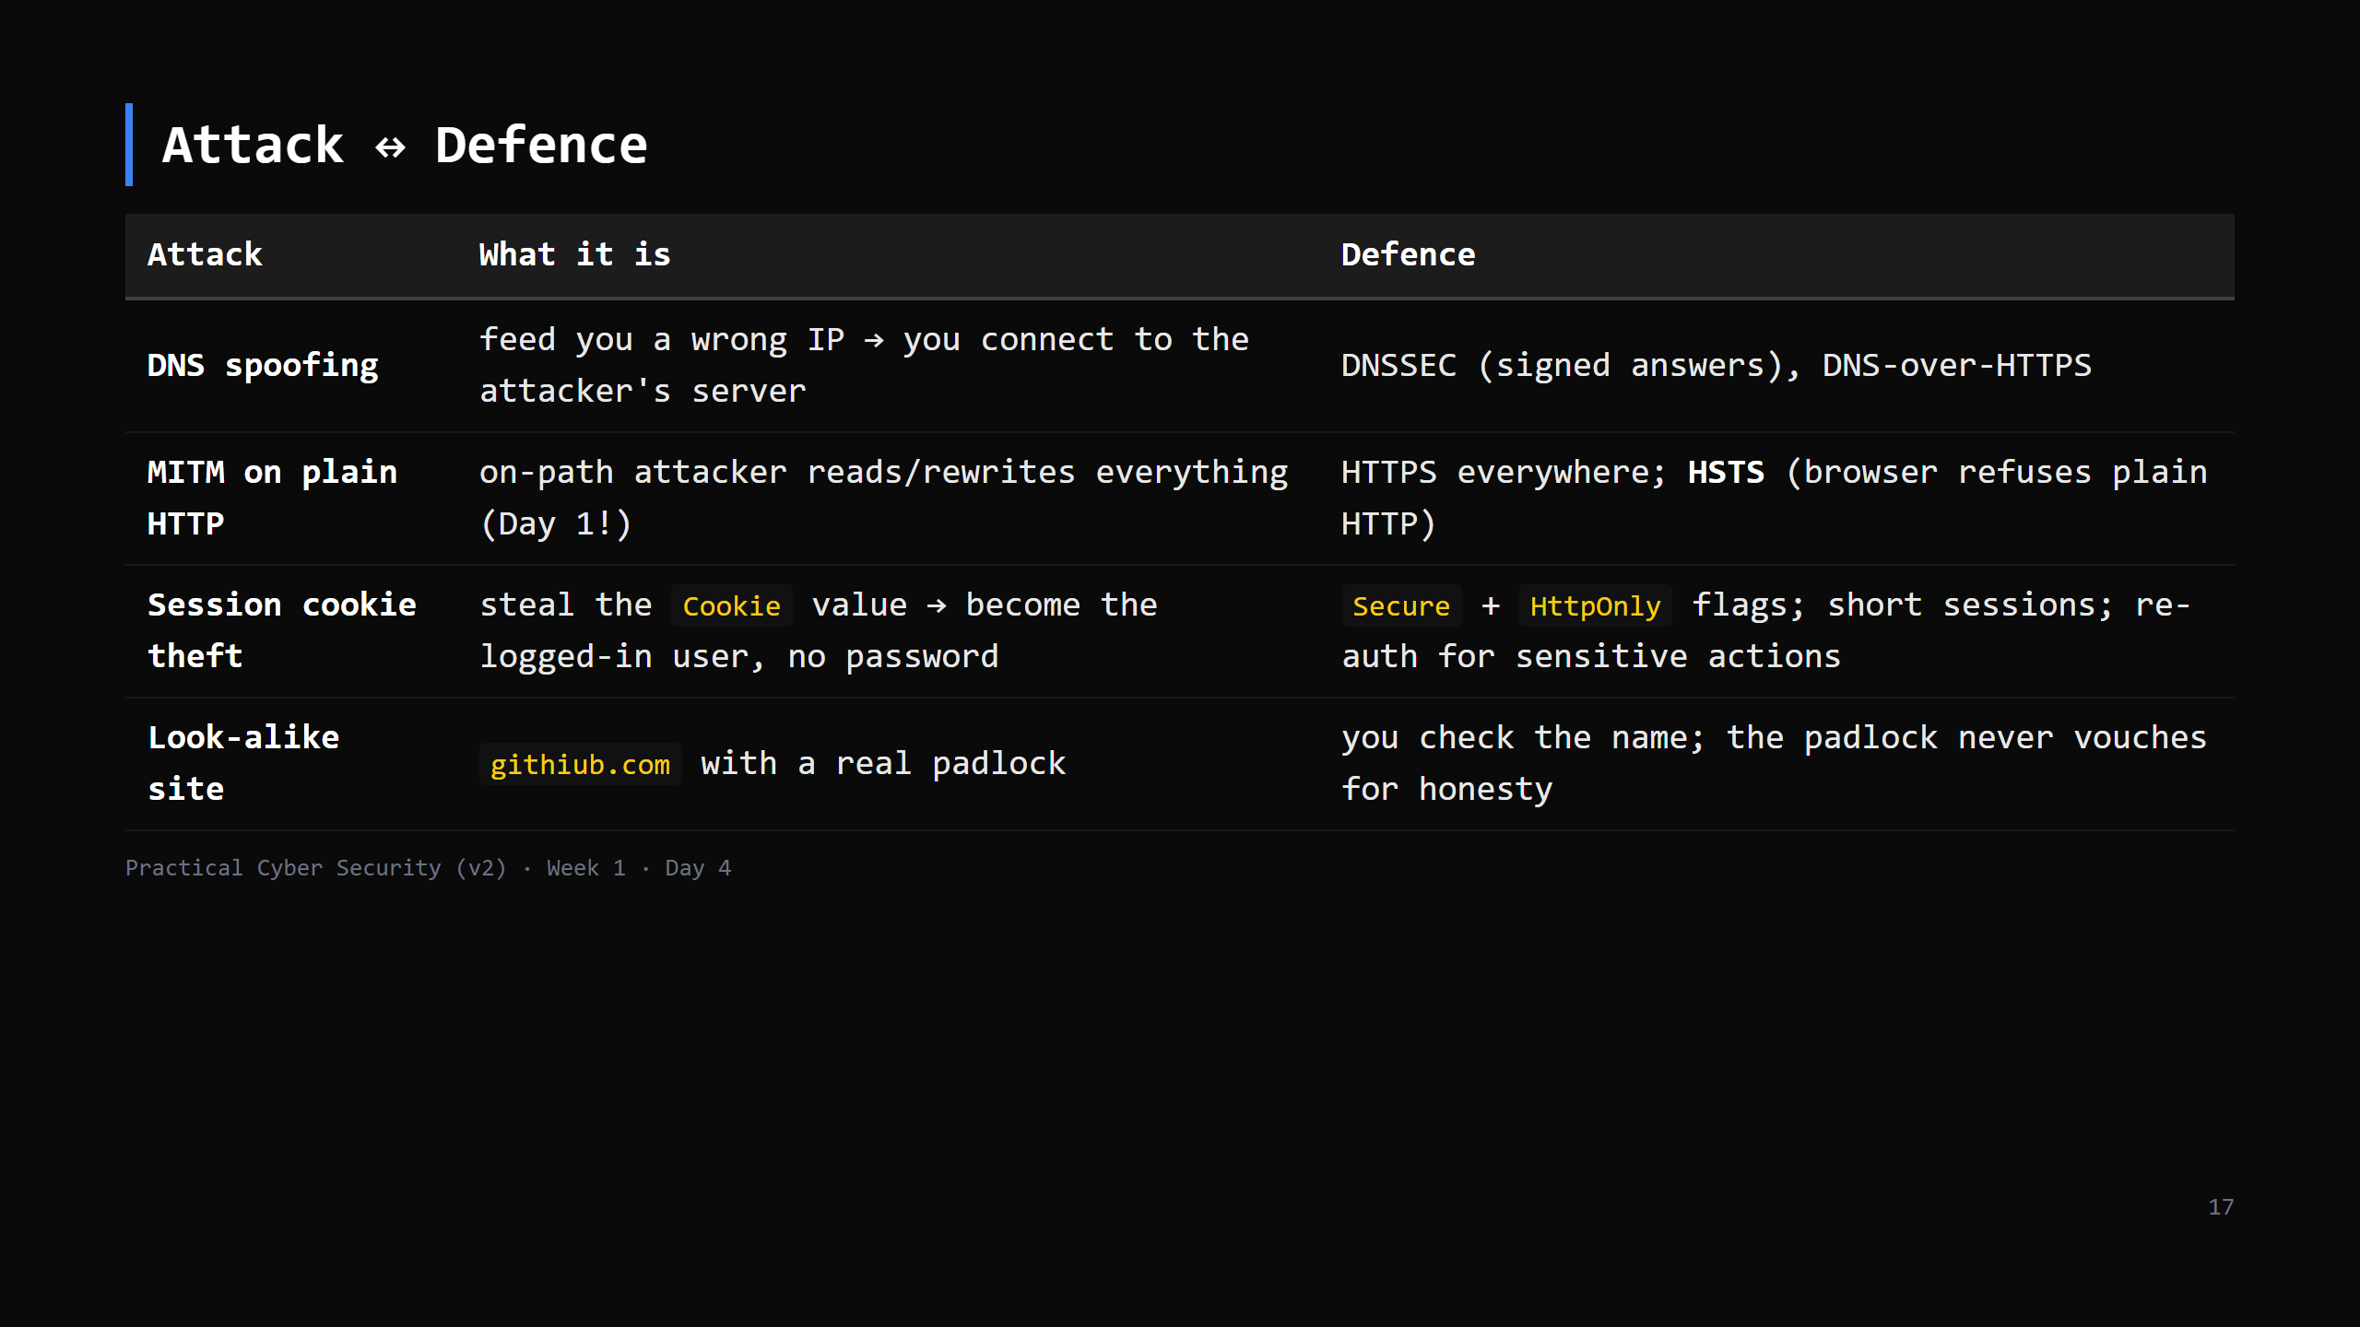
Notes:
Tie together: the Day 1 sniff = MITM on plain HTTP. The cookie theft one lands hardest —
"the password isn't the crown jewel; the session is." forward-ref Day 16 (web attacks).

Slide 18
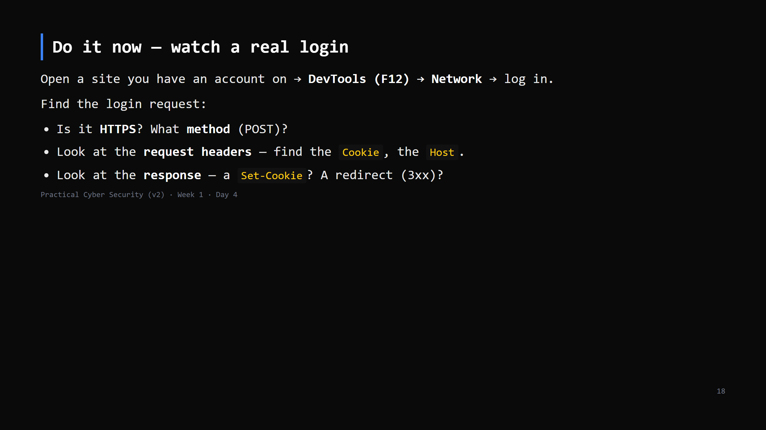
Notes:
6 min, the payoff of the whole day — every concept, live, on a site they use.
Tell them NOT to paste passwords into the class chat / screenshots for homework — blur creds.
Chrome & Firefox both: F12 -> Network, tick "Preserve log", then log in.

Slide 19
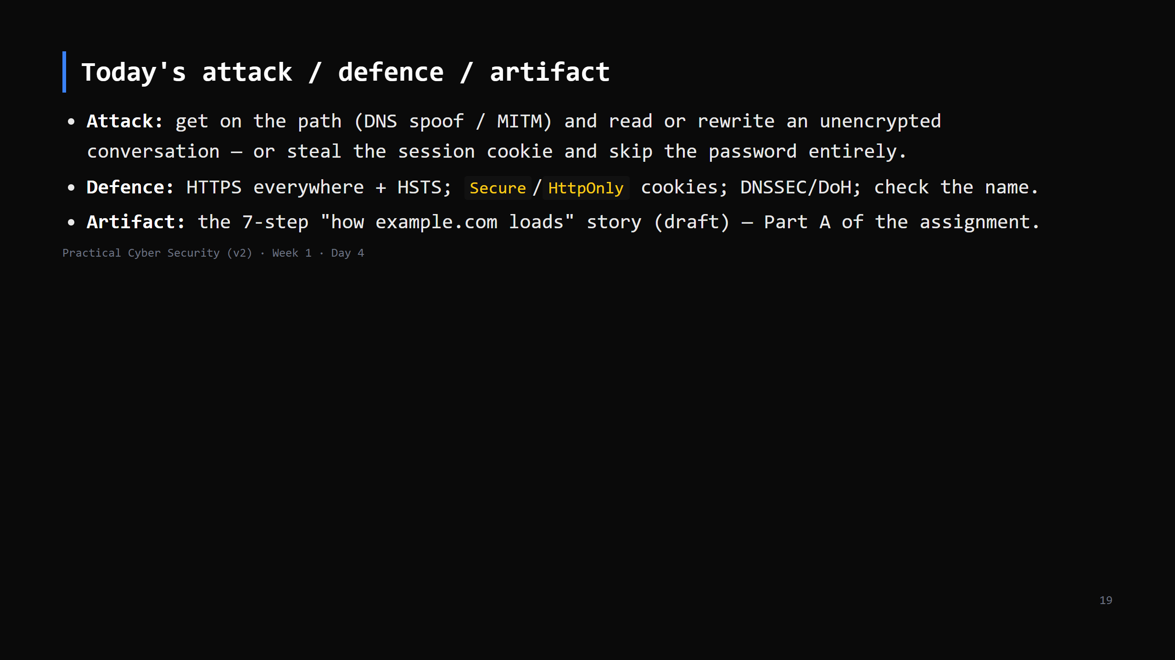

Slide 20
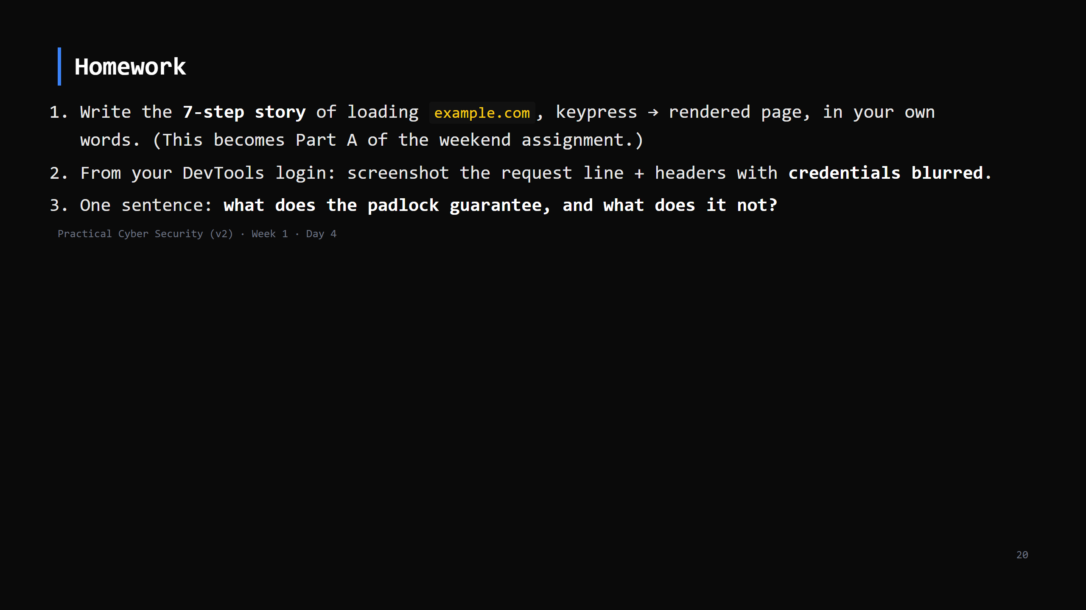
Notes:
Due start of Day 5. Day 5 (Friday) briefs the full weekend assignment.

Slide 21
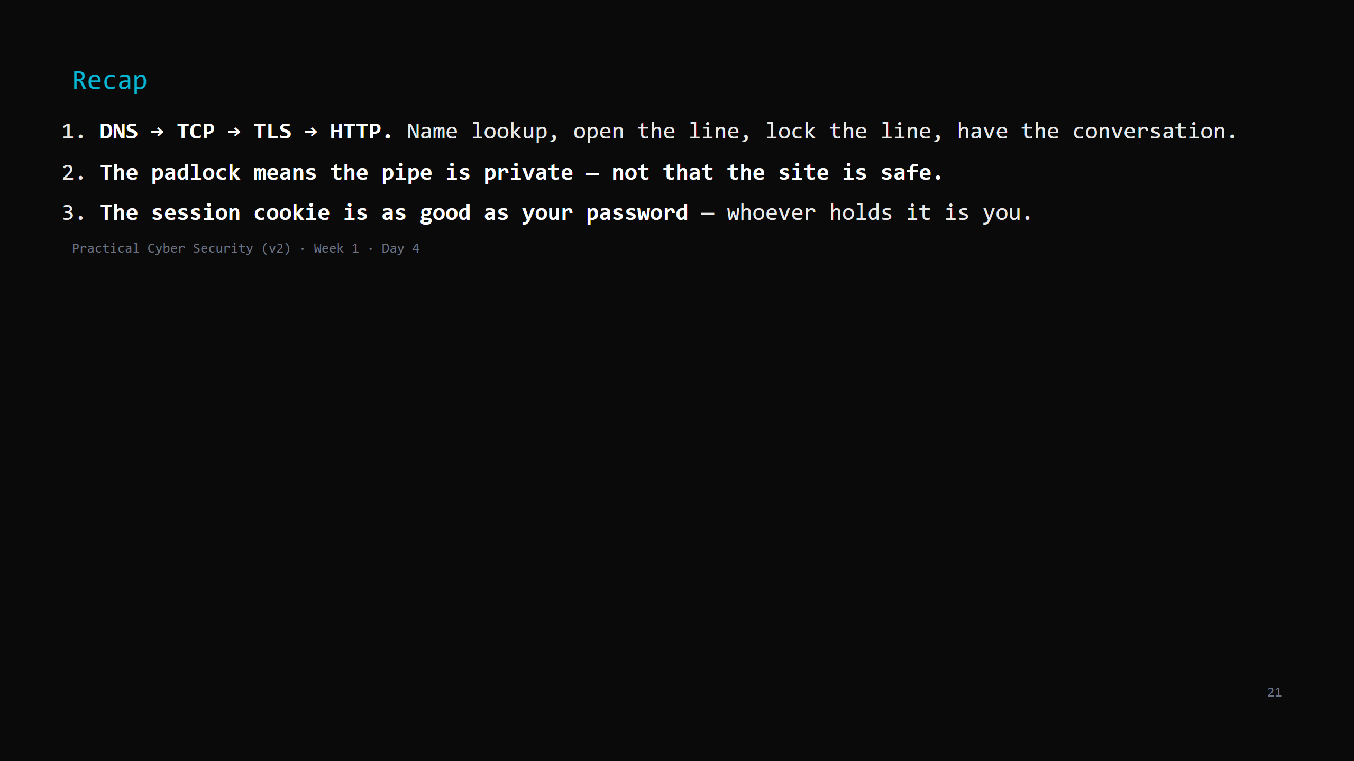
Notes:
Say the three lines. Tomorrow: how the lock actually works — hashing, keys, certificates —
and you'll crack a password hash yourself.

