Slide 1
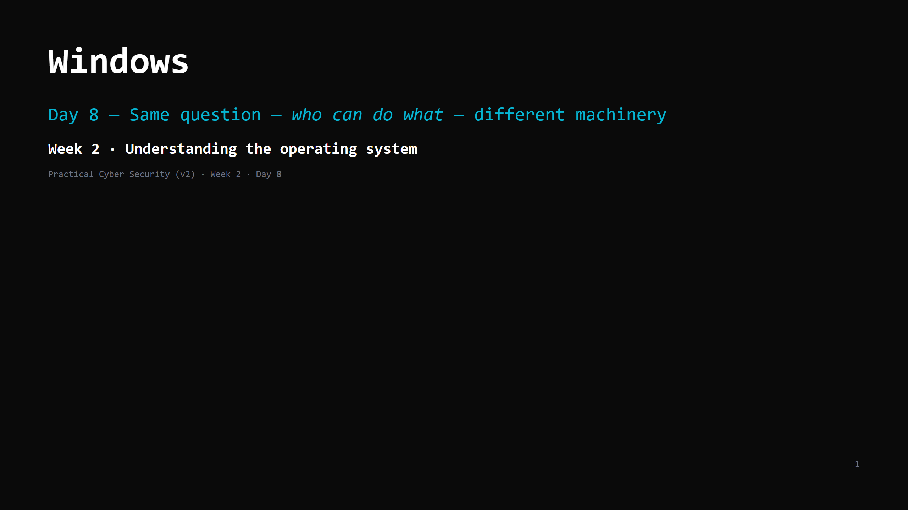
Notes:
RUN SHEET (~85 min). Hands-on INTERLEAVED. Most students are ON Windows — native for them. 00:00 Journey check + hook (whoami /all) 4 00:04 Same question, different answers (the mapping) 4 00:08 Accounts, groups, SIDs 7 00:15 DO: who am I 5 00:20 Admin vs standard + UAC 7 00:27 NTFS permissions / ACLs 7 00:34 DO: read an ACL with icacls 5 00:39 The registry 7 00:46 DO: peek at a Run key 4 00:50 Services & Scheduled Tasks 5 00:55 PowerShell — the real interface (not cmd+colours) 7 01:02 DO: a 3-line PowerShell pipeline 5 01:07 Active Directory — one slide 4 01:11 Attack <-> defence 6 01:17 Wrap + artifact + homework 4 CUT FIRST IF SHORT: the SID detail; Scheduled Tasks (name it, "= Windows cron"); the AD slide to two sentences. NEVER CUT: the Linux->Windows mapping, admin/UAC, ACLs, "PowerShell pipes objects", the Run-key persistence idea, the artifact. ANALOGY (kitchen / key cabinet from Day 7): same key cabinet, labels written in a more detailed system — ID badges (tokens/SIDs), a full guest-list per door (ACL), UAC = "show the badge again for the big doors", the registry = the master binder of every setting, AD = one HR department issuing badges for every building in the company. NON-WINDOWS STUDENTS: pair with a Windows neighbour, use the shared Windows box (RDP), or follow on the projector. Every command here is read-only.

Slide 2
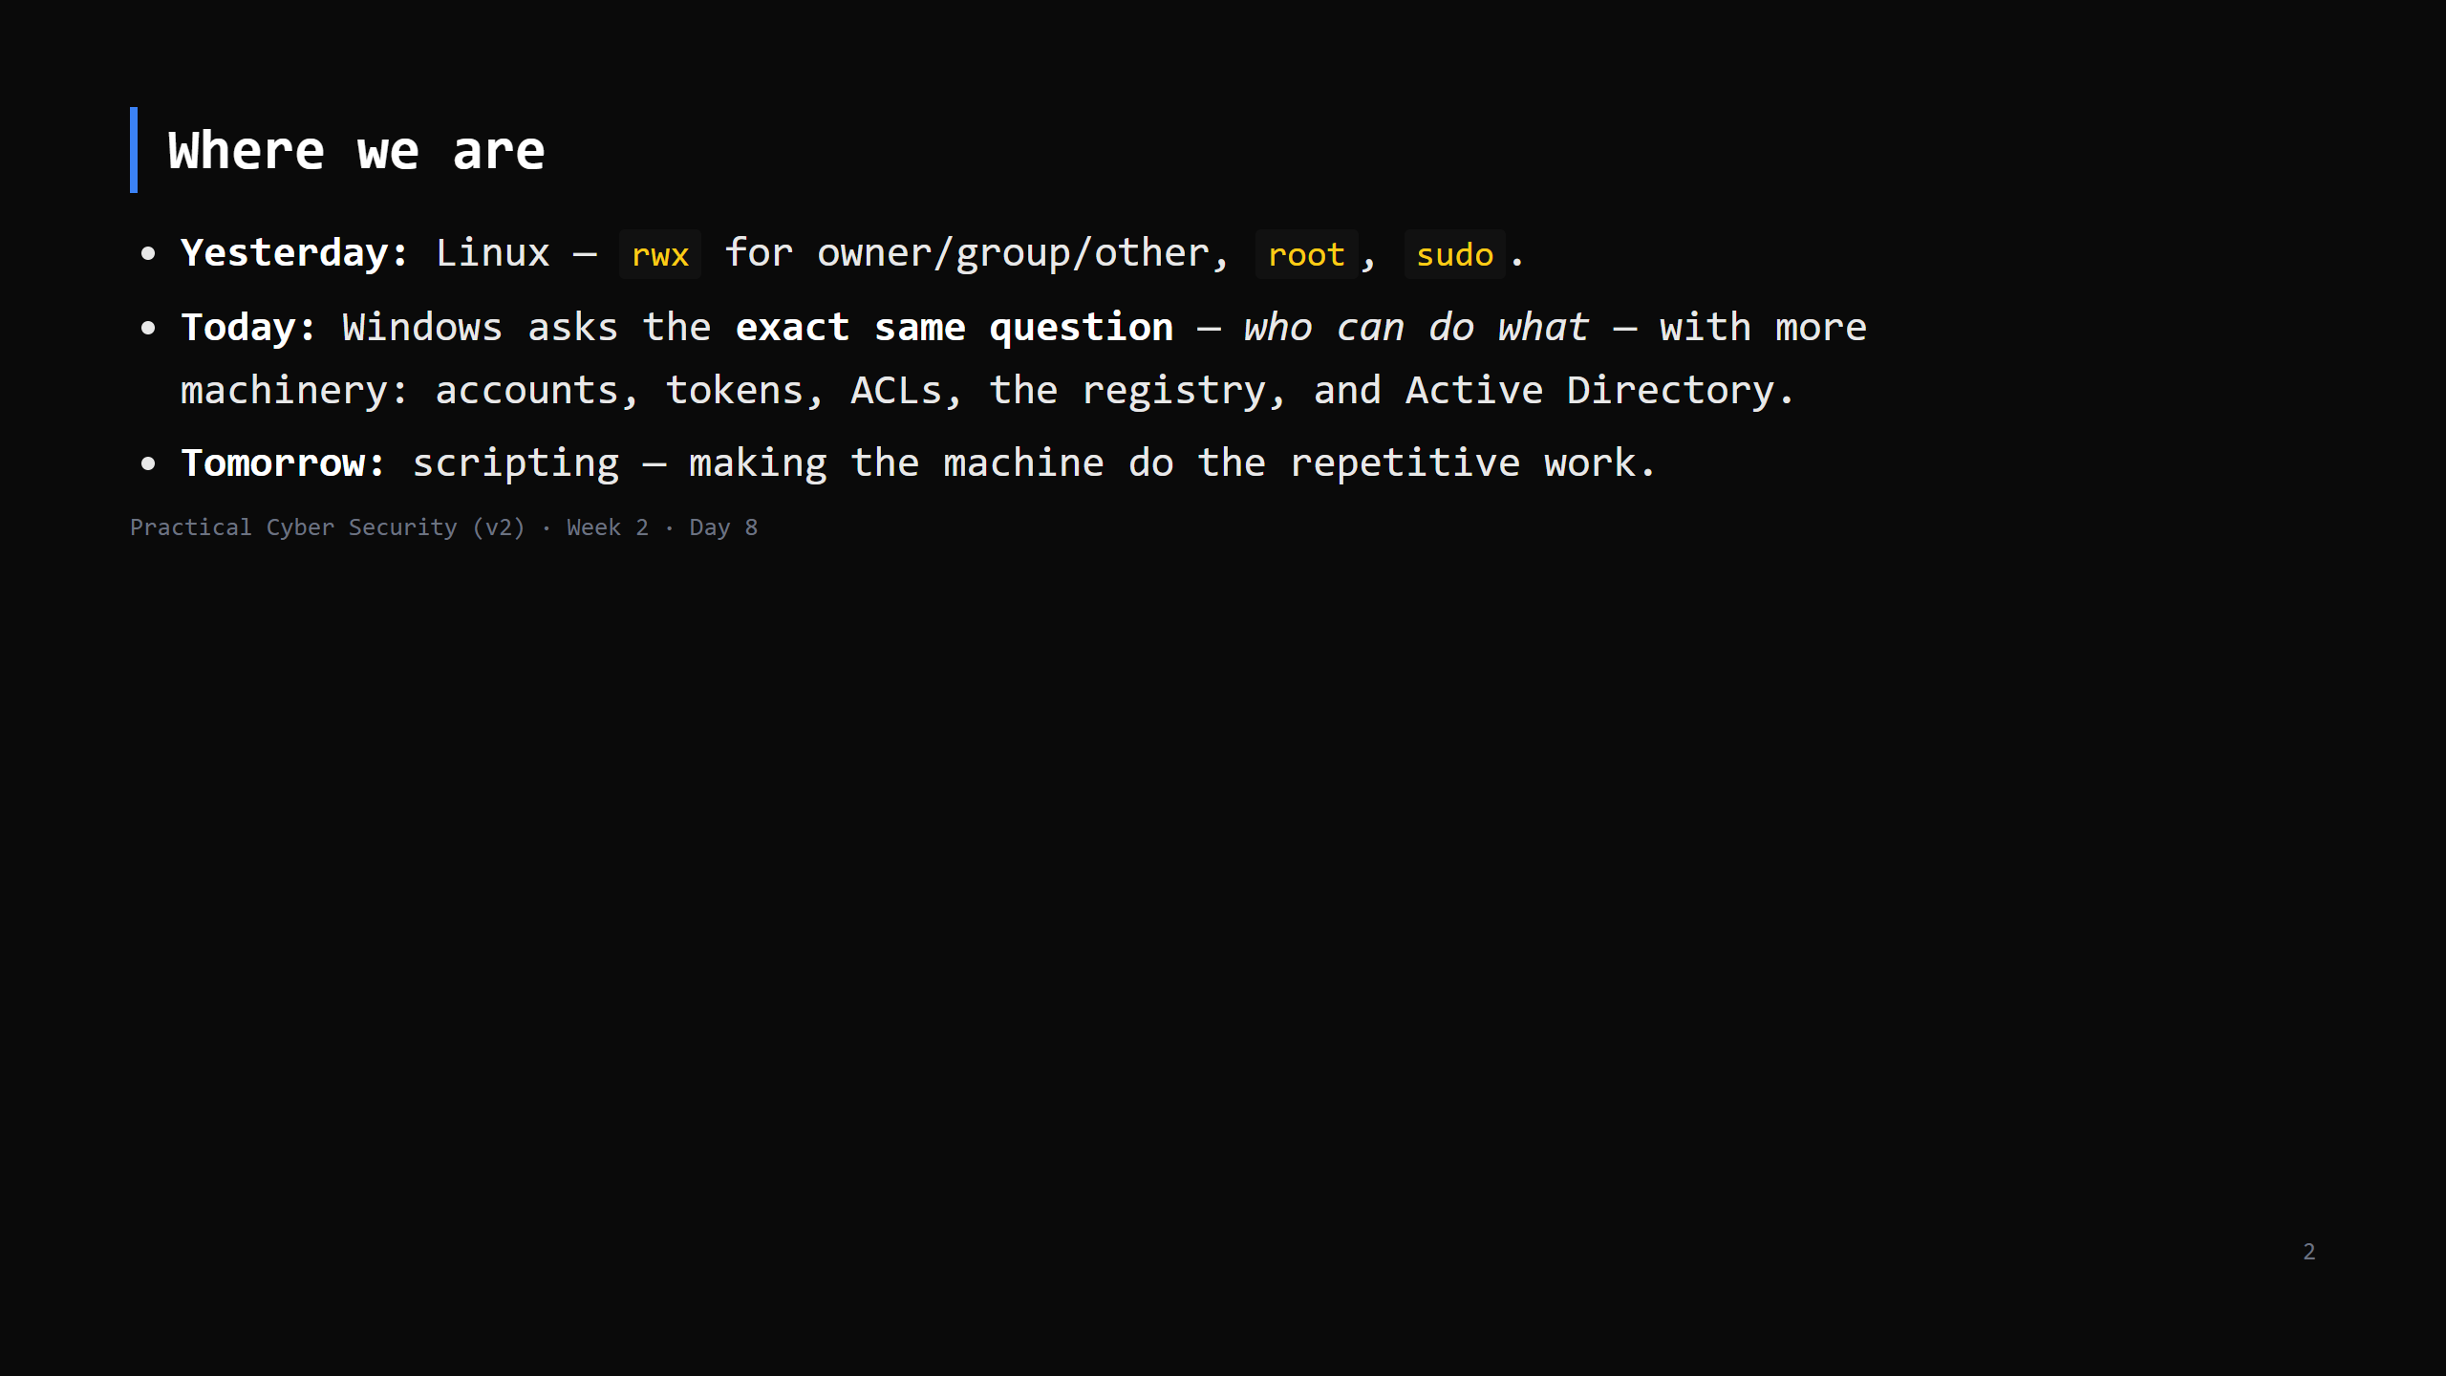
Notes:
Learning Journey Check. Frame today as TRANSLATION, not a whole new world. Every Windows idea maps to something they learned yesterday.

Slide 3
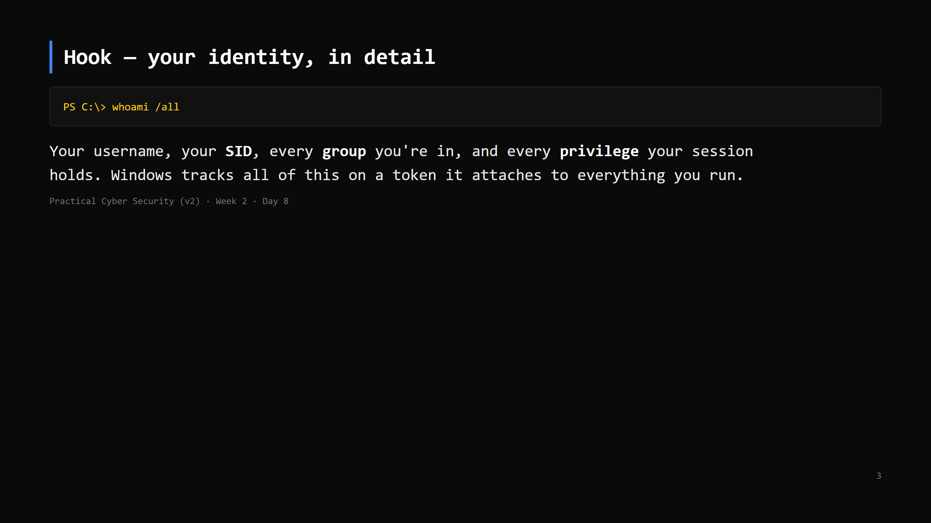
Notes:
Run it. It's a wall of output — point at the three sections: User, Groups, Privileges. "Linux had uid + groups. Windows has all this, on a token, checked on every action."

Slide 4
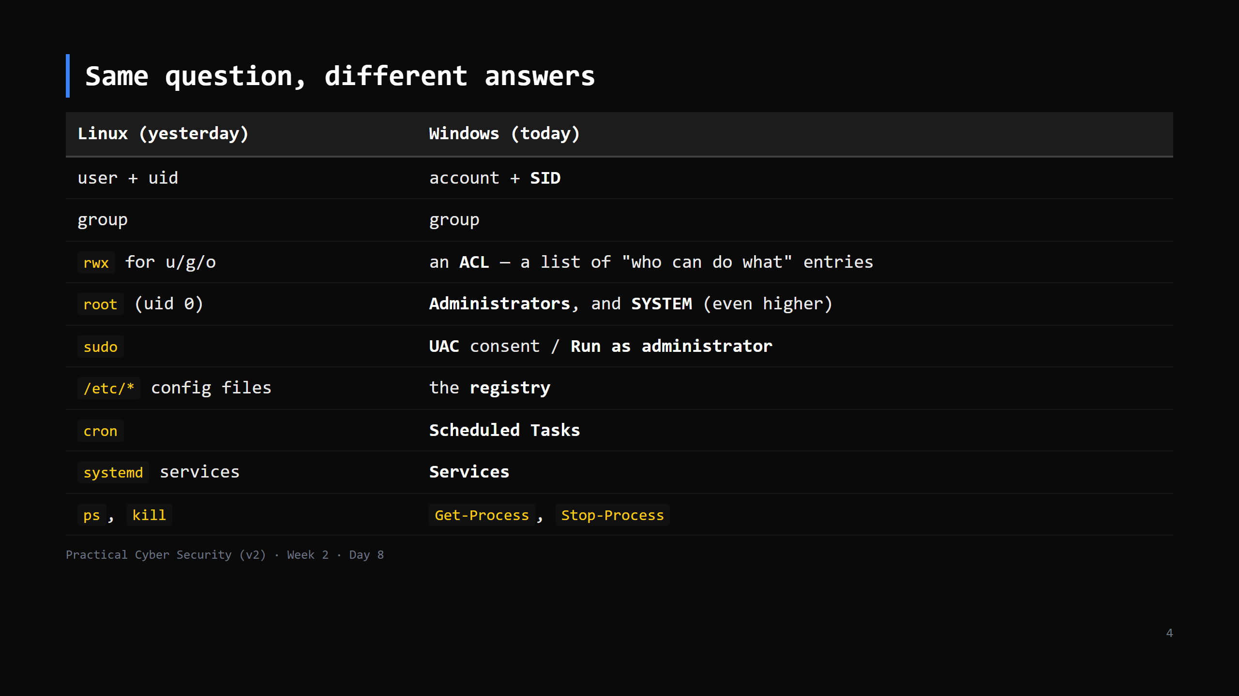
Notes:
This slide is the map for the whole lesson. Keep it up / refer back. The right column is just "the Windows word for a thing you already understand."

Slide 5
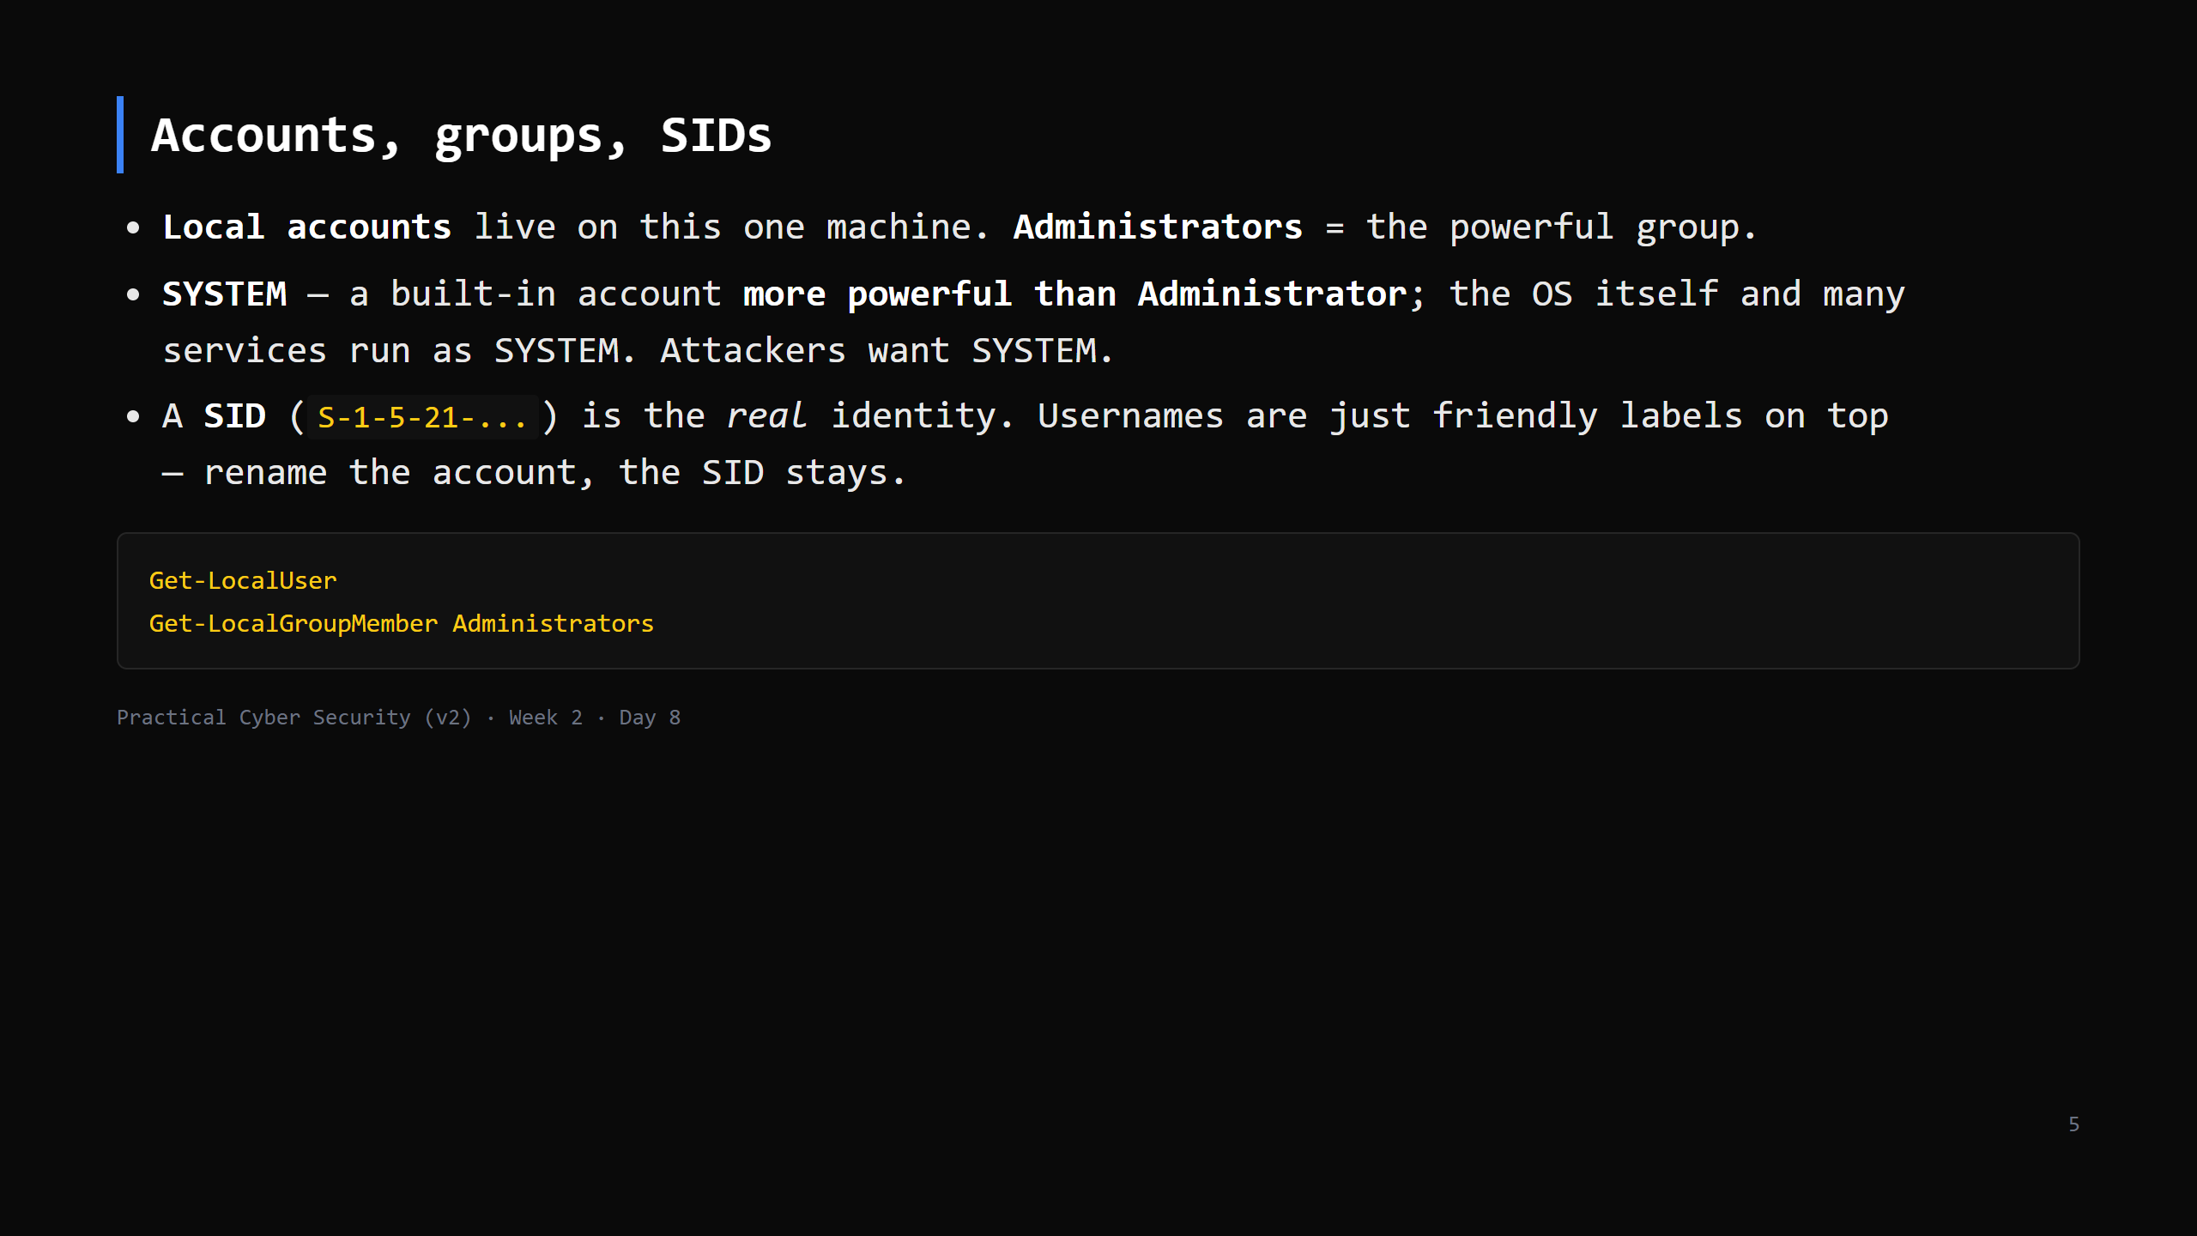
Notes:
The SYSTEM > Administrator point surprises people and matters: "get admin" is often a stepping stone to "get SYSTEM". SIDs matter because permissions are stored against SIDs, not names — deleting and recreating "Alice" gives a new SID and none of the old access. CUT SID detail first if short.

Slide 6
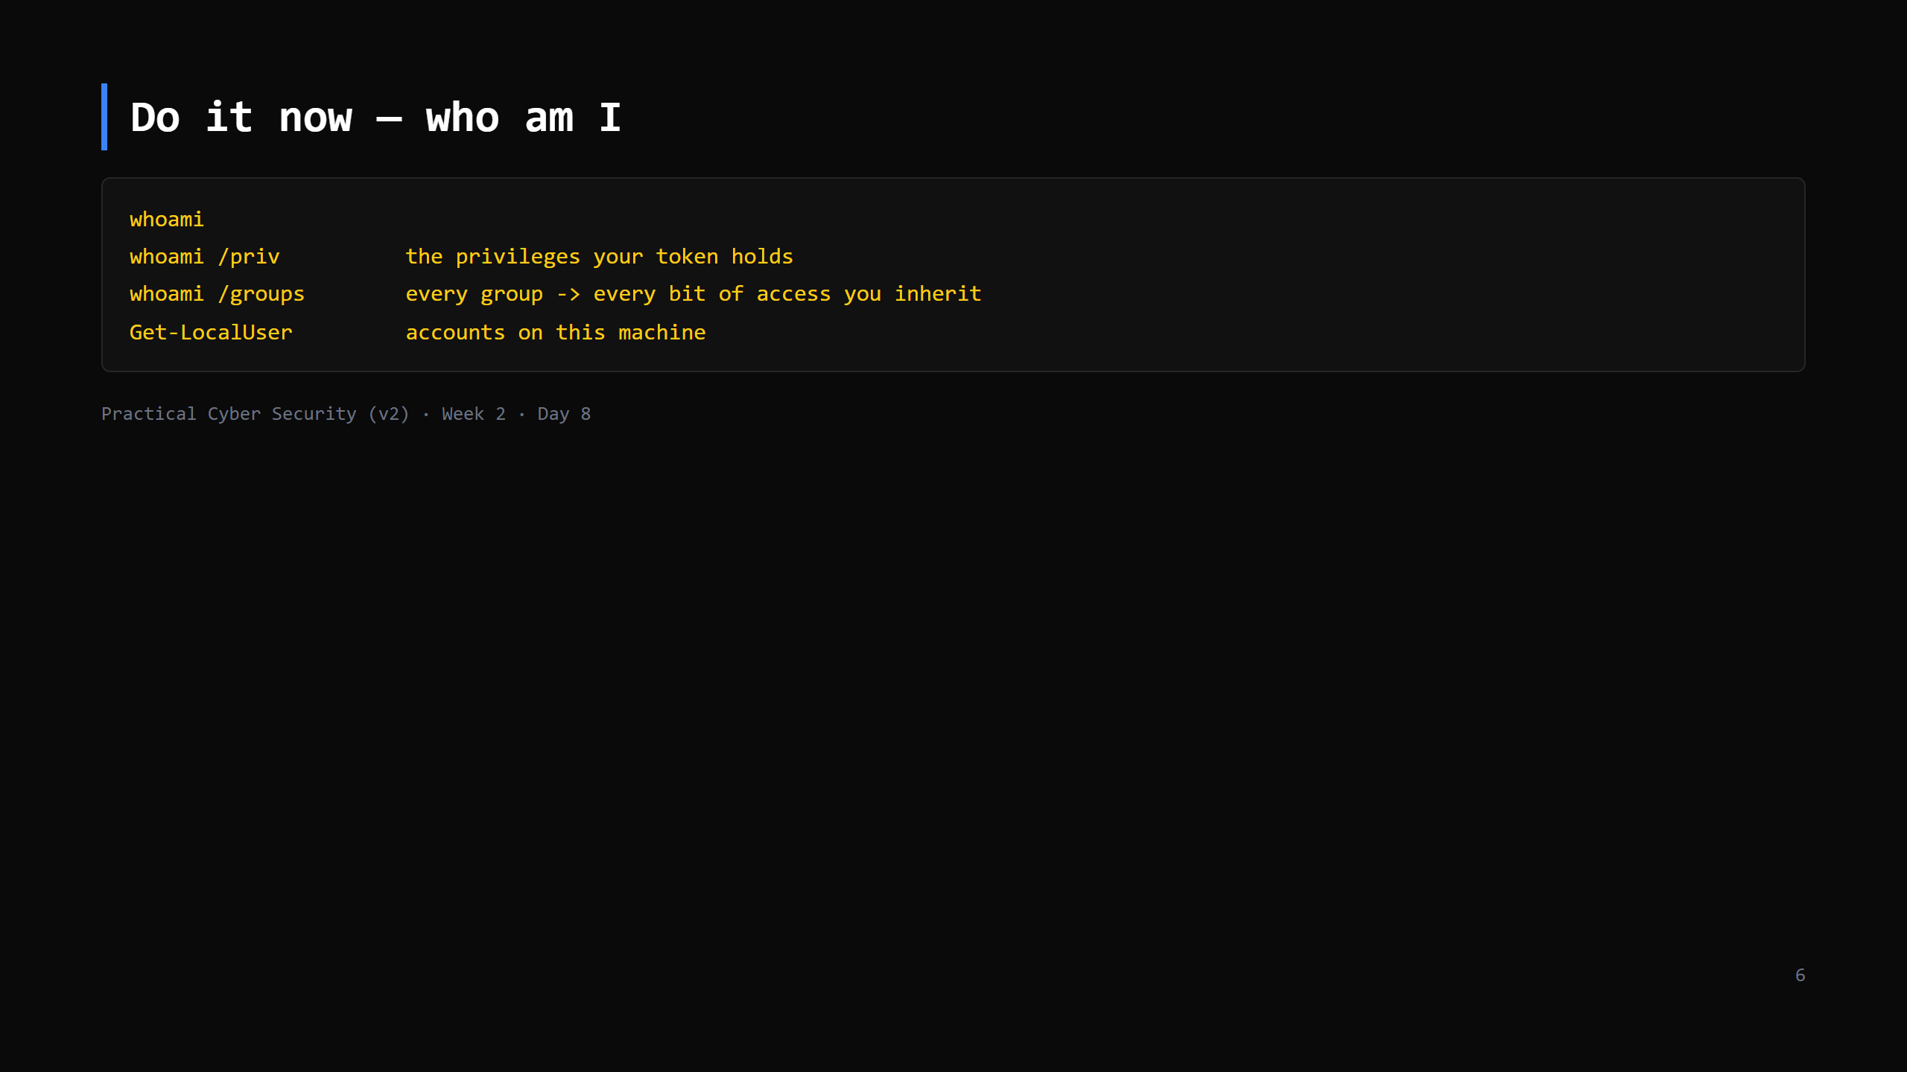
Notes:
5 min. `whoami /priv` — most are "Disabled" until a program needs them. SeDebugPrivilege, SeBackupPrivilege etc. are the dangerous ones (can read any process / any file) — note, don't dwell.

Slide 7
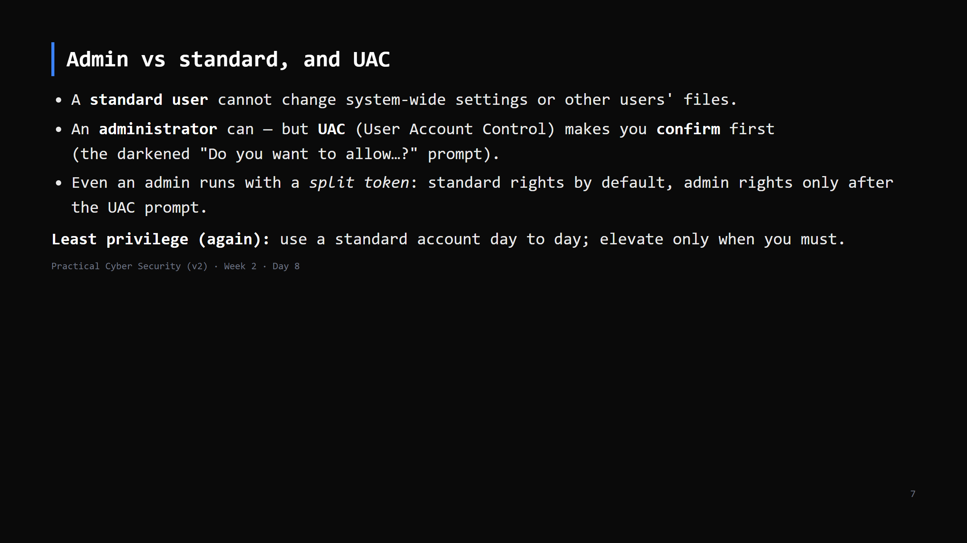
Notes:
Same lesson as Day 7's "don't live as root". UAC is not a security boundary Microsoft guarantees, but it stops silent privilege use and casual mistakes. Malware's goal: run something with admin WITHOUT triggering UAC ("UAC bypass") — name it.

Slide 8
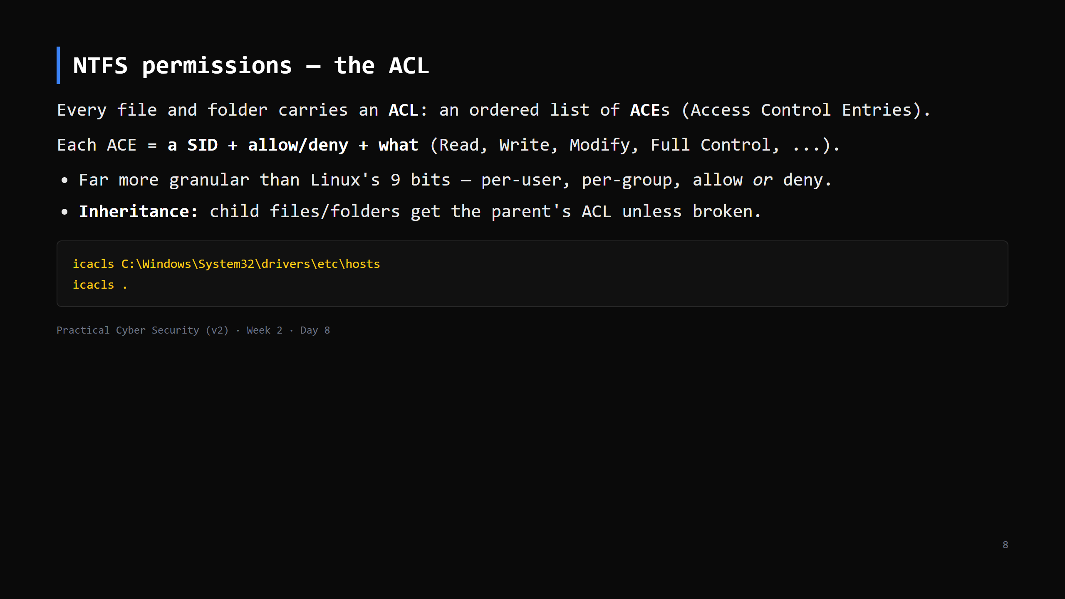
Notes:
`icacls` output codes: (F) full, (M) modify, (RX) read+execute, (R) read, (W) write; (I) = inherited. `BUILTIN\Users:(RX)` etc. The `hosts` file is a nice example — Users can read, only Administrators can write (it's a tampering target — Day 4 DNS).

Slide 9
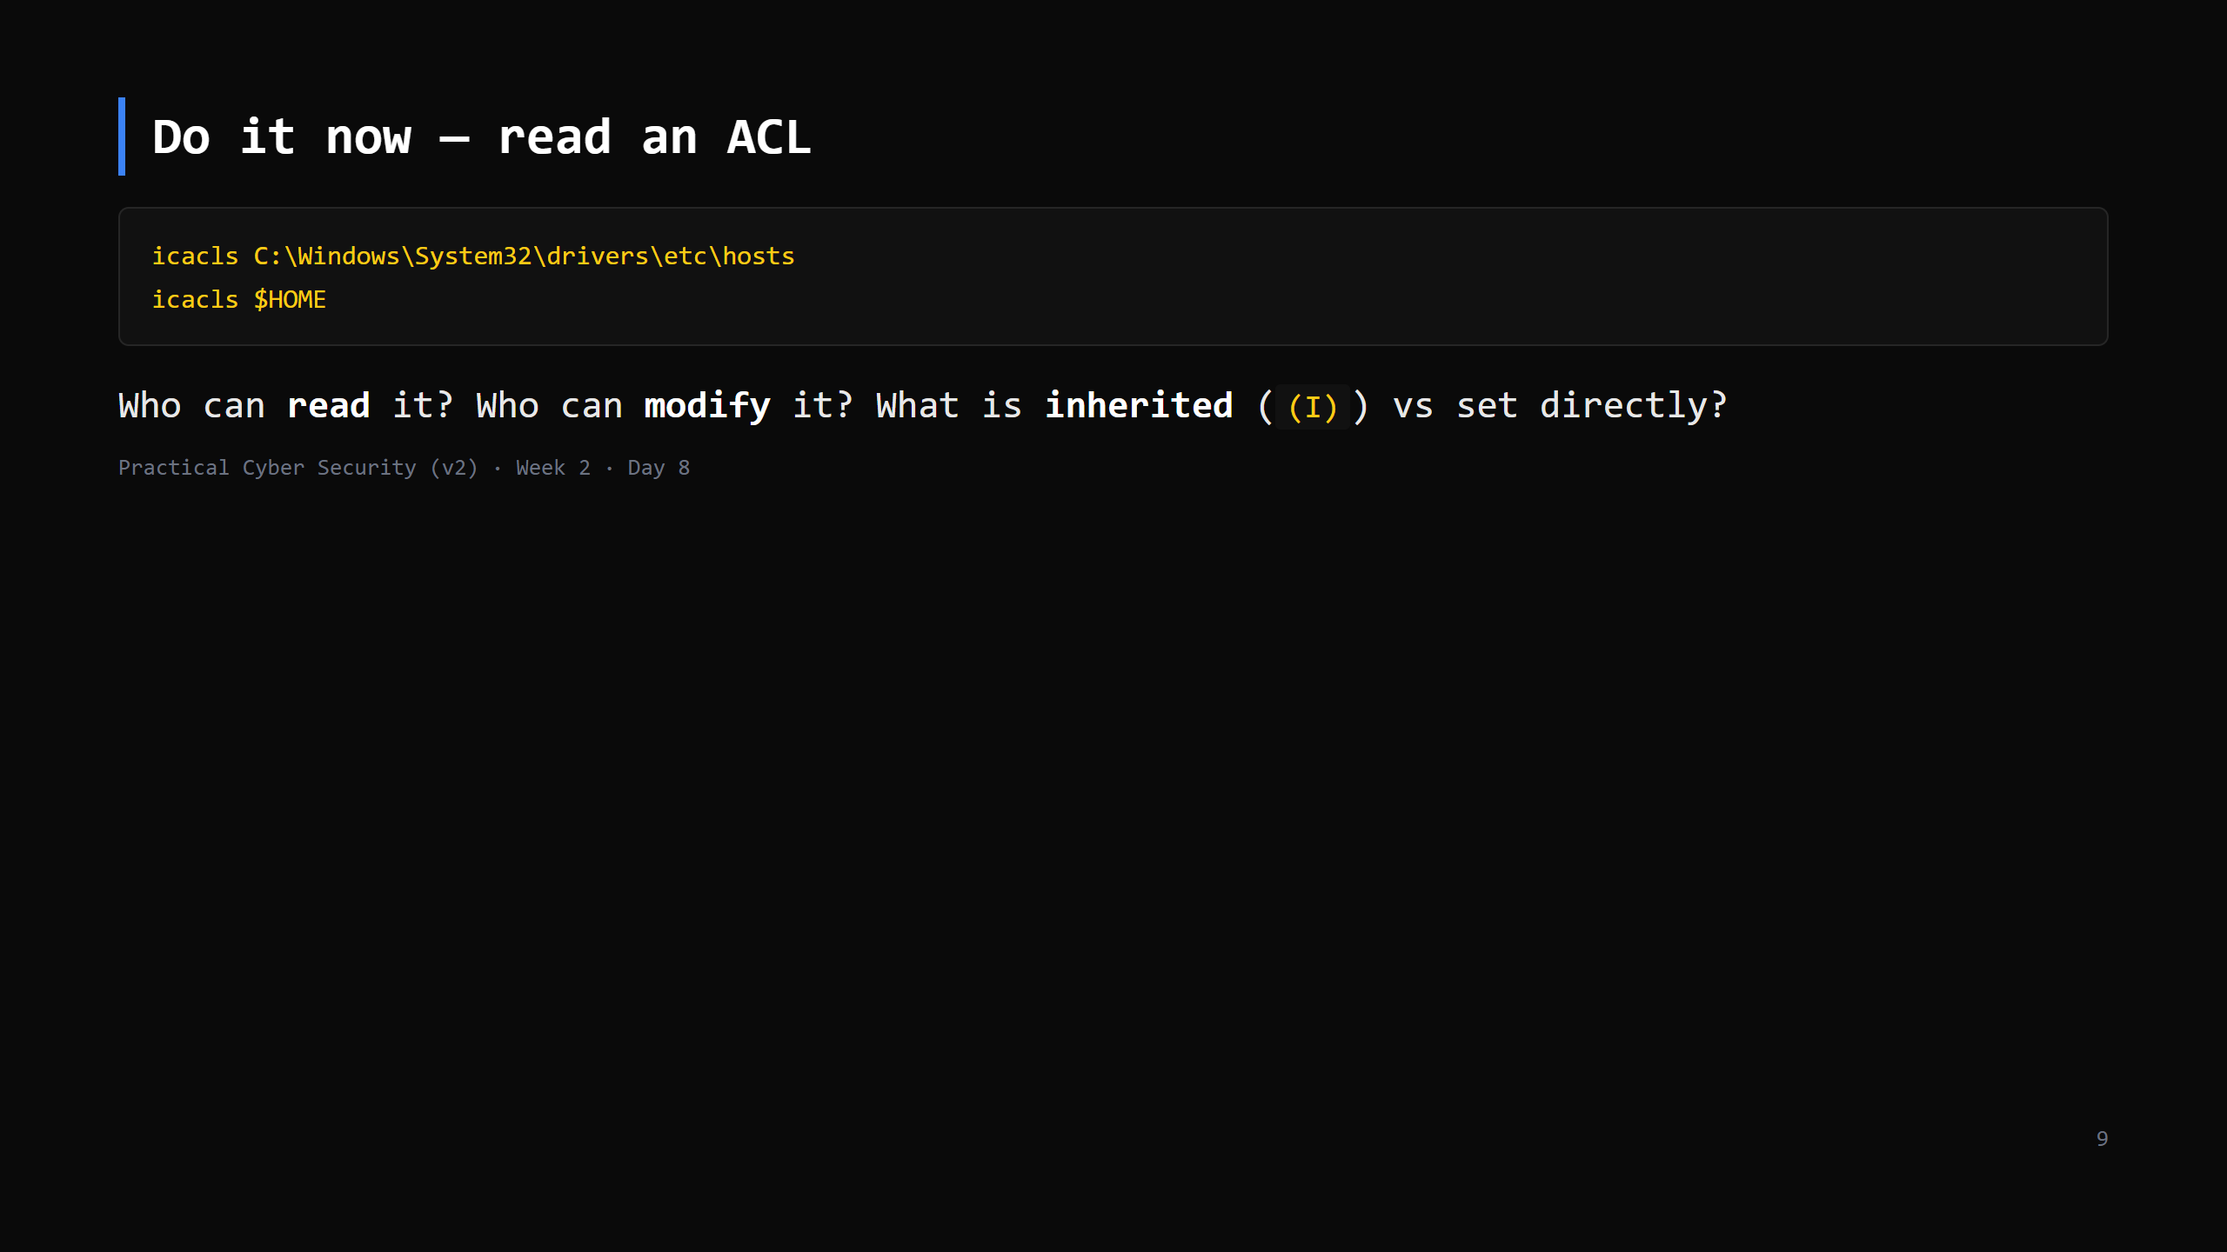
Notes:
5 min. On the hosts file: everyone reads, only admins/SYSTEM modify. On their home folder: themselves + SYSTEM + Administrators, full control, inherited. Contrast out loud with yesterday's `ls -l` — same information, more detail.

Slide 10
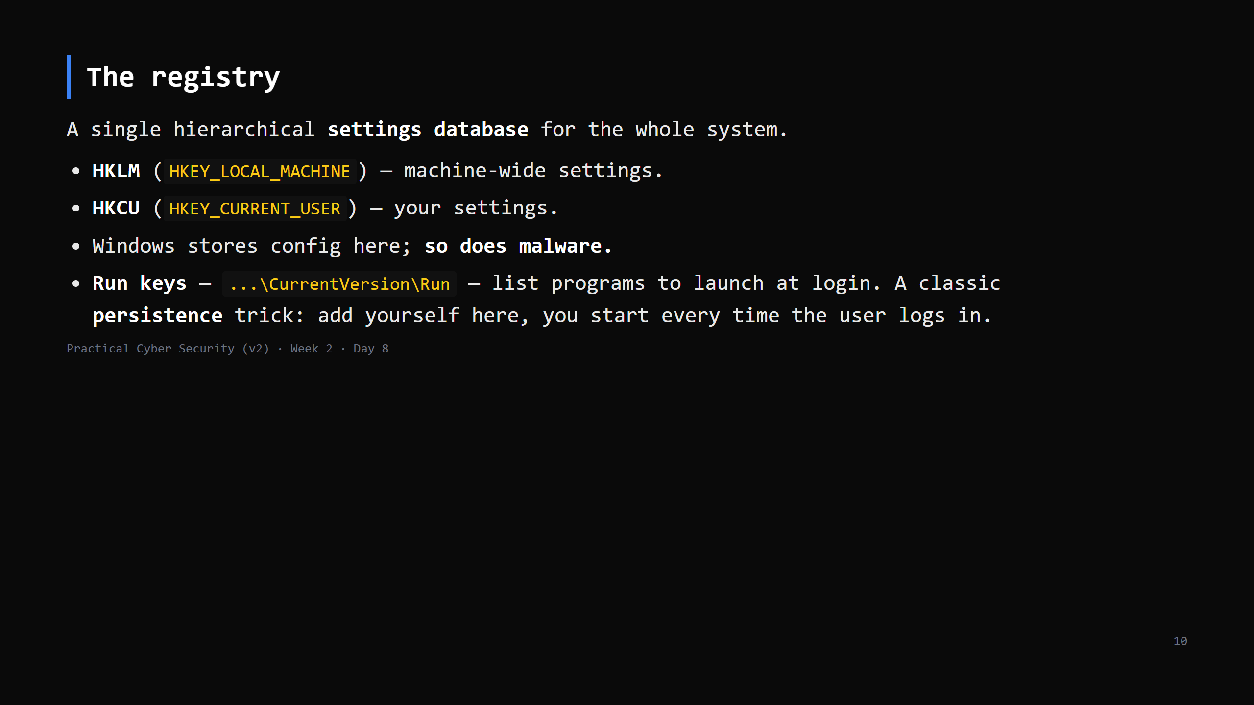
Notes:
Analogy: the master binder of every setting in the building. `regedit` is the GUI; `Get-ItemProperty` / `reg query` on the CLI. "Persistence" = how an attacker survives a reboot. Run keys, Services, Scheduled Tasks are the top 3 — all things we're covering today. That's not a coincidence.

Slide 11
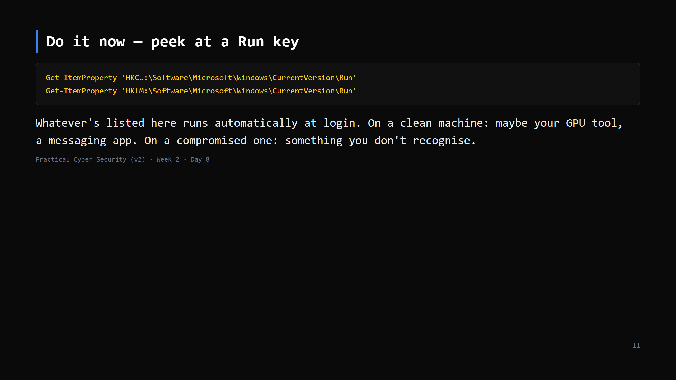
Notes:
4 min. Read-only. If a student sees something odd, that's a teachable moment, not necessarily malware (lots of legit software uses Run keys). "Investigate, don't panic" — Day 19.

Slide 12
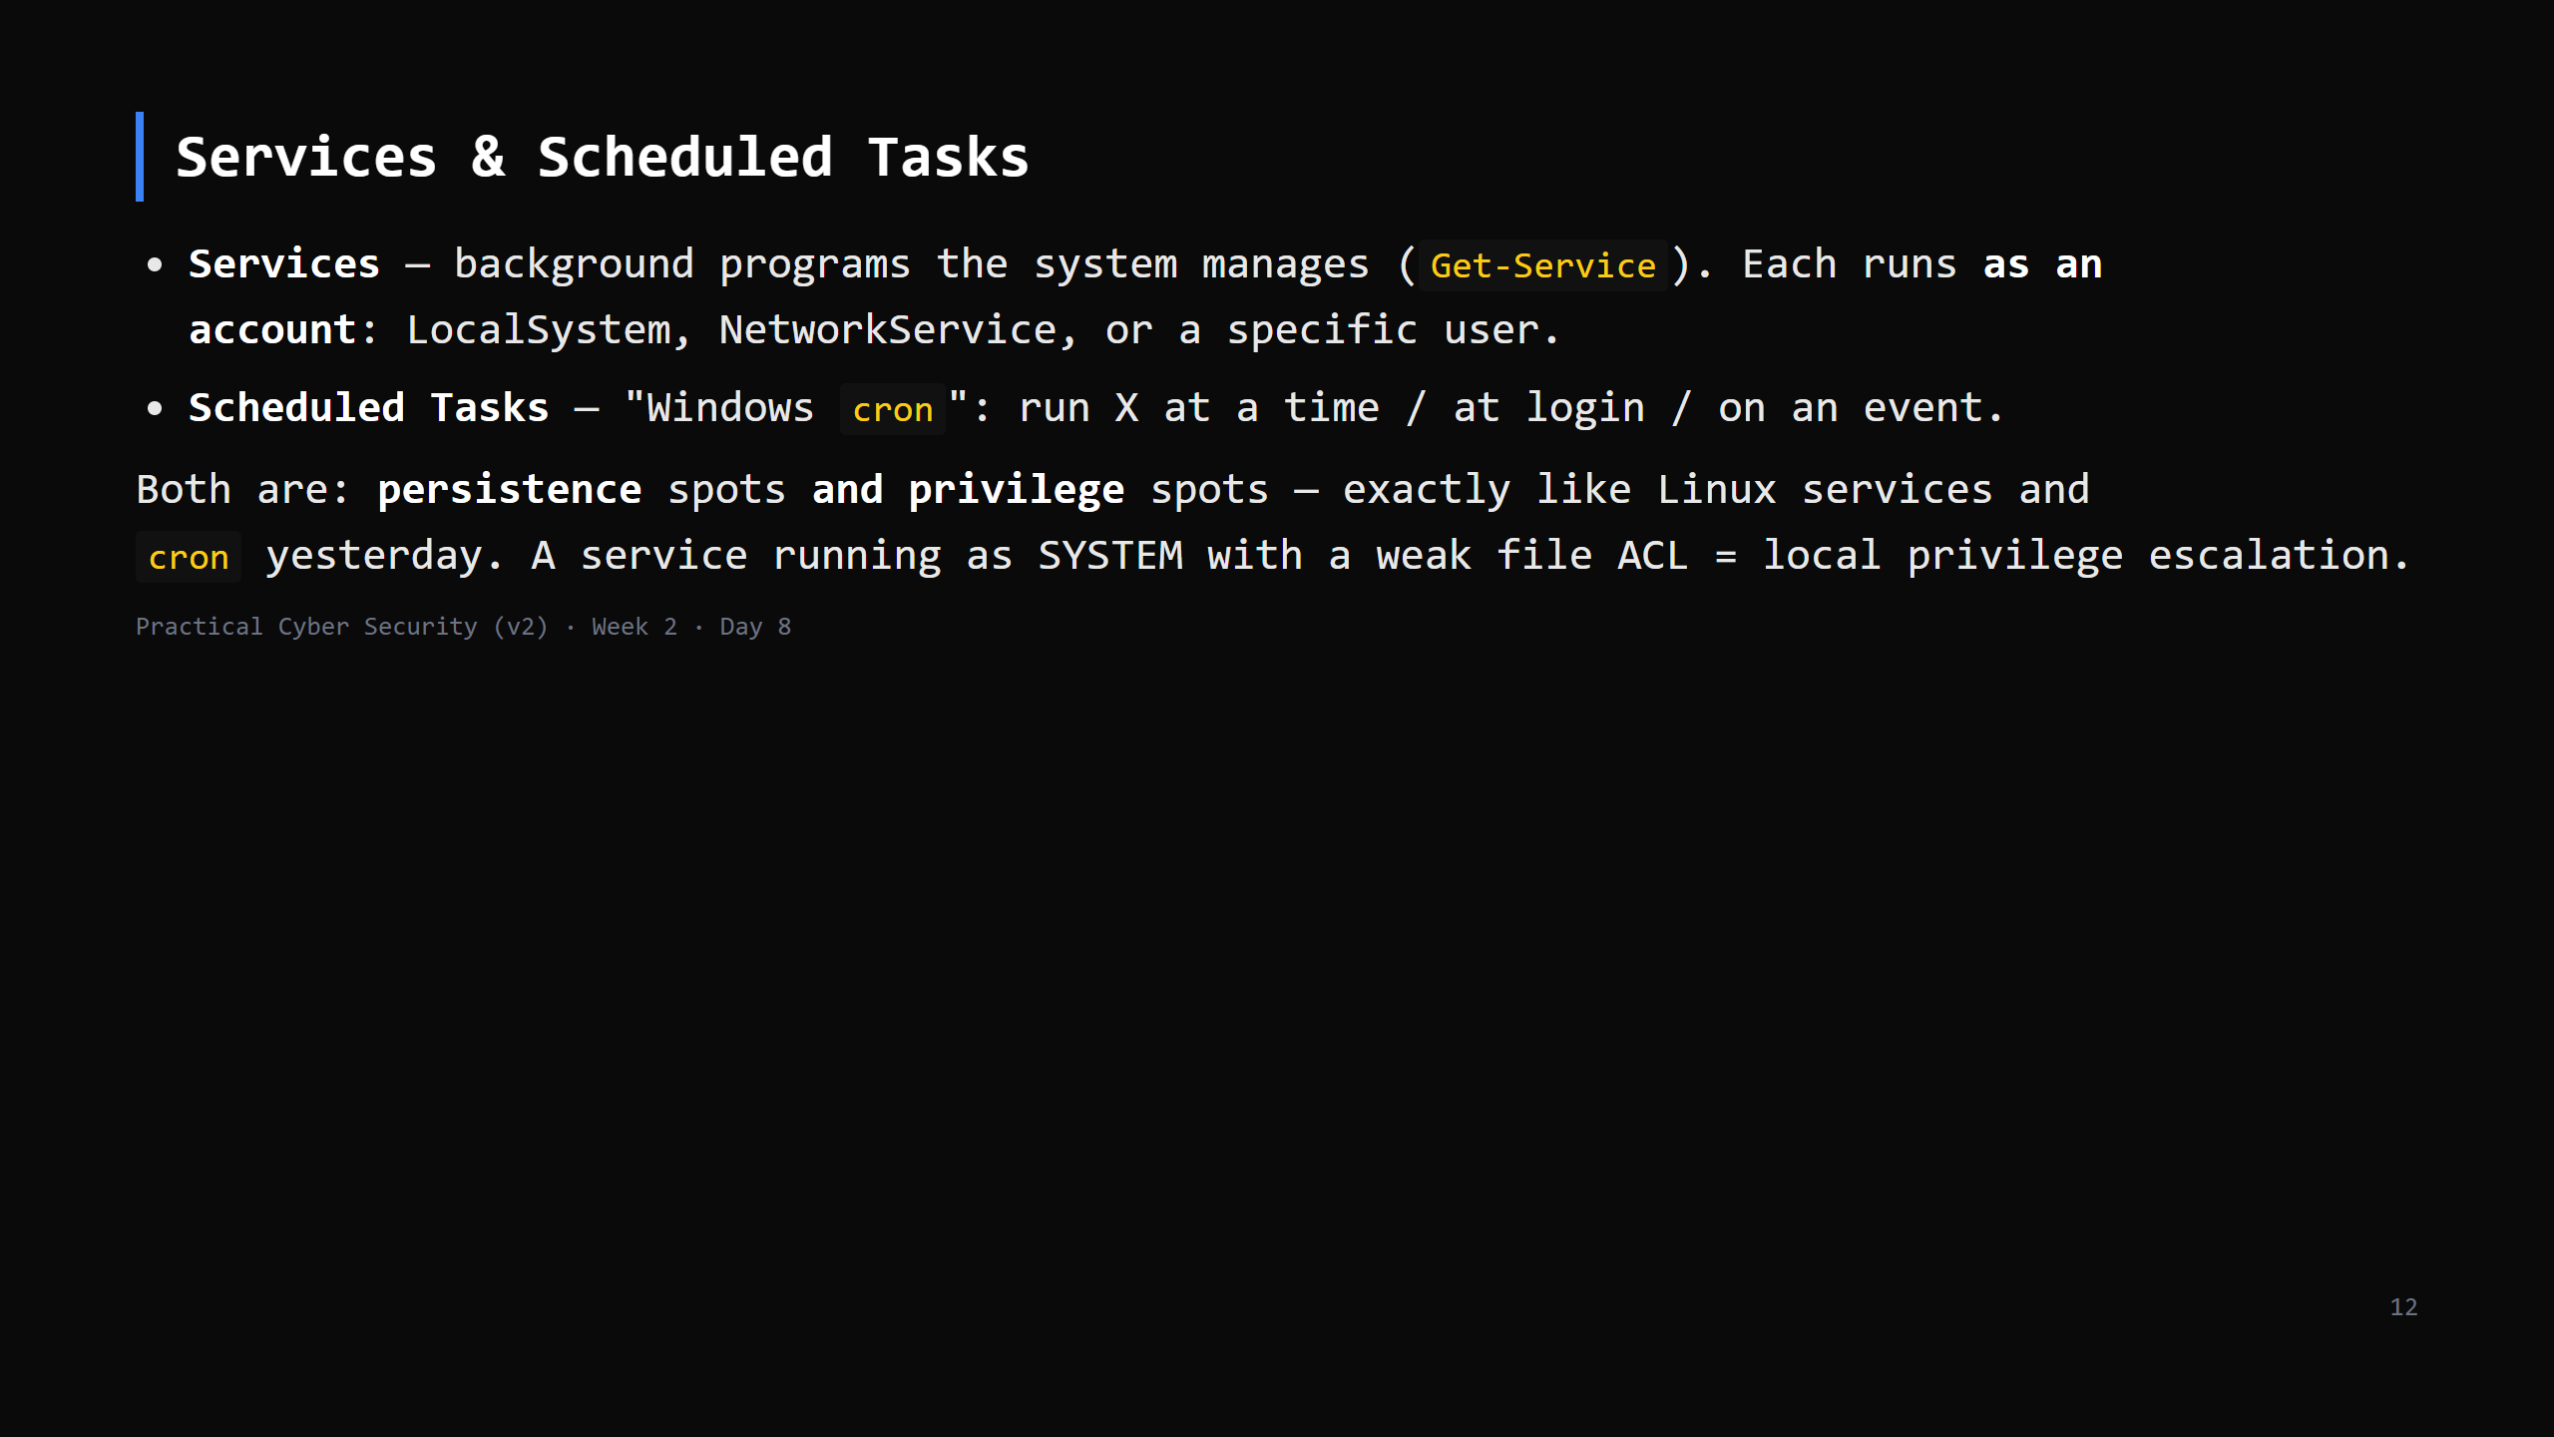
Notes:
Deliberate callback to Day 7. The pattern is identical across OSes: "a powerful background thing that trusts a file/path you can write = you inherit its power." CUT to one line if short: "Scheduled Tasks = Windows cron; Services = Windows daemons; both run as an account and both are persistence spots."

Slide 13
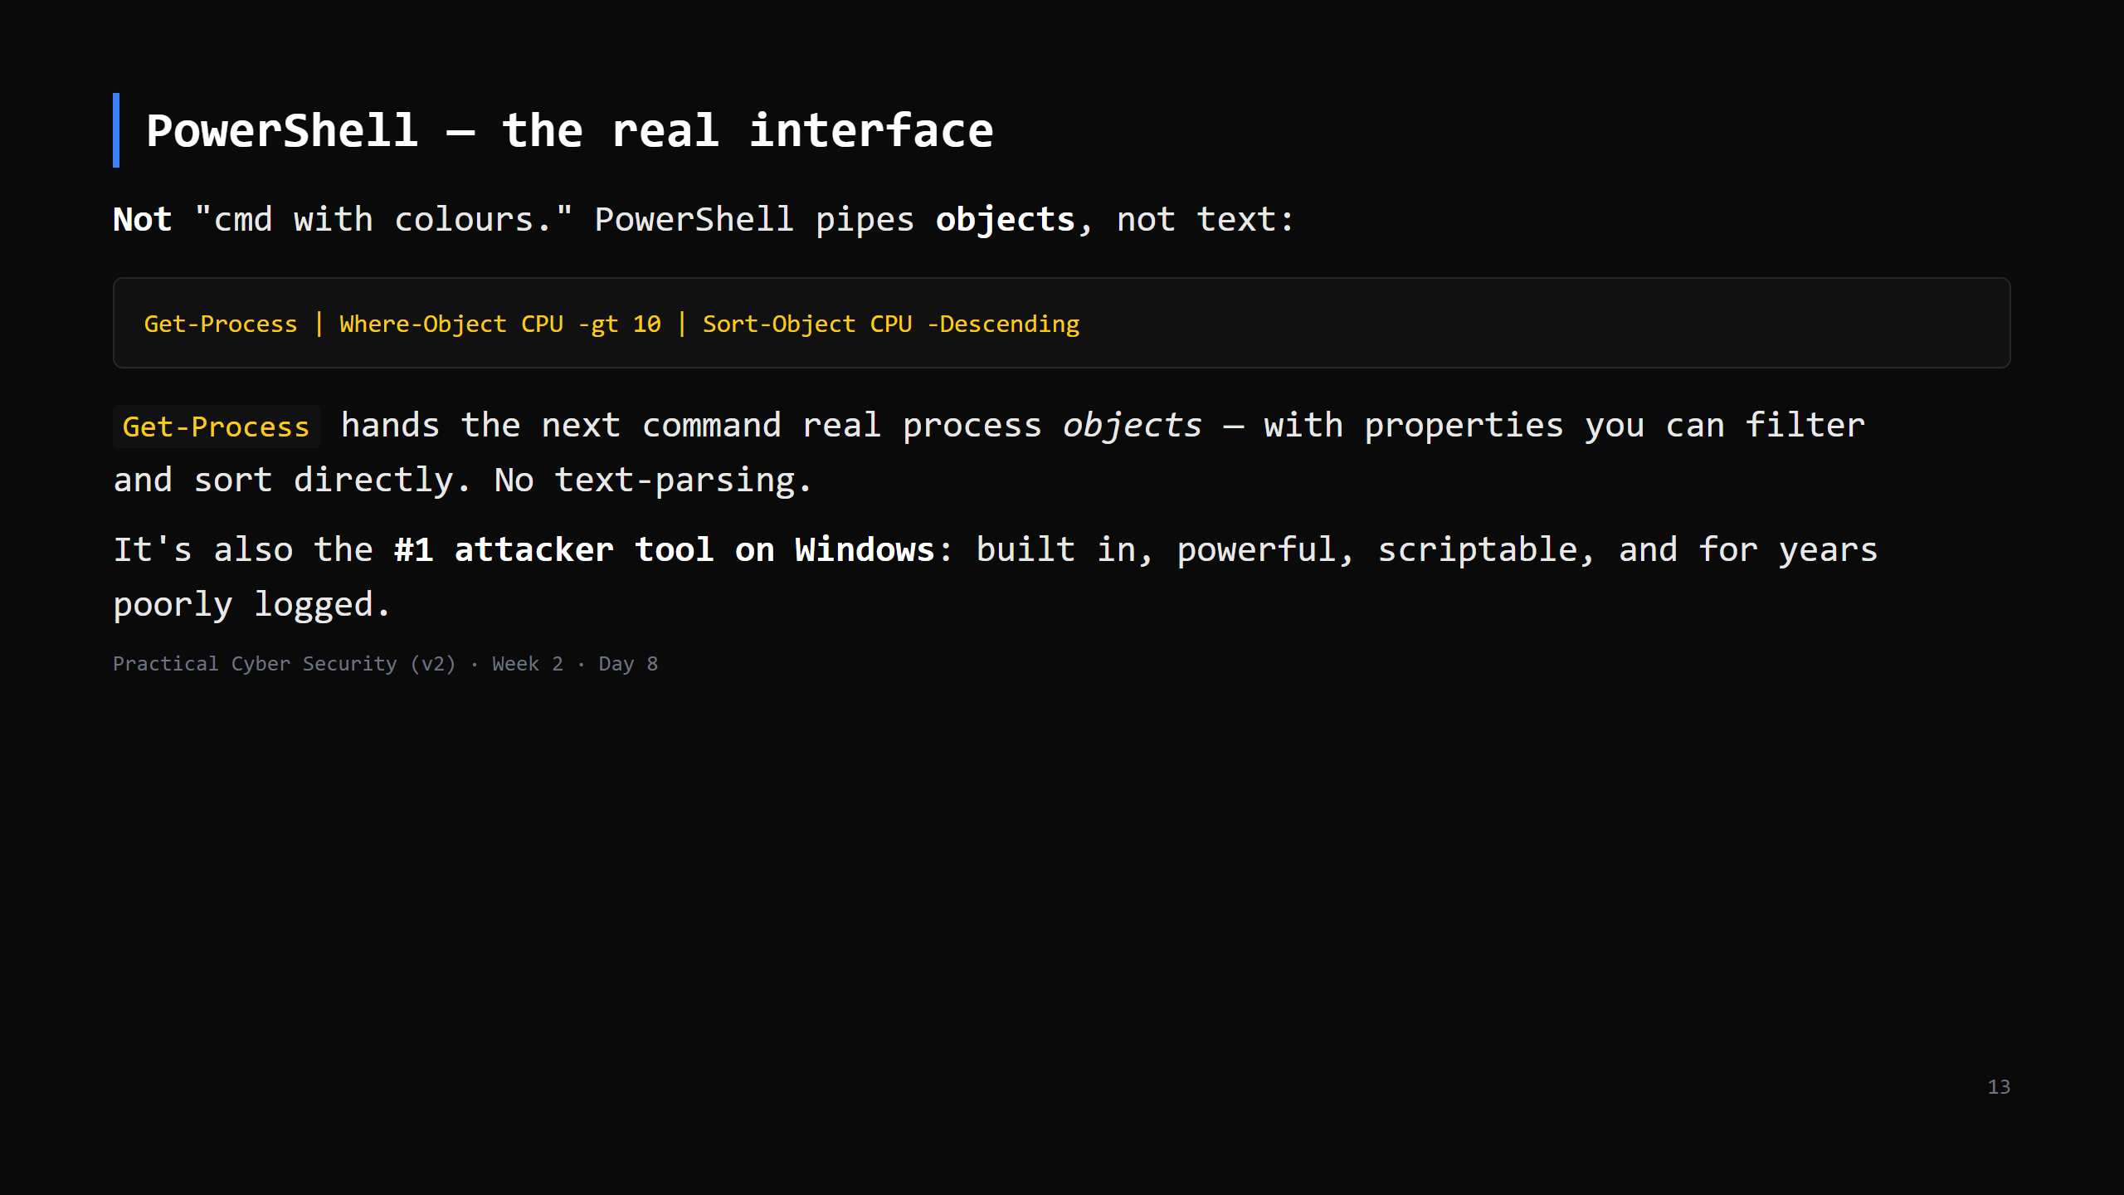
Notes:
The Day 8 TRAP: "PowerShell is just a prettier cmd." No — it's an object pipeline and the primary offensive tooling surface. `Get-Help <cmd>` / `<cmd> -?` for docs. Modern defence: Script Block Logging, Constrained Language Mode, AMSI — name them for the attack slide.

Slide 14
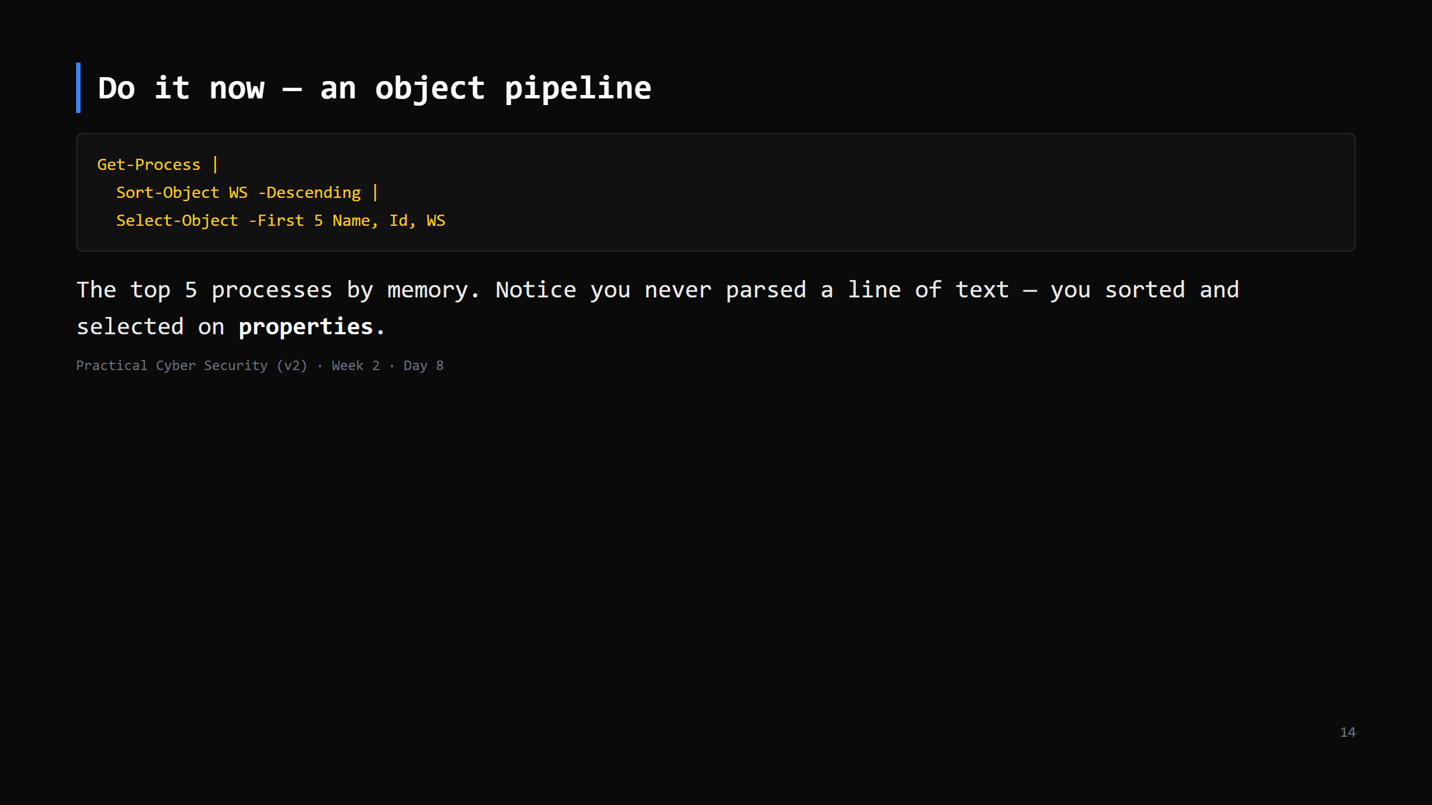
Notes:
5 min. WS = working set (RAM). Contrast with Day 6 `ps aux | sort | head` which was text columns. Same result, different mechanism. Let students tweak it — sort by CPU, select different columns.

Slide 15
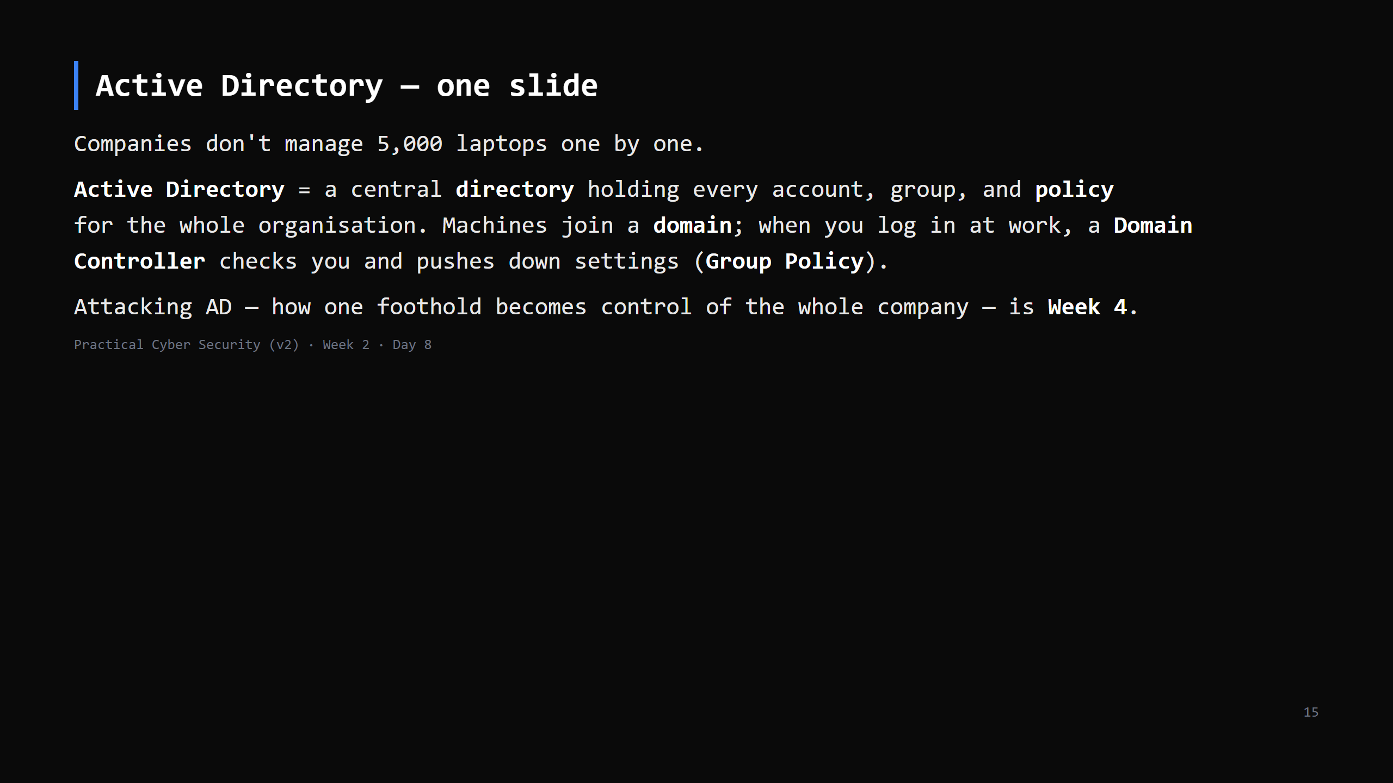
Notes:
Keep it to this. The one idea: "identity and policy, centralised." A DC is the crown jewel. CUT to two sentences if short: "AD = one central login + policy system for a whole company. Compromising it = compromising everything. More in Week 4."

Slide 16
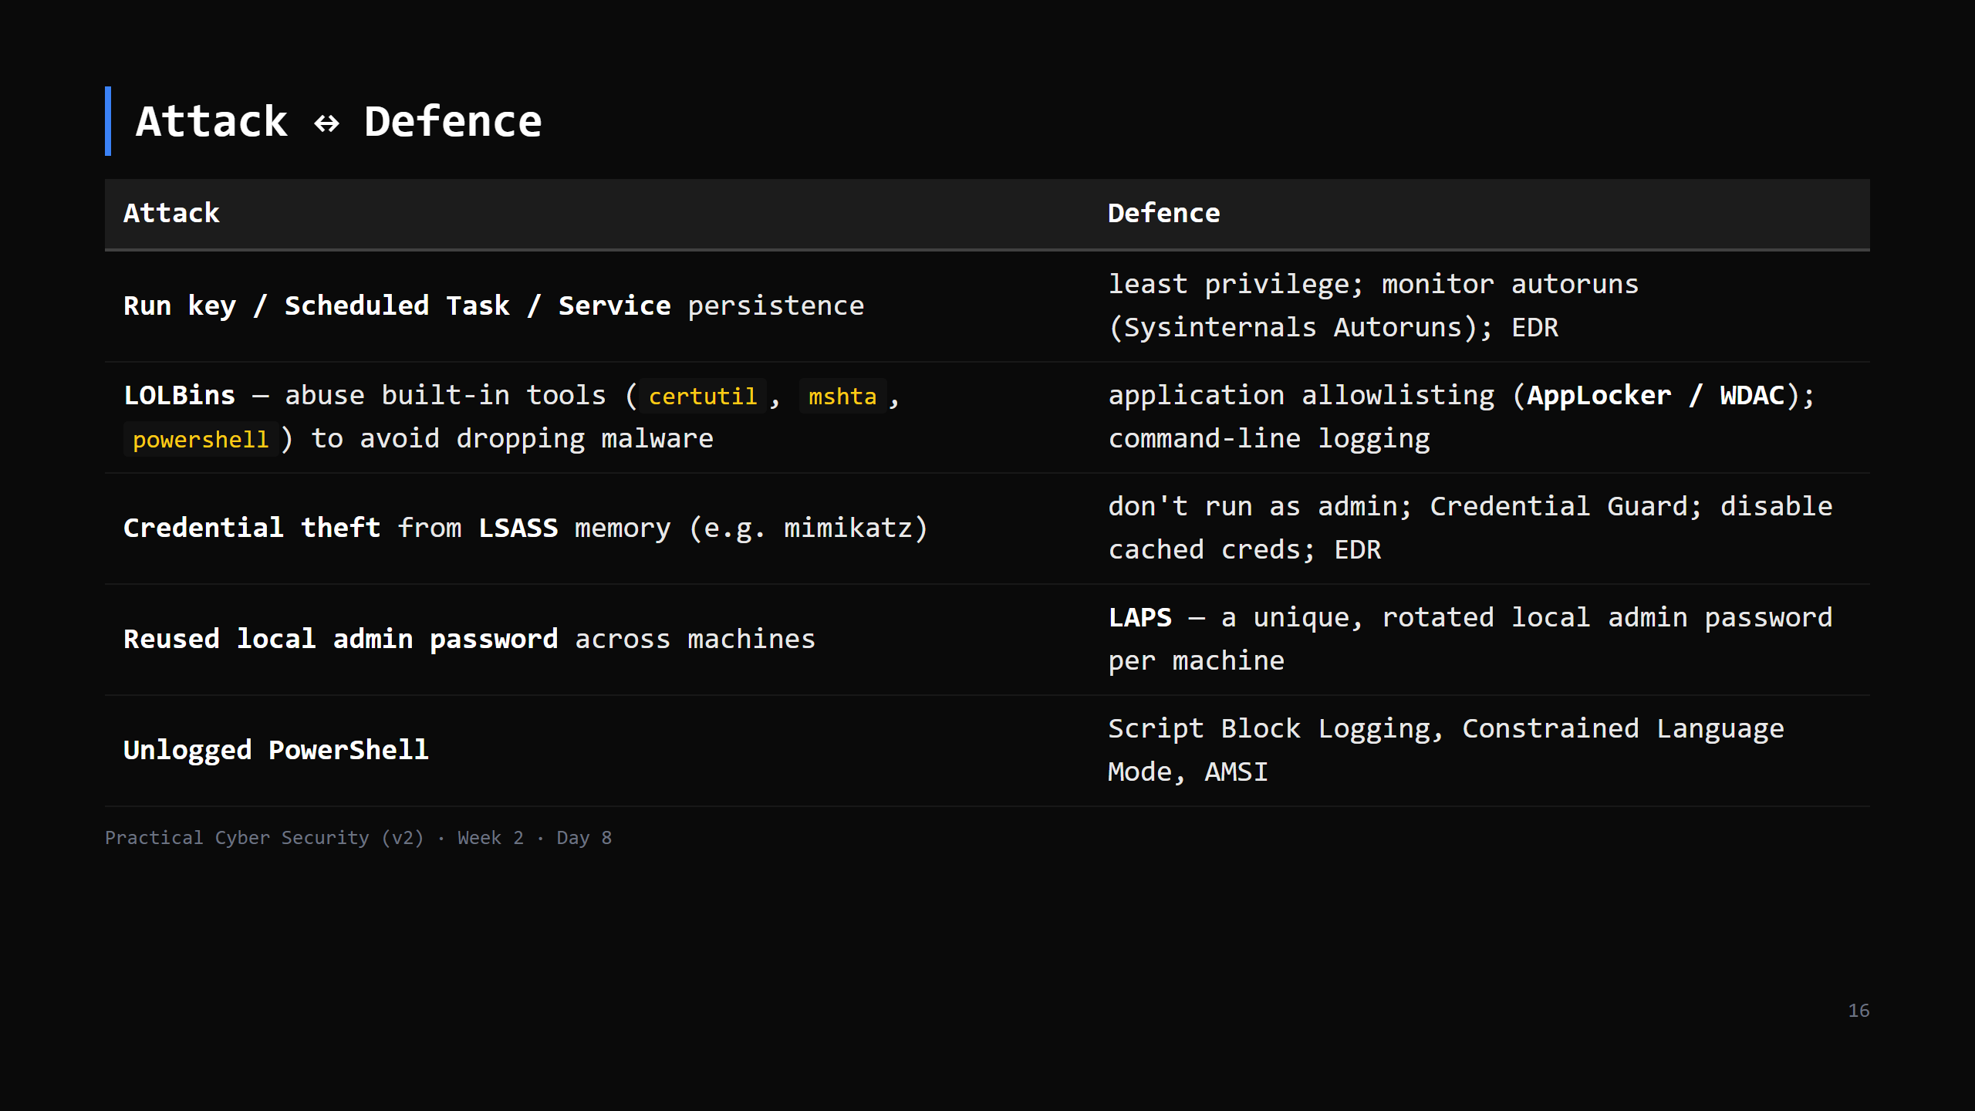
Notes:
LOLBins = "Living Off the Land Binaries" — using what's already installed so there's nothing for antivirus to catch. lolbas-project.github.io is the reference (name only). LSASS holds credentials in memory for single sign-on; dumping it is the classic post-exploit move on Windows. Ties to Day 17.

Slide 17
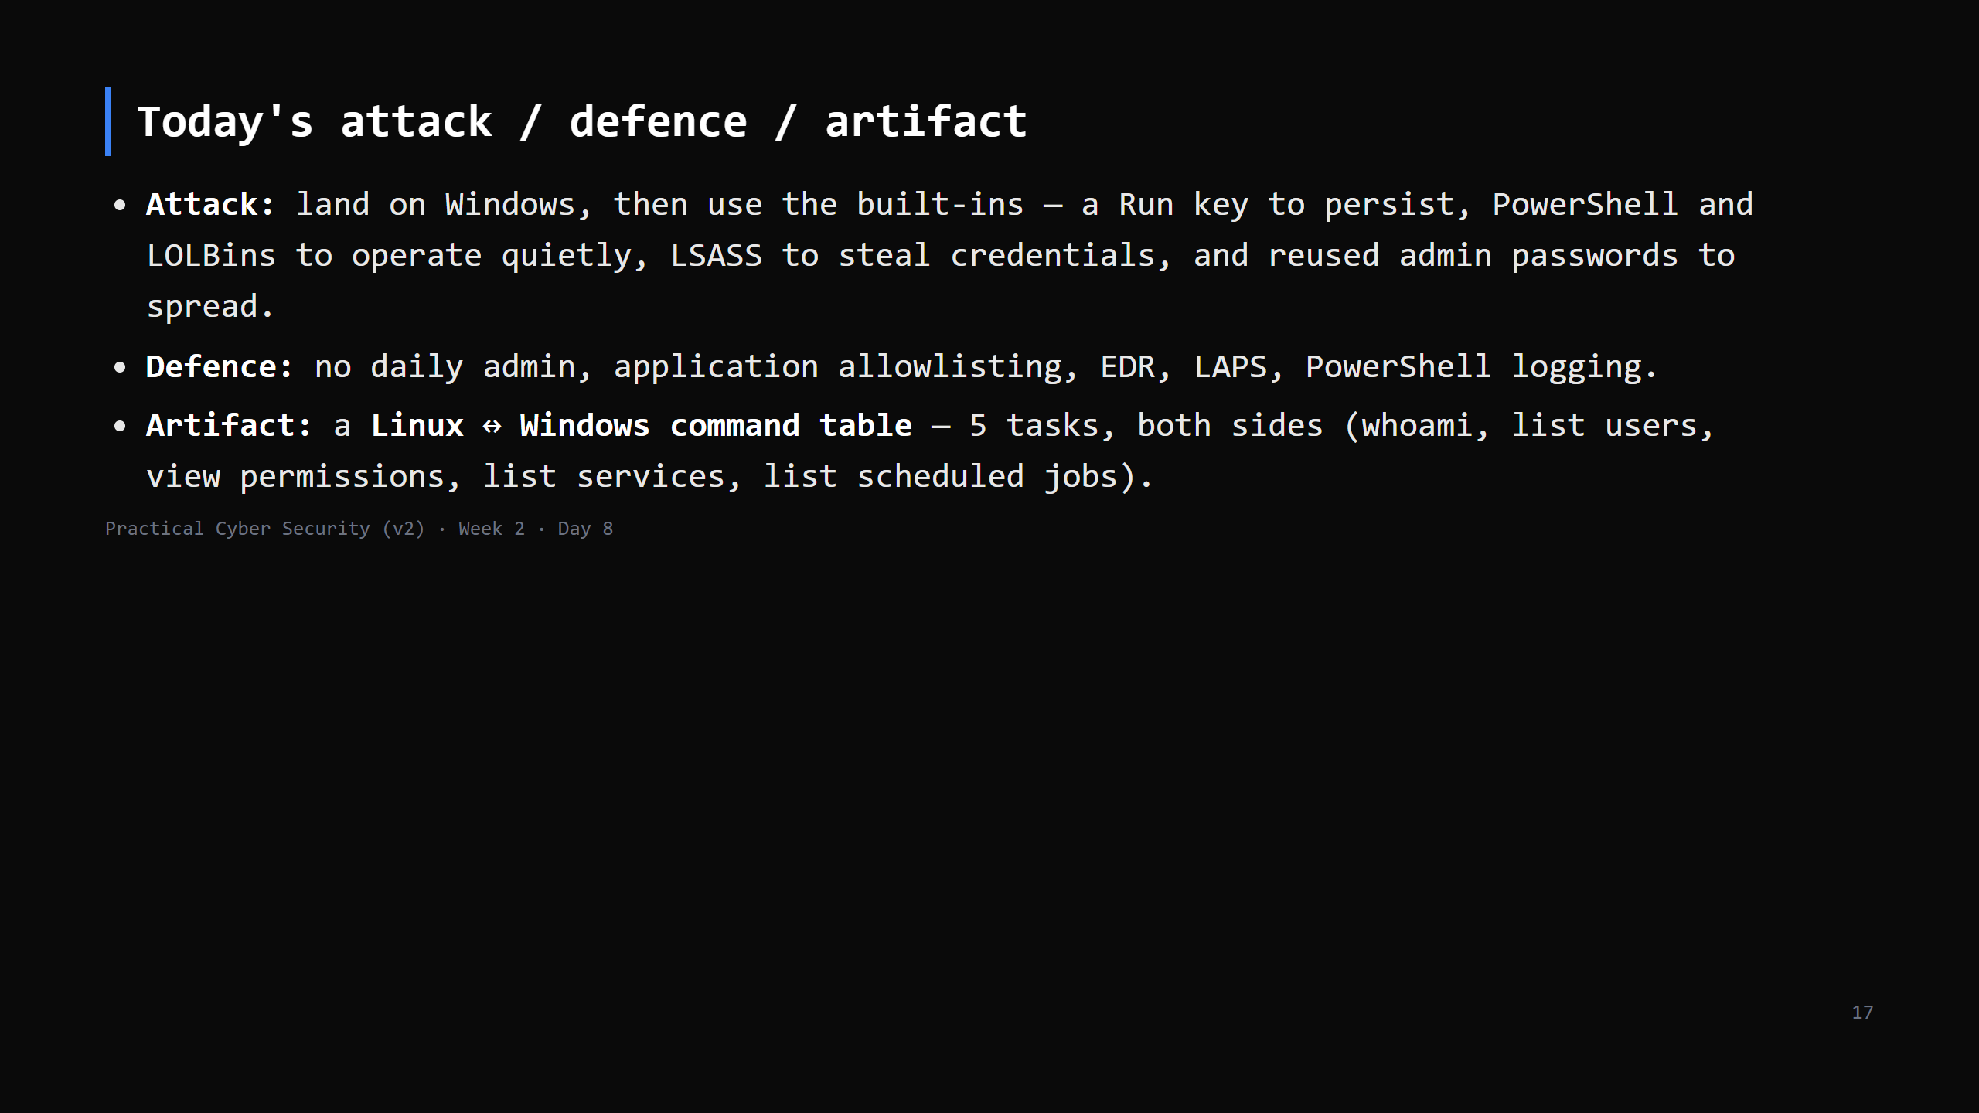

Slide 18
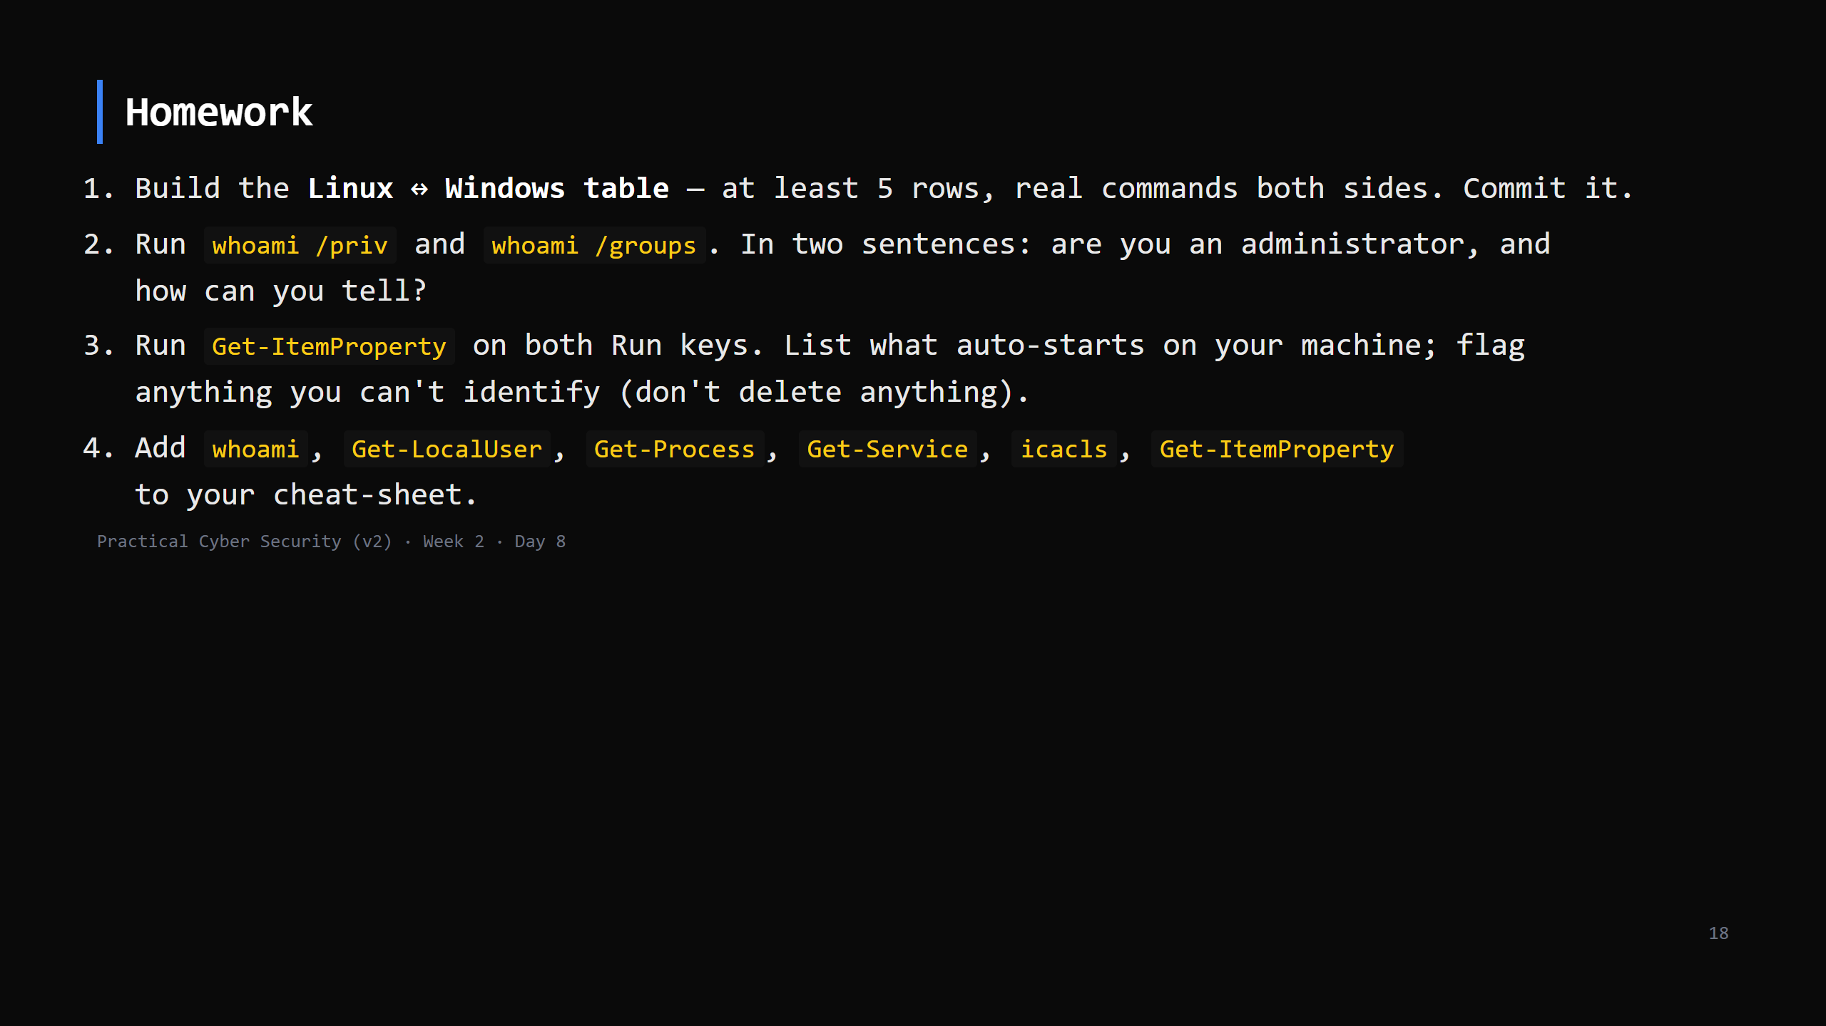
Notes:
Due start of Day 9. Non-Windows students: use the shared Windows box or pair up; note which.

Slide 19
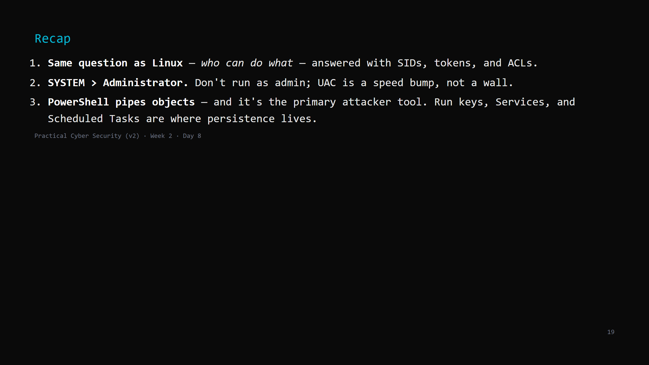
Notes:
Say the three lines. Tomorrow: you stop doing this by hand — Bash and Python to automate the repetitive parts. You'll build a small scanner.

