Slide 1
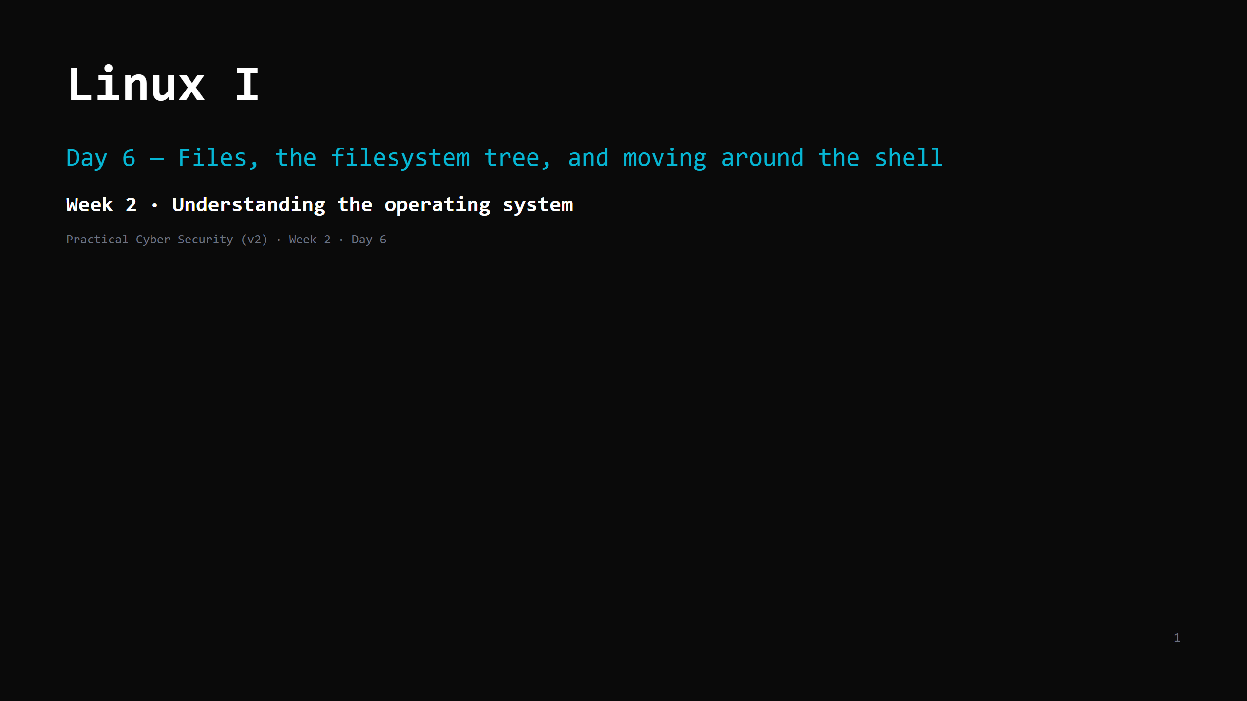
Notes:
RUN SHEET (~85 min). Hands-on INTERLEAVED — this is a skills day, keep them typing. 00:00 Journey check + hook (fast tour of a shell) 4 00:04 Why Linux 4 00:08 What a file actually is 5 00:13 The filesystem tree + paths 7 00:20 DO: pwd / ls / cd — get oriented 6 00:26 The shell — what it actually is 6 00:32 Reading files: cat / less / head / tail / wc 7 00:39 DO: read real files 6 00:45 Finding things: find and grep 8 00:53 DO: find + grep 6 00:59 Pipes & redirection — the superpower 9 01:08 DO: build a one-liner 6 01:14 Attack <-> defence 5 01:19 Wrap + cheat-sheet + homework 5 CUT FIRST IF SHORT: head/tail detail; the redirection ( > >> ) half of the pipes slide. NEVER CUT: paths (absolute/relative, . .. ~), pwd/ls/cd, grep, pipes, the cheat-sheet artifact. ANALOGY (kitchen — we're back inside one computer): the filesystem = the whole building's storage as one tree from the front door `/`. The shell = the order pad you write instructions on. PREREQ: every student must be at a Linux shell — WSL / a provided VM / the class Linux box. This was set up as Day 5 homework; fix stragglers in the first 5 minutes.

Slide 2
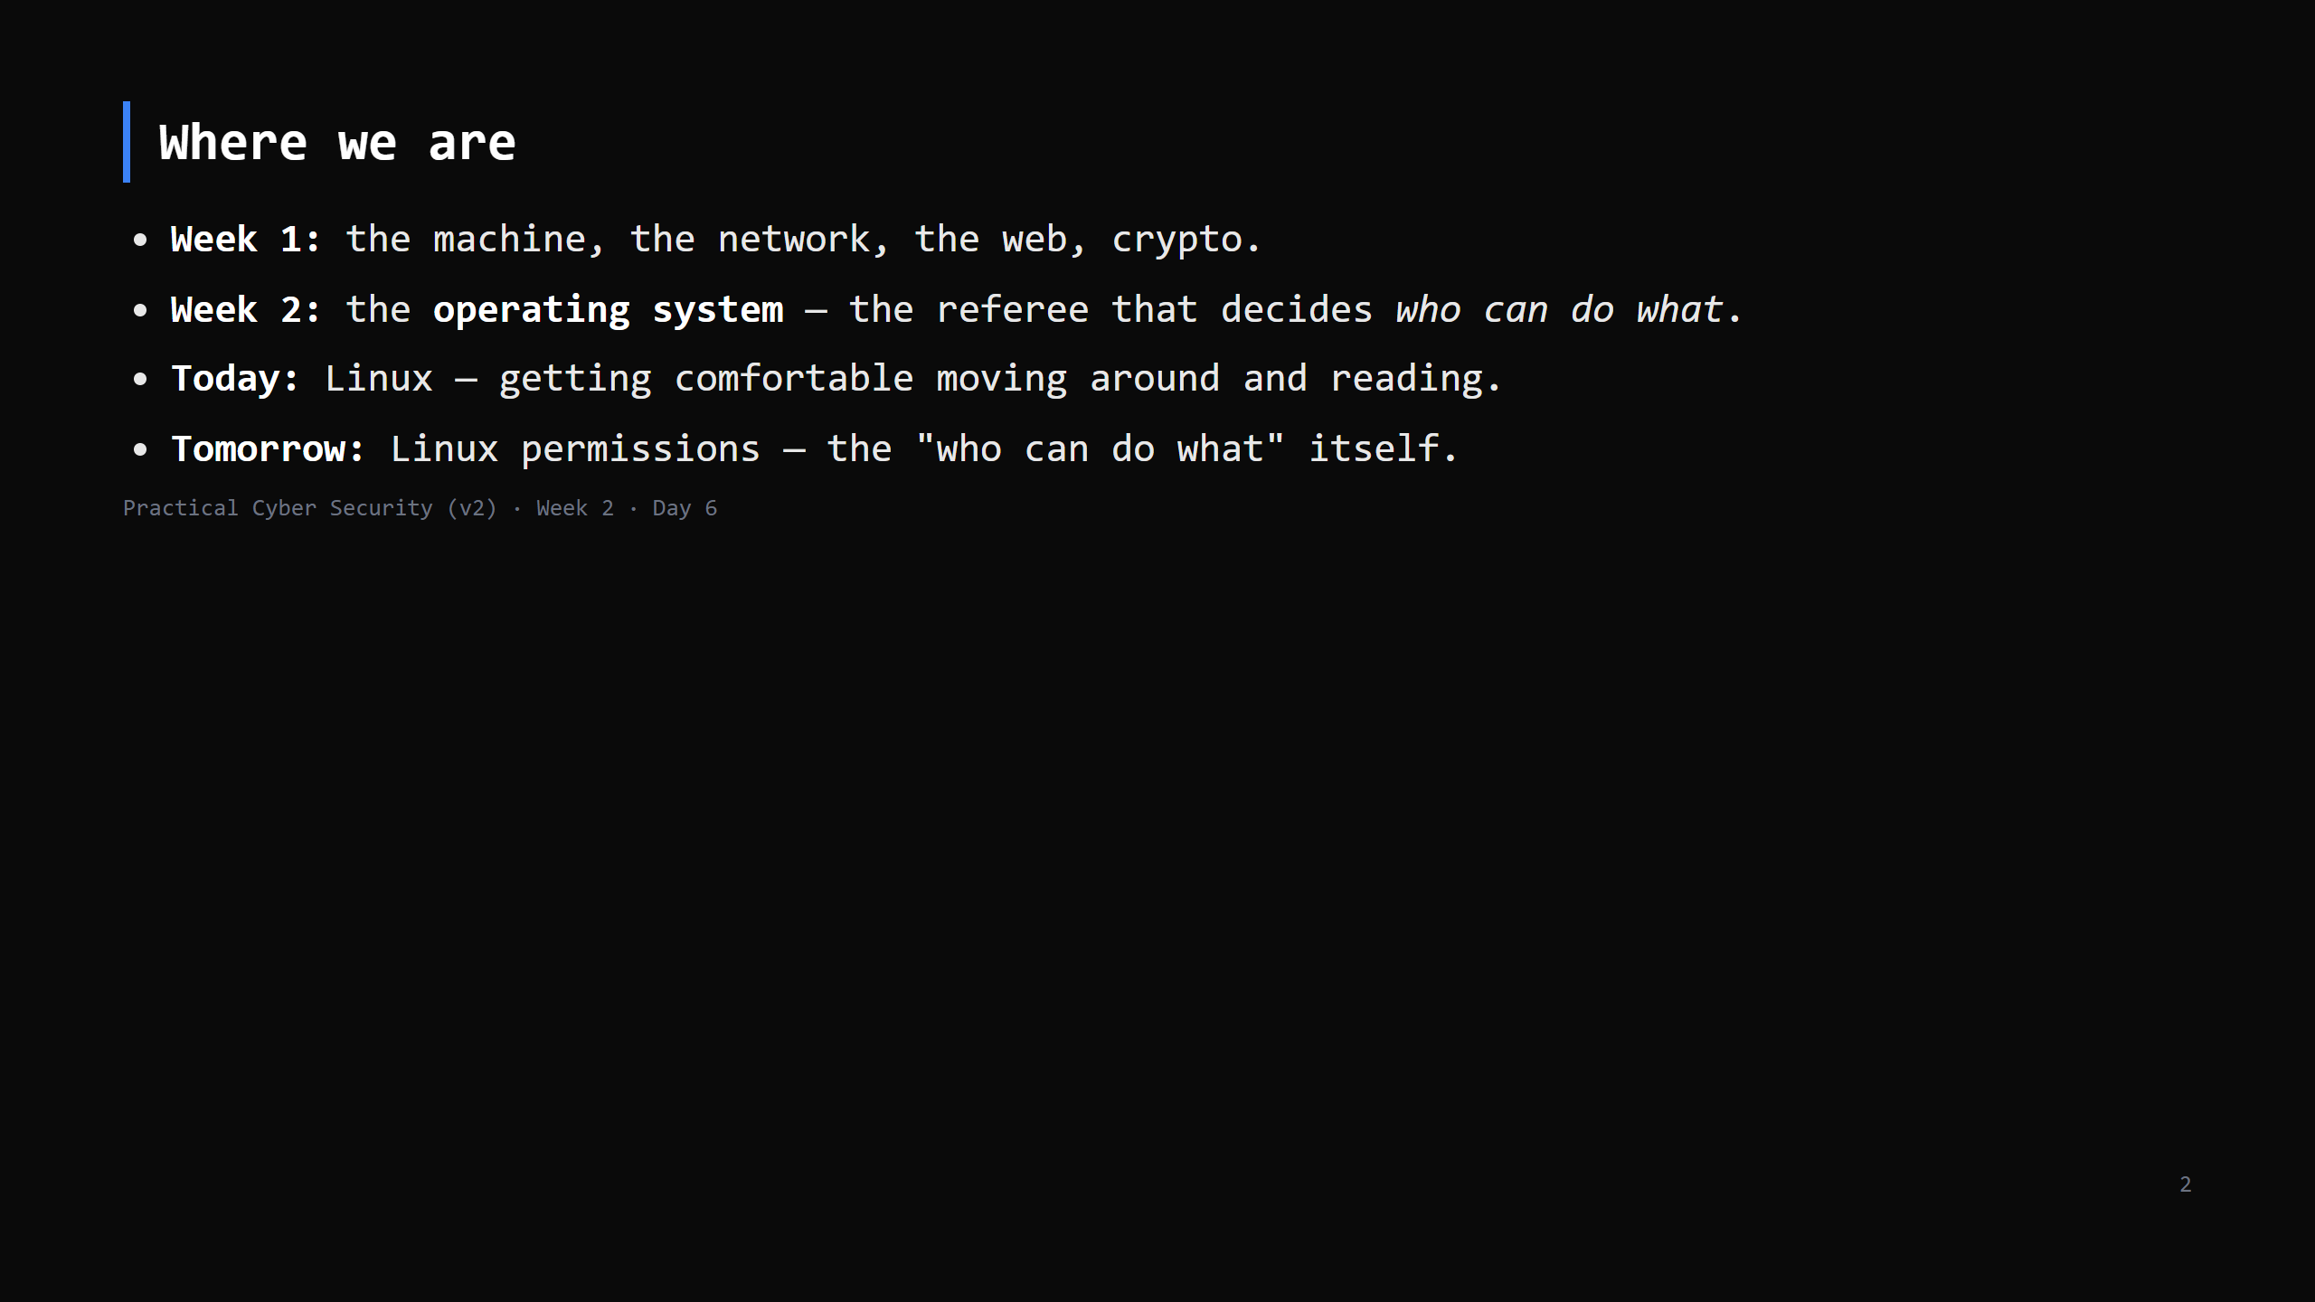
Notes:
Learning Journey Check. Callback to Day 2: "the OS as referee" — this week we go and meet it.

Slide 3
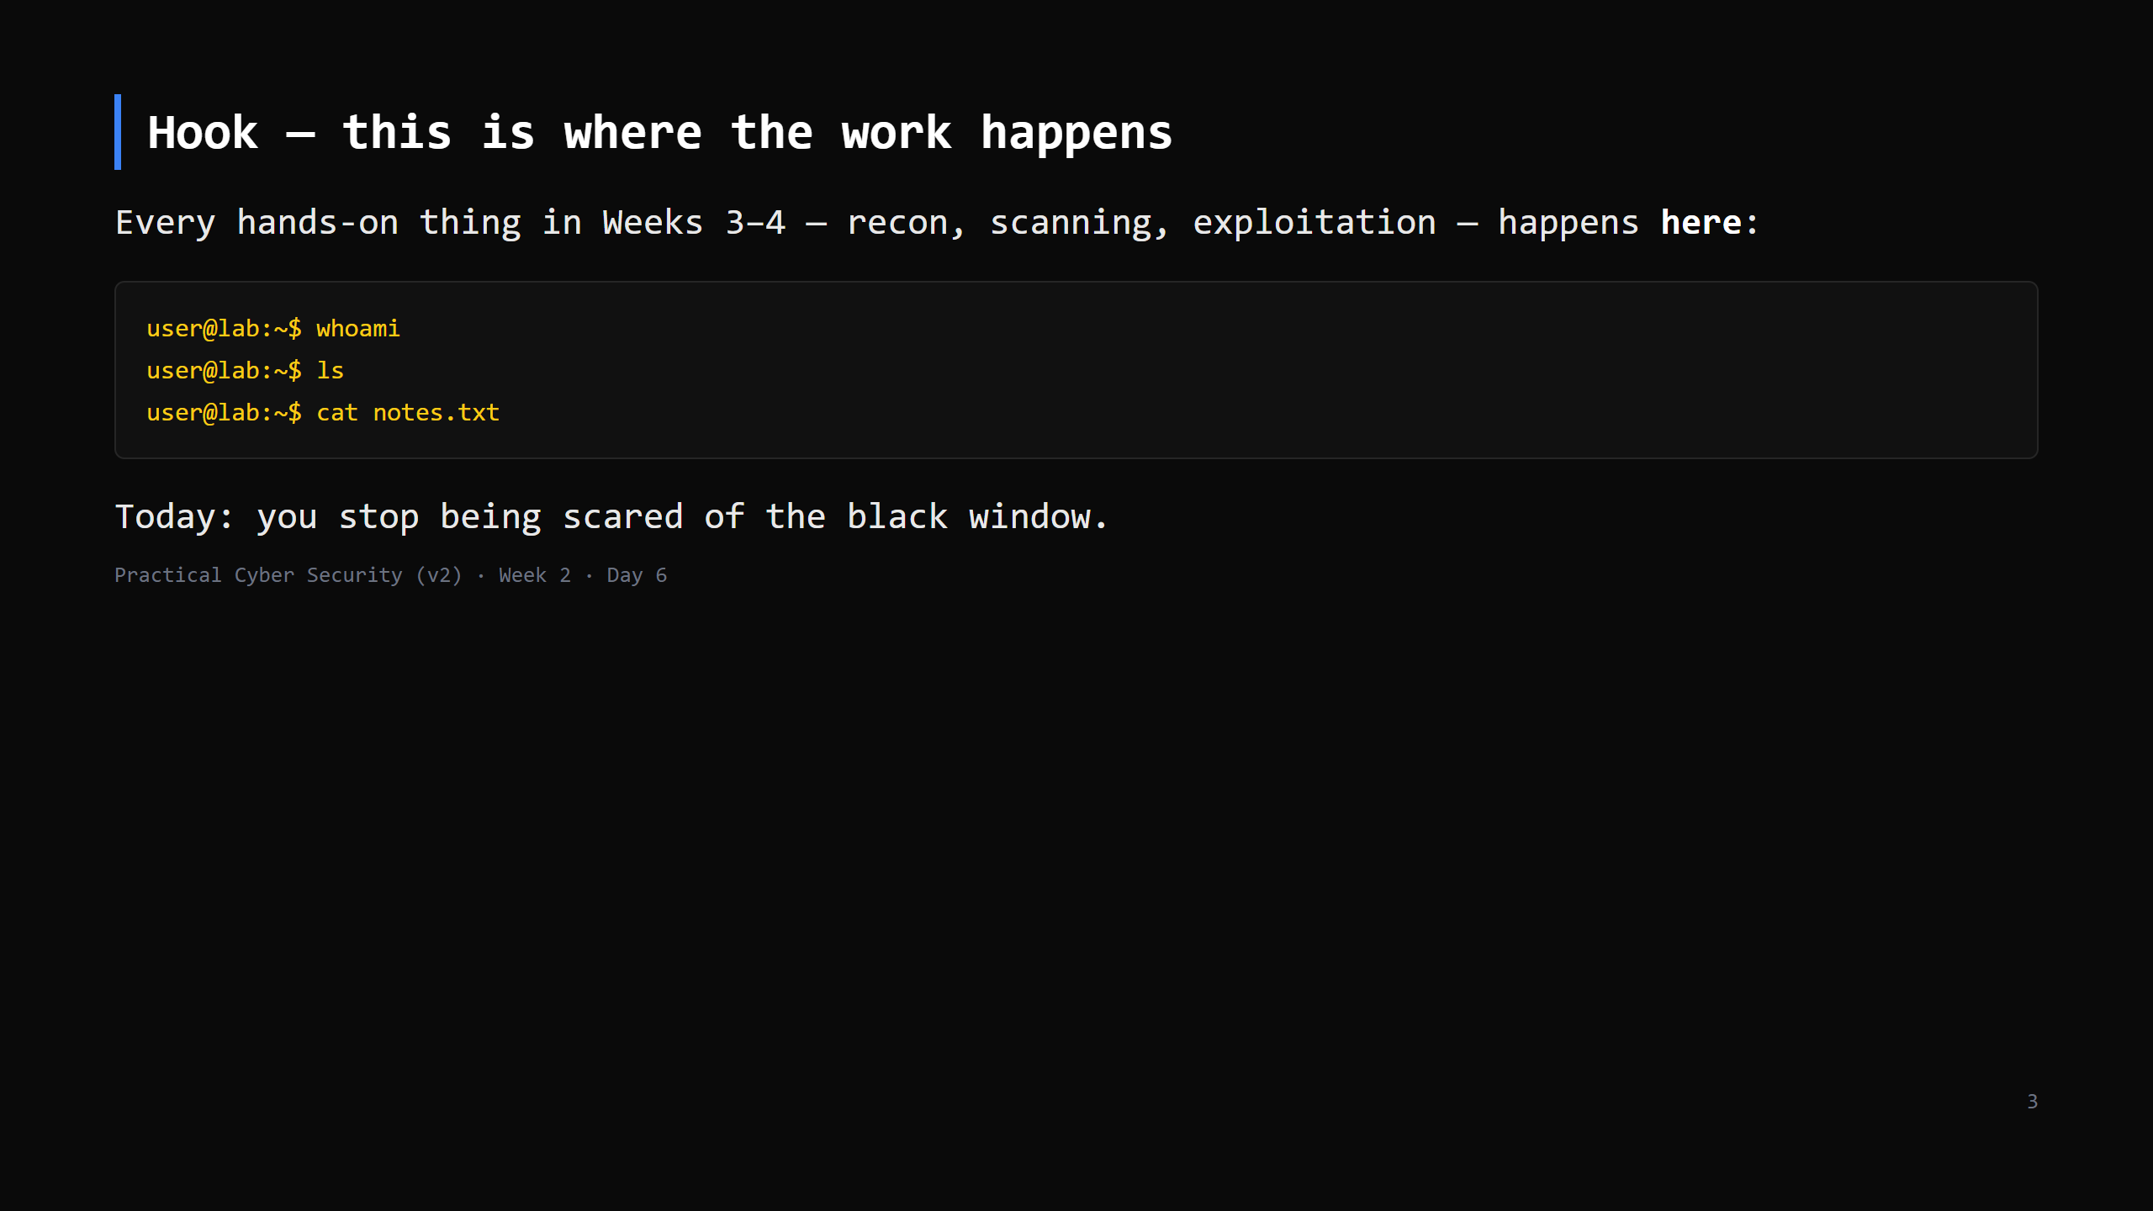
Notes:
Type a few commands live, fast, no explanation. Just show it's not mystical — it's a program waiting for you to tell it what to do. Reassure: "by Friday this feels normal."

Slide 4
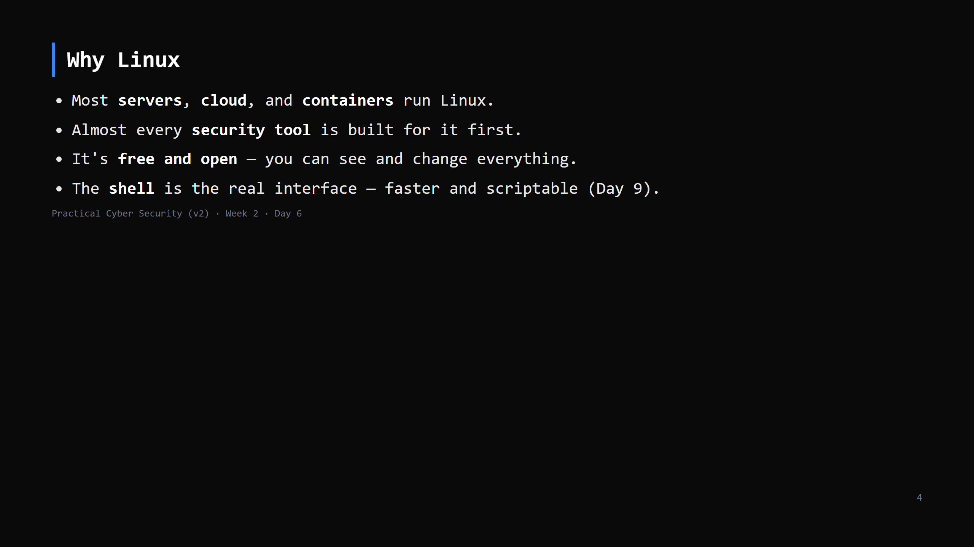
Notes:
Not a Linux-vs-Windows fight (Windows is Day 8). Just: this is where the industry lives, so this is where we work.

Slide 5
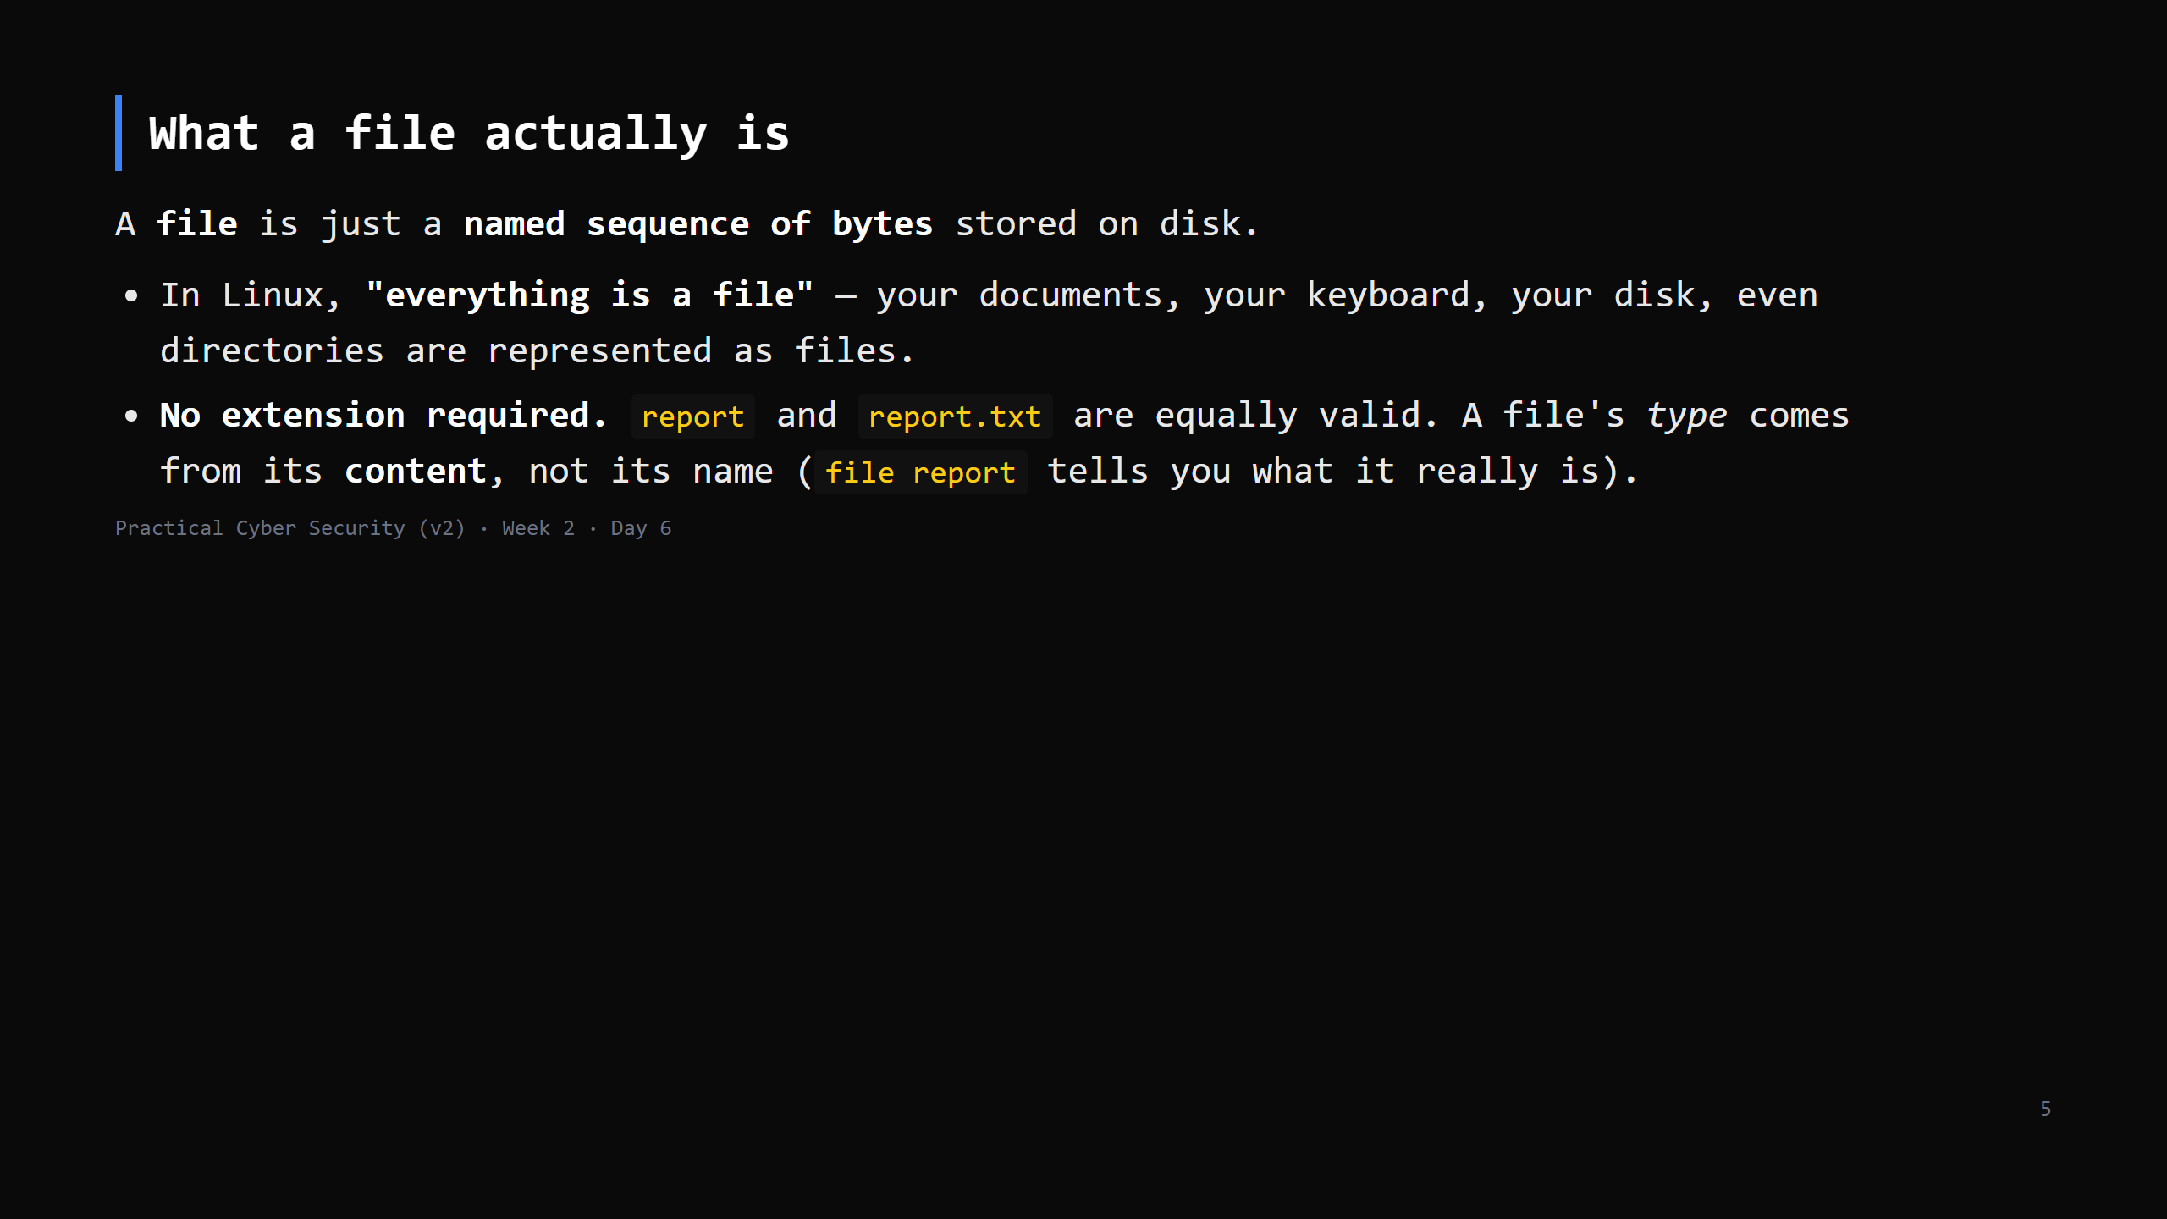
Notes:
This is the "files" concept deferred from Day 2. Keep it short. The "everything is a file" idea matters later: reading /dev/... , /proc/... is how you inspect a running system. Don't go deep now — just plant it. Windows contrast (one line): Windows leans on extensions (.exe, .docx) to decide what a file is.

Slide 6
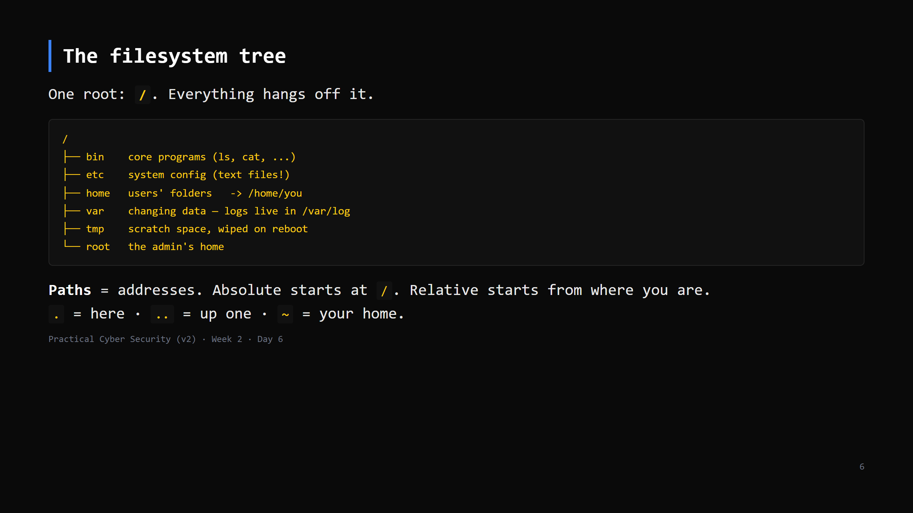
Notes:
Analogy: the whole building's storage as one tree from the front door. /etc = the binder room (all config, as plain text — a recurring theme). /var/log = the logbook shelf. Draw the tree on the board and leave it up.

Slide 7
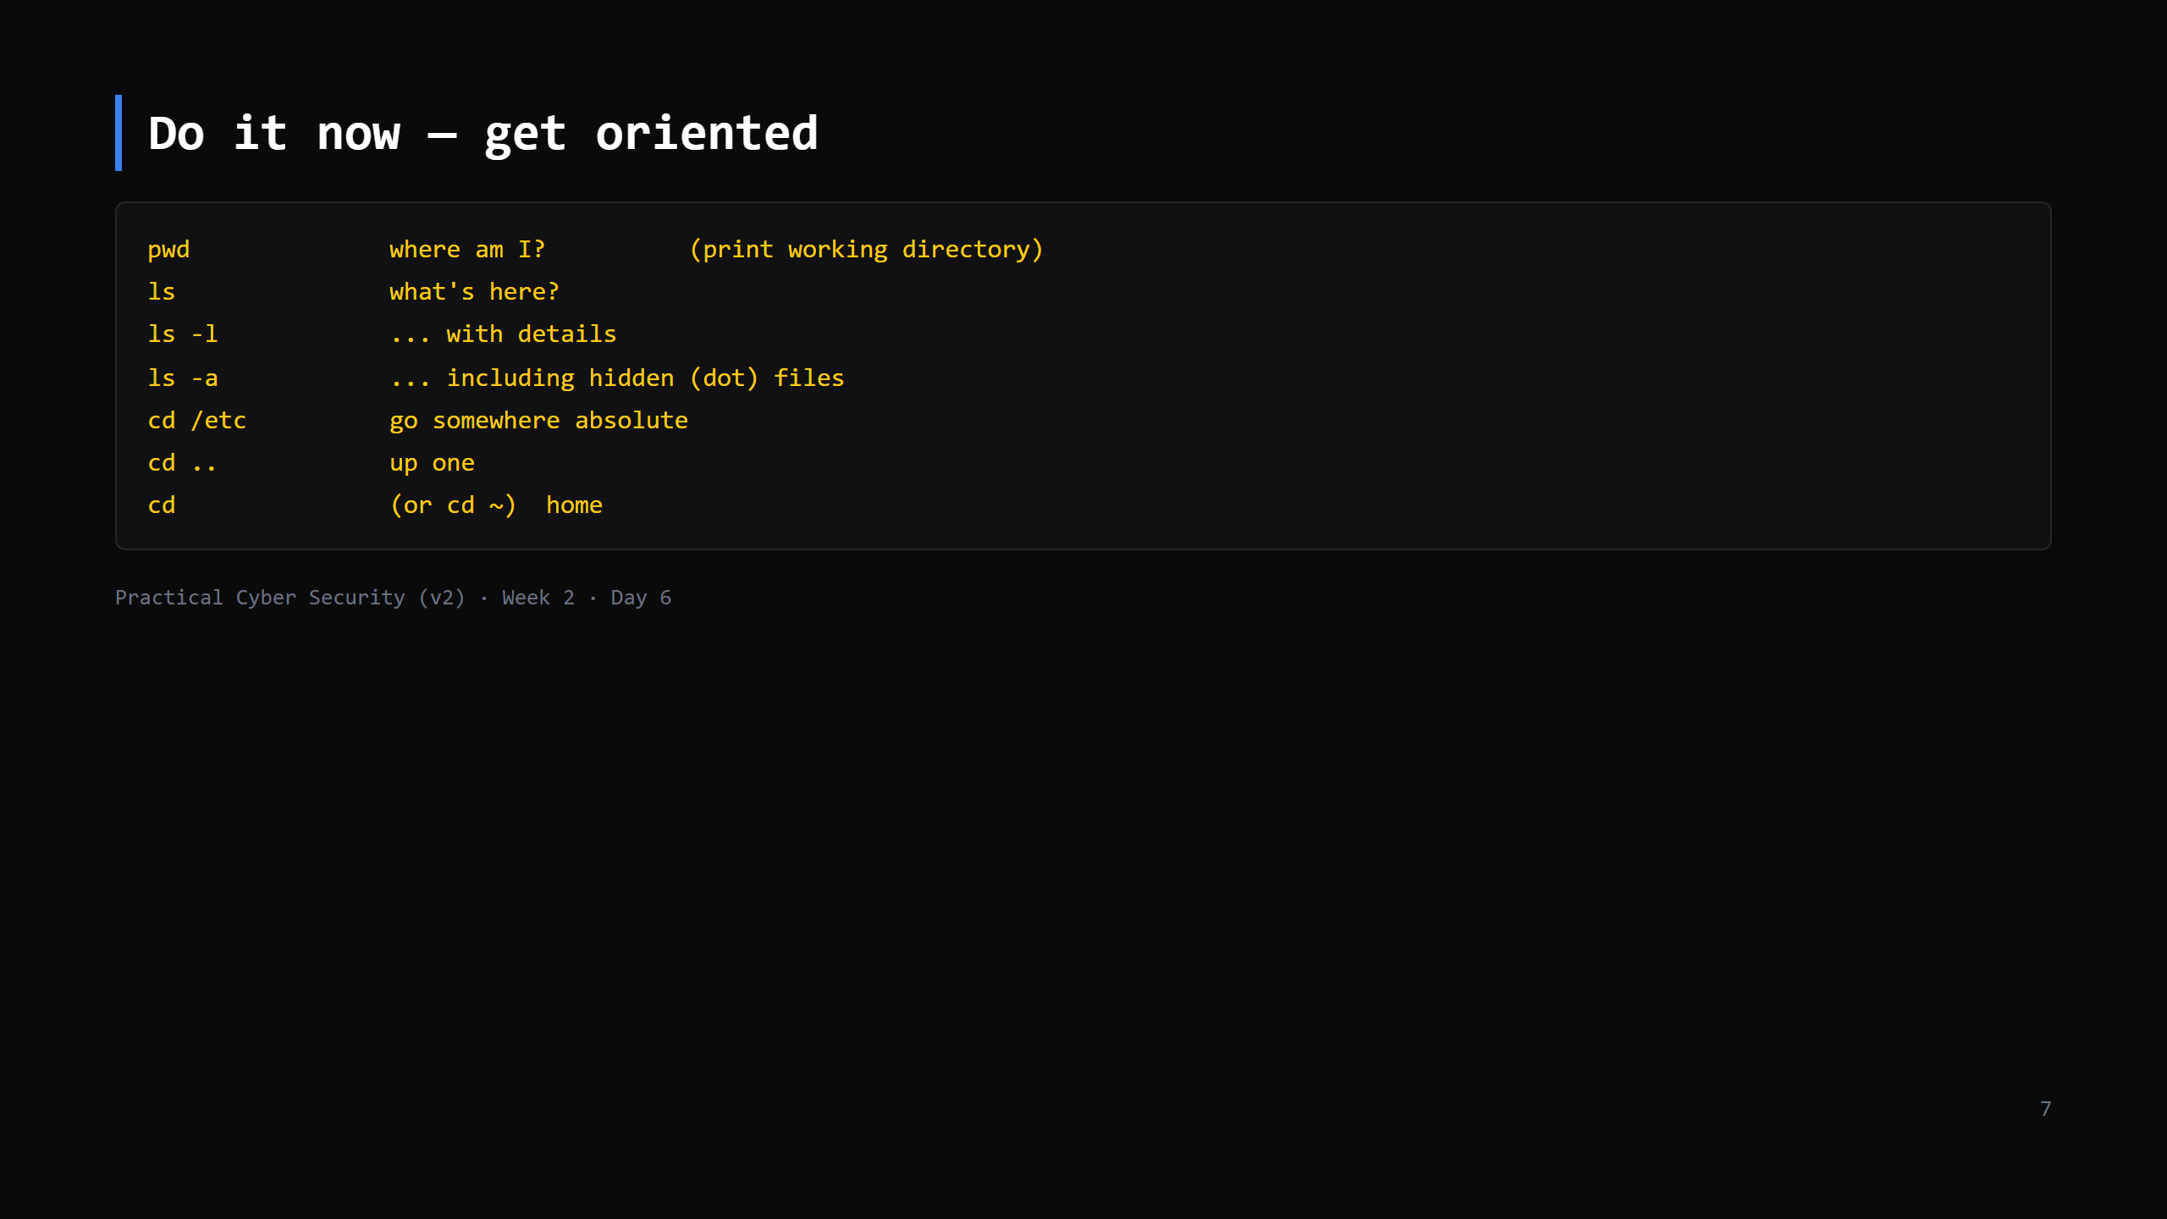
Notes:
6 min. Walk the room. Everyone should be able to say where they are and get home from anywhere. Common confusion: `cd` with no argument goes home; hidden files start with `.`

Slide 8
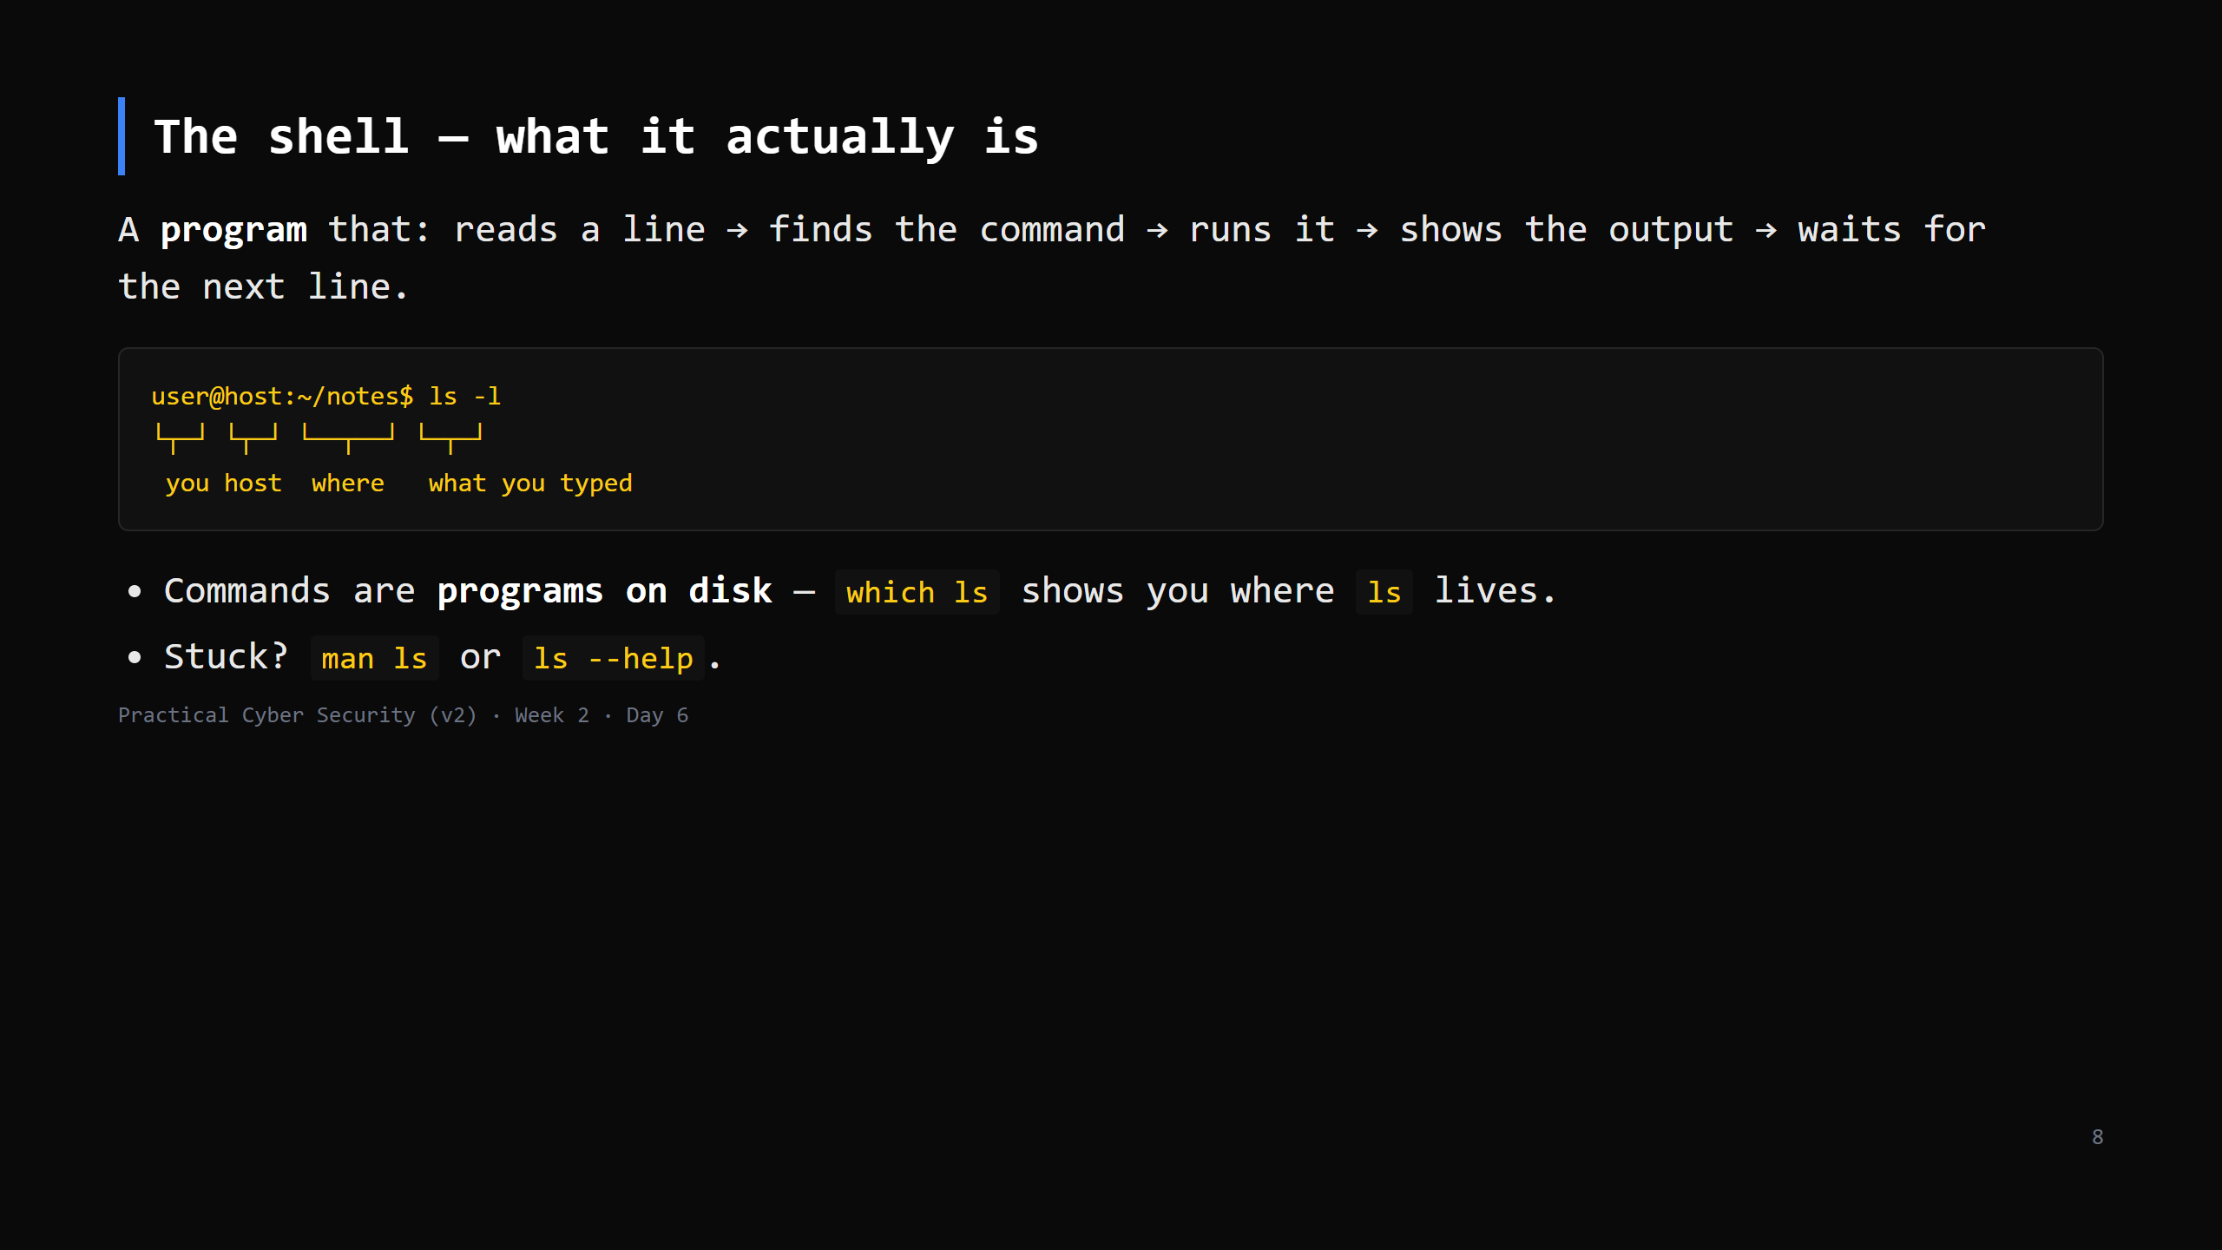
Notes:
Demystify: the shell (bash / zsh) is just another program (Day 2: a process with a PID). The "magic words" are executable files in /bin, /usr/bin. `which` proves it. Teach `man` / `--help` now — per the course standard, we don't memorise flags, we look them up.

Slide 9
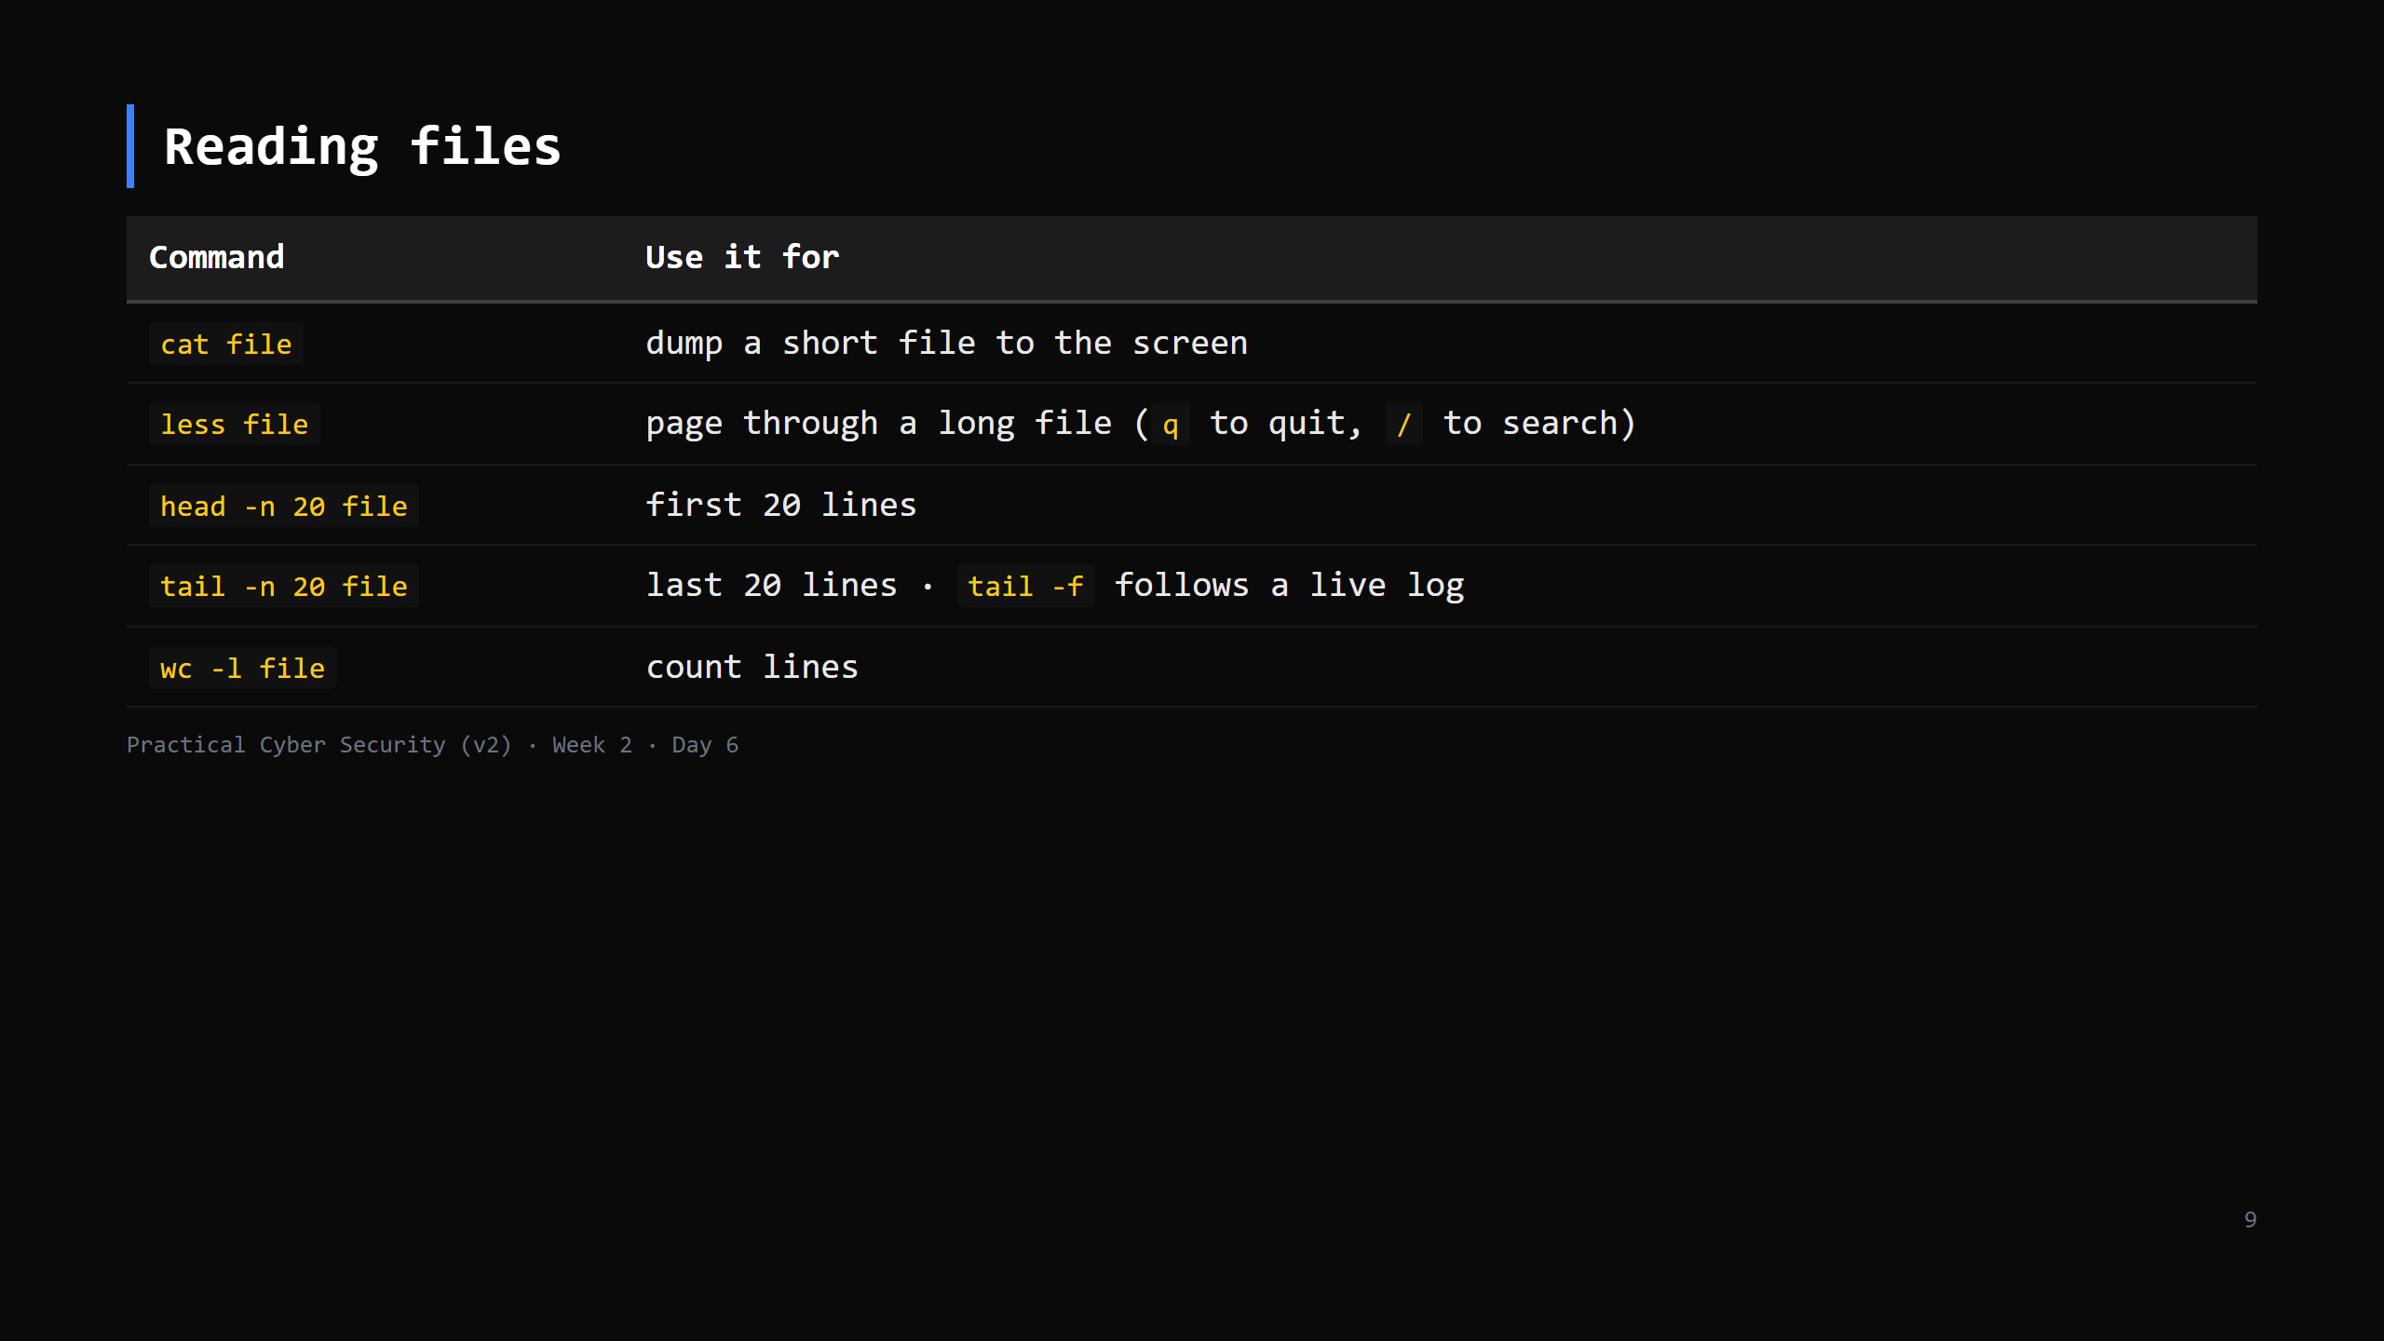
Notes:
`less` is the one to push — safe for huge files, searchable. `cat` a 2 GB log = bad day. `tail -f /var/log/...` (follow) is a preview of Day 19 (watching logs live). CUT head/tail detail first if short.

Slide 10
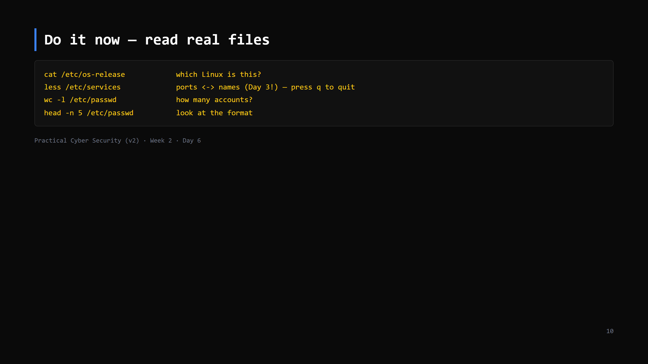
Notes:
6 min. /etc/services is a nice callback to Day 3 ports. /etc/passwd format preview for Day 7. Nobody breaks anything — all read-only.

Slide 11
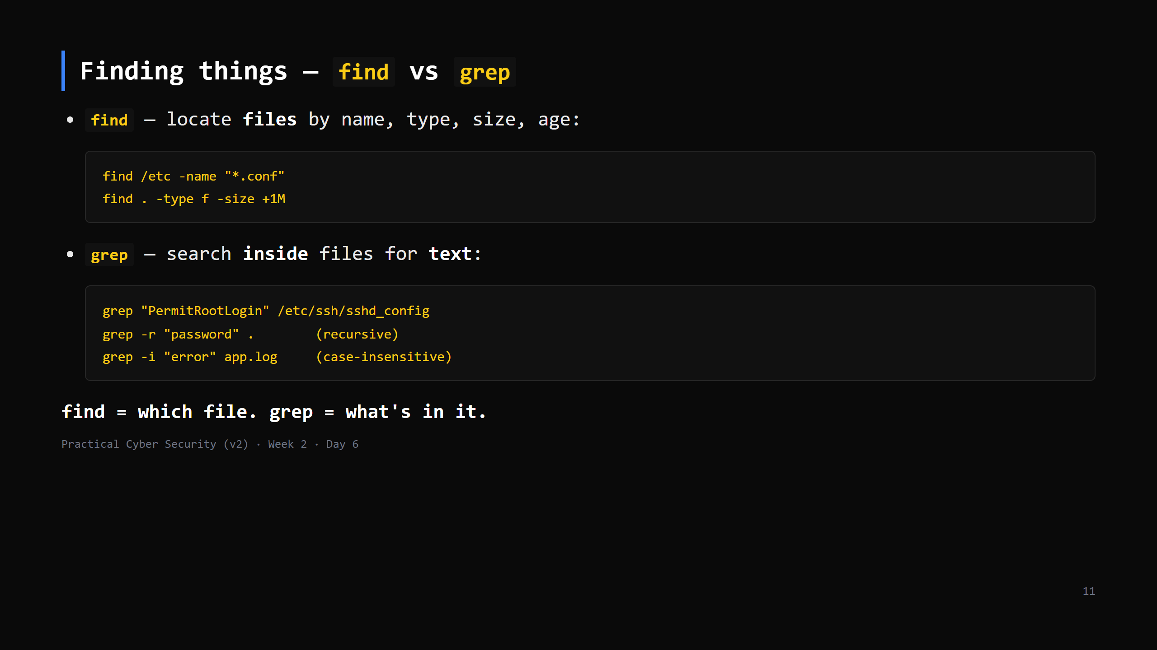
Notes:
This is the distinction students blur. `find` walks the tree matching metadata; `grep` reads contents matching a pattern. Both are everyday tools for the rest of the course. `grep -r` and `-i` are the two flags worth knowing.

Slide 12
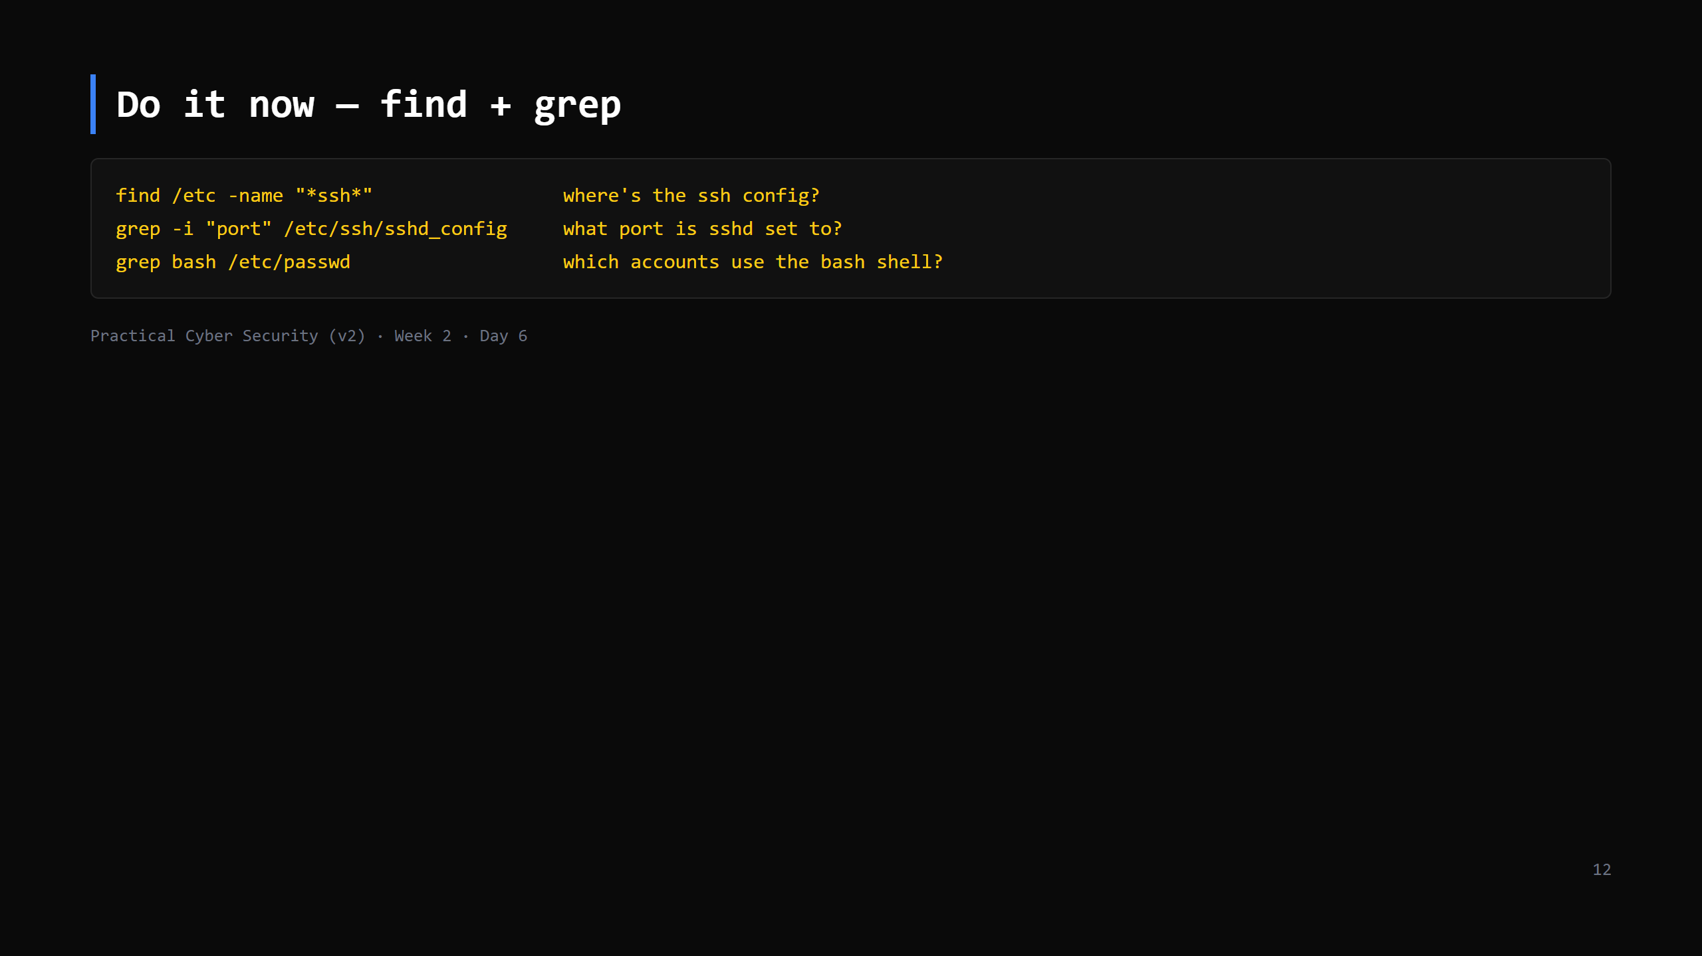
Notes:
6 min. If /etc/ssh/sshd_config doesn't exist (no ssh server installed), use /etc/ssh/ssh_config or any file in /etc. The point is the tool, not the specific file.

Slide 13
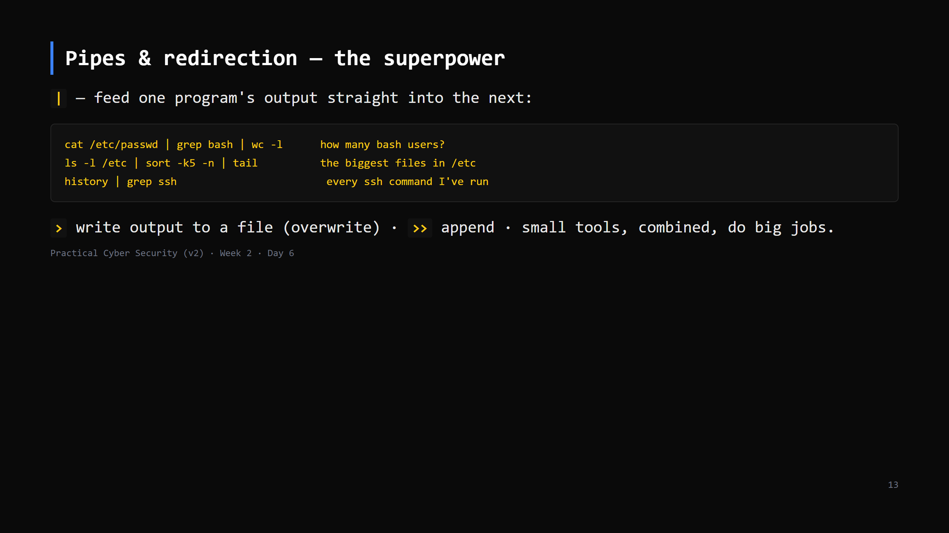
Notes:
THE big idea of Unix: many tiny sharp tools + a pipe. Each program does one thing; you compose. This is also how attackers and defenders both work — chains of small commands. CUT the > >> half first if short — the pipe is the must-teach.

Slide 14
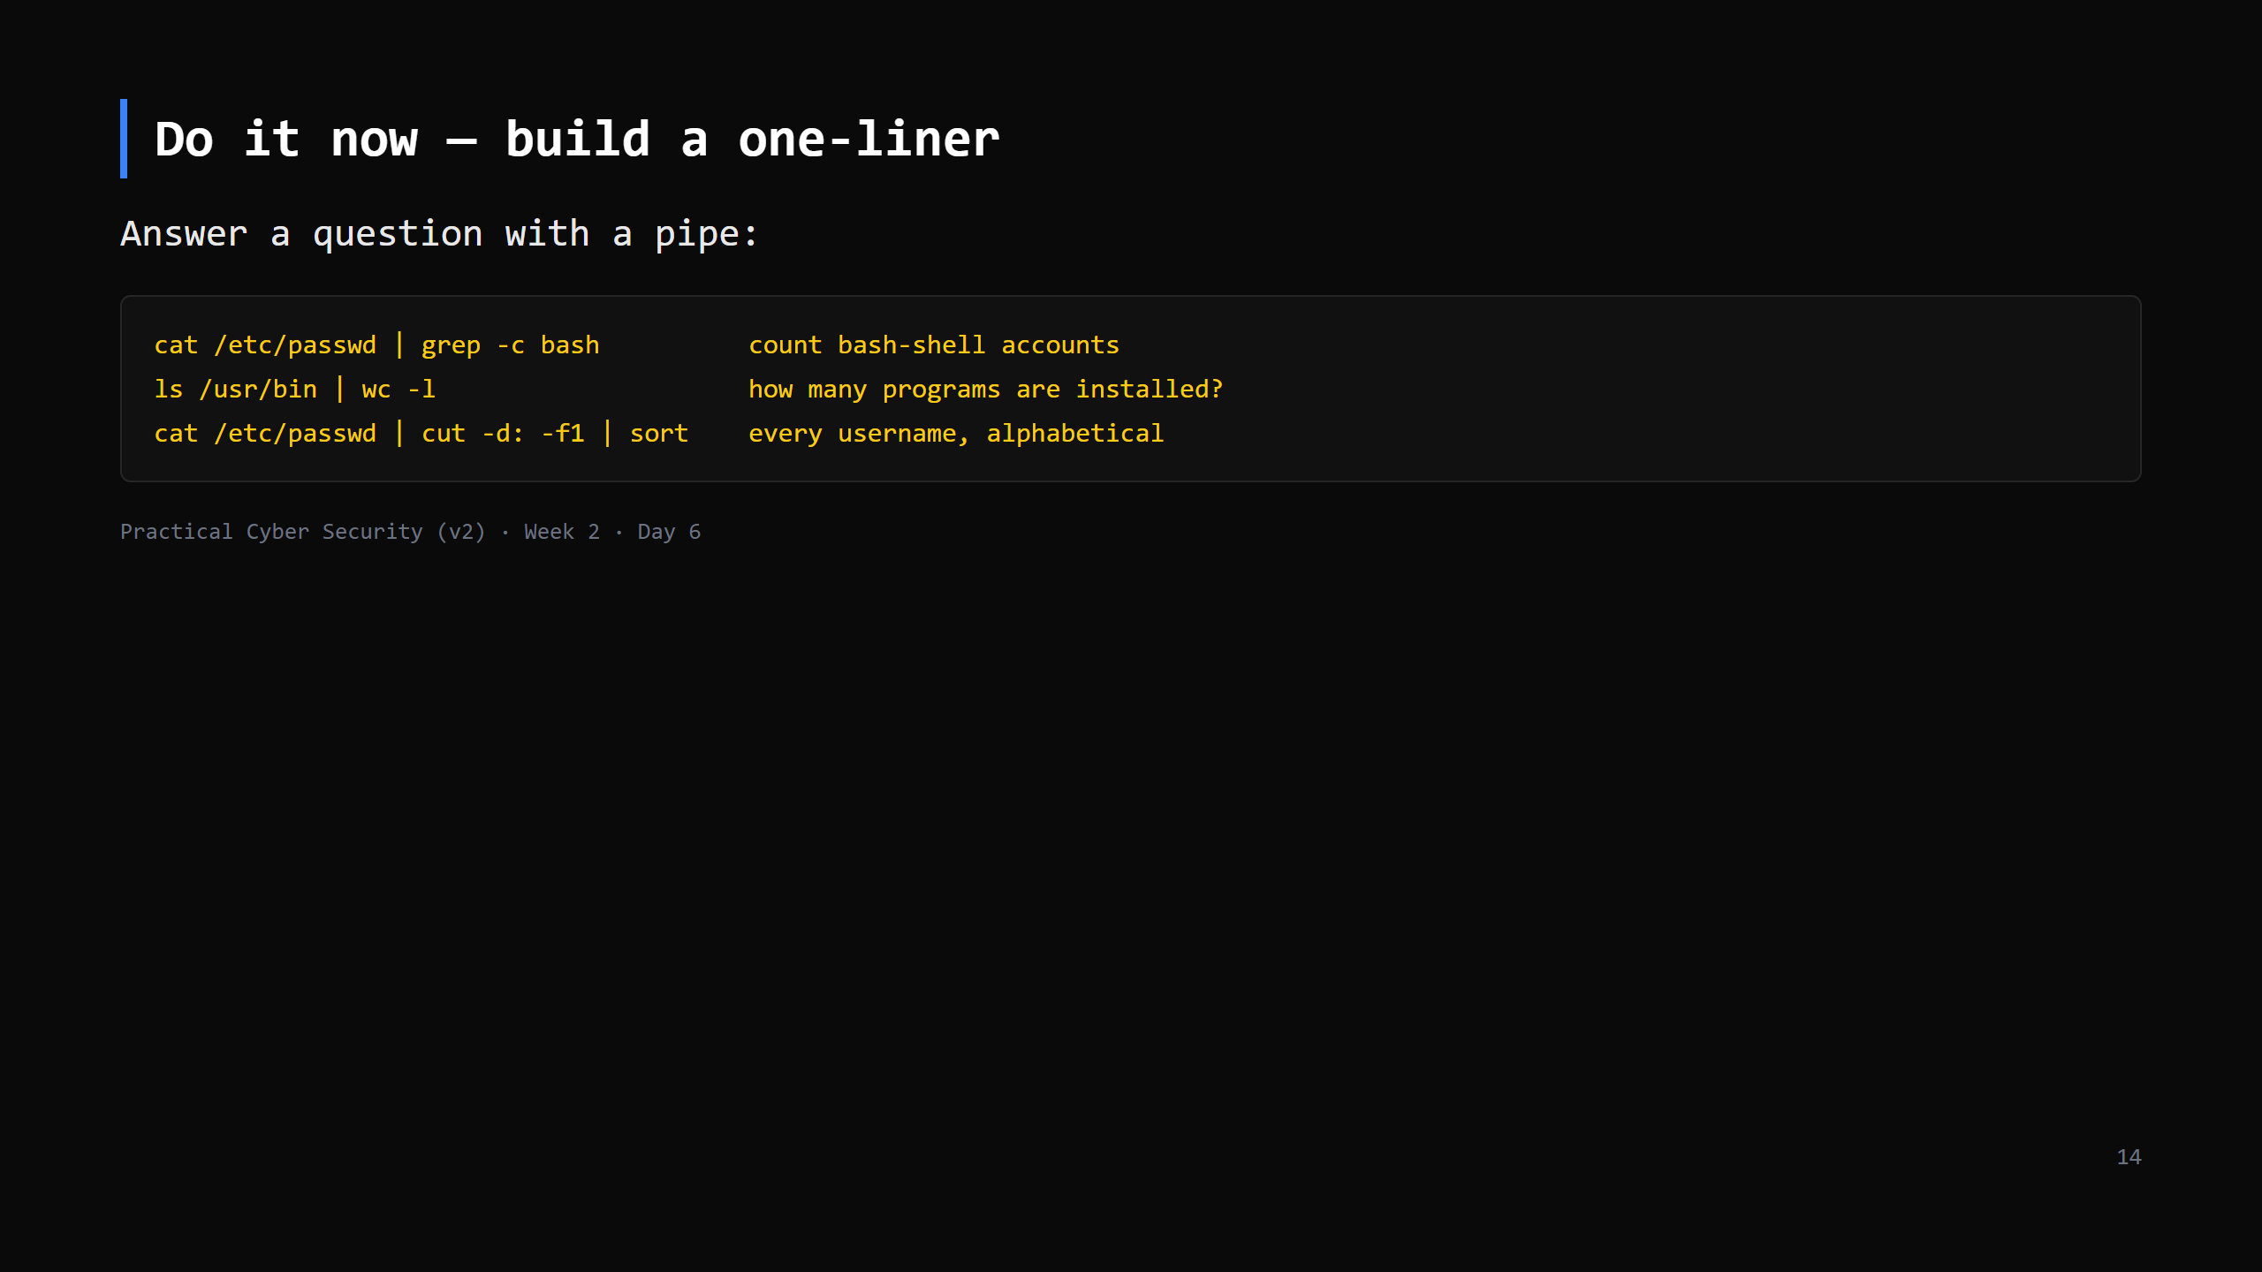
Notes:
6 min. Let them try their own combos. `cut -d: -f1` = "split on colon, take field 1" — nice to introduce here, used again Day 7 and Day 9.

Slide 15
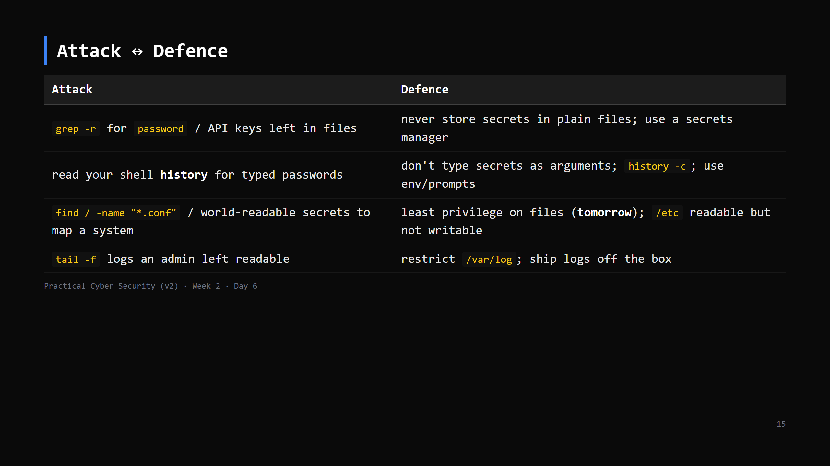
Notes:
Everything an attacker does after getting a shell starts with exactly today's commands — ls, cat, grep, find — to understand where they landed. That's why we learn them first. Forward-ref Day 7 (permissions) and Day 13 (post-shell enumeration).

Slide 16
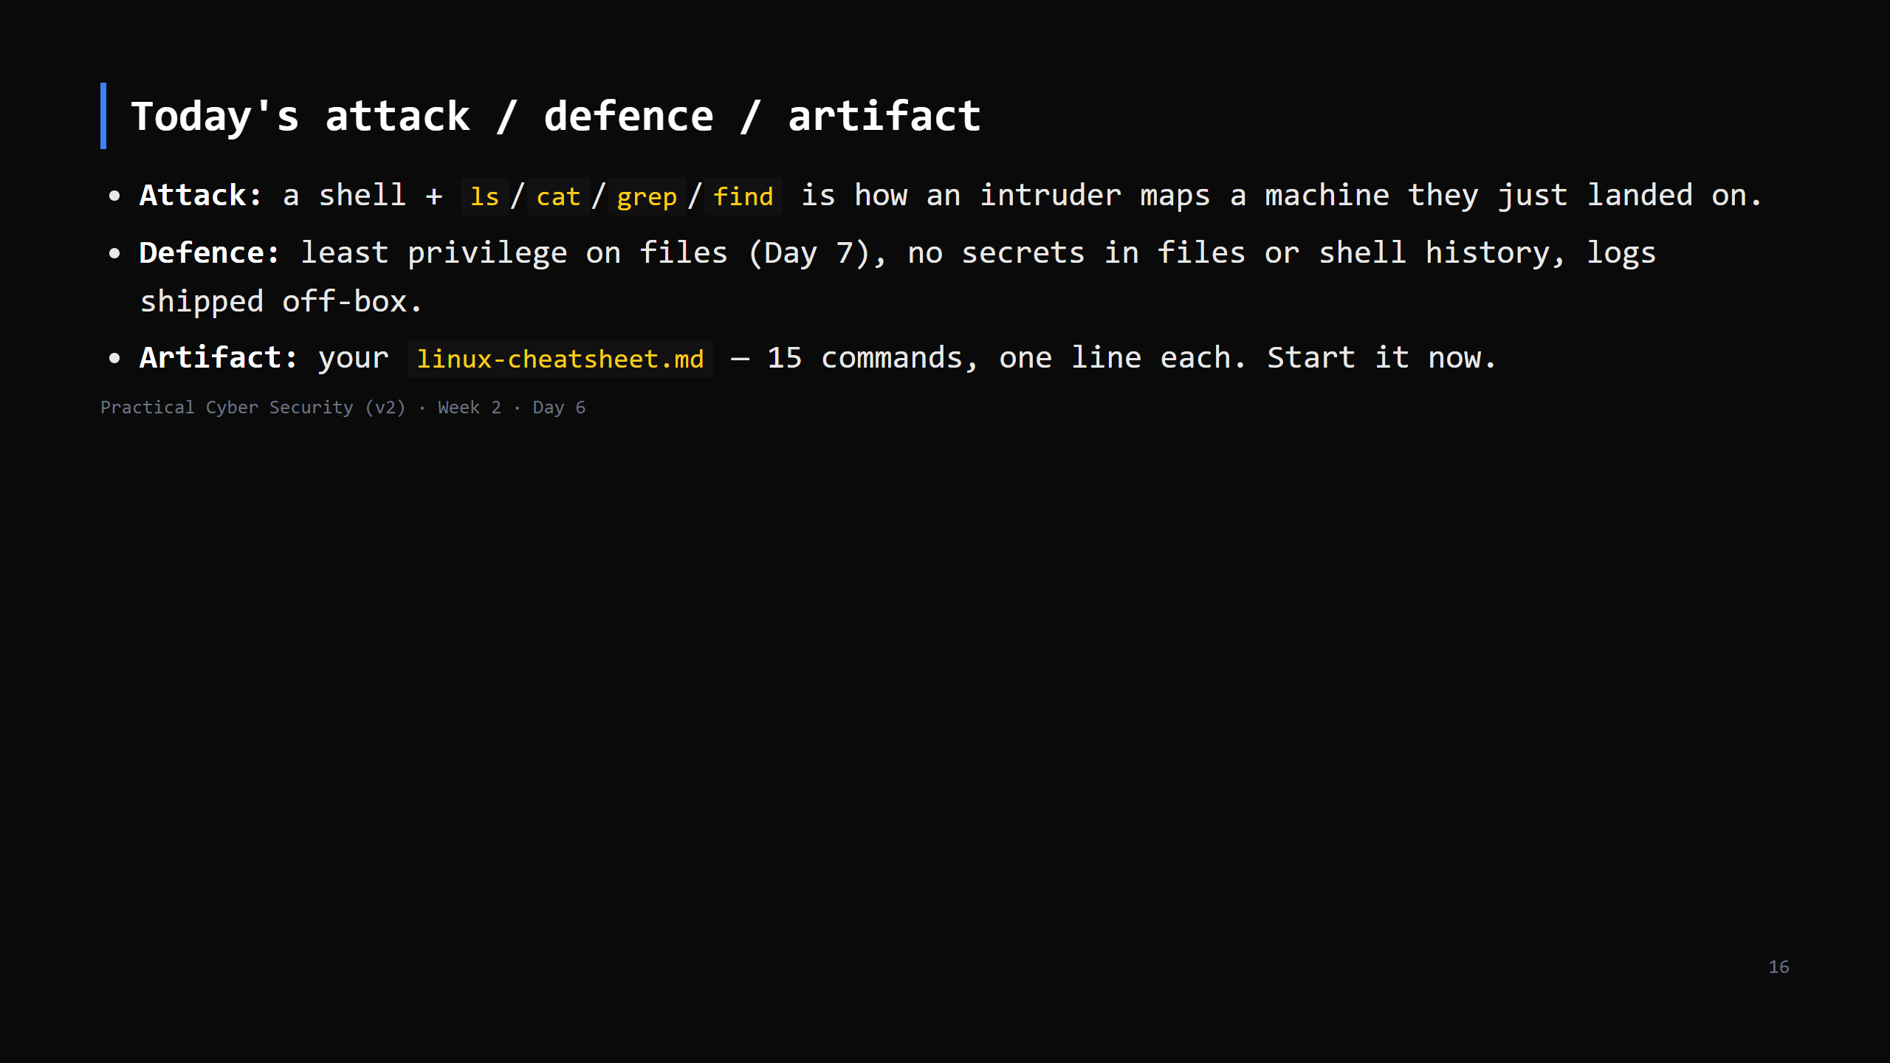

Slide 17
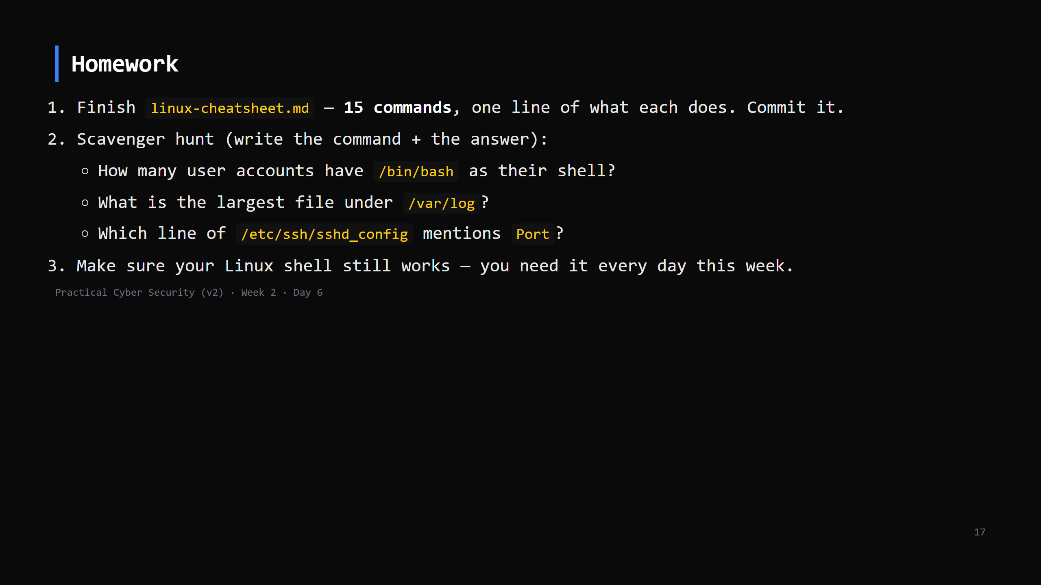
Notes:
Due start of Day 7. Checklist grading in the week-2 student pack.

Slide 18
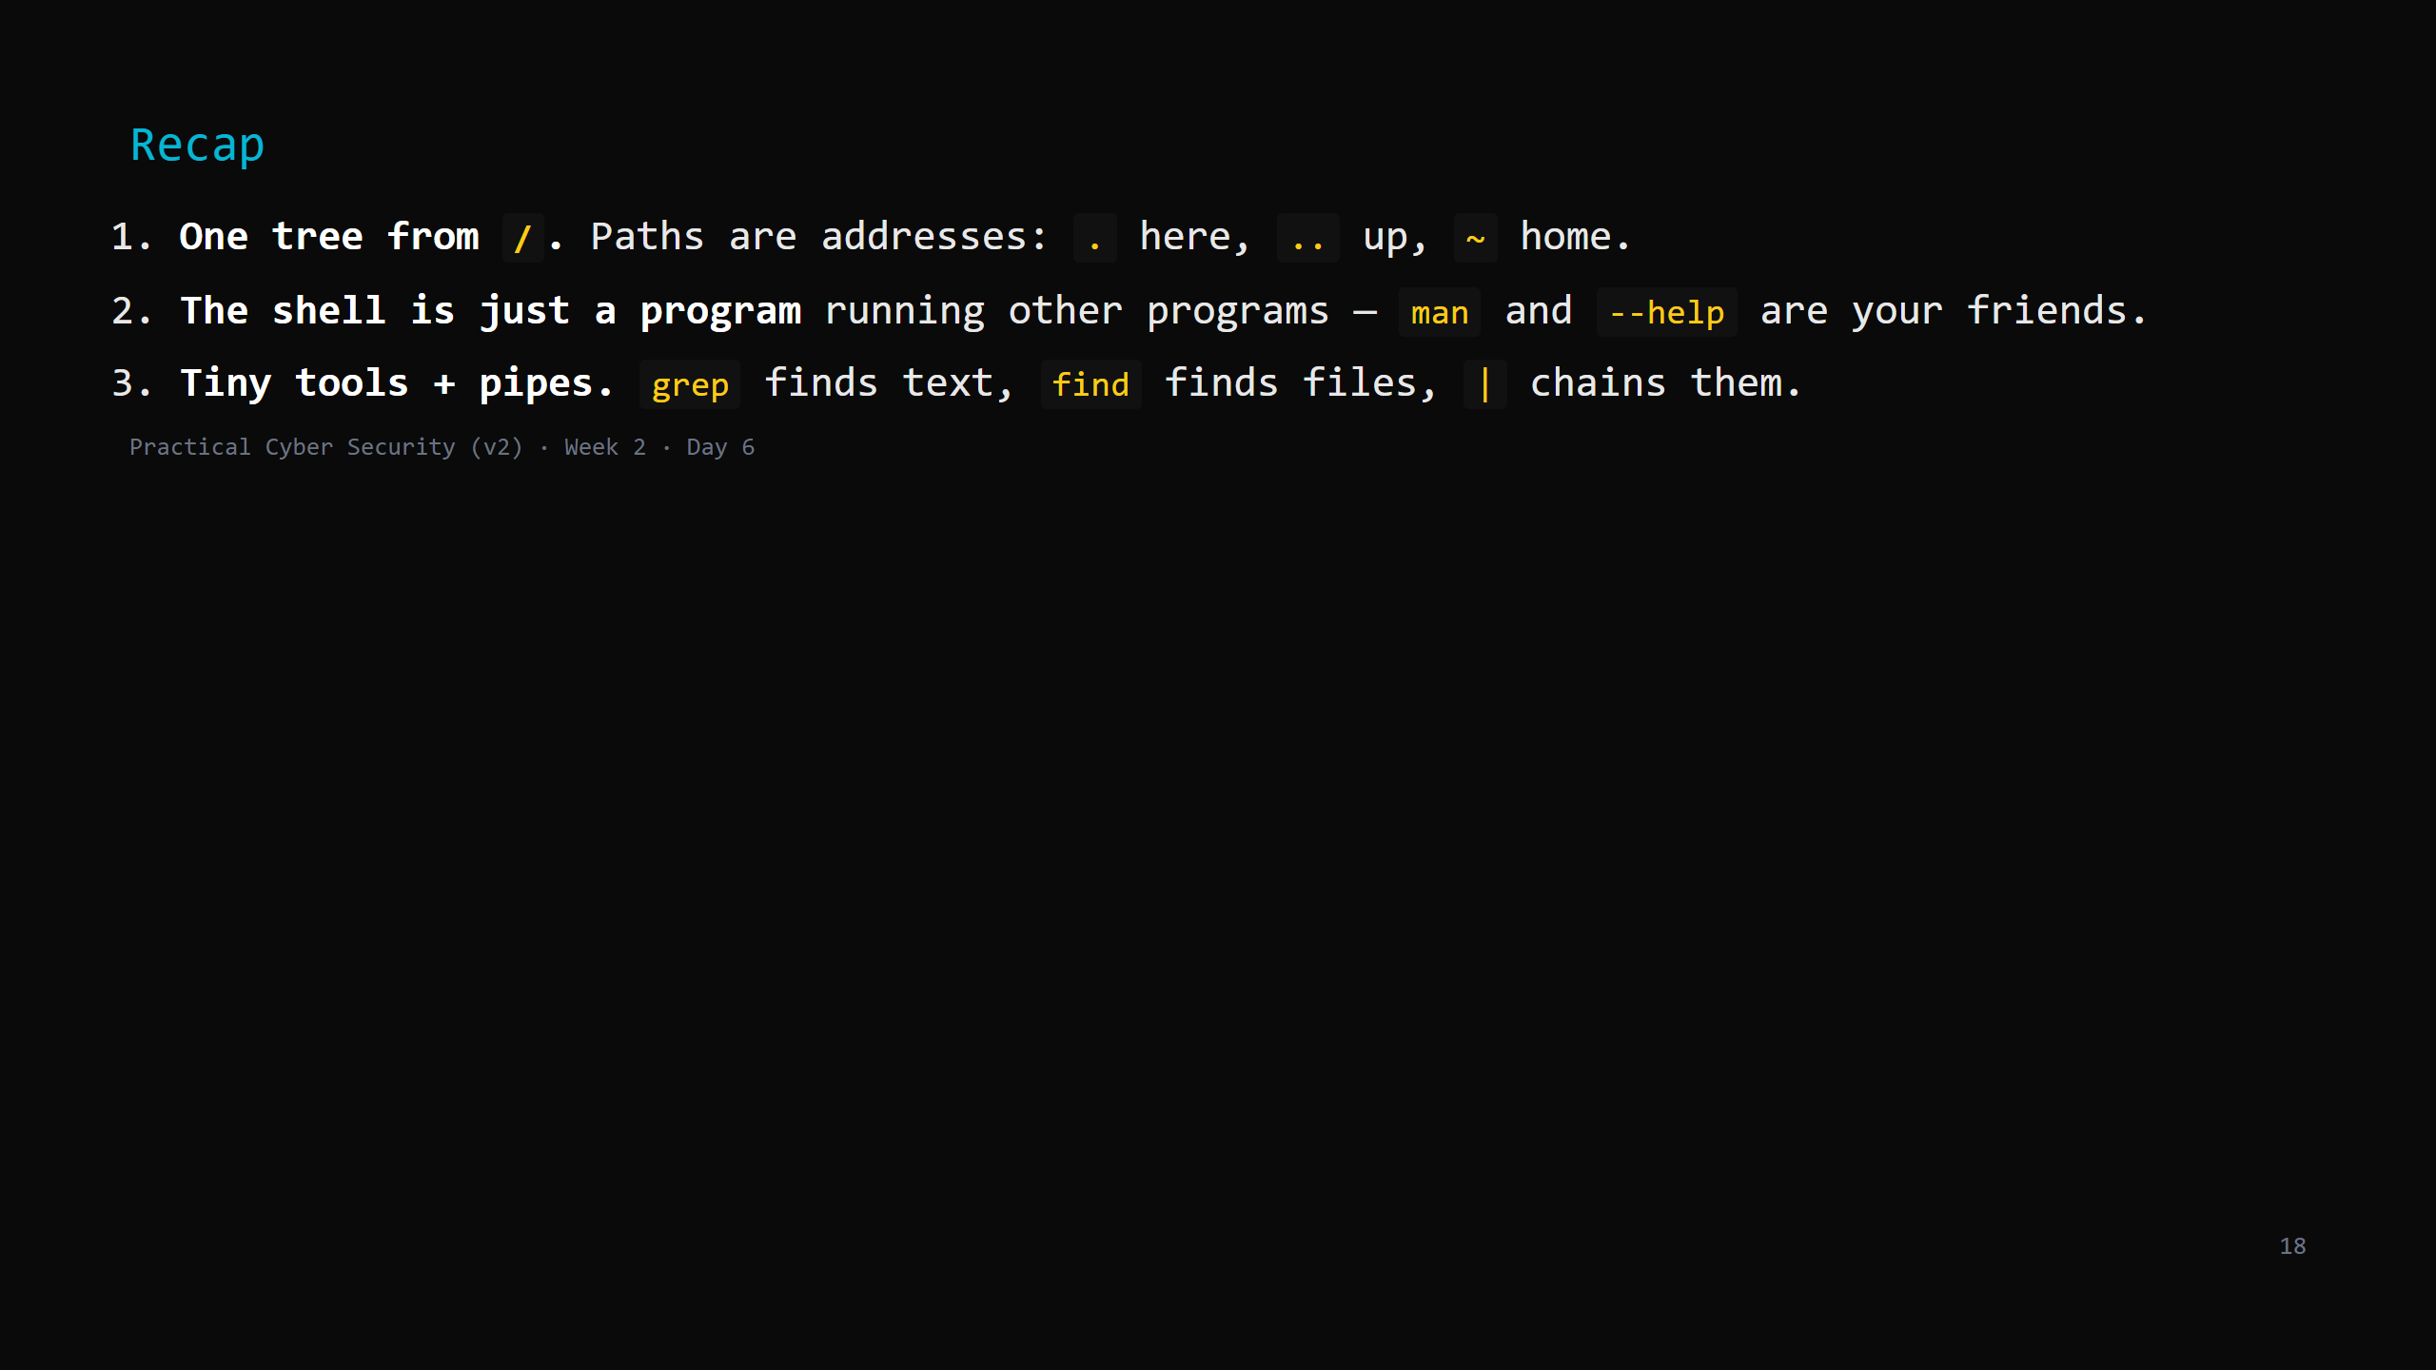
Notes:
Say the three lines. Tomorrow: the permission bits on every one of those files — who may read, write, and run them. The "who can do what" at the centre of security.

