Slide 1
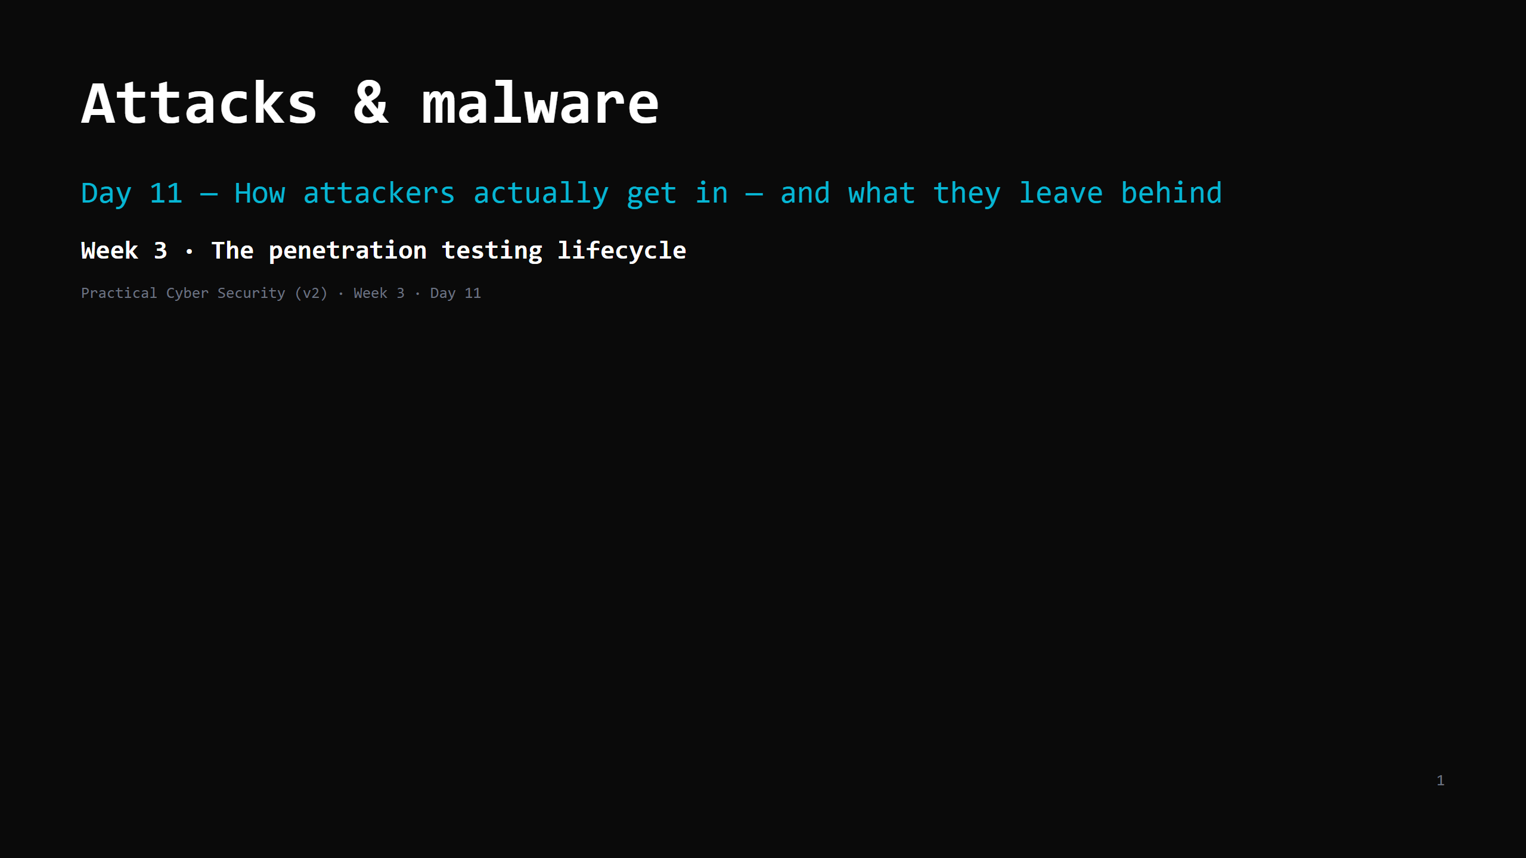
Notes:
RUN SHEET (~85 min). Hands-on: phishing dissection, a connection-log analysis, then the LAB KICKOFF.
00:00 Journey check + hook (spot the phish) 4
00:04 The short list — how attackers get in 5
00:09 Social engineering & phishing (#1) 9
00:18 DO: dissect a phishing email 8
00:26 Credential attacks 7
(HIBP check = HOMEWORK by default, to make room for the lab)
00:33 Malware families — by behaviour, not "virus" 10
00:43 DO: spot the C2 beacon in a connection log 8
00:51 MITM, DoS/DDoS, supply chain (kept to 3 min) 3
00:54 Attack <-> defence: the 6 ways in (the artifact) 6
01:00 "We'd notice" — dwell time 4
01:04 LAB KICKOFF: the map (2 diagrams) + start Step 1 12
01:16 Wrap + homework 5
CUT FIRST IF SHORT: the C2 DO to 5 min (do the beacon as a class); the credential sub-types.
NEVER CUT: the short list, phishing anatomy + the dissection DO, the malware behaviour taxonomy,
the 6-ways-in table, dwell time, the lab-map diagram walk-through (it frames Days 12-15).
LIVE DIAGRAMS (folder archify/ — open both in browser tabs BEFORE class; each has view buttons
that step through the story, and a light/dark toggle for the projector):
01-lab-architecture.html -> 'Your lab' slide (3 views: three networks / attack path / kept private)
02-scan-traffic.html -> same slide, after the map (3 views: find it / knock on ports / read + look up)
ANALOGY (kitchen): the ways a thief gets into the restaurant — talks past the host (phishing),
uses a copied key (stolen creds), the back door nobody fixed (unpatched), a window left open
(misconfig), a poisoned delivery (supply chain), jamming the phone lines (DoS). Malware = what
they bring in or leave behind.

Slide 2
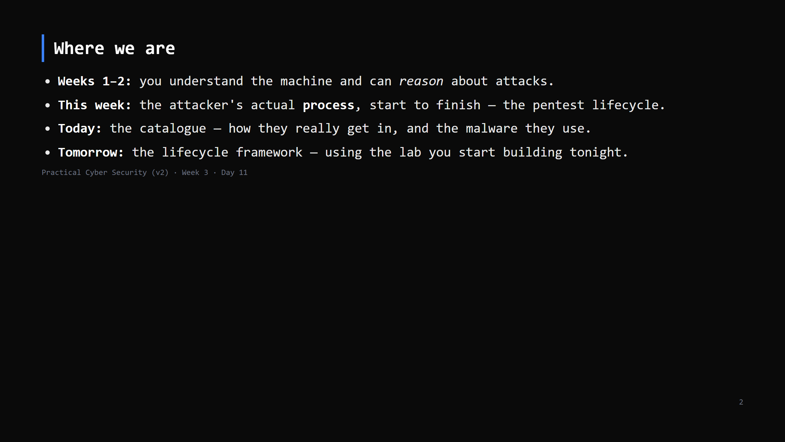
Notes:
Journey Check. Week 3 opens. Frame: "movie hacking" is rare. Real breaches are boring and
repeatable — that's good news, because boring and repeatable can be defended.

Slide 3
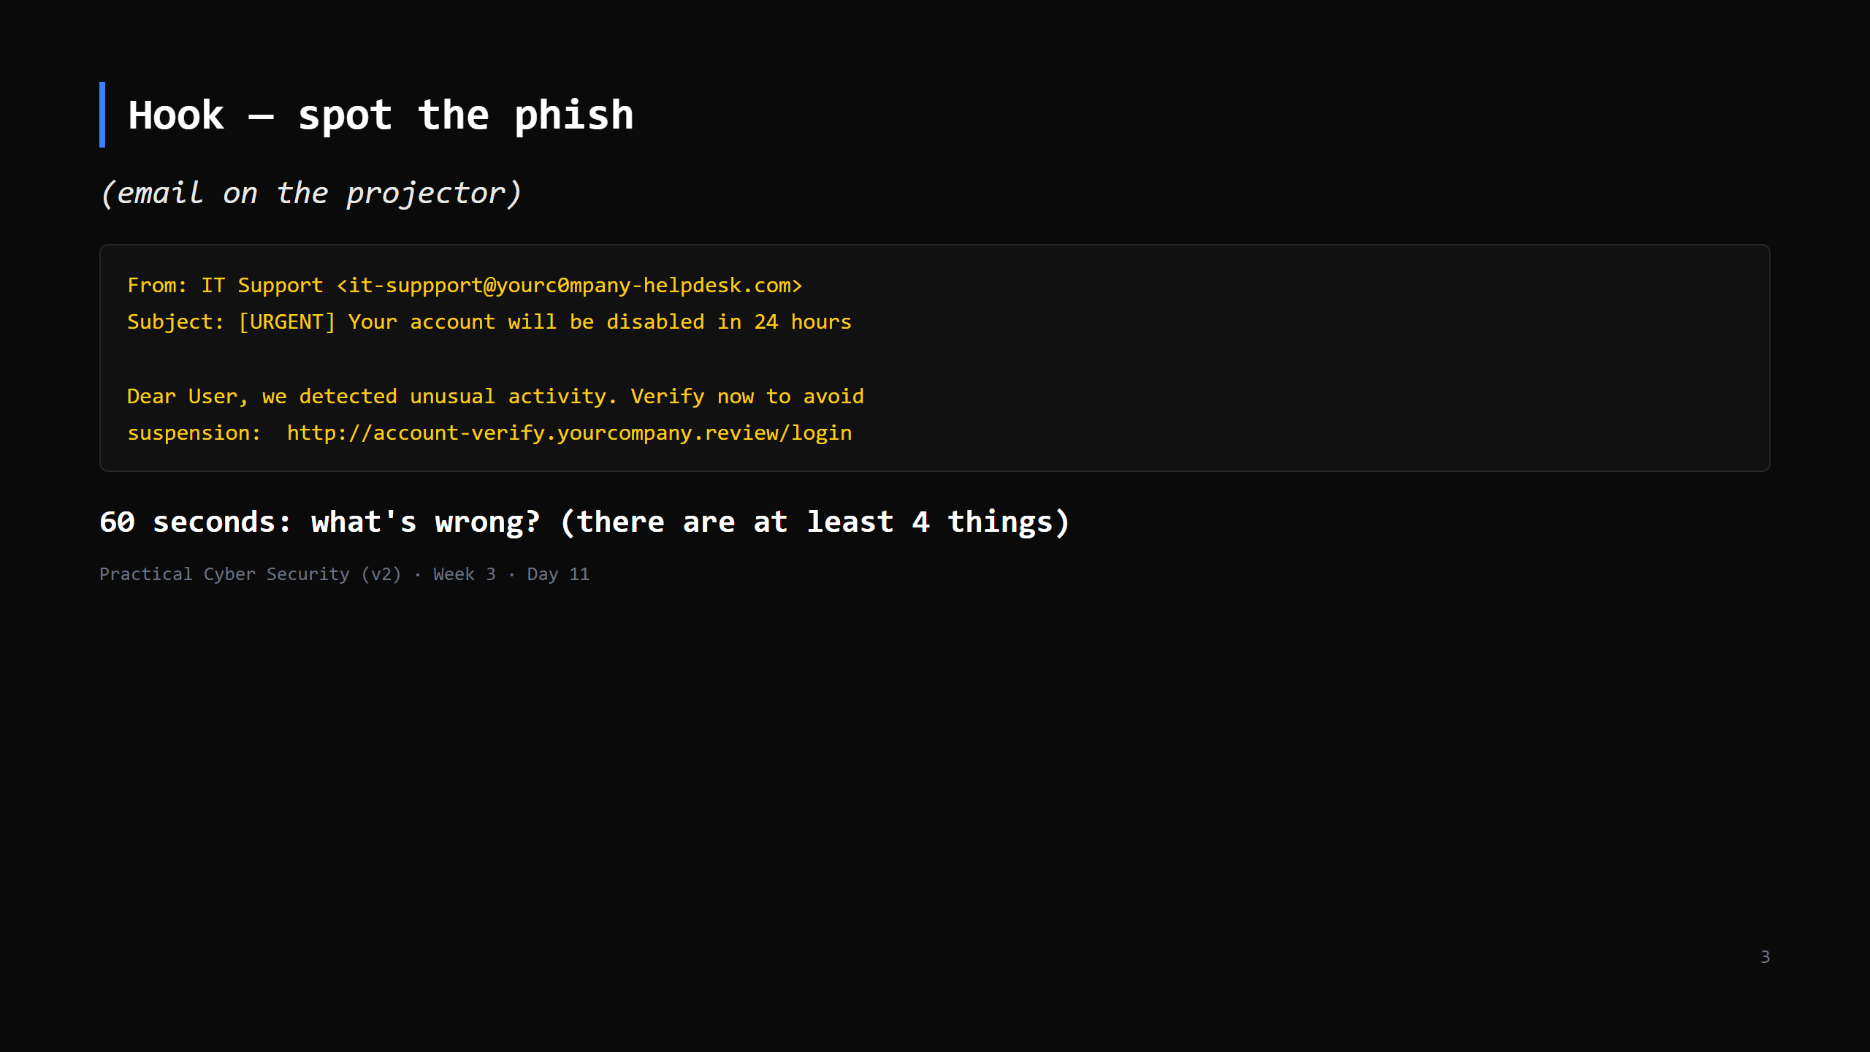
Notes:
Answers: misspelled "suppport"; lookalike domain (yourc0mpany, .review TLD); manufactured
urgency + fear; the link text vs where it goes; generic "Dear User". Take shouts, then move on.

Slide 4
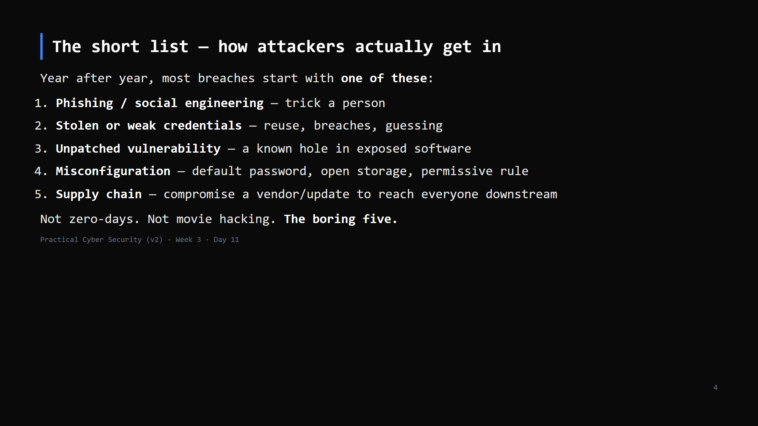
Notes:
This is the mental model for the whole week. When you assess a system (Days 12-15) or defend
one (Week 4), you're mostly working this list. Everything today is a variety of one of these.

Slide 5
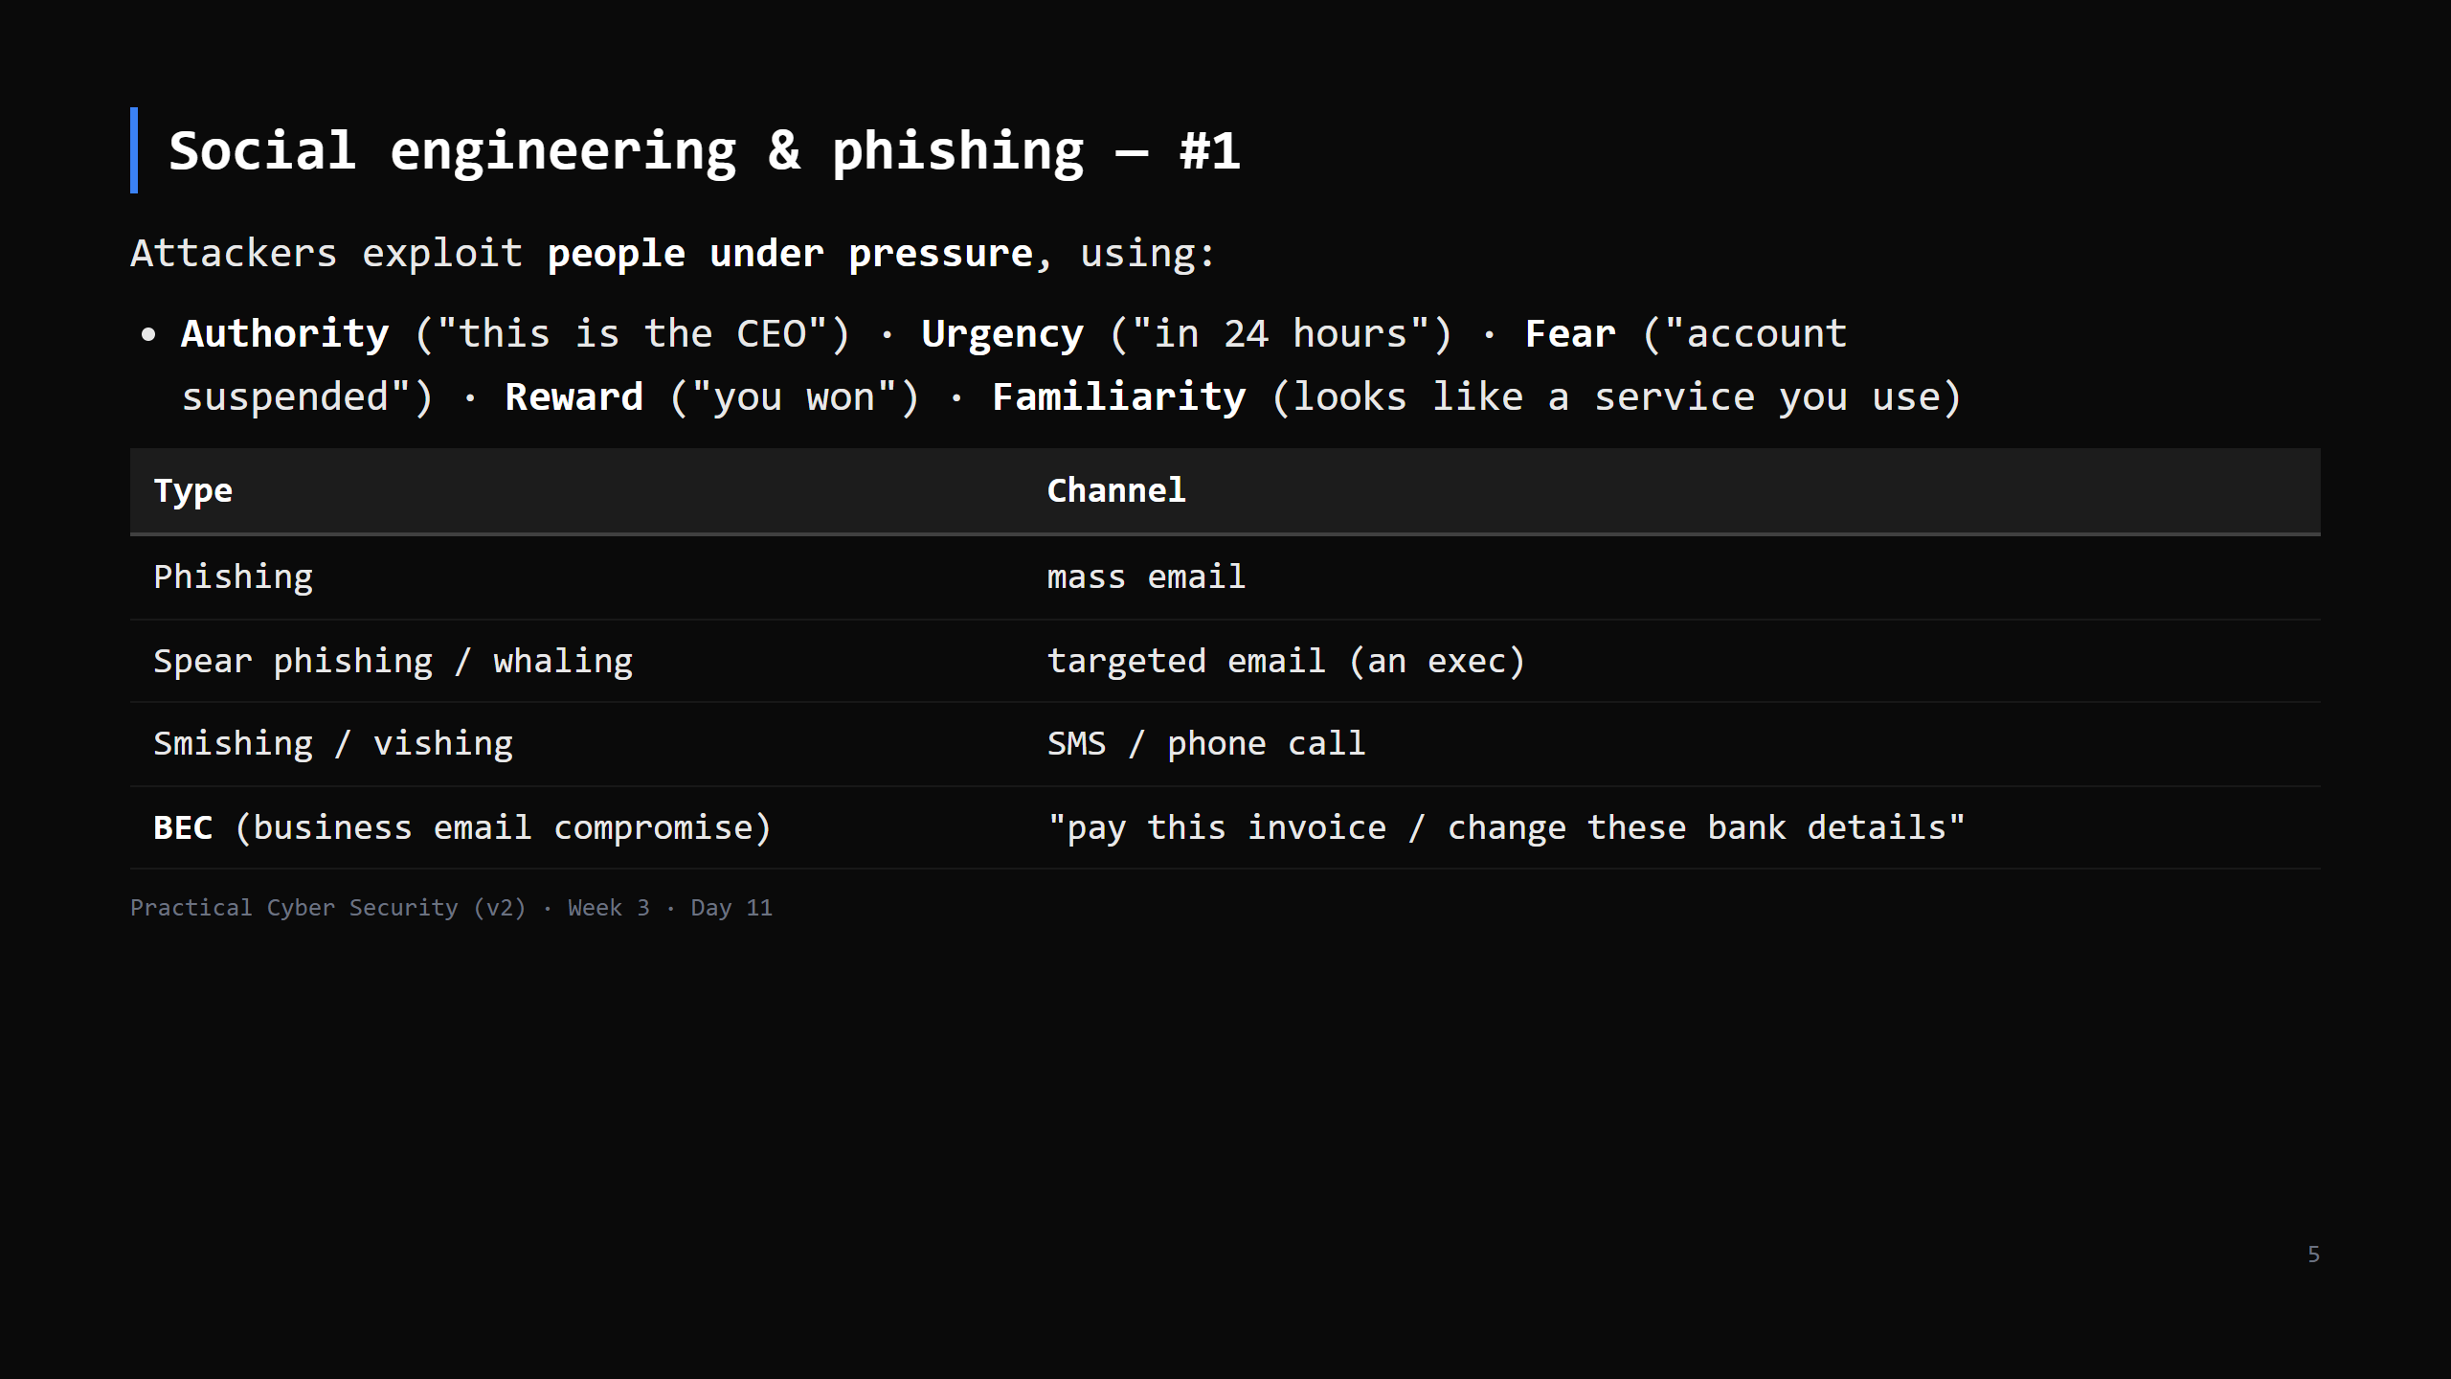
Notes:
Phishing works on everyone — it's not about intelligence, it's about catching someone busy,
stressed, or distracted. BEC has no malware at all — pure social engineering — and causes
enormous financial losses.

Slide 6
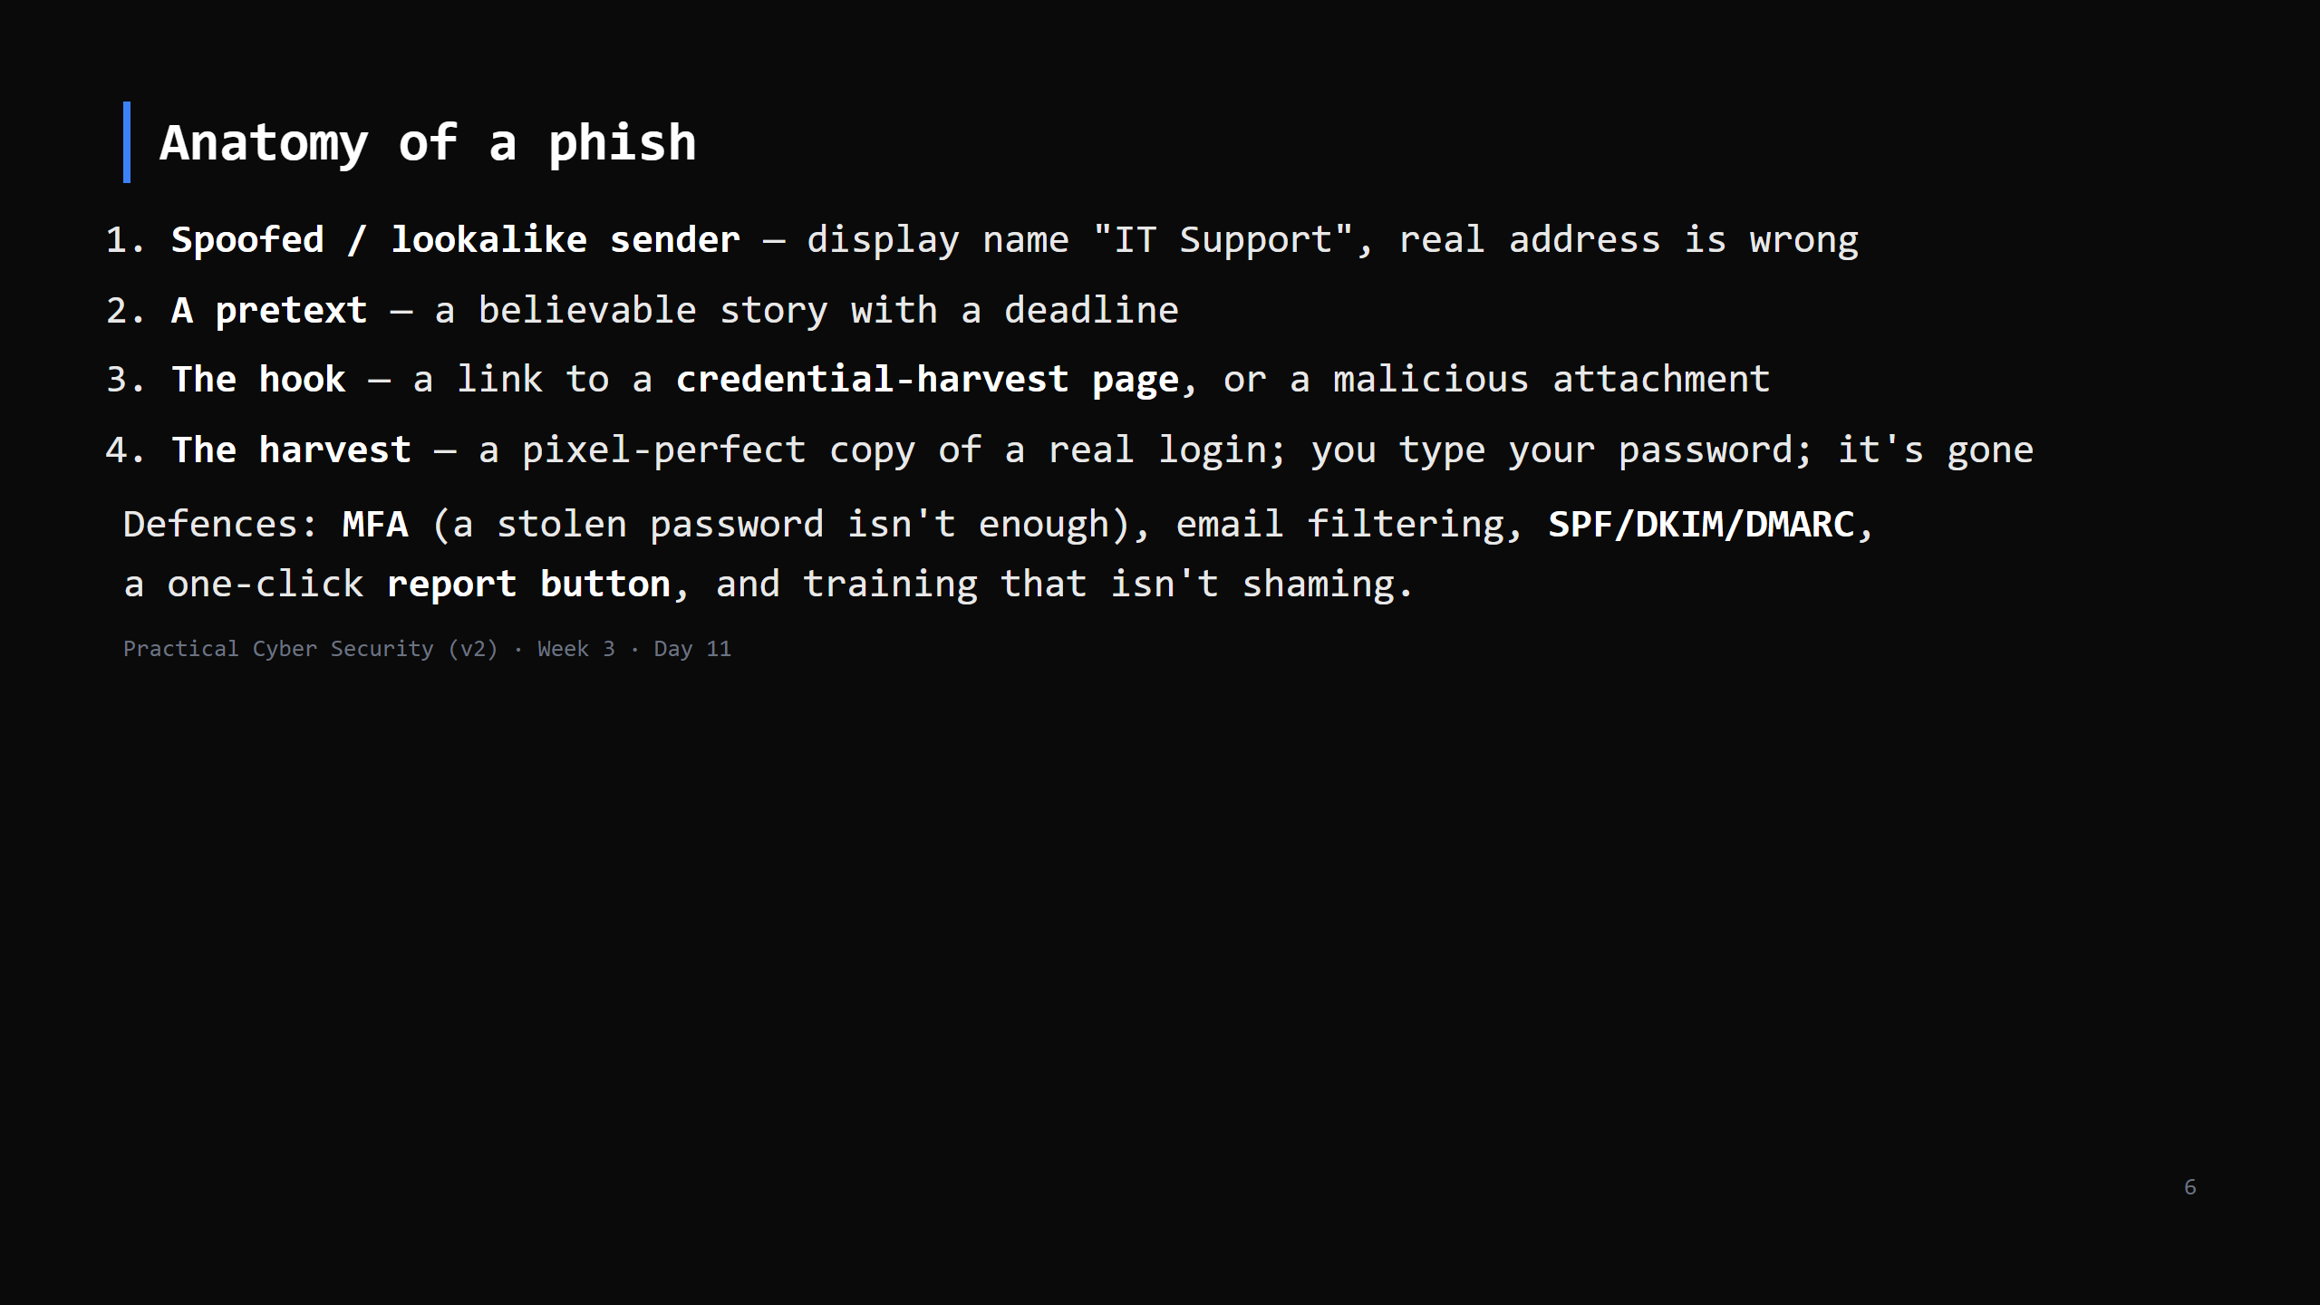
Notes:
MFA is the single highest-value control here — it breaks step 4.

Slide 7
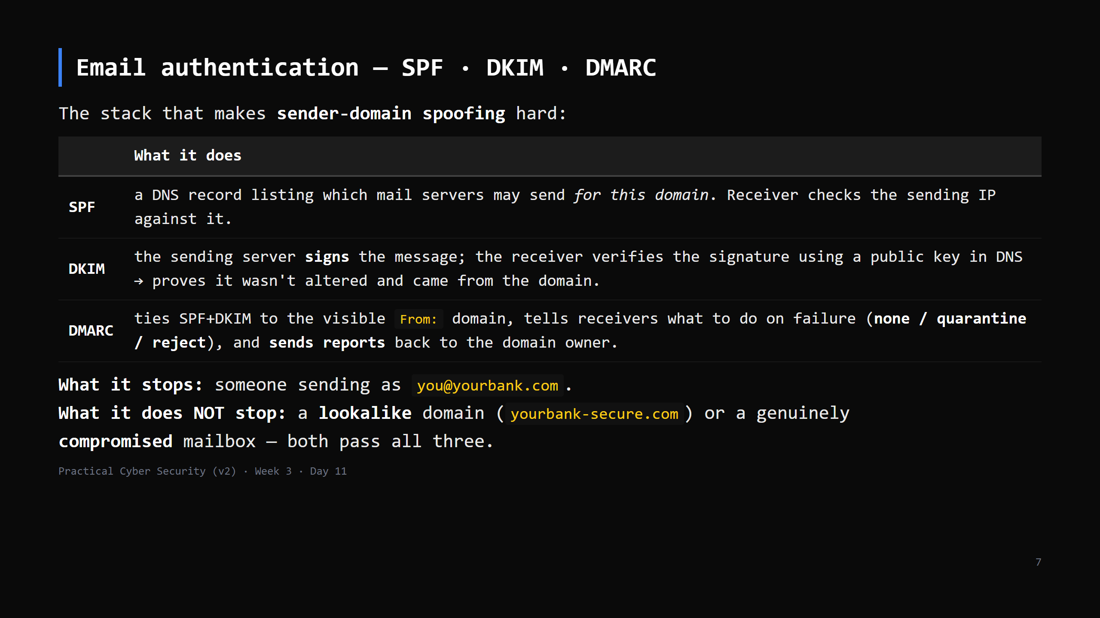
Notes:
Reading a header: `Received:` chain shows the real path; `Authentication-Results:` shows
spf=pass/fail, dkim=pass/fail, dmarc=pass/fail. The Day-11 phish dissection asset asks about
exactly these fields. Most SOC L1 work is triaging reported phish — this is the check they run.
CUT to the one-line summary if behind: "SPF/DKIM/DMARC stop domain spoofing, not lookalikes or
a hacked account."

Slide 8
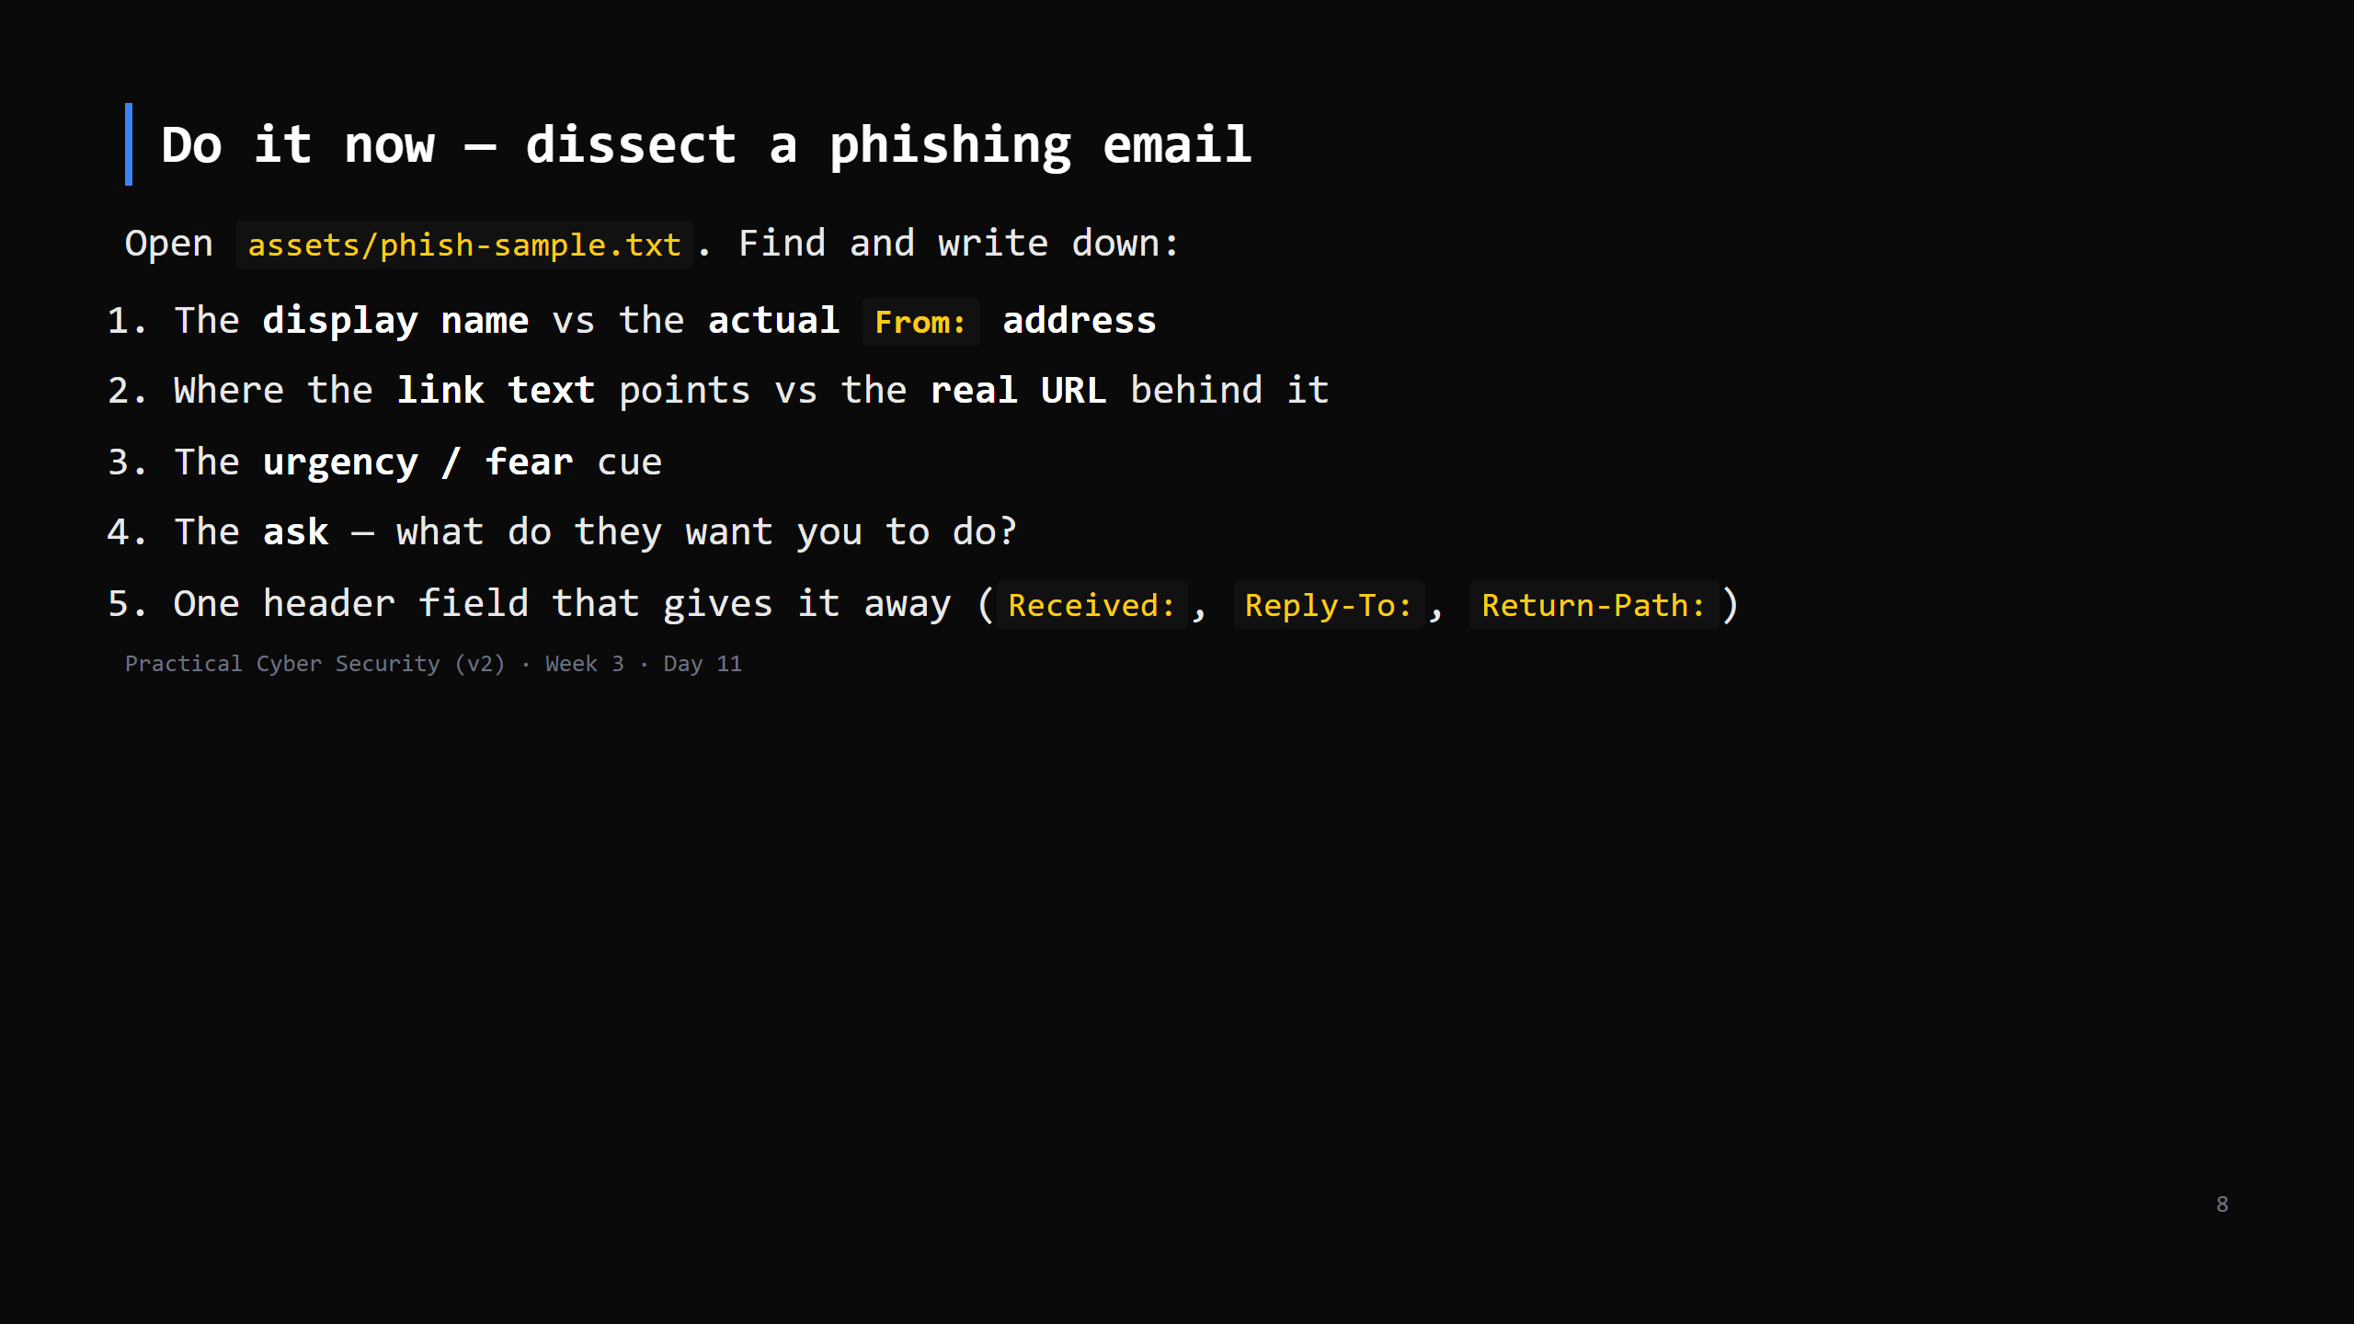
Notes:
8 min. The sample is a defanged real-style phish with full headers. Walk the Received chain —
it originated somewhere unrelated to the claimed sender. Reply-To often differs from From in
BEC. This is exactly what a SOC analyst does on an alert (Day 19).

Slide 9
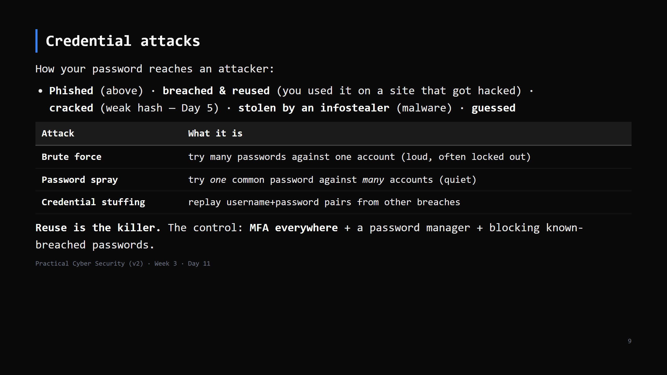
Notes:
Credential stuffing is why "but my password is strong" doesn't save you — if you reused it and
the other site leaked, attackers just log in. MFA is the fix that actually scales.

Slide 10
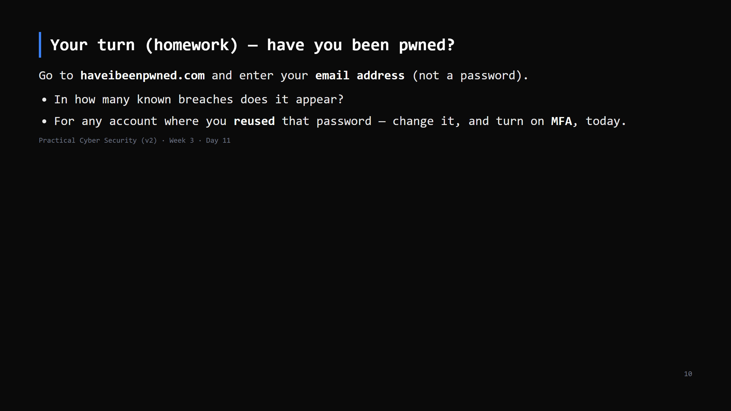
Notes:
HOMEWORK by default now (the lab kickoff needs the time). 30 s to set it up: HIBP is Troy Hunt's
breach-aggregation service — safe, reputable, email only, never a password. Most students will
have 2-10 hits. Make the action concrete: the reused ones are the danger.
If you finish early, run it in class (4 min).

Slide 11
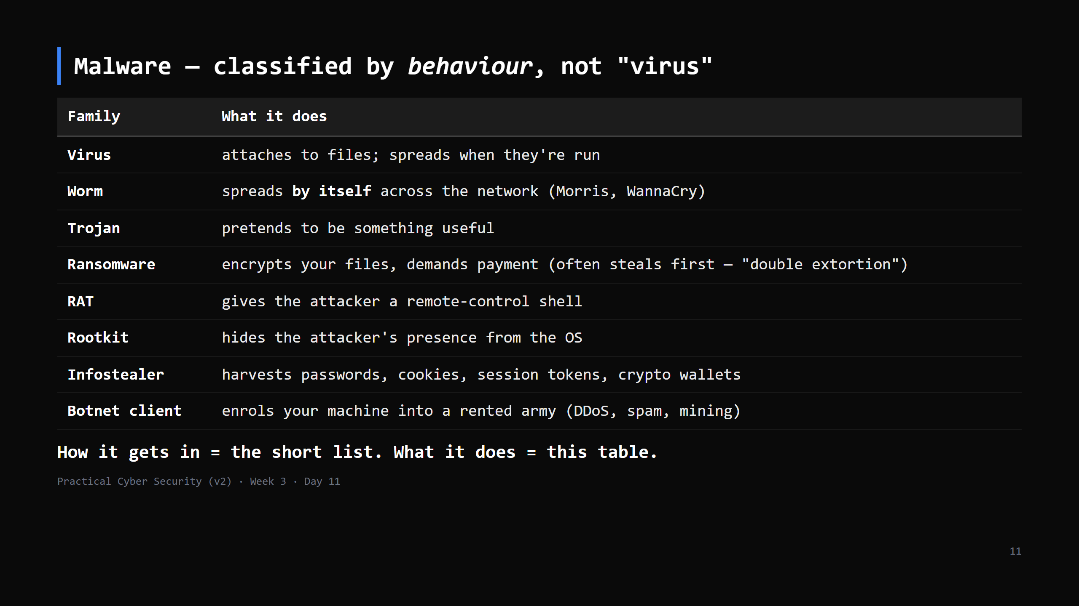
Notes:
The Day 11 TRAP: "malware = virus". Virus is one small category. Modern crime is ransomware +
infostealers + RATs. Separate DELIVERY (phishing/exploit/supply chain) from PAYLOAD (this
table) — a phish can deliver any of these.

Slide 12
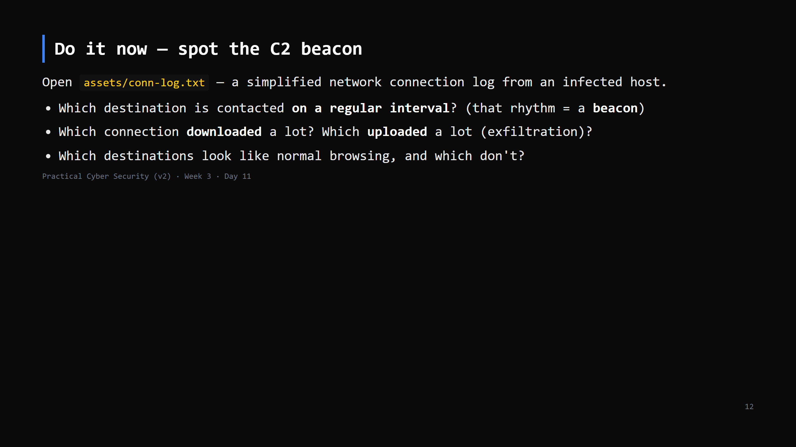
Notes:
8 min. The log has: normal web traffic + one host contacted every ~60s (the C2 beacon) + one
big download (the payload) + one big upload to an odd host (exfil).
On Day 13 you'll see this live in Wireshark. Today: the pattern. This is the bridge to Blue team.

Slide 13
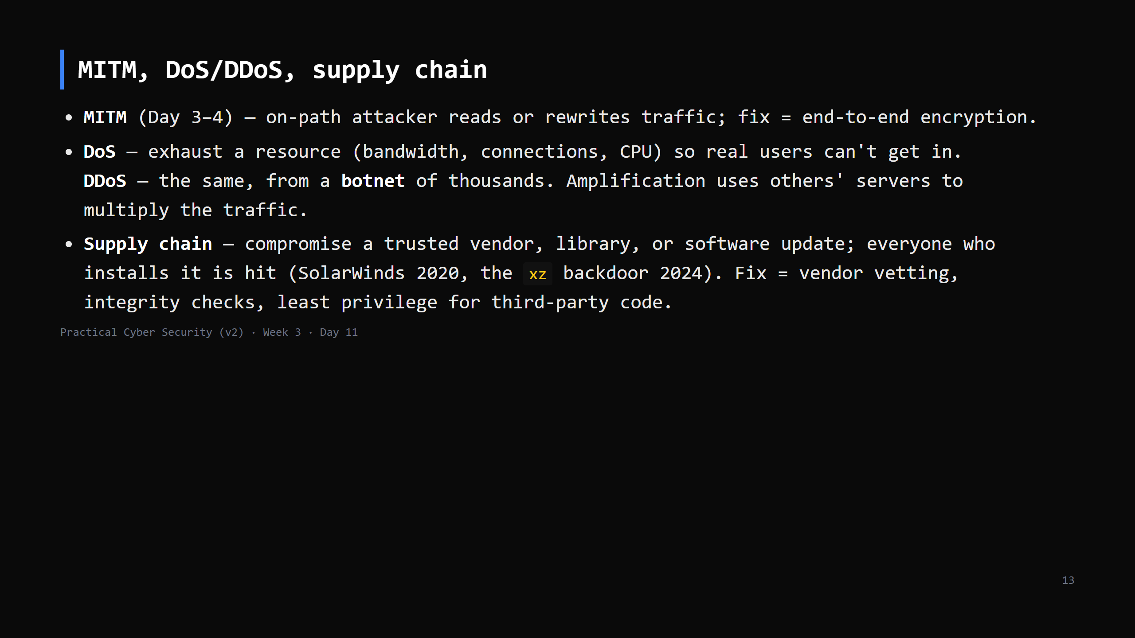
Notes:
Mostly callbacks — keep it brisk. Supply chain is the scariest because the malicious code
arrives *signed and trusted*. Keep to 3 min today (lab kickoff needs the time).

Slide 14
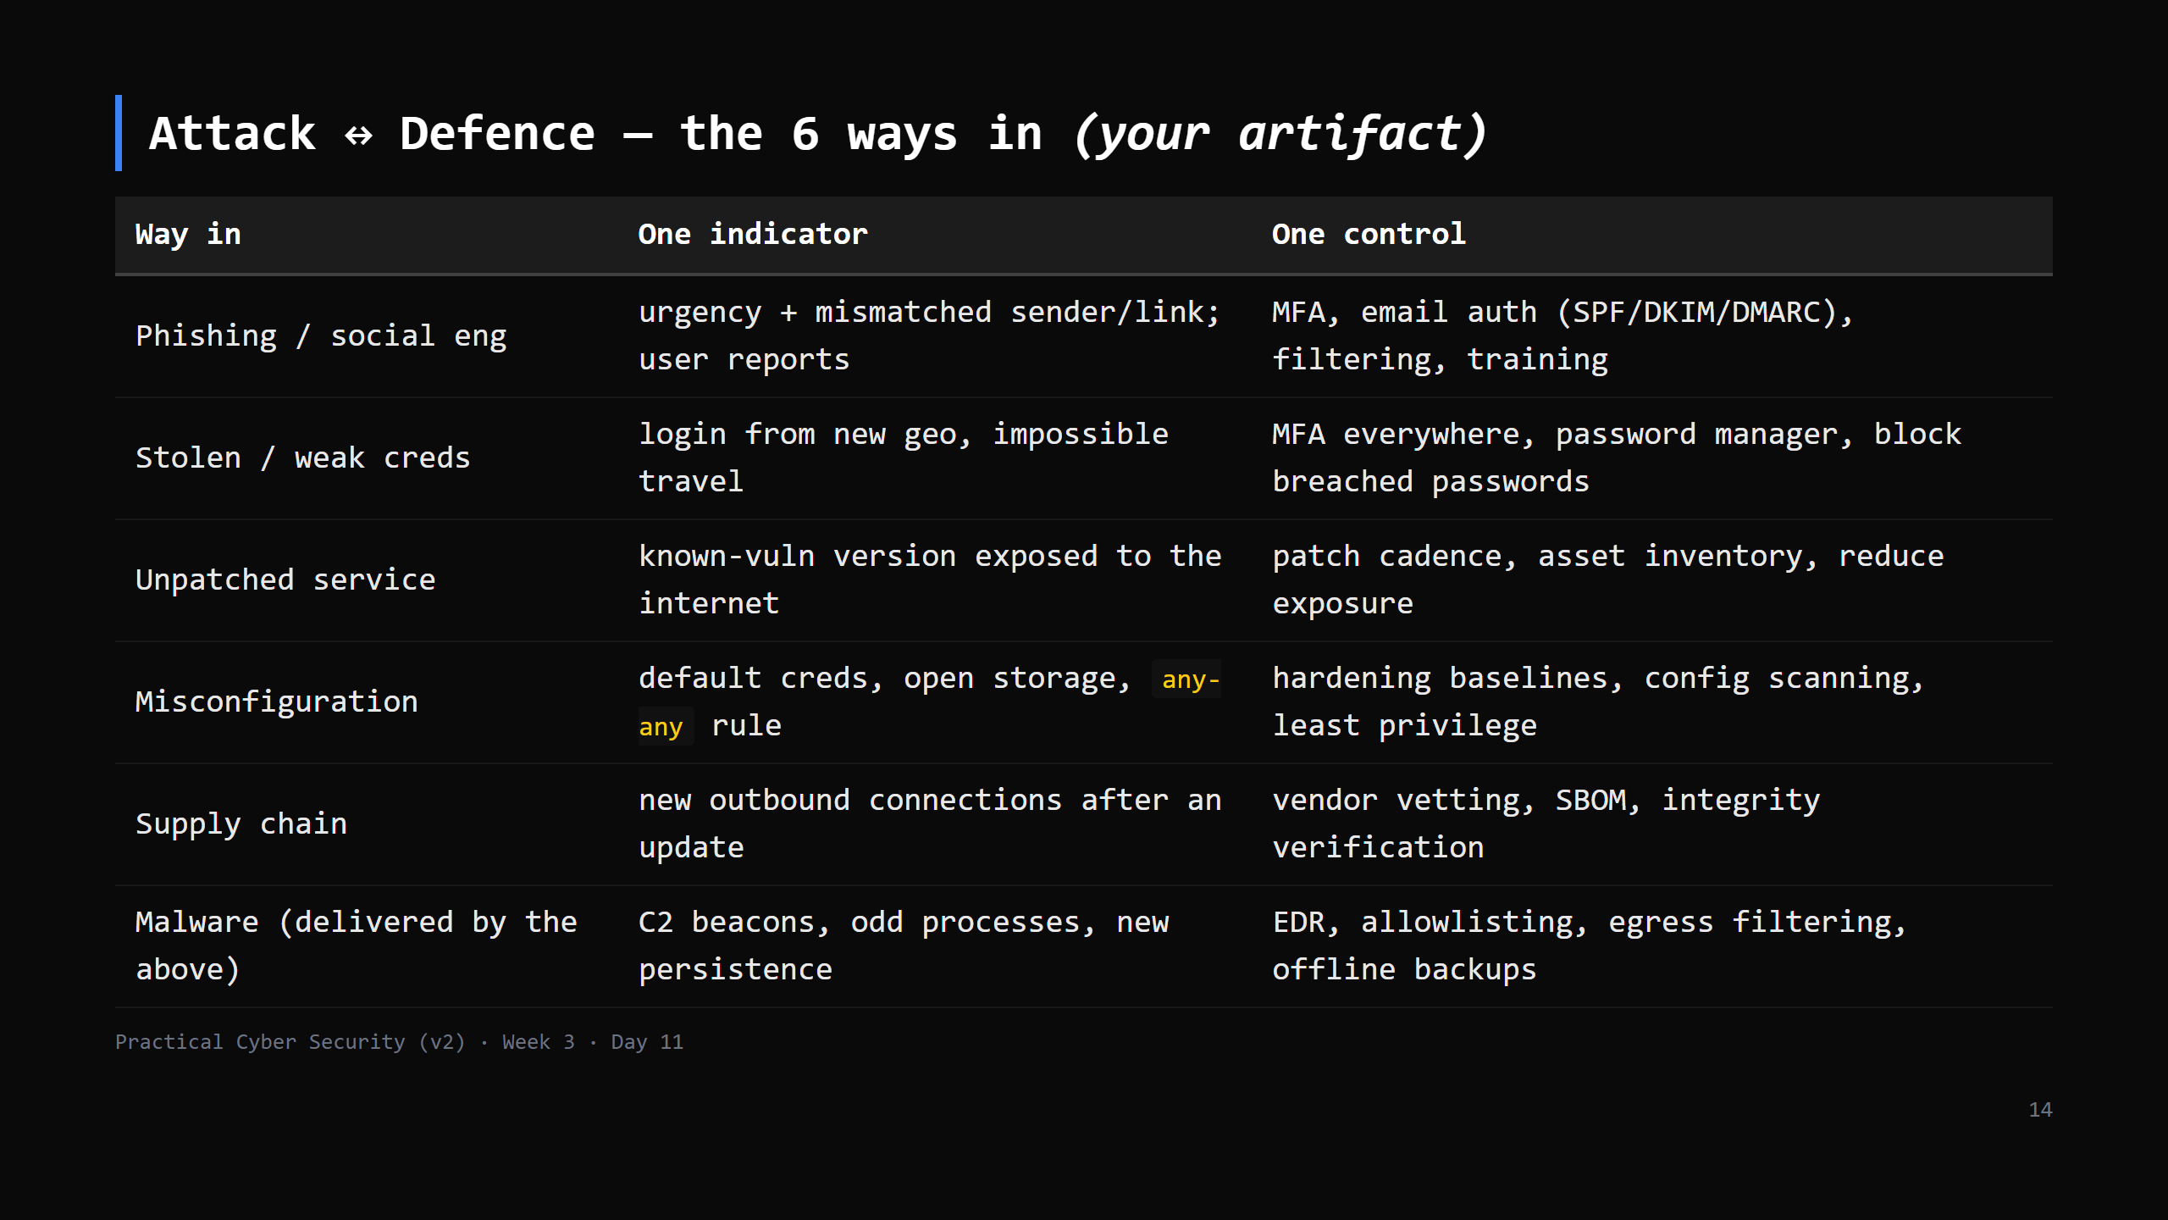
Notes:
This table IS the artifact. Students copy it, in their own words, to day11/ways-in.md.
Every Week-4 defence day maps back to a row here.

Slide 15
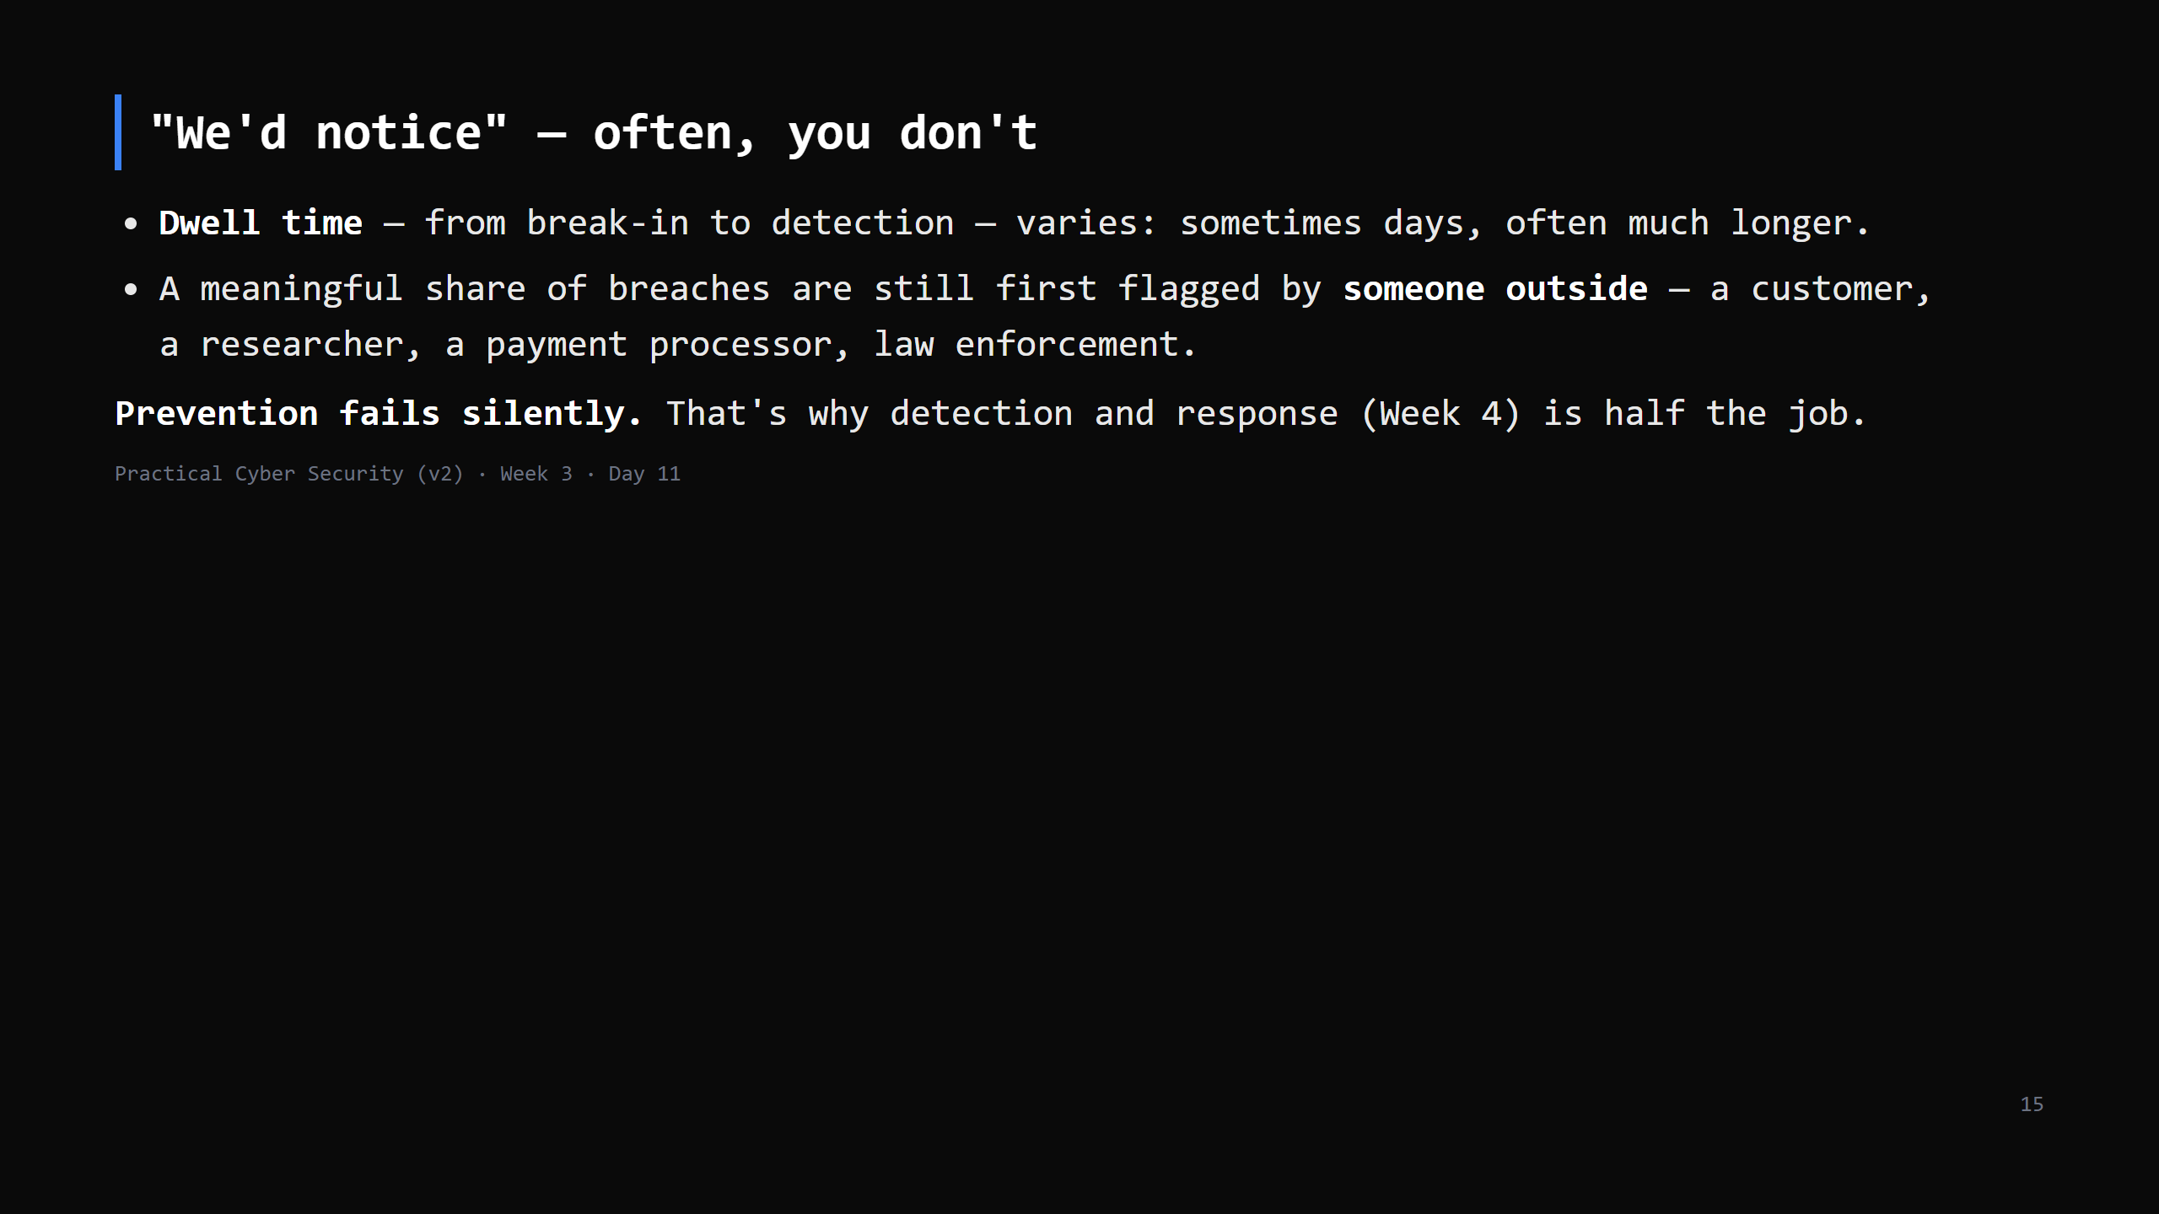
Notes:
The second Day 11 trap. The shape is what matters, not a number: attackers can be inside a
long time unnoticed, and orgs frequently learn from a third party. Reporting has improved
year on year — say "varies, often longer than you'd think", not a hard stat.

Slide 16
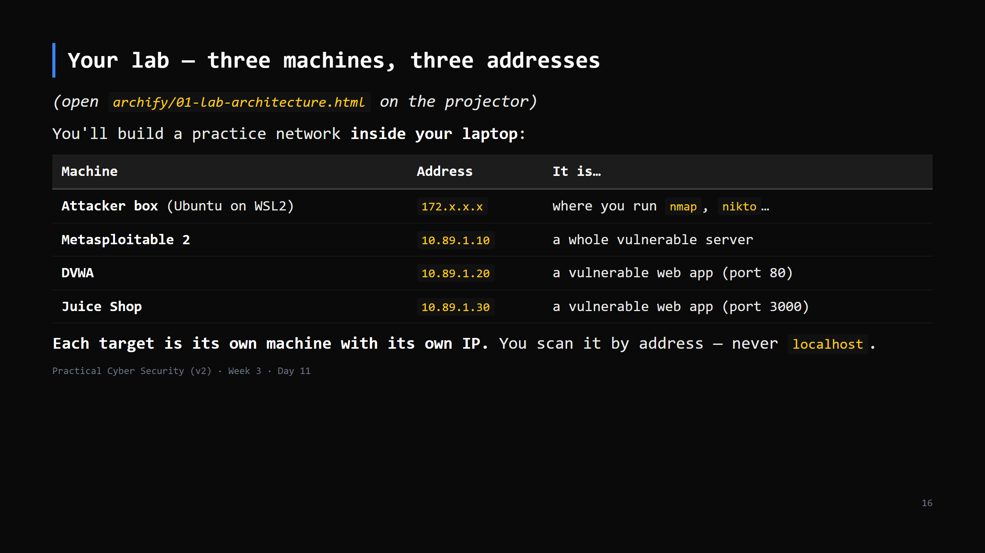
Notes:
~7 min. Kitchen analogy: a PRACTICE restaurant built inside our own building, walled off so nobody
can walk in from the street. We break into it on purpose; nobody real gets hurt.
DIAGRAM 1 — 01-lab-architecture.html (click the view buttons):
view 1 'Three networks': one laptop, THREE addresses — Windows 192.168.x.x (your real Wi-Fi),
WSL Ubuntu 172.x.x.x (the attacker box), the lab 10.89.1.0/24 (exists only inside the laptop).
Callback to Day 3 'three addresses': same idea, now all in one machine.
view 2 'Your attack path': every scan starts in Ubuntu, crosses the lab network, lands on a
target's OWN IP and REAL port. 10.89.1.10 = a whole server (many ports); .20 and .30 = web apps.
view 3 'Kept private': Wi-Fi never sees the targets. That is why it's safe — and why we never
forward them to a real network (Day 1: authorization).
DIAGRAM 2 — 02-scan-traffic.html: walk the four bands — (1) ARP 'who has 10.89.1.10?' (same
network, no router needed); (2) SYN -> SYN-ACK = open, SYN -> RST = closed (Day 4's handshake,
nmap just doesn't finish it); (3) connect + banner 'vsFTPd 2.3.4'; (4) searchsploit that string
offline. 'That's a whole scan — recon, port scan, version, assess. Days 12-15 do exactly this.'
Exploitation comes later and rides the same path. Don't drill the details today.
Class check cards on each diagram double as the exit questions.

Slide 17
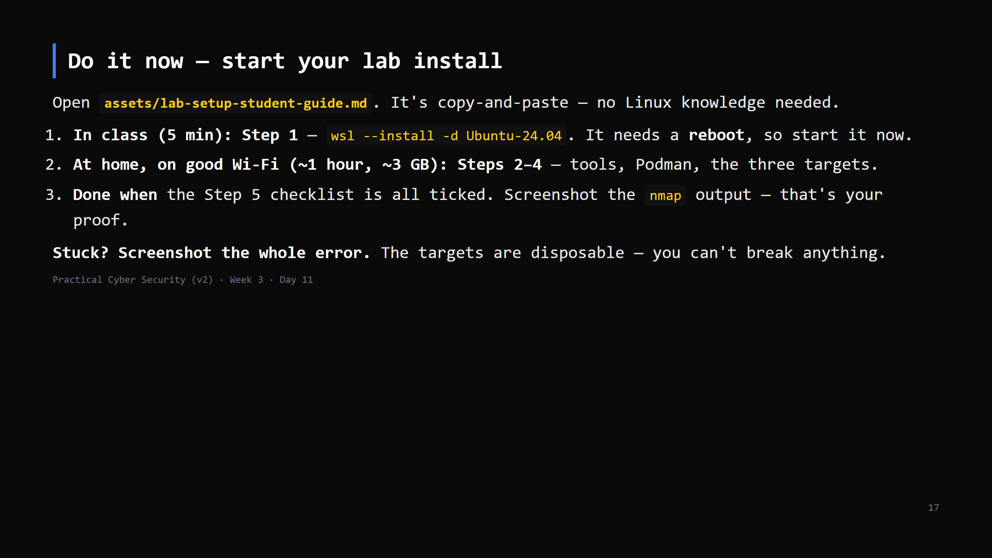
Notes:
~5 min. Only Step 1 happens in class; everything else is homework. Walk the room: the common
blocker is VIRTUALIZATION DISABLED in BIOS/UEFI (Intel VT-x / AMD-V) — note it, they fix it at home
(guide's troubleshooting has the line). Mac users: point them at the VM route. Remind them the
reboot is needed before Ubuntu opens. Don't stand there while 25 laptops download — it's homework.
Gate: Days 12-15 use THIS lab. Anyone who can't finish → office hours / shared class lab.

Slide 18
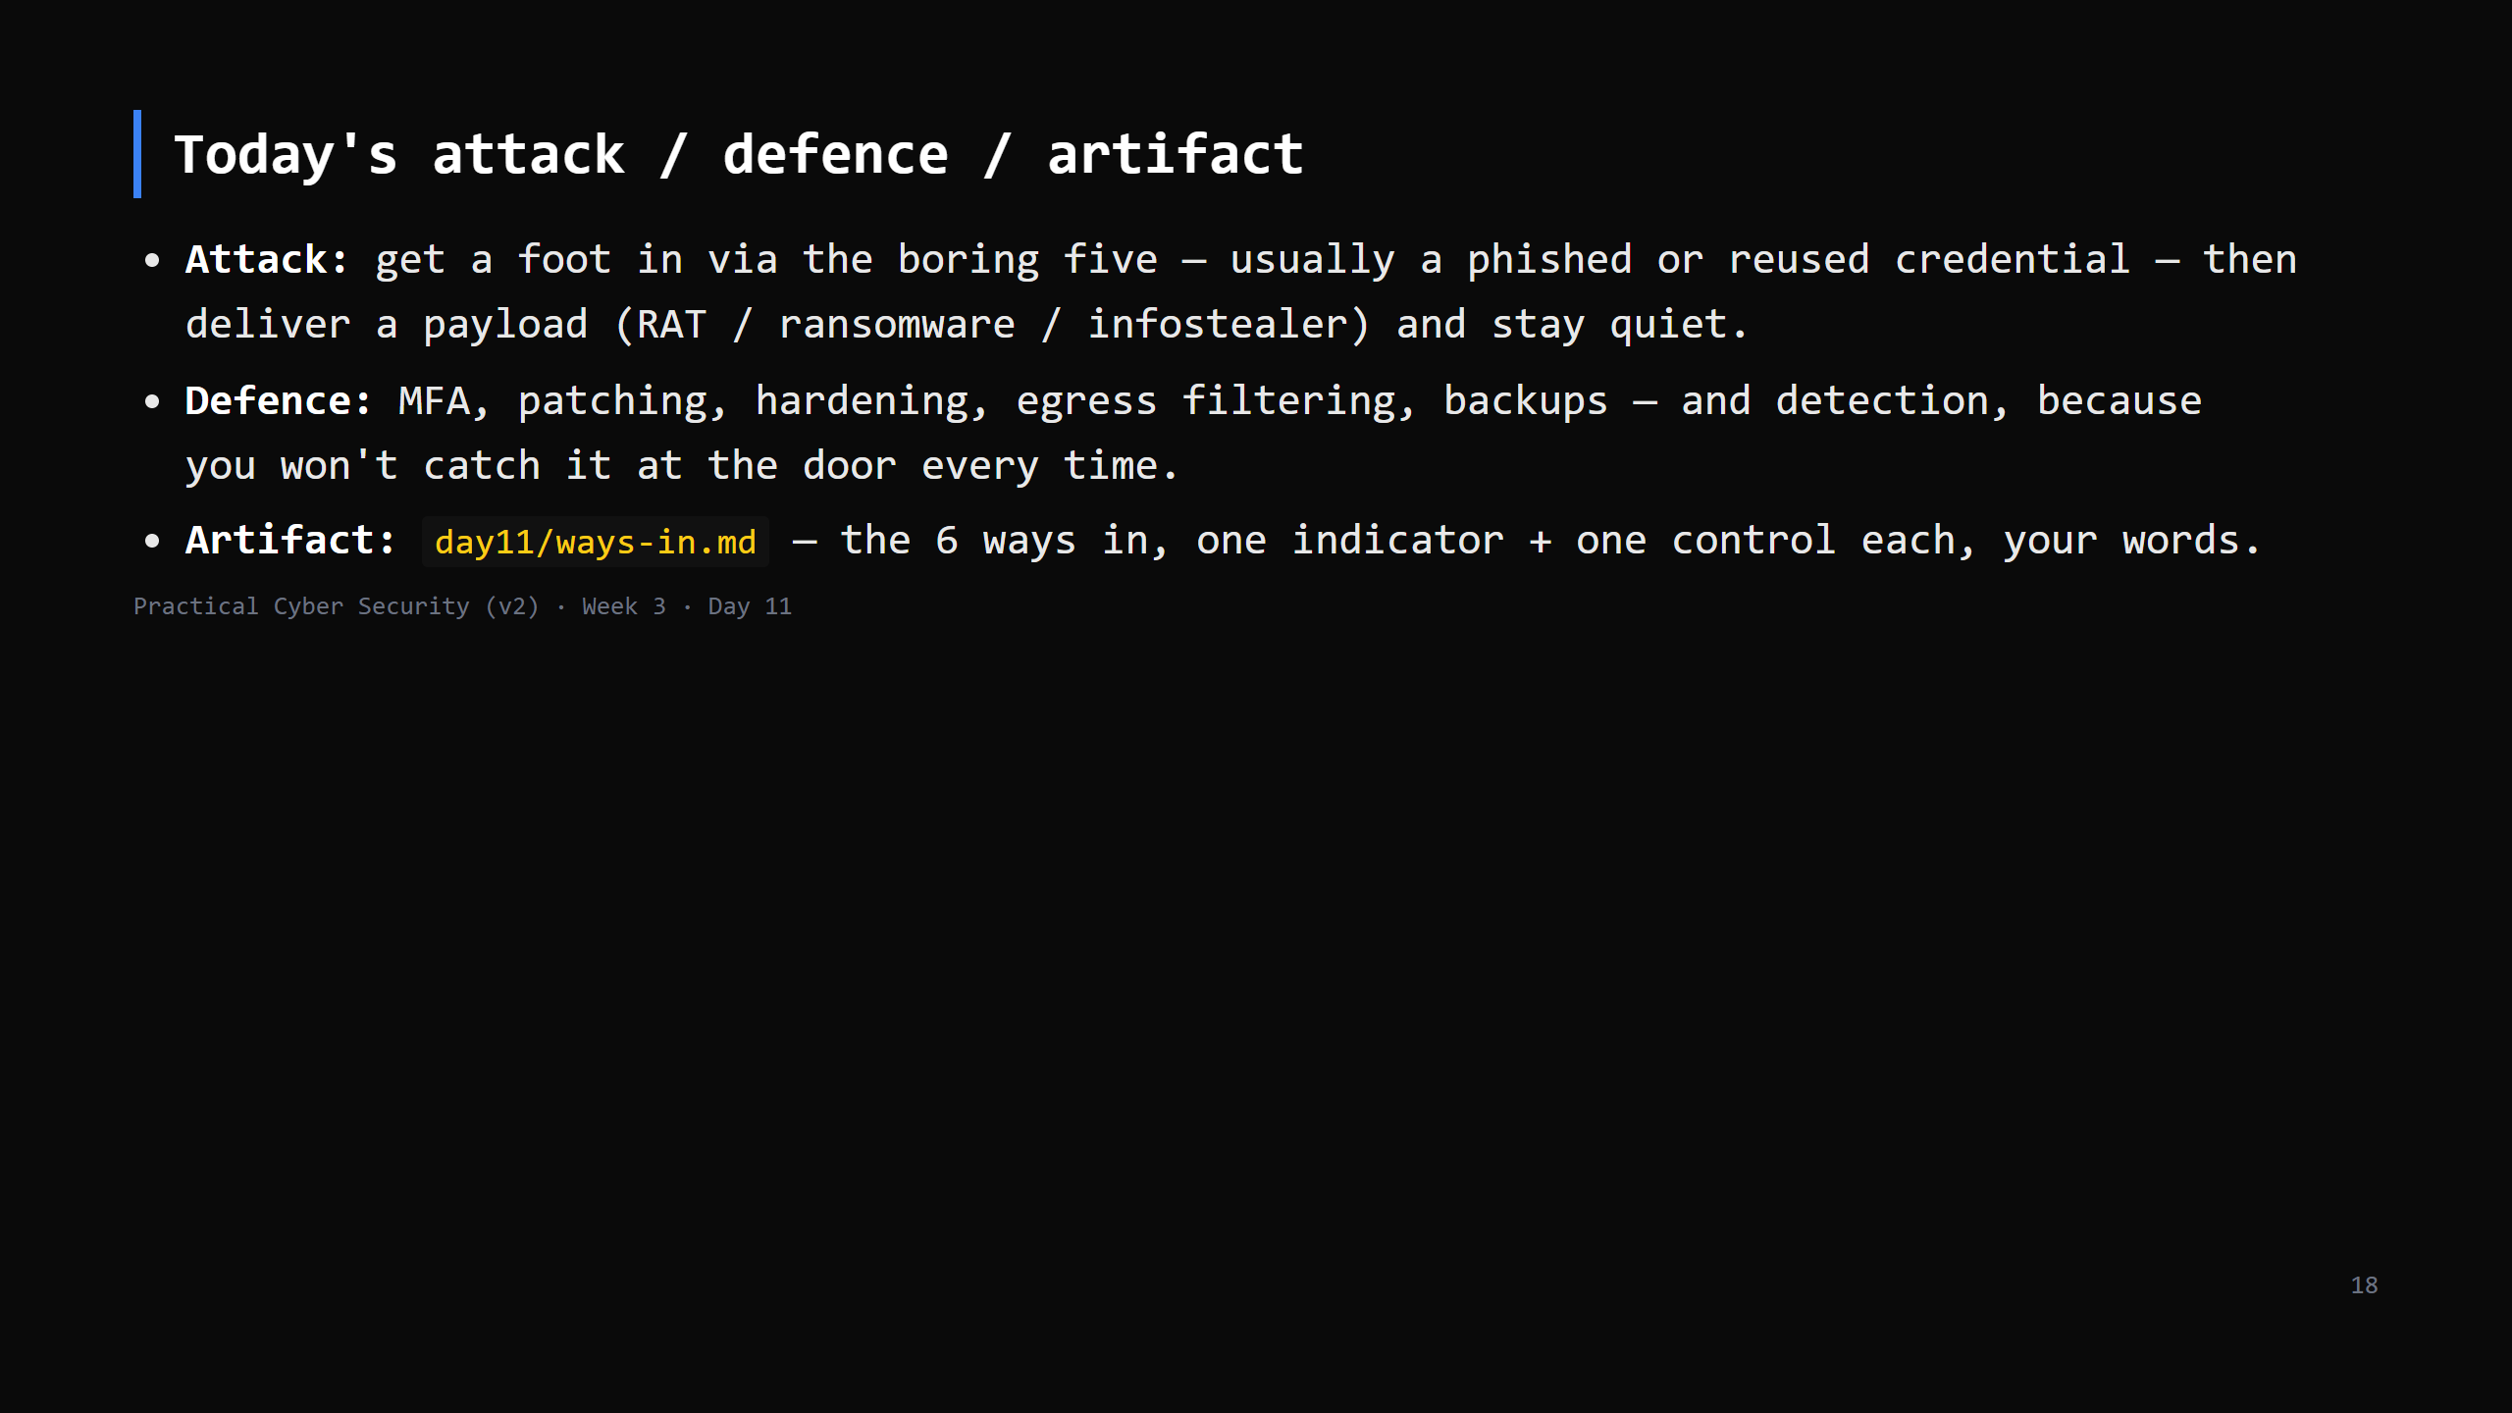

Slide 19
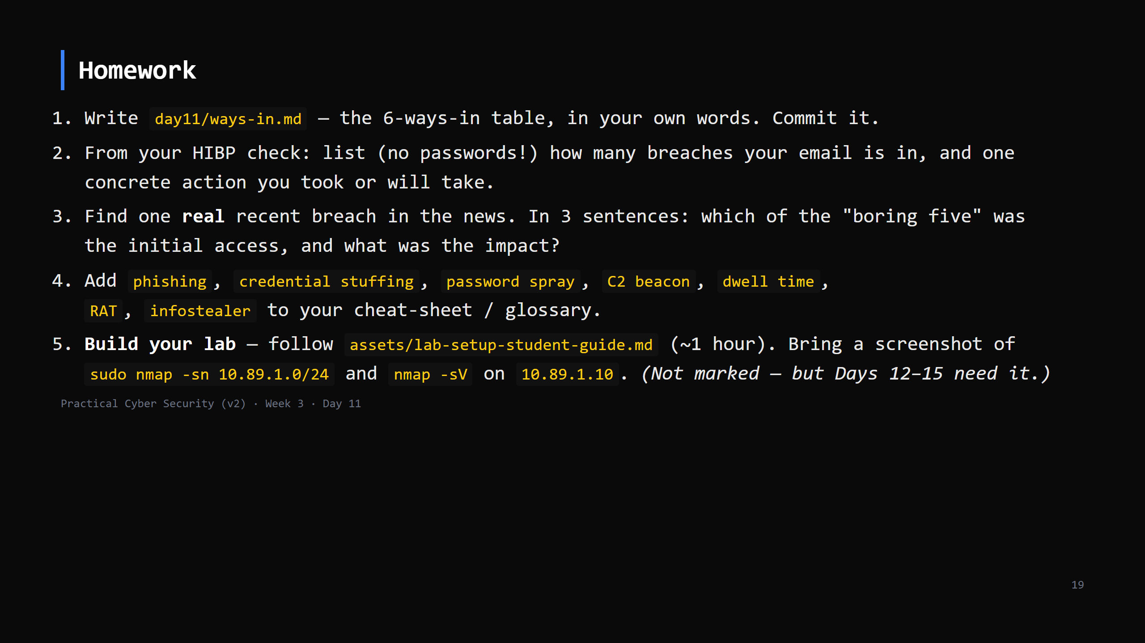
Notes:
Due start of Day 12.

Slide 20
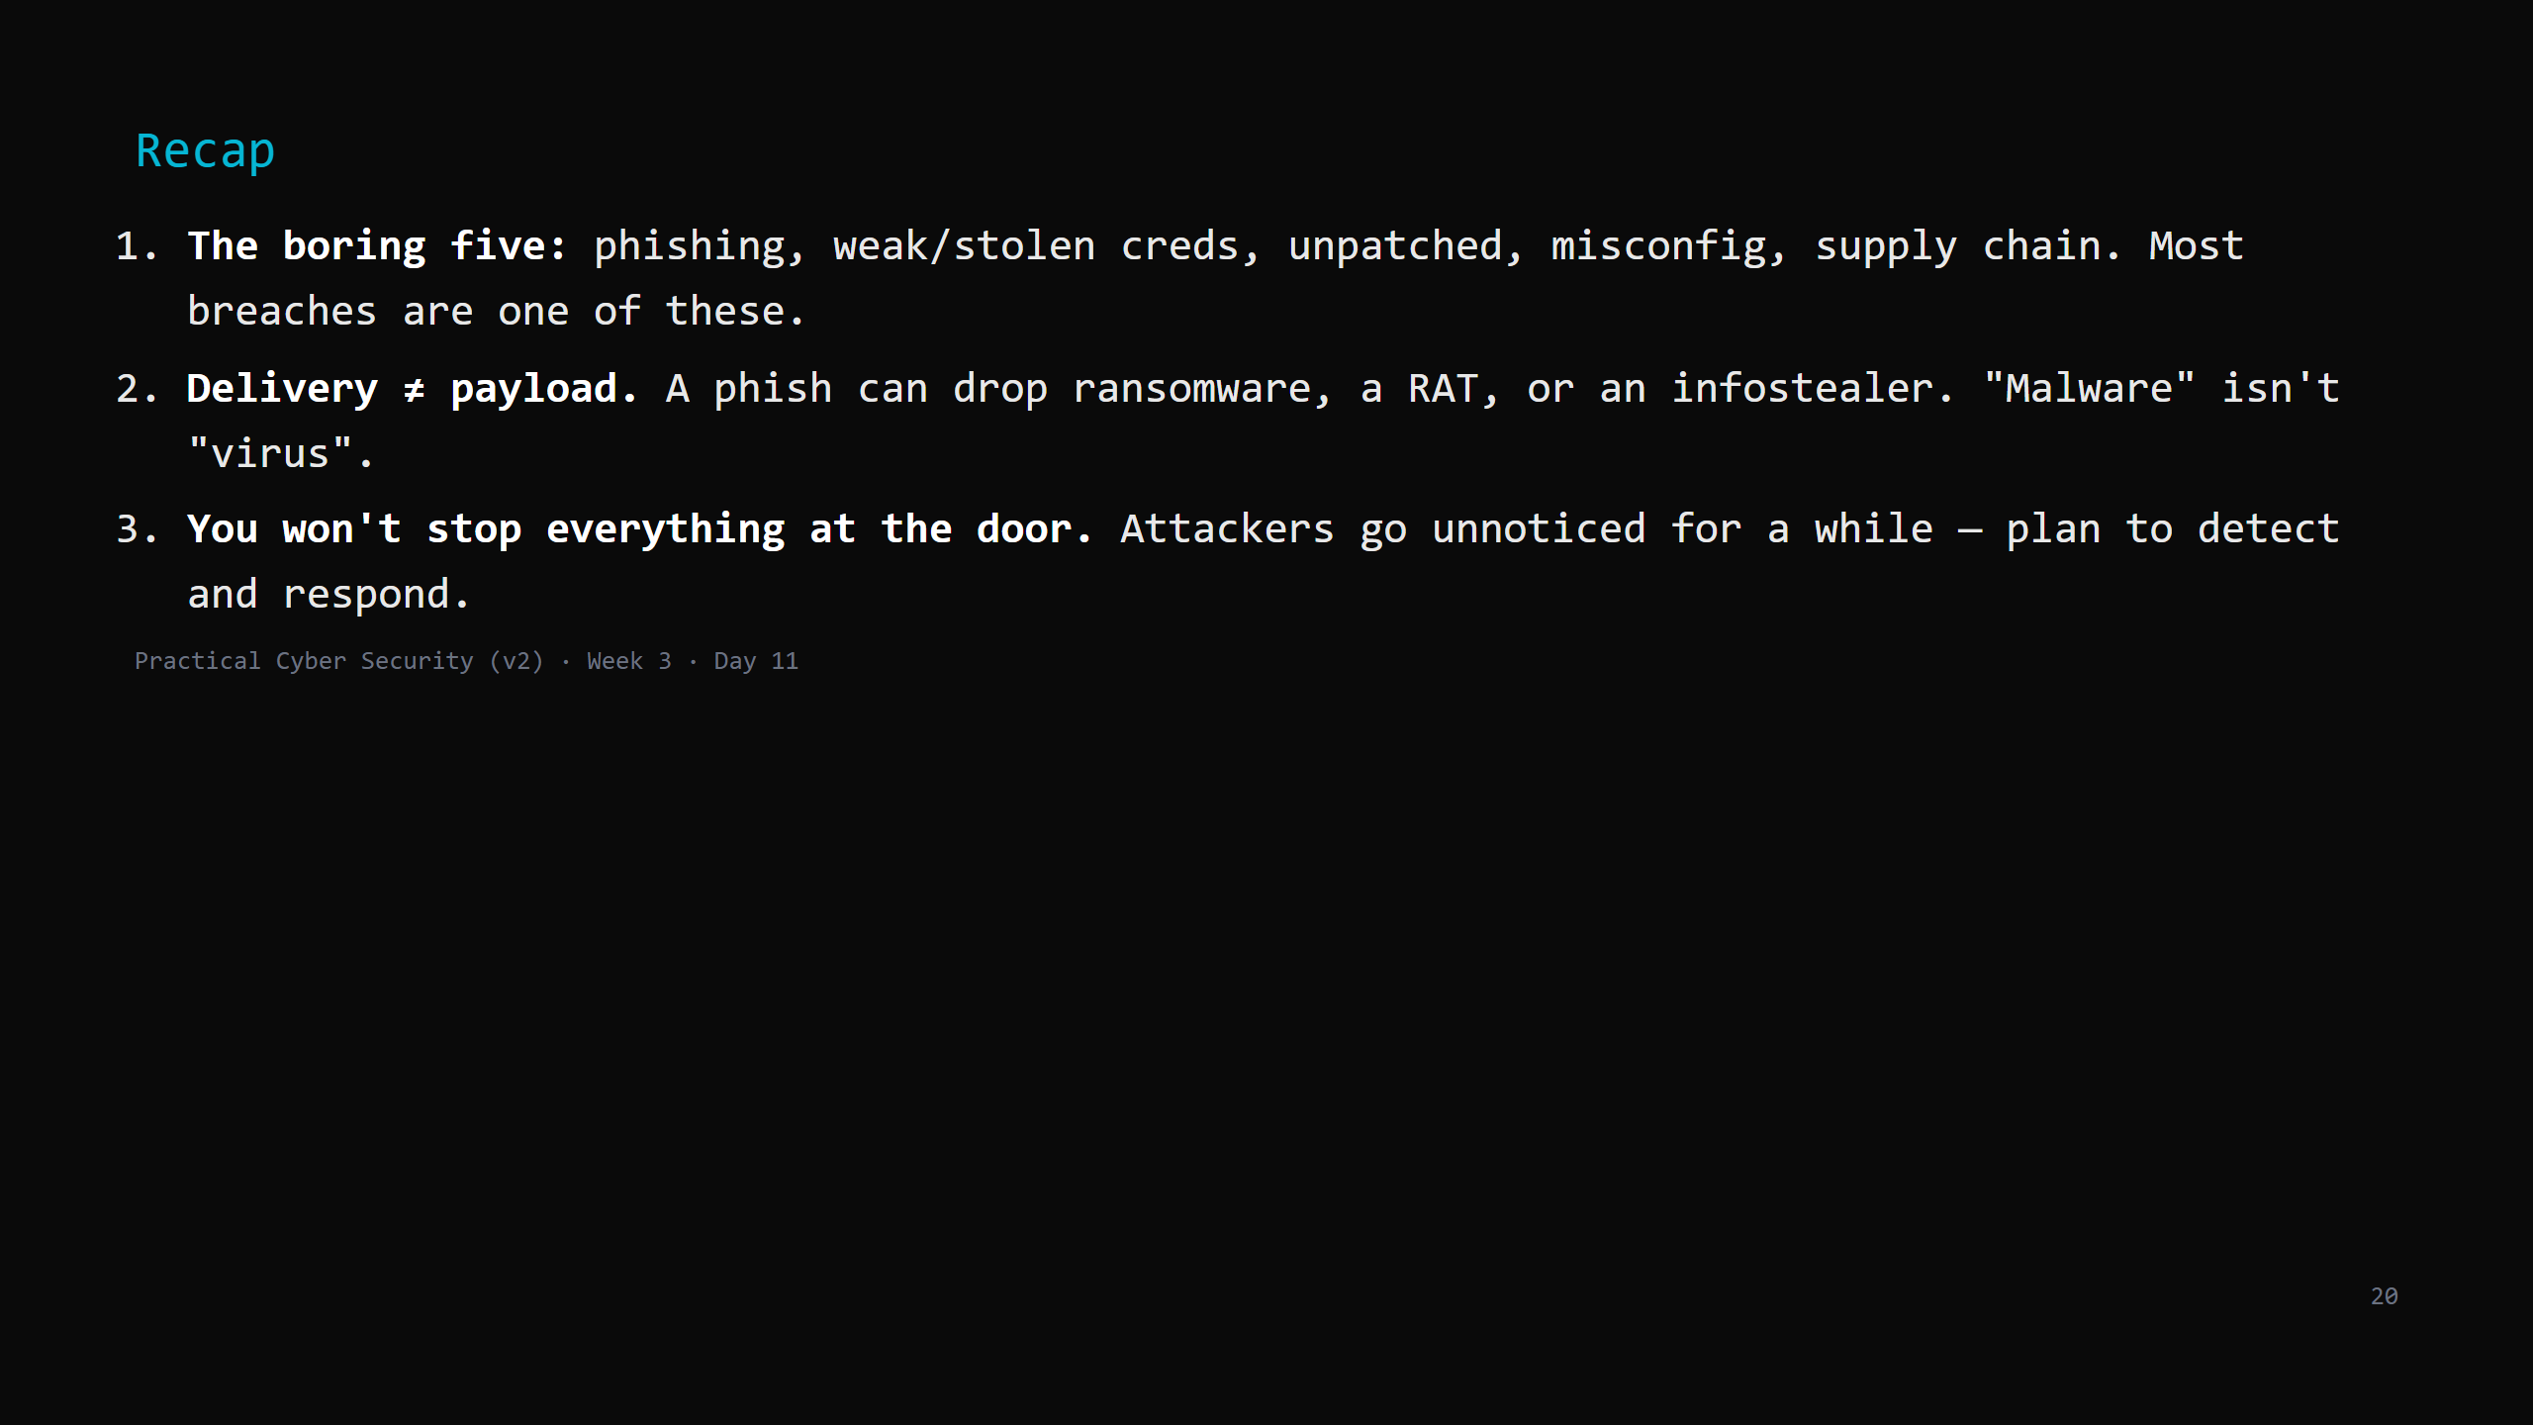
Notes:
Say the three lines. Tomorrow: we turn "here are the attacks" into "here is the repeatable
process an attacker (and a pentester) follows" — the lifecycle — and use the lab they start
building tonight.

