Slide 1
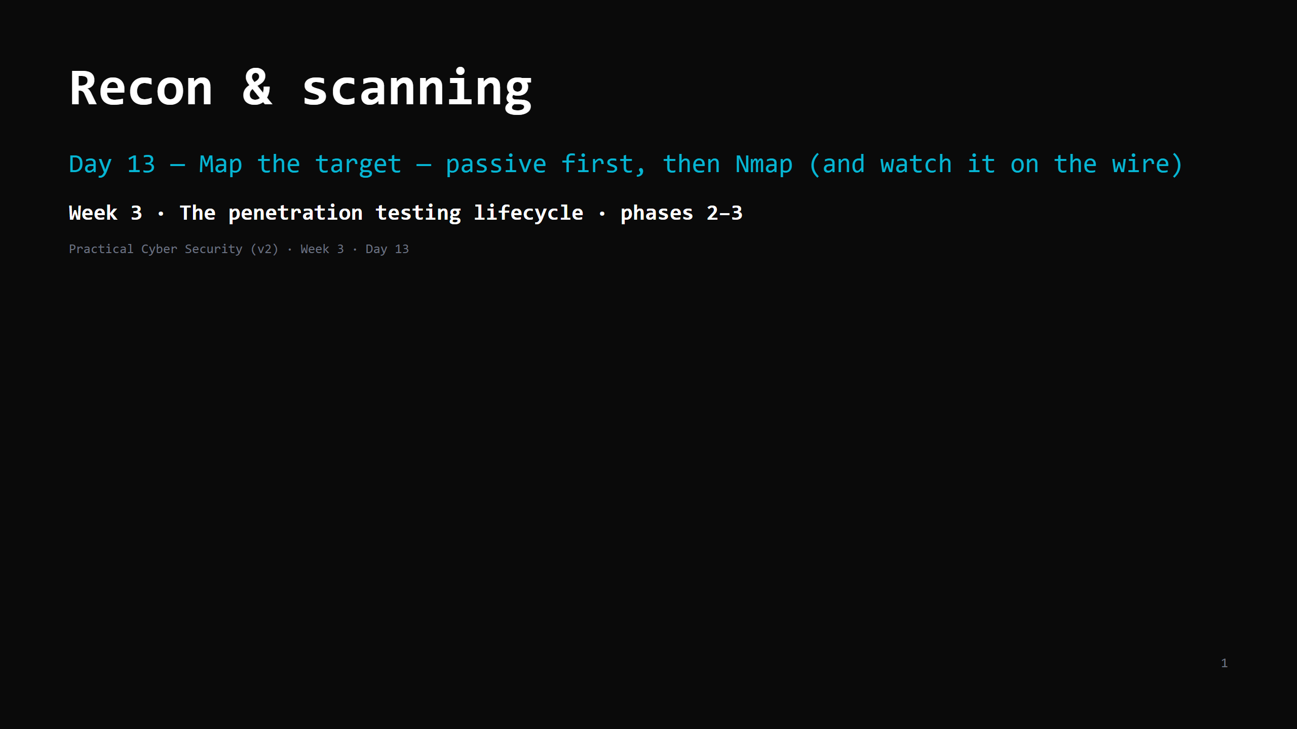
Notes:
RUN SHEET (~85 min). Wireshark gets installed today.
00:00 Journey check + hook (what's public about a domain) 4
00:04 Passive vs active 4
00:08 Passive recon — OSINT sources 10
00:18 DO: passive recon on a permitted domain 8
00:26 Active scanning — the idea 5
00:31 Nmap — the one tool worth learning well 12
00:43 DO: nmap the lab + watch it in Wireshark 18
01:01 From scan output to an asset list 6
01:07 Attack <-> defence 6
01:13 Wrap + artifact + homework 4
CUT FIRST IF SHORT: OS detection / timing detail on the Nmap slide; the "from output to asset
list" slide to a 2-min demo.
NEVER CUT: passive-before-active, the OSINT sources, nmap -sV -sC + reading output, the
Wireshark watch, the service inventory artifact.
ANALOGY (kitchen / health inspector): recon = walk the outside first — read the sign, check
public records, look in the windows, note the delivery schedule — before touching anything.
Scanning = walk up and try every door handle (and the neighbours hear you rattling them).
ETHICS: passive recon only on the instructor-permitted domain. Active scans only on <LAB_HOST>
(in the ROE) or scanme.nmap.org (the Nmap project explicitly allows scanning it). If you built
your own lab (Day 11), <LAB_HOST> = your Metasploitable2 at 10.89.1.10 — see the Lab tool map
in teacher-notes.md for which target/tool goes with which technique across Days 13-19.

Slide 2
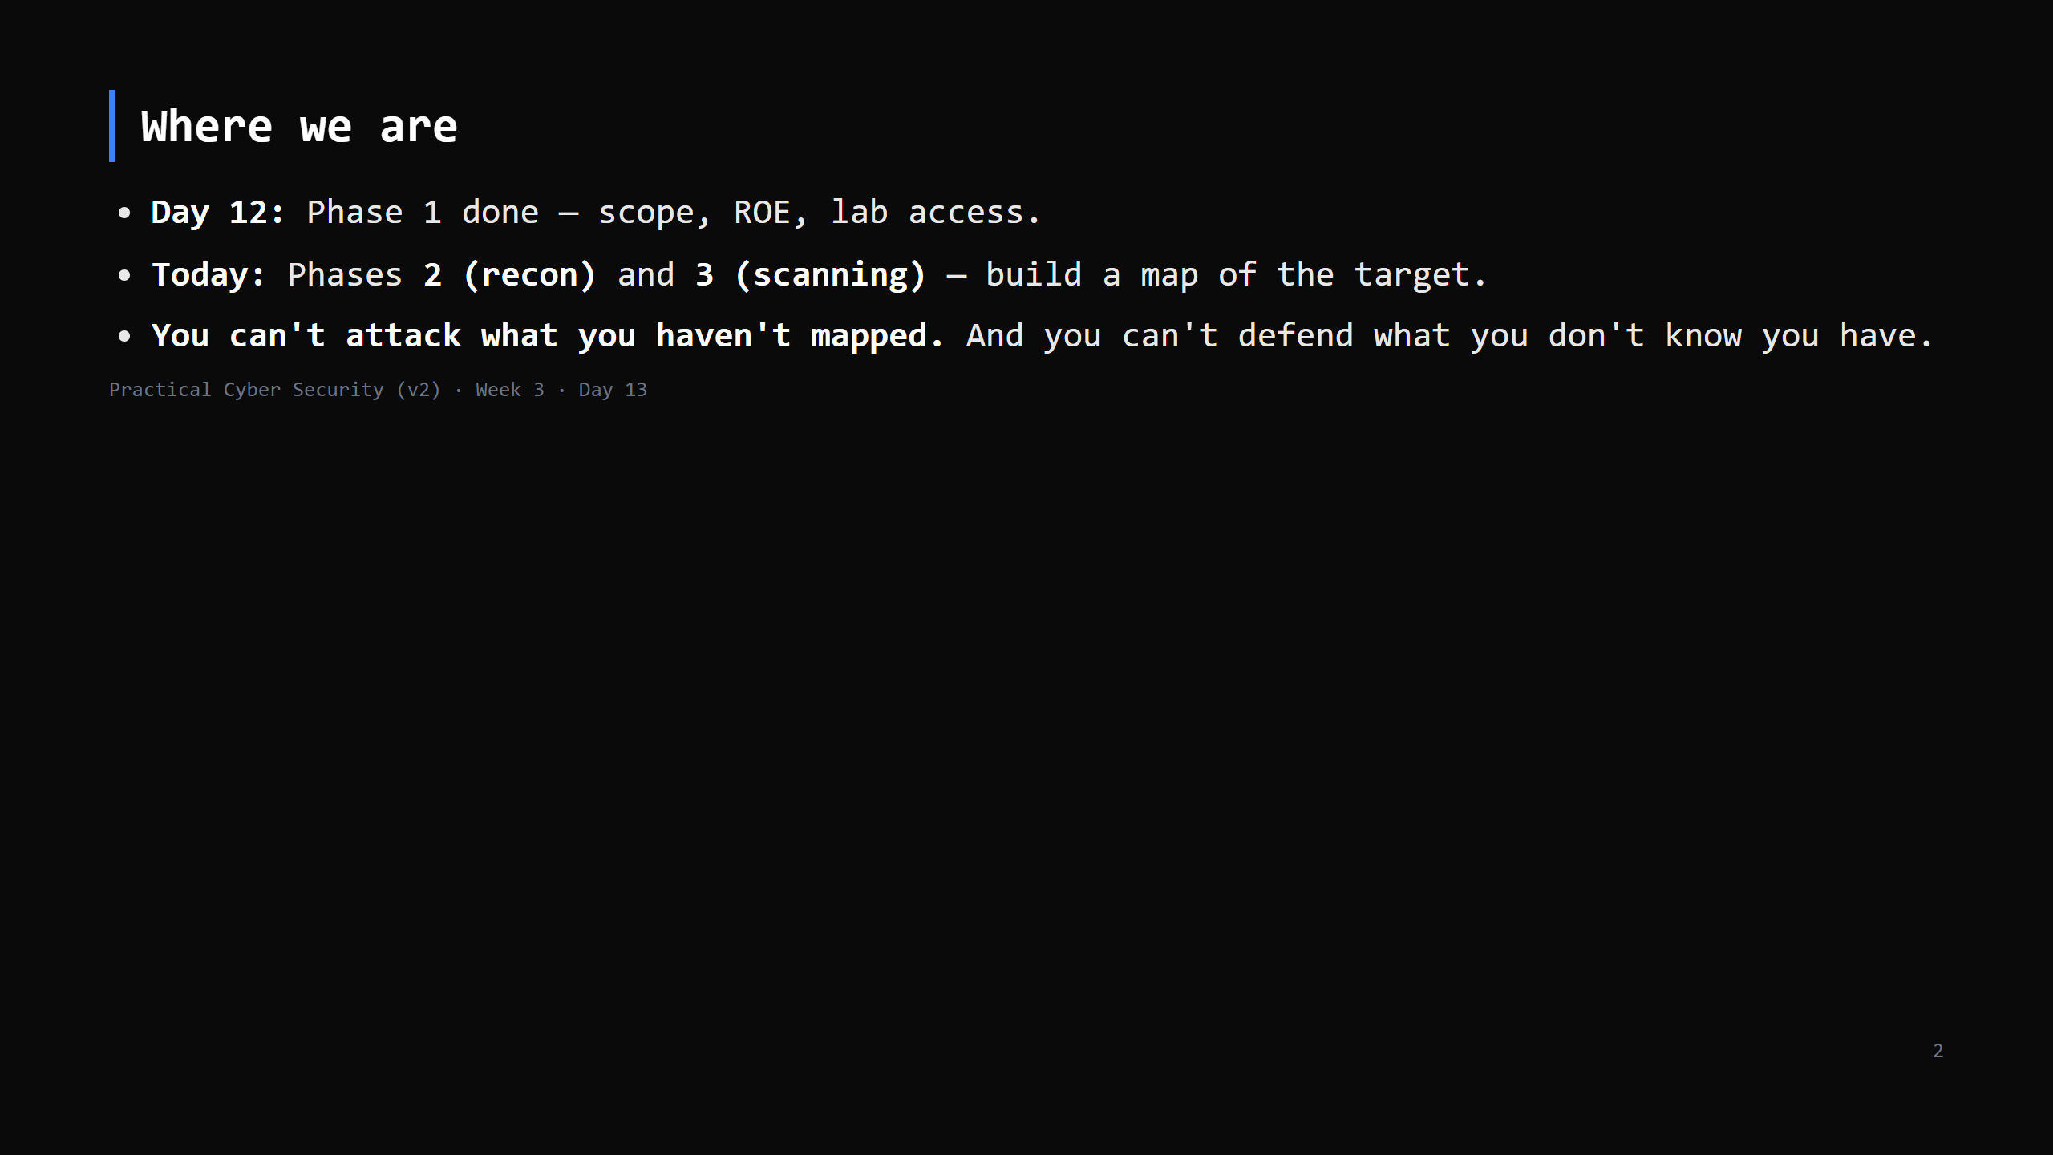
Notes:
Journey Check. The service inventory you build today is the input to Days 14-16.

Slide 3
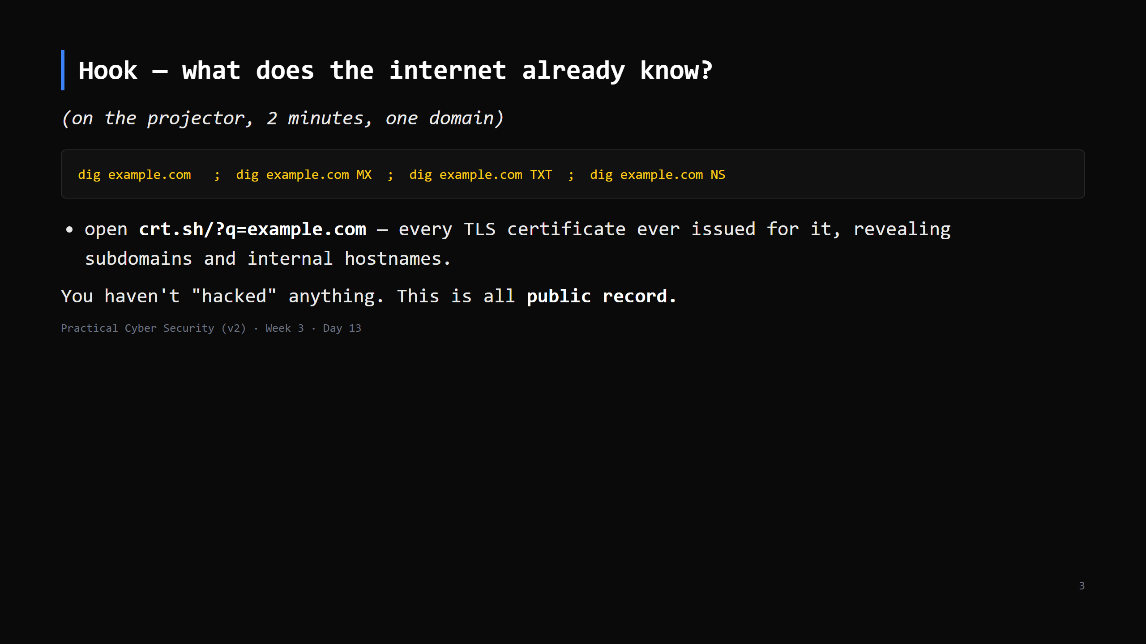
Notes:
`dig <domain> ANY` used to dump everything but most resolvers now refuse it (RFC 8482) — ask
for the record types you want. TXT = SPF (sending IPs) + verification records; NS/MX = the DNS
and mail providers.
crt.sh (Certificate Transparency logs) is the single most useful passive source — it leaks
hostnames like dev.example.com, vpn.example.com, jira.internal.example.com that the org never
advertised. Do this live.

Slide 4
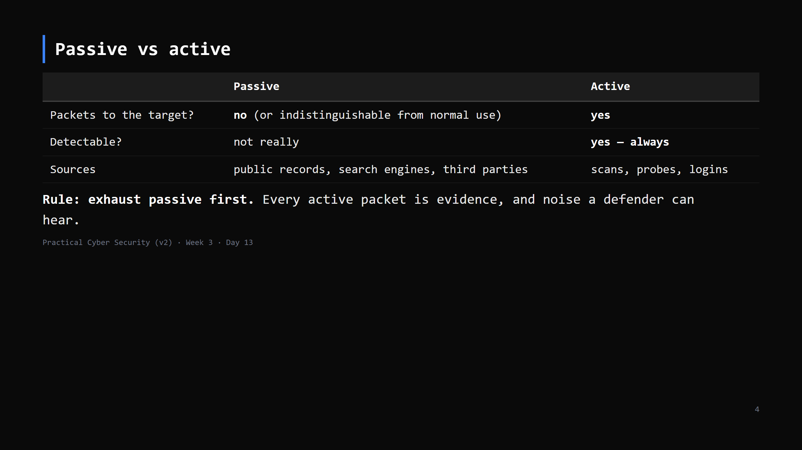
Notes:
Passive keeps you invisible and (for public data) generally legal to gather. Active is where
scope and authorization matter — you're now touching someone's system.

Slide 5
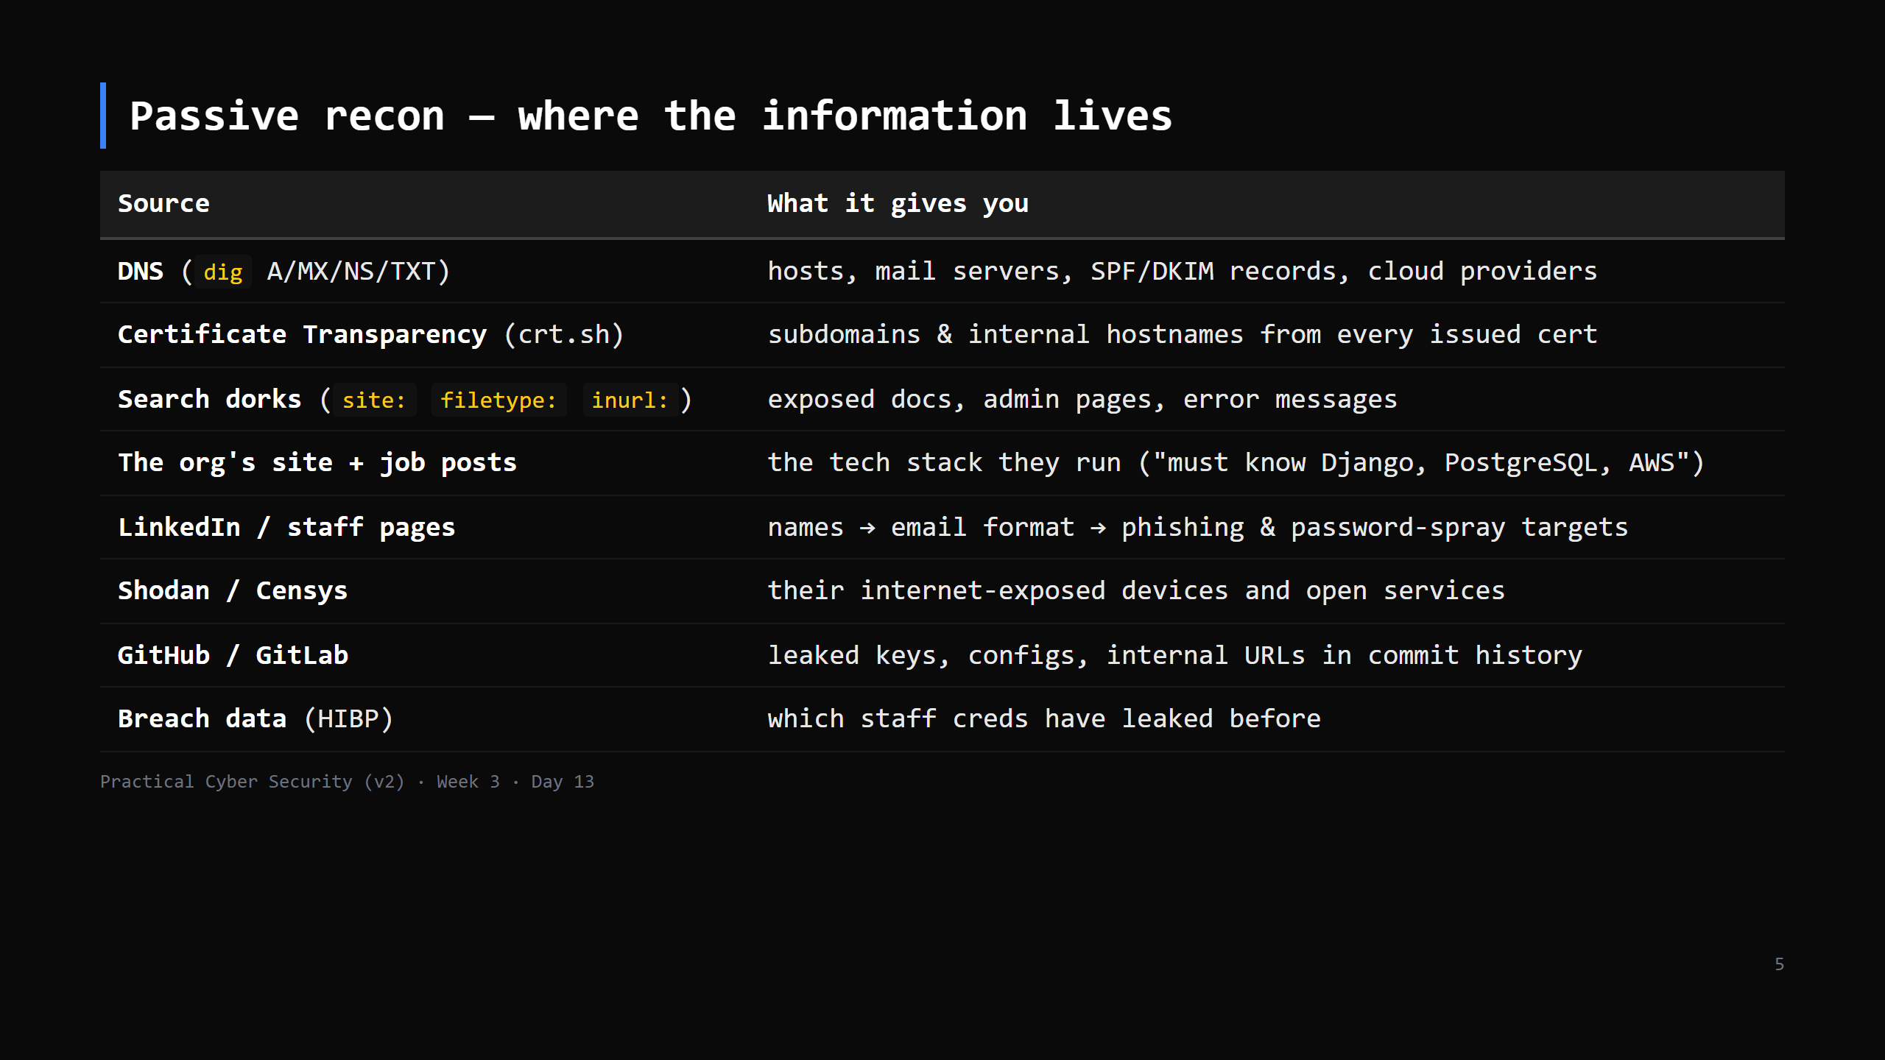
Notes:
The mindset: an attacker builds a picture of the org — its people, its tech, its exposure —
before sending a single packet. Job ads are goldmines for the tech stack.

Slide 6
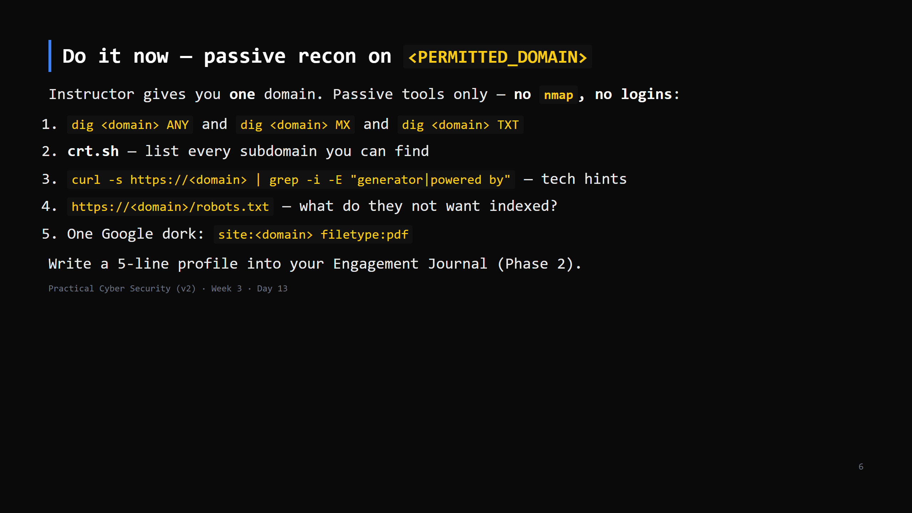
Notes:
8 min. Use a domain you control or one that's clearly OK (the college's public site, or
example.com). This is passive - it does not need to be in the pentest scope, but keep it
sane and don't enumerate people aggressively.

Slide 7
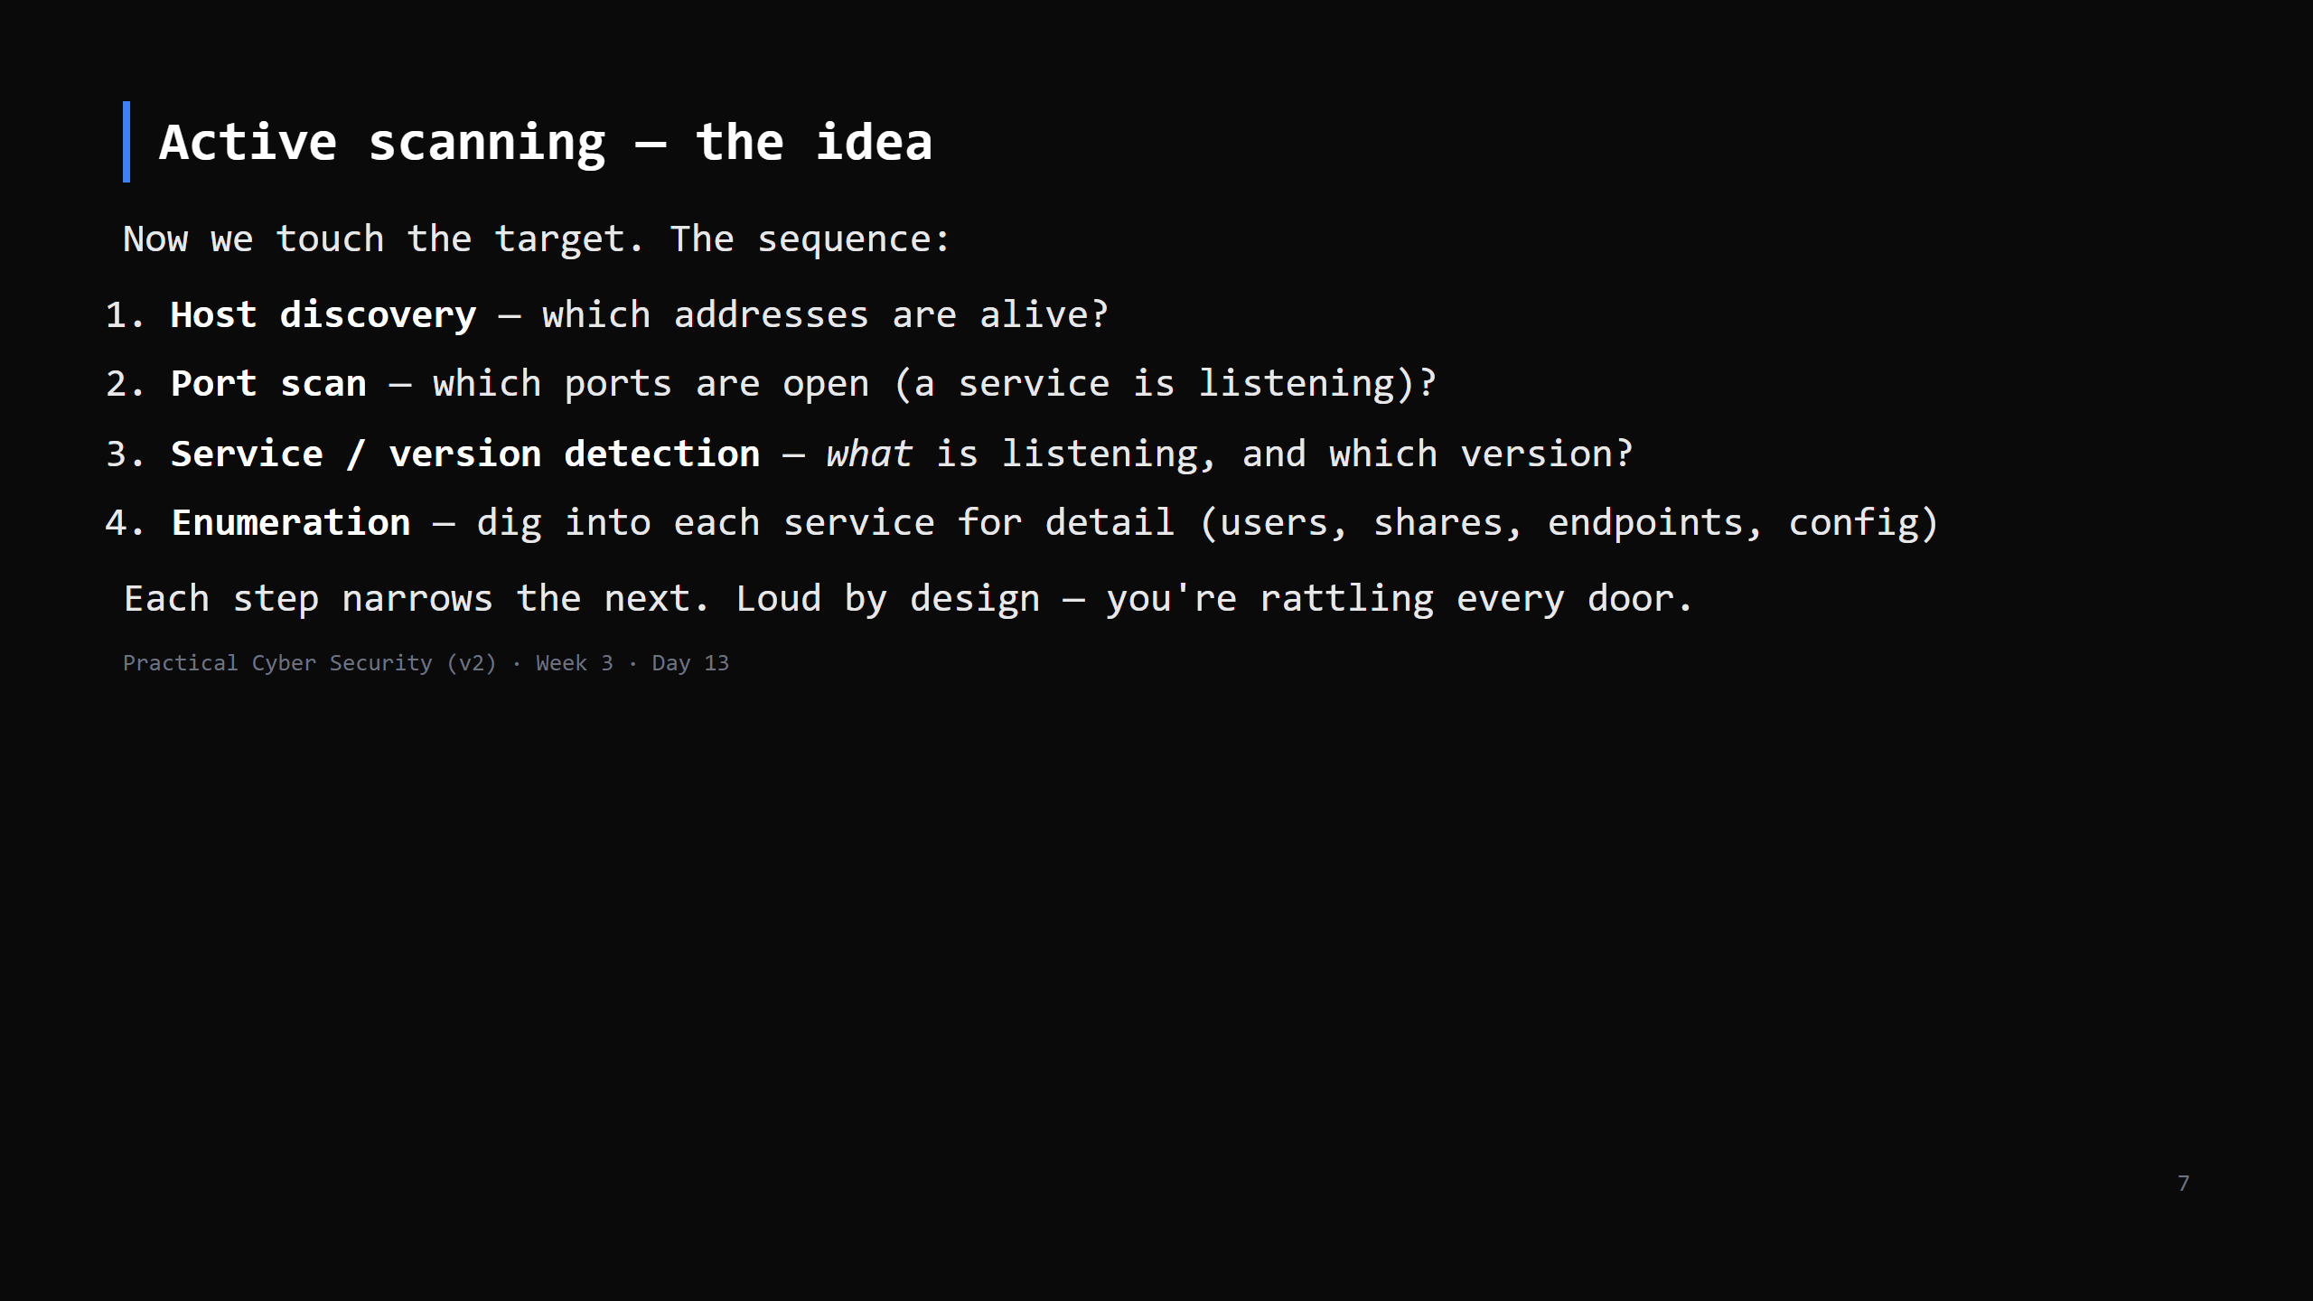
Notes:
Version detection (step 3) is the pivot to Day 14: "Apache 2.4.49" -> look up its CVEs.
Enumeration (step 4) is service-specific and continues all week.

Slide 8
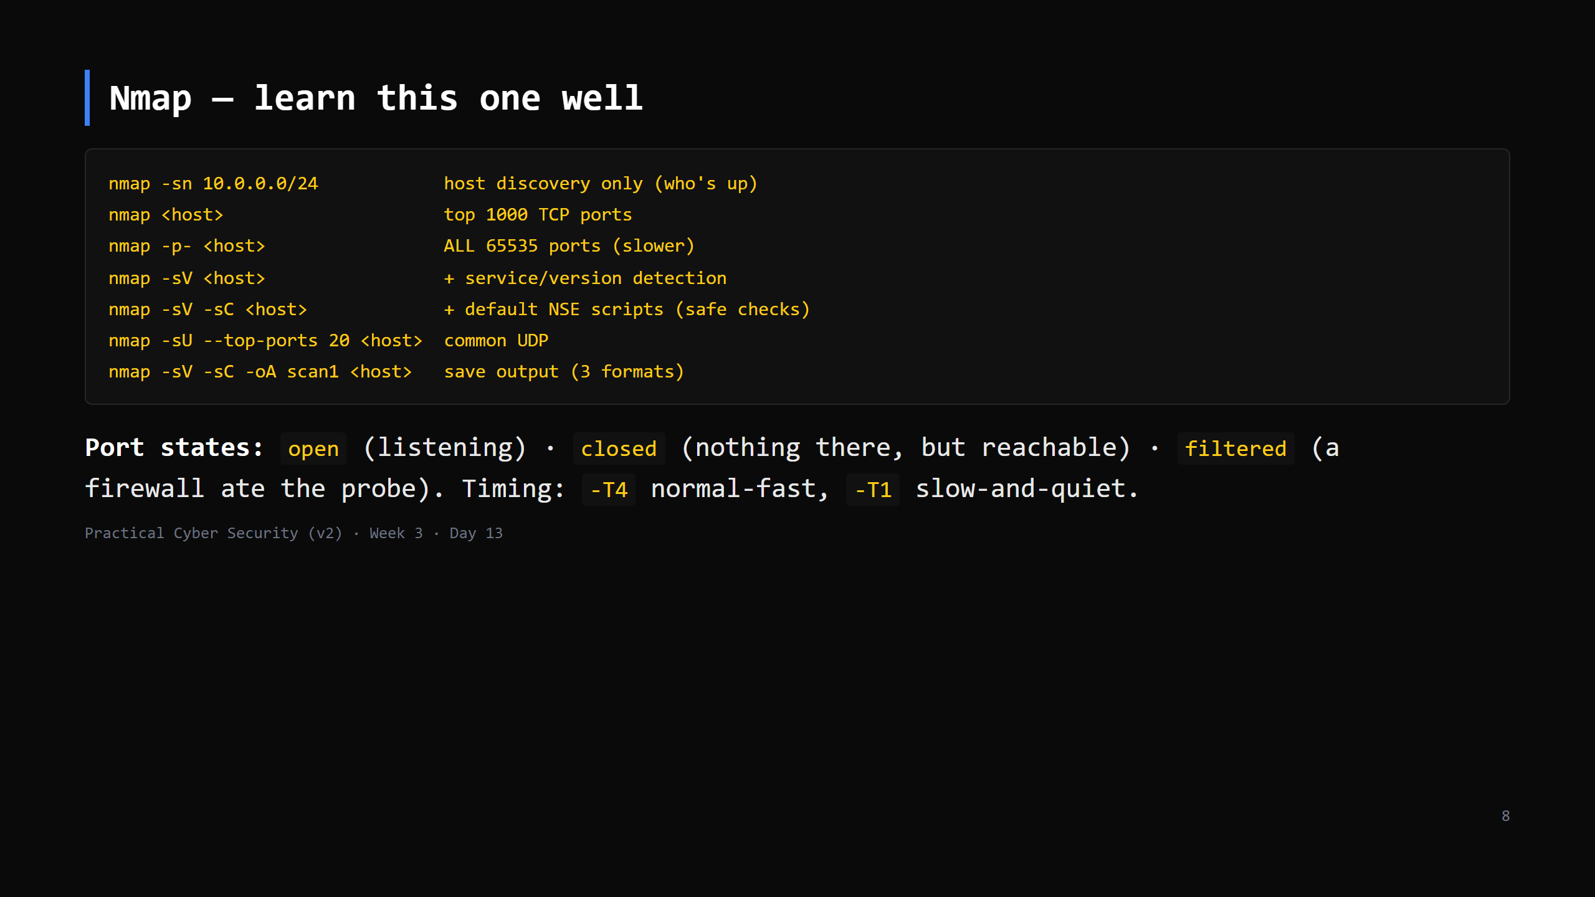
Notes:
`-sV -sC -oA` is the everyday combo. `-sS` (SYN) is the default when run as root; `-sT`
(full connect) otherwise. Don't drill every flag - `-sV`, `-sC`, `-p`, `-oA`, `-T` cover 95%.
`-O` (OS detection) and NSE categories are a "look it up" (Day 6 lesson: --help / man).
CUT the OS/timing detail first if short.

Slide 9
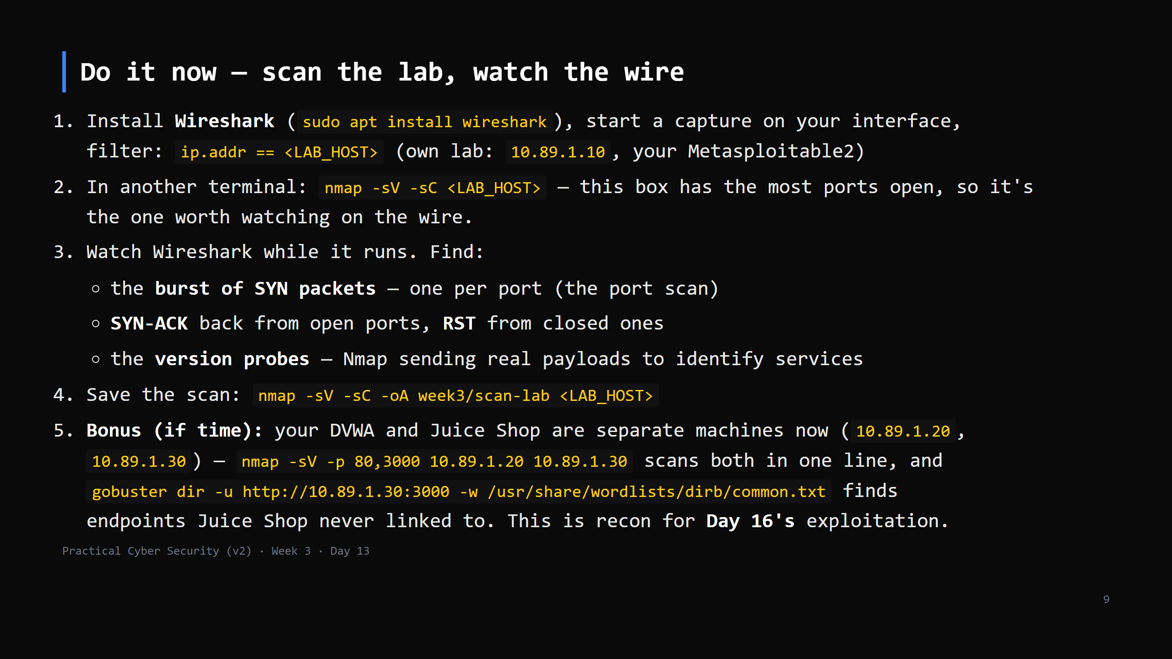
Notes:
18 min. This is THE blue-team bridge - "here is what a scan looks like from the defender's
chair". A default scan is hundreds of packets in seconds; utterly obvious in a capture or an IDS.
No lab? scanme.nmap.org is explicitly OK to scan (be gentle - one scan).
Wireshark install: the "should non-root capture?" prompt -> Yes, add your user to `wireshark`
group, log out/in (or use sudo for today).

Slide 10
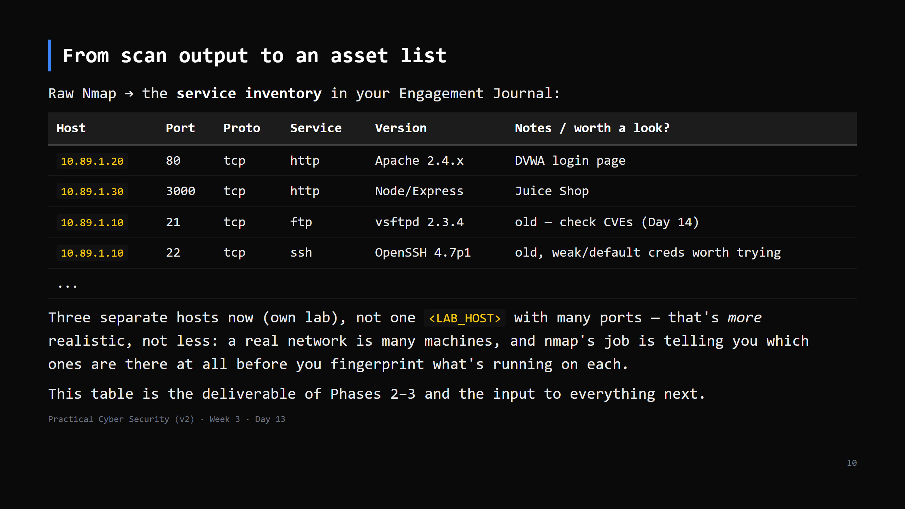
Notes:
The skill: not "run nmap" but "turn 200 lines of output into a prioritised list of things to
investigate". Old version numbers and unusual services rise to the top.

Slide 11
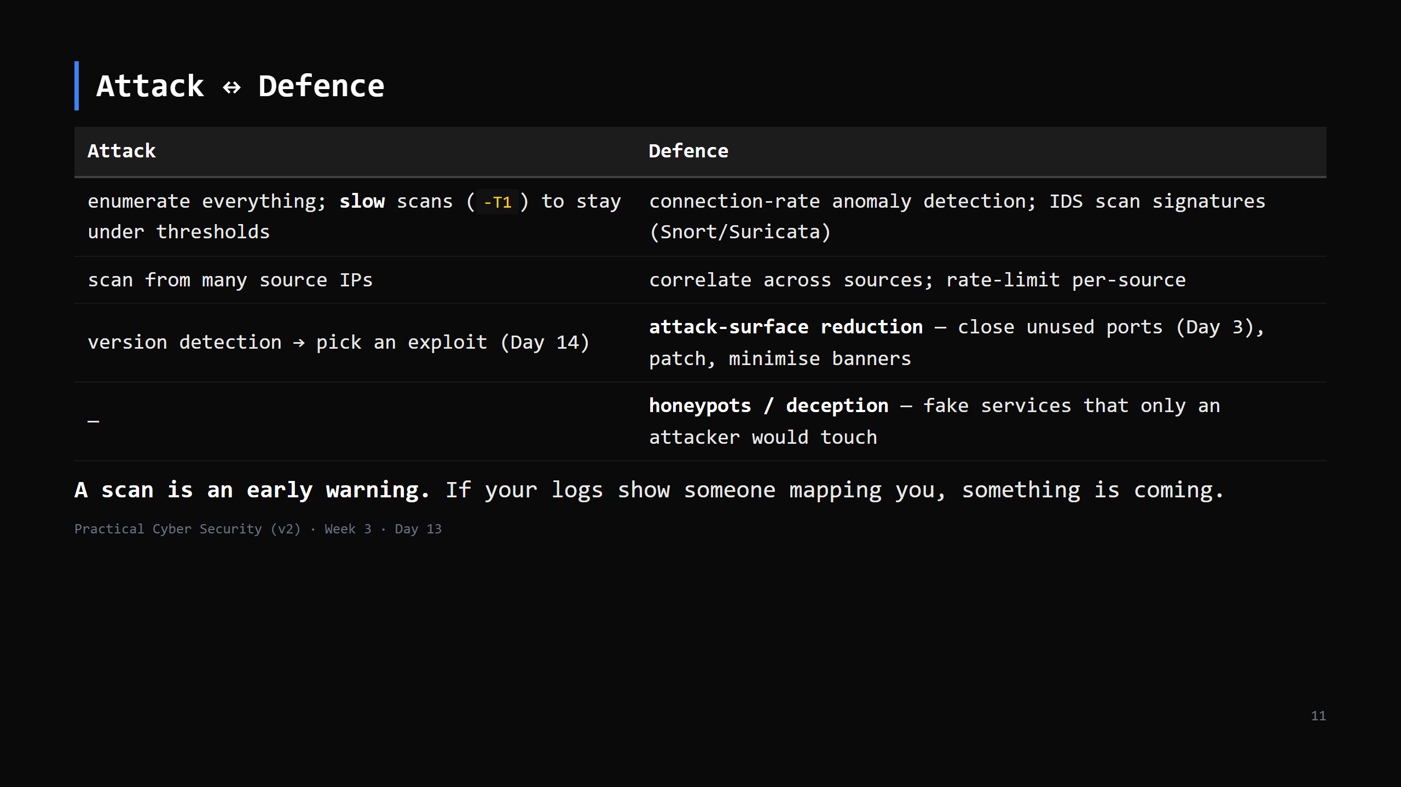
Notes:
The two Day 13 traps, addressed: (1) "harmless" - unauthorized scanning has been prosecuted;
stay in scope. (2) "undetectable" - it is one of the loudest things you can do. A pentester
scans openly *because they're authorised*; an attacker who wants stealth pays a big speed cost.

Slide 12
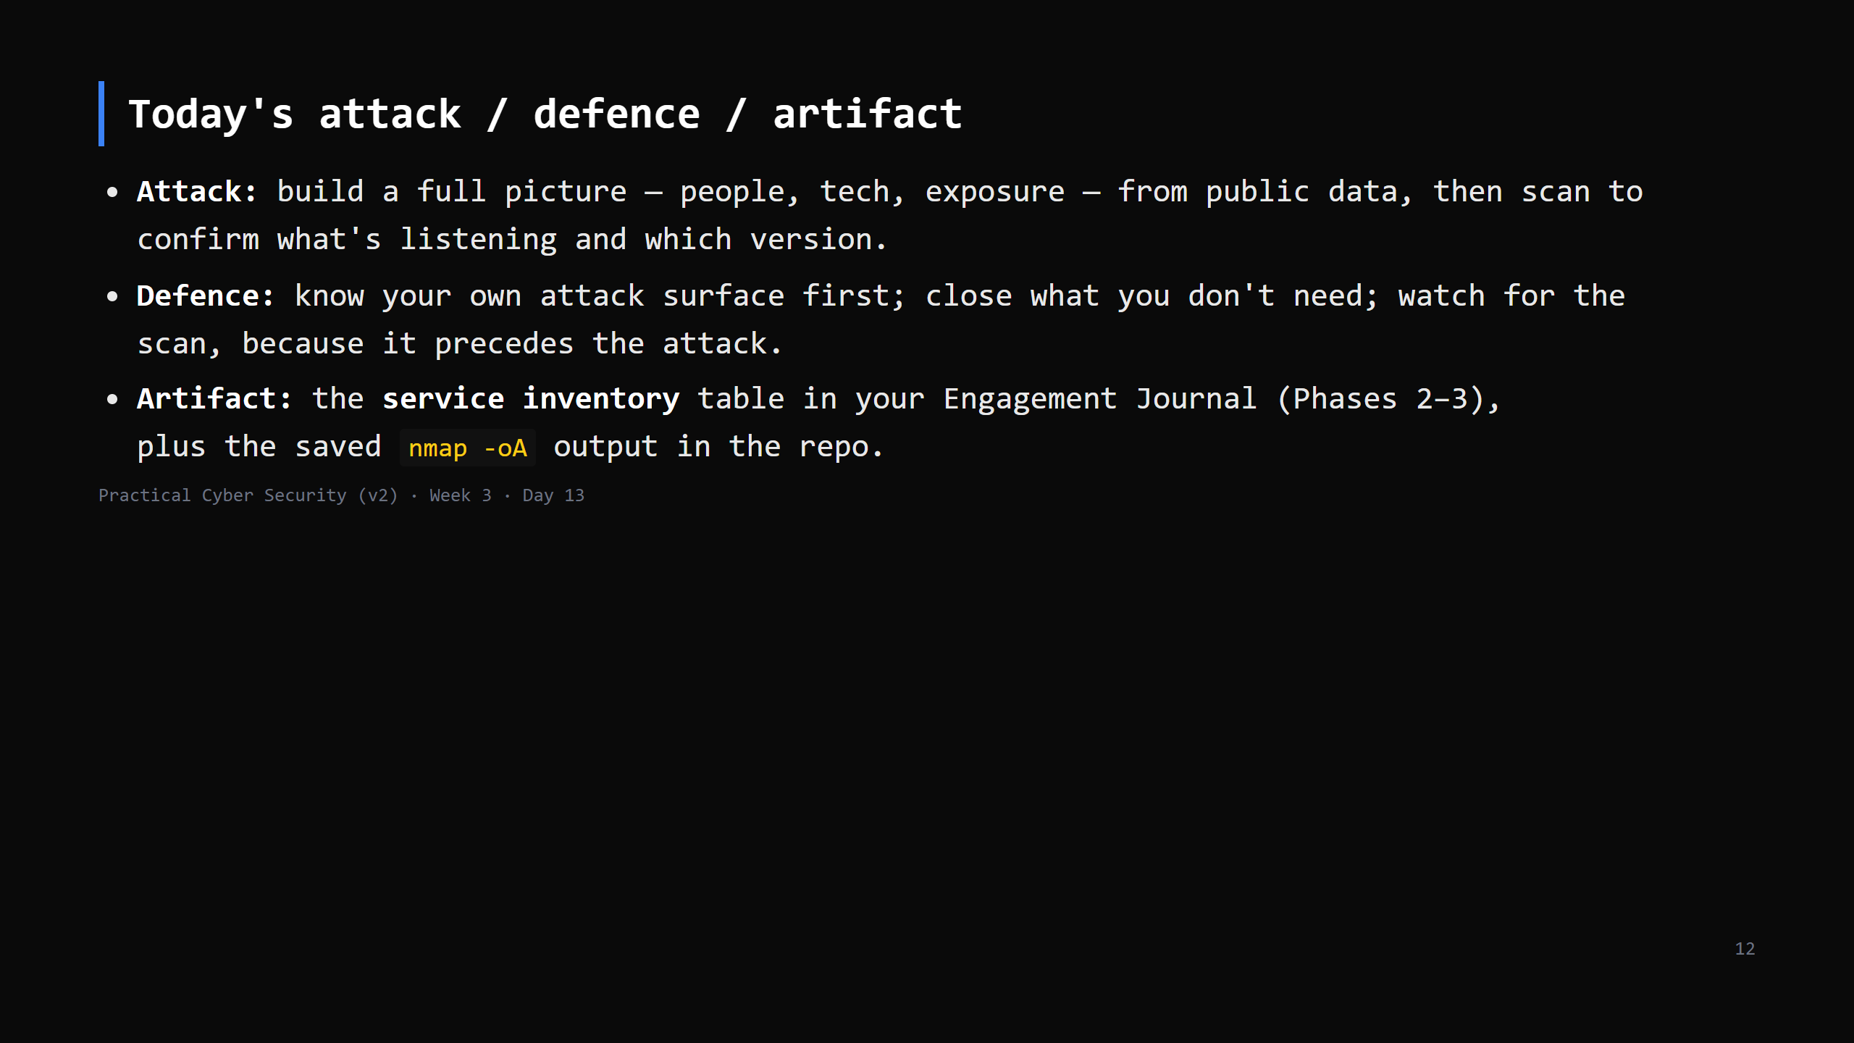

Slide 13
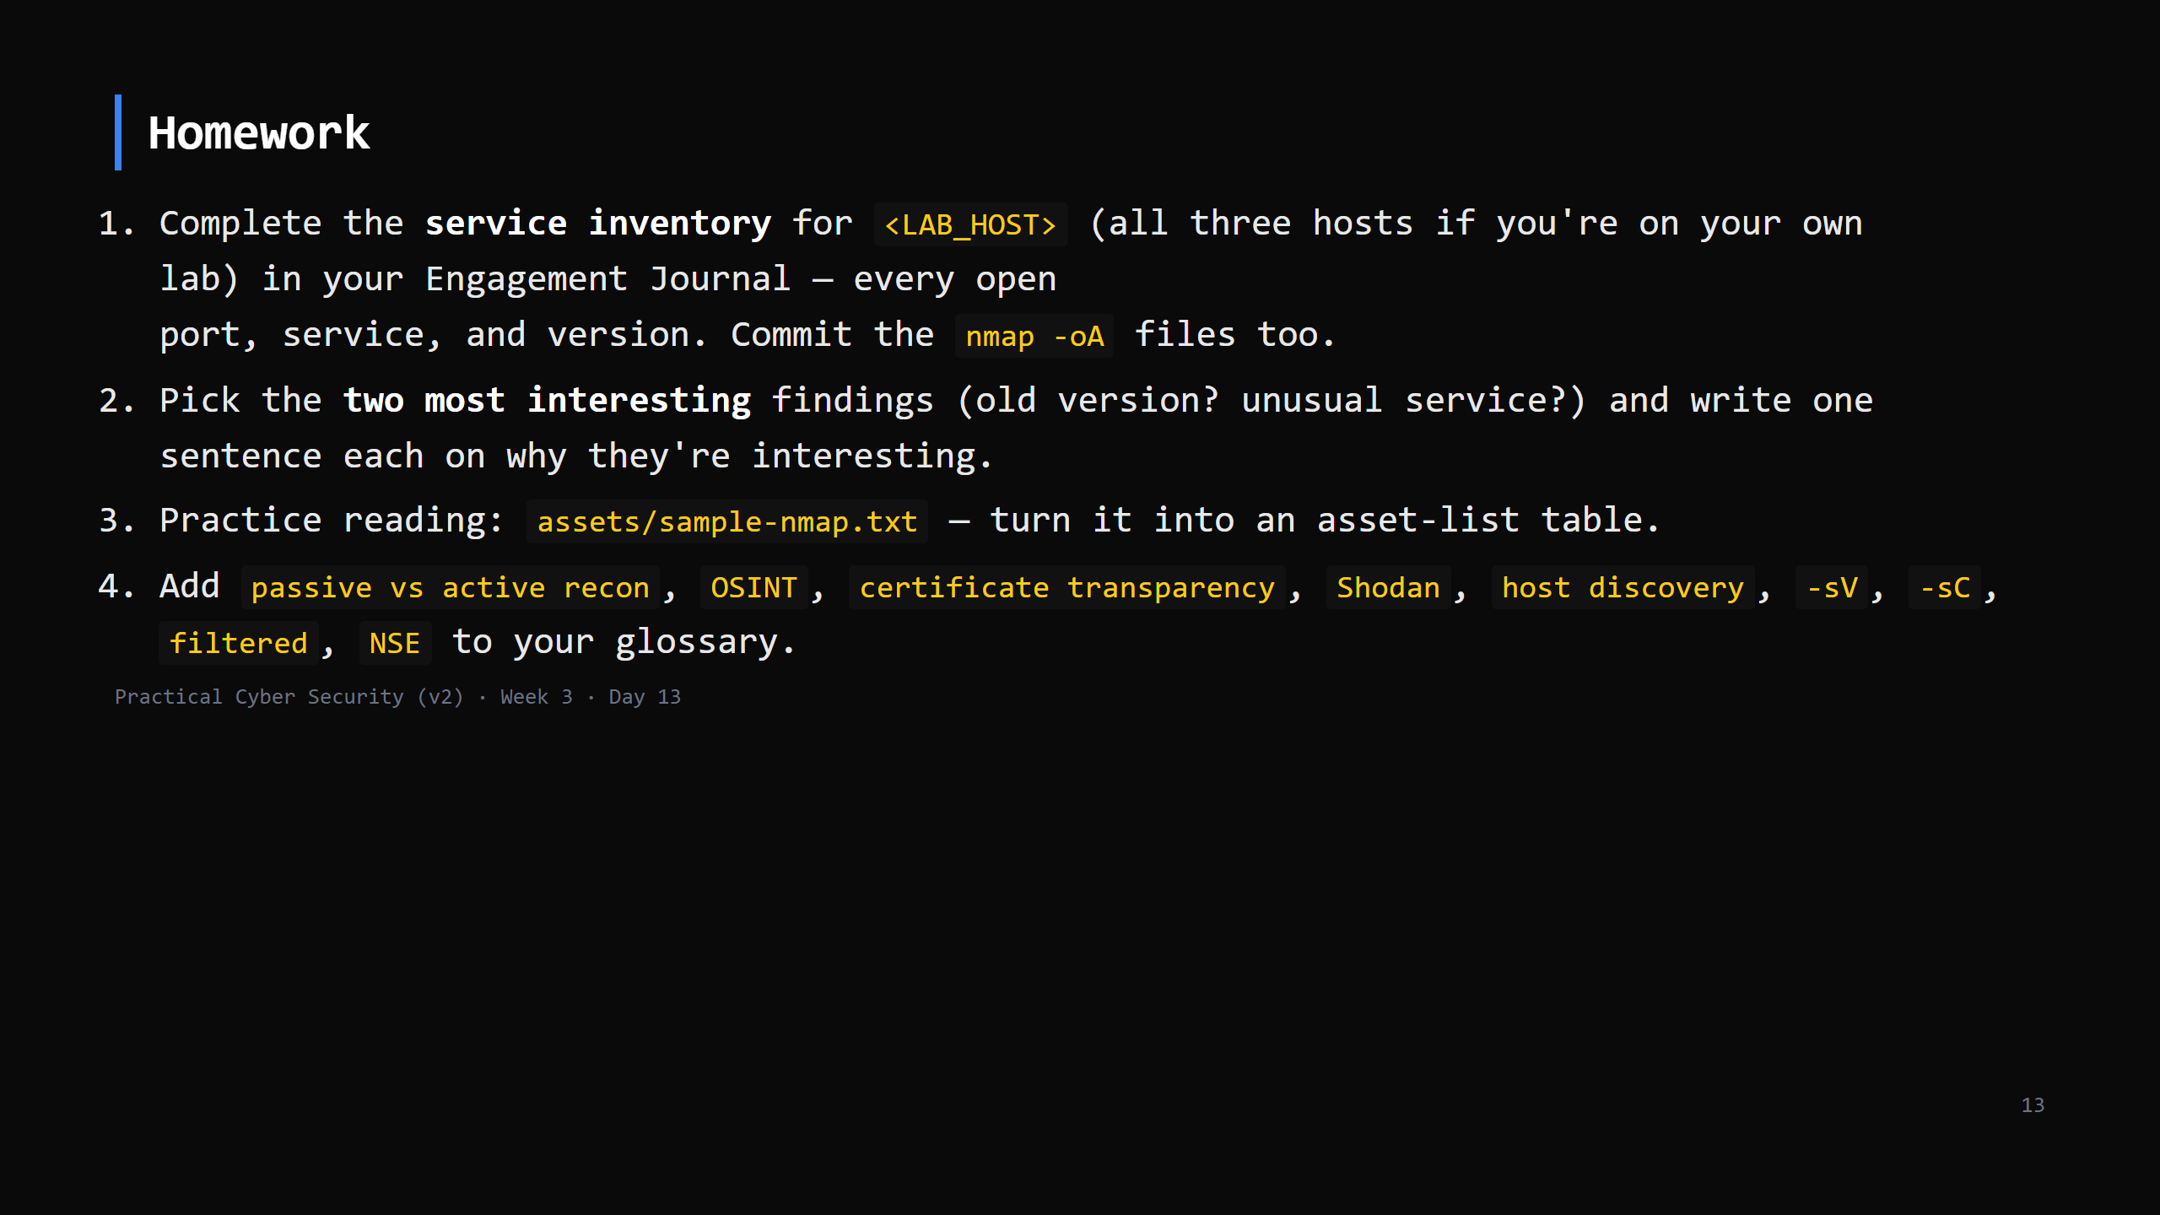
Notes:
Due start of Day 14.

Slide 14
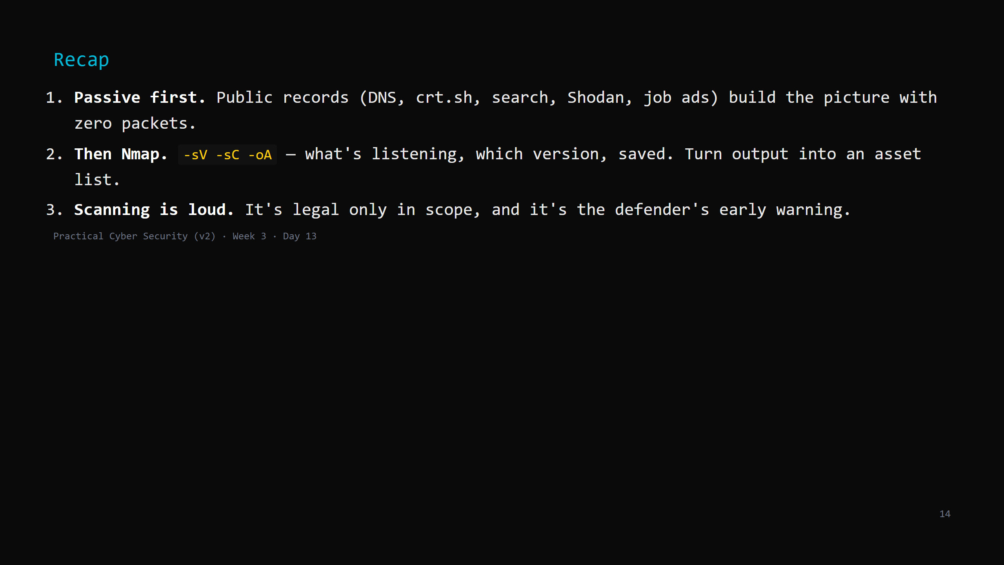
Notes:
Say the three lines. Tomorrow: take the versions from your inventory and turn them into a
ranked list of real weaknesses - vulnerability assessment.

